Slide 1
RESTORE REBUILD RENEW
welcome
we are glad to
Have you with us
IN 2022
WHEELER
CHURCH
OF
CHRIST

Slide 2
1-1 Just Over in the Glory Land
Just Over in the Glory Land

Slide 3
1-2 Just Over in the Glory Land
Just Over in the Glory Land

Slide 4
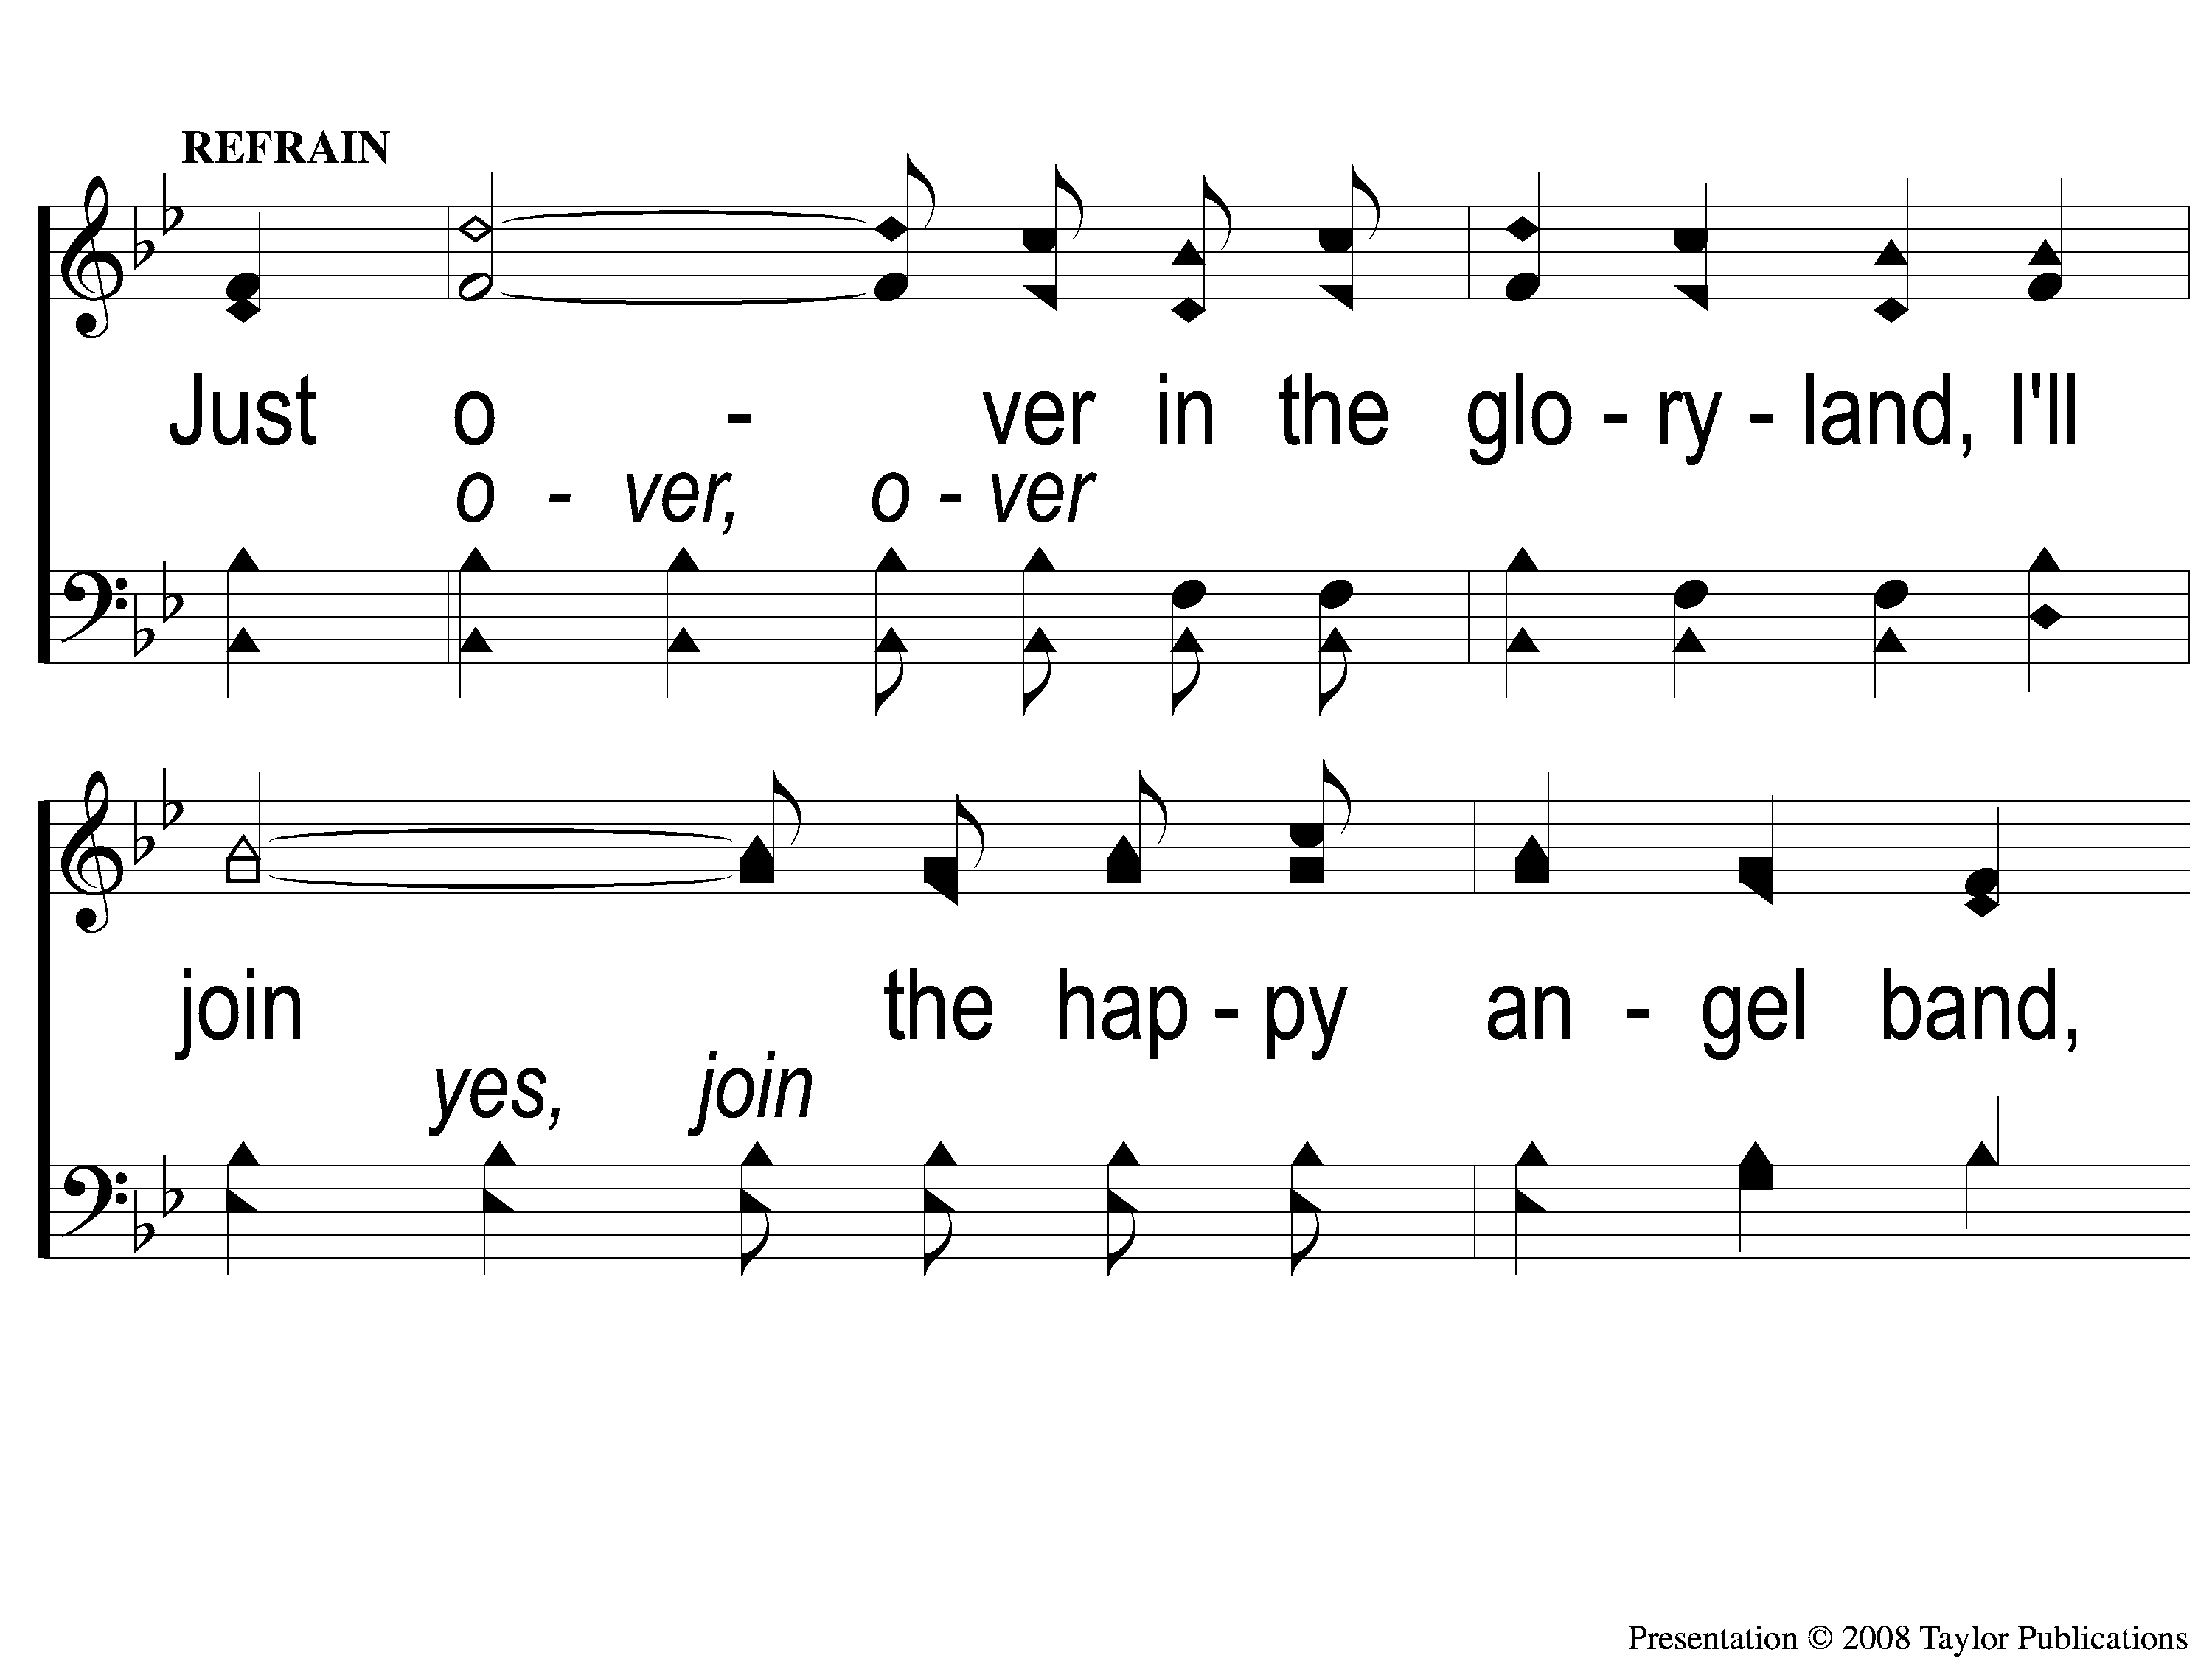
C-1 Just Over in the Glory Land
Just Over in the Glory Land

Slide 5
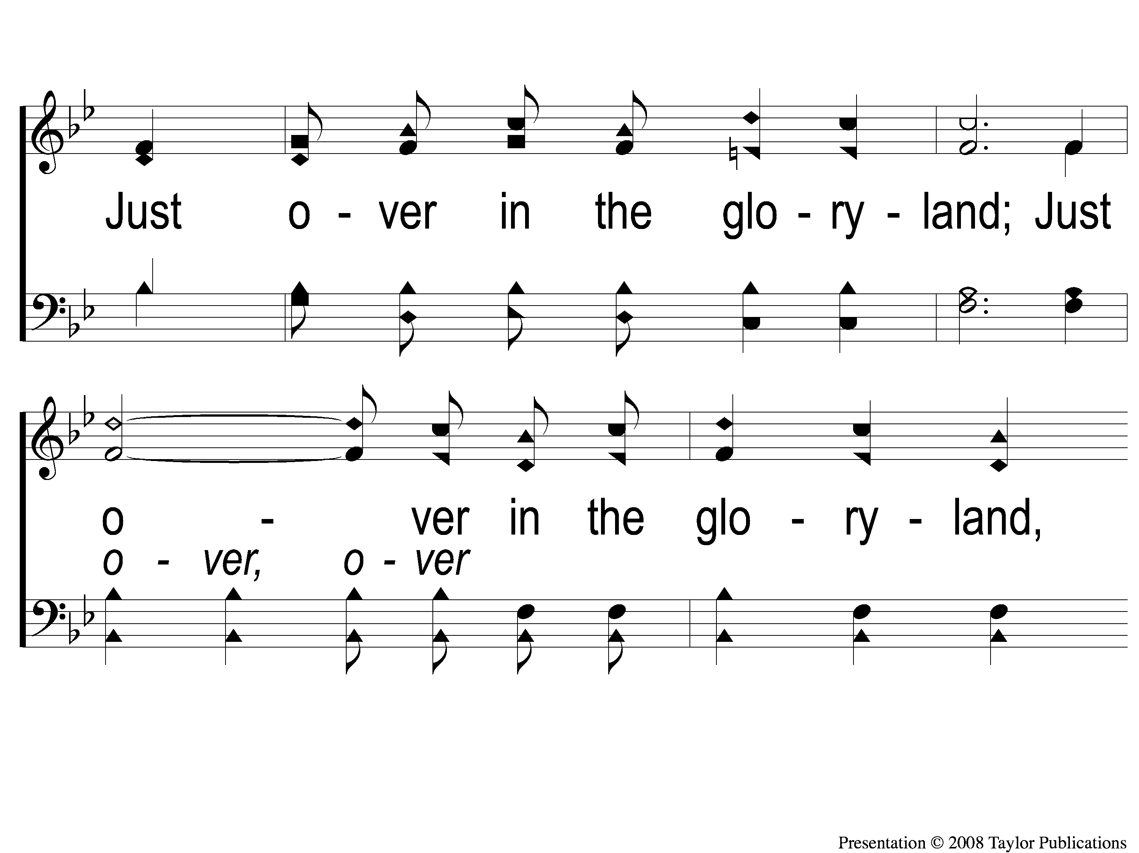
C-2 Just Over in the Glory Land
Just Over in the Glory Land

Slide 6
C-3 Just Over in the Glory Land
Just Over in the Glory Land

Slide 7
2-1 Just Over in the Glory Land
Just Over in the Glory Land

Slide 8
2-2 Just Over in the Glory Land
Just Over in the Glory Land

Slide 9
C-1 Just Over in the Glory Land
Just Over in the Glory Land

Slide 10
C-2 Just Over in the Glory Land
Just Over in the Glory Land

Slide 11
C-3 Just Over in the Glory Land
Just Over in the Glory Land

Slide 12
4-1 Just Over in the Glory Land
Just Over in the Glory Land

Slide 13
4-2 Just Over in the Glory Land
Just Over in the Glory Land

Slide 14
C-1 Just Over in the Glory Land
Just Over in the Glory Land

Slide 15
C-2 Just Over in the Glory Land
Just Over in the Glory Land

Slide 16
C-3 Just Over in the Glory Land
Just Over in the Glory Land

Slide 17
Songs of Praise To God

Slide 18
Opening Prayer

Slide 19
Songs of Praise To God

Slide 20
RESTORE
OUR
FOUNDATIONS
JANUARY - APRIL

Slide 21
The Beginning
Of Sin & Death
(Genesis Ch. 3)

Slide 22
Which Is Greater:
Heaven OR The Garden of Eden
?

Slide 23
In Heaven, There Will Be…
…No Temptation

Slide 24
Temptation
In The Garden
Opportunity For Temptation
Jms. 1:13-15

Slide 25
Temptation
In Heaven
NO Opportunity For Temptation
Jms. 1:13-15

Slide 26
In Heaven, There Will Be…
…No Temptation
…No Devil

Slide 27
Devil / Satan
In The Garden
Able To Enter The Garden
Gen. 3:1-5 – Jn. 8:44

Slide 28
Devil / Satan
In Heaven
The Devil’s Fate Is Sealed
Rev. 12:9, 20:10
Matt. 25:41

Slide 29
In Heaven, There Will Be…
…No Temptation
…No Devil
…No Death

Slide 30
Physical Death
In The Garden
The Possibility Existed
Gen. 2:8-9, 3:22-24

Slide 31
Physical Death
In Heaven
No Possibility Exists
“Eternal Life” – 32 Times in N.T.
Job 14:14 – Rev. 20:13-14, 21:4

Slide 32
In Heaven, There Will Be…
…No Temptation
…No Devil
…No Death
…No Change

Slide 33
Change
In The Garden
Time = Measure of Change / Motion
Gen. 1:1-3

Slide 34
Change
In Heaven
“Eternal” = unlimited, perpetual
Eccl. 12:5 – Matt. 25:46
2 Pet. 3:8

Slide 35
In Heaven, There Will Be…
…No Temptation
…No Devil
…No Death
…No Change
…No Work

Slide 36
Work / Labor
In The Garden
Work Was Expected
Gen. 2:2-15, 3:17-18

Slide 37
Work / Labor
In Heaven
Eternal Rest
Heb. 4:9-11 – Rev. 4:8, 14:13
Gen. 2:1-3

Slide 38
In Heaven, There Will Be…
…No Temptation
…No Devil
…No Death
…No Change
…No Work
…No Separation From God

Slide 39
Separation From God
In The Garden
God Was NOT Always Present
Gen. 3:8

Slide 40
Separation From God
In Heaven
God IS Always Present
Gen. 1:1 – Heb. 9:24
Rev. 21:25, 22:5 – 2 Thess. 1:9

Slide 41
Songs of Praise To God

Slide 42
THE LORD’S SUPPER
Acts 20:7

Slide 43
Closing Prayer

Slide 44
Songs of Praise To God

Slide 45
RESTORE REBUILD RENEW
Wednesday
WORSHIP @ 6:30 pm
Bible classes @ 7:00 pm
IN 2022
WHEELER
CHURCH
OF
CHRIST

