Slide 1
1 We Shall Assemble
We Shall Assemble
718

Slide 2
2 We Shall Assemble
We Shall Assemble
718

Slide 3
3 We Shall Assemble
We Shall Assemble
718

Slide 4
4 We Shall Assemble
We Shall Assemble
718

Slide 5
1 We Shall Assemble
We Shall Assemble
718

Slide 6
2 We Shall Assemble
We Shall Assemble
718

Slide 7
3 We Shall Assemble
We Shall Assemble
718

Slide 8
4 We Shall Assemble
We Shall Assemble
718

Slide 9
RESTORE REBUILD RENEW
welcome
we are glad to
Have you with us
IN 2022
WHEELER
CHURCH
OF
CHRIST

Slide 10
Song:
He’s My King
#166

Slide 11
1-1 He’s My King
He’s My King
166

Slide 12
1-2 He’s My King
He’s My King
166

Slide 13
C-1 He’s My King
He’s My King
166

Slide 14
C-2 He’s My King
He’s My King
166

Slide 15
3-1 He’s My King
He’s My King
166

Slide 16
3-2 He’s My King
He’s My King
166

Slide 17
C-1 He’s My King
He’s My King
166

Slide 18
C-2 He’s My King
He’s My King
166

Slide 19
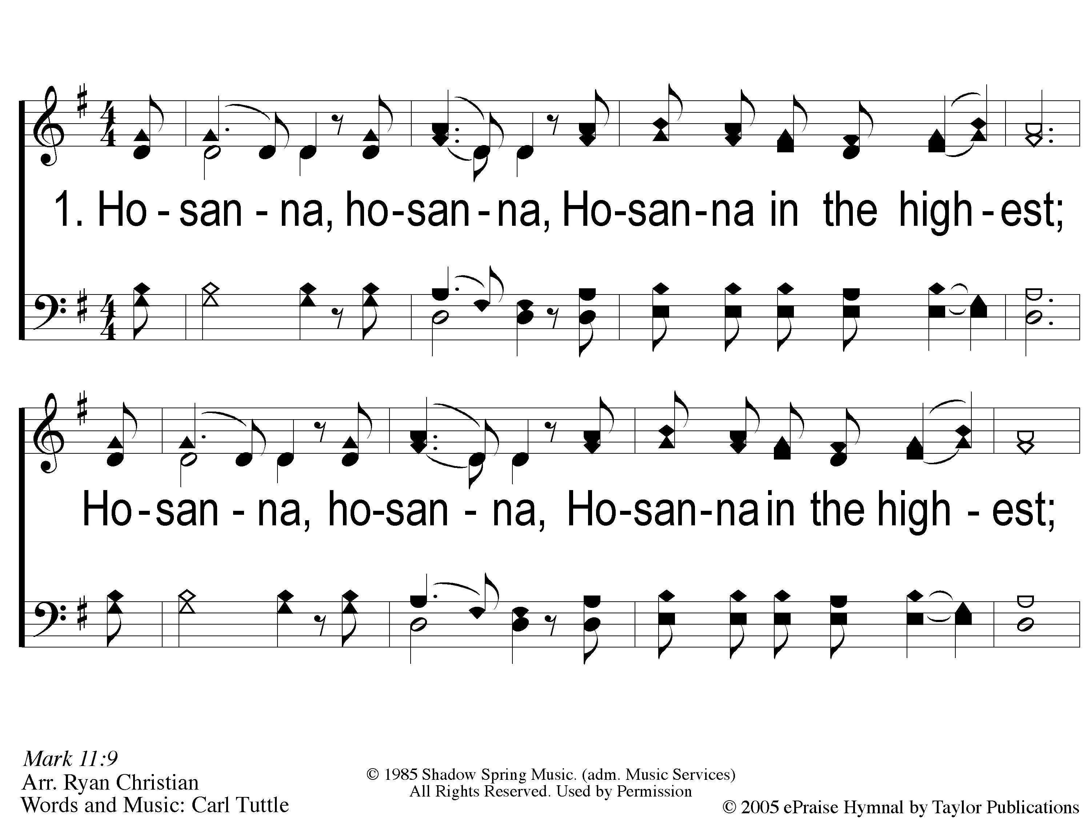
1 Hosanna
Hosanna
167

Slide 20
C-1 Hosanna
Hosanna
167

Slide 21
C-2 Hosanna
Hosanna
167

Slide 22
2 Hosanna
Hosanna
167

Slide 23
C-1 Hosanna
Hosanna
167

Slide 24
C-2 Hosanna
Hosanna
167

Slide 25
1-1 Hosanna you’re my King
Hosanna, You’re My King

Slide 26
1-2 Hosanna you’re my King
Hosanna, You’re My King

Slide 27
1-3 Hosanna you’re my King
Hosanna, You’re My King

Slide 28
2-1 Hosanna you’re my King
Hosanna, You’re My King

Slide 29
2-2 Hosanna you’re my King
Hosanna, You’re My King

Slide 30
2-3 Hosanna you’re my King
Hosanna, You’re My King

Slide 31
Song:
We Will Glorify
#578

Slide 32
1-1 We Will Glorify
We Will Glorify
578

Slide 33
1-2 We Will Glorify
We Will Glorify
578

Slide 34
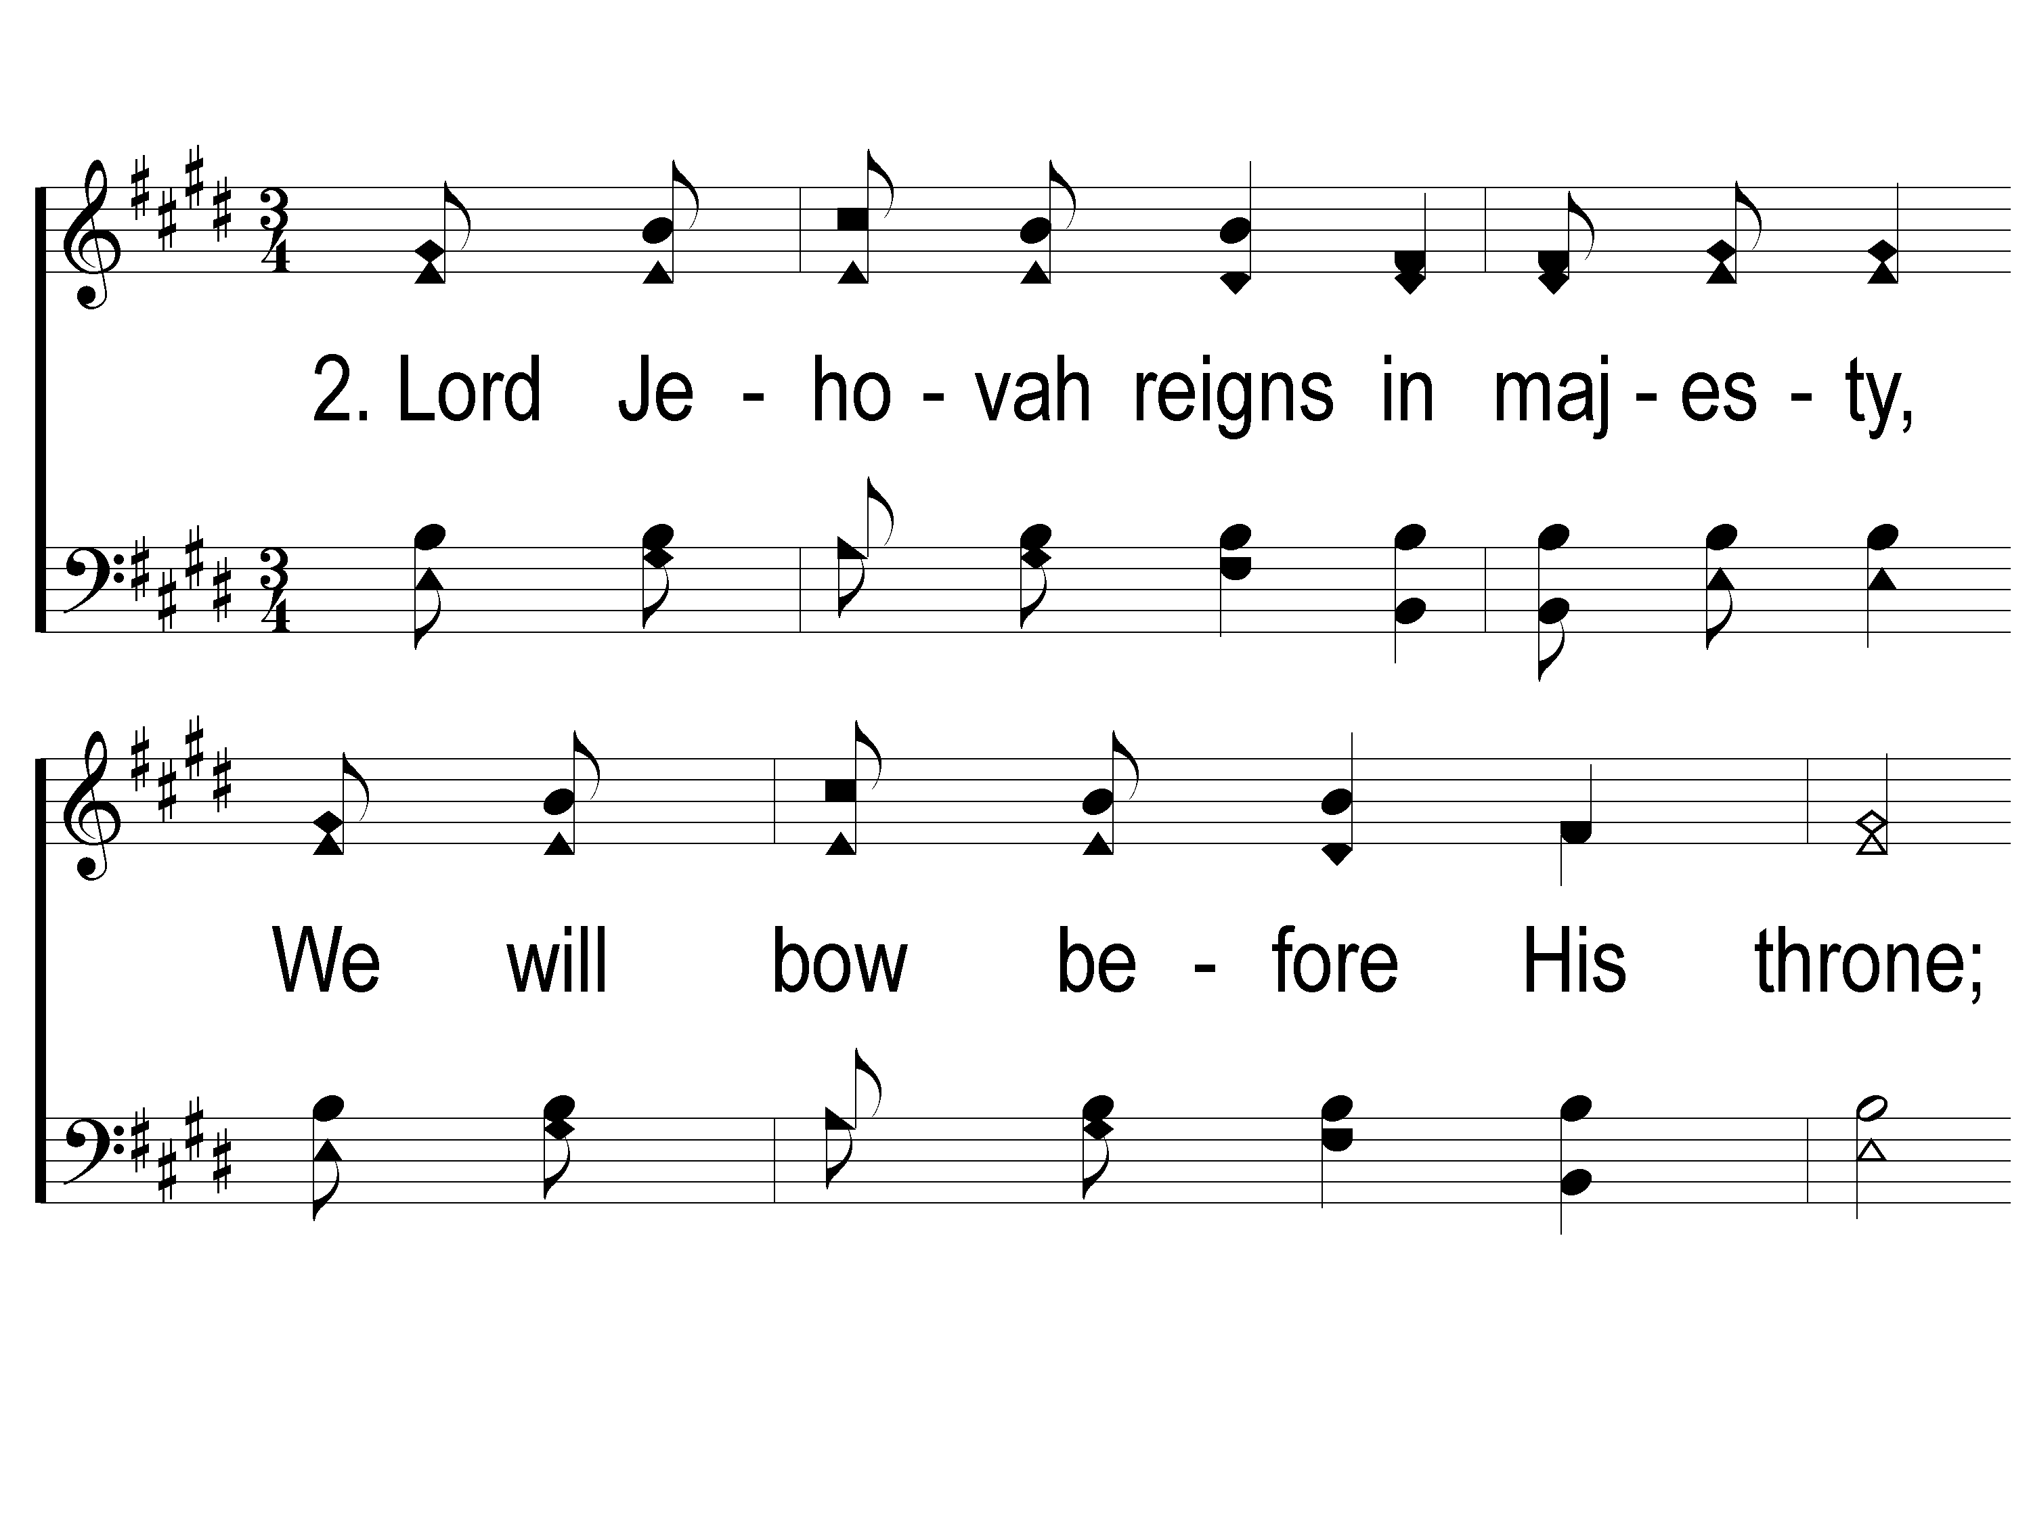
2-1 We Will Glorify
We Will Glorify
578

Slide 35
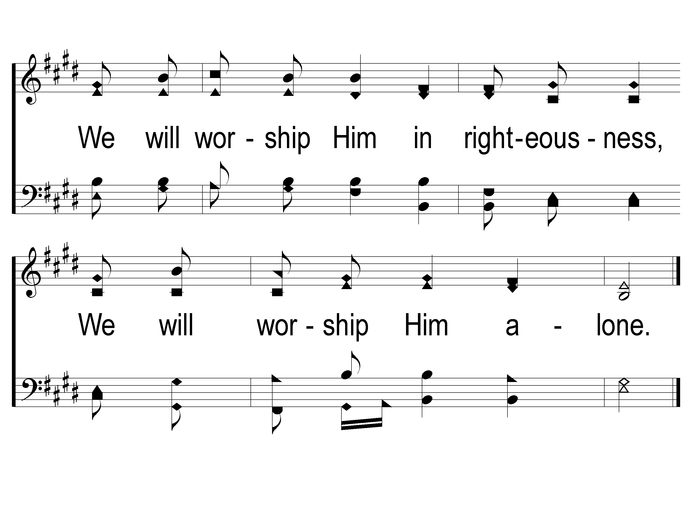
2-2 We Will Glorify
We Will Glorify
578

Slide 36
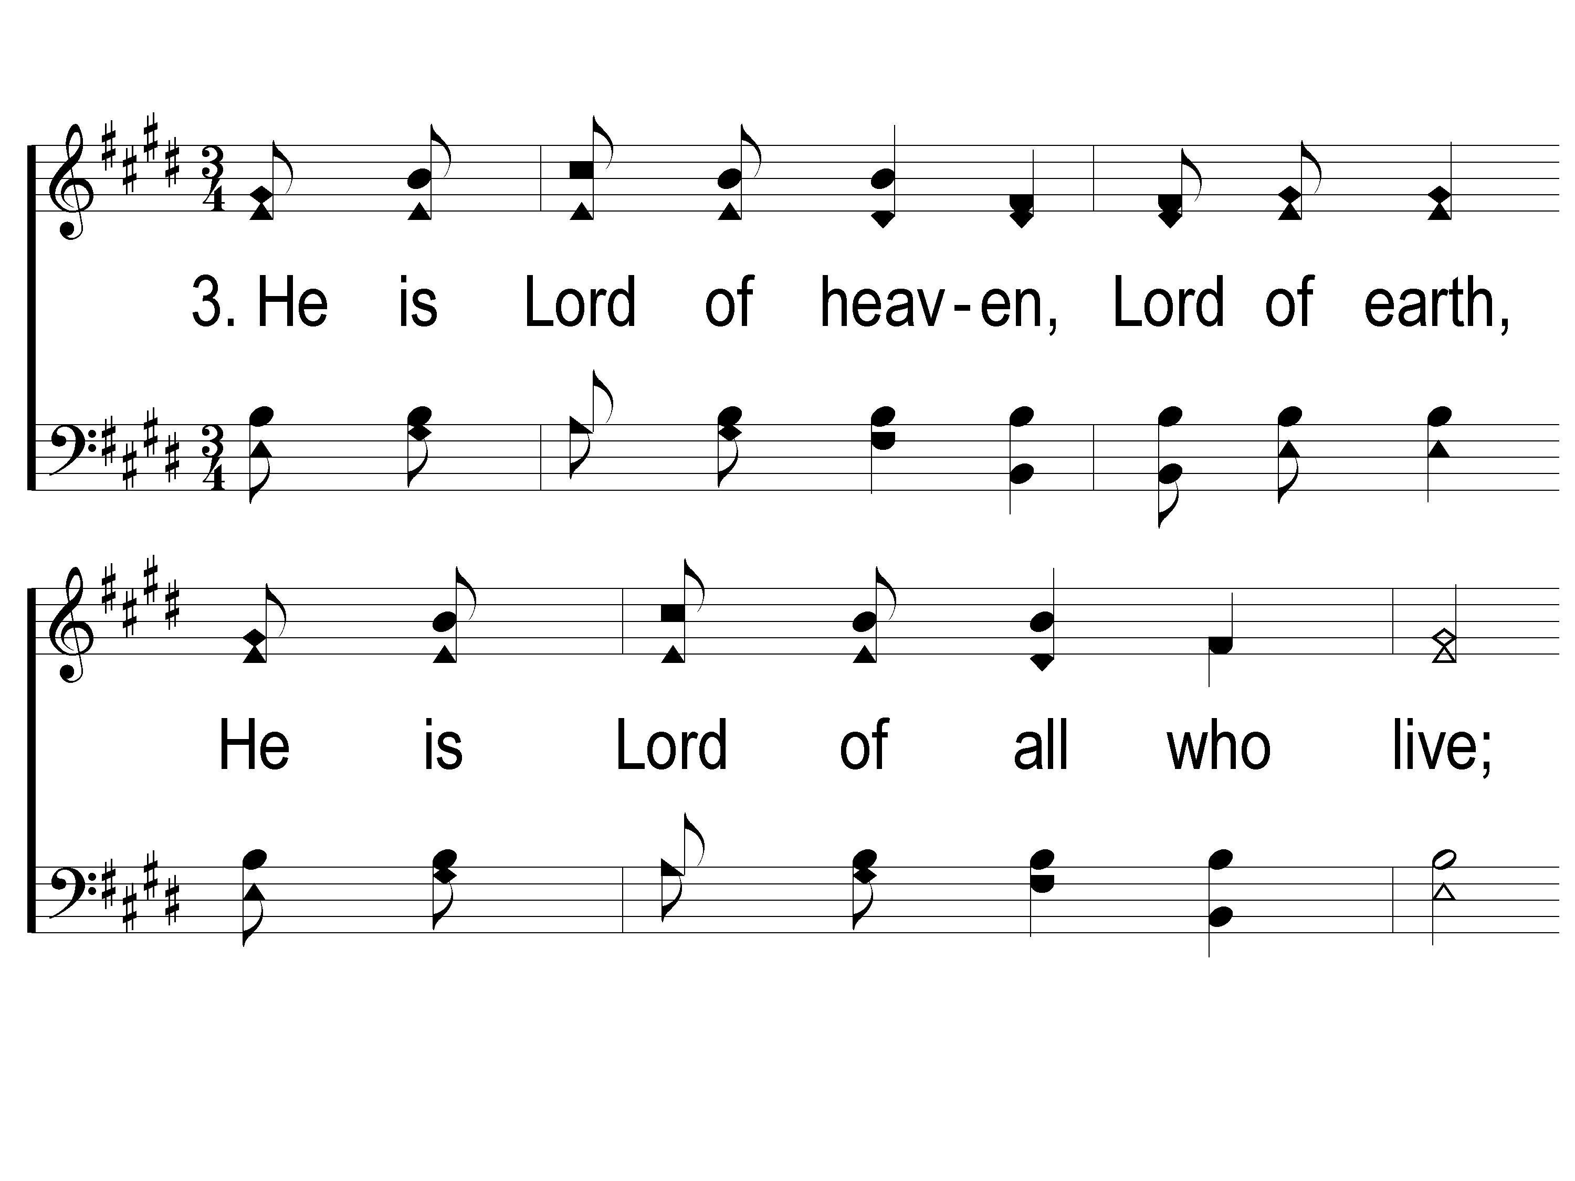
3-1 We Will Glorify
We Will Glorify
578

Slide 37
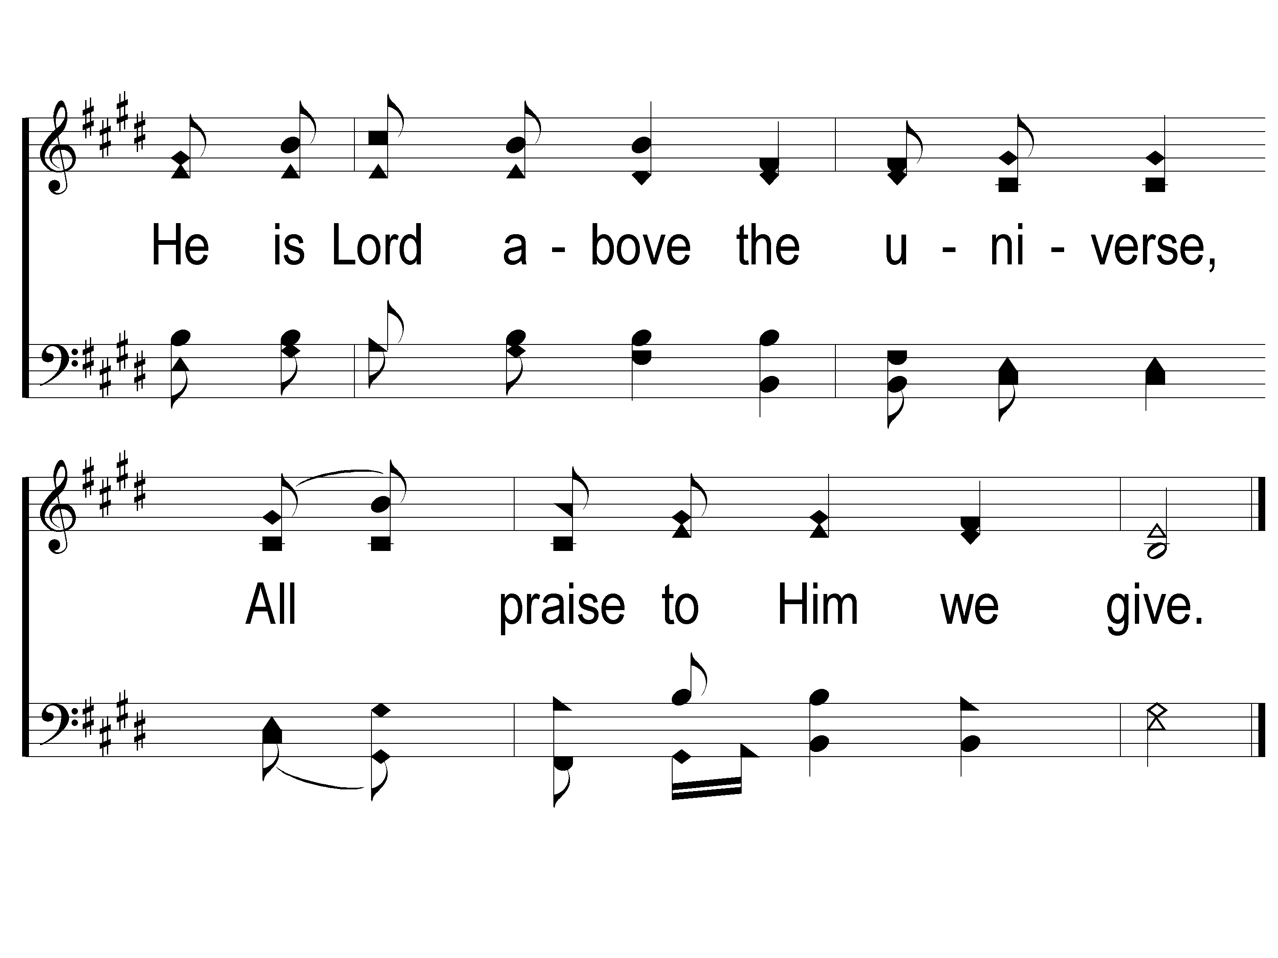
3-2 We Will Glorify
We Will Glorify
578

Slide 38
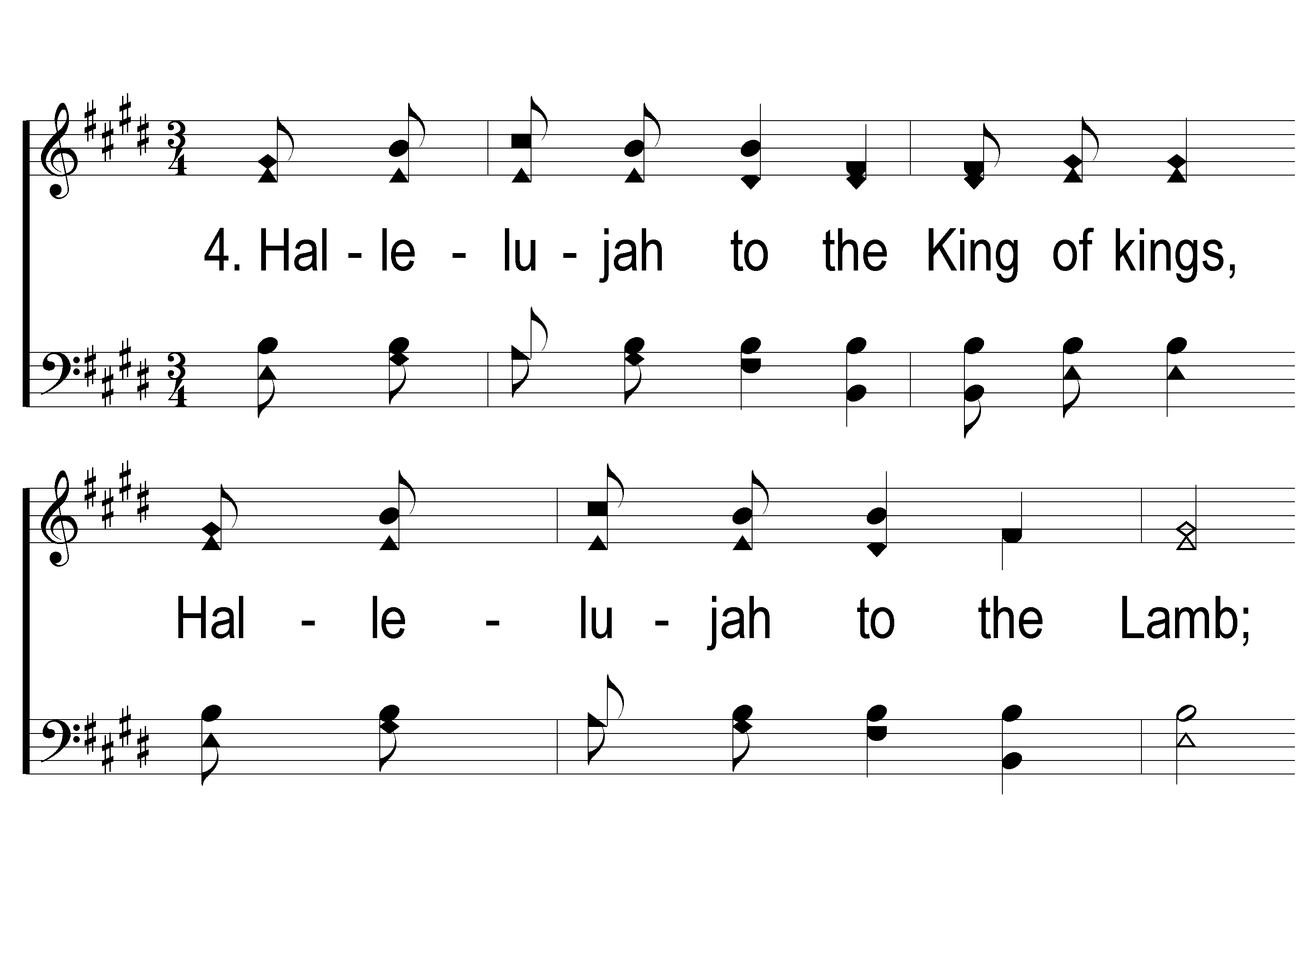
4-1 We Will Glorify
We Will Glorify
578

Slide 39
4-2 We Will Glorify
We Will Glorify
578

Slide 40
Opening Prayer

Slide 41
Song:
It Is Well With My Soul
#490

Slide 42
1-1 It Is Well With My Soul
It Is Well With My Soul
490

Slide 43
1-2 It Is Well With My Soul
It Is Well With My Soul
490

Slide 44
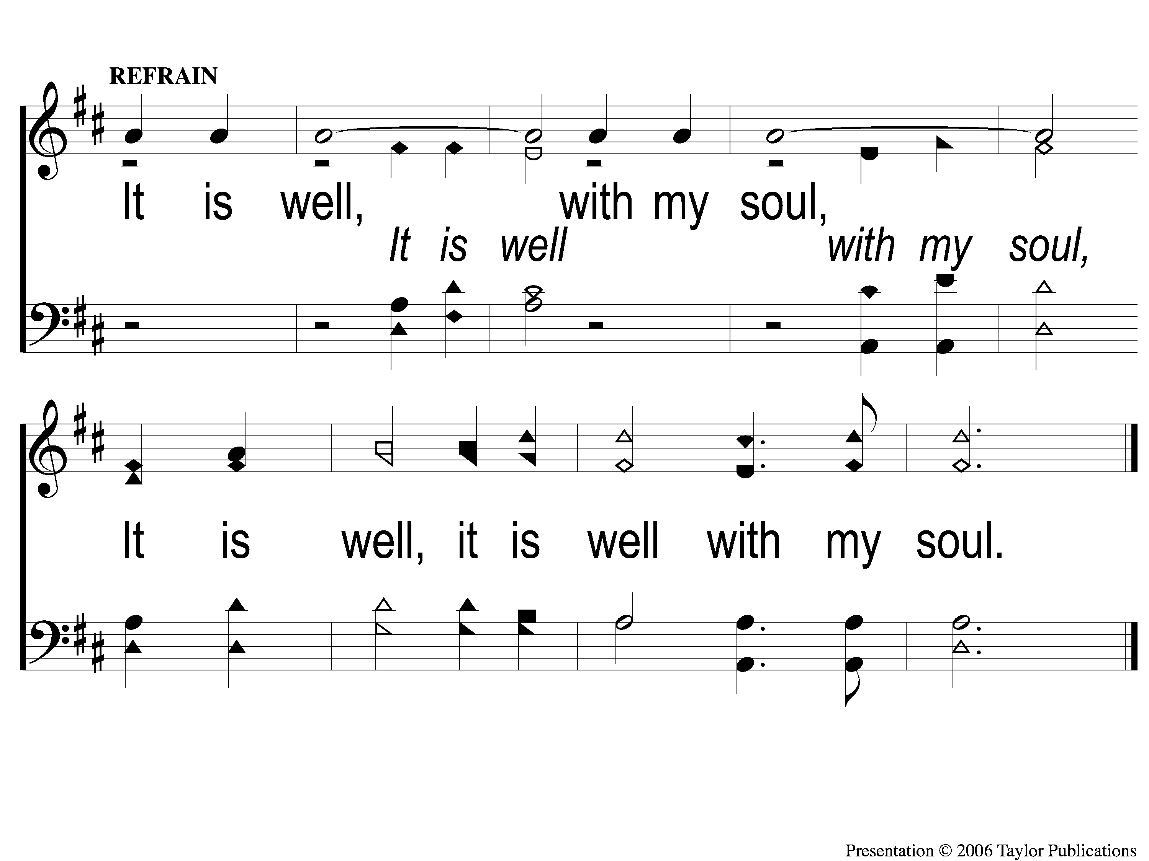
C-1 It Is Well With My Soul
It Is Well With My Soul
490

Slide 45
2-1 It Is Well With My Soul
It Is Well With My Soul
490

Slide 46
2-2 It Is Well With My Soul
It Is Well With My Soul
490

Slide 47
C-1 It Is Well With My Soul
It Is Well With My Soul
490

Slide 48
3-1 It Is Well With My Soul
It Is Well With My Soul
490

Slide 49
3-2 It Is Well With My Soul
It Is Well With My Soul
490

Slide 50
C-1 It Is Well With My Soul
It Is Well With My Soul
490

Slide 51
Song:
Restore My Soul
#567

Slide 52
1-1 Restore My Soul
Restore My Soul
567

Slide 53
1-2 Restore My Soul
Restore My Soul
567

Slide 54
2-1 Restore My Soul
Restore My Soul
567

Slide 55
2-2 Restore My Soul
Restore My Soul
567

Slide 56
3-1 Restore My Soul
Restore My Soul
567

Slide 57
3-2 Restore My Soul
Restore My Soul
567

Slide 58
Scripture Reading:
Romans 15:1-4

Slide 59
RESTORE REBUILD RENEW
IN 2022

Slide 60
RESTORE
OUR
FOUNDATIONS
JANUARY - APRIL

Slide 61
4 Reasons To Study the O.T.
To fully understand the N.T.

Slide 62
4 Reasons To Study the O.T.
To fully understand the N.T.

Slide 63
To fully understand the N.T.
By The Numbers:
41 References to Isaiah in Matthew
412 to Isaiah in the N.T.
2574 References of all the O.T.

Slide 64
4 Reasons To Study the O.T.
To fully understand the N.T.
To learn from the past

Slide 65
To learn from the Past
To Learn Patience
Noah – Gen. 5-9
God – 1 Pet. 3:20, Acts 13:18

Slide 66
To learn from the Past
Rom. 15:4 – “written for our learning”

Slide 67
To learn from the Past
To Learn Perseverance
Job – Job 1-2, Jms. 5:11
Elijah – 1 Ki. 19:10, 14, 18

Slide 68
4 Reasons To Study the O.T.
To fully understand the N.T.
To learn from the past
To Be Comforted

Slide 69
To be Comforted
By Fulfilled Prophecies
300+ Messianic
Isa. 7:14

Slide 70
To be Comforted
By Fulfilled Prophecies
Odds of just 8?
1 in 10¹⁷ or
1,000,000,000,000,000,000

Slide 71
To be Comforted
By Future Hope
Acts 1:11
1 Thess. 4:16-18

Slide 72
4 Reasons To Study the O.T.
To fully understand the N.T.
To learn from the past
To Be Comforted
It is inspired by God

Slide 73
It is inspired by God
2 Tim. 3:16-17

Slide 74
It is inspired by God
2 Tim. 3:16-17
“Scripture” always refers to O.T.
when used by Paul

Slide 75
4 Reasons To Study Genesis
The References to Genesis

Slide 76
The references to genesis
By The Numbers:
228 Total References
10 Direct Quotes in 7 Books
Mk. 10:7-8 (Gen. 2:24)

Slide 77
4 Reasons To Study Genesis
The References to Genesis
The Existence of Adam & Eve

Slide 78
The existence of Adam & Eve
Creation vs. Evolutionary Theory
Adam → 7 times in 5 books
Eve → 2 times in 2 books
Lk. 3:38

Slide 79
The existence of Adam & Eve
Adam as Type of Jesus
Rom. 5:14
1 Cor. 15:22

Slide 80
4 Reasons To Study Genesis
The References to Genesis
The Existence of Adam & Eve
The Importance of Abraham

Slide 81
The importance of Abraham
Mentioned 75 times in 11 books
Matt. 1:1
Acts 3:25, Gal. 3:8 (Gen. 12:3)

Slide 82
The importance of Abraham
Parallels of Isaac & Jesus
Only son
Sent To Be Sacrificed
Came back Alive

Slide 83
4 Reasons To Study Genesis
The References to Genesis
The Existence of Adam & Eve
The Importance of Abraham
The Relevance of Melchizedek

Slide 84
The relevance of Melchizedek
Only mentioned twice in O.T.
Gen. 14 & Psa. 110
Heb. 5:5-6, 7:22-25

Slide 85
RESTORE REBUILD RENEW
RESTORE OUR
FOUNDATIONS

Slide 86
Invitation
Song:
I Believe In Jesus
#356

Slide 87
1-1 I Believe in Jesus
I Believe In Jesus
356

Slide 88
1-2 I Believe in Jesus
I Believe In Jesus
356

Slide 89
C-1 I Believe in Jesus
I Believe In Jesus
356

Slide 90
C-2 I Believe in Jesus
I Believe In Jesus
356

Slide 91
2-1 I Believe in Jesus
I Believe In Jesus
356

Slide 92
2-2 I Believe in Jesus
I Believe In Jesus
356

Slide 93
C-1 I Believe in Jesus
I Believe In Jesus
356

Slide 94
C-2 I Believe in Jesus
I Believe In Jesus
356

Slide 95
3-1 I Believe in Jesus
I Believe In Jesus
356

Slide 96
3-2 I Believe in Jesus
I Believe In Jesus
356

Slide 97
C-1 I Believe in Jesus
I Believe In Jesus
356

Slide 98
C-2 I Believe in Jesus
I Believe In Jesus
356

Slide 99
The Offering:
Luke 6:38
“Give, and it will be given to you: good measure, pressed down, shaken together, and running over will be put into your bosom. For with the same measure that you use, it will be measured back to you.”

Slide 100
Song:
Highly Exalted

Slide 101
1 Highly Exalted
Highly Exalted
338

Slide 102
2 Highly Exalted
Highly Exalted
338

Slide 103
3 Highly Exalted
Highly Exalted
338

Slide 104
4 Highly Exalted
Highly Exalted
338

Slide 105
5 Highly Exalted
Highly Exalted
338

Slide 106
6 Highly Exalted
Highly Exalted
338

Slide 107
7 Highly Exalted
Highly Exalted
338

Slide 108
8 Highly Exalted
Highly Exalted
338

Slide 109
9 Highly Exalted
Highly Exalted
338

Slide 110
10 Highly Exalted
Highly Exalted
338

Slide 111
11 Highly Exalted
Highly Exalted
338

Slide 112
12 Highly Exalted
Highly Exalted
338

Slide 113
13 Highly Exalted
Highly Exalted
338

Slide 114
14 Highly Exalted
Highly Exalted
338

Slide 115
The Unleavened Bread
Hebrews 2:14-15
”Inasmuch then as the children have partaken of flesh and blood, He Himself likewise shared in the same, that through death He might destroy him who had the power of death, that is, the devil, 15 and release those who through fear of death were all their lifetime subject to bondage.”

Slide 116
The Fruit of the Vine
Hebrews 12:1-2
“Therefore we also, since we are surrounded by so great a cloud of witnesses, let us lay aside every weight, and the sin which so easily ensnares us, and let us run with endurance the race that is set before us, looking unto Jesus, the author and finisher of our faith, who for the joy that was set before Him endured the cross, despising the shame, and has sat down at the right hand of the throne of God.”

Slide 117
Closing Prayer

Slide 118
Song:
What A Day That Will Be
#916

Slide 119
1-1 What a Day That Will Be
What a Day That Will Be
916

Slide 120
1-2 What a Day That Will Be
What a Day That Will Be
916

Slide 121
1-3 What a Day That Will Be
What a Day That Will Be
916

Slide 122
C-1 What a Day That Will Be
What a Day That Will Be
916

Slide 123
C-2 What a Day That Will Be
What a Day That Will Be
916

Slide 124
C-3 What a Day That Will Be
What a Day That Will Be
916

Slide 125
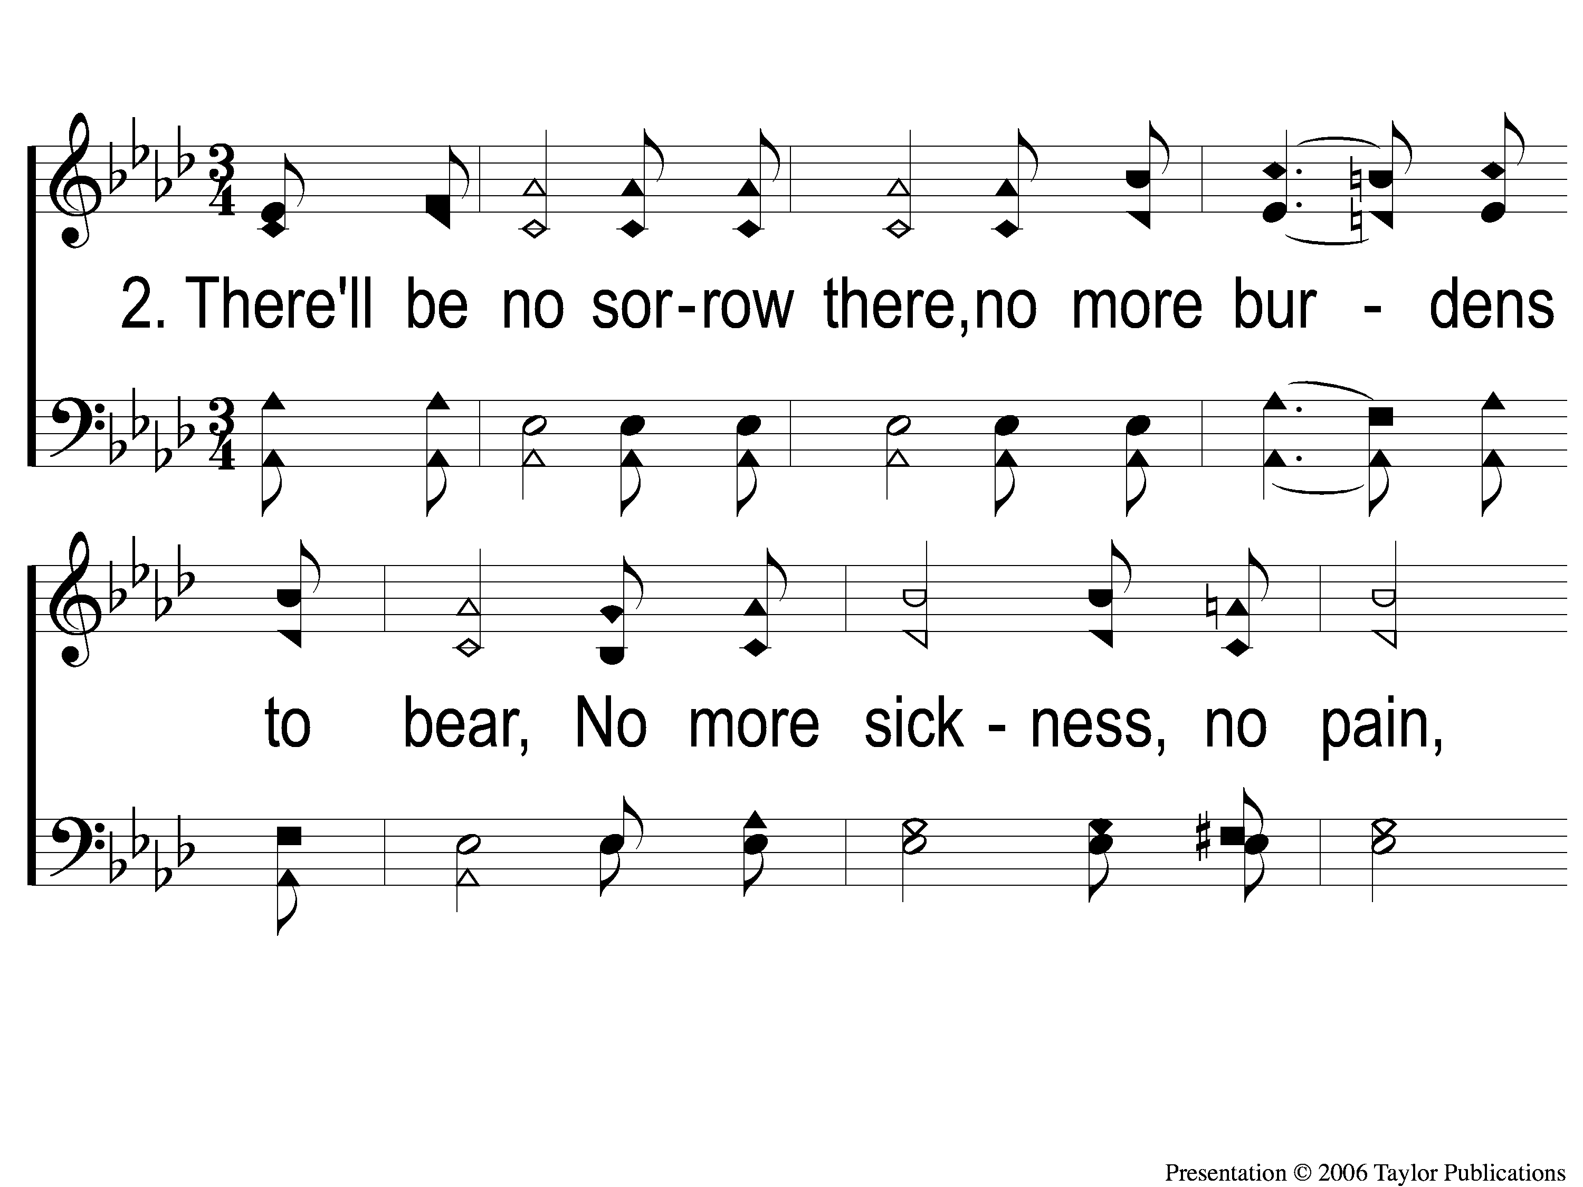
2-1 What a Day That Will Be
What a Day That Will Be
916

Slide 126
2-2 What a Day That Will Be
What a Day That Will Be
916

Slide 127
2-3 What a Day That Will Be
What a Day That Will Be
916

Slide 128
C-1 What a Day That Will Be
What a Day That Will Be
916

Slide 129
C-2 What a Day That Will Be
What a Day That Will Be
916

Slide 130
C-3 What a Day That Will Be
What a Day That Will Be
916

Slide 131
JOIN US
IN THE MPB FOR
A FELLOWSHIP MEAL
@ NOON
&
HOLIDAY PARTY @ 6PM
(MCCASLAND HOME)
RESTORE REBUILD RENEW
IN 2022
WHEELER
CHURCH
OF
CHRIST

