Slide 1
1-1 On Bended Knee
On Bended Knee
791

Slide 2
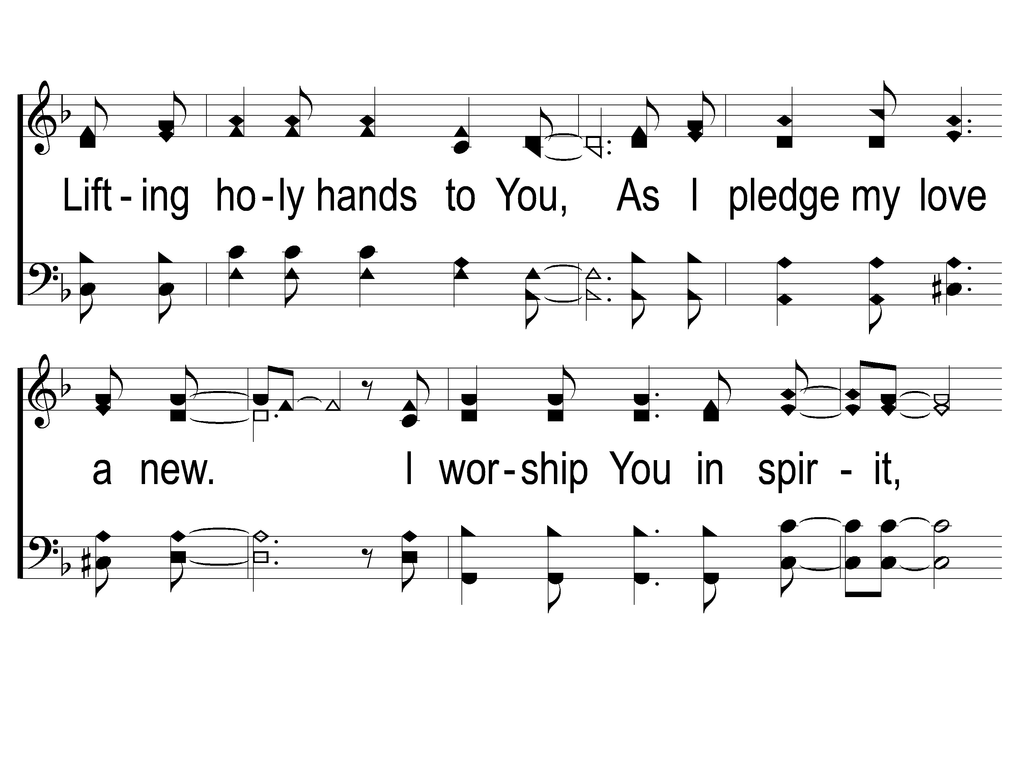
1-2 On Bended Knee
On Bended Knee
791

Slide 3
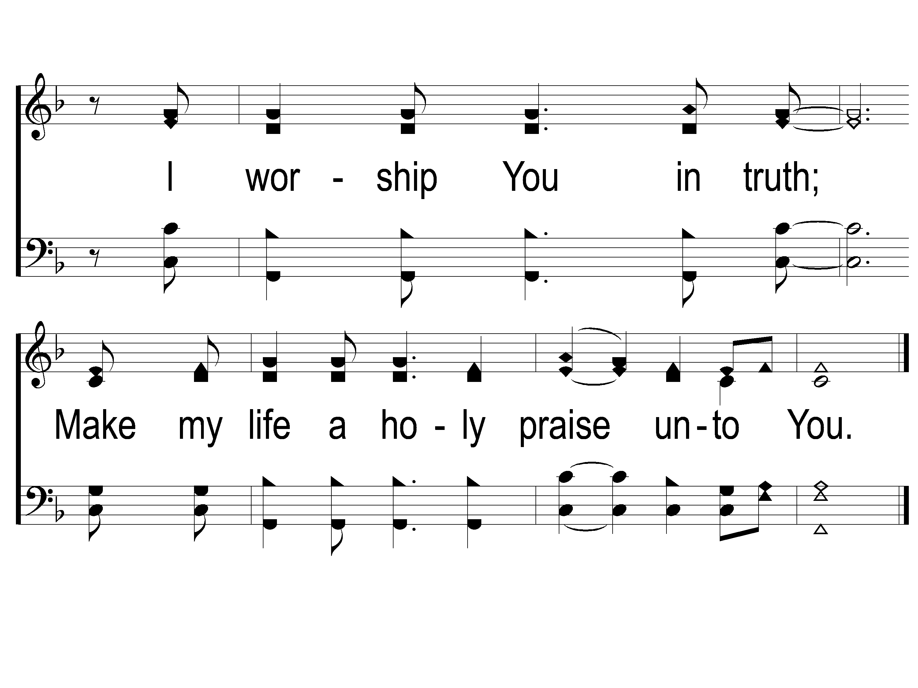
1-3 On Bended Knee
On Bended Knee
791

Slide 4
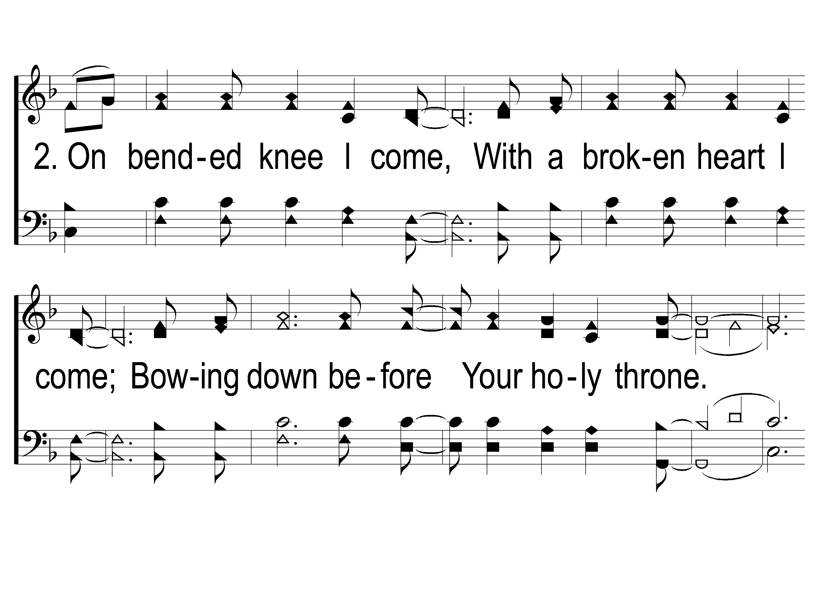
2-1 On Bended Knee
On Bended Knee
791

Slide 5
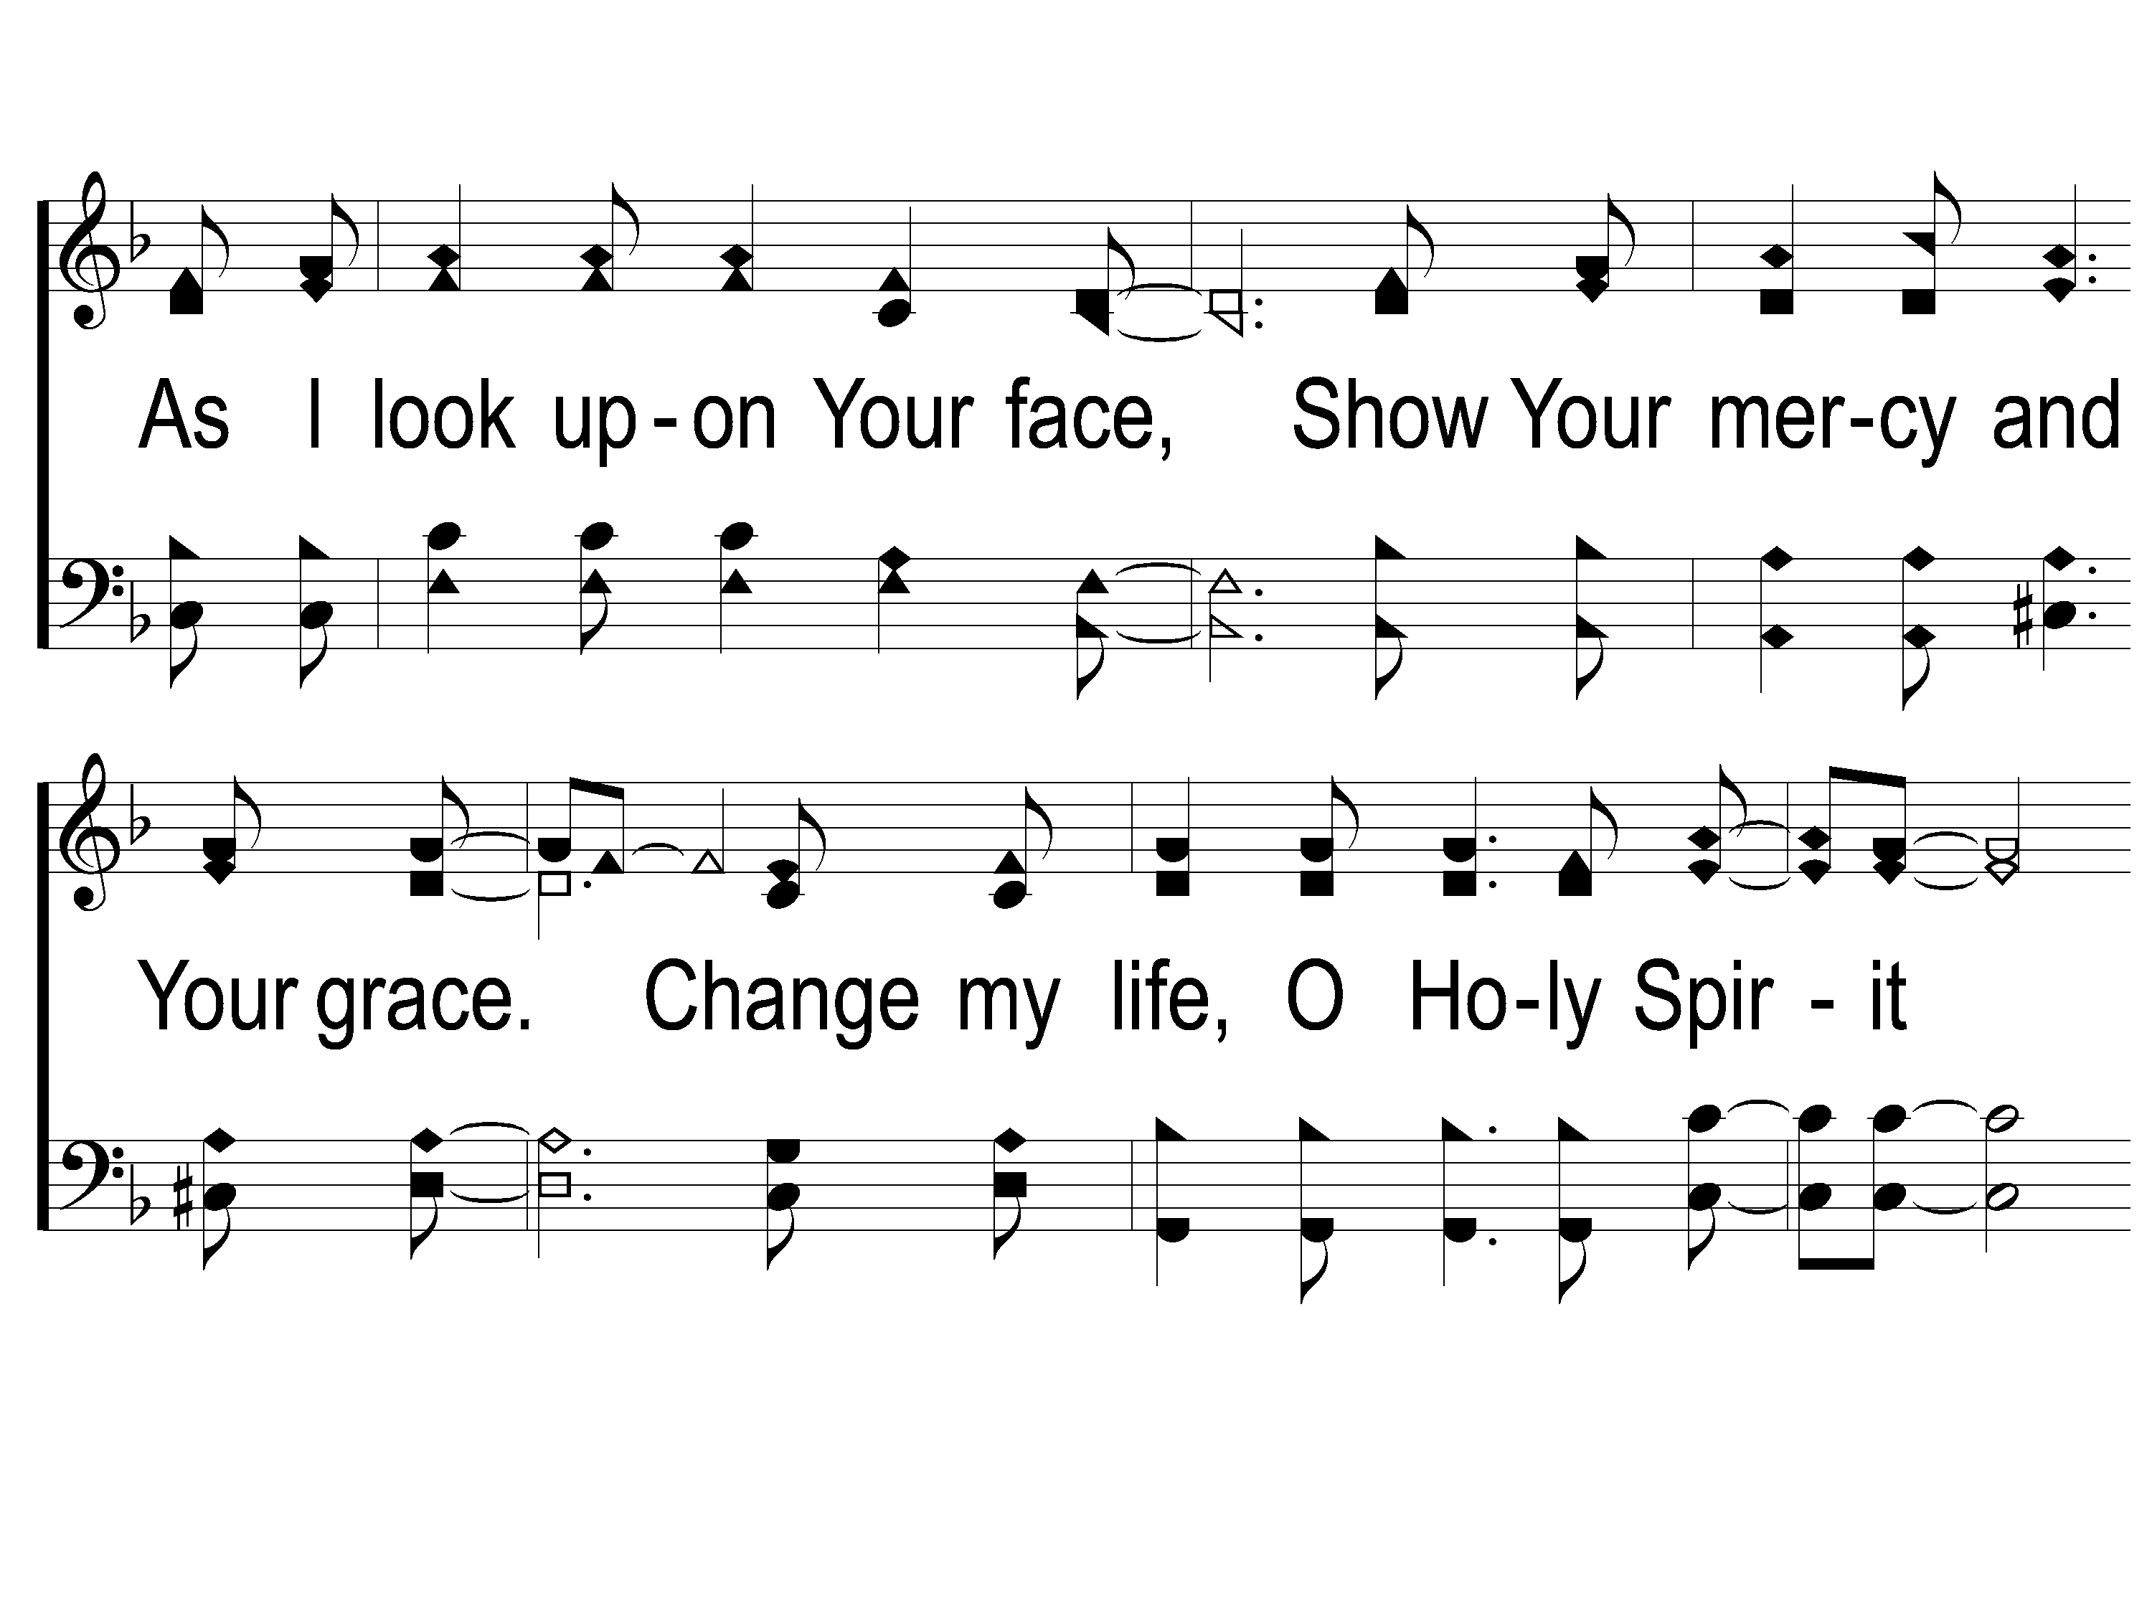
2-2 On Bended Knee
On Bended Knee
791

Slide 6
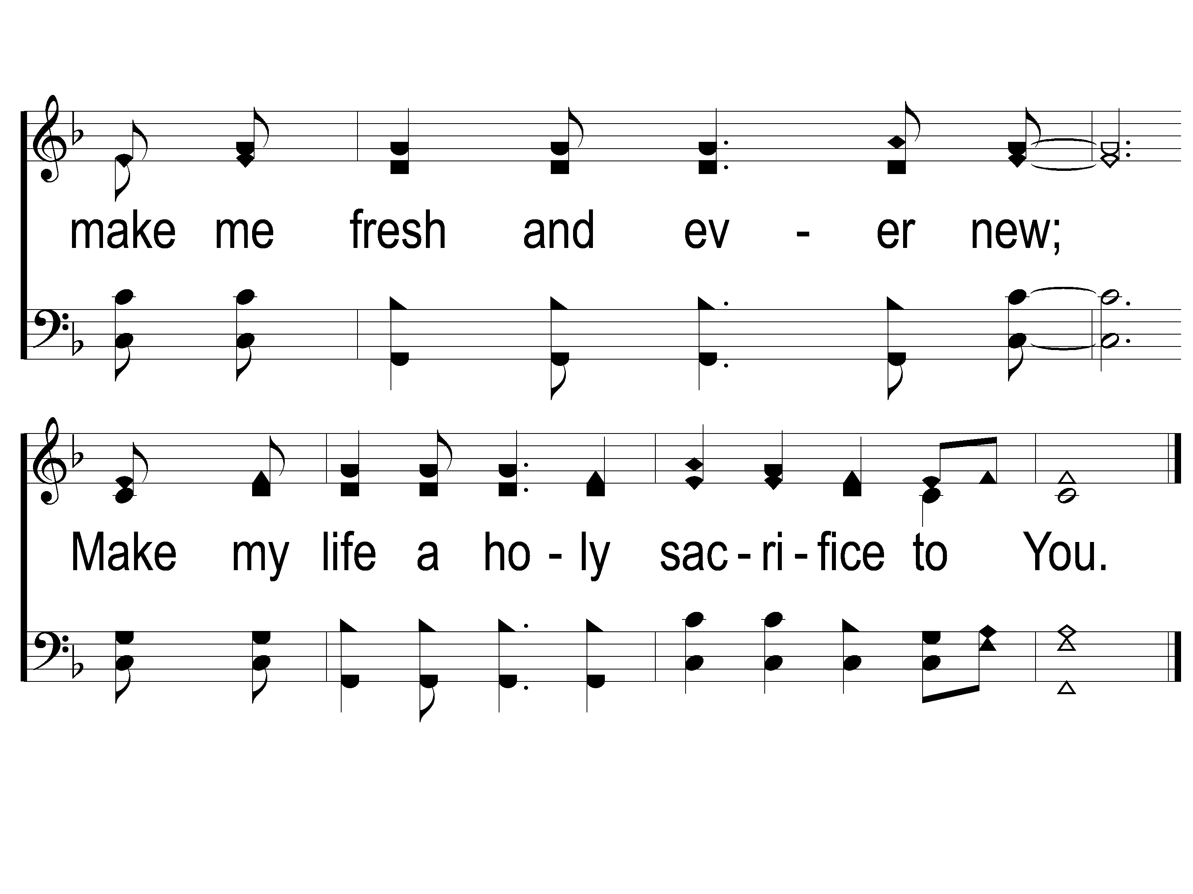
2-3 On Bended Knee
On Bended Knee
791

Slide 7
RESTORE REBUILD RENEW
welcome
we are glad to
Have you with us
IN 2022
WHEELER
CHURCH
OF
CHRIST

Slide 8
Song:
Jesus Is Coming Soon
#712

Slide 9
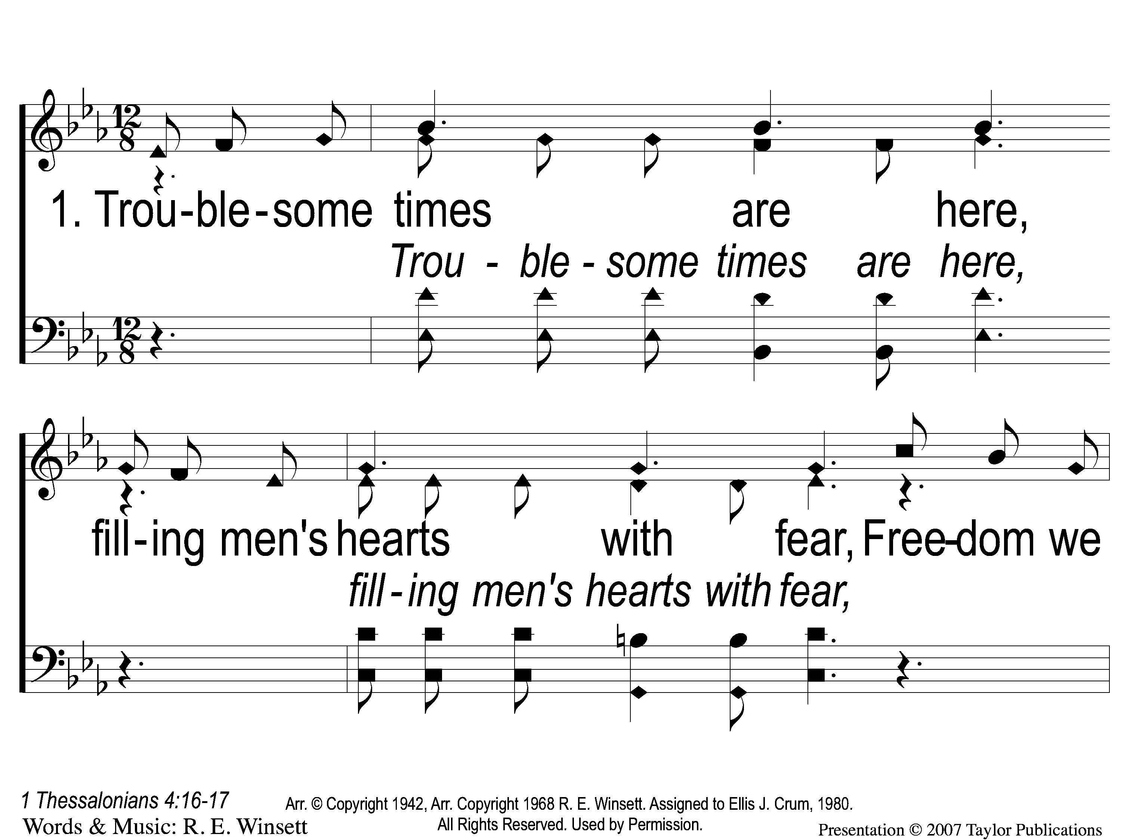
1-1 Jesus is Coming Soon
Jesus is Coming Soon
712

Slide 10
1-2 Jesus is Coming Soon
Jesus is Coming Soon
712

Slide 11
1-3 Jesus is Coming Soon
Jesus is Coming Soon
712

Slide 12
C-1 Jesus is Coming Soon
Jesus is Coming Soon
712

Slide 13
C-2 Jesus is Coming Soon
Jesus is Coming Soon
712

Slide 14
C-3 Jesus is Coming Soon
Jesus is Coming Soon
712

Slide 15
C-4 Jesus is Coming Soon
Jesus is Coming Soon
712

Slide 16
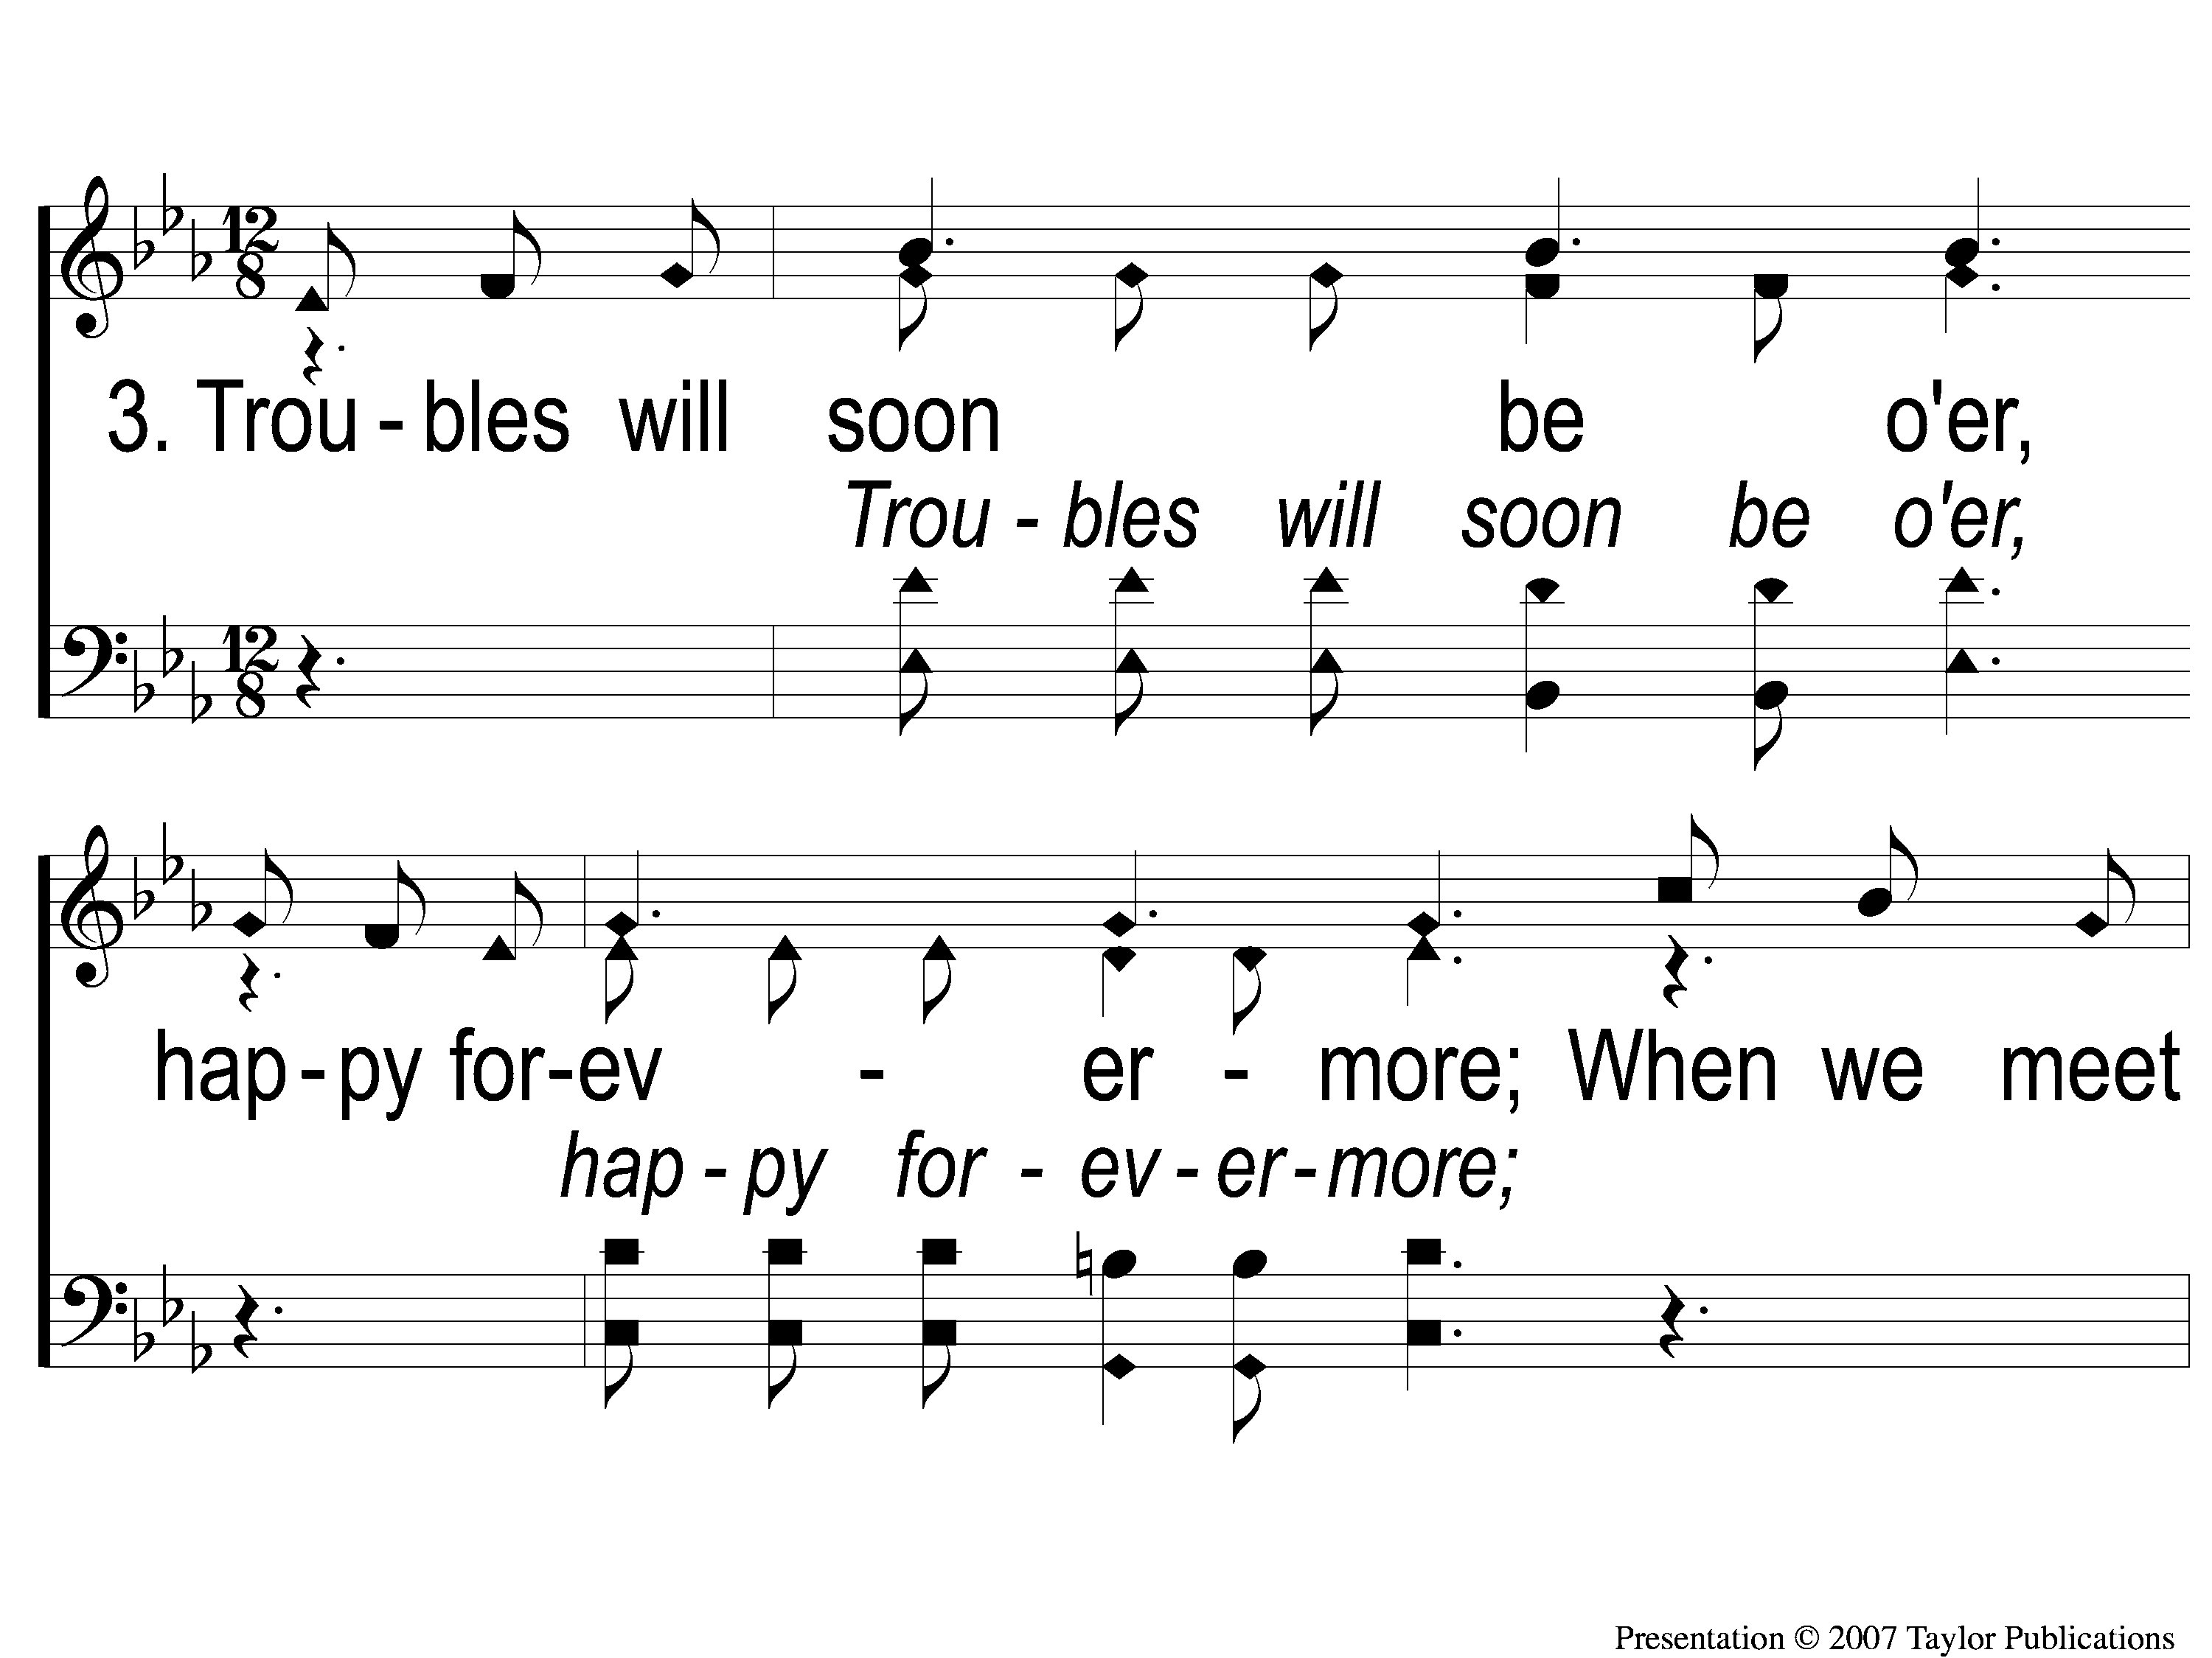
3-1 Jesus is Coming Soon
Jesus is Coming Soon
712

Slide 17
3-2 Jesus is Coming Soon
Jesus is Coming Soon
712

Slide 18
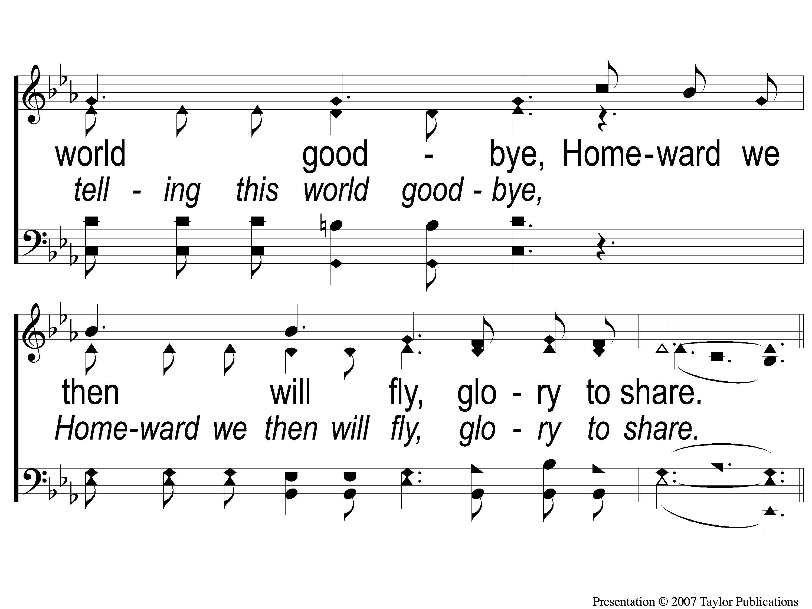
3-3 Jesus is Coming Soon
Jesus is Coming Soon
712

Slide 19
C-1 Jesus is Coming Soon
Jesus is Coming Soon
712

Slide 20
C-2 Jesus is Coming Soon
Jesus is Coming Soon
712

Slide 21
C-3 Jesus is Coming Soon
Jesus is Coming Soon
712

Slide 22
C-4 Jesus is Coming Soon
Jesus is Coming Soon
712

Slide 23
1-1 Jesus Hold My Hand
Jesus, Hold My Hand
412

Slide 24
1-2 Jesus Hold My Hand
Jesus, Hold My Hand
412

Slide 25
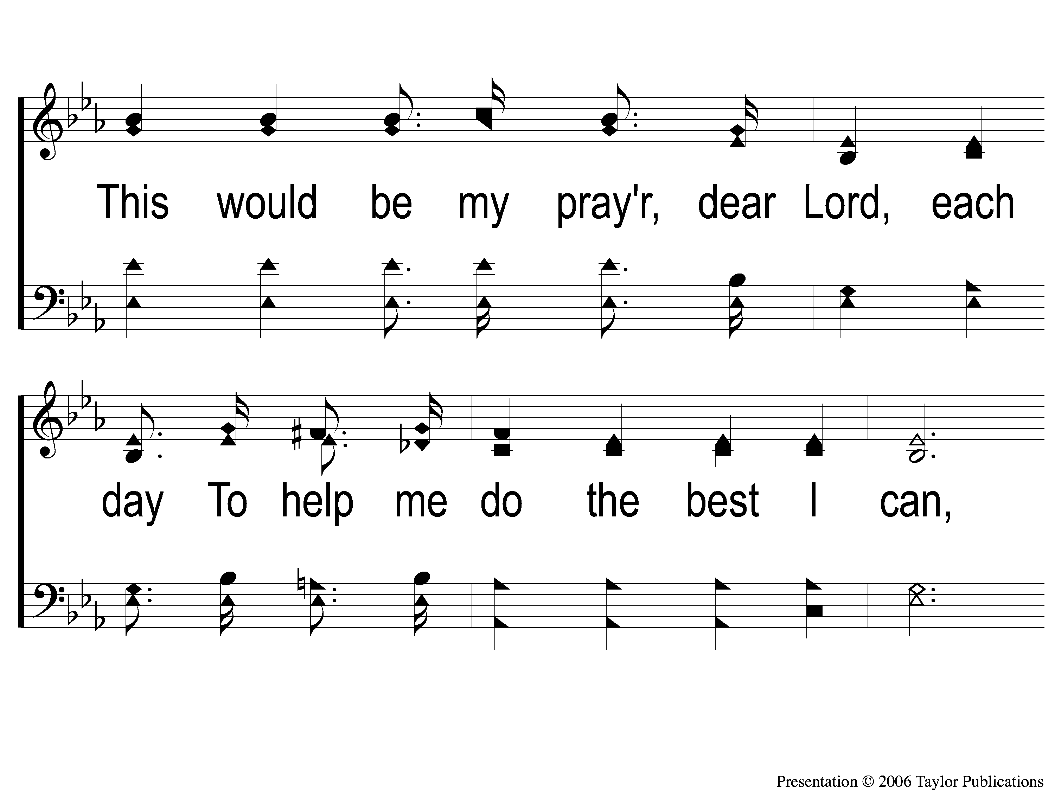
1-3 Jesus Hold My Hand
Jesus, Hold My Hand
412

Slide 26
1-4 Jesus Hold My Hand
Jesus, Hold My Hand
412

Slide 27
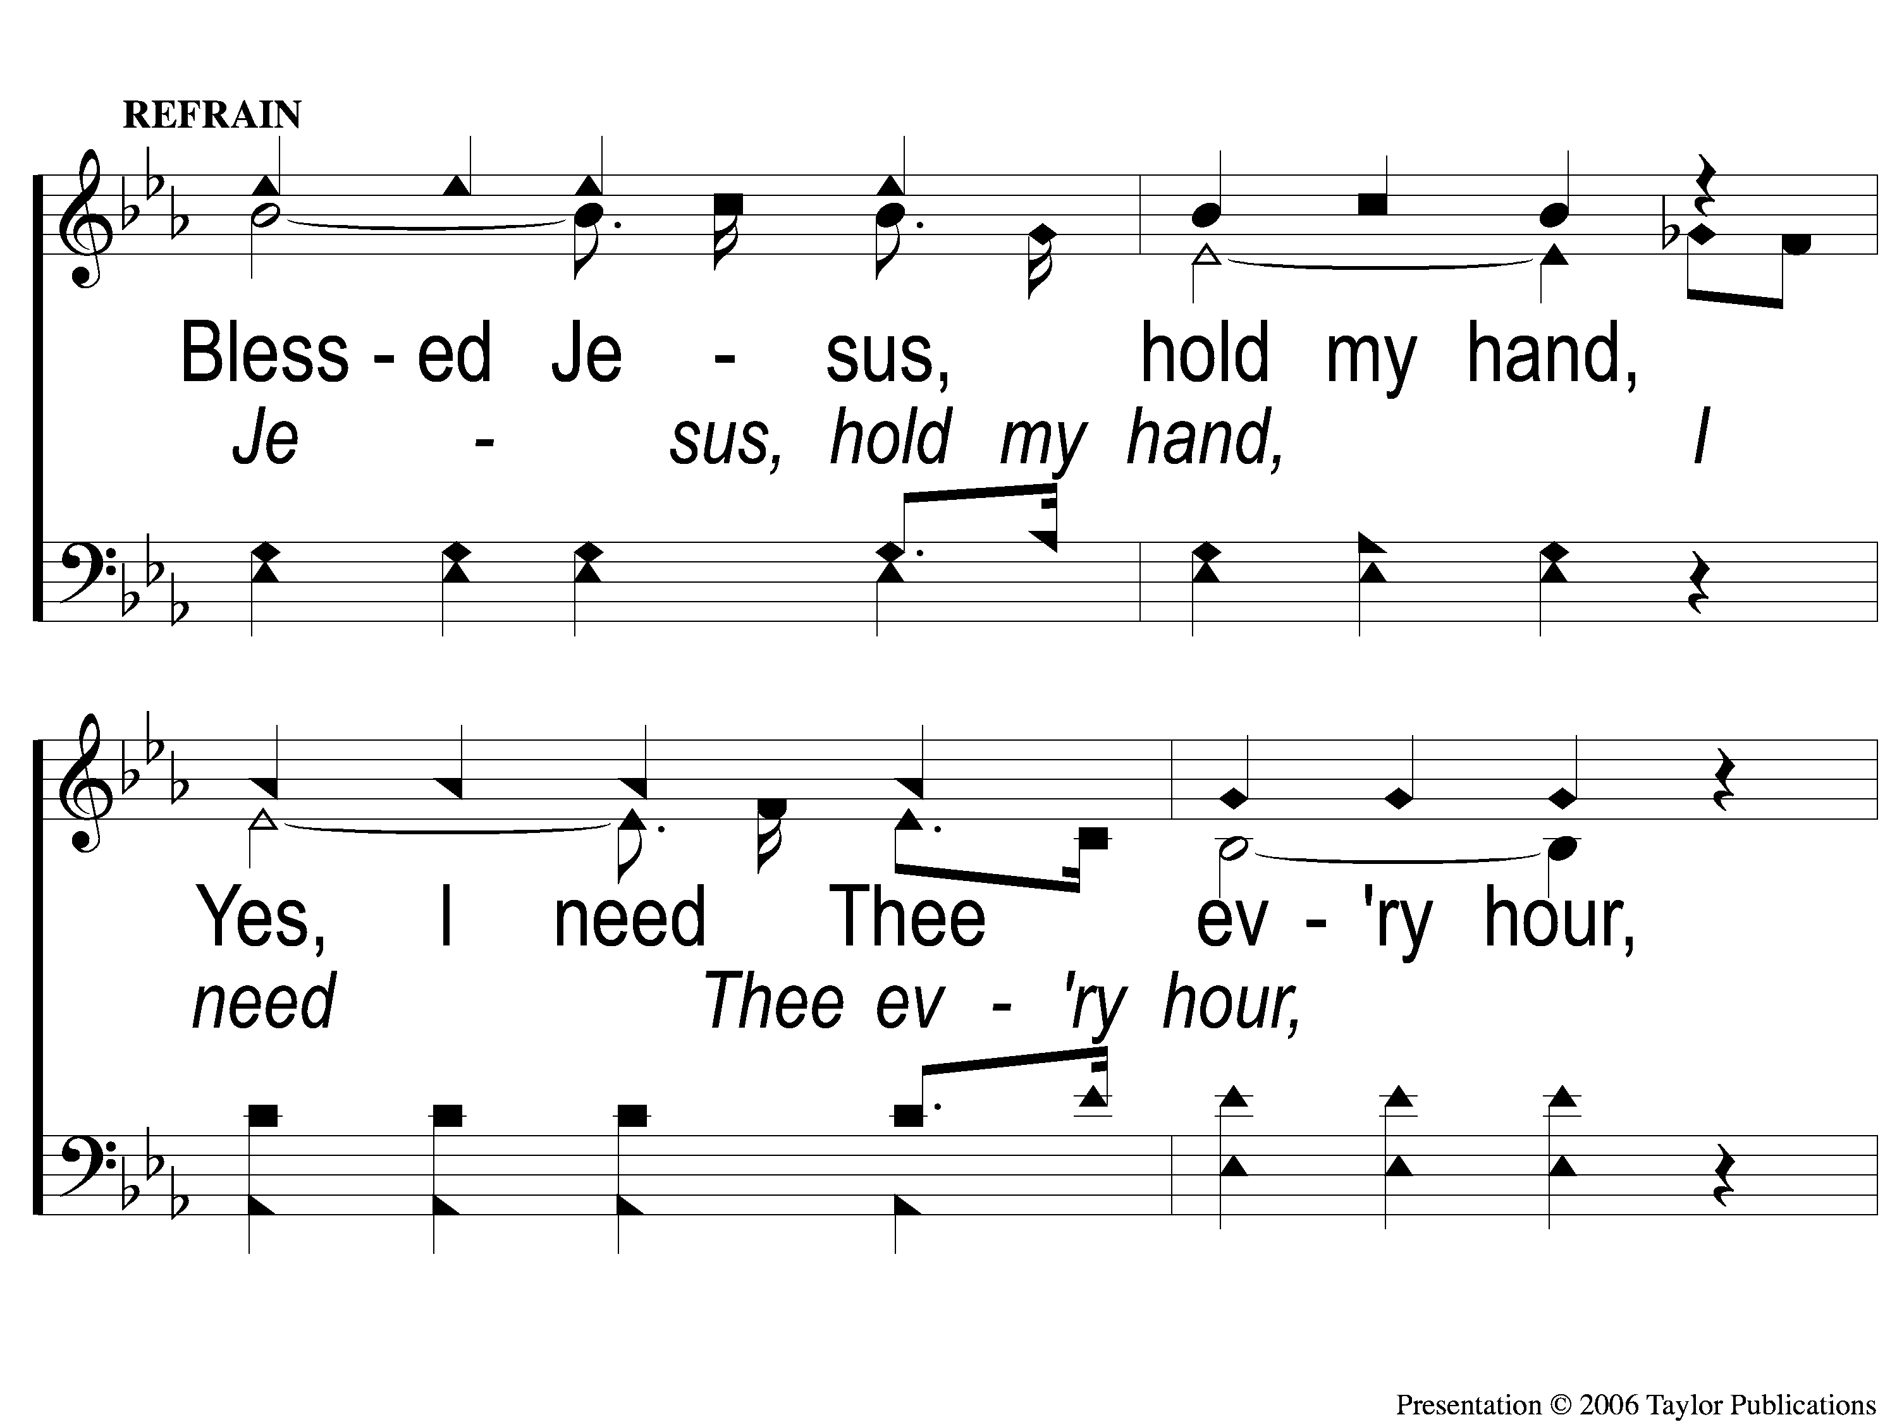
C-1 Jesus Hold My Hand
Jesus, Hold My Hand
412

Slide 28
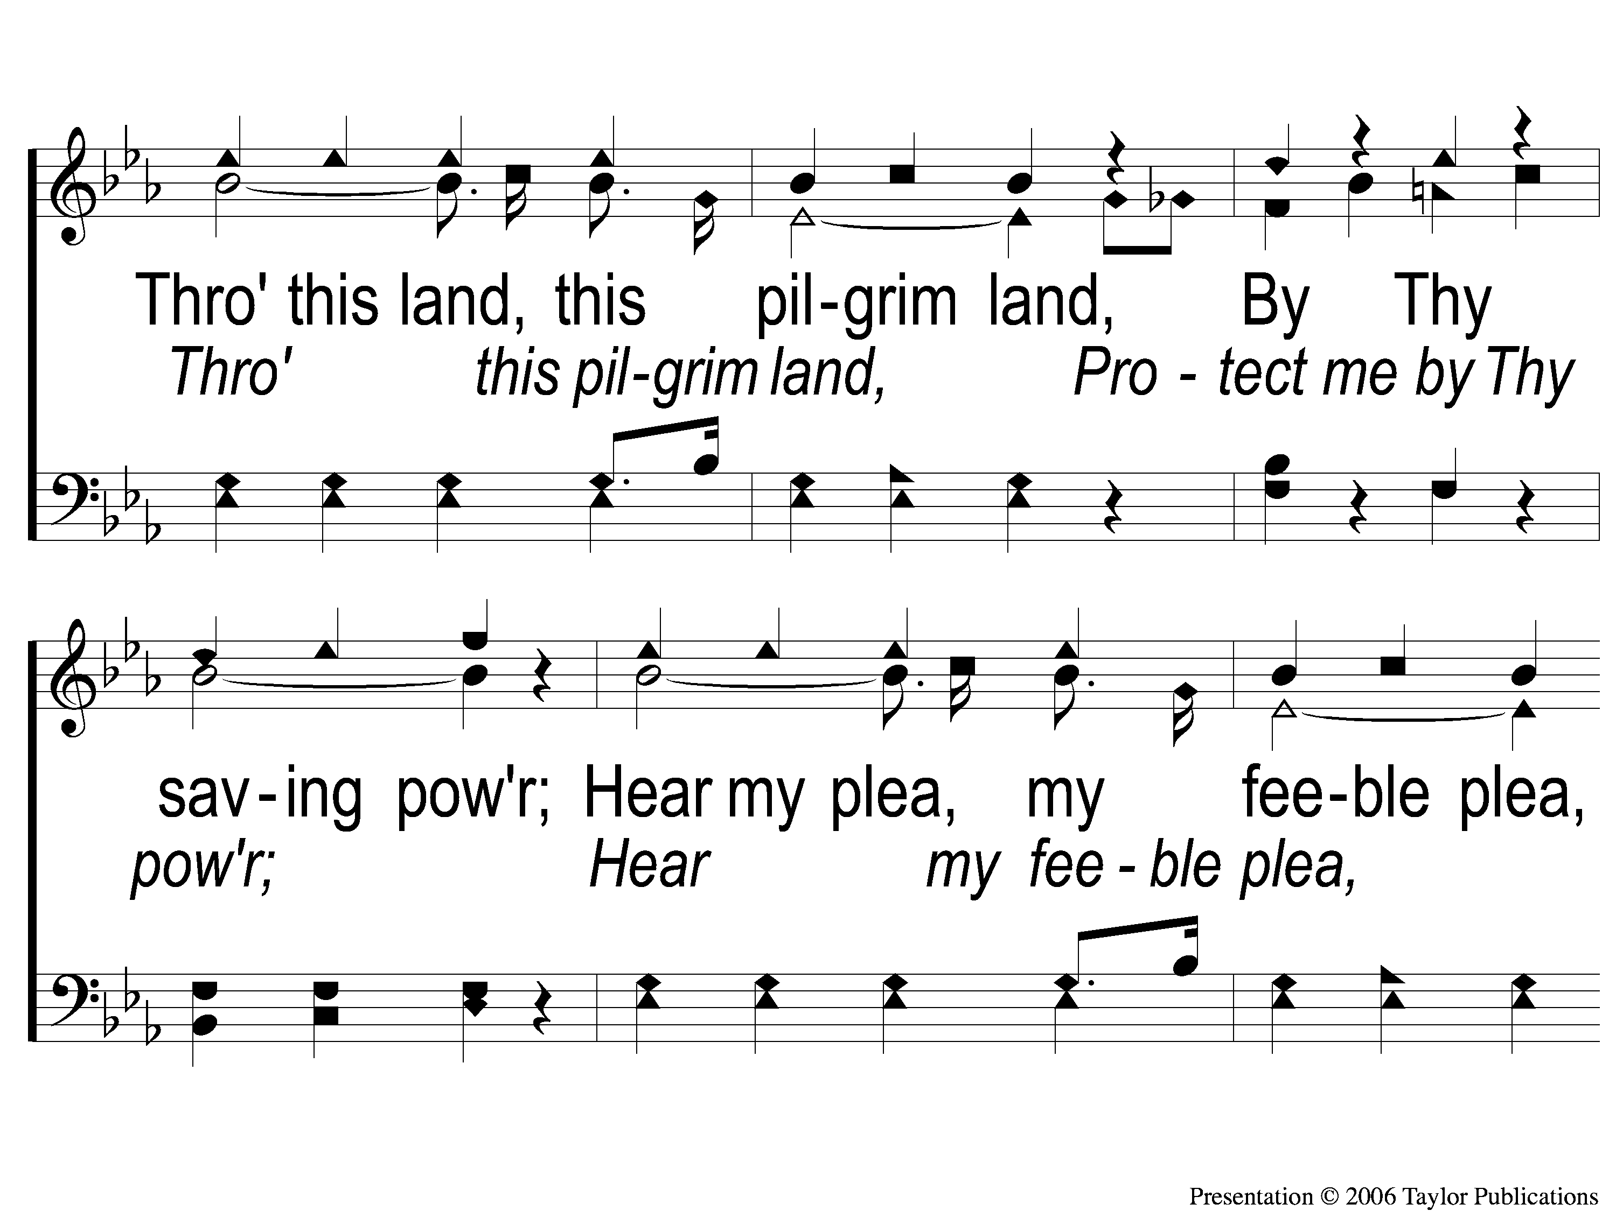
C-2 Jesus Hold My Hand
Jesus, Hold My Hand
412

Slide 29
C-3 Jesus Hold My Hand
Jesus, Hold My Hand
412

Slide 30
3-1 Jesus Hold My Hand
Jesus, Hold My Hand
412

Slide 31
3-2 Jesus Hold My Hand
Jesus, Hold My Hand
412

Slide 32
3-3 Jesus Hold My Hand
Jesus, Hold My Hand
412

Slide 33
3-4 Jesus Hold My Hand
Jesus, Hold My Hand
412

Slide 34
C-1 Jesus Hold My Hand
Jesus, Hold My Hand
412

Slide 35
C-2 Jesus Hold My Hand
Jesus, Hold My Hand
412

Slide 36
C-3 Jesus Hold My Hand
Jesus, Hold My Hand
412

Slide 37
Song:
Where No One Stands Alone
#801

Slide 38
1-1 Where No One Stands Alone
Where No One Stands Alone
801

Slide 39
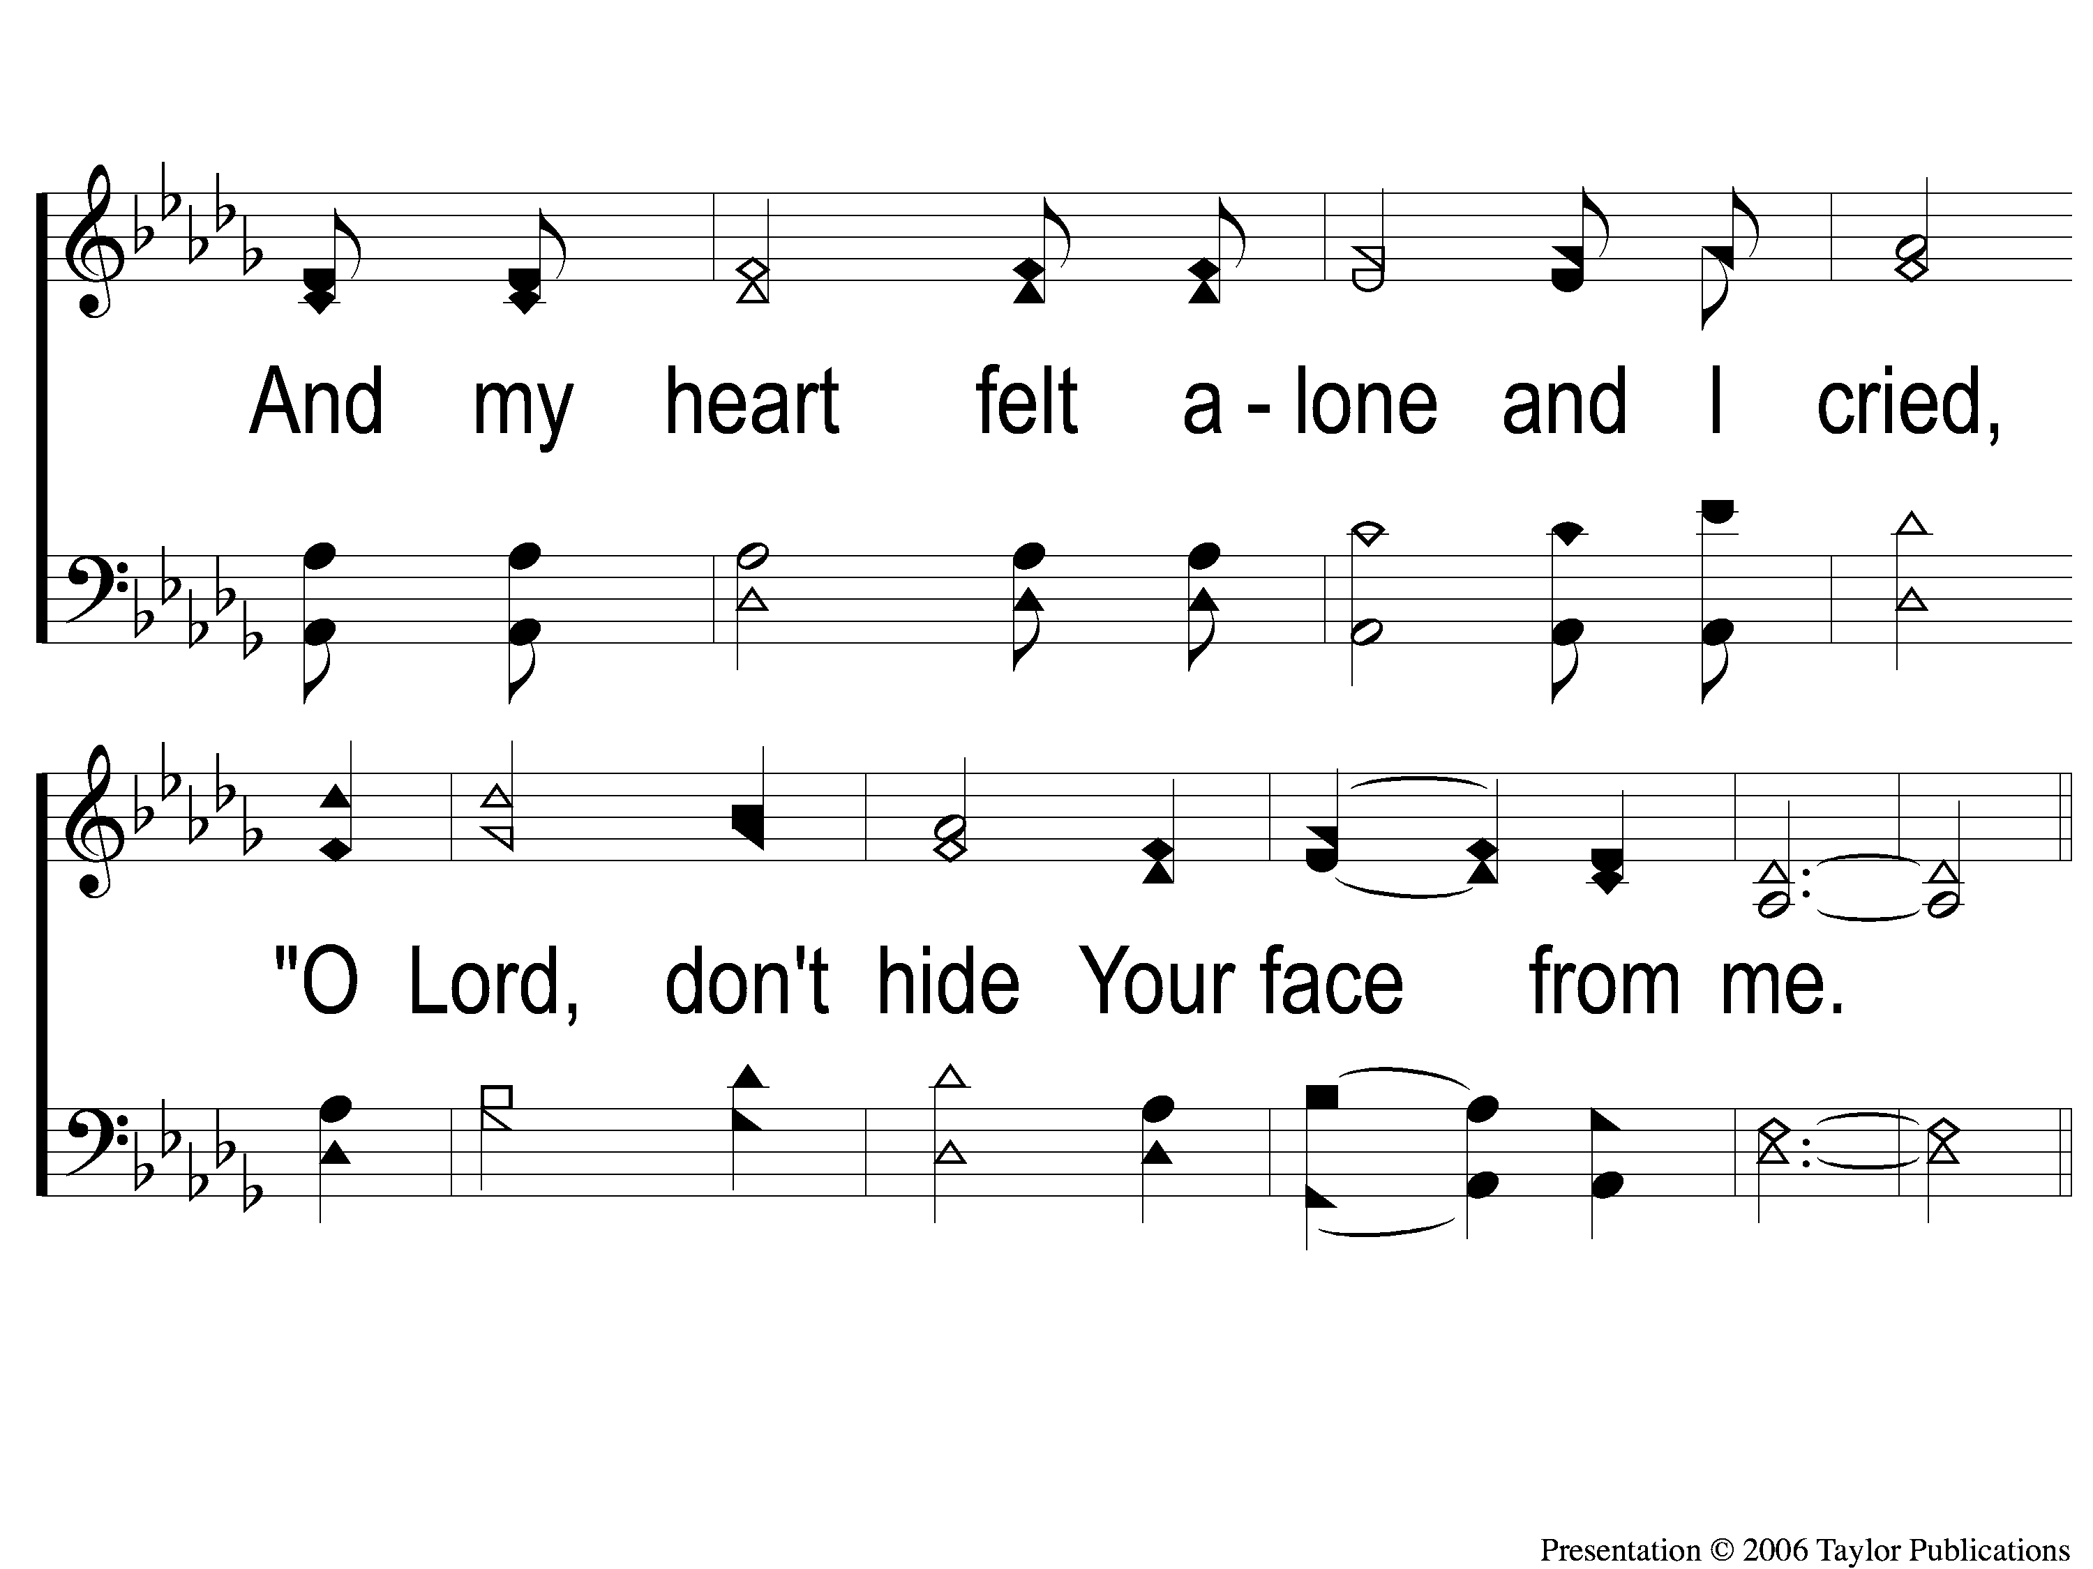
1-2 Where No One Stands Alone
Where No One Stands Alone
801

Slide 40
C-1 Where No One Stands Alone
Where No One Stands Alone
801

Slide 41
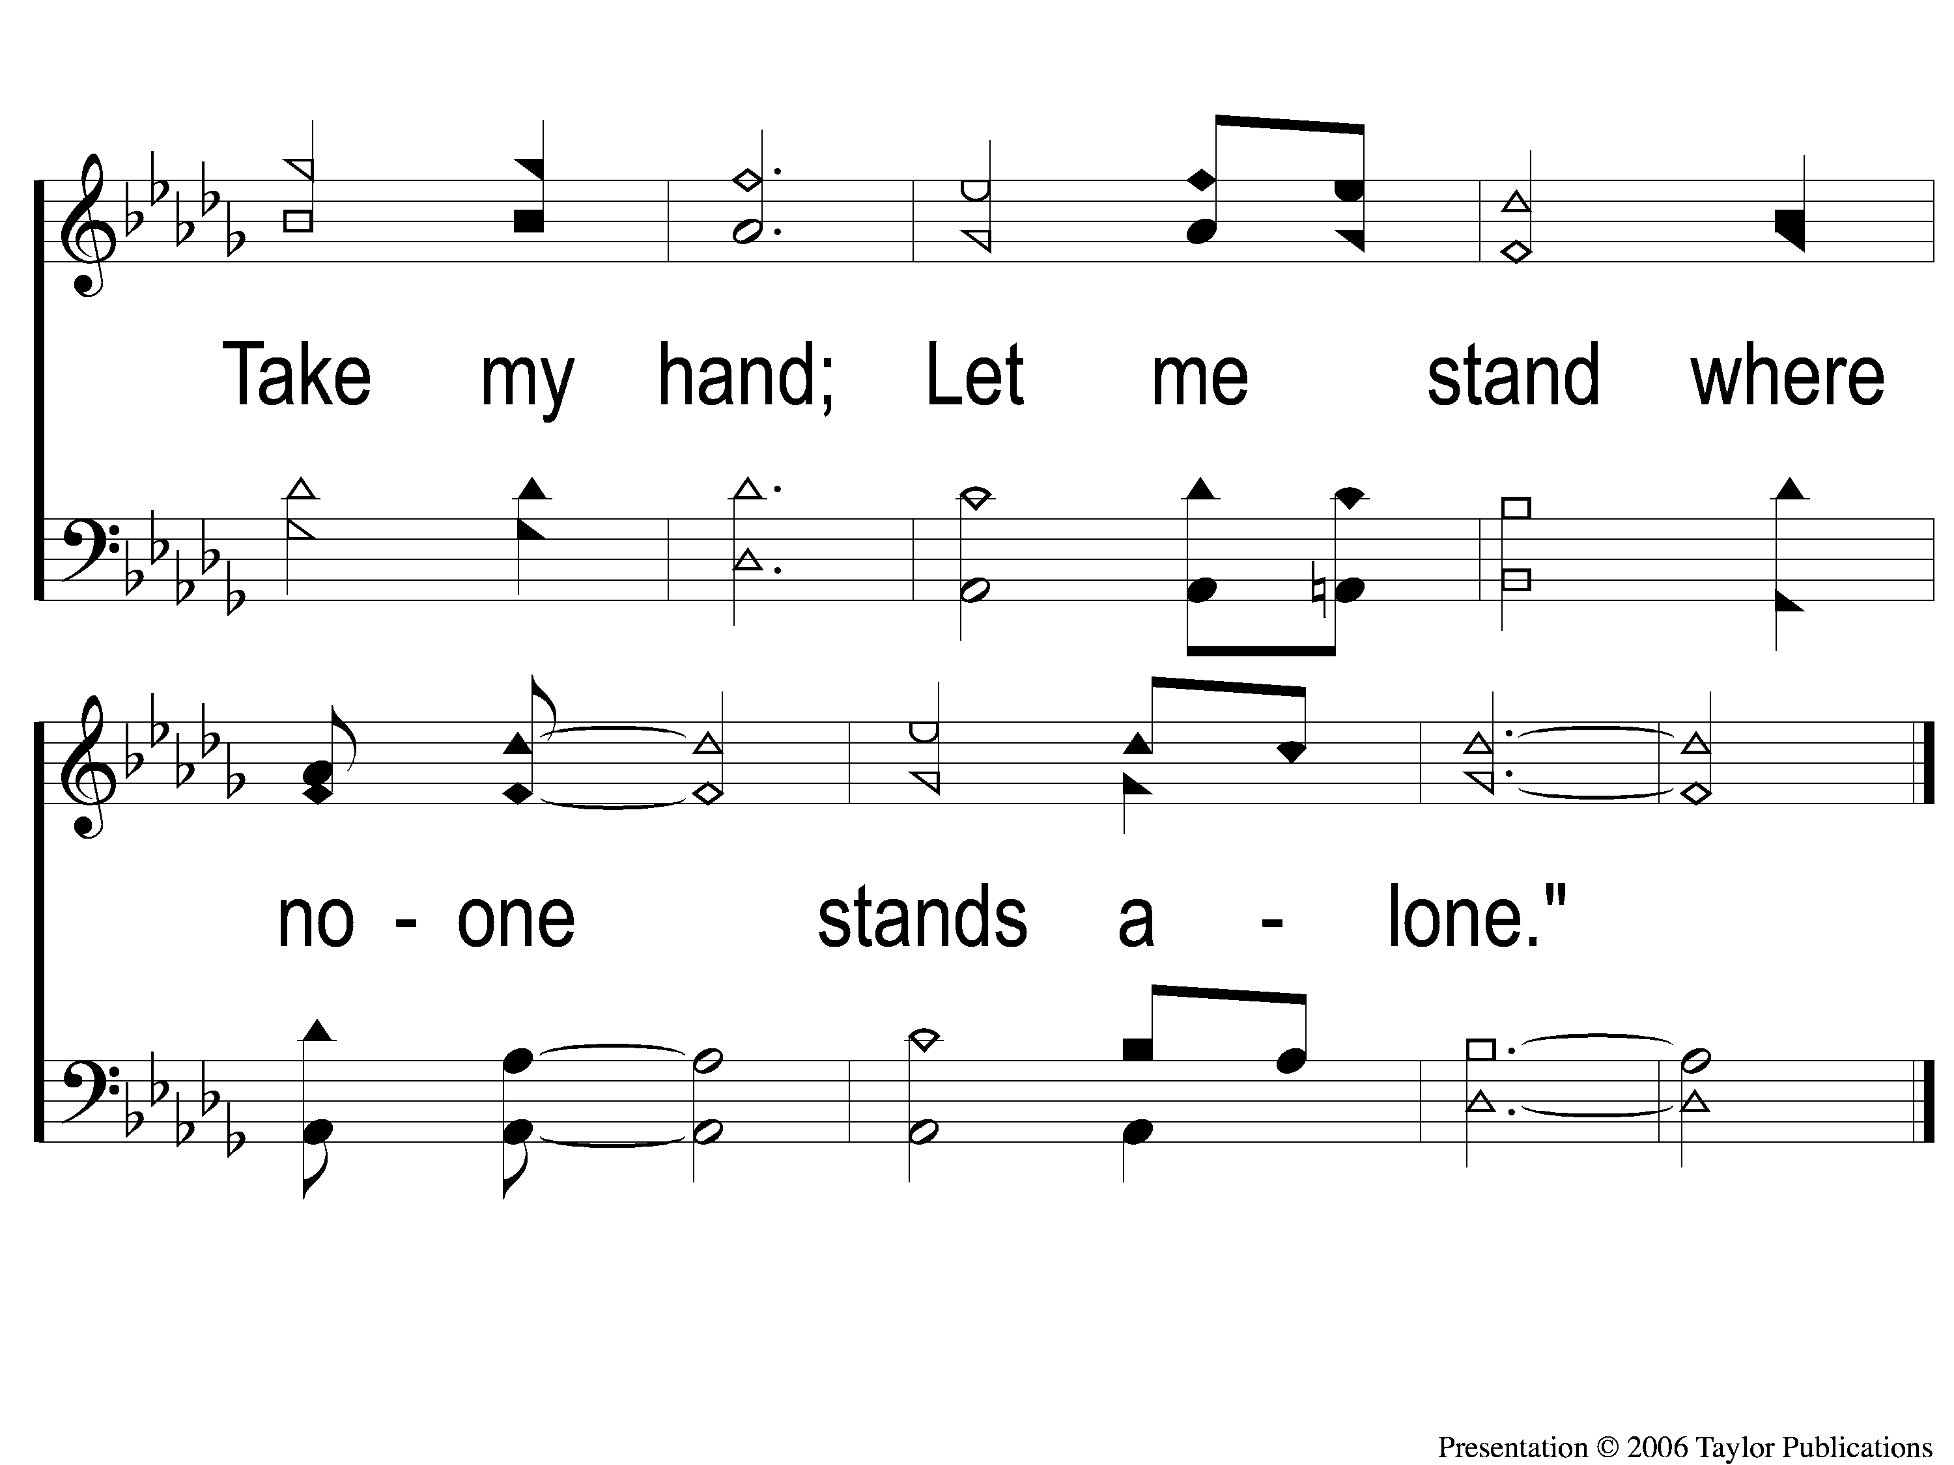
C-2 Where No One Stands Alone
Where No One Stands Alone
801

Slide 42
2-1 Where No One Stands Alone
Where No One Stands Alone
801

Slide 43
2-2 Where No One Stands Alone
Where No One Stands Alone
801

Slide 44
C-1 Where No One Stands Alone
Where No One Stands Alone
801

Slide 45
C-2 Where No One Stands Alone
Where No One Stands Alone
801

Slide 46
Opt tag Where No One Stands Alone
Where No One Stands Alone
801
Tag

Slide 47
Opening Prayer

Slide 48
Song:
He Lives!
#346

Slide 49
1-1 He Lives
He Lives
346

Slide 50
1-2 He Lives
He Lives
346

Slide 51
C-1 He Lives
He Lives
346

Slide 52
C-2 He Lives
He Lives
346

Slide 53
3-1 He Lives
He Lives
346

Slide 54
3-2 He Lives
He Lives
346

Slide 55
C-1 He Lives
He Lives
346

Slide 56
C-2 He Lives
He Lives
346

Slide 57
Song:
I Walk With The King
#550

Slide 58
1-1 I Walk With the King
I Walk With The King
550

Slide 59
1-2 I Walk With the King
I Walk With The King
550

Slide 60
1-3 I Walk With the King
I Walk With The King
550

Slide 61
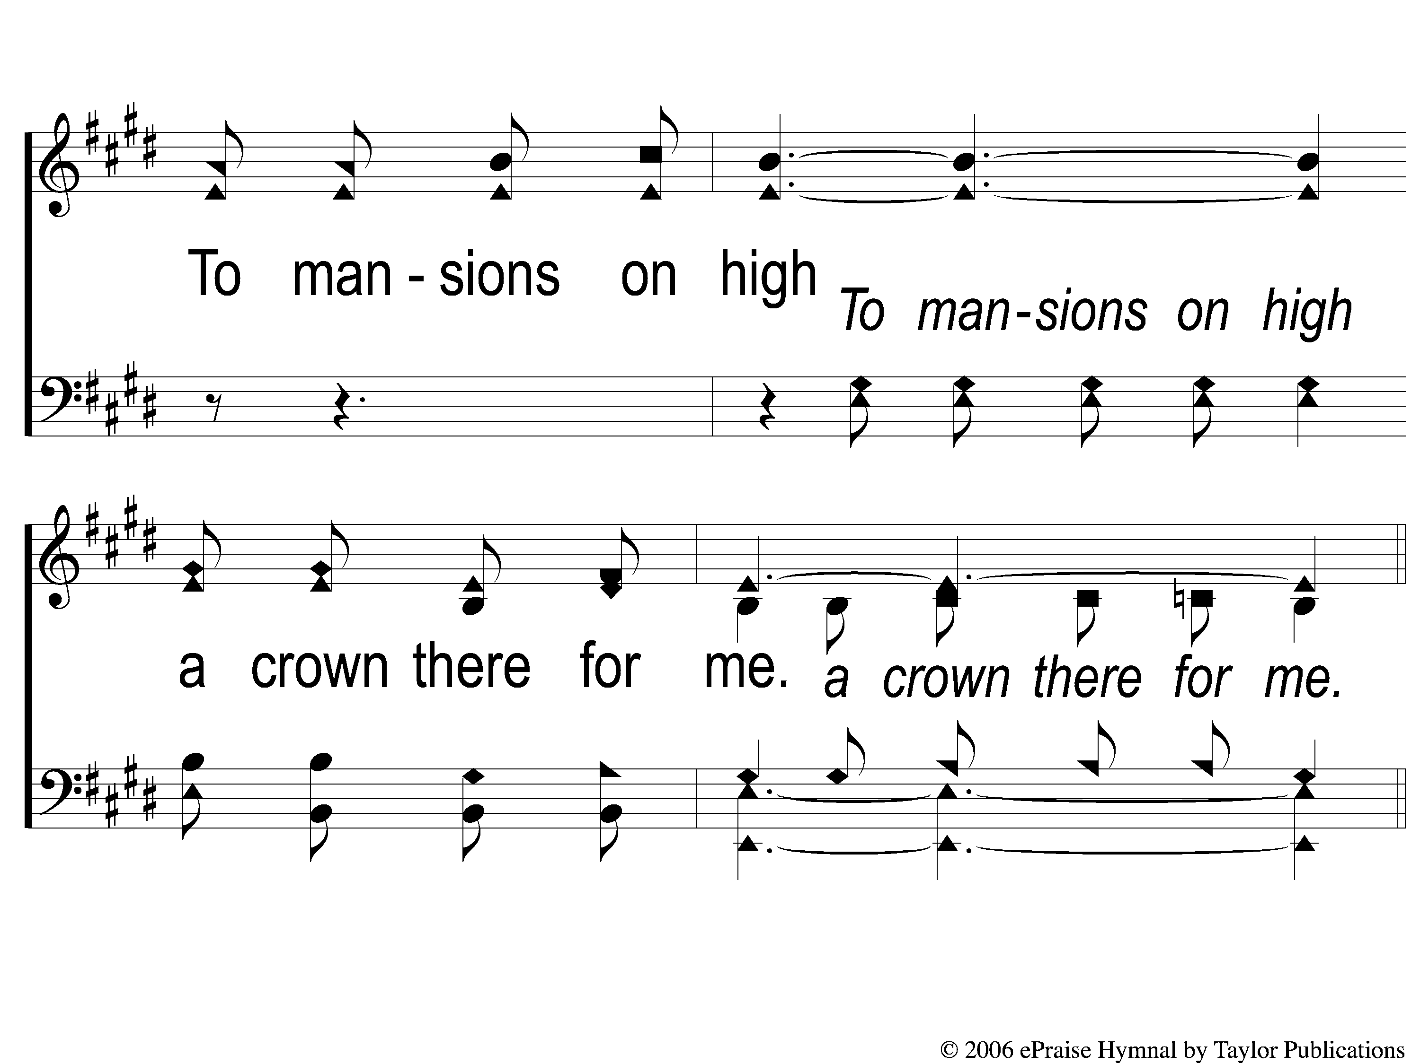
1-4 I Walk With the King
I Walk With The King
550

Slide 62
C-1 I Walk With the King
I Walk With The King
550

Slide 63
C-2 I Walk With the King
I Walk With The King
550

Slide 64
C-3 I Walk With the King
I Walk With The King
550

Slide 65
C-4 I Walk With the King
I Walk With The King
550

Slide 66
2-1 I Walk With the King
I Walk With The King
550

Slide 67
2-2 I Walk With the King
I Walk With The King
550

Slide 68
2-3 I Walk With the King
I Walk With The King
550

Slide 69
2-4 I Walk With the King
I Walk With The King
550

Slide 70
C-1 I Walk With the King
I Walk With The King
550

Slide 71
C-2 I Walk With the King
I Walk With The King
550

Slide 72
C-3 I Walk With the King
I Walk With The King
550

Slide 73
C-4 I Walk With the King
I Walk With The King
550

Slide 74
3-1 I Walk With the King
I Walk With The King
550

Slide 75
3-2 I Walk With the King
I Walk With The King
550

Slide 76
3-3 I Walk With the King
I Walk With The King
550

Slide 77
3-4 I Walk With the King
I Walk With The King
550

Slide 78
C-1 I Walk With the King
I Walk With The King
550

Slide 79
C-2 I Walk With the King
I Walk With The King
550

Slide 80
C-3 I Walk With the King
I Walk With The King
550

Slide 81
C-4 I Walk With the King
I Walk With The King
550

Slide 82
Scripture Reading:
Genesis 4:1-7

Slide 83
RESTORE REBUILD RENEW
IN 2022

Slide 84
RESTORE
OUR
FOUNDATIONS
JANUARY - APRIL

Slide 85
Tonight:
Cain Speaks Today:
The root of the problem

Slide 86
Give Your Best:
The Way of Abel

Slide 87
GIVE Your Best
Gen. 4:3-4

Slide 88
GIVE Your Best
Gen. 4:3-4
They Brought an Offering
Keywords: “Brought” & “Offering”

Slide 89
GIVE Your Best
Gen. 4:3-4
They Brought an Offering
Keywords: “Brought” & “Offering”
Brought their possessions

Slide 90
GIVE Your Best
Gen. 4:3-4
They Brought an Offering
To the Right Being
Psa. 29:1-2, 10-11

Slide 91
GIVE Your Best
Gen. 4:3-4
What can we give in worship to God?
Heb. 13:15-16

Slide 92
Give YOUR Best
Gen. 4:2-4

Slide 93
Give YOUR Best
Gen. 4:2-4
Our Sacrifices Must Be Ours
Lev. 2:1, 23:18, Ch. 1, 3-6
1 Chron. 21:24

Slide 94
Give Your BEST
Gen. 4:3-4

Slide 95
Give Your BEST
Gen. 4:3-4
Why Was Abel’s Accepted By God
& Cain’s rejected?
Heb. 11:4, Rom. 10:17

Slide 96
Give Your BEST
Gen. 4:3-4
God Desires Our Best
Matt. 6:24

Slide 97
Are You Giving Your BEST?

Slide 98
Invitation
Song:
A New Creature
#619

Slide 99
1-1 A New Creature
A New Creature
619

Slide 100
1-2 A New Creature
A New Creature
619

Slide 101
C-1 A New Creature
A New Creature
619

Slide 102
C-2 A New Creature
A New Creature
619

Slide 103
3-1 A New Creature
A New Creature
619

Slide 104
3-2 A New Creature
A New Creature
619

Slide 105
C-1 A New Creature
A New Creature
619

Slide 106
C-2 A New Creature
A New Creature
619

Slide 107
The Contribution:
Romans 9:6-8
“The point is this: whoever sows sparingly will also reap sparingly, and whoever sows bountifully will also reap bountifully. Each one must give as he has decided in his heart, not reluctantly or under compulsion, for God loves a cheerful giver. And God is able to make all grace abound to you, so that having all sufficiency in all things at all times, you may abound in every good work.”

Slide 108
Song:
One Day
#353

Slide 109
1-1 One Day
One Day
353

Slide 110
1-2 One Day
One Day
353

Slide 111
2-1 One Day
One Day
353

Slide 112
2-2 One Day
One Day
353

Slide 113
3-1 One Day
One Day
353

Slide 114
3-2 One Day
One Day
353

Slide 115
4-1 One Day
One Day
353

Slide 116
4-2 One Day
One Day
353

Slide 117
5-1 One Day
One Day
353

Slide 118
5-2 One Day
One Day
353

Slide 119
C-1 One Day
One Day
353

Slide 120
C-2 One Day
One Day
353

Slide 121
The Unleavened Bread
Romans 5:18-19
“Therefore, as through one man’s offense judgment came to all men, resulting in condemnation, even so through one Man’s righteous act the free gift came to all men, resulting in justification of life. For as by one man’s disobedience many were made sinners, so also by one Man’s obedience many will be made righteous.”

Slide 122
The Fruit of the Vine
Romans 5:9-11
“Since, therefore, we have now been justified by his blood, much more shall we be saved by him from the wrath of God. For if while we were enemies we were reconciled to God by the death of his Son, much more, now that we are reconciled, shall we be saved by his life. More than that, we also rejoice in God through our Lord Jesus Christ, through whom we have now received reconciliation.”

Slide 123
Closing Prayer

Slide 124
Song:
He Gave Me A Song
#608

Slide 125
1-1 He Gave Me A Song
He Gave Me A Song
608

Slide 126
1-2 He Gave Me A Song
He Gave Me A Song
608

Slide 127
1-3 He Gave Me A Song
He Gave Me A Song
608

Slide 128
C-1 He Gave Me A Song
He Gave Me A Song
608

Slide 129
C-2 He Gave Me A Song
He Gave Me A Song
608

Slide 130
C-3 He Gave Me A Song
He Gave Me A Song
608

Slide 131
3-1 He Gave Me A Song
He Gave Me A Song
608

Slide 132
3-2 He Gave Me A Song
He Gave Me A Song
608

Slide 133
3-3 He Gave Me A Song
He Gave Me A Song
608

Slide 134
C-1 He Gave Me A Song
He Gave Me A Song
608

Slide 135
C-2 He Gave Me A Song
He Gave Me A Song
608

Slide 136
C-3 He Gave Me A Song
He Gave Me A Song
608

Slide 137
RESTORE REBUILD RENEW
JOIN US
IN THE MPB FOR
A FELLOWSHIP MEAL
@ NOON
IN 2022
WHEELER
CHURCH
OF
CHRIST

Slide 138
Tonight
WORSHIP @ 6:00 pm
Wednesday
WORSHIP @ 6:30 pm
Bible classes @ 7:00 pm
RESTORE REBUILD RENEW
IN 2022
WHEELER
CHURCH
OF
CHRIST

