Slide 1
RESTORE REBUILD RENEW
welcome
we are glad to
Have you with us
IN 2022
WHEELER
CHURCH
OF
CHRIST

Slide 2
Songs of Praise To God

Slide 3
Opening Prayer

Slide 4
Songs of Praise To God

Slide 5
RESTORE
OUR
FOUNDATIONS
JANUARY - APRIL

Slide 6
The Global Flood:
Biblical Evidences

Slide 7
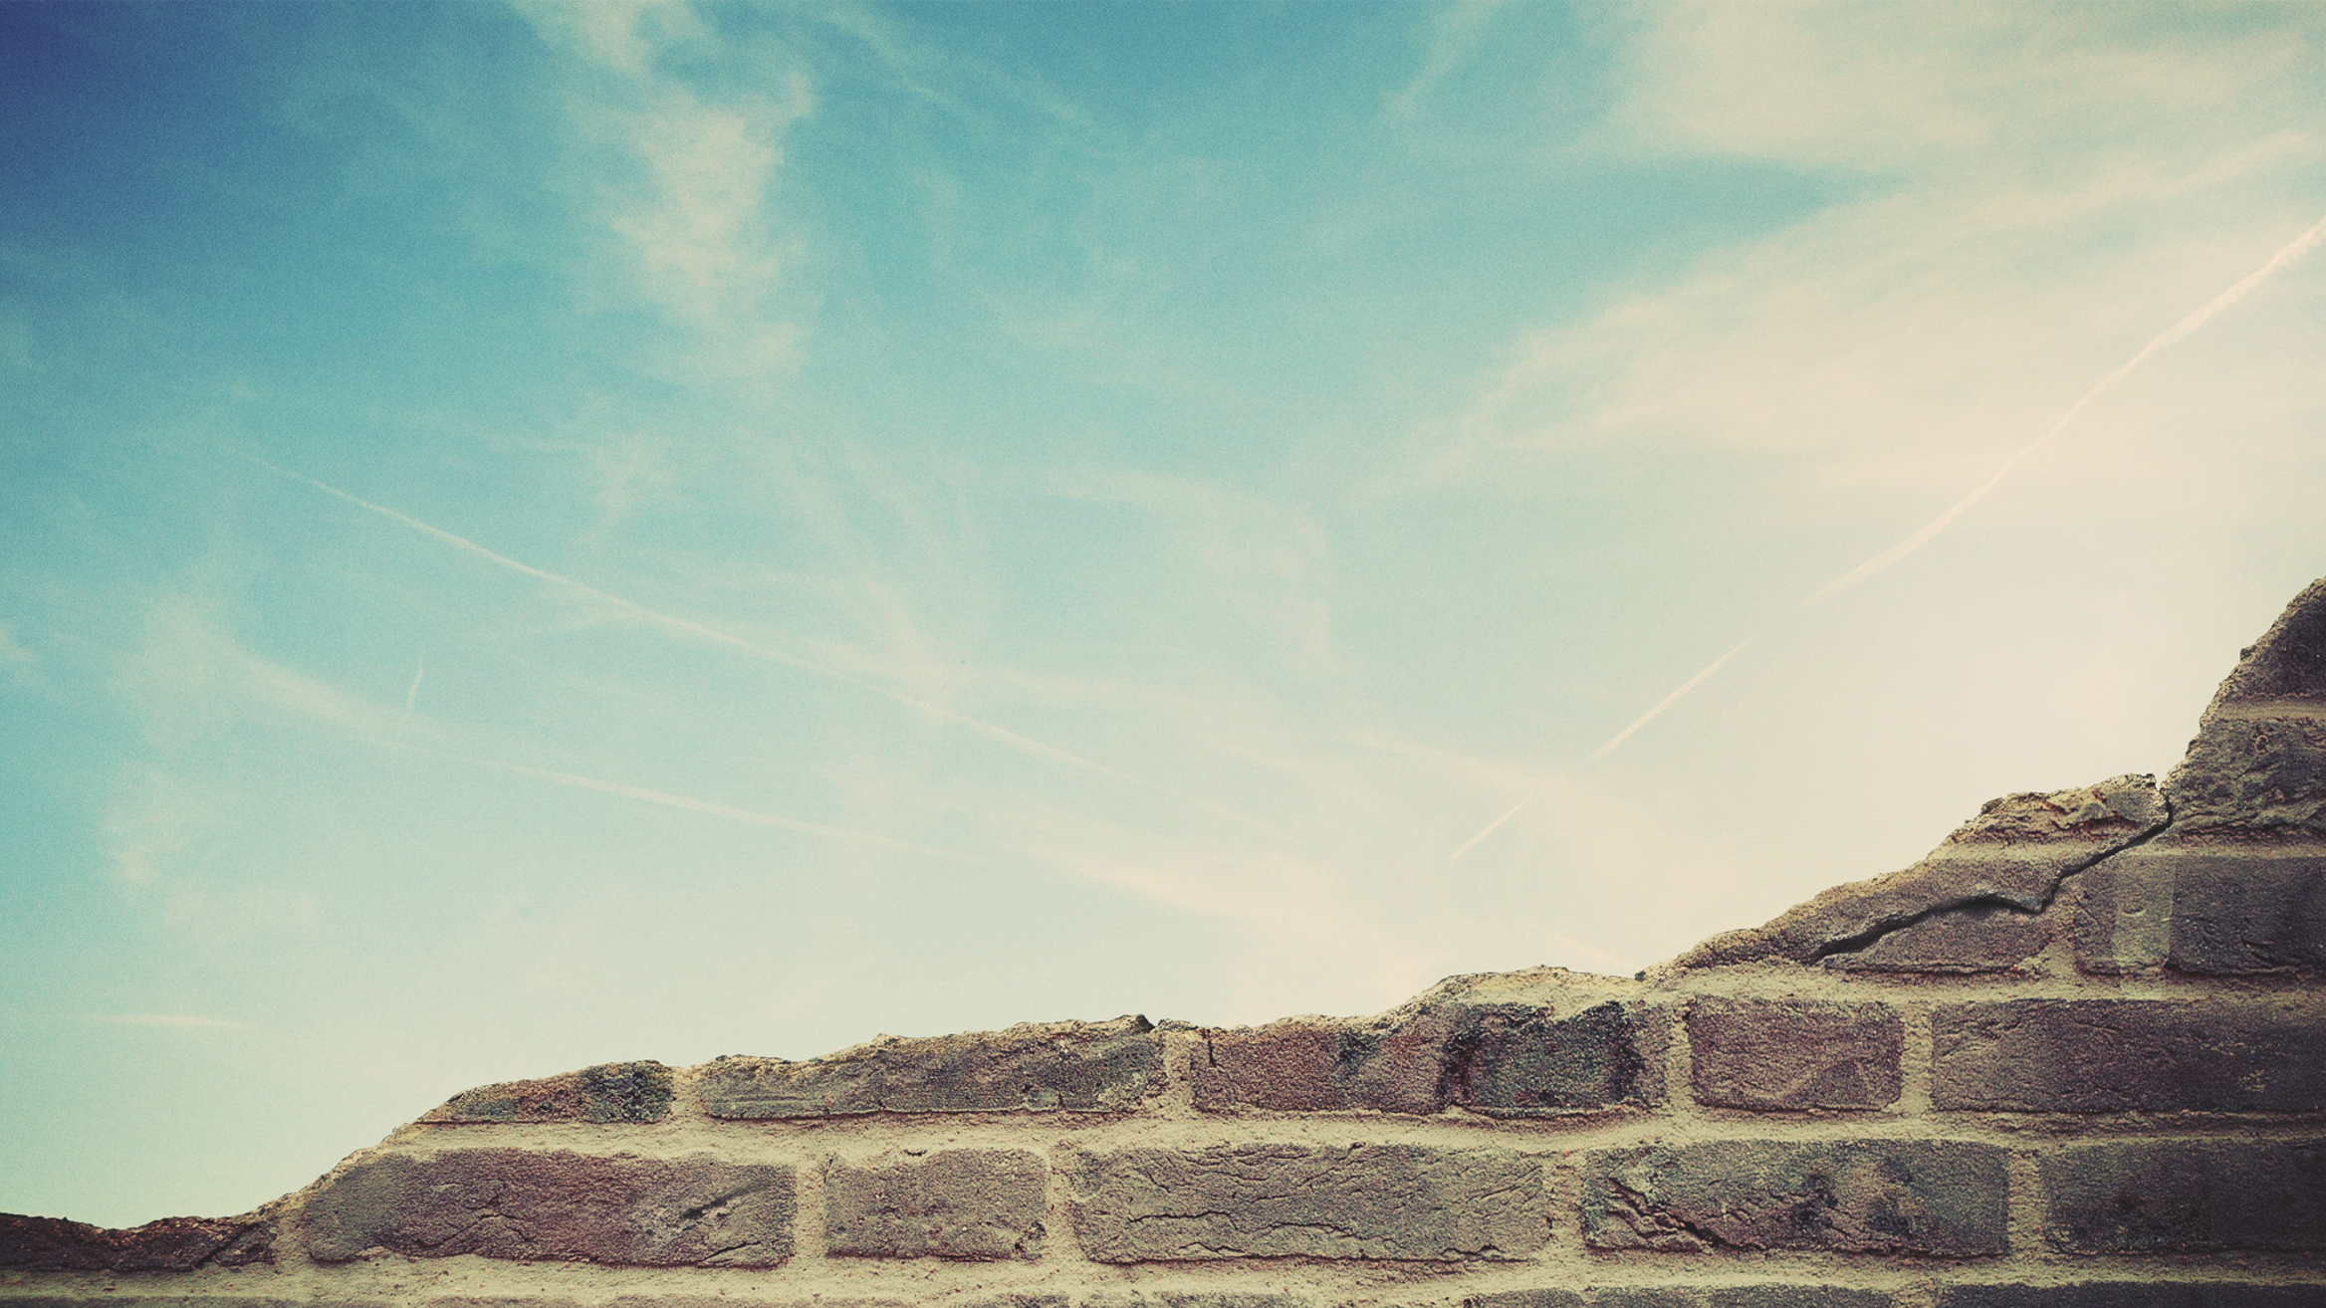
Why the flood was Global:

Slide 8
Why the flood was Global:
The Time

Slide 9
The Time Spent
Building the Ark
Gen. 5:32, 7:6

Slide 10
The Time Spent
On the Ark
Gen. 7:11, 8:3, 14-17
371 Days!

Slide 11
Why the flood was Global:
The Time
The Animals

Slide 12
The Animals
Gen. 6:19-20
Gen. 8:3

Slide 13
Why the flood was Global:
The Time
The Animals
The Language

Slide 14
The Language
“The face of the Earth”
Gen. 6:6-7, 7:4
Deut. 7:6 – Acts 17:26

Slide 15
The Language
“All flesh…on the earth”
Gen. 6:11-13
Lev. 17:14

Slide 16
The Language
It Covered The Mountains
Gen. 7:19, 20, 24-8:5

Slide 17
Why the flood was Global:
The Time
The Animals
The Language
The Promise

Slide 18
The Promise
Gen. 9:8-16
Not to flood the whole earth again

Slide 19
Why the flood was Global:
The Time
The Animals
The Language
The Promise
The Comparison

Slide 20
The Comparison
The Judgement Day
2 Pet. 3:5-7
Lk. 17:27

Slide 21
Songs of Praise To God

Slide 22
THE LORD’S SUPPER
Acts 20:7

Slide 23
Closing Prayer

Slide 24
Songs of Praise To God

Slide 25
RESTORE REBUILD RENEW
Wednesday
WORSHIP @ 6:30 pm
Bible classes @ 7:00 pm
IN 2022
WHEELER
CHURCH
OF
CHRIST

