Slide 1
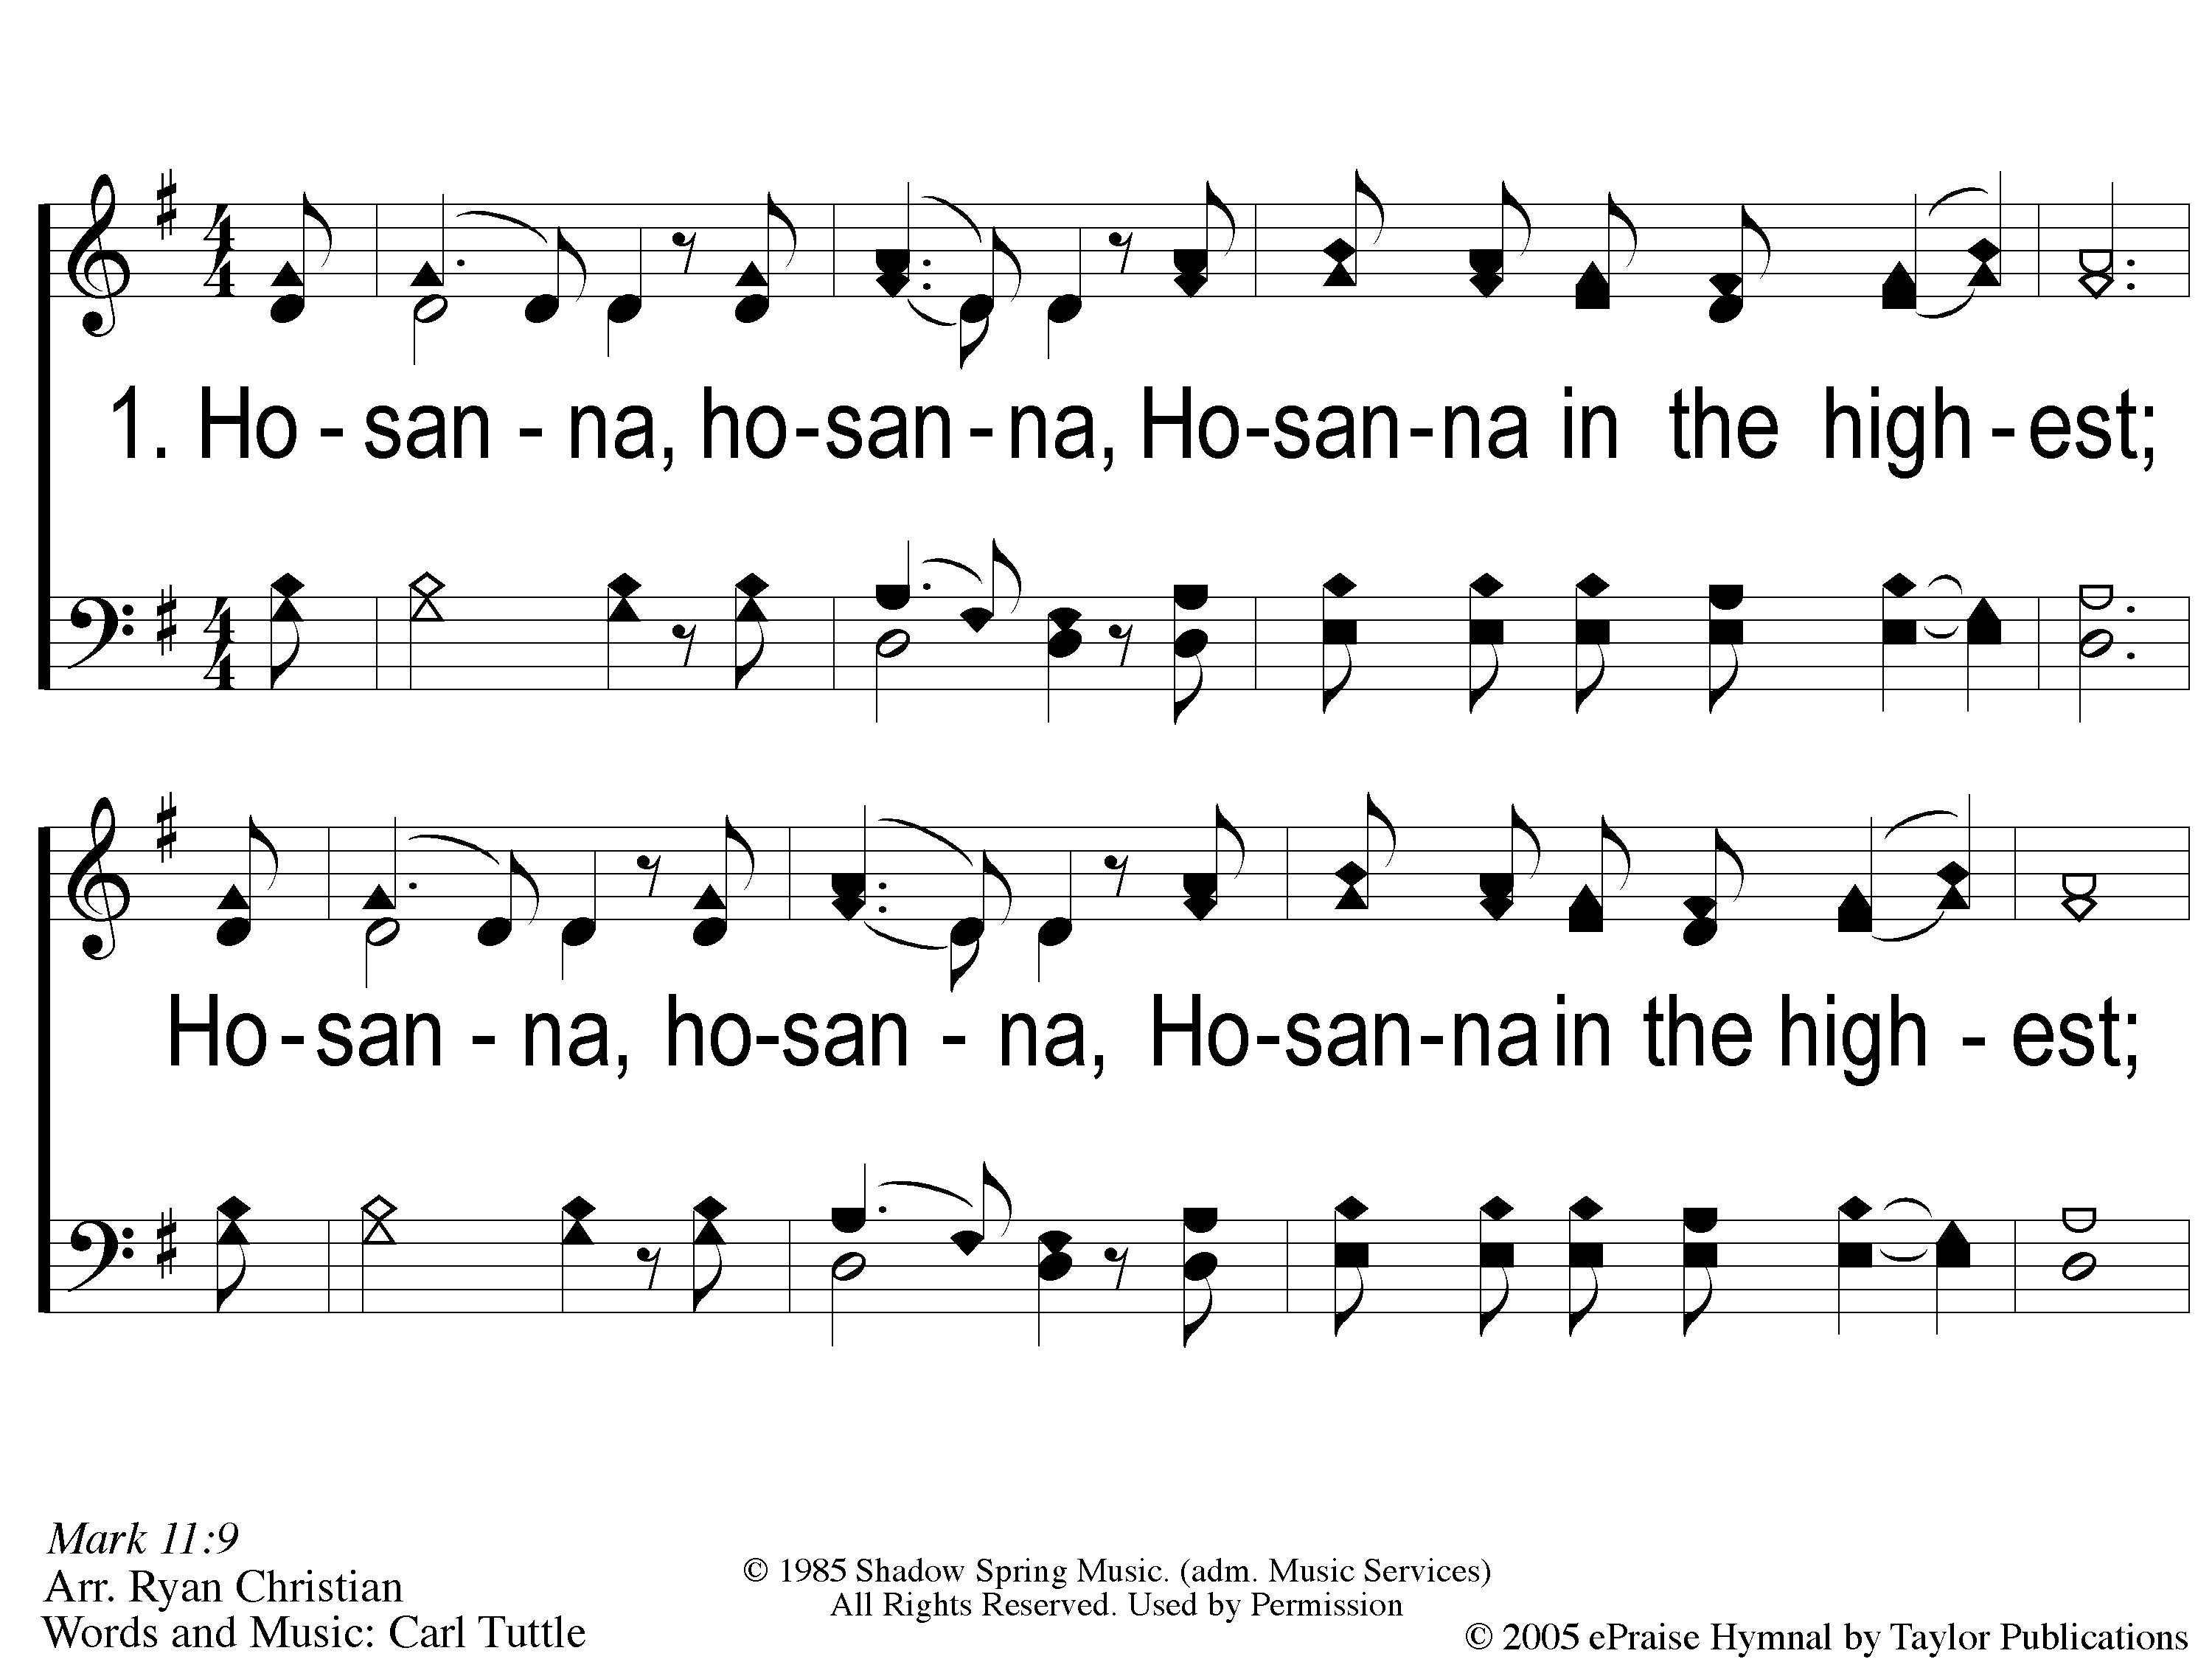
1 Hosanna
Hosanna
167

Slide 2
C-1 Hosanna
Hosanna
167

Slide 3
C-2 Hosanna
Hosanna
167

Slide 4
2 Hosanna
Hosanna
167

Slide 5
C-1 Hosanna
Hosanna
167

Slide 6
C-2 Hosanna
Hosanna
167

Slide 7
RESTORE REBUILD RENEW
welcome
we are glad to
Have you with us
IN 2022
WHEELER
CHURCH
OF
CHRIST

Slide 8
Song:
There Is A Habitation
#860

Slide 9
1 There is a Habitation
There Is A Habitation
860

Slide 10
c There is a Habitation
There Is A Habitation
860

Slide 11
2 There is a Habitation
There Is A Habitation
860

Slide 12
c There is a Habitation
There Is A Habitation
860

Slide 13
3 There is a Habitation
There Is A Habitation
860

Slide 14
c There is a Habitation
There Is A Habitation
860

Slide 15
4 There is a Habitation
There Is A Habitation
860

Slide 16
c There is a Habitation
There Is A Habitation
860

Slide 17
Song:
Just A Little Talk With Jesus
#959

Slide 18
1-1 Just A Little Talk With Jesus
Just A Little Talk With Jesus
959

Slide 19
1-2 Just A Little Talk With Jesus
Just A Little Talk With Jesus
959

Slide 20
C-1 Just A Little Talk With Jesus
Just A Little Talk With Jesus
959

Slide 21
C-2 Just A Little Talk With Jesus
Just A Little Talk With Jesus
959

Slide 22
C-3 Just A Little Talk With Jesus
Just A Little Talk With Jesus
959

Slide 23
2-1 Just A Little Talk With Jesus
Just A Little Talk With Jesus
959

Slide 24
2-2 Just A Little Talk With Jesus
Just A Little Talk With Jesus
959

Slide 25
C-1 Just A Little Talk With Jesus
Just A Little Talk With Jesus
959

Slide 26
C-2 Just A Little Talk With Jesus
Just A Little Talk With Jesus
959

Slide 27
C-3 Just A Little Talk With Jesus
Just A Little Talk With Jesus
959

Slide 28
3-1 Just A Little Talk With Jesus
Just A Little Talk With Jesus
959

Slide 29
3-2 Just A Little Talk With Jesus
Just A Little Talk With Jesus
959

Slide 30
C-1 Just A Little Talk With Jesus
Just A Little Talk With Jesus
959

Slide 31
C-2 Just A Little Talk With Jesus
Just A Little Talk With Jesus
959

Slide 32
C-3 Just A Little Talk With Jesus
Just A Little Talk With Jesus
959

Slide 33
Opening Prayer

Slide 34
Song:
I Will Call Upon The Lord
#63

Slide 35
1 I Will Call Upon the Lord
I Will Call Upon the Lord
63

Slide 36
2 I Will Call Upon the Lord
I Will Call Upon the Lord
63

Slide 37
3 I Will Call Upon the Lord
I Will Call Upon the Lord
63

Slide 38
4 I Will Call Upon the Lord
I Will Call Upon the Lord
63

Slide 39
DC1 I Will Call Upon the Lord
I Will Call Upon the Lord
63

Slide 40
DC2 I Will Call Upon the Lord
I Will Call Upon the Lord
63

Slide 41
DC3 I Will Call Upon the Lord
I Will Call Upon the Lord
63

Slide 42
DC4 I Will Call Upon the Lord
I Will Call Upon the Lord
63

Slide 43
tag I Will Call Upon the Lord
I Will Call Upon the Lord
63

Slide 44
Song:
Create In Me A Clean Heart

Slide 45
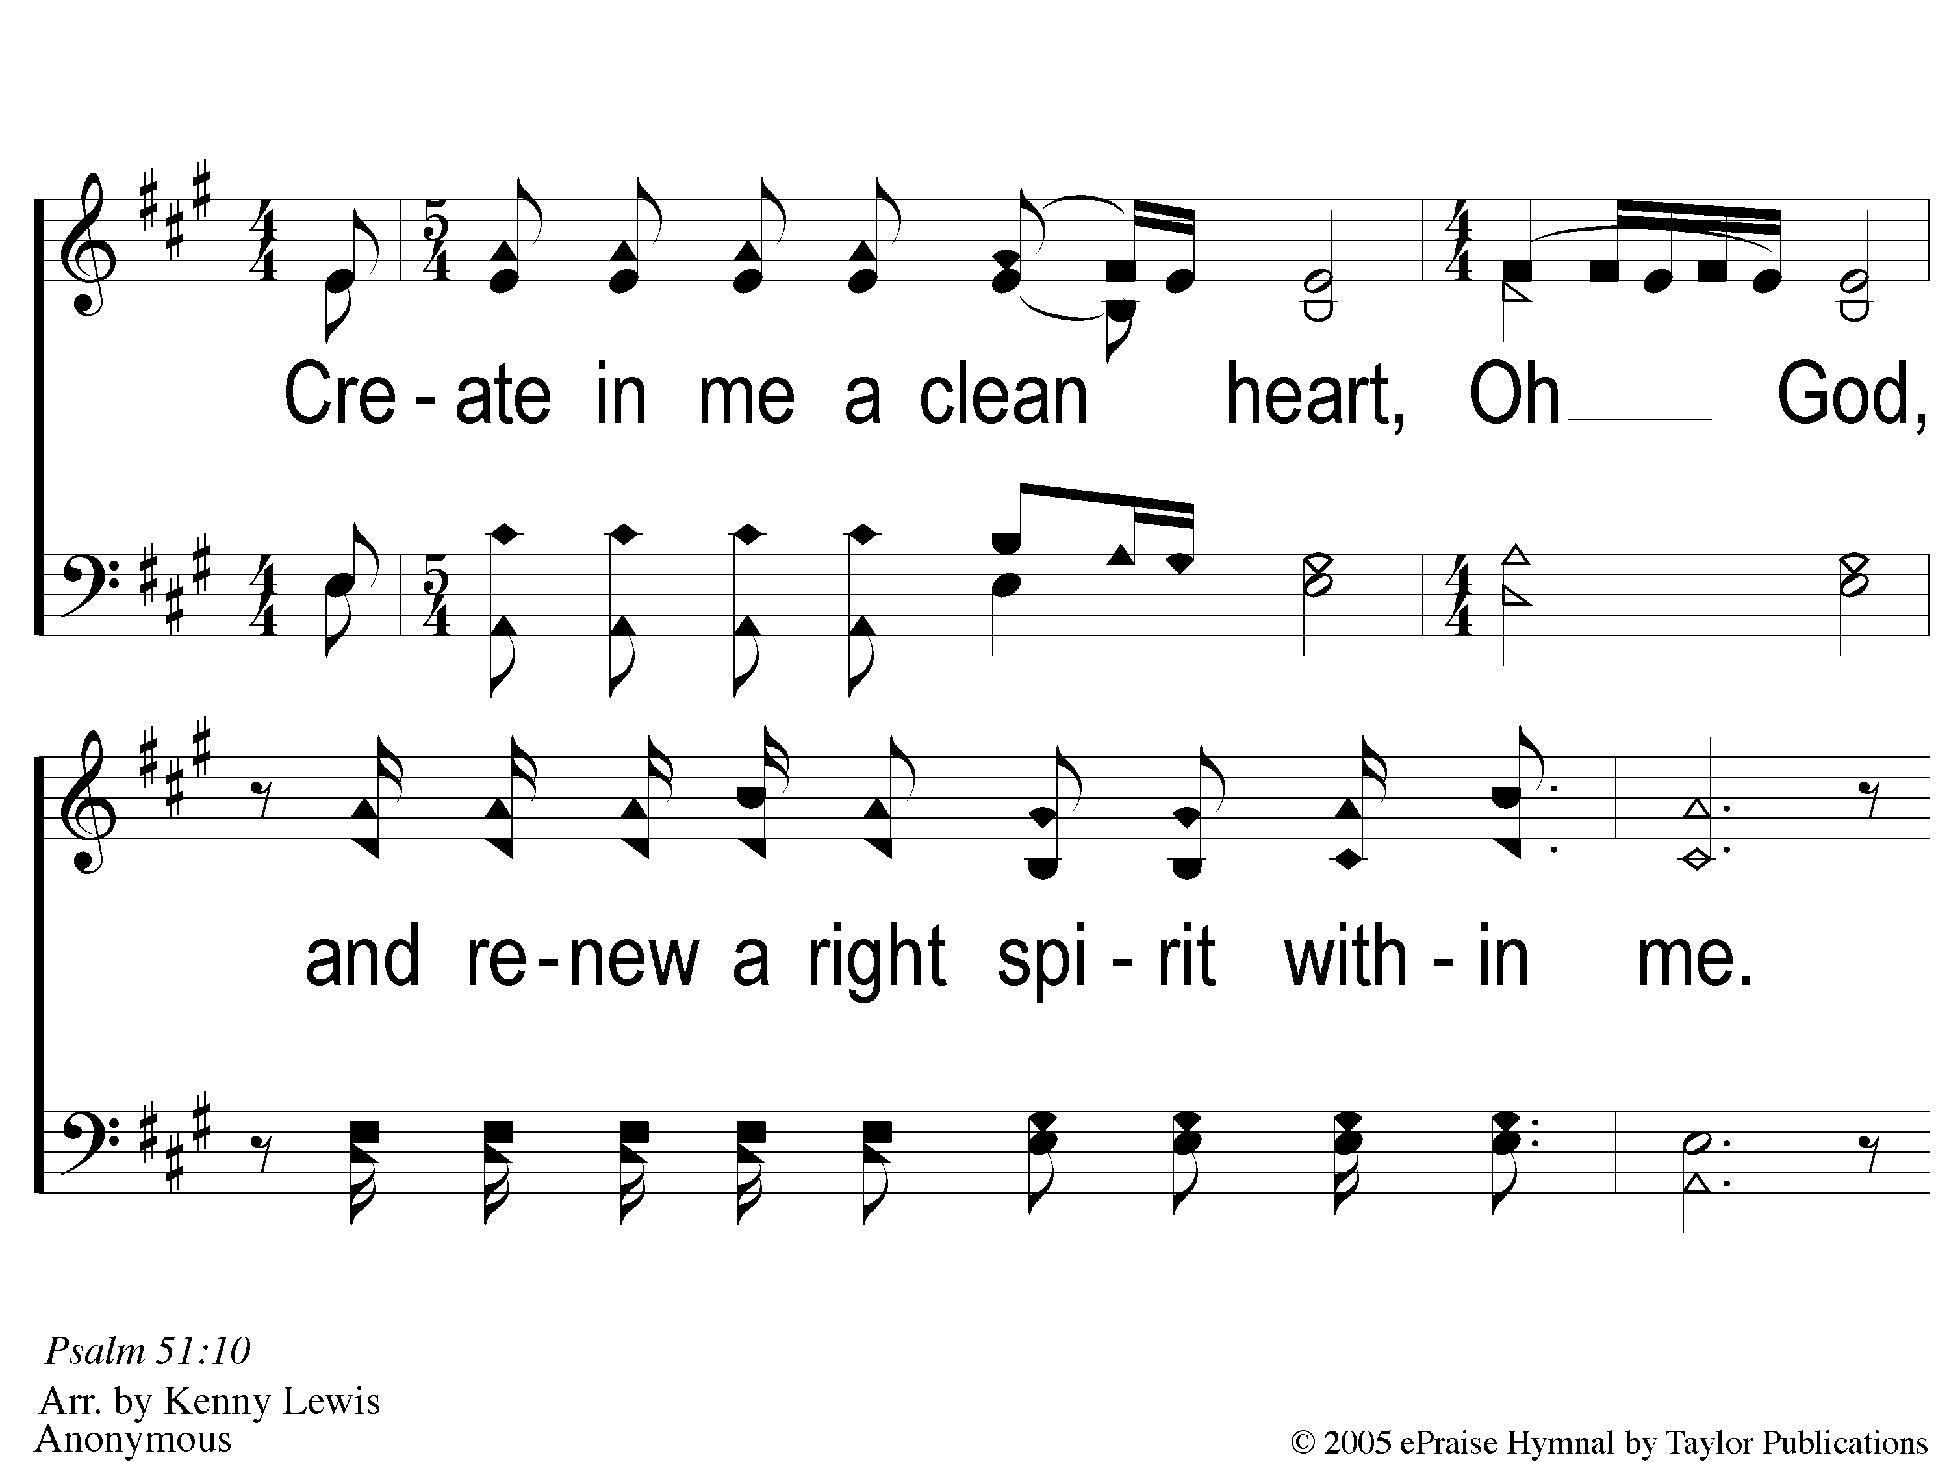
1 Create in Me
Create In Me A Clean Heart

Slide 46
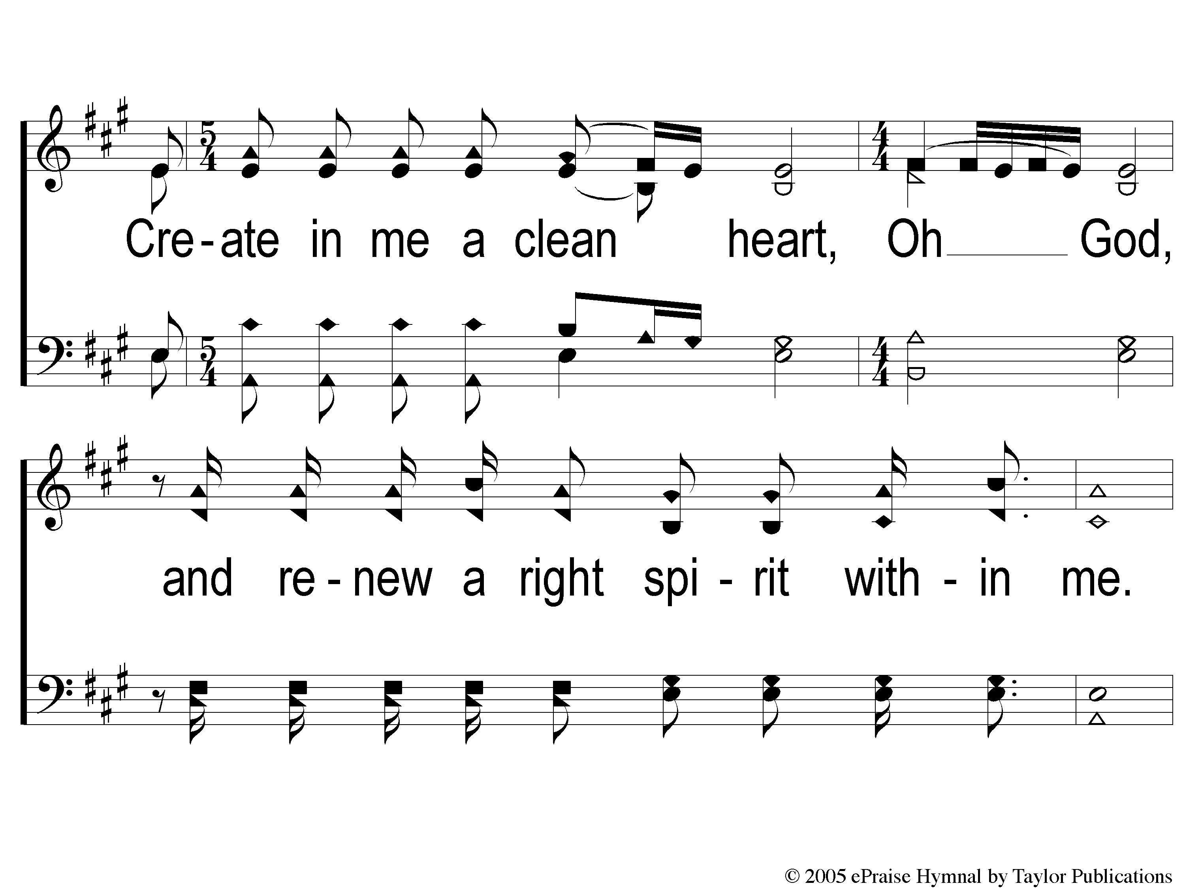
2 Create in Me
Create In Me A Clean Heart

Slide 47
3 Create in Me
Create In Me A Clean Heart

Slide 48
4 Create in Me
Create In Me A Clean Heart

Slide 49
1 Create in Me
Create In Me A Clean Heart

Slide 50
2 Create in Me
Create In Me A Clean Heart

Slide 51
3 Create in Me
Create In Me A Clean Heart

Slide 52
4 Create in Me
Create In Me A Clean Heart

Slide 53
Scripture Reading:
Genesis 1:1-5, 26-28

Slide 54
RESTORE REBUILD RENEW
IN 2022

Slide 55
RESTORE
OUR
FOUNDATIONS
JANUARY - APRIL

Slide 56
Tonight:
The Beginning
Of The Mystery of God:
The Gospel In Genesis

Slide 57
4 Beginnings
Atheism Cannot Explain
(But The Bible Can)

Slide 58
4 Beginnings Atheism Cannot Explain:

Slide 59
4 Beginnings Atheism Cannot Explain:
The Beginning of Matter

Slide 60
The Beginning of Matter
Without God:
Something must come from Nothing

Slide 61
The Beginning of Matter
“It all started around 13.7 billion years ago with a big bang that was the creation of our universe that popped out from singularity, nothingness…how can something come out of nothing? Speculations are that matter came from fluctuations in a pre-existing quantum vacuum. These fluctuations are virtual particles that simply pop in and out of existence…”

Slide 62
The Beginning of Matter
Without God:
Something must come from Nothing
The Big Bang – What was before it?

Slide 63
The Beginning of Matter
Objections / Compromises:
The Gap Theory

Slide 64
The Beginning of Matter
Objections / Compromises:
The Gap Theory
The Day-Age Theory

Slide 65
The Beginning of Matter
The Bible Answer:
God created the world in
6 literal, 24-hour days
Gen. 1:1-5, 11-14

Slide 66
4 Beginnings Atheism Cannot Explain:
The Beginning of Matter
The Beginning of Mankind

Slide 67
The Beginning of Mankind
Without God:
Life must come from non-life
Against The Law of Biogenesis

Slide 68
The Beginning of Mankind
The Bible Answer:
Mankind was created by God
Gen. 1:26-27, 2:7, 15-25, 5:1-2

Slide 69
4 Beginnings Atheism Cannot Explain:
The Beginning of Matter
The Beginning of Mankind
The Beginning of Marriage

Slide 70
The Beginning of Marriage
Without God:
Have to evolve 2 genders

Slide 71
The Beginning of Marriage
Without God:
Have to evolve 2 genders
Have to evolve in the same time period

Slide 72
The Beginning of Marriage
The Bible Answer:
God created Male & Female
God Instituted Marriage & Defined It

Slide 73
4 Beginnings Atheism Cannot Explain:
The Beginning of Matter
The Beginning of Mankind
The Beginning of Marriage
The Beginning of Morality

Slide 74
The Beginning of Morality
Without God:
There Is No Objective Morality

Slide 75
The Beginning of Morality
Without God:
There Is No Objective Morality
Mankind is just an animal

Slide 76
The Beginning of Morality
The Bible Answer:
Mankind was made in God’s image (1:26)

Slide 77
The Beginning of Morality
The Bible Answer:
Mankind was made in God’s image
Mankind has dominion over animals
Gen. 1:26-30

Slide 78
The Beginning of Your Walk with Christ:
God’s grace + Your Faith
Acts 2:36-38
Rom. 6:3-4

Slide 79
Invitation
Song:
I Am A Poor
Wayfaring Stranger
#979

Slide 80
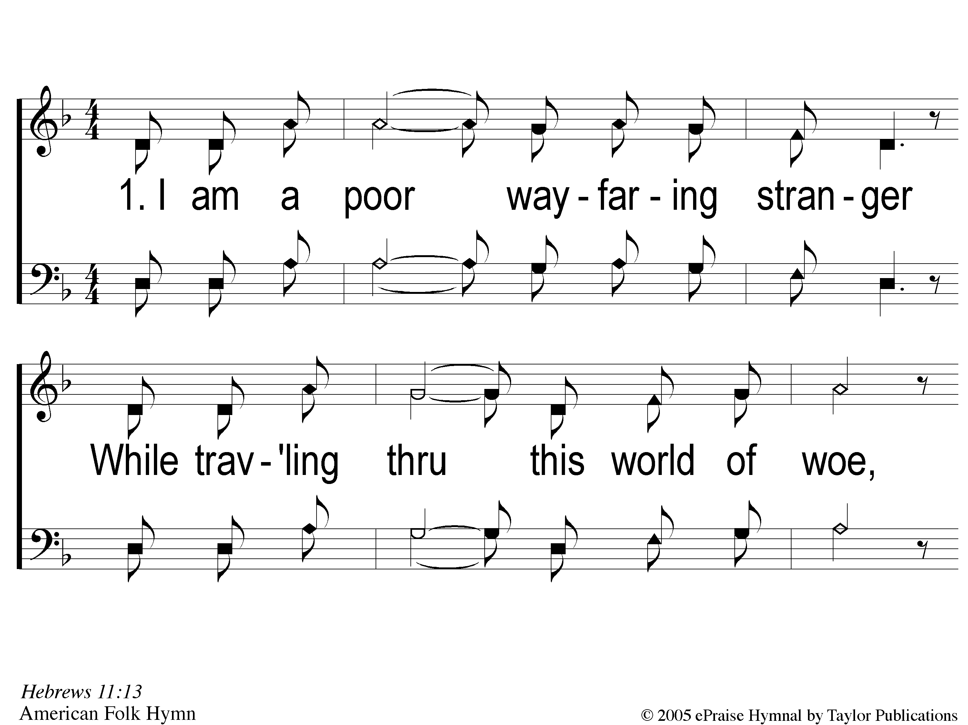
1-1 I Am A Poor Wayfaring Stranger
I Am A Poor Wayfaring Stranger
979

Slide 81
1-2 I Am A Poor Wayfaring Stranger
I Am A Poor Wayfaring Stranger
979

Slide 82
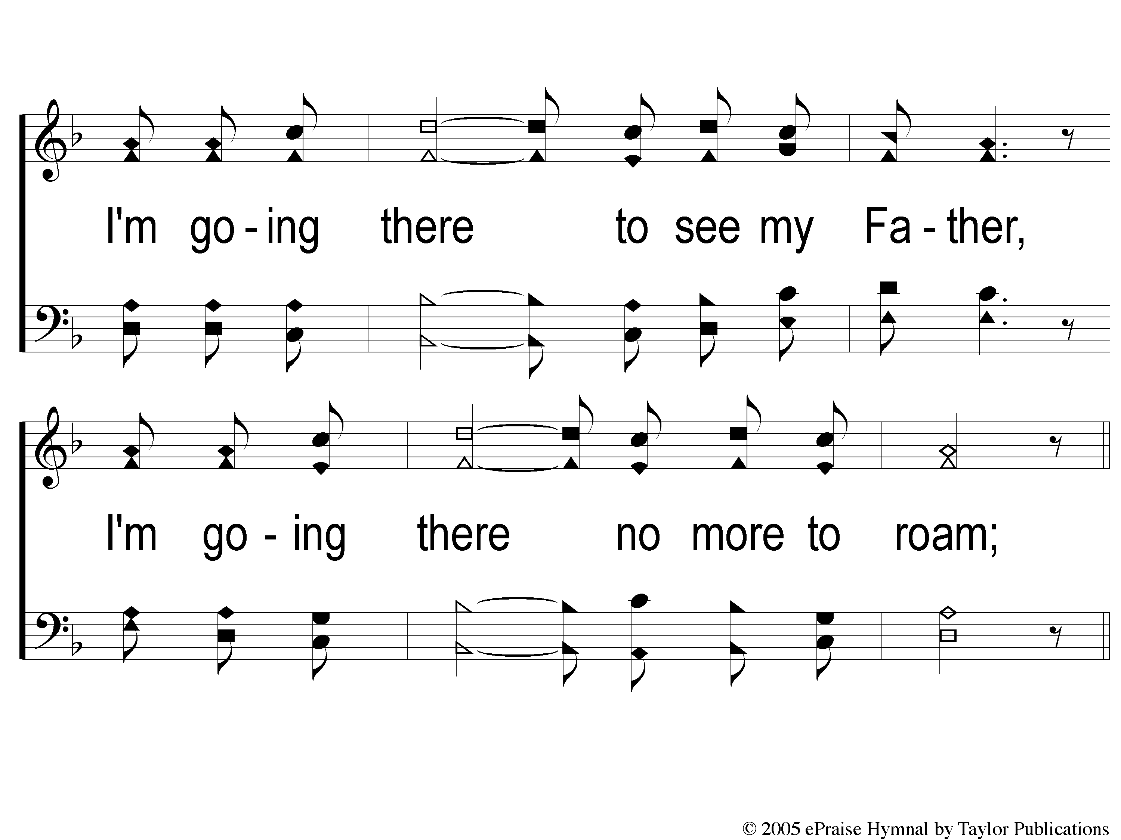
1-3 I Am A Poor Wayfaring Stranger
I Am A Poor Wayfaring Stranger
979

Slide 83
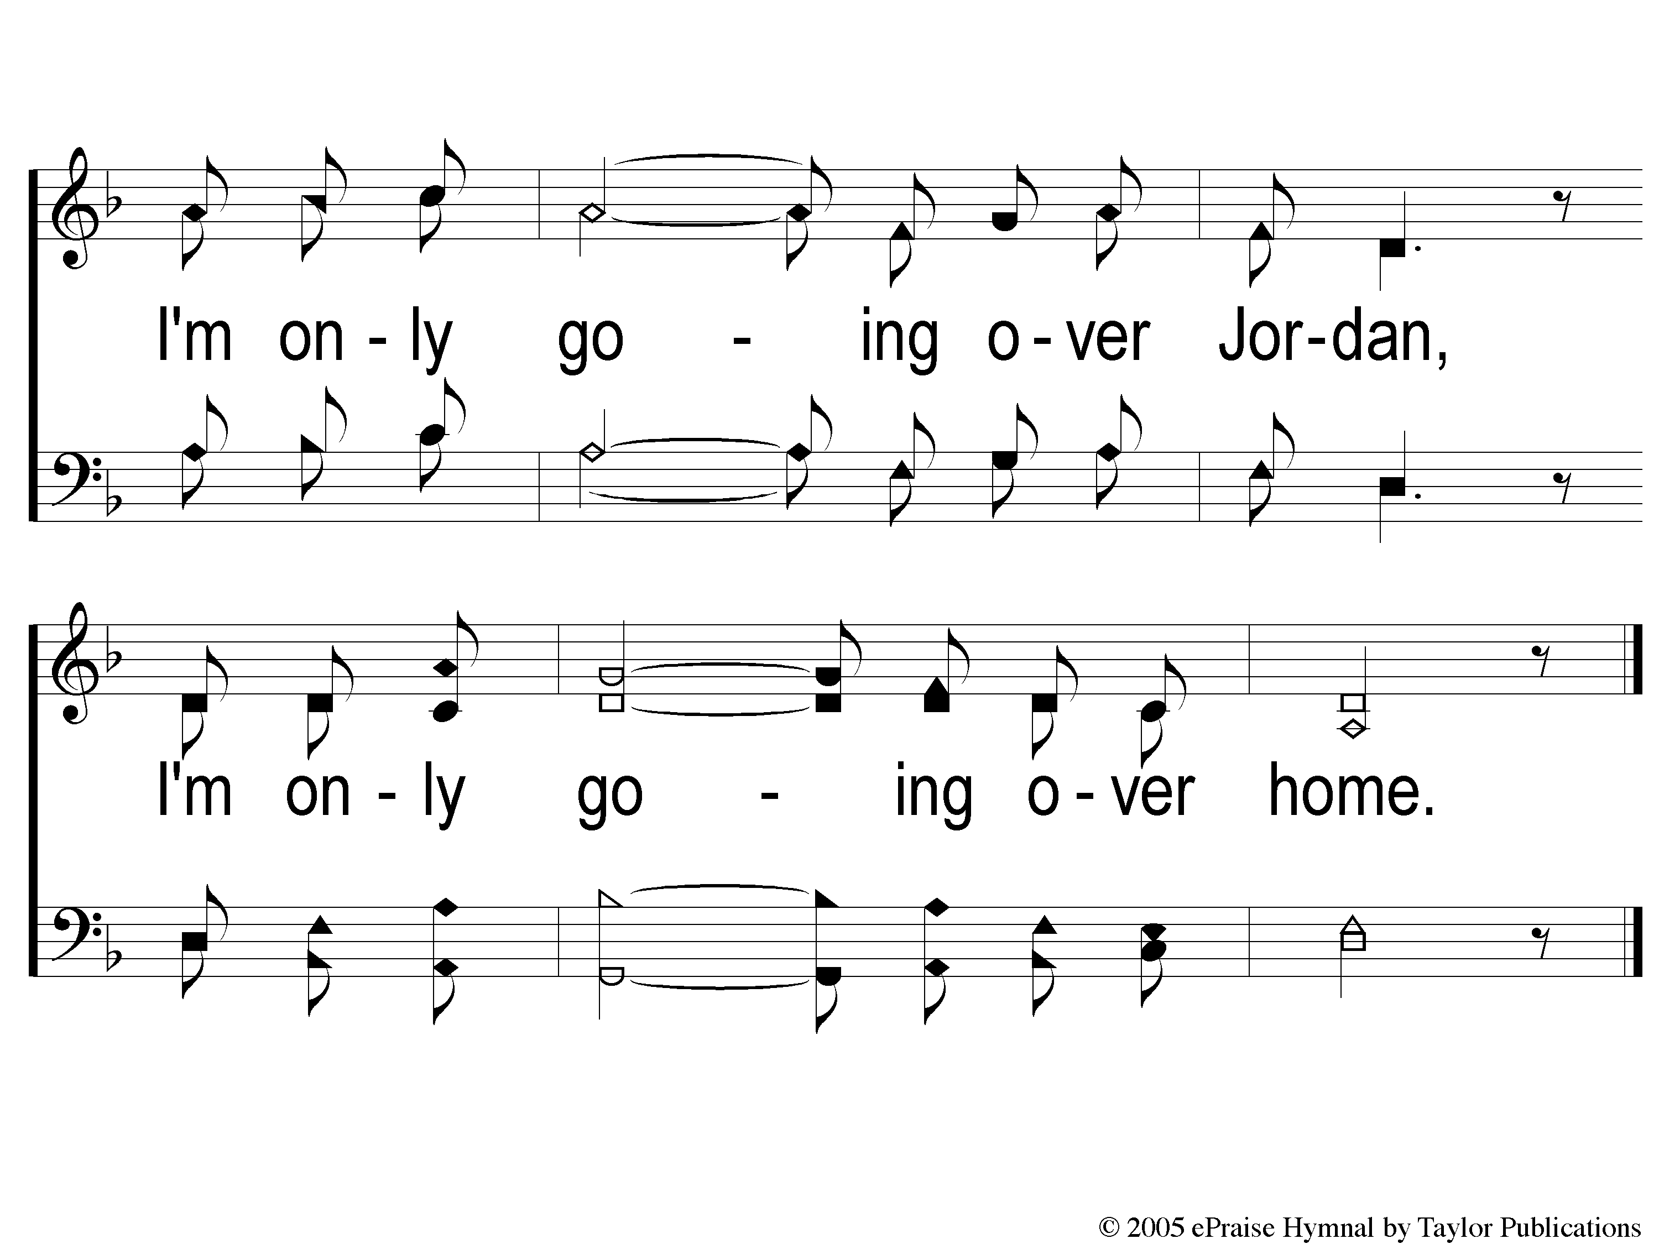
c I Am A Poor Wayfaring Stranger
I Am A Poor Wayfaring Stranger
979

Slide 84
2-1 I Am A Poor Wayfaring Stranger
I Am A Poor Wayfaring Stranger
979

Slide 85
2-2 I Am A Poor Wayfaring Stranger
I Am A Poor Wayfaring Stranger
979

Slide 86
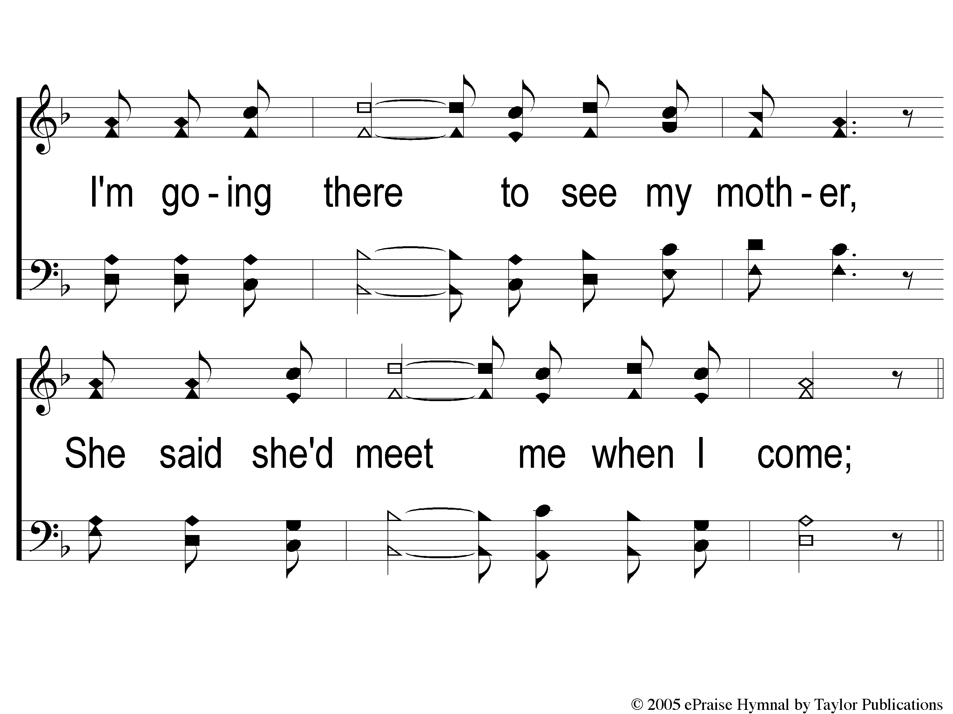
2-3 I Am A Poor Wayfaring Stranger
I Am A Poor Wayfaring Stranger
979

Slide 87
c I Am A Poor Wayfaring Stranger
I Am A Poor Wayfaring Stranger
979

Slide 88
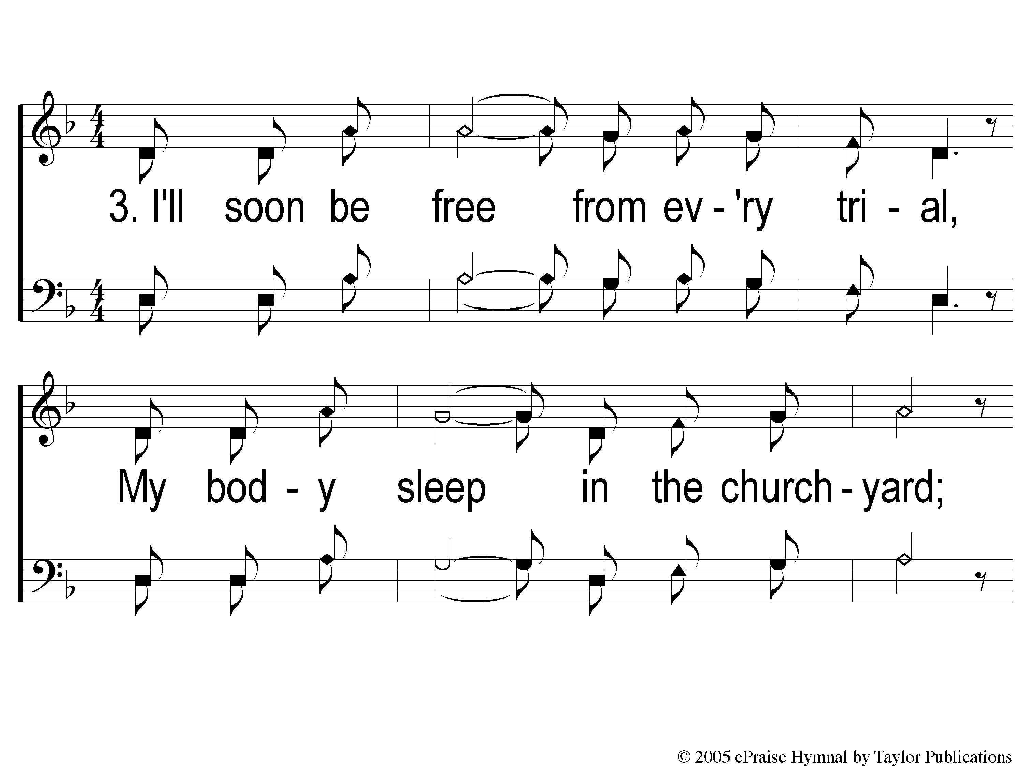
3-1 I Am A Poor Wayfaring Stranger
I Am A Poor Wayfaring Stranger
979

Slide 89
3-2 I Am A Poor Wayfaring Stranger
I Am A Poor Wayfaring Stranger
979

Slide 90
3-3 I Am A Poor Wayfaring Stranger
I Am A Poor Wayfaring Stranger
979

Slide 91
c I Am A Poor Wayfaring Stranger
I Am A Poor Wayfaring Stranger
979

Slide 92
The Offering:
Luke 12:15
“And He said to them, ‘Take heed and beware of covetousness, for one’s life does not consist in the abundance of the things he possesses.’ ”

Slide 93
Song:
Highly Exalted
#176

Slide 94
1-1 Lamb of God
Lamb of God
176

Slide 95
1-2 Lamb of God
Lamb of God
176

Slide 96
1-3 Lamb of God
Lamb of God
176

Slide 97
1-4 Lamb of God
Lamb of God
176

Slide 98
C-1 Lamb of God
Lamb of God
176

Slide 99
C-2 Lamb of God
Lamb of God
176

Slide 100
2-1 Lamb of God
Lamb of God
176

Slide 101
2-2 Lamb of God
Lamb of God
176

Slide 102
C-1 Lamb of God
Lamb of God
176

Slide 103
C-2 Lamb of God
Lamb of God
176

Slide 104
The Unleavened Bread
Luke 9:23-24
“Then He said to them all, ‘If anyone desires to come after Me, let him deny himself, and take up his cross daily, and follow Me. For whoever desires to save his life will lose it, but whoever loses his life for My sake will save it.’ ”

Slide 105
The Fruit of the Vine
Luke 9:25-26
“For what profit is it to a man if he gains the whole world, and is himself destroyed or lost? For whoever is ashamed of Me and My words, of him the Son of Man will be ashamed when He comes in His own glory, and in His Father’s, and of the holy angels.”

Slide 106
Closing Prayer

Slide 107
Song:
The Greatest Commands
#448

Slide 108
1-1 The Greatest Commands-SFP
The Greatest Commands
448

Slide 109
1-2 The Greatest Commands-SFP
The Greatest Commands
448

Slide 110
1-3 The Greatest Commands-SFP
The Greatest Commands
448

Slide 111
1-4 The Greatest Commands-SFP
The Greatest Commands
448

Slide 112
2-1 The Greatest Commands-SFP
The Greatest Commands
448

Slide 113
2-2 The Greatest Commands-SFP
The Greatest Commands
448

Slide 114
2-3 The Greatest Commands-SFP
The Greatest Commands
448

Slide 115
2-4 The Greatest Commands-SFP
The Greatest Commands
448

Slide 116
3-1 The Greatest Commands-SFP
The Greatest Commands
448

Slide 117
3-2 The Greatest Commands-SFP
The Greatest Commands
448

Slide 118
3-3 The Greatest Commands-SFP
The Greatest Commands
448

Slide 119
3-4 The Greatest Commands-SFP
The Greatest Commands
448

Slide 120
4-1 The Greatest Commands-SFP
The Greatest Commands
448

Slide 121
4-2 The Greatest Commands-SFP
The Greatest Commands
448

Slide 122
4-3 The Greatest Commands-SFP
The Greatest Commands
448

Slide 123
4-4 The Greatest Commands-SFP
The Greatest Commands
448

Slide 124
JOIN US
IN THE MPB FOR
A FELLOWSHIP MEAL
@ NOON
&
HOLIDAY PARTY @ 6PM
(MCCASLAND HOME)
RESTORE REBUILD RENEW
IN 2022
WHEELER
CHURCH
OF
CHRIST

Slide 125
Tonight
WORSHIP @ 6:00 pm
Wednesday
WORSHIP @ 6:30 pm
Bible classes @ 7:00 pm
RESTORE REBUILD RENEW
IN 2022
WHEELER
CHURCH
OF
CHRIST

