Slide 1
RESTORE REBUILD RENEW
welcome
we are glad to
Have you with us
IN 2022
WHEELER
CHURCH
OF
CHRIST

Slide 2
Songs of Praise To God

Slide 3
Opening Prayer

Slide 4
Songs of Praise To God

Slide 5
RESTORE
OUR
FOUNDATIONS
JANUARY - APRIL

Slide 6
The Beginning
Of The Mystery of God:
The Gospel In Genesis

Slide 7
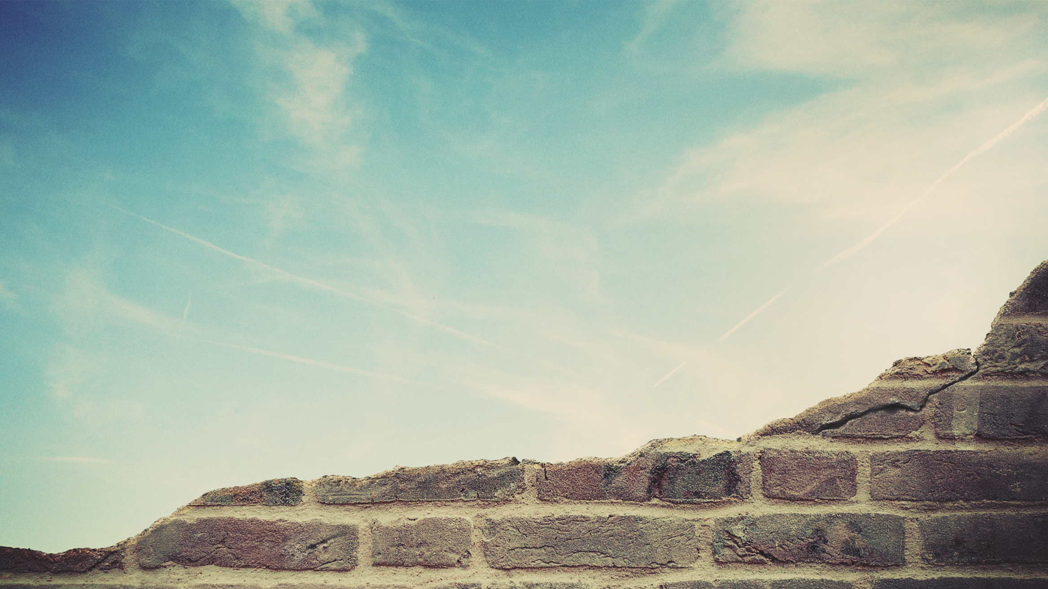
There Is A Mystery Of God:
Μυστήριον (Musterion)
Matt. 13:11
1 Cor. 2:7
Rom. 16:25-27
Col. 1:24-27, 2:1-2
Eph. 1:7-10, 3:3-4, 9

Slide 8
What Is The Mystery?

Slide 9
What Is The Mystery?
The Church
Eph. 5:22-32

Slide 10
The Beginning Of The Mystery

Slide 11
The Beginning Of The Mystery
Before The Foundations Of The Earth
Eph. 1:3-5

Slide 12
The Beginning Of The Mystery
The Seed Of Woman
Gen. 3:14-15
Matt. 1:

Slide 13
The Beginning Of The Mystery
The Seed Of Abraham
Gen. 12:1-3

Slide 14
The Beginning Of The Mystery
3 Parts to the Promise:
Many Descendants (Physical)
A Nation (Physical)
A Blessing to All Families (Spiritual)

Slide 15
Shadows Of The Mystery:
Heb. 8:4-5, 10:1

Slide 16
Shadows Of The Mystery:
The Ark
Gen. 6:13-18, 7:13-16
1 Pet. 3:18-21

Slide 17
Shadows Of The Mystery:
Marriage / A Wife
Gen. 2:21-25
Eph 2:22-32
Rev. 21:2, 9

Slide 18
What To Do With The Mystery:

Slide 19
What To Do With The Mystery:
Make It Known
1 Pet. 2:9
Eph. 6:18-20
1 Cor. 4:1

Slide 20
Our Mission:
To Know Jesus & Make Him Known

Slide 21
Songs of Praise To God

Slide 22
THE LORD’S SUPPER
Acts 20:7

Slide 23
Closing Prayer

Slide 24
Songs of Praise To God

Slide 25
JOIN US
IN THE MPB FOR
A FELLOWSHIP MEAL
@ NOON
&
HOLIDAY PARTY @ 6PM
(MCCASLAND HOME)
RESTORE REBUILD RENEW
IN 2022
WHEELER
CHURCH
OF
CHRIST

Slide 26
Wednesday
WORSHIP @ 6:30 pm
Bible classes @ 7:00 pm
Saturday
Hibler Baby Shower @ 2 pm
RESTORE REBUILD RENEW
IN 2022
WHEELER
CHURCH
OF
CHRIST

