Slide 1
1 More Precious Than Silver
More Precious Than Silver
273

Slide 2
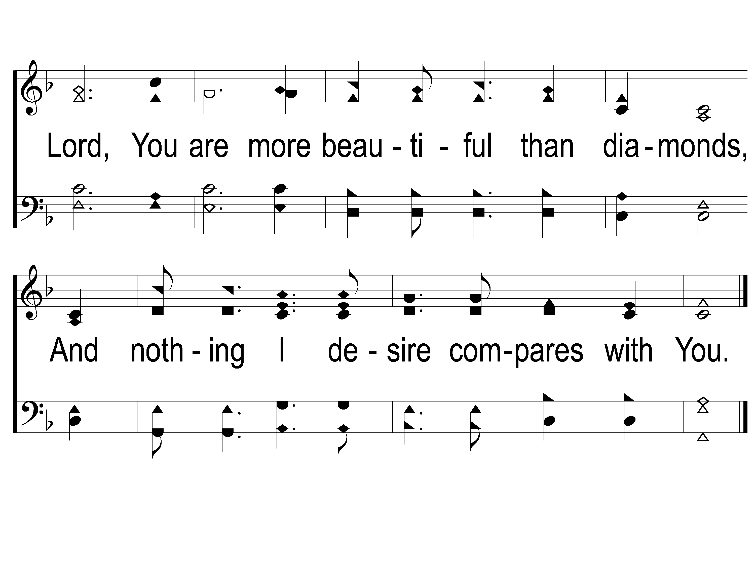
2 More Precious Than Silver
More Precious Than Silver
273

Slide 3
Opt Tag More Precious Than Silver
More Precious Than Silver
273

Slide 4
1 More Precious Than Silver
More Precious Than Silver
273

Slide 5
2 More Precious Than Silver
More Precious Than Silver
273

Slide 6
Opt Tag More Precious Than Silver
More Precious Than Silver
273

Slide 7
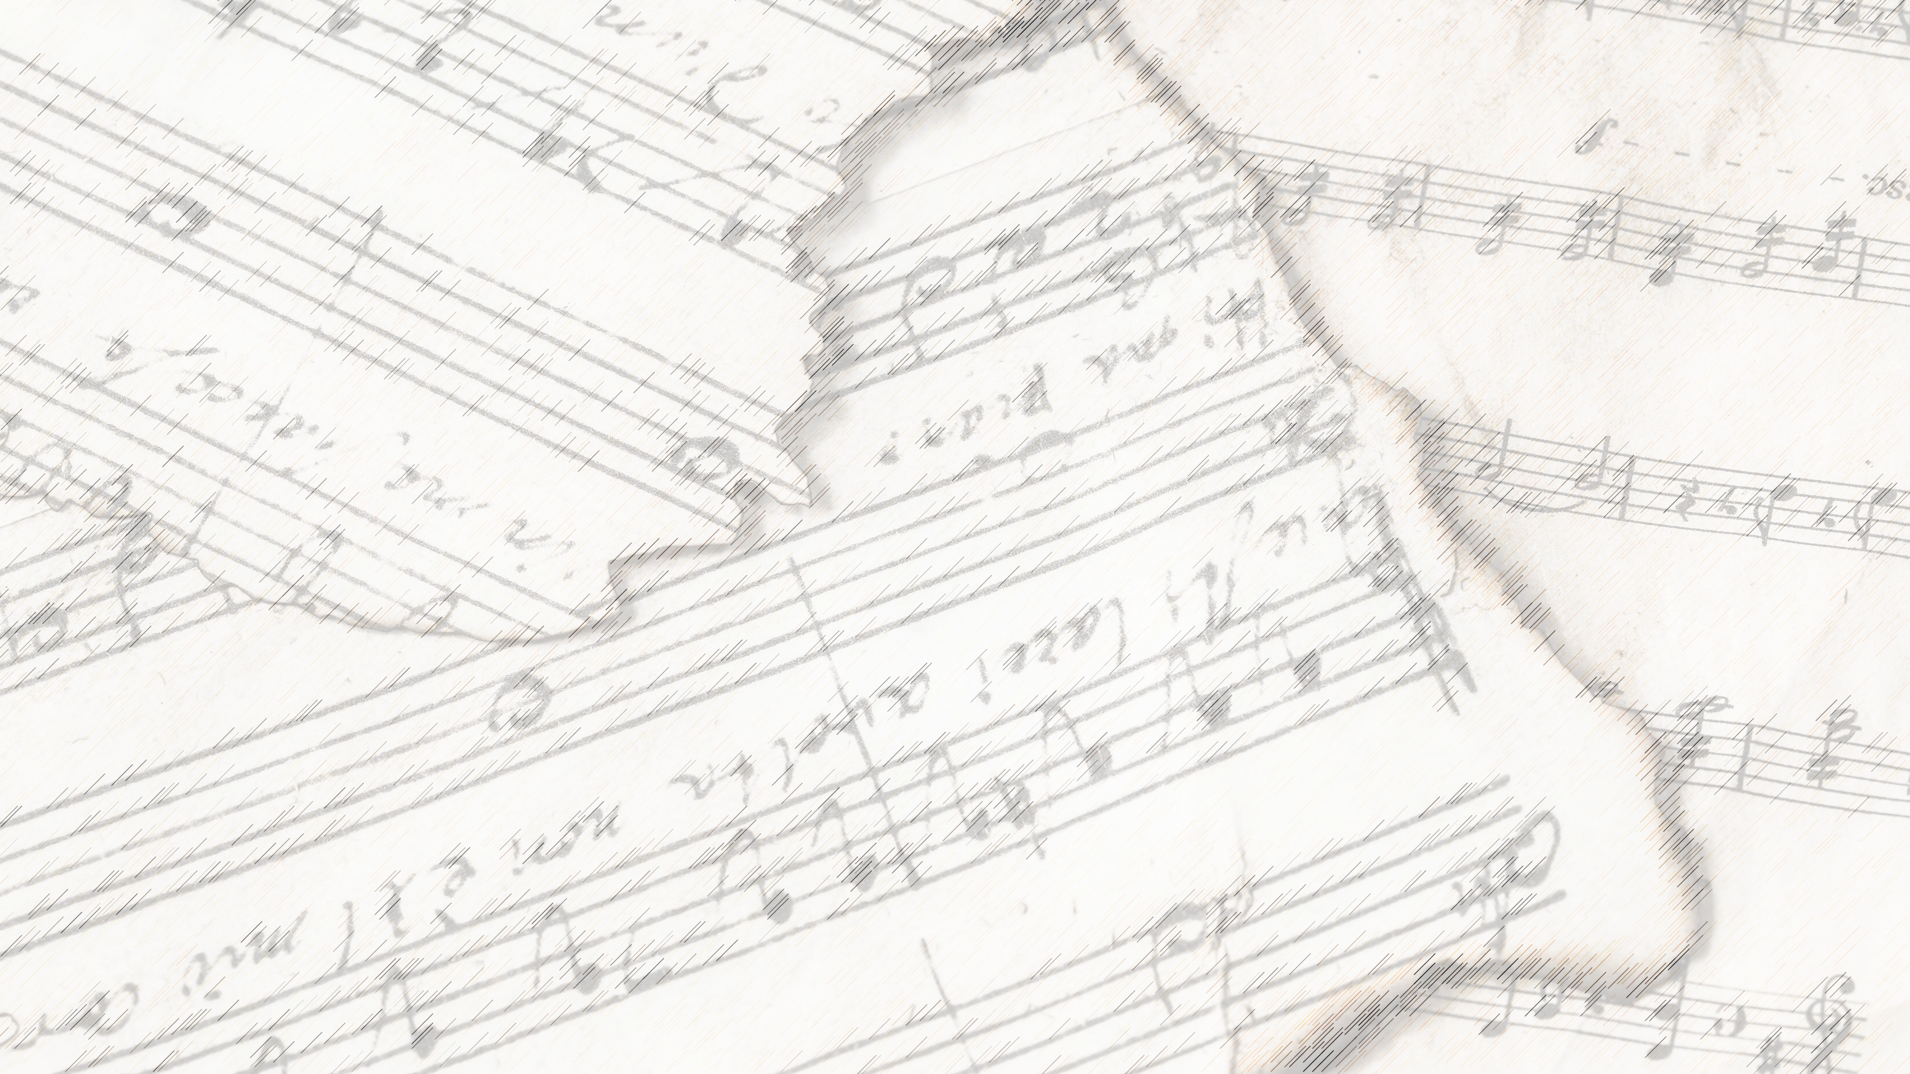
Welcome!
We Are Glad You Are Here

Slide 8
When We All
Get To Heaven
#853

Slide 9
1-1 When We All Get To Heaven
When We All Get To Heaven
853

Slide 10
1-2 When We All Get To Heaven
When We All Get To Heaven
853

Slide 11
C-1 When We All Get To Heaven
When We All Get To Heaven
853

Slide 12
C-2 When We All Get To Heaven
When We All Get To Heaven
853

Slide 13
3-1 When We All Get To Heaven
When We All Get To Heaven
853

Slide 14
3-2 When We All Get To Heaven
When We All Get To Heaven
853

Slide 15
C-1 When We All Get To Heaven
When We All Get To Heaven
853

Slide 16
C-2 When We All Get To Heaven
When We All Get To Heaven
853

Slide 17
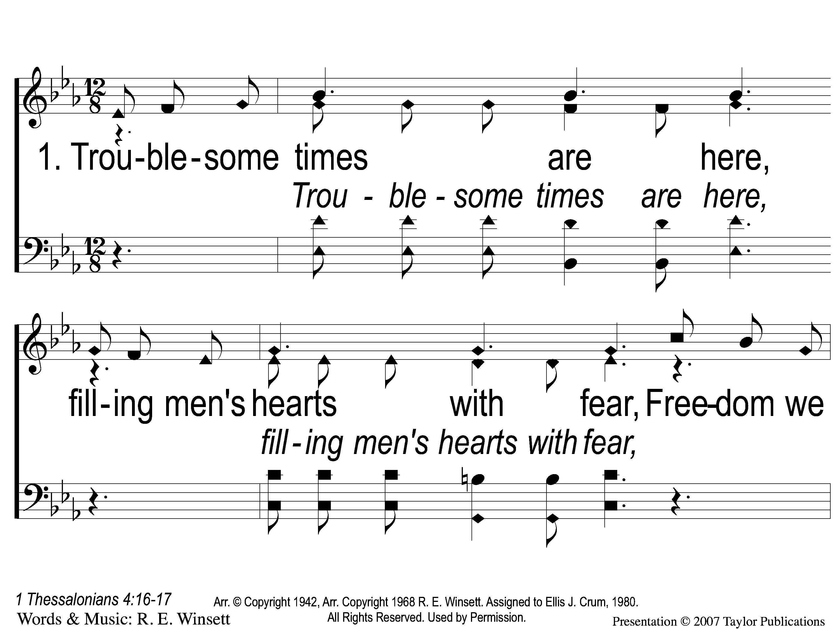
1-1 Jesus is Coming Soon
Jesus is Coming Soon
712

Slide 18
1-2 Jesus is Coming Soon
Jesus is Coming Soon
712

Slide 19
1-3 Jesus is Coming Soon
Jesus is Coming Soon
712

Slide 20
C-1 Jesus is Coming Soon
Jesus is Coming Soon
712

Slide 21
C-2 Jesus is Coming Soon
Jesus is Coming Soon
712

Slide 22
C-3 Jesus is Coming Soon
Jesus is Coming Soon
712

Slide 23
C-4 Jesus is Coming Soon
Jesus is Coming Soon
712

Slide 24
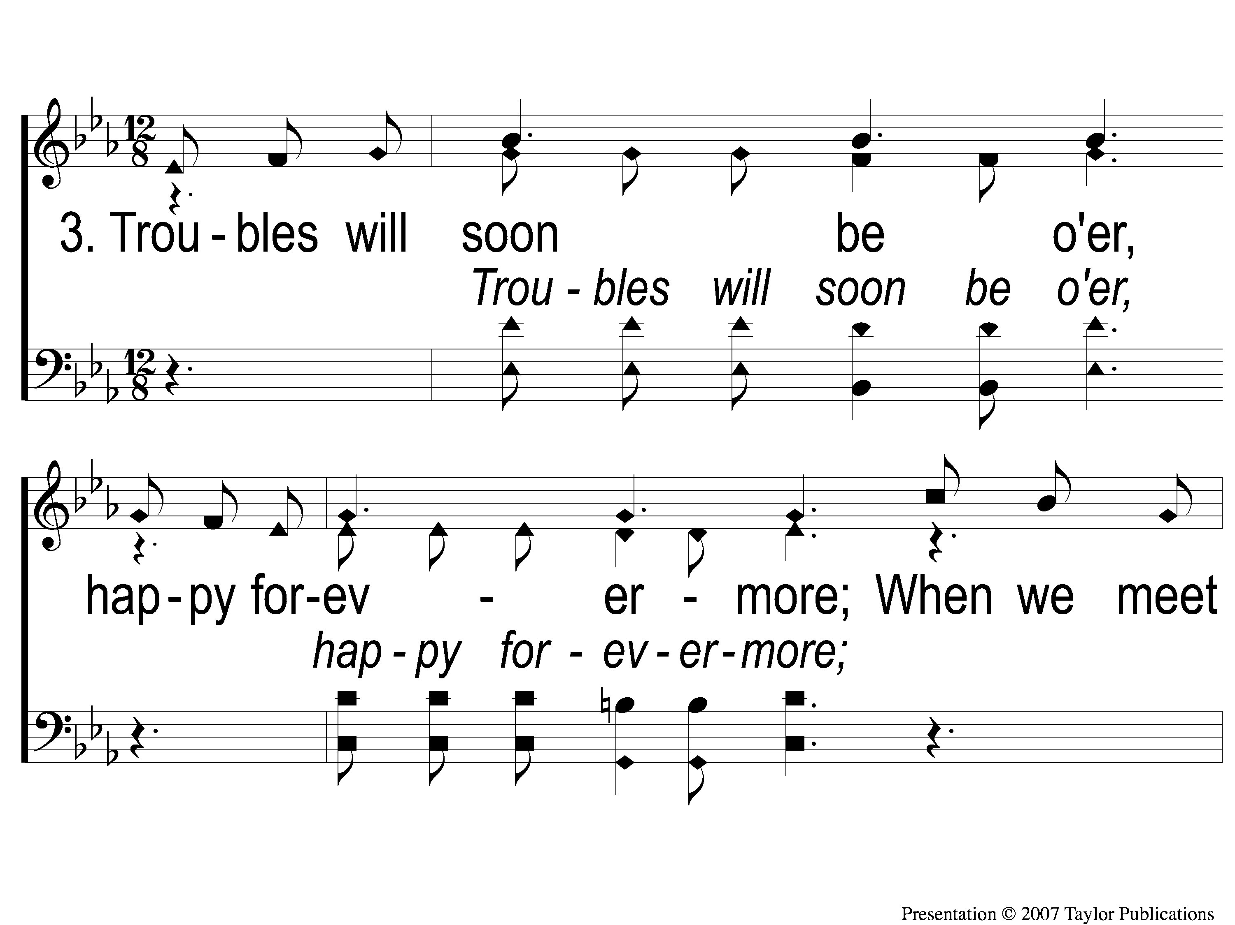
3-1 Jesus is Coming Soon
Jesus is Coming Soon
712

Slide 25
3-2 Jesus is Coming Soon
Jesus is Coming Soon
712

Slide 26
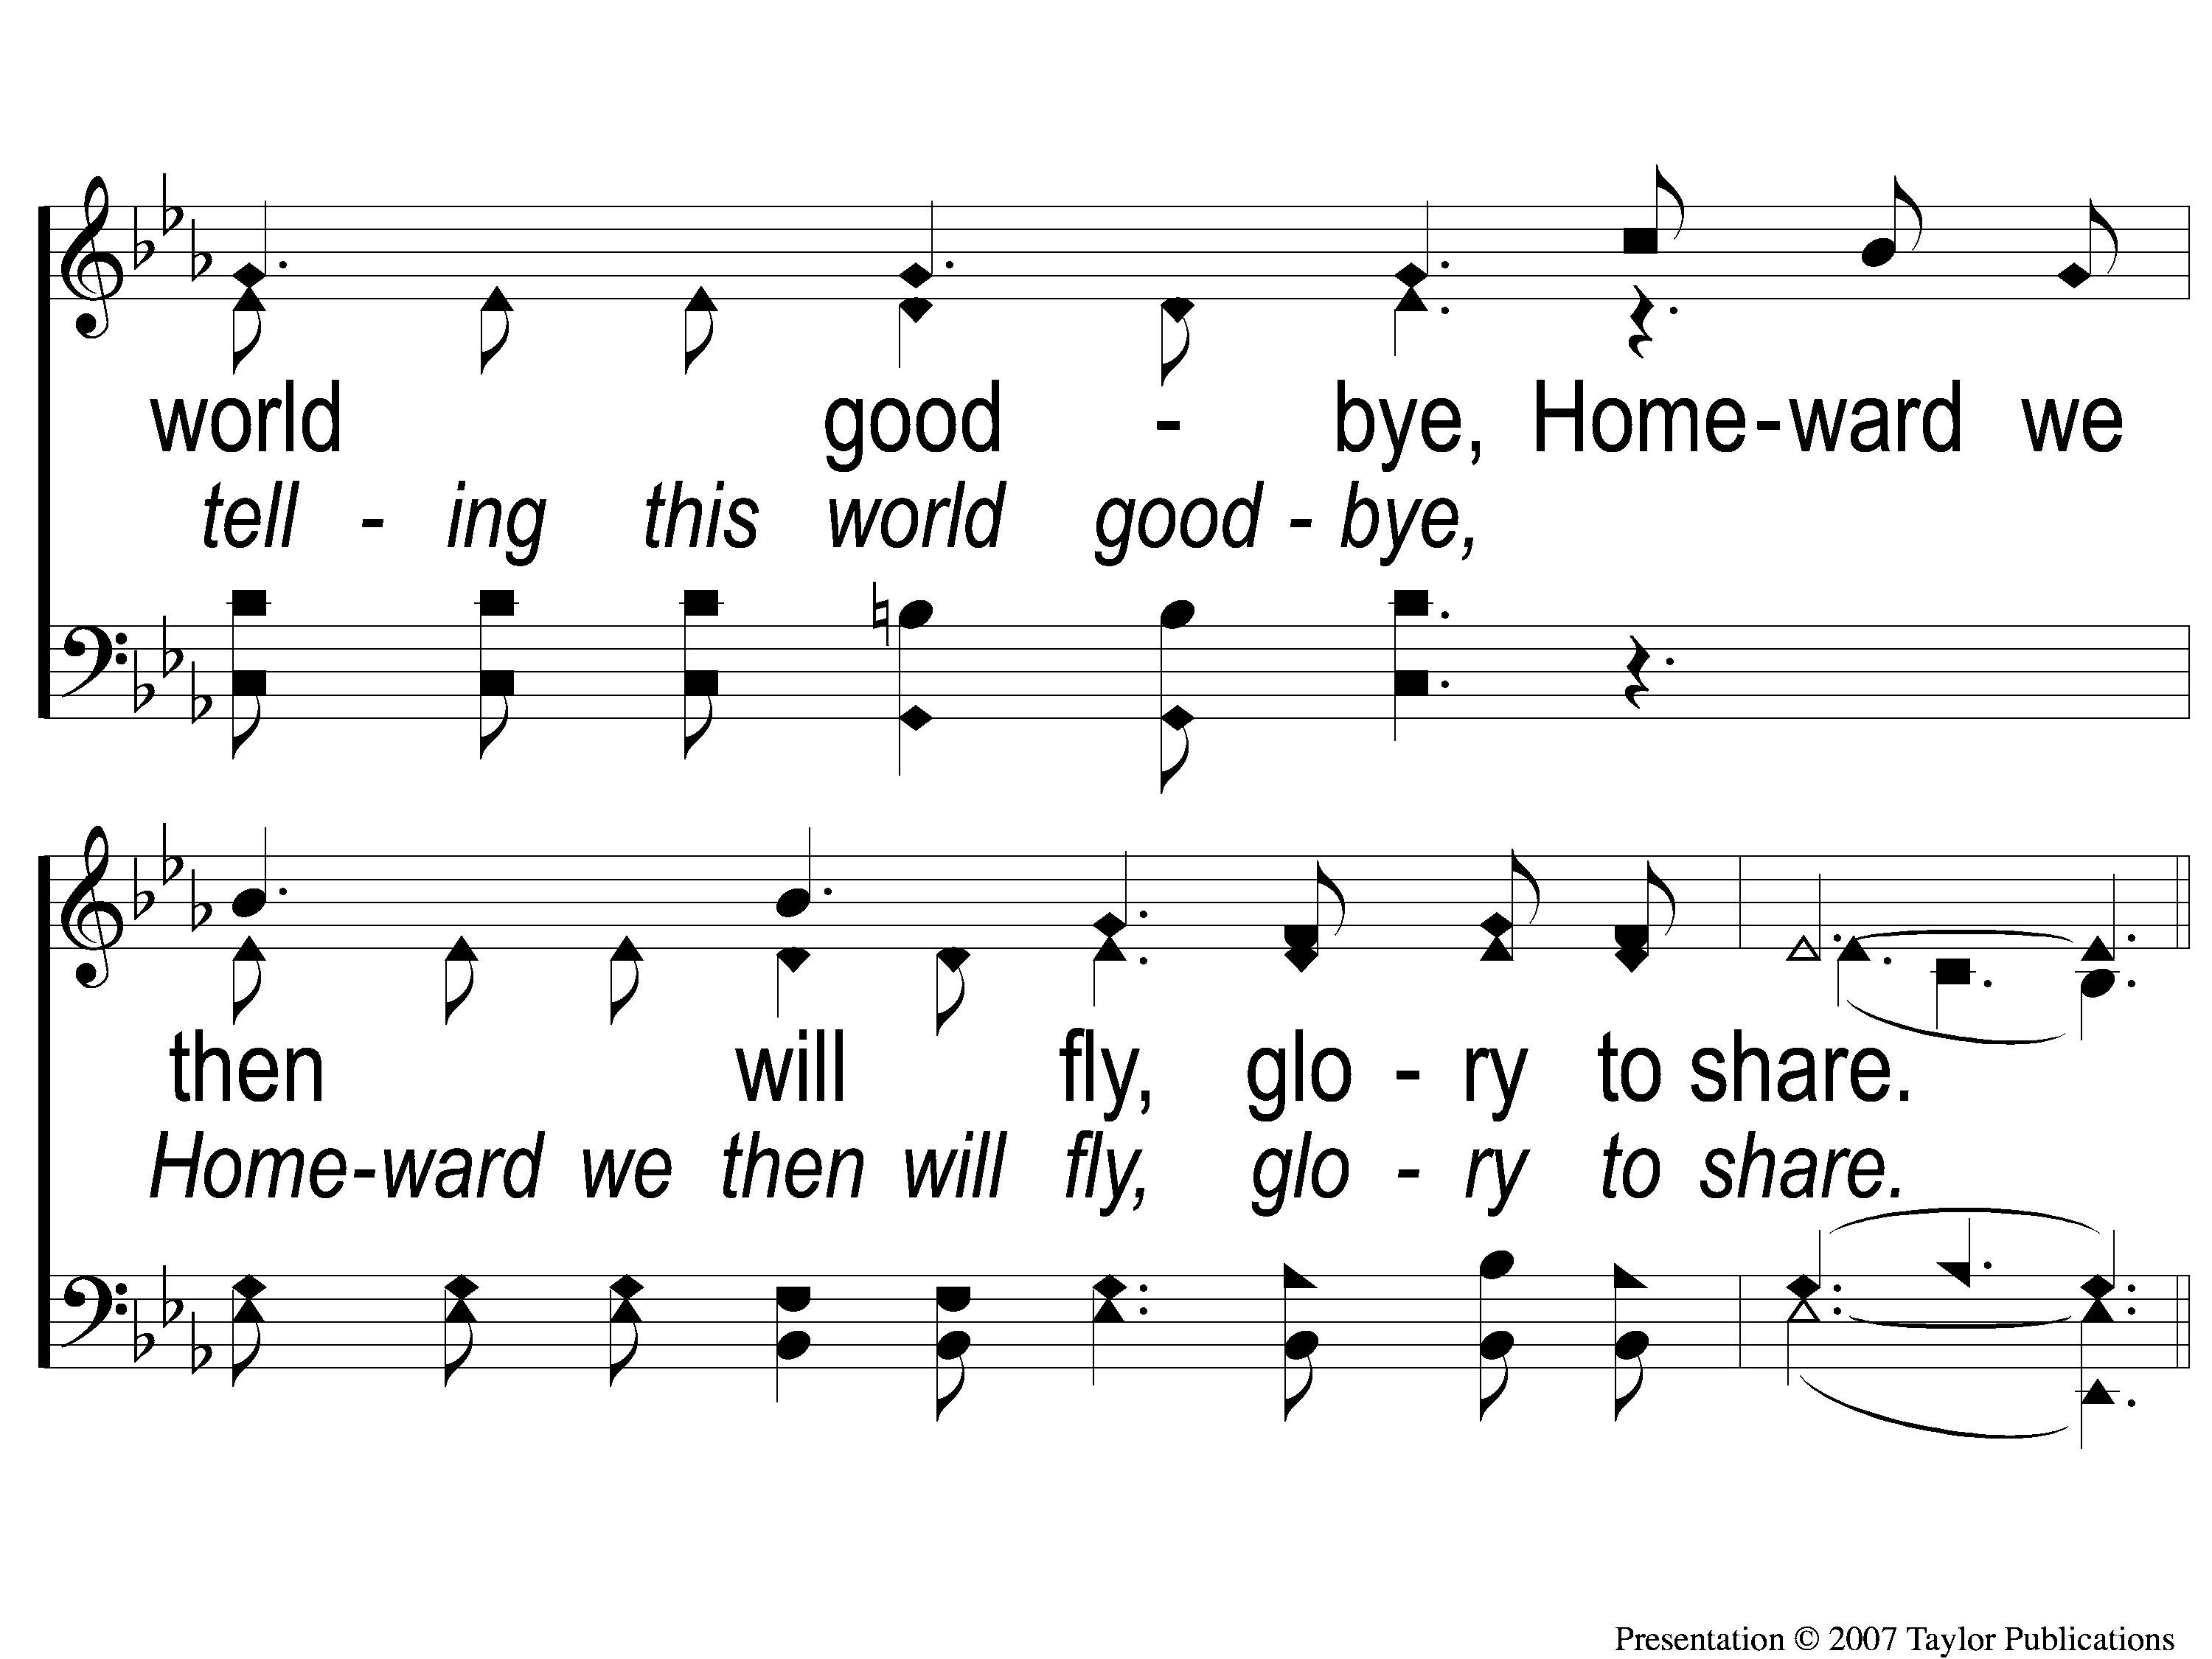
3-3 Jesus is Coming Soon
Jesus is Coming Soon
712

Slide 27
C-1 Jesus is Coming Soon
Jesus is Coming Soon
712

Slide 28
C-2 Jesus is Coming Soon
Jesus is Coming Soon
712

Slide 29
C-3 Jesus is Coming Soon
Jesus is Coming Soon
712

Slide 30
C-4 Jesus is Coming Soon
Jesus is Coming Soon
712

Slide 31
O How I Love Jesus
#574

Slide 32
1-1 O How I Love Jesus
O How I Love Jesus
574

Slide 33
1-2 O How I Love Jesus
O How I Love Jesus
574

Slide 34
C O How I Love Jesus
O How I Love Jesus
574

Slide 35
2-1 O How I Love Jesus
O How I Love Jesus
574

Slide 36
2-2 O How I Love Jesus
O How I Love Jesus
574

Slide 37
C O How I Love Jesus
O How I Love Jesus
574

Slide 38
3-1 O How I Love Jesus
O How I Love Jesus
574

Slide 39
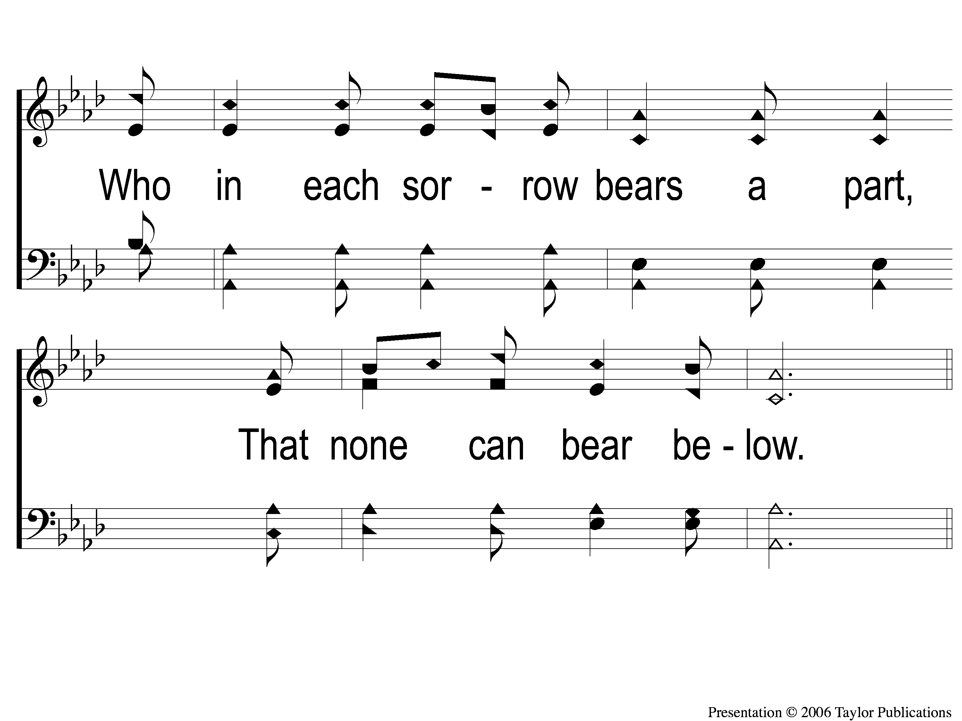
3-2 O How I Love Jesus
O How I Love Jesus
574

Slide 40
C O How I Love Jesus
O How I Love Jesus
574

Slide 41
Opening Prayer

Slide 42
Sunlight
#620

Slide 43
1-1 Sunlight
Sunlight
620

Slide 44
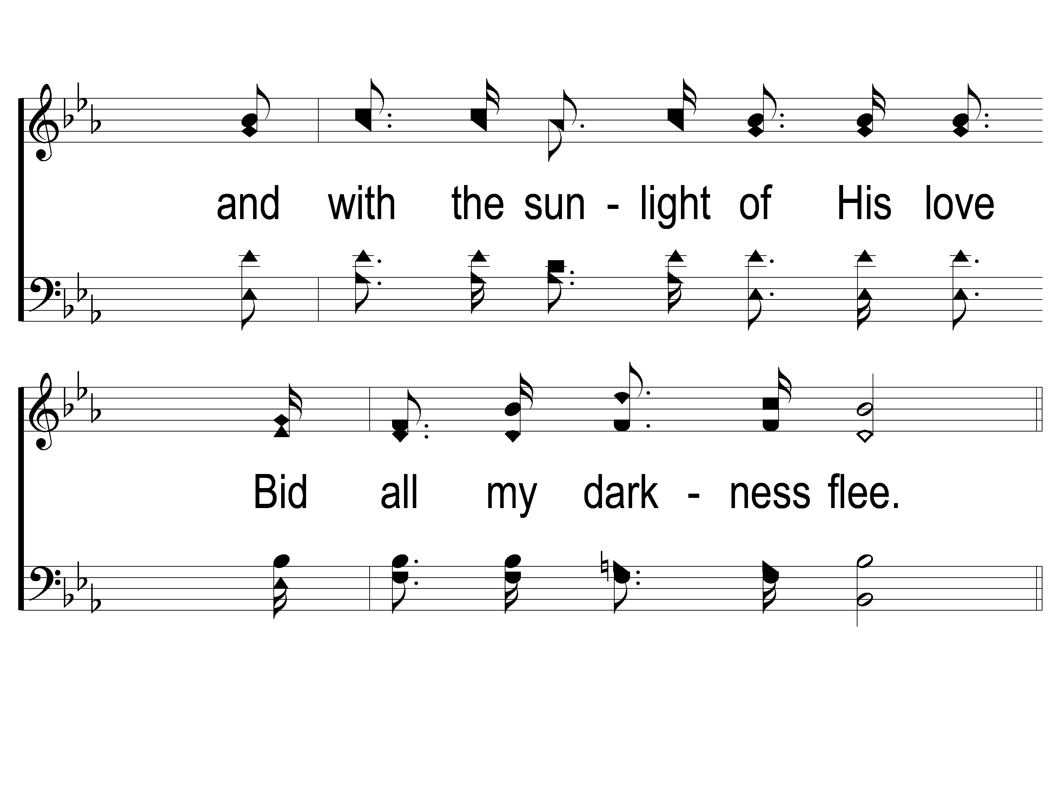
1-2 Sunlight
Sunlight
620

Slide 45
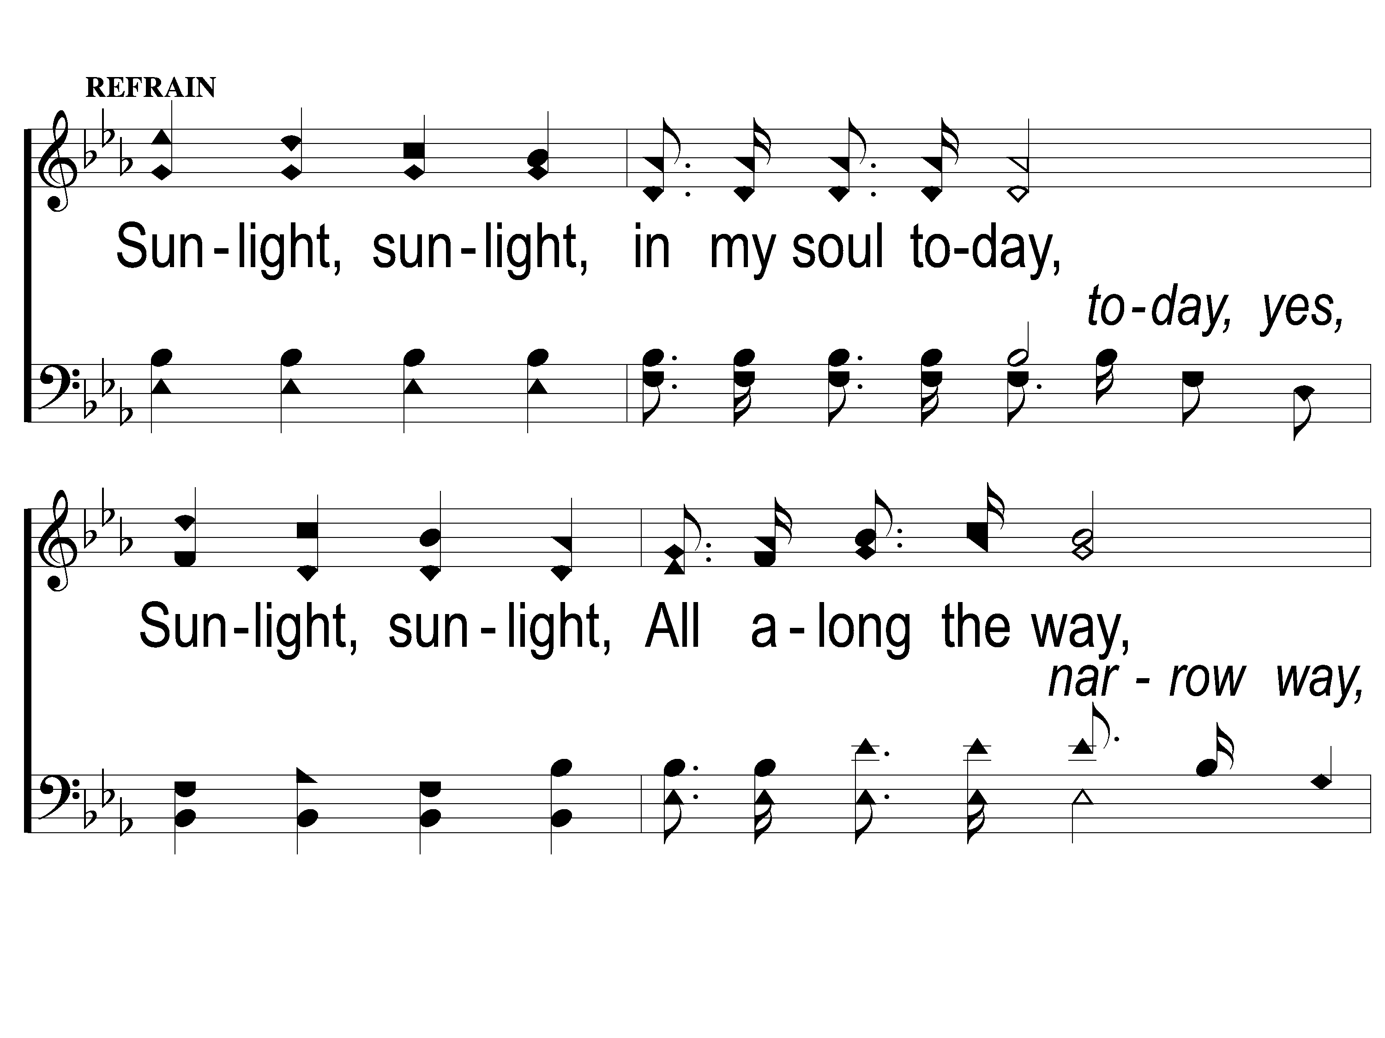
C-1 Sunlight
Sunlight
620

Slide 46
C-2 Sunlight
Sunlight
620

Slide 47
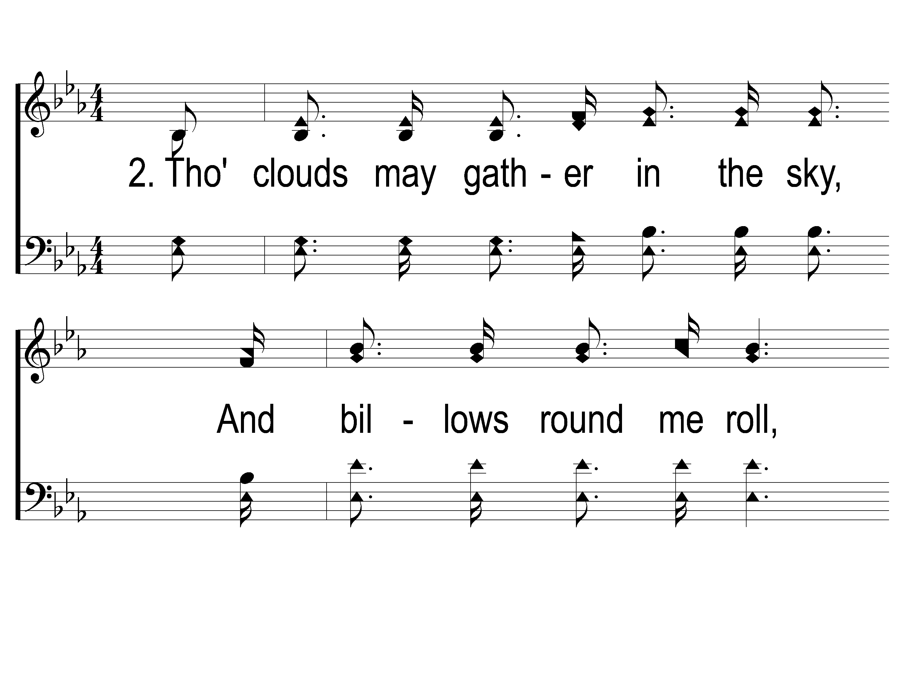
2-1 Sunlight
Sunlight
620

Slide 48
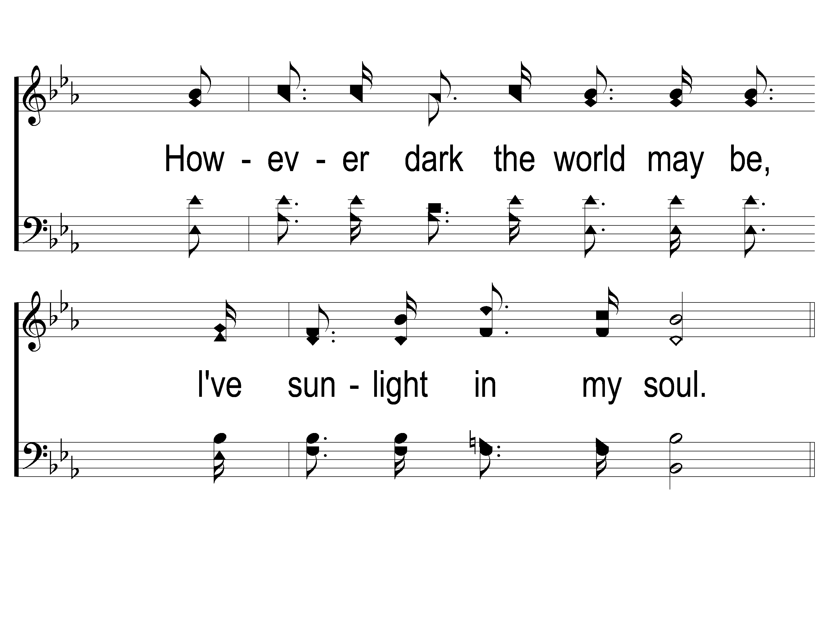
2-2 Sunlight
Sunlight
620

Slide 49
C-1 Sunlight
Sunlight
620

Slide 50
C-2 Sunlight
Sunlight
620

Slide 51
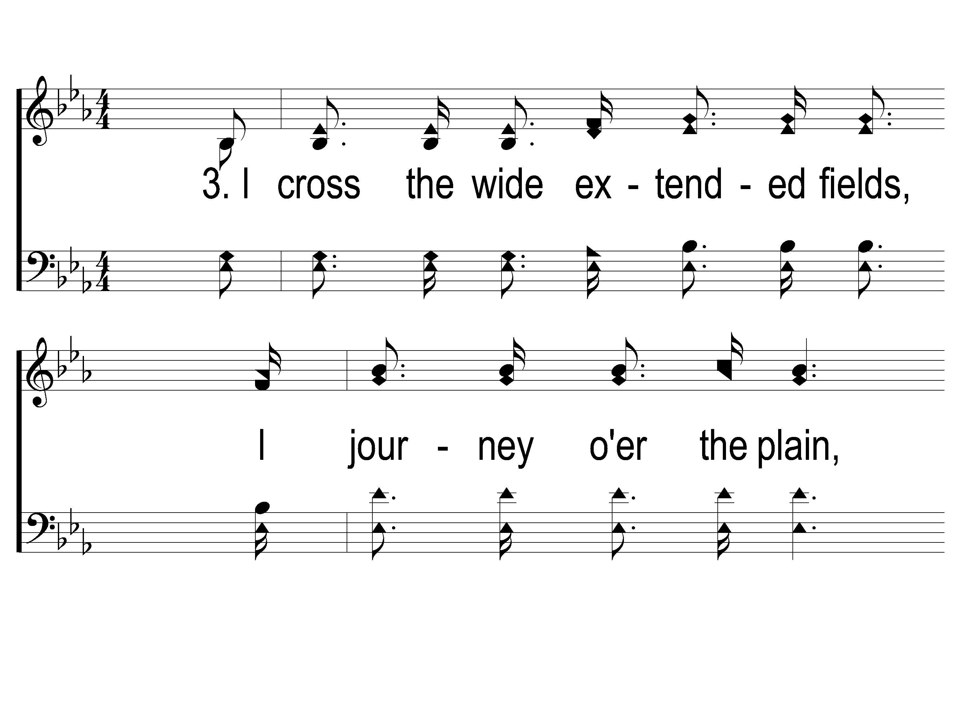
3-1 Sunlight
Sunlight
620

Slide 52
3-2 Sunlight
Sunlight
620

Slide 53
C-1 Sunlight
Sunlight
620

Slide 54
C-2 Sunlight
Sunlight
620

Slide 55
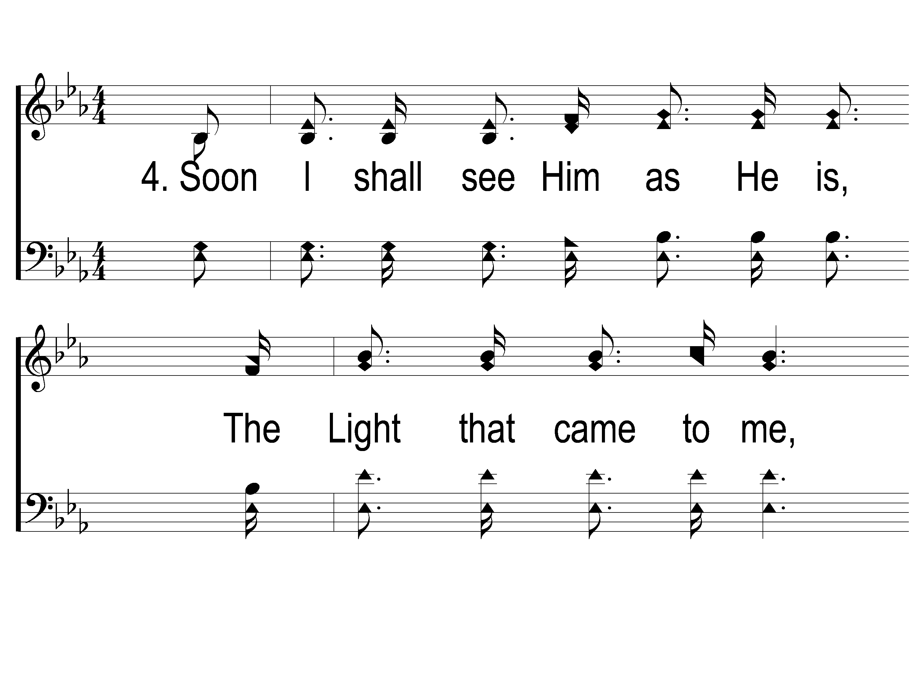
4-1 Sunlight
Sunlight
620

Slide 56
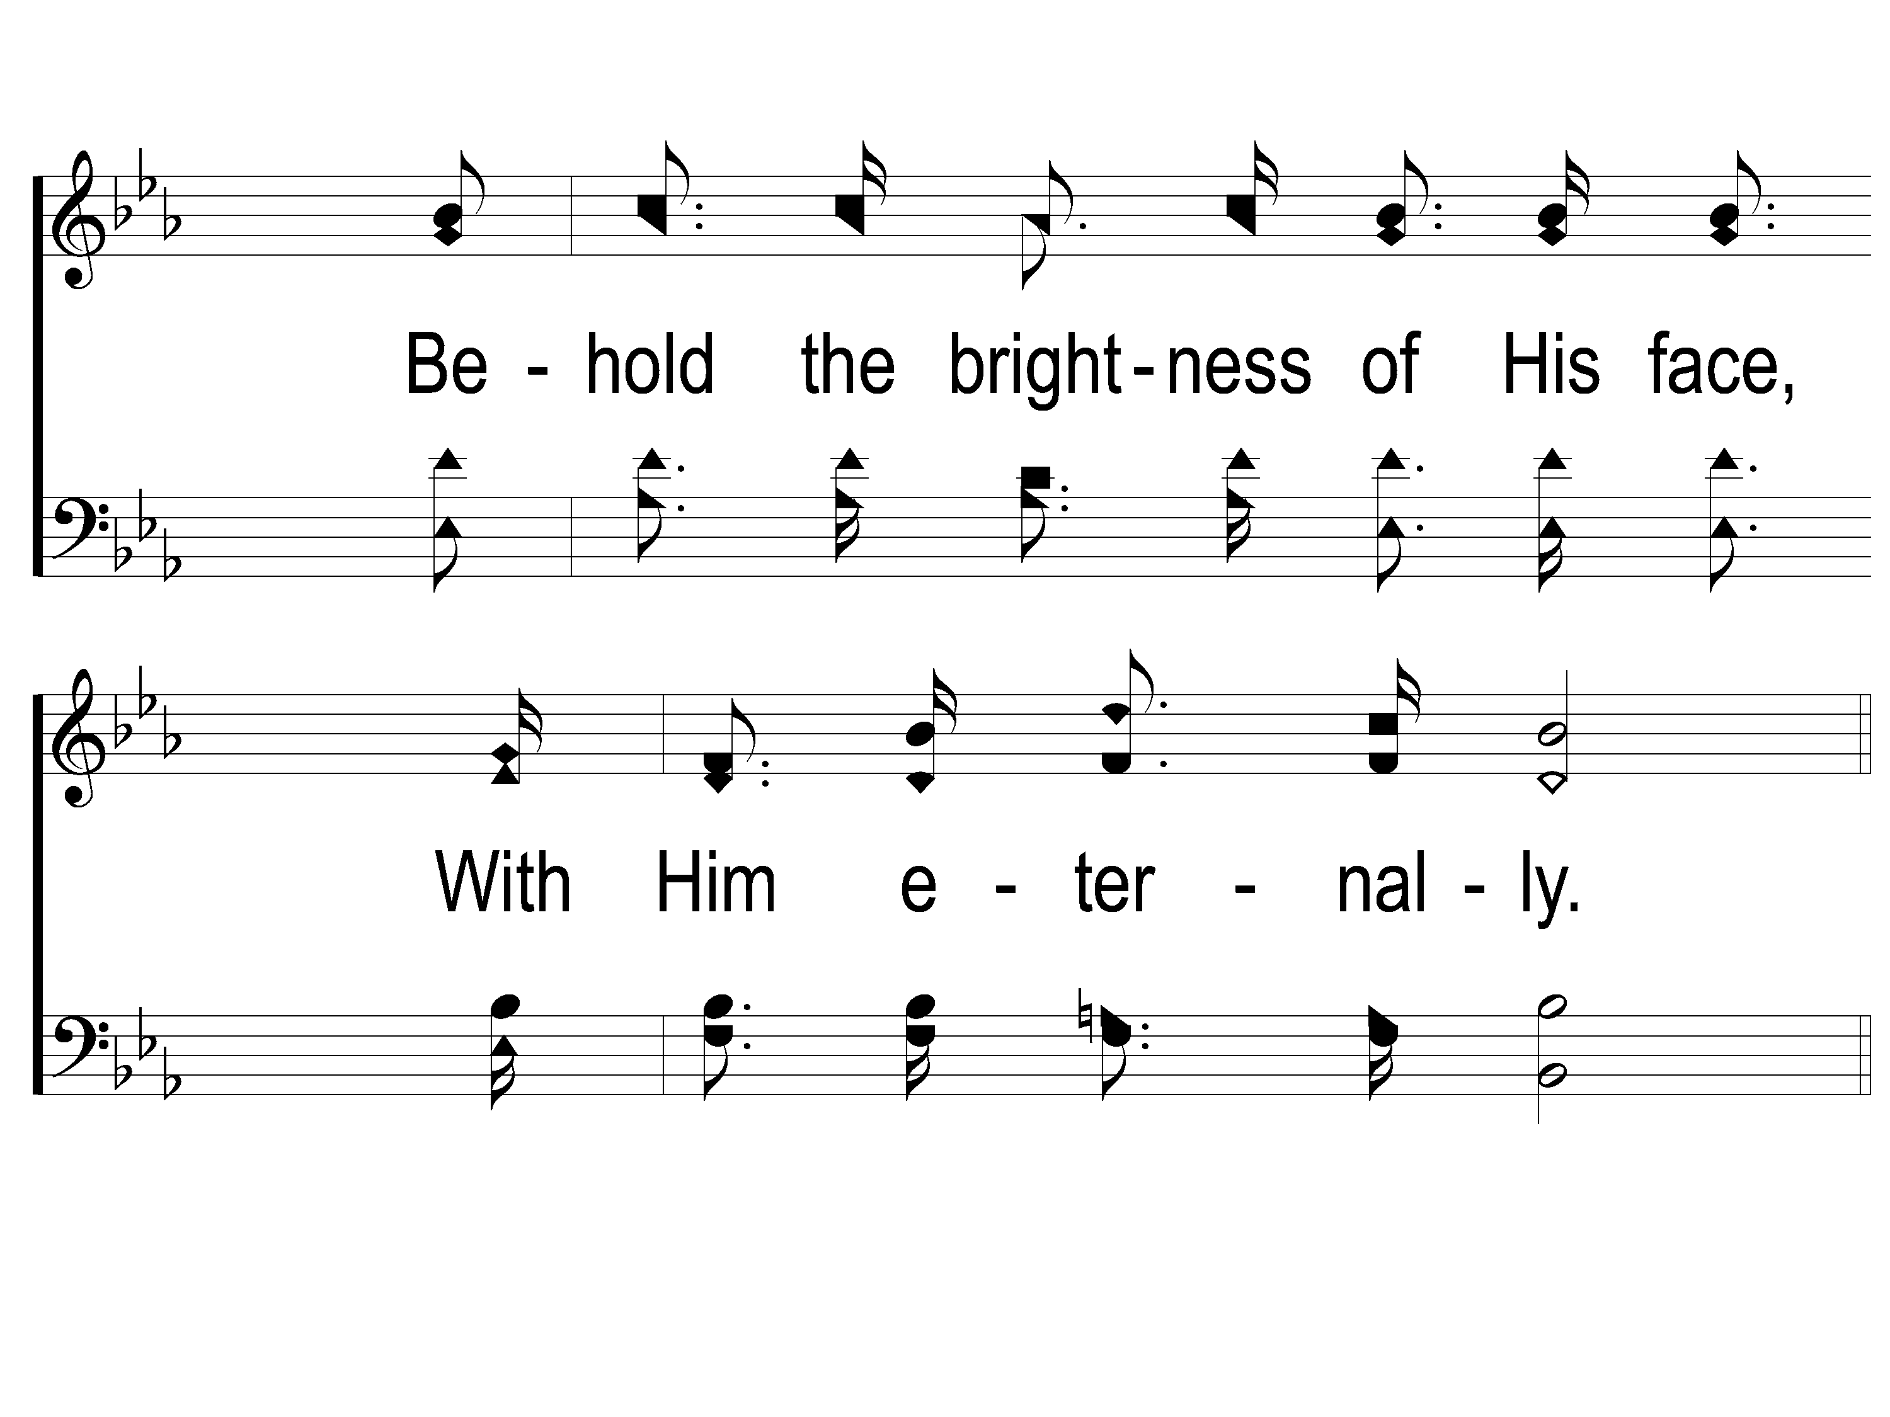
4-2 Sunlight
Sunlight
620

Slide 57
C-1 Sunlight
Sunlight
620

Slide 58
C-2 Sunlight
Sunlight
620

Slide 59
What Will
Your Answer Be?

Slide 60
Verse 1:
"Someday you’ll stand at the bar on high,
Someday your record you’ll see,
Someday you’ll answer the question of life;
What will your answer be?"

Slide 61
Verse 2:
"Sadly you’ll stand if you’re unprepared, Trembling, you’ll fall on your knee,
Facing the sentence of life or of death;
What will that sentence be?"

Slide 62
Verse 3:
"Now is the time to prepare, my friend;
Make your soul spotless and free,
Washed in the blood of the Crucified One.
He will your answer be."

Slide 63
Chorus:
"What will it be? What will it be?
Where will you spend your eternity?
What will it be, O, what will it be?
What will your answer be?"

Slide 64
Scripture Reading:
Matthew 27: 15-25

Slide 65
Songs About
Standing Firm

Slide 66
What Will
Your Answer Be?

Slide 67
Verse 1:
"Someday you’ll stand at the bar on high,
Someday your record you’ll see,
Someday you’ll answer the question of life;
What will your answer be?"

Slide 68
4 Bible Guarantees:

Slide 69
4 Bible Guarantees:
We will All stand in Judgment

Slide 70
We Will Stand In Judgment
Heb. 9: 27
2 Cor. 5: 10
Rev. 20: 11-15
Acts 24: 25
2 Tim. 4: 1

Slide 71
4 Bible Guarantees:
We will All stand in Judgment
We will All give an Account

Slide 72
We Will Give An Account
Of What We Have Said
Matt. 12: 36
Jn. 12:48
Jms. 1: 19, 26, 2: 12, 3: 1, 5: 12

Slide 73
We Will Give An Account
Of What We Have Done
Acts 17: 30-31
Heb. 13: 4

Slide 74
We Will Give An Account
Of What We Have Thought
Jms. 2: 4
Matt. 5:

Slide 75
We Will Give An Account
Of What We Have Hidden
Rom. 2: 16
Eccl. 12: 14

Slide 76
We Will Give An Account
Of How We Have Worshiped
1 Cor. 11: 29
Jn. 4: 24

Slide 77
Verse 2:
"Sadly you’ll stand if you’re unprepared, Trembling, you’ll fall on your knee,
Facing the sentence of life or of death;
What will that sentence be?"

Slide 78
4 Bible Guarantees:
We will All stand in Judgment
We will All give an Account
Many will stand Unprepared

Slide 79
Many Will Be Unprepared
Rom. 1: 28-32, 2: 2
2 Pet. 2: 9
Matt. 7: 13-14, 22: 1-14

Slide 80
Verse 3:
"Now is the time to prepare, my friend;
Make your soul spotless and free,
Washed in the blood of the Crucified One.
He will your answer be."

Slide 81
4 Bible Guarantees:
We will All stand in Judgment
We will All give an Account
Many will stand Unprepared
We must make Preparations

Slide 82
We Must Make Preparations
Matt. 25:1-7
Heb. 11: 7
1 Pet. 3: 20-21
2 Tim. 4:8

Slide 83
Chorus:
"What will it be? What will it be?
Where will you spend your eternity?
What will it be, O, what will it be?
What will your answer be?"

Slide 84
What Will Your Answer Be?

Slide 85
Invitation Song:
Love Lifted Me

Slide 86
1-1 Love Lifted Me
Love Lifted Me
453

Slide 87
1-2 Love Lifted Me
Love Lifted Me
453

Slide 88
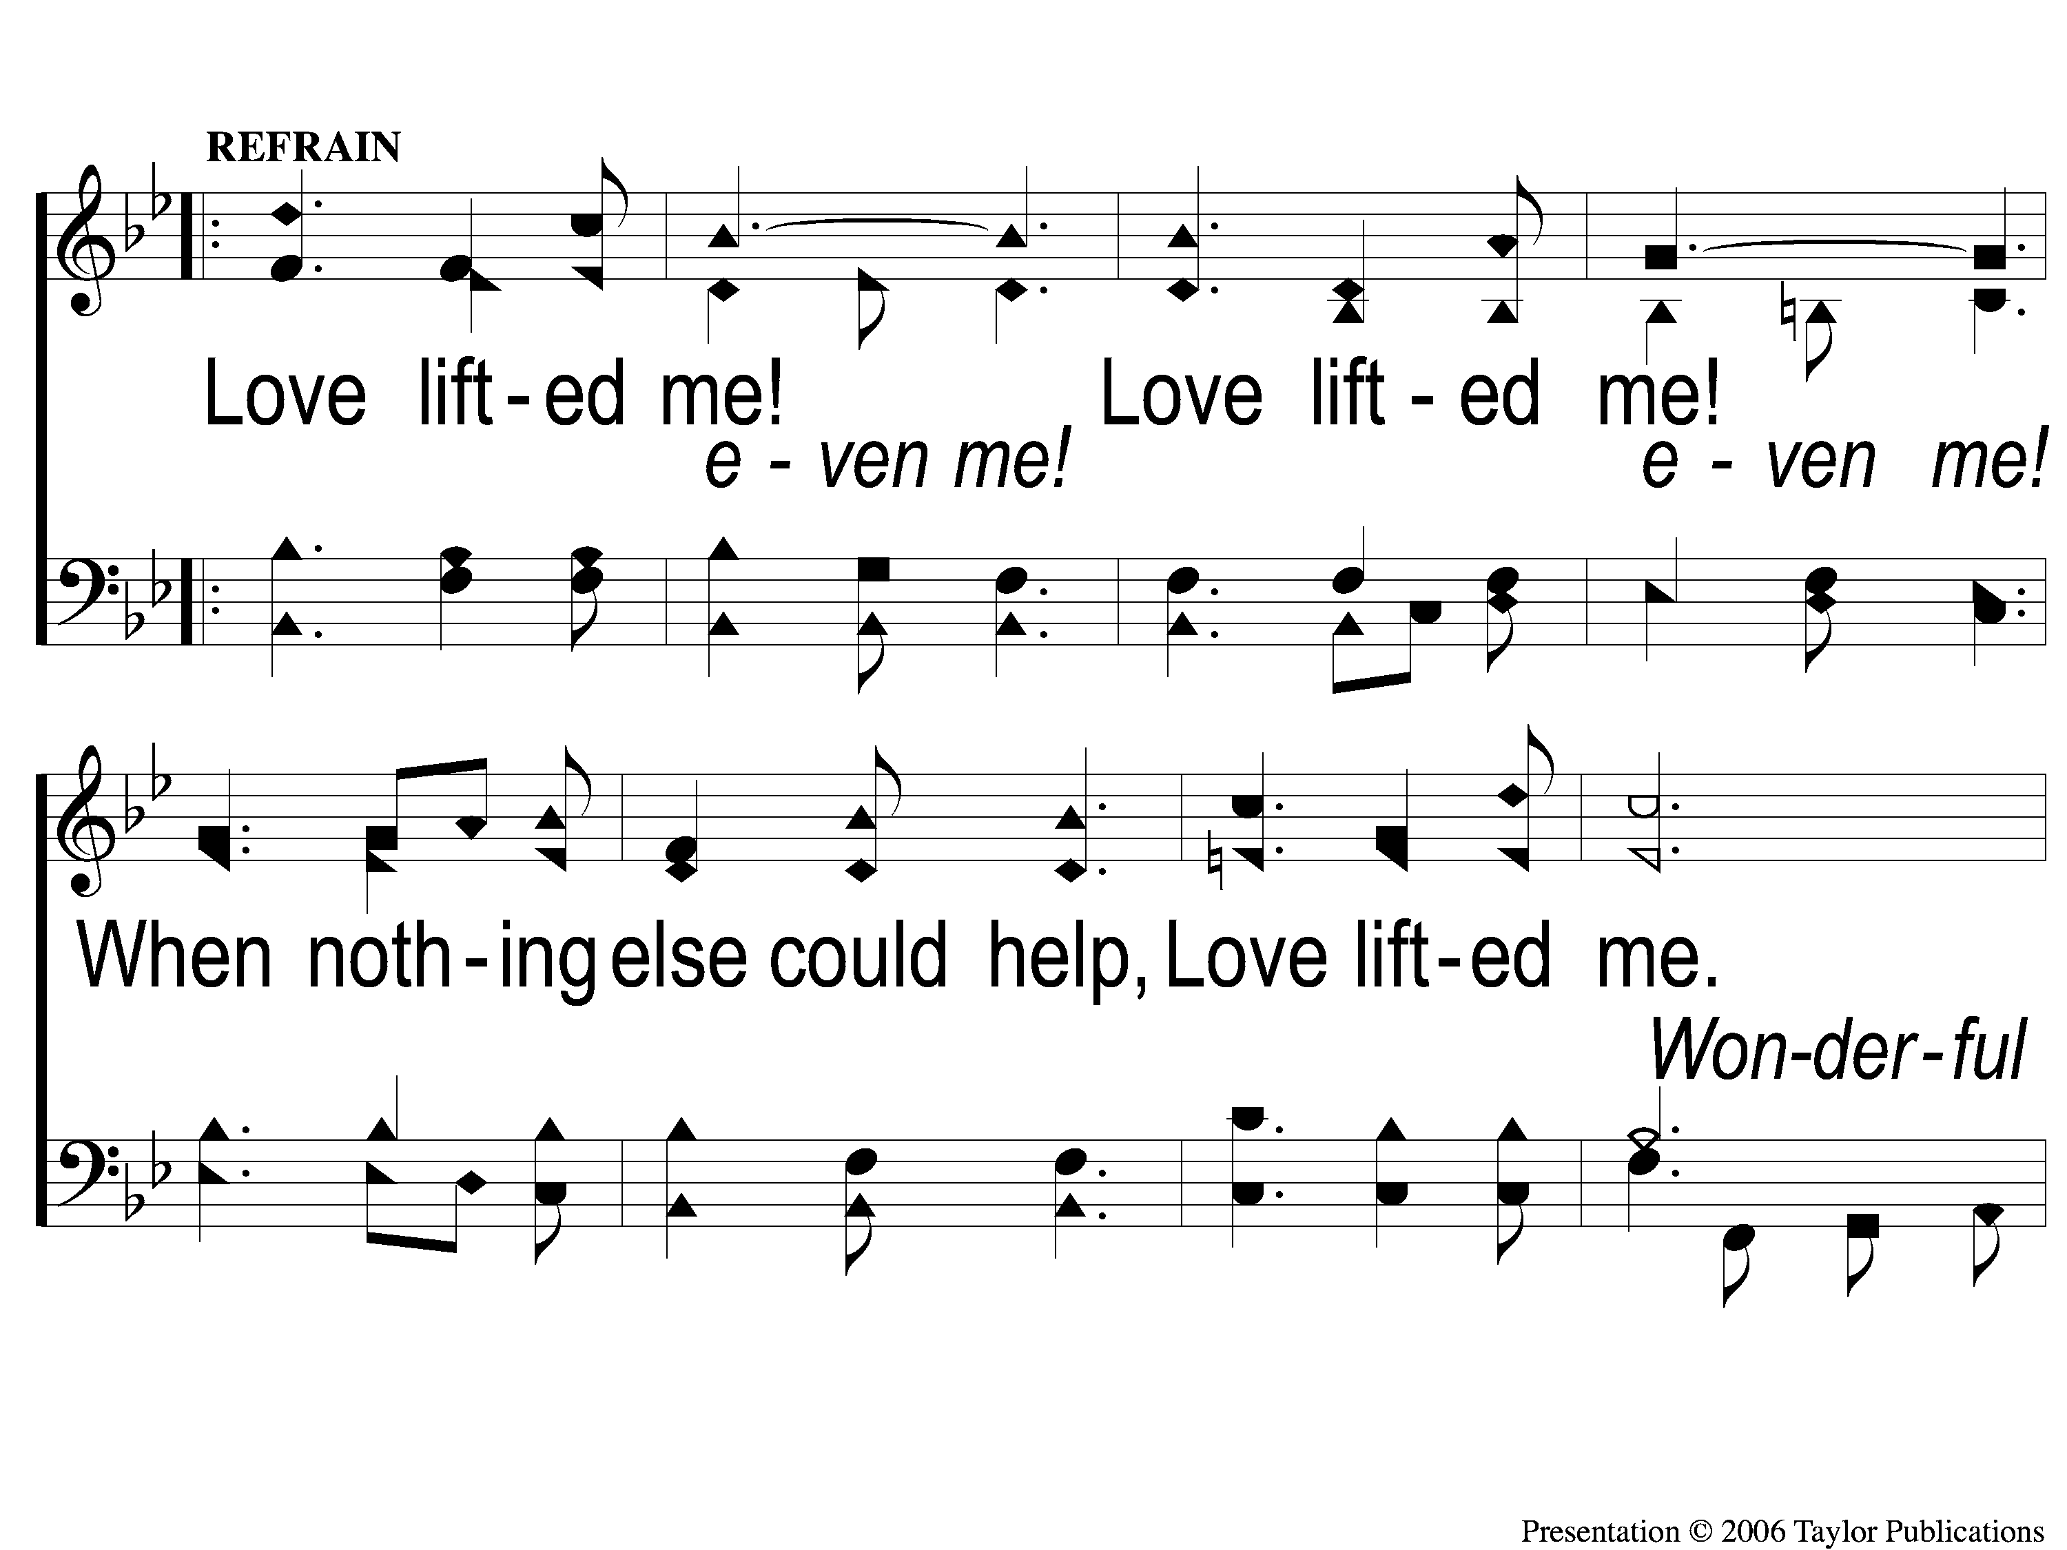
C-1 Love Lifted Me
Love Lifted Me
453

Slide 89
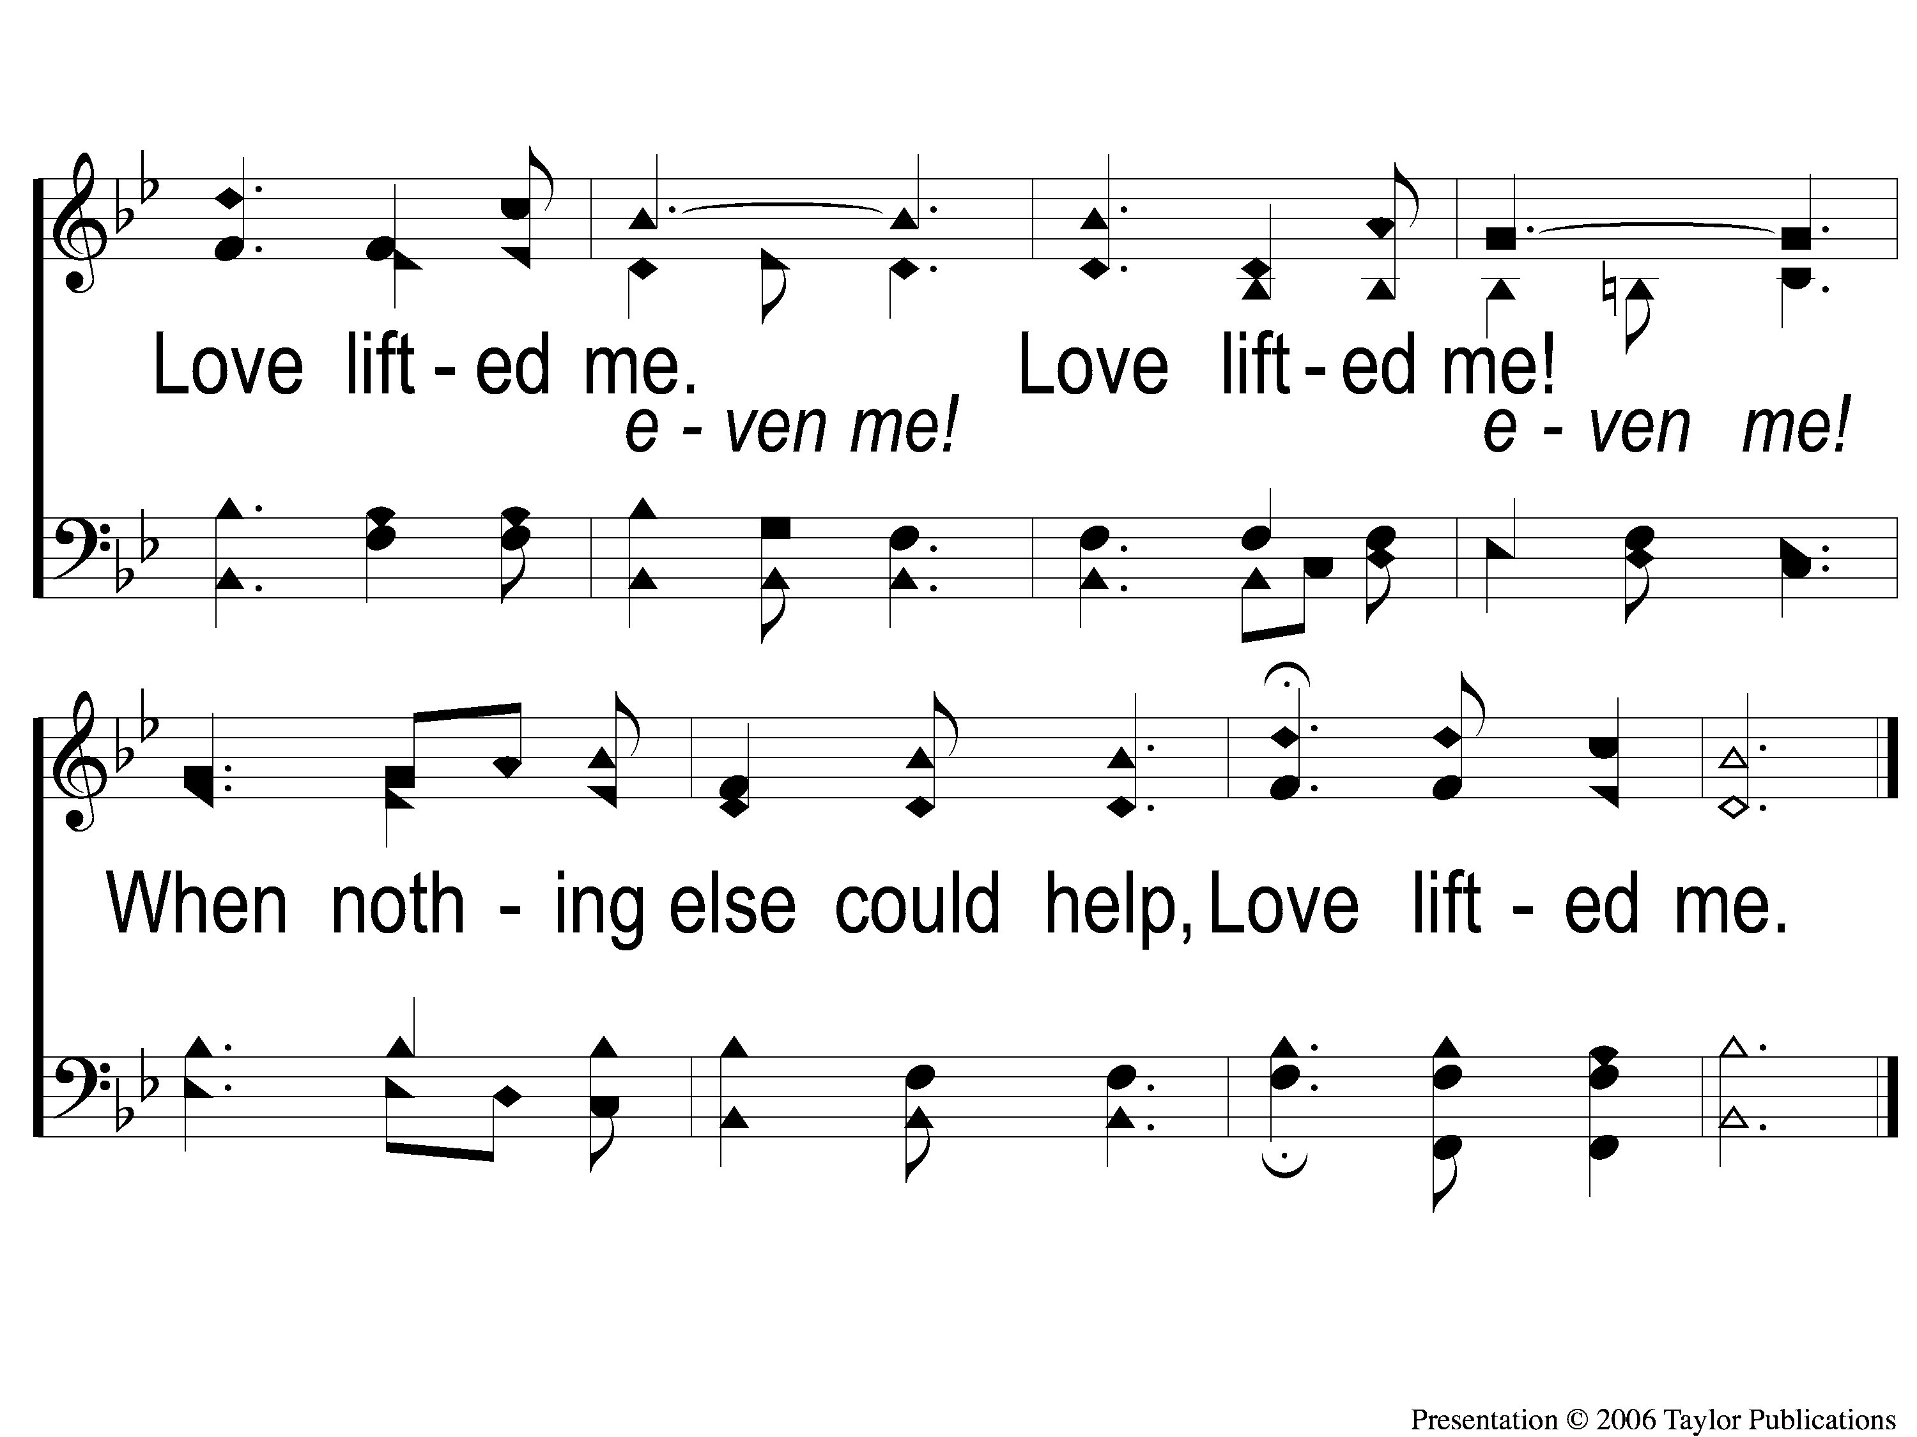
C-2 Love Lifted Me
Love Lifted Me
453

Slide 90
2-1 Love Lifted Me
Love Lifted Me
453

Slide 91
2-2 Love Lifted Me
Love Lifted Me
453

Slide 92
C-1 Love Lifted Me
Love Lifted Me
453

Slide 93
C-2 Love Lifted Me
Love Lifted Me
453

Slide 94
3-1 Love Lifted Me
Love Lifted Me
453

Slide 95
3-2 Love Lifted Me
Love Lifted Me
453

Slide 96
C-1 Love Lifted Me
Love Lifted Me
453

Slide 97
C-2 Love Lifted Me
Love Lifted Me
453

Slide 98
Wonderful, Merciful Savior

Slide 99
1-1 Wonderful Merciful Savior
Wonderful, Merciful, Savior

Slide 100
1-2 Wonderful Merciful Savior
Wonderful, Merciful, Savior

Slide 101
2-1 Wonderful Merciful Savior
Wonderful, Merciful, Savior

Slide 102
2-2 Wonderful Merciful Savior
Wonderful, Merciful, Savior

Slide 103
C-1 Wonderful Merciful Savior
Wonderful, Merciful, Savior

Slide 104
C-2 Wonderful Merciful Savior
Wonderful, Merciful, Savior

Slide 105
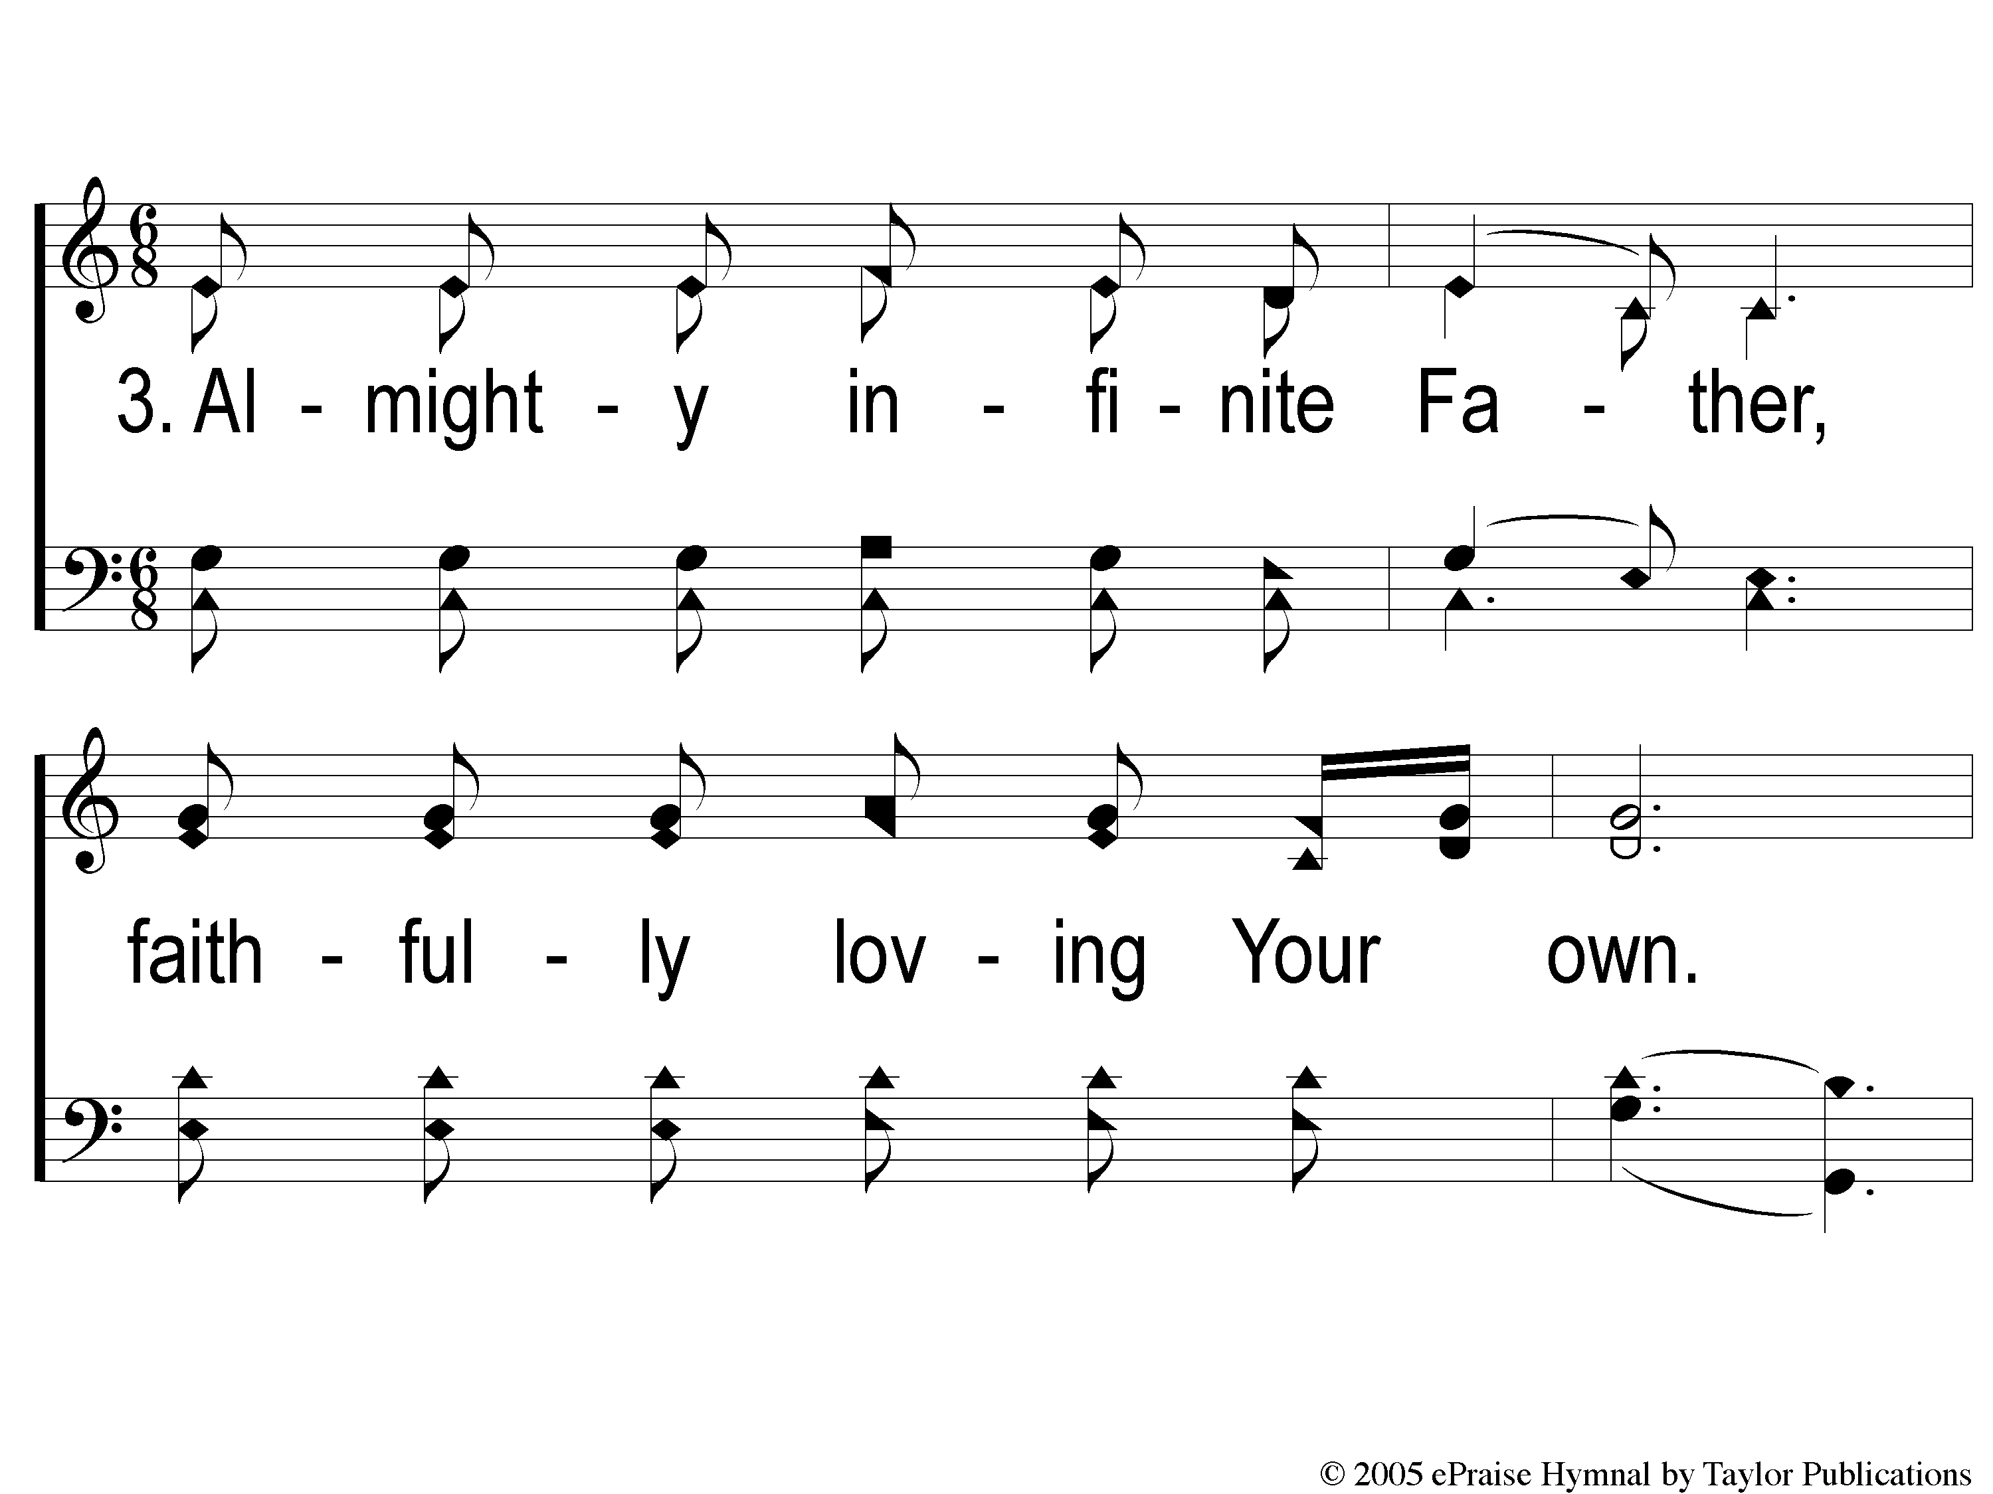
3-1 Wonderful Merciful Savior
Wonderful, Merciful, Savior

Slide 106
3-2 Wonderful Merciful Savior
Wonderful, Merciful, Savior

Slide 107
C-1 Wonderful Merciful Savior
Wonderful, Merciful, Savior

Slide 108
C-2 Wonderful Merciful Savior
Wonderful, Merciful, Savior

Slide 109
The Lord’s Supper
Acts 20:7

Slide 110
The Unleavened Bread
”There is therefore now no condemnation to those who are in Christ Jesus, who do not walk according to the flesh, but according to the Spirit. For the law of the Spirit of life in Christ Jesus has made me free from the law of sin and death.”
- Romans 8: 1-2

Slide 111
The Fruit of the Vine
“What then shall we say to these things? If God is for us, who can be against us? He who did not spare His own Son, but delivered Him up for us all, how shall He not with Him also freely give us all things?” – Romans 8: 31-32

Slide 112
Our Offering
“I have shown you in every way, by laboring like this, that you must support the weak. And remember the words of the Lord Jesus, that He said, ‘It is more blessed to give than to receive.’ ” - Acts 20: 35

Slide 113
Closing Prayer

Slide 114
A Shield About Me

Slide 115
1 Shield About Me
Shield About Me
357

Slide 116
2 Shield About Me
Shield About Me
357

Slide 117
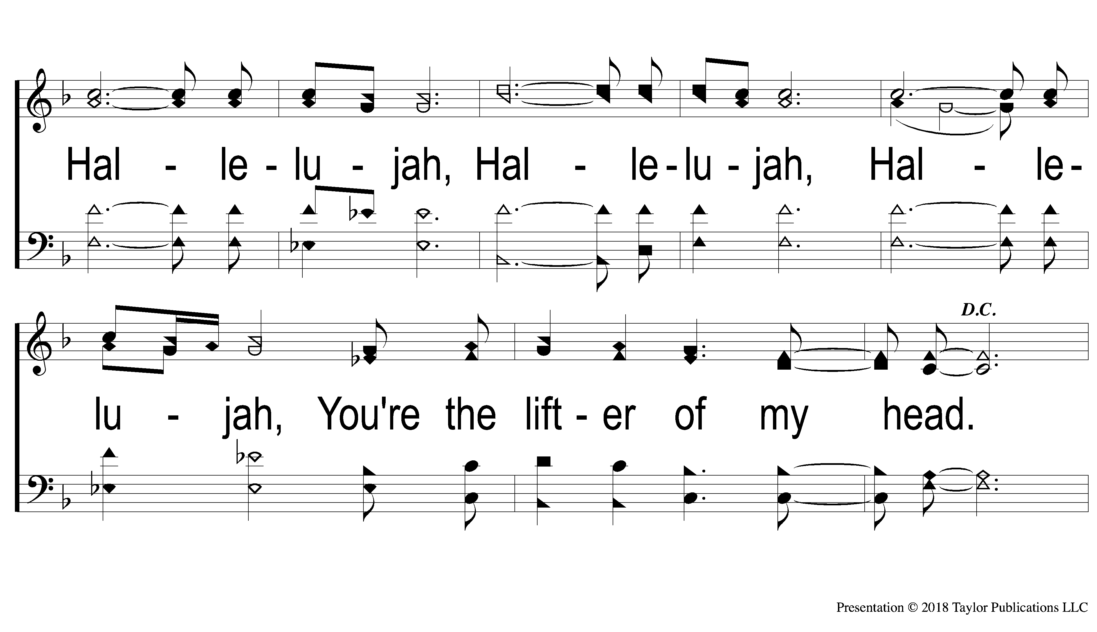
3 Shield About Me
Shield About Me
357

Slide 118
DC-1 Shield About Me
Shield About Me
357

Slide 119
DC-2 Shield About Me
Shield About Me
357

Slide 120
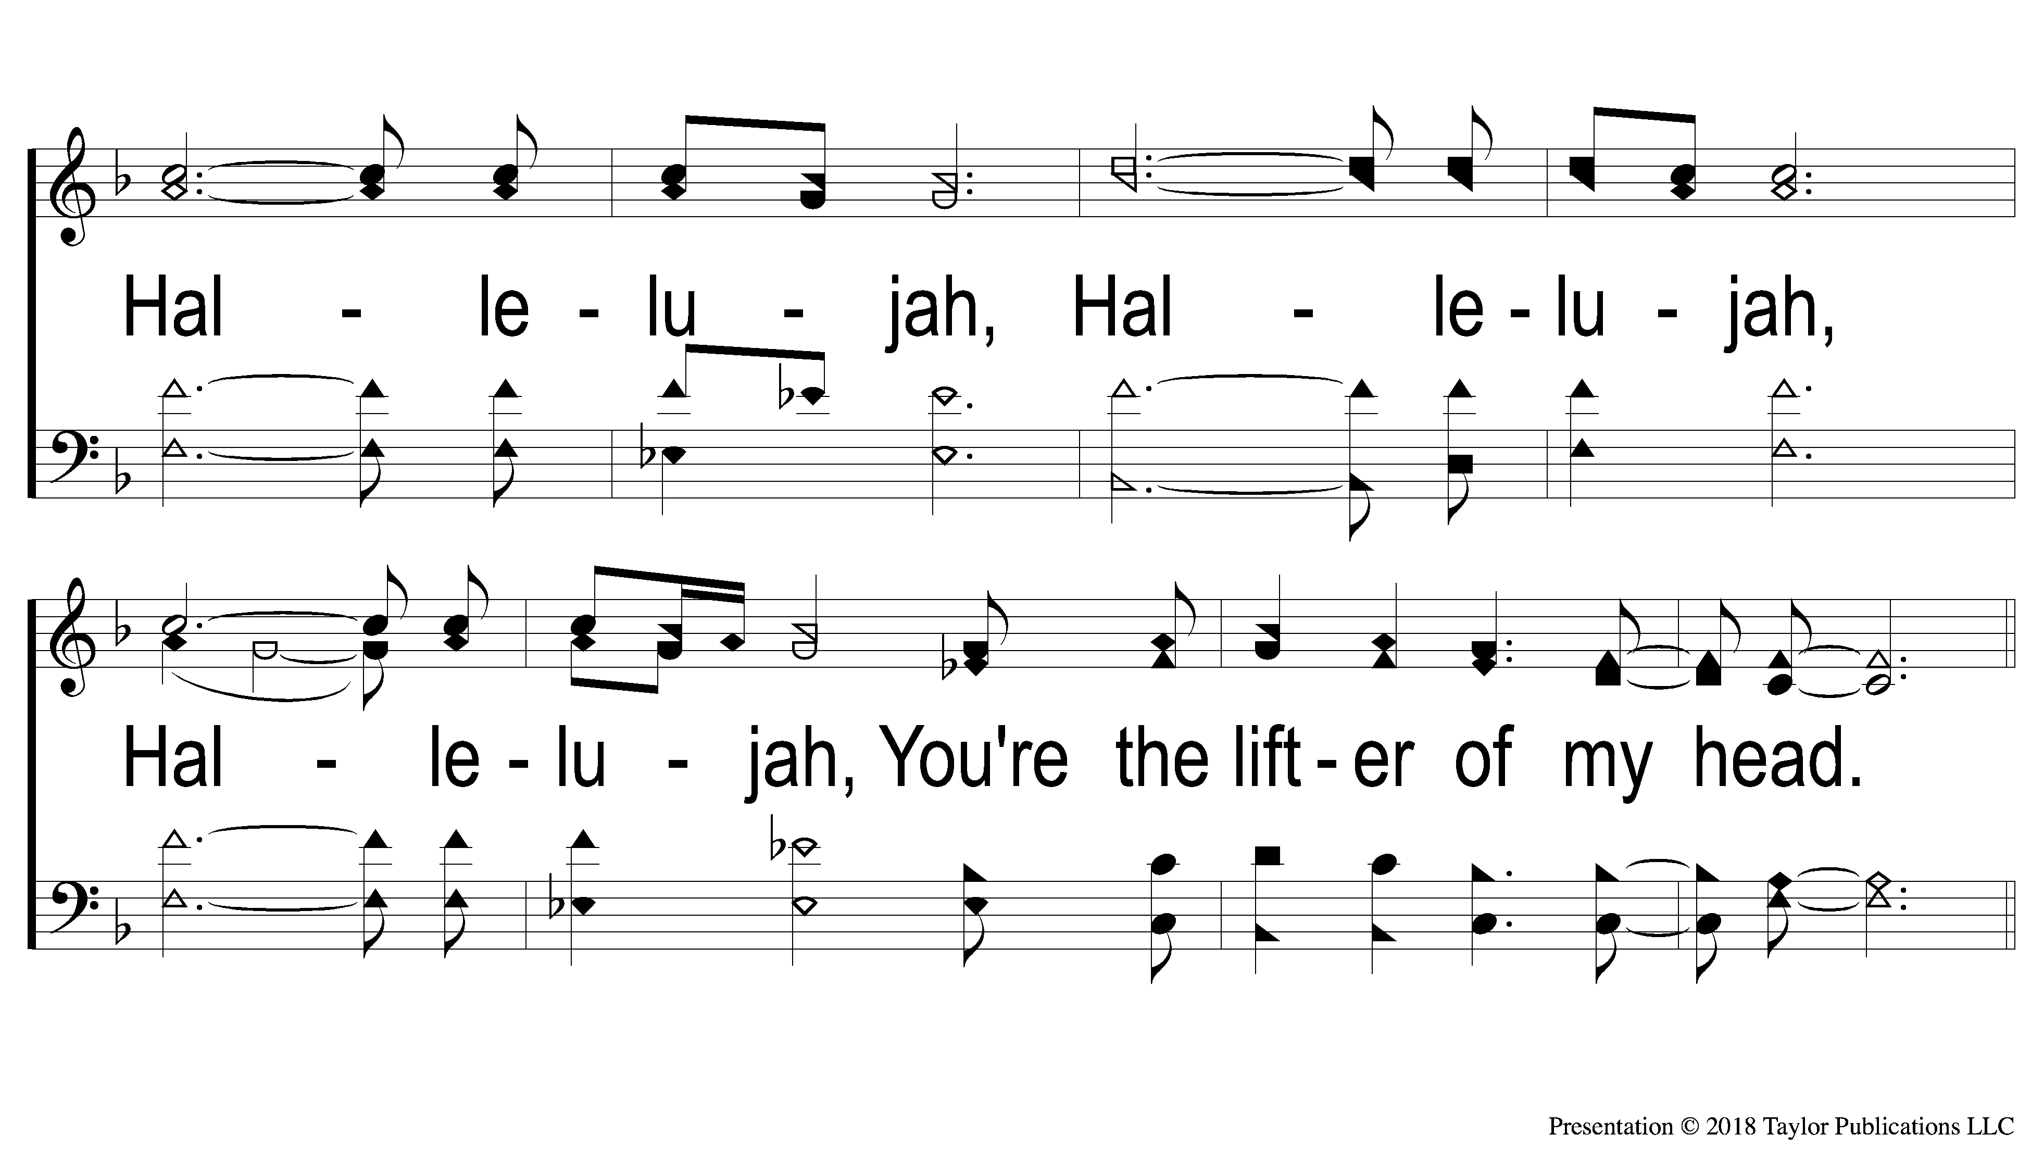
DC-3 Shield About Me
Shield About Me
357

Slide 121
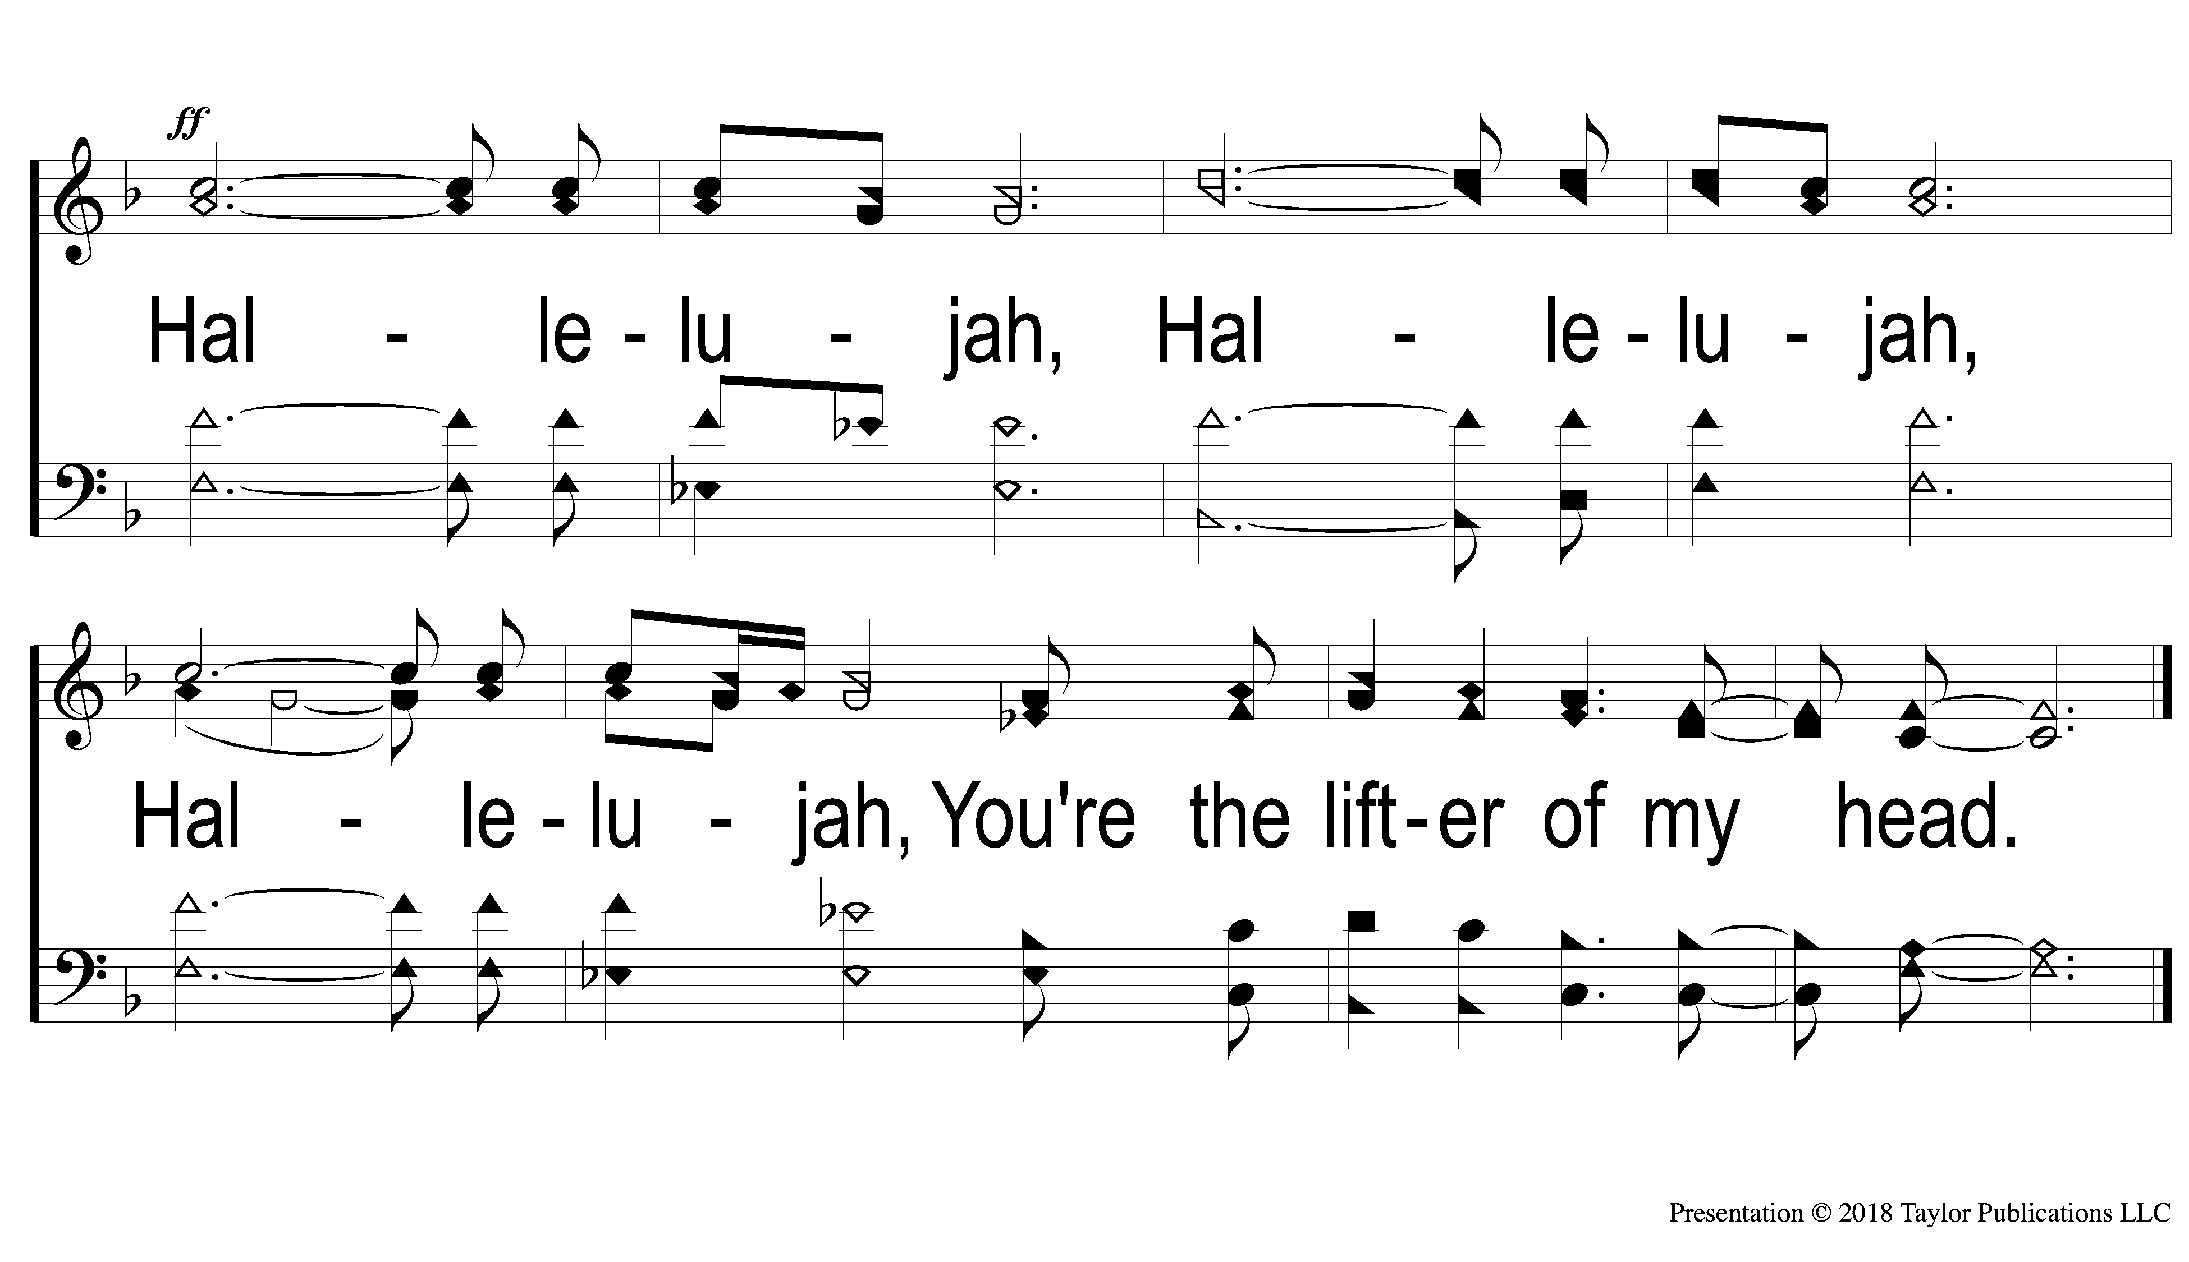
End Shield About Me
Shield About Me
357

Slide 122
Join us for
Worship Tonight
@ 6:00pm!

