Slide 1
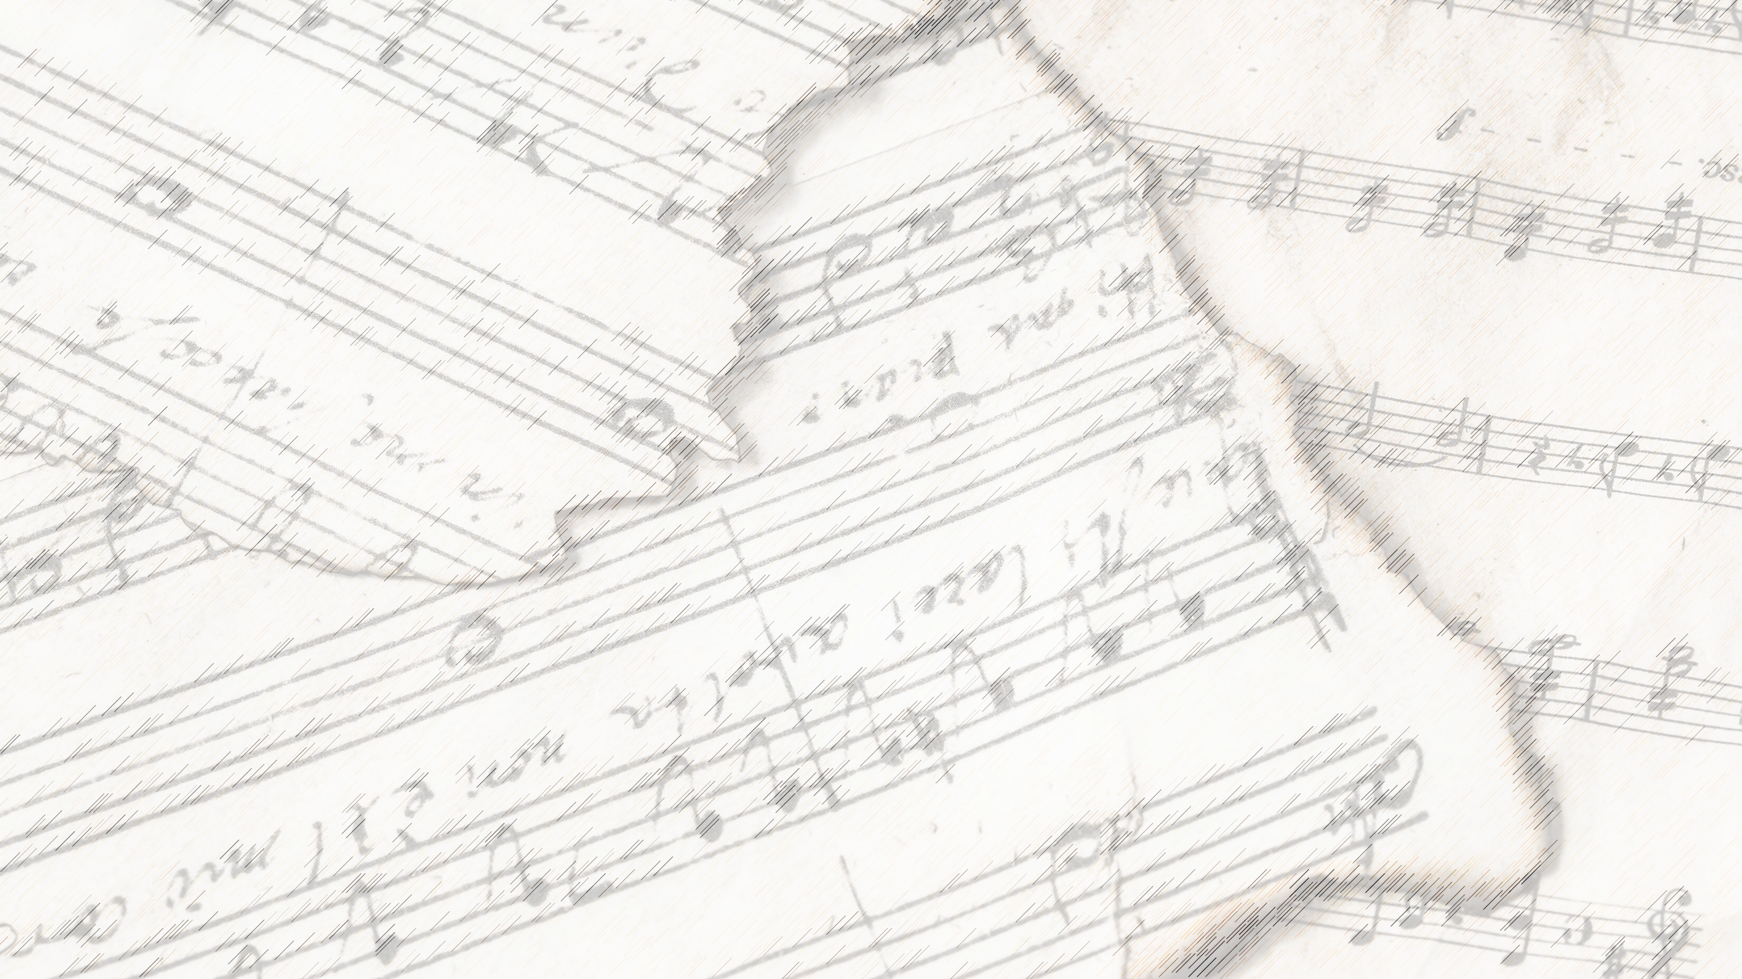
Welcome!
We Are Glad You Are Here

Slide 2
Songs of Praise to God

Slide 3
Opening Prayer

Slide 4
Songs of Praise to God

Slide 5
The B-I-B-L-E

Slide 6
The B-I-B-L-E,
Yes that’s the book for me;
I stand alone on the Word of God,
The B-I-B-L-E.

Slide 7
3 Reasons to Stand on God’s Word:
It Tells Us…

Slide 8
3 Reasons to Stand on God’s Word:
It Tells Us…
… How to Communicate with God

Slide 9
The B-I-B-L-E
I’ll take it along with me,
I’ll read and pray, and then obey,
the B-I-B-L-E.

Slide 10
How To Communicate With God
Read / Study
2 Tim. 2: 15
2 Pet. 1: 3
Acts 17: 11

Slide 11
How To Communicate With God
Pray
Mk. 1: 35
Lk. 5: 16
Acts 12: 12, 13: 3, 16: 25, 20: 36

Slide 12
The B-I-B-L-E
I’ll take it along with me,
I’ll read and pray, and then obey,
the B-I-B-L-E.

Slide 13
3 Reasons to Stand on God’s Word:
It Tells Us…
… How to Communicate with God

Slide 14
3 Reasons to Stand on God’s Word:
It Tells Us…
… How to Communicate with God
… How to Please God

Slide 15
How To Please With God
Obedience
Jms. 1: 22
Jn. 14:15
2 Tim. 2: 15

Slide 16
By F-A-I-T-H,
I’m S-A-V-E-D,
I’ll stand alone on the word of God,
The B-I-B-L-E.

Slide 17
The B-L-O-O-D
That Jesus shed for me
Cleansed me from sin, I belong to him,
The B-L-O-O-D

Slide 18
3 Reasons to Stand on God’s Word:
It Tells Us…
… How to Communicate with God
… How to Please God

Slide 19
3 Reasons to Stand on God’s Word:
It Tells Us…
… How to Communicate with God
… How to Please God
… How to Be Saved

Slide 20
How To Be Saved
Faith, Grace, & Works
Jms. 2: 14-26
Matt. 26: 28
Acts 20: 28
Rom. 5: 9
Eph. 1: 3, 7
Heb. 9: 14, 22, 13: 12

Slide 21
Are you Standing upon
The Word of God?

Slide 22
Songs of Praise to God

Slide 23
The Lord’s Supper
Acts 20:7

Slide 24
Closing Prayer

Slide 25
Songs of Praise to God

Slide 26
Join us for
Worship & Bible Classes
Wednesday
@ 6:30pm!

