Slide 1
1 Step by Step
Step by Step
15

Slide 2
2 Step by Step
Step by Step
15

Slide 3
3 Step by Step
Step by Step
15

Slide 4
DC1 Step by Step
Step by Step
15

Slide 5
DC2 Step by Step
Step by Step
15

Slide 6
DC3 Step by Step
Step by Step
15

Slide 7
DS1 Step by Step
Step by Step
15

Slide 8
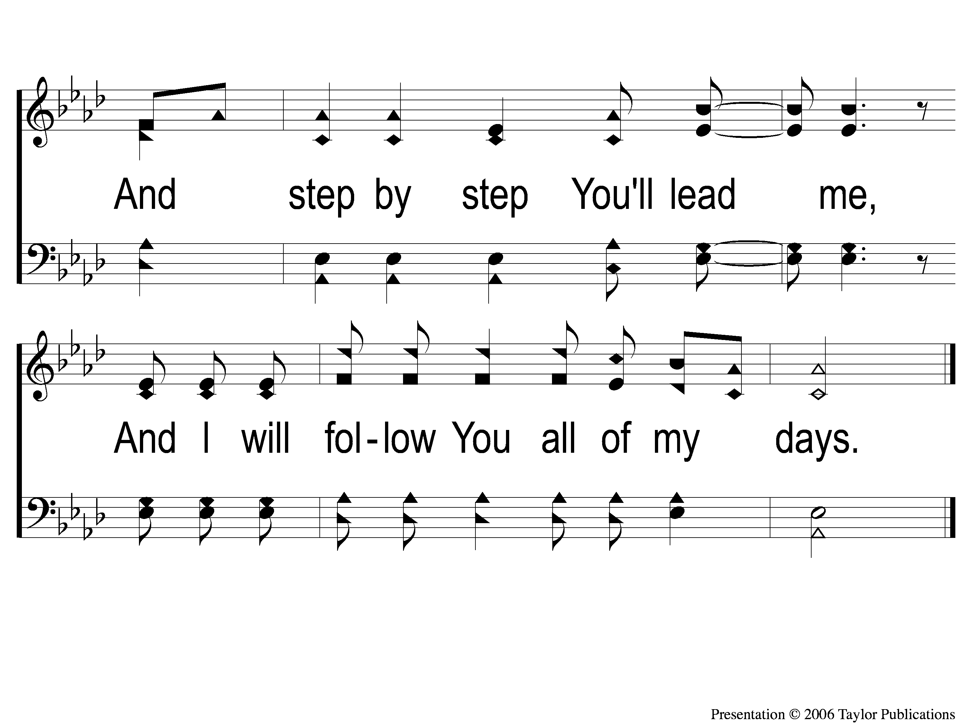
DS2 Step by Step
Step by Step
15

Slide 9
RESTORE REBUILD RENEW
welcome
we are glad to
Have you with us
IN 2022
WHEELER
CHURCH
OF
CHRIST

Slide 10
Song:
I Stand Amazed
#147

Slide 11
1-1 I Stand Amazed
I Stand Amazed
147

Slide 12
1-2 I Stand Amazed
I Stand Amazed
147

Slide 13
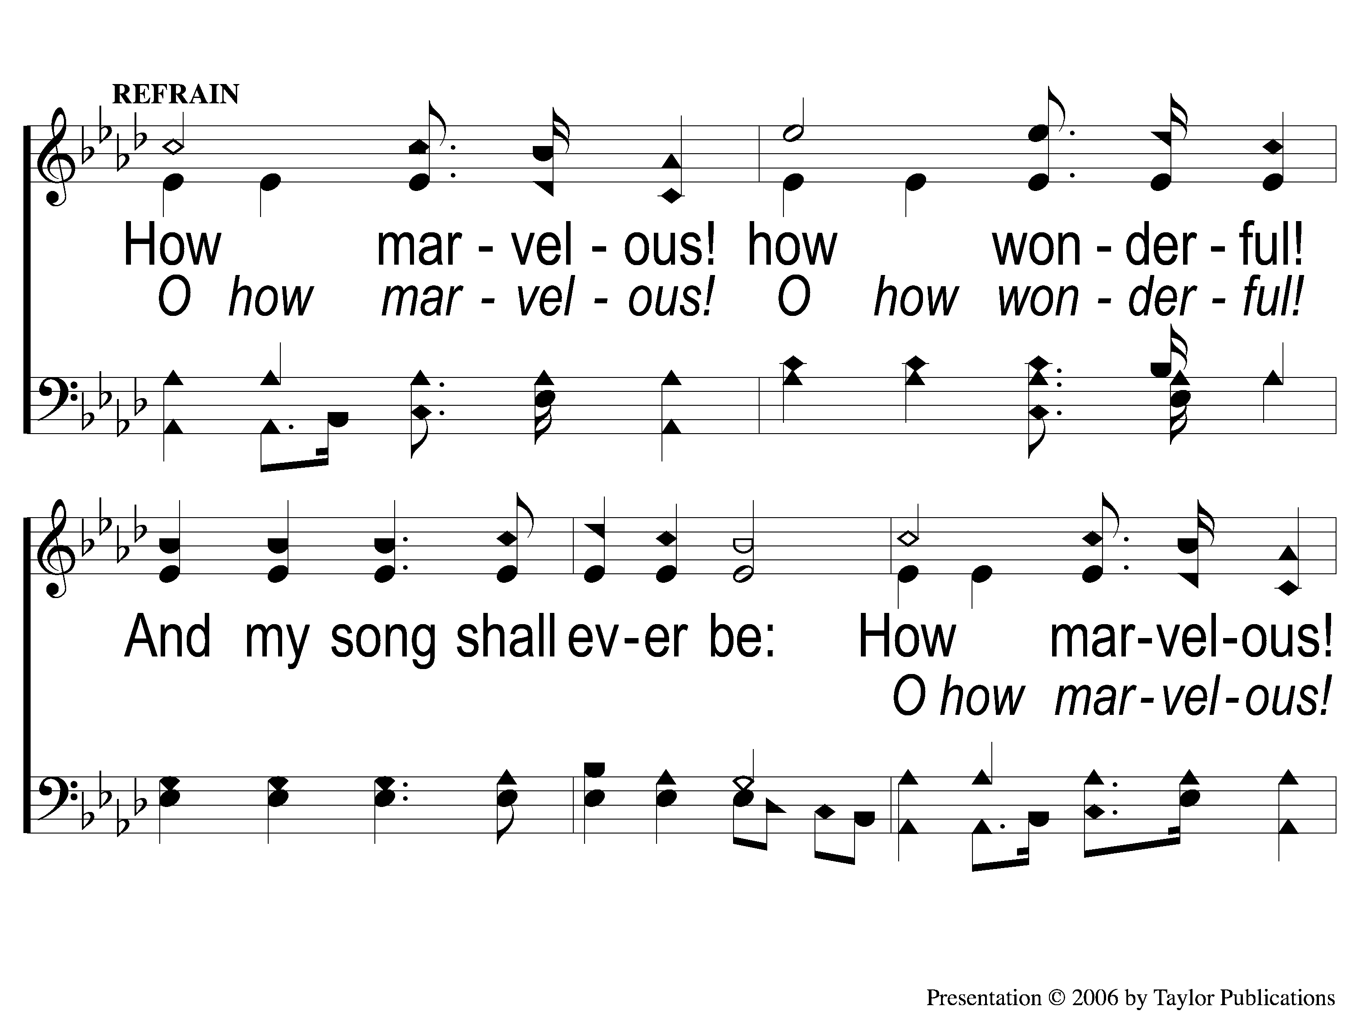
C-1 I Stand Amazed
I Stand Amazed
147

Slide 14
C-2 I Stand Amazed
I Stand Amazed
147

Slide 15
2-1 I Stand Amazed
I Stand Amazed
147

Slide 16
2-2 I Stand Amazed
I Stand Amazed
147

Slide 17
C-1 I Stand Amazed
I Stand Amazed
147

Slide 18
C-2 I Stand Amazed
I Stand Amazed
147

Slide 19
3-1 I Stand Amazed
I Stand Amazed
147

Slide 20
3-2 I Stand Amazed
I Stand Amazed
147

Slide 21
C-1 I Stand Amazed
I Stand Amazed
147

Slide 22
C-2 I Stand Amazed
I Stand Amazed
147

Slide 23
4-1 I Stand Amazed
I Stand Amazed
147

Slide 24
4-2 I Stand Amazed
I Stand Amazed
147

Slide 25
C-1 I Stand Amazed
I Stand Amazed
147

Slide 26
C-2 I Stand Amazed
I Stand Amazed
147

Slide 27
Song:
In Moments Like These
#239

Slide 28
1-1 In Moments Like These
In Moments Like These
239

Slide 29
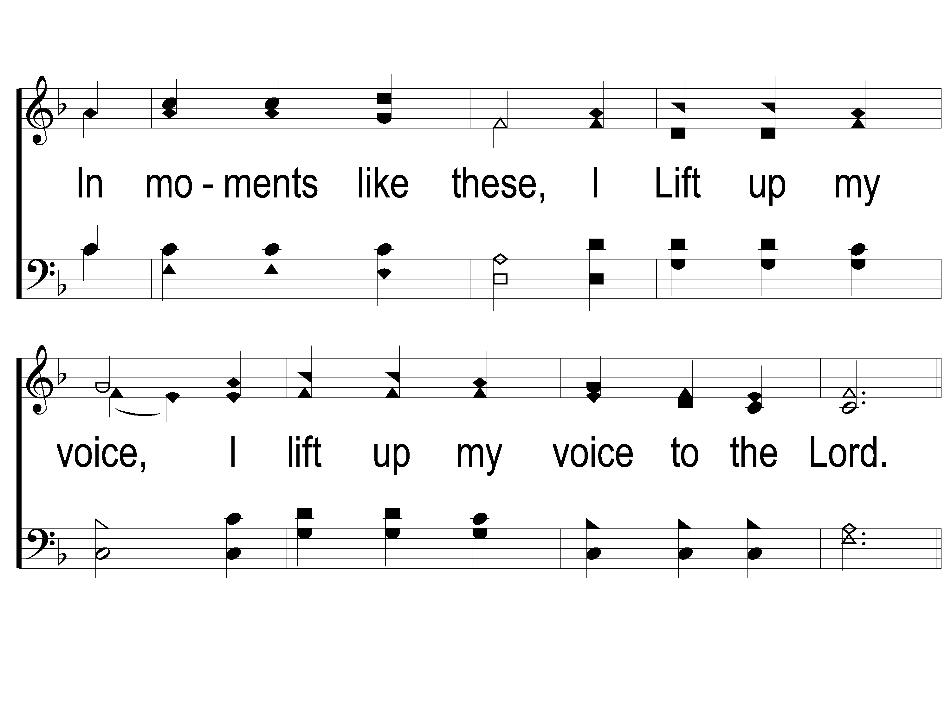
1-2 In Moments Like These
In Moments Like These
239

Slide 30
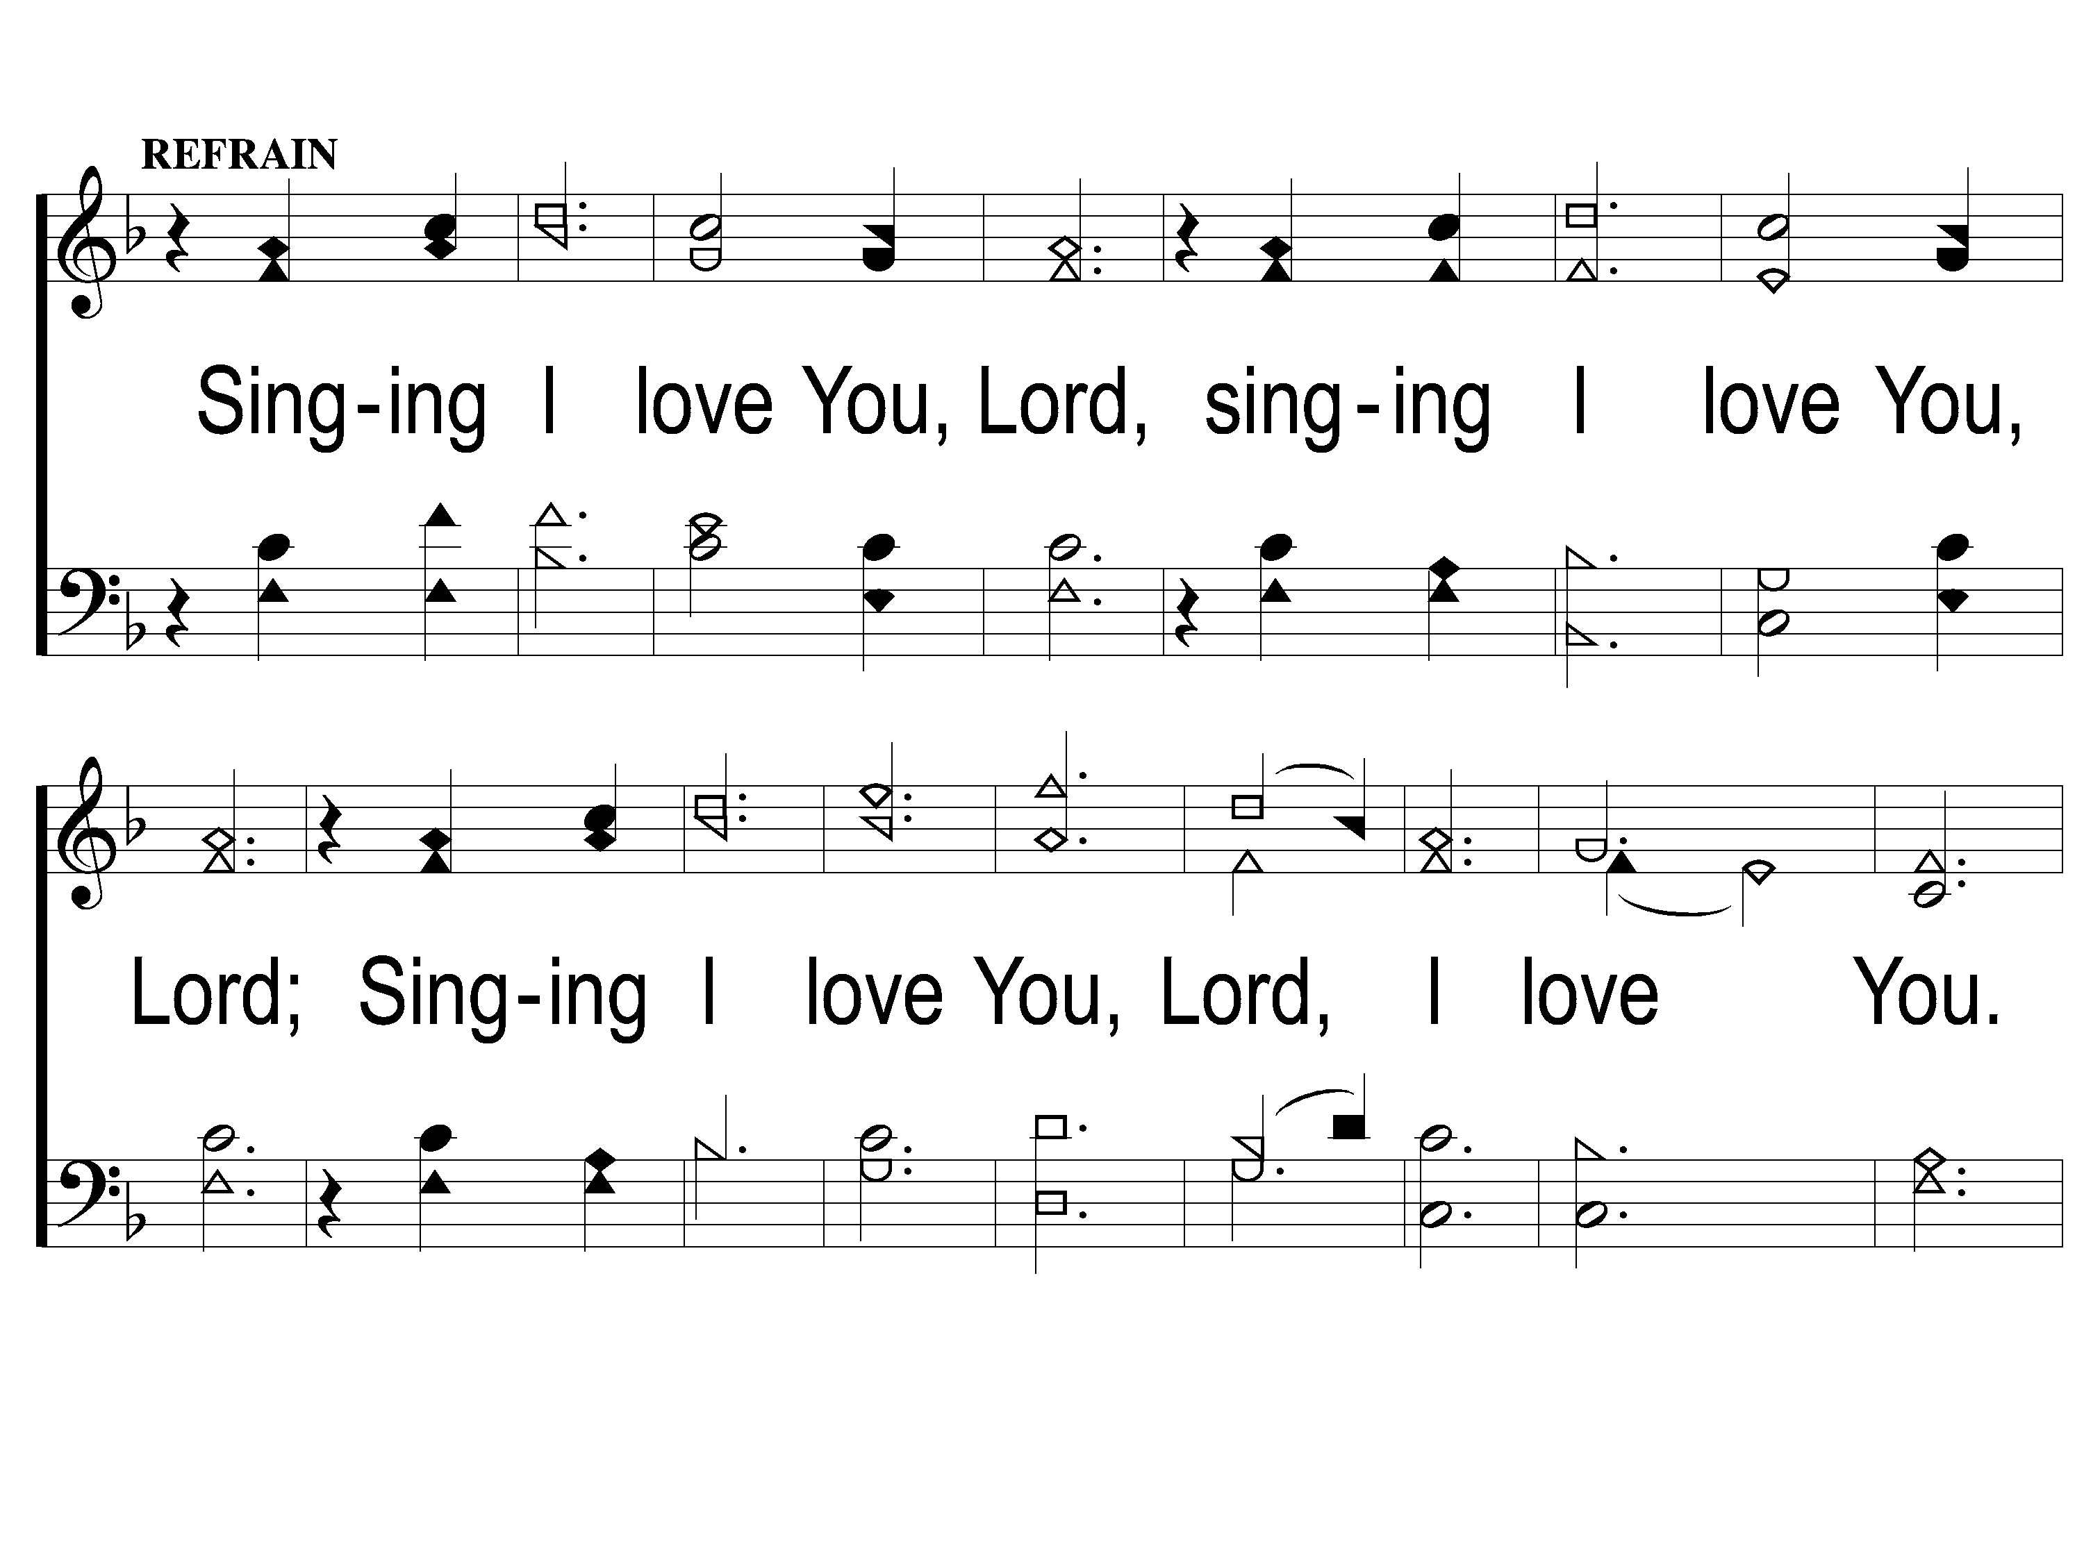
C-1 In Moments Like These
In Moments Like These
239

Slide 31
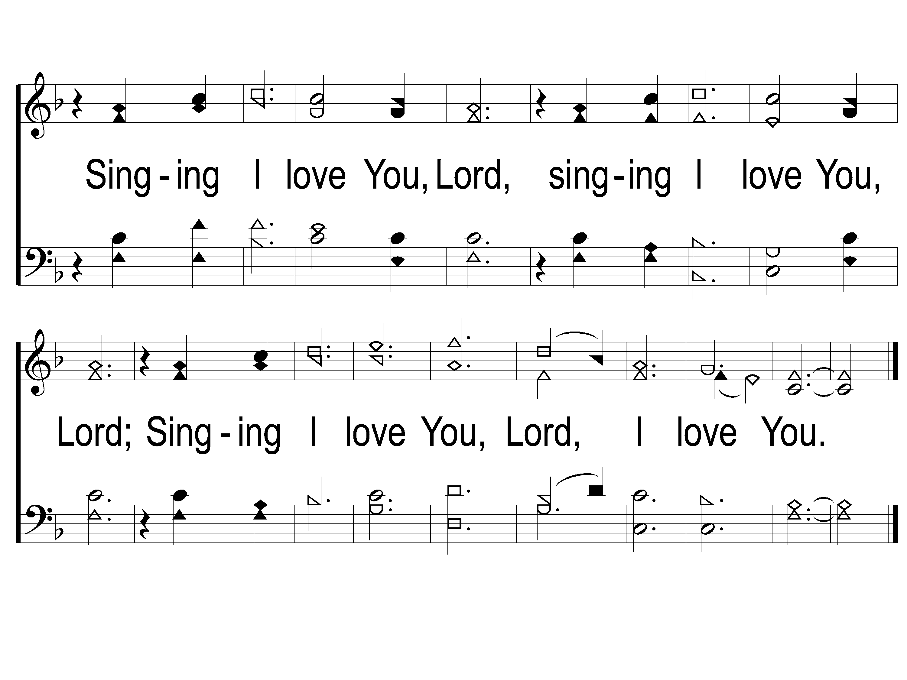
C-2 In Moments Like These
In Moments Like These
239

Slide 32
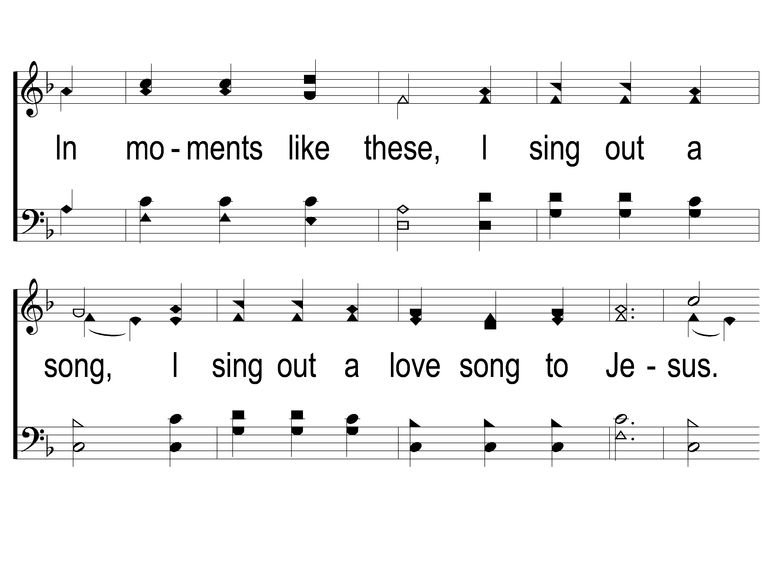
2-1 In Moments Like These
In Moments Like These
239

Slide 33
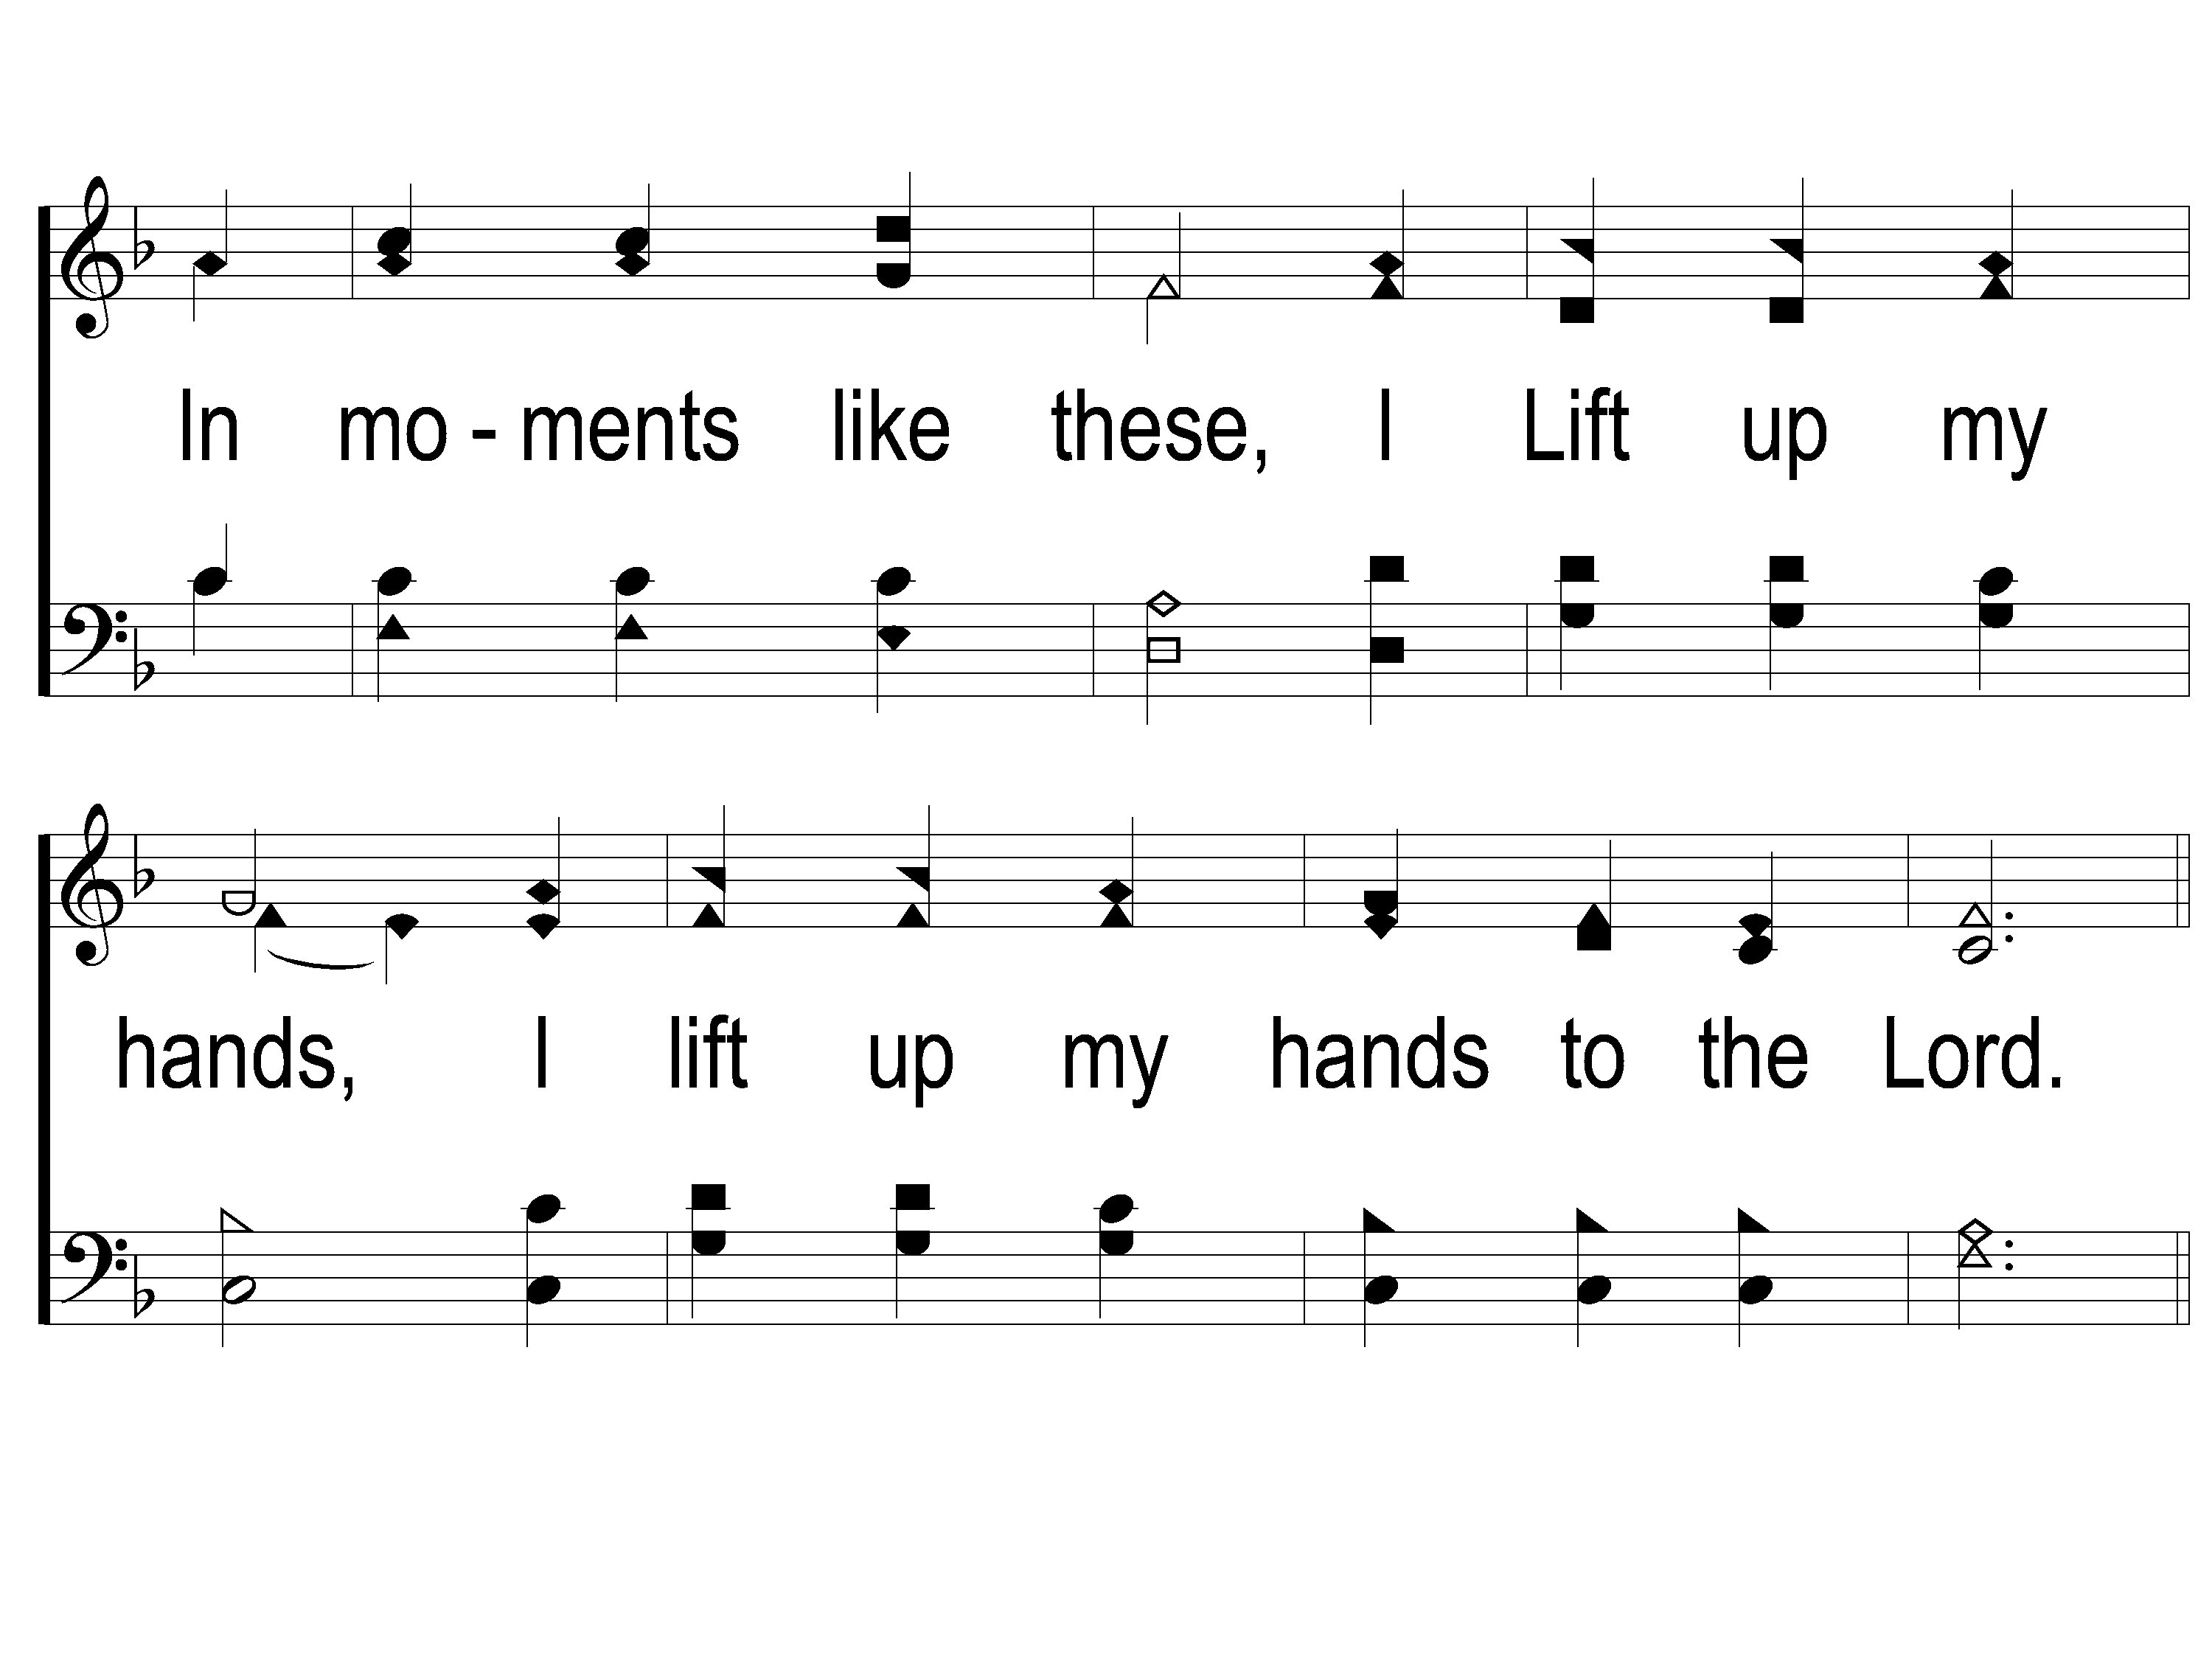
2-2 In Moments Like These
In Moments Like These
239

Slide 34
C-1 In Moments Like These
In Moments Like These
239

Slide 35
C-2 In Moments Like These
In Moments Like These
239

Slide 36
Opening Prayer

Slide 37
Song:
God Will Take Care Of You
#461

Slide 38
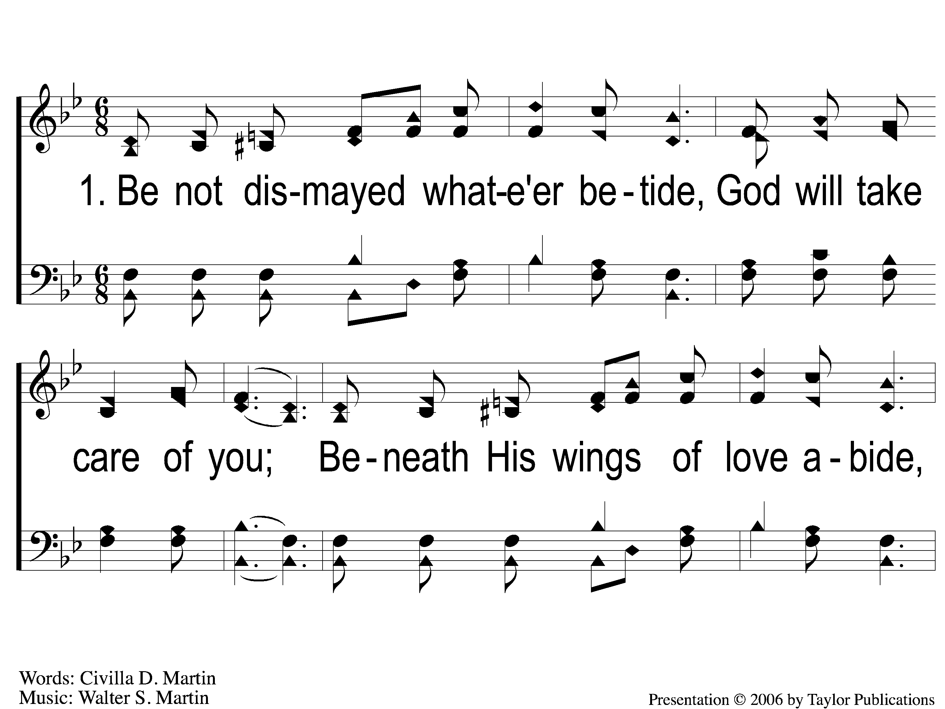
1-1 God Will Take Care Of You
God Will Take Care Of You
461

Slide 39
1-2 God Will Take Care Of You
God Will Take Care Of You
461

Slide 40
C-1 God Will Take Care Of You
God Will Take Care Of You
461

Slide 41
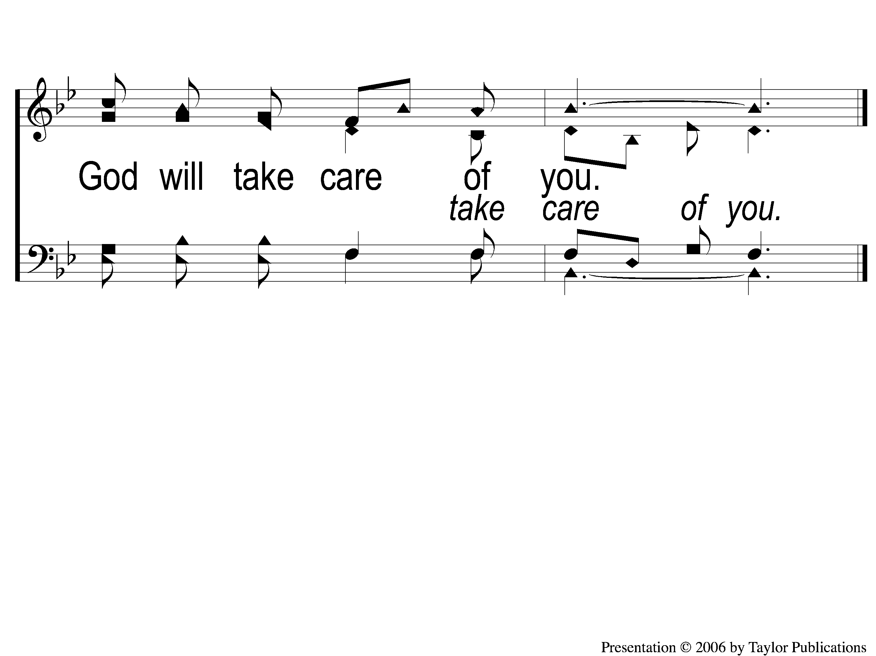
C-2 God Will Take Care Of You
God Will Take Care Of You
461

Slide 42
4-1 God Will Take Care Of You
God Will Take Care Of You
461

Slide 43
4-2 God Will Take Care Of You
God Will Take Care Of You
461

Slide 44
C-1 God Will Take Care Of You
God Will Take Care Of You
461

Slide 45
C-2 God Will Take Care Of You
God Will Take Care Of You
461

Slide 46
Song:
I Must Tell Jesus
#564

Slide 47
1-1 I Must Tell Jesus
I Must Tell Jesus
564

Slide 48
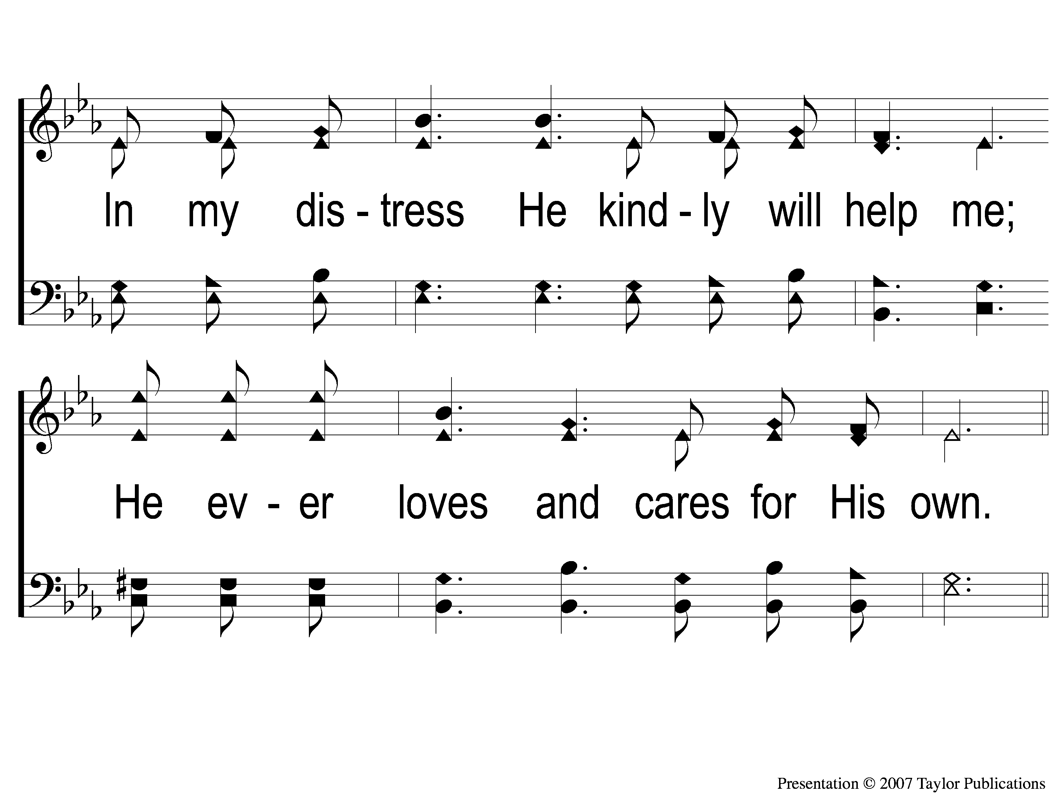
1-2 I Must Tell Jesus
I Must Tell Jesus
564

Slide 49
C-1 I Must Tell Jesus
I Must Tell Jesus
564

Slide 50
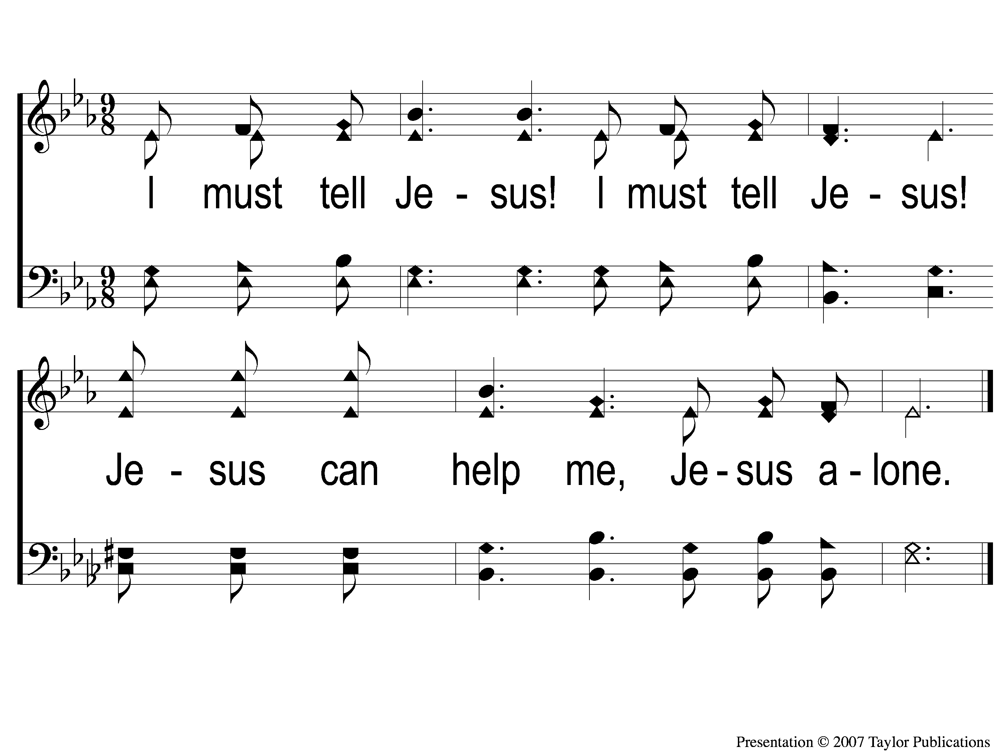
C-2 I Must Tell Jesus
I Must Tell Jesus
564

Slide 51
3-1 I Must Tell Jesus
I Must Tell Jesus
564

Slide 52
3-2 I Must Tell Jesus
I Must Tell Jesus
564

Slide 53
C-1 I Must Tell Jesus
I Must Tell Jesus
564

Slide 54
C-2 I Must Tell Jesus
I Must Tell Jesus
564

Slide 55
Scripture Reading:
Job 1:18-21

Slide 57
Renew My Love For
Spiritual Growth

Slide 58
A Logical Argument
Premise 1: We are called to grow closer to God.
Premise 2: If we stay in our comfort zone, we are not growing closer to God.
Conclusion: We must get out of our comfort zone.

Slide 59
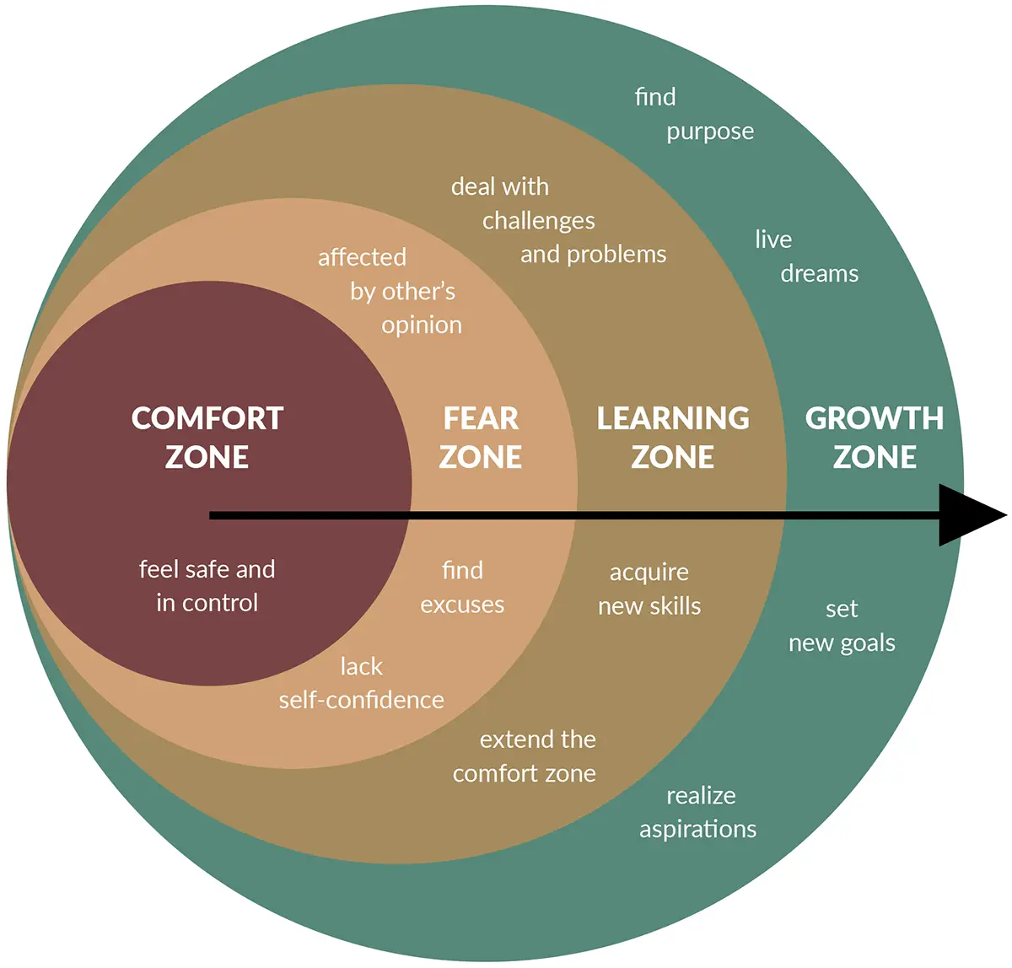
A Logical Argument

Slide 60
6 Things To Stop

Slide 61
6 Things To Stop
Complaining - Phili. 2:14, Jn. 6:41-43

Slide 62
6 Things To Stop
Complaining - Phili. 2:14, Jn. 6:41-43
Assigning Seats – Lk. 4:16, 22:39, Jn. 18:2

Slide 63
6 Things To Stop
Complaining - Phili. 2:14, Jn. 6:41-43
Assigning Seats – Lk. 4:16, 22:39, Jn. 18:2
Leaving Quickly – Acts 20:16

Slide 64
6 Things To Stop
Complaining - Phili. 2:14, Jn. 6:41-43
Assigning Seats – Lk. 4:16, 22:39, Jn. 18:2
Leaving Quickly – Acts 20:16
Neglecting Those Who Need Help – Acts 6:1

Slide 65
6 Things To Stop
Complaining - Phili. 2:14, Jn. 6:41-43
Assigning Seats – Lk. 4:16, 22:39, Jn. 18:2
Leaving Quickly – Acts 20:16
Neglecting Those Who Need Help – Acts 6:1
Inactivity – Prov. 19:15, Matt. 20:1ff, Isa. 6:8, Eccl. 9:10

Slide 66
6 Things To Stop
Complaining - Phili. 2:14, Jn. 6:41-43
Assigning Seats – Lk. 4:16, 22:39, Jn. 18:2
Leaving Quickly – Acts 20:16
Neglecting Those Who Need Help – Acts 6:1
Inactivity – Prov. 19:15, Matt. 20:1ff, Isa. 6:8, Eccl. 9:10
Making Excuses – Job 1:20 Lk. 9:59-60

Slide 67
6 Things To Start

Slide 68
6 Things To Start
Prepare – Eph. 4:1, Col. 1:10, Psalms 120-134

Slide 69
6 Things To Start
Prepare – Eph. 4:1, Col. 1:10, Psalms 120-134
Serve – Acts 6:3, Matt. 10:1ff

Slide 70
6 Things To Start
Prepare – Eph. 4:1, Col. 1:10, Psalms 120-134
Serve – Acts 6:3, Matt. 10:1ff
Sing – Eph. 5:19, Neh. 12:43

Slide 71
6 Things To Start
Prepare – Eph. 4:1, Col. 1:10, Psalms 120-134
Serve – Acts 6:3, Matt. 10:1ff
Sing – Eph. 5:19, Neh. 12:43
Listen – 2 Cor. 3:18, Gal. 2:20, Lk. 19:48, Neh. 8:3

Slide 72
6 Things To Start
Prepare – Eph. 4:1, Col. 1:10, Psalms 120-134
Serve – Acts 6:3, Matt. 10:1ff
Sing – Eph. 5:19, Neh. 12:43
Listen – 2 Cor. 3:18, Gal. 2:20, Lk. 19:48, Neh. 8:3
Remember – 1 Cor. 11:23-29

Slide 73
6 Things To Start
Prepare – Eph. 4:1, Col. 1:10, Psalms 120-134
Serve – Acts 6:3, Matt. 10:1ff
Sing – Eph. 5:19, Neh. 12:43
Listen – 2 Cor. 3:18, Gal. 2:20, Lk. 19:48, Neh. 8:3
Remember – 1 Cor. 11:23-29
Give – Acts 4:36-37

Slide 74
Are you Growing?

Slide 75
A Hill Called Mount Calvary
#373
Invitation
Song:

Slide 76
1-1 A Hill Called Mount Calvary
A Hill Called Mount Calvary
373

Slide 77
1-2 A Hill Called Mount Calvary
A Hill Called Mount Calvary
373

Slide 78
C-1 A Hill Called Mount Calvary
A Hill Called Mount Calvary
373

Slide 79
C-2 A Hill Called Mount Calvary
A Hill Called Mount Calvary
373

Slide 80
2-1 A Hill Called Mount Calvary
A Hill Called Mount Calvary
373

Slide 81
2-2 A Hill Called Mount Calvary
A Hill Called Mount Calvary
373

Slide 82
C-1 A Hill Called Mount Calvary
A Hill Called Mount Calvary
373

Slide 83
C-2 A Hill Called Mount Calvary
A Hill Called Mount Calvary
373

Slide 84
3-1 A Hill Called Mount Calvary
A Hill Called Mount Calvary
373

Slide 85
3-2 A Hill Called Mount Calvary
A Hill Called Mount Calvary
373

Slide 86
C-1 A Hill Called Mount Calvary
A Hill Called Mount Calvary
373

Slide 87
C-2 A Hill Called Mount Calvary
A Hill Called Mount Calvary
373

Slide 88
Our Contribution:
Hebrews 13:15-16
“Therefore by Him let us continually offer the sacrifice of praise to God, that is, the fruit of our lips, giving thanks to His name. But do not forget to do good and to share, for with such sacrifices God is well pleased.”

Slide 89
Song:
The Old Rugged Cross
#313

Slide 90
s
The Old Rugged Cross
313

Slide 91
1-2 The Old Rugged Cross
The Old Rugged Cross
313

Slide 92
C-1 The Old Rugged Cross
The Old Rugged Cross
313

Slide 93
C-2 The Old Rugged Cross
The Old Rugged Cross
313

Slide 94
2-1 The Old Rugged Cross
The Old Rugged Cross
313

Slide 95
2-2 The Old Rugged Cross
The Old Rugged Cross
313

Slide 96
C-1 The Old Rugged Cross
The Old Rugged Cross
313

Slide 97
C-2 The Old Rugged Cross
The Old Rugged Cross
313

Slide 98
4-1 The Old Rugged Cross
The Old Rugged Cross
313

Slide 99
4-2 The Old Rugged Cross
The Old Rugged Cross
313

Slide 100
C-1 The Old Rugged Cross
The Old Rugged Cross
313

Slide 101
C-2 The Old Rugged Cross
The Old Rugged Cross
313

Slide 102
The Unleavened Bread
Hebrews 4:14-16
“Seeing then that we have a great High Priest who has passed through the heavens, Jesus the Son of God, olet us hold fast our confession. For we do not have a High Priest who cannot sympathize with our weaknesses, but was in all points tempted as we are, yet without sin. Let us therefore come boldly to the throne of grace, that we may obtain mercy and find grace to help in time of need.”

Slide 103
The Fruit
of the Vine
Hebrews 9:11-14
“But Christ came as High Priest of the good things to come, with the greater and more perfect tabernacle not made with hands, that is, not of this creation. Not with the blood of goats and calves, but with His own blood…For if the blood of bulls and goats and the ashes of a heifer, sprinkling the unclean, sanctifies for the purifying of the flesh, how much more shall the blood of Christ, who through the eternal Spirit offered Himself without spot to God, cleanse your conscience from dead works to serve the living God?”

Slide 104
Closing Prayer

Slide 105
Song:
Farther Along
#753

Slide 106
1-1 Farther Along
Farther Along
753

Slide 107
1-2 Farther Along
Farther Along
753

Slide 108
C-1 Farther Along
Farther Along
753

Slide 109
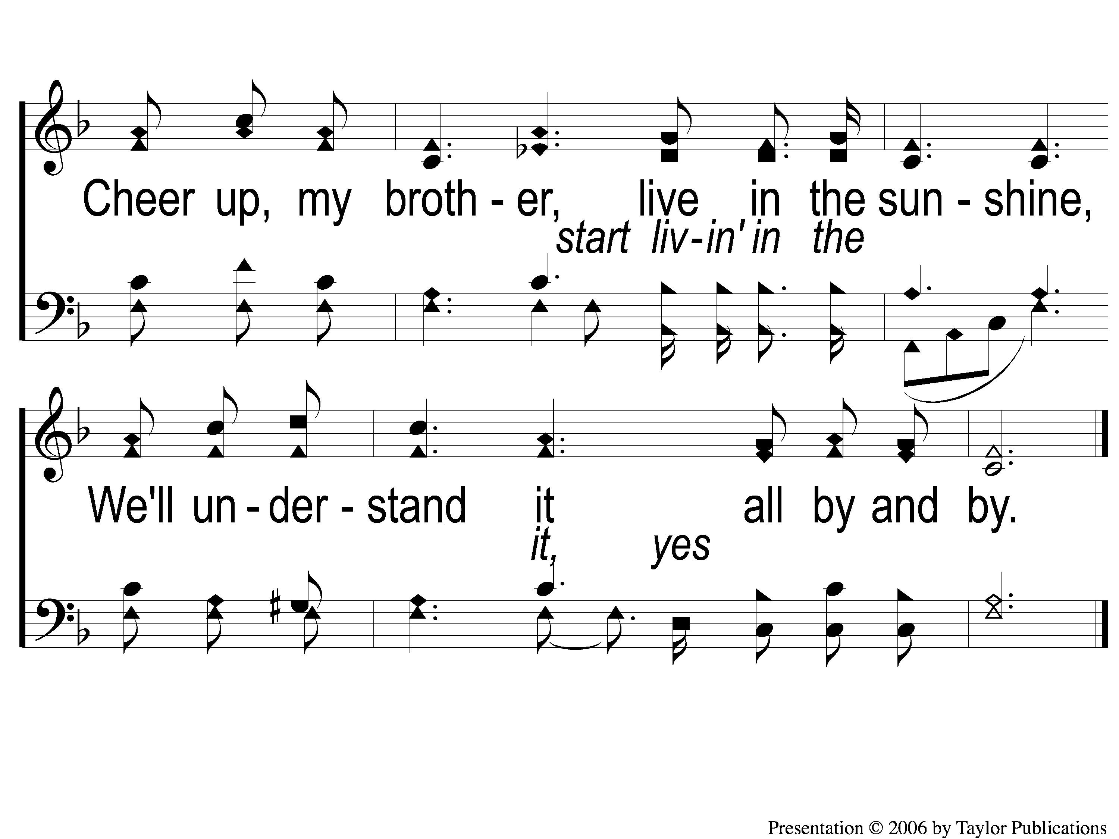
C-2 Farther Along
Farther Along
753

Slide 110
3-1 Farther Along
Farther Along
753

Slide 111
3-2 Farther Along
Farther Along
753

Slide 112
C-1 Farther Along
Farther Along
753

Slide 113
C-2 Farther Along
Farther Along
753

Slide 114
today
LTC @ 4:30 PM
Worship @ 6:00 PM
with Bret McCasland
RESTORE REBUILD RENEW
IN 2022
WHEELER
CHURCH
OF
CHRIST

