Slide 1
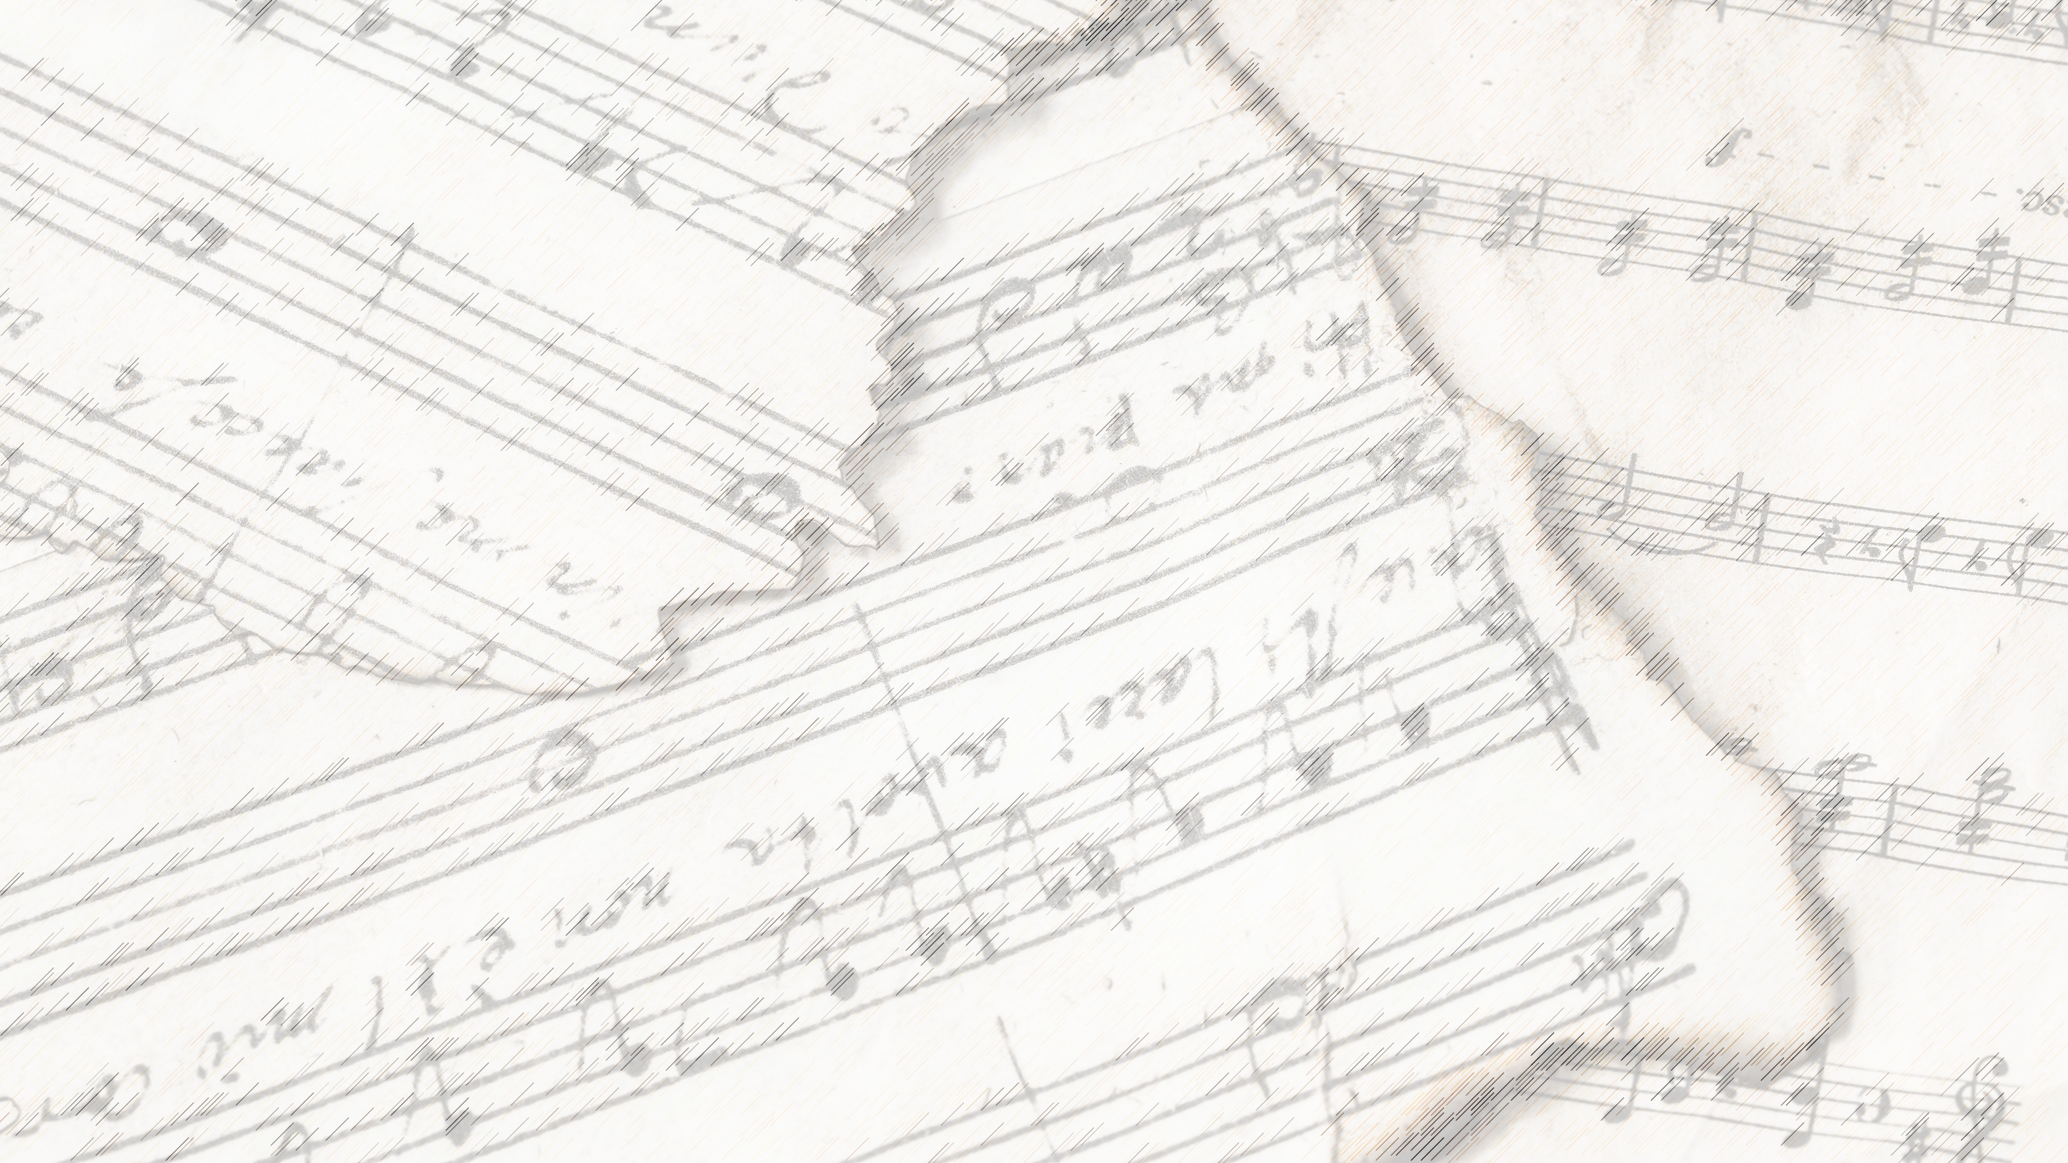
Welcome!
We Are Glad You Are Here

Slide 2
Faithful Love
#18

Slide 3
1-1 Faithful Love
Faithful Love
18

Slide 4
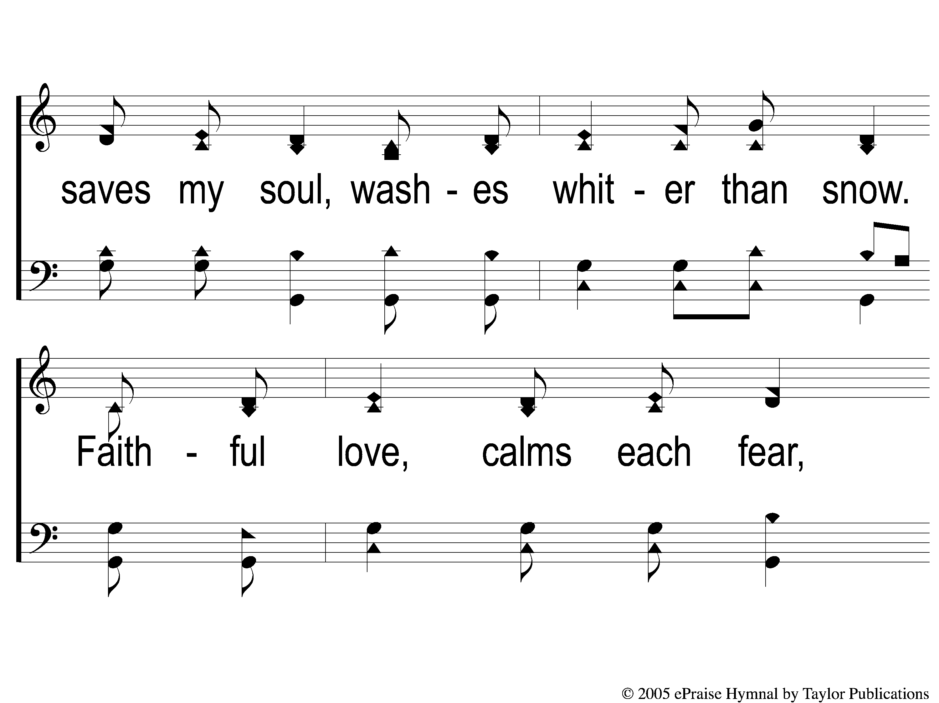
1-2 Faithful Love
Faithful Love
18

Slide 5
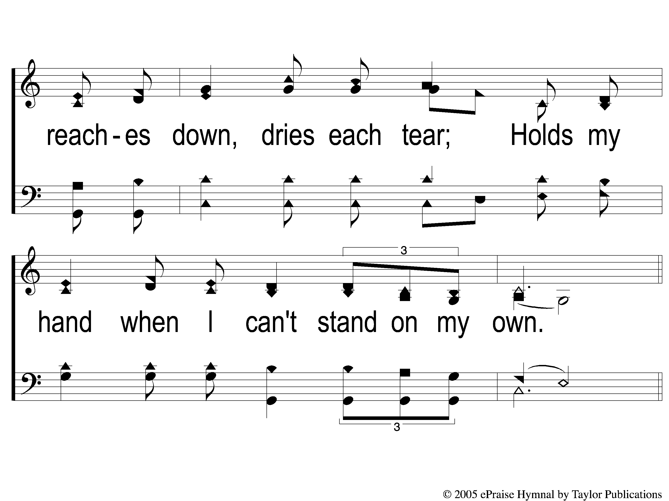
1-3 Faithful Love
Faithful Love
18

Slide 6
C-1 Faithful Love
Faithful Love
18

Slide 7
C-2 Faithful Love
Faithful Love
18

Slide 8
2-1 Faithful Love
Faithful Love
18

Slide 9
2-2 Faithful Love
Faithful Love
18

Slide 10
2-3 Faithful Love
Faithful Love
18

Slide 11
C-1 Faithful Love
Faithful Love
18

Slide 12
C-2 Faithful Love
Faithful Love
18

Slide 13
Sweet Hour Of Prayer
#827

Slide 14
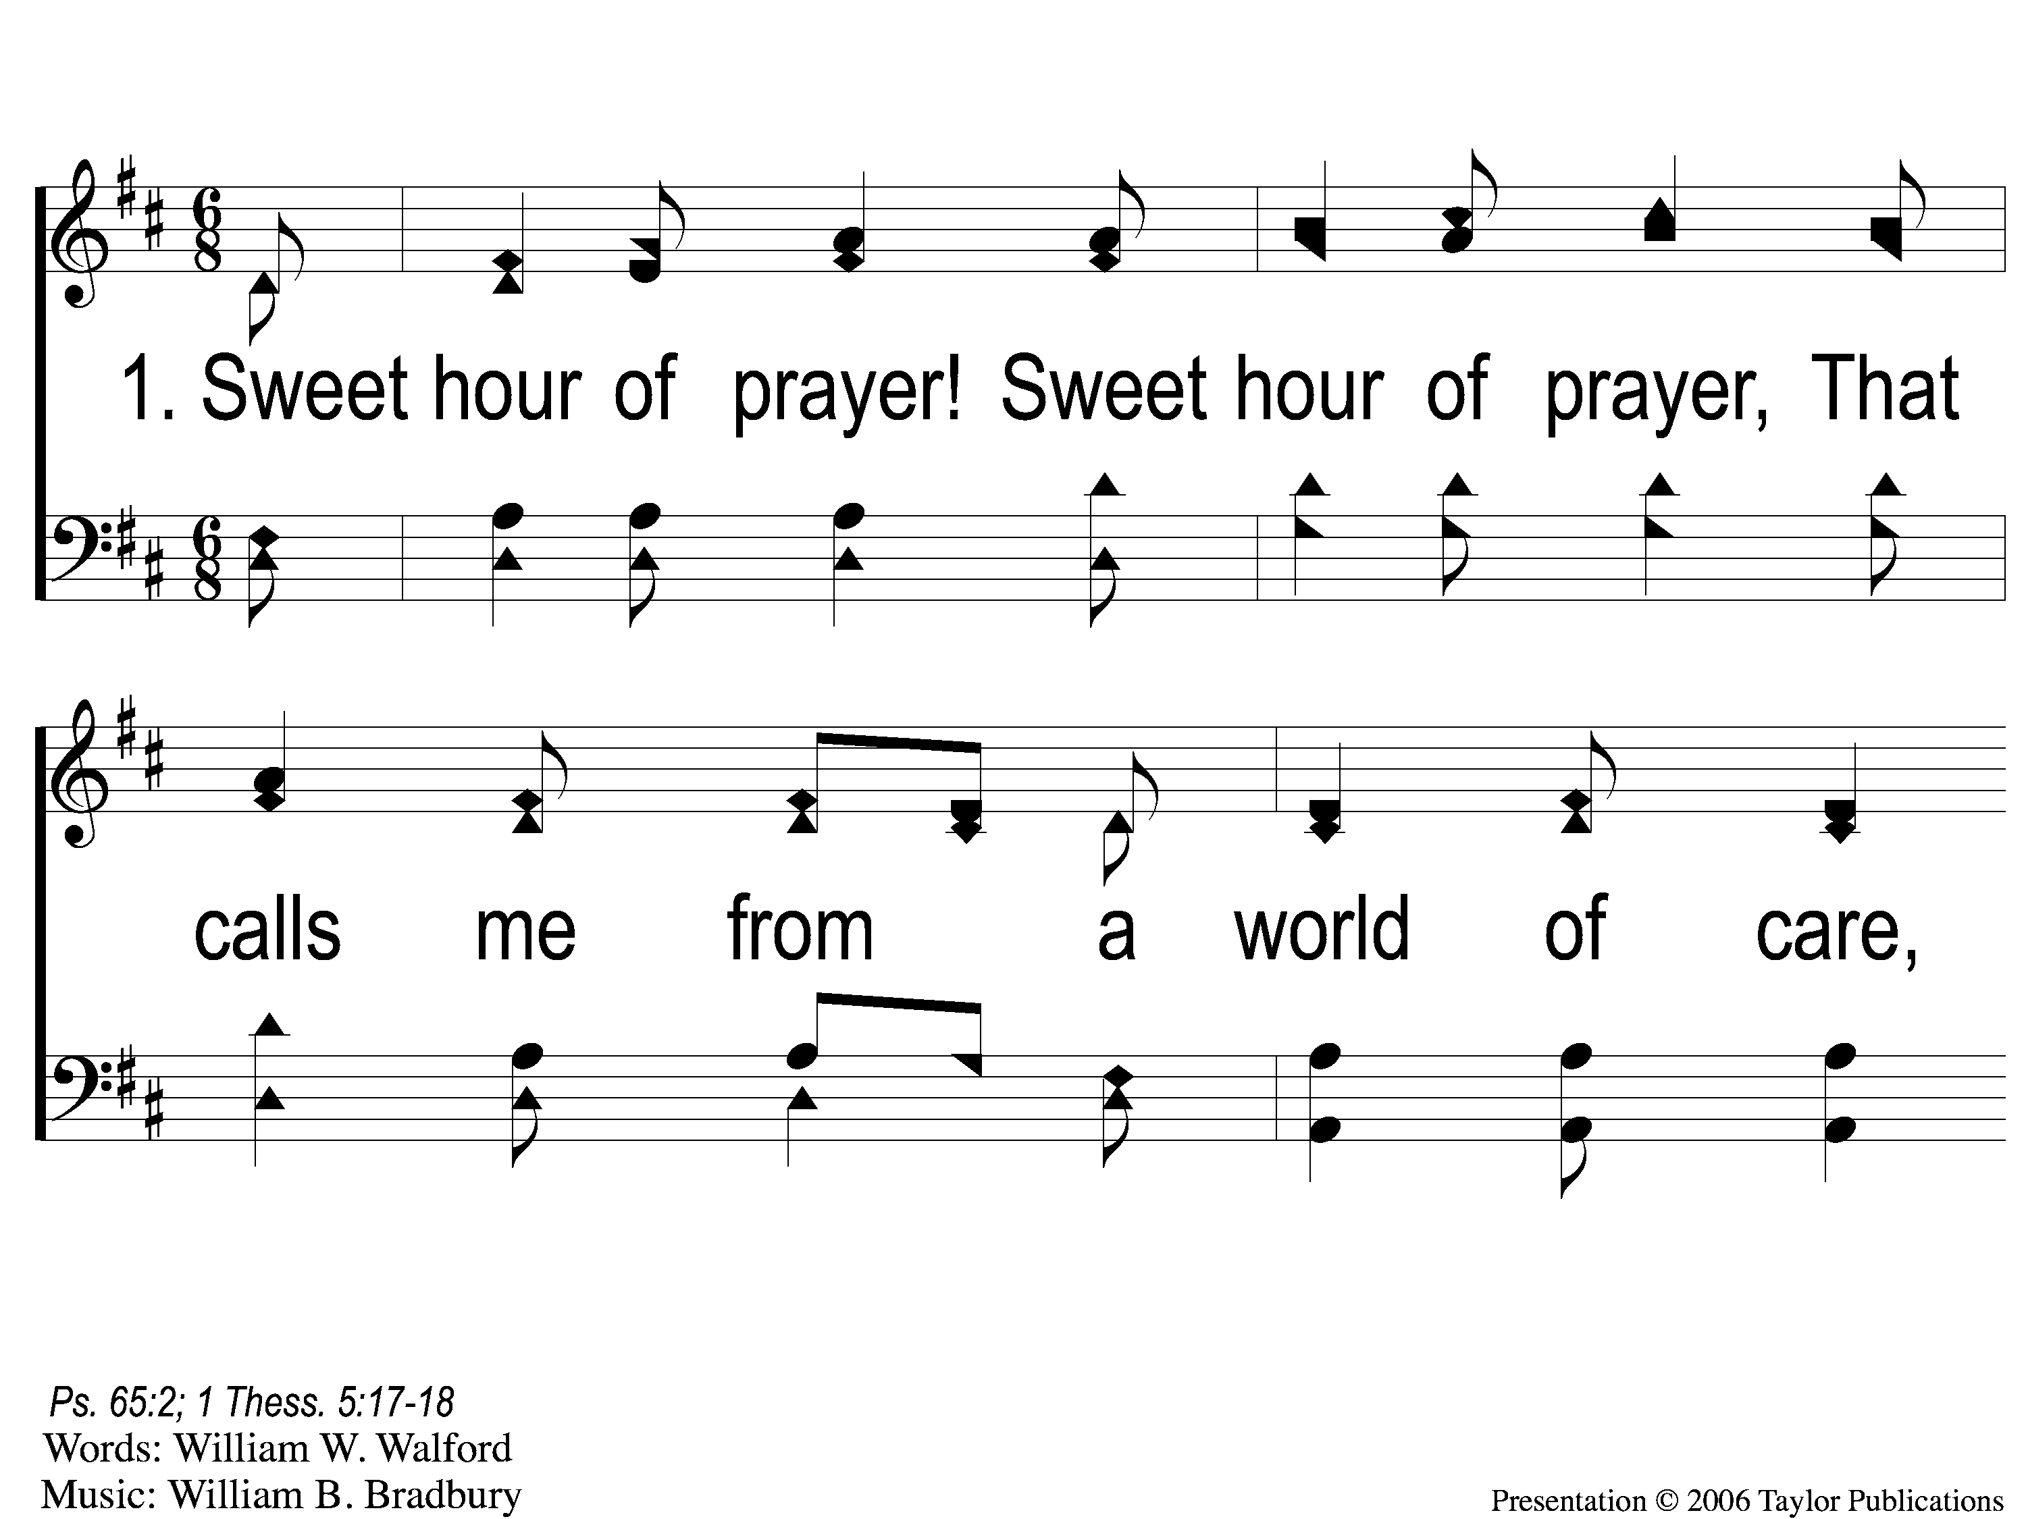
1-1 Sweet Hour of Prayer
Sweet Hour of Prayer
827

Slide 15
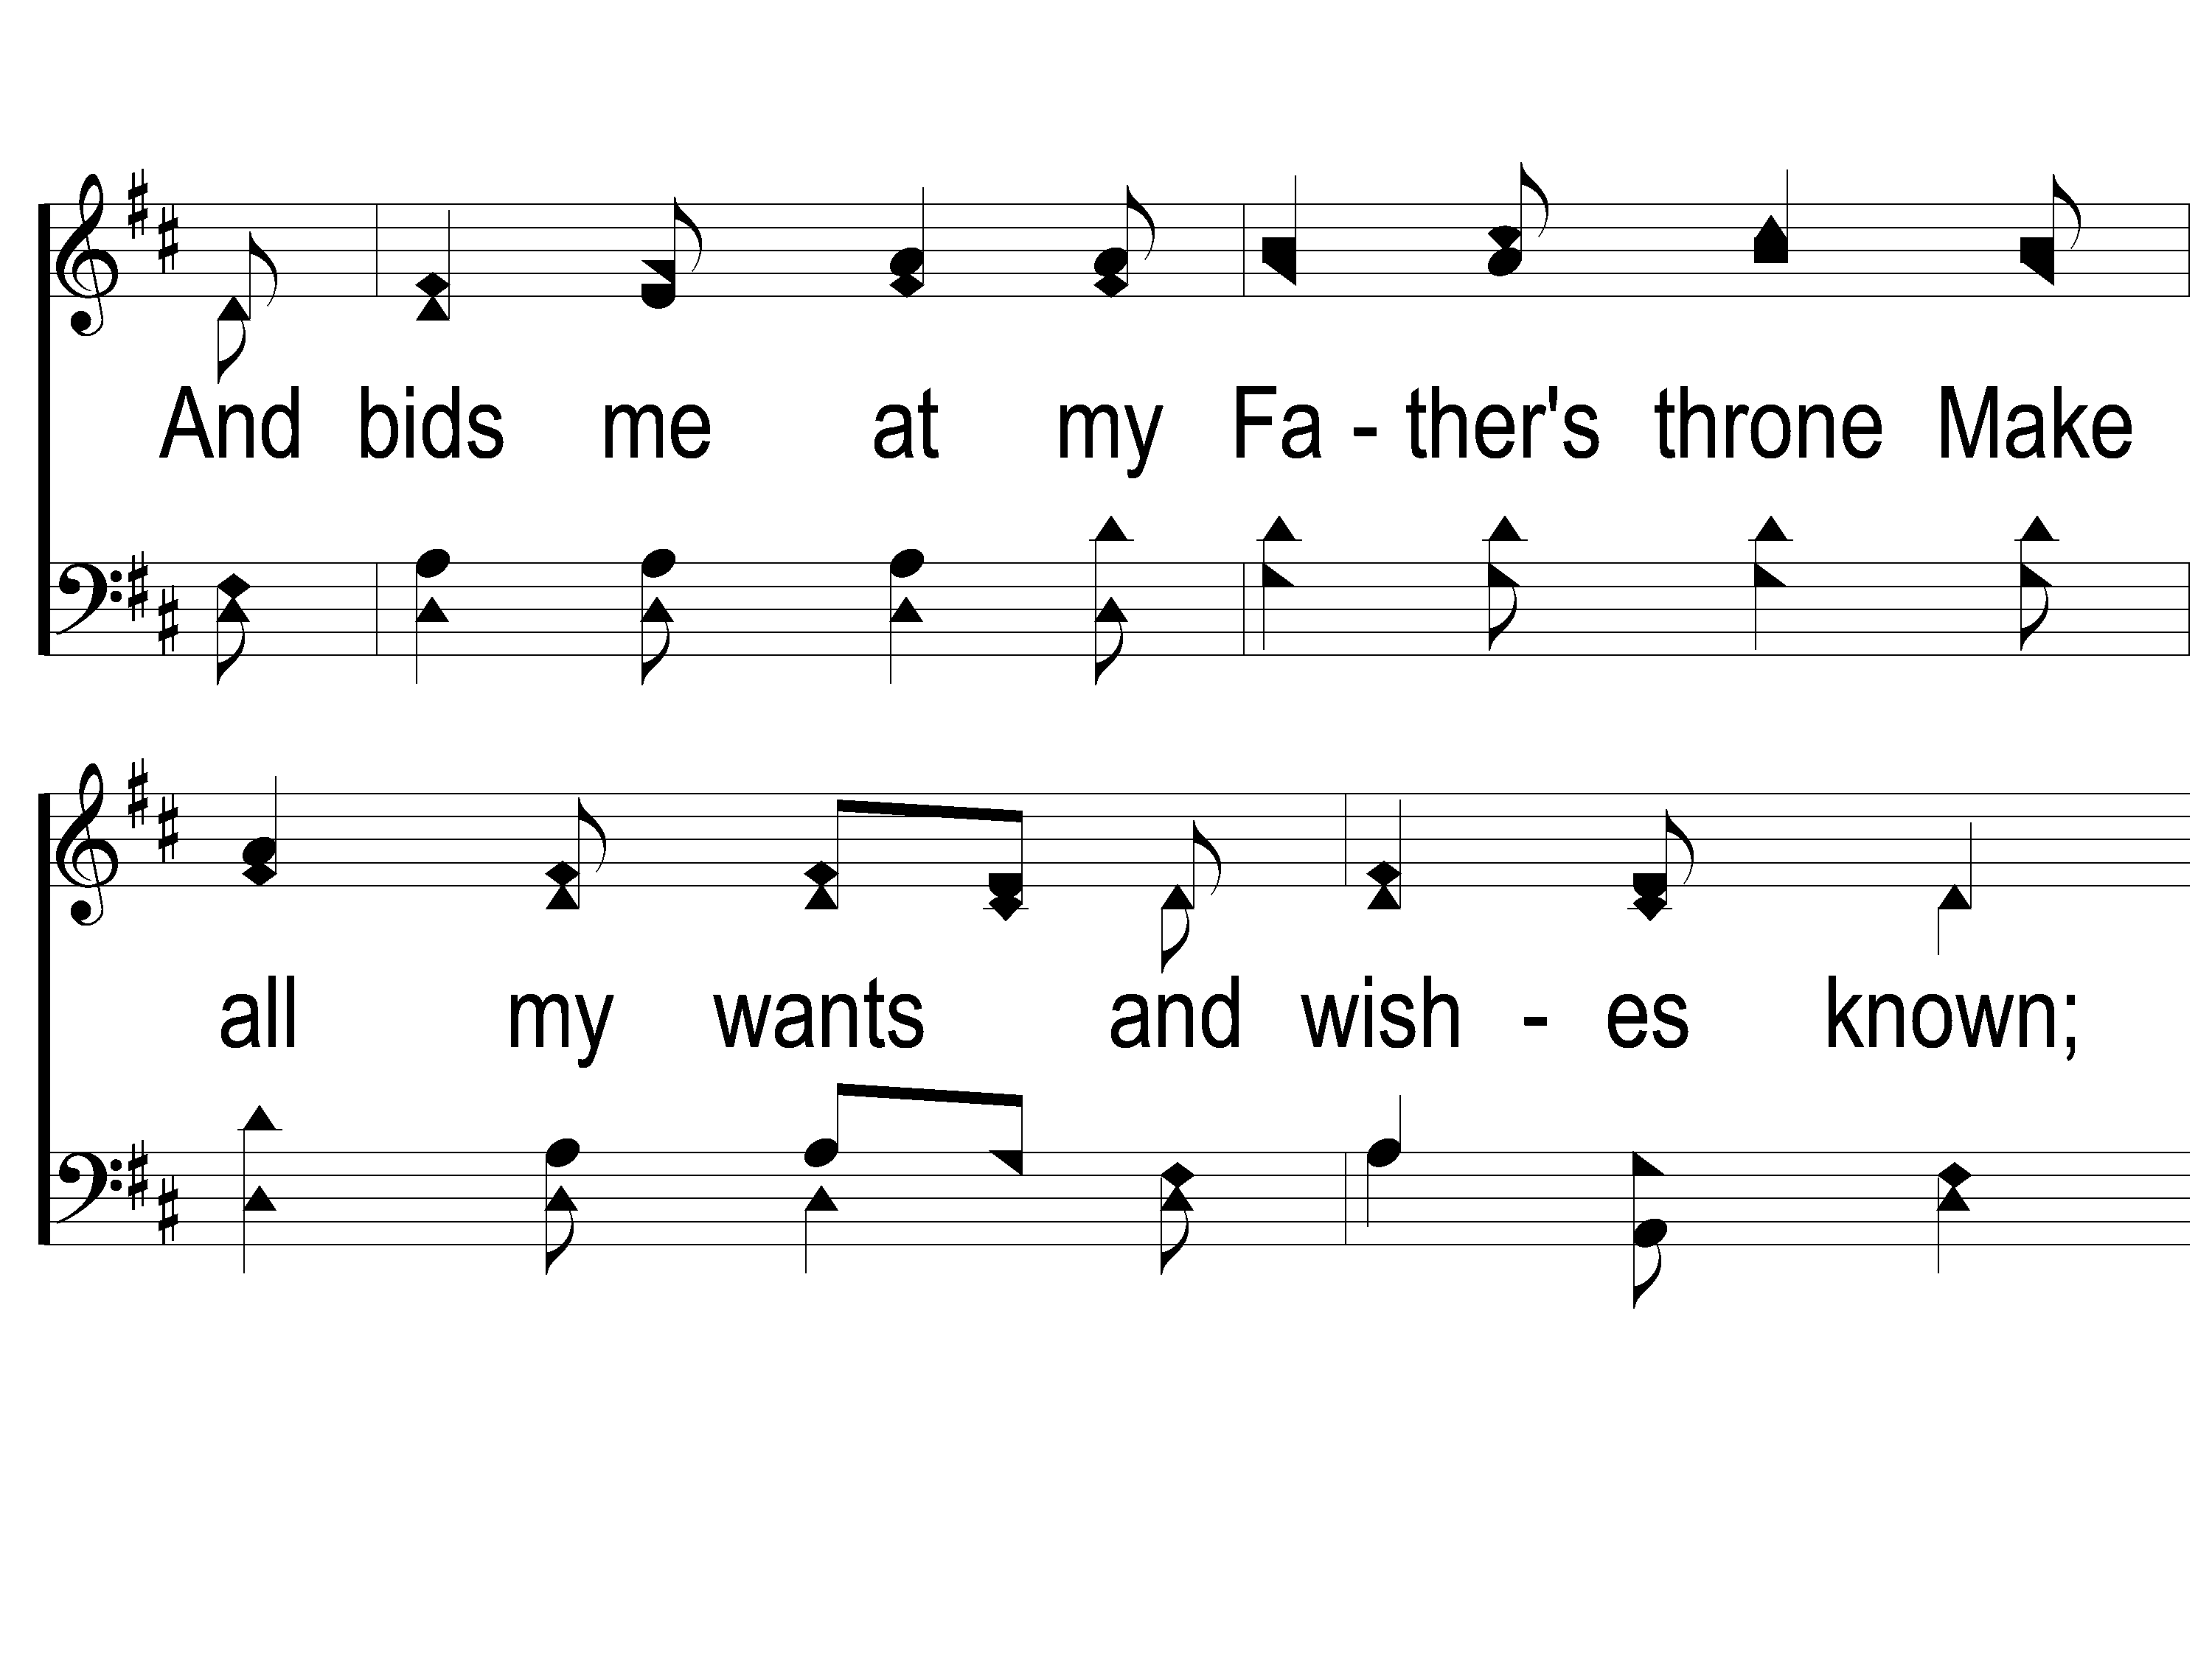
1-2 Sweet Hour of Prayer
Sweet Hour of Prayer
827

Slide 16
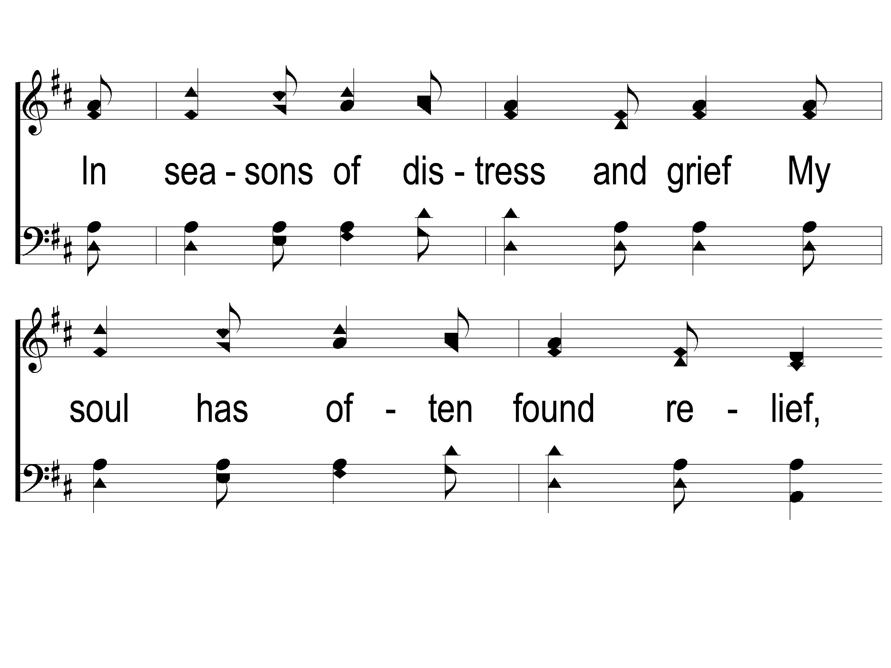
1-3 Sweet Hour of Prayer
Sweet Hour of Prayer
827

Slide 17
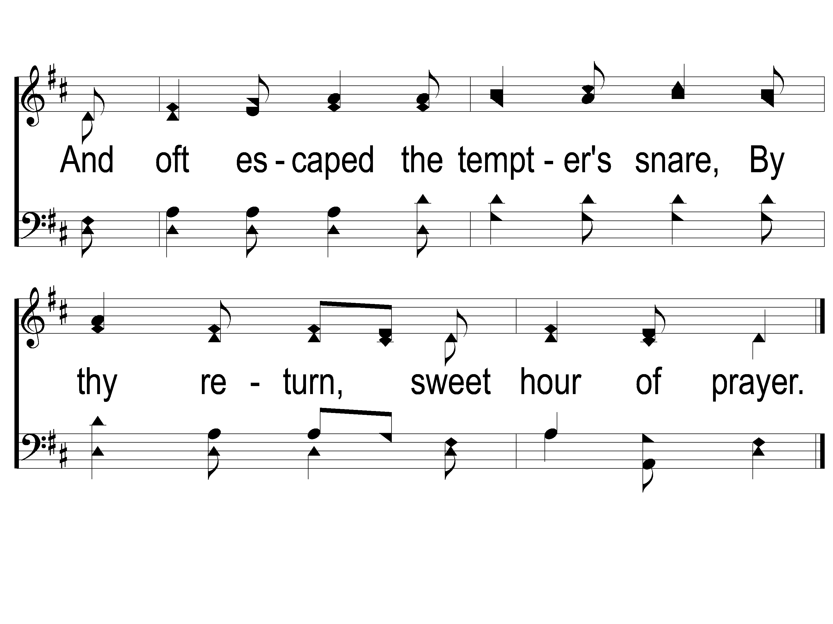
1-4 Sweet Hour of Prayer
Sweet Hour of Prayer
827

Slide 18
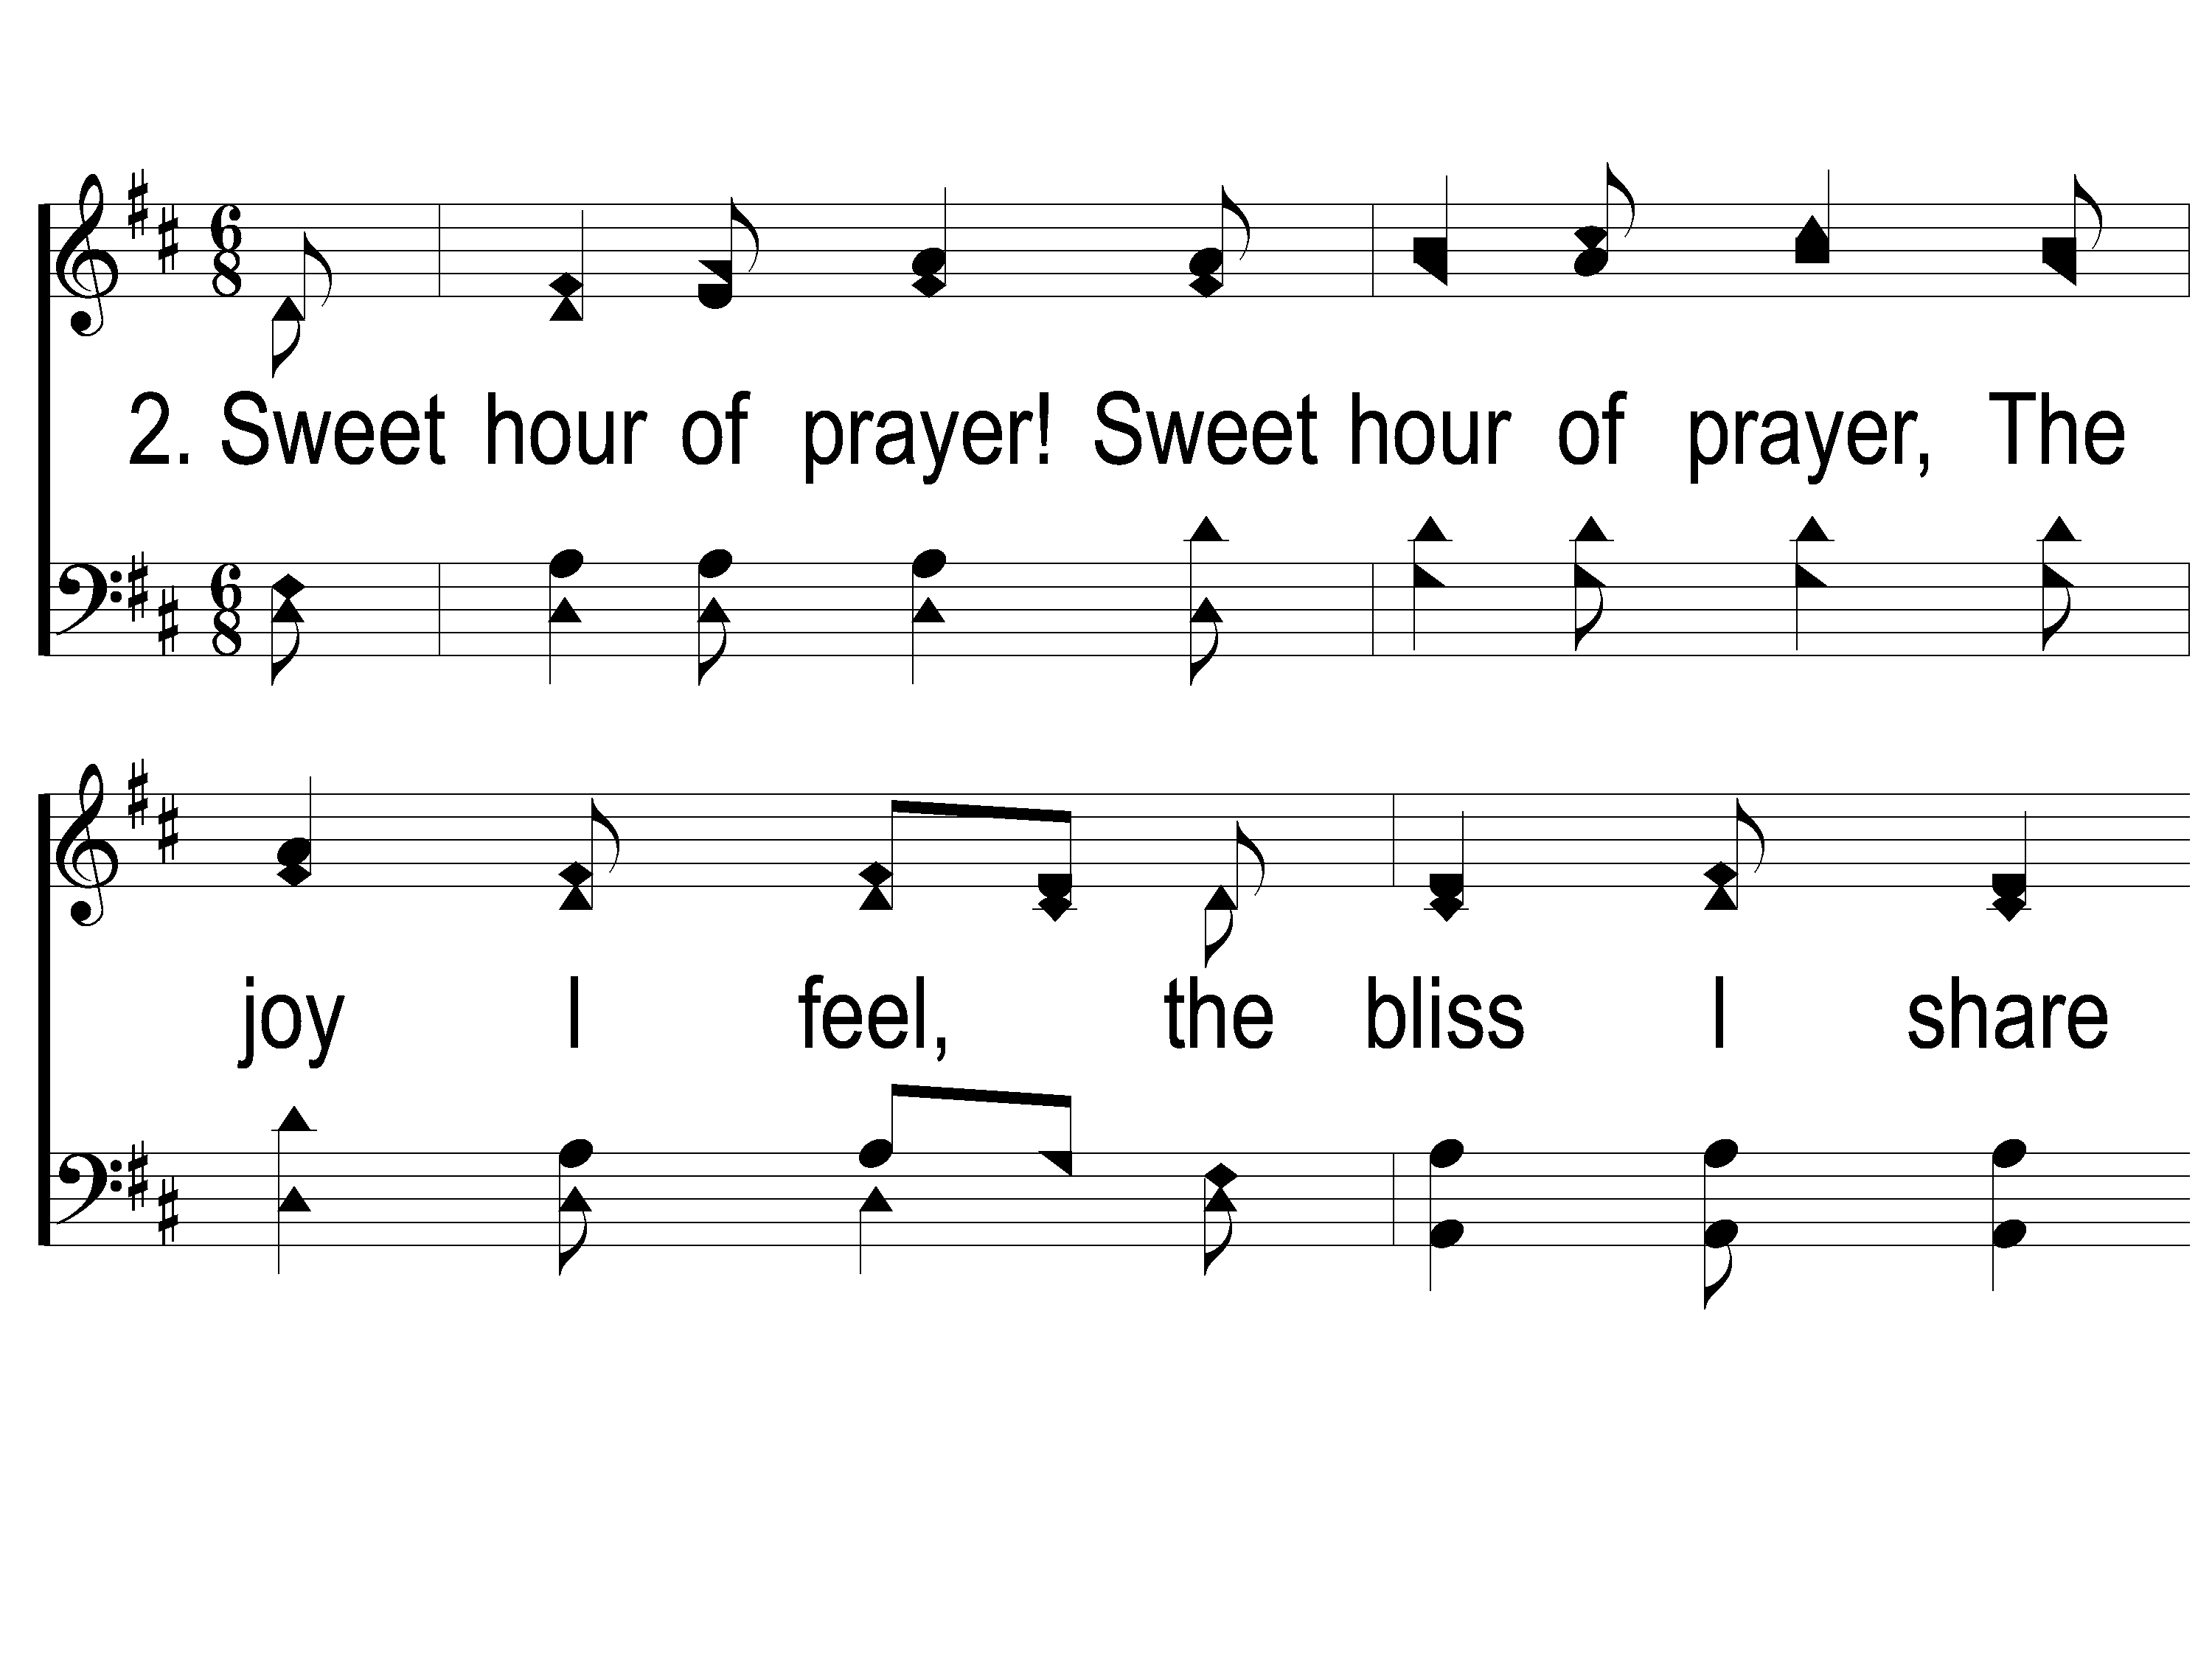
2-1 Sweet Hour of Prayer
Sweet Hour of Prayer
827

Slide 19
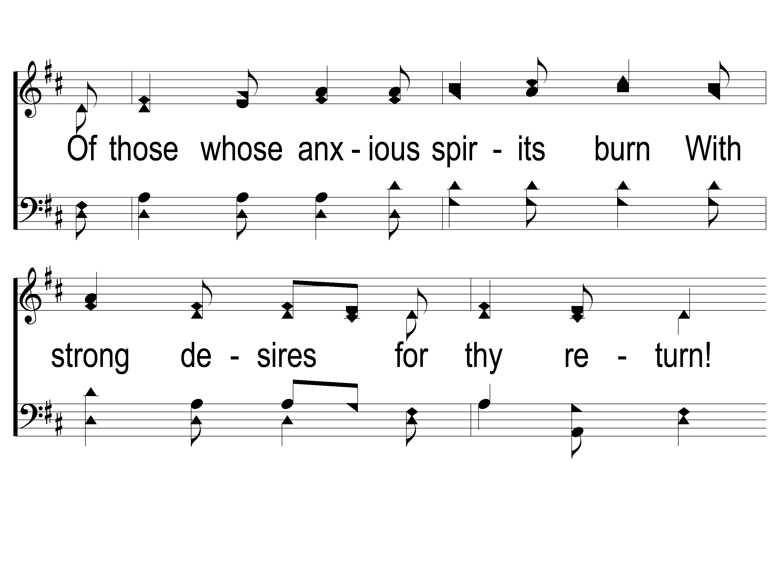
2-2 Sweet Hour of Prayer
Sweet Hour of Prayer
827

Slide 20
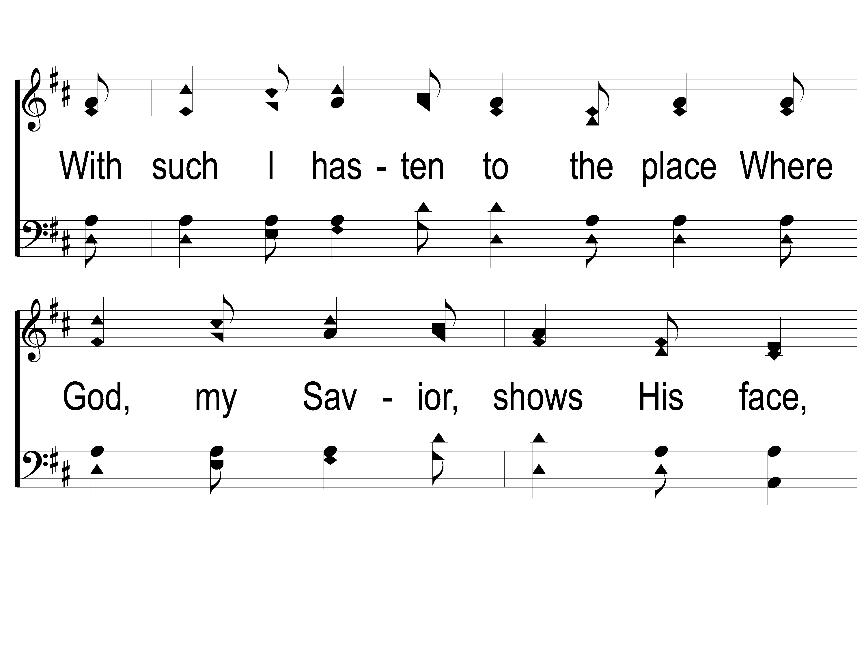
2-3 Sweet Hour of Prayer
Sweet Hour of Prayer
827

Slide 21
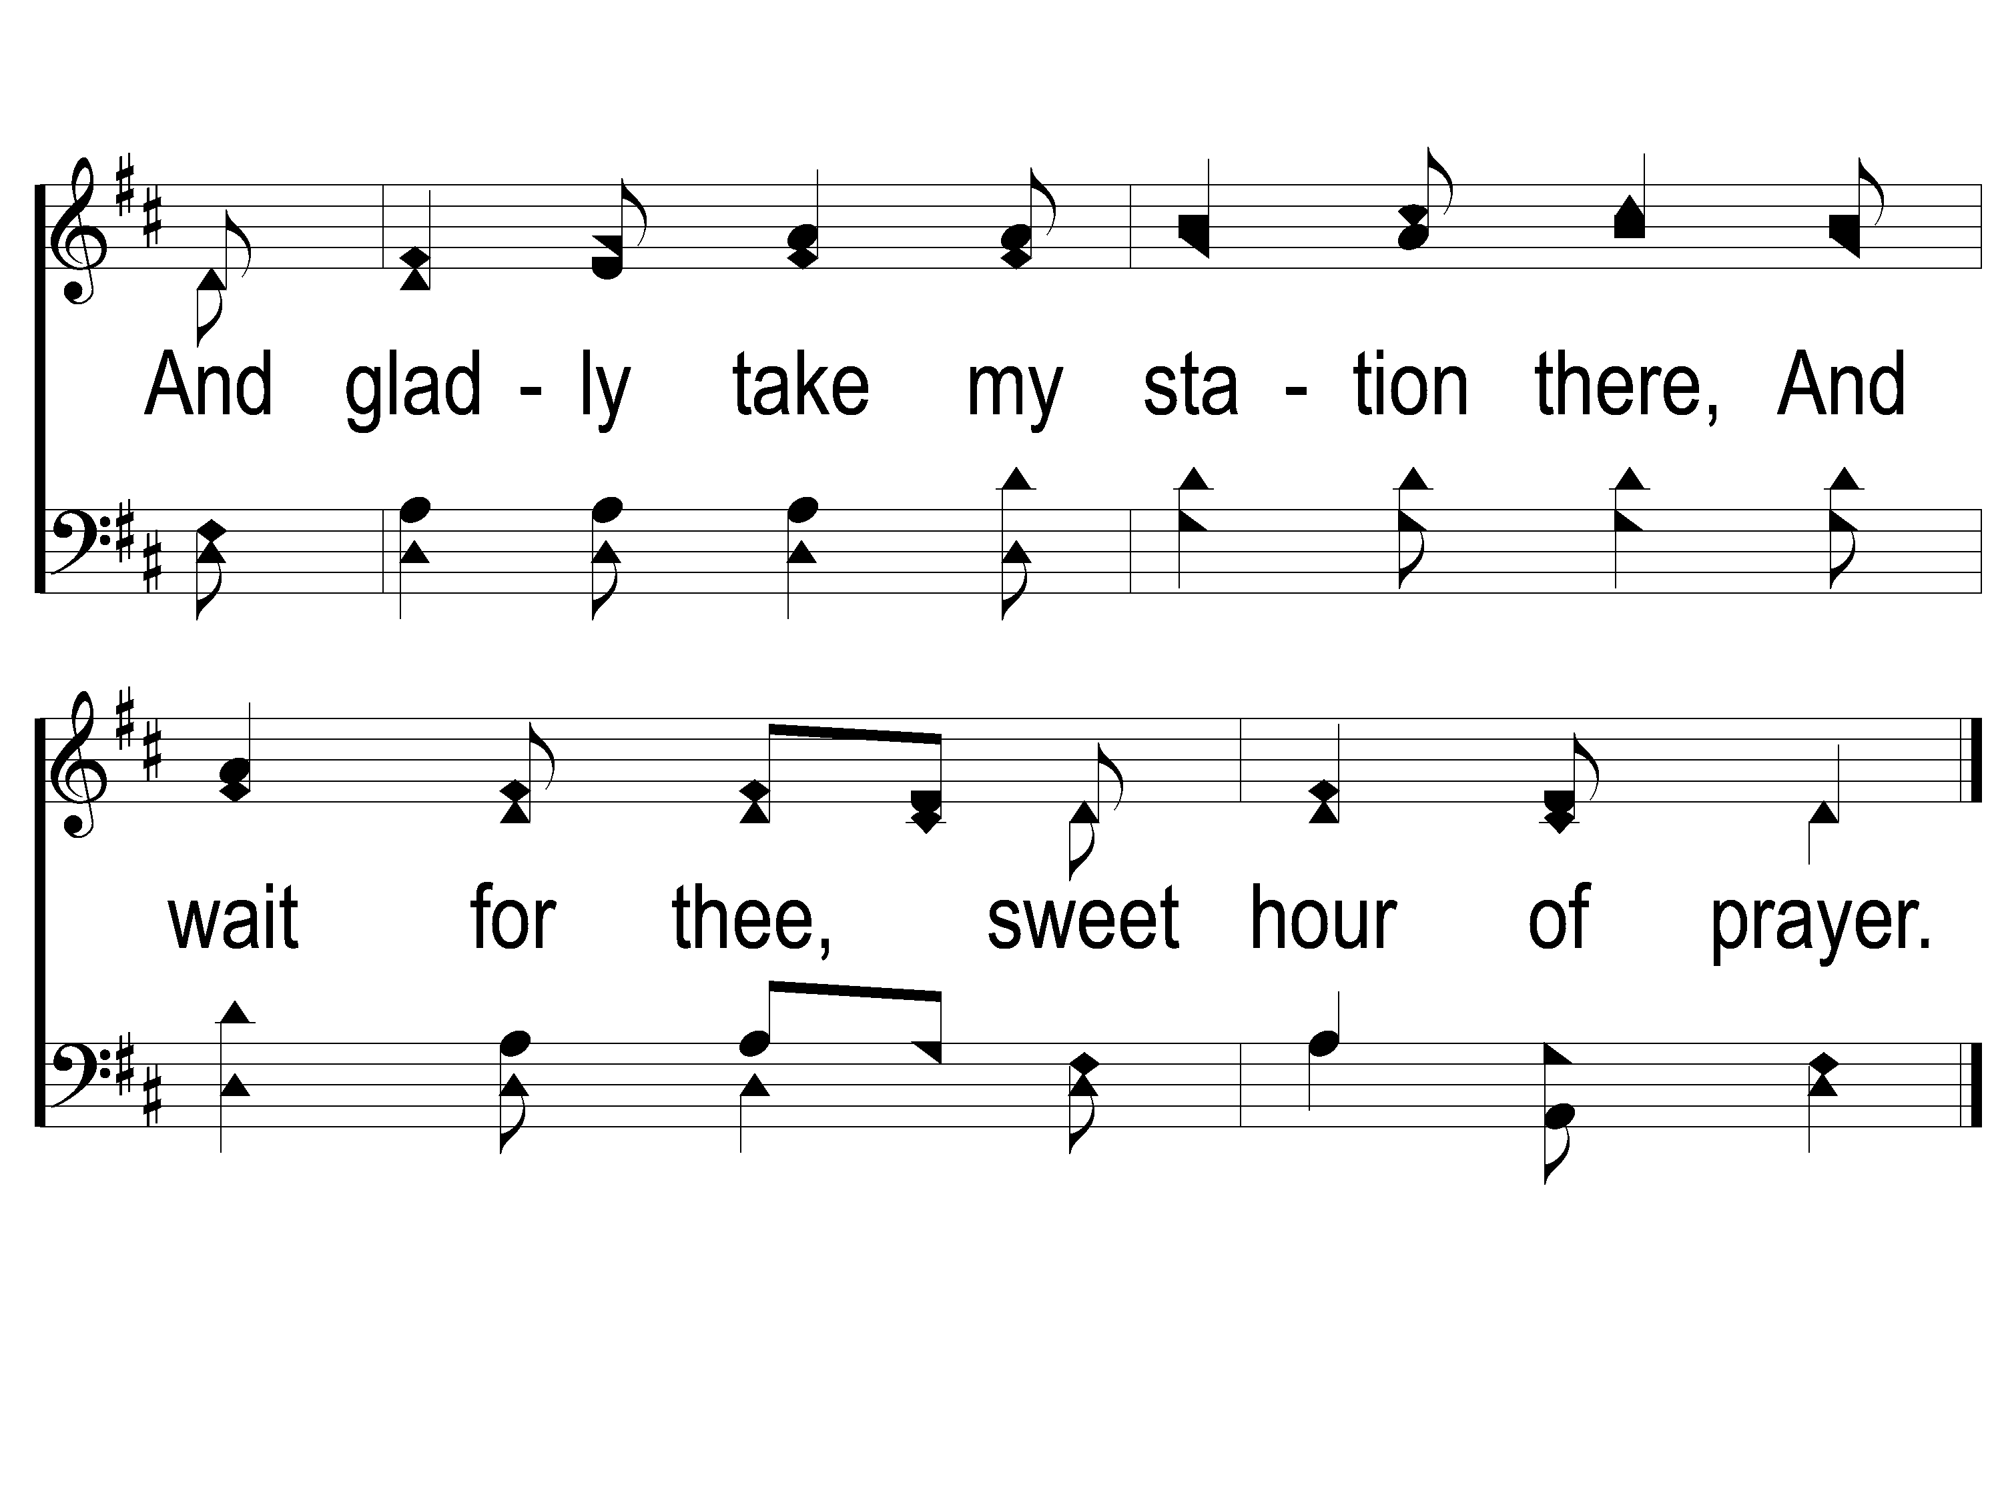
2-4 Sweet Hour of Prayer
Sweet Hour of Prayer
827

Slide 22
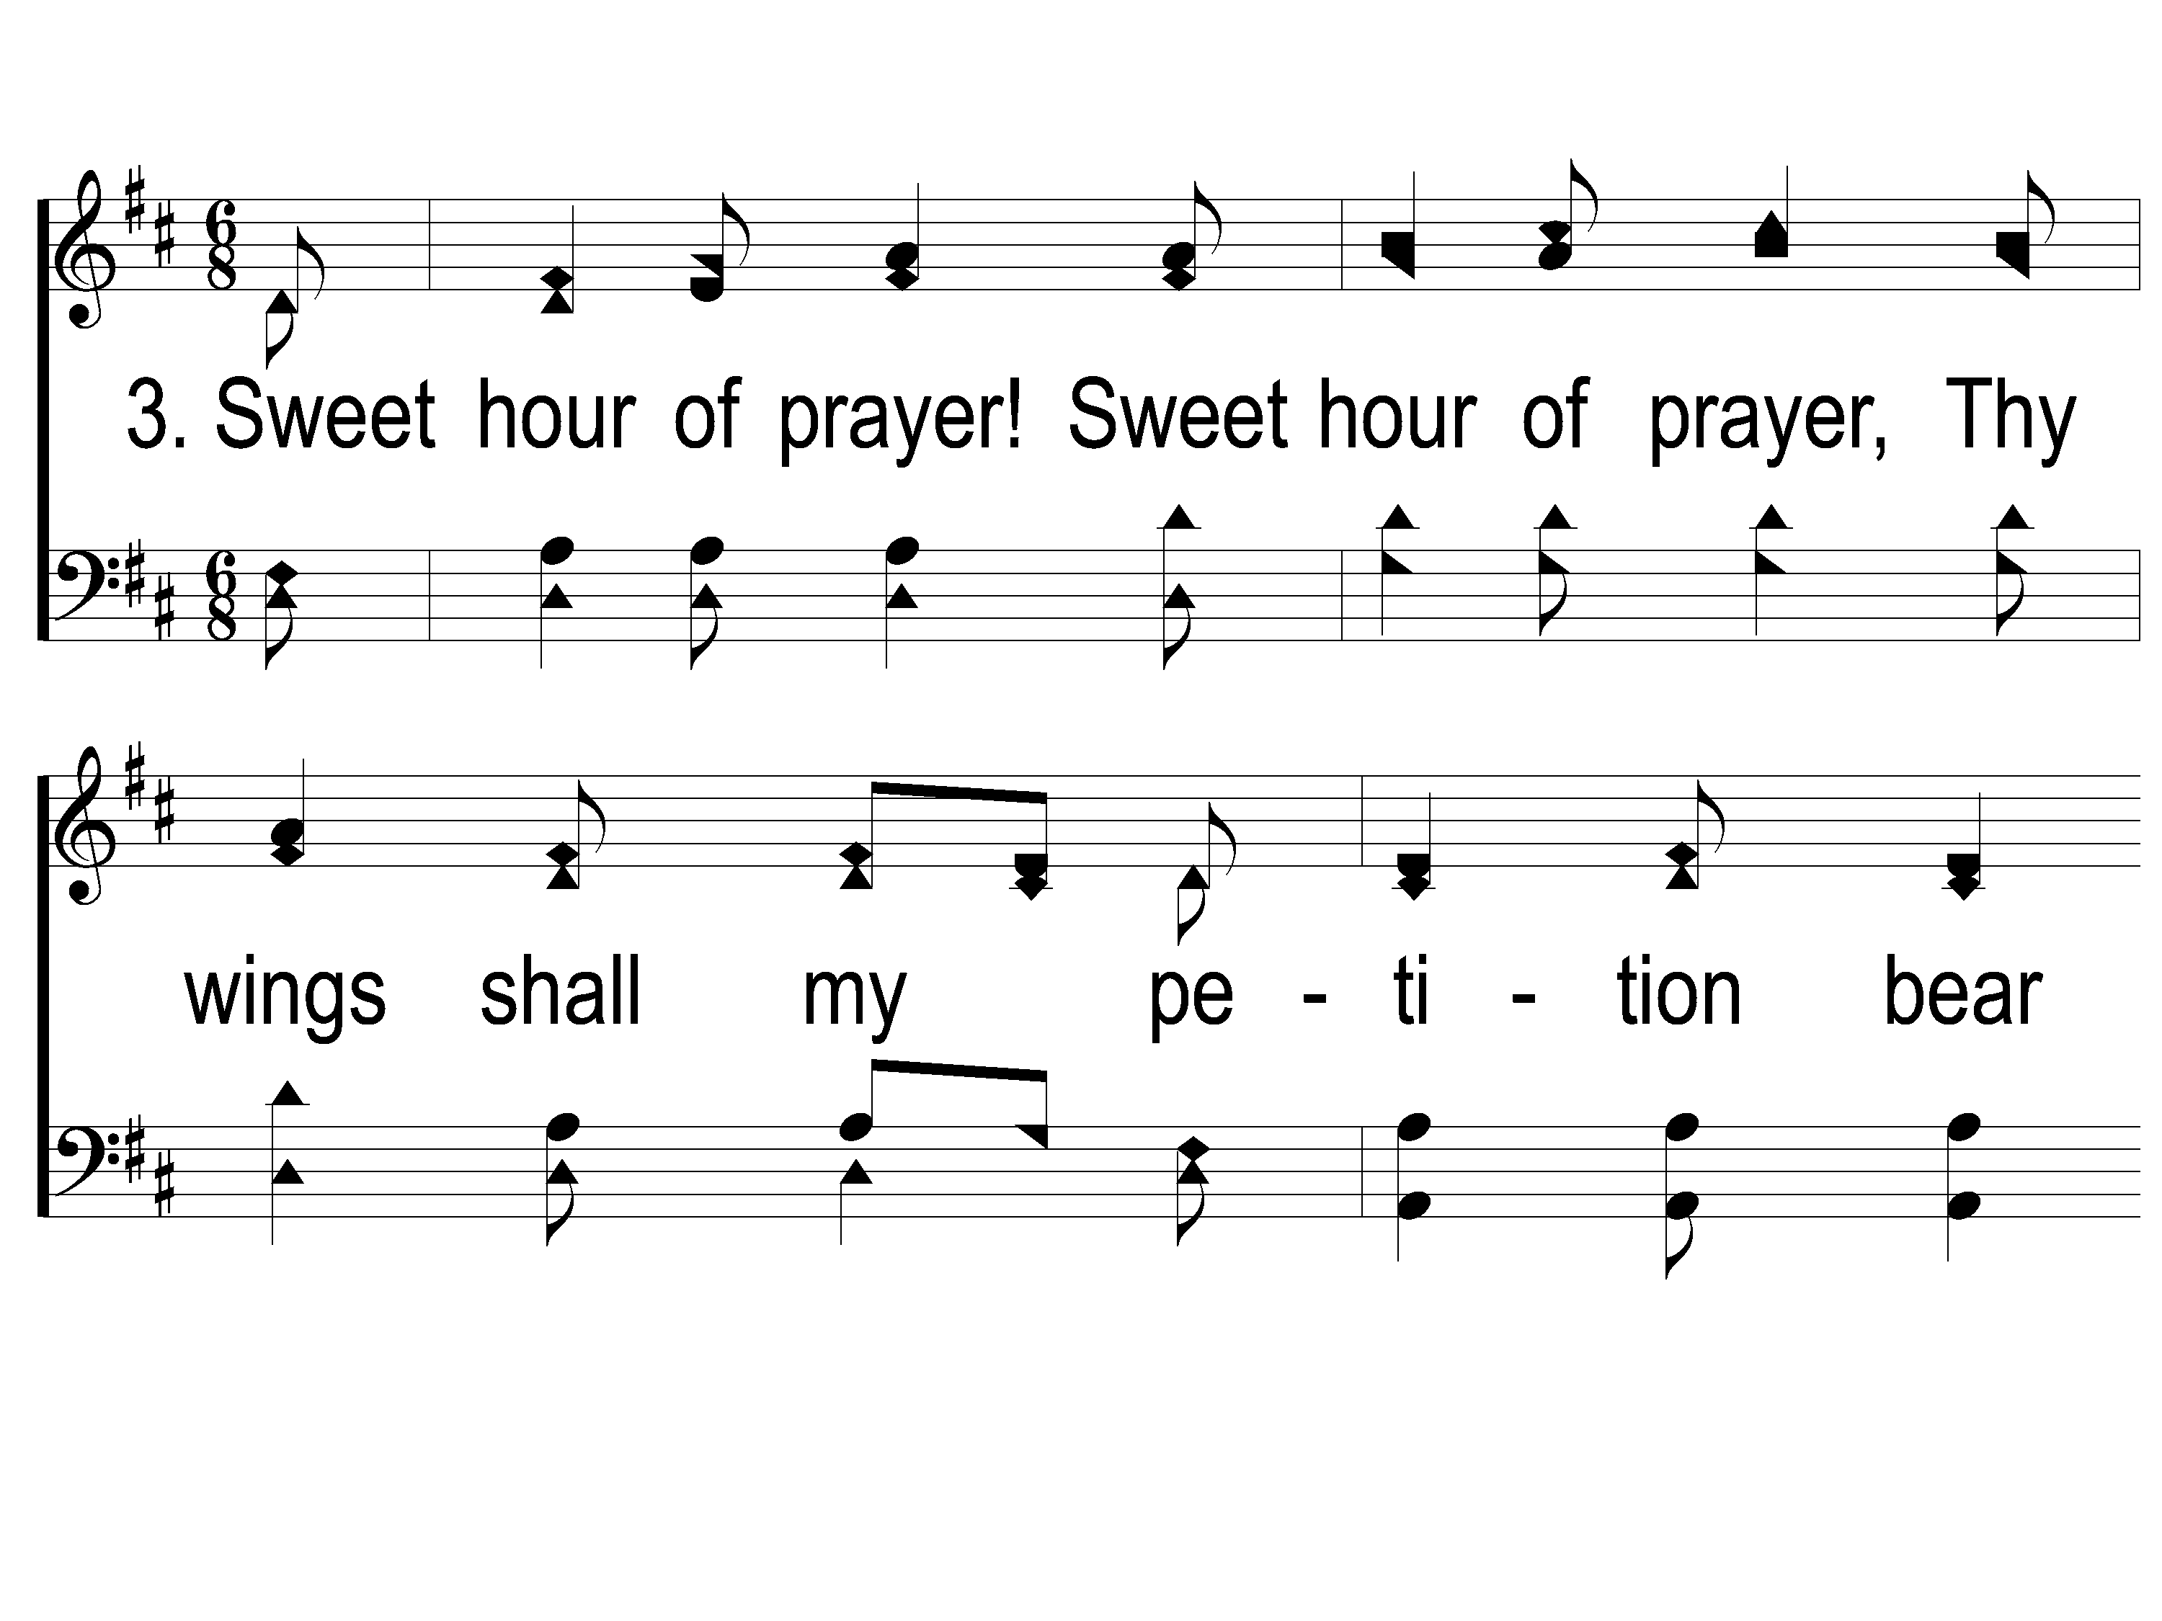
3-1 Sweet Hour of Prayer
Sweet Hour of Prayer
827

Slide 23
3-2 Sweet Hour of Prayer
Sweet Hour of Prayer
827

Slide 24
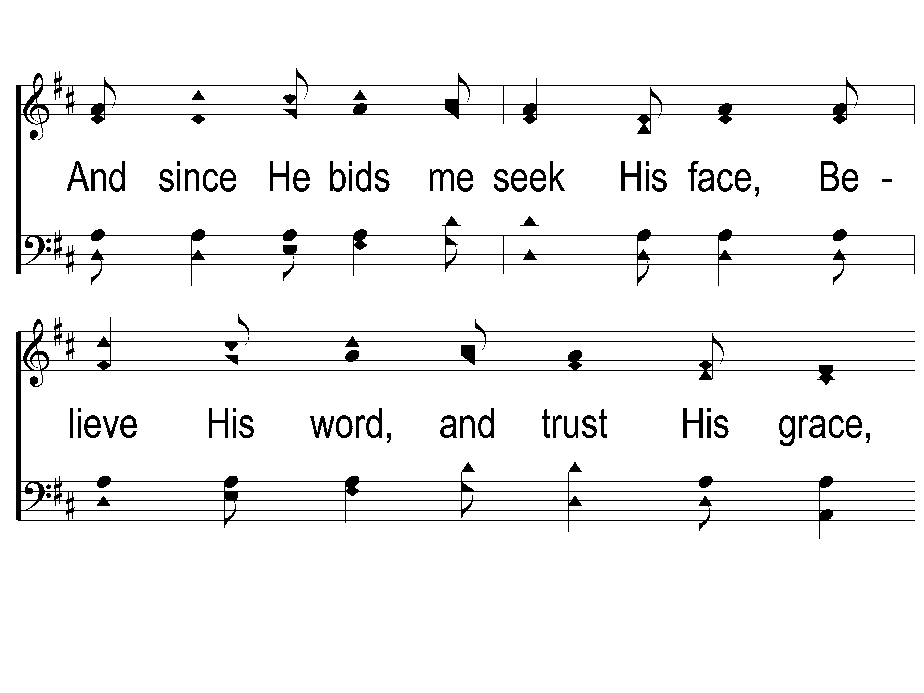
3-3 Sweet Hour of Prayer
Sweet Hour of Prayer
827

Slide 25
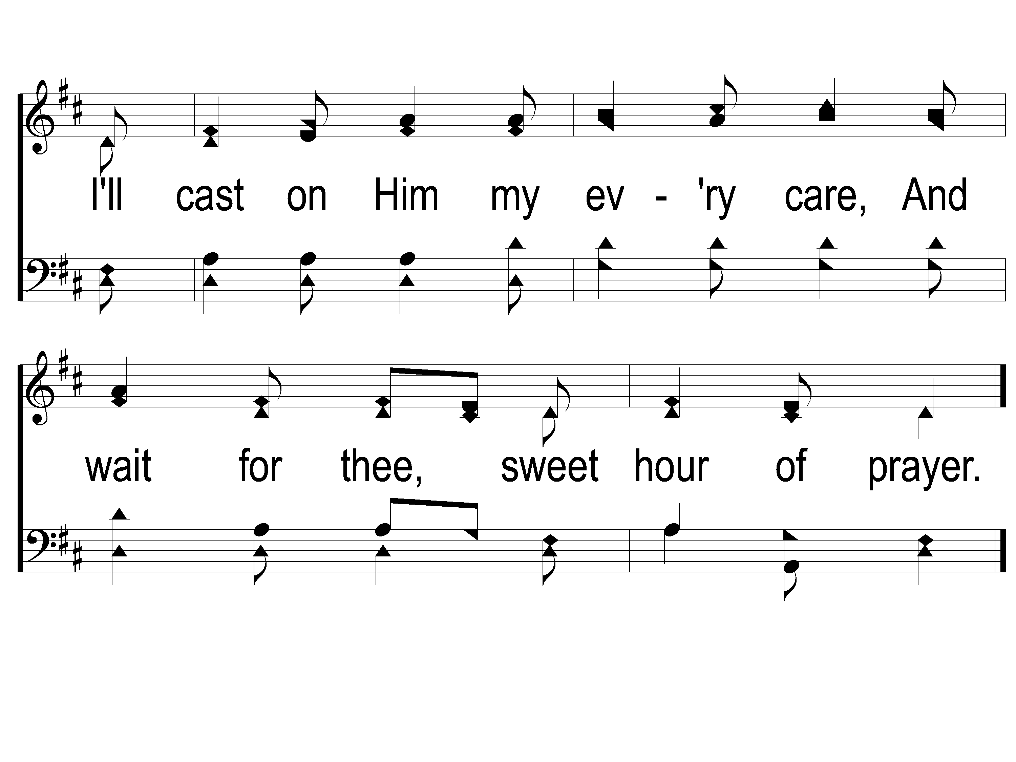
3-4 Sweet Hour of Prayer
Sweet Hour of Prayer
827

Slide 26
Opening Prayer

Slide 27
Living By Faith
#620

Slide 28
1-1 Living by Faith
Living by Faith
560
© 2005 ePraise Hymn Presentation by Taylor Publications

Slide 29
1-2 Living by Faith
Living by Faith
560
© 2005 ePraise Hymn Presentation by Taylor Publications

Slide 30
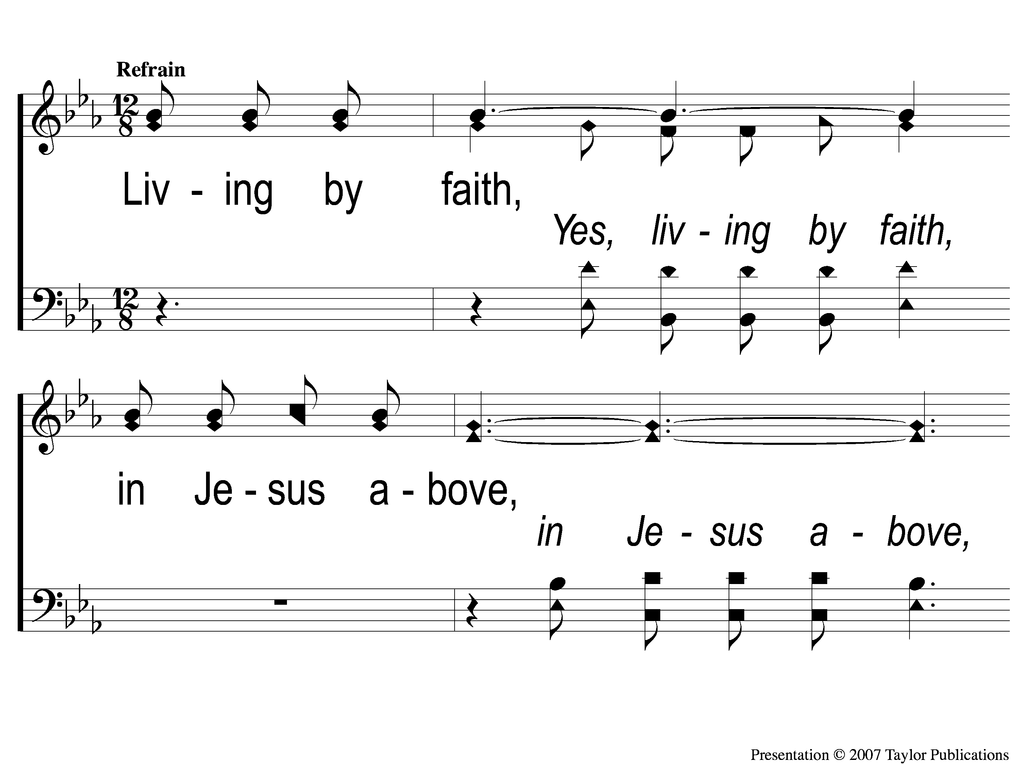
C-1 Living by Faith
Living by Faith
560
© 2005 ePraise Hymn Presentation by Taylor Publications

Slide 31
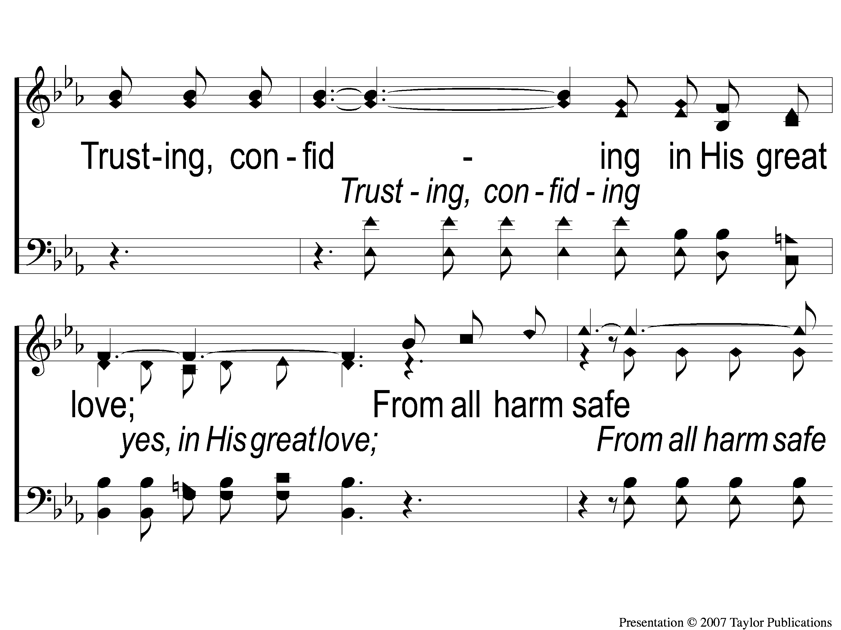
C-2 Living by Faith
Living by Faith
560
© 2005 ePraise Hymn Presentation by Taylor Publications

Slide 32
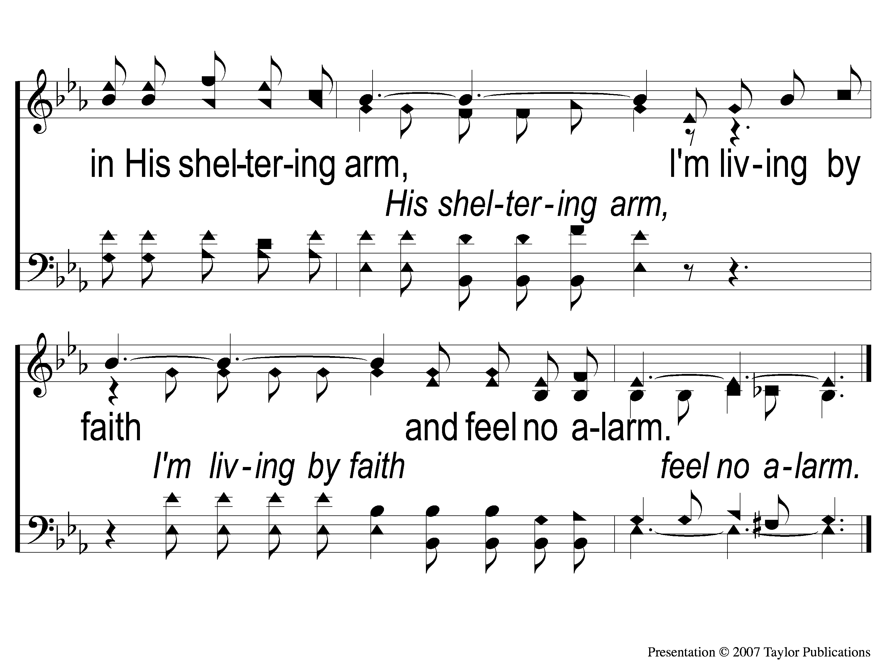
C-3 Living by Faith
Living by Faith
560
© 2005 ePraise Hymn Presentation by Taylor Publications

Slide 33
3-1 Living by Faith
Living by Faith
560
© 2005 ePraise Hymn Presentation by Taylor Publications

Slide 34
3-2 Living by Faith
Living by Faith
560
© 2005 ePraise Hymn Presentation by Taylor Publications

Slide 35
C-1 Living by Faith
Living by Faith
560
© 2005 ePraise Hymn Presentation by Taylor Publications

Slide 36
C-2 Living by Faith
Living by Faith
560
© 2005 ePraise Hymn Presentation by Taylor Publications

Slide 37
C-3 Living by Faith
Living by Faith
560
© 2005 ePraise Hymn Presentation by Taylor Publications

Slide 38
Where No One
Stands Alone
#801

Slide 39
1-1 Where No One Stands Alone
Where No One Stands Alone
801

Slide 40
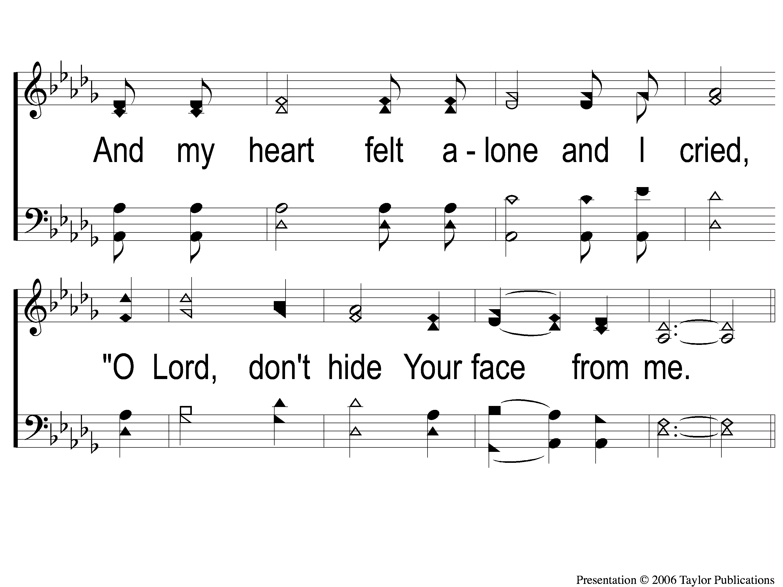
1-2 Where No One Stands Alone
Where No One Stands Alone
801

Slide 41
C-1 Where No One Stands Alone
Where No One Stands Alone
801

Slide 42
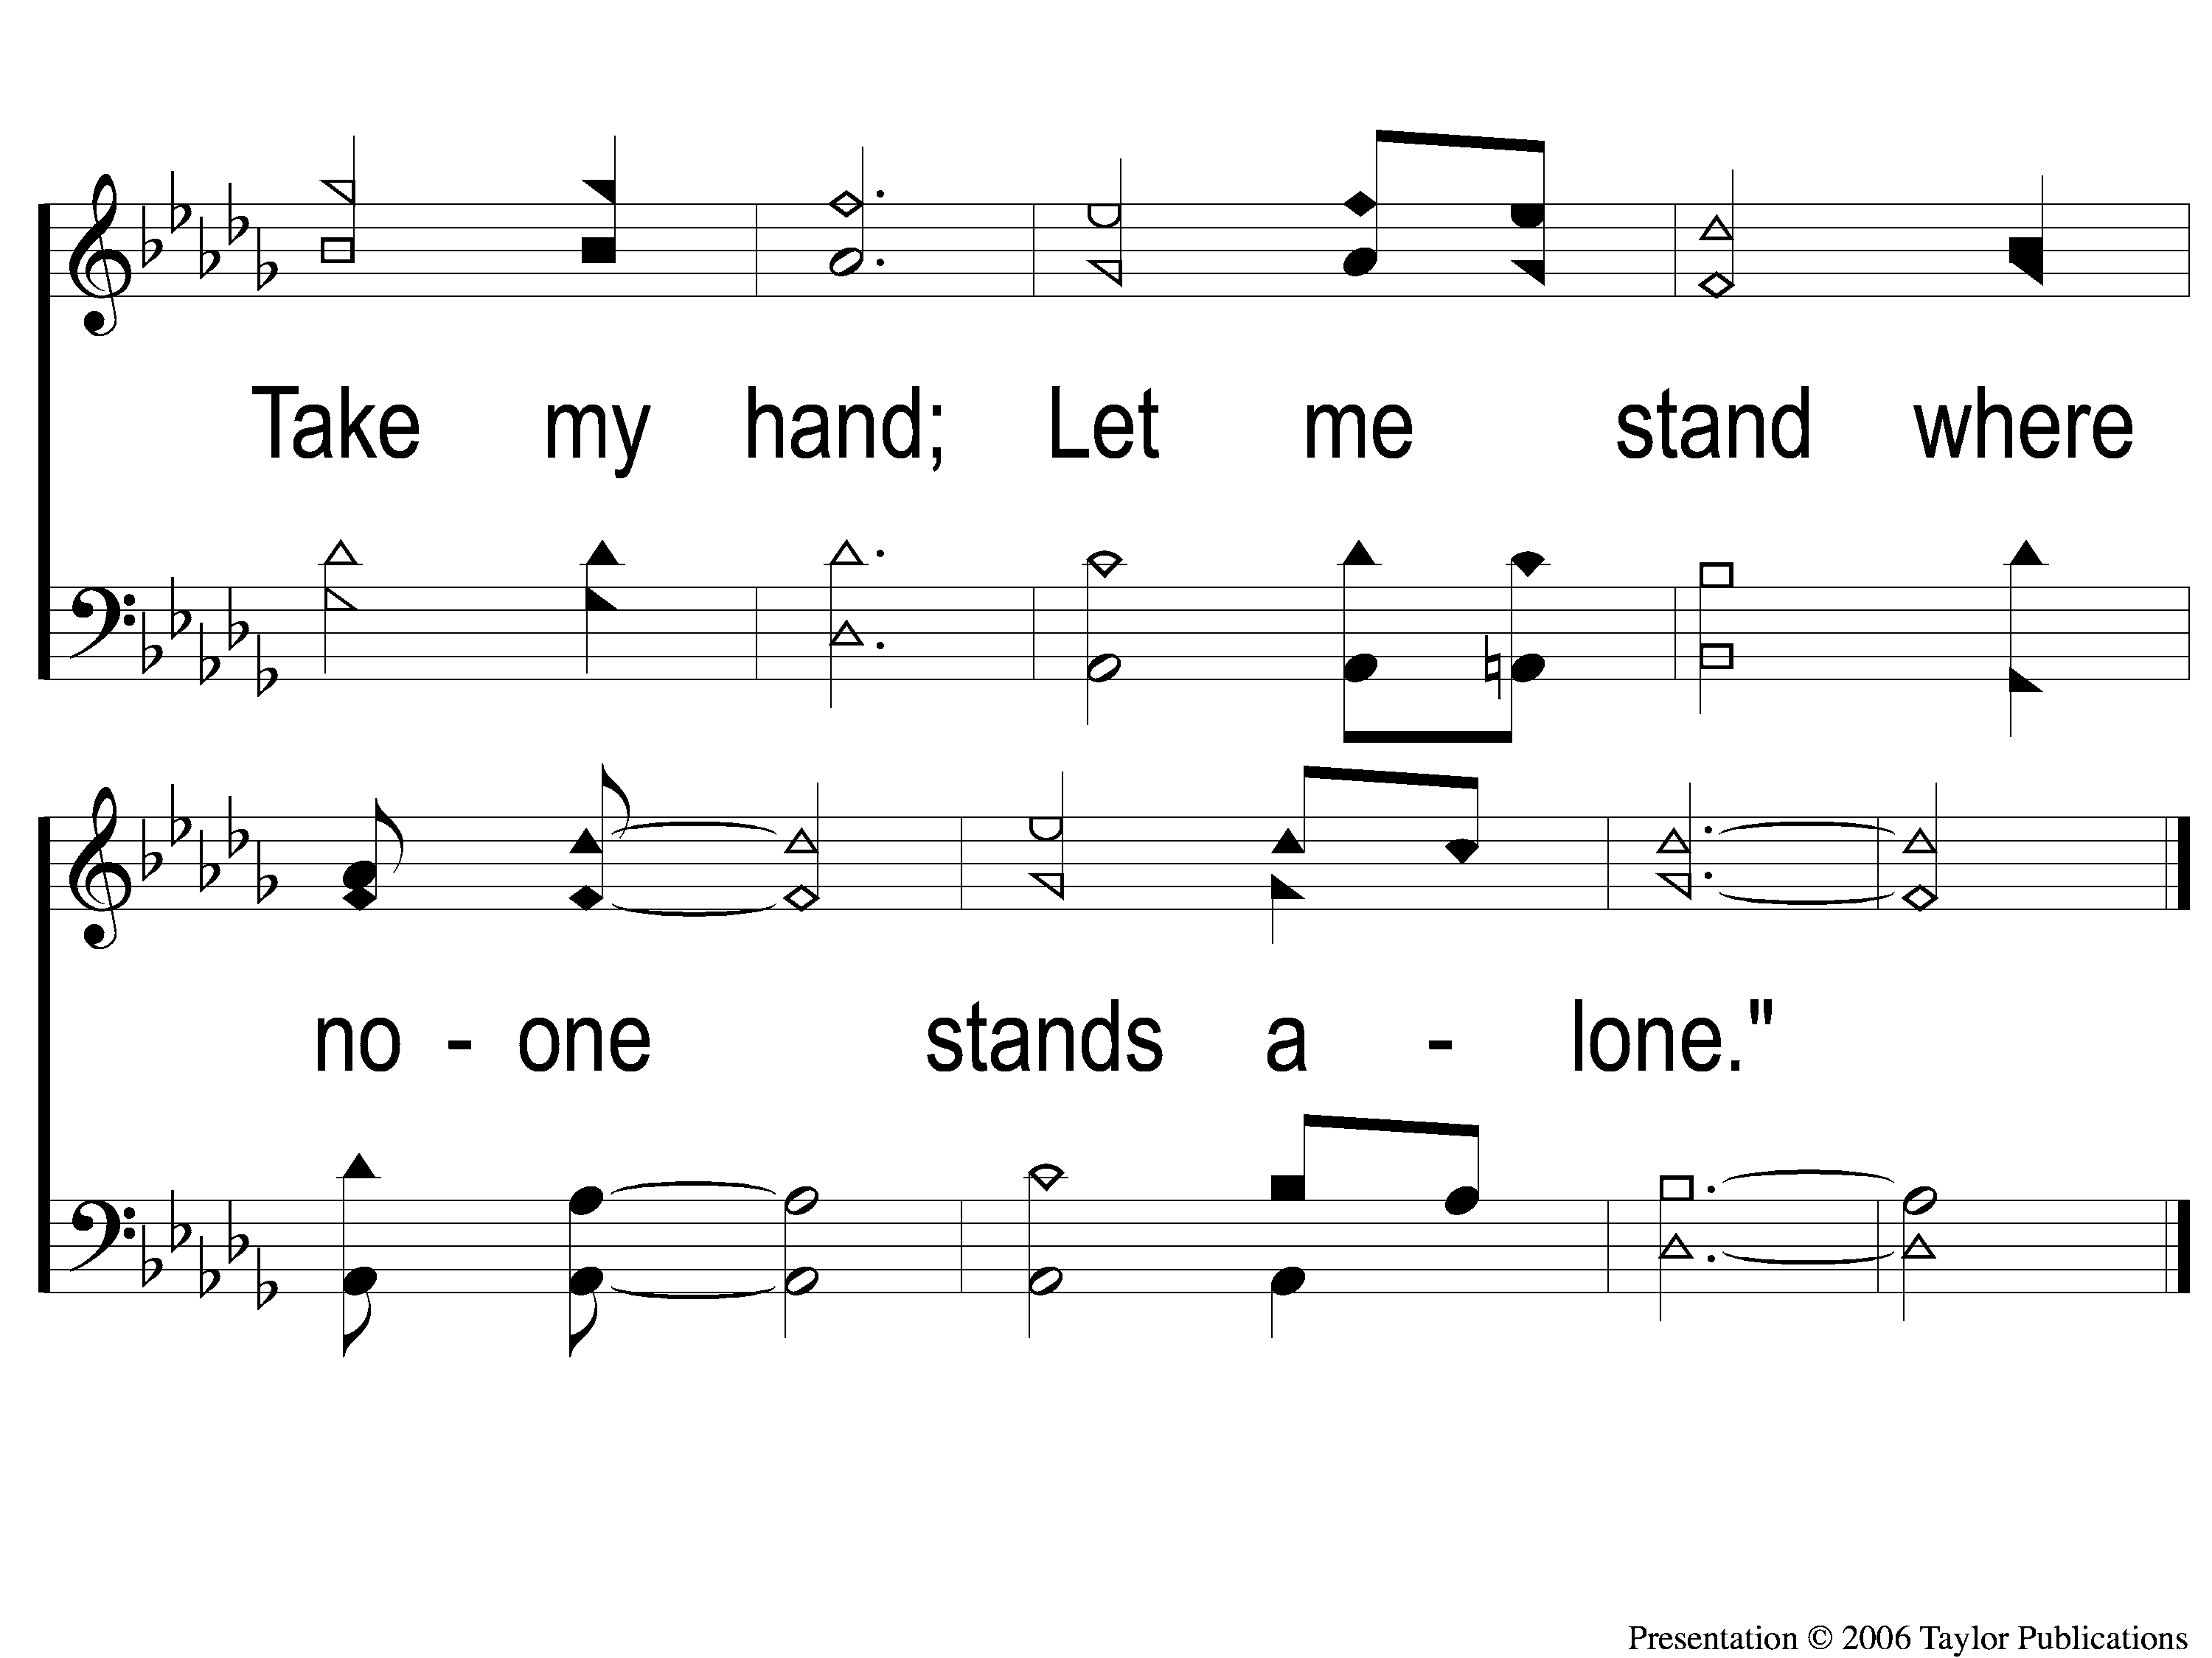
C-2 Where No One Stands Alone
Where No One Stands Alone
801

Slide 43
2-1 Where No One Stands Alone
Where No One Stands Alone
801

Slide 44
2-2 Where No One Stands Alone
Where No One Stands Alone
801

Slide 45
C-1 Where No One Stands Alone
Where No One Stands Alone
801

Slide 46
C-2 Where No One Stands Alone
Where No One Stands Alone
801

Slide 47
Opt tag Where No One Stands Alone
Where No One Stands Alone
801
Tag

Slide 48
Scripture Reading:
Ecclesiastes 1: 12-18

Slide 49
Songs About
Standing Firm

Slide 50
Where No One
Stands Alone

Slide 51
3 Bible Truths:

Slide 52
3 Bible Truths:
The Loneliest Place is Without God

Slide 53
Verse 1:
“Once I stood in the night with my head bowed low
In darkness as black as the sea
In my heart felt alone and I cried oh Lord
Don't hide your face from me.”

Slide 54
The Worst Place
Separated From God
Isa. 59: 1-2

Slide 55
The Worst Place
Eph. 2: 12
Without God
Without Hope
Without Comfort
Without Guidance

Slide 56
Verse 2:
“Like a king I may live in a palace so fine
With great riches to call my own
But I don't know a thing in this whole wide world
That's worse than being alone.”

Slide 57
The Worst Place
King Solomon– Eccl. 1: 12-18,
Great Riches– 5: 10-15
Great Sorrow– 4: 10-11

Slide 58
3 Bible Truths:
The Loneliest Place is Without God
The Best Place is the Church

Slide 59
Chorus:
“Hold my hand all the way
every hour every day
From here to the great unknown
Take my hand let me stand
Where no one stands alone.”

Slide 60
The Best Place
In Christ
Eph. 1: 3, 2: 13-22

Slide 61
The Best Place
In Christ
God’s Presence
Heb. 13: 5-6, Psa. 22-23, 27
Gen. 28: 15, Deut. 31: 6, Josh. 1: 5

Slide 62
The Best Place
In Christ
Eternal Hope
1 Cor. 15: 19, Acts 24: 15
Rom. 15: 4, 13, Col. 1: 5

Slide 63
The Best Place
In Christ
Comfort
From God– 2 Cor. 1: 3-4
From God’s People– 1 Thess. 5: 11, 14, 2 Cor. 7: 6, Col. 4: 11

Slide 64
The Best Place
In Christ
Guidance
2 Tim. 3: 16-17
2 Pet. 1: 3

Slide 65
3 Bible Truths:
The Loneliest Place is Without God
The Best Place is the Church
Christians are Not Immune to Loneliness

Slide 66
We Are Not Immune
Examples:

Slide 67
We Are Not Immune
Examples:
King David– Psa. 69:20, 22: 1-2

Slide 68
We Are Not Immune
Examples:
King David– Psa. 69:20, 22: 1-2
Joseph– Gen. 37-50

Slide 69
We Are Not Immune
Examples:
King David– Psa. 69:20, 22: 1-2
Joseph– Gen. 37-50
Elijah – 1 Kings 18: 22, 19: 9-10, 18

Slide 70
Are you in the place
where no one stands alone?

Slide 71
Invitation Song:
Softly & Tenderly
#934

Slide 72
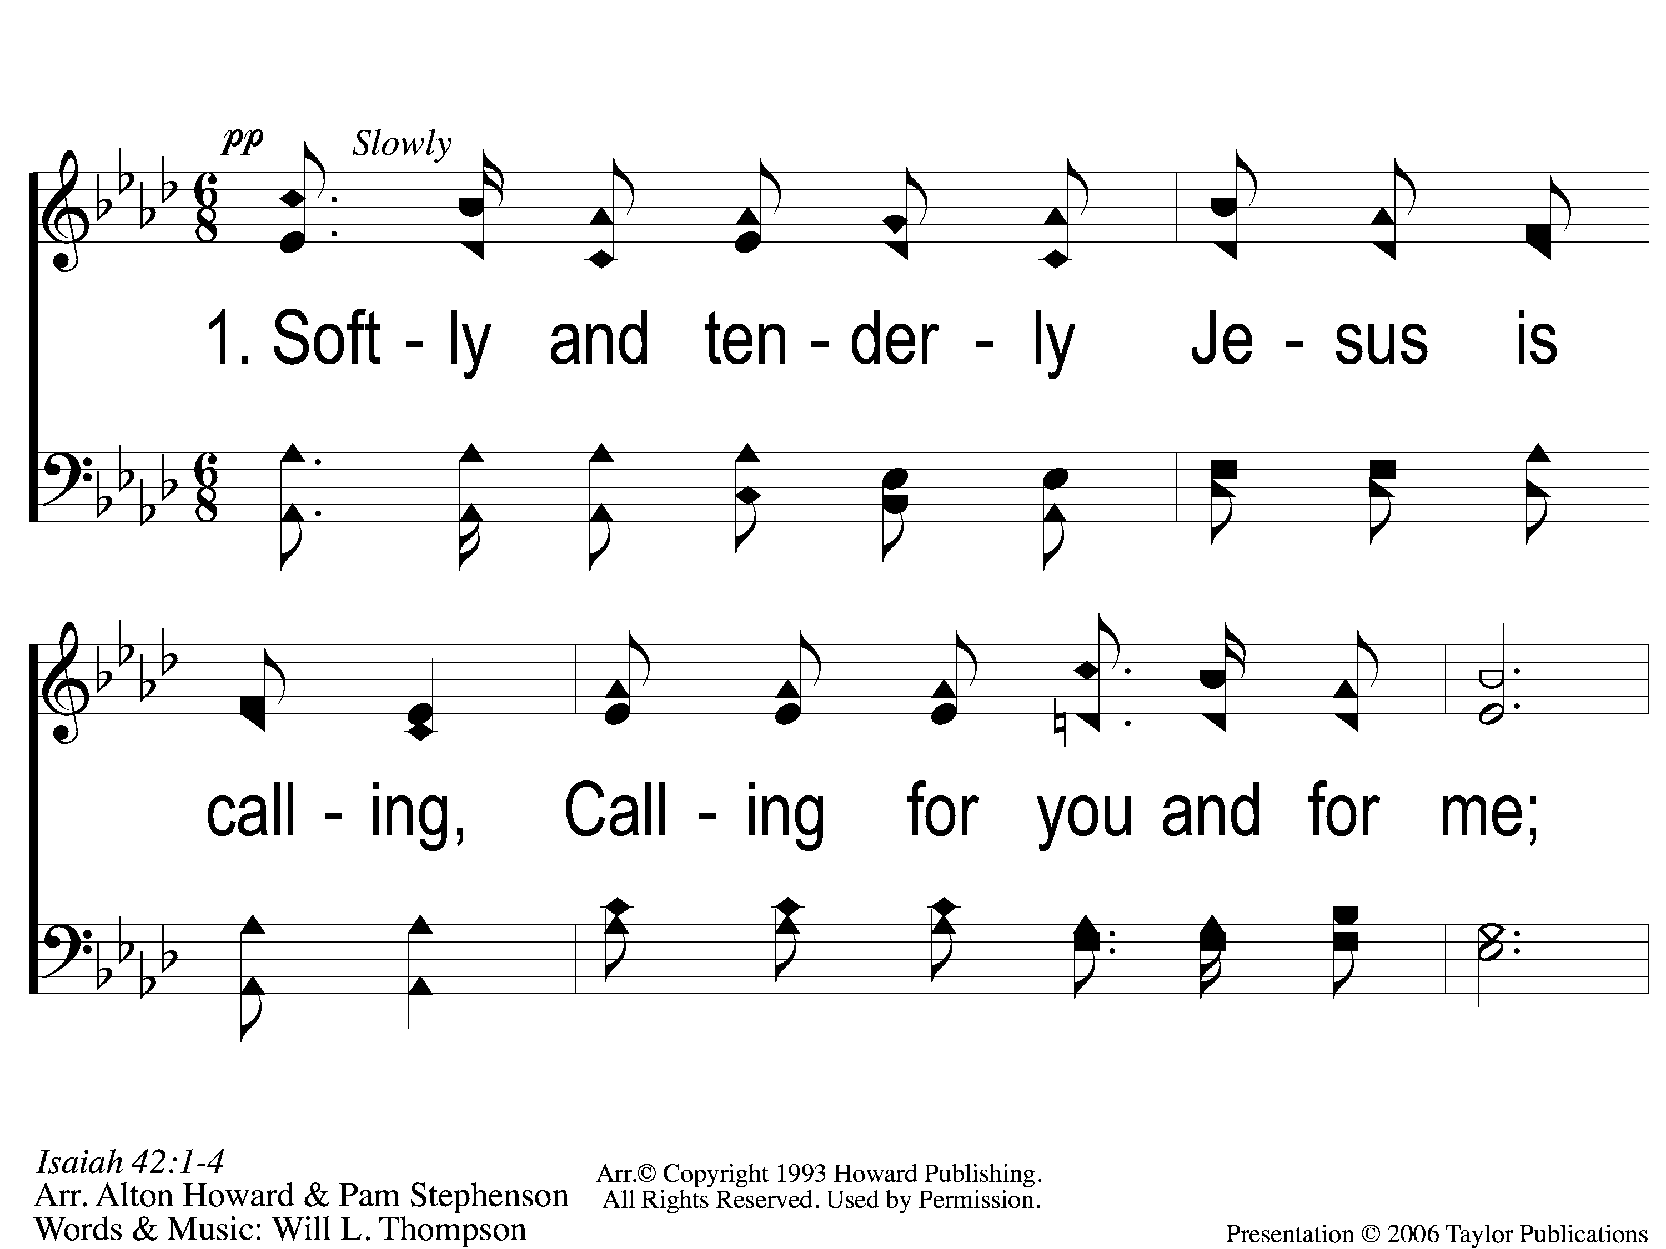
1-1 Softly and Tenderly
Softly and Tenderly
934

Slide 73
1-2 Softly and Tenderly
Softly and Tenderly
934

Slide 74
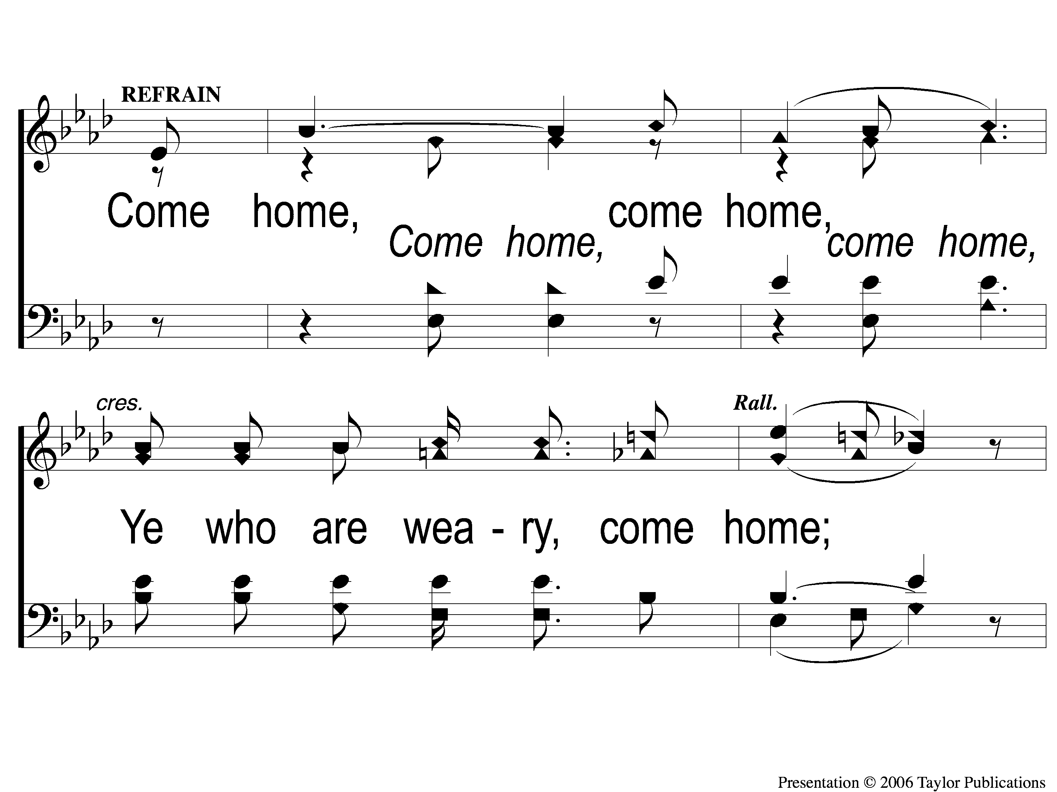
C-1 Softly and Tenderly
Softly and Tenderly
934

Slide 75
C-2 Softly and Tenderly
Softly and Tenderly
934

Slide 76
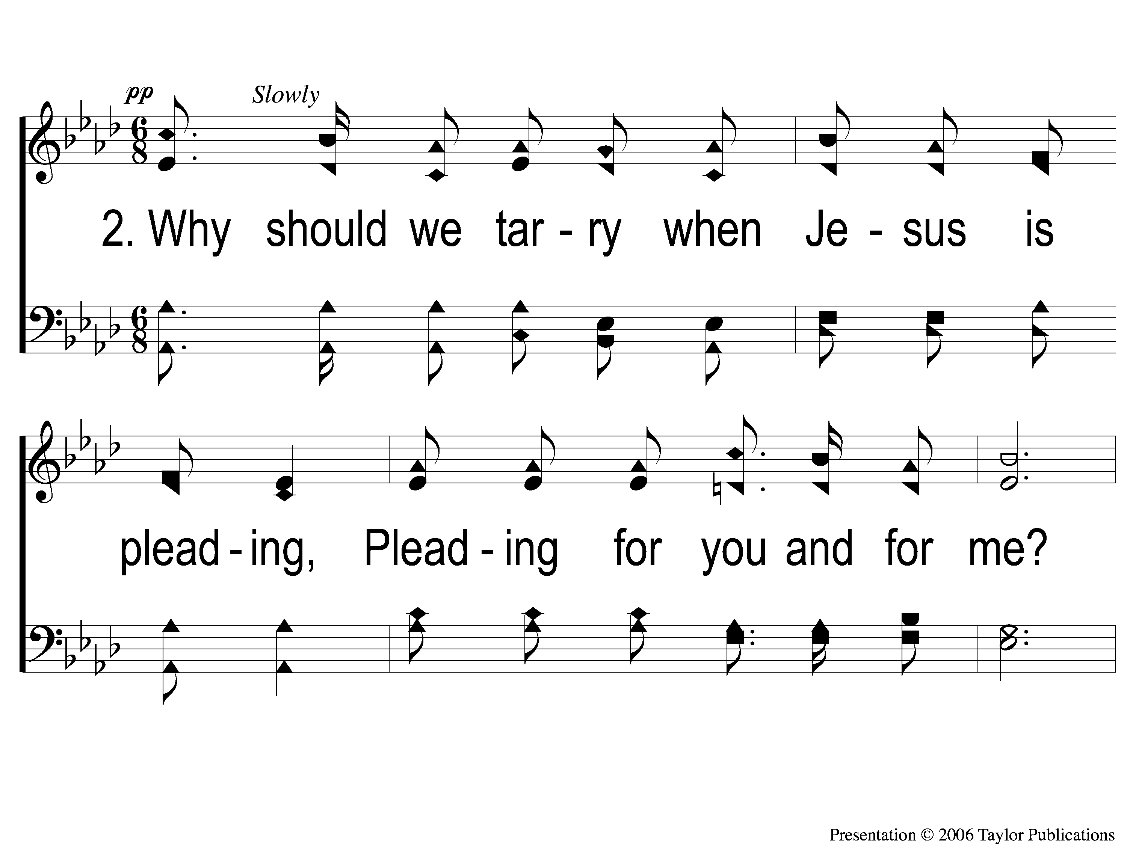
2-1 Softly and Tenderly
Softly and Tenderly
934

Slide 77
2-2 Softly and Tenderly
Softly and Tenderly
934

Slide 78
C-1 Softly and Tenderly
Softly and Tenderly
934

Slide 79
C-2 Softly and Tenderly
Softly and Tenderly
934

Slide 80
3-1 Softly and Tenderly
Softly and Tenderly
934

Slide 81
3-2 Softly and Tenderly
Softly and Tenderly
934

Slide 82
C-1 Softly and Tenderly
Softly and Tenderly
934

Slide 83
C-2 Softly and Tenderly
Softly and Tenderly
934

Slide 84
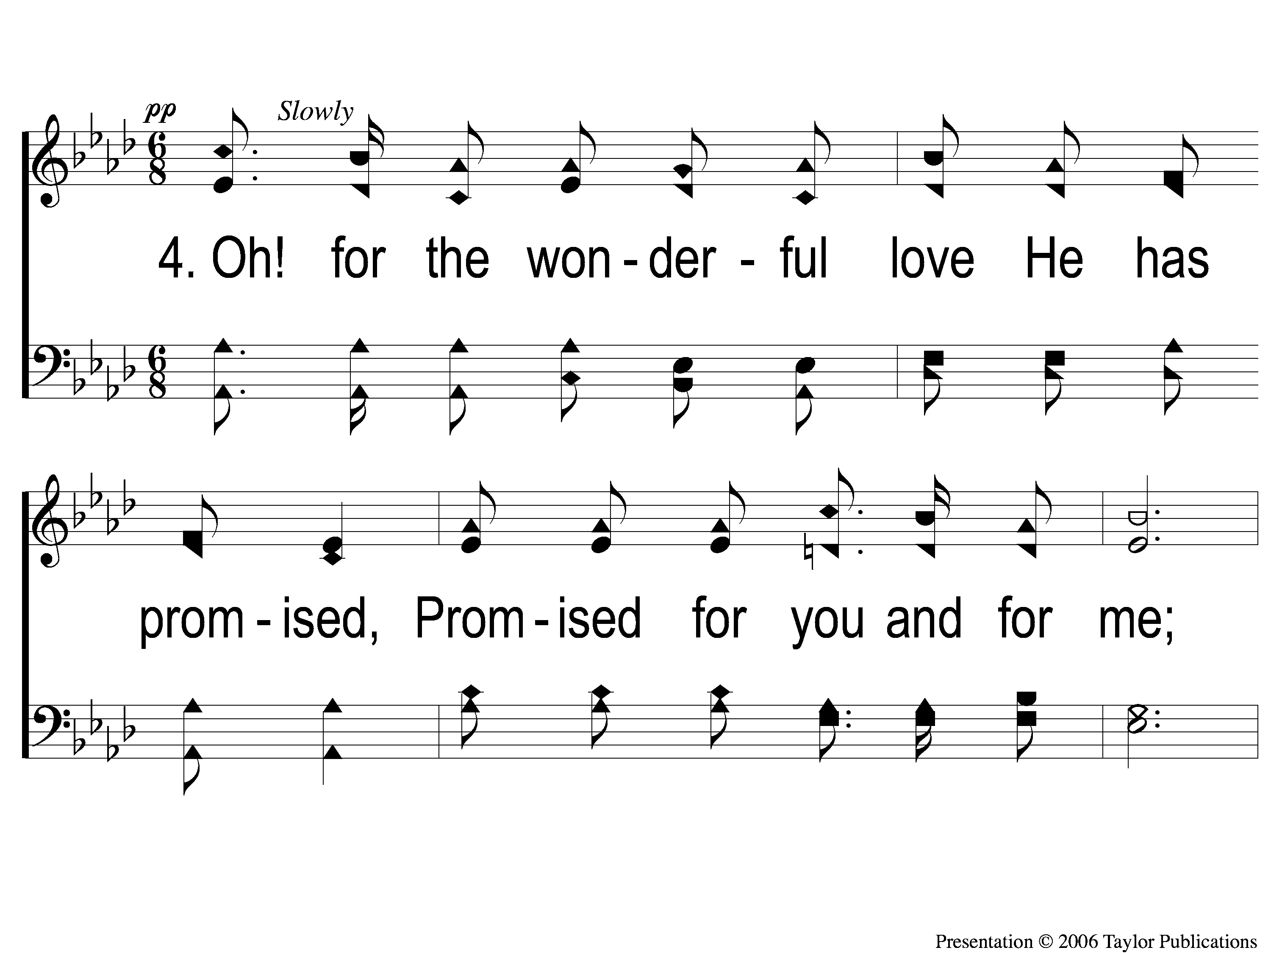
4-1 Softly and Tenderly
Softly and Tenderly
934

Slide 85
4-2 Softly and Tenderly
Softly and Tenderly
934

Slide 86
C-1 Softly and Tenderly
Softly and Tenderly
934

Slide 87
C-2 Softly and Tenderly
Softly and Tenderly
934

Slide 88
Ten Thousand Angels
#349

Slide 89
1-1 Ten Thousand Angels
Ten Thousand Angels
349

Slide 90
1-2 Ten Thousand Angels
Ten Thousand Angels
349

Slide 91
C-1 Ten Thousand Angels
Ten Thousand Angels
349

Slide 92
C-2 Ten Thousand Angels
Ten Thousand Angels
349

Slide 93
2-1 Ten Thousand Angels
Ten Thousand Angels
349

Slide 94
2-2 Ten Thousand Angels
Ten Thousand Angels
349

Slide 95
C-1 Ten Thousand Angels
Ten Thousand Angels
349

Slide 96
C-2 Ten Thousand Angels
Ten Thousand Angels
349

Slide 97
4-1 Ten Thousand Angels
Ten Thousand Angels
349

Slide 98
4-2 Ten Thousand Angels
Ten Thousand Angels
349

Slide 99
C-1 Ten Thousand Angels
Ten Thousand Angels
349

Slide 100
C-2 Ten Thousand Angels
Ten Thousand Angels
349

Slide 101
The Lord’s Supper
Acts 20:7

Slide 102
The Unleavened Bread
”There is therefore now no condemnation to those who are in Christ Jesus, who do not walk according to the flesh, but according to the Spirit. For the law of the Spirit of life in Christ Jesus has made me free from the law of sin and death.”
- Romans 8: 1-2

Slide 103
The Fruit of the Vine
“What then shall we say to these things? If God is for us, who can be against us? He who did not spare His own Son, but delivered Him up for us all, how shall He not with Him also freely give us all things?” – Romans 8: 31-32

Slide 104
Our Offering
“I have shown you in every way, by laboring like this, that you must support the weak. And remember the words of the Lord Jesus, that He said, ‘It is more blessed to give than to receive.’ ” - Acts 20: 35

Slide 105
Closing Prayer

Slide 106
The Greatest Commands
#448

Slide 107
1-1 The Greatest Commands-SFP
The Greatest Commands
448

Slide 108
1-2 The Greatest Commands-SFP
The Greatest Commands
448

Slide 109
1-3 The Greatest Commands-SFP
The Greatest Commands
448

Slide 110
1-4 The Greatest Commands-SFP
The Greatest Commands
448

Slide 111
2-1 The Greatest Commands-SFP
The Greatest Commands
448

Slide 112
2-2 The Greatest Commands-SFP
The Greatest Commands
448

Slide 113
2-3 The Greatest Commands-SFP
The Greatest Commands
448

Slide 114
2-4 The Greatest Commands-SFP
The Greatest Commands
448

Slide 115
3-1 The Greatest Commands-SFP
The Greatest Commands
448

Slide 116
3-2 The Greatest Commands-SFP
The Greatest Commands
448

Slide 117
3-3 The Greatest Commands-SFP
The Greatest Commands
448

Slide 118
3-4 The Greatest Commands-SFP
The Greatest Commands
448

Slide 119
4-1 The Greatest Commands-SFP
The Greatest Commands
448

Slide 120
4-2 The Greatest Commands-SFP
The Greatest Commands
448

Slide 121
4-3 The Greatest Commands-SFP
The Greatest Commands
448

Slide 122
4-4 The Greatest Commands-SFP
The Greatest Commands
448

Slide 123
Join us for
Worship Tonight
@ 6:00pm!

