Slide 1
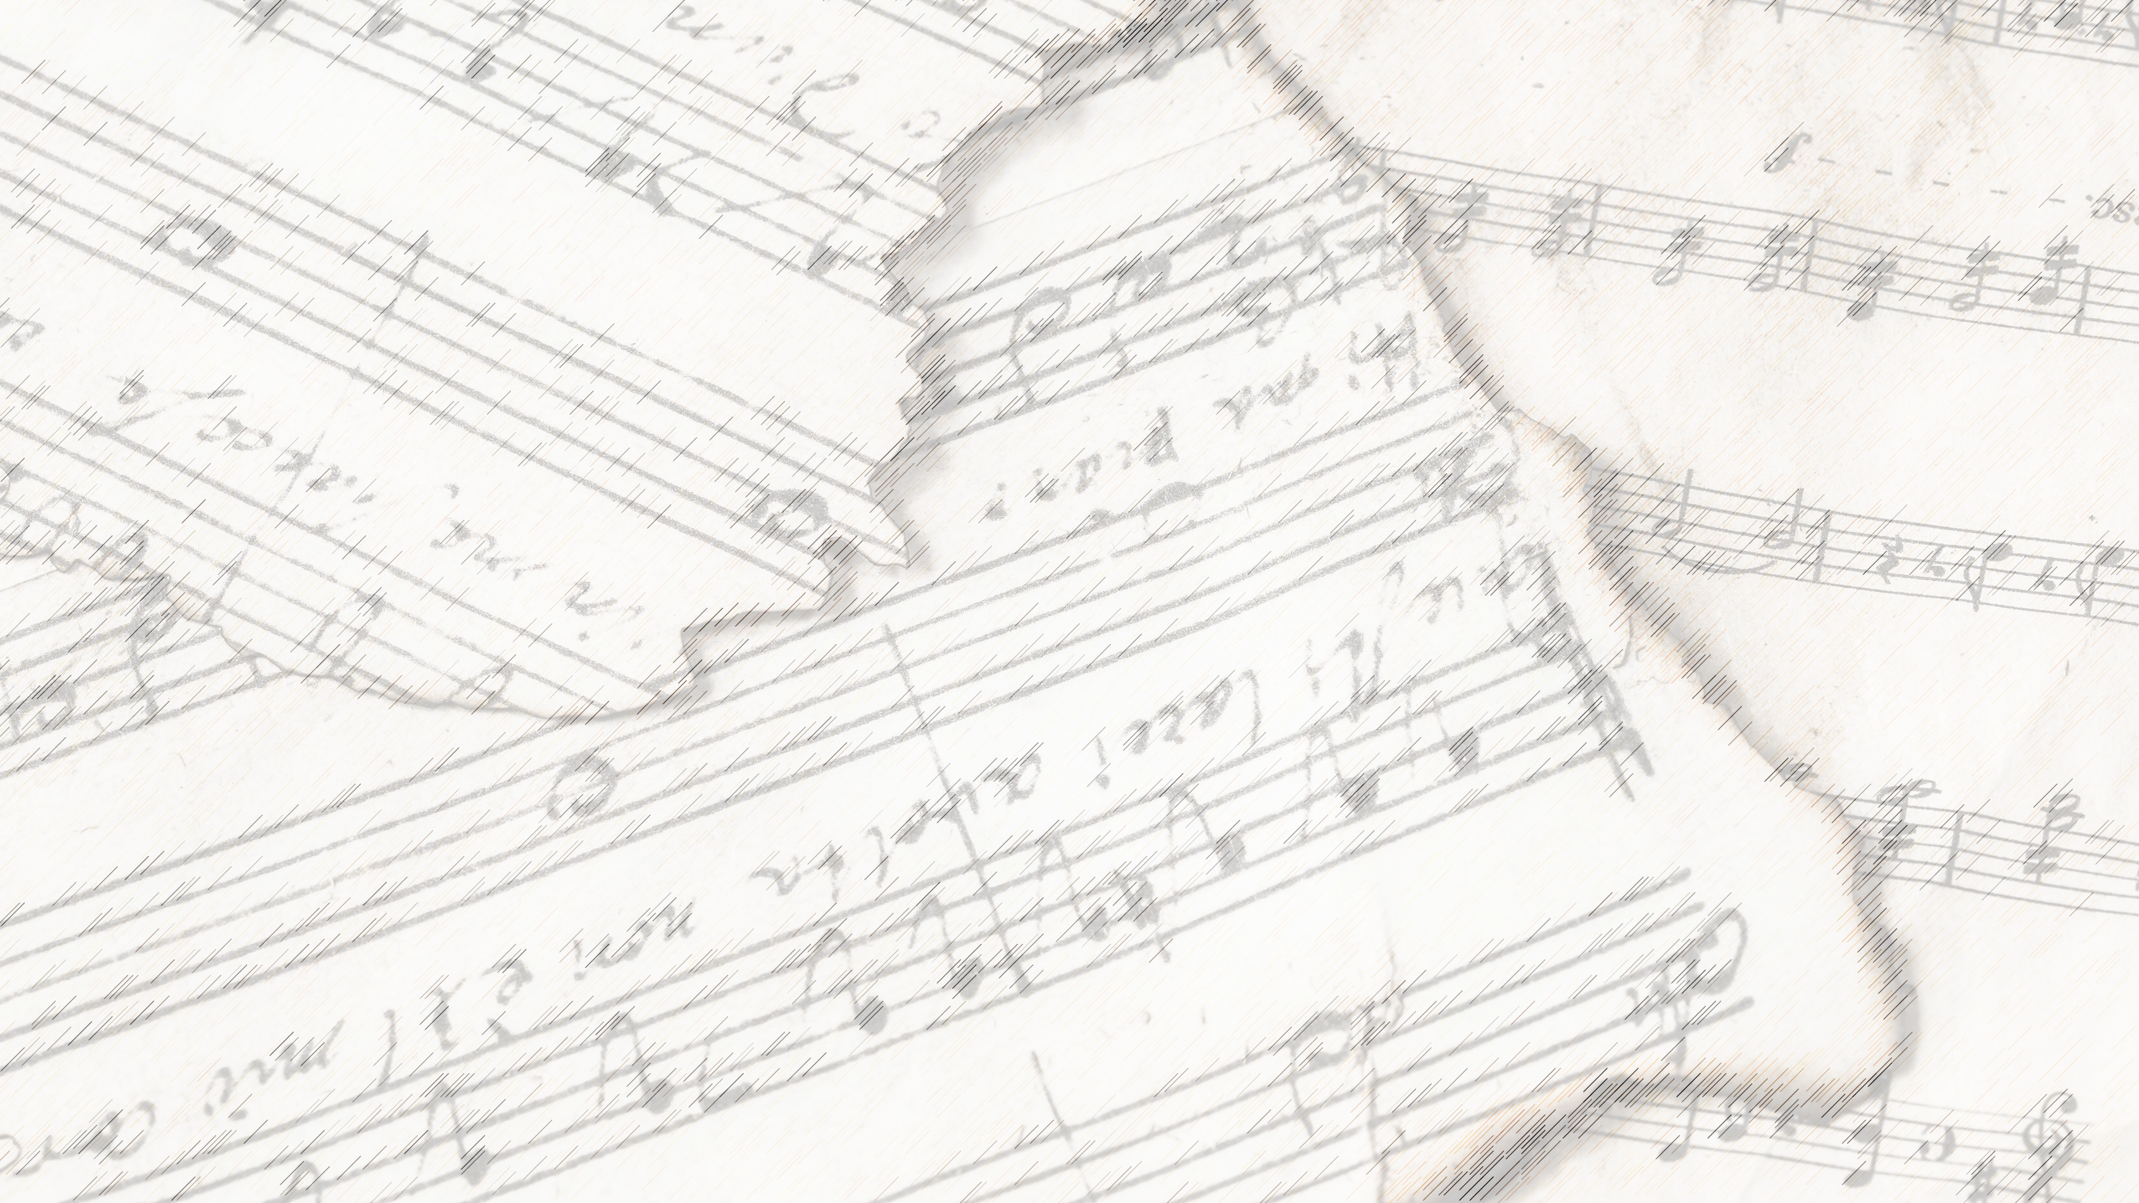
Welcome!
We Are Glad You Are Here

Slide 2
Songs of Praise to God

Slide 3
Opening Prayer

Slide 4
Songs of Praise to God

Slide 5
In Christ Alone

Slide 6
Writers / Composers:
Keith Getty & Stuart Townend

Slide 7
Writers / Composers:
Keith Getty & Stuart Townend
The song “was composed in 2001 with
the purpose of creating a modern hymn
that would explain the life of Christ.”

Slide 8
We Must Stand In:

Slide 9
We Must Stand In:
The Love of Christ

Slide 10
“In Christ alone my hope is found;
He is my light, my strength, my song,
This Cornerstone, this solid ground,
Firm through the fiercest drought and storm.
What heights of love, what depths of peace,
When fears are stilled, when strivings cease!
My Comforter, my All in All–
Here in the love of Christ I stand.”

Slide 11
Standing In The Love Of Christ
Phili. 2: 5-11
Jn. 14: 15, 15: 4-9
1 Jn. 3: 24, 4: 15-16

Slide 12
We Must Stand In:
The Love of Christ
The Death of Christ

Slide 13
“In Christ alone, who took on flesh,
Fullness of God in helpless babe!
This gift of love and righteousness,
Scorned by the ones He came to save.
Till on that cross, as Jesus died,
The wrath of God was satisfied
For every sin on Him was laid–
Here in the death of Christ I live.”

Slide 14
Standing In The Death of Christ
2 Tim. 1: 10
1 Pet. 3: 18
Phili. 3: 9-11
Col. 1: 22
Rom. 5: 10, 6: 3-4, 23

Slide 15
We Must Stand In:
The Love of Christ
The Death of Christ
The Blood of Christ

Slide 16
“There in the ground His body lay,
Light of the world by darkness slain;
Then bursting forth in glorious day,
Up from the grave He rose again!
And as He stands in victory,
Sin’s curse has lost its grip on me;
For I am His and He is mine–
Bought with the precious blood of Christ”

Slide 17
Standing In The Blood of Christ
1 Pet. 1: 1-2, 17-21, 2: 9-10
1 Jn. 1: 7, 9 (Acts 8: 22)
Heb. 10: 19, 13: 12
Rev. 1: 5, 5: 9, 7: 14, 12: 11
Eph. 1: 7

Slide 18
We Must Stand In:
The Love of Christ
The Death of Christ
The Blood of Christ
The Power of Christ

Slide 19
“No guilt in life, no fear in death–
This is the power of Christ in me;
From life’s first cry to final breath,
Jesus commands my destiny.
No power of hell, no scheme of man
Can ever pluck me from His hand;
Till He returns or calls me home–
Here in the power of Christ I’ll stand.”

Slide 20
Standing In The Power of Christ

Slide 21
Standing In The Power of Christ
Power Over…
… The 2nd Death– Rev. 20: 6

Slide 22
Standing In The Power of Christ
Power Over…
… The 2nd Death– Rev. 20: 6
… Fear of Death – 1 Cor. 15: 26, Phili. 1: 21

Slide 23
We Can Stand In Christ, Because:
His Death Gives Us Life
His Blood Washes Our Sins
His Victory Is Eternal
His Example Is Freeing

Slide 24
Where Do You Stand?

Slide 25
Songs of Praise to God

Slide 26
The Lord’s Supper
Acts 20:7

Slide 27
Closing Prayer

Slide 28
Songs of Praise to God

Slide 29
Join us for
Worship & Bible Classes
Wednesday
@ 6:30pm!

