Slide 1
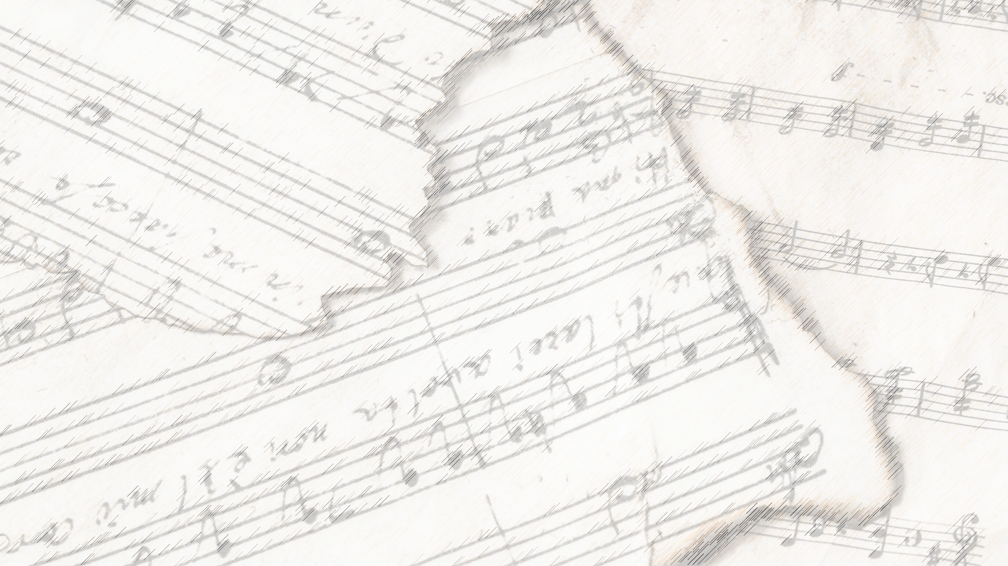
Welcome!
We Are Glad You Are Here

Slide 2
Songs of Praise to God

Slide 3
Opening Prayer

Slide 4
Songs of Praise to God

Slide 5
Blest Be The Tie
#711

Slide 6
1-1 Blest Be the Tie That Binds
Blest Be the Tie That Binds
711

Slide 7
1-2 Blest Be the Tie That Binds
Blest Be the Tie That Binds
711

Slide 8
2-1 Blest Be the Tie That Binds
Blest Be the Tie That Binds
711

Slide 9
2-2 Blest Be the Tie That Binds
Blest Be the Tie That Binds
711

Slide 10
3-1 Blest Be the Tie That Binds
Blest Be the Tie That Binds
711

Slide 11
3-2 Blest Be the Tie That Binds
Blest Be the Tie That Binds
711

Slide 12
4-1 Blest Be the Tie That Binds
Blest Be the Tie That Binds
711

Slide 13
4-2 Blest Be the Tie That Binds
Blest Be the Tie That Binds
711

Slide 14
Lesson:
Blest Be The Tie

Slide 15
Songs of Praise to God

Slide 16
The Lord’s Supper
Acts 20:7

Slide 17
Closing Prayer

Slide 18
Songs of Praise to God

Slide 19
Join us for
Worship & Bible Classes
Wednesday
@ 6: 30pm!

