Slide 1
1-1 We Will Glorify
We Will Glorify
578

Slide 2
1-2 We Will Glorify
We Will Glorify
578

Slide 3
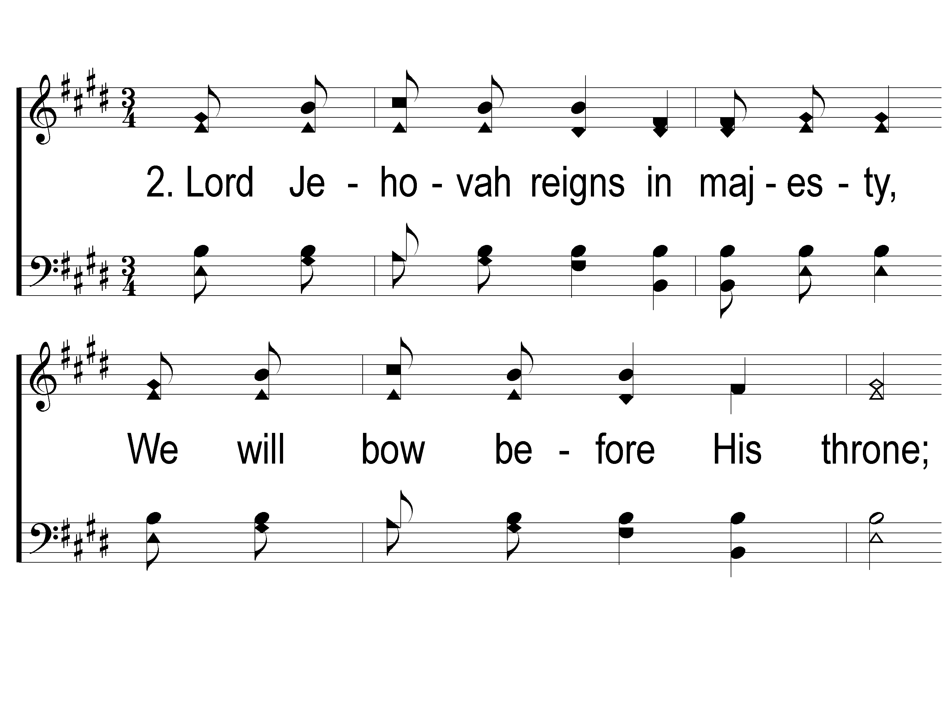
2-1 We Will Glorify
We Will Glorify
578

Slide 4
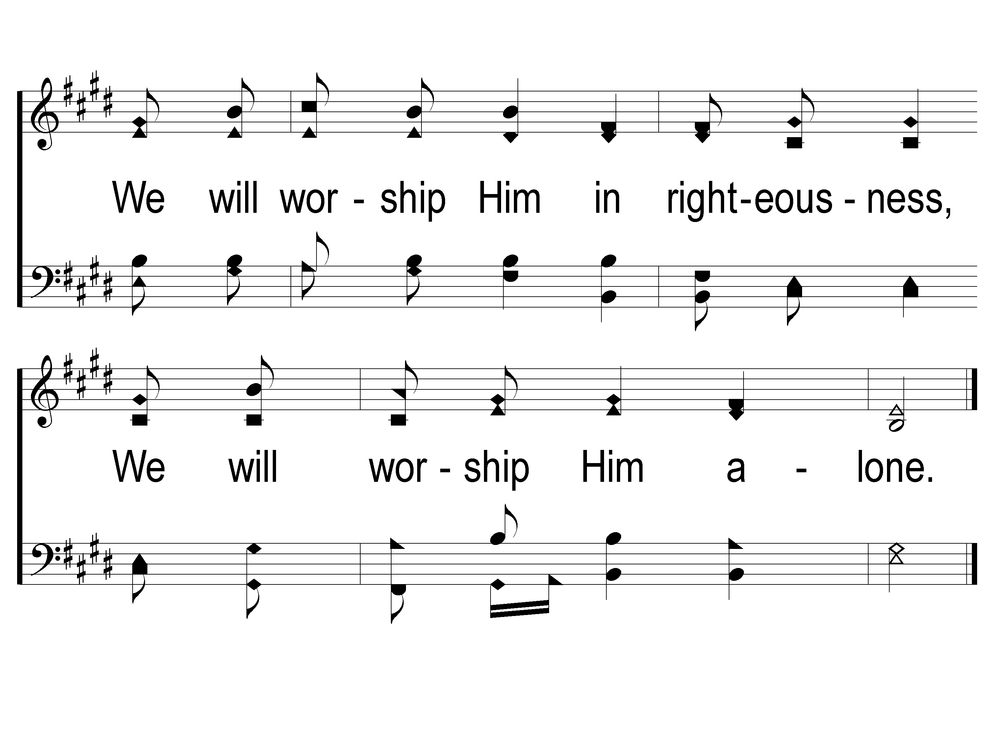
2-2 We Will Glorify
We Will Glorify
578

Slide 5
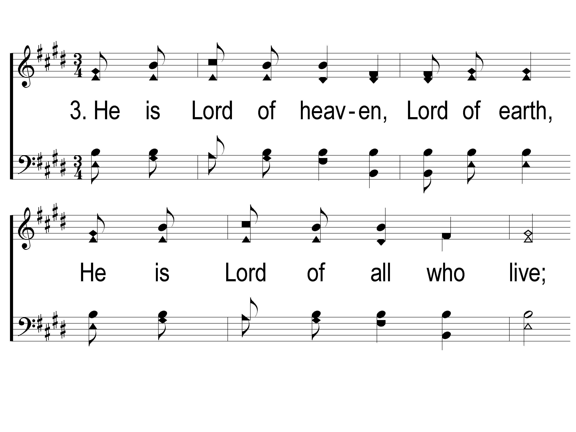
3-1 We Will Glorify
We Will Glorify
578

Slide 6
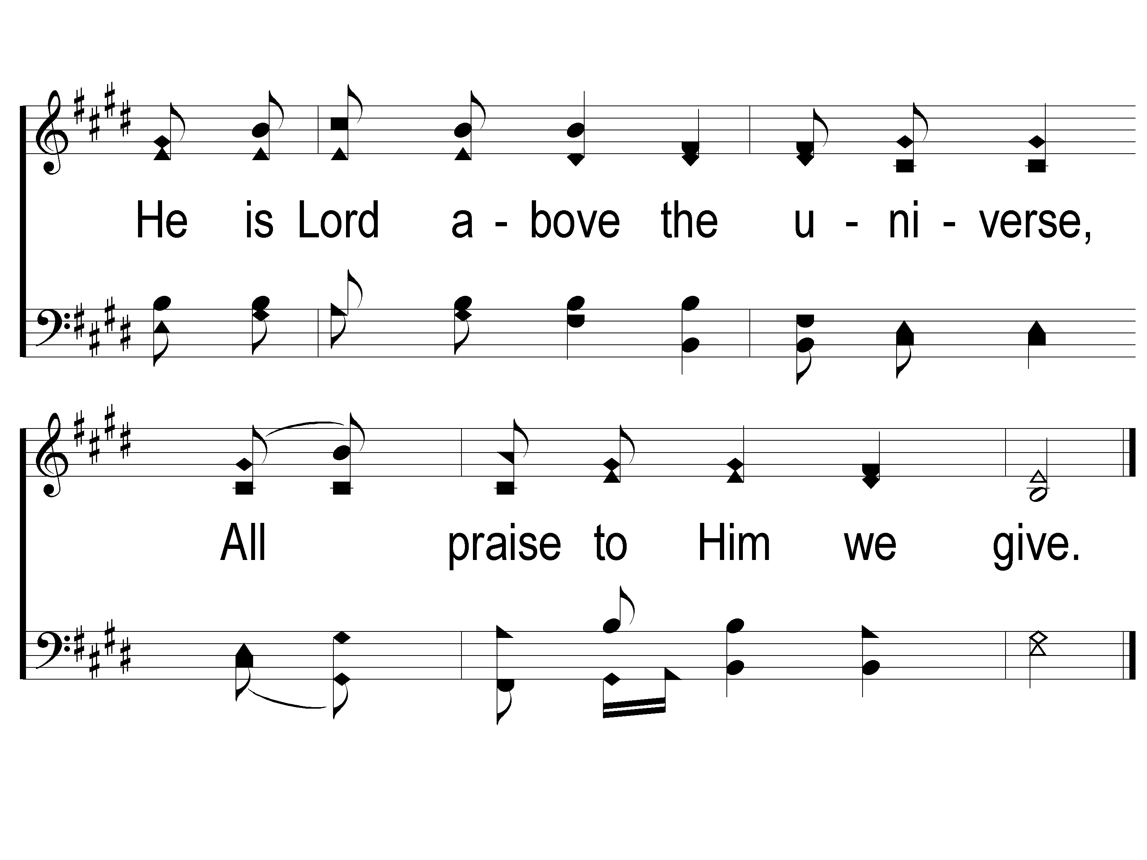
3-2 We Will Glorify
We Will Glorify
578

Slide 7
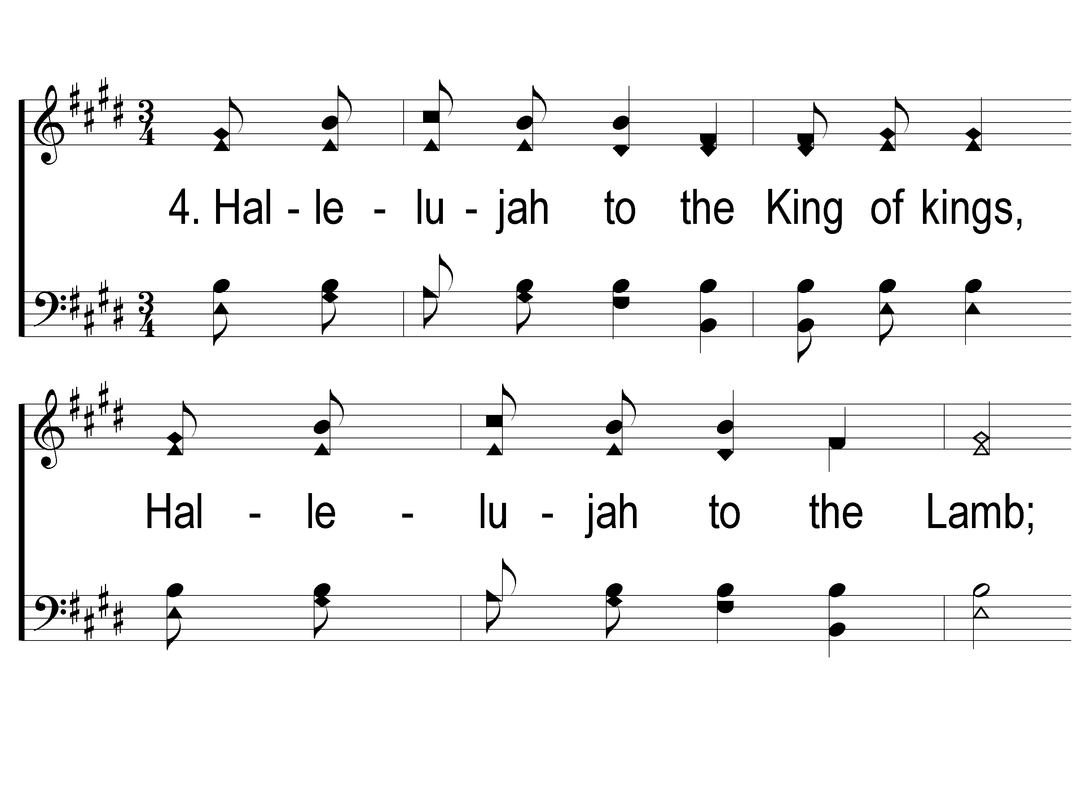
4-1 We Will Glorify
We Will Glorify
578

Slide 8
4-2 We Will Glorify
We Will Glorify
578

Slide 9
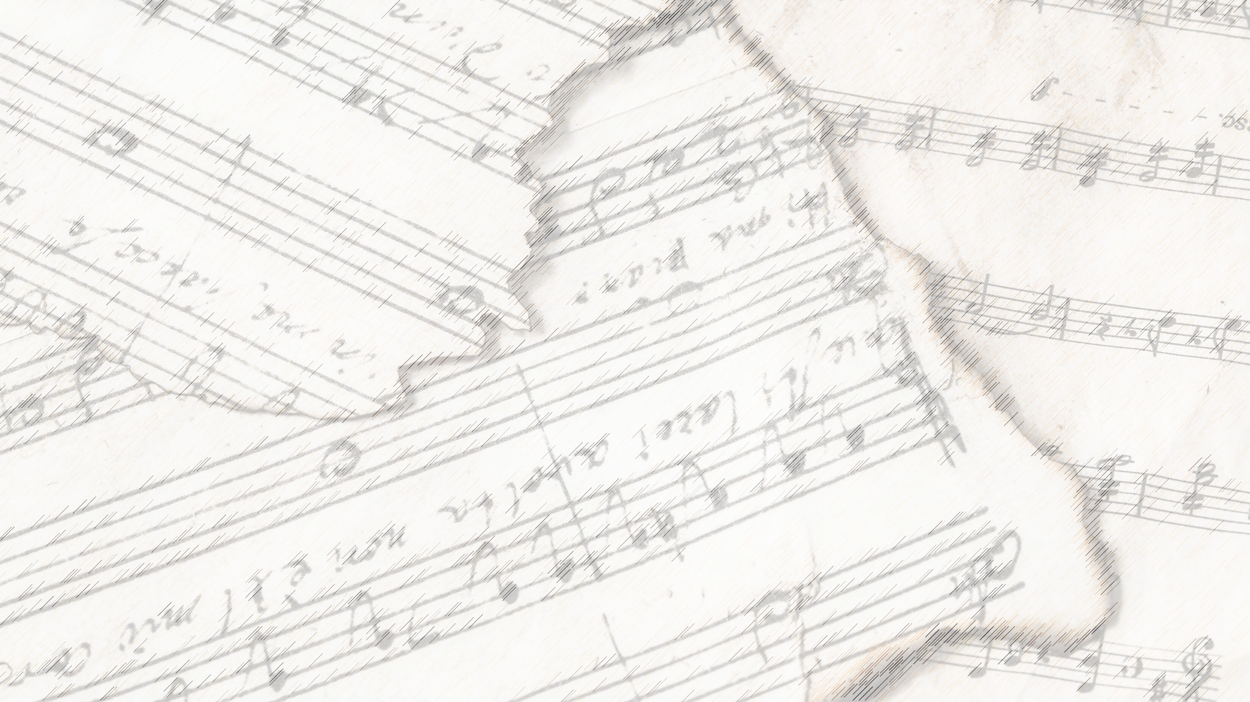
Welcome!
We Are Glad You Are Here

Slide 10
Redeemed
#458

Slide 11
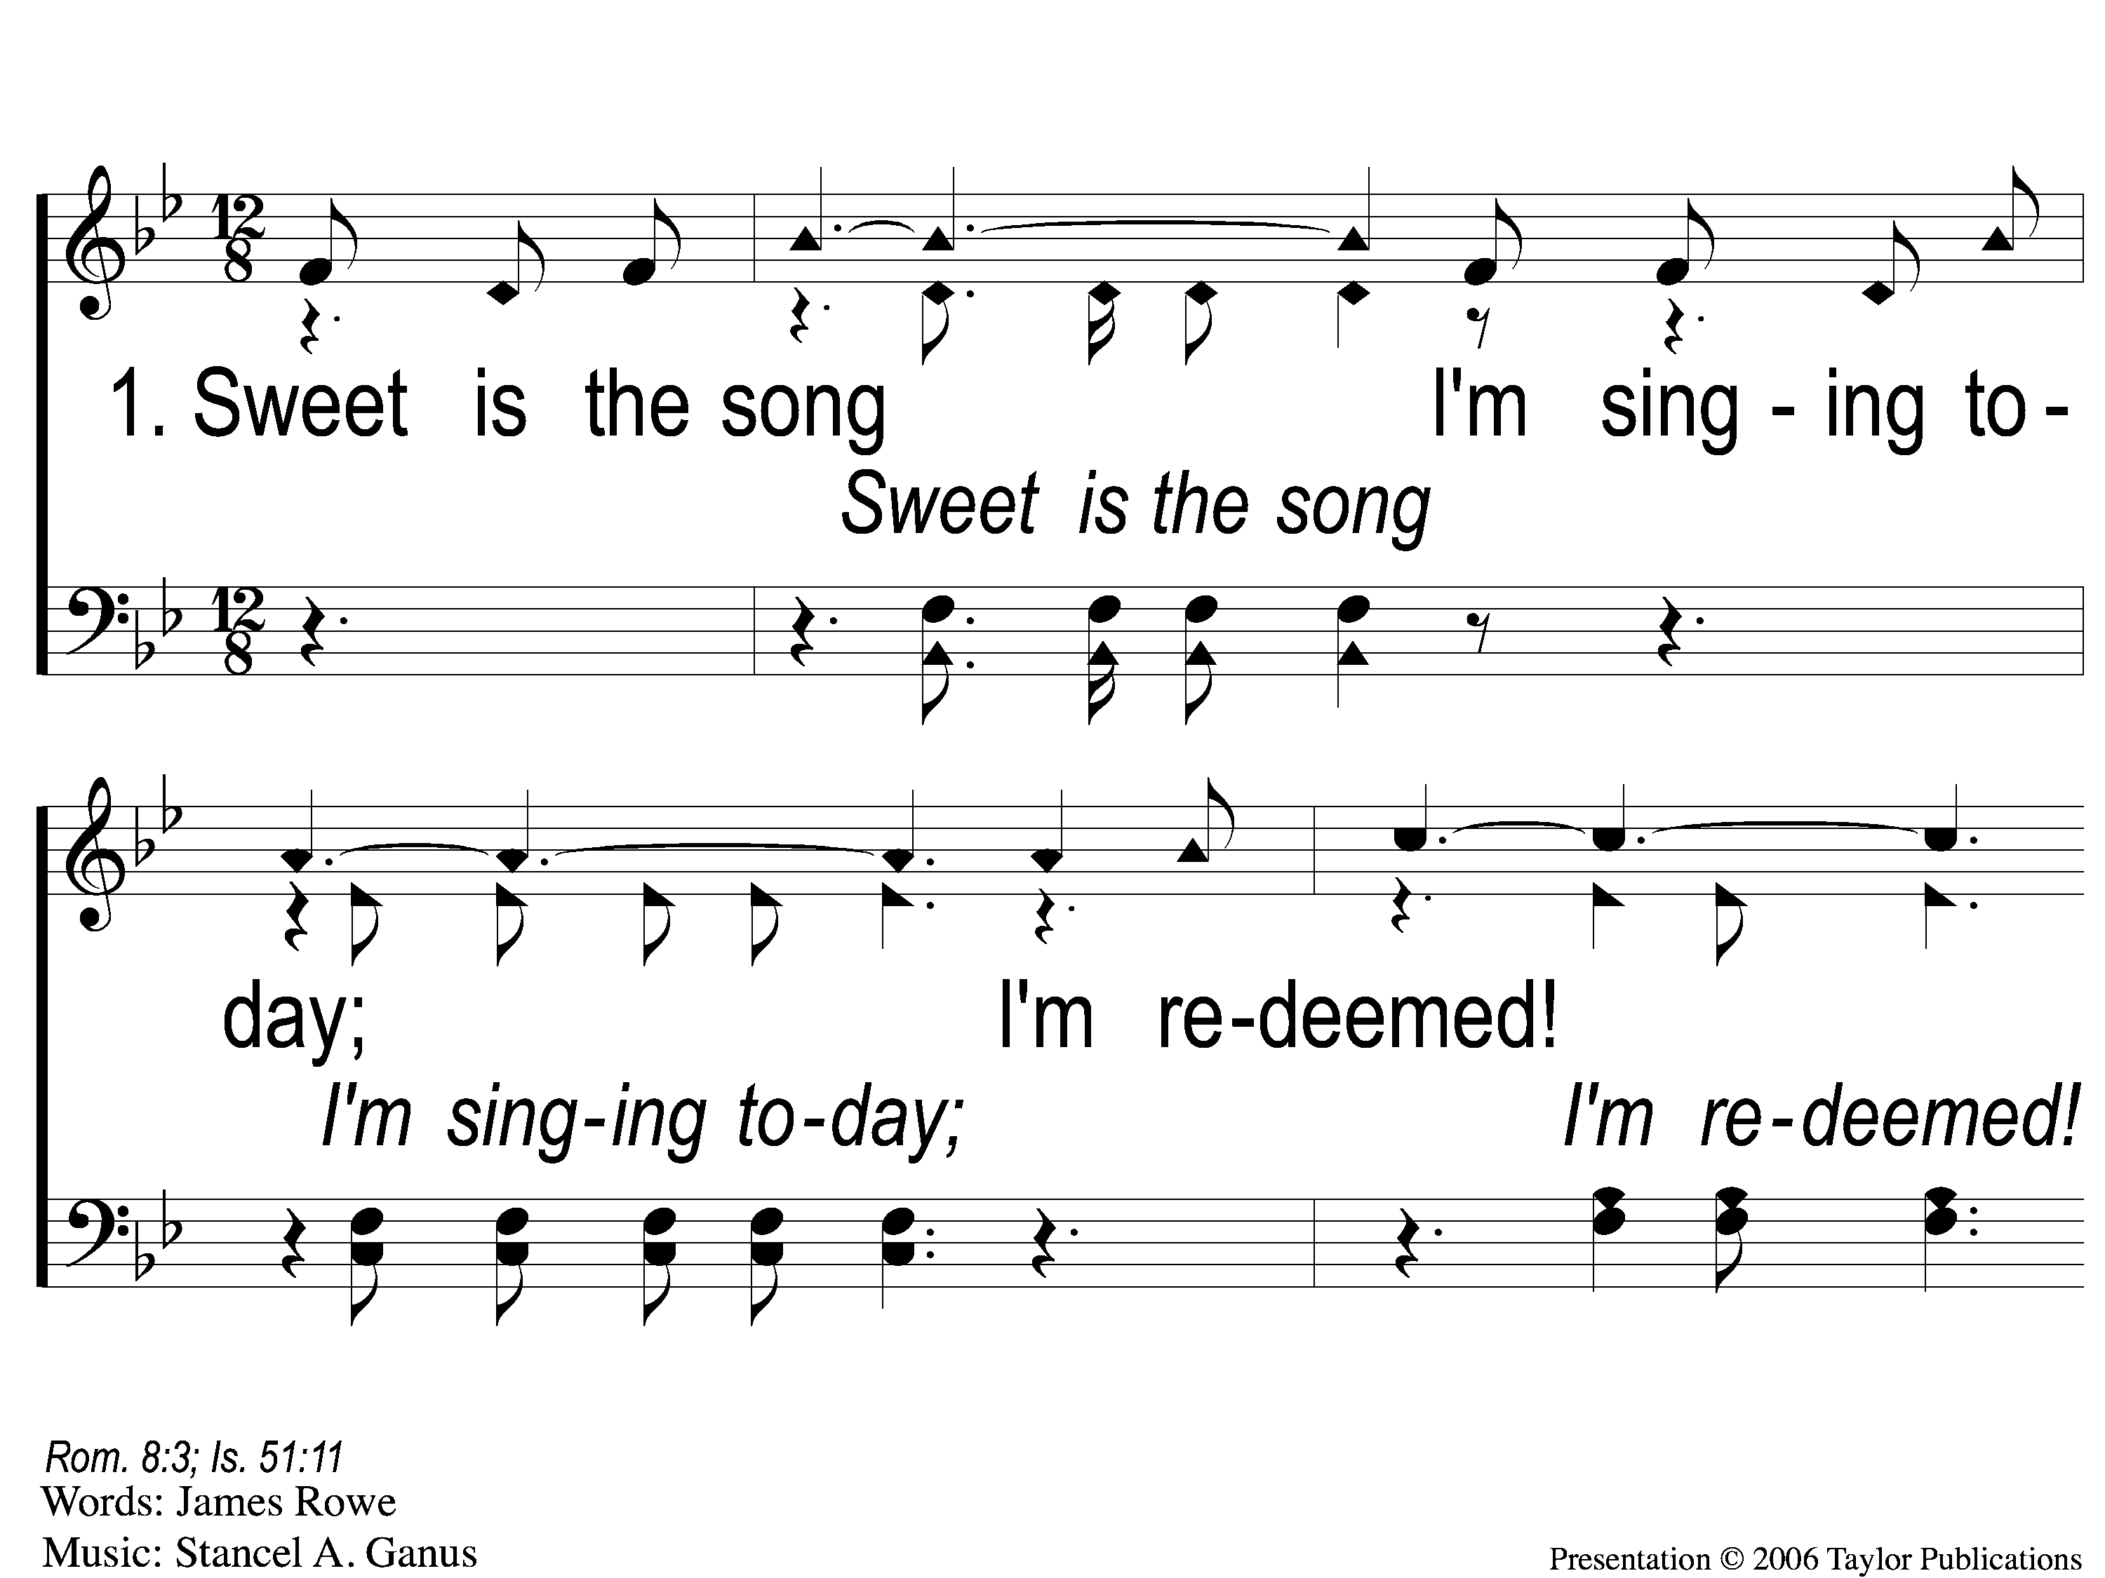
1-1 Redeemed - Sweet is the Song
Redeemed
458

Slide 12
1-2 Redeemed - Sweet is the Song
Redeemed
458

Slide 13
1-3 Redeemed - Sweet is the Song
Redeemed
458

Slide 14
C-1 Redeemed - Sweet is the Song
Redeemed
458

Slide 15
C-2 Redeemed - Sweet is the Song
Redeemed
458

Slide 16
3-1 Redeemed - Sweet is the Song
Redeemed
458

Slide 17
3-2 Redeemed - Sweet is the Song
Redeemed
458

Slide 18
3-3 Redeemed - Sweet is the Song
Redeemed
458

Slide 19
C-1 Redeemed - Sweet is the Song
Redeemed
458

Slide 20
C-2 Redeemed - Sweet is the Song
Redeemed
458

Slide 21
1-1 I Know That My Redeemer Lives
I Know That My Redeemer Lives
528

Slide 22
1-2 I Know That My Redeemer Lives
I Know That My Redeemer Lives
528

Slide 23
C-1 I Know That My Redeemer Lives
I Know That My Redeemer Lives
528

Slide 24
C-2 I Know That My Redeemer Lives
I Know That My Redeemer Lives
528

Slide 25
4-1 I Know That My Redeemer Lives
I Know That My Redeemer Lives
528

Slide 26
4-2 I Know That My Redeemer Lives
I Know That My Redeemer Lives
528

Slide 27
C-1 I Know That My Redeemer Lives
I Know That My Redeemer Lives
528

Slide 28
C-2 I Know That My Redeemer Lives
I Know That My Redeemer Lives
528

Slide 29
I Walk With The King
#550

Slide 30
1-1 I Walk With the King
I Walk With The King
550

Slide 31
1-2 I Walk With the King
I Walk With The King
550

Slide 32
1-3 I Walk With the King
I Walk With The King
550

Slide 33
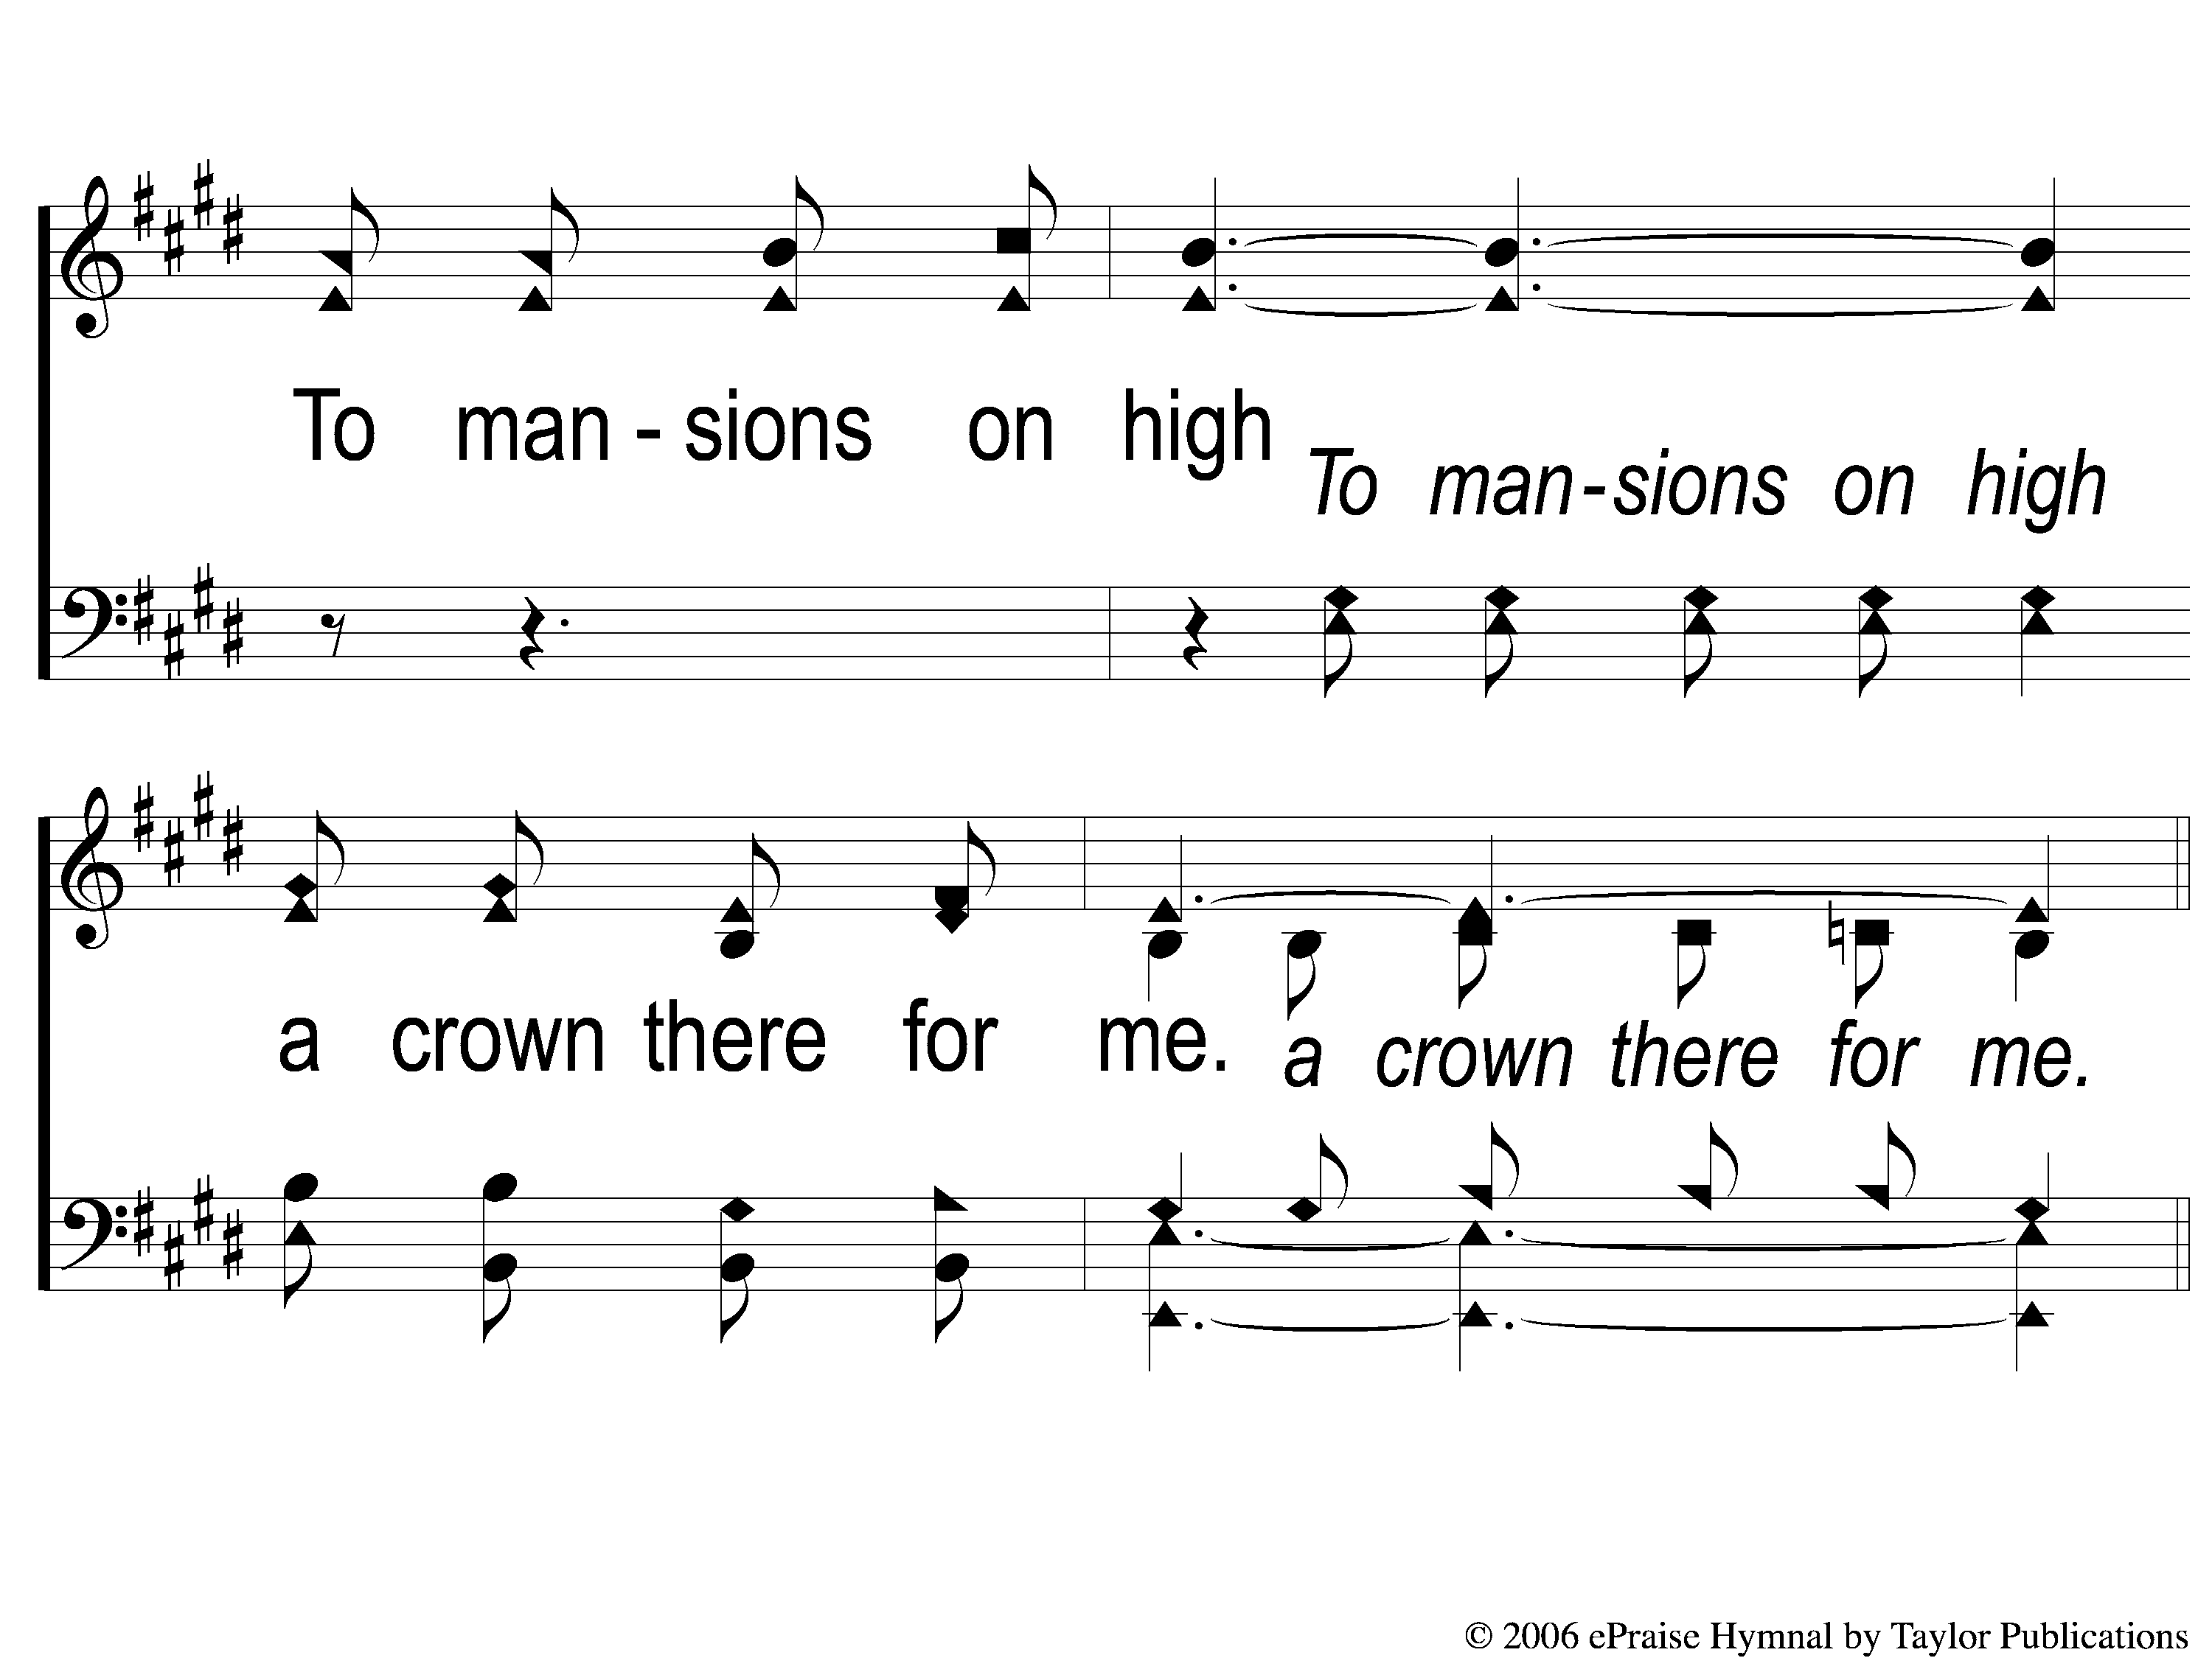
1-4 I Walk With the King
I Walk With The King
550

Slide 34
C-1 I Walk With the King
I Walk With The King
550

Slide 35
C-2 I Walk With the King
I Walk With The King
550

Slide 36
C-3 I Walk With the King
I Walk With The King
550

Slide 37
C-4 I Walk With the King
I Walk With The King
550

Slide 38
3-1 I Walk With the King
I Walk With The King
550

Slide 39
3-2 I Walk With the King
I Walk With The King
550

Slide 40
3-3 I Walk With the King
I Walk With The King
550

Slide 41
3-4 I Walk With the King
I Walk With The King
550

Slide 42
C-1 I Walk With the King
I Walk With The King
550

Slide 43
C-2 I Walk With the King
I Walk With The King
550

Slide 44
C-3 I Walk With the King
I Walk With The King
550

Slide 45
C-4 I Walk With the King
I Walk With The King
550

Slide 46
Opening Prayer

Slide 47
A Hill Called
Mount Calvary
#373

Slide 48
1-1 A Hill Called Mount Calvary
A Hill Called Mount Calvary
373

Slide 49
1-2 A Hill Called Mount Calvary
A Hill Called Mount Calvary
373

Slide 50
C-1 A Hill Called Mount Calvary
A Hill Called Mount Calvary
373

Slide 51
C-2 A Hill Called Mount Calvary
A Hill Called Mount Calvary
373

Slide 52
2-1 A Hill Called Mount Calvary
A Hill Called Mount Calvary
373

Slide 53
2-2 A Hill Called Mount Calvary
A Hill Called Mount Calvary
373

Slide 54
C-1 A Hill Called Mount Calvary
A Hill Called Mount Calvary
373

Slide 55
C-2 A Hill Called Mount Calvary
A Hill Called Mount Calvary
373

Slide 56
3-1 A Hill Called Mount Calvary
A Hill Called Mount Calvary
373

Slide 57
3-2 A Hill Called Mount Calvary
A Hill Called Mount Calvary
373

Slide 58
C-1 A Hill Called Mount Calvary
A Hill Called Mount Calvary
373

Slide 59
C-2 A Hill Called Mount Calvary
A Hill Called Mount Calvary
373

Slide 60
Kneel At The Cross
#945

Slide 61
1-1 Kneel At the Cross
Kneel At the Cross
945

Slide 62
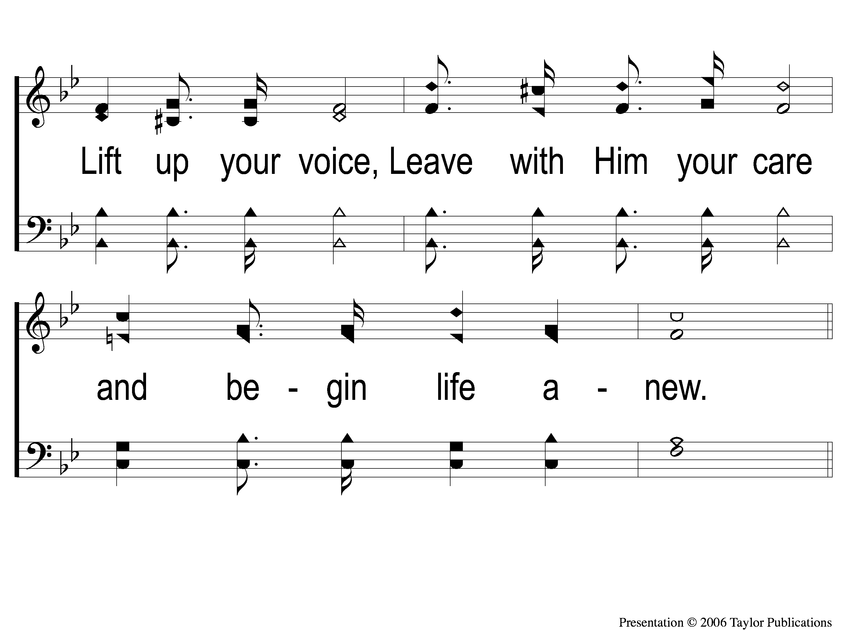
1-2 Kneel At the Cross
Kneel At the Cross
945

Slide 63
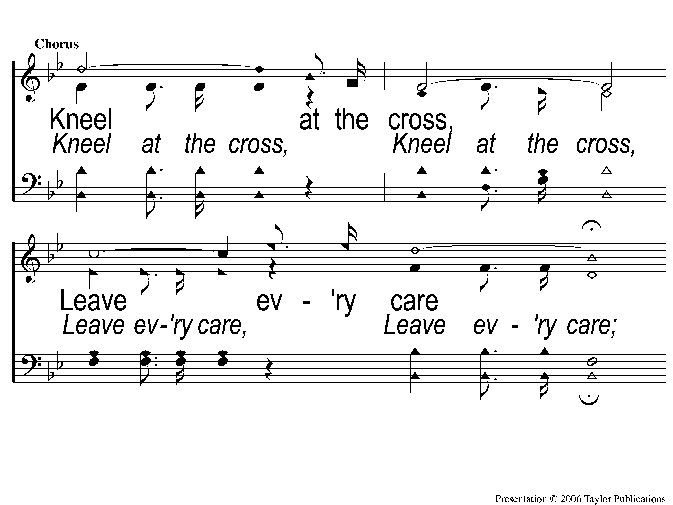
C-1 Kneel At the Cross
Kneel At the Cross
945

Slide 64
C-2 Kneel At the Cross
Kneel At the Cross
945

Slide 65
2-1 Kneel At the Cross
Kneel At the Cross
945

Slide 66
2-2 Kneel At the Cross
Kneel At the Cross
945

Slide 67
C-1 Kneel At the Cross
Kneel At the Cross
945

Slide 68
C-2 Kneel At the Cross
Kneel At the Cross
945

Slide 69
3-1 Kneel At the Cross
Kneel At the Cross
945

Slide 70
3-2 Kneel At the Cross
Kneel At the Cross
945

Slide 71
C-1 Kneel At the Cross
Kneel At the Cross
945

Slide 72
C-2 Kneel At the Cross
Kneel At the Cross
945

Slide 73
Scripture Reading:
Colossians 3: 1-3

Slide 74
Songs About
Standing Firm

Slide 75
Kneel at the Cross

Slide 76
Kneeling at the Cross Requires:

Slide 77
Kneeling at the Cross Requires:
Leaving your Cares & Transforming your Life

Slide 78
Verse 1:
"Kneel at the cross, Christ will meet you there,
Come while He waits for you;
Lift up your voice, Leave with Him your care,
And begin life anew."

Slide 79
Leaving your Cares
Jesus Is Waiting For You
Matt. 6:25-34, 11: 28-30
Jn. 14: 1-4
Phili. 4: 6

Slide 80
Leaving your Cares
How?
Phili. 4: 6-9
Jms. 5: 13
Lk. 18: 1
Rom. 8: 26

Slide 81
Kneeling at the Cross Requires:
Leaving your Cares & Transforming your Life

Slide 82
Kneeling at the Cross Requires:
Leaving your Cares & Transforming your Life
Leaving your Pride & Being Anchored in Christ

Slide 83
Verse 2:
"Kneel at the cross, There is room for all
Who would His glory share;
Bliss there awaits, Harm can ne’er befall
Those who are anchored there."

Slide 84
Leaving your Pride
Humility Is Required
Psa. 149: 4
Prov. 11: 2, 16: 19
Matt. 5: 3, 18: 4
Rom. 12: 16– Phili. 2:5-9

Slide 85
Kneeling at the Cross Requires:
Leaving your Cares & Transforming your Life
Leaving your Pride & Being Anchored in Christ

Slide 86
Kneeling at the Cross Requires:
Leaving your Cares & Transforming your Life
Leaving your Pride & Being Anchored in Christ
Leaving your Idols & Looking to Jesus

Slide 87
Verse 3:
"Kneel at the cross, Give your idols up,
Look unto realms above;
Turn not again To life’s sparkling cup;
Trust always in His love."

Slide 88
Leaving your Idols
Idolatry
Ex. 20: 1-3
1 Ki. 15: 9-12

Slide 89
Leaving your Idols
How?
Col. 3: 1-3
Phili. 3: 20
Matt. 16: 23– Lk. 9: 62
Gen. 19: 26

Slide 90
Have you Kneeled
at the Cross?

Slide 91
Kneel At The Cross
#945

Slide 92
1-1 Kneel At the Cross
Kneel At the Cross
945

Slide 93
1-2 Kneel At the Cross
Kneel At the Cross
945

Slide 94
C-1 Kneel At the Cross
Kneel At the Cross
945

Slide 95
C-2 Kneel At the Cross
Kneel At the Cross
945

Slide 96
2-1 Kneel At the Cross
Kneel At the Cross
945

Slide 97
2-2 Kneel At the Cross
Kneel At the Cross
945

Slide 98
C-1 Kneel At the Cross
Kneel At the Cross
945

Slide 99
C-2 Kneel At the Cross
Kneel At the Cross
945

Slide 100
3-1 Kneel At the Cross
Kneel At the Cross
945

Slide 101
3-2 Kneel At the Cross
Kneel At the Cross
945

Slide 102
C-1 Kneel At the Cross
Kneel At the Cross
945

Slide 103
C-2 Kneel At the Cross
Kneel At the Cross
945

Slide 104
Our Offering
“I have shown you in every way, by laboring like this, that you must support the weak. And remember the words of the Lord Jesus, that He said, ‘It is more blessed to give than to receive.’ ” - Acts 20: 35

Slide 105
In Need

Slide 106
1 In Need
342
In Need
CCLI#645323

Slide 107
2 In Need
342
In Need

Slide 108
3 In Need
342
In Need

Slide 109
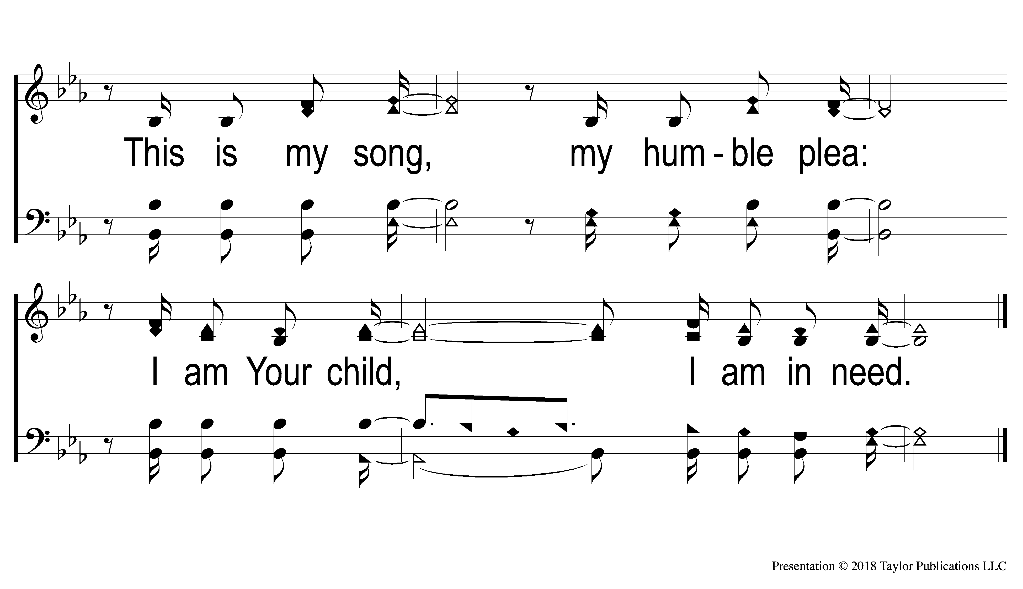
4 In Need
342
In Need

Slide 110
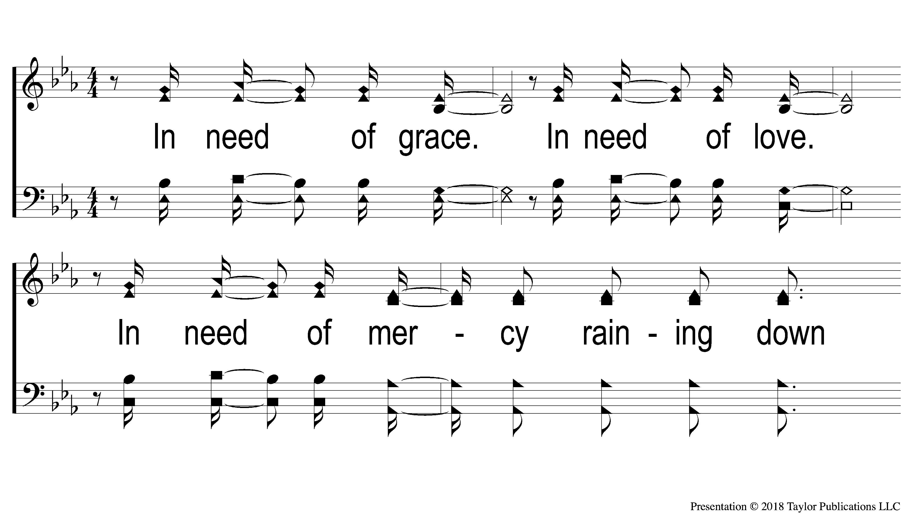
5 In Need
342
In Need

Slide 111
6 In Need
342
In Need

Slide 112
7 In Need
342
In Need

Slide 113
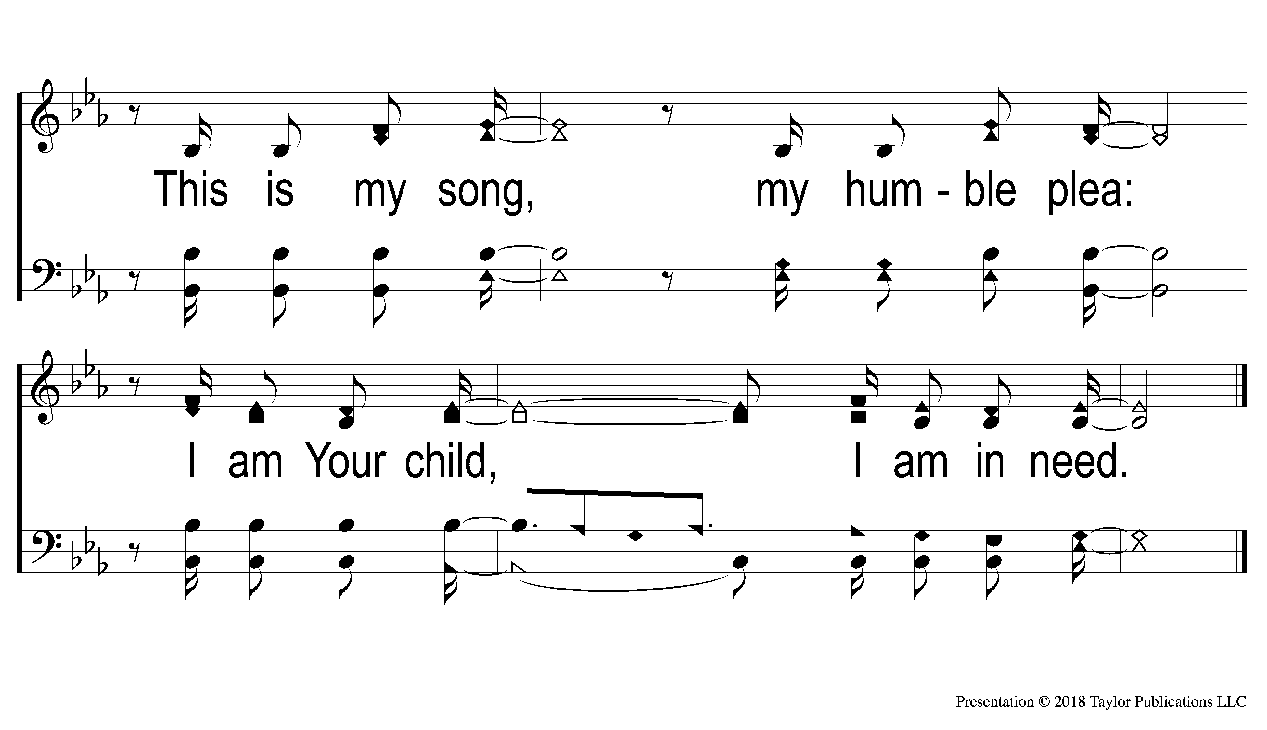
8 In Need
342
In Need

Slide 114
The Lord’s Supper
Acts 20:7

Slide 115
The Unleavened Bread
”There is therefore now no condemnation to those who are in Christ Jesus, who do not walk according to the flesh, but according to the Spirit. For the law of the Spirit of life in Christ Jesus has made me free from the law of sin and death.”
- Romans 8: 1-2

Slide 116
The Fruit of the Vine
“What then shall we say to these things? If God is for us, who can be against us? He who did not spare His own Son, but delivered Him up for us all, how shall He not with Him also freely give us all things?” – Romans 8: 31-32

Slide 117
Closing Prayer

Slide 118
Sing & Be Happy
#587

Slide 119
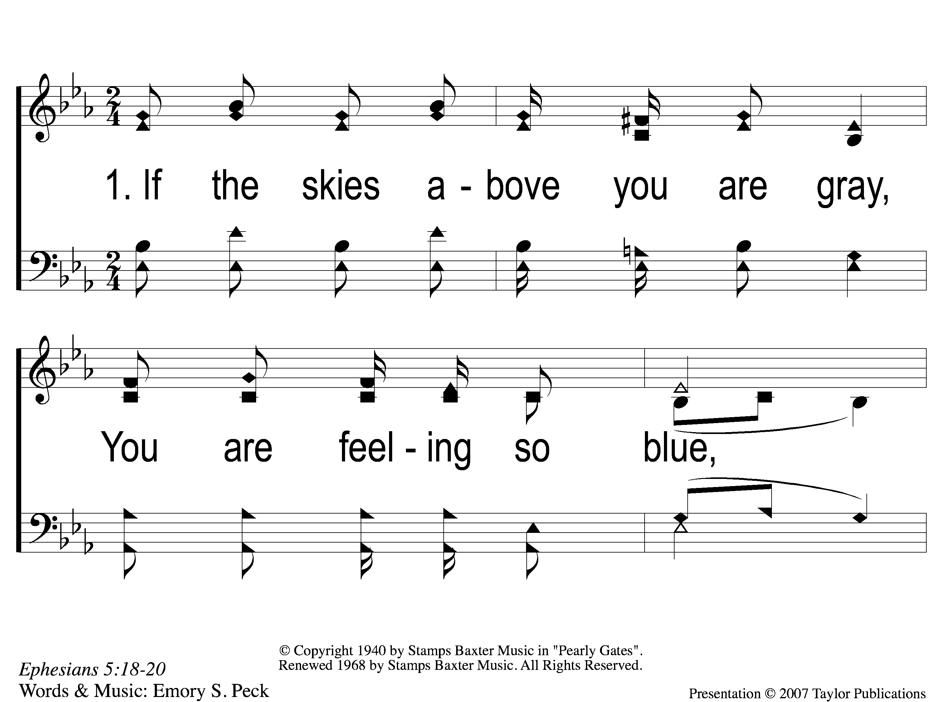
1-1 Sing and Be Happy
Sing and Be Happy
587

Slide 120
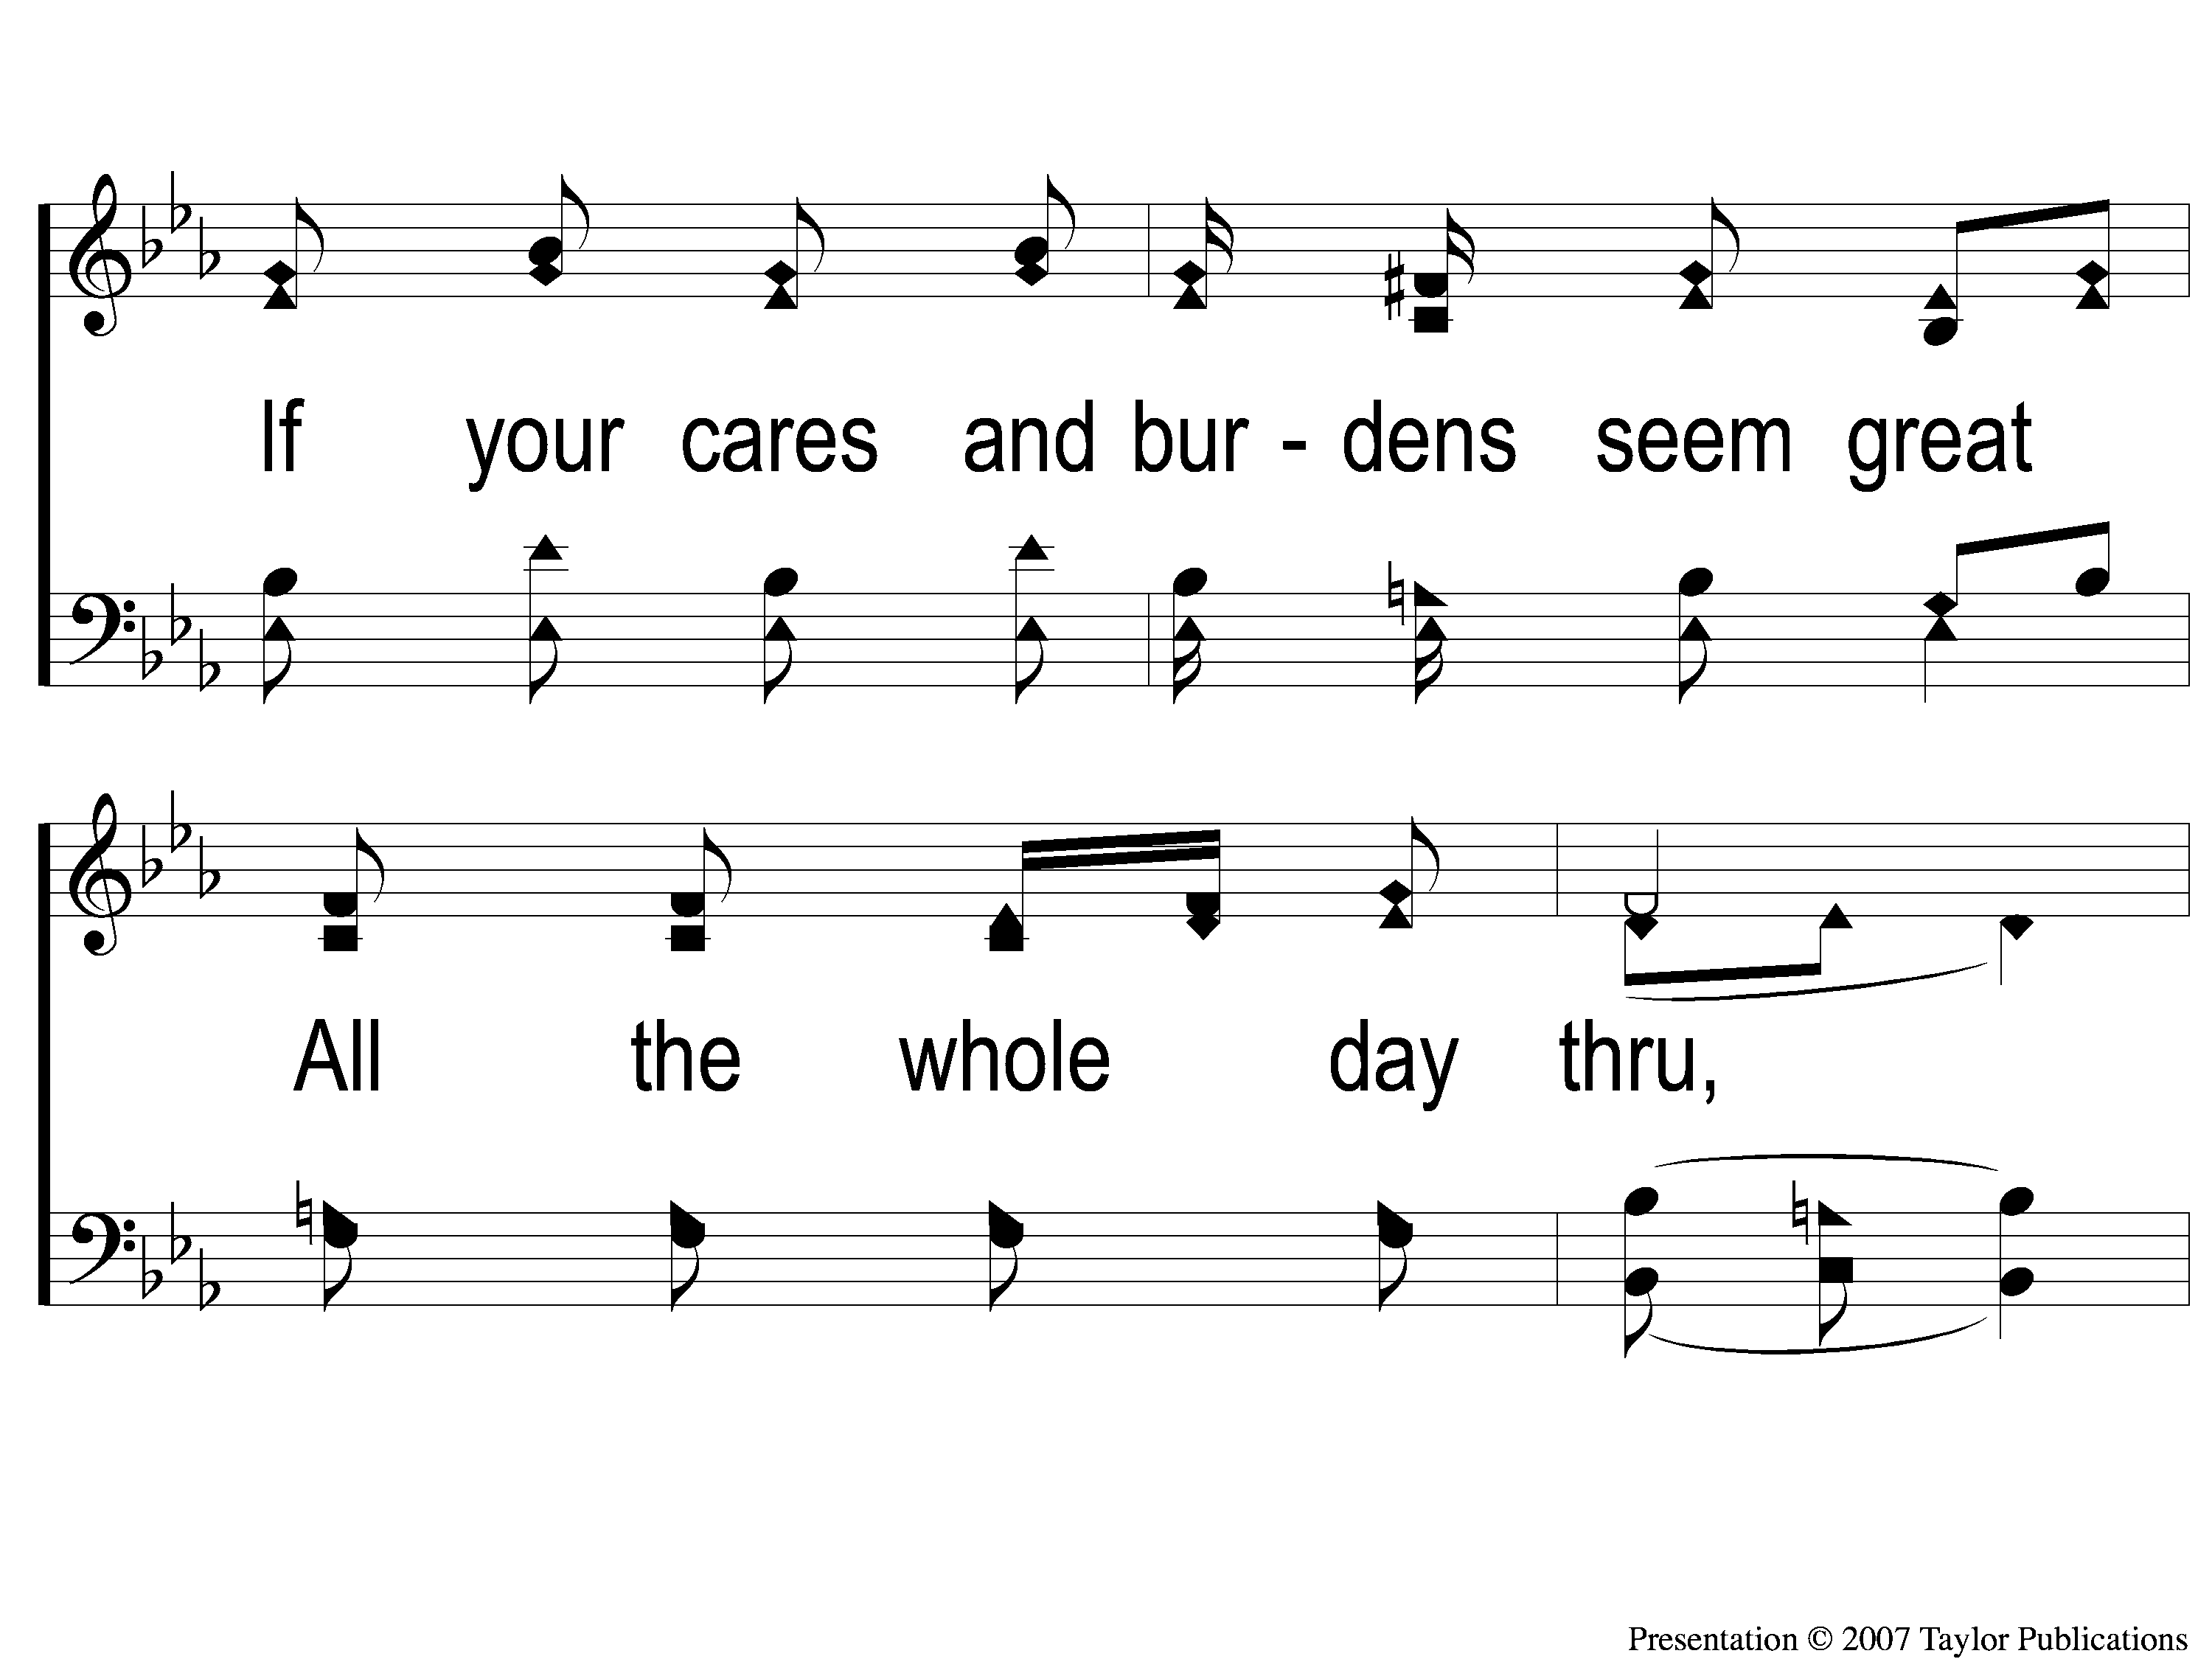
1-2 Sing and Be Happy
Sing and Be Happy
587

Slide 121
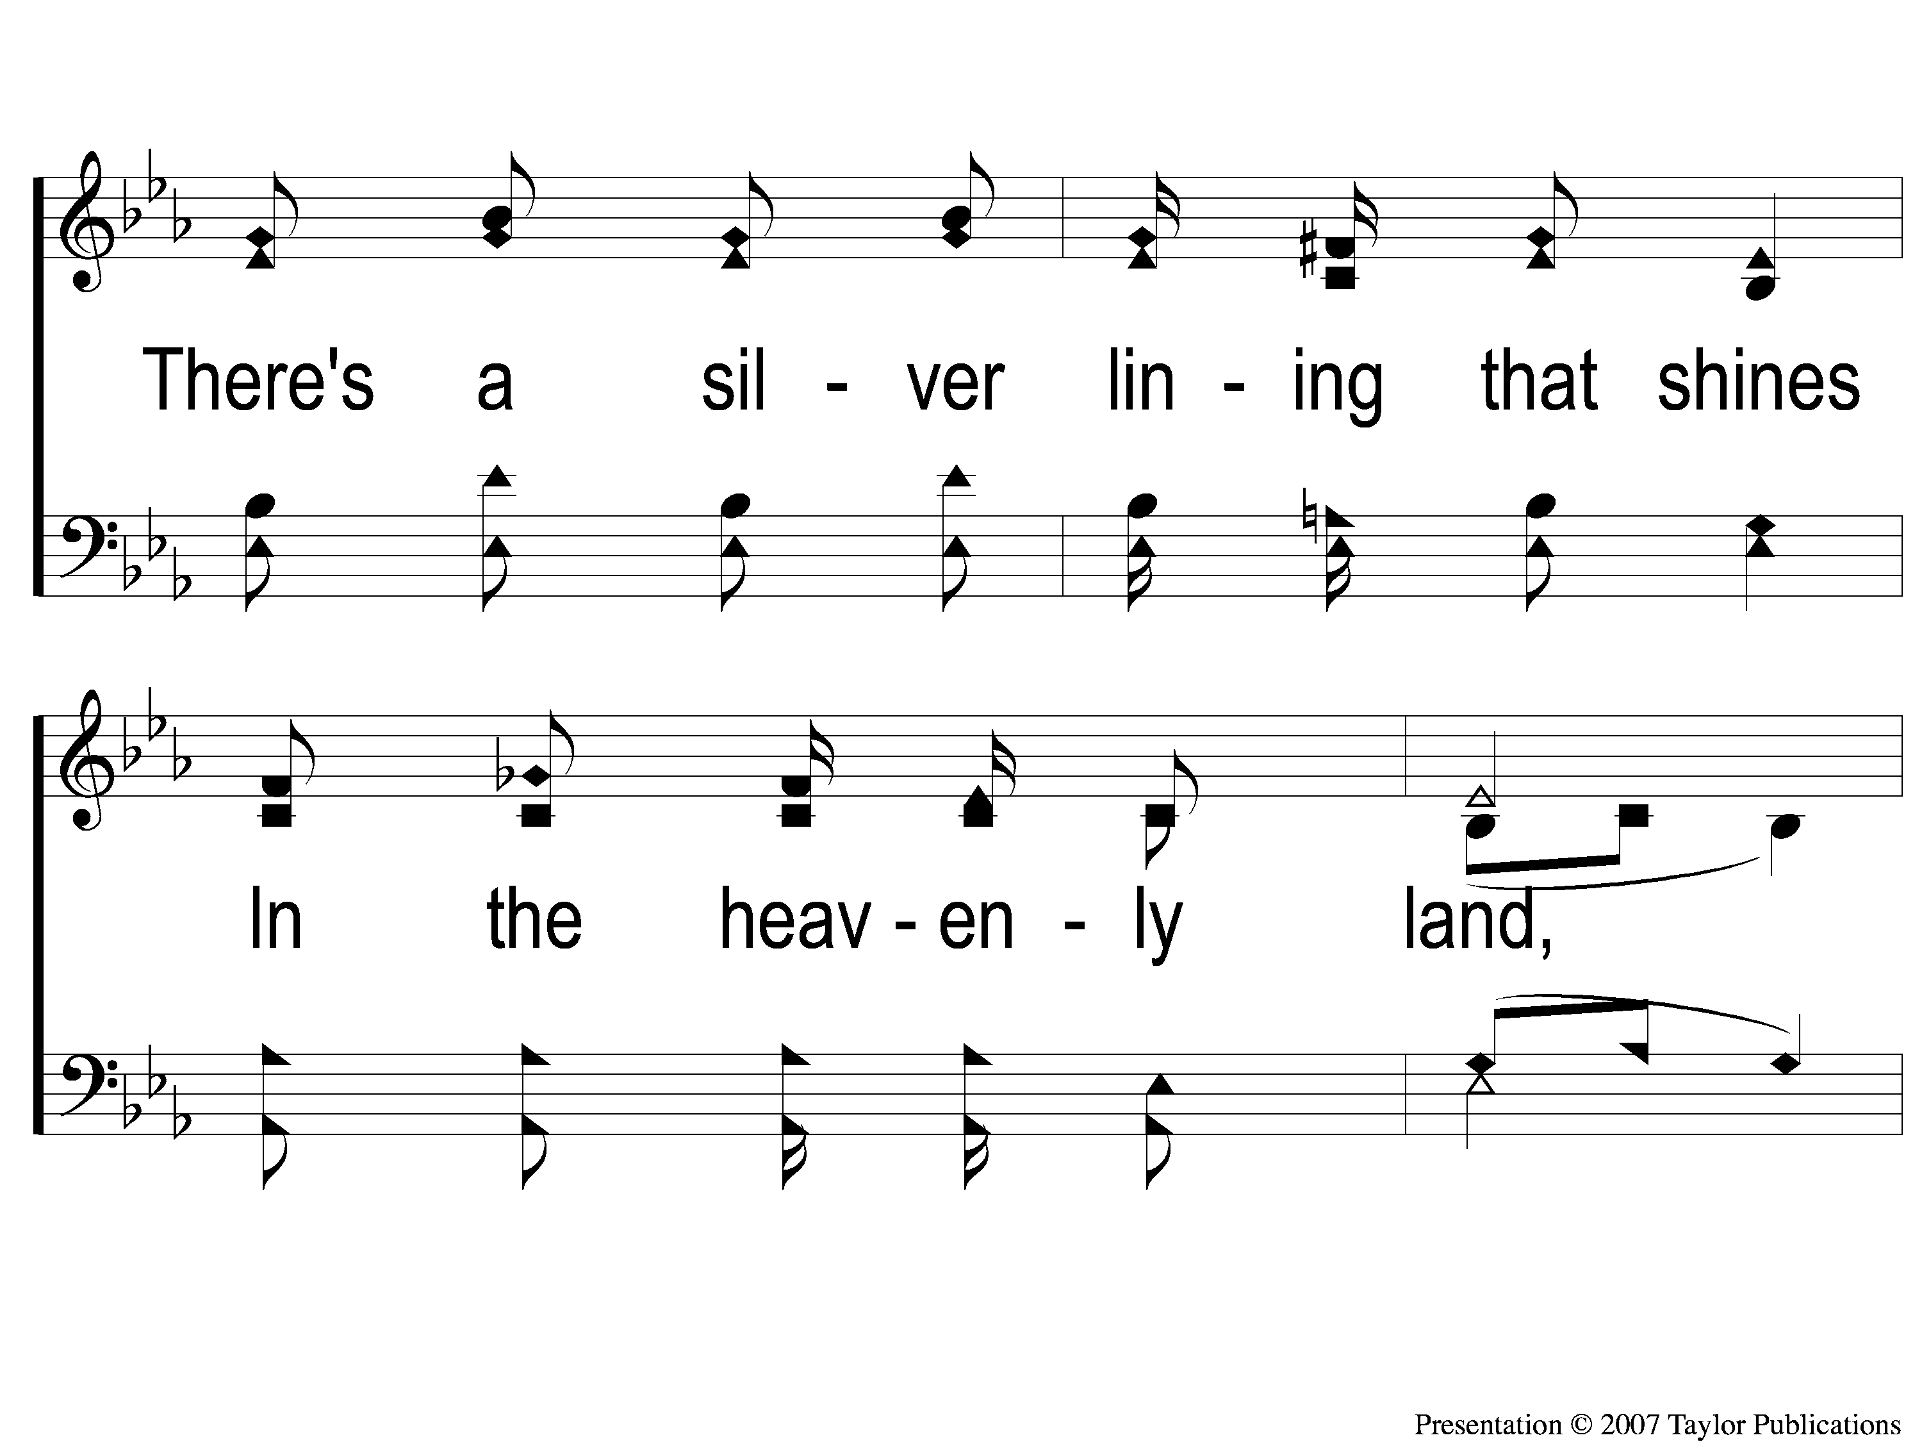
1-3 Sing and Be Happy
Sing and Be Happy
587

Slide 122
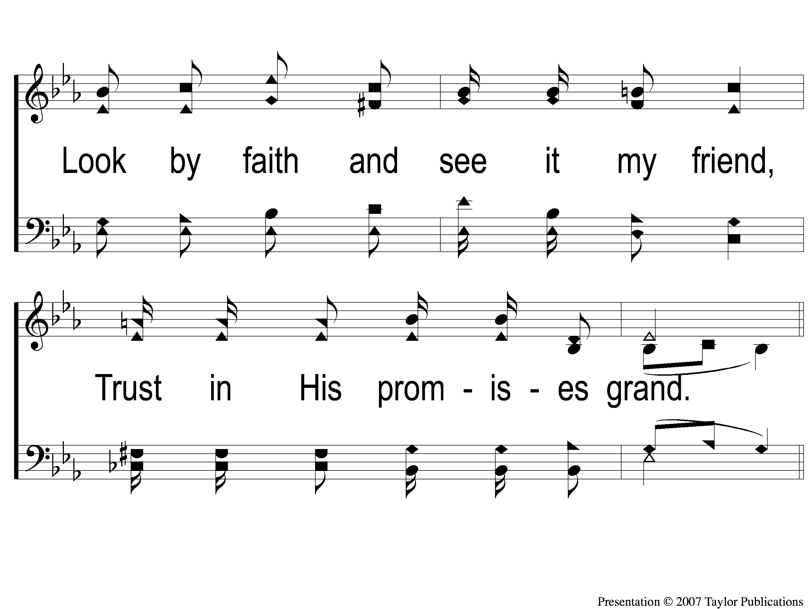
1-4 Sing and Be Happy
Sing and Be Happy
587

Slide 123
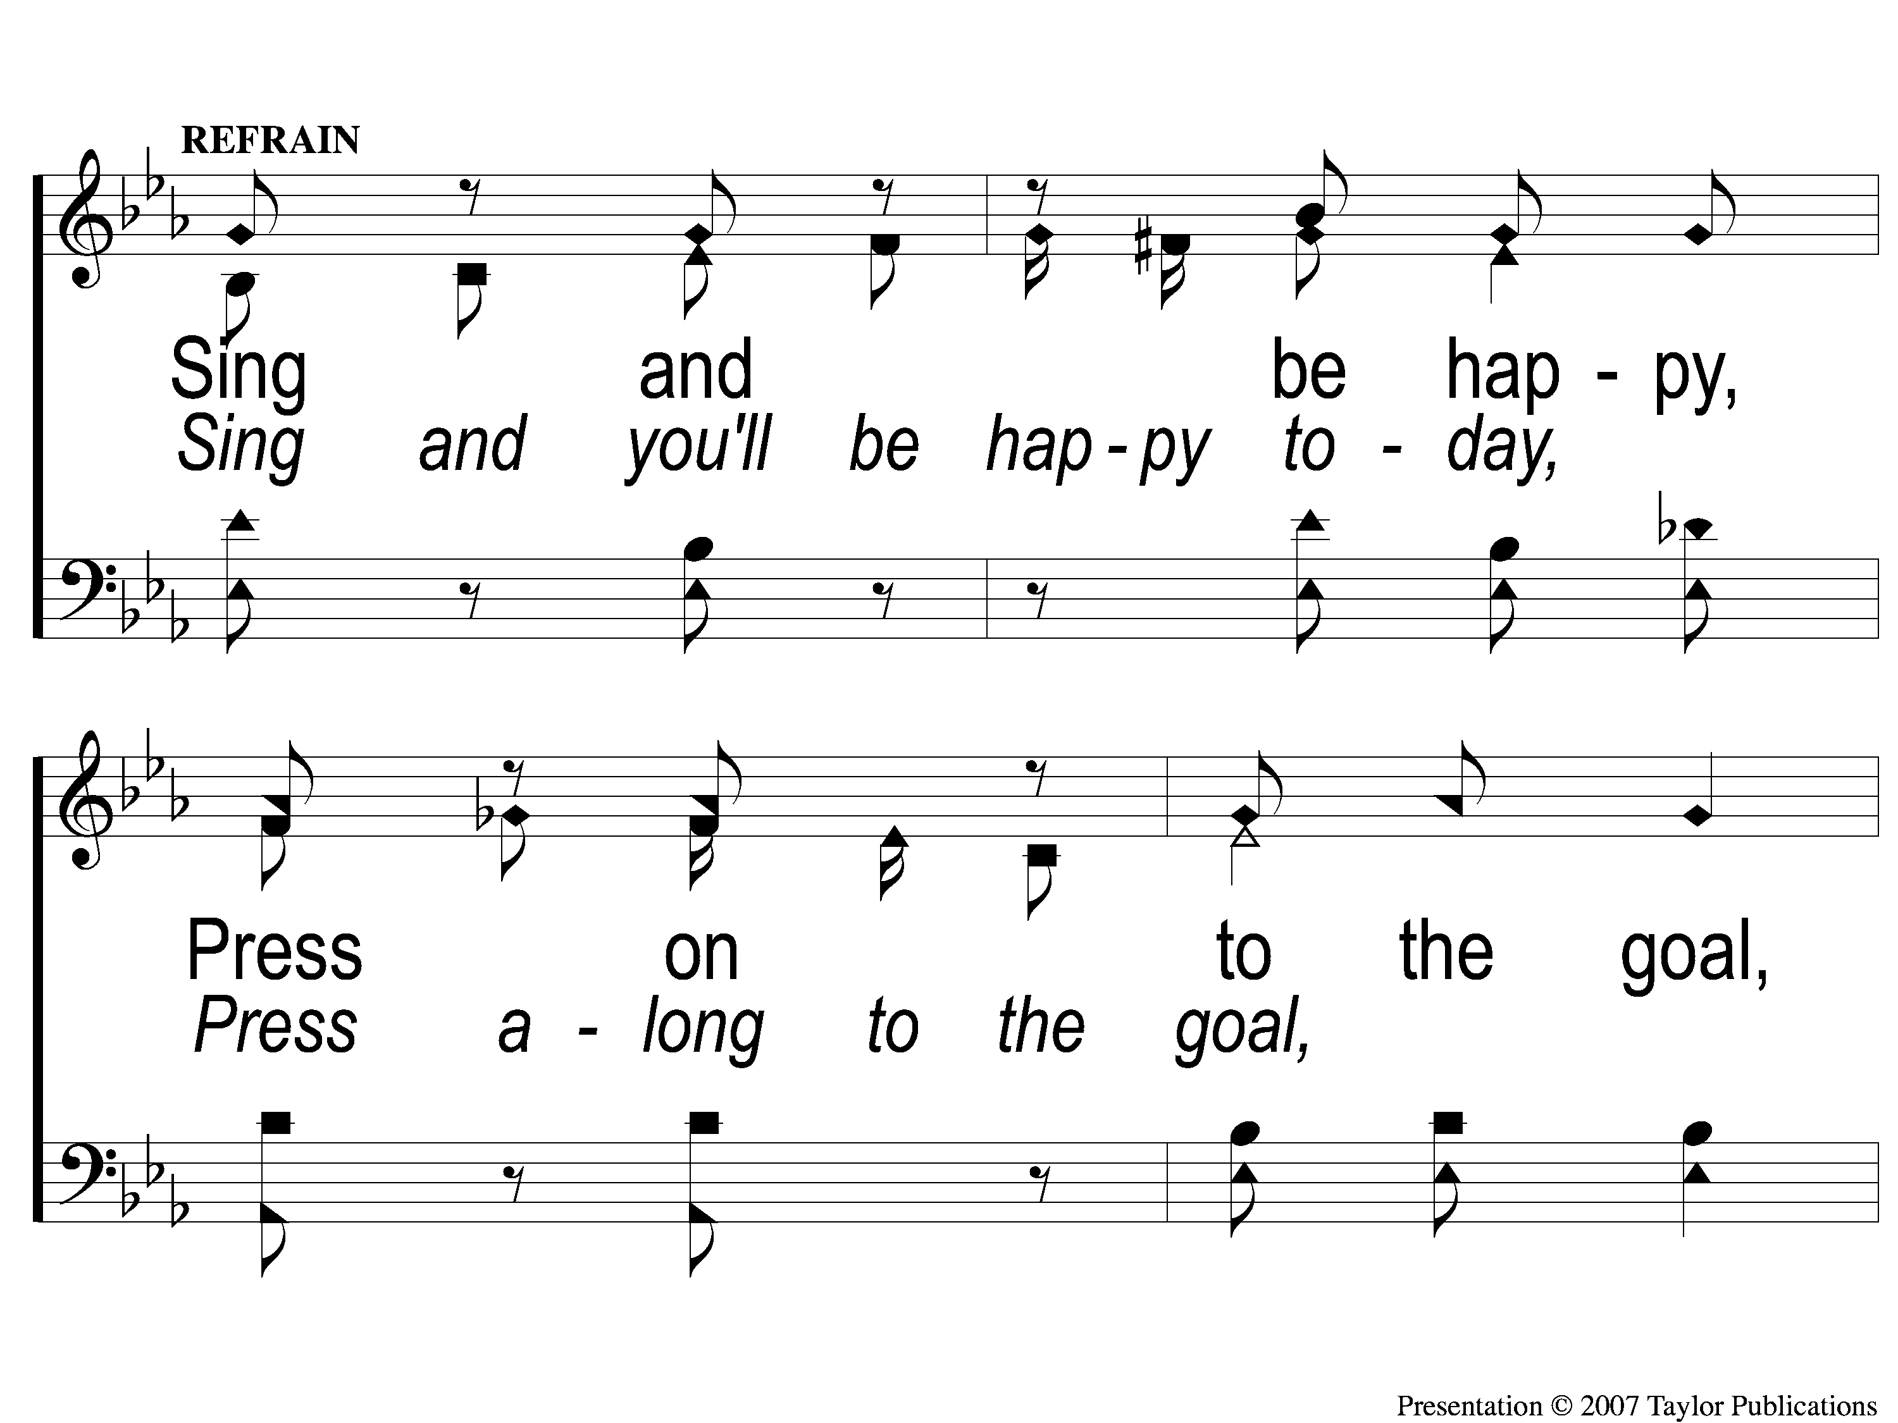
C-1 Sing and Be Happy
Sing and Be Happy
587

Slide 124
C-2 Sing and Be Happy
Sing and Be Happy
587

Slide 125
C-3 Sing and Be Happy
Sing and Be Happy
587

Slide 126
C-4 Sing and Be Happy
Sing and Be Happy
587

Slide 127
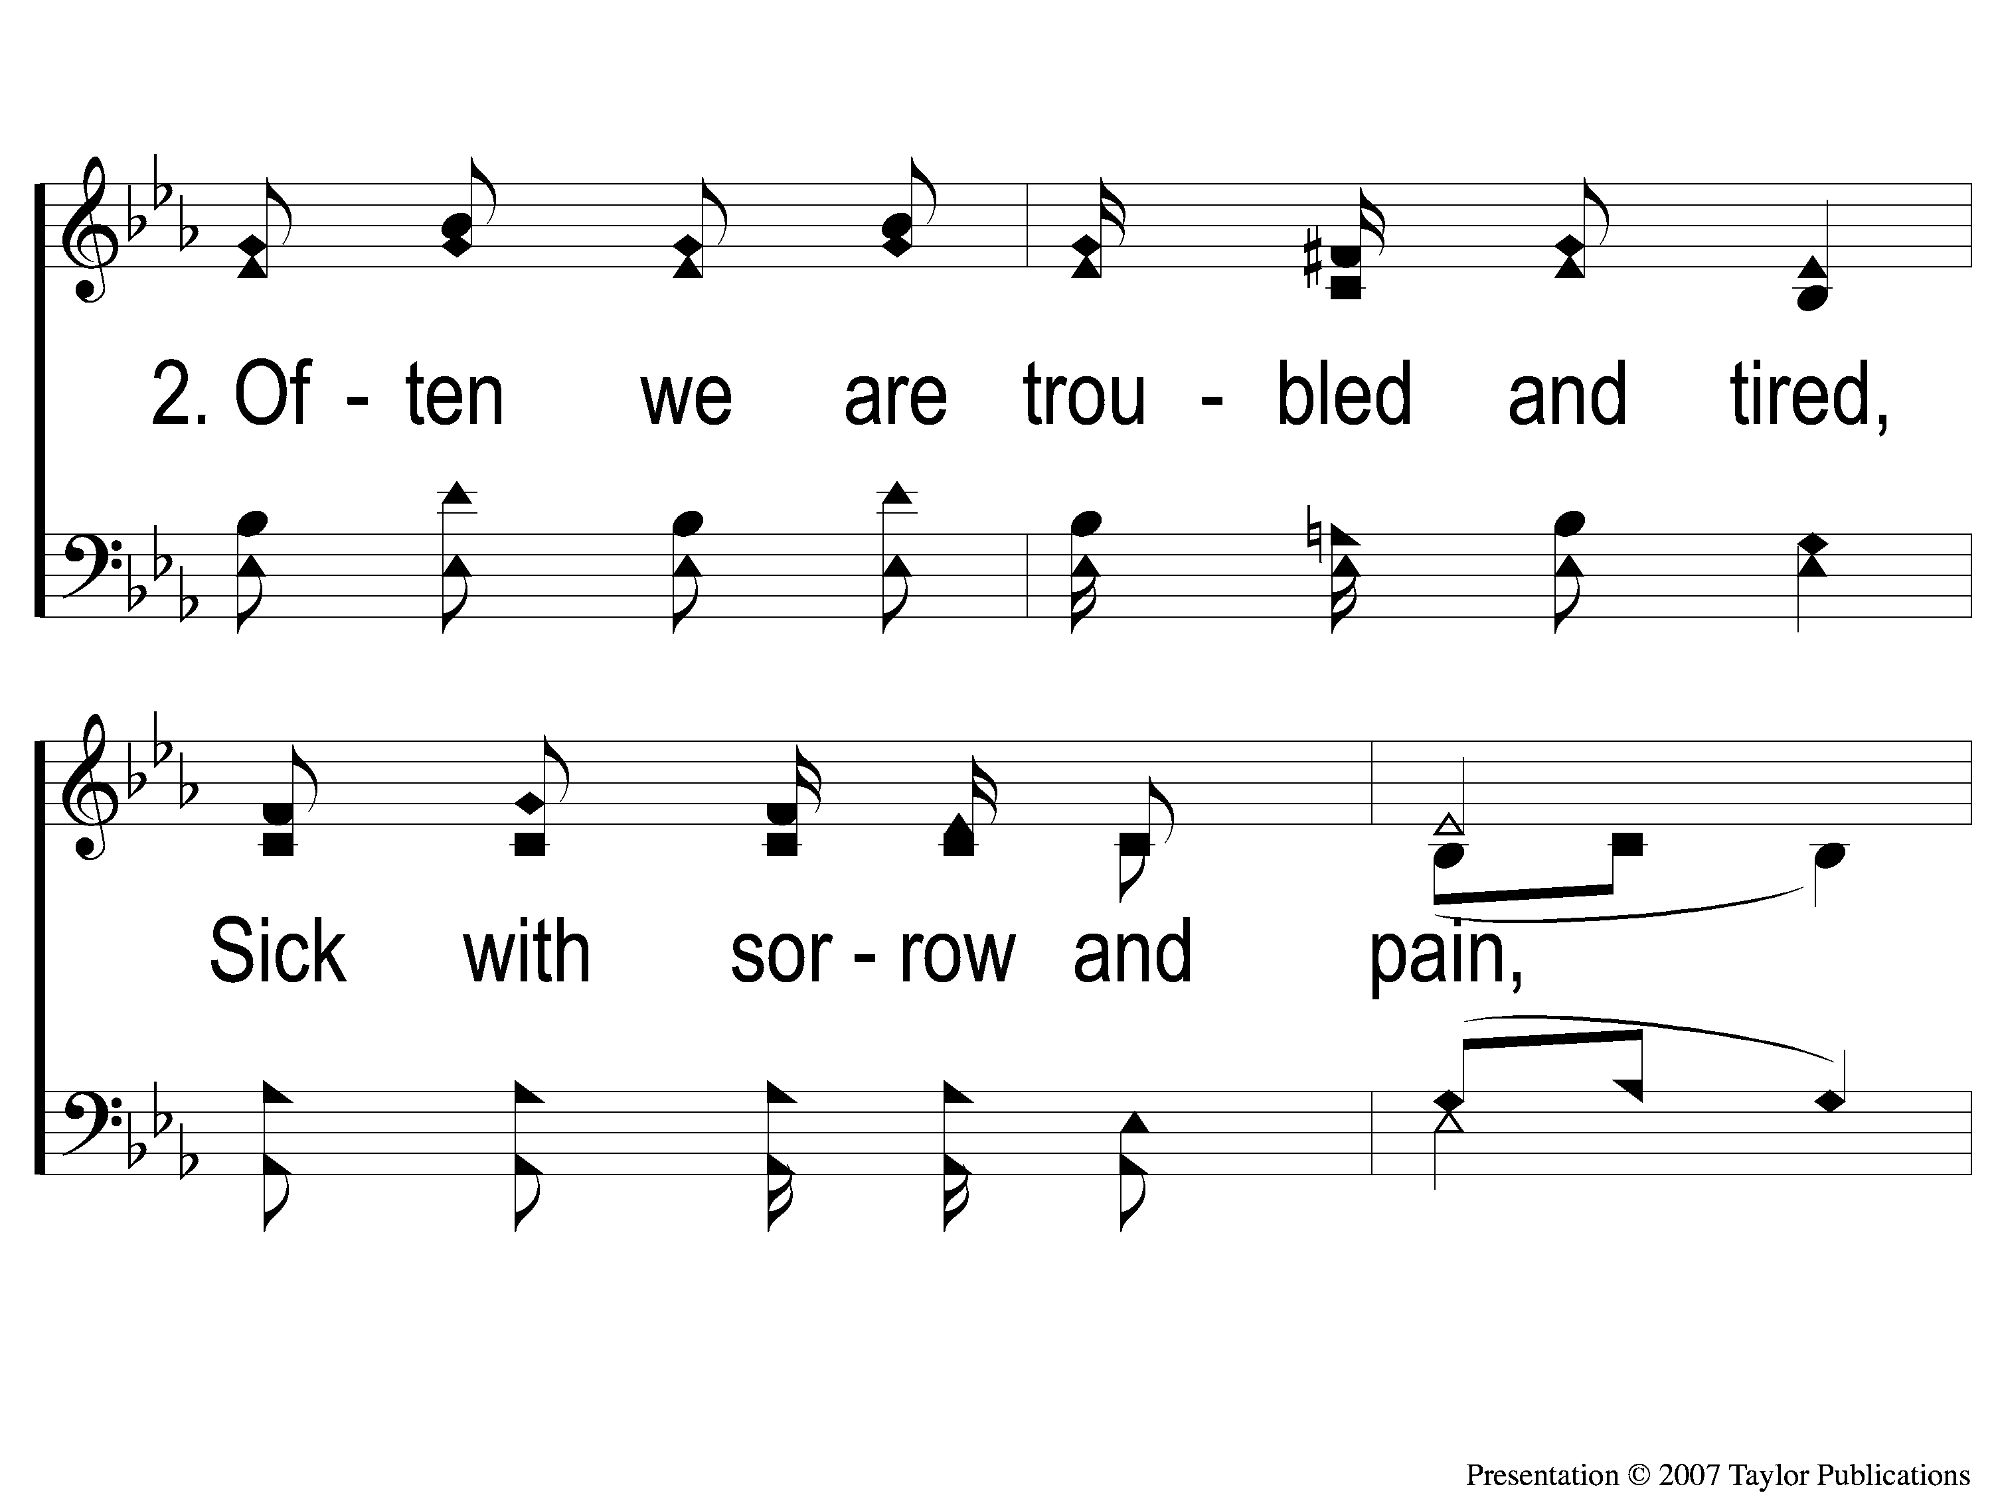
2-1 Sing and Be Happy
Sing and Be Happy
587

Slide 128
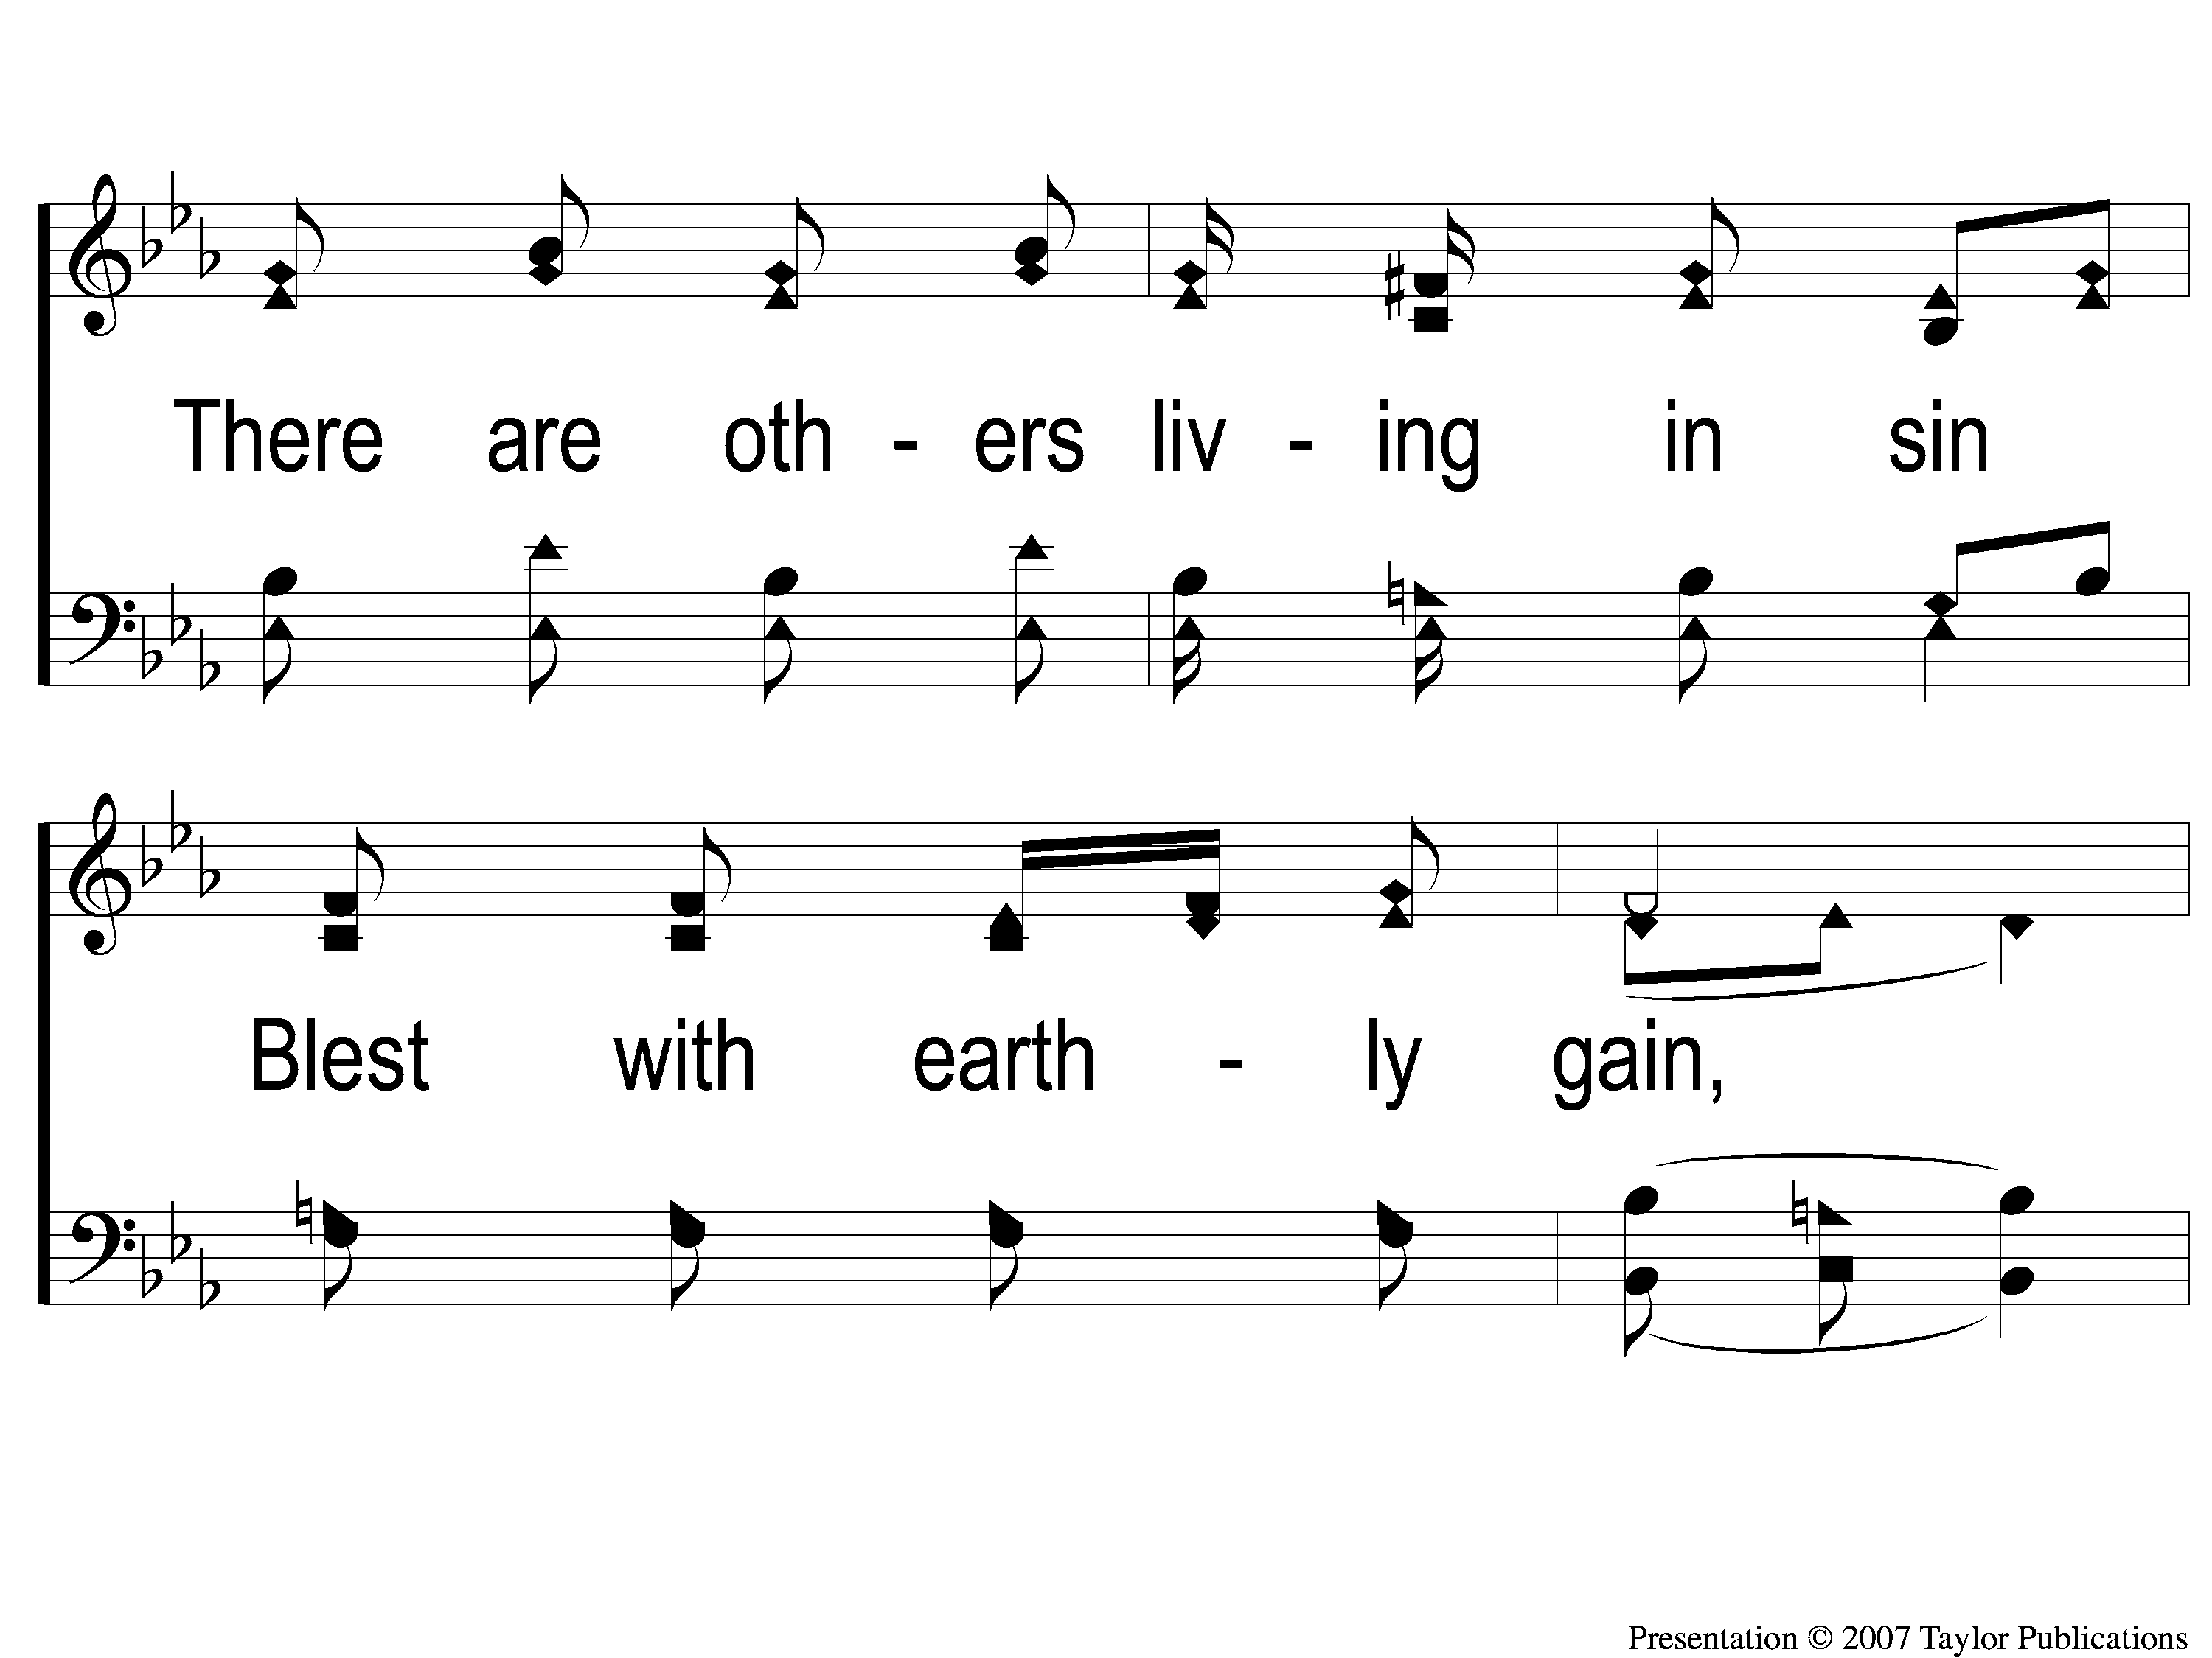
2-2 Sing and Be Happy
Sing and Be Happy
587

Slide 129
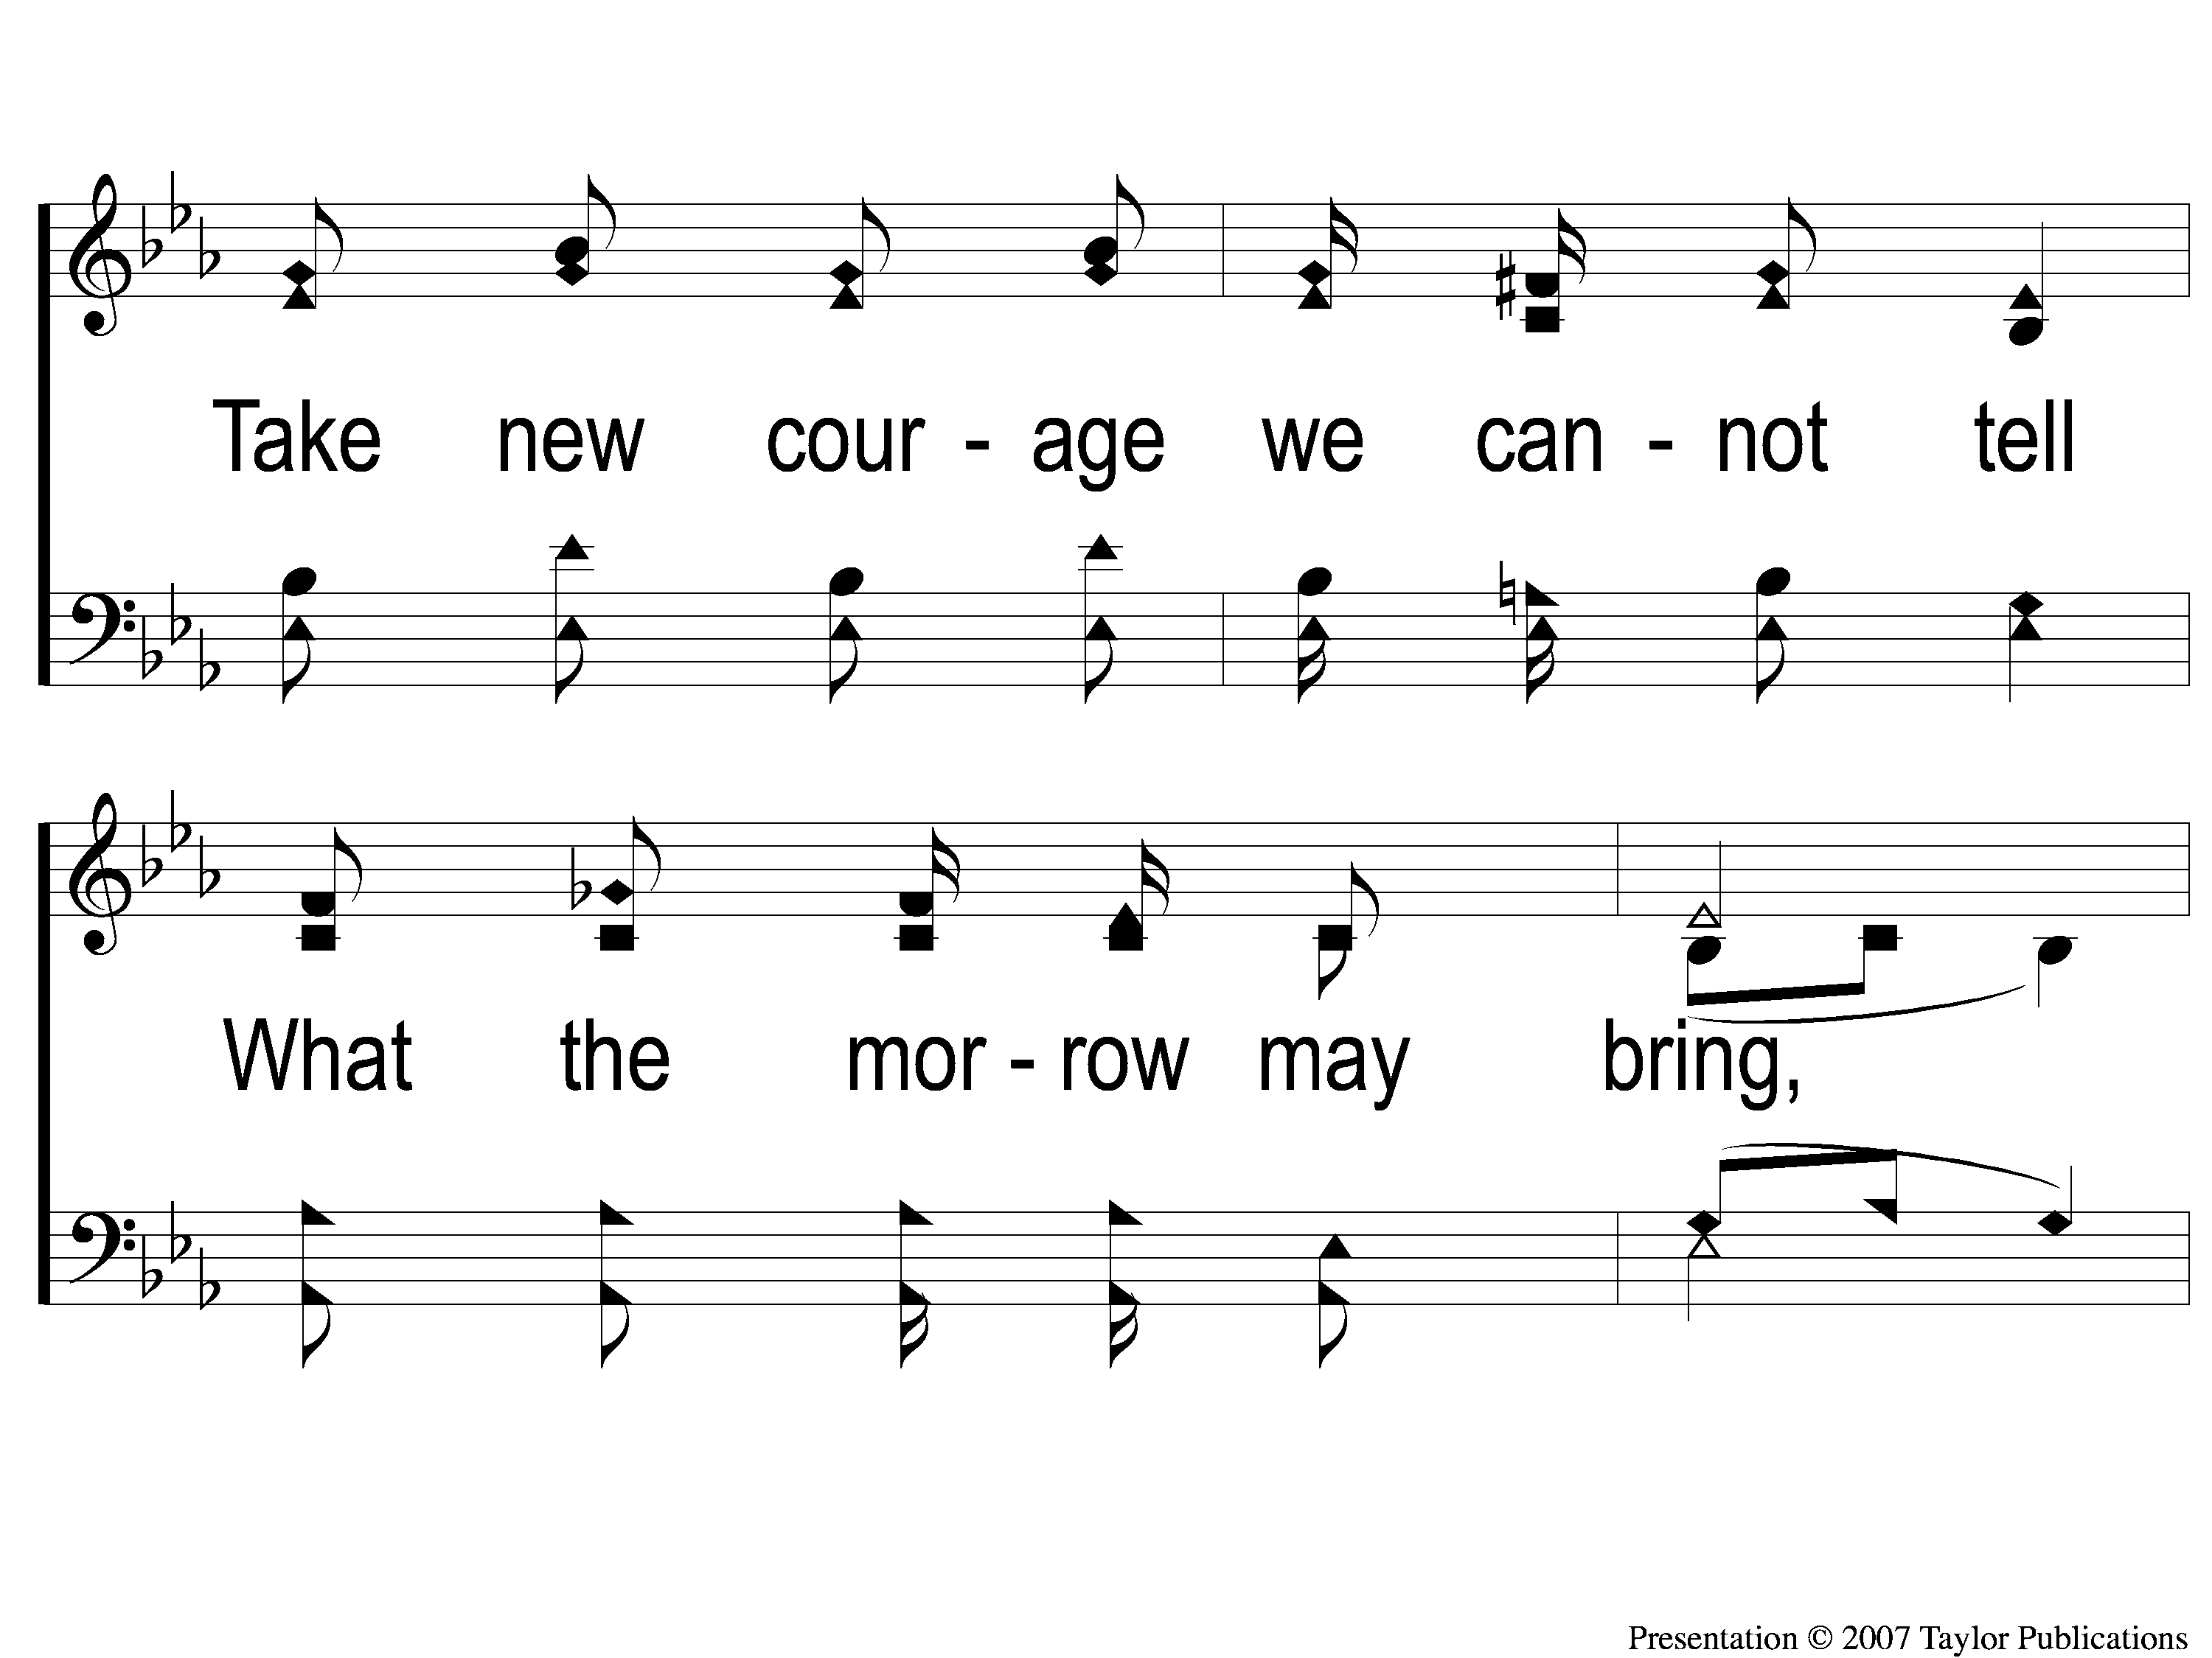
2-3 Sing and Be Happy
Sing and Be Happy
587

Slide 130
2-4 Sing and Be Happy
Sing and Be Happy
587

Slide 131
C-1 Sing and Be Happy
Sing and Be Happy
587

Slide 132
C-2 Sing and Be Happy
Sing and Be Happy
587

Slide 133
C-3 Sing and Be Happy
Sing and Be Happy
587

Slide 134
C-4 Sing and Be Happy
Sing and Be Happy
587

Slide 135
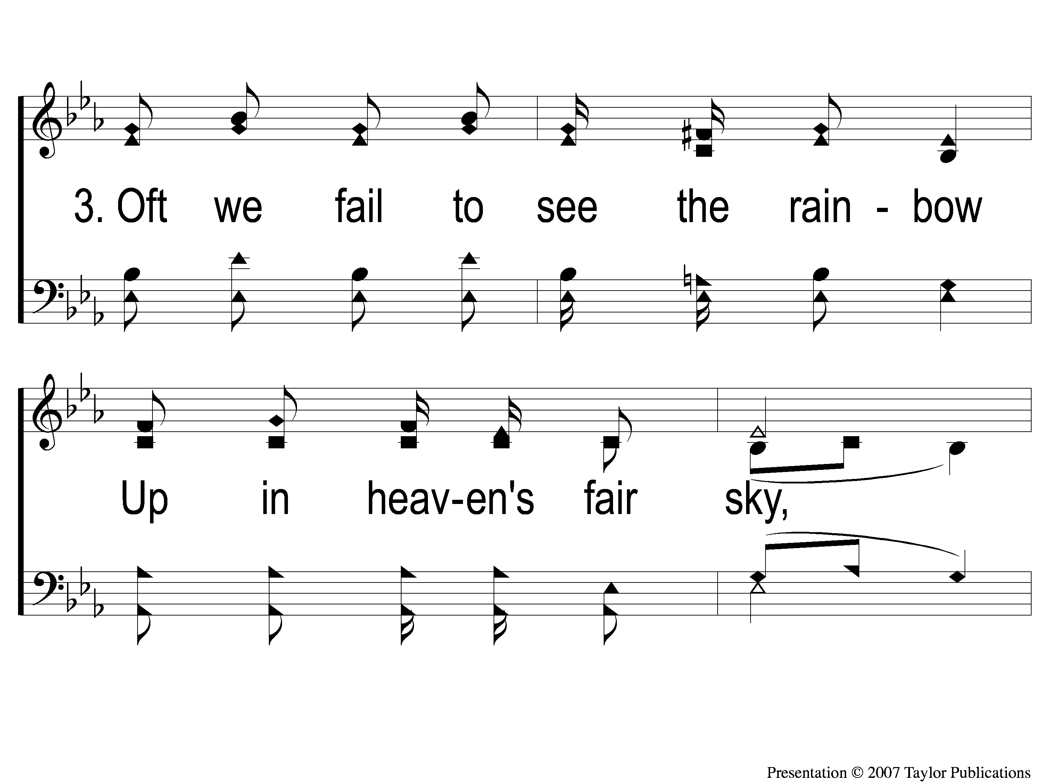
3-1 Sing and Be Happy
Sing and Be Happy
587

Slide 136
3-2 Sing and Be Happy
Sing and Be Happy
587

Slide 137
3-3 Sing and Be Happy
Sing and Be Happy
587

Slide 138
3-4 Sing and Be Happy
Sing and Be Happy
587

Slide 139
C-1 Sing and Be Happy
Sing and Be Happy
587

Slide 140
C-2 Sing and Be Happy
Sing and Be Happy
587

Slide 141
C-3 Sing and Be Happy
Sing and Be Happy
587

Slide 142
C-4 Sing and Be Happy
Sing and Be Happy
587

Slide 143
Join us for
Worship Tonight
@ 6:00pm!

