Slide 1
1-1 As the Deer
As The Deer
71

Slide 2
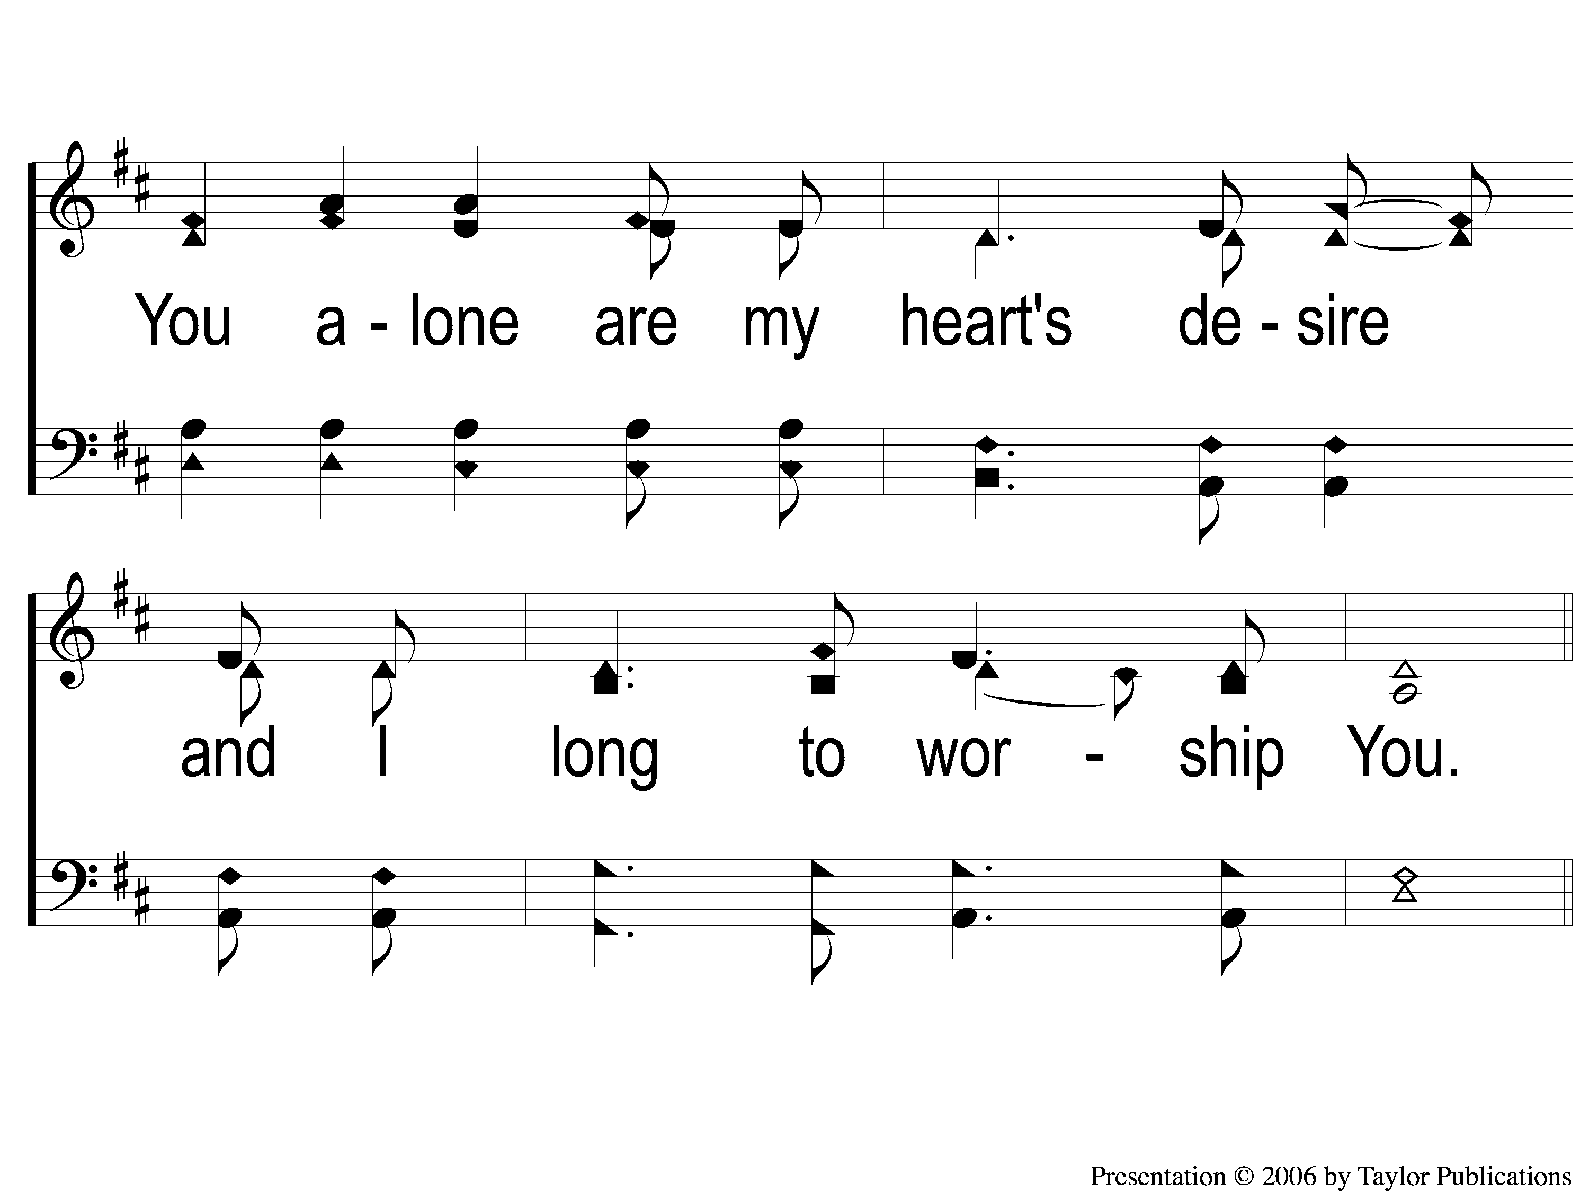
1-2 As the Deer
As The Deer
71

Slide 3
C-1 As the Deer
As The Deer
71

Slide 4
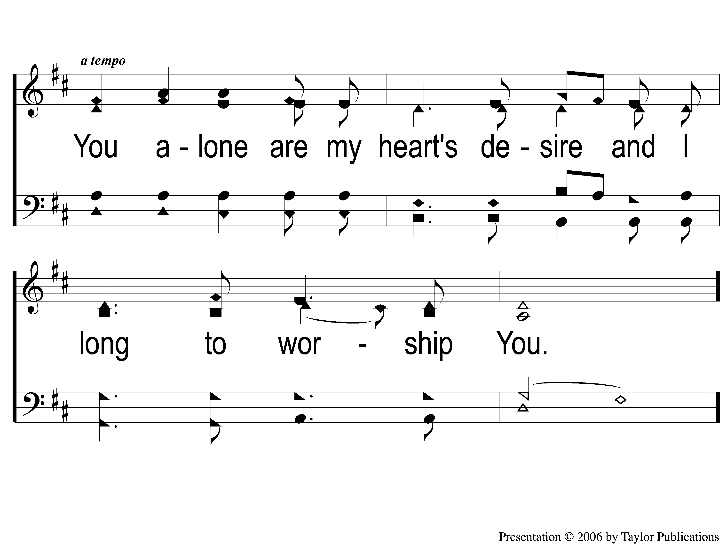
C-2 As the Deer
As The Deer
71

Slide 5
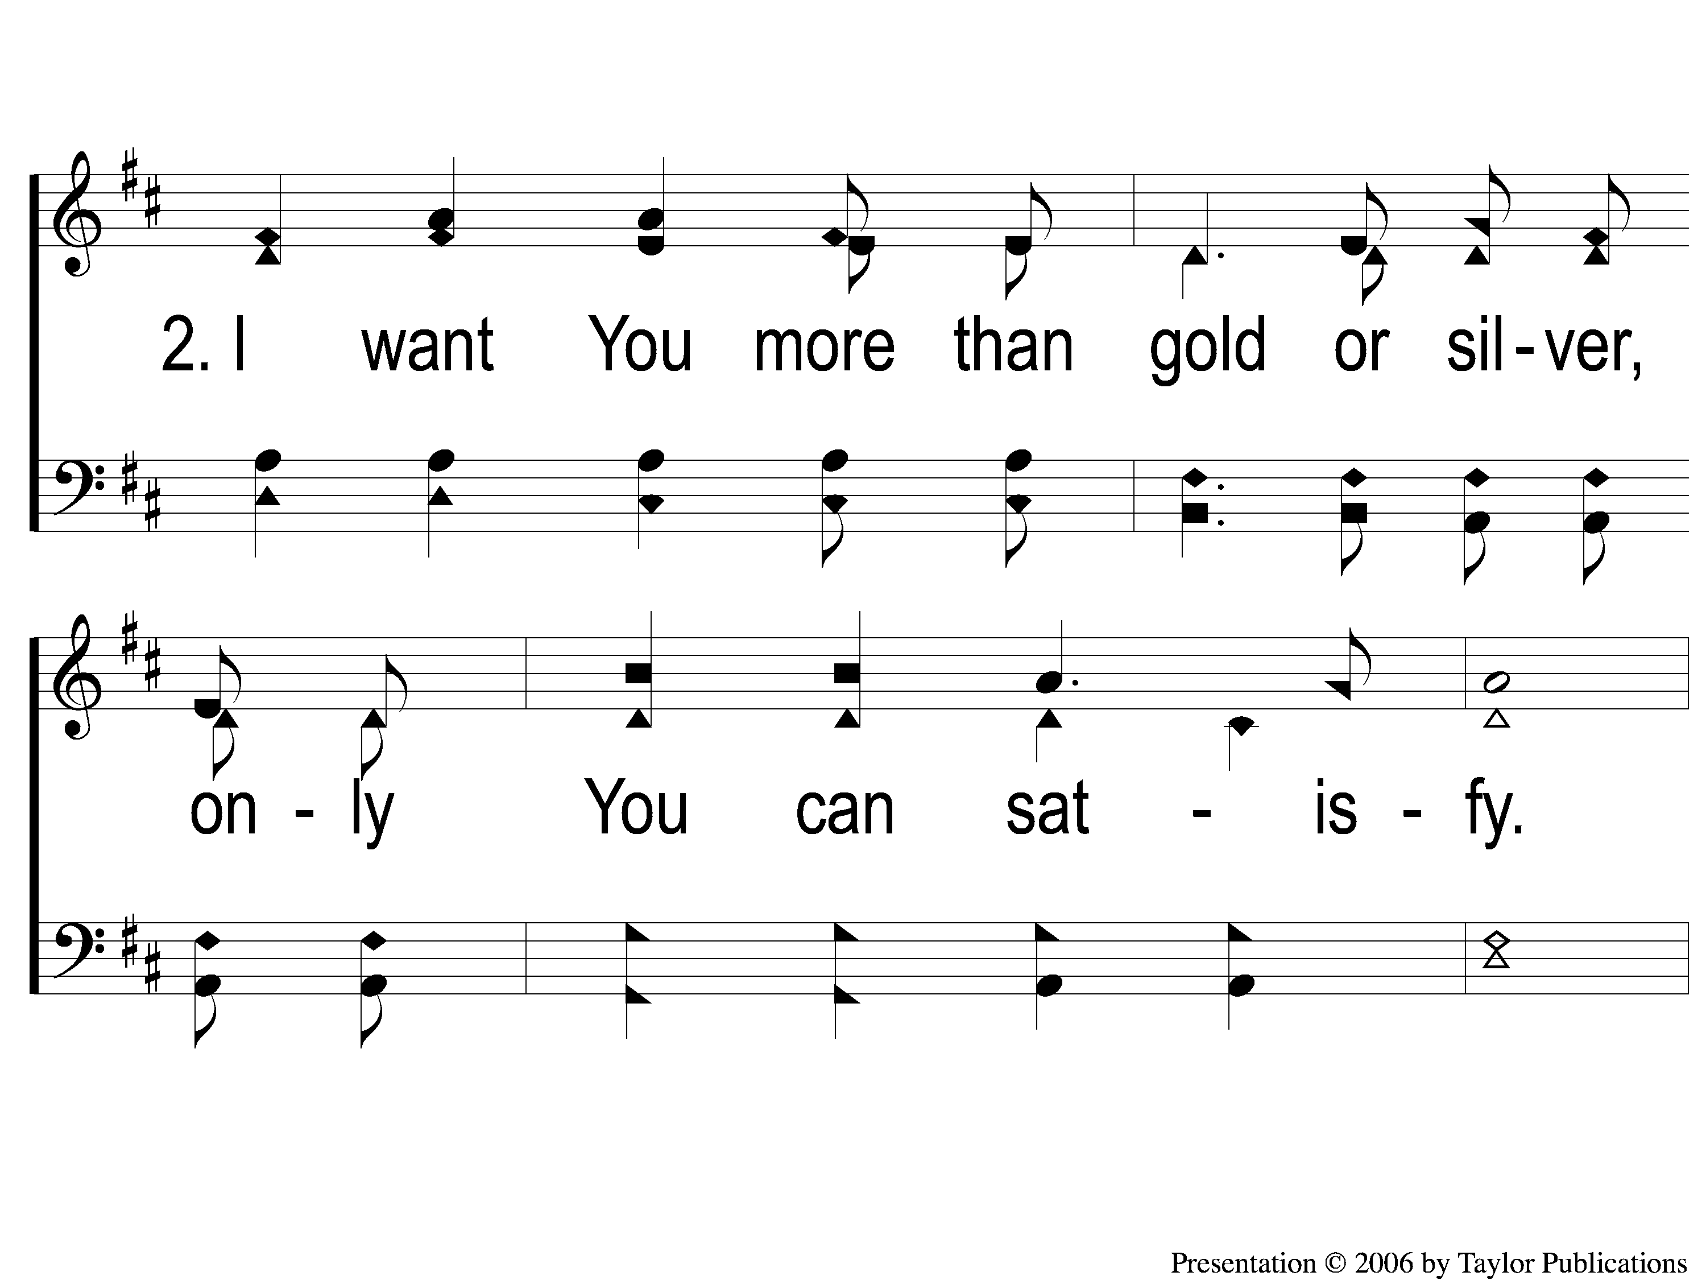
2-1 As the Deer
As The Deer
71

Slide 6
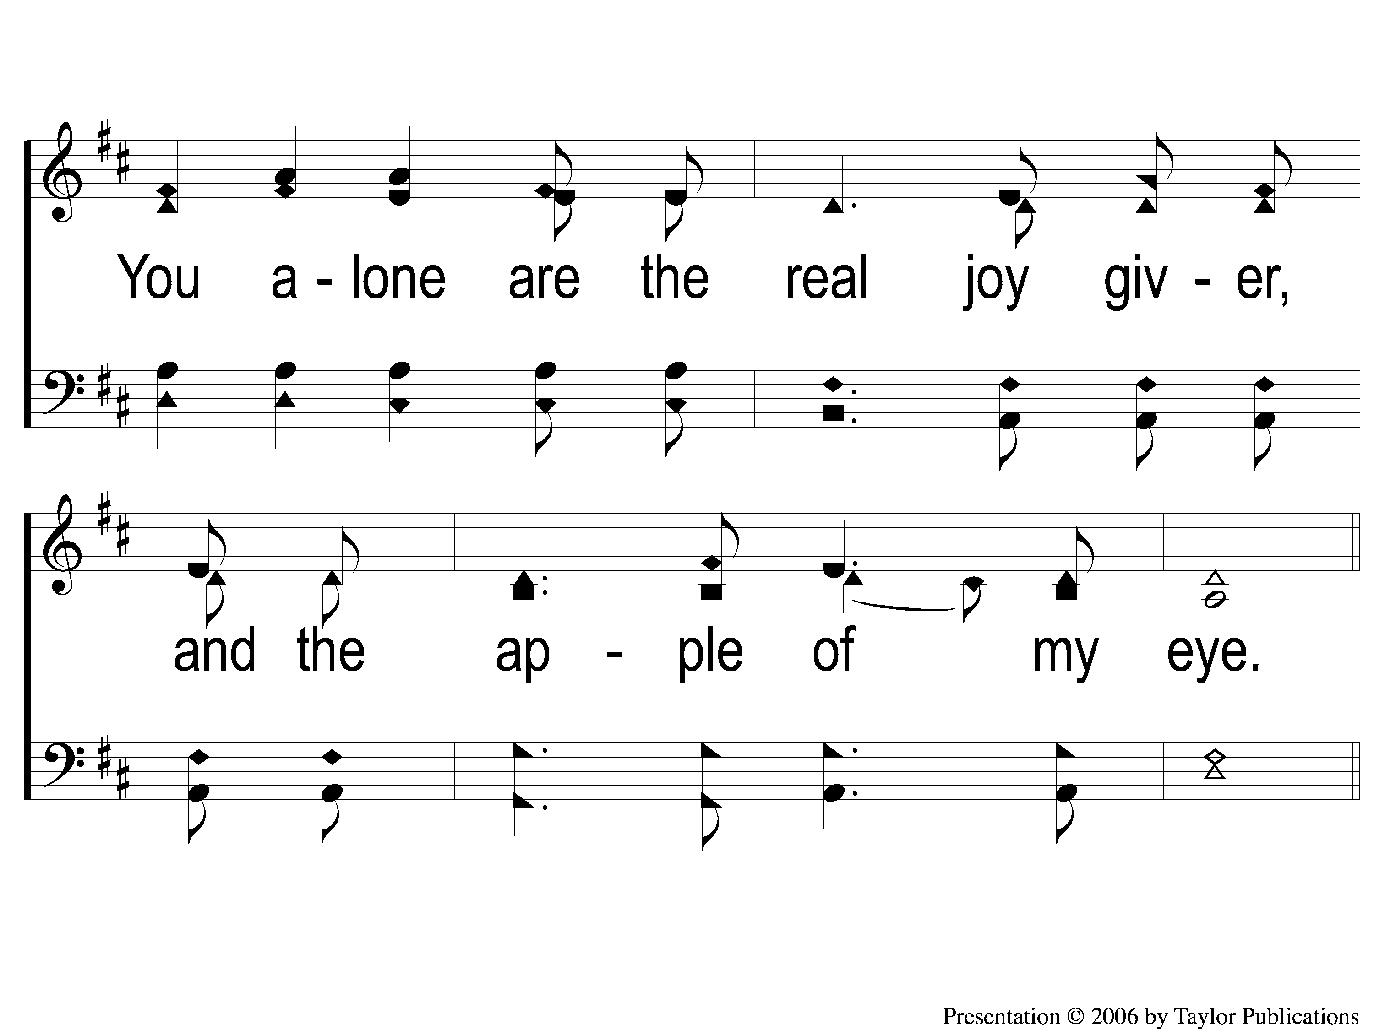
2-2 As the Deer
As The Deer
71

Slide 7
C-1 As the Deer
As The Deer
71

Slide 8
C-2 As the Deer
As The Deer
71

Slide 10
Song:
Days of Elijah
PH #173

Slide 11
1-1 Days of Elijah
Days of Elijah

Slide 12
1-2 Days of Elijah
Days of Elijah

Slide 13
1-3 Days of Elijah
Days of Elijah

Slide 14
1-4 Days of Elijah
Days of Elijah

Slide 15
C-1 Days of Elijah
Days of Elijah

Slide 16
C-2 Days of Elijah
Days of Elijah

Slide 17
2-1 Days of Elijah
Days of Elijah

Slide 18
2-2 Days of Elijah
Days of Elijah

Slide 19
2-3 Days of Elijah
Days of Elijah

Slide 20
2-4 Days of Elijah
Days of Elijah

Slide 21
C-1 Days of Elijah
Days of Elijah

Slide 22
C-2 Days of Elijah
Days of Elijah

Slide 23
C-1 Days of Elijah
Days of Elijah

Slide 24
C-2 Days of Elijah
Days of Elijah

Slide 25
Song:
What a Friend We have in Jesus
#800

Slide 26
1-1 What A Friend We Have in Jesus
What a Friend We Have in Jesus
800

Slide 27
1-2 What A Friend We Have in Jesus
What a Friend We Have in Jesus
800

Slide 28
1-3 What A Friend We Have in Jesus
What a Friend We Have in Jesus
800

Slide 29
1-4 What A Friend We Have in Jesus
What a Friend We Have in Jesus
800

Slide 30
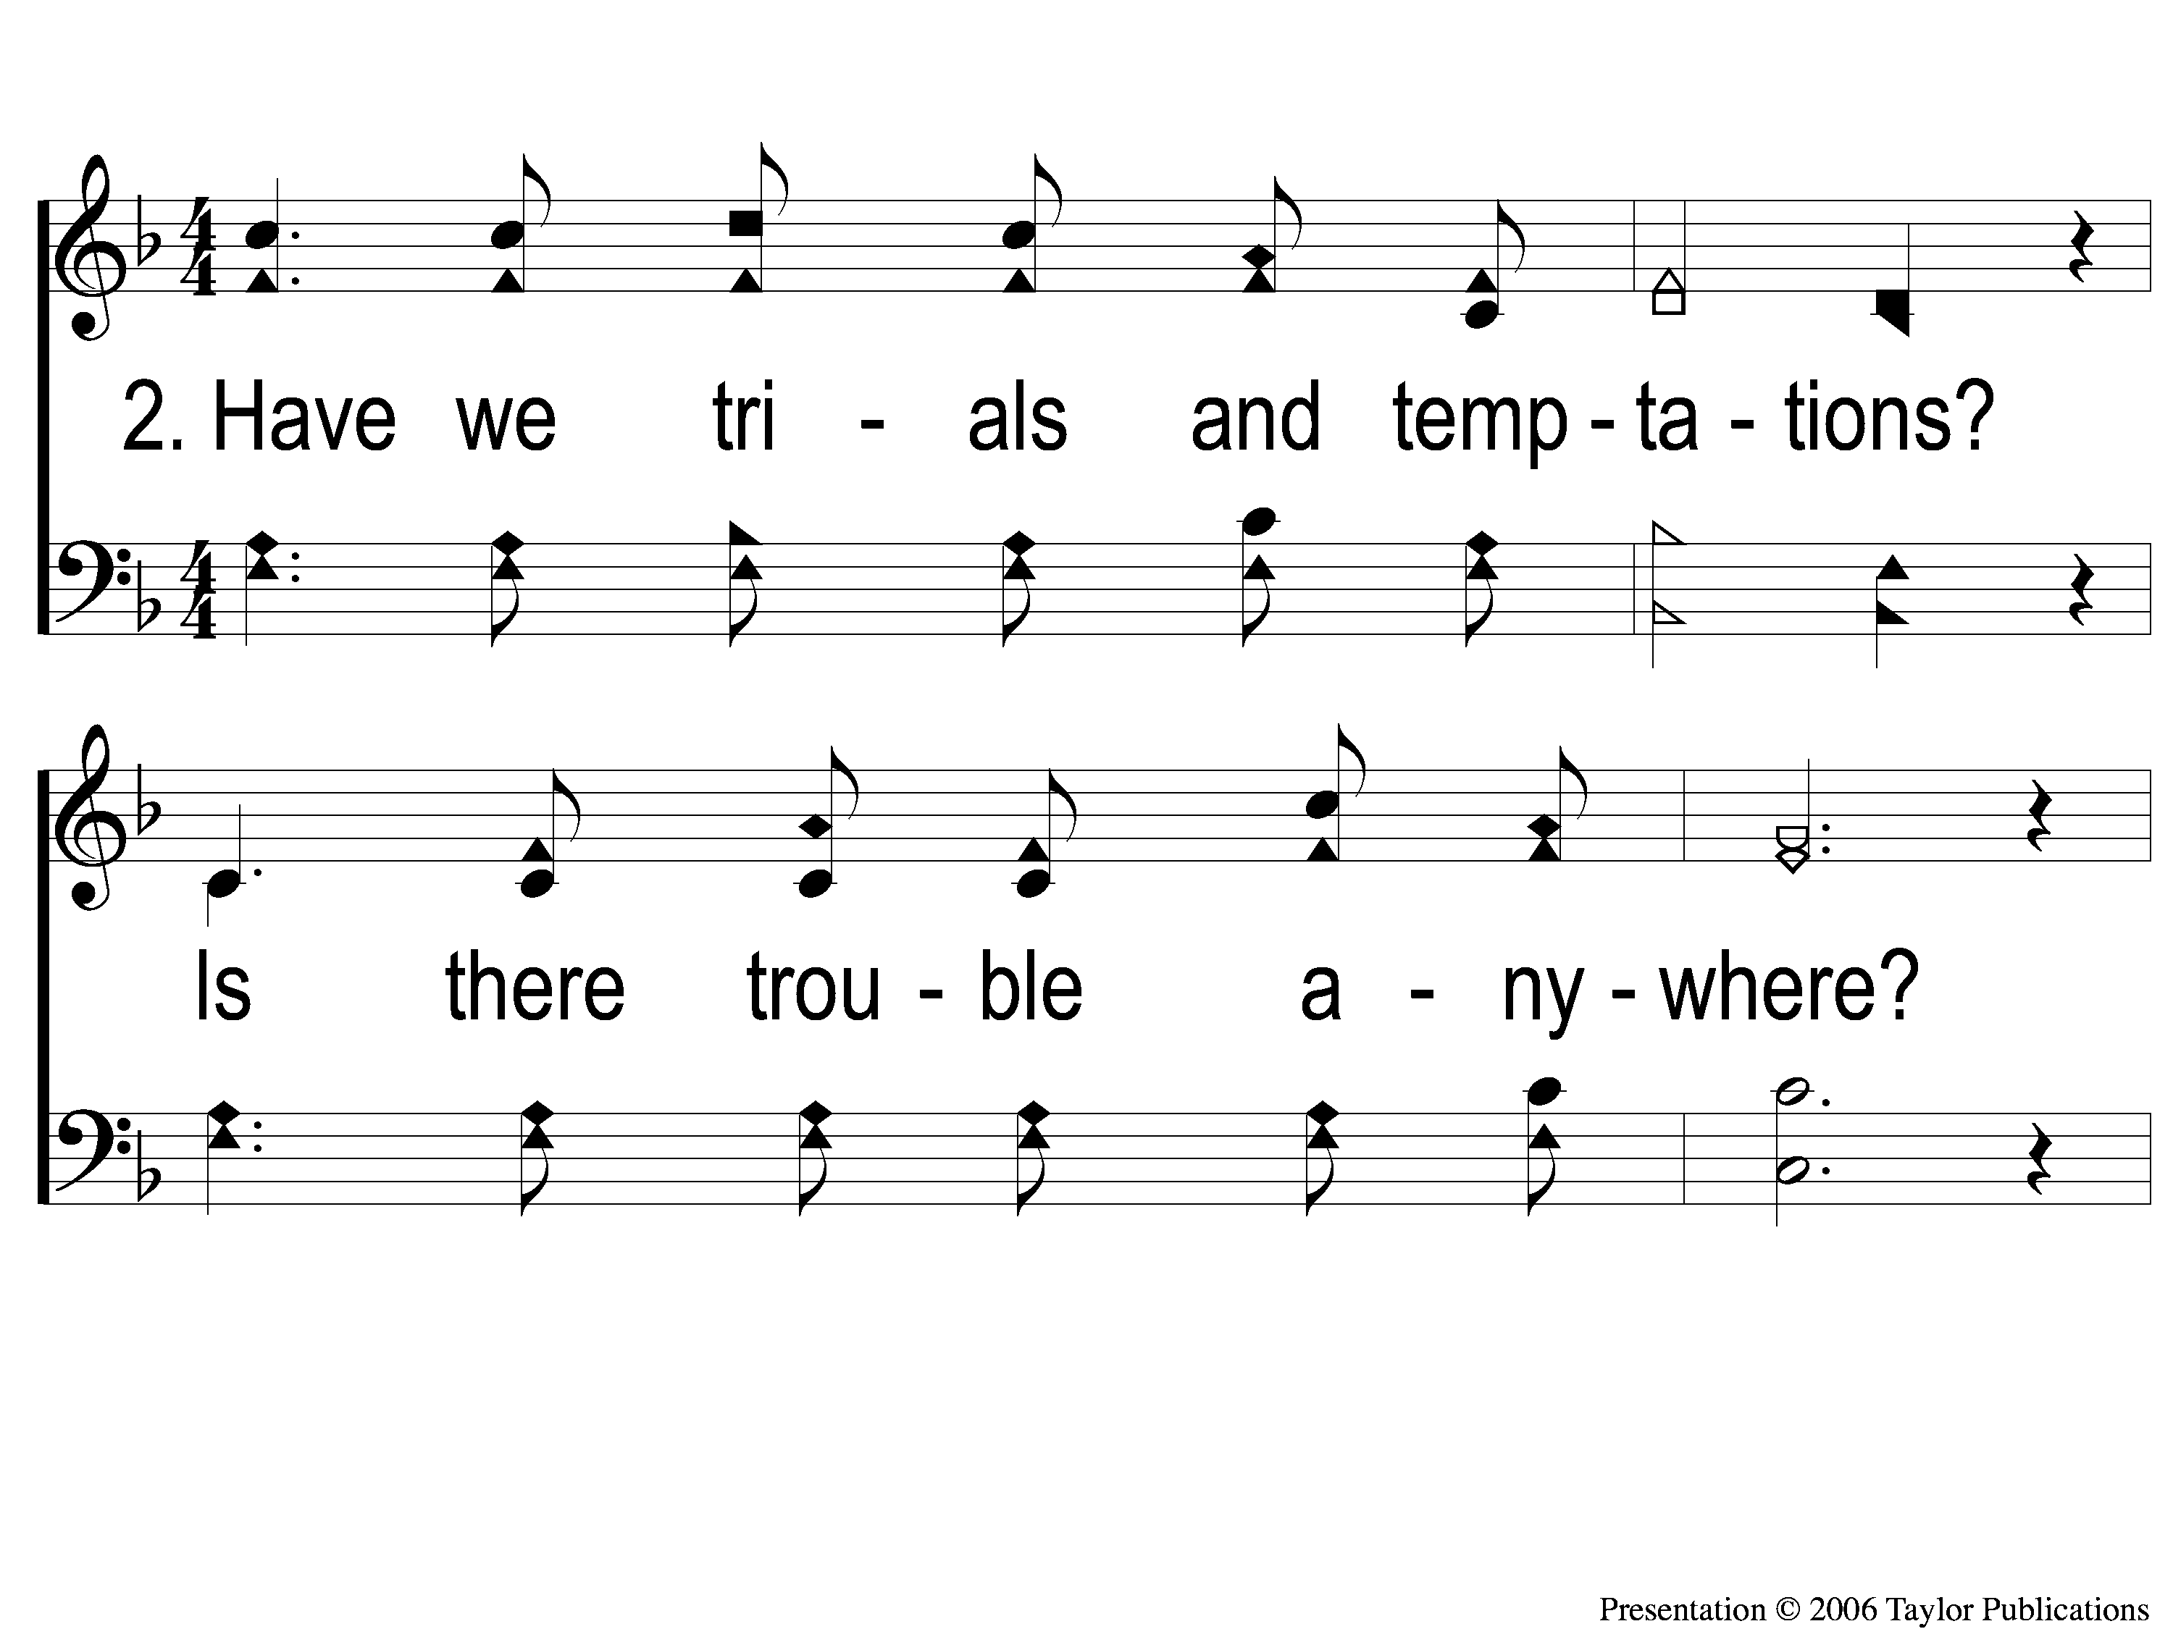
2-1 What A Friend We Have in Jesus
What a Friend We Have in Jesus
800

Slide 31
2-2 What A Friend We Have in Jesus
What a Friend We Have in Jesus
800

Slide 32
2-3 What A Friend We Have in Jesus
What a Friend We Have in Jesus
800

Slide 33
2-4 What A Friend We Have in Jesus
What a Friend We Have in Jesus
800

Slide 34
3-1 What A Friend We Have in Jesus
What a Friend We Have in Jesus
800

Slide 35
3-2 What A Friend We Have in Jesus
What a Friend We Have in Jesus
800

Slide 36
3-3 What A Friend We Have in Jesus
What a Friend We Have in Jesus
800

Slide 37
3-4 What A Friend We Have in Jesus
What a Friend We Have in Jesus
800

Slide 38
Opening Prayer

Slide 39
Song:
Take the Name of Jesus
PH #738

Slide 40
1-1 Take the Name of Jesus With You
Take the Name of Jesus
738

Slide 41
1-2 Take the Name of Jesus With You
Take the Name of Jesus
738

Slide 42
C-1 Take the Name of Jesus With You
Take the Name of Jesus
738

Slide 43
C-2 Take the Name of Jesus With You
Take the Name of Jesus
738

Slide 44
2-1 Take the Name of Jesus With You
Take the Name of Jesus
738

Slide 45
2-2 Take the Name of Jesus With You
Take the Name of Jesus
738

Slide 46
C-1 Take the Name of Jesus With You
Take the Name of Jesus
738

Slide 47
C-2 Take the Name of Jesus With You
Take the Name of Jesus
738

Slide 48
3-1 Take the Name of Jesus With You
Take the Name of Jesus
738

Slide 49
3-2 Take the Name of Jesus With You
Take the Name of Jesus
738

Slide 50
C-1 Take the Name of Jesus With You
Take the Name of Jesus
738

Slide 51
C-2 Take the Name of Jesus With You
Take the Name of Jesus
738

Slide 52
Song:
Trust & Obey
#915

Slide 53
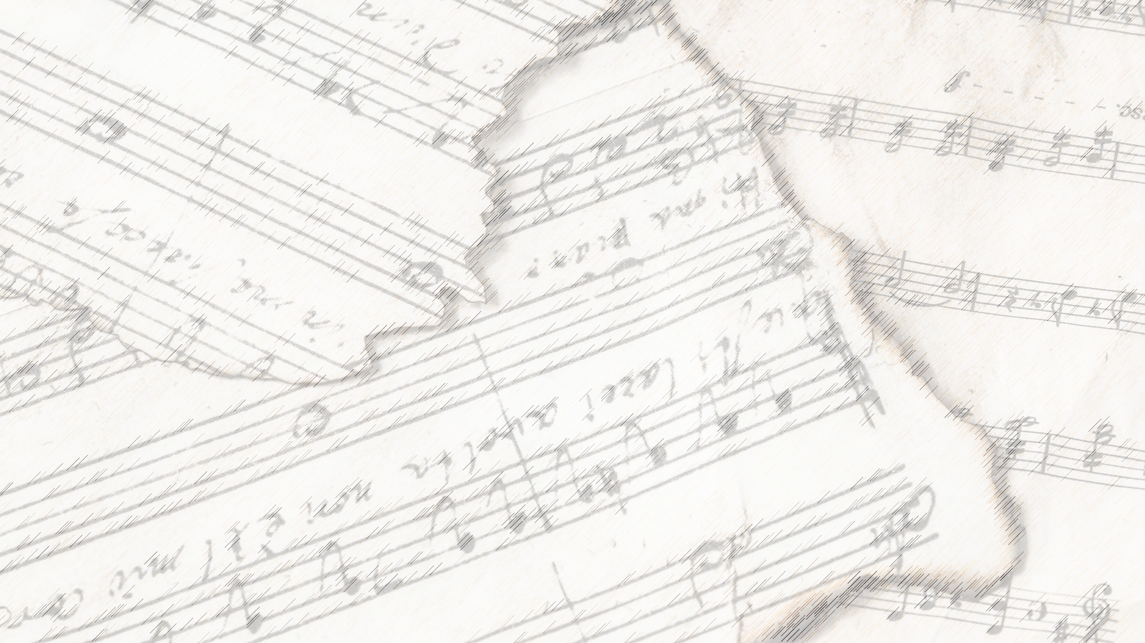
Trust & Obey
#915

Slide 54
1-1 Trust and Obey
Trust and Obey
915

Slide 55
1-2 Trust and Obey
Trust and Obey
915

Slide 56
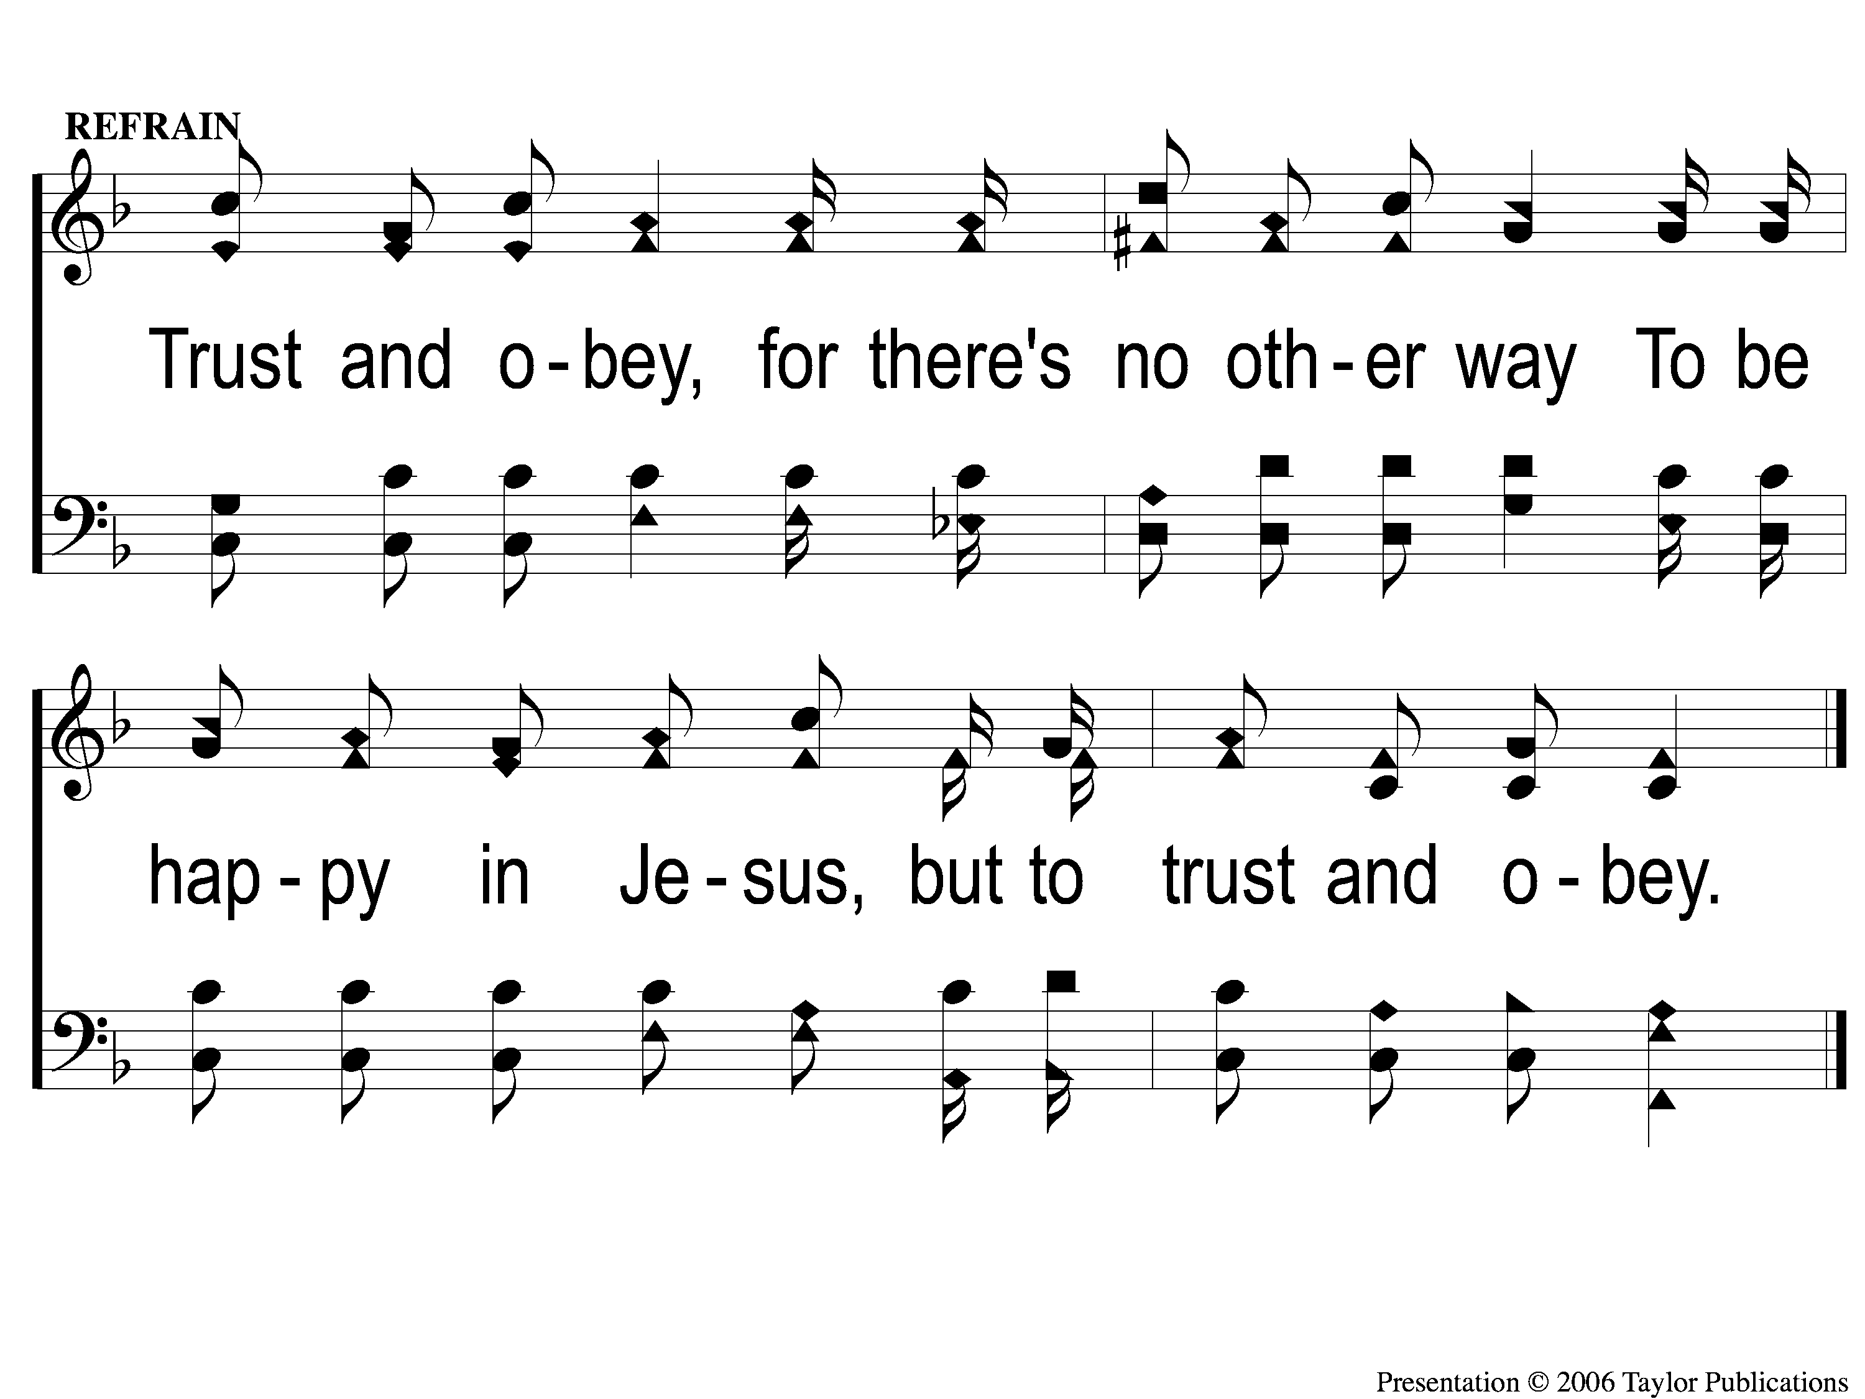
C Trust and Obey
Trust and Obey
915

Slide 57
3-1 Trust and Obey
Trust and Obey
915

Slide 58
3-2 Trust and Obey
Trust and Obey
915

Slide 59
4-1 Trust and Obey
Trust and Obey
915

Slide 60
4-2 Trust and Obey
Trust and Obey
915

Slide 61
C Trust and Obey
Trust and Obey
915

Slide 62
5-1 Trust and Obey
Trust and Obey
915

Slide 63
5-2 Trust and Obey
Trust and Obey
915

Slide 64
C Trust and Obey
Trust and Obey
915

Slide 65
Scripture Reading:
Acts 17:16-23

Slide 66
Songs About
Standing Firm

Slide 67
“RELIGIOUS”
A WORD STUDY

Slide 68
The Definition
“Religiously”

Slide 69
The Definition
“Religiously”
“with consistent and conscientious regularity”

Slide 70
The Definition
“Religiously”
“with consistent and conscientious regularity”
“regularly and seriously”

Slide 71
The Definition
“Religiously”
“with consistent and conscientious regularity”
“regularly and seriously”
“devoted, devout, faithfully”

Slide 72
The Definition
3 Passages:
Acts 17:22 – “very religious”
Jms. 1:26 – “religious”
Heb. 10:11 – “religious duties”

Slide 73
The Definition
Acts 17:22 – “very religious” = Deisidaimon
Adjective
“expressing reverence for a deity”

Slide 74
The Definition
Jms. 1:26 – “religious…religion” = Thraskos
Adjective
“living according to the tenets of a religion”
“pertaining to being devoted
to a proper expression of beliefs”

Slide 75
The Definition
Jms. 1:26 – “religious…religion” = Thraskos
Adjective
Acts 10:2 – Cornelius
Jn. 9:31 - Bartimaeus

Slide 76
The Definition
Heb. 10:11 – “religious duties” = Leitourgeo
Verb

Slide 77
The Definition
Heb. 10:11 – “religious duties” = Leitourgeo
Verb
Acts 13:2, Rom. 15:27
Num. 3:31, 4:9, 4:26, 18:21

Slide 78
The Application
To Be Truly Religious, We Must:

Slide 79
The Application
To Be Truly Religious, We Must:
Praise the One, True, Living God

Slide 80
The Application
To Be Truly Religious, We Must:
Praise the One, True, Living God
Live for the One, True, Living God

Slide 81
The Application
To Be Truly Religious, We Must:
Praise the One, True, Living God
Live for the One, True, Living God
Habitually Serve the One, True, Living God

Slide 82
The Question
Am I Religious?

Slide 83
InvitationSong:
There is Power
In the Blood
#903

Slide 84
1-1 There Is Power In the Blood
There Is Power In the Blood
903

Slide 85
1-2 There Is Power In the Blood
There Is Power In the Blood
903

Slide 86
C-1 There Is Power In the Blood
There Is Power In the Blood
903

Slide 87
C-2 There Is Power In the Blood
There Is Power In the Blood
903

Slide 88
2-1 There Is Power In the Blood
There Is Power In the Blood
903

Slide 89
2-2 There Is Power In the Blood
There Is Power In the Blood
903

Slide 90
C-1 There Is Power In the Blood
There Is Power In the Blood
903

Slide 91
C-2 There Is Power In the Blood
There Is Power In the Blood
903

Slide 92
4-1 There Is Power In the Blood
There Is Power In the Blood
903

Slide 93
4-2 There Is Power In the Blood
There Is Power In the Blood
903

Slide 94
C-1 There Is Power In the Blood
There Is Power In the Blood
903

Slide 95
C-2 There Is Power In the Blood
There Is Power In the Blood
903

Slide 96
The Offering:
“And He said to them, ‘Take heed and beware of covetousness, for one’s life does not consist in the abundance of the things he possesses.’ ” – Lk. 12:15

Slide 97
Song:
Come,
Share the Lord
#364

Slide 98
1-1 Come Share the Lord
Come, Share The Lord
364

Slide 99
1-2 Come Share the Lord
Come, Share The Lord
364

Slide 100
C-1 Come Share the Lord
Come, Share The Lord
364

Slide 101
2-1 Come Share the Lord
Come, Share The Lord
364

Slide 102
2-2 Come Share the Lord
Come, Share The Lord
364

Slide 103
C-2 Come Share the Lord
Come, Share The Lord
364

Slide 104
3-1 Come Share the Lord
Come, Share The Lord
364

Slide 105
3-2 Come Share the Lord
Come, Share The Lord
364

Slide 106
The Lord’s Supper
Acts 20:7

Slide 107
The Unleavened Bread
Then He said to them all, “If anyone desires to come after Me, let him deny himself, and take up his cross daily, and follow Me. For whoever desires to save his life will lose it, but whoever loses his life for My sake will save it.” – Luke 9:23-24

Slide 108
The Fruit of the Vine
For what profit is it to a man if he gains the whole world, and is himself destroyed or lost? For whoever is ashamed of Me and My words, of him the Son of Man will be ashamed when He comes in His own glory, and in His Father’s, and of the holy angels.” – Luke 9:25-26

Slide 109
Closing Prayer

Slide 110
Song:
This World is Not my Home
#957

Slide 111
1-1 This World is Not My Home
This World Is Not My Home
957

Slide 112
1-2 This World is Not My Home
This World Is Not My Home
957

Slide 113
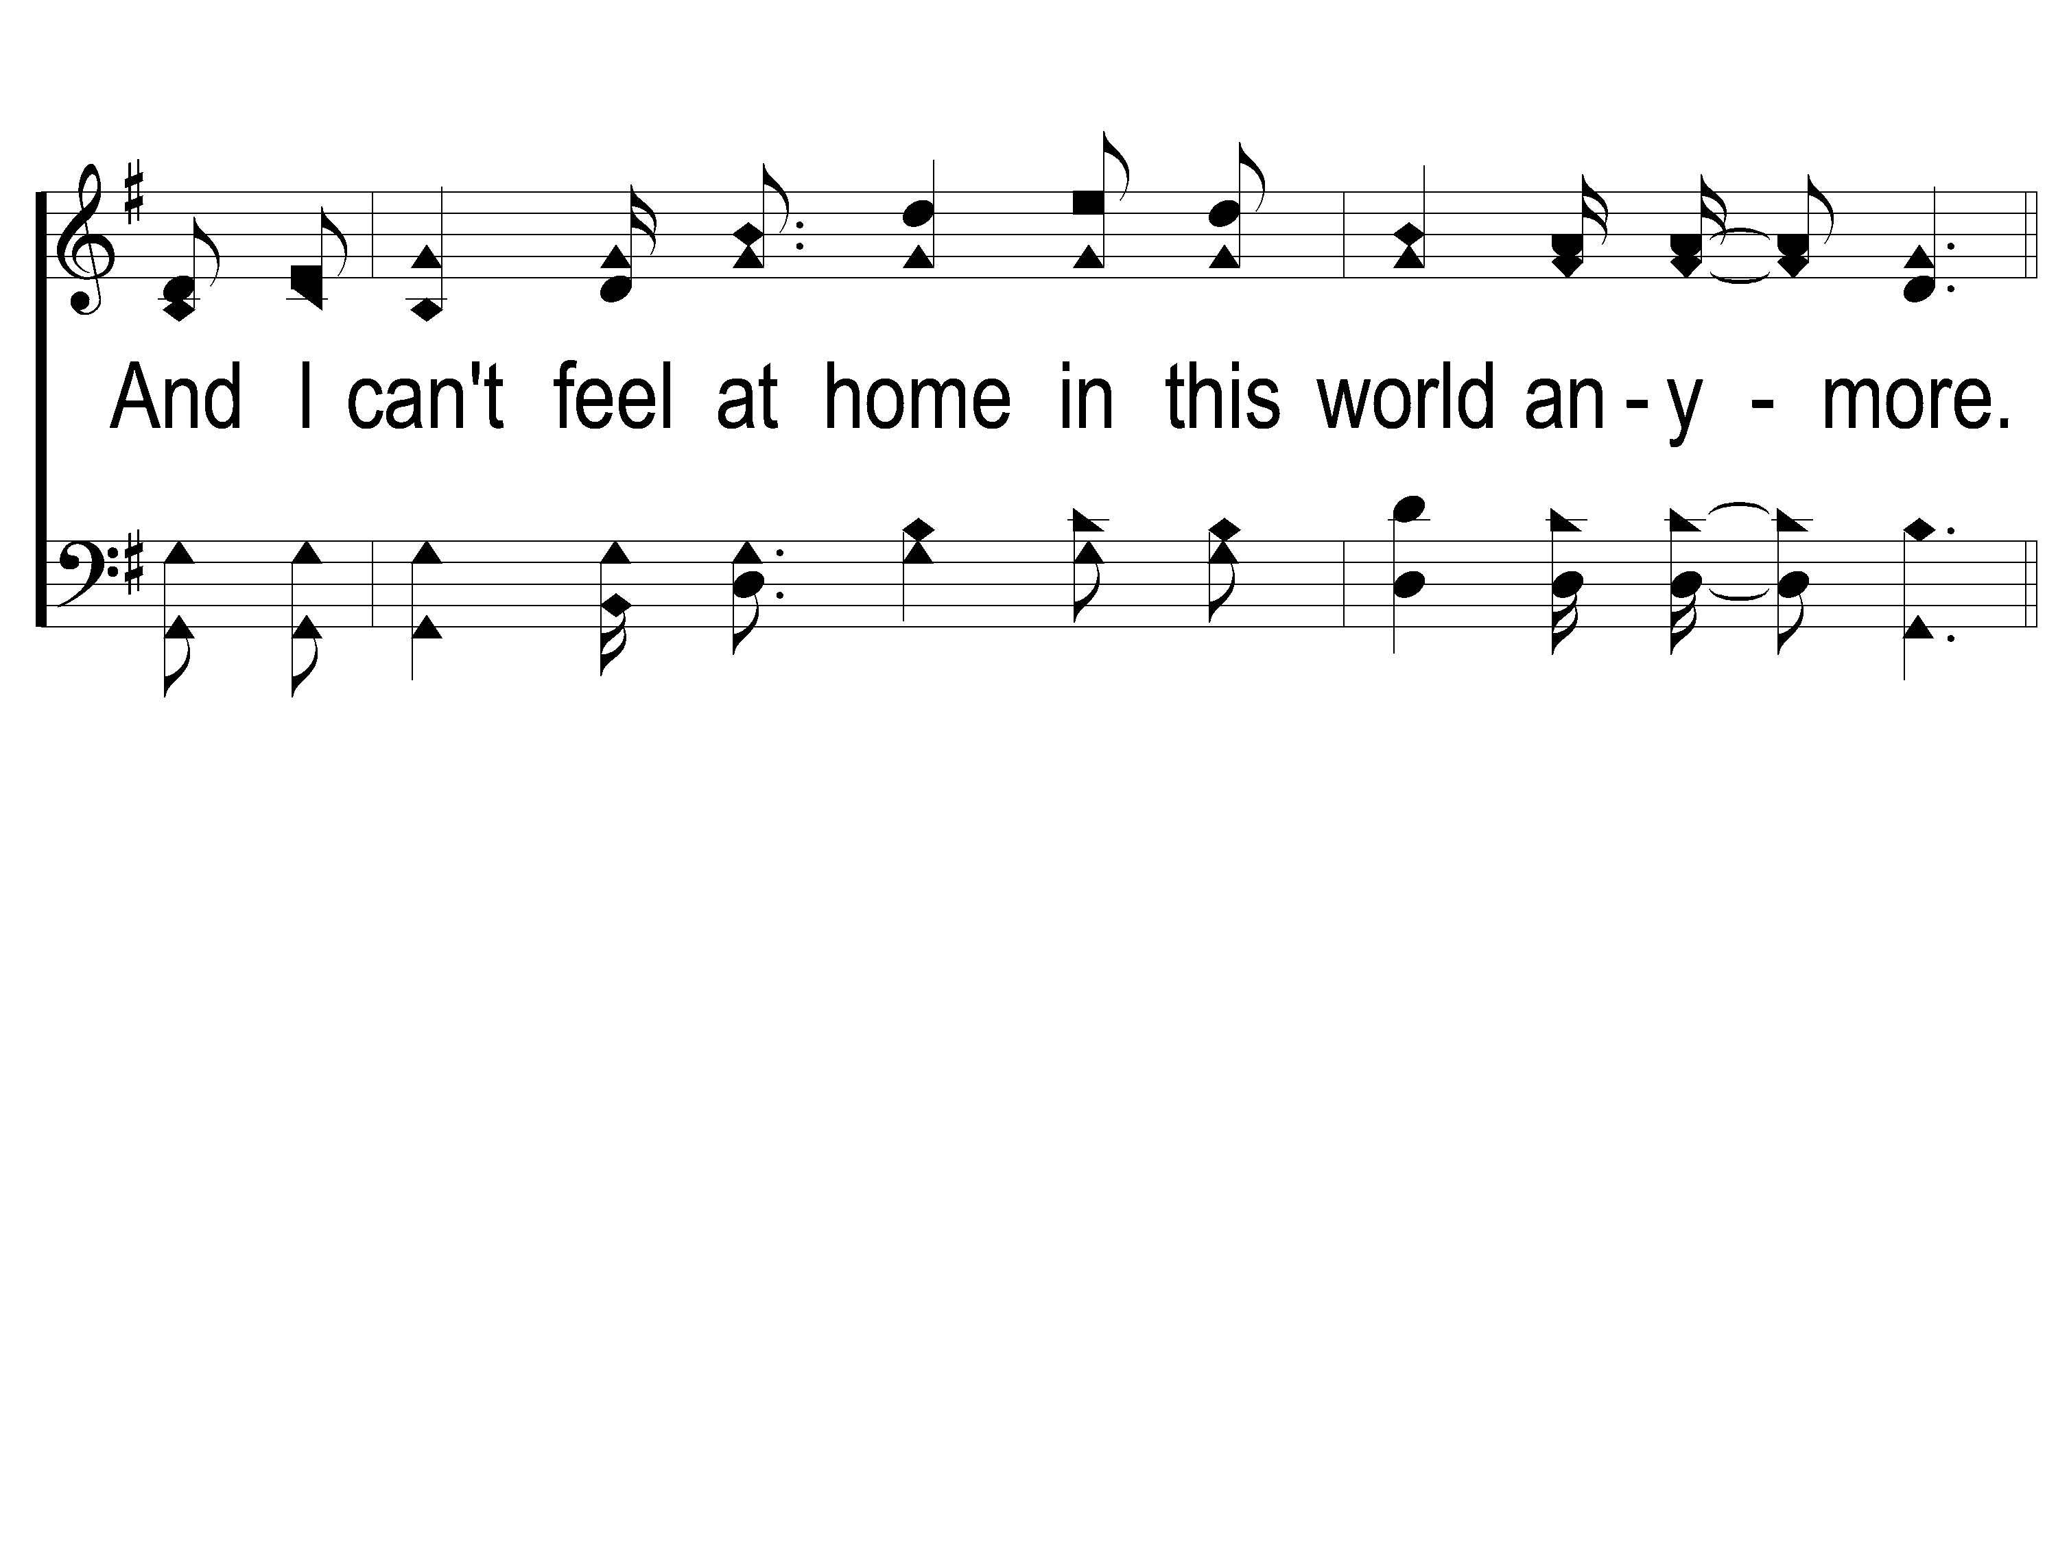
1-3 This World is Not My Home
This World Is Not My Home
957

Slide 114
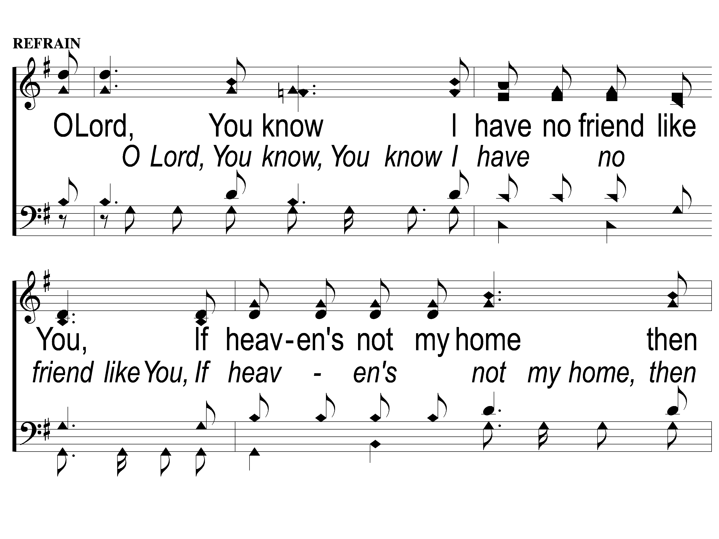
C-1 This World is Not My Home
This World Is Not My Home
957

Slide 115
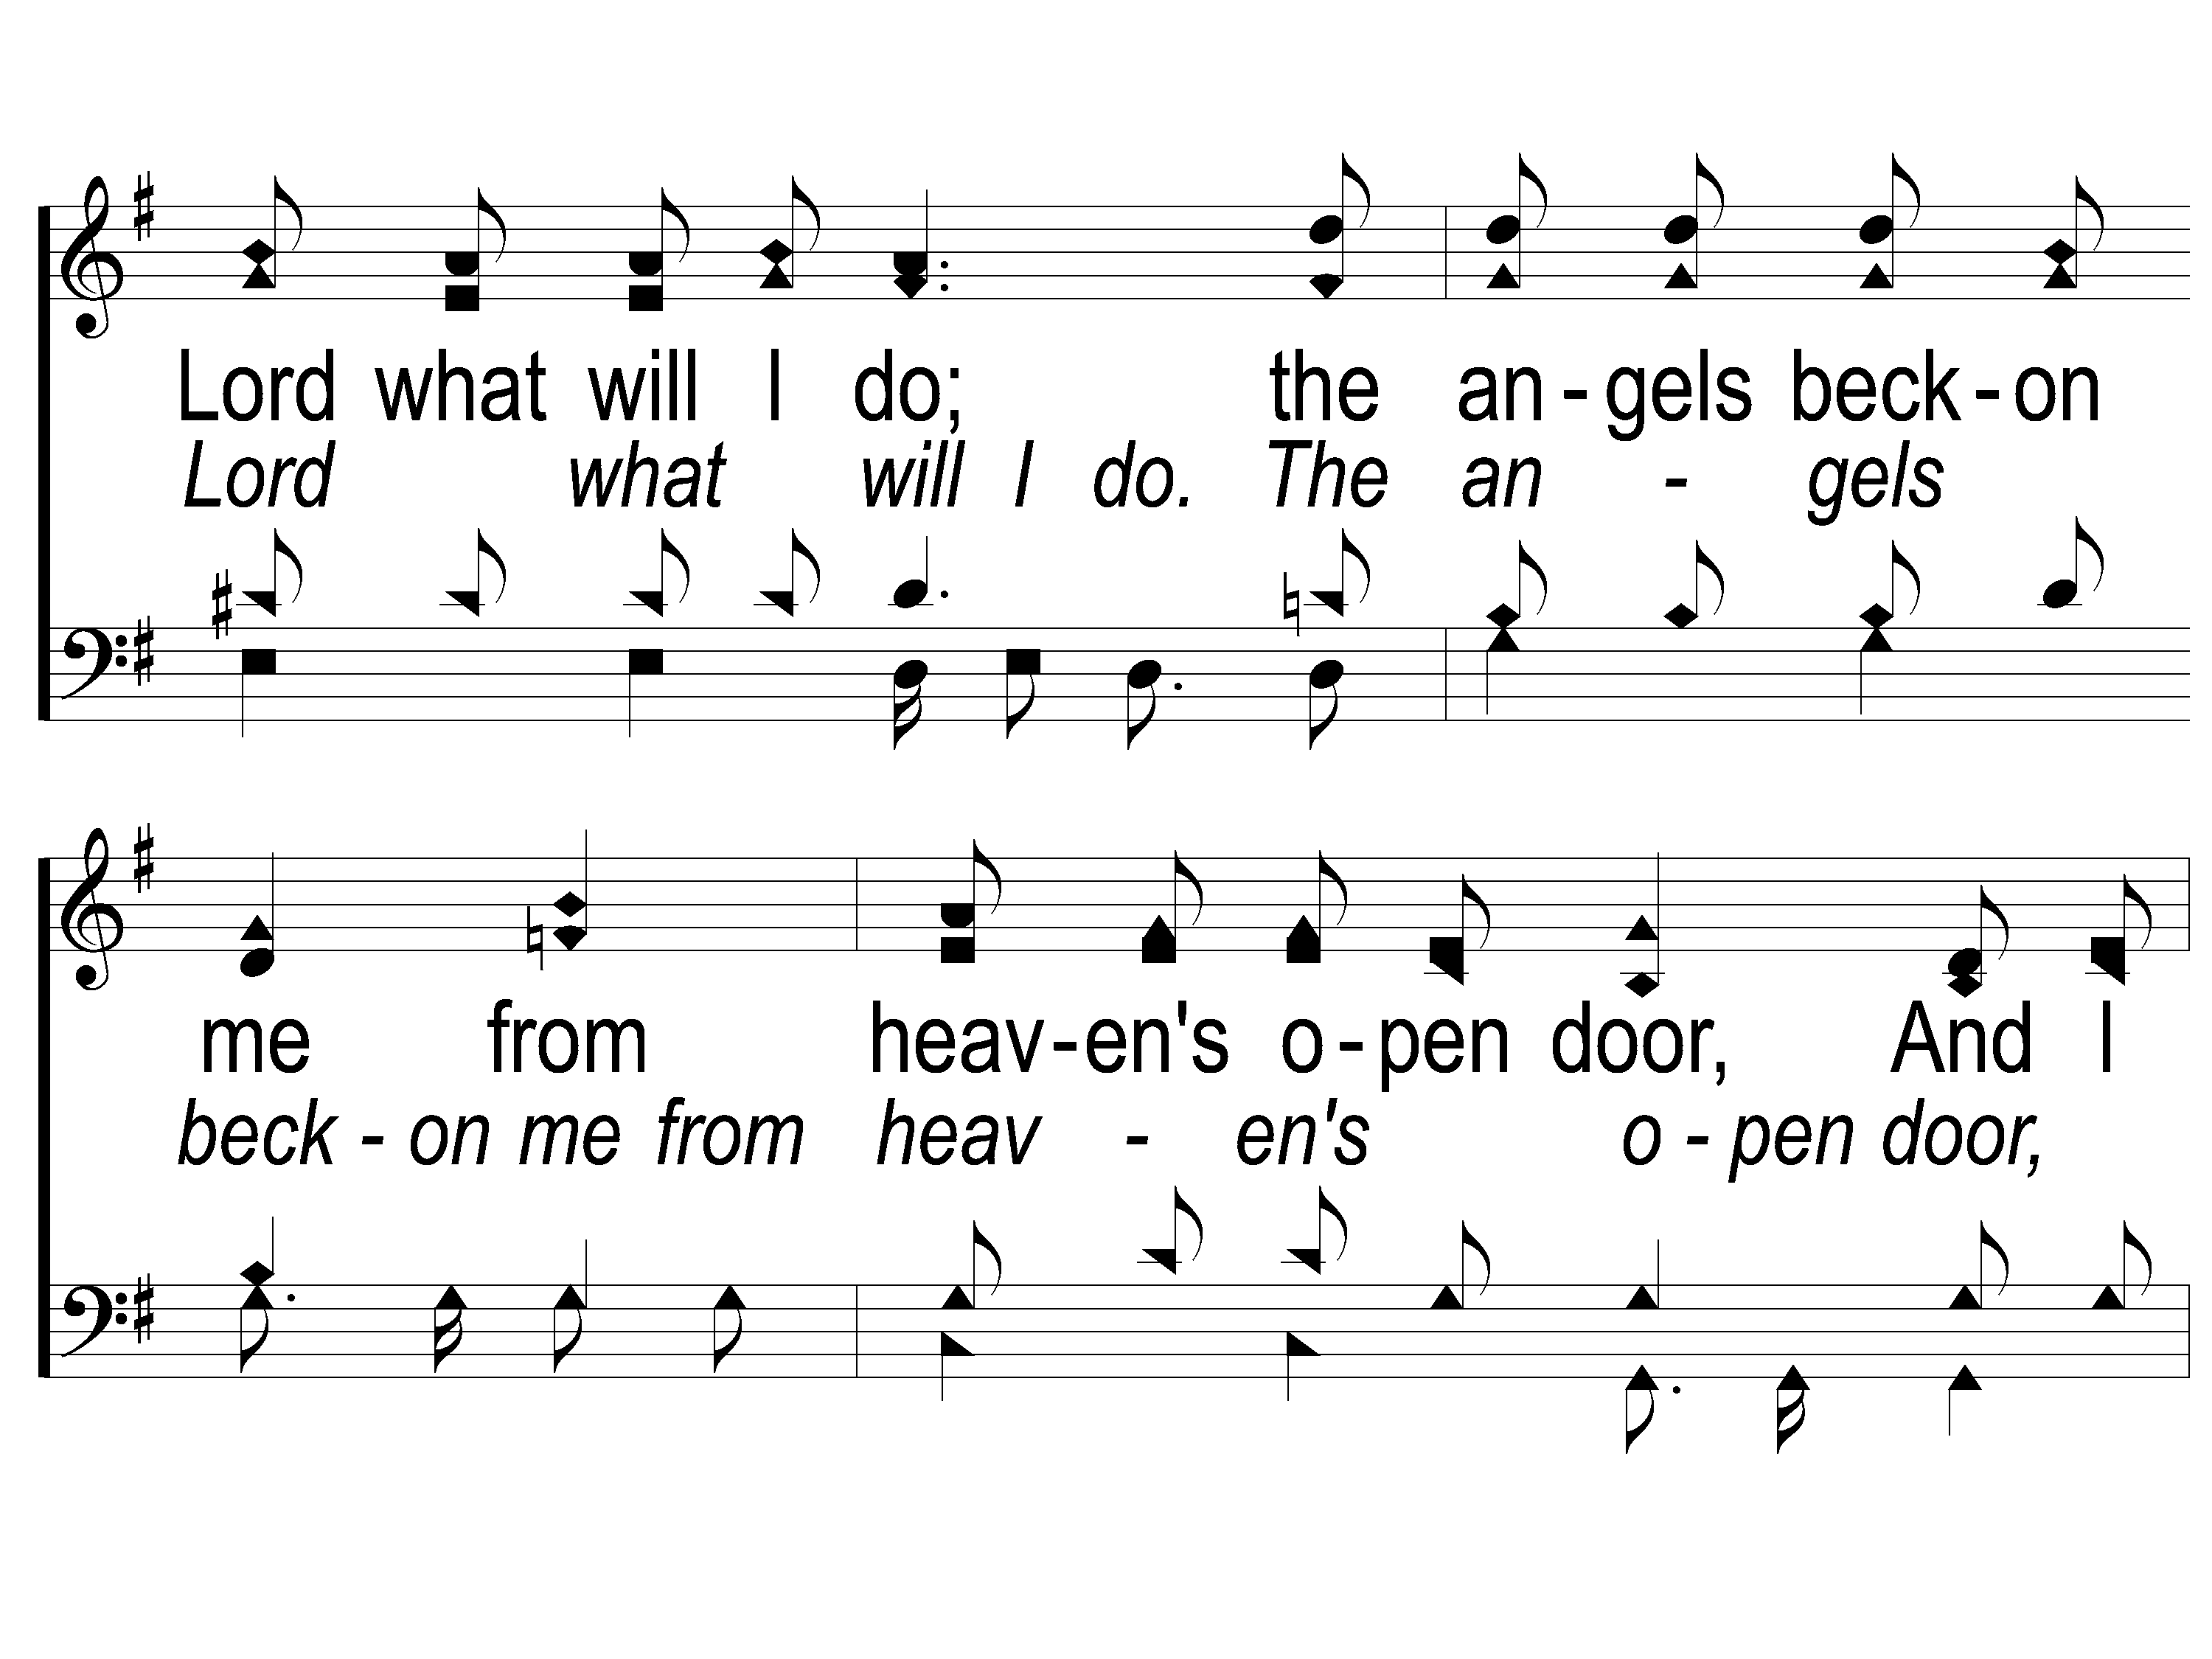
C-2 This World is Not My Home
This World Is Not My Home
957

Slide 116
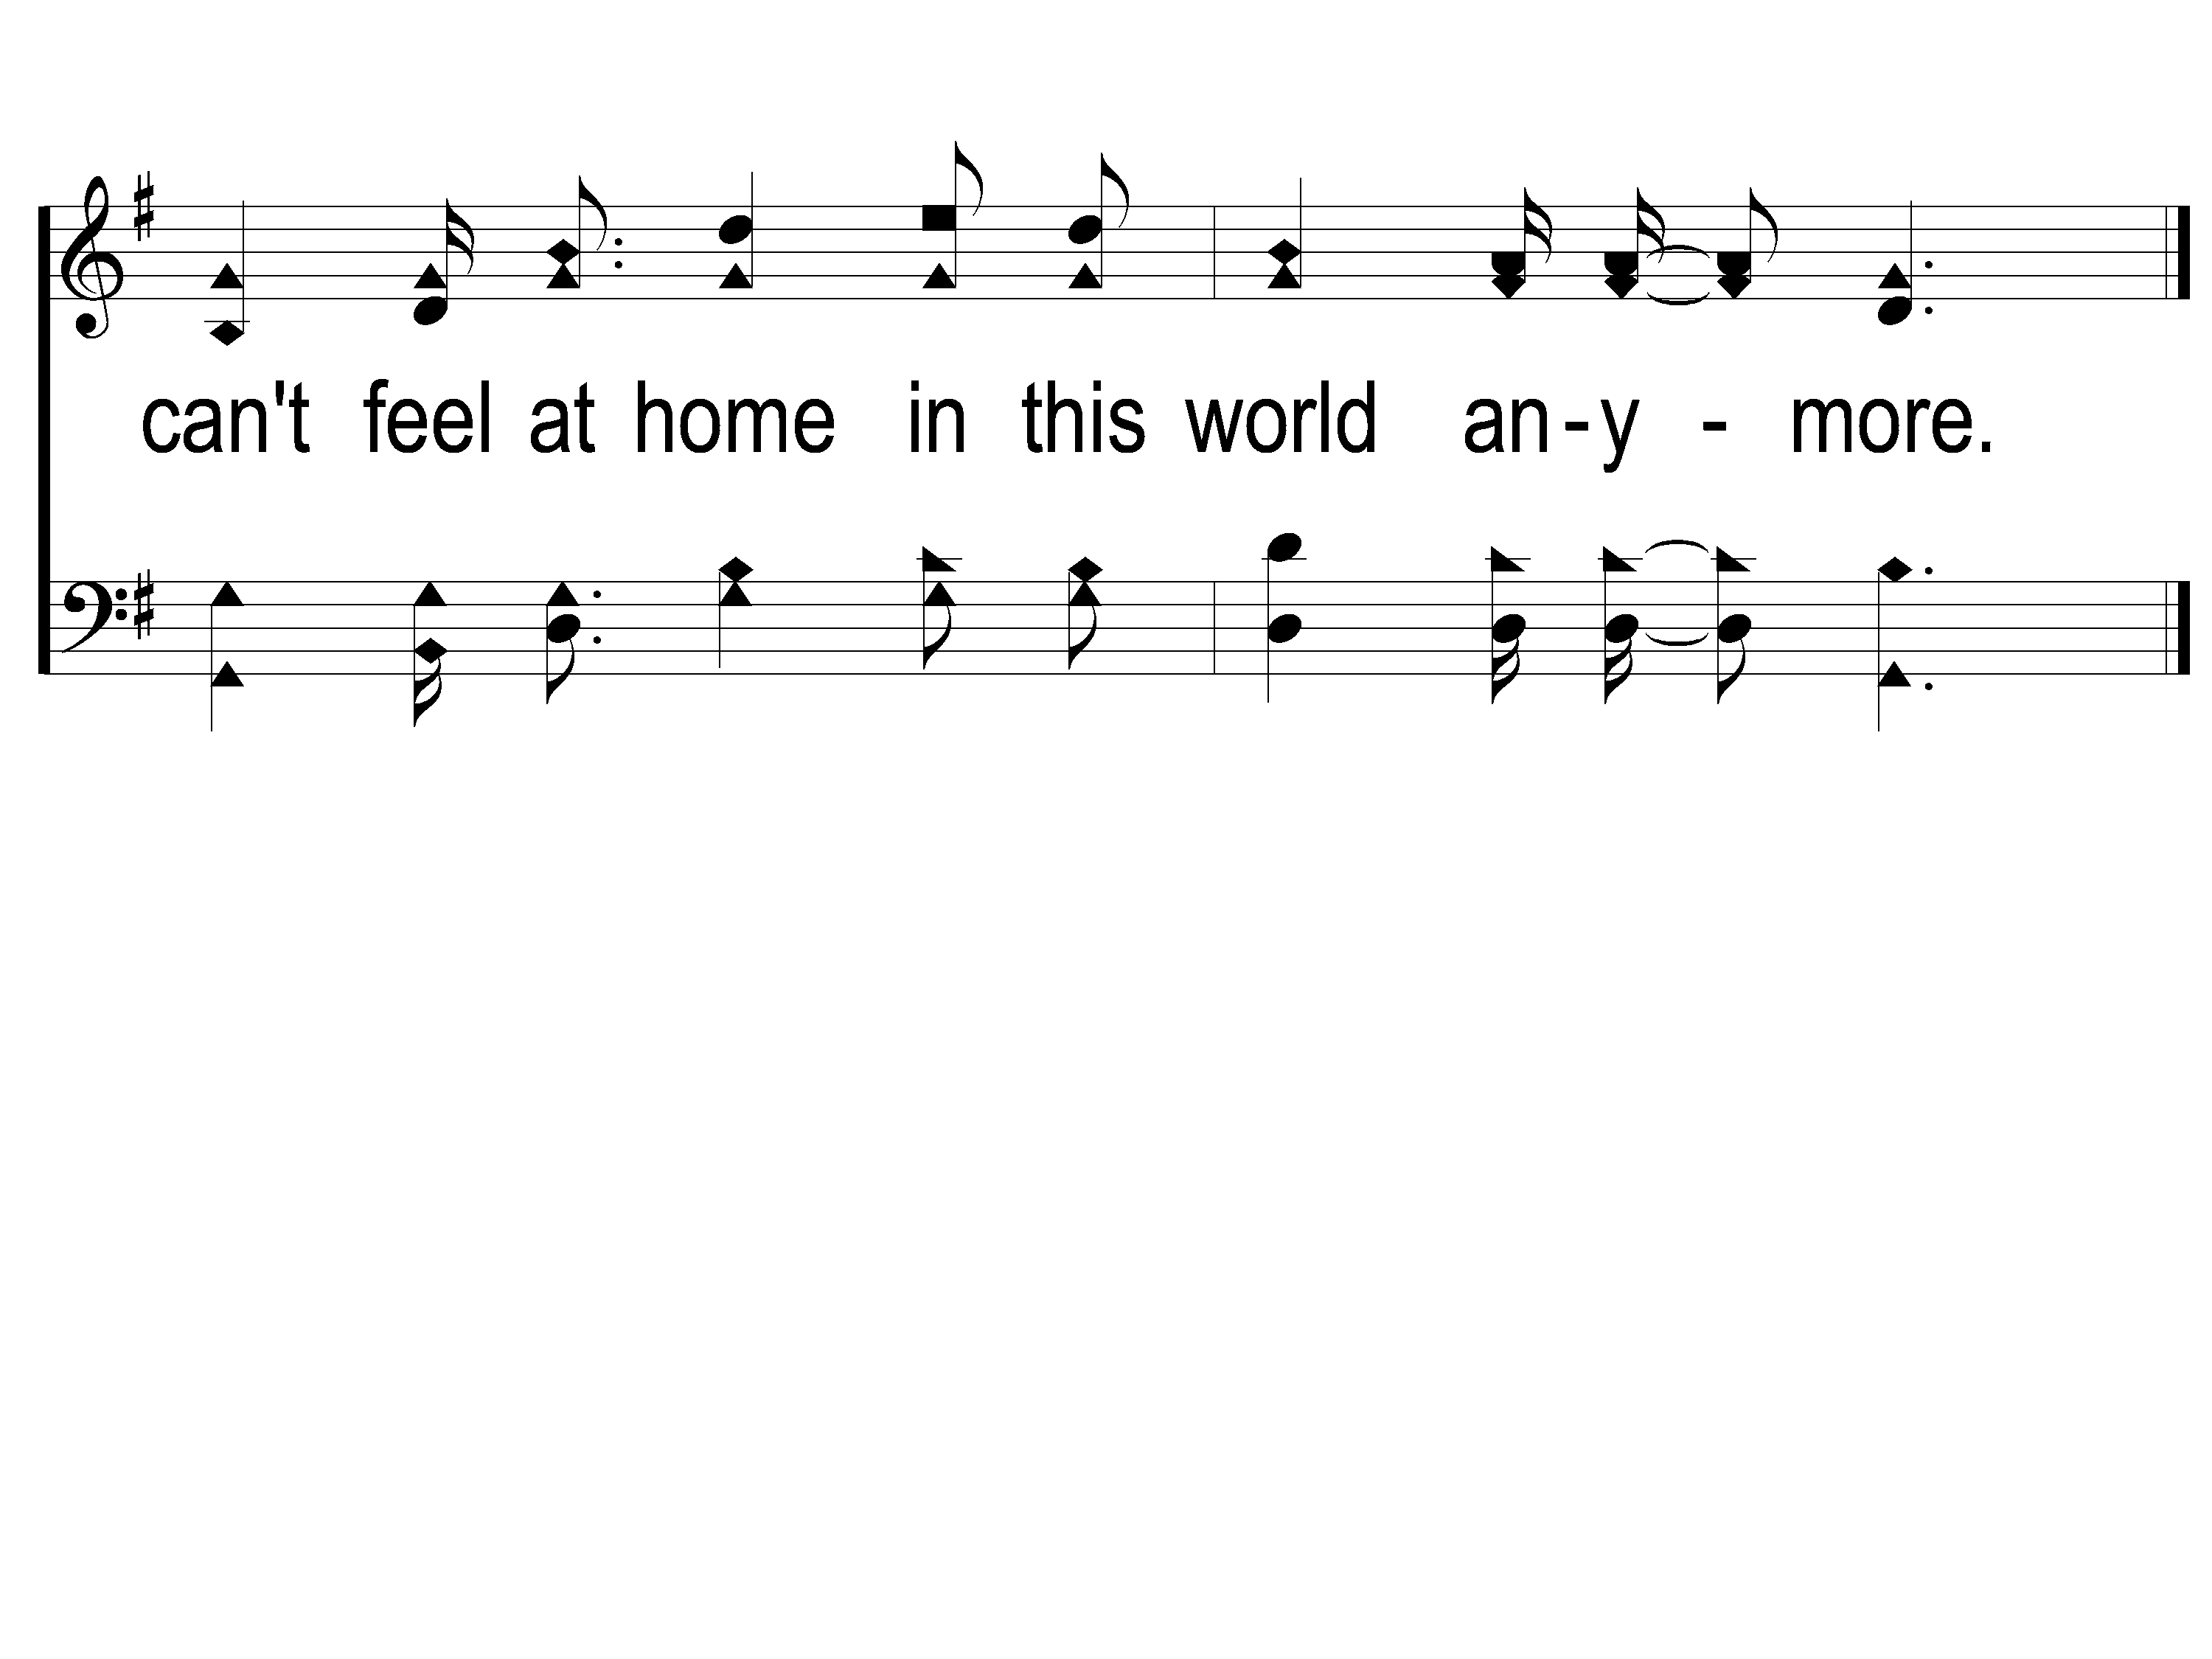
C-3 This World is Not My Home
This World Is Not My Home
957

Slide 117
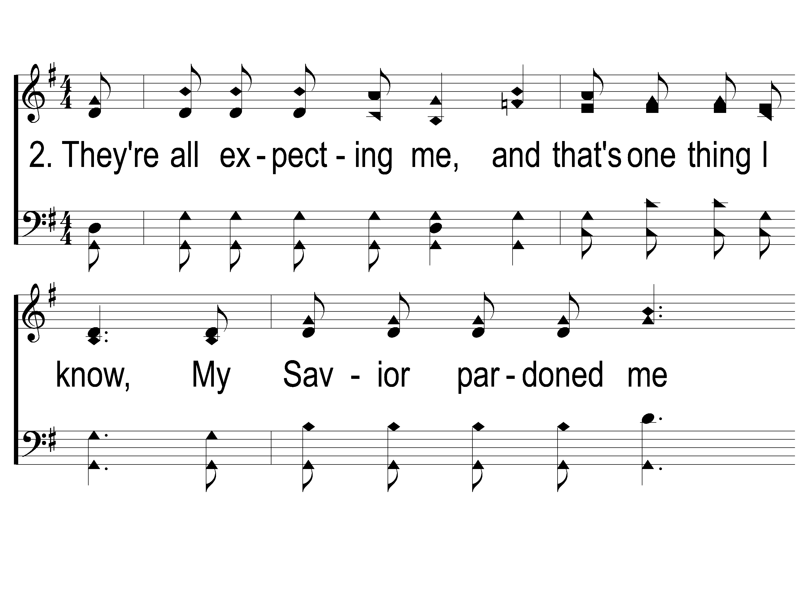
2-1 This World is Not My Home
This World Is Not My Home
957

Slide 118
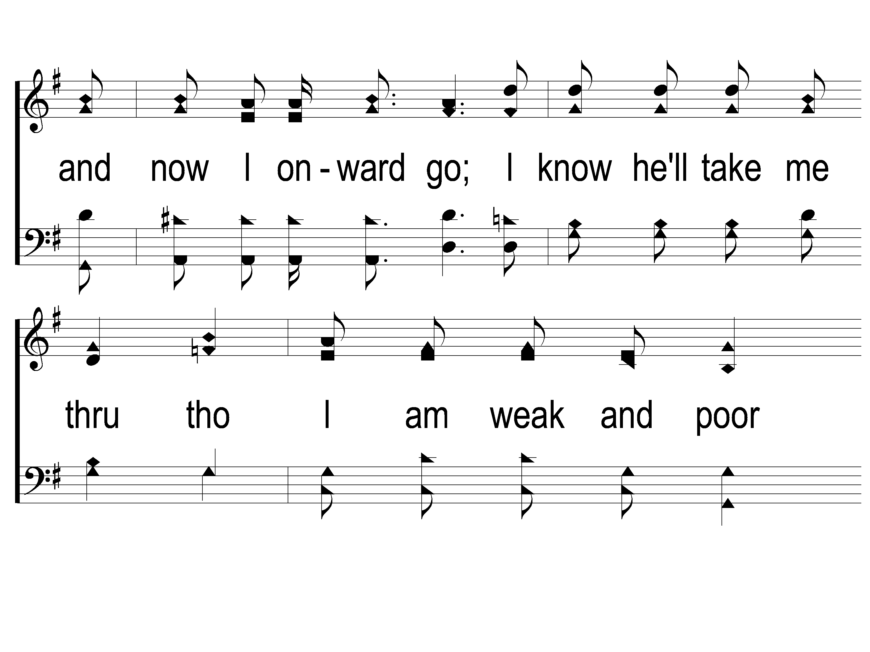
2-2 This World is Not My Home
This World Is Not My Home
957

Slide 119
2-3 This World is Not My Home
This World Is Not My Home
957

Slide 120
C-1 This World is Not My Home
This World Is Not My Home
957

Slide 121
C-2 This World is Not My Home
This World Is Not My Home
957

Slide 122
C-3 This World is Not My Home
This World Is Not My Home
957

Slide 123
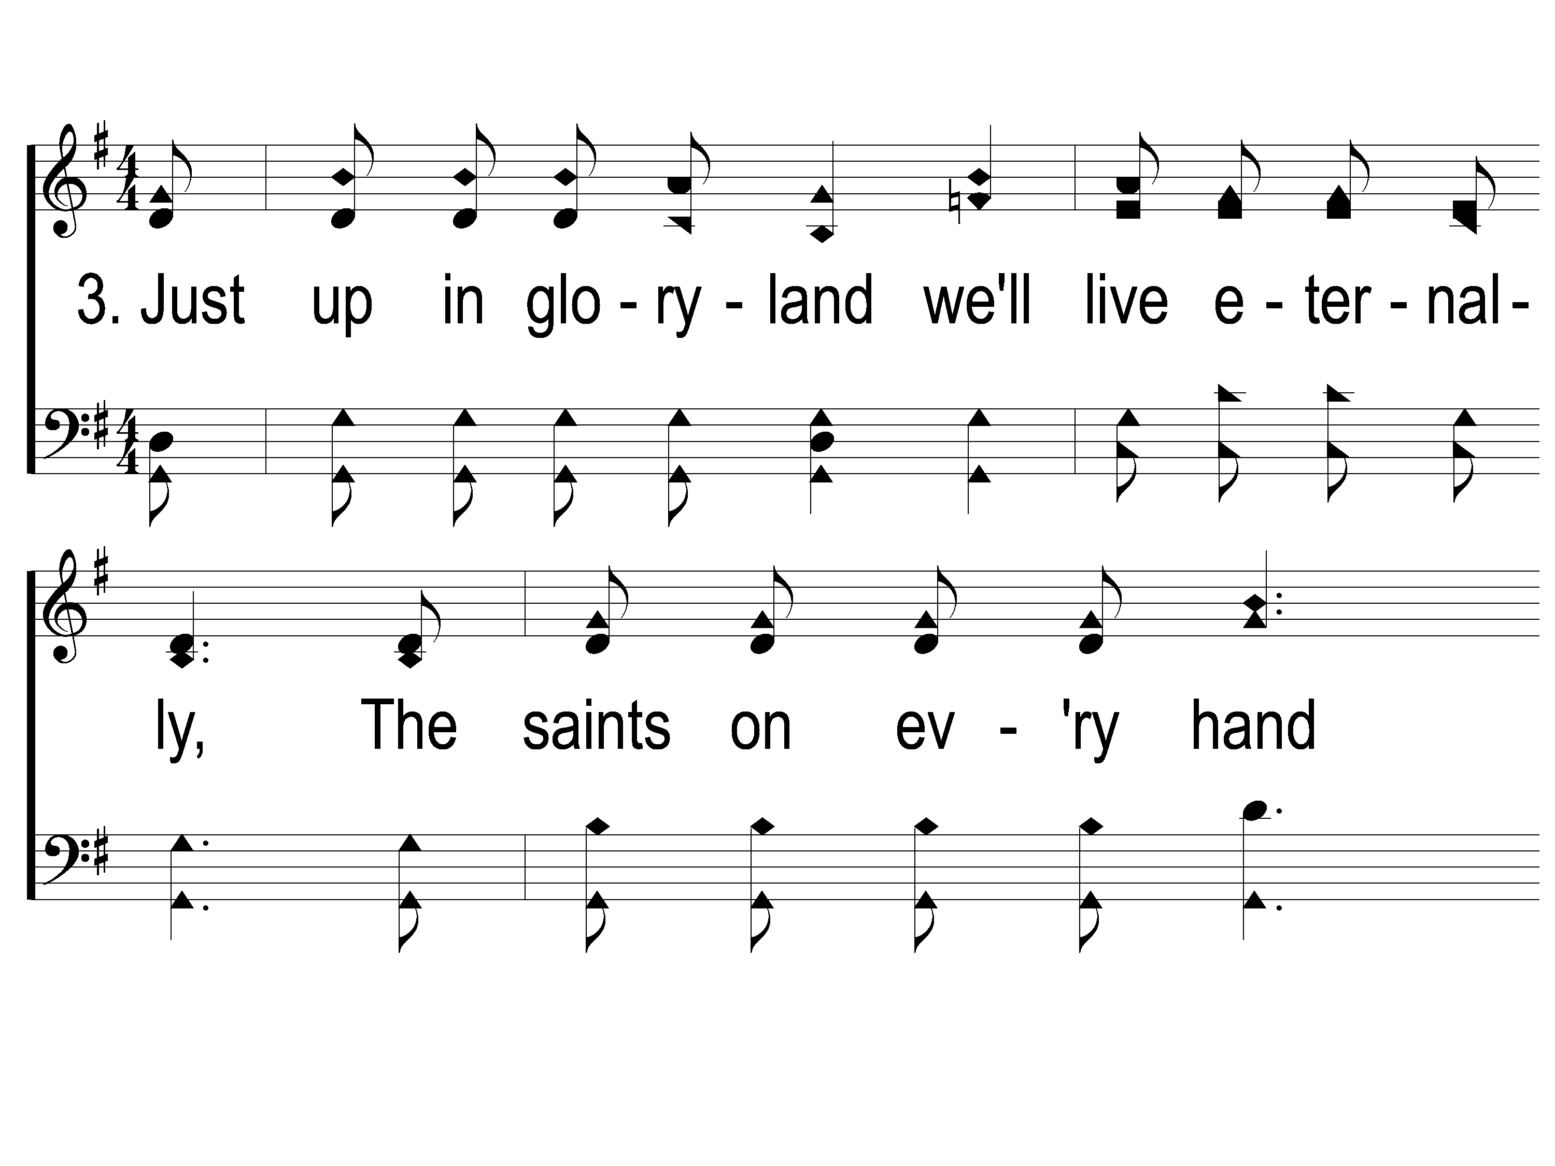
3-1 This World is Not My Home
This World Is Not My Home
957

Slide 124
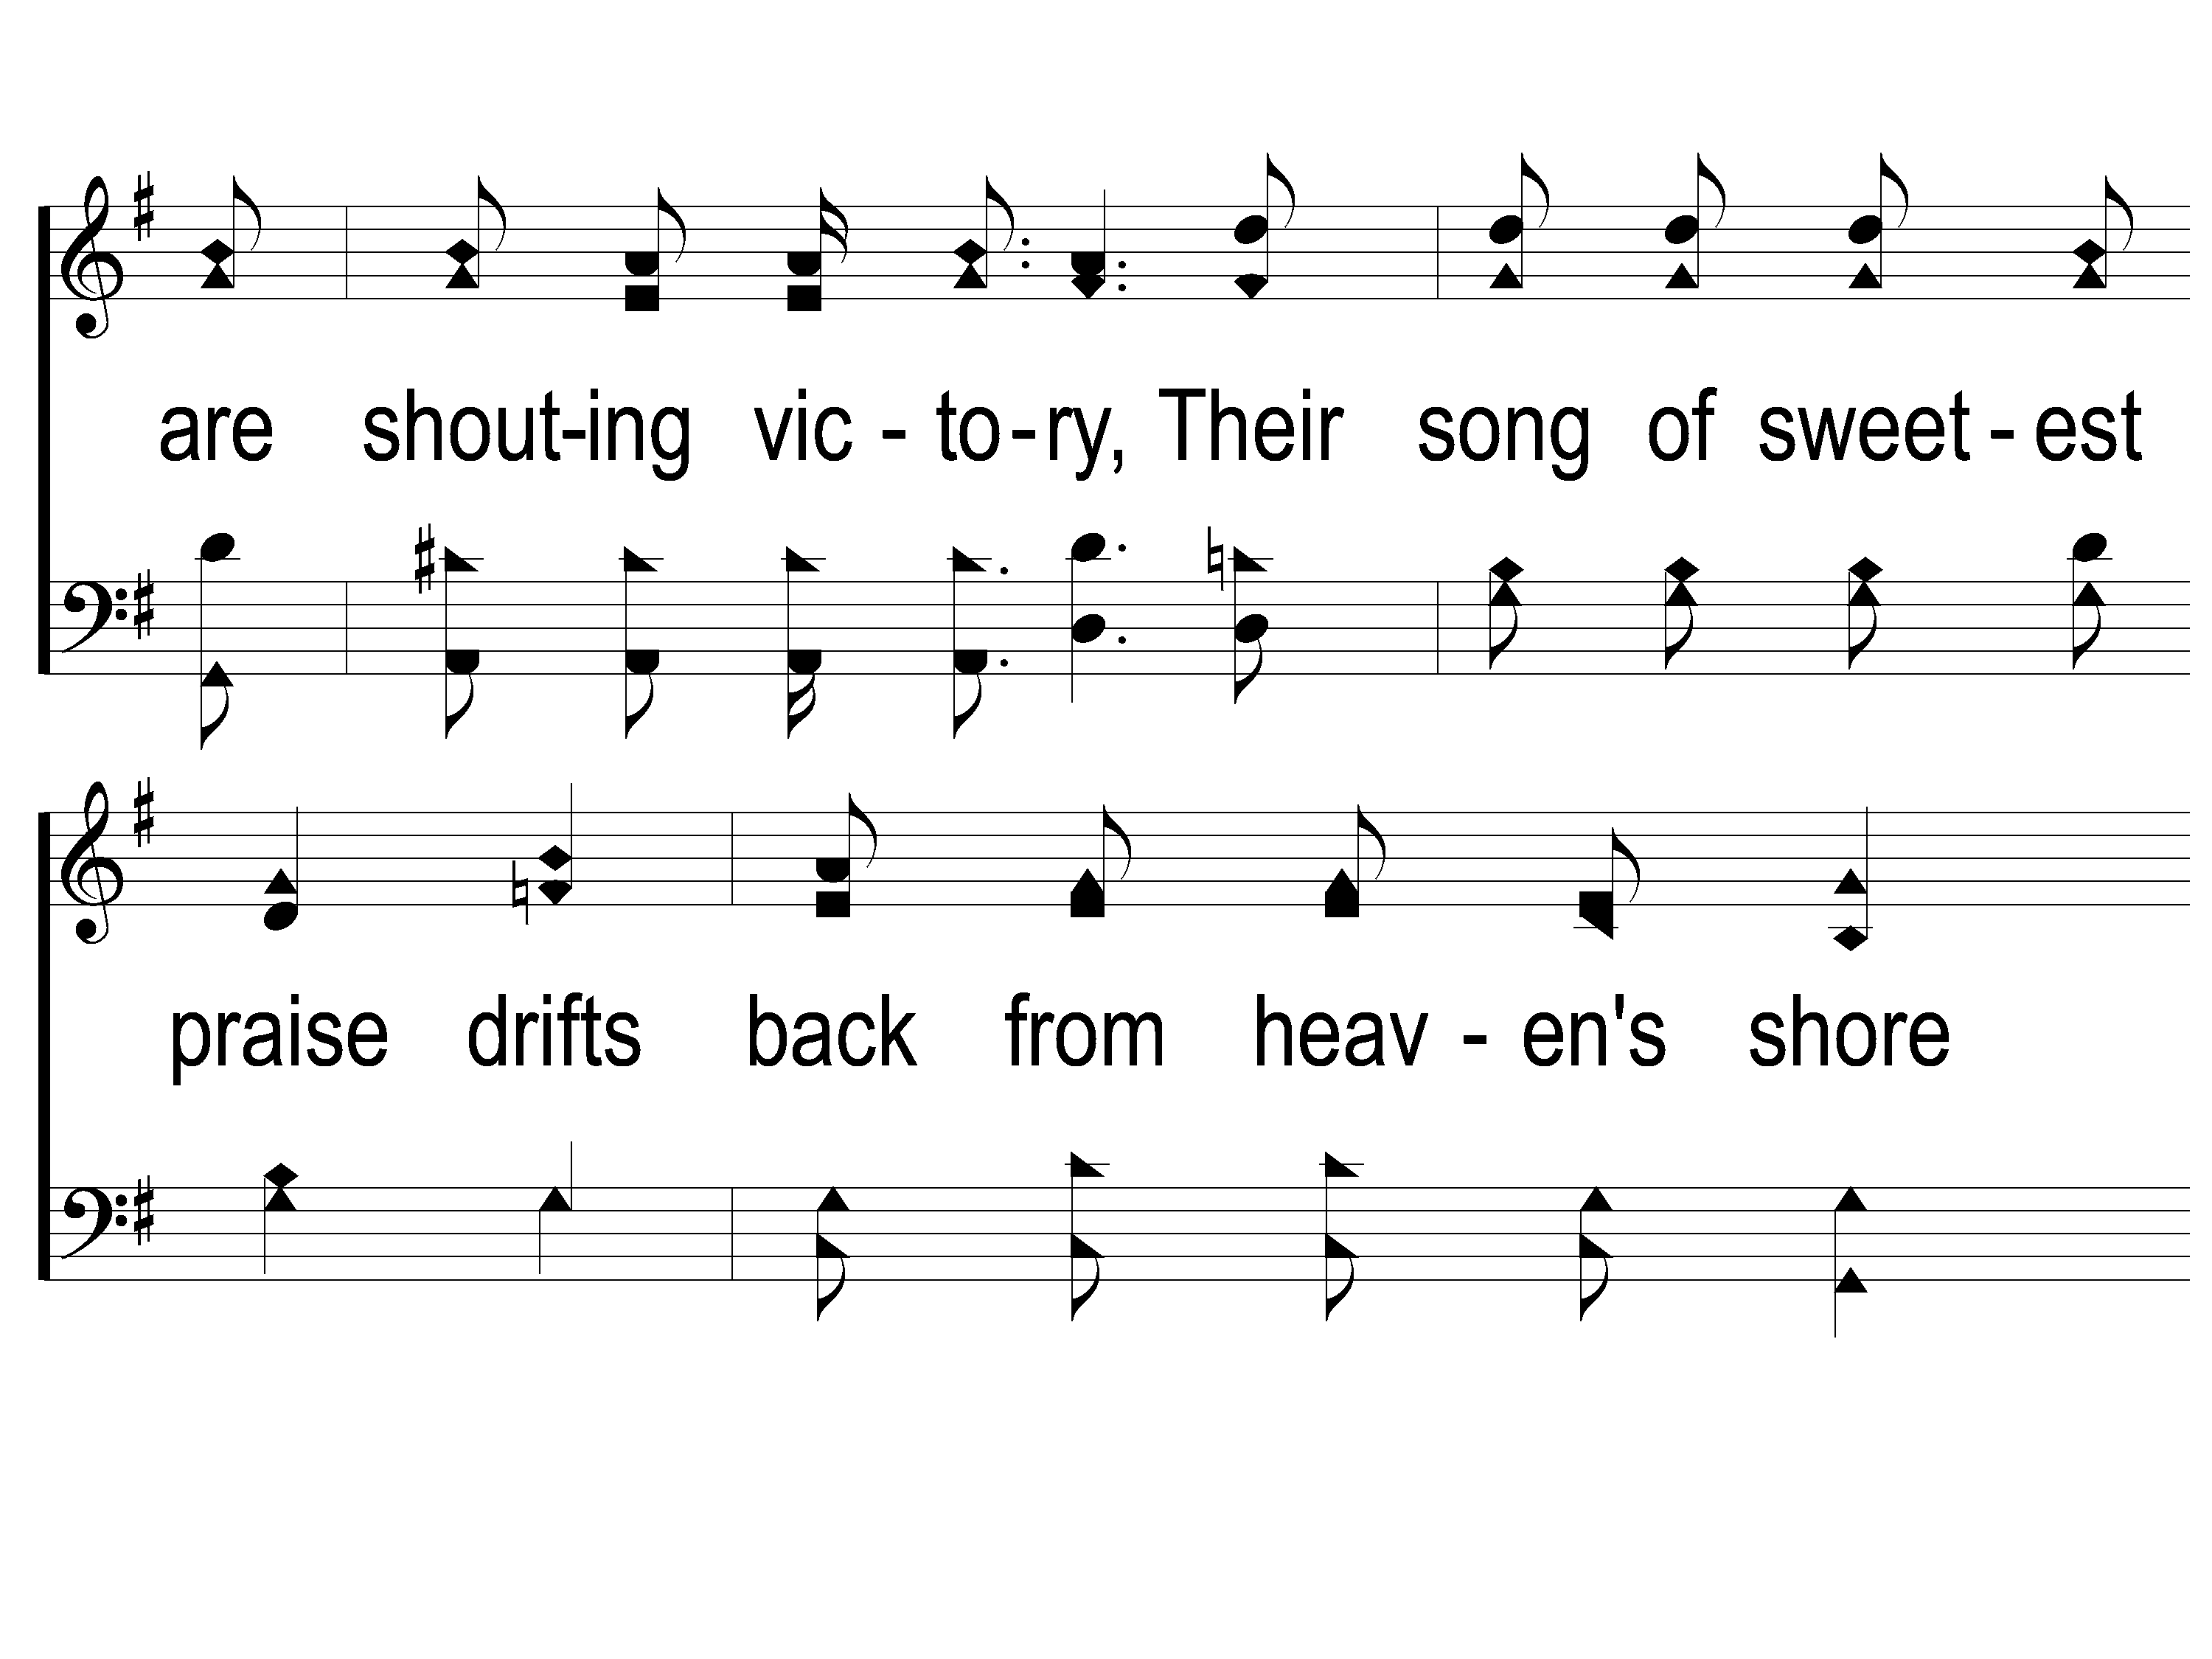
3-2 This World is Not My Home
This World Is Not My Home
957

Slide 125
3-3 This World is Not My Home
This World Is Not My Home
957

Slide 126
C-1 This World is Not My Home
This World Is Not My Home
957

Slide 127
C-2 This World is Not My Home
This World Is Not My Home
957

Slide 128
C-3 This World is Not My Home
This World Is Not My Home
957

Slide 129
Reminder:
Hay Ride & Costume Party @ 4:30pm
Devo & Soup Dinner
@ 6:00pm

