Slide 1
1-1 The Lily of the Valley
The Lily of the Valley
548

Slide 2
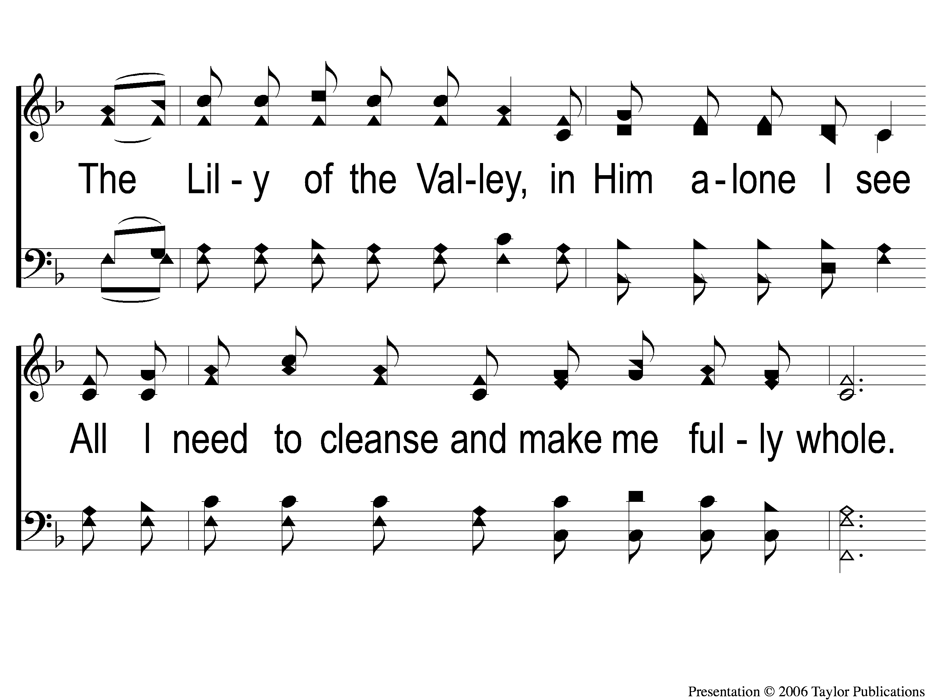
1-2 The Lily of the Valley
The Lily of the Valley
548

Slide 3
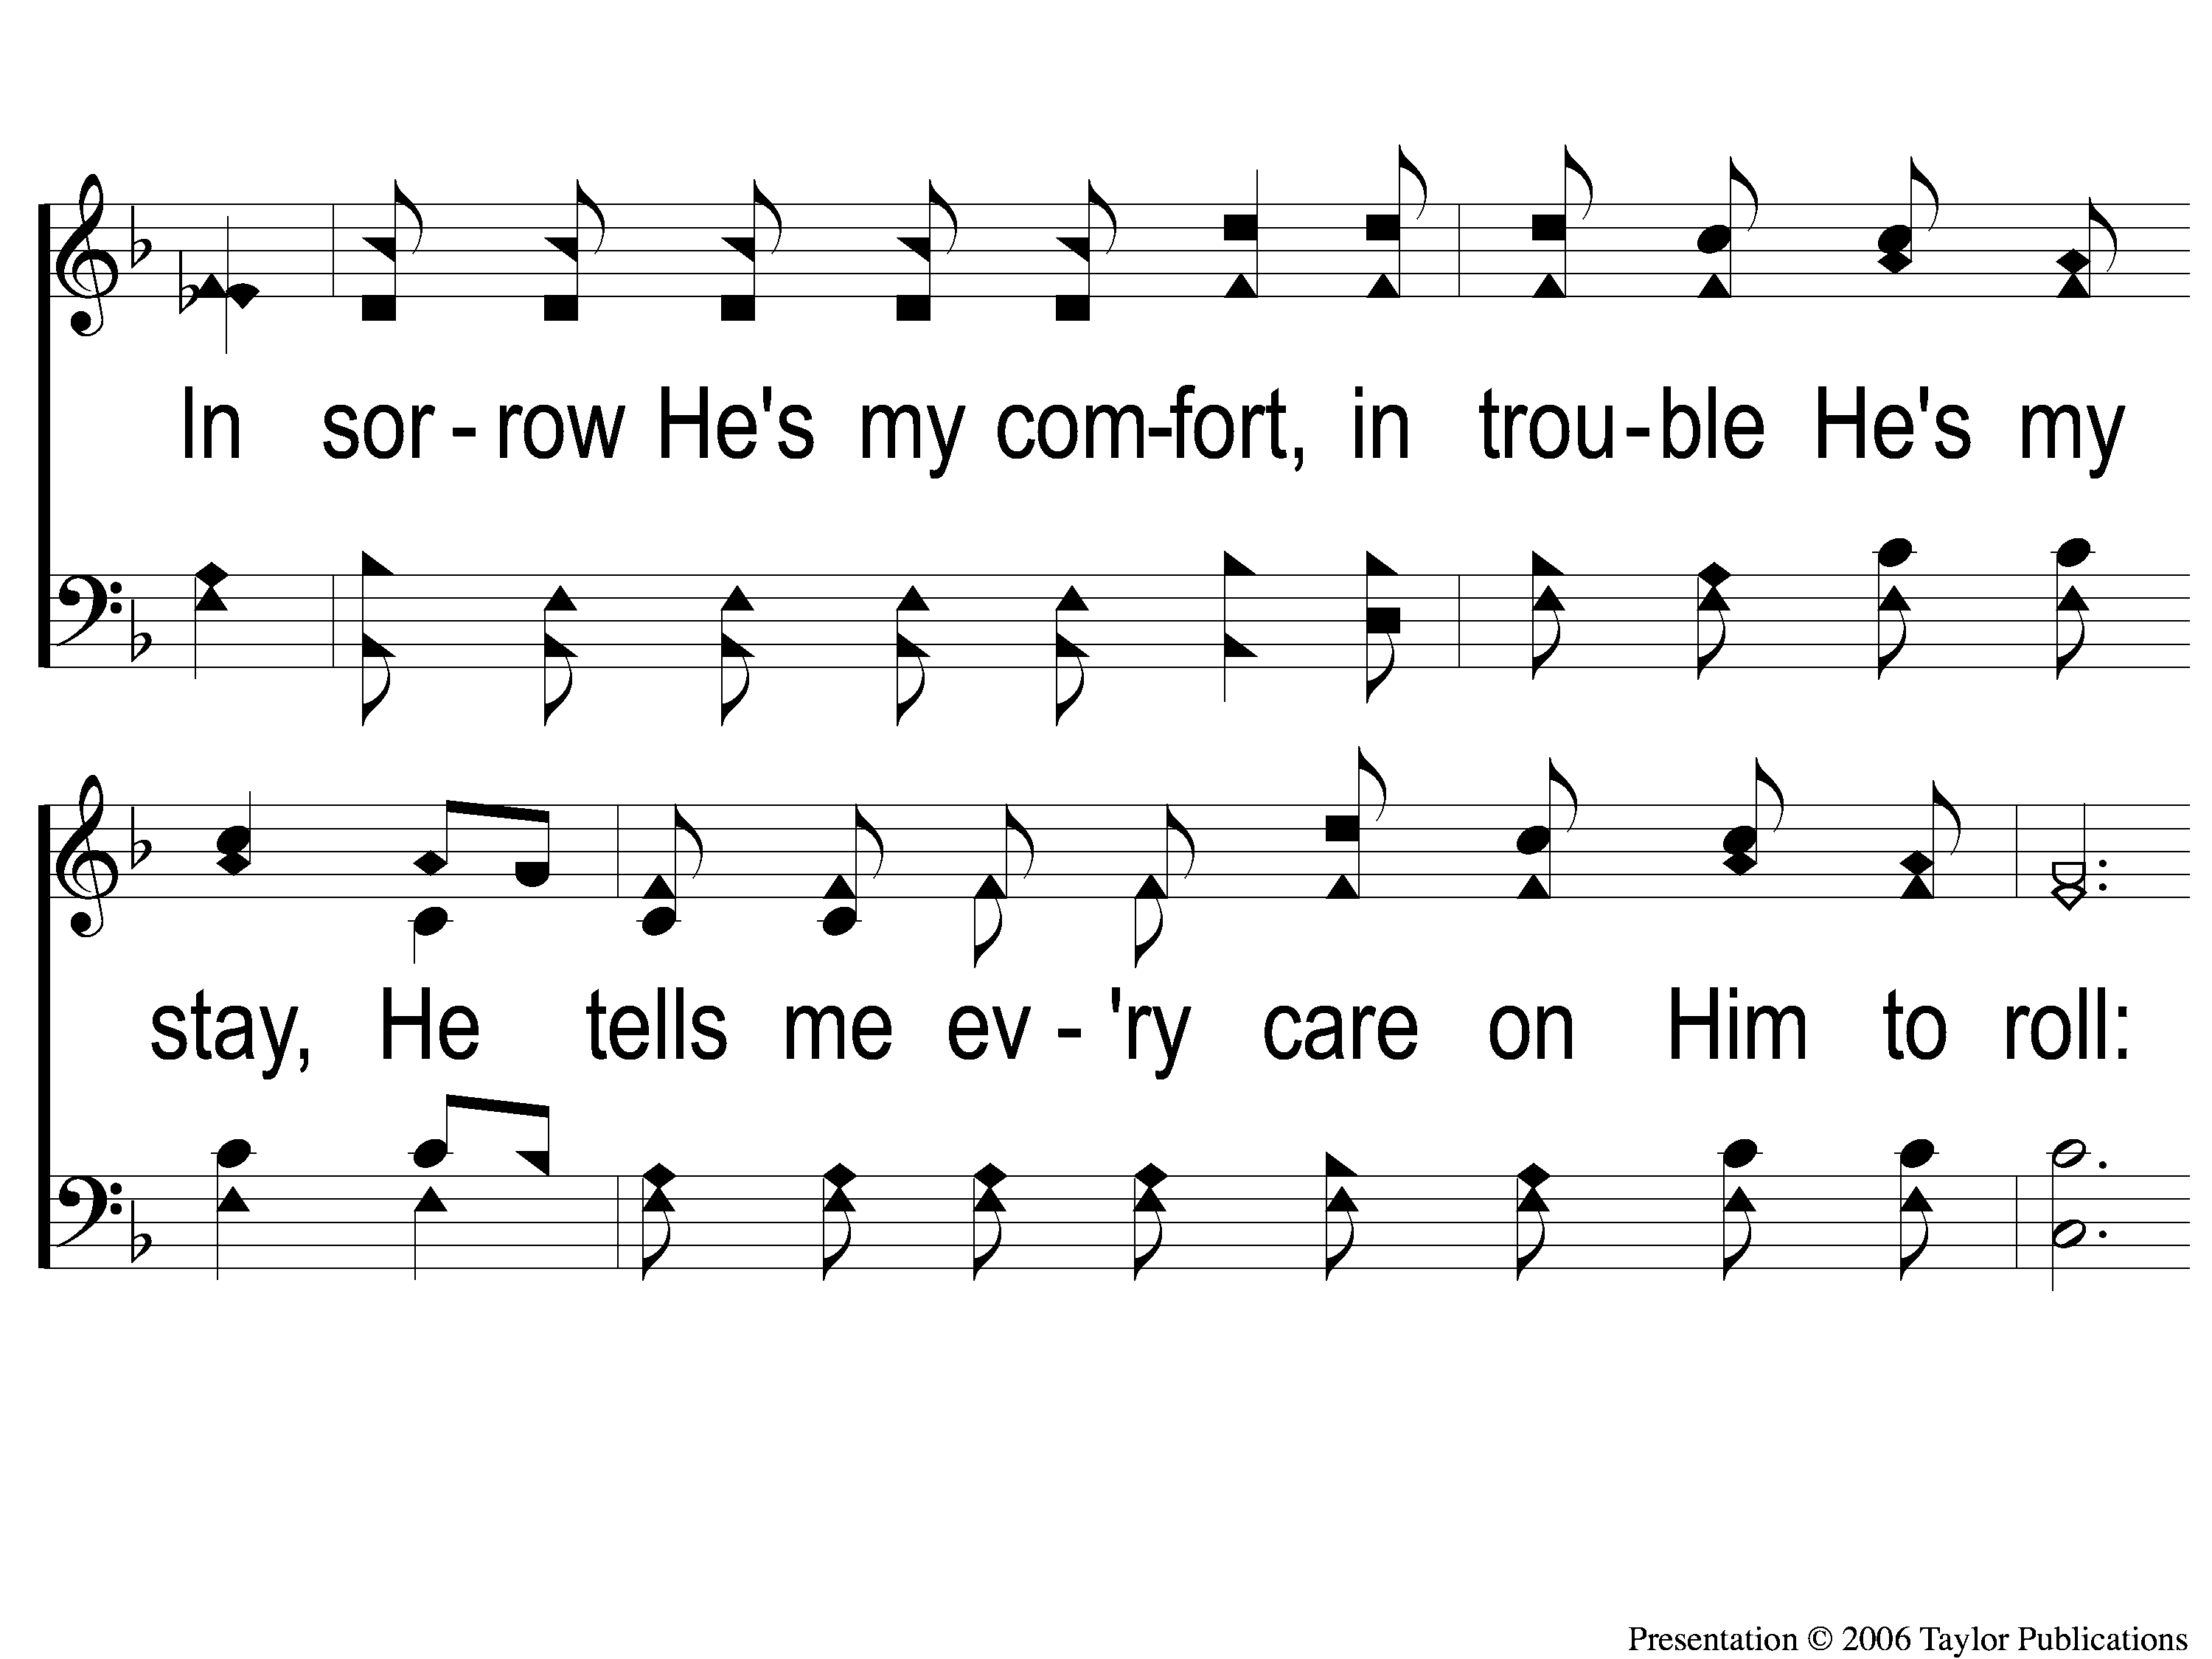
1-3 The Lily of the Valley
The Lily of the Valley
548

Slide 4
C The Lily of the Valley
The Lily of the Valley
548

Slide 5
3-1 The Lily of the Valley
The Lily of the Valley
548

Slide 6
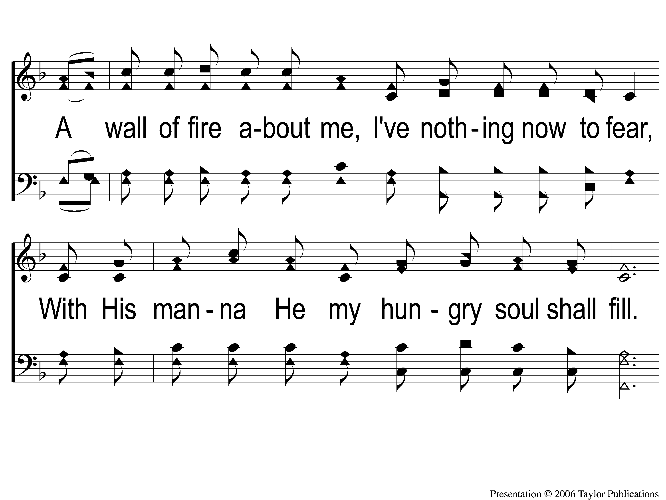
3-2 The Lily of the Valley
The Lily of the Valley
548

Slide 7
3-3 The Lily of the Valley
The Lily of the Valley
548

Slide 8
C The Lily of the Valley
The Lily of the Valley
548

Slide 9
RESTORE REBUILD RENEW
welcome
we are glad to
Have you with us
IN 2022
WHEELER
CHURCH
OF
CHRIST

Slide 10
Song:
Paradise Valley
#898

Slide 11
1-1 Paradise Valley
Paradise Valley
898

Slide 12
1-2 Paradise Valley
Paradise Valley
898

Slide 13
C-1 Paradise Valley
Paradise Valley
898

Slide 14
C-2 Paradise Valley
Paradise Valley
898

Slide 15
C-3 Paradise Valley
Paradise Valley
898

Slide 16
C-4 Paradise Valley
Paradise Valley
898

Slide 17
3-1 Paradise Valley
Paradise Valley
898

Slide 18
3-2 Paradise Valley
Paradise Valley
898

Slide 19
C-1 Paradise Valley
Paradise Valley
898

Slide 20
C-2 Paradise Valley
Paradise Valley
898

Slide 21
C-3 Paradise Valley
Paradise Valley
898

Slide 22
C-4 Paradise Valley
Paradise Valley
898

Slide 23
Song:
Dear Lord and
Father of Mankind
#770

Slide 24
1-1 Dear Lord and Father of Mankind
Dear Lord and Father of Mankind
770

Slide 25
1-2 Dear Lord and Father of Mankind
Dear Lord and Father of Mankind
770

Slide 26
2-1 Dear Lord and Father of Mankind
Dear Lord and Father of Mankind
770

Slide 27
2-2 Dear Lord and Father of Mankind
Dear Lord and Father of Mankind
770

Slide 28
3-1 Dear Lord and Father of Mankind
Dear Lord and Father of Mankind
770

Slide 29
3-2 Dear Lord and Father of Mankind
Dear Lord and Father of Mankind
770

Slide 30
4-1 Dear Lord and Father of Mankind
Dear Lord and Father of Mankind
770

Slide 31
4-2 Dear Lord and Father of Mankind
Dear Lord and Father of Mankind
770

Slide 32
Opening Prayer

Slide 33
Song:
Oh, How I Love Jesus
#574

Slide 34
1-1 O How I Love Jesus
O How I Love Jesus
574

Slide 35
1-2 O How I Love Jesus
O How I Love Jesus
574

Slide 36
C O How I Love Jesus
O How I Love Jesus
574

Slide 37
3-1 O How I Love Jesus
O How I Love Jesus
574

Slide 38
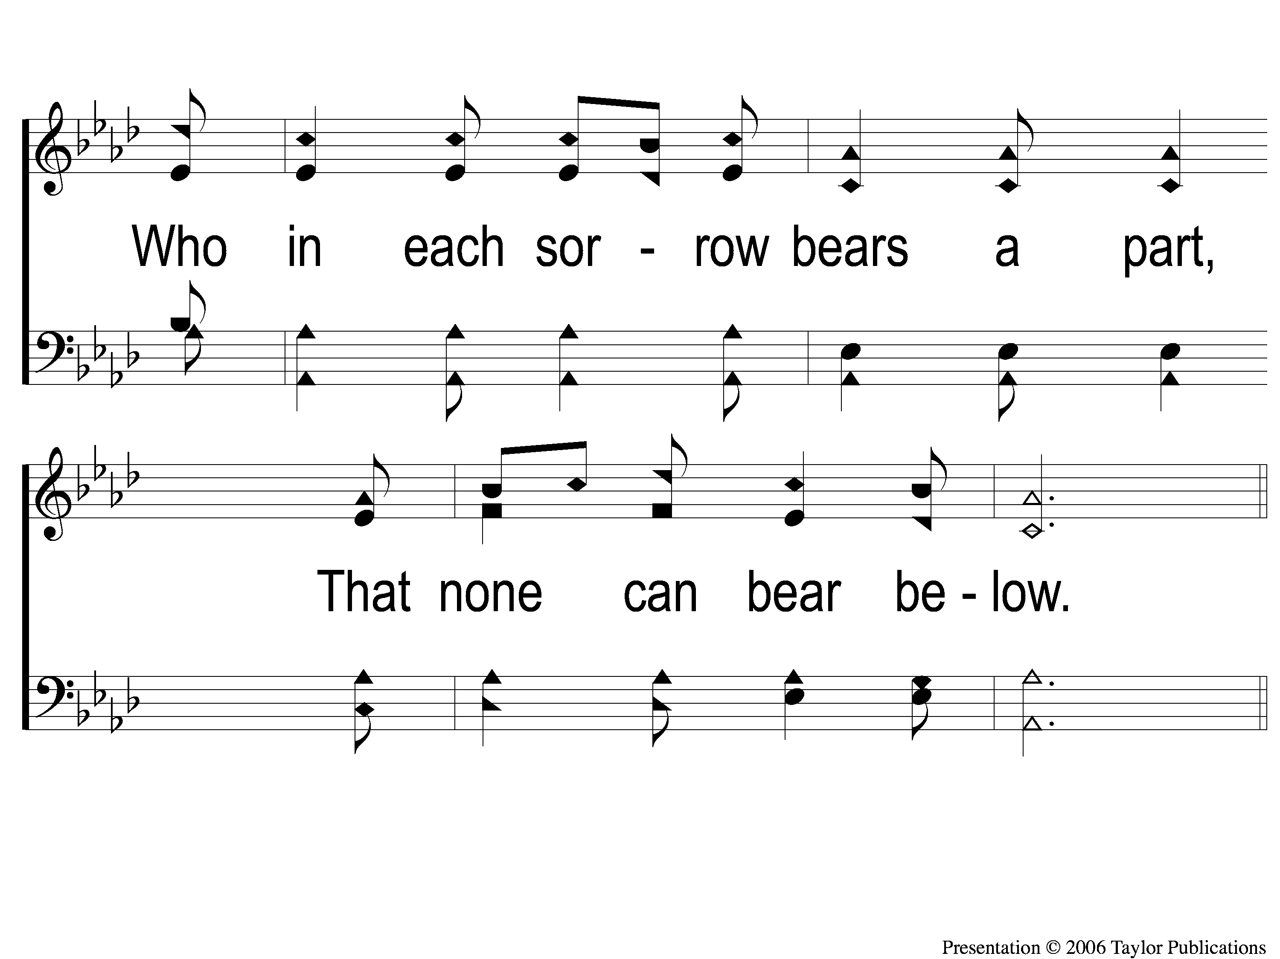
3-2 O How I Love Jesus
O How I Love Jesus
574

Slide 39
C O How I Love Jesus
O How I Love Jesus
574

Slide 40
Song:
Just A Closer Walk With Thee
#406

Slide 41
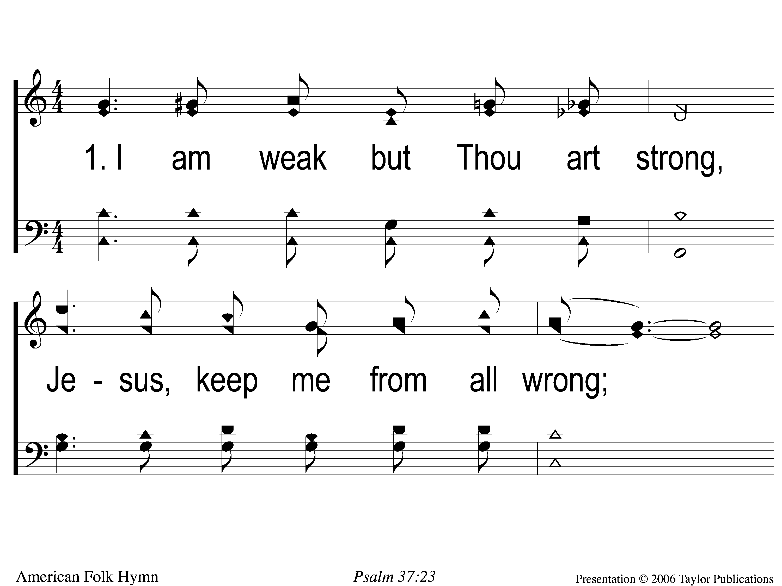
1-1 Just A Closer Walk With Thee
Just A Closer Walk With Thee
406

Slide 42
1-2 Just A Closer Walk With Thee
Just A Closer Walk With Thee
406

Slide 43
C-1 Just A Closer Walk With Thee
Just A Closer Walk With Thee
406

Slide 44
C-2 Just A Closer Walk With Thee
Just A Closer Walk With Thee
406

Slide 45
2-1 Just A Closer Walk With Thee
Just A Closer Walk With Thee
406

Slide 46
2-2 Just A Closer Walk With Thee
Just A Closer Walk With Thee
406

Slide 47
C-1 Just A Closer Walk With Thee
Just A Closer Walk With Thee
406

Slide 48
C-2 Just A Closer Walk With Thee
Just A Closer Walk With Thee
406

Slide 49
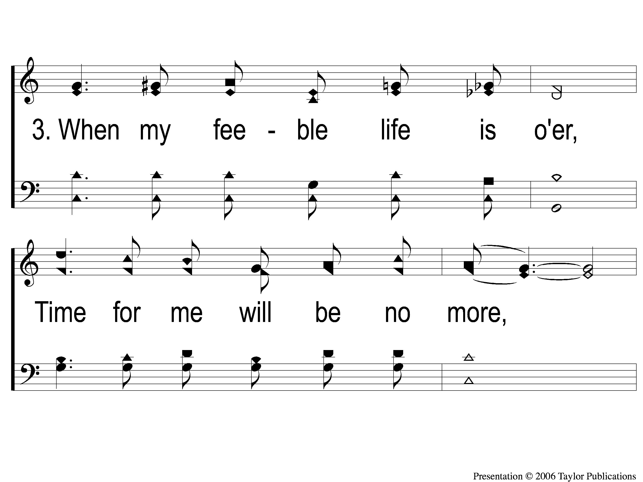
3-1 Just A Closer Walk With Thee
Just A Closer Walk With Thee
406

Slide 50
3-2 Just A Closer Walk With Thee
Just A Closer Walk With Thee
406

Slide 51
C-1 Just A Closer Walk With Thee
Just A Closer Walk With Thee
406

Slide 52
C-2 Just A Closer Walk With Thee
Just A Closer Walk With Thee
406

Slide 53
Scripture Reading:
2 Peter 1:5-11

Slide 55
Renew my
LOVE
for God’s Word

Slide 56
Renew My Love For
Spiritual Growth

Slide 57
A Logical Argument

Slide 58
A Logical Argument
Premise 1: If Sesame Street is starting, it is 8:30.
Premise 2: Sesame Street is starting.
Conclusion: It is 8:30

Slide 59
A Logical Argument
Premise 1: We are called to grow closer to God.

Slide 60
A Logical Argument
Premise 1: We are called to grow closer to God.
1 Pet. 2:2
2 Pet. 1:5-9, 3:18
Col. 1:10, 2 Thess. 1:3

Slide 61
A Logical Argument
Premise 1: We are called to grow closer to God.
Premise 2: If we stay in our comfort zone, we are not growing closer to God.

Slide 62
A Logical Argument
Premise 1: We are called to grow closer to God.
Premise 2: If we stay in our comfort zone, we are not growing closer to God.
Conclusion: We must get out of our comfort zone.

Slide 63
A Logical Argument

Slide 64
7 Individuals

Slide 65
7 Individuals
Old Testament
Job – 1:1-3, 9-11, 2:7-10

Slide 66
7 Individuals
Old Testament
Job – 1:1-3, 9-11, 2:7-10
Moses – Heb. 11:24-27

Slide 67
7 Individuals
Old Testament
Job – 1:1-3, 9-11, 2:7-10
Moses – Heb. 11:24-27
Ezekiel – 4:9-17

Slide 68
7 Individuals
Old Testament
Job – 1:1-3, 9-11, 2:7-10
Moses – Heb. 11:24-27
Ezekiel – 4:9-17
Daniel – 1:1-6, 2:12-13

Slide 69
7 Individuals
Old Testament
Job – 1:1-3, 9-11, 2:7-10
Moses – Heb. 11:24-27
Ezekiel – 4:9-17
Daniel – 1:1-6, 2:12-13
New Testament
Paul – 2 Cor. 11:23-25, Acts 21:30-31, 40-22:2

Slide 70
7 Individuals
Old Testament
Job – 1:1-3, 9-11, 2:7-10
Moses – Heb. 11:24-27
Ezekiel – 4:9-17
Daniel – 1:1-6, 2:12-13
New Testament
Paul – 2 Cor. 11:23-25, Acts 21:30-31, 40-22:2
Peter – Acts 10:13-14, 34, 12:3-5

Slide 71
7 Individuals
#7: You

Slide 72
Are you Growing?

Slide 73
Tis So Sweet To Trust In Jesus
#679
Invitation
Song:

Slide 74
1-1 ‘Tis so Sweet To Trust in Jesus
‘Tis So Sweet To Trust In Jesus
679

Slide 75
1-2 ‘Tis so Sweet To Trust in Jesus
‘Tis So Sweet To Trust In Jesus
679

Slide 76
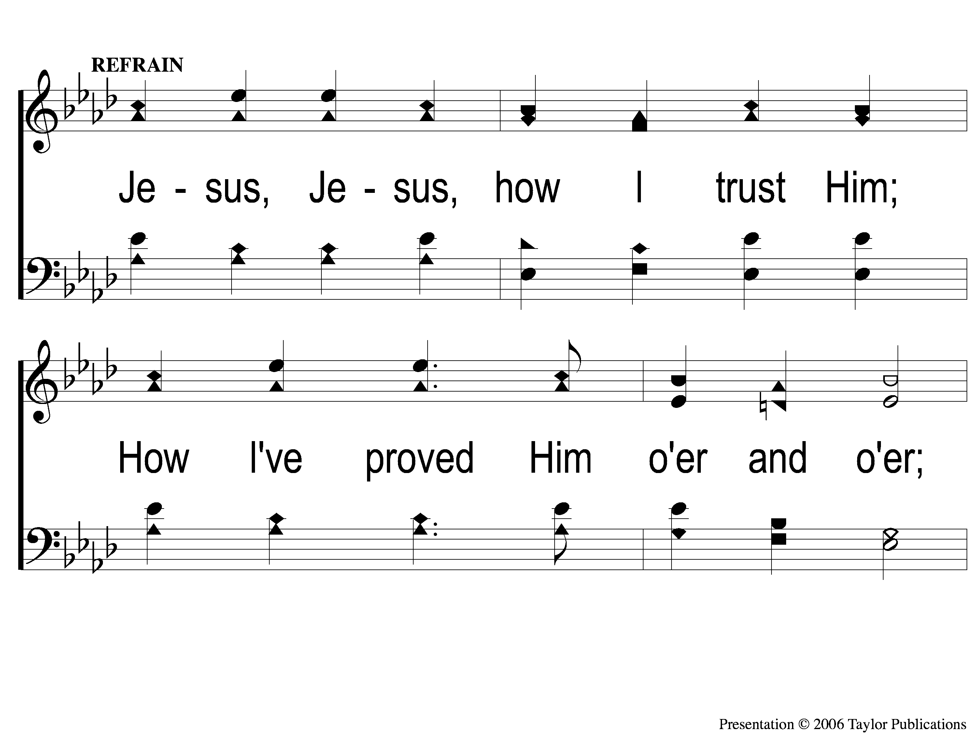
C-1 ‘Tis so Sweet To Trust in Jesus
‘Tis So Sweet To Trust In Jesus
679

Slide 77
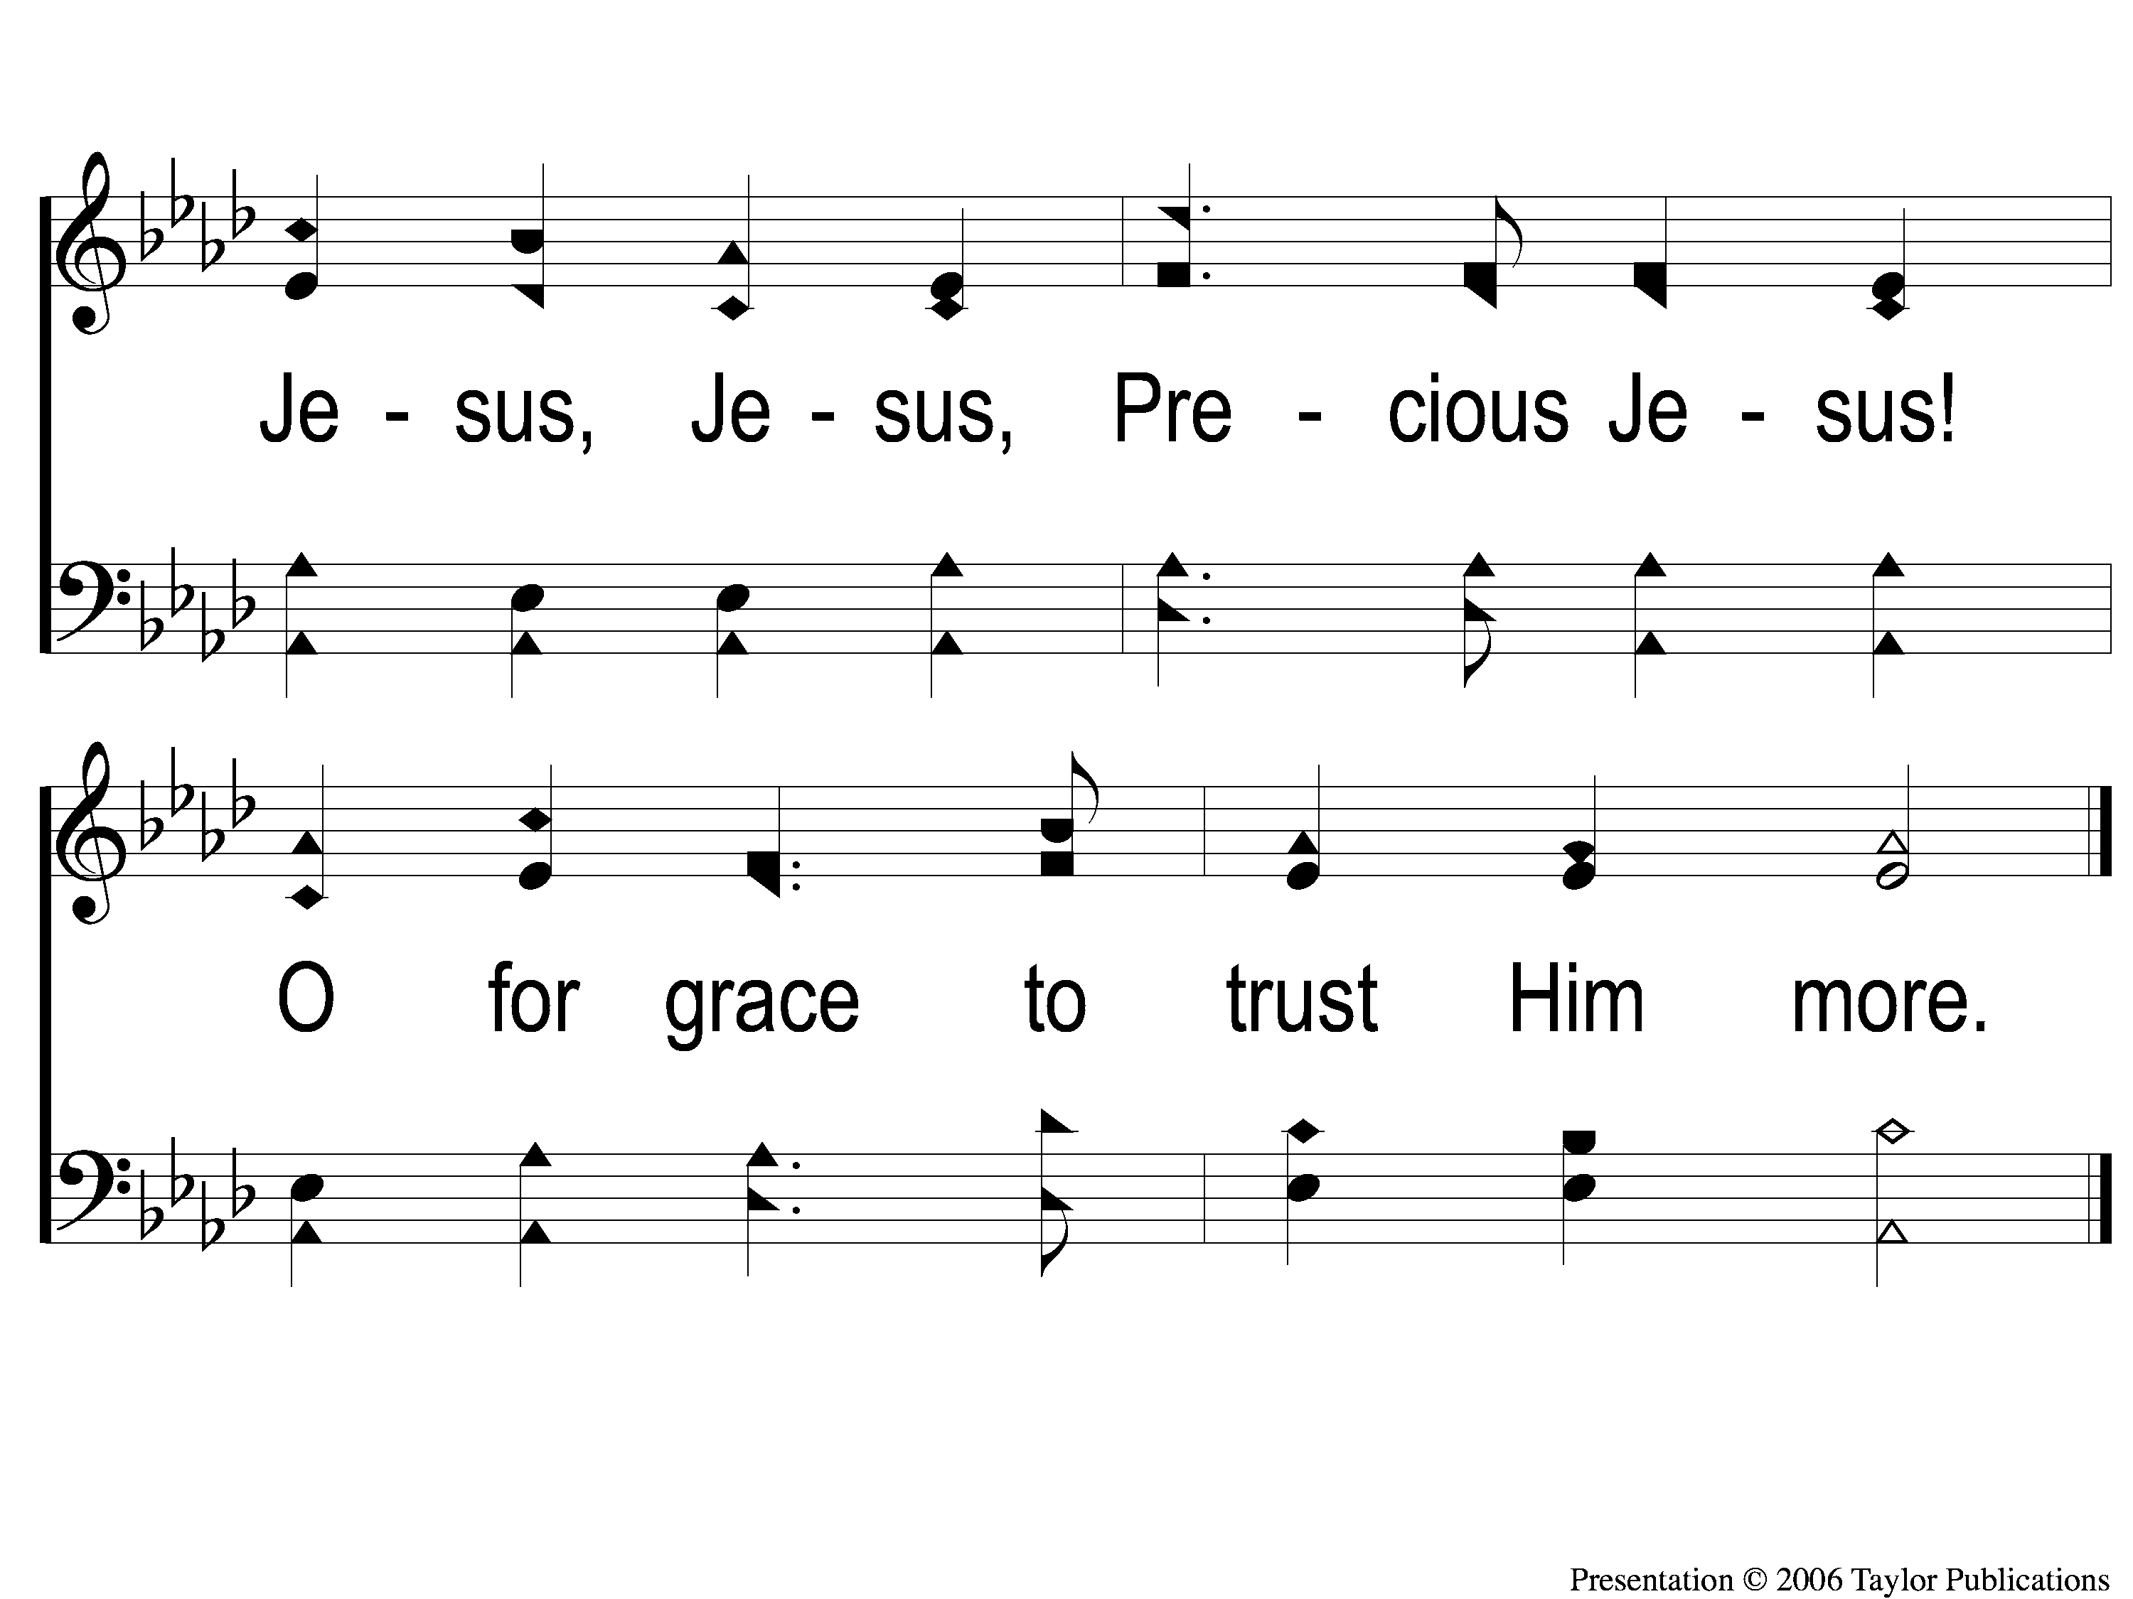
C-2 ‘Tis so Sweet To Trust in Jesus
‘Tis So Sweet To Trust In Jesus
679

Slide 78
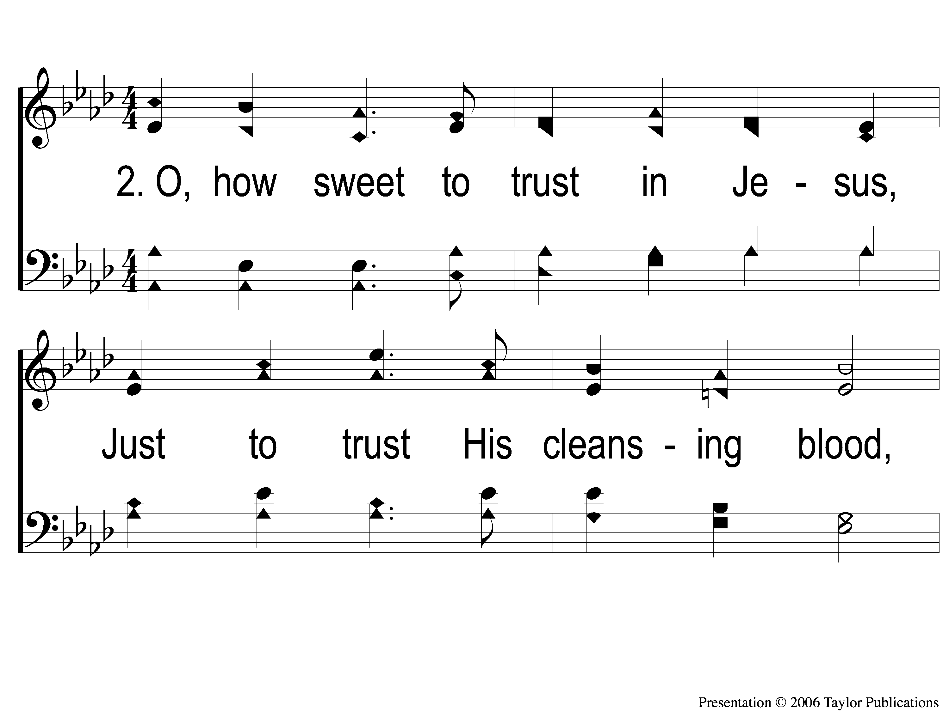
2-1 ‘Tis so Sweet To Trust in Jesus
‘Tis So Sweet To Trust In Jesus
679

Slide 79
2-2 ‘Tis so Sweet To Trust in Jesus
‘Tis So Sweet To Trust In Jesus
679

Slide 80
C-1 ‘Tis so Sweet To Trust in Jesus
‘Tis So Sweet To Trust In Jesus
679

Slide 81
C-2 ‘Tis so Sweet To Trust in Jesus
‘Tis So Sweet To Trust In Jesus
679

Slide 82
4-1 ‘Tis so Sweet To Trust in Jesus
‘Tis So Sweet To Trust In Jesus
679

Slide 83
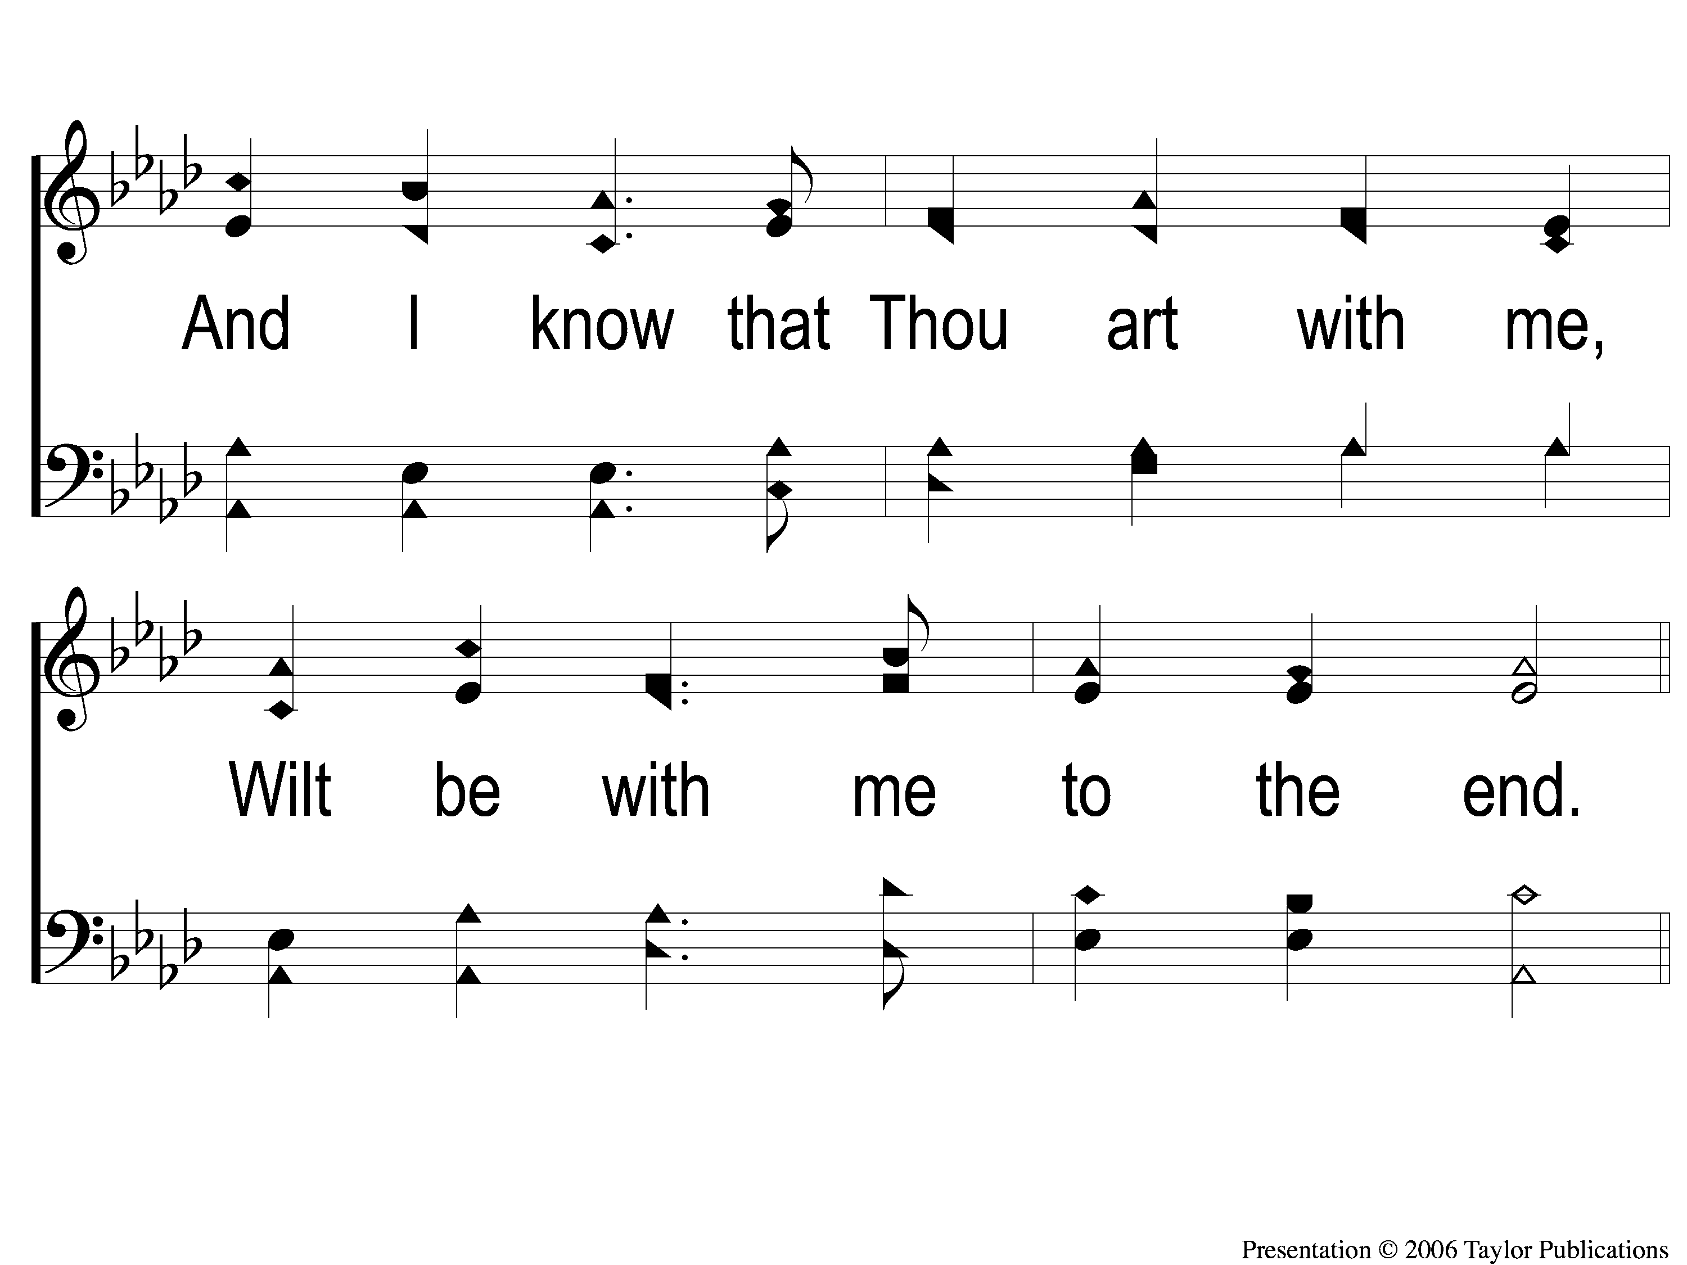
4-2 ‘Tis so Sweet To Trust in Jesus
‘Tis So Sweet To Trust In Jesus
679

Slide 84
C-1 ‘Tis so Sweet To Trust in Jesus
‘Tis So Sweet To Trust In Jesus
679

Slide 85
C-2 ‘Tis so Sweet To Trust in Jesus
‘Tis So Sweet To Trust In Jesus
679

Slide 86
The Contribution:
Mark 10:21
Then Jesus, looking at him, loved him, and said to him, ‘One thing you lack: Go your way, sell whatever you have and give to the poor, and you will have treasure in heaven; and come, take up the cross, and follow Me.’ ”

Slide 87
Song:
Jesus, Keep Me Near The Cross
#383

Slide 88
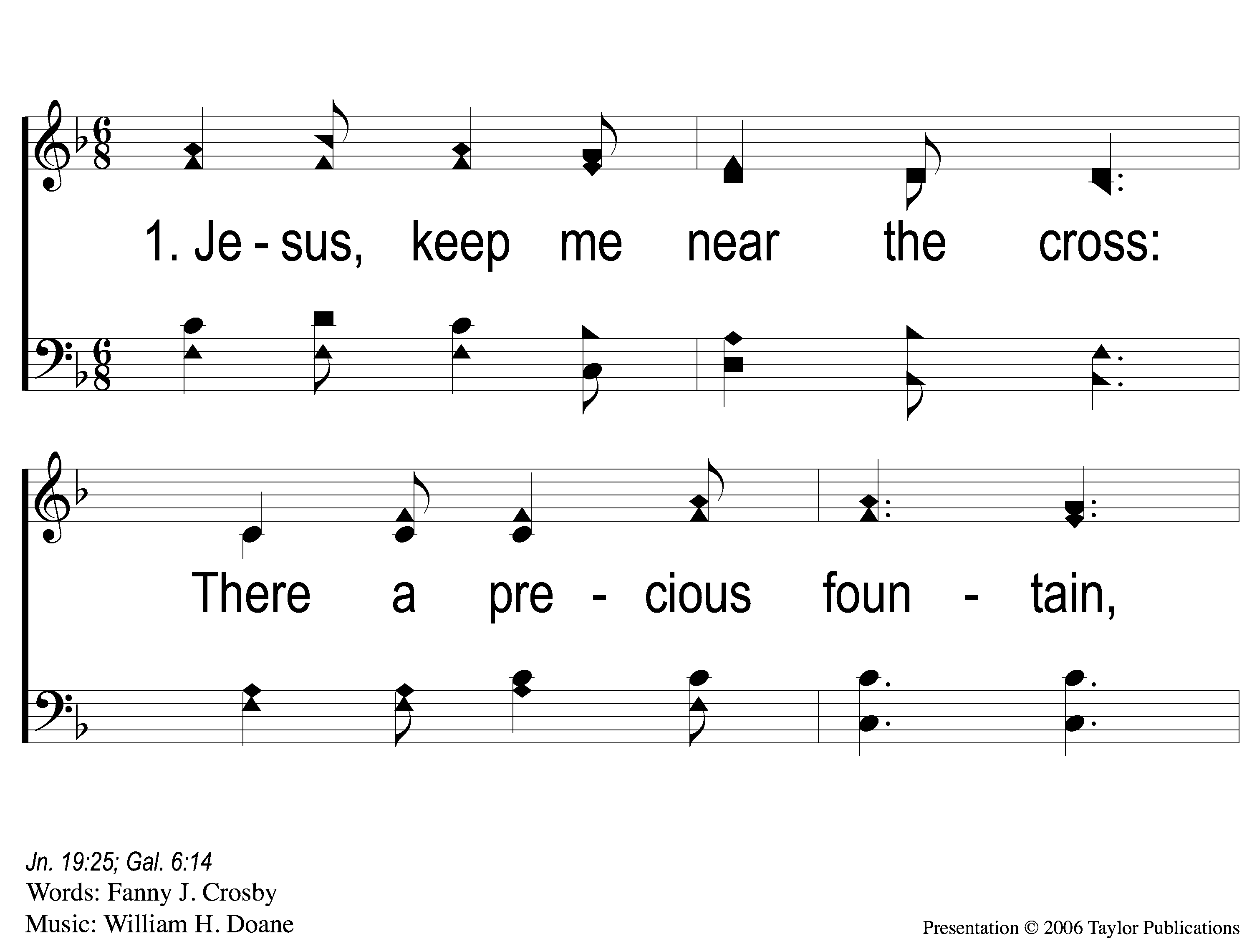
1-1 Jesus Keep Me Near the Cross
Jesus Keep Me Near The Cross
383

Slide 89
1-2 Jesus Keep Me Near the Cross
Jesus Keep Me Near The Cross
383

Slide 90
C Jesus Keep Me Near the Cross
Jesus Keep Me Near The Cross
383

Slide 91
2-1 Jesus Keep Me Near the Cross
Jesus Keep Me Near The Cross
383

Slide 92
2-2 Jesus Keep Me Near the Cross
Jesus Keep Me Near The Cross
383

Slide 93
C Jesus Keep Me Near the Cross
Jesus Keep Me Near The Cross
383

Slide 94
3-1 Jesus Keep Me Near the Cross
Jesus Keep Me Near The Cross
383

Slide 95
3-2 Jesus Keep Me Near the Cross
Jesus Keep Me Near The Cross
383

Slide 96
C Jesus Keep Me Near the Cross
Jesus Keep Me Near The Cross
383

Slide 97
The Unleavened Bread
Mark 14:22
“And as they were eating, Jesus took bread, blessed and broke it, and gave it to them and said, ‘Take, eat; this is My body.’ ”

Slide 98
The Fruit
of the Vine
Mark 14:23-25
Then He took the cup, and when He had given thanks He gave it to them, and they all drank from it. And He said to them, ‘This is My blood of the new covenant, which is shed for many. Assuredly, I say to you, I will no longer drink of the fruit of the vine until that day when I drink it new in the kingdom of God.’ ”

Slide 99
Closing Prayer

Slide 100
Song:
Yield Not To Temptation
#905

Slide 101
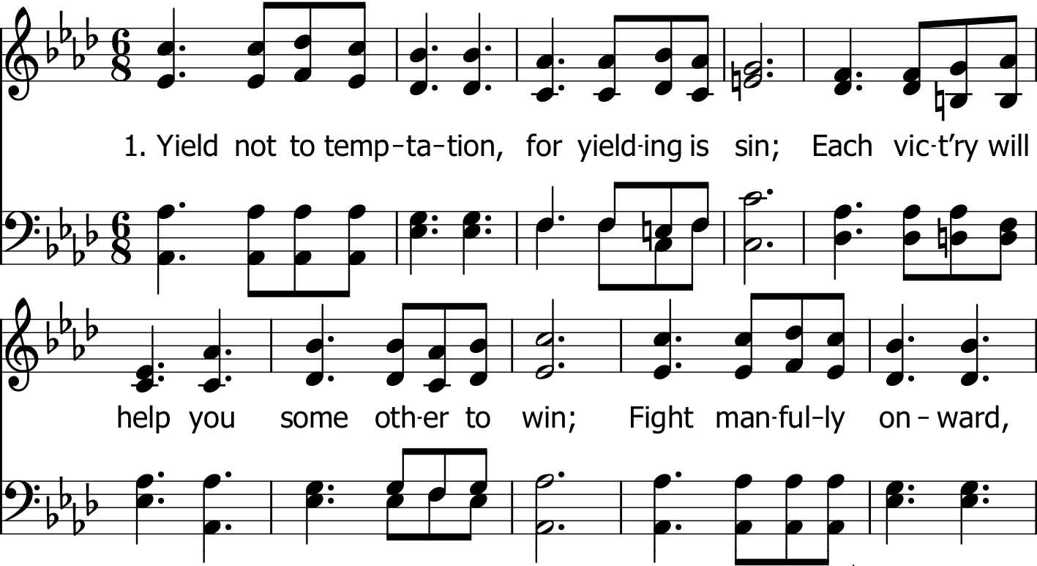

Slide 102
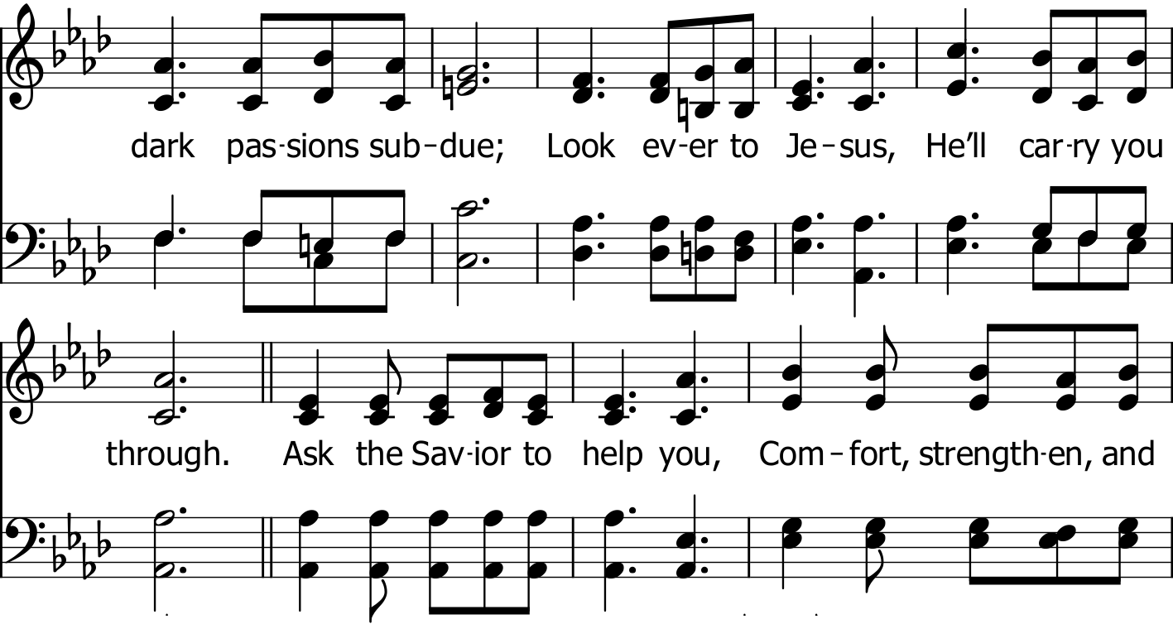

Slide 104
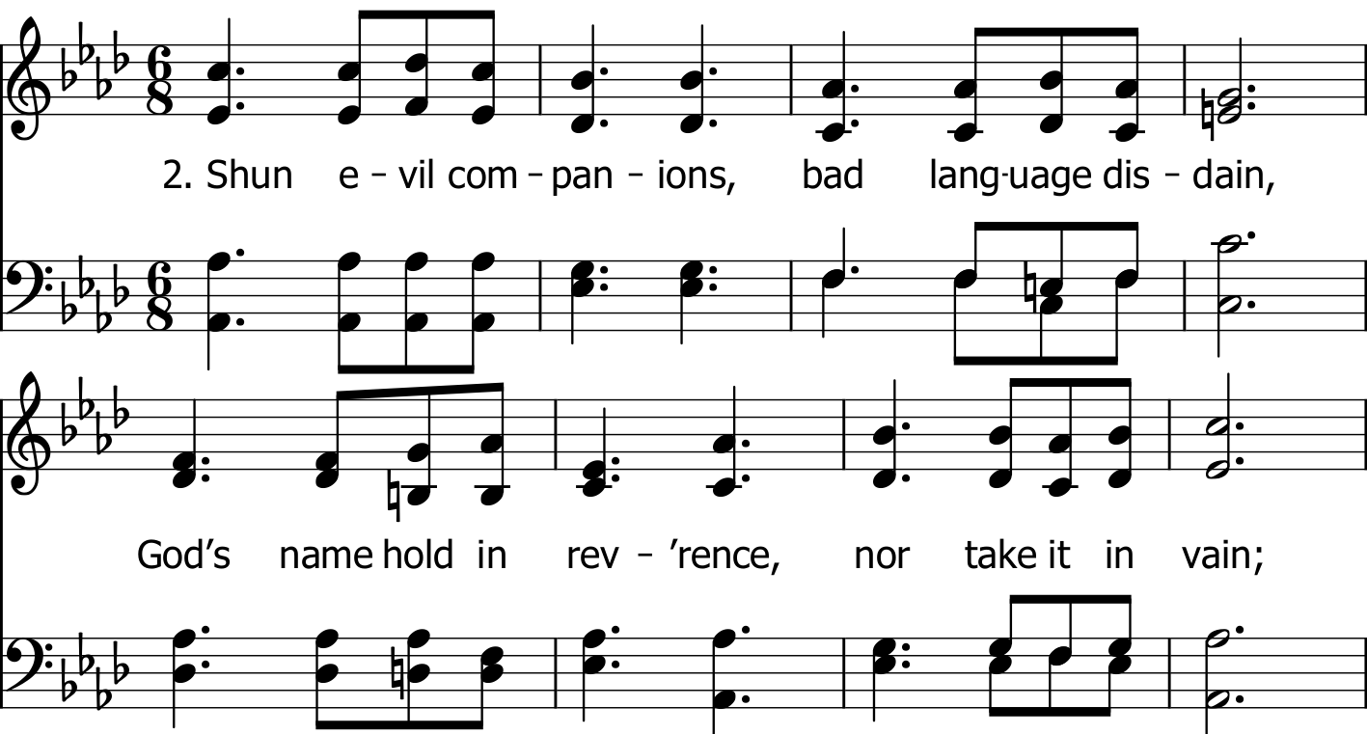

Slide 105
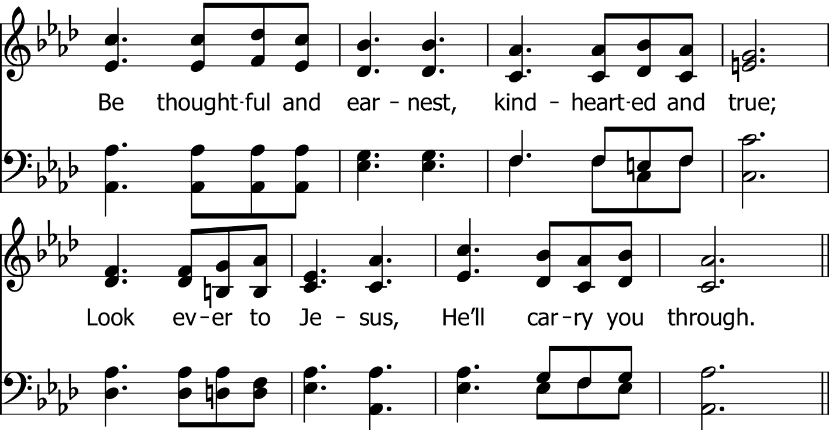

Slide 106
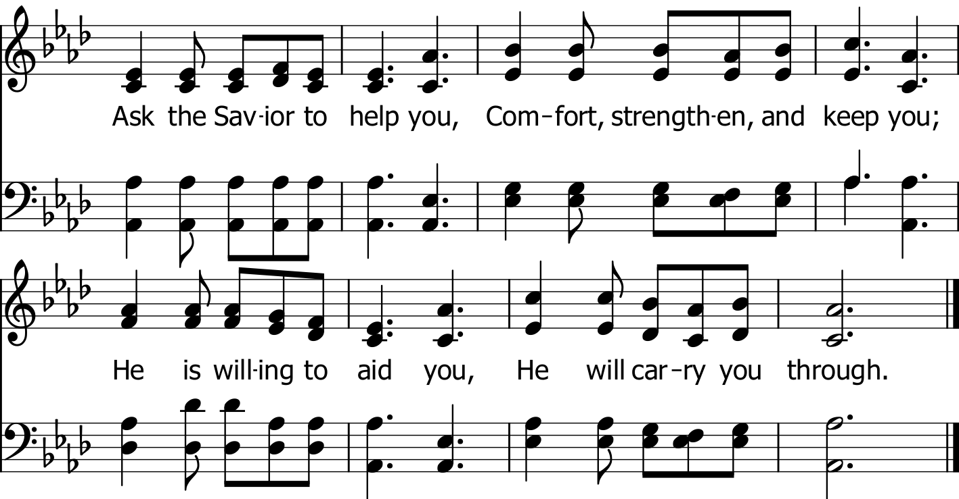

Slide 107
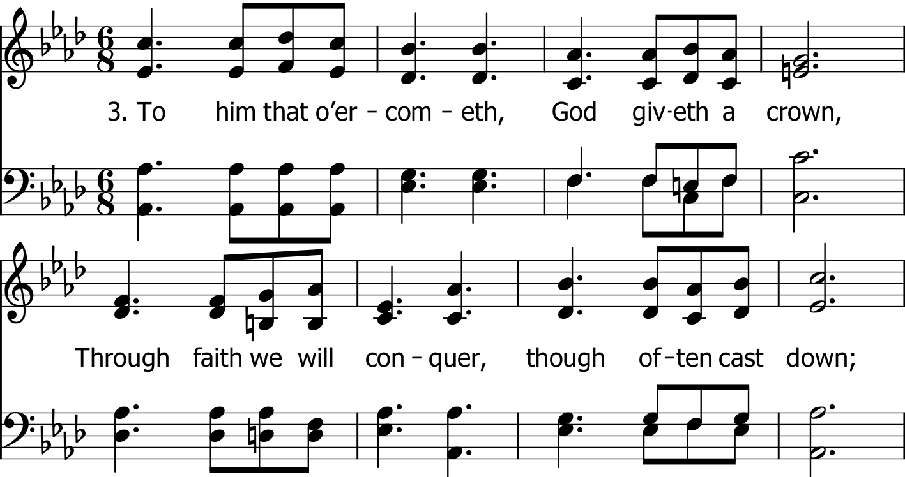

Slide 108
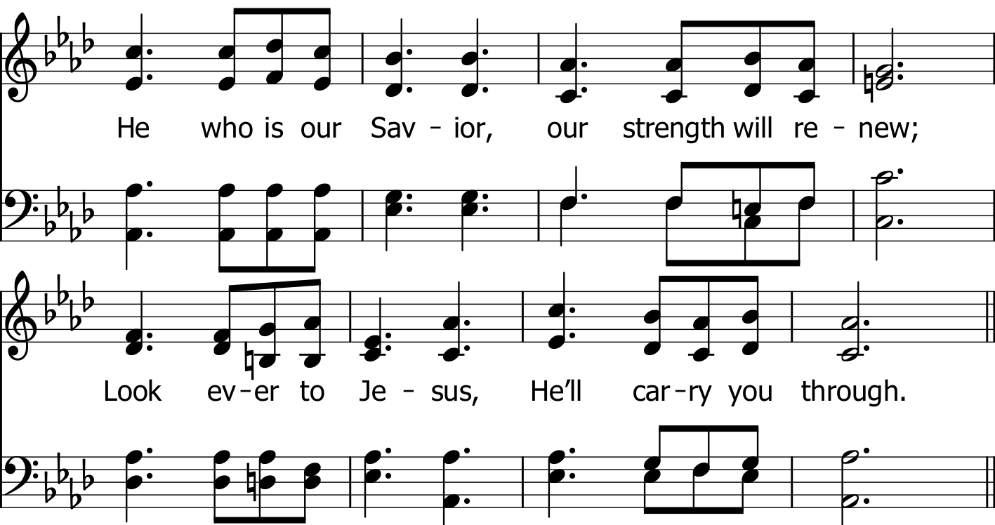

Slide 110
RESTORE REBUILD RENEW
today
LTC @ 4:30 PM
Elders’ meeting @ 5:30 PM
Worship @ 6:00 PM
Men’s Meeting @ 7:00 PM
IN 2022
WHEELER
CHURCH
OF
CHRIST

