Slide 1
RESTORE REBUILD RENEW
welcome
we are glad to
Have you with us
IN 2022
WHEELER
CHURCH
OF
CHRIST

Slide 2
Songs of Praise To God

Slide 3
Opening Prayer

Slide 4
Songs of Praise To God

Slide 5
Renew My Love For
Spiritual Growth

Slide 6
A Logical Argument
Premise 1: We are called to grow closer to God.
Premise 2: If we stay in our comfort zone, we are not growing closer to God.
Conclusion: We must get out of our comfort zone.

Slide 7
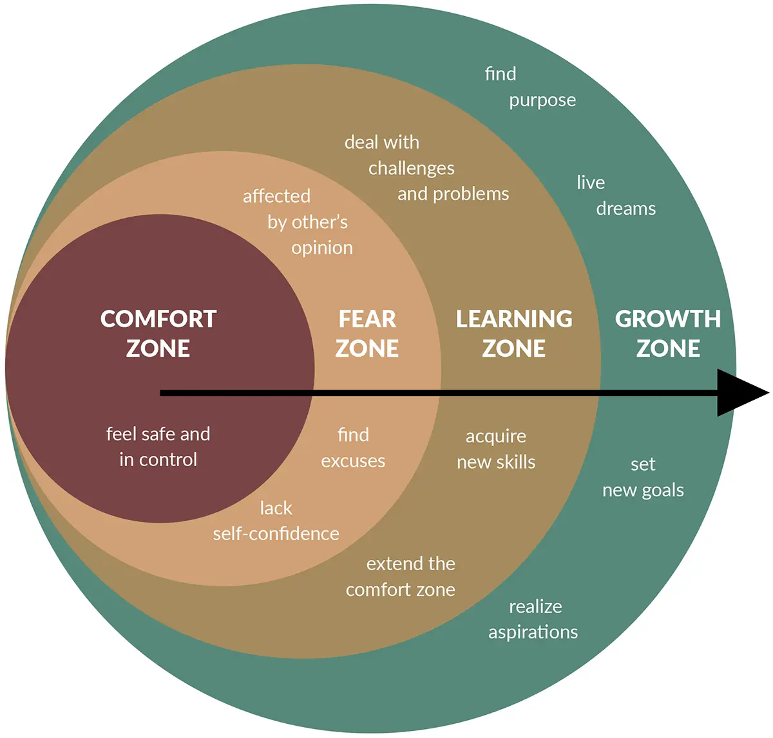
A Logical Argument

Slide 9
7 Individuals
Old Testament
Job – 1:1-3, 9-11, 2:7-10
Moses – Heb. 11:24-27
Ezekiel – 4:9-17
Daniel – 1:1-6, 2:12-13
New Testament
Paul – 2 Cor. 11:23-25, Acts 21:30-31, 40-22:2
Peter – Acts 10:13-14, 34, 12:3-5

Slide 10
Uncomfortable Evangelism
Who You Share The Gospel With

Slide 11
Uncomfortable Evangelism
Who You Share The Gospel With
A Ninevite – Jon. 1:1-4, 3:3-4, 4:1-2, 10-11

Slide 12
Uncomfortable Evangelism
Who You Share The Gospel With
A Ninevite – Jon. 1:1-4, 3:3-4, 4:1-2, 10-11
A Samaritan – Jn. 4:1-9

Slide 13
Uncomfortable Evangelism
Who You Share The Gospel With
A Ninevite – Jon. 1:1-4, 3:3-4, 4:1-2, 10-11
A Samaritan – Jn. 4:1-9
An Athenian – Acts 17:16-23

Slide 14
Uncomfortable Evangelism
Who You Share The Gospel With
A Ninevite – Jon. 1:1-4, 3:3-4, 4:1-2, 10-11
A Samaritan – Jn. 4:1-9
An Athenian – Acts 17:16-23
A Judaizer – Acts 15:1, 13-17, 1 Cor. 1:20

Slide 15
Uncomfortable Evangelism
How You Share The Gospel
Your Method

Slide 16
Uncomfortable Evangelism
How You Share The Gospel
Your Method
Door knocking – Matt. 10:1-14, 28, 32-33

Slide 17
Uncomfortable Evangelism
How You Share The Gospel
Your Method
Door knocking – Matt. 10:1-14, 28, 32-33
Spiritual Conversations – Jn. 4:13-14, 34

Slide 18
Uncomfortable Evangelism
How You Share The Gospel
Your Method
Door knocking – Matt. 10:1-14, 28, 32-33
Spiritual Conversations – Jn. 4:13-14, 34
Your Materials – Matt. 10:7

Slide 19
Are you Sowing?

Slide 20
Songs of Praise To God

Slide 21
The Lord’s Supper
Acts 20:7

Slide 22
Closing Prayer

Slide 23
Songs of Praise To God

Slide 24
RESTORE REBUILD RENEW
Wednesday
Worship & Classes @ 6:30 pm
IN 2022
WHEELER
CHURCH
OF
CHRIST

