Slide 1
1 All in All
You Are My All in All
484

Slide 2
2 All in All
You Are My All in All
484

Slide 3
3 All in All
You Are My All in All
484

Slide 4
4 All in All
You Are My All in All
484

Slide 5
5 All in All
You Are My All in All
484

Slide 6
6 All in All
You Are My All in All
484

Slide 7
C-1 All in All
You Are My All in All
484

Slide 8
C-2 All in All
You Are My All in All
484

Slide 10
Song:
He’s My King
#166

Slide 11
1-1 He’s My King
He’s My King
166

Slide 12
1-2 He’s My King
He’s My King
166

Slide 13
C-1 He’s My King
He’s My King
166

Slide 14
C-2 He’s My King
He’s My King
166

Slide 15
2-1 He’s My King
He’s My King
166

Slide 16
2-2 He’s My King
He’s My King
166

Slide 17
C-1 He’s My King
He’s My King
166

Slide 18
C-2 He’s My King
He’s My King
166

Slide 19
3-1 He’s My King
He’s My King
166

Slide 20
3-2 He’s My King
He’s My King
166

Slide 21
C-1 He’s My King
He’s My King
166

Slide 22
C-2 He’s My King
He’s My King
166

Slide 23
Song:
As The Deer
#71

Slide 24
1-1 As the Deer
As The Deer
71

Slide 25
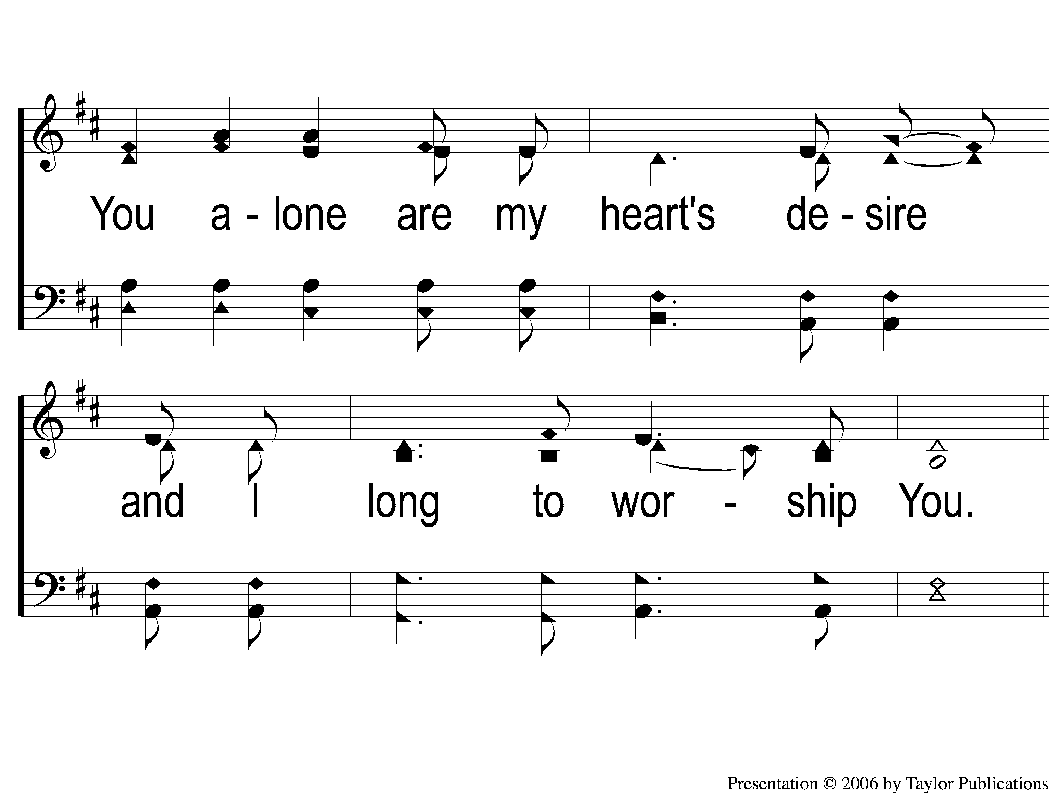
1-2 As the Deer
As The Deer
71

Slide 26
C-1 As the Deer
As The Deer
71

Slide 27
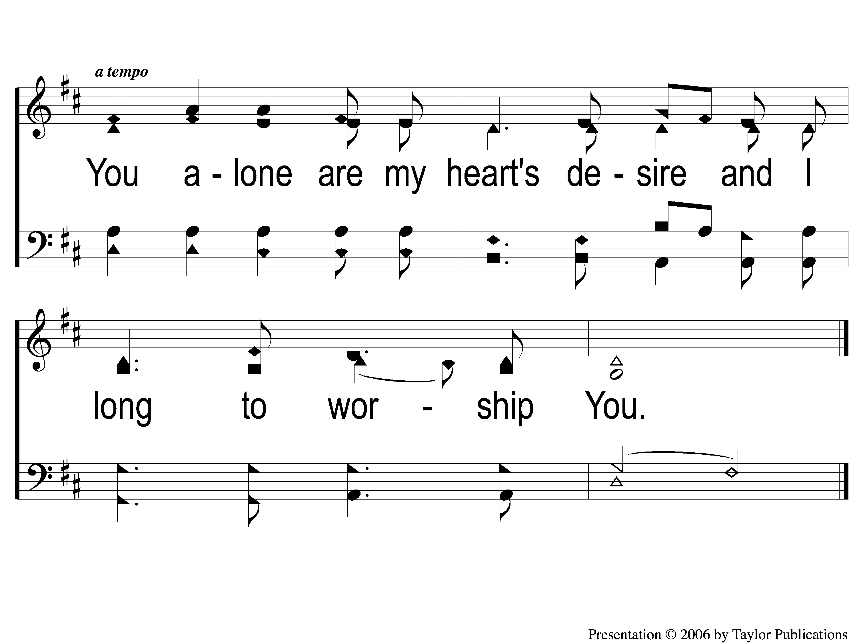
C-2 As the Deer
As The Deer
71

Slide 28
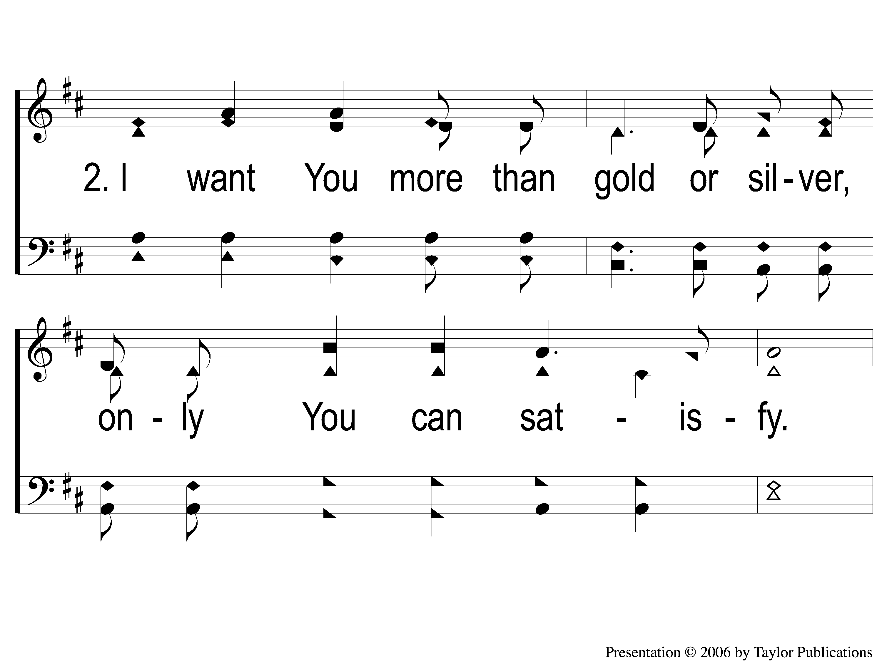
2-1 As the Deer
As The Deer
71

Slide 29
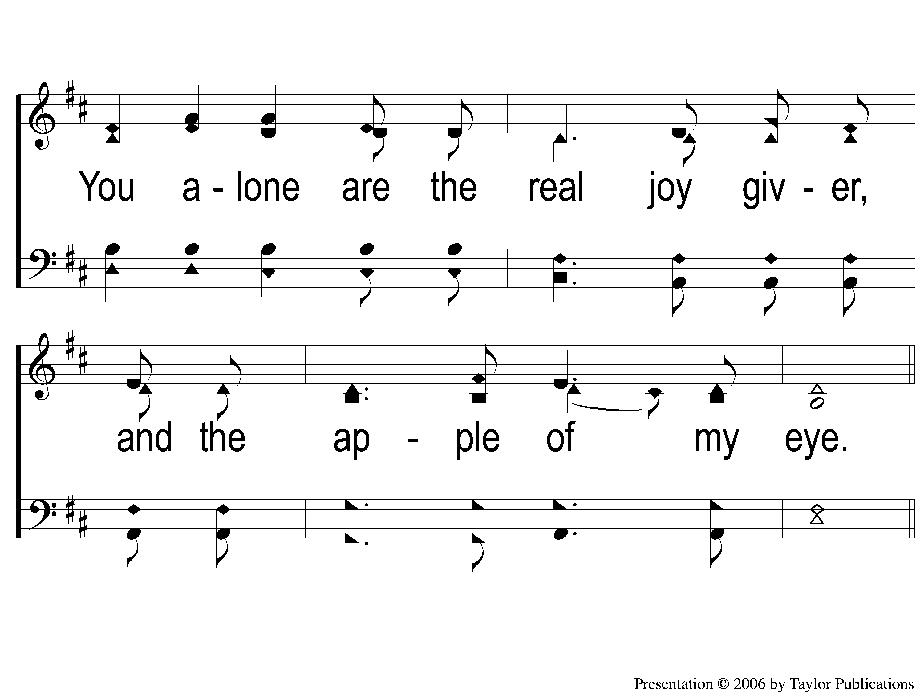
2-2 As the Deer
As The Deer
71

Slide 30
C-1 As the Deer
As The Deer
71

Slide 31
C-2 As the Deer
As The Deer
71

Slide 32
Opening Prayer

Slide 33
Song:
Victory In Jesus
#470

Slide 34
1-1 Victory in Jesus
Victory in Jesus
470

Slide 35
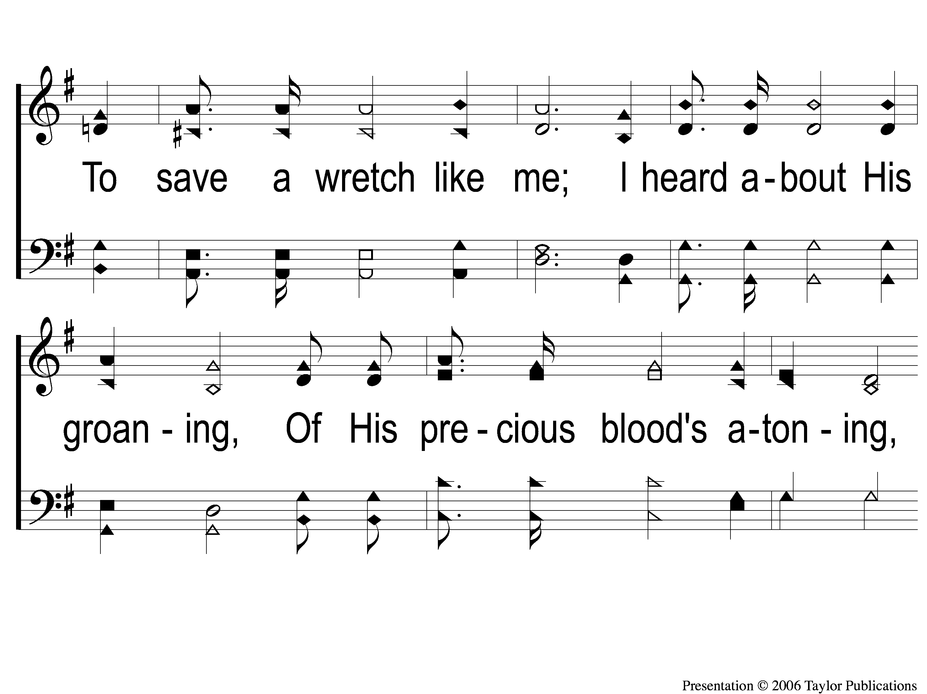
1-2 Victory in Jesus
Victory in Jesus
470

Slide 36
1-3 Victory in Jesus
Victory in Jesus
470

Slide 37
C-1 Victory in Jesus
Victory in Jesus
470

Slide 38
C-2 Victory in Jesus
Victory in Jesus
470

Slide 39
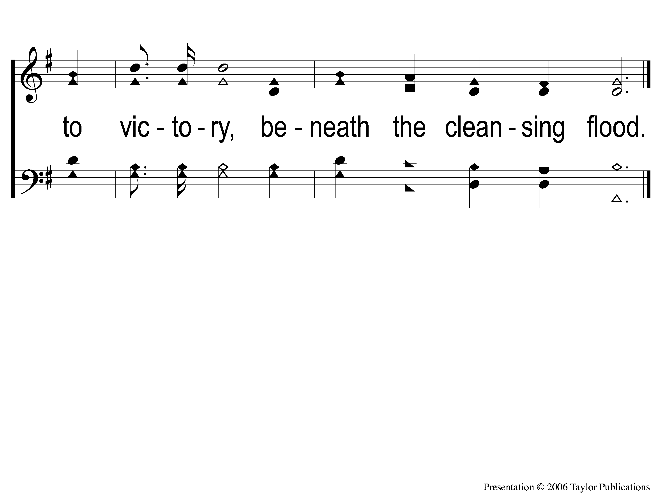
C-3 Victory in Jesus
Victory in Jesus
470

Slide 40
2-1 Victory in Jesus
Victory in Jesus
470

Slide 41
2-2 Victory in Jesus
Victory in Jesus
470

Slide 42
2-3 Victory in Jesus
Victory in Jesus
470

Slide 43
C-1 Victory in Jesus
Victory in Jesus
470

Slide 44
C-2 Victory in Jesus
Victory in Jesus
470

Slide 45
C-3 Victory in Jesus
Victory in Jesus
470

Slide 46
3-1 Victory in Jesus
Victory in Jesus
470

Slide 47
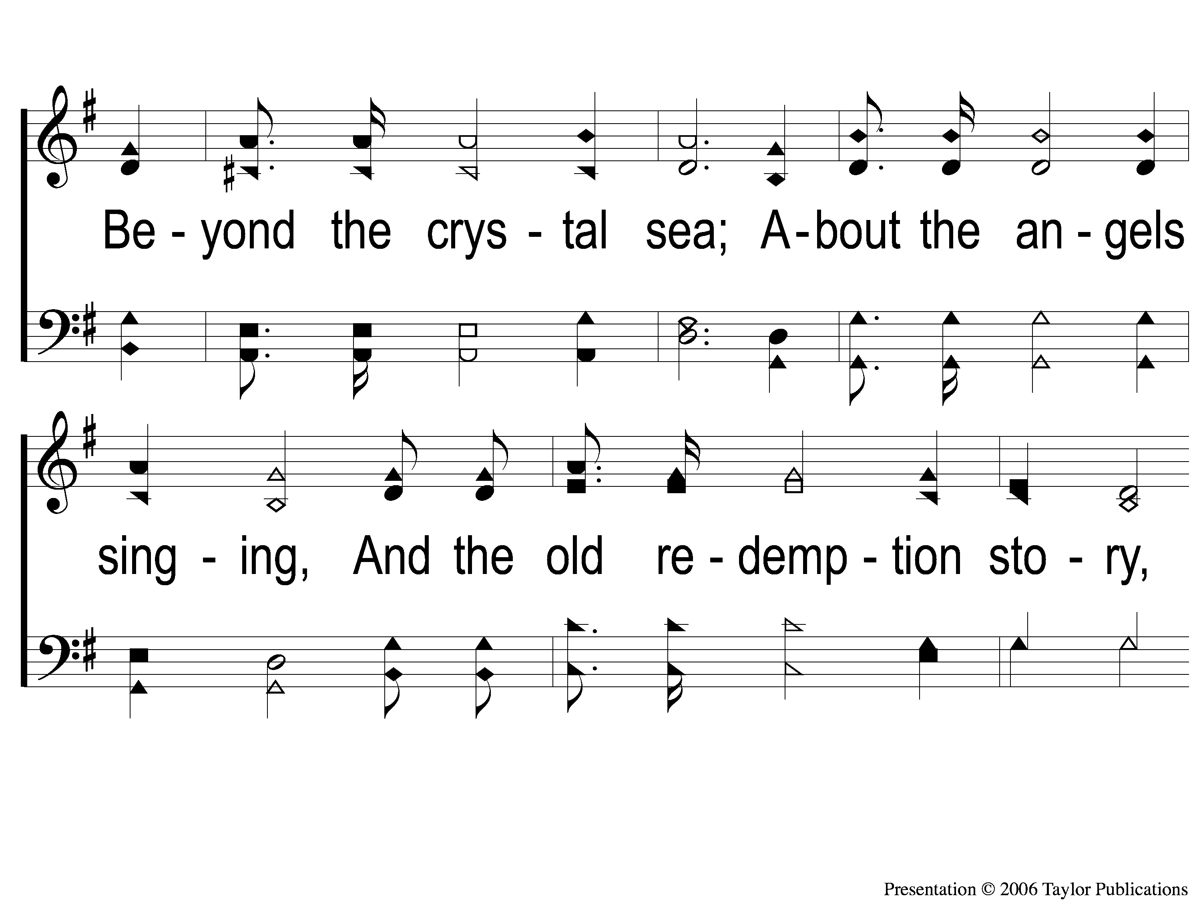
3-2 Victory in Jesus
Victory in Jesus
470

Slide 48
3-3 Victory in Jesus
Victory in Jesus
470

Slide 49
C-1 Victory in Jesus
Victory in Jesus
470

Slide 50
C-2 Victory in Jesus
Victory in Jesus
470

Slide 51
C-3 Victory in Jesus
Victory in Jesus
470

Slide 52
Song:
Glorify Thy Name
#77

Slide 53
1 Glorify Thy Name
Glorify Thy Name
77

Slide 54
C Glorify Thy Name
Glorify Thy Name
77

Slide 55
2 Glorify Thy Name
Glorify Thy Name
77

Slide 56
C Glorify Thy Name
Glorify Thy Name
77

Slide 57
3 Glorify Thy Name
Glorify Thy Name
77

Slide 58
C Glorify Thy Name
Glorify Thy Name
77

Slide 59
Scripture Reading:
Joshua 4:1-9

Slide 60
STAND
IN GOOD STEAD

Slide 61
WHY
PASS THE TRAYS?

Slide 62
WHY MEET EVERY SUNDAY?

Slide 63
WHY MEET EVERY SUNDAY?
THE EARLY CHRISTIANS’ EXAMPLE
Acts 20:7
Acts 2:42
Mark 16:9

Slide 64
WHY GIVE EVERY SUNDAY?

Slide 65
WHY GIVE EVERY SUNDAY?
THE EARLY CHRISTIANS’ EXAMPLE
Acts 11:29

Slide 66
WHY GIVE EVERY SUNDAY?
THE APOSTLE PAUL’S COMMAND
1 Cor. 16:1-2

Slide 67
WHY PASS THE TRAYS?

Slide 68
WHY PASS THE TRAYS?
NOT…
…BECAUSE IT IS THE ONLY WAY

Slide 69
WHY PASS THE TRAYS?
NOT…
…BECAUSE IT IS THE ONLY WAY
…IN ORDER TO FORCE GIVING

Slide 70
WHY PASS THE TRAYS?
TO BE GOOD EXAMPLES
Ex. 10:1-2, 12:25-27, 13:13-15
Deut. 6:20-25, 27:1-2
Josh. 4:5-7, 21-23

Slide 71
InvitationSong:
Have You Been To Jesus?
#904

Slide 72
1-1 Have You Been To Jesus
Have You Been To Jesus?
904

Slide 73
1-2 Have You Been To Jesus
Have You Been To Jesus?
904

Slide 74
C-1 Have You Been To Jesus
Have You Been To Jesus?
904

Slide 75
C-2 Have You Been To Jesus
Have You Been To Jesus?
904

Slide 76
2-1 Have You Been To Jesus
Have You Been To Jesus?
904

Slide 77
2-2 Have You Been To Jesus
Have You Been To Jesus?
904

Slide 78
C-1 Have You Been To Jesus
Have You Been To Jesus?
904

Slide 79
C-2 Have You Been To Jesus
Have You Been To Jesus?
904

Slide 80
3-1 Have You Been To Jesus
Have You Been To Jesus?
904

Slide 81
3-2 Have You Been To Jesus
Have You Been To Jesus?
904

Slide 82
C-1 Have You Been To Jesus
Have You Been To Jesus?
904

Slide 83
C-2 Have You Been To Jesus
Have You Been To Jesus?
904

Slide 84
4-1 Have You Been To Jesus
Have You Been To Jesus?
904

Slide 85
4-2 Have You Been To Jesus
Have You Been To Jesus?
904

Slide 86
C-1 Have You Been To Jesus
Have You Been To Jesus?
904

Slide 87
C-2 Have You Been To Jesus
Have You Been To Jesus?
904

Slide 88
The Offering:
Rom. 9:6-8
“The point is this: whoever sows sparingly will also reap sparingly, and whoever sows bountifully will also reap bountifully. Each one must give as he has decided in his heart, not reluctantly or under compulsion, for God loves a cheerful giver. And God is able to make all grace abound to you, so that having all sufficiency in all things at all times, you may abound in every good work.”

Slide 89
Song:
Lead Me
To Calvary
#332

Slide 90
1-1 Lead Me To Calvary
Lead Me To Calvary
332

Slide 91
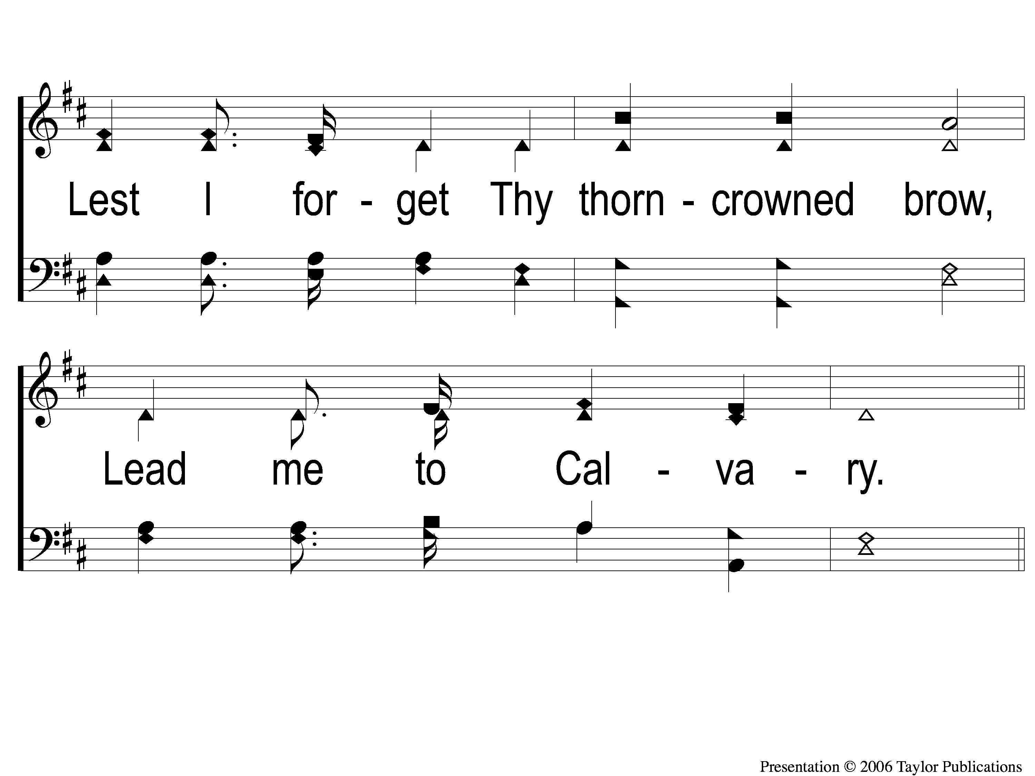
1-2 Lead Me To Calvary
Lead Me To Calvary
332

Slide 92
C-1 Lead Me To Calvary
Lead Me To Calvary
332

Slide 93
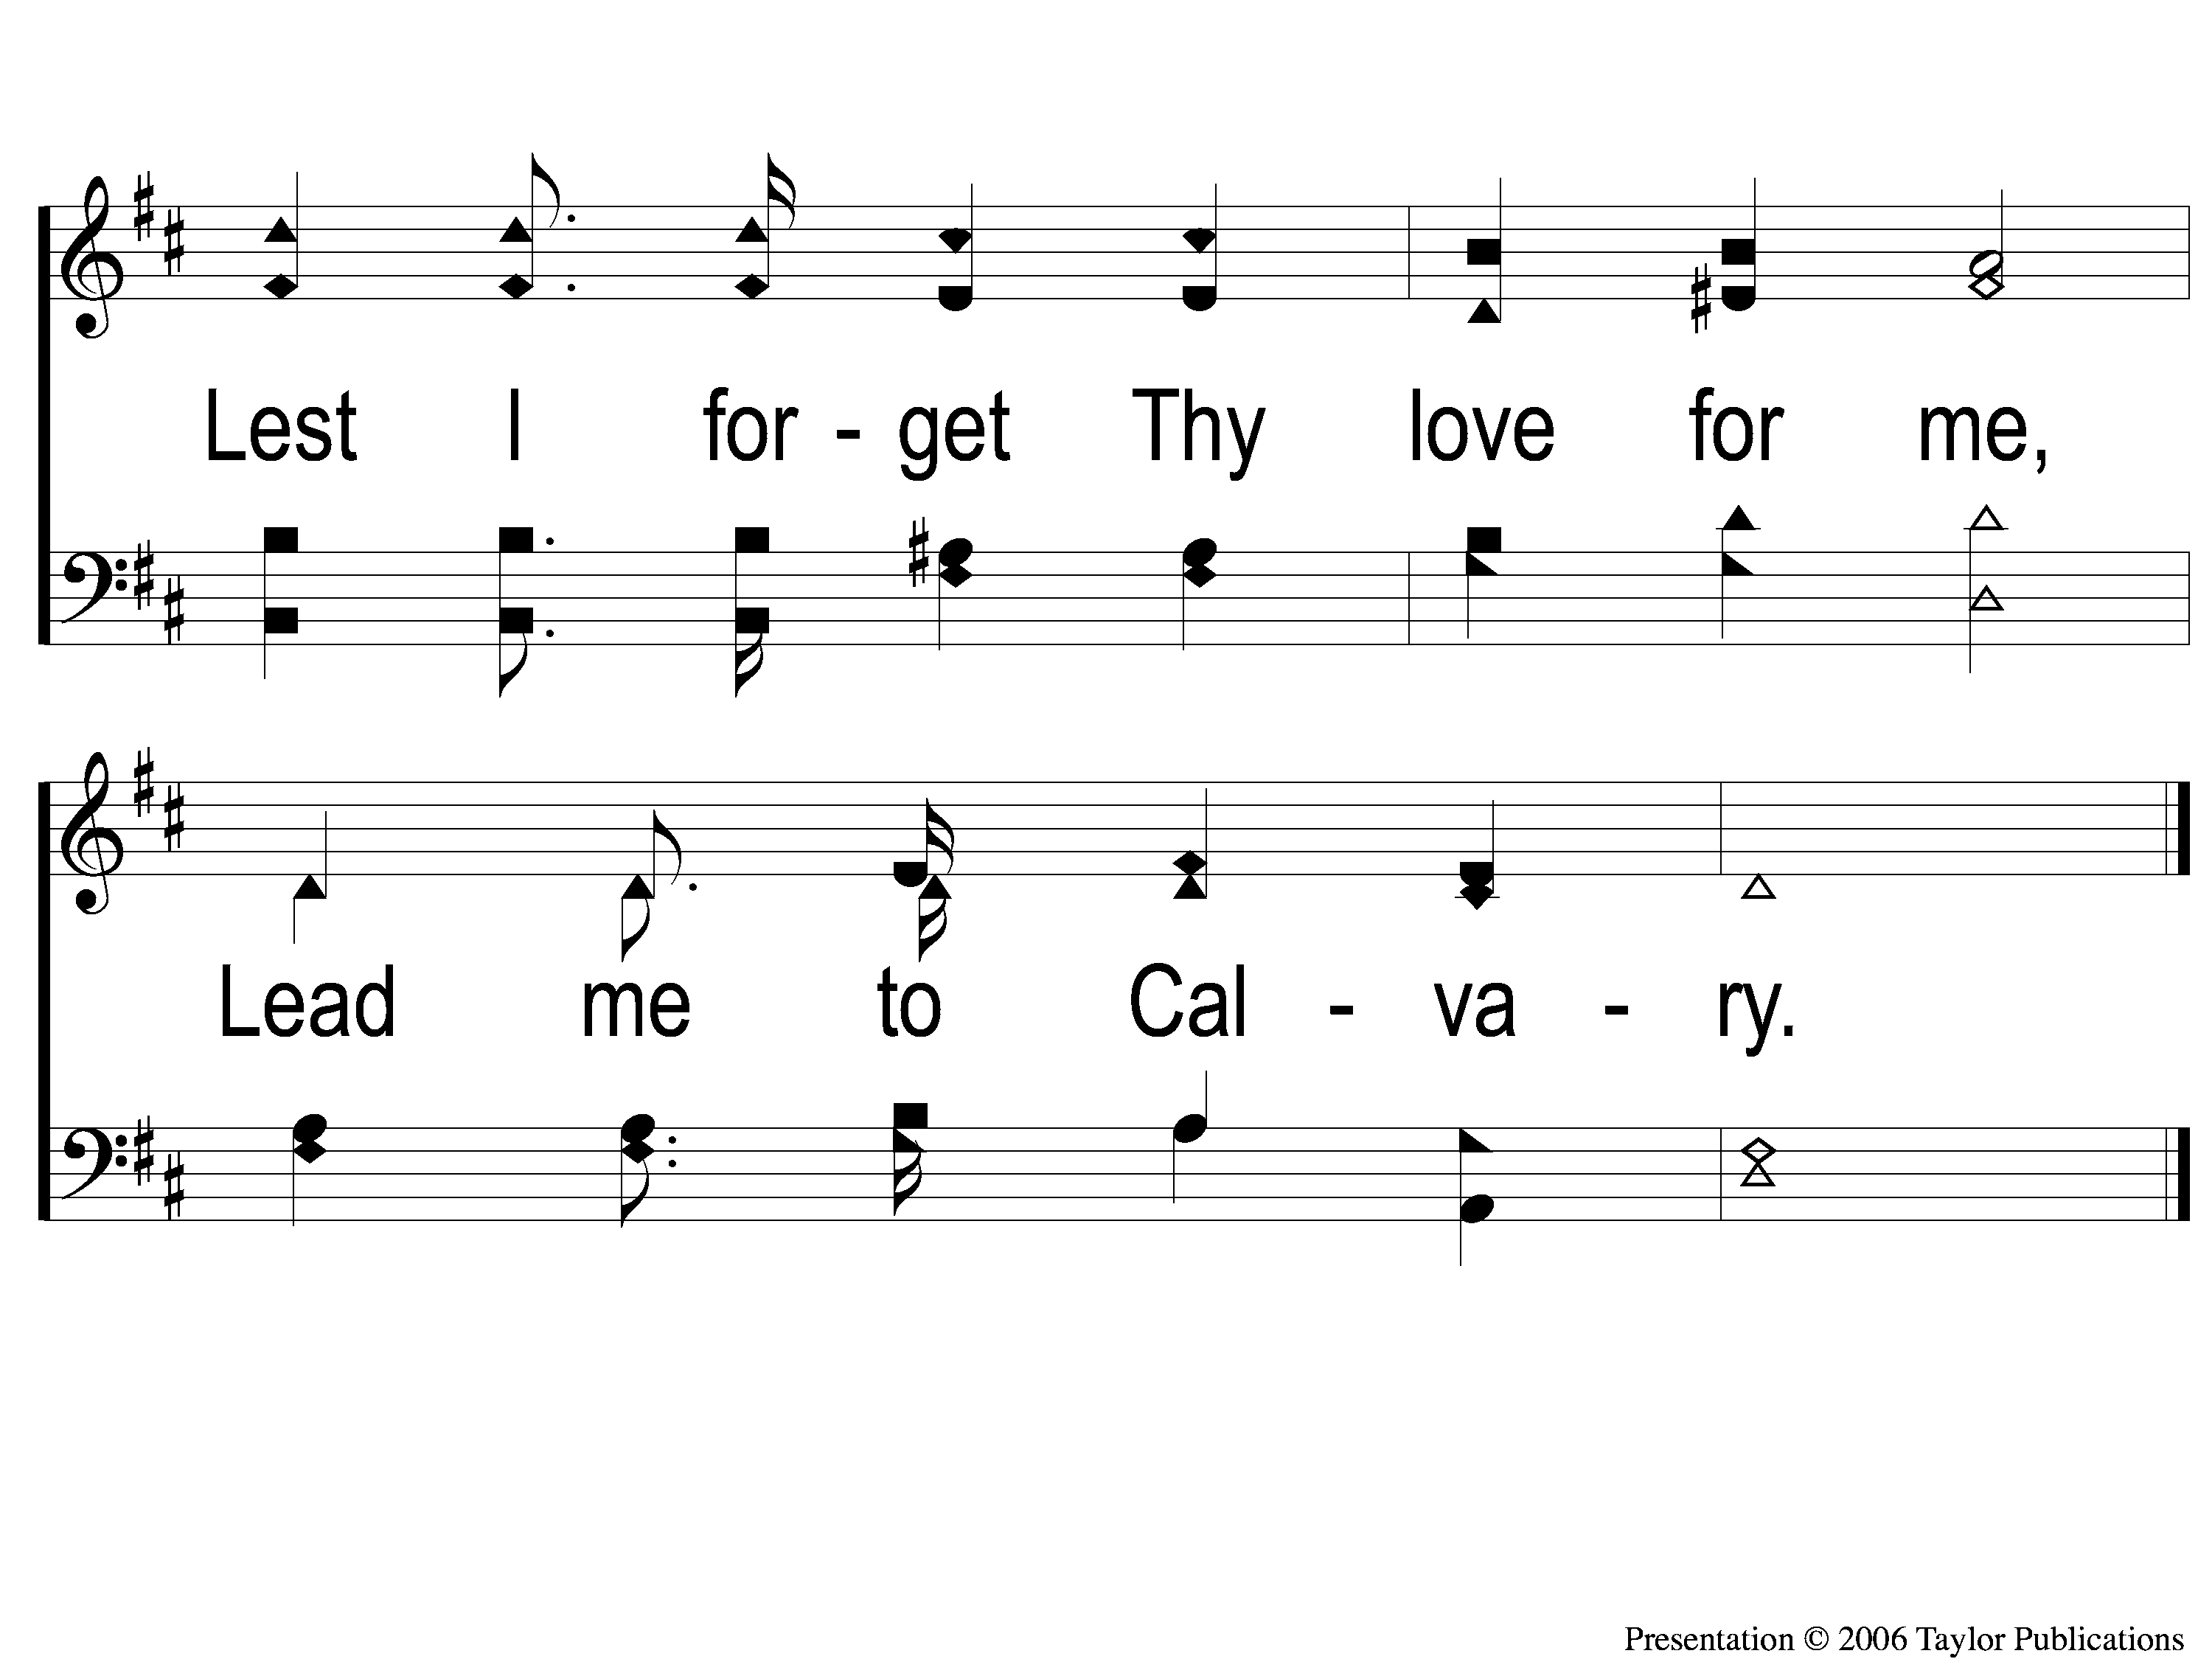
C-2 Lead Me To Calvary
Lead Me To Calvary
332

Slide 94
2-1 Lead Me To Calvary
Lead Me To Calvary
332

Slide 95
2-2 Lead Me To Calvary
Lead Me To Calvary
332

Slide 96
C-1 Lead Me To Calvary
Lead Me To Calvary
332

Slide 97
C-2 Lead Me To Calvary
Lead Me To Calvary
332

Slide 98
3-1 Lead Me To Calvary
Lead Me To Calvary
332

Slide 99
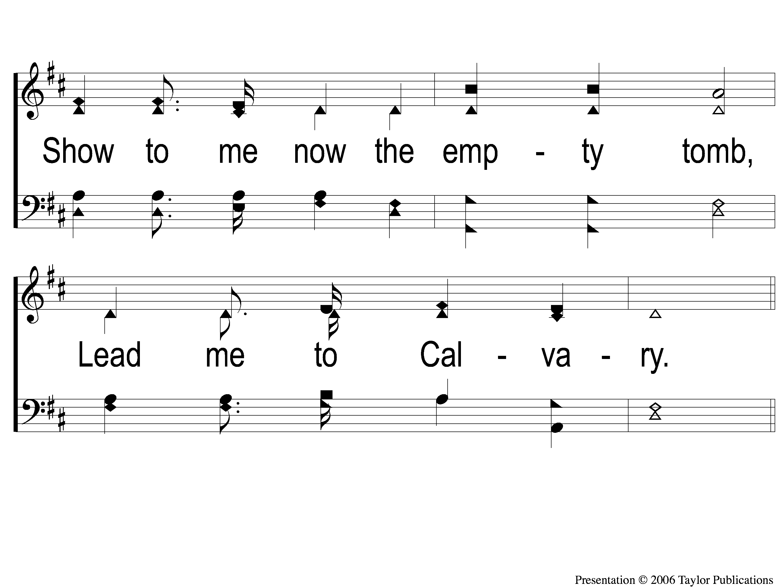
3-2 Lead Me To Calvary
Lead Me To Calvary
332

Slide 100
C-1 Lead Me To Calvary
Lead Me To Calvary
332

Slide 101
C-2 Lead Me To Calvary
Lead Me To Calvary
332

Slide 102
4-1 Lead Me To Calvary
Lead Me To Calvary
332

Slide 103
4-2 Lead Me To Calvary
Lead Me To Calvary
332

Slide 104
C-1 Lead Me To Calvary
Lead Me To Calvary
332

Slide 105
C-2 Lead Me To Calvary
Lead Me To Calvary
332

Slide 106
The Lord’s Supper
Acts 20:7

Slide 107
The Unleavened Bread
Rom. 5:18-19
“Therefore, as through one man’s offense judgment came to all men, resulting in condemnation, even so through one Man’s righteous act the free gift came to all men, resulting in justification of life. For as by one man’s disobedience many were made sinners, so also by one Man’s obedience many will be made righteous.”

Slide 108
The Fruit of the Vine
Rom. 5:9-11
“Since, therefore, we have now been justified by his blood, much more shall we be saved by him from the wrath of God. For if while we were enemies we were reconciled to God by the death of his Son, much more, now that we are reconciled, shall we be saved by his life. More than that, we also rejoice in God through our Lord Jesus Christ, through whom we have now received reconciliation.”

Slide 109
Closing Prayer

Slide 110
Song:
Hosanna
#167

Slide 111
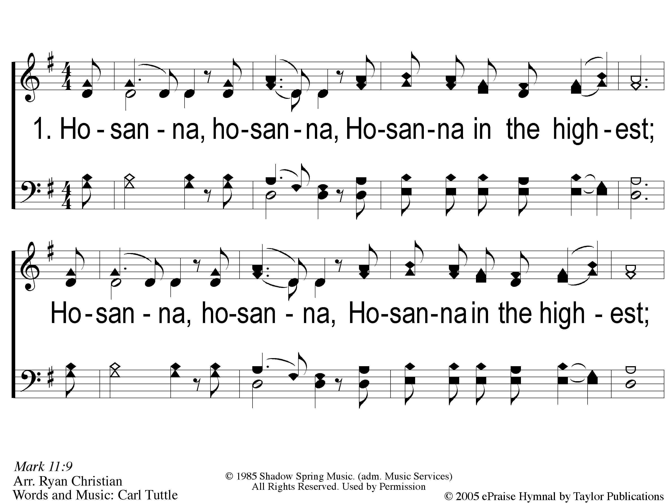
1 Hosanna
Hosanna
167

Slide 112
C-1 Hosanna
Hosanna
167

Slide 113
C-2 Hosanna
Hosanna
167

Slide 114
2 Hosanna
Hosanna
167

Slide 115
C-1 Hosanna
Hosanna
167

Slide 116
C-2 Hosanna
Hosanna
167

Slide 117
Reminders
Tonight:
LTC @ 4:30pm
Worship @ 6:00pm

