Slide 1
1 We Shall Assemble
We Shall Assemble
718

Slide 2
2 We Shall Assemble
We Shall Assemble
718

Slide 3
3 We Shall Assemble
We Shall Assemble
718

Slide 4
4 We Shall Assemble
We Shall Assemble
718

Slide 5
WELCOME
WE ARE GLAD YOU ARE HERE

Slide 6
SONG
STEP BY STEP
#15

Slide 7
1 Step by Step
Step by Step
15

Slide 8
2 Step by Step
Step by Step
15

Slide 9
3 Step by Step
Step by Step
15

Slide 10
DC1 Step by Step
Step by Step
15

Slide 11
DC2 Step by Step
Step by Step
15

Slide 12
DC3 Step by Step
Step by Step
15

Slide 13
DS1 Step by Step
Step by Step
15

Slide 14
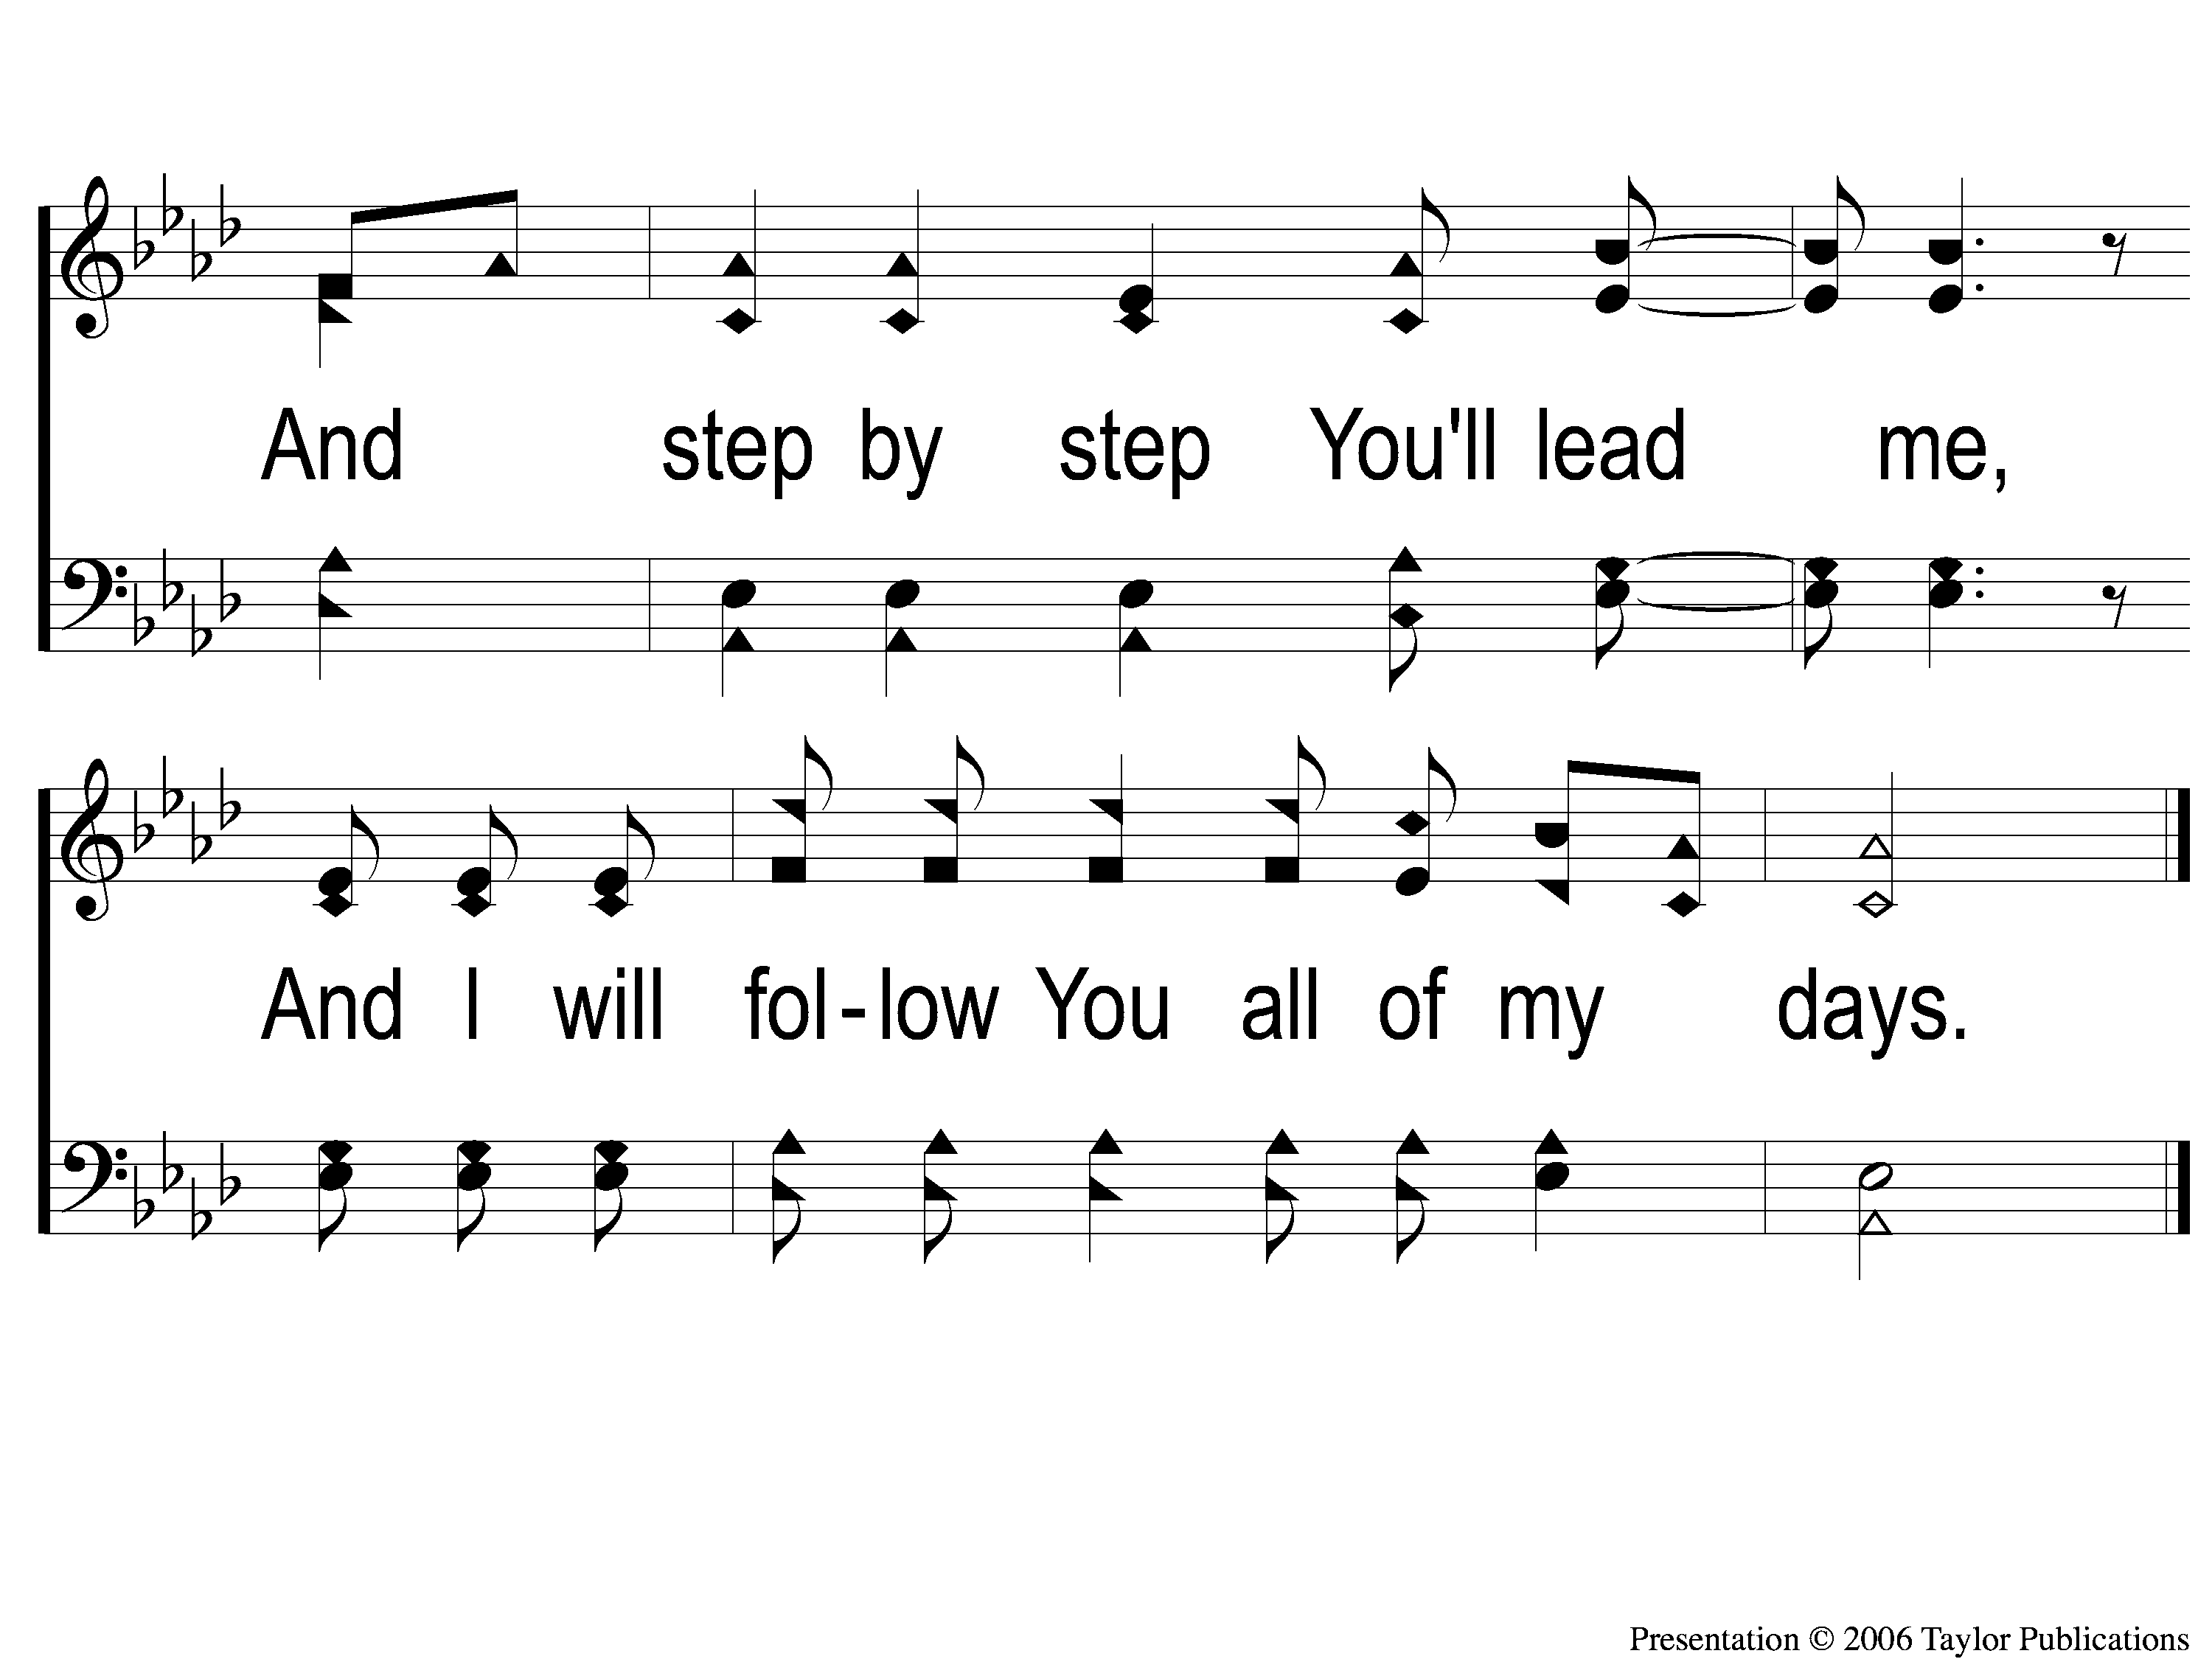
DS2 Step by Step
Step by Step
15

Slide 15
SONG
FAITHFUL LOVE
#18

Slide 16
1-1 Faithful Love
Faithful Love
18

Slide 17
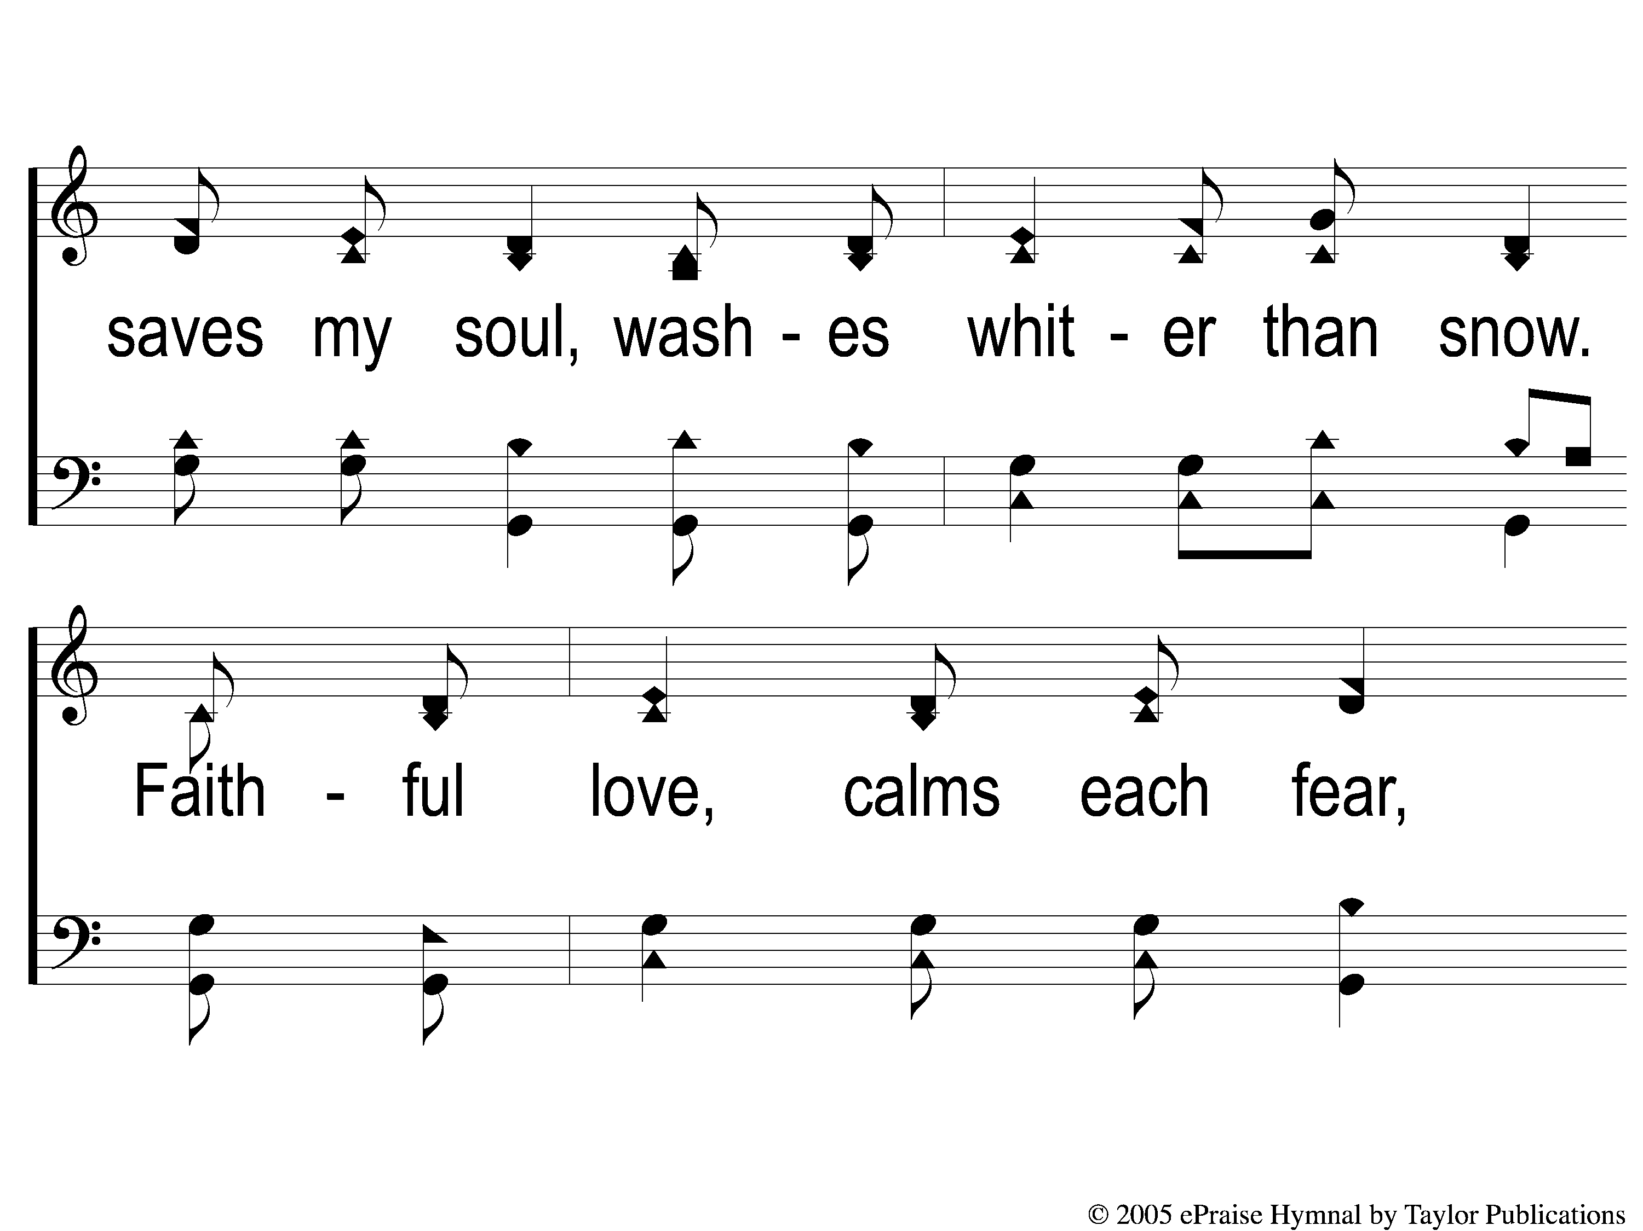
1-2 Faithful Love
Faithful Love
18

Slide 18
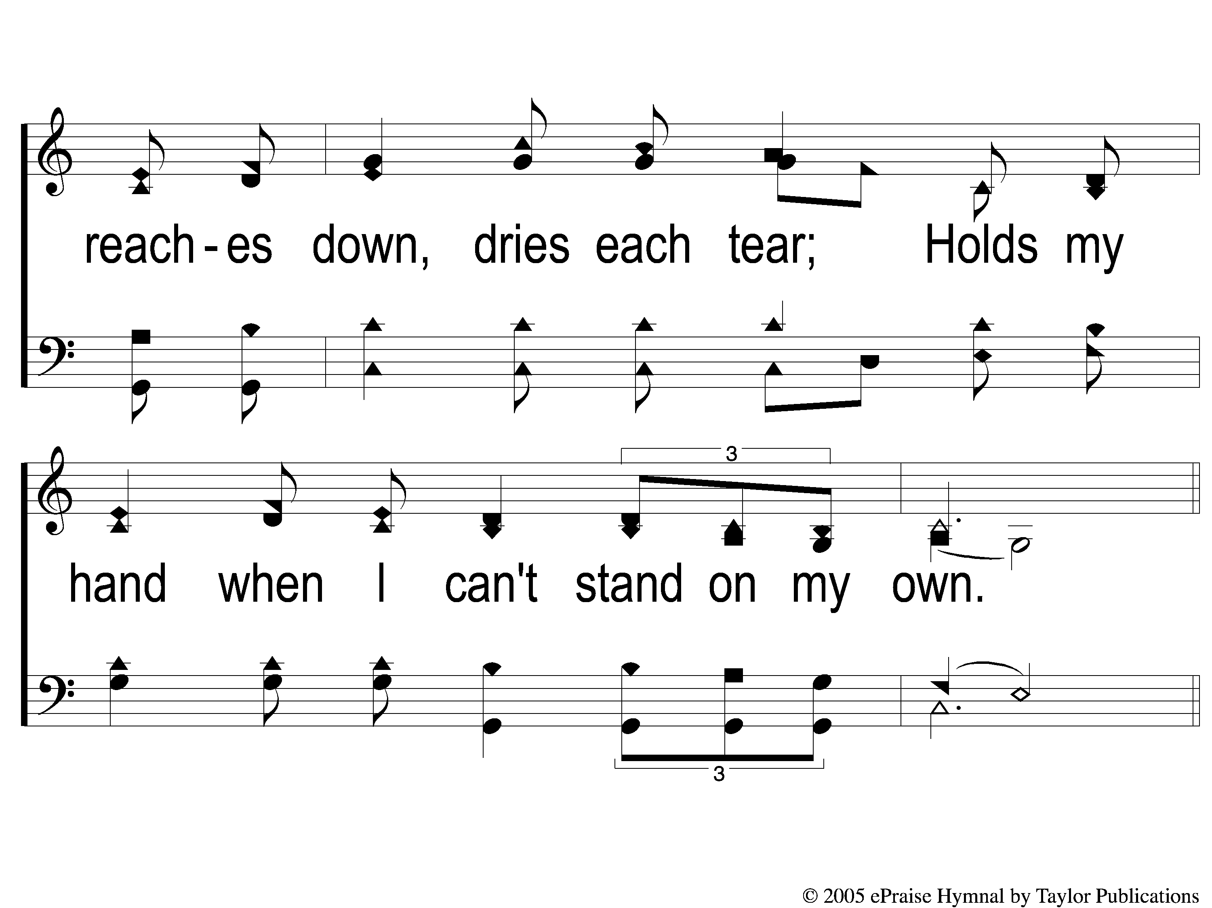
1-3 Faithful Love
Faithful Love
18

Slide 19
C-1 Faithful Love
Faithful Love
18

Slide 20
C-2 Faithful Love
Faithful Love
18

Slide 21
2-1 Faithful Love
Faithful Love
18

Slide 22
2-2 Faithful Love
Faithful Love
18

Slide 23
2-3 Faithful Love
Faithful Love
18

Slide 24
C-1 Faithful Love
Faithful Love
18

Slide 25
C-2 Faithful Love
Faithful Love
18

Slide 26
OPENING
PRAYER

Slide 27
SONG
I AM A SHEEP
#533

Slide 28
1-1 I Am A Sheep
I Am A Sheep
533

Slide 29
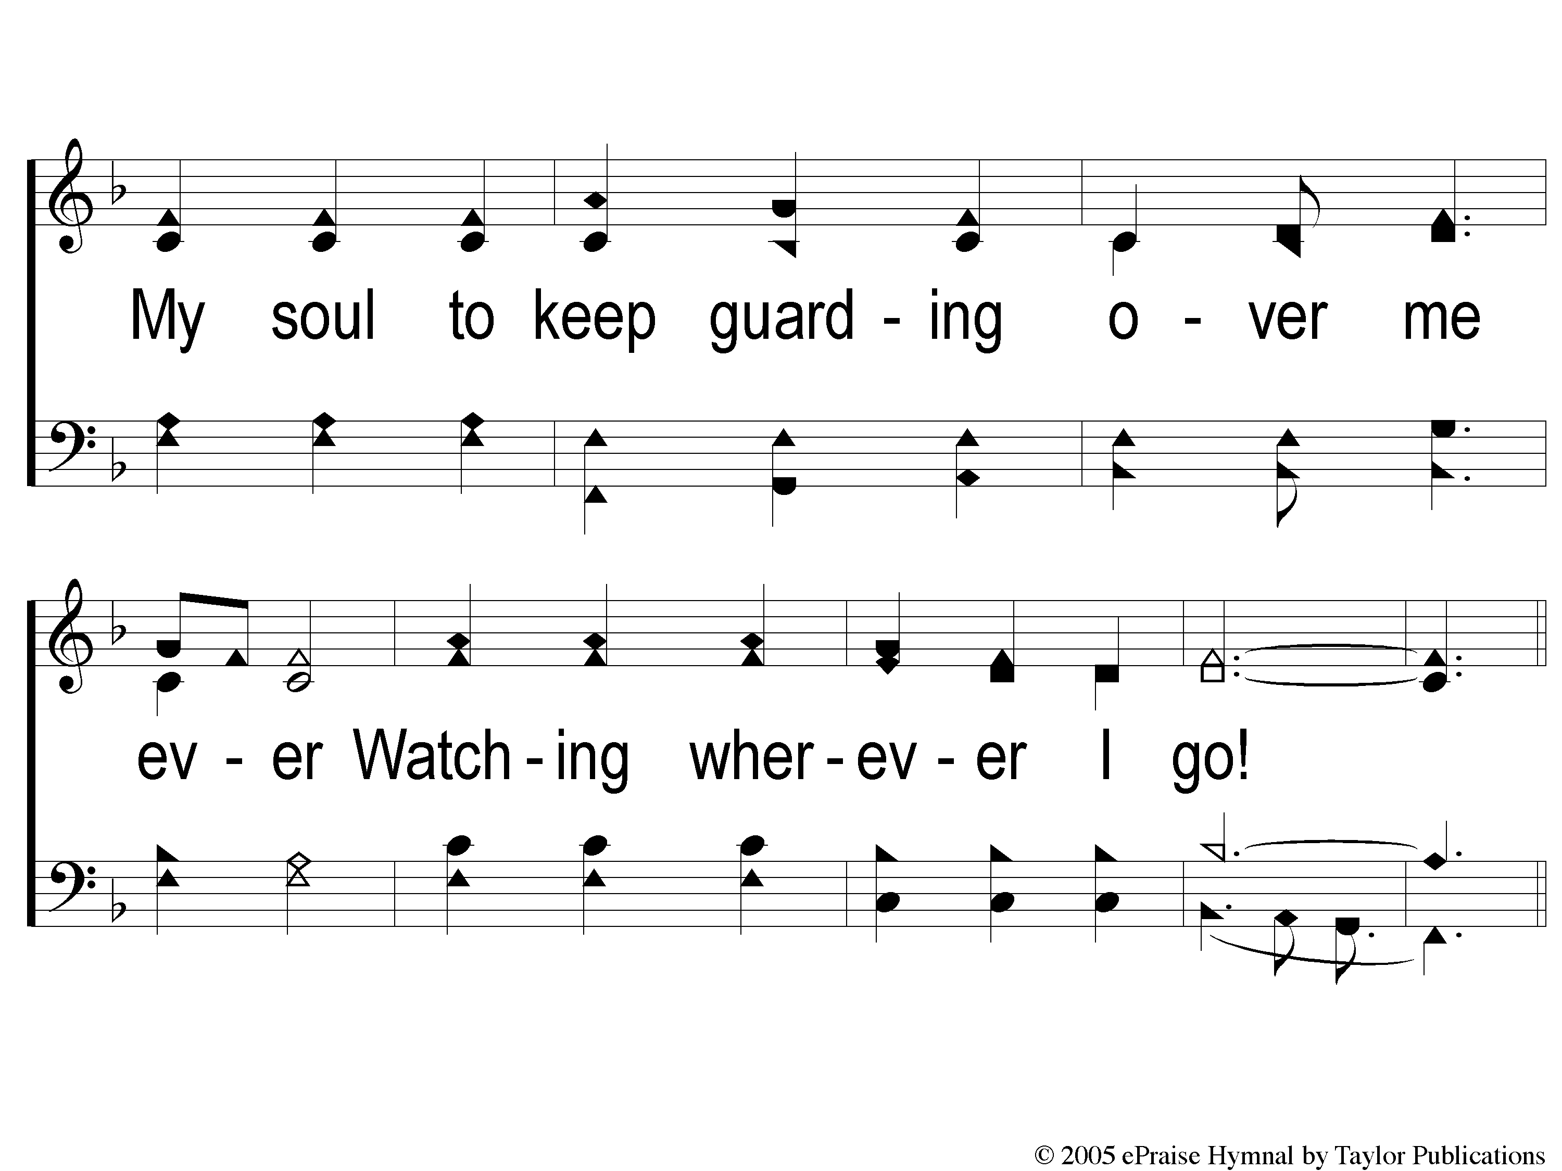
1-2 I Am A Sheep
I Am A Sheep
533

Slide 30
C-1 I Am A Sheep
I Am A Sheep
533

Slide 31
C-2 I Am A Sheep
I Am A Sheep
533

Slide 32
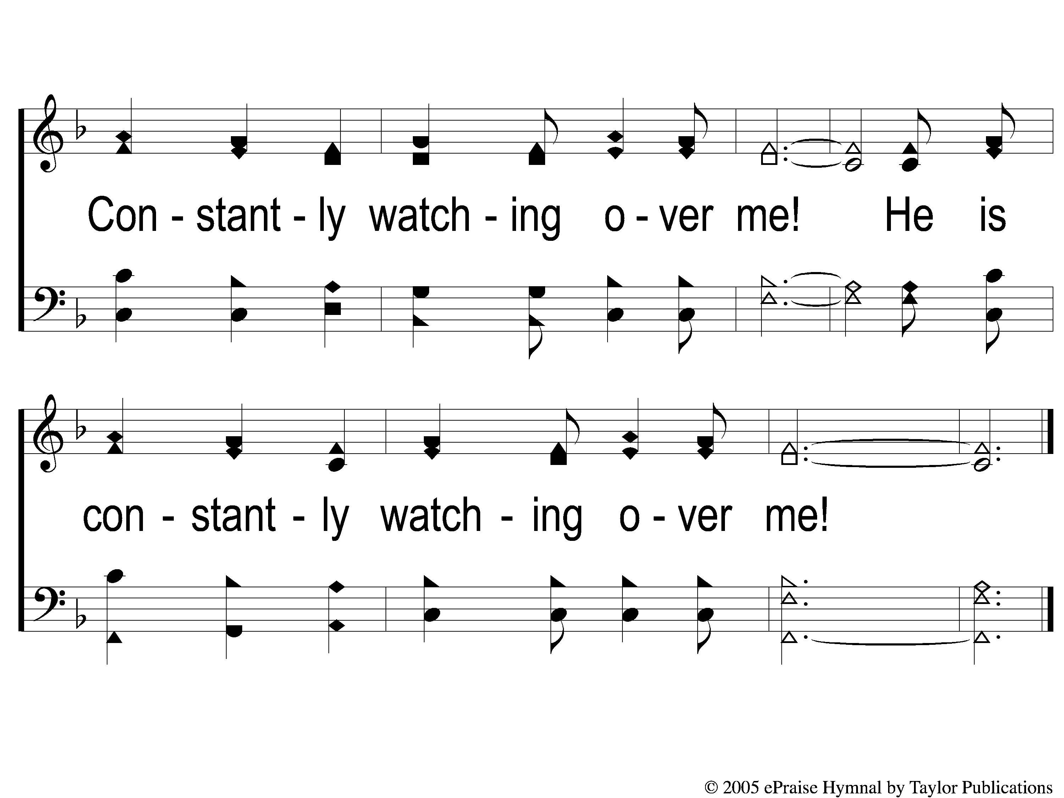
C-3 I Am A Sheep
I Am A Sheep
533

Slide 33
2-1 I Am A Sheep
I Am A Sheep
533

Slide 34
2-2 I Am A Sheep
I Am A Sheep
533

Slide 35
C-1 I Am A Sheep
I Am A Sheep
533

Slide 36
C-2 I Am A Sheep
I Am A Sheep
533

Slide 37
C-3 I Am A Sheep
I Am A Sheep
533

Slide 38
SONG
THE STEADFAST LOVE OF THE LORD
#123

Slide 39
1 The Steadfast Love of the Lord
The Steadfast Love of the Lord
123

Slide 40
2 The Steadfast Love of the Lord
The Steadfast Love of the Lord
123

Slide 41
3 The Steadfast Love of the Lord
The Steadfast Love of the Lord
123

Slide 42
DC-1 The Steadfast Love of the Lord
The Steadfast Love of the Lord
123

Slide 43
DC-2 The Steadfast Love of the Lord
The Steadfast Love of the Lord
123

Slide 44
DC-3 The Steadfast Love of the Lord
The Steadfast Love of the Lord
123

Slide 45
DC-4 The Steadfast Love of the Lord
The Steadfast Love of the Lord
123

Slide 46
SCRIPTURE READING:
1 Corinthians 13:1-7

Slide 47
STAND
IN THE LOVE OF GOD

Slide 48
FOUR WORDS
PHILEO
STORGE
EROS
AGAPE

Slide 49
AGAPE
ἀγάπη

Slide 50
AGAPE LOVE
= selfless, universal love for all
Rom. 5:6-8
1 Jn. 4:9-10, 19

Slide 51
3 Key Facts:
1. It Is NOT An Emotion
2. It Is NOT An Option
3. It Will NOT Occur By Accident

Slide 52
AGAPE LOVE…
…Thinks No Evil

Slide 53
THINKS NO EVIL
Λογίζομαι (LOGIZOMAI)
= “to keep a mental record of events for the sake of some future action”
2 Cor. 5:19 – Matt. 5:39, 18:22

Slide 54
AGAPE LOVE…
…Thinks No Evil
…Does Not Rejoice In Evil

Slide 55
DOES NOT REJOICE IN INIQUITY
Χαίρω (CHAIRO)
= “to enjoy a state of happiness
or well-being”
2 Thess. 2:12, Rom. 1:32

Slide 56
AGAPE LOVE…
…Thinks No Evil
…Does Not Rejoice In Evil
…Rejoices In Truth

Slide 57
REJOICES IN TRUTH
Χαίρω (CHAIRO)
Phili. 4:8
John 1:17, 8:32, 14:17,
16:13, 18:38

Slide 58
AM I SHOWING
AGAPE LOVE
TO ALL?

Slide 59
INVITATION SONG
I LOVE THE LORD
#359

Slide 60
1-1 I Love the Lord
I Love The Lord
359

Slide 61
1-2 I Love the Lord
I Love The Lord
359

Slide 62
C-1 I Love the Lord
I Love The Lord
359

Slide 63
C-2 I Love the Lord
I Love The Lord
359

Slide 64
2-1 I Love the Lord
I Love The Lord
359

Slide 65
2-2 I Love the Lord
I Love The Lord
359

Slide 66
C-1 I Love the Lord
I Love The Lord
359

Slide 67
C-2 I Love the Lord
I Love The Lord
359

Slide 68
3-1 I Love the Lord
I Love The Lord
359

Slide 69
3-2 I Love the Lord
I Love The Lord
359

Slide 70
C-1 I Love the Lord
I Love The Lord
359

Slide 71
C-2 I Love the Lord
I Love The Lord
359

Slide 72
THE OFFERING
2 CORINTHIANS 9:7-8
“So let each one give as he purposes in his heart, not grudgingly or of necessity; for God loves a cheerful giver. And God is able to make all grace abound toward you, that you, always having all sufficiency in all things, may have an abundance for every good work.”

Slide 73
SONG
COME, SHARE
THE LORD
#364

Slide 74
1-1 Come Share the Lord
Come, Share The Lord
364

Slide 75
1-2 Come Share the Lord
Come, Share The Lord
364

Slide 76
C-1 Come Share the Lord
Come, Share The Lord
364

Slide 77
2-1 Come Share the Lord
Come, Share The Lord
364

Slide 78
2-2 Come Share the Lord
Come, Share The Lord
364

Slide 79
C-2 Come Share the Lord
Come, Share The Lord
364

Slide 80
3-1 Come Share the Lord
Come, Share The Lord
364

Slide 81
3-2 Come Share the Lord
Come, Share The Lord
364

Slide 82
THE LORD’S SUPPER
ACTS 20:7

Slide 83
THE UNLEAVENED BREAD
1 PETER 4:1-2
“Therefore, since Christ suffered for us in the flesh, arm yourselves also with the same mind, for he who has suffered in the flesh has ceased from sin, 2 that he no longer should live the rest of his time in the flesh for the lusts of men, but for the will of God.”

Slide 84
THE FRUIT OF THE VINE
1 PETER 1:17-19
“And if you call on the Father, who without partiality judges according to each one’s work, conduct yourselves throughout the time of your stay here in fear; knowing that you were not redeemed with corruptible things, like silver or gold, from your aimless conduct received by tradition from your fathers, but with the precious blood of Christ, as of a lamb without blemish and without spot.”

Slide 85
CLOSING
PRAYER

Slide 86
SONG
ANYWHERE WITH JESUS
#414

Slide 87
1-1 Anywhere with Jesus
Anywhere With Jesus
414

Slide 88
1-2 Anywhere with Jesus
Anywhere With Jesus
414

Slide 89
C-1 Anywhere with Jesus
Anywhere With Jesus
414

Slide 90
4-1 Anywhere with Jesus
Anywhere With Jesus
414

Slide 91
4-2 Anywhere with Jesus
Anywhere With Jesus
414

Slide 92
C-1 Anywhere with Jesus
Anywhere With Jesus
414

Slide 93
TONIGHT’S LESSON:
DEFINING AGAPE (PART 4)
@ 6:00 PM

