Slide 1
1 Highest Place
Highest Place
155

Slide 2
2 Highest Place
Highest Place
155

Slide 3
3 Highest Place
Highest Place
155

Slide 4
4 Highest Place
Highest Place
155

Slide 5
5 Highest Place
Highest Place
155

Slide 6
Tag Highest Place
Highest Place
155

Slide 7
3 Highest Place
Highest Place
155

Slide 8
4 Highest Place
Highest Place
155

Slide 9
5 Highest Place
Highest Place
155

Slide 10
Tag Highest Place
Highest Place
155

Slide 11
WELCOME
WE ARE GLAD YOU ARE HERE

Slide 12
SONG
REDEEMED
#458

Slide 13
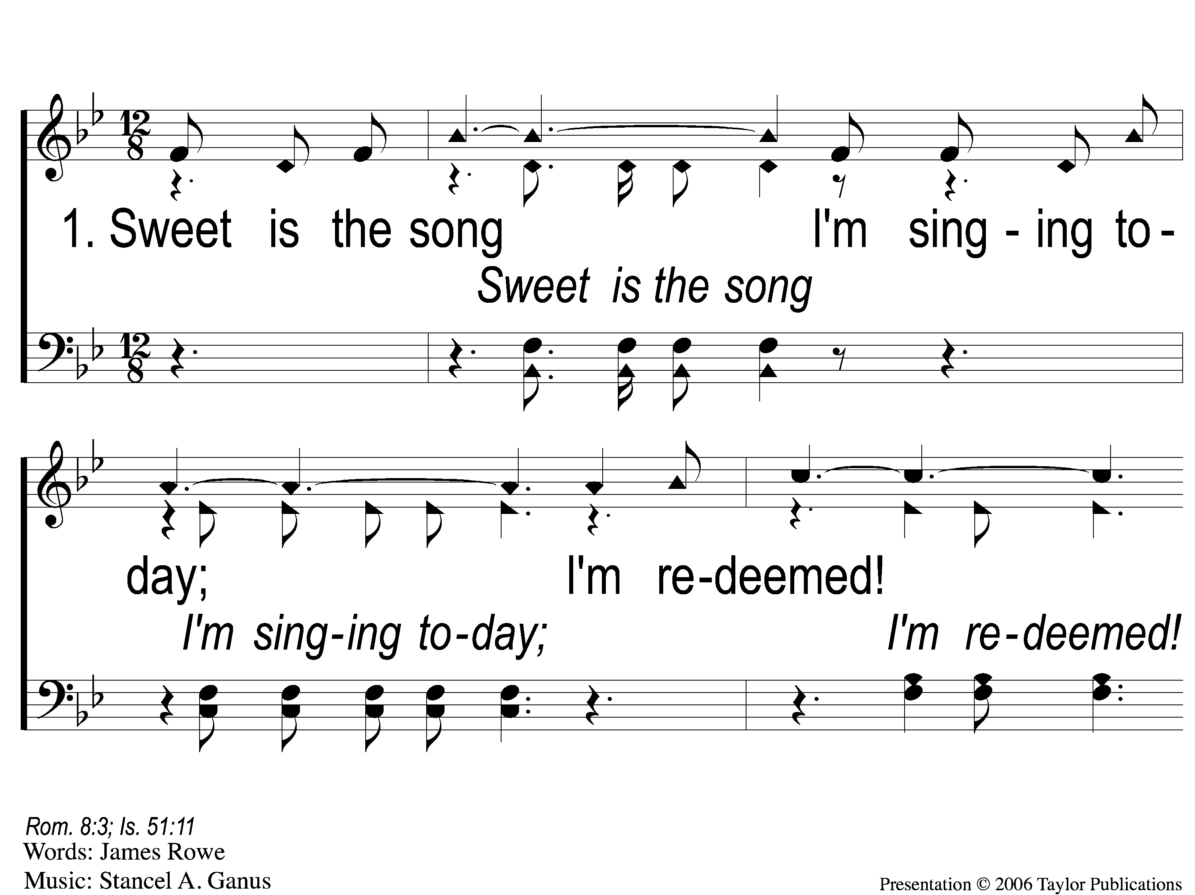
1-1 Redeemed - Sweet is the Song
Redeemed
458

Slide 14
1-2 Redeemed - Sweet is the Song
Redeemed
458

Slide 15
1-3 Redeemed - Sweet is the Song
Redeemed
458

Slide 16
C-1 Redeemed - Sweet is the Song
Redeemed
458

Slide 17
C-2 Redeemed - Sweet is the Song
Redeemed
458

Slide 18
3-1 Redeemed - Sweet is the Song
Redeemed
458

Slide 19
3-2 Redeemed - Sweet is the Song
Redeemed
458

Slide 20
3-3 Redeemed - Sweet is the Song
Redeemed
458

Slide 21
C-1 Redeemed - Sweet is the Song
Redeemed
458

Slide 22
C-2 Redeemed - Sweet is the Song
Redeemed
458

Slide 23
1-1 I Know That My Redeemer Lives
I Know That My Redeemer Lives
528

Slide 24
1-2 I Know That My Redeemer Lives
I Know That My Redeemer Lives
528

Slide 25
C-1 I Know That My Redeemer Lives
I Know That My Redeemer Lives
528

Slide 26
C-2 I Know That My Redeemer Lives
I Know That My Redeemer Lives
528

Slide 27
4-1 I Know That My Redeemer Lives
I Know That My Redeemer Lives
528

Slide 28
4-2 I Know That My Redeemer Lives
I Know That My Redeemer Lives
528

Slide 29
C-1 I Know That My Redeemer Lives
I Know That My Redeemer Lives
528

Slide 30
C-2 I Know That My Redeemer Lives
I Know That My Redeemer Lives
528

Slide 31
SONG
PRAISE HIM! PRAISE HIM!
#300

Slide 32
1-1 Praise Him, Praise Him
Praise Him! Praise Him
300

Slide 33
1-2 Praise Him, Praise Him
Praise Him! Praise Him
300

Slide 34
1-3 Praise Him, Praise Him
Praise Him! Praise Him
300

Slide 35
C Praise Him, Praise Him
Praise Him! Praise Him
300

Slide 36
2-1 Praise Him, Praise Him
Praise Him! Praise Him
300

Slide 37
2-2 Praise Him, Praise Him
Praise Him! Praise Him
300

Slide 38
2-3 Praise Him, Praise Him
Praise Him! Praise Him
300

Slide 39
C Praise Him, Praise Him
Praise Him! Praise Him
300

Slide 40
3-1 Praise Him, Praise Him
Praise Him! Praise Him
300

Slide 41
3-2 Praise Him, Praise Him
Praise Him! Praise Him
300

Slide 42
3-3 Praise Him, Praise Him
Praise Him! Praise Him
300

Slide 43
C Praise Him, Praise Him
Praise Him! Praise Him
300

Slide 44
OPENING
PRAYER

Slide 45
SONG
THE LOVE OF GOD
#122

Slide 46
1-1 The Love of God
The Love Of God
122

Slide 47
1-2 The Love of God
The Love Of God
122

Slide 48
C-1 The Love of God
The Love Of God
122

Slide 49
C-2 The Love of God
The Love Of God
122

Slide 50
C-3 The Love of God
The Love Of God
122

Slide 51
C-4 The Love of God
The Love Of God
122

Slide 52
C-5 The Love of God
The Love Of God
122

Slide 53
3-1 The Love of God
The Love Of God
122

Slide 54
3-2 The Love of God
The Love Of God
122

Slide 55
C-1 The Love of God
The Love Of God
122

Slide 56
C-2 The Love of God
The Love Of God
122

Slide 57
C-3 The Love of God
The Love Of God
122

Slide 58
C-4 The Love of God
The Love Of God
122

Slide 59
C-5 The Love of God
The Love Of God
122

Slide 60
SONG
AND CAN IT BE

Slide 61
1-1 And Can It Be
And Can It Be

Slide 62
1-2 And Can It Be
And Can It Be

Slide 63
C-1 And Can It Be
And Can It Be

Slide 64
C-2 And Can It Be
And Can It Be

Slide 65
2-1 And Can It Be
And Can It Be

Slide 66
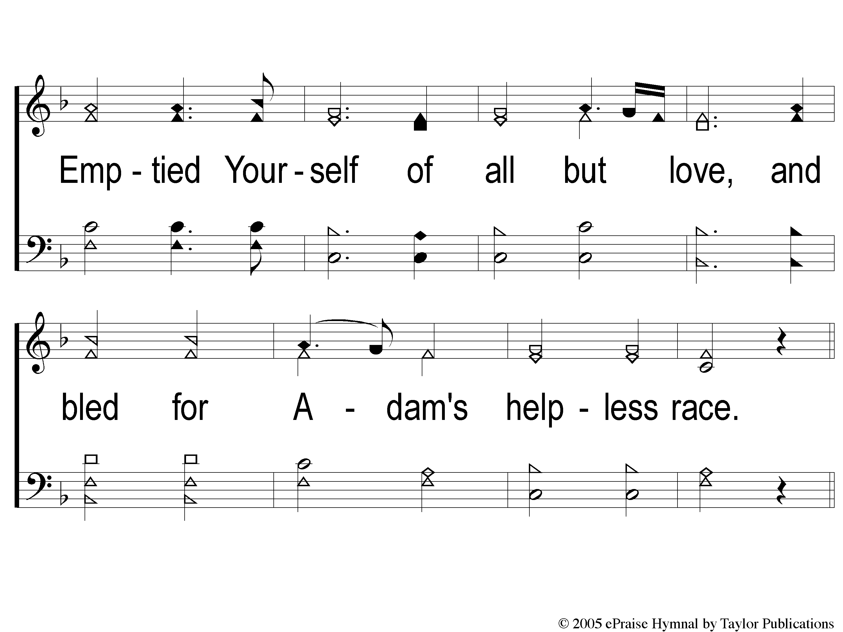
2-2 And Can It Be
And Can It Be

Slide 67
C-1 And Can It Be
And Can It Be

Slide 68
C-2 And Can It Be
And Can It Be

Slide 69
3-1 And Can It Be
And Can It Be

Slide 70
3-2 And Can It Be
And Can It Be

Slide 71
C-1 And Can It Be
And Can It Be

Slide 72
C-2 And Can It Be
And Can It Be

Slide 73
SCRIPTURE READING:
1 Peter 2:1-5

Slide 74
STAND
IN THE LOVE OF GOD

Slide 76
AGAPE
ἀγάπη

Slide 77
AGAPE LOVE
UNCONDITIONAL
SACRIFICIAL

Slide 78
GREAT EXAMPLES:
Joseph & Mary – Lk. 1:26-38
Wise Men – Matt. 2:1-12
Boaz & Ruth – Ruth 1-4

Slide 79
GREATER EXAMPLES:
The Apostle Paul

Slide 80
PAUL SACRIFICED…
1. His Right To Marry
1 Cor. 7:8, 26

Slide 81
PAUL SACRIFICED…
2. His Career
2 Cor. 11:22
Phili. 3:4-8

Slide 82
GREATER EXAMPLES:
The Apostle Paul
Jesus Christ

Slide 83
JESUS SACRIFICED…
His Life
1 Jn. 3:16
Jn. 15:13
Lk. 22:39-44

Slide 84
GREATER EXAMPLES:
The Apostle Paul
Jesus Christ
God, the Father

Slide 85
GOD SACRIFICED…
His Only Son
Gen. 3:15
Isa 9:6
Psa. 22:16-18

Slide 86
GOD SACRIFICED…
His Only Son
Jn. 3:16
Rom. 5:6-8, 8:32
1 Jn 4:9-10

Slide 87
I SACRIFICE…
???

Slide 88
I SACRIFICE…
1 Jn. 4:19
LK. 14:33
Matt. 10:37
Eph. 5:3-7
Gal. 2:20, 5:19-21

Slide 89
WHAT WOULD YOU
SACRIFICE
FOR GOD?

Slide 90
INVITATION SONG
I AM COMING LORD
#923

Slide 91
1-1 I Am Coming Lord
I Am Coming Lord
923

Slide 92
1-2 I Am Coming Lord
I Am Coming Lord
923

Slide 93
C-1 I Am Coming Lord
I Am Coming Lord
923

Slide 94
C-2 I Am Coming Lord
I Am Coming Lord
923

Slide 95
2-1 I Am Coming Lord
I Am Coming Lord
923

Slide 96
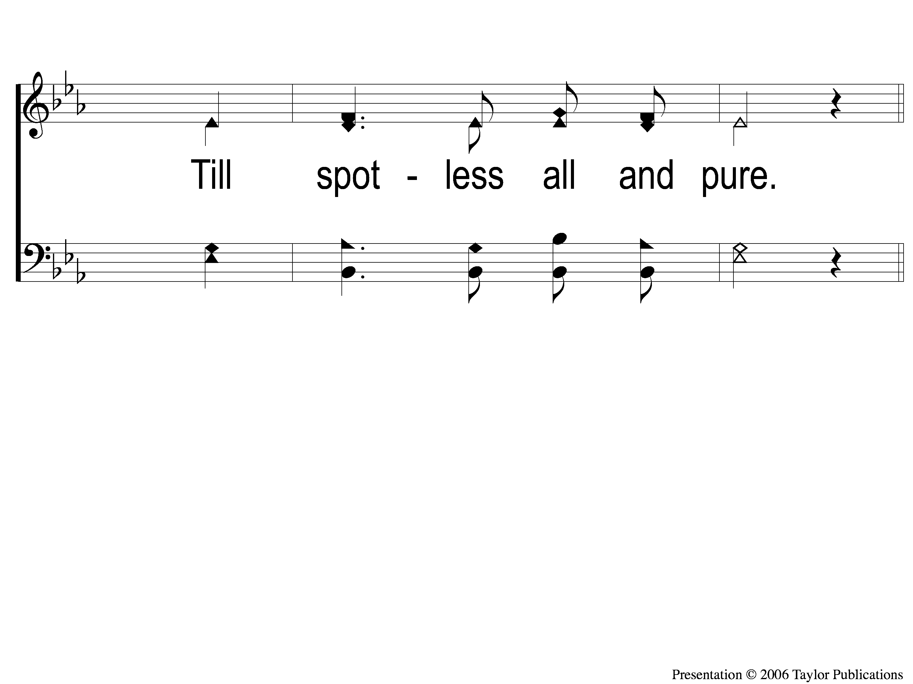
2-2 I Am Coming Lord
I Am Coming Lord
923

Slide 97
C-1 I Am Coming Lord
I Am Coming Lord
923

Slide 98
C-2 I Am Coming Lord
I Am Coming Lord
923

Slide 99
3-1 I Am Coming Lord
I Am Coming Lord
923

Slide 100
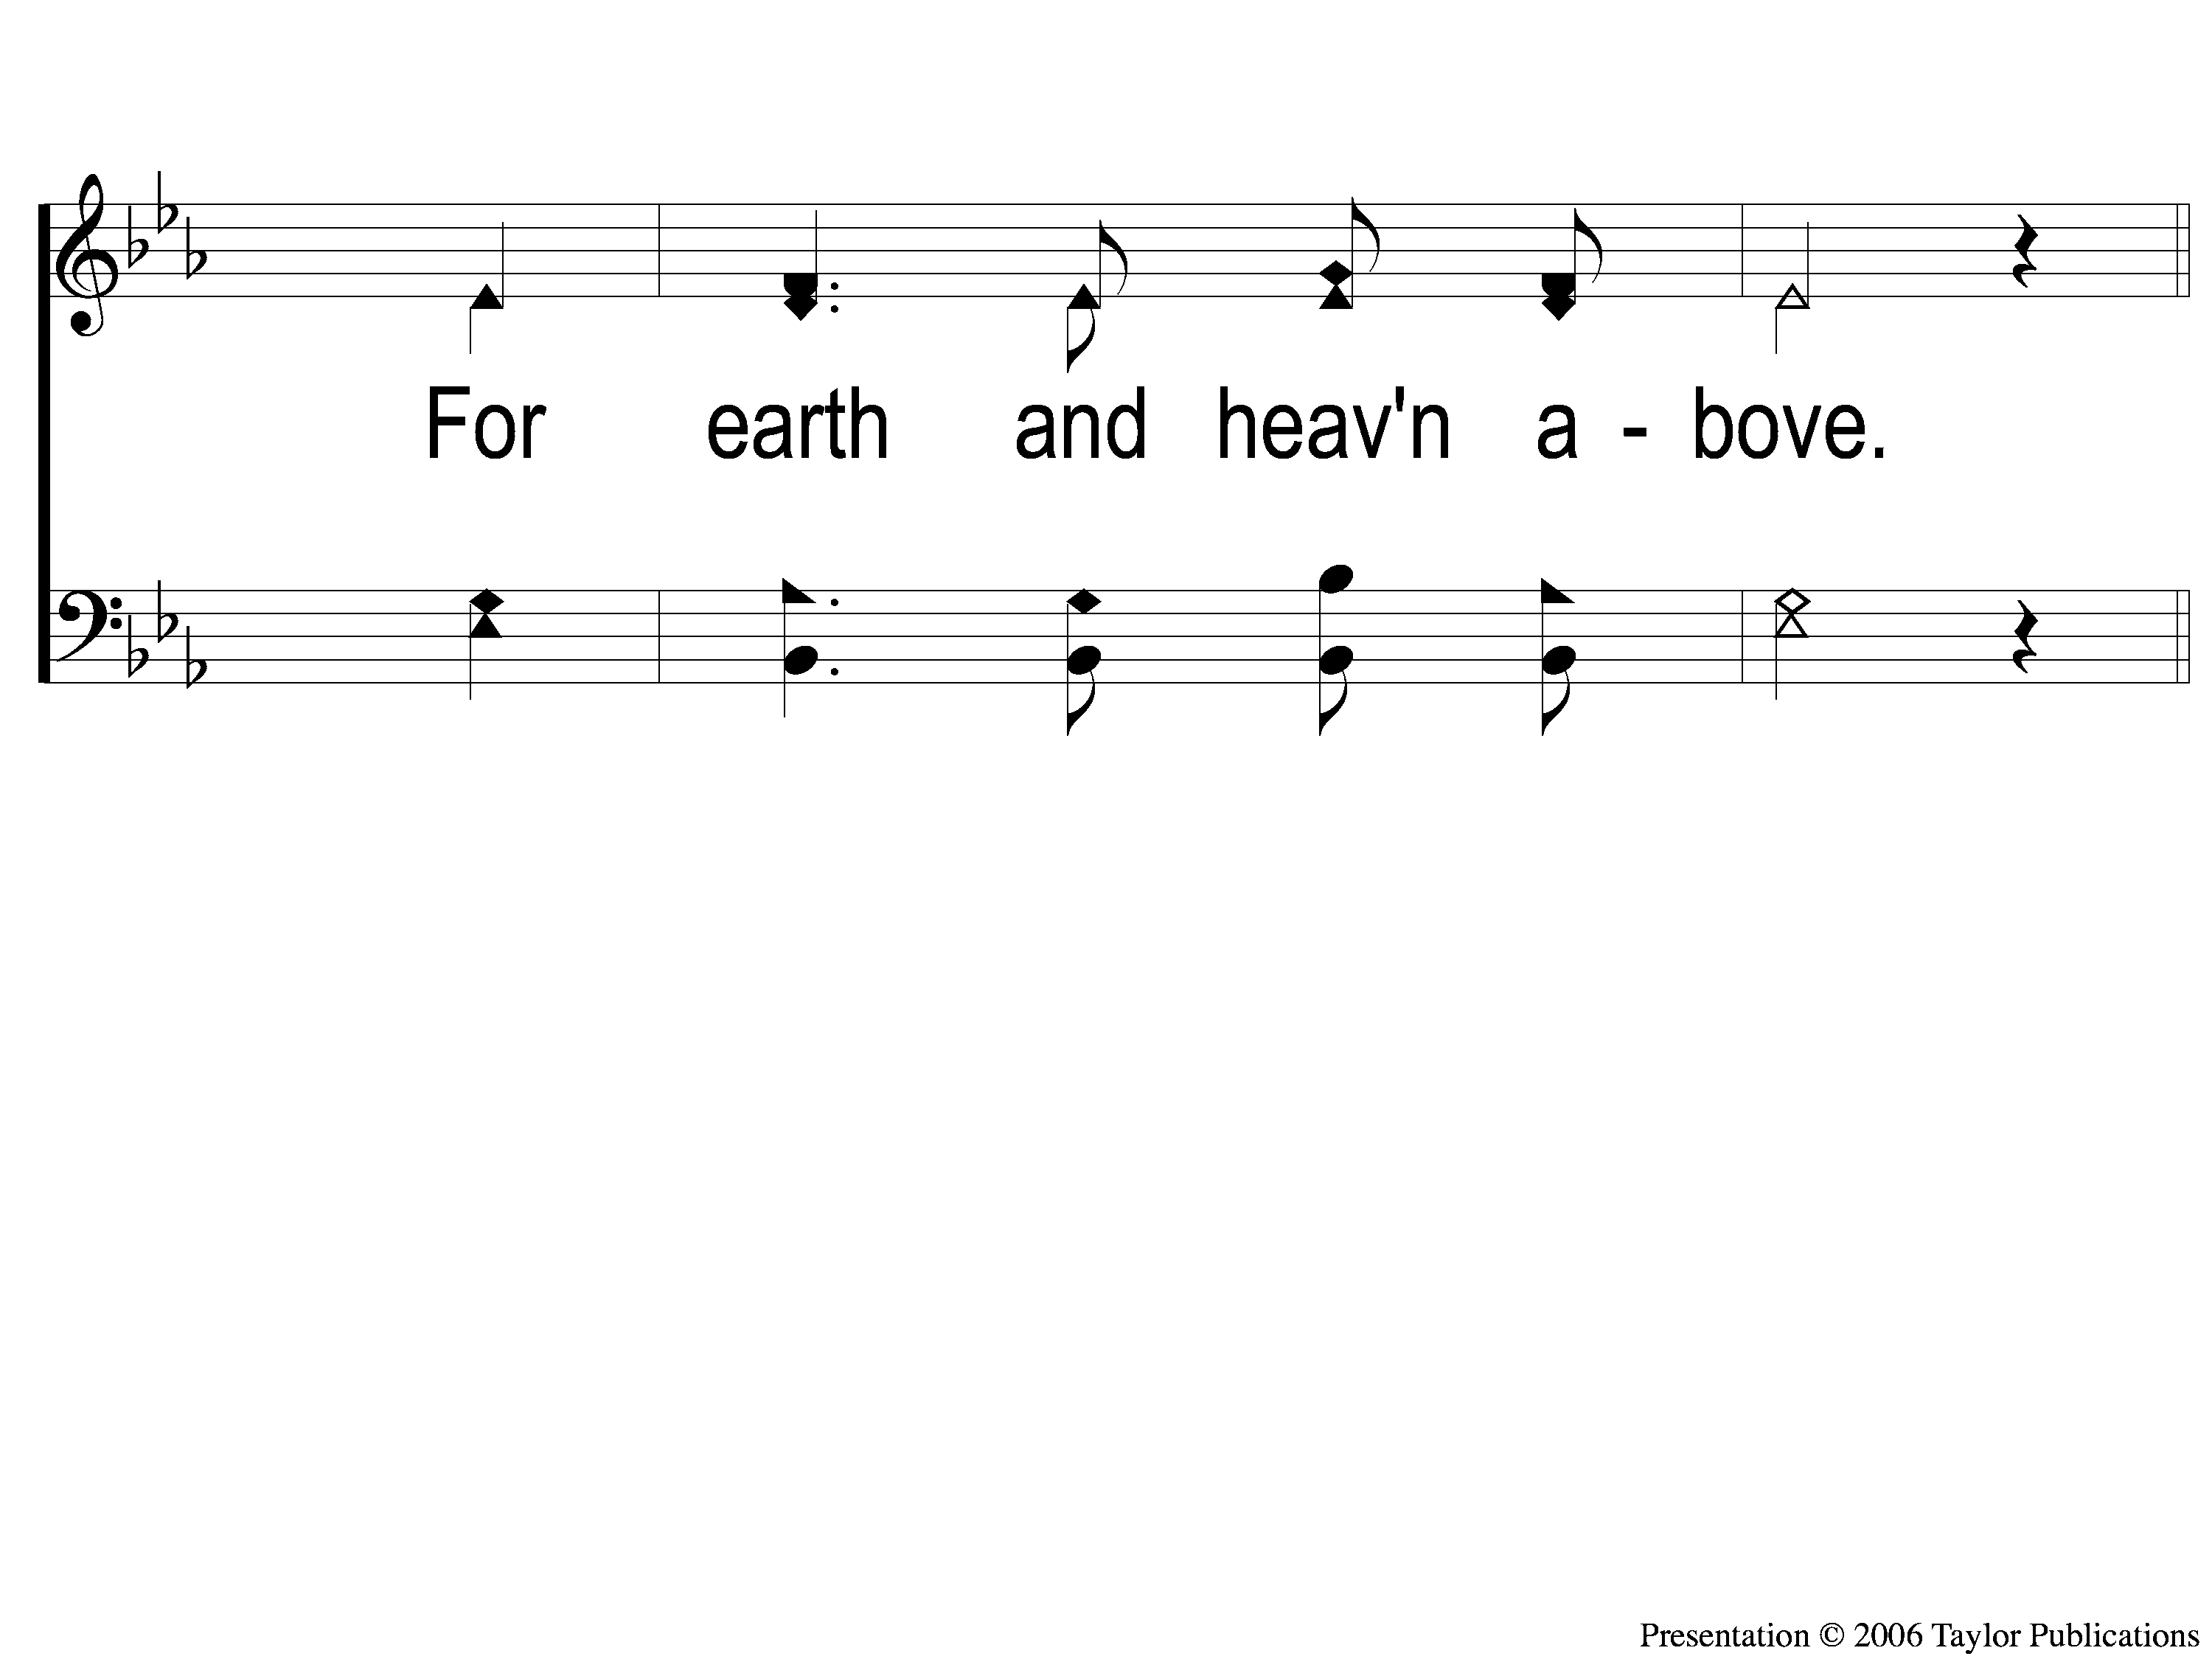
3-2 I Am Coming Lord
I Am Coming Lord
923

Slide 101
C-1 I Am Coming Lord
I Am Coming Lord
923

Slide 102
C-2 I Am Coming Lord
I Am Coming Lord
923

Slide 103
THE OFFERING
ACTS 20:35
“I have shown you in every way, by laboring like this, that you must support the weak. And remember the words of the Lord Jesus, that He said, ‘It is more blessed to give than to receive.’ ”

Slide 104
SONG
CREATE IN ME
A CLEAN HEART

Slide 105
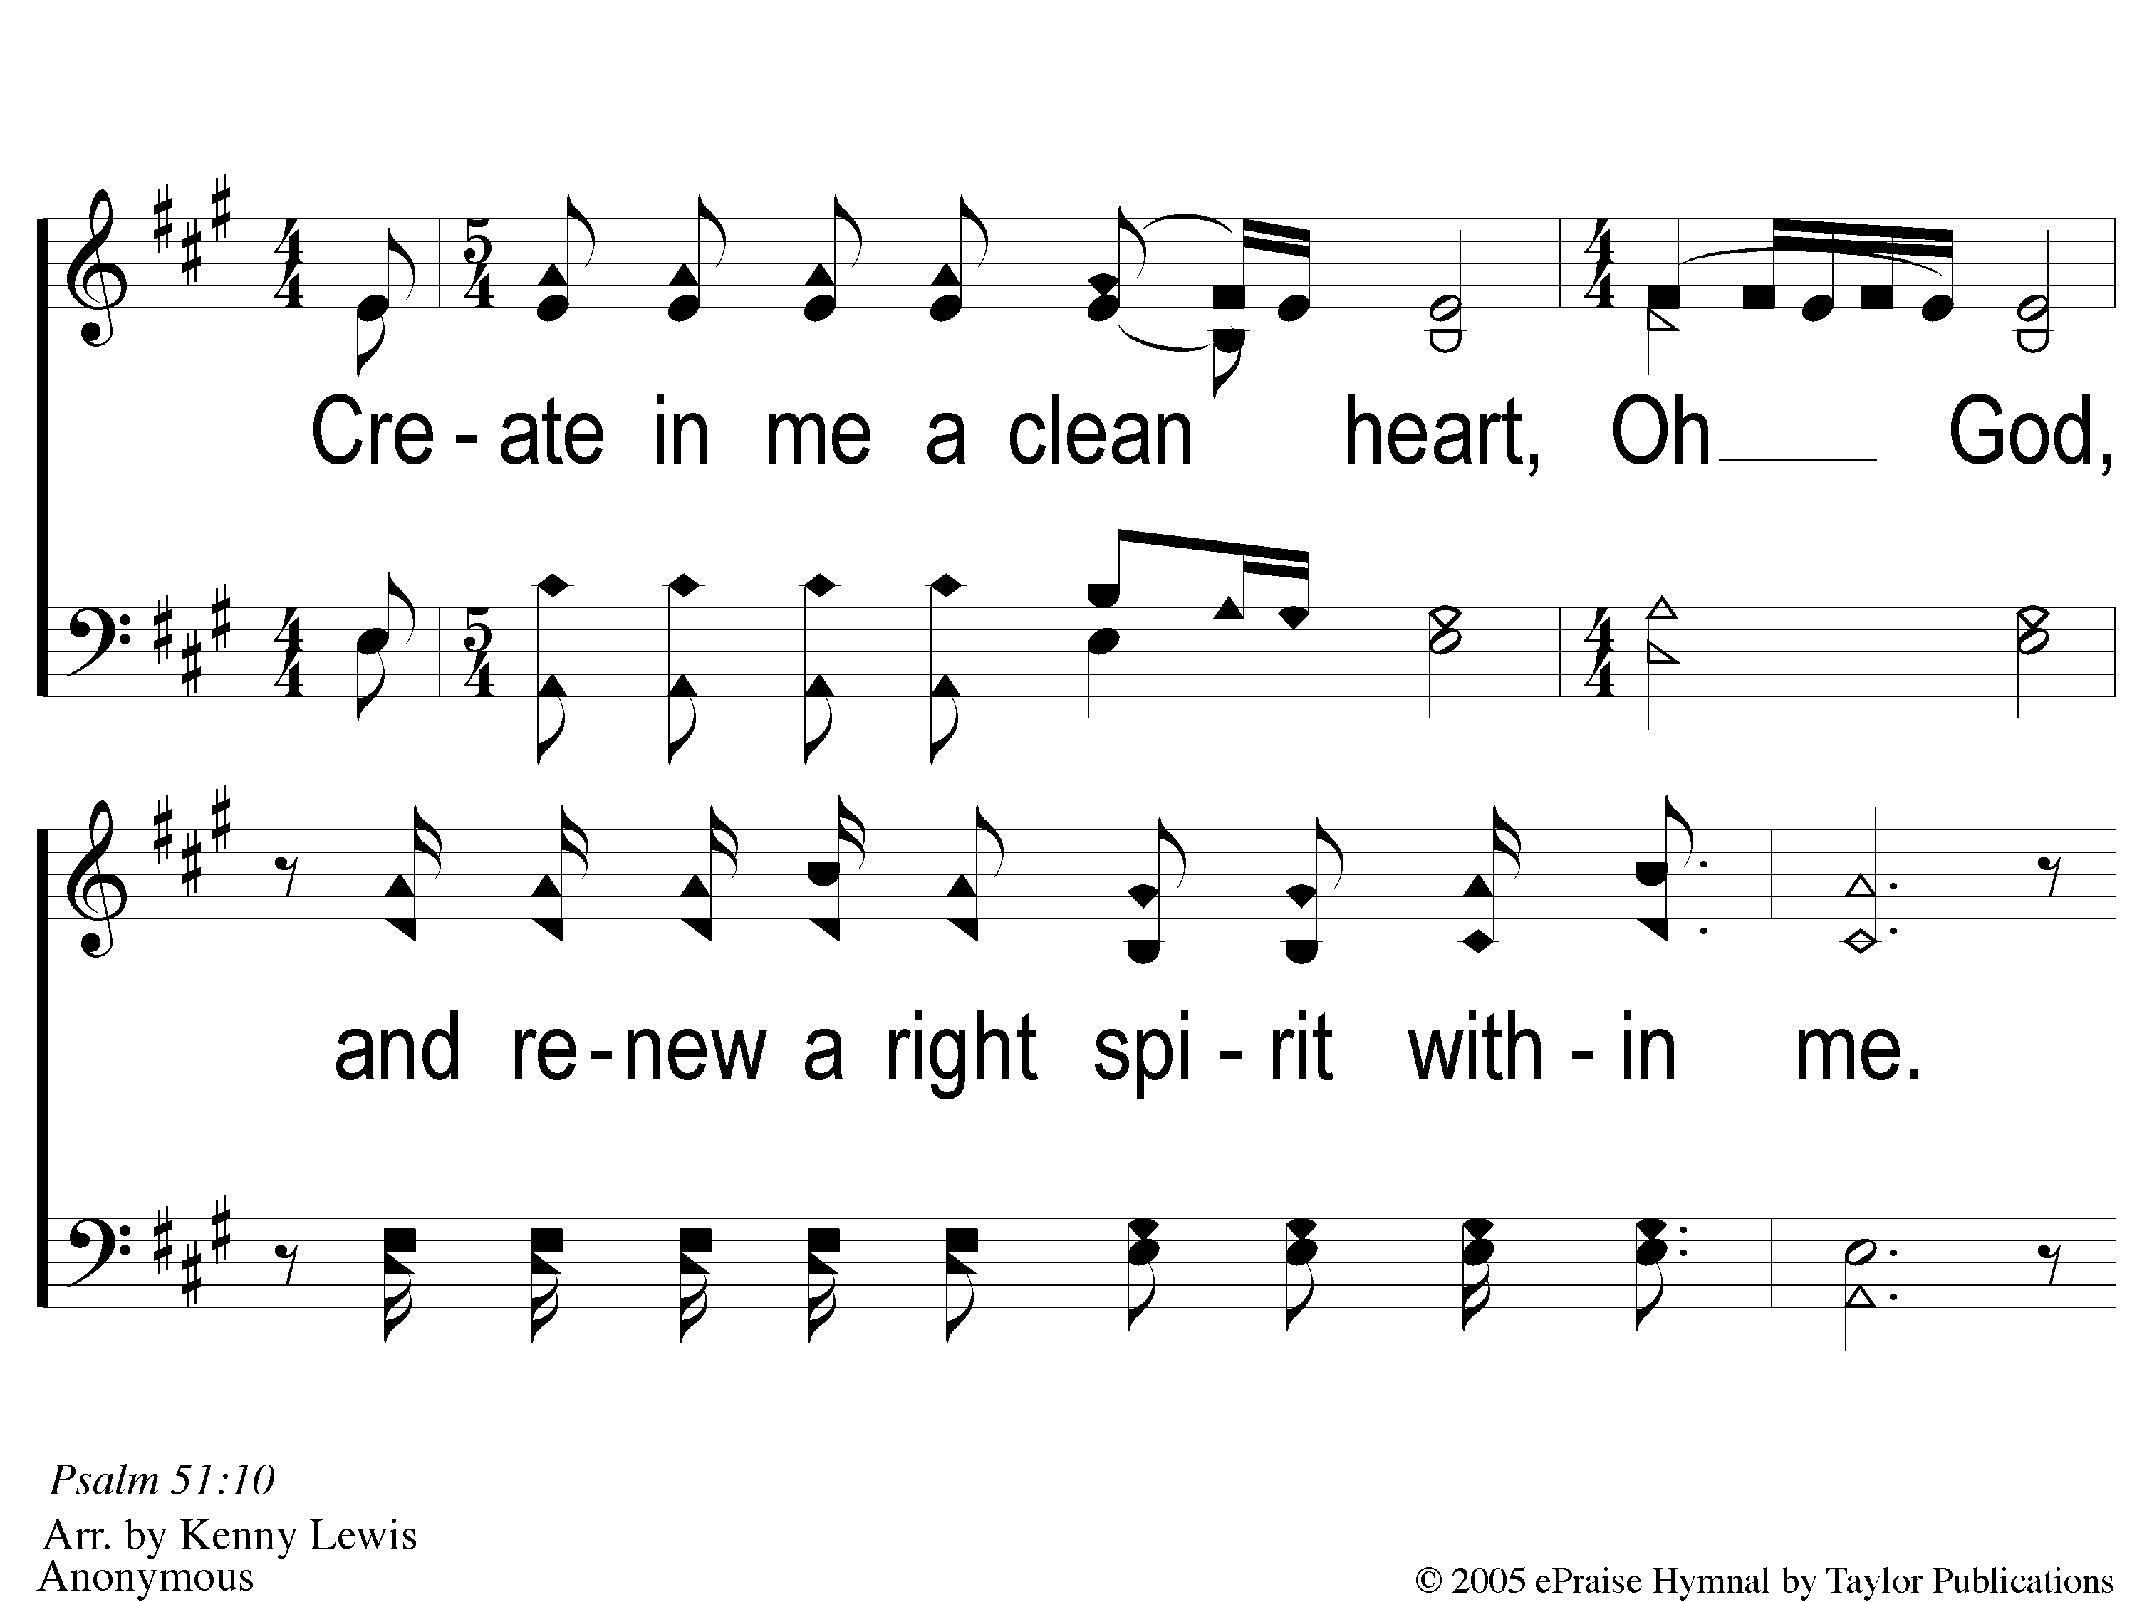
1 Create in Me
Create In Me A Clean Heart

Slide 106
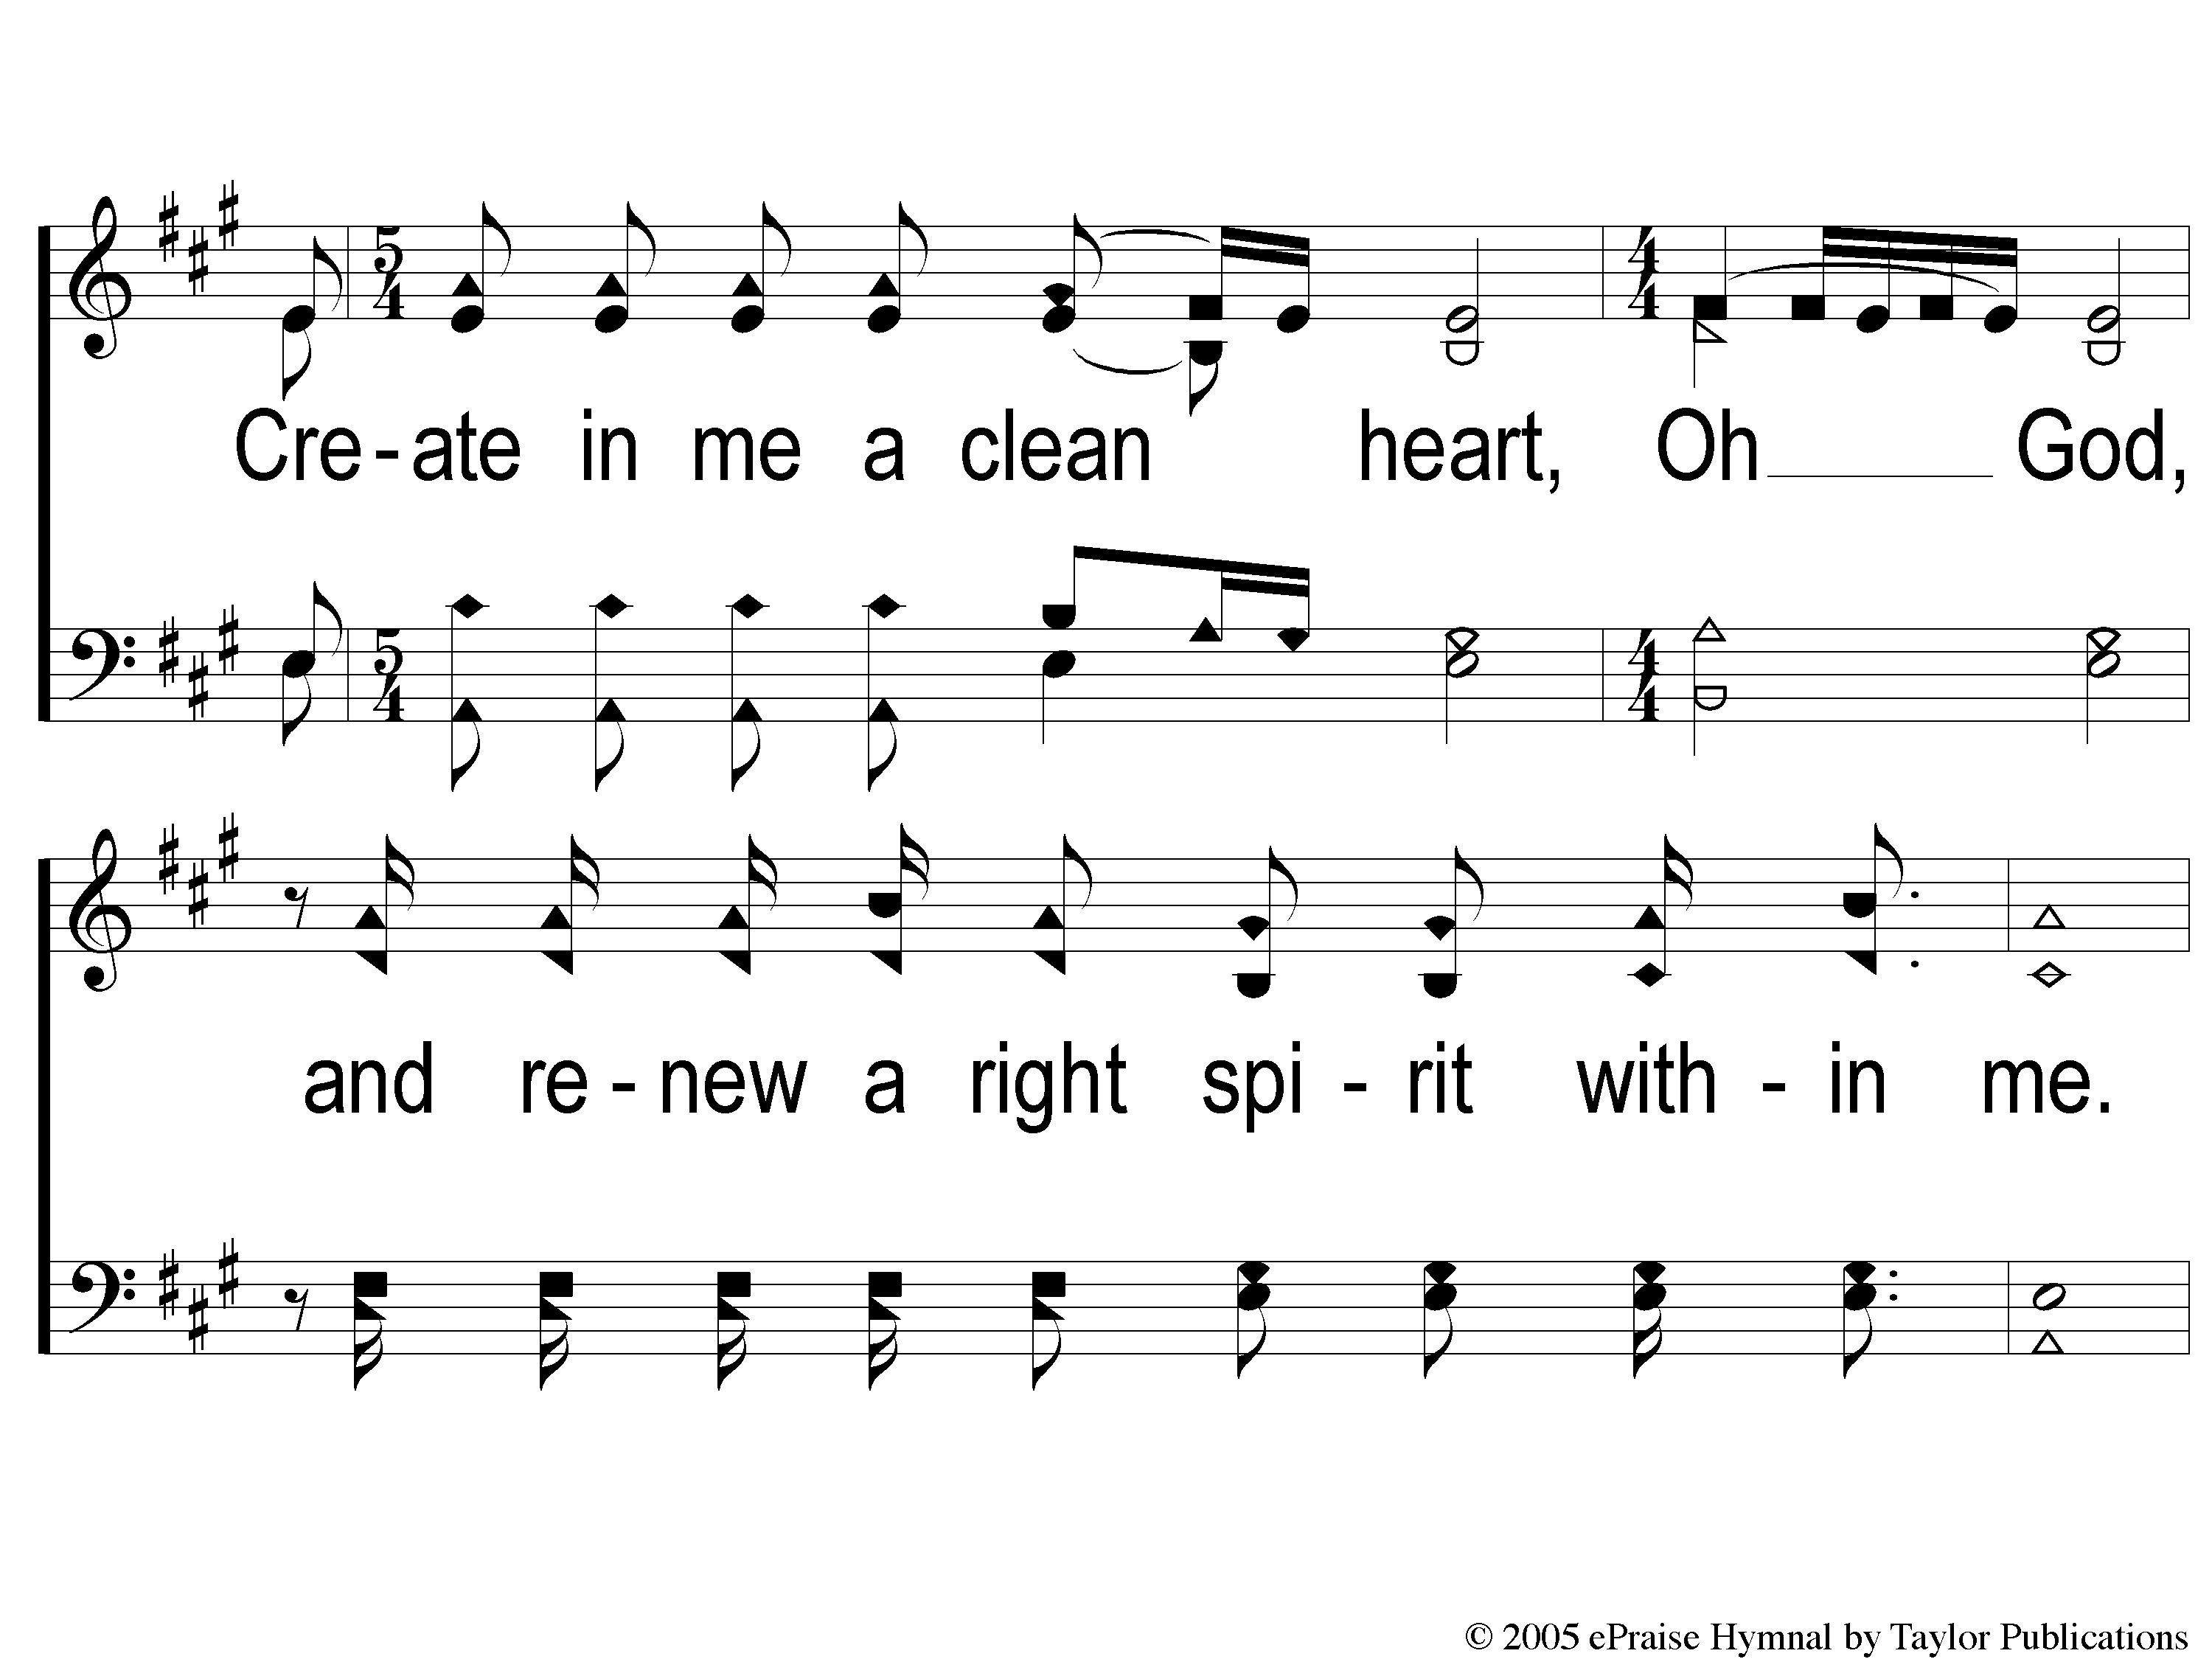
2 Create in Me
Create In Me A Clean Heart

Slide 107
3 Create in Me
Create In Me A Clean Heart

Slide 108
4 Create in Me
Create In Me A Clean Heart

Slide 109
1 Create in Me
Create In Me A Clean Heart

Slide 110
2 Create in Me
Create In Me A Clean Heart

Slide 111
3 Create in Me
Create In Me A Clean Heart

Slide 112
4 Create in Me
Create In Me A Clean Heart

Slide 113
THE LORD’S SUPPER
ACTS 20:7

Slide 114
THE UNLEAVENED BREAD
ROMANS 8:1-2
“There is therefore now no condemnation to those who are in Christ Jesus, who do not walk according to the flesh, but according to the Spirit. For the law of the Spirit of life in Christ Jesus has made me free from the law of sin and death.”

Slide 115
THE FRUIT OF THE VINE
ROMANS 8:31-32
“What then shall we say to these things? If God is for us, who can be against us? He who did not spare His own Son, but delivered Him up for us all, how shall He not with Him also freely give us all things?”

Slide 116
CLOSING
PRAYER

Slide 117
SONG
NO NIGHT THERE
#890

Slide 118
1-1 No Night There
No Night There
890

Slide 119
1-2 No Night There
No Night There
890

Slide 120
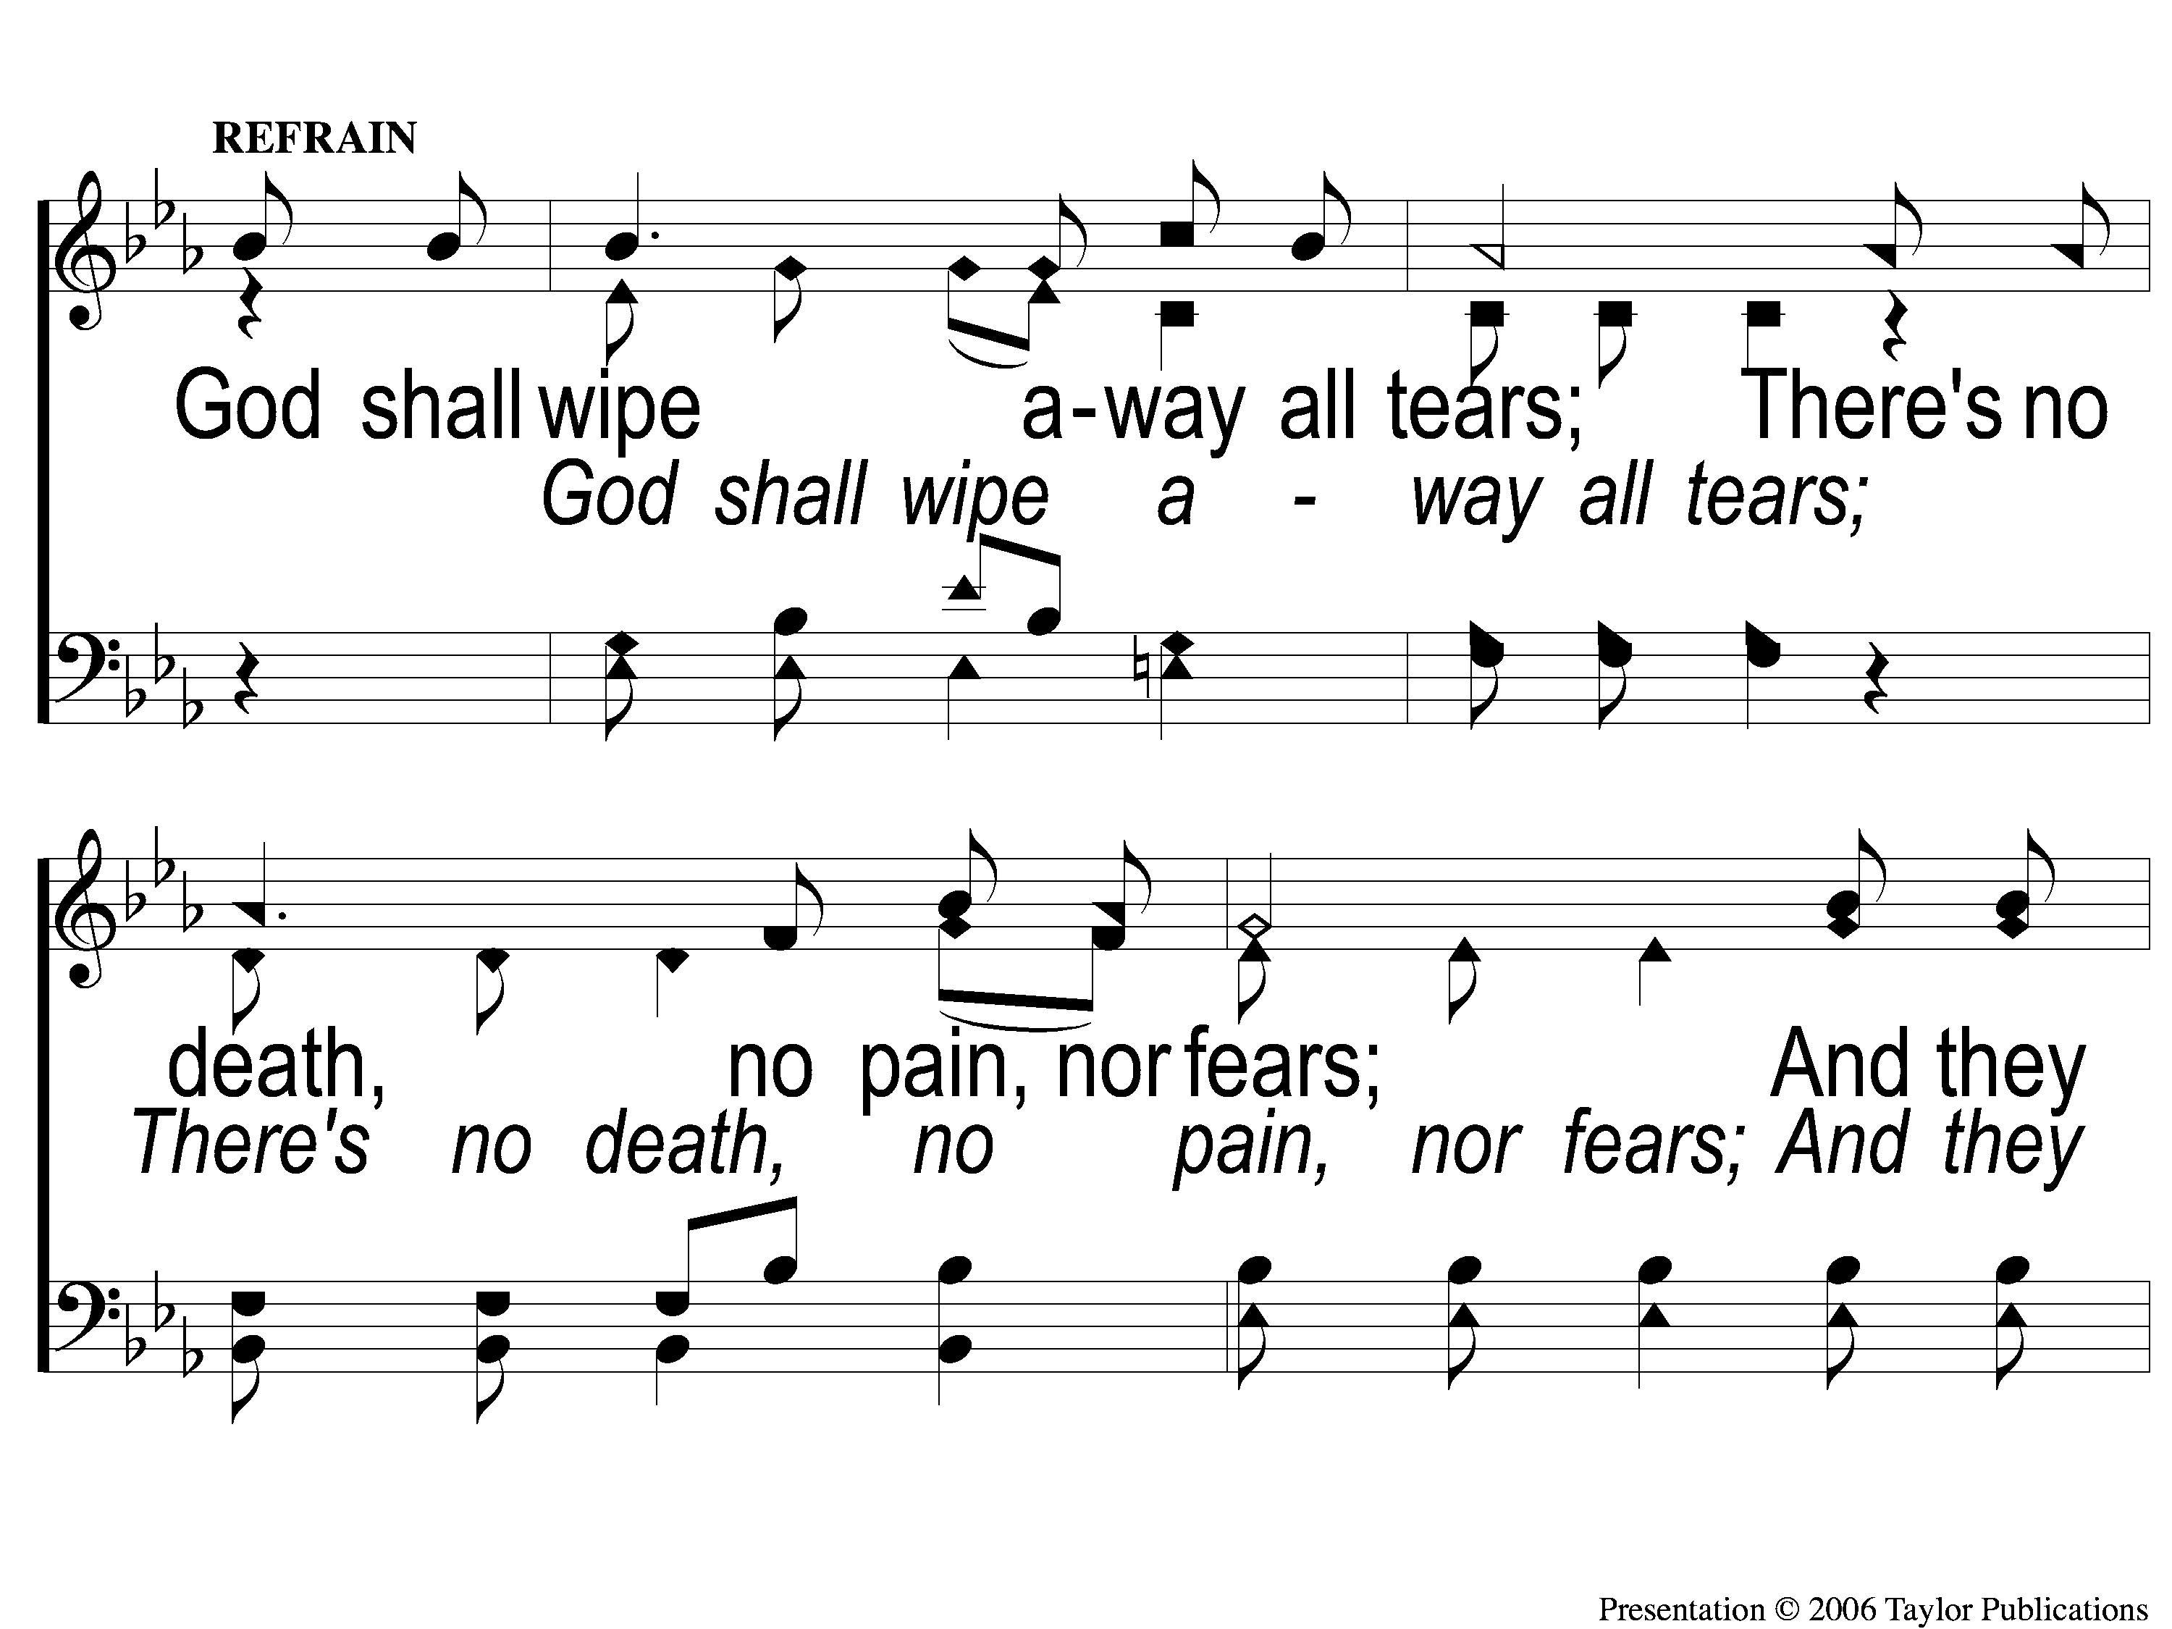
C-1 No Night There
No Night There
890

Slide 121
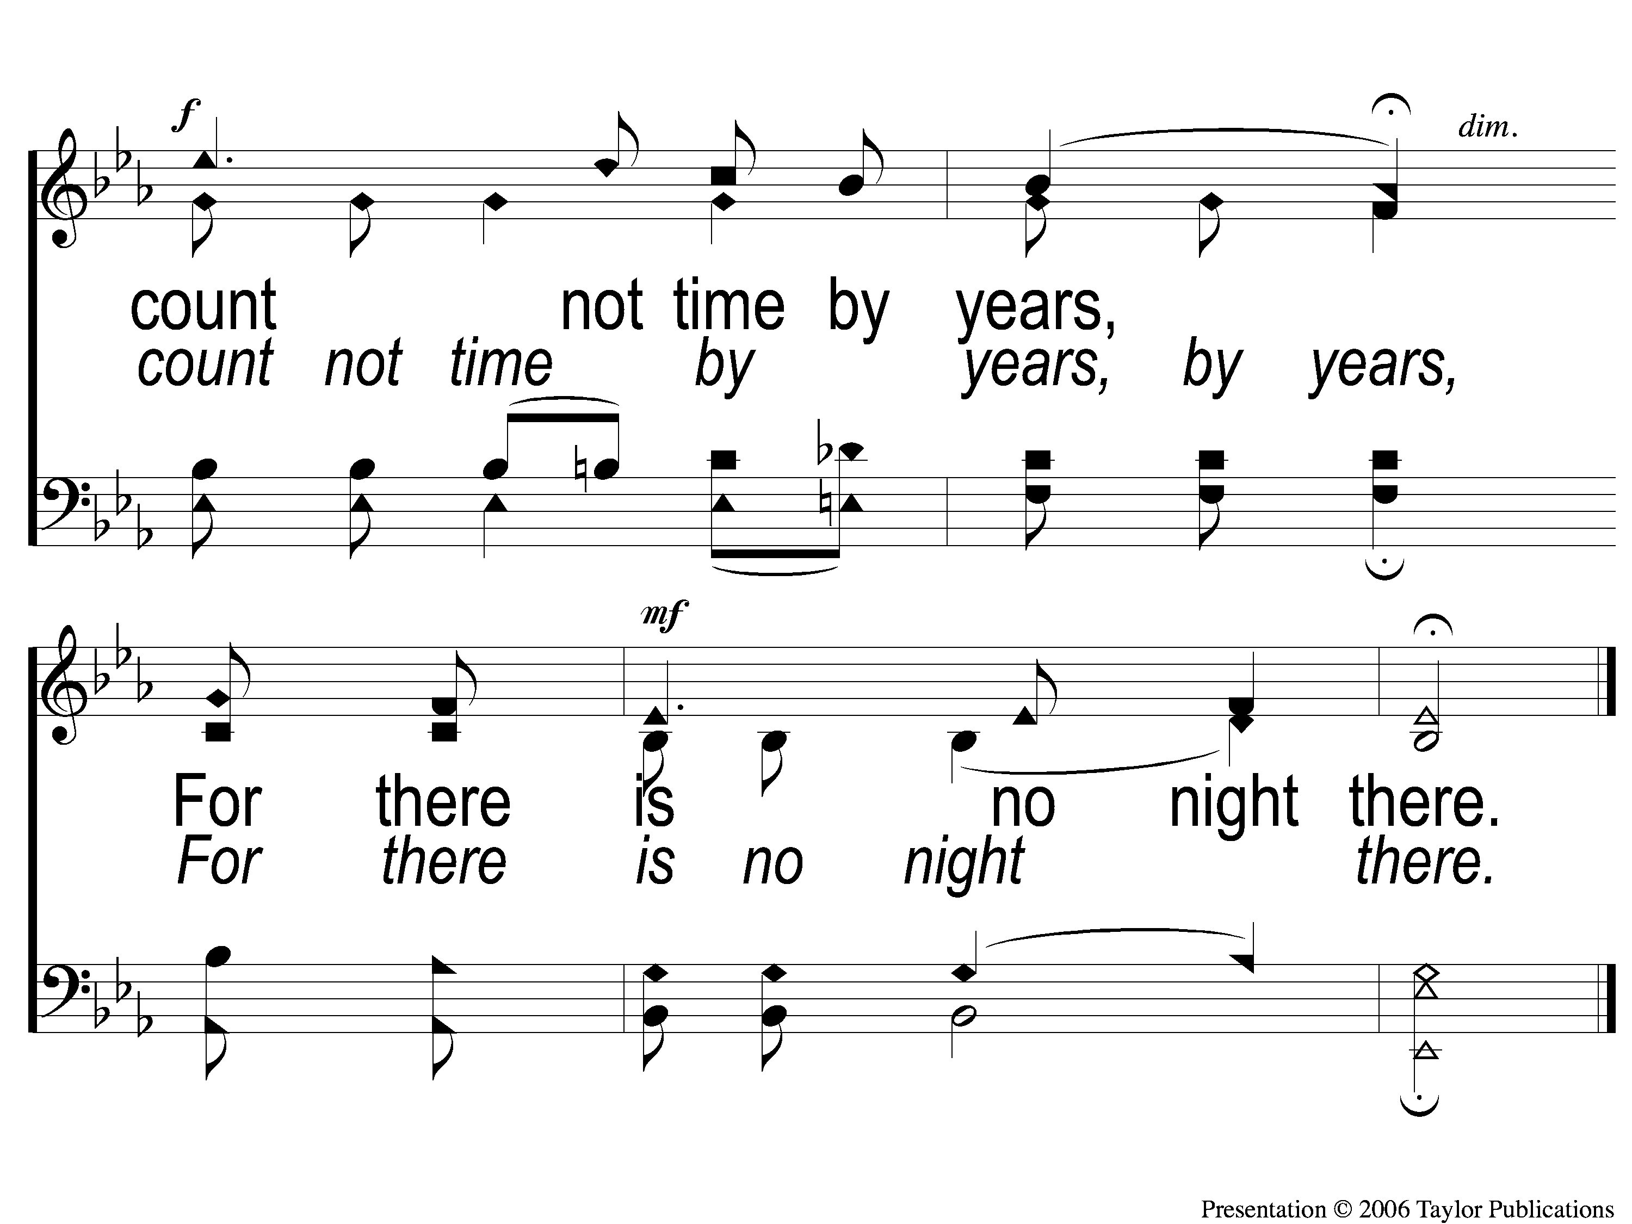
C-2 No Night There
No Night There
890

Slide 122
2-1 No Night There
No Night There
890

Slide 123
2-2 No Night There
No Night There
890

Slide 124
C-1 No Night There
No Night There
890

Slide 125
C-2 No Night There
No Night There
890

Slide 126
3-1 No Night There
No Night There
890

Slide 127
3-2 No Night There
No Night There
890

Slide 128
C-1 No Night There
No Night There
890

Slide 129
C-2 No Night There
No Night There
890

Slide 130
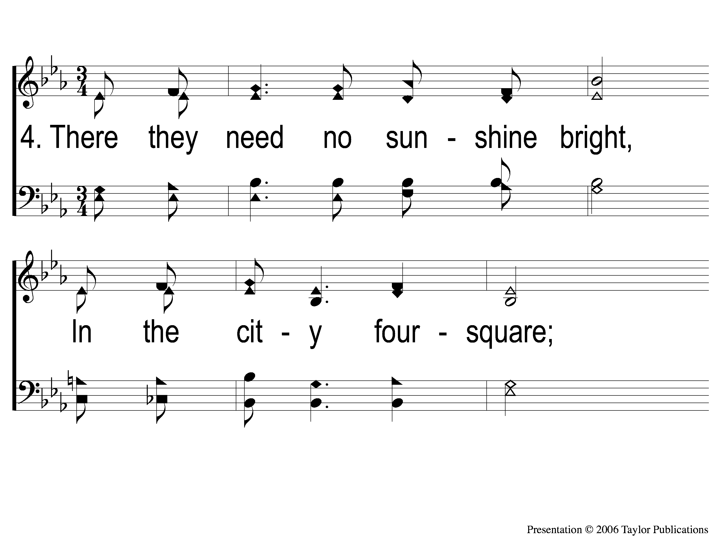
4-1 No Night There
No Night There
890

Slide 131
4-2 No Night There
No Night There
890

Slide 132
C-1 No Night There
No Night There
890

Slide 133
C-2 No Night There
No Night There
890

Slide 134
TONIGHT’S LESSON:
AGAPE???
@ 6:00 PM

