Slide 1
1-1 Faithful Love
Faithful Love

Slide 2
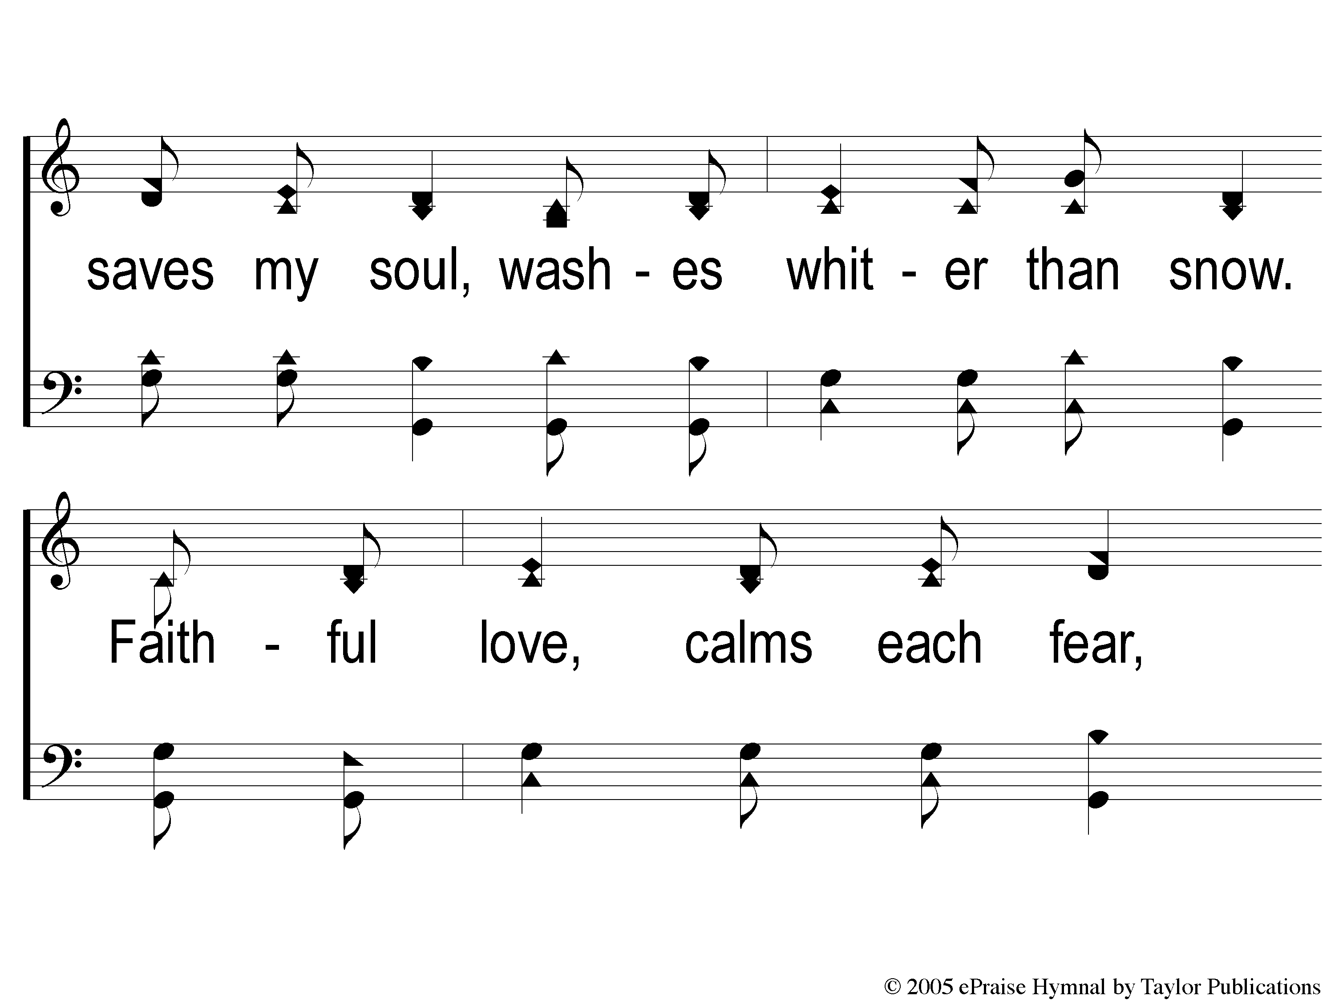
1-2 Faithful Love
Faithful Love

Slide 3
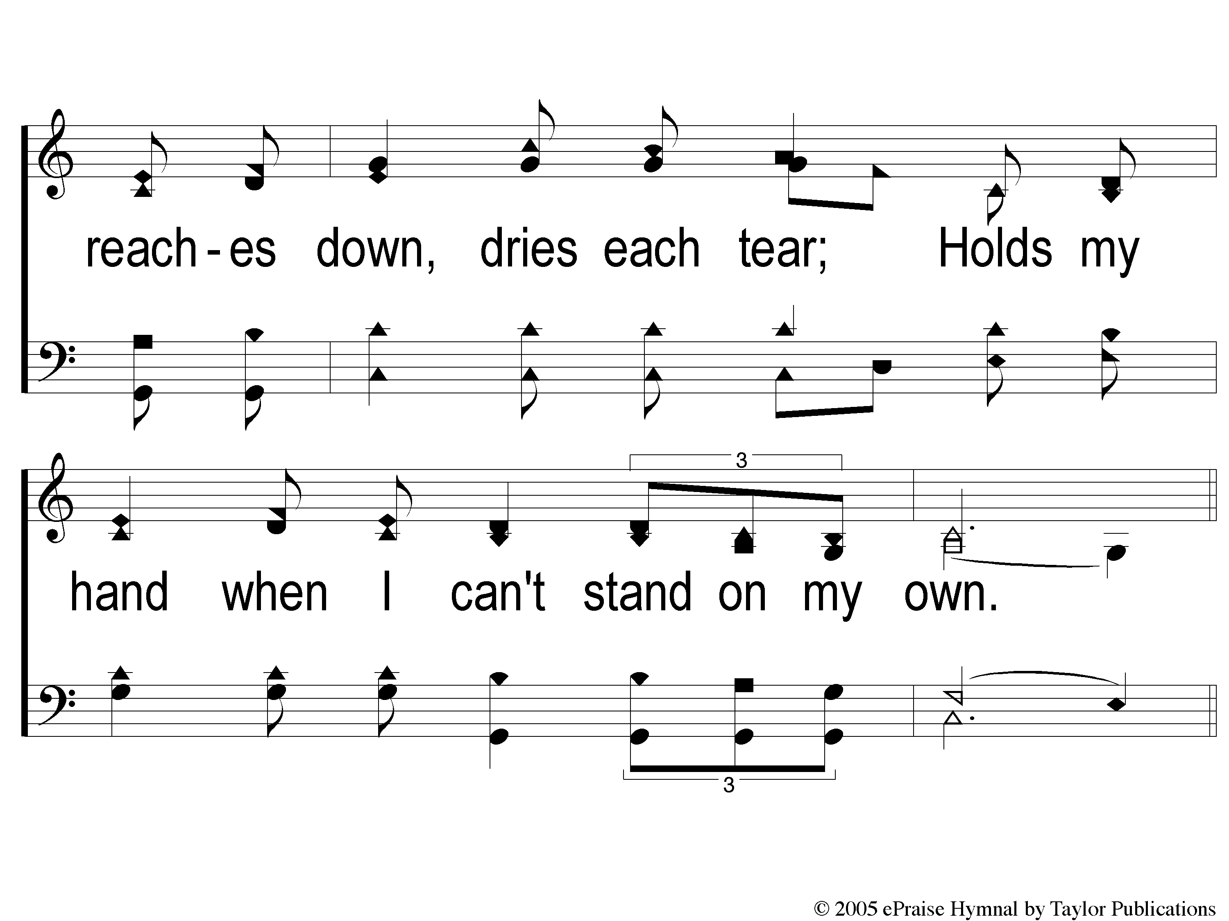
1-3 Faithful Love
Faithful Love

Slide 4
C-1 Faithful Love
Faithful Love

Slide 5
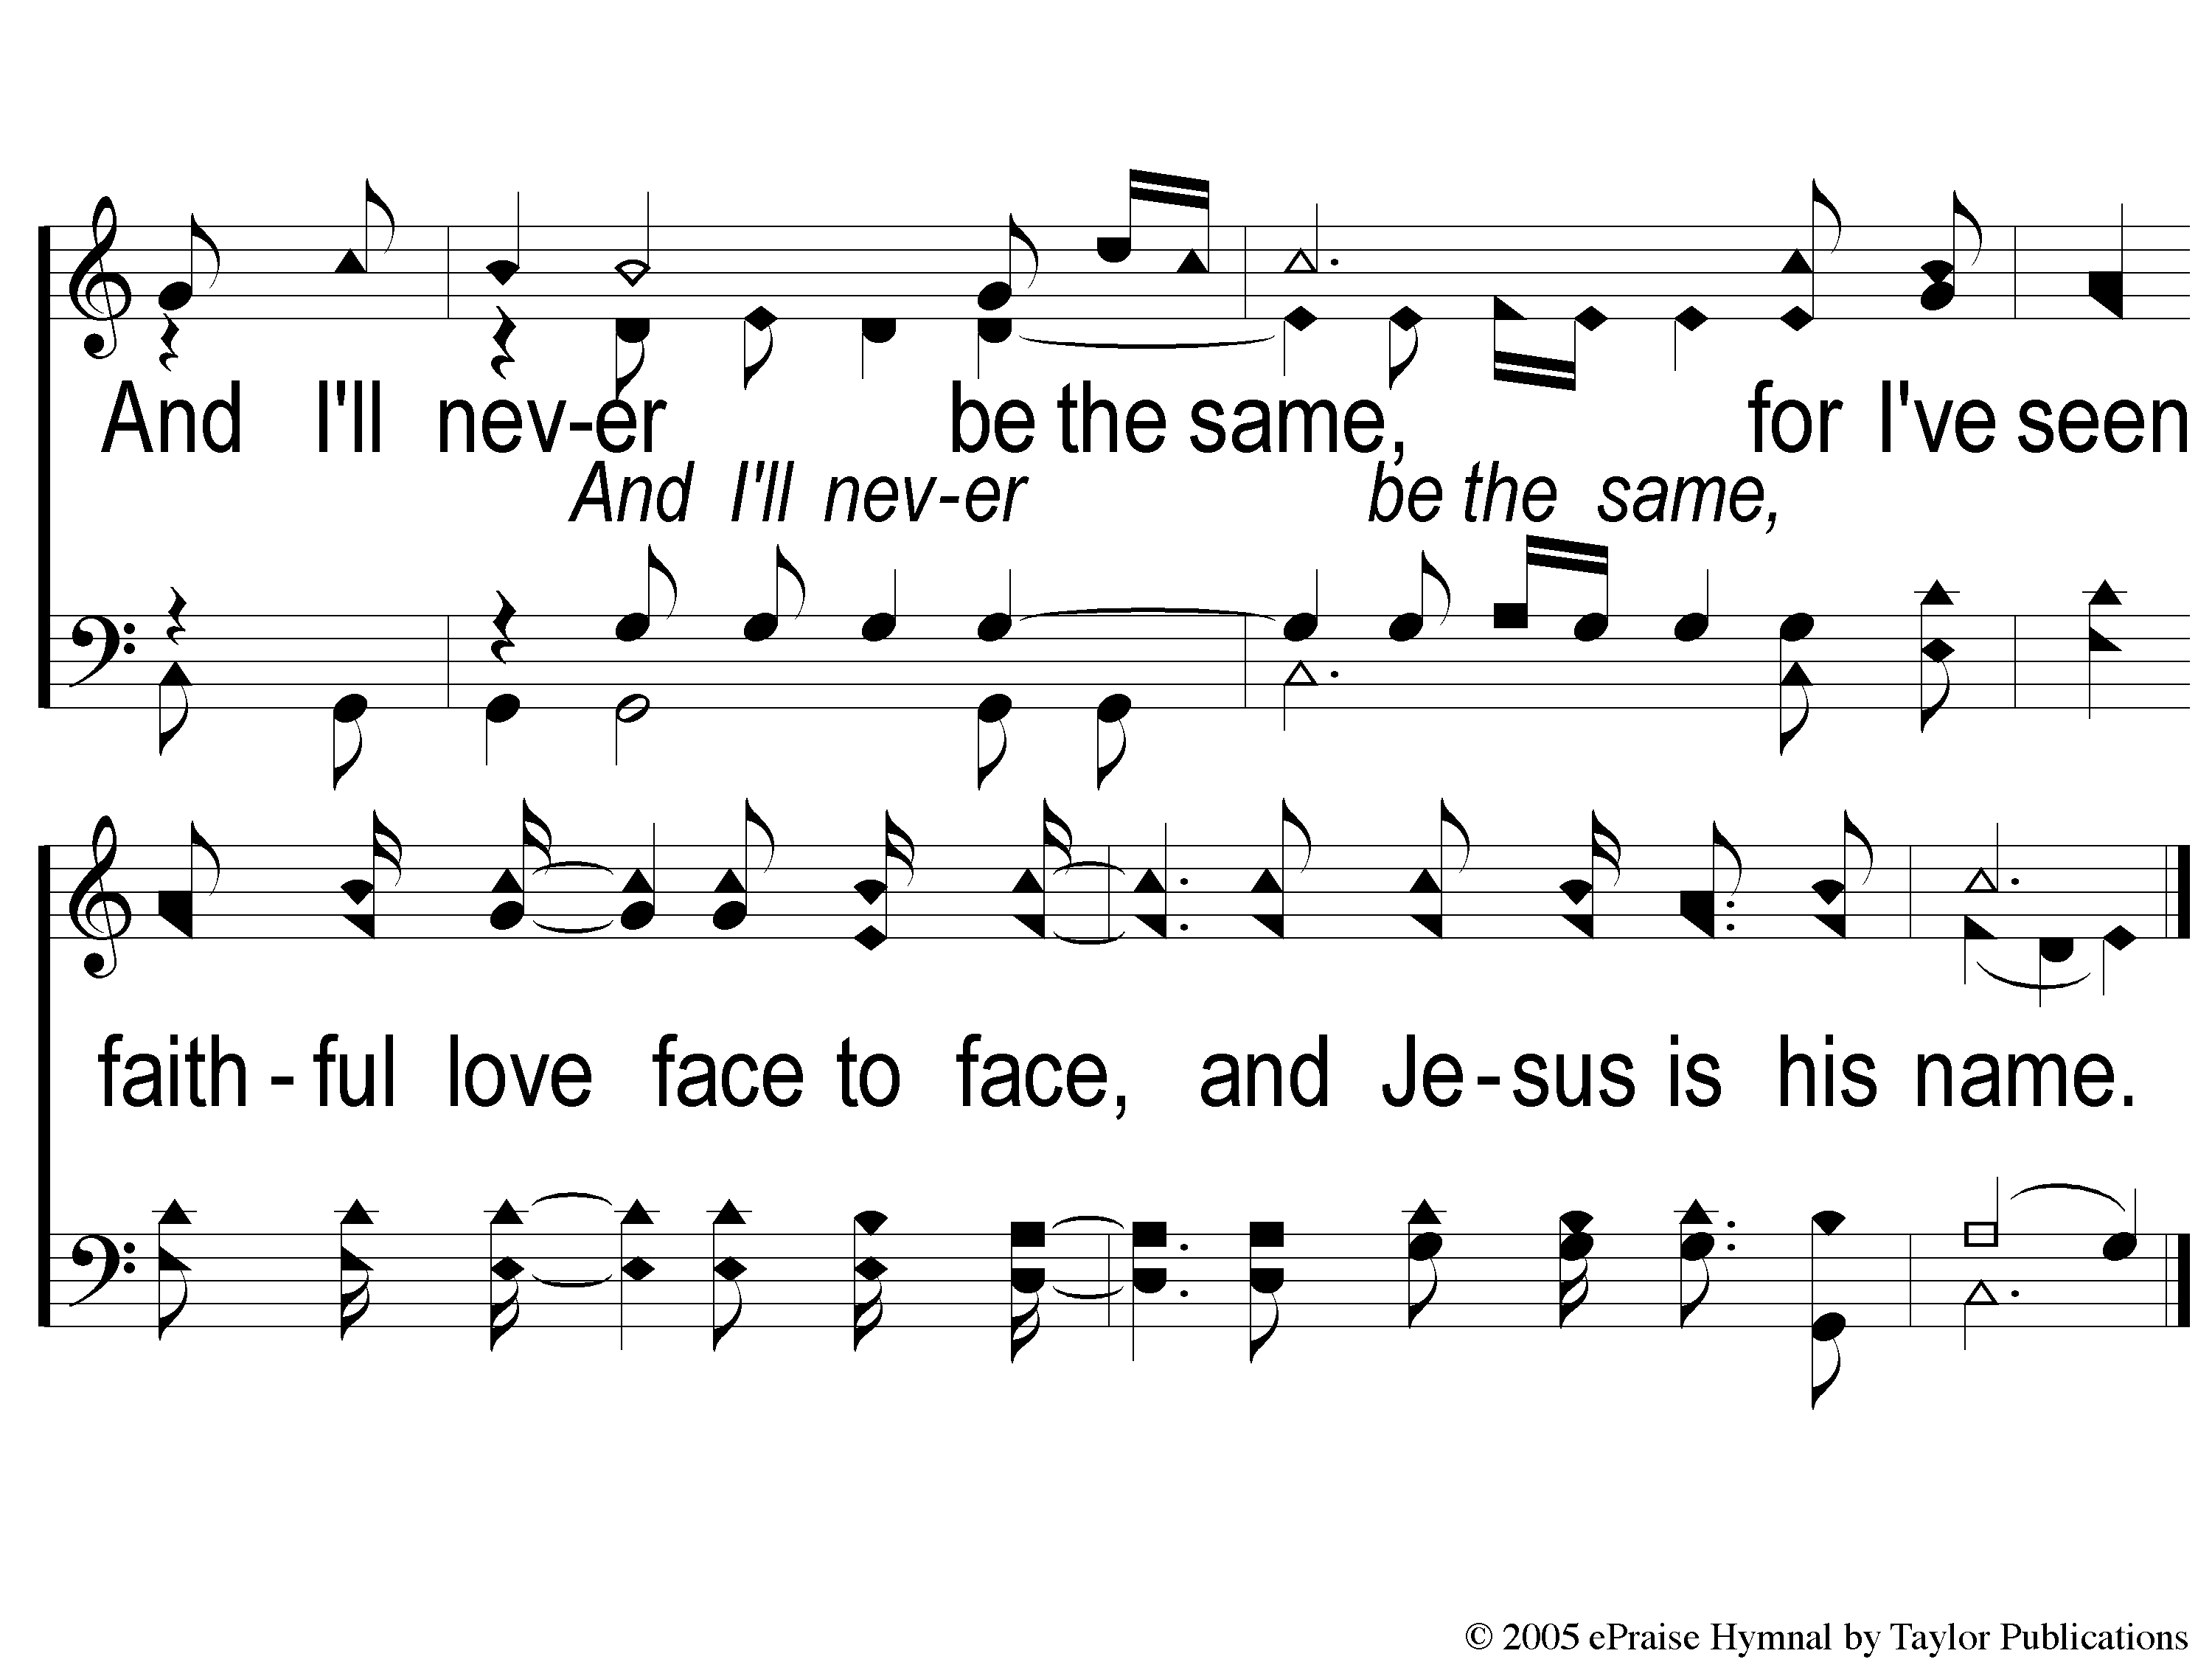
C-2 Faithful Love
Faithful Love

Slide 6
WELCOME
WE ARE GLAD YOU ARE HERE

Slide 7
SONG
A BEAUTIFUL LIFE
#570

Slide 8
1-1 A Beautiful Life
A Beautiful Life
570

Slide 9
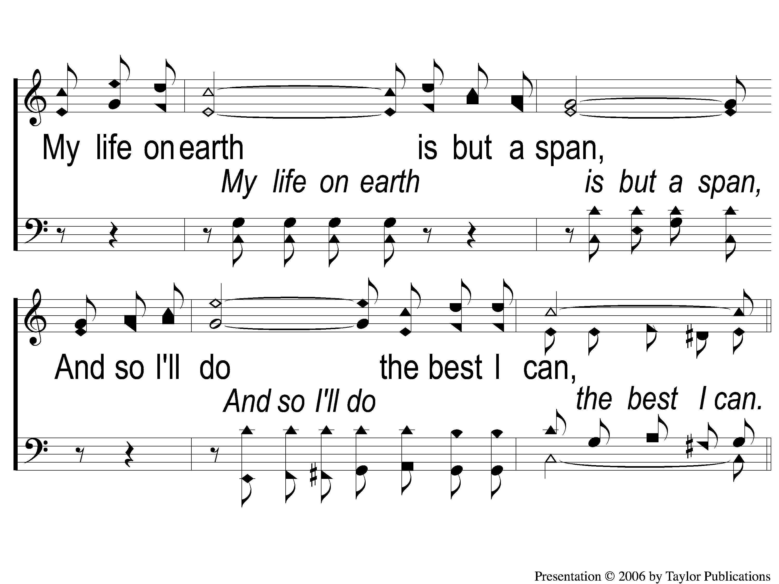
1-2 A Beautiful Life
A Beautiful Life
570

Slide 10
C-1 A Beautiful Life
A Beautiful Life
570

Slide 11
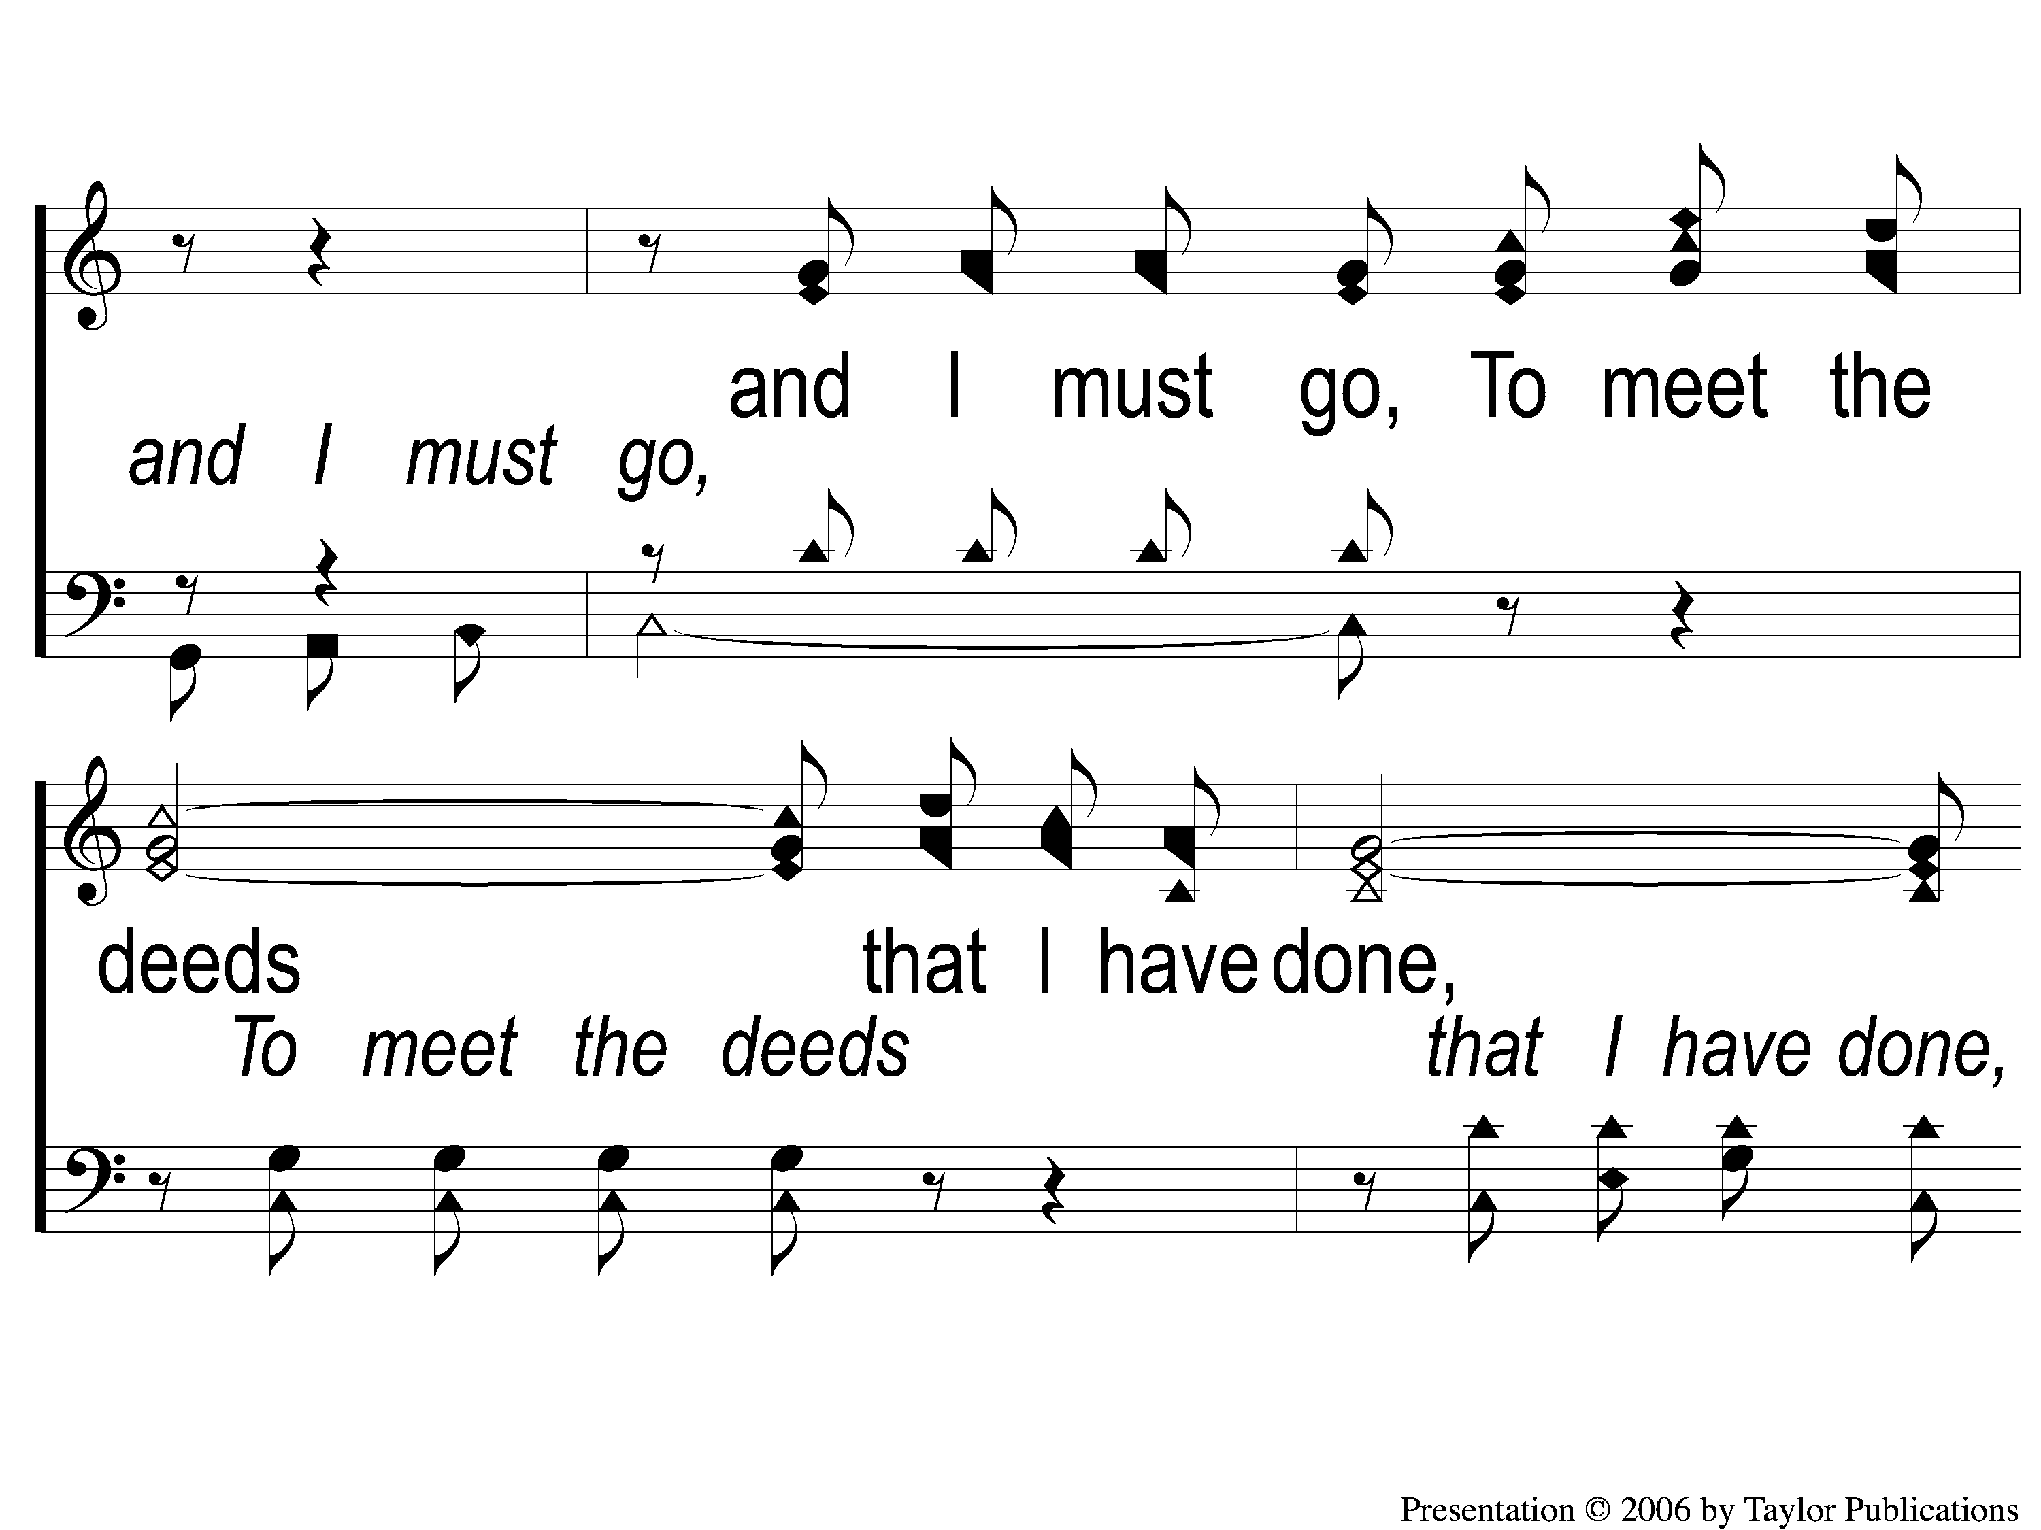
C-2 A Beautiful Life
A Beautiful Life
570

Slide 12
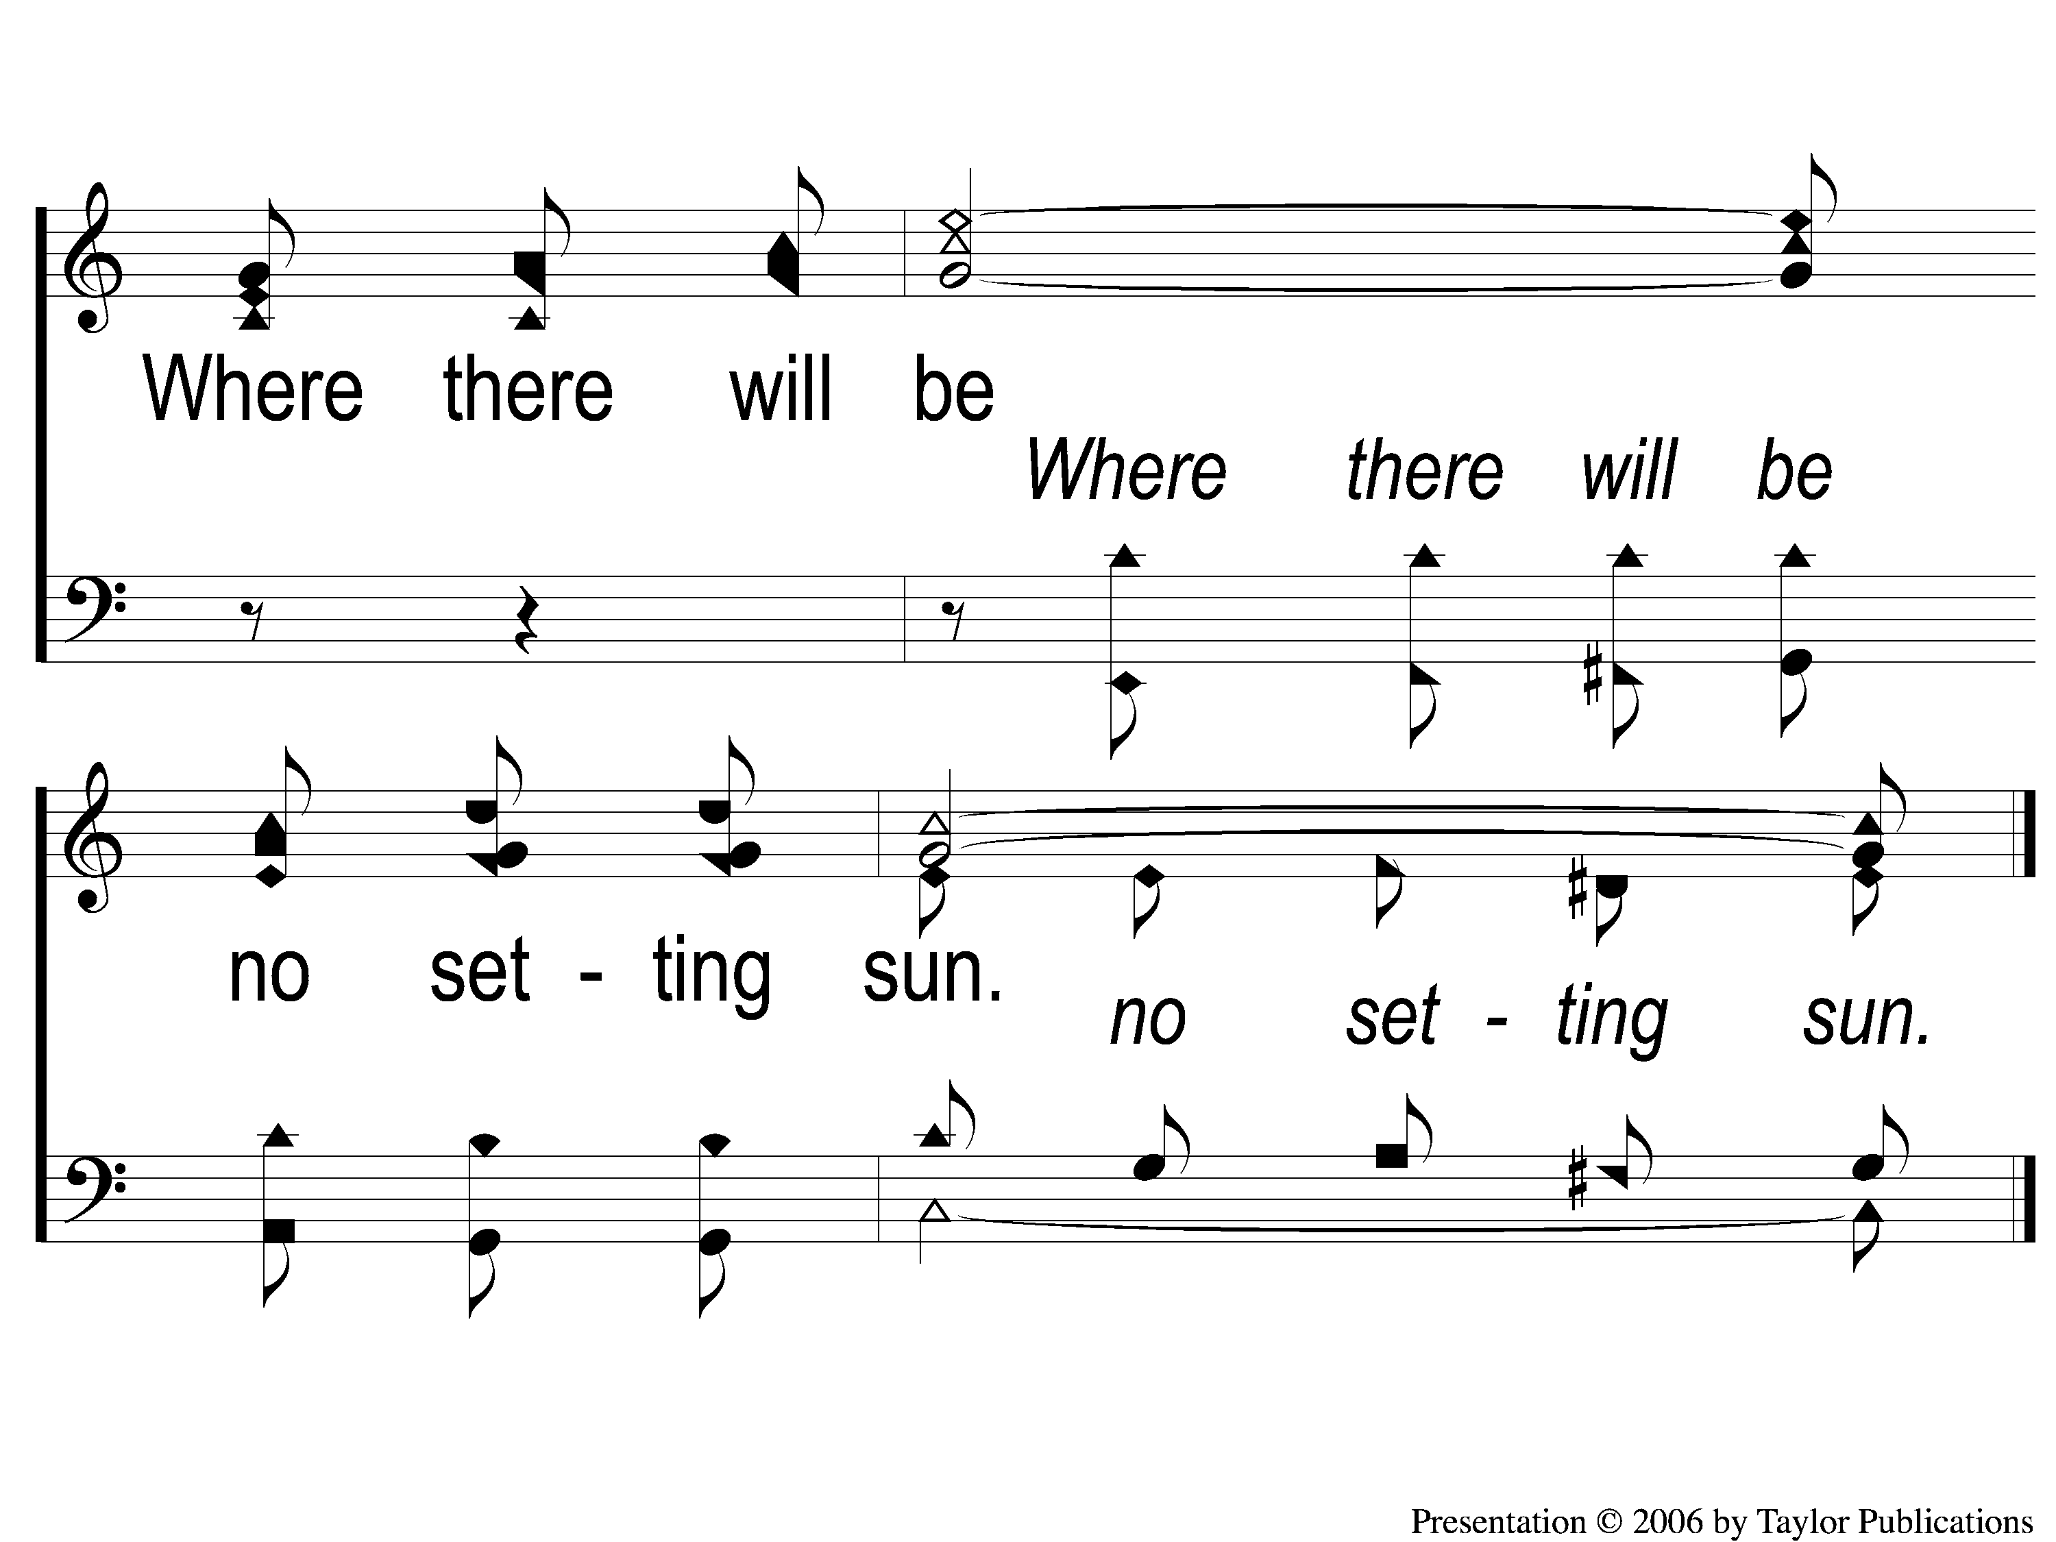
C-3 A Beautiful Life
A Beautiful Life
570

Slide 13
2-1 A Beautiful Life
A Beautiful Life
570

Slide 14
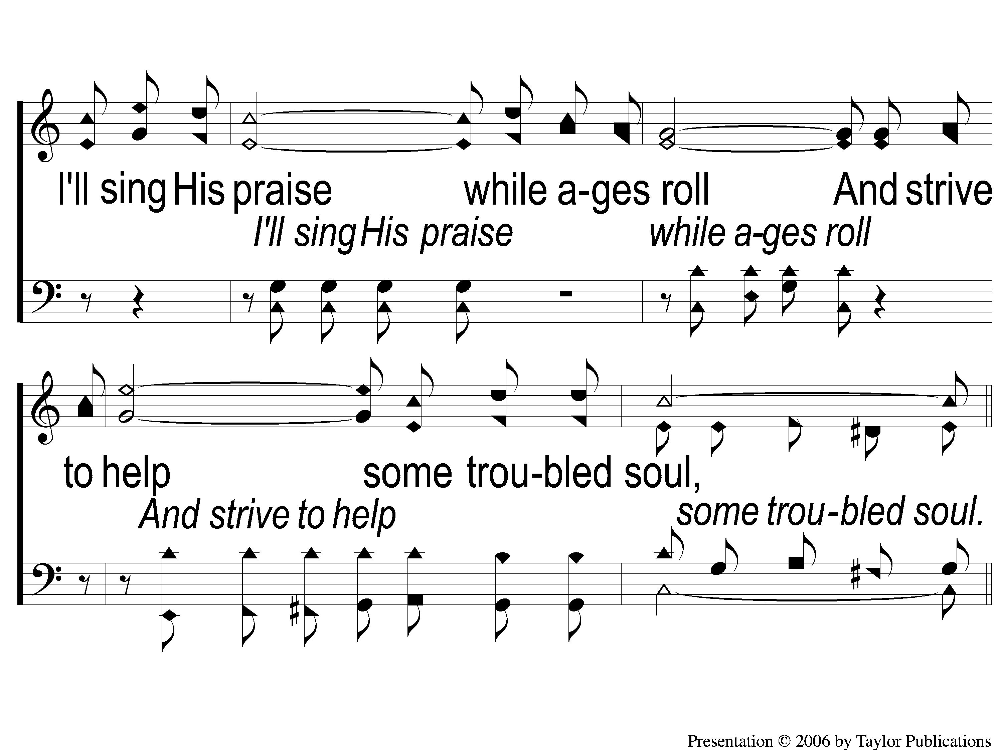
2-2 A Beautiful Life
A Beautiful Life
570

Slide 15
C-1 A Beautiful Life
A Beautiful Life
570

Slide 16
C-2 A Beautiful Life
A Beautiful Life
570

Slide 17
C-3 A Beautiful Life
A Beautiful Life
570

Slide 18
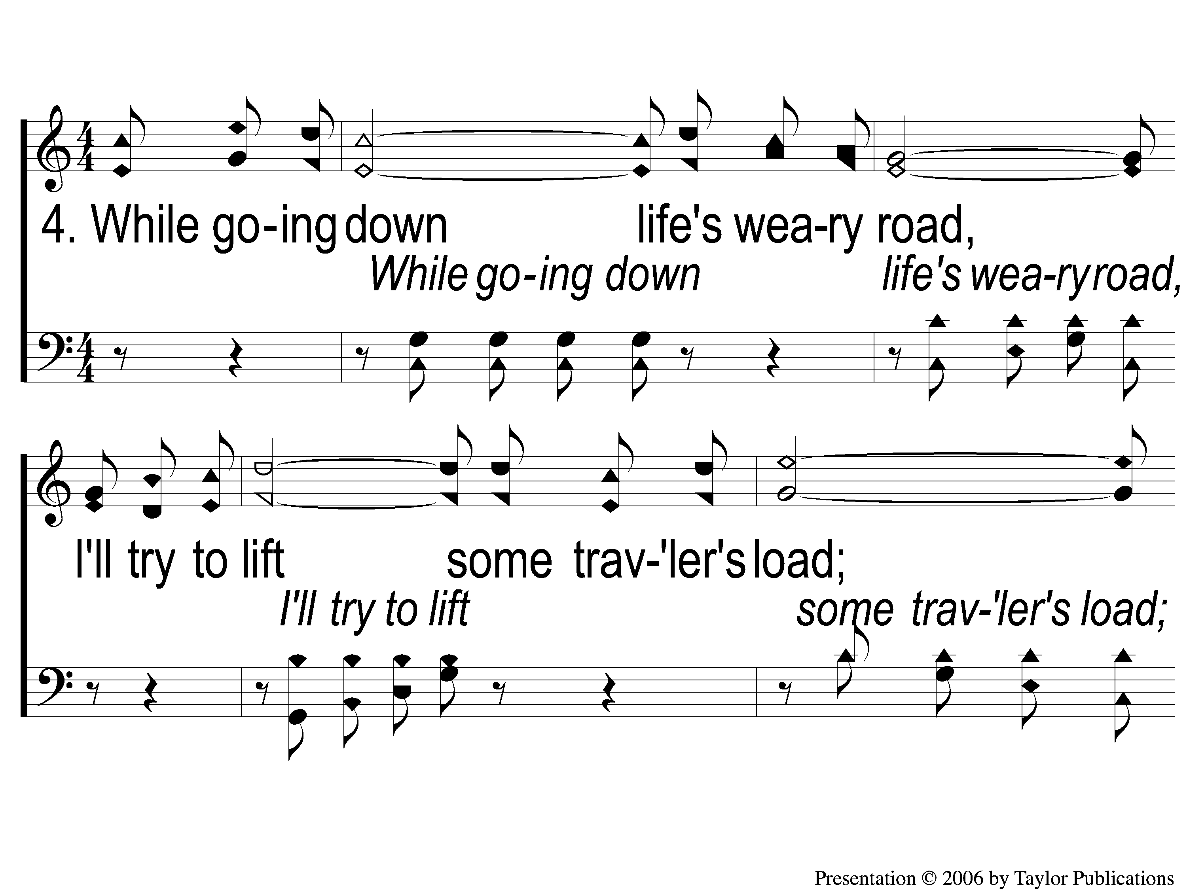
4-1 A Beautiful Life
A Beautiful Life
570

Slide 19
4-2 A Beautiful Life
A Beautiful Life
570

Slide 20
C-1 A Beautiful Life
A Beautiful Life
570

Slide 21
C-2 A Beautiful Life
A Beautiful Life
570

Slide 22
C-3 A Beautiful Life
A Beautiful Life
570

Slide 23
SONG
MY GOD & I
#601

Slide 24
1-1 My God and I
My God and I
601

Slide 25
1-2 My God and I
My God and I
601

Slide 26
1-3 My God and I
My God and I
601

Slide 27
2-1 My God and I
My God and I
601

Slide 28
2-2 My God and I
My God and I
601

Slide 29
2-3 My God and I
My God and I
601

Slide 30
3-1 My God and I
My God and I
601

Slide 31
3-2 My God and I
My God and I
601

Slide 32
3-3 My God and I
My God and I
601

Slide 33
OPENING
PRAYER

Slide 34
SONG
IF THAT ISN’T LOVE
#379

Slide 35
1-1 If That Isn’t Love
If That Isn’t Love
379

Slide 36
1-2 If That Isn’t Love
If That Isn’t Love
379

Slide 37
C-1 If That Isn’t Love
If That Isn’t Love
379

Slide 38
C-2 If That Isn’t Love
If That Isn’t Love
379

Slide 39
2-1 If That Isn’t Love
If That Isn’t Love
379

Slide 40
2-2 If That Isn’t Love
If That Isn’t Love
379

Slide 41
C-1 If That Isn’t Love
If That Isn’t Love
379

Slide 42
C-2 If That Isn’t Love
If That Isn’t Love
379

Slide 43
SONG
THE LOVE OF GOD
#122

Slide 44
1-1 The Love of God
The Love Of God
122

Slide 45
1-2 The Love of God
The Love Of God
122

Slide 46
C-1 The Love of God
The Love Of God
122

Slide 47
C-2 The Love of God
The Love Of God
122

Slide 48
C-3 The Love of God
The Love Of God
122

Slide 49
C-4 The Love of God
The Love Of God
122

Slide 50
C-5 The Love of God
The Love Of God
122

Slide 51
2-1 The Love of God
The Love Of God
122

Slide 52
2-2 The Love of God
The Love Of God
122

Slide 53
C-1 The Love of God
The Love Of God
122

Slide 54
C-2 The Love of God
The Love Of God
122

Slide 55
C-3 The Love of God
The Love Of God
122

Slide 56
C-4 The Love of God
The Love Of God
122

Slide 57
C-5 The Love of God
The Love Of God
122

Slide 58
3-1 The Love of God
The Love Of God
122

Slide 59
3-2 The Love of God
The Love Of God
122

Slide 60
C-1 The Love of God
The Love Of God
122

Slide 61
C-2 The Love of God
The Love Of God
122

Slide 62
C-3 The Love of God
The Love Of God
122

Slide 63
C-4 The Love of God
The Love Of God
122

Slide 64
C-5 The Love of God
The Love Of God
122

Slide 65
SCRIPTURE READING:
1 John 4:7-11

Slide 66
STAND
IN GOOD STEAD

Slide 67
STAND
IN THE LOVE OF GOD

Slide 68
FOUR WORDS
PHILEO
STORGE
EROS
AGAPE

Slide 69
PHILEO
φιλέω

Slide 70
PHILEO LOVE
Philadelphia

Slide 71
PHILEO LOVE
Philadelphia
= Philos + Adelphos

Slide 72
PHILEO LOVE
Philadelphia
= Philos + Adelphos
Love + Brother

Slide 73
PHILEO LOVE
Philosophy
= Philos + Sophia

Slide 74
PHILEO LOVE
Philosophy
= Philos + Sophia
Love + Wisdom

Slide 75
PHILEO LOVE
= affectionate, friendly love
Jn. 11:3, 21:15-17
1 Thess. 3:2

Slide 76
STORGE
στοργή

Slide 77
STORGE LOVE
= family love, kinship
Rom. 1:31, 12:10
2 Tim. 3:3

Slide 78
STORGE LOVE
Examples:
Abram & Lot – Gen. 12:5
Paul & Timothy – Gal. 4:19
John – 1 Jn. 2:1

Slide 79
EROS
ἔρως

Slide 80
EROS LOVE
= passionate, lustful affection
Gen. 2:20-25
Song of Solomon

Slide 81
AGAPE
ἀγάπη

Slide 82
AGAPE LOVE
= selfless, universal love for all
Rom. 5:6-8
1 Jn. 4:9-10, 19

Slide 83
HAVE YOU
SHOWN YOUR LOVE
FOR GOD?

Slide 84
INVITATION SONG
I AM RESOLVED
#948

Slide 85
1-1 I Am Resolved
I Am Resolved
948

Slide 86
1-2 I Am Resolved
I Am Resolved
948

Slide 87
C-1 I Am Resolved
I Am Resolved
948

Slide 88
C-2 I Am Resolved
I Am Resolved
948

Slide 89
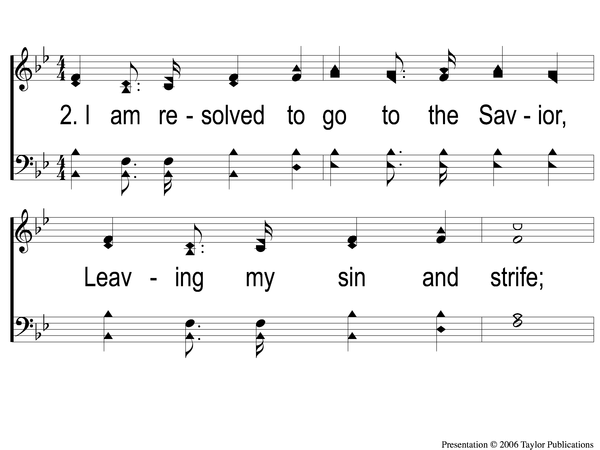
2-1 I Am Resolved
I Am Resolved
948

Slide 90
2-2 I Am Resolved
I Am Resolved
948

Slide 91
C-1 I Am Resolved
I Am Resolved
948

Slide 92
C-2 I Am Resolved
I Am Resolved
948

Slide 93
4-1 I Am Resolved
I Am Resolved
948

Slide 94
4-2 I Am Resolved
I Am Resolved
948

Slide 95
C-1 I Am Resolved
I Am Resolved
948

Slide 96
C-2 I Am Resolved
I Am Resolved
948

Slide 97
THE OFFERING
1 PETER 4:10
“As each one has received a gift, minister it to one another, as good stewards of the manifold grace of God.”

Slide 98
SONG
LEAD ME TO CALVARY
#332

Slide 99
1-1 Lead Me To Calvary
Lead Me To Calvary
332

Slide 100
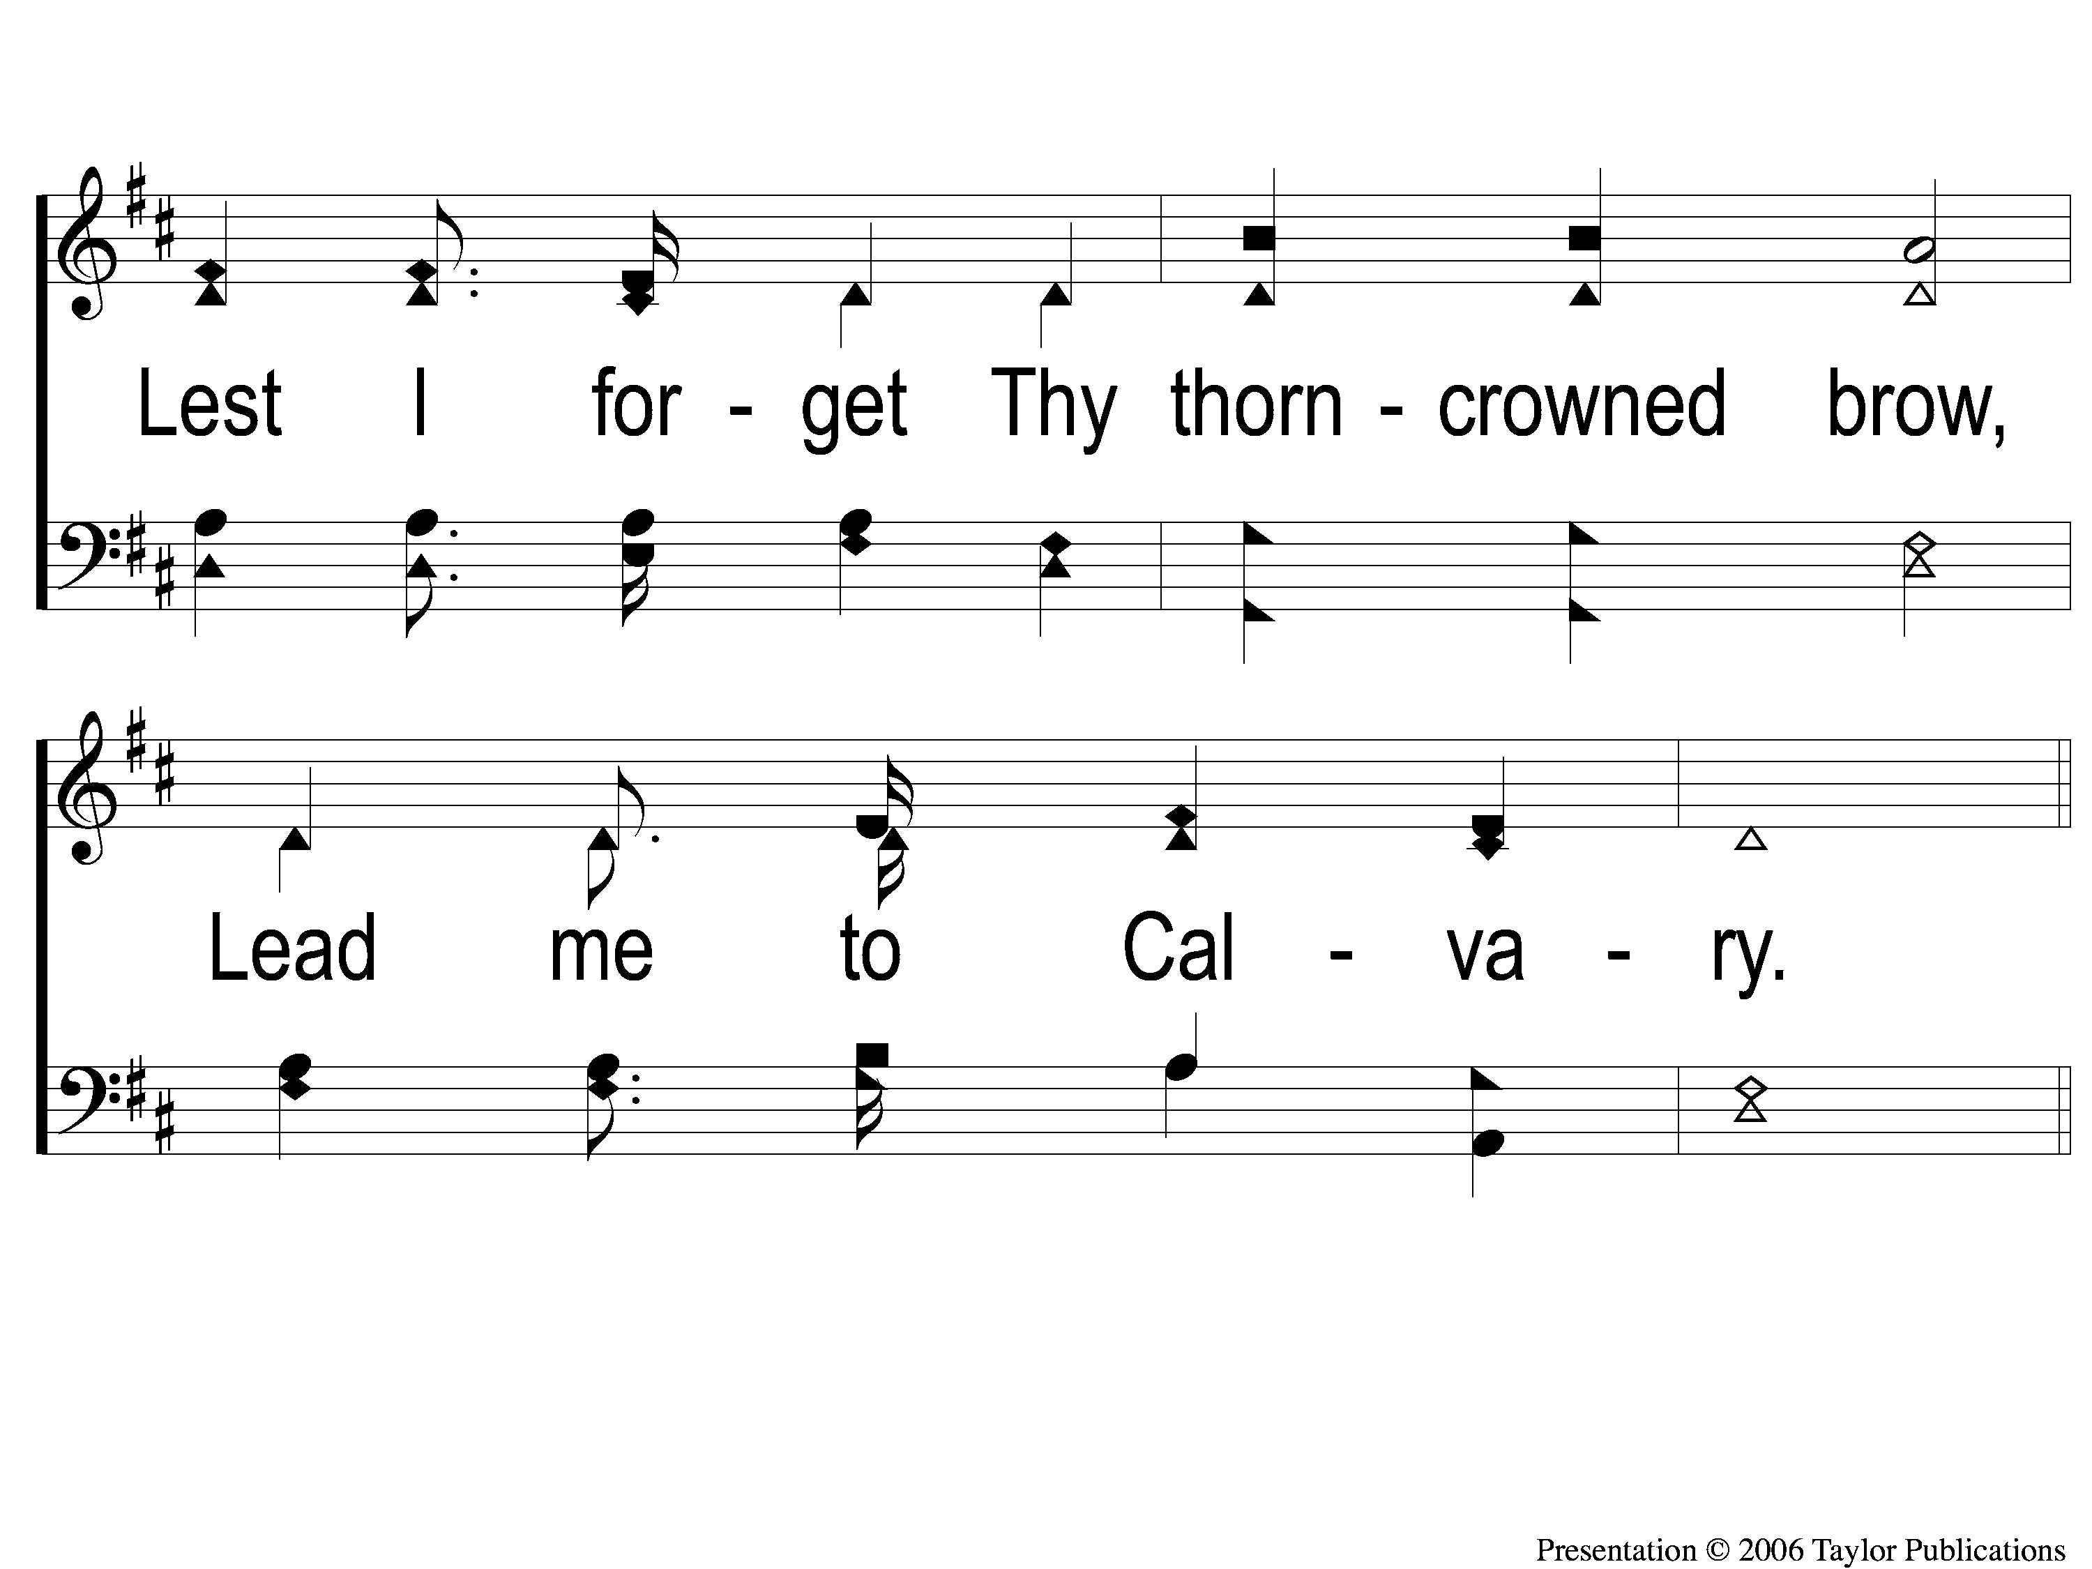
1-2 Lead Me To Calvary
Lead Me To Calvary
332

Slide 101
C-1 Lead Me To Calvary
Lead Me To Calvary
332

Slide 102
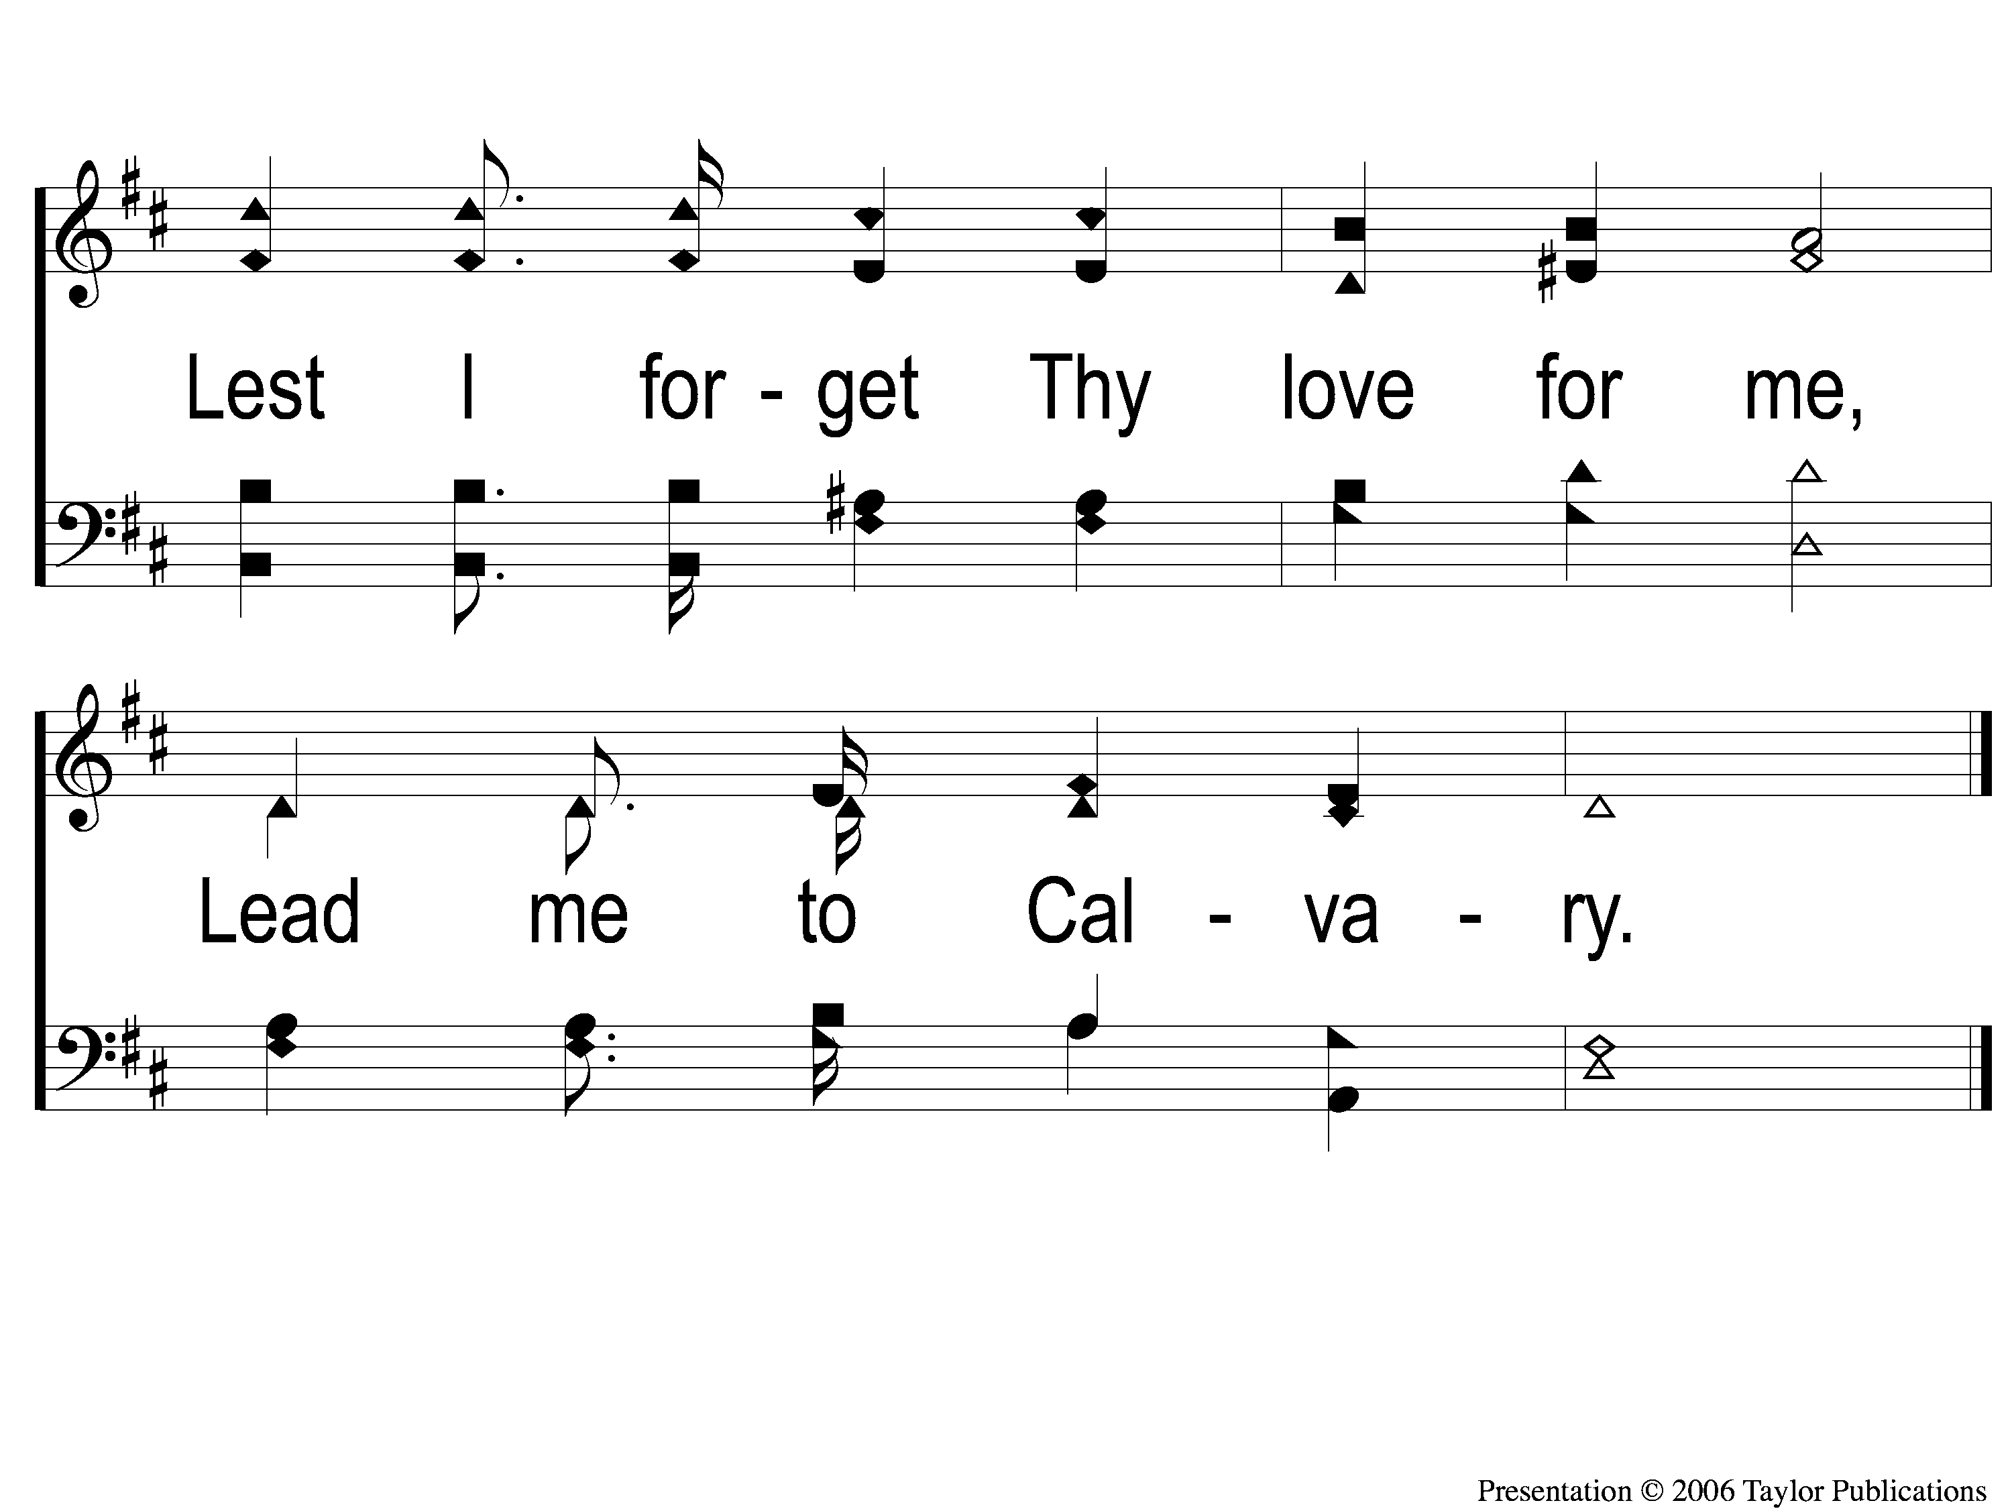
C-2 Lead Me To Calvary
Lead Me To Calvary
332

Slide 103
2-1 Lead Me To Calvary
Lead Me To Calvary
332

Slide 104
2-2 Lead Me To Calvary
Lead Me To Calvary
332

Slide 105
C-1 Lead Me To Calvary
Lead Me To Calvary
332

Slide 106
C-2 Lead Me To Calvary
Lead Me To Calvary
332

Slide 107
3-1 Lead Me To Calvary
Lead Me To Calvary
332

Slide 108
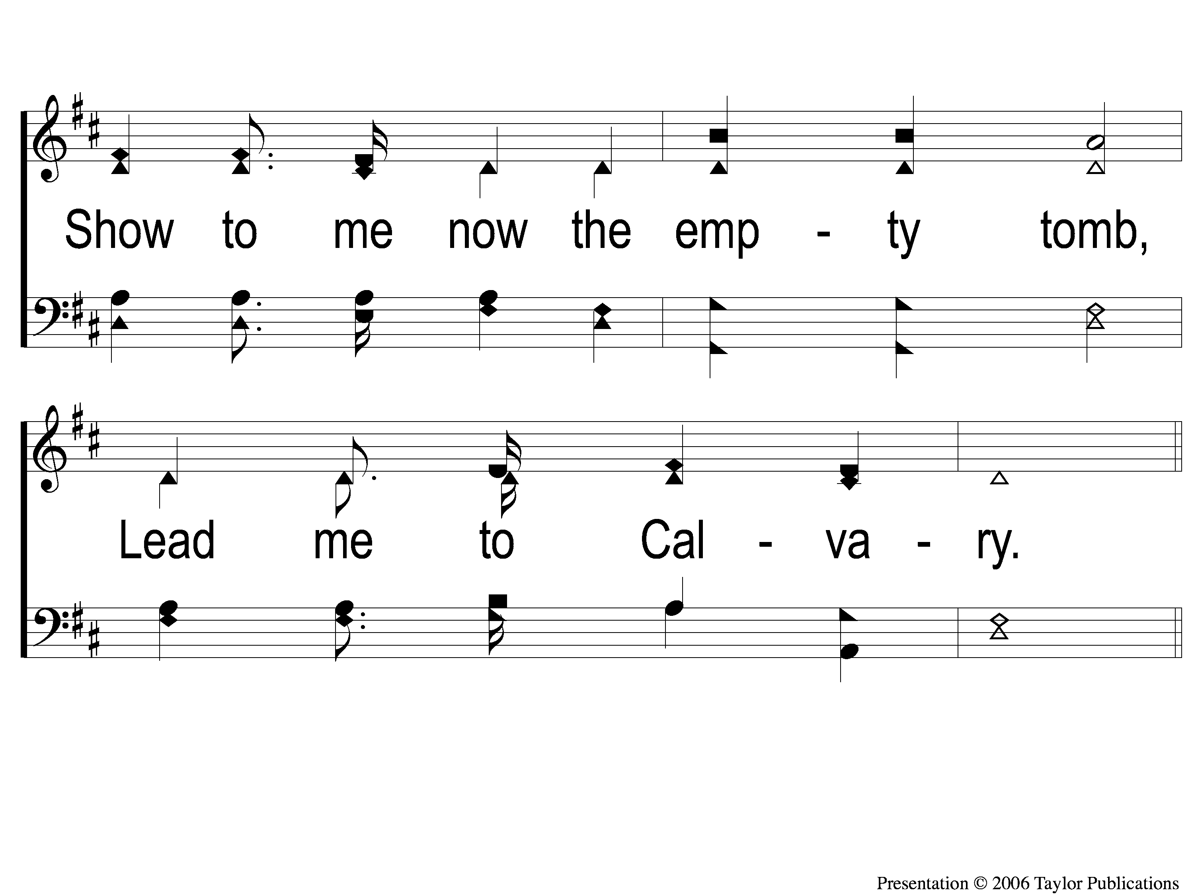
3-2 Lead Me To Calvary
Lead Me To Calvary
332

Slide 109
C-1 Lead Me To Calvary
Lead Me To Calvary
332

Slide 110
C-2 Lead Me To Calvary
Lead Me To Calvary
332

Slide 111
4-1 Lead Me To Calvary
Lead Me To Calvary
332

Slide 112
4-2 Lead Me To Calvary
Lead Me To Calvary
332

Slide 113
C-1 Lead Me To Calvary
Lead Me To Calvary
332

Slide 114
C-2 Lead Me To Calvary
Lead Me To Calvary
332

Slide 115
THE UNLEAVENED BREAD
EPHESIANS 5:11-13
“Therefore remember that you, once Gentiles in the flesh—who are called Uncircumcision by what is called the Circumcision made in the flesh by hands— that at that time you were without Christ, being aliens from the commonwealth of Israel and strangers from the covenants of promise, having no hope and without God in the world. But now in Christ Jesus you who once were far off have been brought near by the blood of Christ.”

Slide 116
THE FRUIT OF THE VINE
EPHESIANS 1:7-10
“In Him we have redemption through His blood, the forgiveness of sins, according to the riches of His grace which He made to abound toward us in all wisdom and prudence, having made known to us the mystery of His will, according to His good pleasure which He purposed in Himself, that in the dispensation of the fullness of the times He might gather together in one pall things in Christ, both which are in heaven and which are on earth—in Him.”

Slide 117
CLOSING
PRAYER

Slide 118
SONG
THE GREATEST COMMANDS
#448

Slide 119
1-1 The Greatest Commands-SFP
The Greatest Commands
448

Slide 120
1-2 The Greatest Commands-SFP
The Greatest Commands
448

Slide 121
1-3 The Greatest Commands-SFP
The Greatest Commands
448

Slide 122
1-4 The Greatest Commands-SFP
The Greatest Commands
448

Slide 123
2-1 The Greatest Commands-SFP
The Greatest Commands
448

Slide 124
2-2 The Greatest Commands-SFP
The Greatest Commands
448

Slide 125
2-3 The Greatest Commands-SFP
The Greatest Commands
448

Slide 126
2-4 The Greatest Commands-SFP
The Greatest Commands
448

Slide 127
3-1 The Greatest Commands-SFP
The Greatest Commands
448

Slide 128
3-2 The Greatest Commands-SFP
The Greatest Commands
448

Slide 129
3-3 The Greatest Commands-SFP
The Greatest Commands
448

Slide 130
3-4 The Greatest Commands-SFP
The Greatest Commands
448

Slide 131
4-1 The Greatest Commands-SFP
The Greatest Commands
448

Slide 132
4-2 The Greatest Commands-SFP
The Greatest Commands
448

Slide 133
4-3 The Greatest Commands-SFP
The Greatest Commands
448

Slide 134
4-4 The Greatest Commands-SFP
The Greatest Commands
448

Slide 135
4-1 The Greatest Commands-SFP
The Greatest Commands
448

Slide 136
4-2 The Greatest Commands-SFP
The Greatest Commands
448

Slide 137
4-3 The Greatest Commands-SFP
The Greatest Commands
448

Slide 138
4-4 The Greatest Commands-SFP
The Greatest Commands
448

Slide 139
JOIN US IN THE MPB FOR A
FELLOWSHIP MEAL
& DEVOTIONAL TO FOLLOW

