Slide 1
1-1 A Wonderful Savior(Crosby)
A Wonderful Savior
508

Slide 2
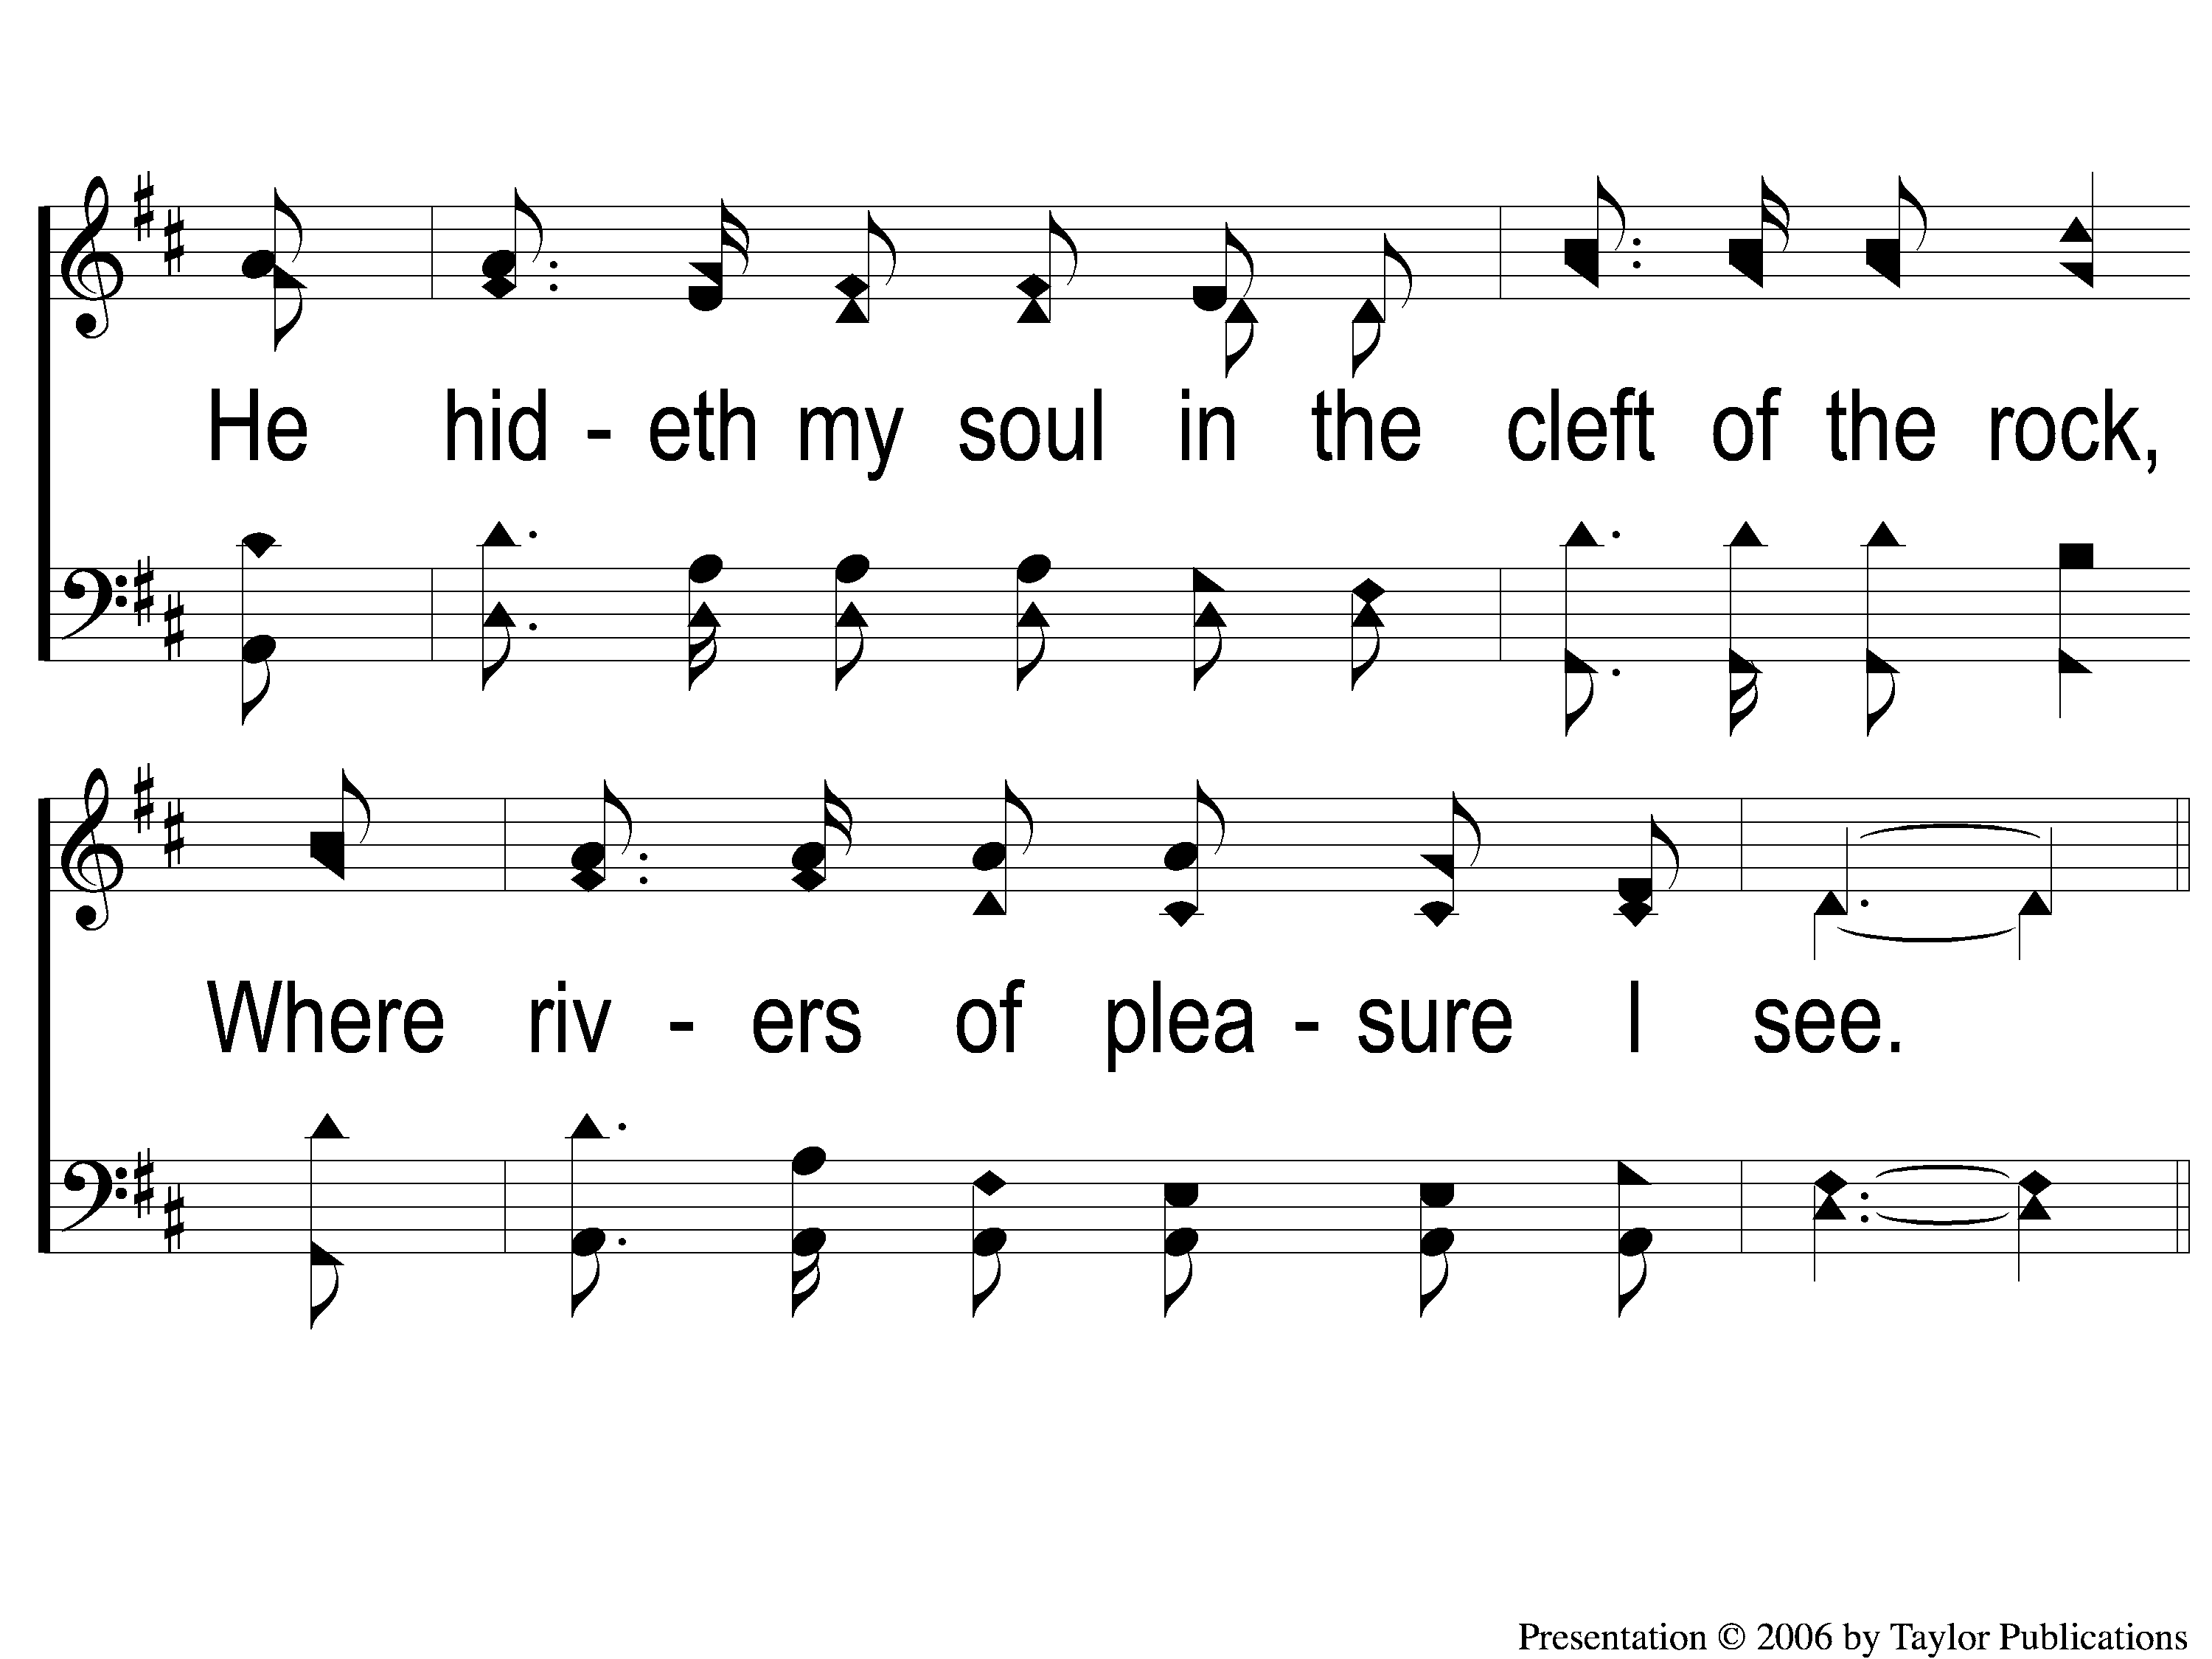
1-2 A Wonderful Savior(Crosby)
A Wonderful Savior
508

Slide 3
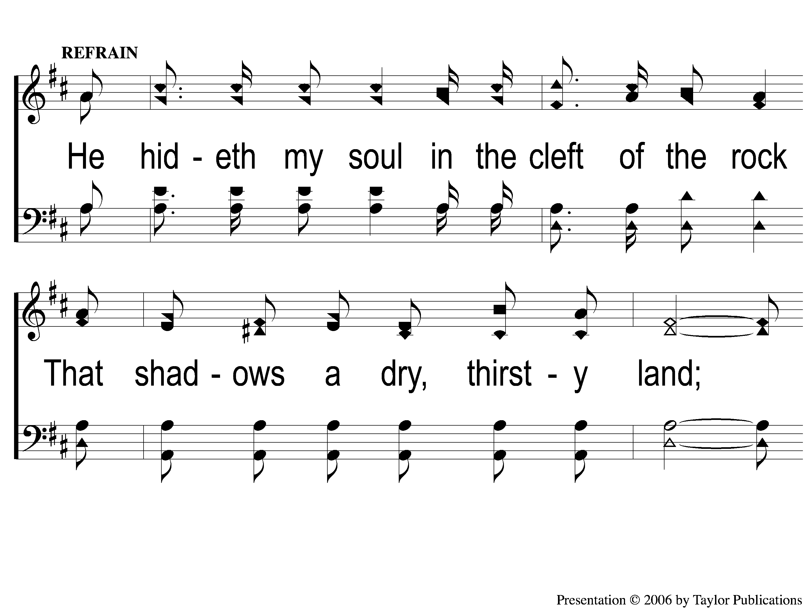
C-1 A Wonderful Savior(Crosby)
A Wonderful Savior
508

Slide 4
C-2 A Wonderful Savior(Crosby)
A Wonderful Savior
508

Slide 5
C-3 A Wonderful Savior(Crosby)
A Wonderful Savior
508

Slide 6
2-1 A Wonderful Savior(Crosby)
A Wonderful Savior
508

Slide 7
2-2 A Wonderful Savior(Crosby)
A Wonderful Savior
508

Slide 8
C-1 A Wonderful Savior(Crosby)
A Wonderful Savior
508

Slide 9
C-2 A Wonderful Savior(Crosby)
A Wonderful Savior
508

Slide 10
C-3 A Wonderful Savior(Crosby)
A Wonderful Savior
508

Slide 11
RESTORE REBUILD RENEW
welcome
we are glad to
Have you with us
IN 2022
WHEELER
CHURCH
OF
CHRIST

Slide 12
Song:
Unto Thee, O Lord
#794

Slide 13
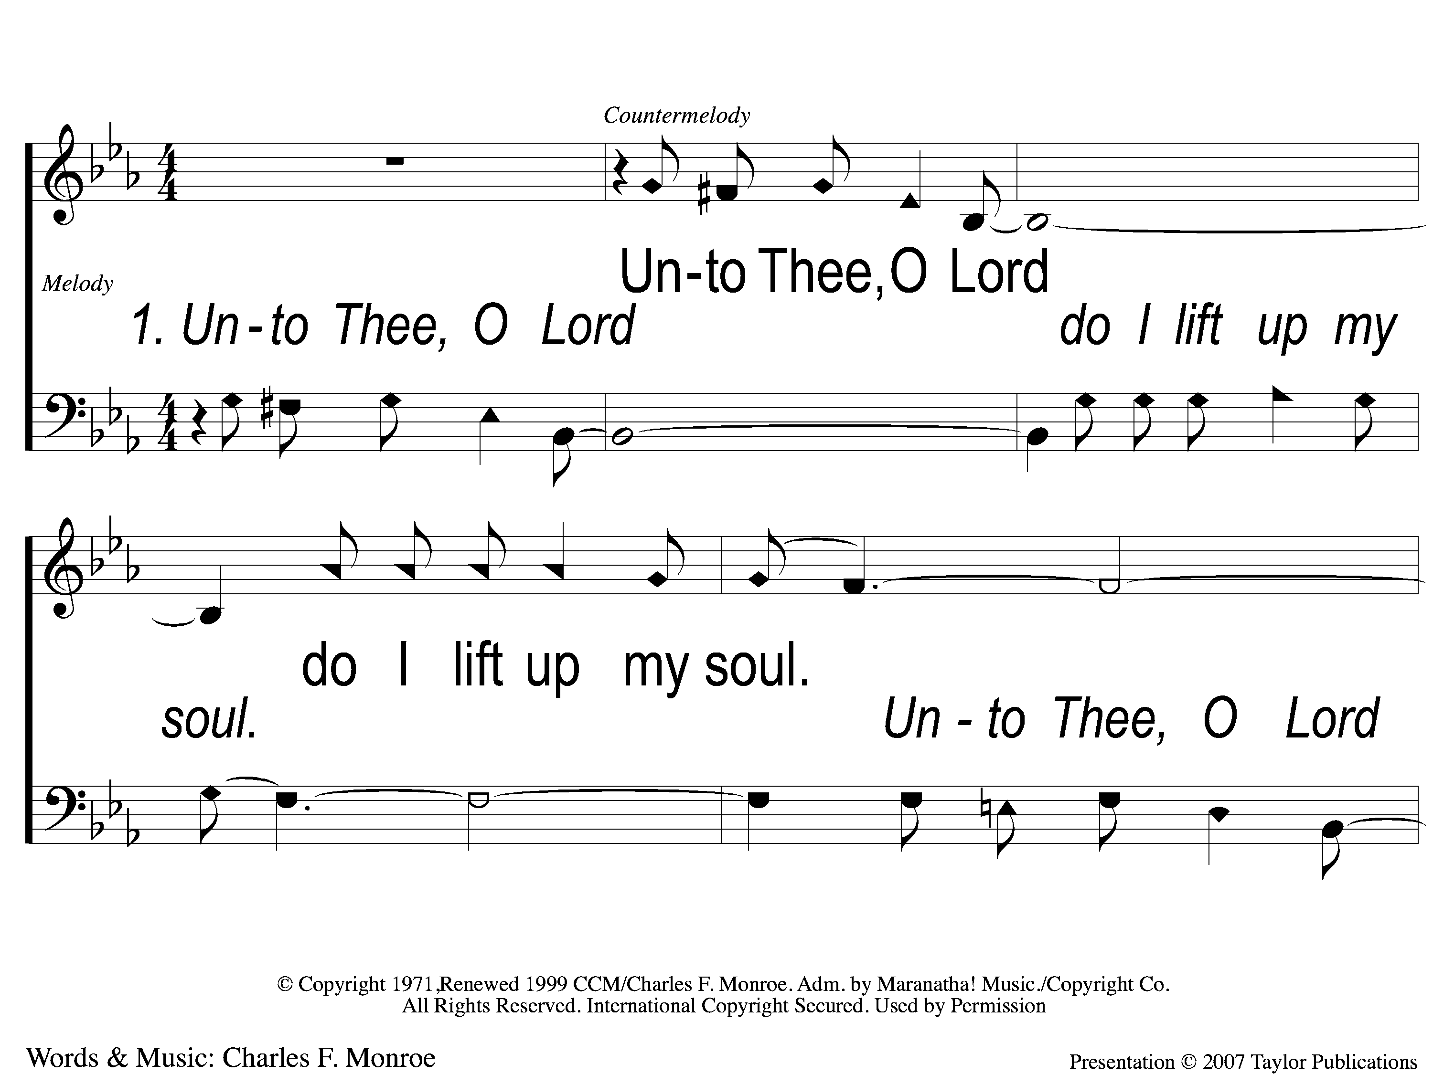
1-1 Unto Thee O Lord
Unto to Thee O Lord
794

Slide 14
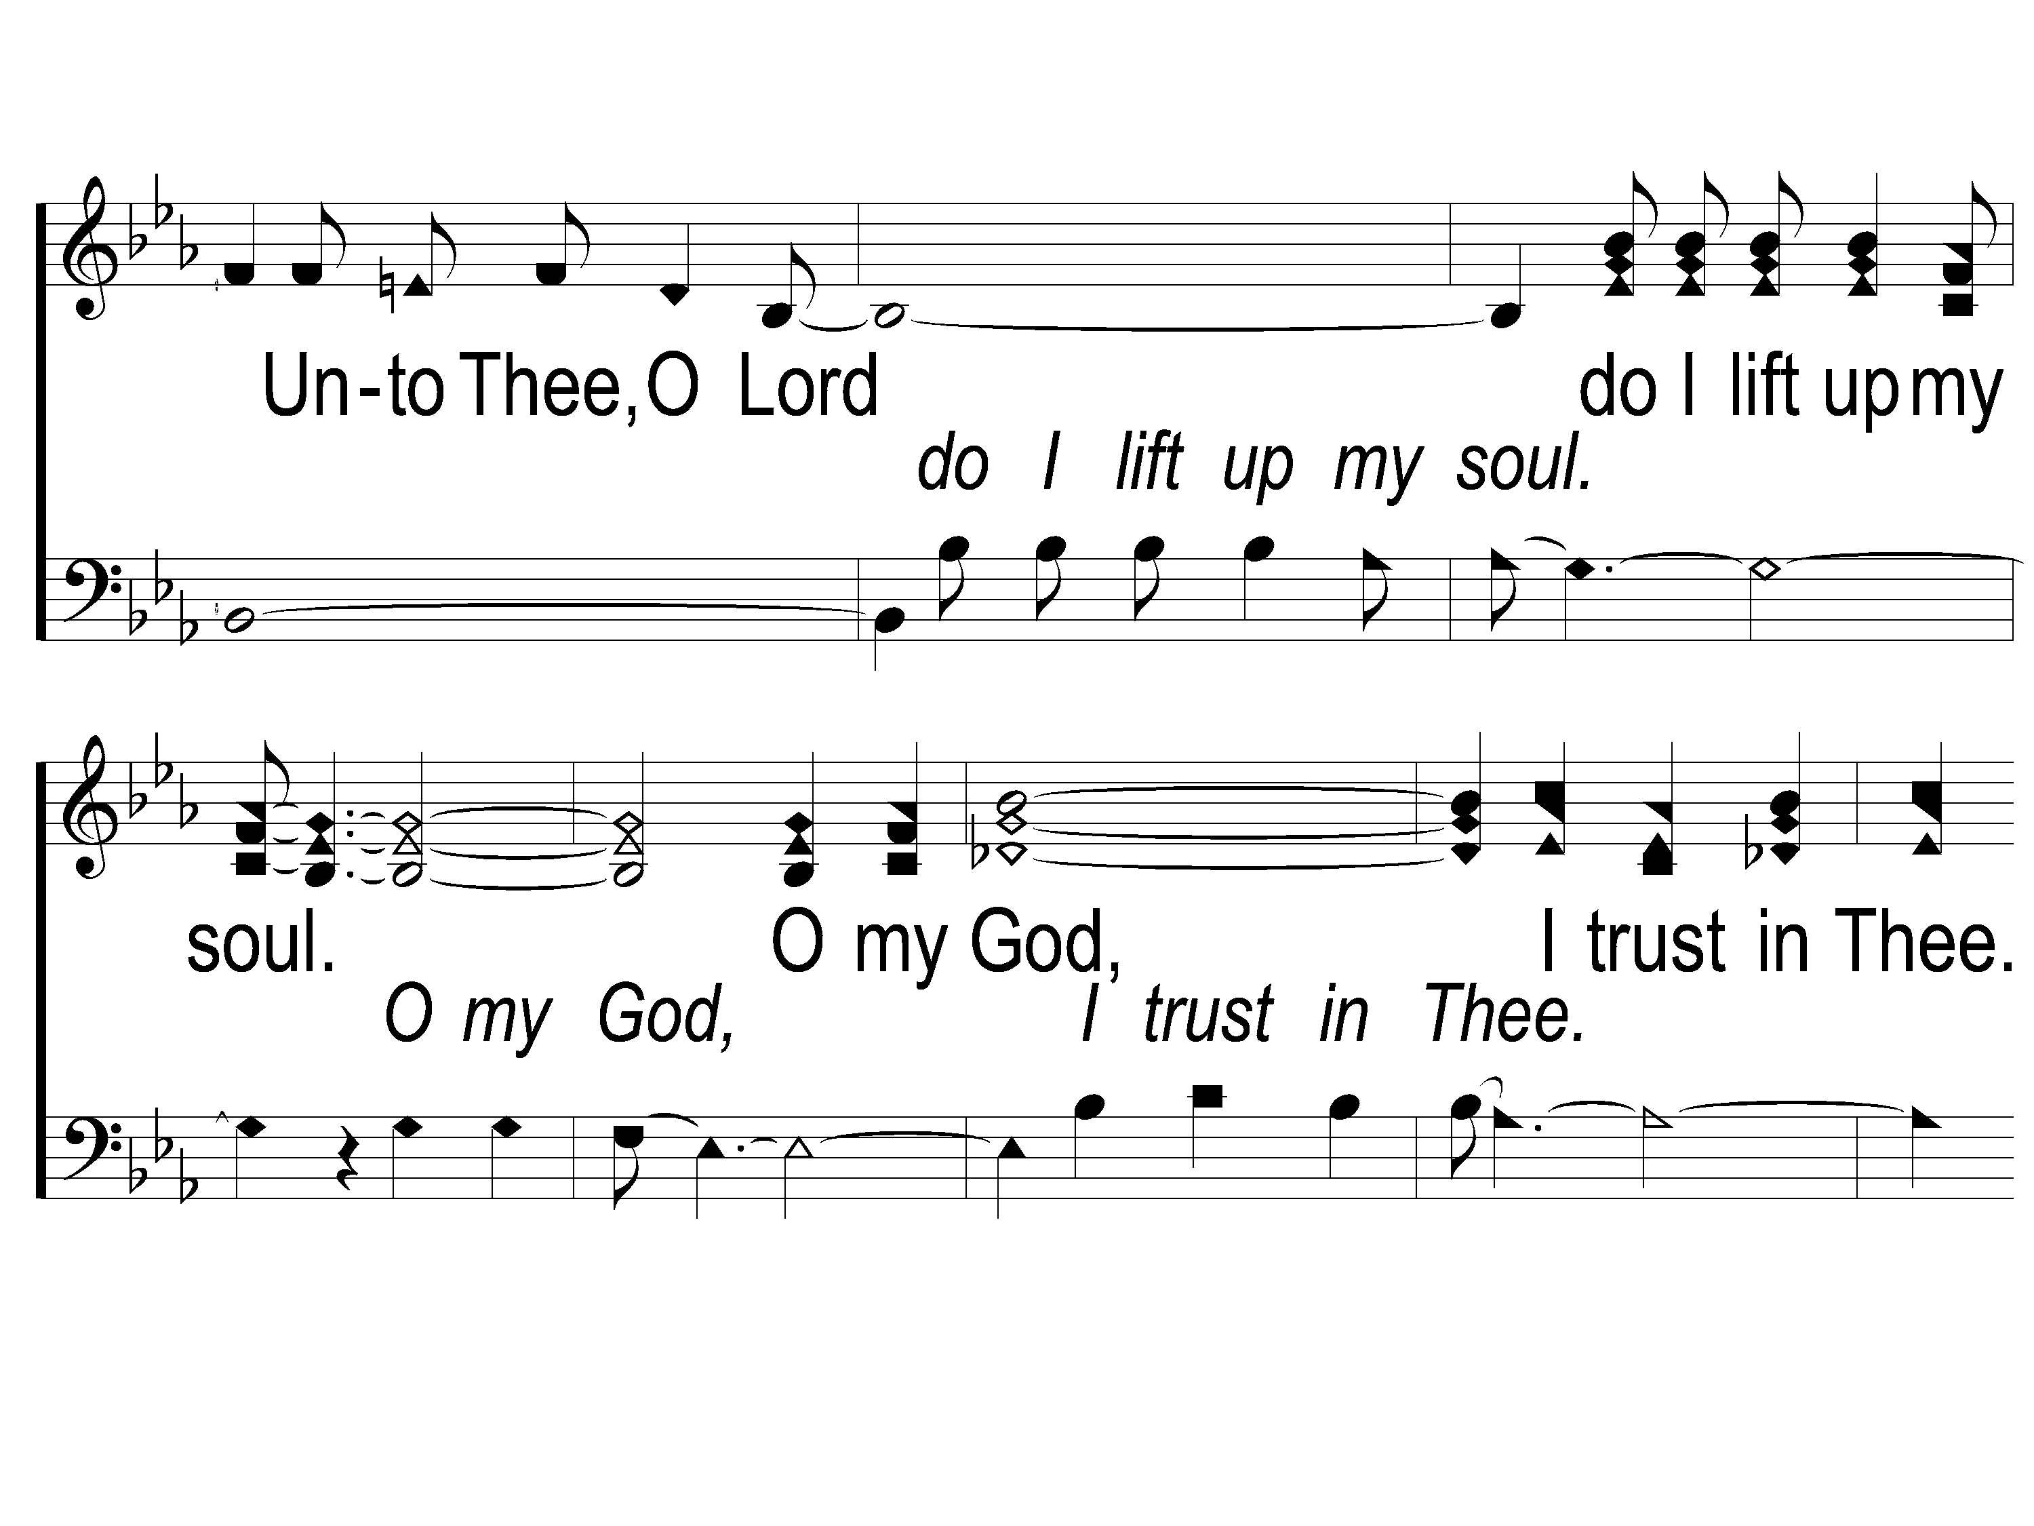
1-2 Unto Thee O Lord
Unto to Thee O Lord
794

Slide 15
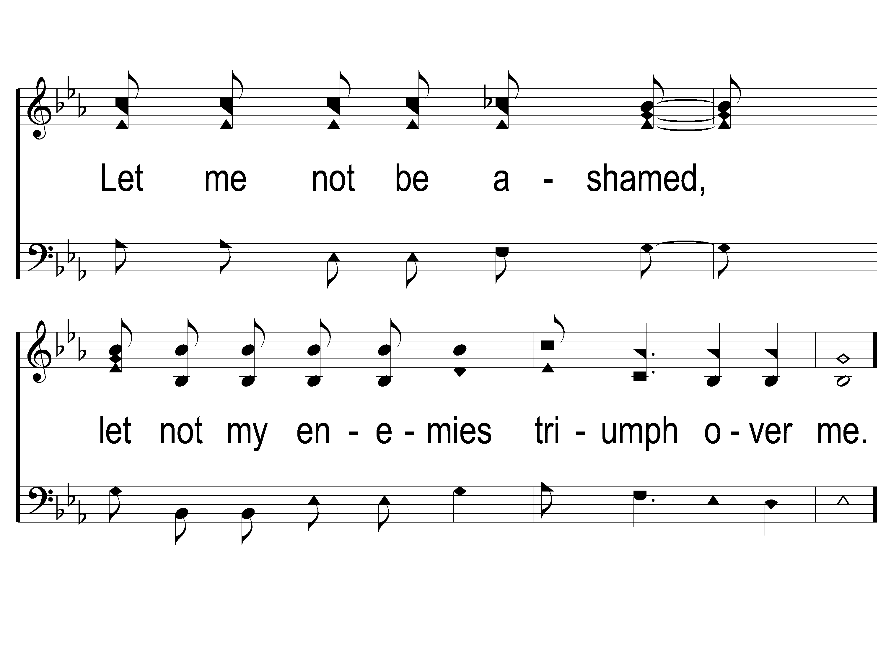
1-3 Unto Thee O Lord
Unto to Thee O Lord
794

Slide 16
2-1 Unto Thee O Lord
Unto to Thee O Lord
794

Slide 17
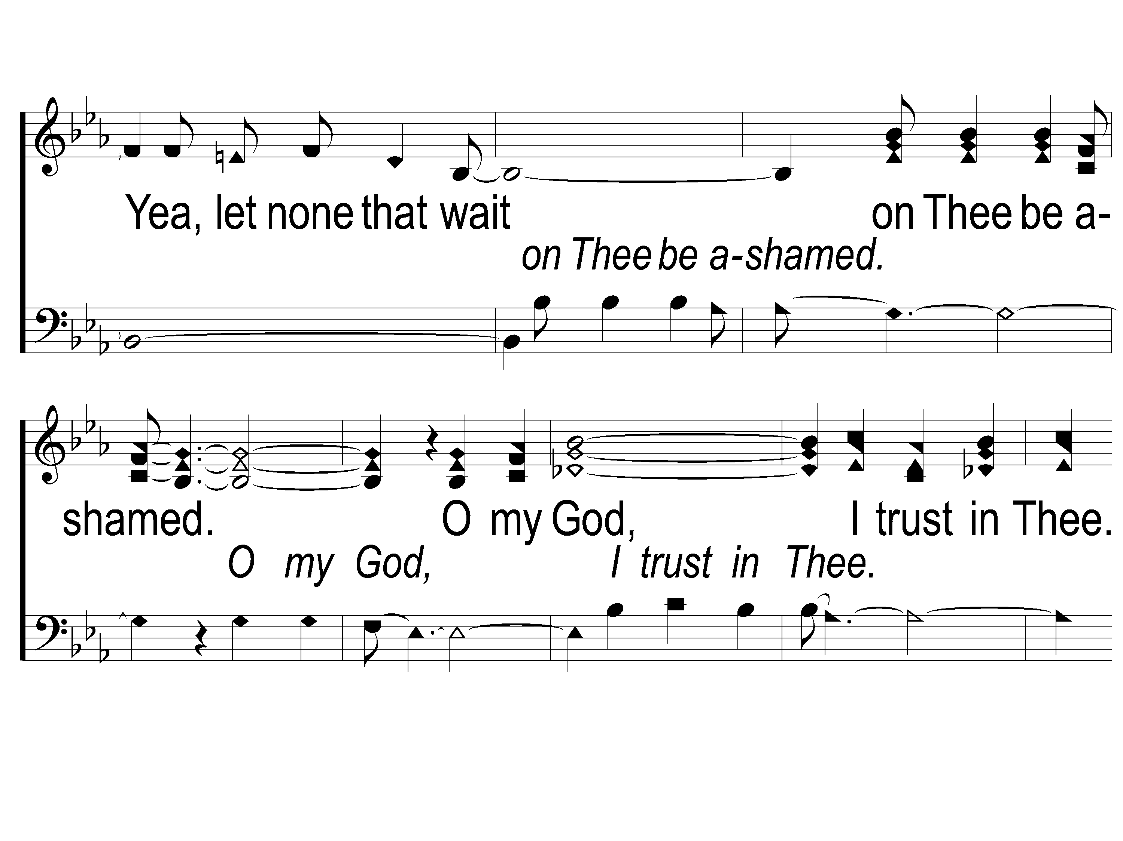
2-2 Unto Thee O Lord
Unto to Thee O Lord
794

Slide 18
2-3 Unto Thee O Lord
Unto to Thee O Lord
794

Slide 19
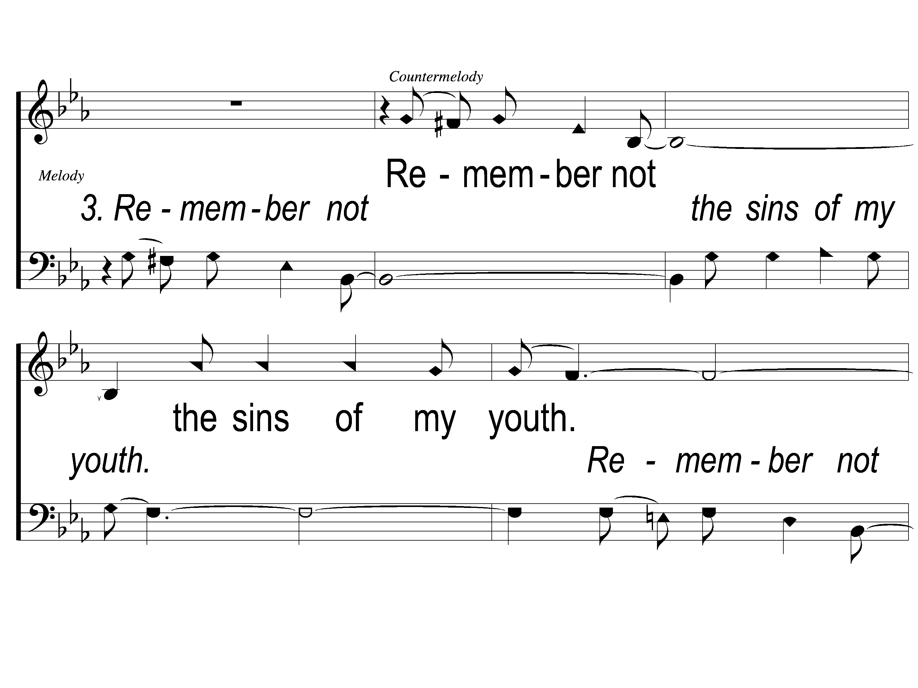
3-1 Unto Thee O Lord
Unto to Thee O Lord
794

Slide 20
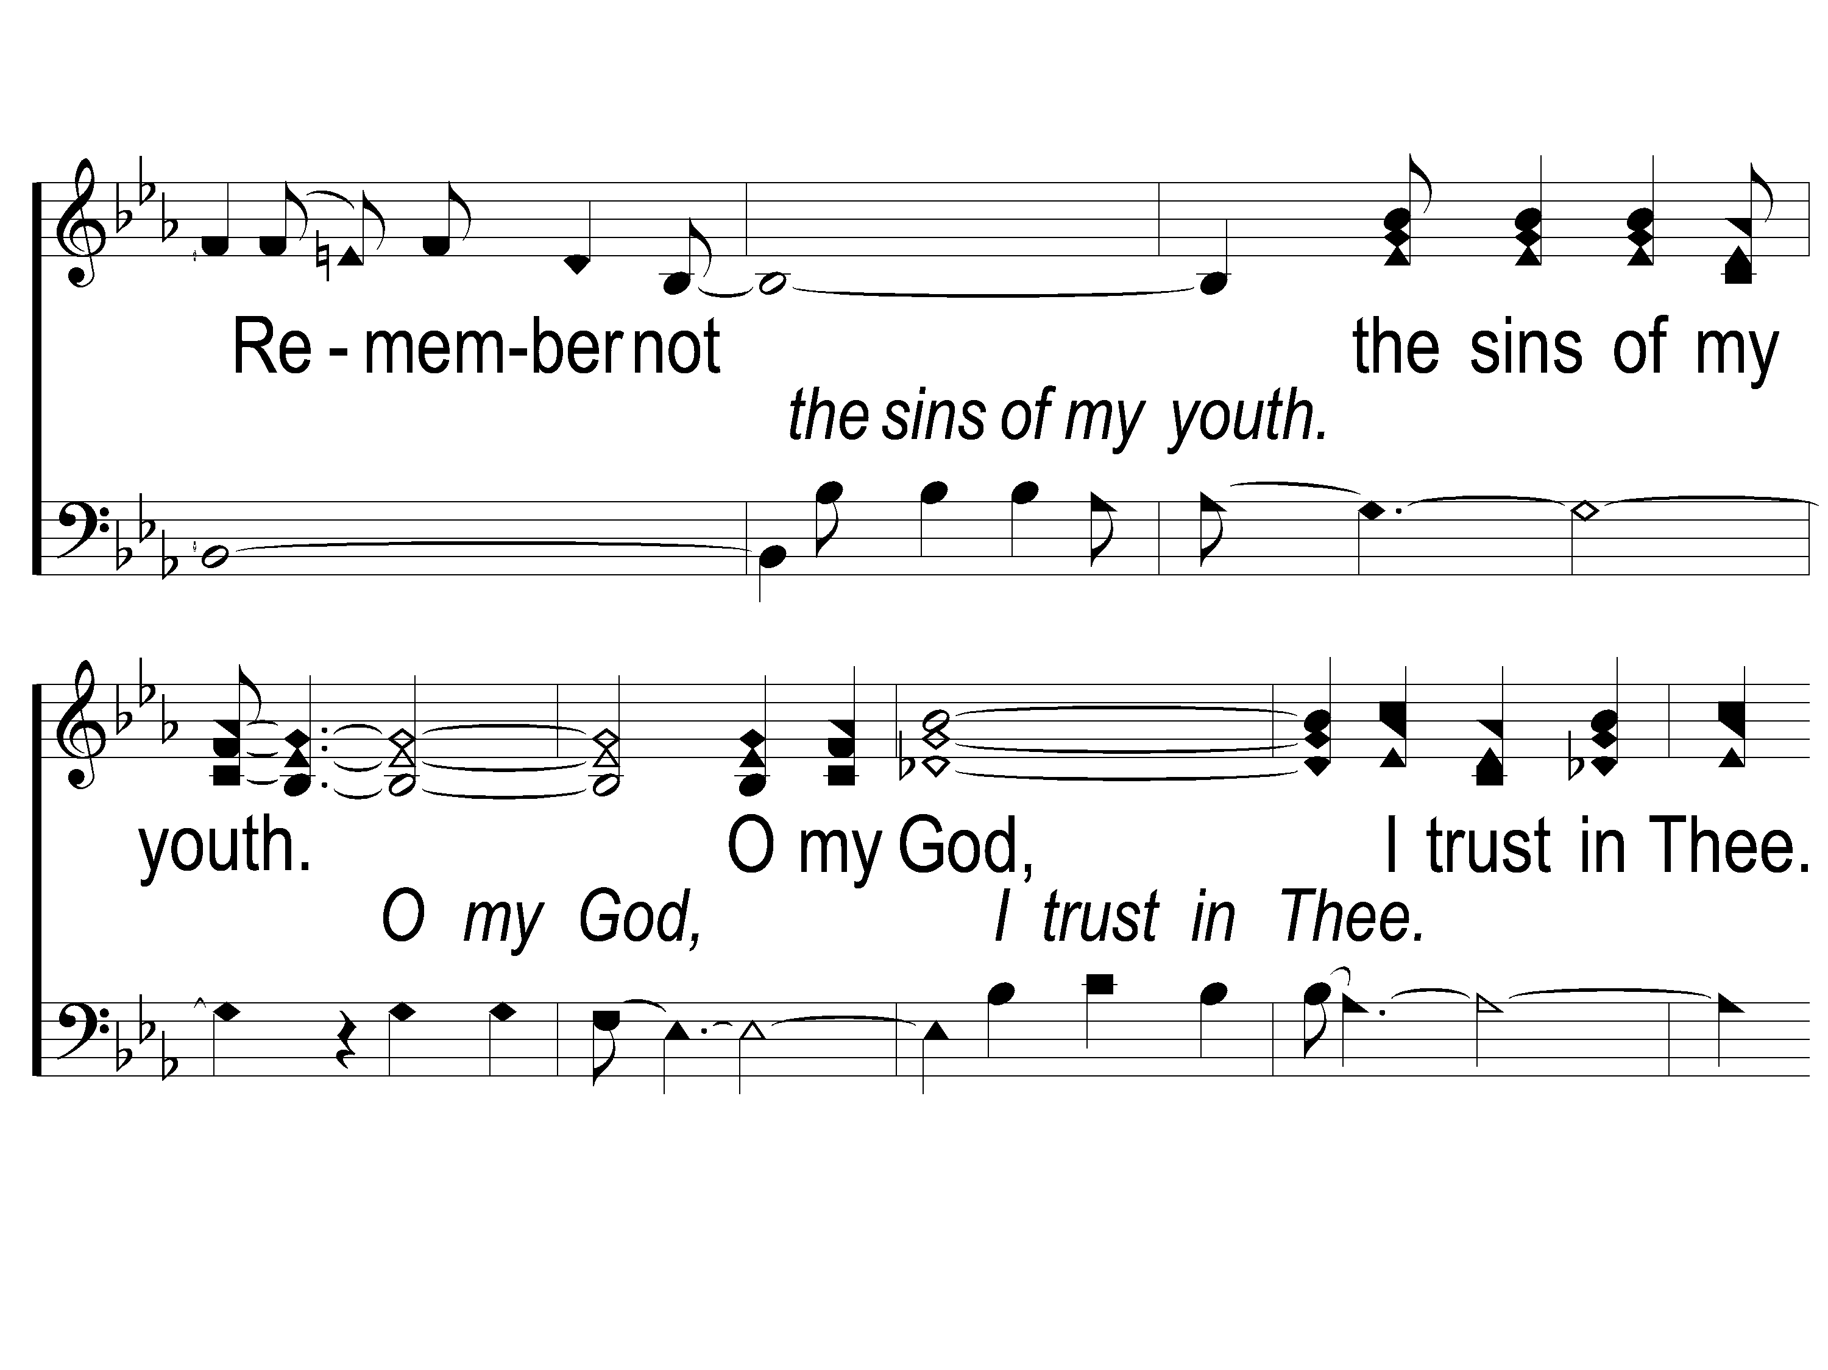
3-2 Unto Thee O Lord
Unto to Thee O Lord
794

Slide 21
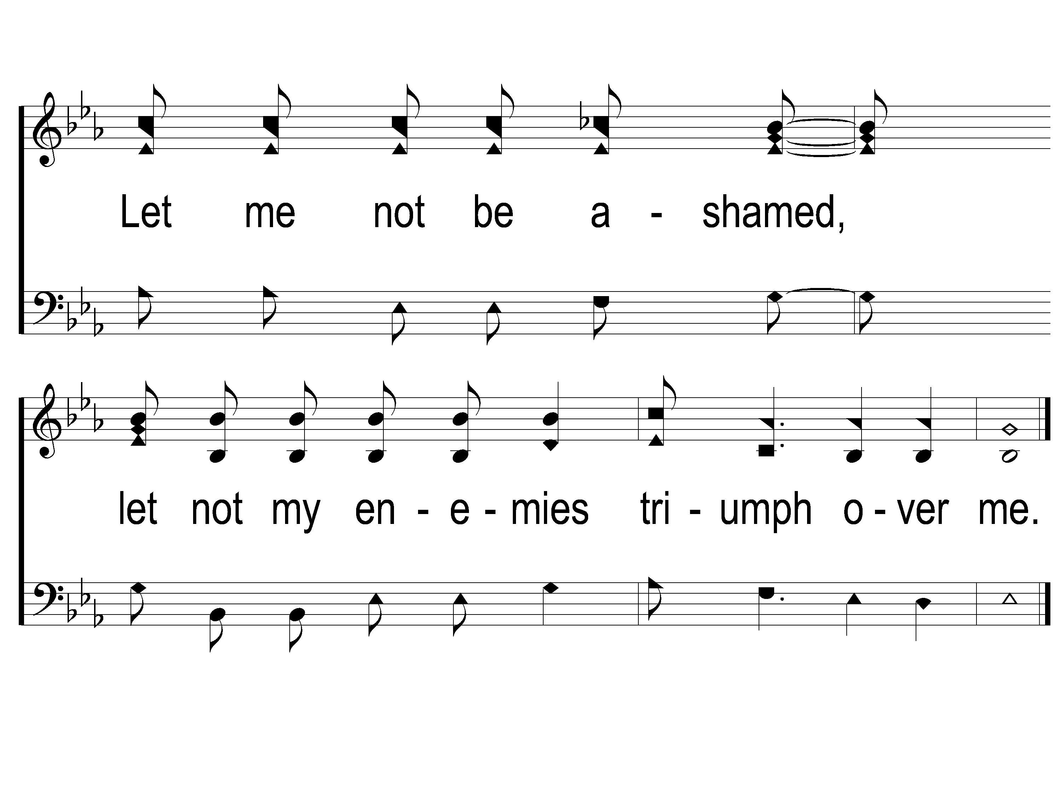
3-3 Unto Thee O Lord
Unto to Thee O Lord
794

Slide 22
Song:
On Bended Knee
#791

Slide 23
1-1 On Bended Knee
On Bended Knee
791

Slide 24
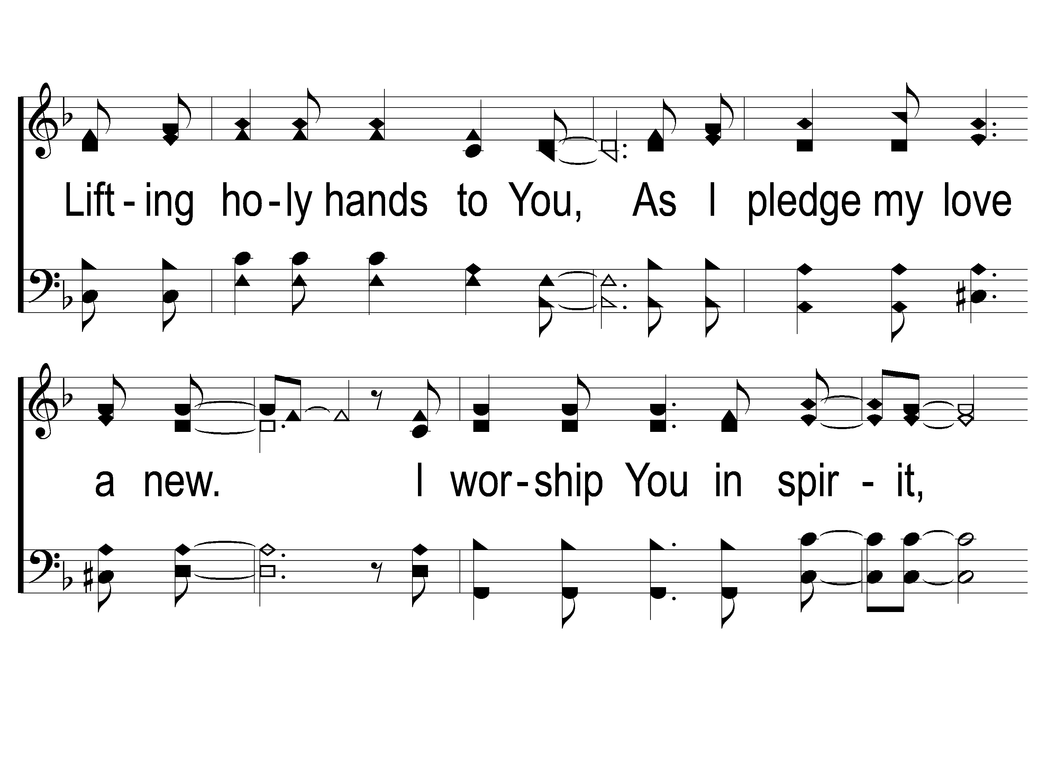
1-2 On Bended Knee
On Bended Knee
791

Slide 25
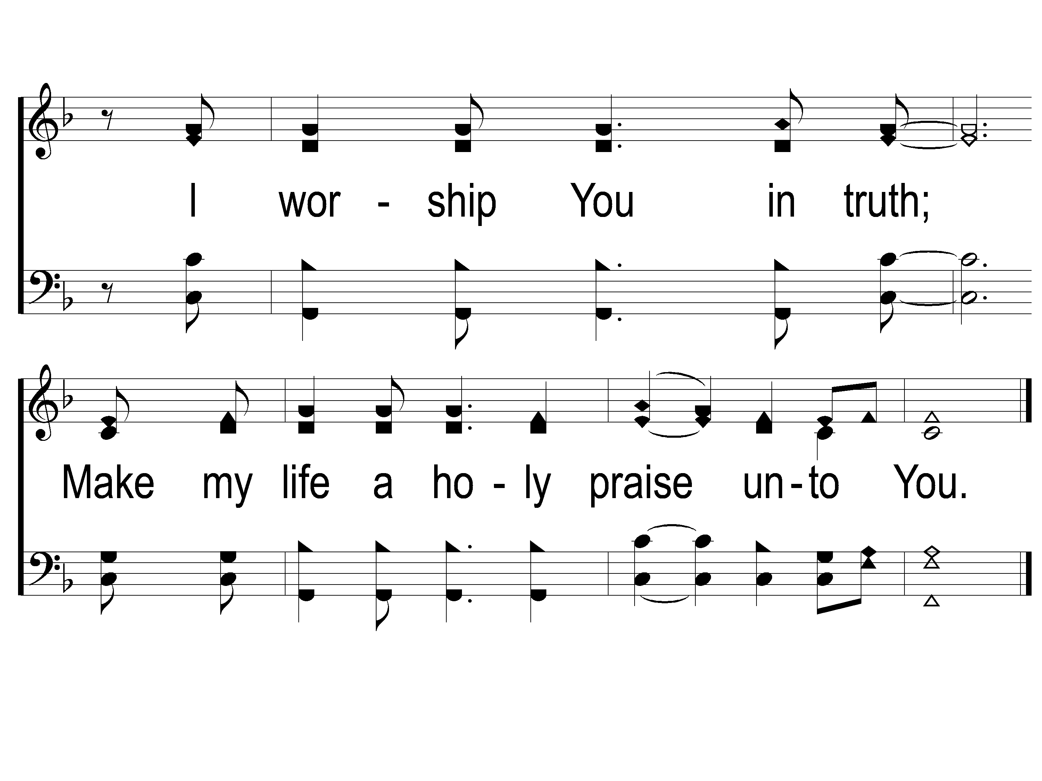
1-3 On Bended Knee
On Bended Knee
791

Slide 26
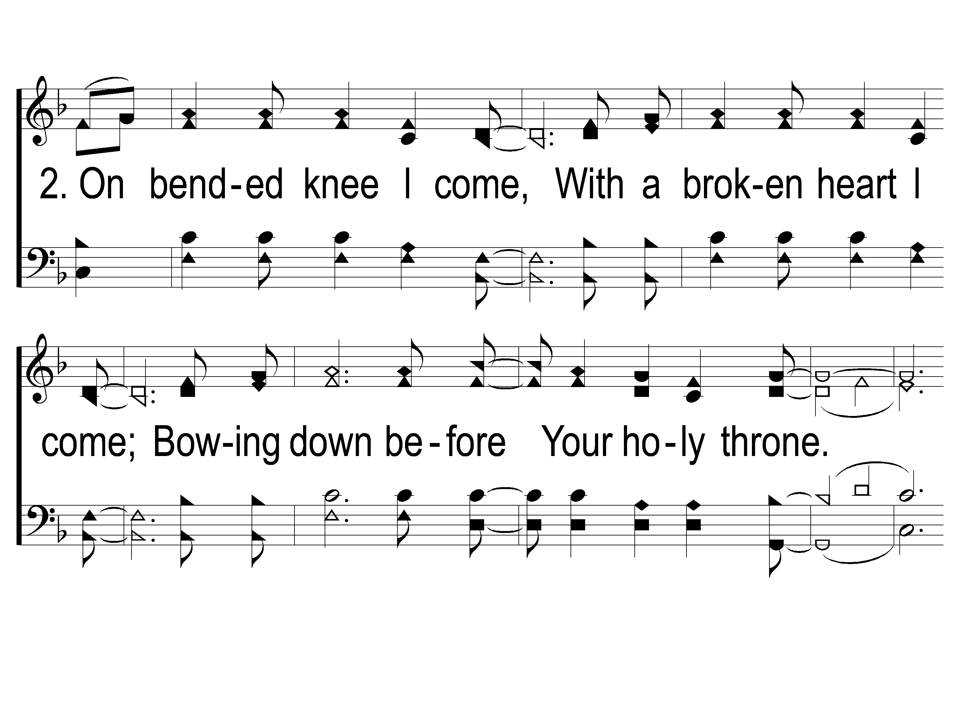
2-1 On Bended Knee
On Bended Knee
791

Slide 27
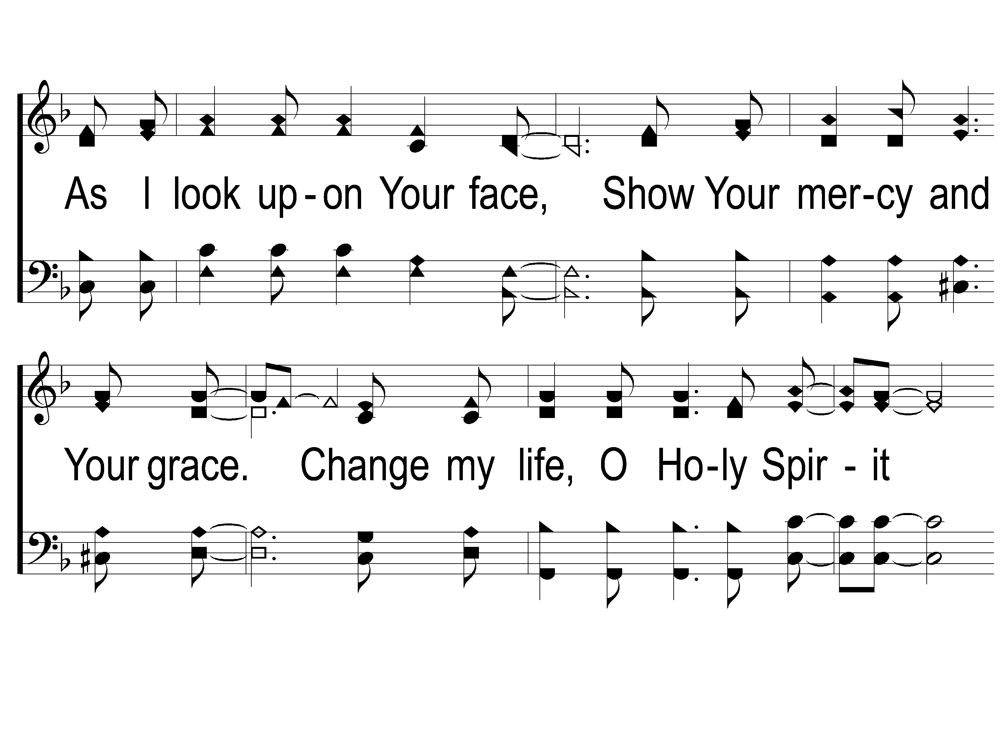
2-2 On Bended Knee
On Bended Knee
791

Slide 28
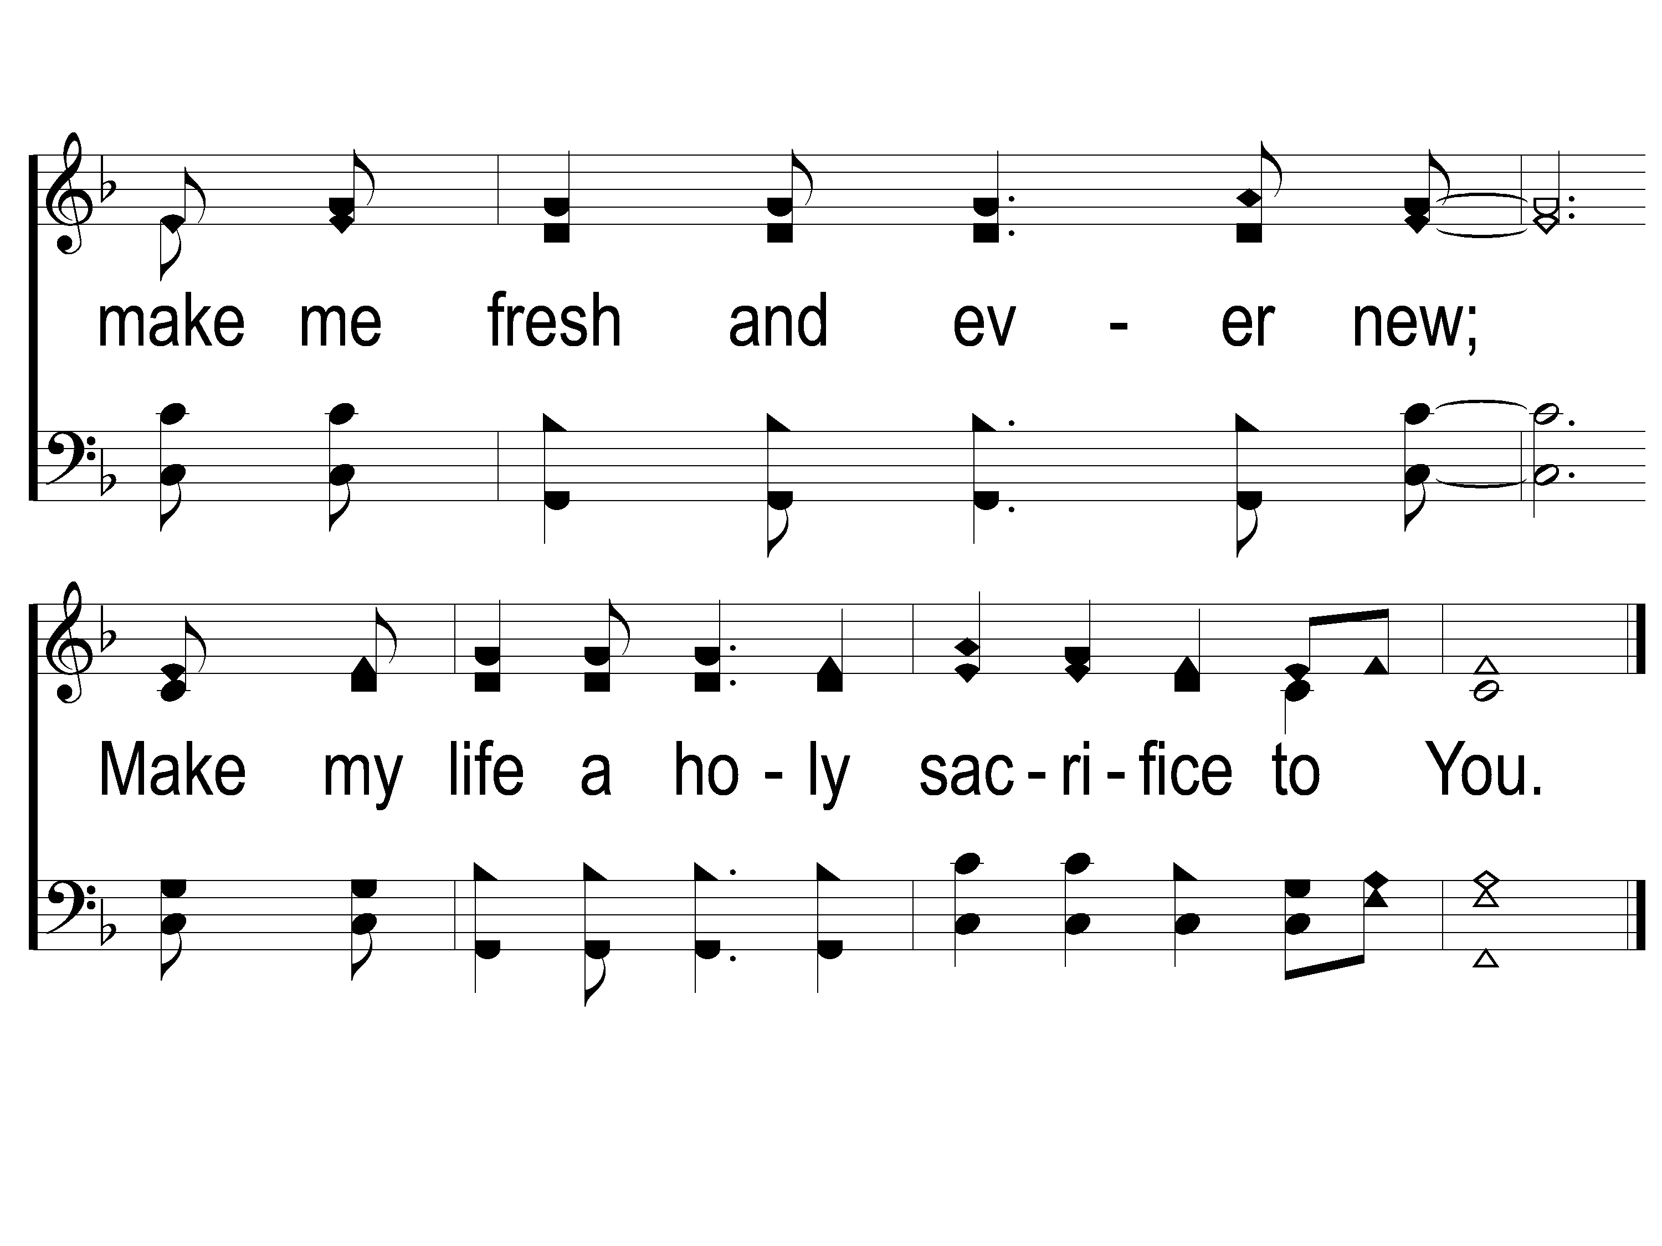
2-3 On Bended Knee
On Bended Knee
791

Slide 29
Opening Prayer

Slide 30
Song:
The Battle Belongs To The Lord
#749

Slide 31
1-1 The Battle Belongs to the Lord
The Battle Belongs to the Lord
749

Slide 32
1-2 The Battle Belongs to the Lord
The Battle Belongs to the Lord
749

Slide 33
C-1 The Battle Belongs to the Lord
The Battle Belongs to the Lord
749

Slide 34
C-2 The Battle Belongs to the Lord
The Battle Belongs to the Lord
749

Slide 35
2-1 The Battle Belongs to the Lord
The Battle Belongs to the Lord
749

Slide 36
2-2 The Battle Belongs to the Lord
The Battle Belongs to the Lord
749

Slide 37
C-1 The Battle Belongs to the Lord
The Battle Belongs to the Lord
749

Slide 38
C-2 The Battle Belongs to the Lord
The Battle Belongs to the Lord
749

Slide 39
3-1 The Battle Belongs to the Lord
The Battle Belongs to the Lord
749

Slide 40
3-2 The Battle Belongs to the Lord
The Battle Belongs to the Lord
749

Slide 41
C-1 The Battle Belongs to the Lord
The Battle Belongs to the Lord
749

Slide 42
C-2 The Battle Belongs to the Lord
The Battle Belongs to the Lord
749

Slide 43
Song:
I Know That
My Redeemer Lives
#528

Slide 44
1-1 I Know That My Redeemer Lives
I Know That My Redeemer Lives
528

Slide 45
1-2 I Know That My Redeemer Lives
I Know That My Redeemer Lives
528

Slide 46
C-1 I Know That My Redeemer Lives
I Know That My Redeemer Lives
528

Slide 47
C-2 I Know That My Redeemer Lives
I Know That My Redeemer Lives
528

Slide 48
2-1 I Know That My Redeemer Lives
I Know That My Redeemer Lives
528

Slide 49
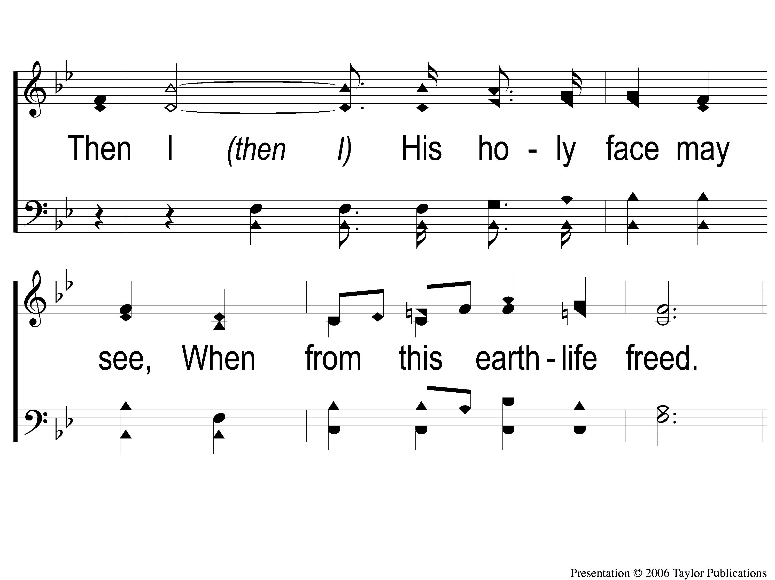
2-2 I Know That My Redeemer Lives
I Know That My Redeemer Lives
528

Slide 50
C-1 I Know That My Redeemer Lives
I Know That My Redeemer Lives
528

Slide 51
C-2 I Know That My Redeemer Lives
I Know That My Redeemer Lives
528

Slide 52
4-1 I Know That My Redeemer Lives
I Know That My Redeemer Lives
528

Slide 53
4-2 I Know That My Redeemer Lives
I Know That My Redeemer Lives
528

Slide 54
C-1 I Know That My Redeemer Lives
I Know That My Redeemer Lives
528

Slide 55
C-2 I Know That My Redeemer Lives
I Know That My Redeemer Lives
528

Slide 56
Scripture Reading:
Genesis 22:1-5

Slide 57
RESTORE
OUR
FOUNDATIONS
JANUARY - APRIL

Slide 58
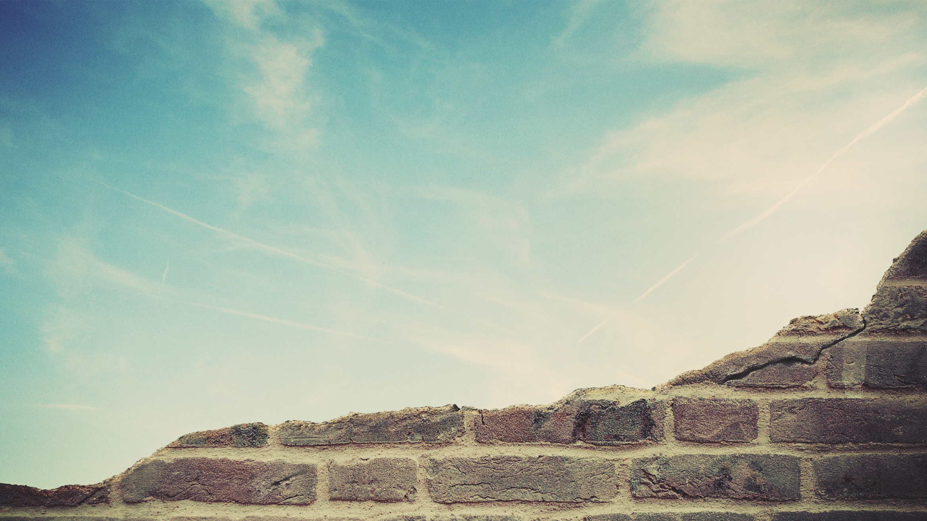
A Desire To Worship
Psa. 150:6, 66:4

Slide 59
A Desire To Worship
Psa. 150:6, 66:4
Of Materials – Isa. 2:4, Psa. 106:19

Slide 60
A Desire To Worship
Psa. 150:6, 66:4
Of Materials – Isa. 2:4, Psa. 106:19
Of Self – Lk. 18:9, 2 Tim. 3:1

Slide 61
A Desire To Worship
John 4:24
In Spirit & In Truth

Slide 62
Abraham’s Worship Was…
…Inconvenient

Slide 63
The Most
Worship Service
Inconvenient

Slide 64
It Was Inconvenient To Sacrifice…

Slide 65
It Was Inconvenient To Sacrifice…
…His Time

Slide 66
It Was Inconvenient To Sacrifice…
…His Time
…His Family

Slide 67
It Was Inconvenient To Sacrifice…
…His Time
…His Family
…His Energy

Slide 68
Abraham’s Worship Was…
…Inconvenient
…Uncomfortable

Slide 69
It Was Uncomfortable
Traveling for 6 Days

Slide 70
It Was Uncomfortable
Traveling for 6 Days
Sacrificing His Son

Slide 71
It Was Uncomfortable
Traveling for 6 Days
Sacrificing His Son
Preparing the Wood & Fire

Slide 72
Abraham’s Worship Was…
…Inconvenient
…Uncomfortable
…Worth It

Slide 73
Are You Comfortable?

Slide 74
Invitation
Song:
There’s A Fountain Free
#909

Slide 75
1-1 There’s A Fountain free
There’s A Fountain Free
909

Slide 76
1-2 There’s A Fountain free
There’s A Fountain Free
909

Slide 77
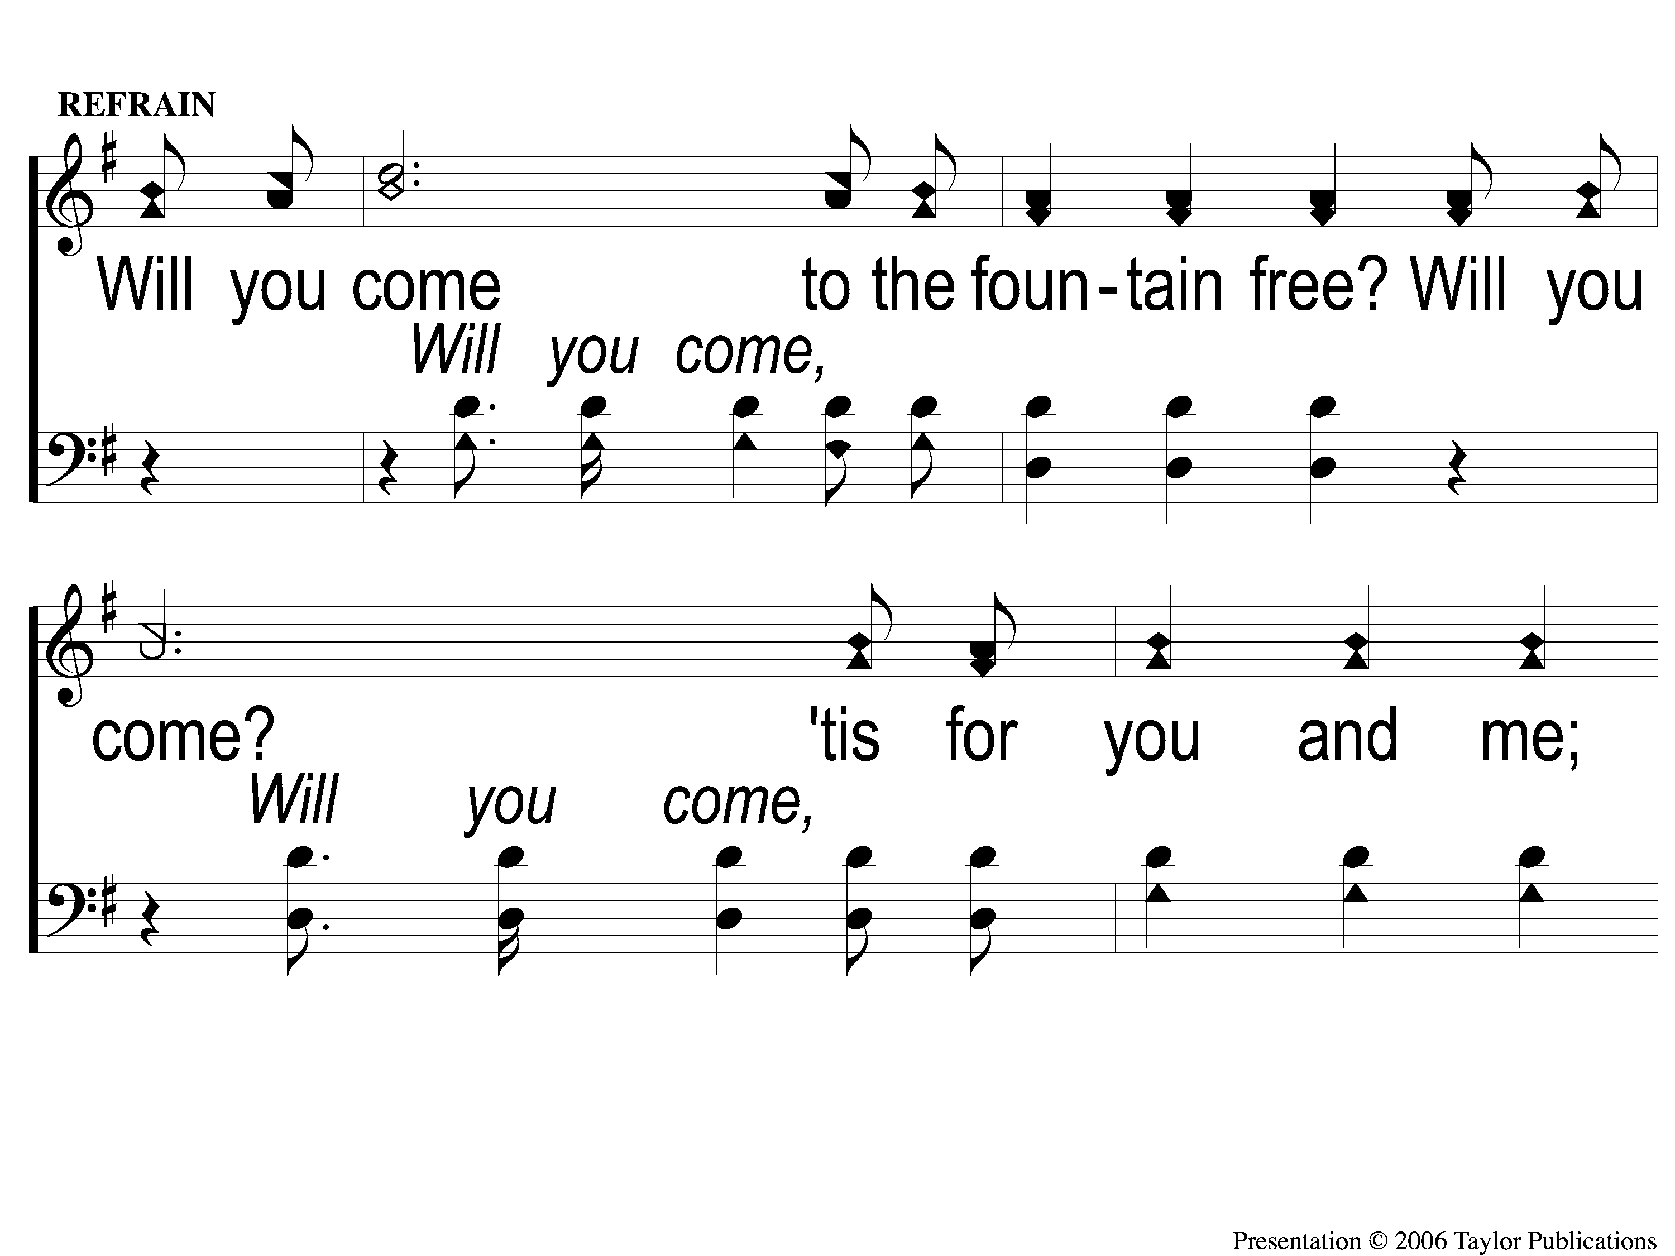
C-1 There’s A Fountain free
There’s A Fountain Free
909

Slide 78
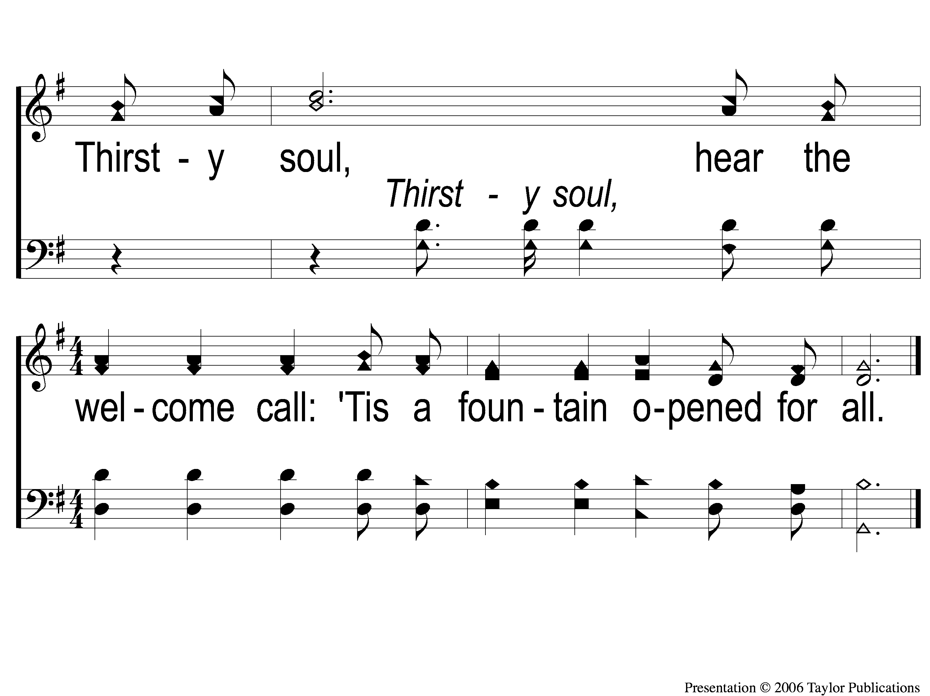
C-2 There’s A Fountain free
There’s A Fountain Free
909

Slide 79
2-1 There’s A Fountain free
There’s A Fountain Free
909

Slide 80
2-2 There’s A Fountain free
There’s A Fountain Free
909

Slide 81
C-1 There’s A Fountain free
There’s A Fountain Free
909

Slide 82
C-2 There’s A Fountain free
There’s A Fountain Free
909

Slide 83
3-1 There’s A Fountain free
There’s A Fountain Free
909

Slide 84
3-2 There’s A Fountain free
There’s A Fountain Free
909

Slide 85
C-1 There’s A Fountain free
There’s A Fountain Free
909

Slide 86
C-2 There’s A Fountain free
There’s A Fountain Free
909

Slide 87
The Contribution:
Luke 6:38
“Give, and it will be given to you: good measure, pressed down, shaken together, and running over will be put into your bosom. For with the same measure that you use, it will be measured back to you.”

Slide 88
Song:
By Christ Redeemed
#366

Slide 89
1-1 By Christ Redeemed
By Christ Redeemed
366

Slide 90
1-2 By Christ Redeemed
By Christ Redeemed
366

Slide 91
2-1 By Christ Redeemed
By Christ Redeemed
366

Slide 92
2-2 By Christ Redeemed
By Christ Redeemed
366

Slide 93
3-1 By Christ Redeemed
By Christ Redeemed
366

Slide 94
3-2 By Christ Redeemed
By Christ Redeemed
366

Slide 95
The Unleavened Bread
Luke 22:19
“And He took bread, gave thanks and broke it, and gave it to them, saying, ‘This is My body which is given for you; do this in remembrance of Me.’ ”

Slide 96
The Fruit of the Vine
Luke 22:20
“Likewise He also took the cup after supper, saying, ‘This cup is the new covenant in My blood, which is shed for you.’ ”

Slide 97
Closing Prayer

Slide 98
Song:
When We All Get To Heaven
#853

Slide 99
1-1 When We All Get To Heaven
When We All Get To Heaven
853

Slide 100
1-2 When We All Get To Heaven
When We All Get To Heaven
853

Slide 101
C-1 When We All Get To Heaven
When We All Get To Heaven
853

Slide 102
C-2 When We All Get To Heaven
When We All Get To Heaven
853

Slide 103
RESTORE REBUILD RENEW
JOIN US
IN THE MPB FOR
A FELLOWSHIP MEAL
@ NOON
IN 2022
WHEELER
CHURCH
OF
CHRIST

Slide 104
Tonight
WORSHIP @ 6:00 pm
Wednesday
WORSHIP @ 6:30 pm
Bible classes @ 7:00 pm
RESTORE REBUILD RENEW
IN 2022
WHEELER
CHURCH
OF
CHRIST

