Slide 1
1-1 Listen to our Hearts
Listen To Our Hearts
810

Slide 2
1-2 Listen to our Hearts
Listen To Our Hearts
810

Slide 3
1-3 Listen to our Hearts
Listen To Our Hearts
810

Slide 4
C-1 Listen to our Hearts
Listen To Our Hearts
810

Slide 5
C-2 Listen to our Hearts
Listen To Our Hearts
810

Slide 6
C-3 Listen to our Hearts
Listen To Our Hearts
810

Slide 7
C-4 Listen to our Hearts
Listen To Our Hearts
810

Slide 8
2-1 Listen to our Hearts
Listen To Our Hearts
810

Slide 9
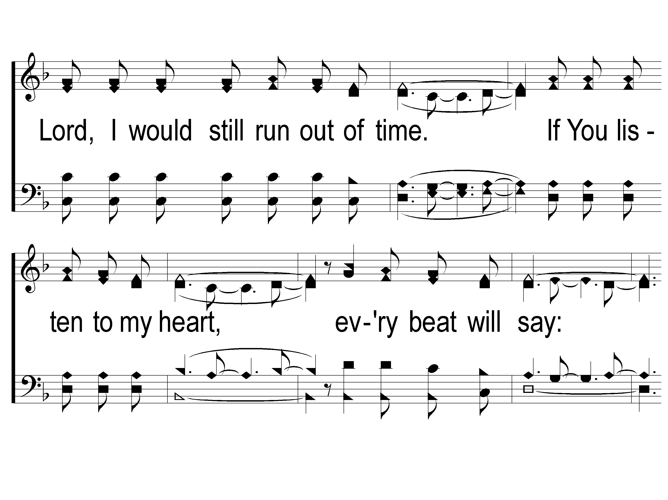
2-2 Listen to our Hearts
Listen To Our Hearts
810

Slide 10
2-3 Listen to our Hearts
Listen To Our Hearts
810

Slide 11
C-1 Listen to our Hearts
Listen To Our Hearts
810

Slide 12
C-2 Listen to our Hearts
Listen To Our Hearts
810

Slide 13
C-3 Listen to our Hearts
Listen To Our Hearts
810

Slide 14
C-4 Listen to our Hearts
Listen To Our Hearts
810

Slide 15
RESTORE REBUILD RENEW
welcome
we are glad to
Have you with us
IN 2022
WHEELER
CHURCH
OF
CHRIST

Slide 16
Song:
Paradise Valley
#898

Slide 17
1-1 Paradise Valley
Paradise Valley
898

Slide 18
1-2 Paradise Valley
Paradise Valley
898

Slide 19
C-1 Paradise Valley
Paradise Valley
898

Slide 20
C-2 Paradise Valley
Paradise Valley
898

Slide 21
C-3 Paradise Valley
Paradise Valley
898

Slide 22
C-4 Paradise Valley
Paradise Valley
898

Slide 23
3-1 Paradise Valley
Paradise Valley
898

Slide 24
3-2 Paradise Valley
Paradise Valley
898

Slide 25
C-1 Paradise Valley
Paradise Valley
898

Slide 26
C-2 Paradise Valley
Paradise Valley
898

Slide 27
C-3 Paradise Valley
Paradise Valley
898

Slide 28
C-4 Paradise Valley
Paradise Valley
898

Slide 29
Song:
We Have An Anchor
#467

Slide 30
1-1 We Have an Anchor
We Have an Anchor
467

Slide 31
1-2 We Have an Anchor
We Have an Anchor
467

Slide 32
C-1 We Have an Anchor
We Have an Anchor
467

Slide 33
C-2 We Have an Anchor
We Have an Anchor
467

Slide 34
2-1 We Have an Anchor
We Have an Anchor
467

Slide 35
2-2 We Have an Anchor
We Have an Anchor
467

Slide 36
C-1 We Have an Anchor
We Have an Anchor
467

Slide 37
C-2 We Have an Anchor
We Have an Anchor
467

Slide 38
3-1 We Have an Anchor
We Have an Anchor
467

Slide 39
3-2 We Have an Anchor
We Have an Anchor
467

Slide 40
C-1 We Have an Anchor
We Have an Anchor
467

Slide 41
C-2 We Have an Anchor
We Have an Anchor
467

Slide 42
Opening Prayer

Slide 43
Song:
There Stands A Rock
#558

Slide 44
1-1 There Stands A Rock
There Stands A Rock
558

Slide 45
1-2 There’s Stands A Rock
There Stands A Rock
558

Slide 46
C-1 There’s Stands A Rock
There Stands A Rock
558

Slide 47
C-2 There’s Stands A Rock
There Stands A Rock
558

Slide 48
2-1 There’s Stands A Rock
There Stands A Rock
558

Slide 49
2-2 There’s Stands A Rock
There Stands A Rock
558

Slide 50
C-1 There’s Stands A Rock
There Stands A Rock
558

Slide 51
C-2 There’s Stands A Rock
There Stands A Rock
558

Slide 52
3-1 There’s Stands A Rock
There Stands A Rock
558

Slide 53
3-2 There’s Stands A Rock
There Stands A Rock
558

Slide 54
C-1 There’s Stands A Rock
There Stands A Rock
558

Slide 55
C-2 There’s Stands A Rock
There Stands A Rock
558

Slide 56
Song:
Remind Me, Dear Lord
#606

Slide 57
1-1 Remind Me Dear Lord
Remind Me Dear Lord
606

Slide 58
1-2 Remind Me Dear Lord
Remind Me Dear Lord
606

Slide 59
C-1 Remind Me Dear Lord
Remind Me Dear Lord
606

Slide 60
C-2 Remind Me Dear Lord
Remind Me Dear Lord
606

Slide 61
2-1 Remind Me Dear Lord
Remind Me Dear Lord
606

Slide 62
2-2 Remind Me Dear Lord
Remind Me Dear Lord
606

Slide 63
C-1 Remind Me Dear Lord
Remind Me Dear Lord
606

Slide 64
C-2 Remind Me Dear Lord
Remind Me Dear Lord
606

Slide 65
Scripture Reading:
Luke 5:16, 6:12

Slide 67
Renew My Love For
Spiritual Growth

Slide 68
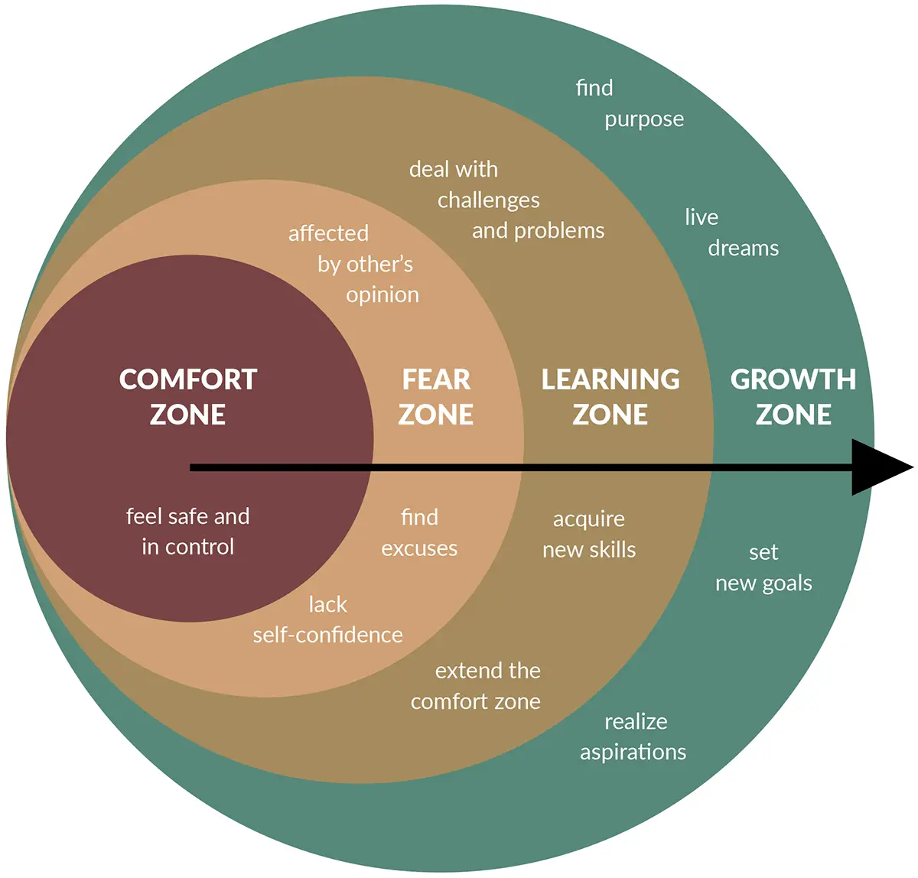
A Logical Argument

Slide 69
4 Ways To Grow In Prayer:

Slide 70
4 Ways To Grow In Prayer:
Pray for Uncomfortable Amounts of Time

Slide 71
4 Ways To Grow In Prayer:
Pray for Uncomfortable Amounts of Time
Longer Prayers – Matt. 6:7, Jn. 17:1-26

Slide 72
4 Ways To Grow In Prayer:
Pray for Uncomfortable Amounts of Time
Longer Prayers – Matt. 6:7, Jn. 17:1-26
Shorter Prayers – Lk. 23:34
1 Chron. 4:10, Ex. 32:31-32, Neh. 2:4

Slide 73
4 Ways To Grow In Prayer:
Pray for Uncomfortable Amounts of Time
Pray in Uncomfortable Positions

Slide 74
4 Ways To Grow In Prayer:
Pray in Uncomfortable Positions
Praying in Public
Praying on your Knees
Praying with Held Hands

Slide 75
4 Ways To Grow In Prayer:
Pray in Uncomfortable Positions
Praying in Public

Slide 76
4 Ways To Grow In Prayer:
Pray in Uncomfortable Positions
Praying in Public
Praying on your Knees – 1 Ki. 8:54, Eph. 3:14

Slide 77
4 Ways To Grow In Prayer:
Pray in Uncomfortable Positions
Praying in Public
Praying on your Knees – 1 Ki. 8:54, Eph. 3:14
Praying with Held Hands

Slide 78
4 Ways To Grow In Prayer:
Pray for Uncomfortable Amounts of Time
Pray in Uncomfortable Positions
Pray in Uncomfortable Situations

Slide 79
4 Ways To Grow In Prayer:
Pray in Uncomfortable Situations
When people Plot Against You – Dan. 6:4-10

Slide 80
4 Ways To Grow In Prayer:
Pray in Uncomfortable Situations
When people Plot Against You – Dan. 6:4-10
When people Act Against You – Dan. 6:13, 16-22

Slide 81
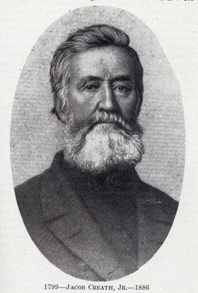
Jacob Creath, Jr. (1799-1886)
"On one occasion, during the War between the States, a company of troops was encamped near Palmyra, intending to capture the city. Creath went out to the grove to pray and the leader of the troops happened to be near. He edged closer to the grove and listened as Creath prayed for his neighbors, his town, and for peace. The next day the troops withdrew without any attempt to capture the town.” (West, 124).

Slide 82
4 Ways To Grow In Prayer:
Pray in Uncomfortable Situations
When people Plot Against You – Dan. 6:4-10
When people Act Against You – Dan. 6:13, 16-22
When you Have Sinned or Tempted to Sin – Acts 8:18-23

Slide 83
4 Ways To Grow In Prayer:
Pray for Uncomfortable Amounts of Time
Pray in Uncomfortable Positions
Pray in Uncomfortable Situations
Pray with Uncomfortable Words

Slide 84
4 Ways To Grow In Prayer:
Pray with Uncomfortable Words
New Phrases – Matt. 6:7

Slide 85
4 Ways To Grow In Prayer:
Pray with Uncomfortable Words
New Phrases – Matt. 6:7
New Focus – Matt. 6:11-13, 1 Tim. 2:1-2, Matt. 5:44

Slide 86
4 Ways To Grow In Prayer:
Pray with Uncomfortable Words
New Phrases – Matt. 6:7
New Focus – Matt. 6:11-13, 1 Tim. 2:1-2, Matt. 5:44
New Situations – Jn. 17:15, Lk. 22:32

Slide 87
Practical Prayer Pointers:

Slide 88
Practical Prayer Pointers:
Be Sincere – Matt. 23:14

Slide 89
Practical Prayer Pointers:
Be Sincere – Matt. 23:14
Be Consistent – 1 Thess. 5:17

Slide 90
Practical Prayer Pointers:
Be Sincere – Matt. 23:14
Be Consistent – 1 Thess. 5:17
Be Humble – Matt. 5:3

Slide 91
Are you Praying?

Slide 92
Just As I Am
#924
Invitation
Song:

Slide 93
1-1 Just As I Am
Just As I Am
924

Slide 94
1-2 Just As I Am
Just As I Am
924

Slide 95
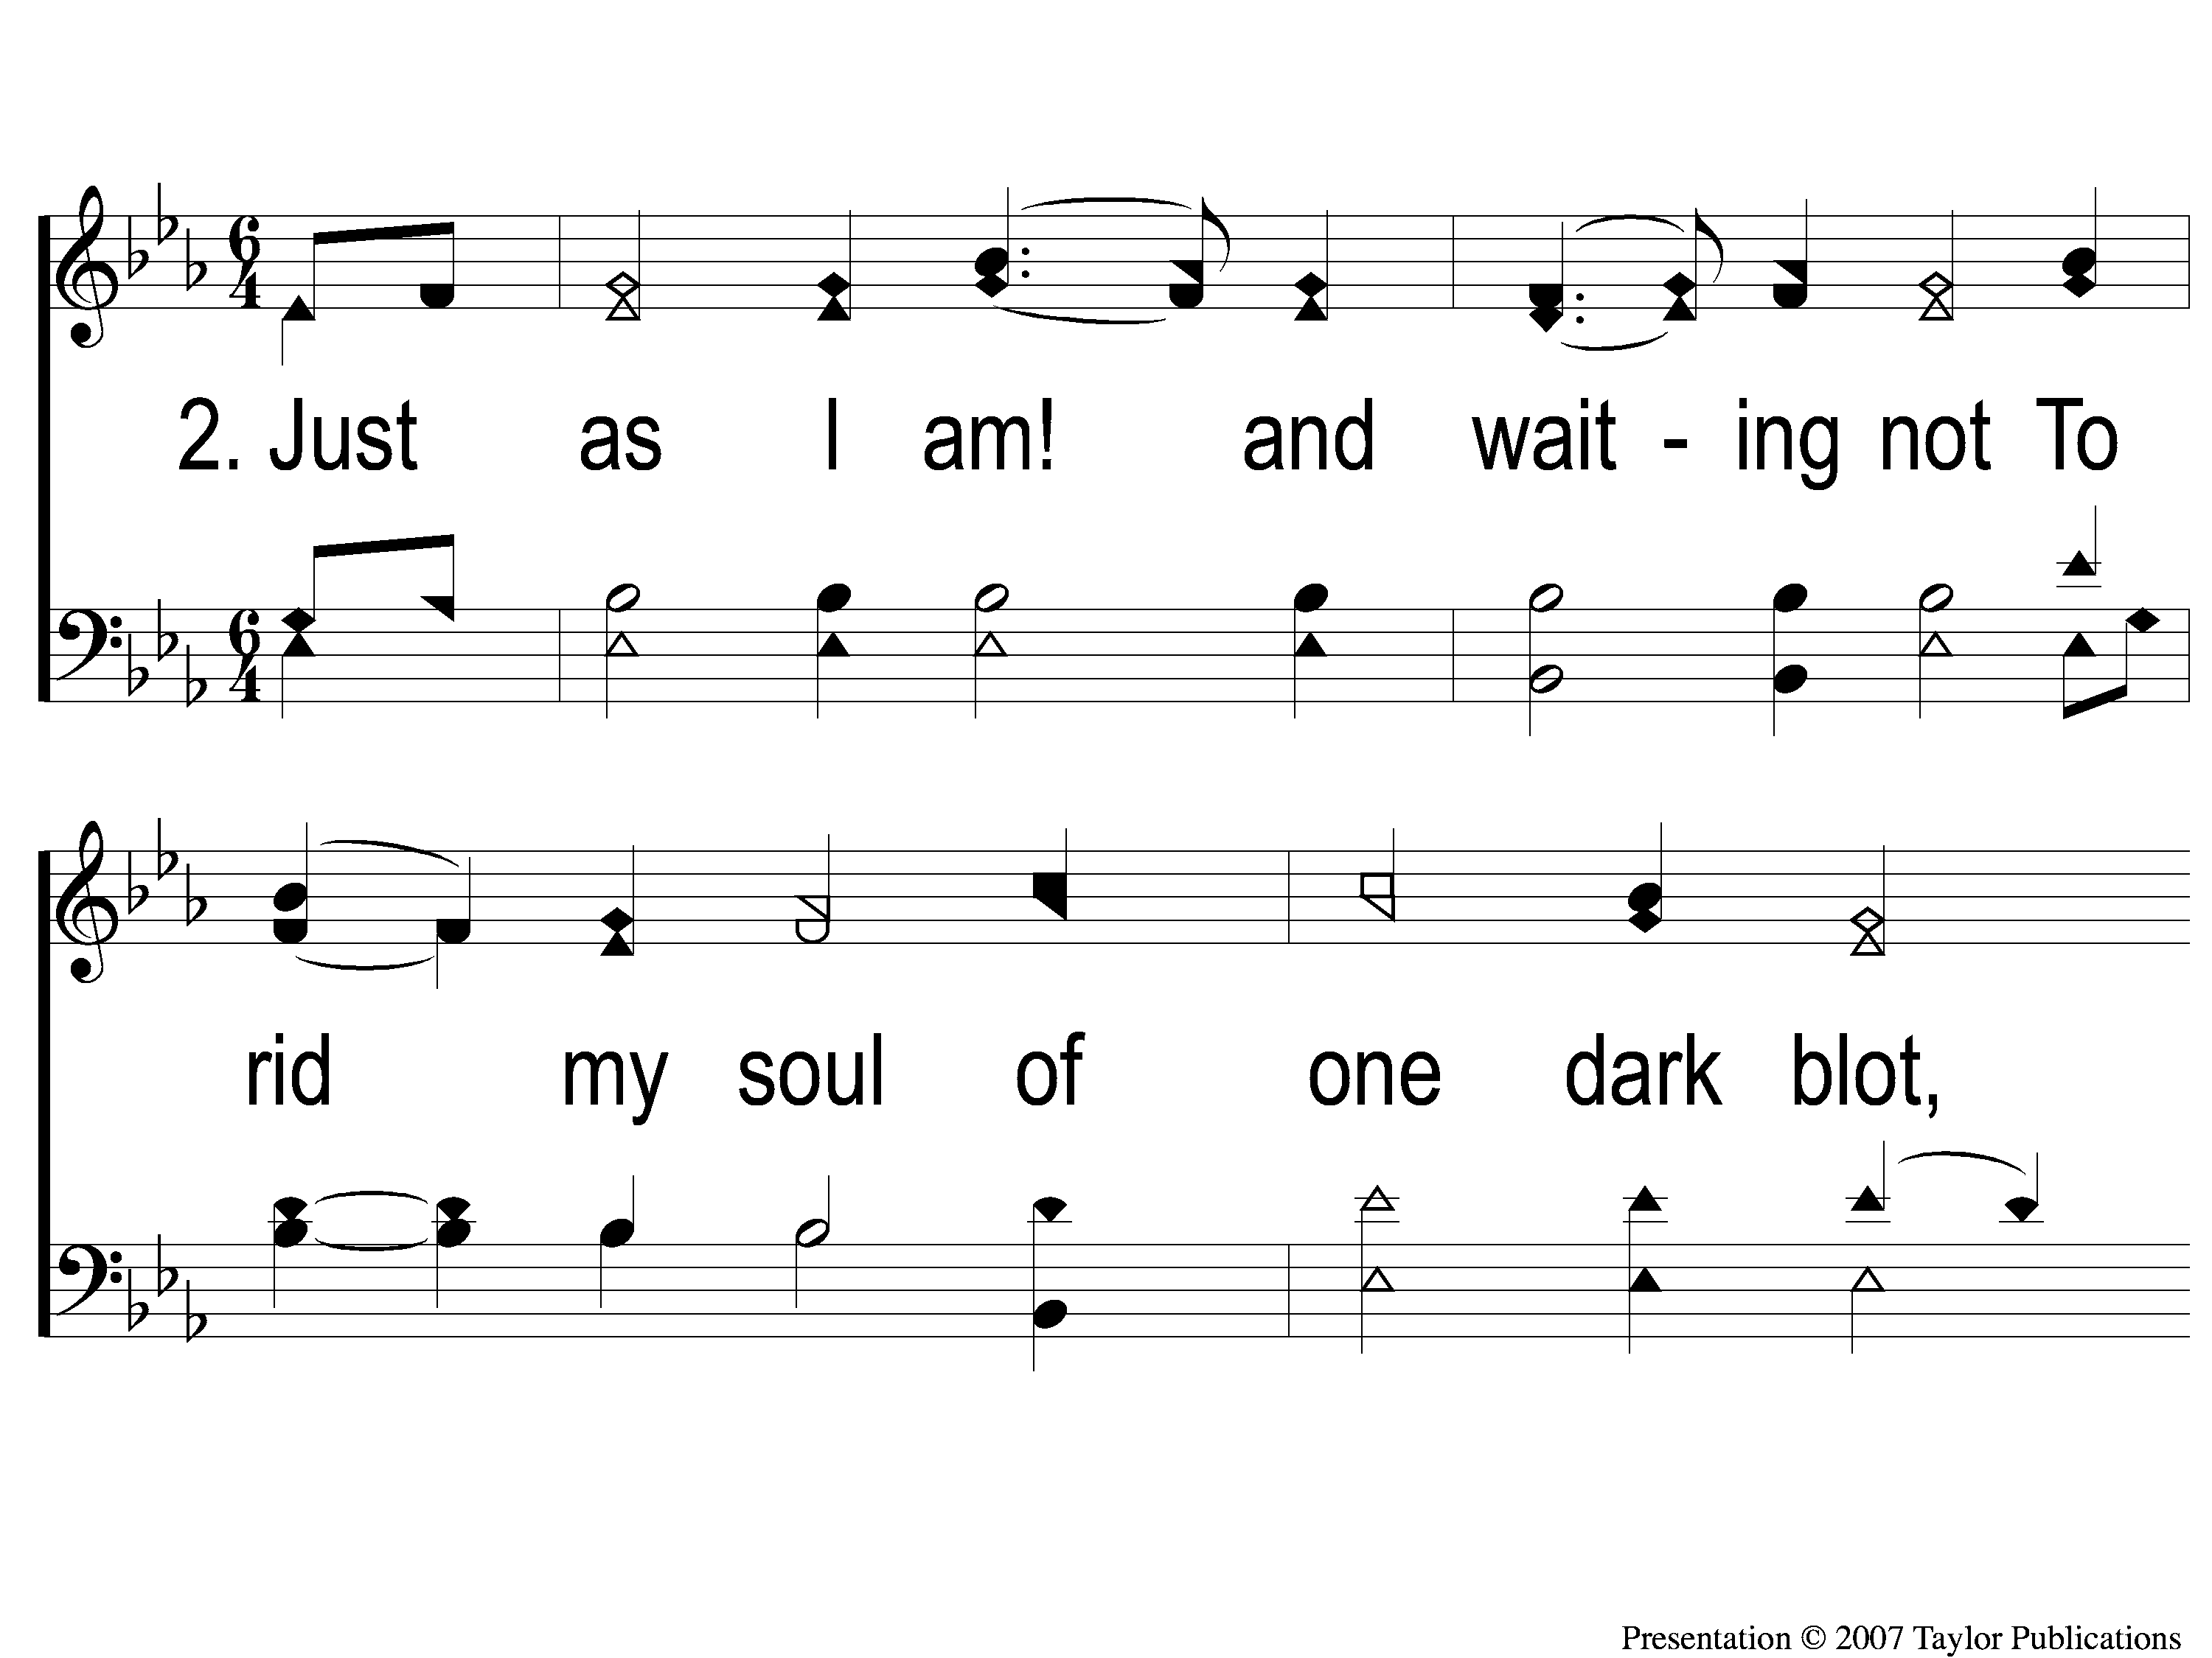
2-1 Just As I Am
Just As I Am
924

Slide 96
2-2 Just As I Am
Just As I Am
924

Slide 97
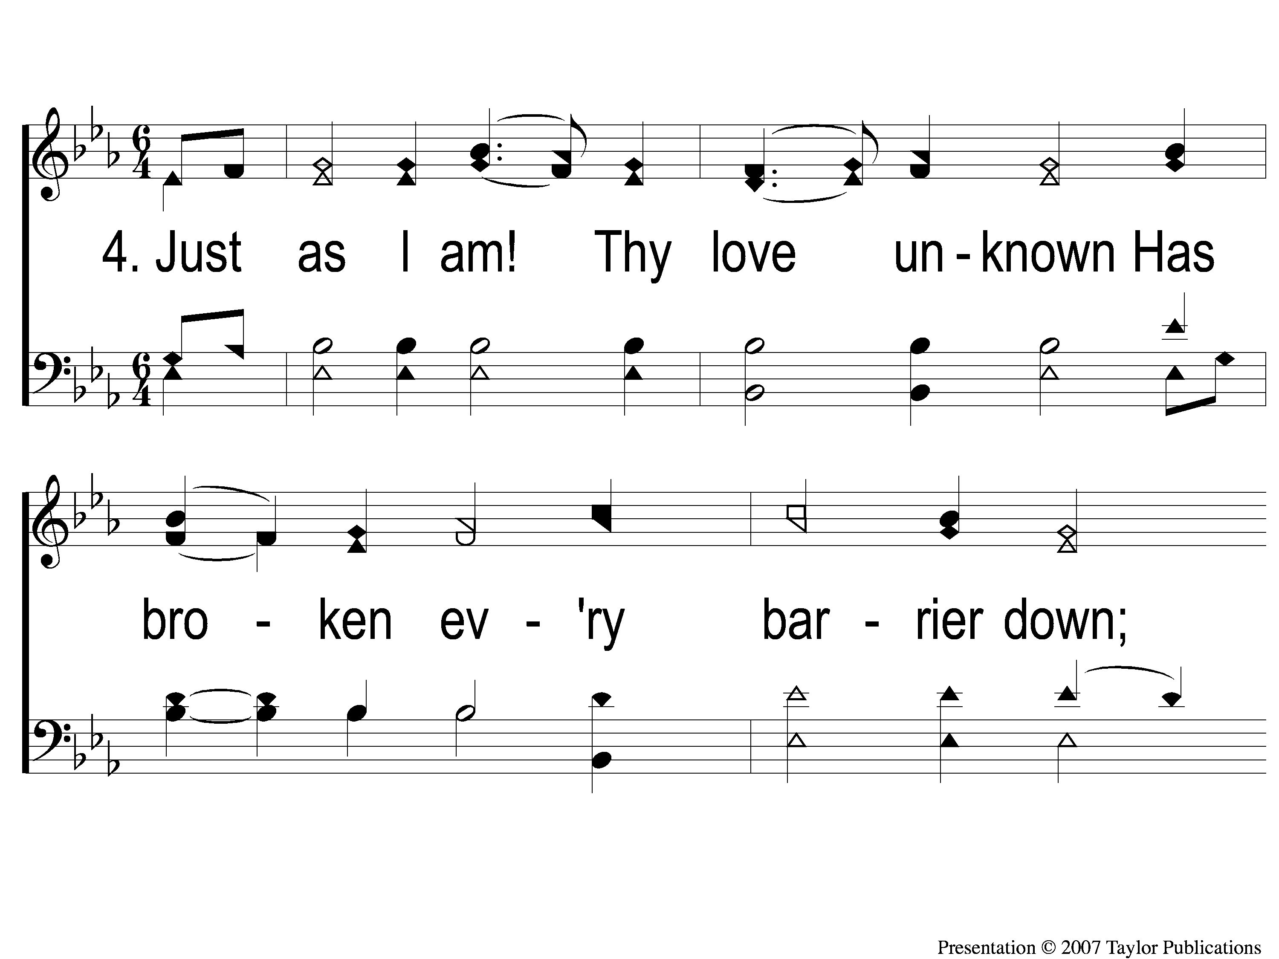
4-1 Just As I Am
Just As I Am
924

Slide 98
4-2 Just As I Am
Just As I Am
924

Slide 99
Our Contribution:
2 Corinthians 9:7-8
“So let each one give as he purposes in his heart, not grudgingly or of necessity; for God loves a cheerful giver. And God is able to make all grace abound toward you, that you, always having all sufficiency in all things, may have an abundance for every good work.”

Slide 100
Song:
Lead Me To Calvary
#332

Slide 101
1-1 Lead Me To Calvary
Lead Me To Calvary
332

Slide 102
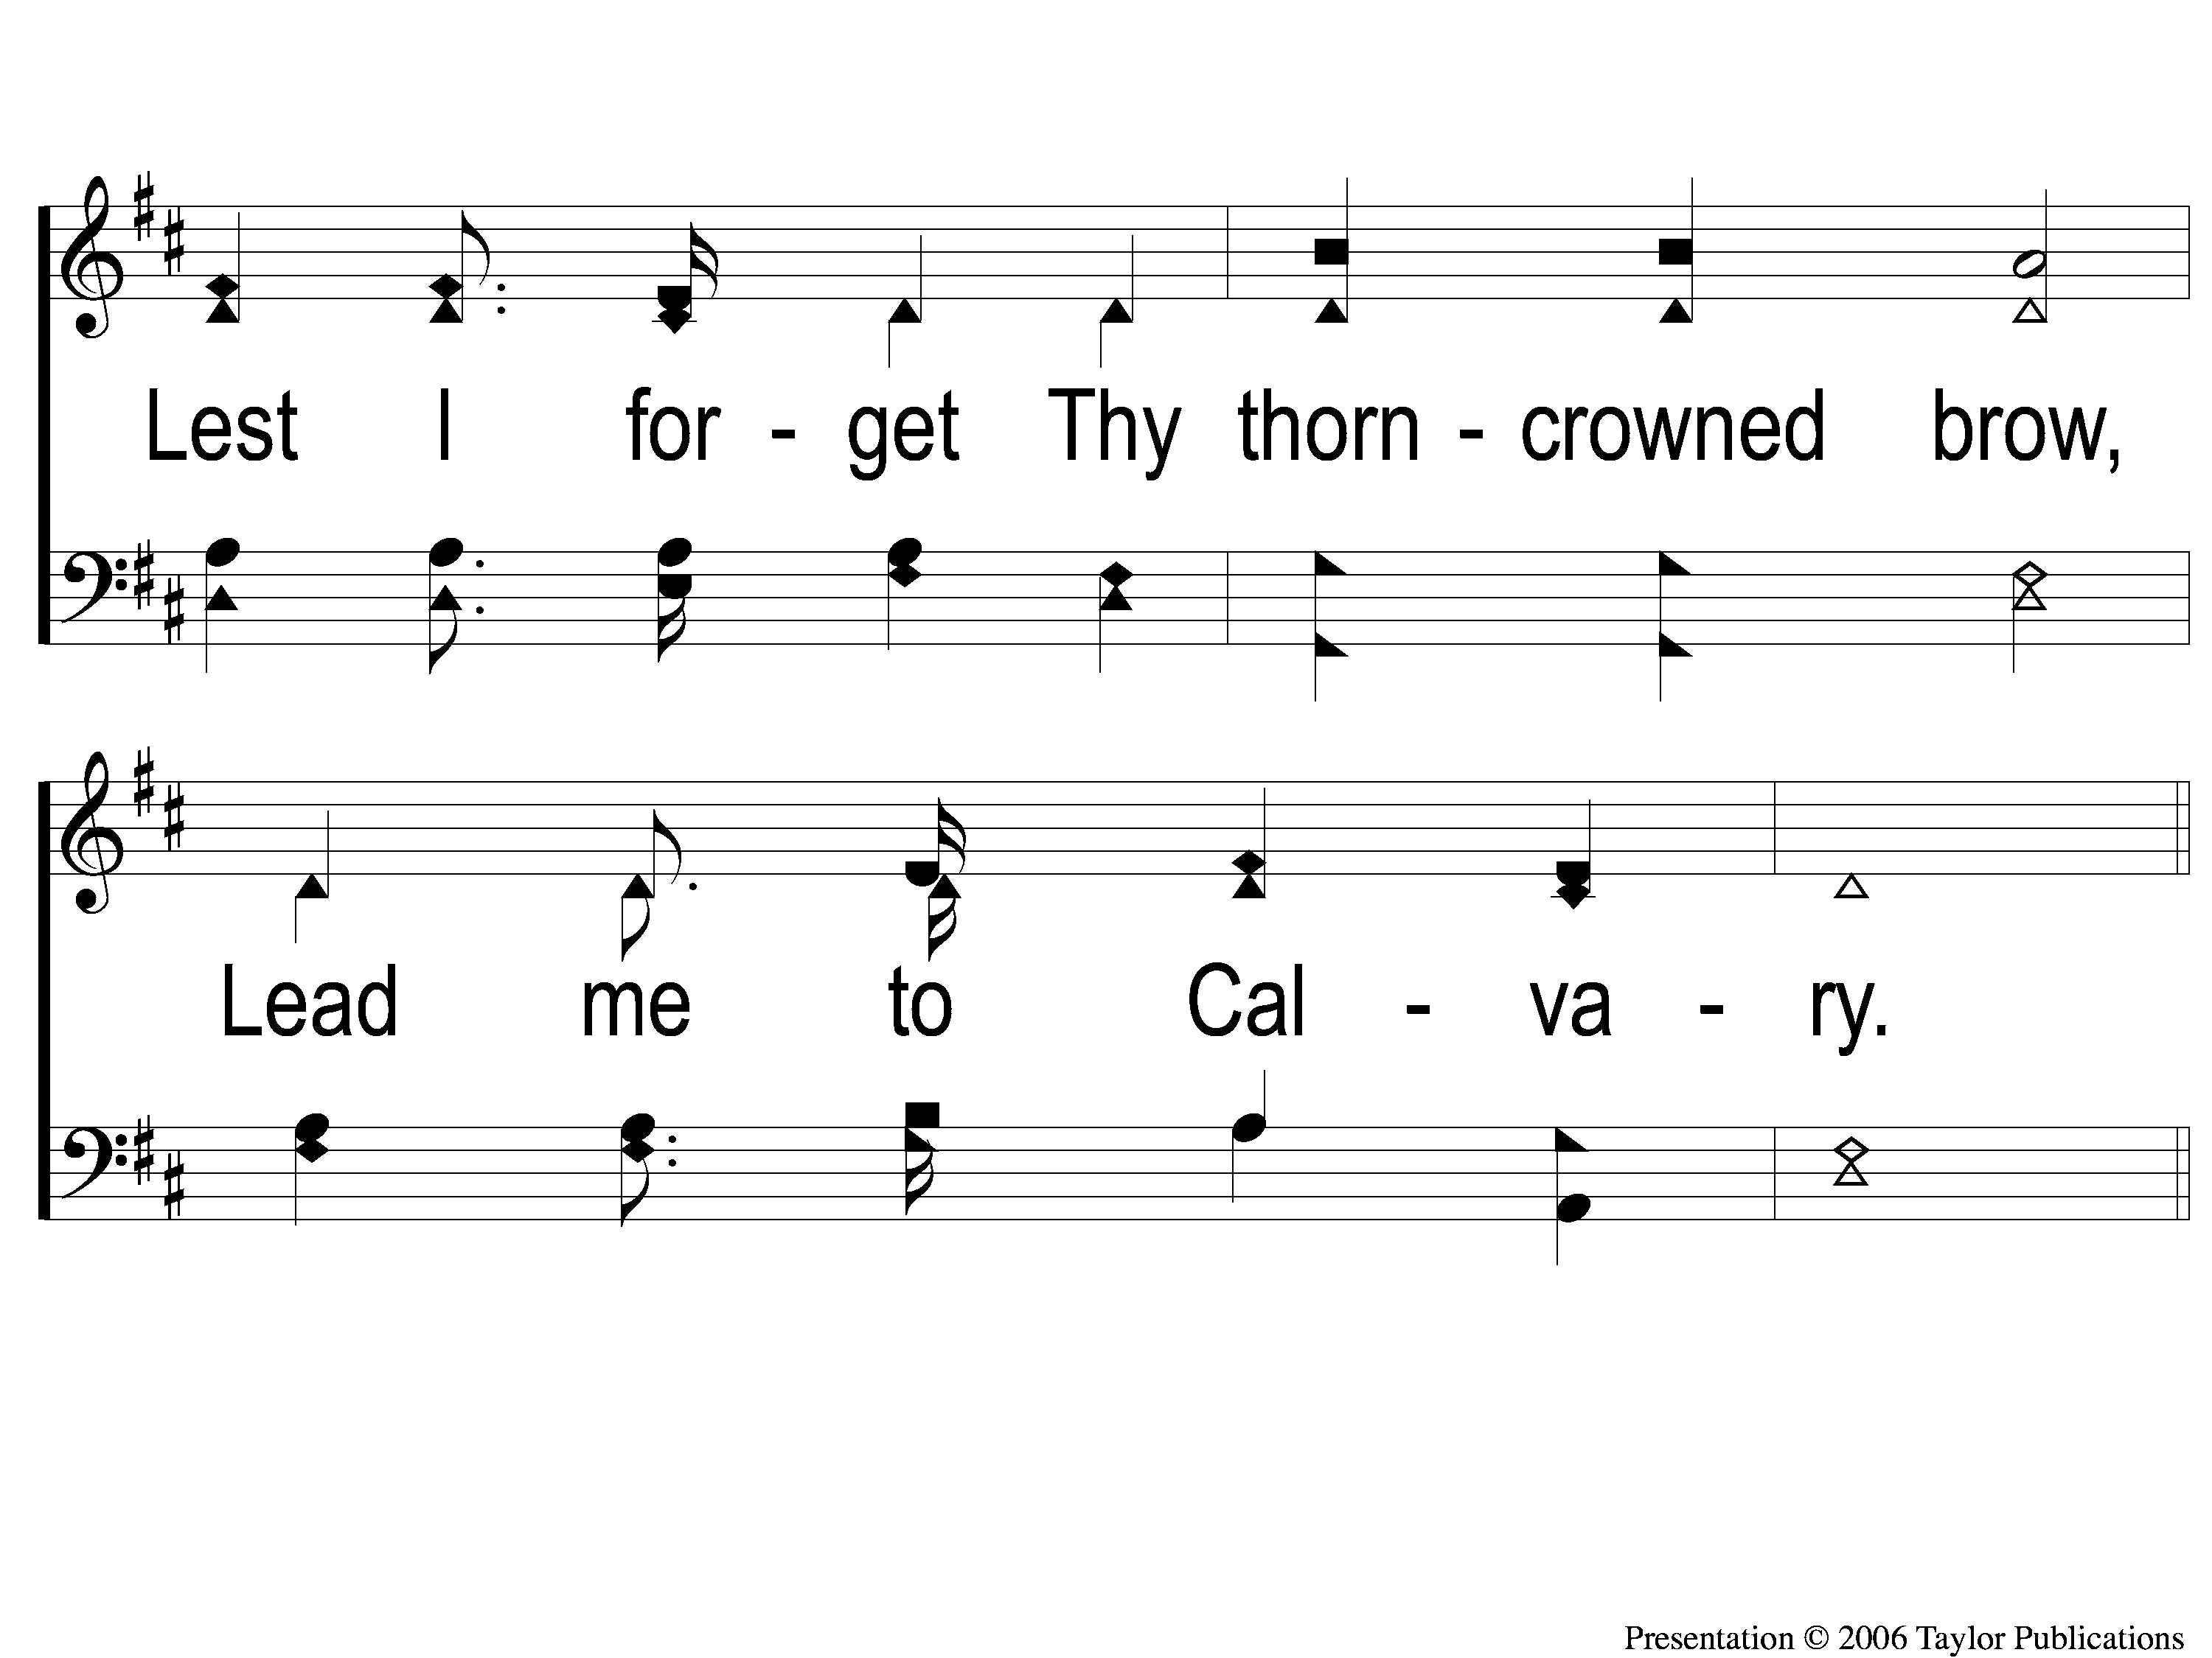
1-2 Lead Me To Calvary
Lead Me To Calvary
332

Slide 103
C-1 Lead Me To Calvary
Lead Me To Calvary
332

Slide 104
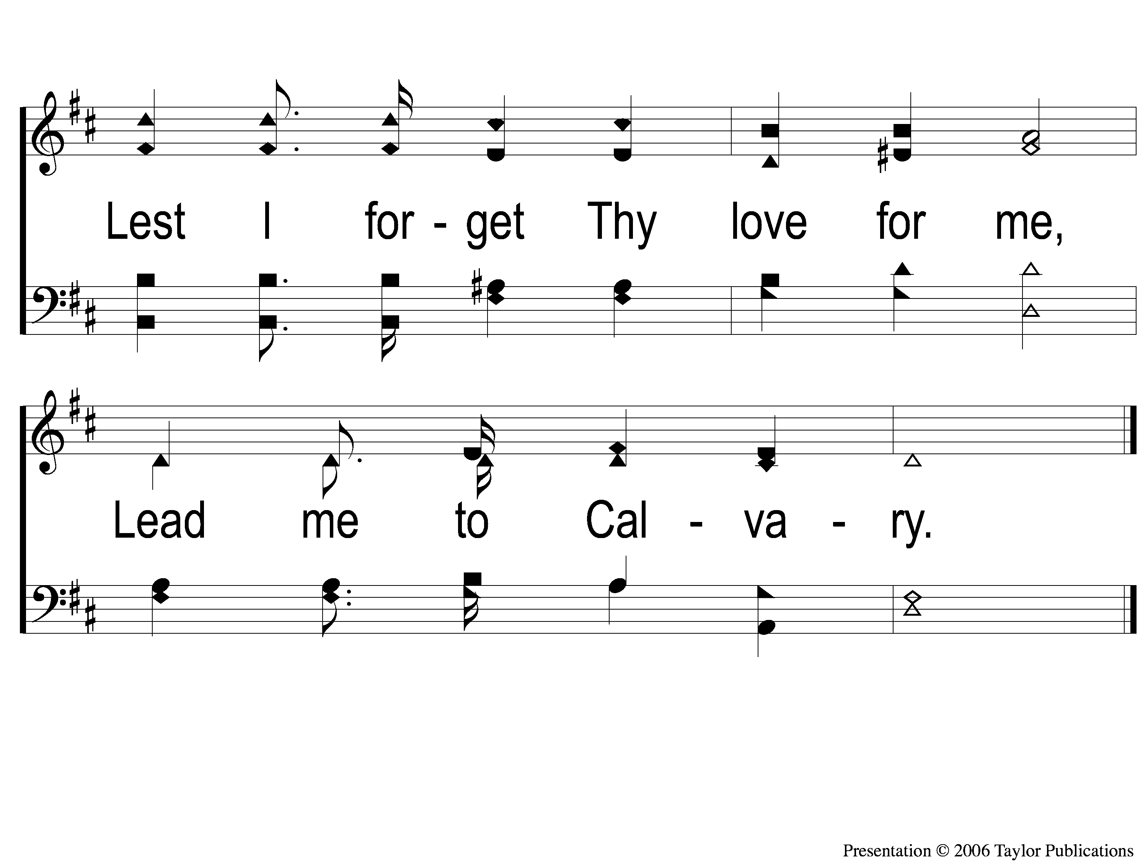
C-2 Lead Me To Calvary
Lead Me To Calvary
332

Slide 105
2-1 Lead Me To Calvary
Lead Me To Calvary
332

Slide 106
2-2 Lead Me To Calvary
Lead Me To Calvary
332

Slide 107
C-1 Lead Me To Calvary
Lead Me To Calvary
332

Slide 108
C-2 Lead Me To Calvary
Lead Me To Calvary
332

Slide 109
3-1 Lead Me To Calvary
Lead Me To Calvary
332

Slide 110
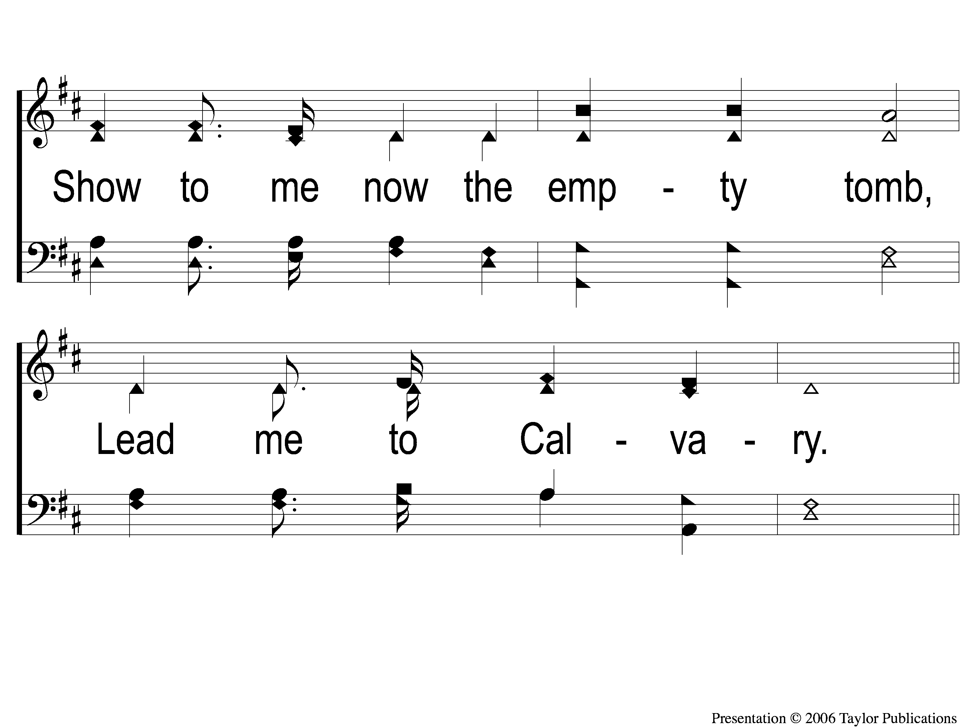
3-2 Lead Me To Calvary
Lead Me To Calvary
332

Slide 111
C-1 Lead Me To Calvary
Lead Me To Calvary
332

Slide 112
C-2 Lead Me To Calvary
Lead Me To Calvary
332

Slide 113
4-1 Lead Me To Calvary
Lead Me To Calvary
332

Slide 114
4-2 Lead Me To Calvary
Lead Me To Calvary
332

Slide 115
C-1 Lead Me To Calvary
Lead Me To Calvary
332

Slide 116
C-2 Lead Me To Calvary
Lead Me To Calvary
332

Slide 117
The Unleavened Bread
1 Peter 4:1-2
“Therefore, since Christ suffered for us in the flesh, arm yourselves also with the same mind, for he who has suffered in the flesh has ceased from sin, that he no longer should live the rest of his time in the flesh for the lusts of men, but for the will of God. ”

Slide 118
The Fruit
of the Vine
1 Peter 1:17-19
“And if you call on the Father, who without partiality judges according to each one’s work, conduct yourselves throughout the time of your stay here in fear; knowing that you were not redeemed with corruptible things, like silver or gold, from your aimless conduct received by tradition from your fathers, but with the precious blood of Christ, as of a lamb without blemish and without spot.”

Slide 119
Closing Prayer

Slide 120
Song:
Take The Name Of Jesus
#738

Slide 121
1-1 Take the Name of Jesus With You
Take the Name of Jesus
738

Slide 122
1-2 Take the Name of Jesus With You
Take the Name of Jesus
738

Slide 123
C-1 Take the Name of Jesus With You
Take the Name of Jesus
738

Slide 124
C-2 Take the Name of Jesus With You
Take the Name of Jesus
738

Slide 125
2-1 Take the Name of Jesus With You
Take the Name of Jesus
738

Slide 126
2-2 Take the Name of Jesus With You
Take the Name of Jesus
738

Slide 127
C-1 Take the Name of Jesus With You
Take the Name of Jesus
738

Slide 128
C-2 Take the Name of Jesus With You
Take the Name of Jesus
738

Slide 129
3-1 Take the Name of Jesus With You
Take the Name of Jesus
738

Slide 130
3-2 Take the Name of Jesus With You
Take the Name of Jesus
738

Slide 131
C-1 Take the Name of Jesus With You
Take the Name of Jesus
738

Slide 132
C-2 Take the Name of Jesus With You
Take the Name of Jesus
738

Slide 133
today
LTC @ 4:55 PM
Worship @ 6:00 PM → Q&A Night!
Wednesday
LTC @ 5:30 PM
Worship & Classes @ 6:30 PM
RESTORE REBUILD RENEW
IN 2022
WHEELER
CHURCH
OF
CHRIST

