Slide 1
1 I Will Call Upon the Lord
I Will Call Upon the Lord
63

Slide 2
2 I Will Call Upon the Lord
I Will Call Upon the Lord
63

Slide 3
3 I Will Call Upon the Lord
I Will Call Upon the Lord
63

Slide 4
4 I Will Call Upon the Lord
I Will Call Upon the Lord
63

Slide 5
DC1 I Will Call Upon the Lord
I Will Call Upon the Lord
63

Slide 6
DC2 I Will Call Upon the Lord
I Will Call Upon the Lord
63

Slide 7
DC3 I Will Call Upon the Lord
I Will Call Upon the Lord
63

Slide 8
DC4 I Will Call Upon the Lord
I Will Call Upon the Lord
63

Slide 9
tag I Will Call Upon the Lord
I Will Call Upon the Lord
63

Slide 10
RESTORE REBUILD RENEW
welcome
we are glad to
Have you with us
IN 2022
WHEELER
CHURCH
OF
CHRIST

Slide 11
Song:
We Will Glorify
#578

Slide 12
1-1 We Will Glorify
We Will Glorify
578

Slide 13
1-2 We Will Glorify
We Will Glorify
578

Slide 14
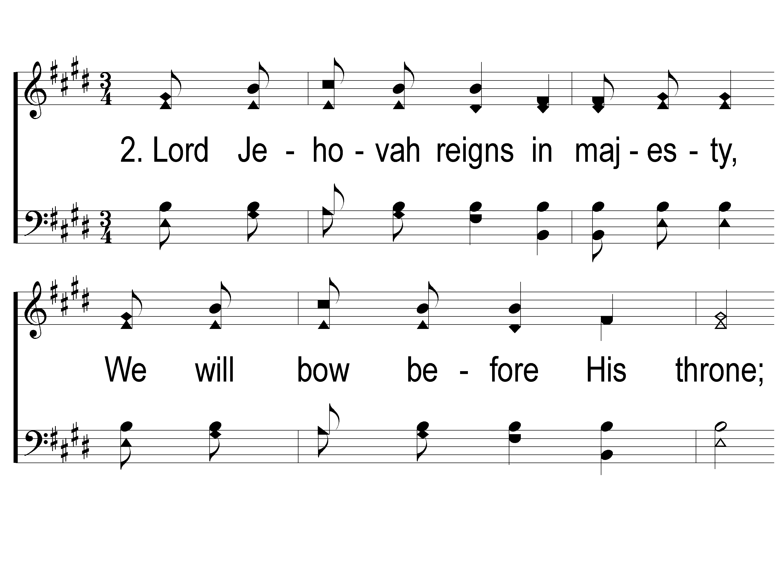
2-1 We Will Glorify
We Will Glorify
578

Slide 15
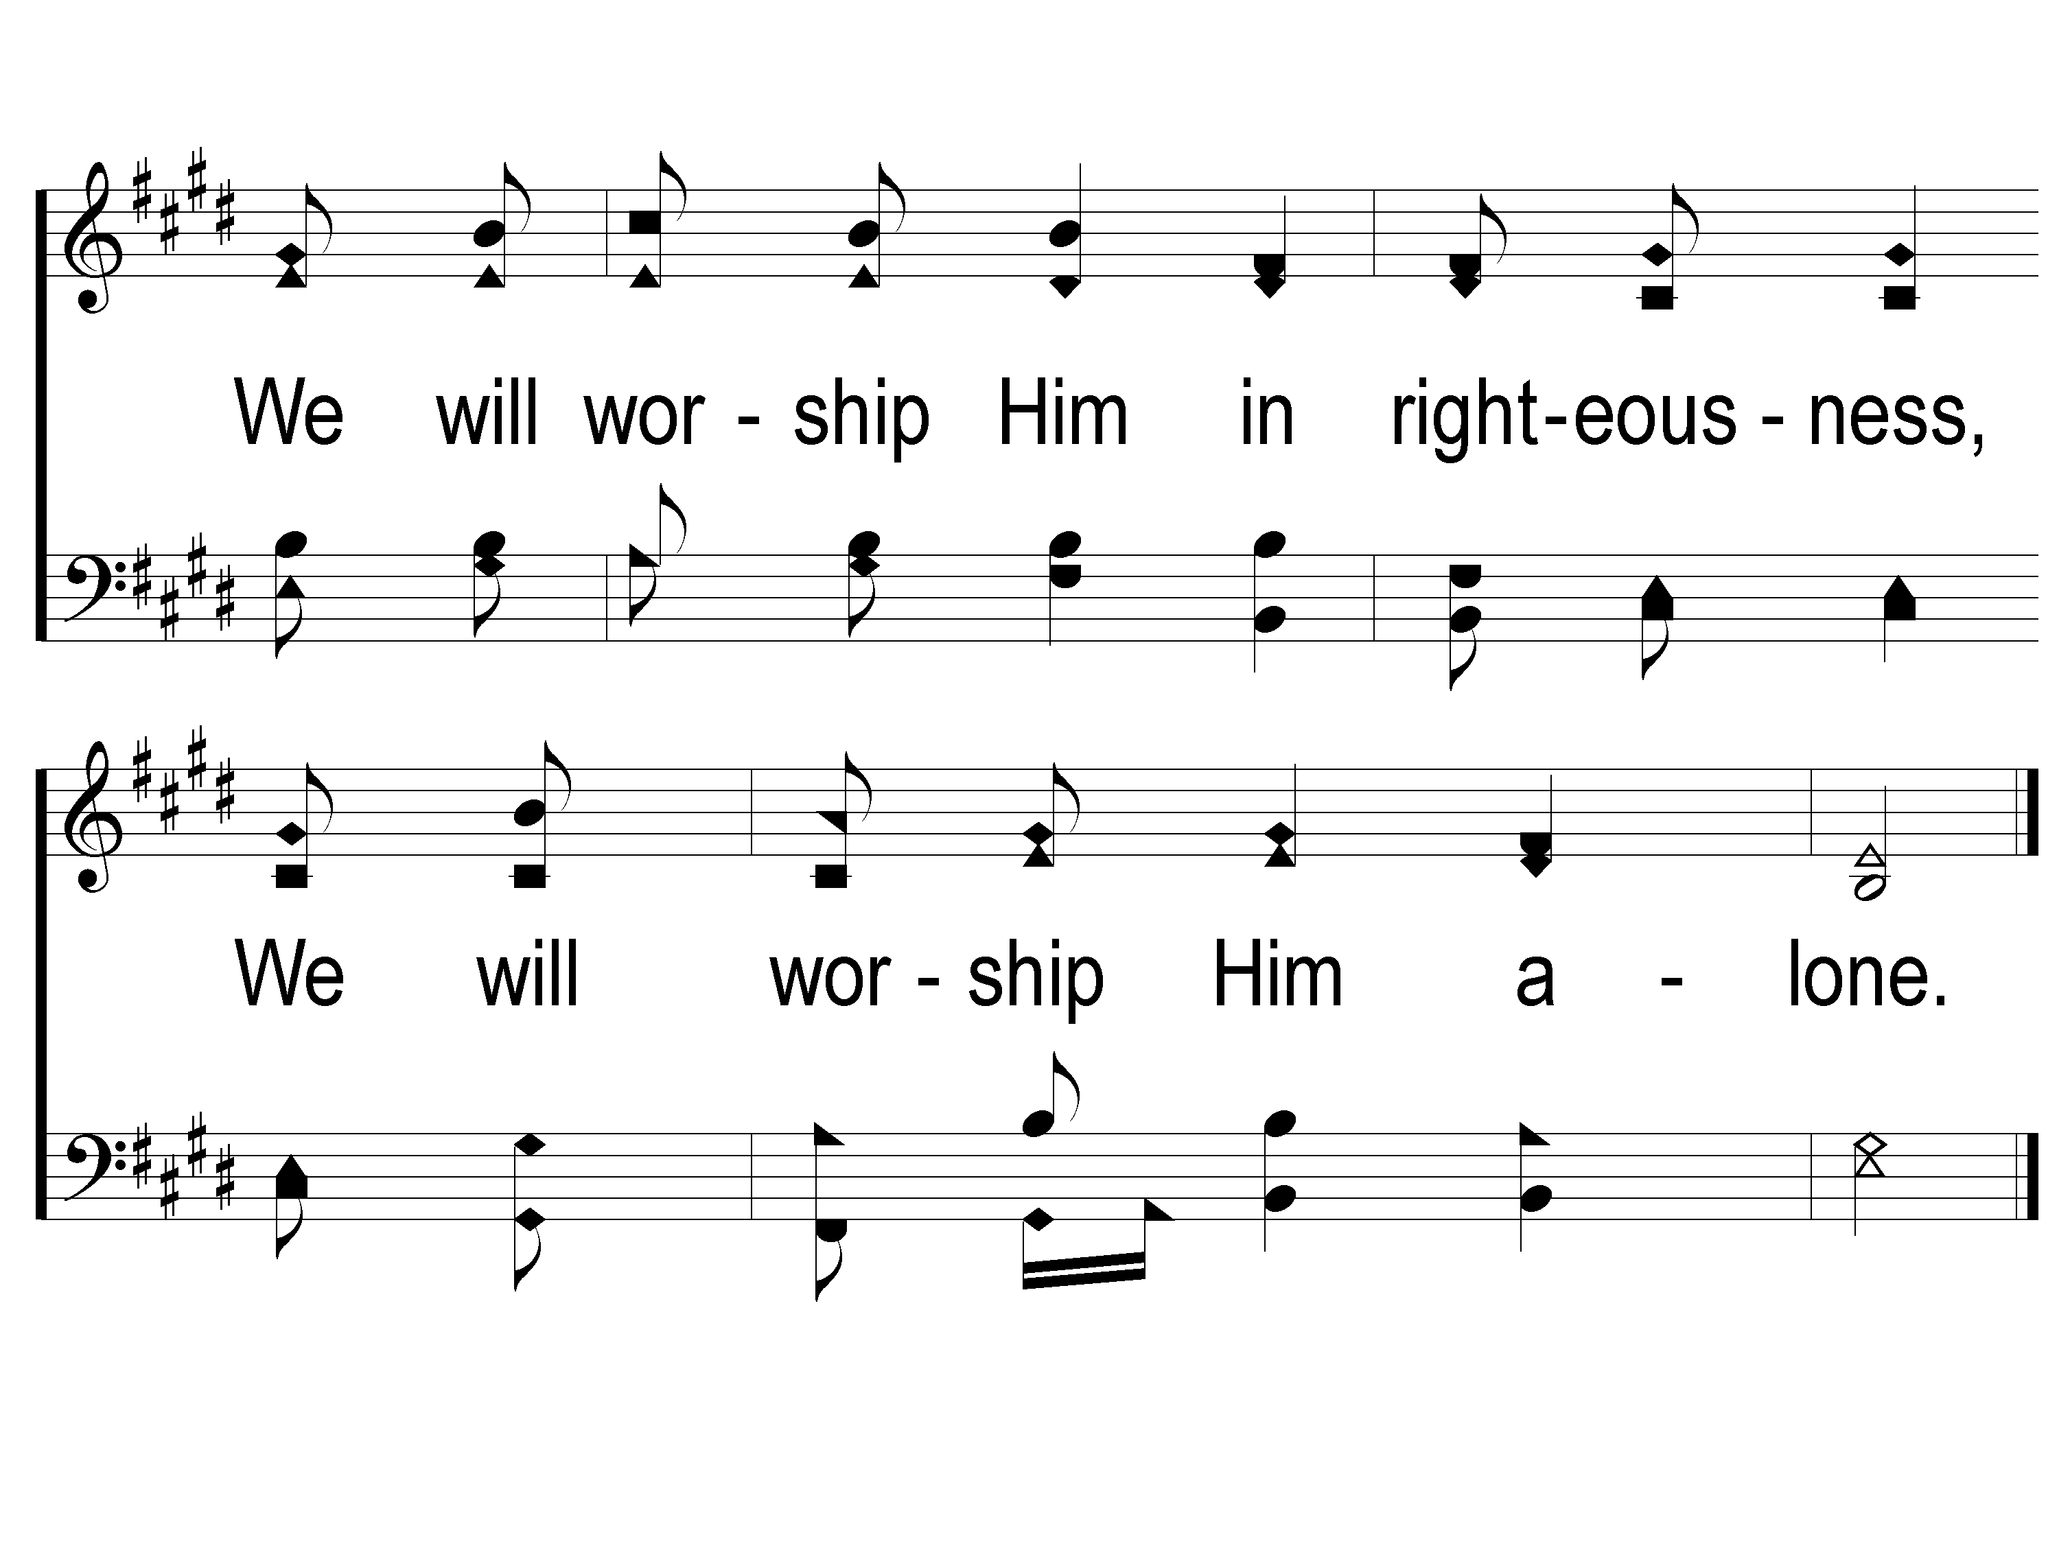
2-2 We Will Glorify
We Will Glorify
578

Slide 16
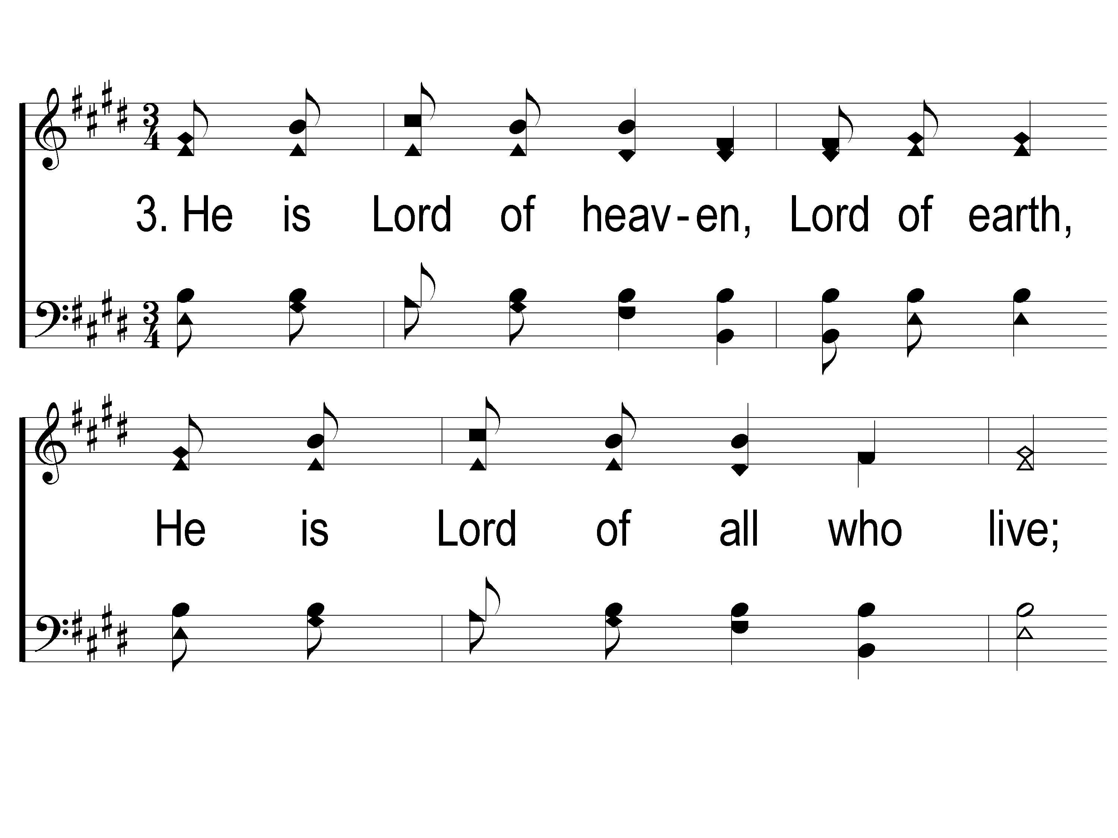
3-1 We Will Glorify
We Will Glorify
578

Slide 17
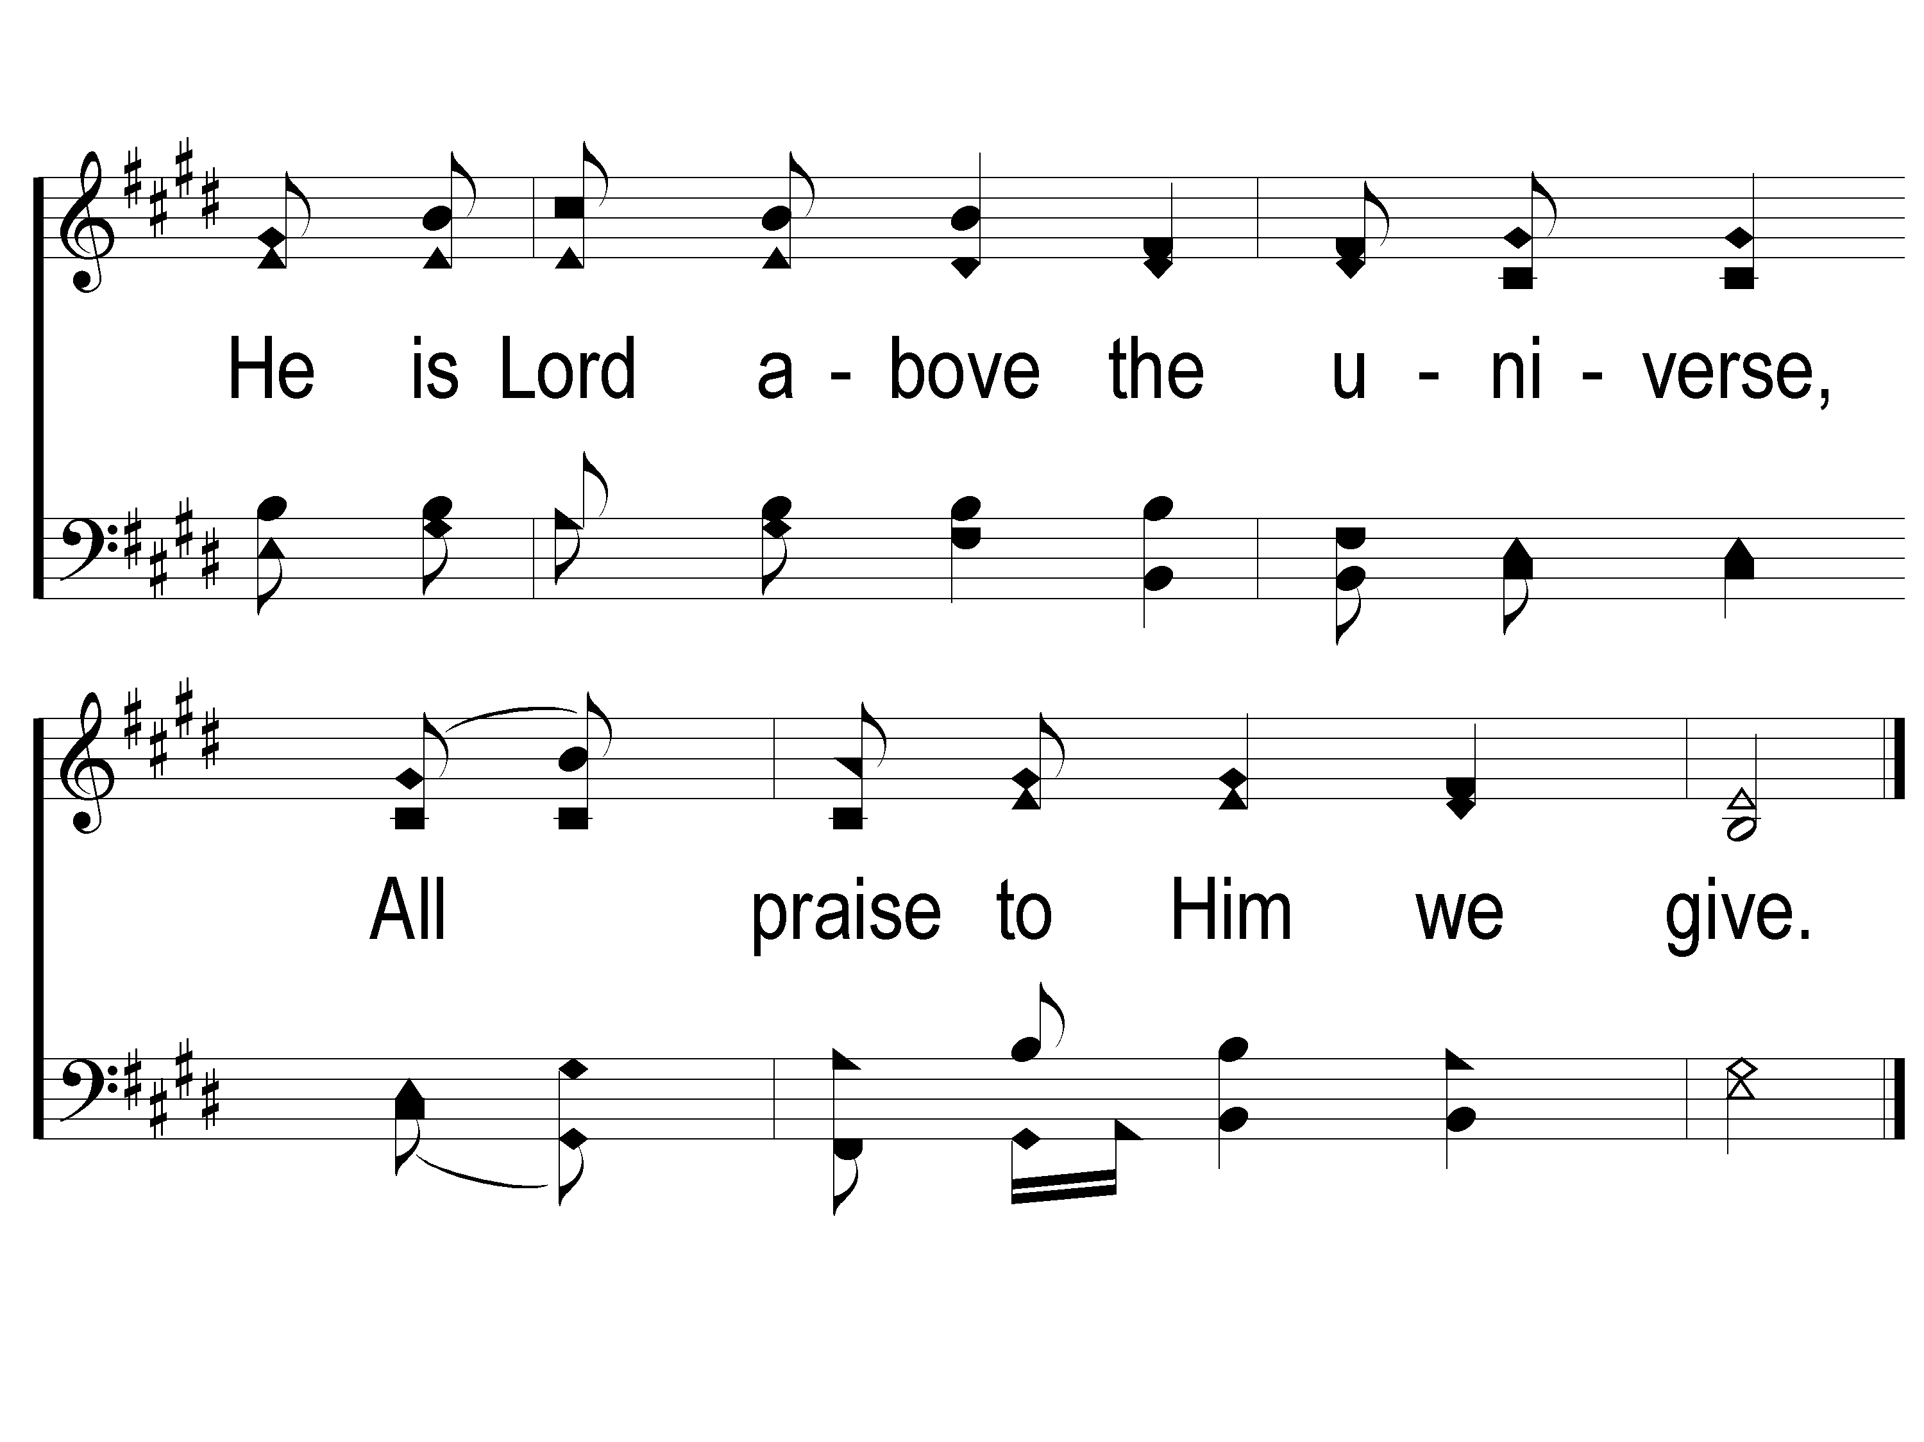
3-2 We Will Glorify
We Will Glorify
578

Slide 18
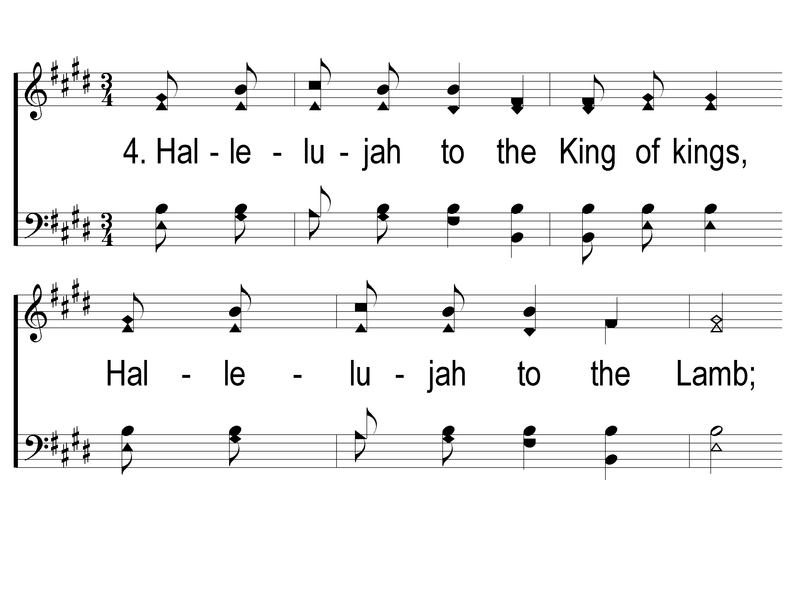
4-1 We Will Glorify
We Will Glorify
578

Slide 19
4-2 We Will Glorify
We Will Glorify
578

Slide 20
Song:
Jesus, Let Us
Come To Know You
#768

Slide 21
1-1 Jesus Let us Come to Know You
Jesus, Let Us Come to Know You
768

Slide 22
1-2 Jesus Let us Come to Know You
Jesus, Let Us Come to Know You
768

Slide 23
2-1 Jesus Let us Come to Know You
Jesus, Let Us Come to Know You
768

Slide 24
2-2 Jesus Let us Come to Know You
Jesus, Let Us Come to Know You
768

Slide 25
Opening Prayer

Slide 26
Song:
Hide Me, Rock Of Ages
#774

Slide 27
1-1 Hide Me Rock Of Ages
Hide Me, Rock Of Ages
774

Slide 28
1-2 Hide Me Rock Of Ages
Hide Me, Rock Of Ages
774

Slide 29
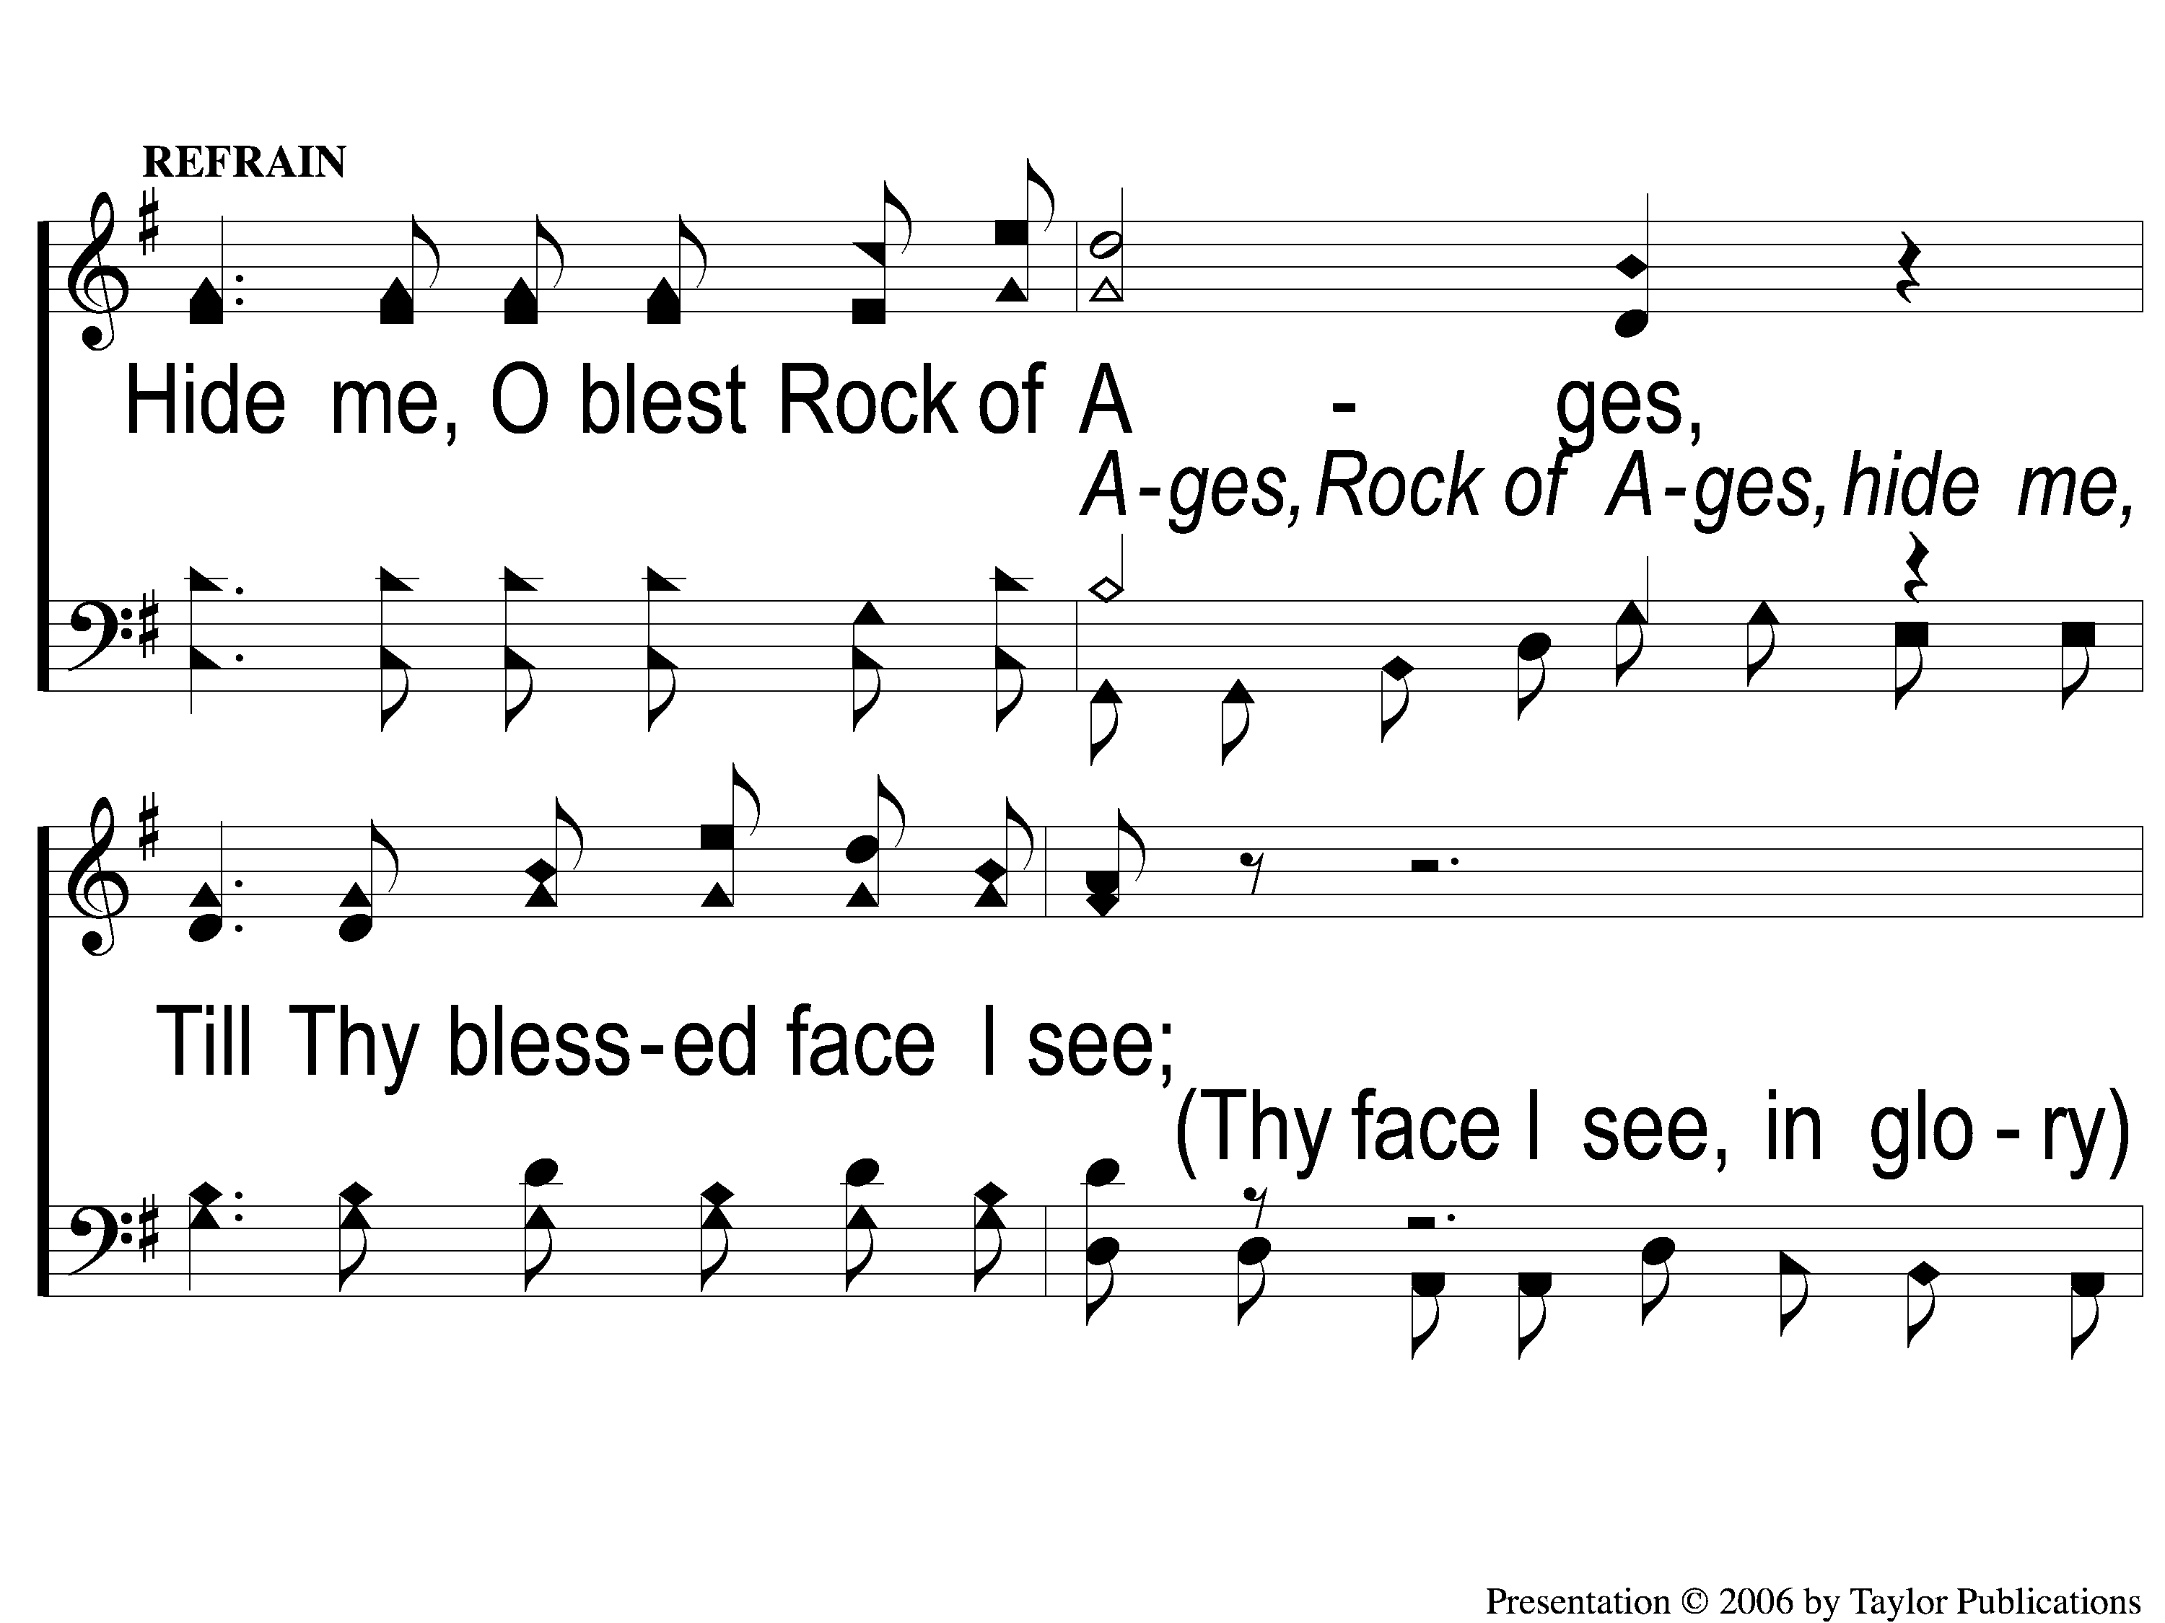
C-1 Hide Me Rock Of Ages
Hide Me, Rock Of Ages
774

Slide 30
C-2 Hide Me Rock Of Ages
Hide Me, Rock Of Ages
774

Slide 31
3-1 Hide Me Rock Of Ages
Hide Me, Rock Of Ages
774

Slide 32
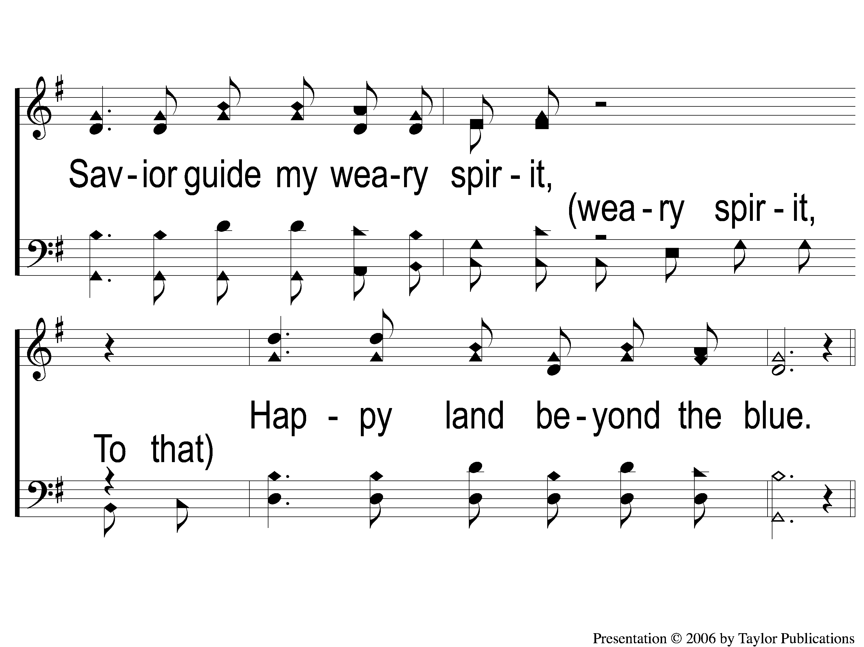
3-2 Hide Me Rock Of Ages
Hide Me, Rock Of Ages
774

Slide 33
C-1 Hide Me Rock Of Ages
Hide Me, Rock Of Ages
774

Slide 34
C-2 Hide Me Rock Of Ages
Hide Me, Rock Of Ages
774

Slide 35
Song:
In The Morning Of Joy
#887

Slide 36
1-1 In the Morning of Joy
In the Morning of Joy
887

Slide 37
1-2 In the Morning of Joy
In the Morning of Joy
887

Slide 38
1-3 In the Morning of Joy
In the Morning of Joy
887

Slide 39
C-1 In the Morning of Joy
In the Morning of Joy
887

Slide 40
C-2 In the Morning of Joy
In the Morning of Joy
887

Slide 41
2-1 In the Morning of Joy
In the Morning of Joy
887

Slide 42
2-2 In the Morning of Joy
In the Morning of Joy
887

Slide 43
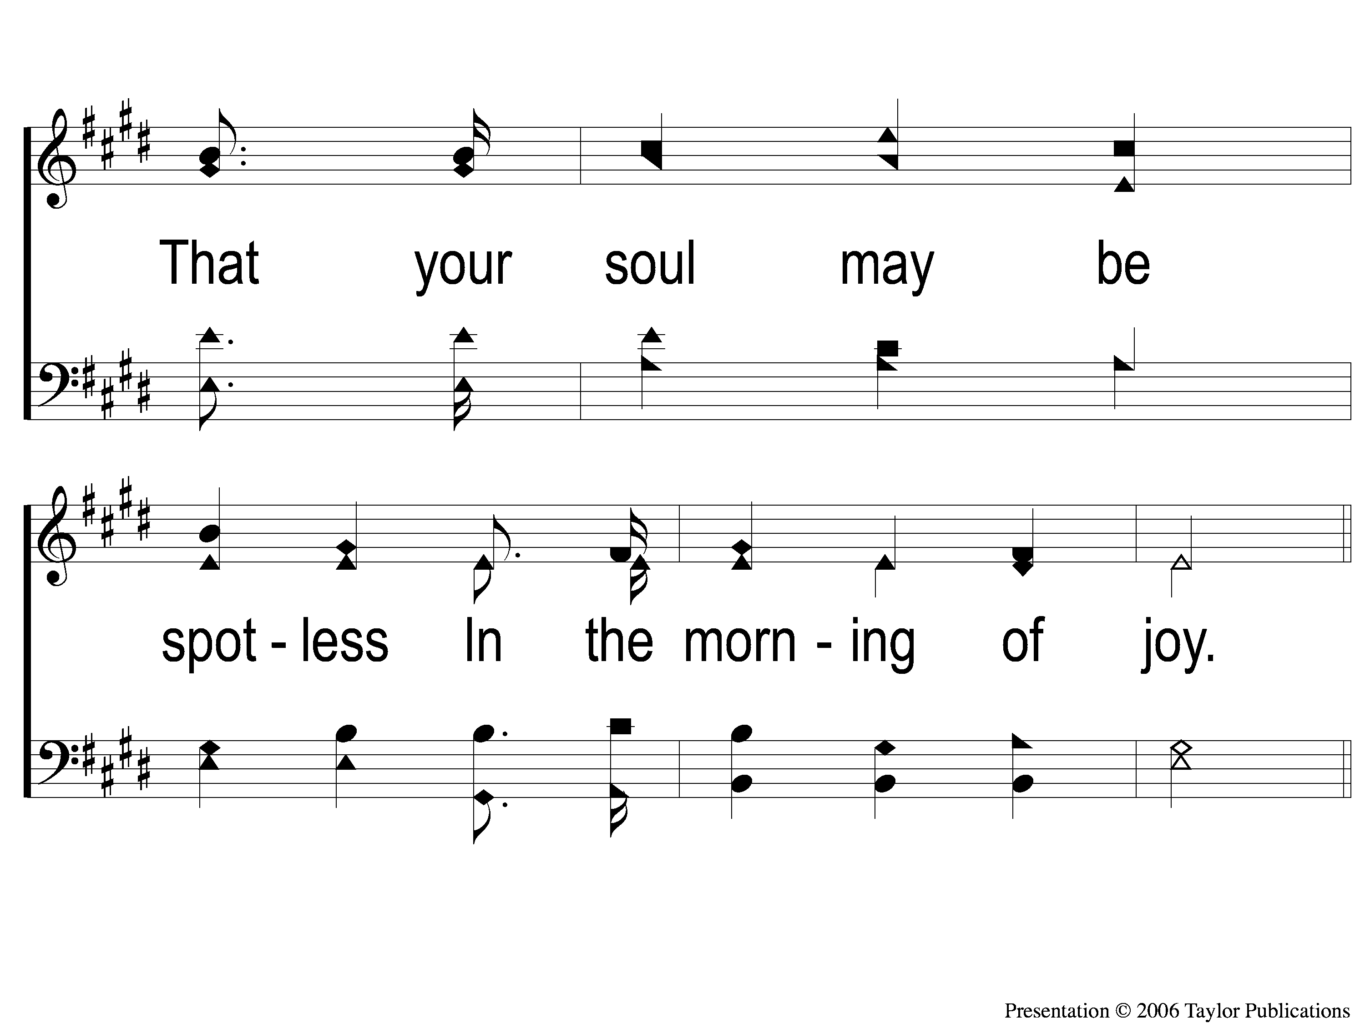
2-3 In the Morning of Joy
In the Morning of Joy
887

Slide 44
C-1 In the Morning of Joy
In the Morning of Joy
887

Slide 45
C-2 In the Morning of Joy
In the Morning of Joy
887

Slide 46
3-1 In the Morning of Joy
In the Morning of Joy
887

Slide 47
3-2 In the Morning of Joy
In the Morning of Joy
887

Slide 48
3-3 In the Morning of Joy
In the Morning of Joy
887

Slide 49
C-1 In the Morning of Joy
In the Morning of Joy
887

Slide 50
C-2 In the Morning of Joy
In the Morning of Joy
887

Slide 51
Scripture Reading:
John 20:1-10

Slide 52
Renewed Joy

Slide 53
Joy & The Christian
Heb. 12:2
Hab. 3:18
Psa. 46:1-3, 7, 51:12
Prov. 15:15, 17:22

Slide 54
John 20:19-20
Life with the Risen Savior…

Slide 55
Life with the Risen Savior…
…Calms our Fears

Slide 56
Calms Our Fears
Fears Are Natural
Jn. 20:9, 19
2 Cor. 7:5

Slide 57
Calms Our Fears
Fears Can Be Calmed
Jn. 14:27, 16:33, 20:20
Eph. 2:17, Phili. 4:7

Slide 58
Life with the Risen Savior…
…Calms our Fears
…Renews our Joy

Slide 59
Renews Our Joy
Trials Test Our Joy
Jms. 1:2
1 Pet. 1:6

Slide 60
Renews Our Joy
Endurance Renews Our Joy
Jn. 16:20-22, 20:20
Matt. 28:5-8

Slide 61
Life with the Risen Savior…
…Calms our Fears
…Renews our Joy
…Anchors us in Hope

Slide 62
Anchors Us In Hope
Life without the Risen Savior = Hopeless

Slide 63
Anchors Us In Hope
Life without the Risen Savior = Hopeless
Jn. 20:19, Lk. 22:54, Mk. 14:50

Slide 64
Anchors Us In Hope
Life without the Risen Savior = Hopeless
Life WITH the Risen Savior = Hopeful
1 Pet. 1:3-4, 1 Cor. 15:12-19

Slide 65
Do You Know
The Risen Savior?

Slide 66
Do You Know My Jesus
#943
Invitation
Song:

Slide 67
1-1 Do You Know my Jesus
Do You Know My Jesus
943

Slide 68
1-2 Do You Know my Jesus
Do You Know My Jesus
943

Slide 69
C-1 Do You Know my Jesus
Do You Know My Jesus
943

Slide 70
C-2 Do You Know my Jesus
Do You Know My Jesus
943

Slide 71
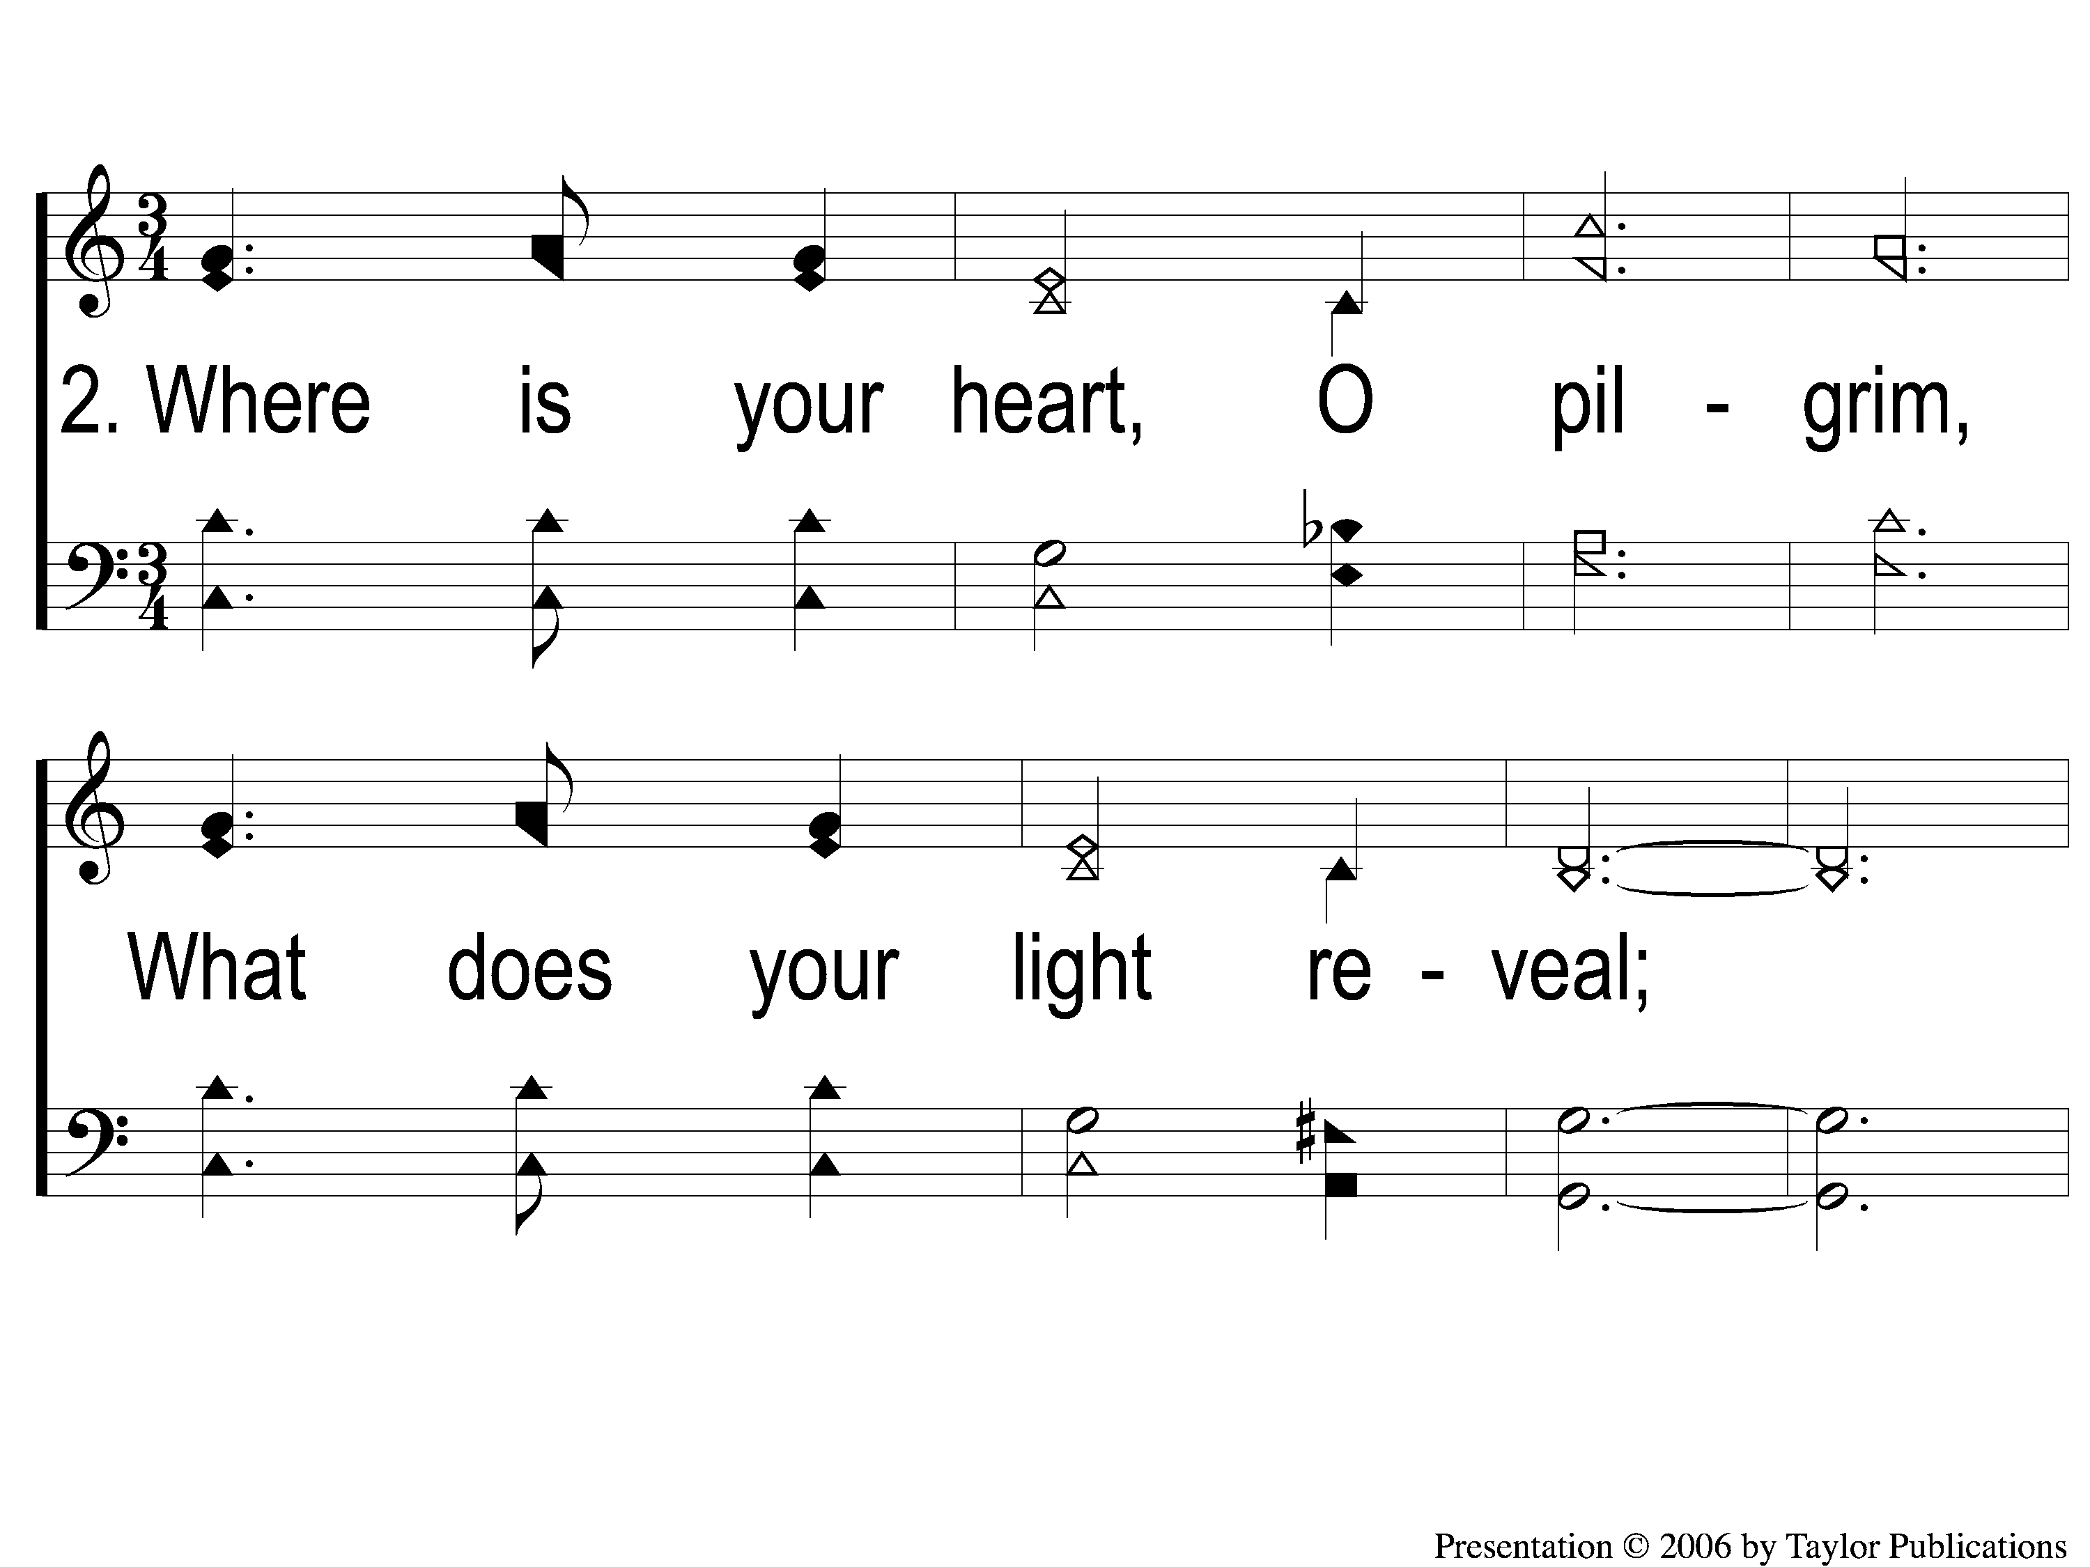
2-1 Do You Know my Jesus
Do You Know My Jesus
943

Slide 72
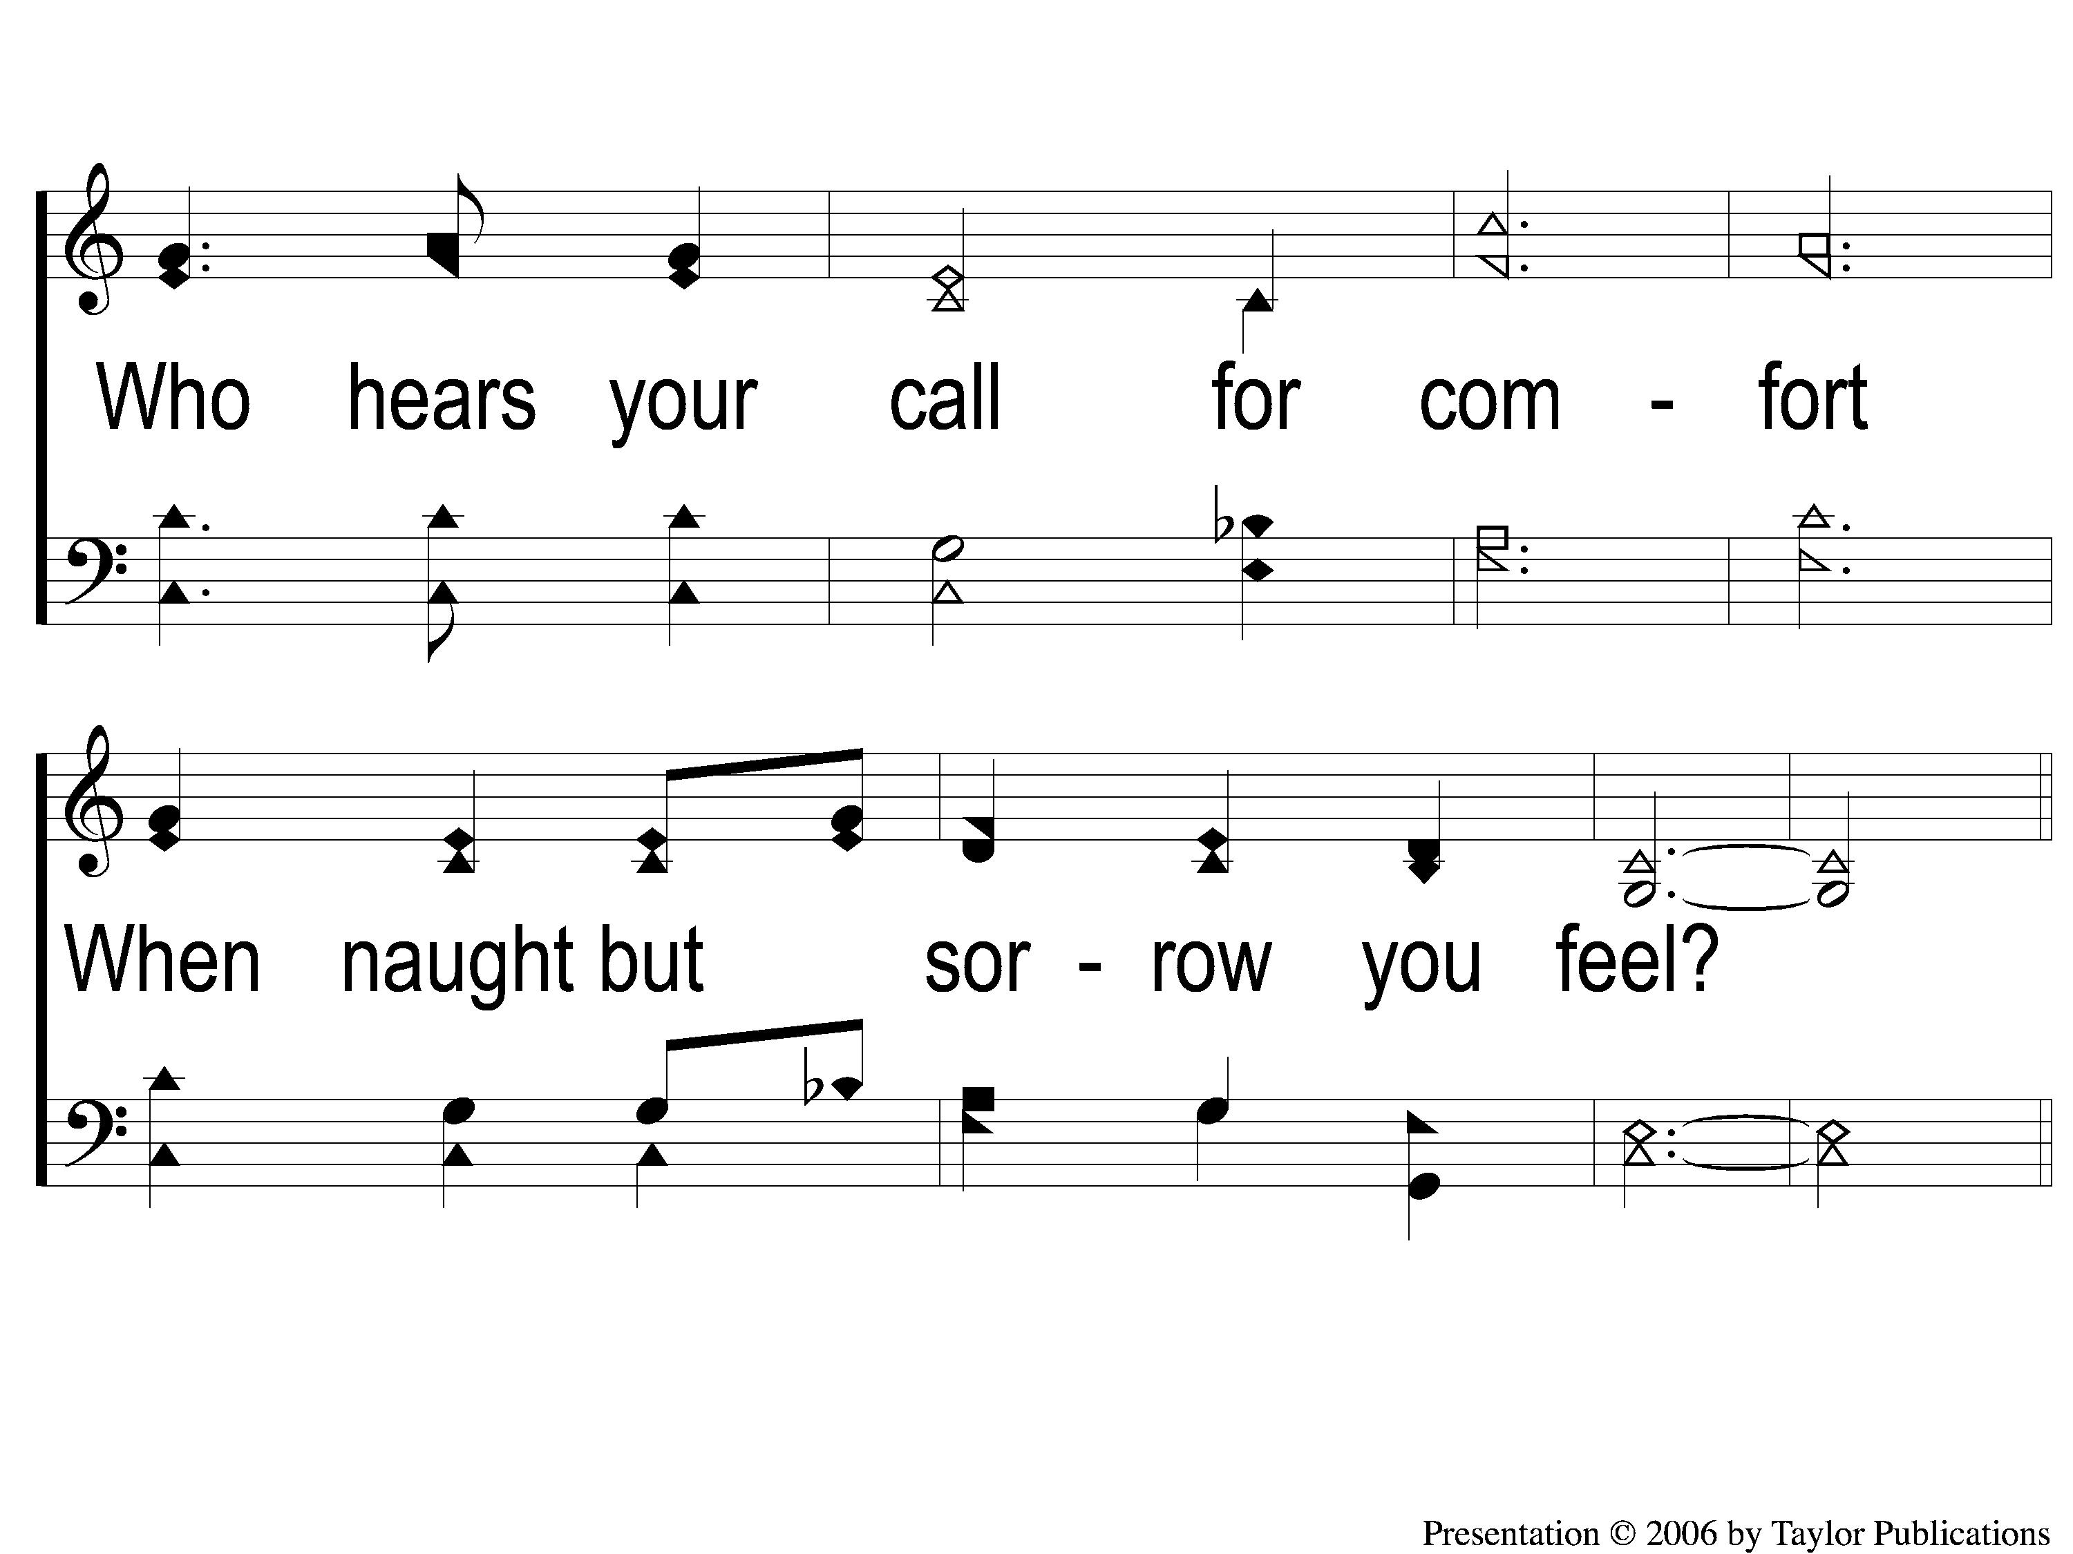
2-2 Do You Know my Jesus
Do You Know My Jesus
943

Slide 73
C-1 Do You Know my Jesus
Do You Know My Jesus
943

Slide 74
C-2 Do You Know my Jesus
Do You Know My Jesus
943

Slide 75
3-1 Do You Know my Jesus
Do You Know My Jesus
943

Slide 76
3-2 Do You Know my Jesus
Do You Know My Jesus
943

Slide 77
C-1 Do You Know my Jesus
Do You Know My Jesus
943

Slide 78
C-2 Do You Know my Jesus
Do You Know My Jesus
943

Slide 79
Our Contribution:
Luke 6:38
“Give, and it will be given to you: good measure, pressed down, shaken together, and running over will be put into your bosom. For with the same measure that you use, it will be measured back to you.”

Slide 80
Song:
I Love The Lord
#359

Slide 81
1-1 I Love the Lord
I Love The Lord
359

Slide 82
1-2 I Love the Lord
I Love The Lord
359

Slide 83
C-1 I Love the Lord
I Love The Lord
359

Slide 84
C-2 I Love the Lord
I Love The Lord
359

Slide 85
2-1 I Love the Lord
I Love The Lord
359

Slide 86
2-2 I Love the Lord
I Love The Lord
359

Slide 87
C-1 I Love the Lord
I Love The Lord
359

Slide 88
C-2 I Love the Lord
I Love The Lord
359

Slide 89
3-1 I Love the Lord
I Love The Lord
359

Slide 90
3-2 I Love the Lord
I Love The Lord
359

Slide 91
C-1 I Love the Lord
I Love The Lord
359

Slide 92
C-2 I Love the Lord
I Love The Lord
359

Slide 93
The Unleavened Bread
Luke 22:14-16, 19
“When the hour had come, He sat down, and the twelve apostles with Him. Then He said to them, ‘With fervent desire I have desired to eat this Passover with you before I suffer; for I say to you, I will no longer eat of it until it is fulfilled in the kingdom of God.’ ”…“And He took bread, gave thanks and broke it, and gave it to them, saying, ‘This is My body which is given for you; do this in remembrance of Me.’ ”

Slide 94
The Fruit
of the Vine
Luke 22:17-18
“Then He took the cup, and gave thanks, and said, ‘Take this and divide it among yourselves; for I say to you, I will not drink of the fruit of the vine until the kingdom of God comes.’ ”

Slide 95
Closing Prayer

Slide 96
Song:
Beyond This Land Of Parting
#870

Slide 97
1-1 Beyond this Land of Parting
Beyond This Land Of Parting
870
ePraise Hymn Presentation © 2005 Taylor Publications

Slide 98
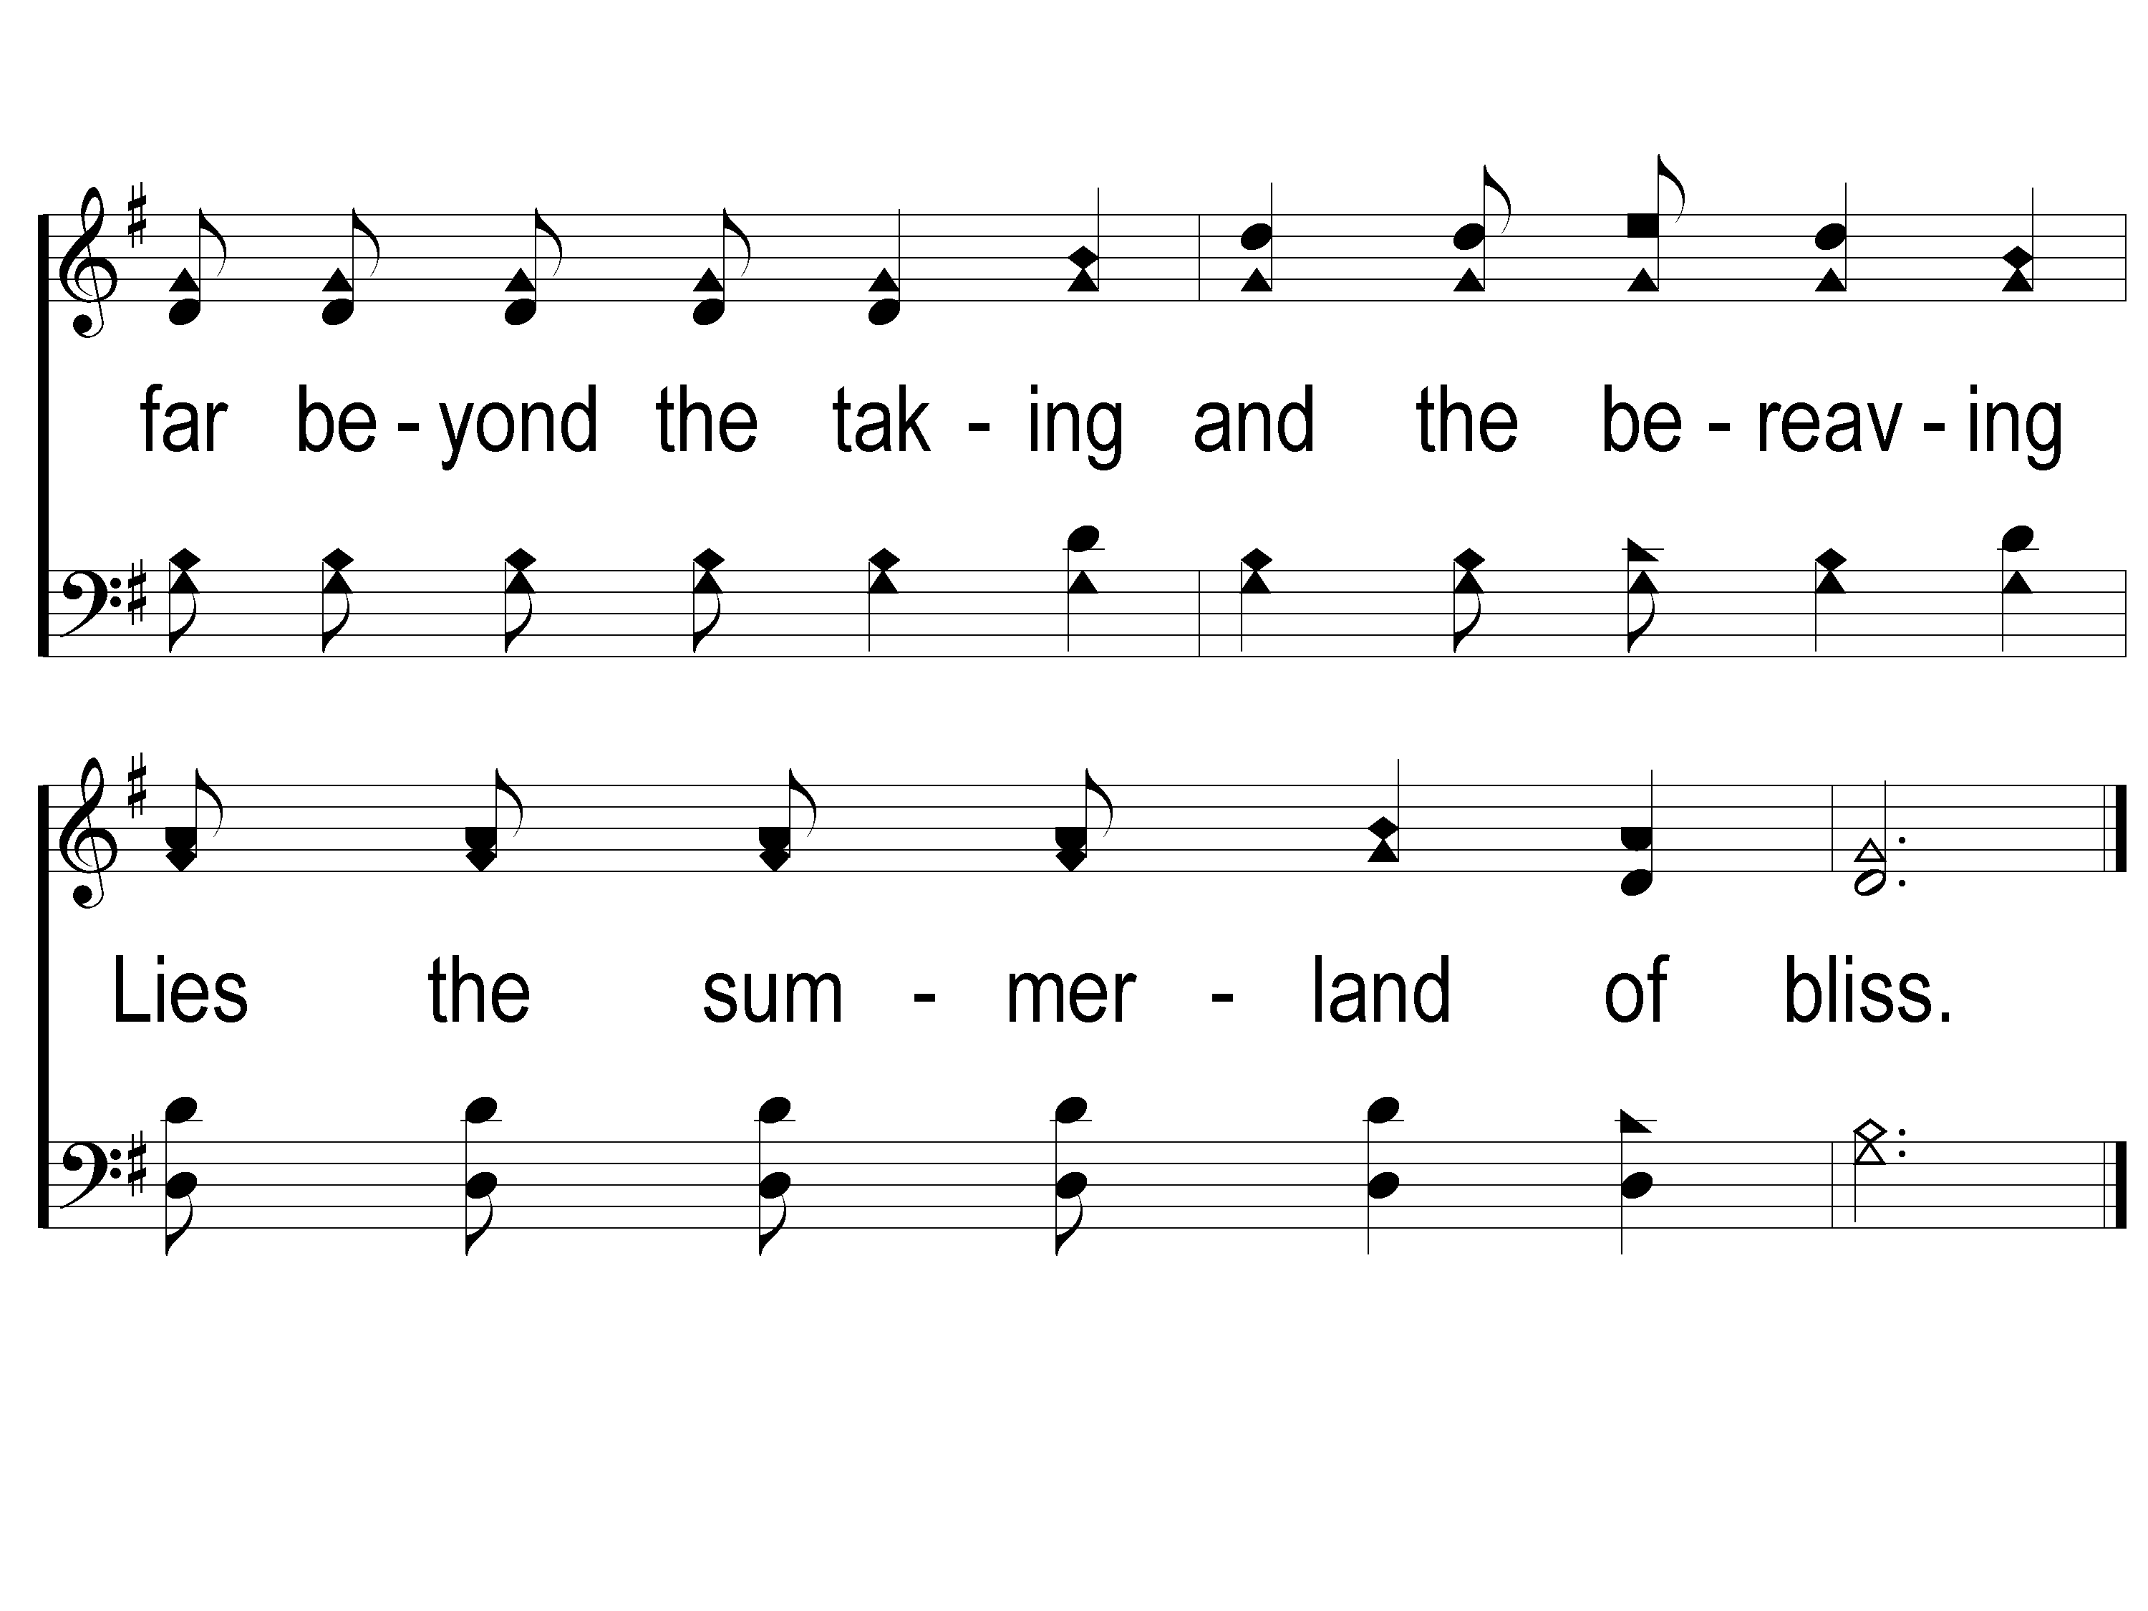
1-2 Beyond this Land of Parting
Beyond This Land Of Parting
870
ePraise Hymn Presentation © 2005 Taylor Publications

Slide 99
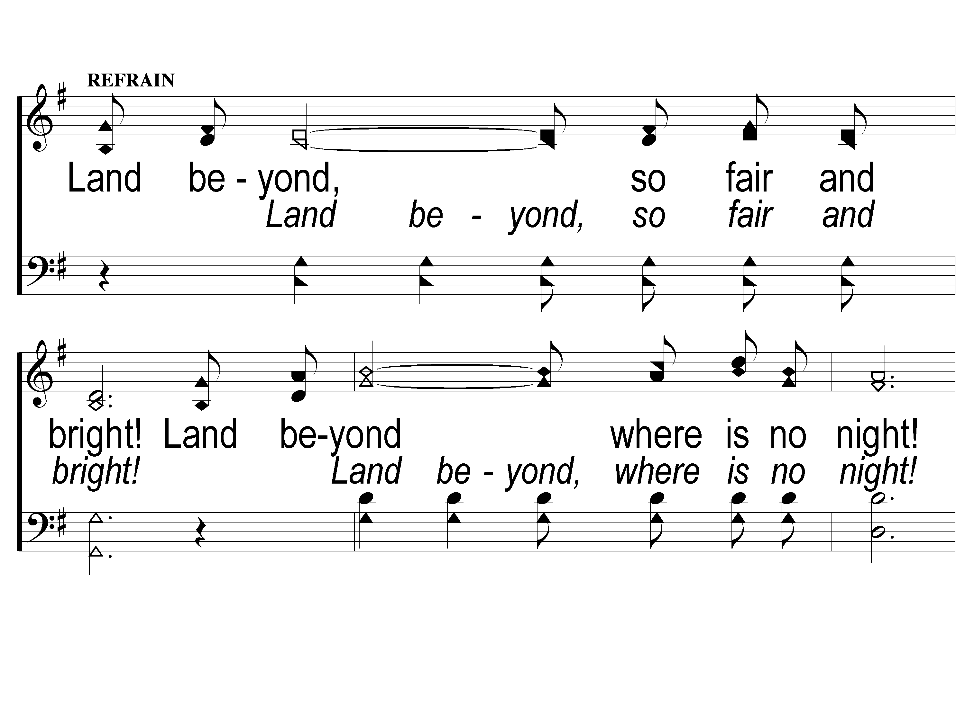
C-1 Beyond this Land of Parting
Beyond This Land Of Parting
870
ePraise Hymn Presentation © 2005 Taylor Publications

Slide 100
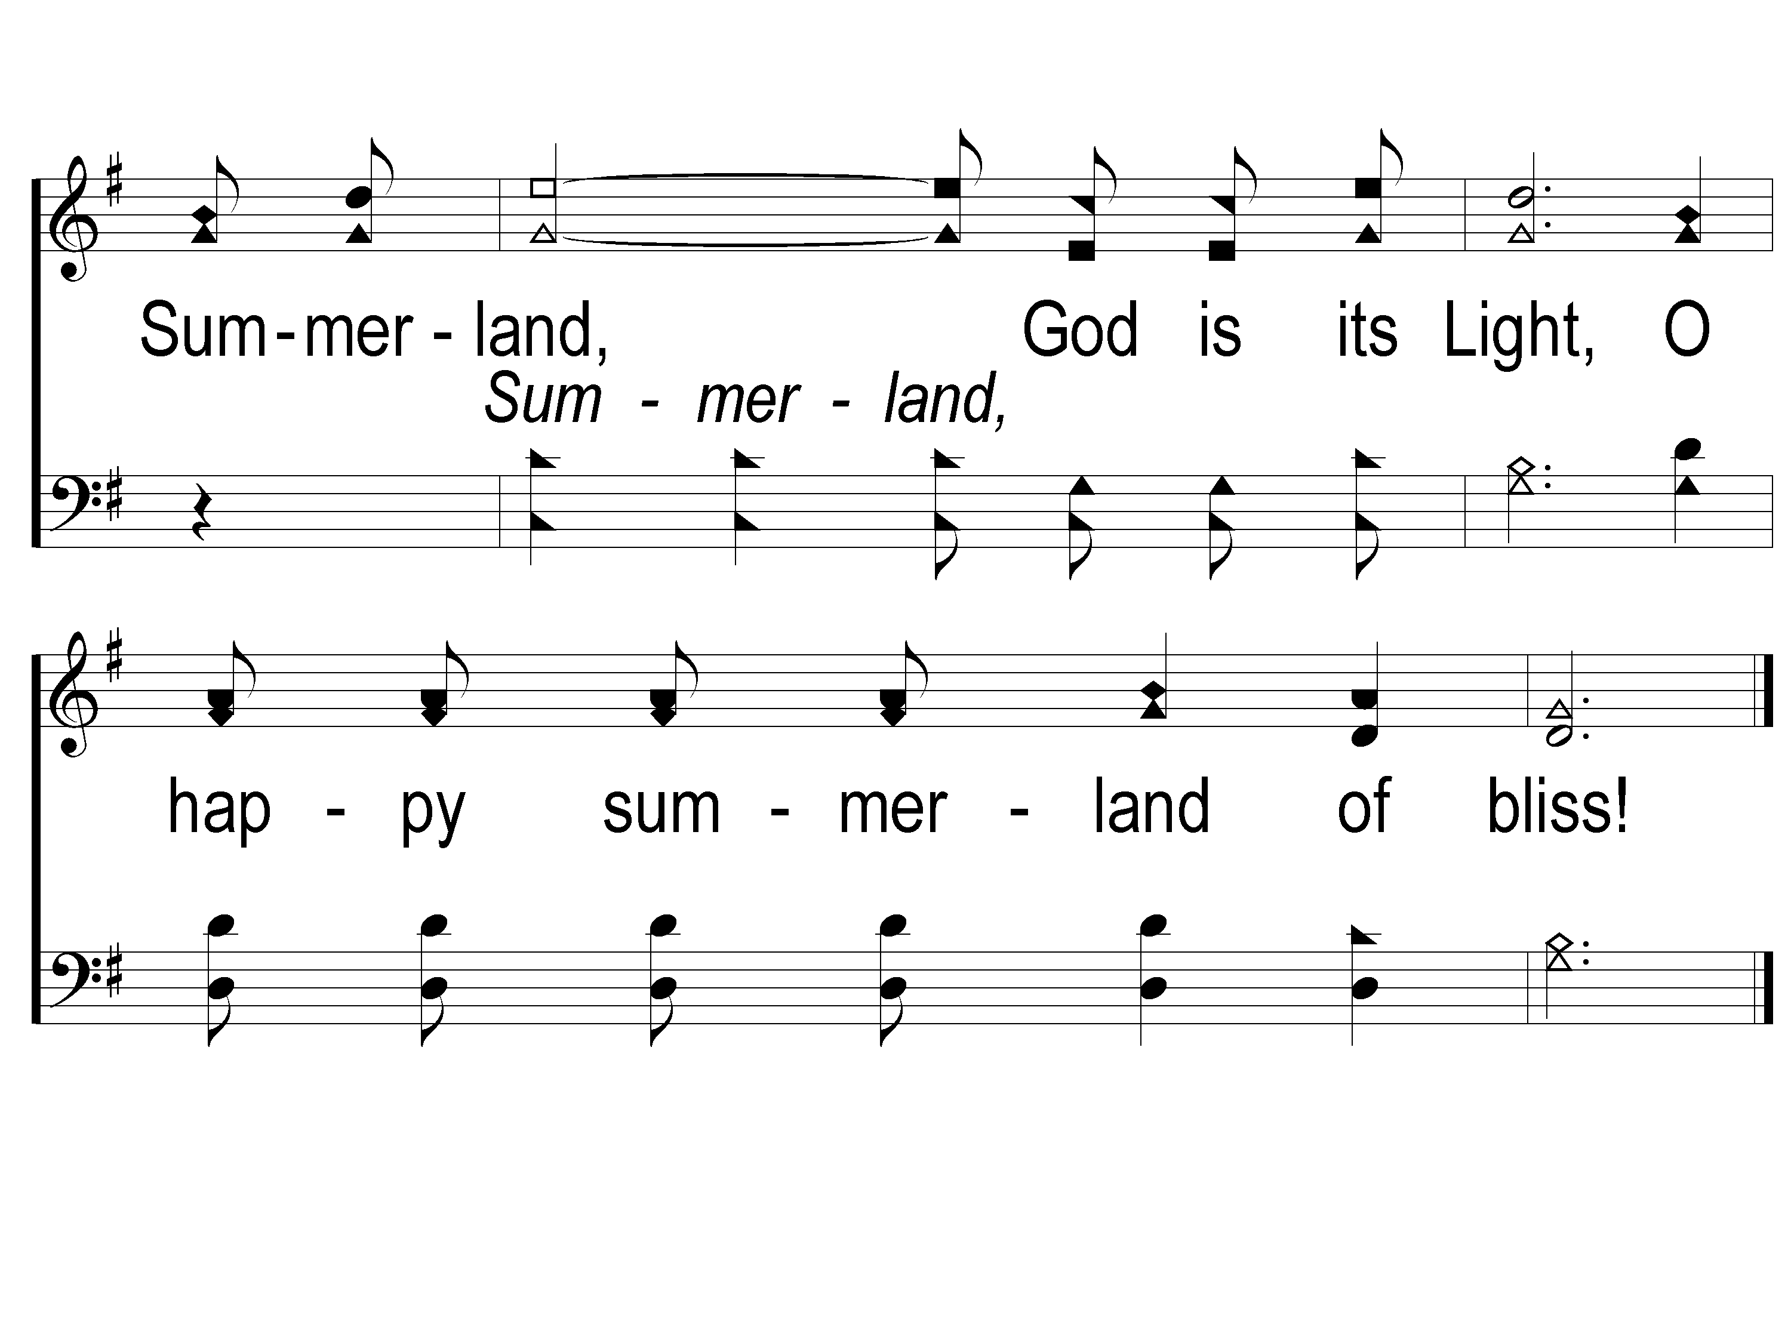
C-2 Beyond this Land of Parting
Beyond This Land Of Parting
870
ePraise Hymn Presentation © 2005 Taylor Publications

Slide 101
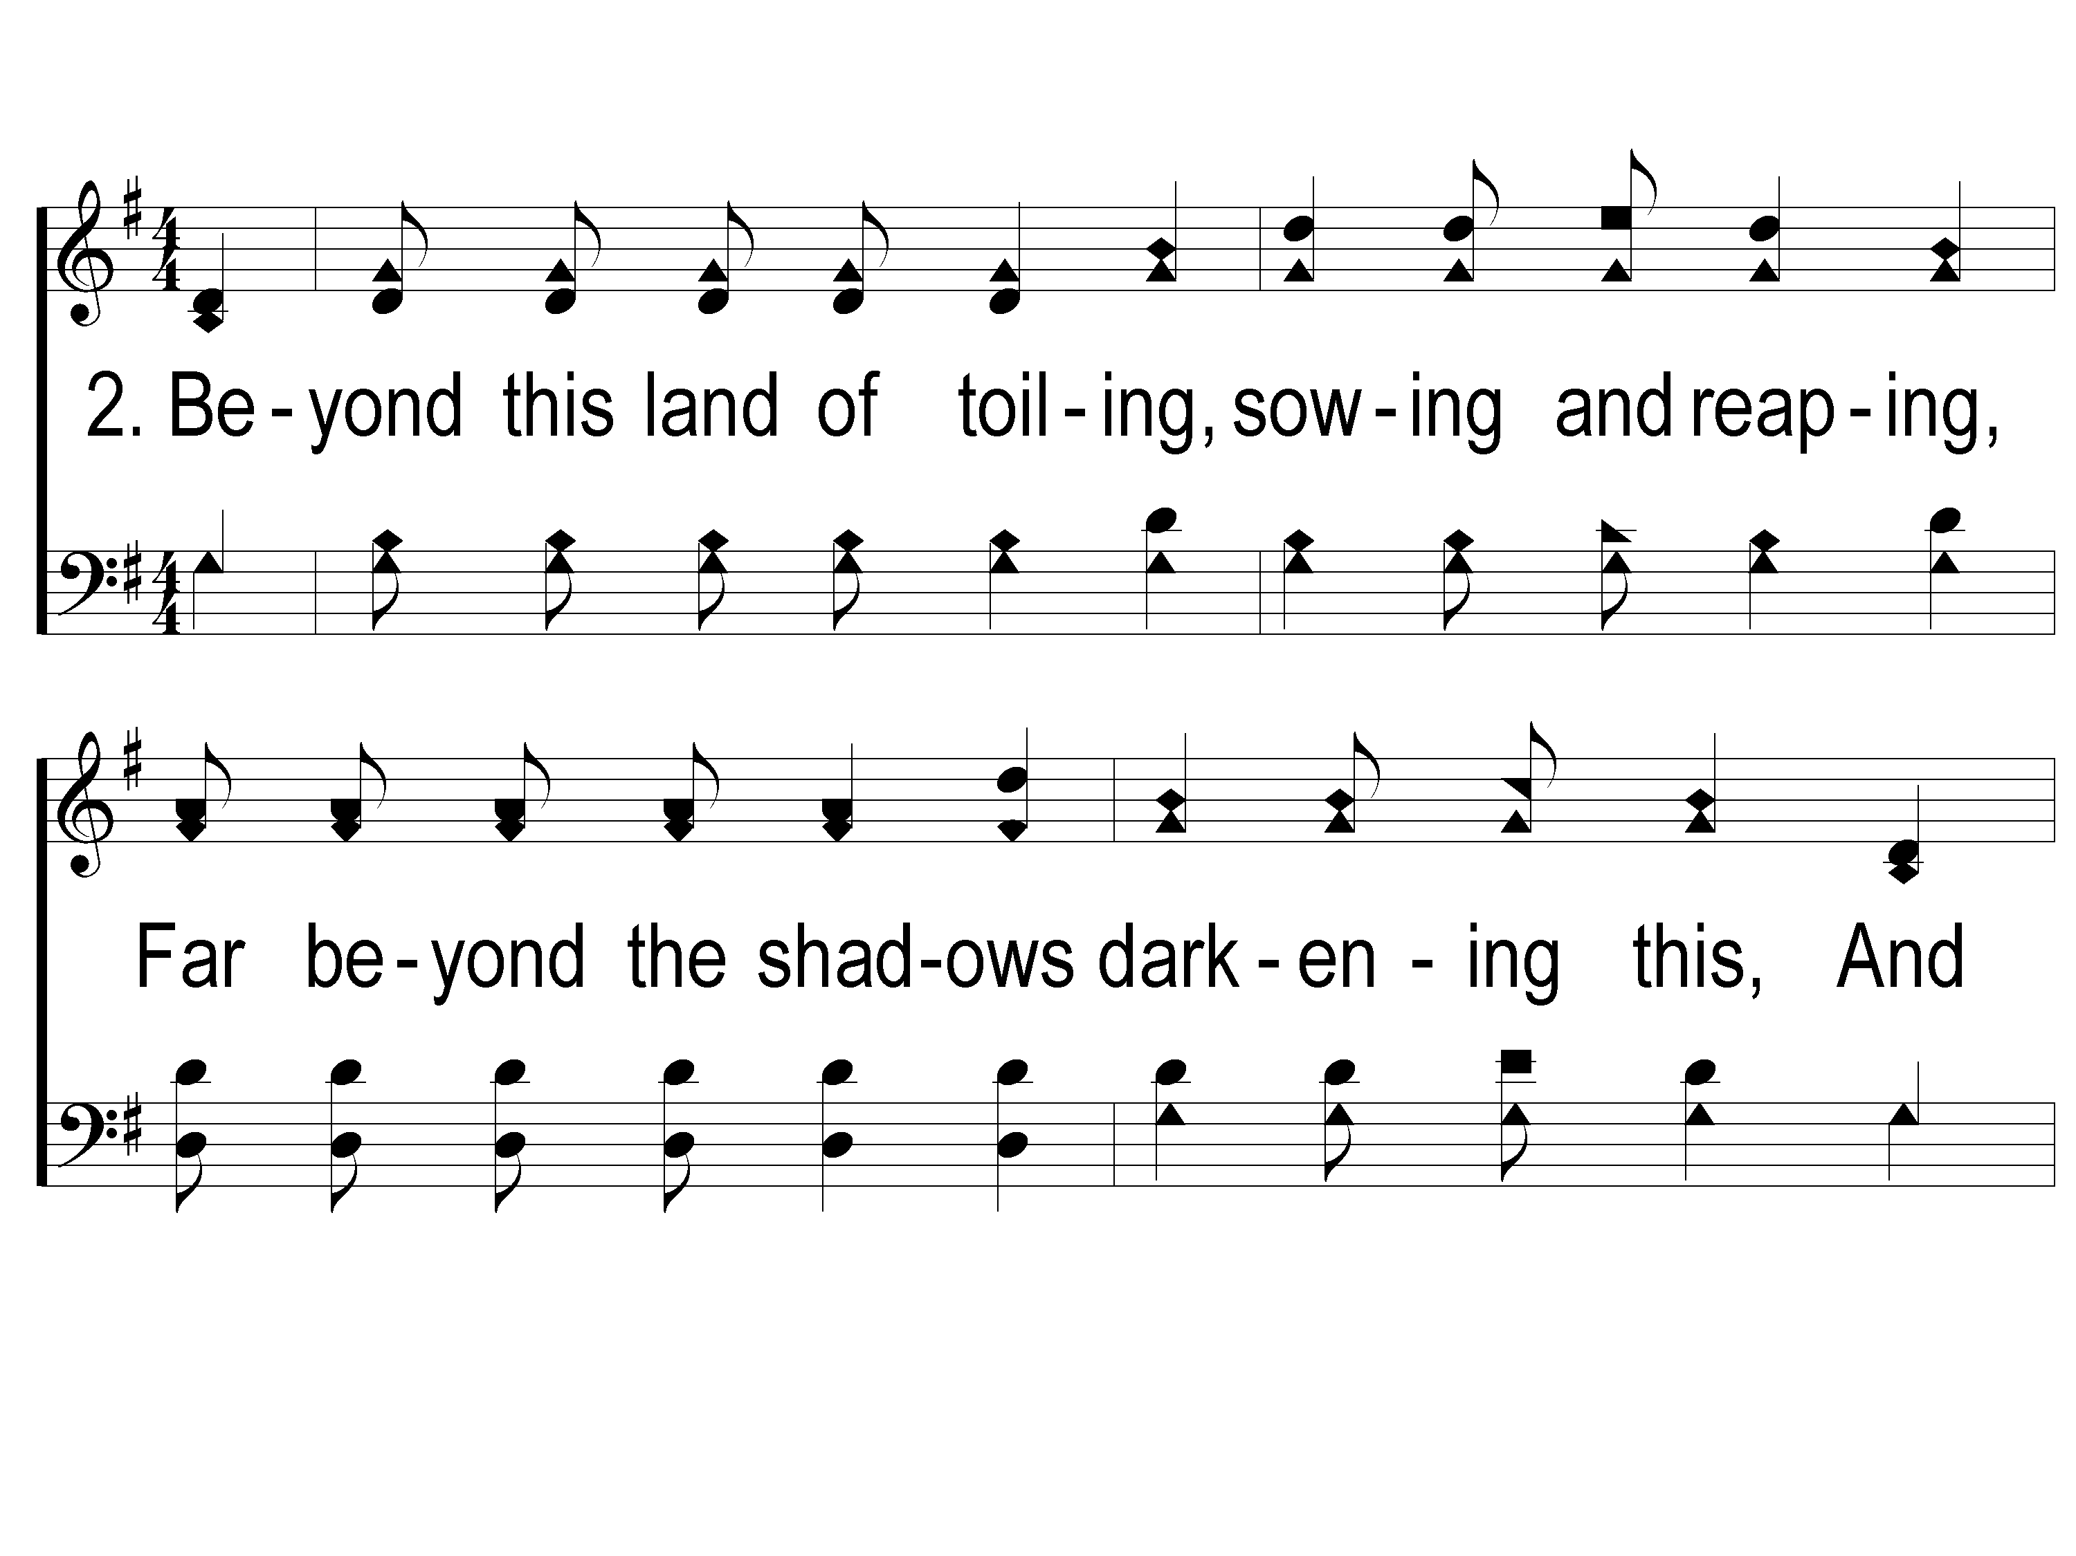
2-1 Beyond this Land of Parting
Beyond This Land Of Parting
870
ePraise Hymn Presentation © 2005 Taylor Publications

Slide 102
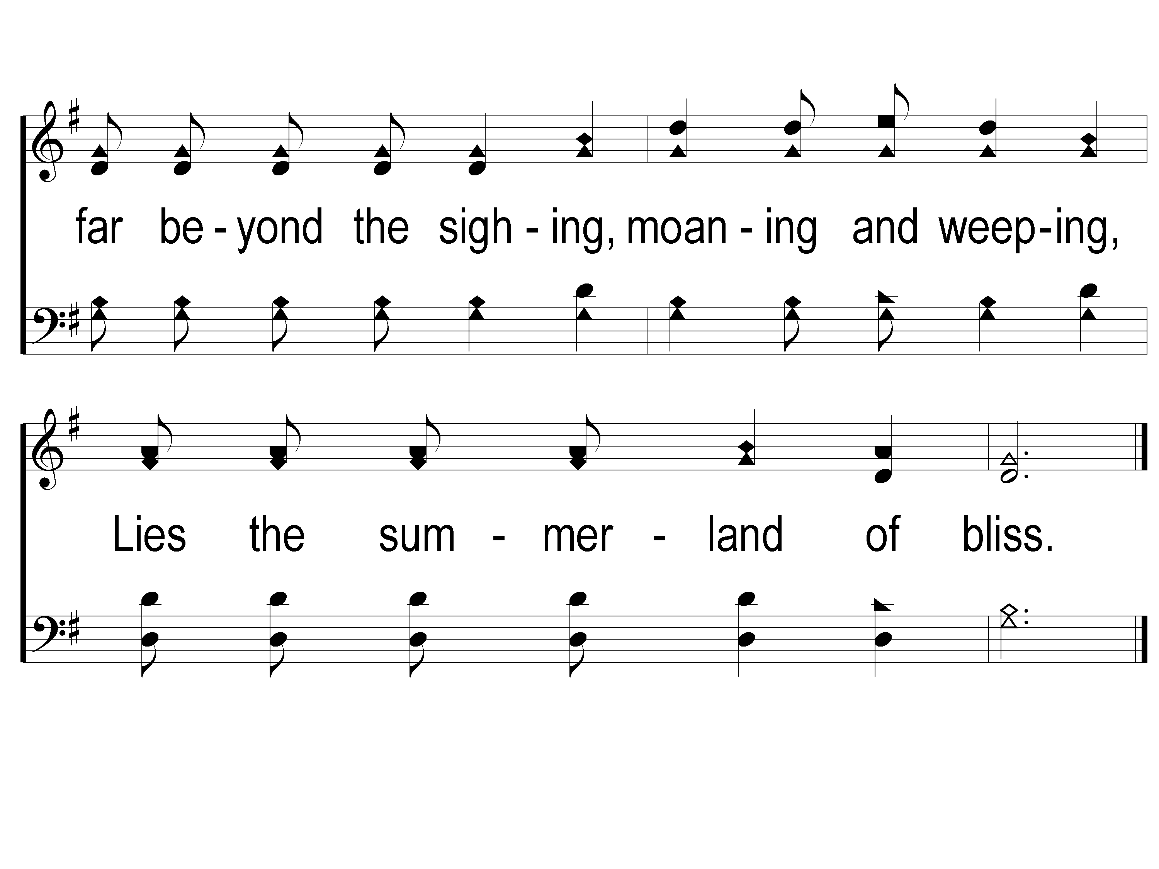
2-2 Beyond this Land of Parting
Beyond This Land Of Parting
870
ePraise Hymn Presentation © 2005 Taylor Publications

Slide 103
C-1 Beyond this Land of Parting
Beyond This Land Of Parting
870
ePraise Hymn Presentation © 2005 Taylor Publications

Slide 104
C-2 Beyond this Land of Parting
Beyond This Land Of Parting
870
ePraise Hymn Presentation © 2005 Taylor Publications

Slide 105
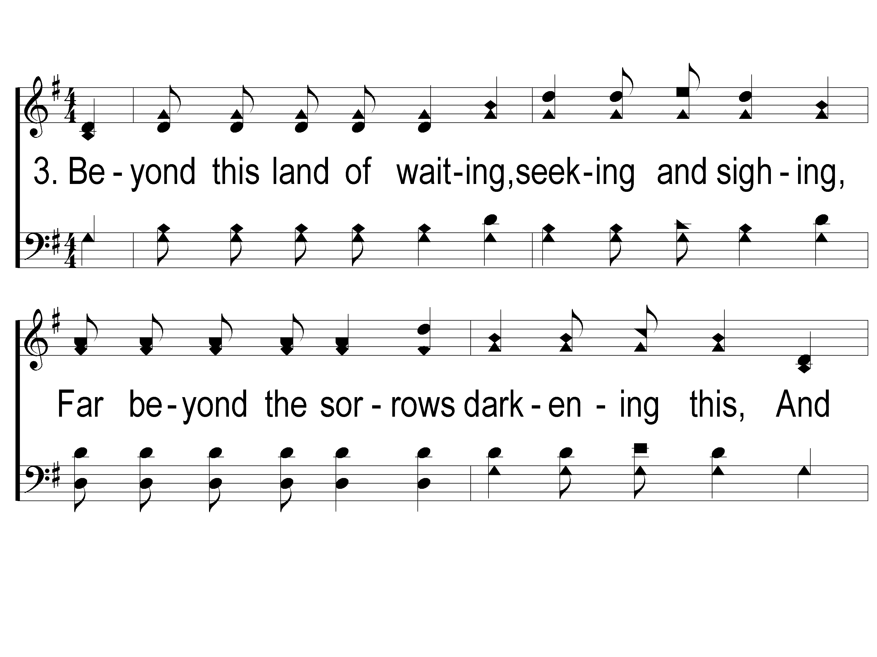
3-1 Beyond this Land of Parting
Beyond This Land Of Parting
870
ePraise Hymn Presentation © 2005 Taylor Publications

Slide 106
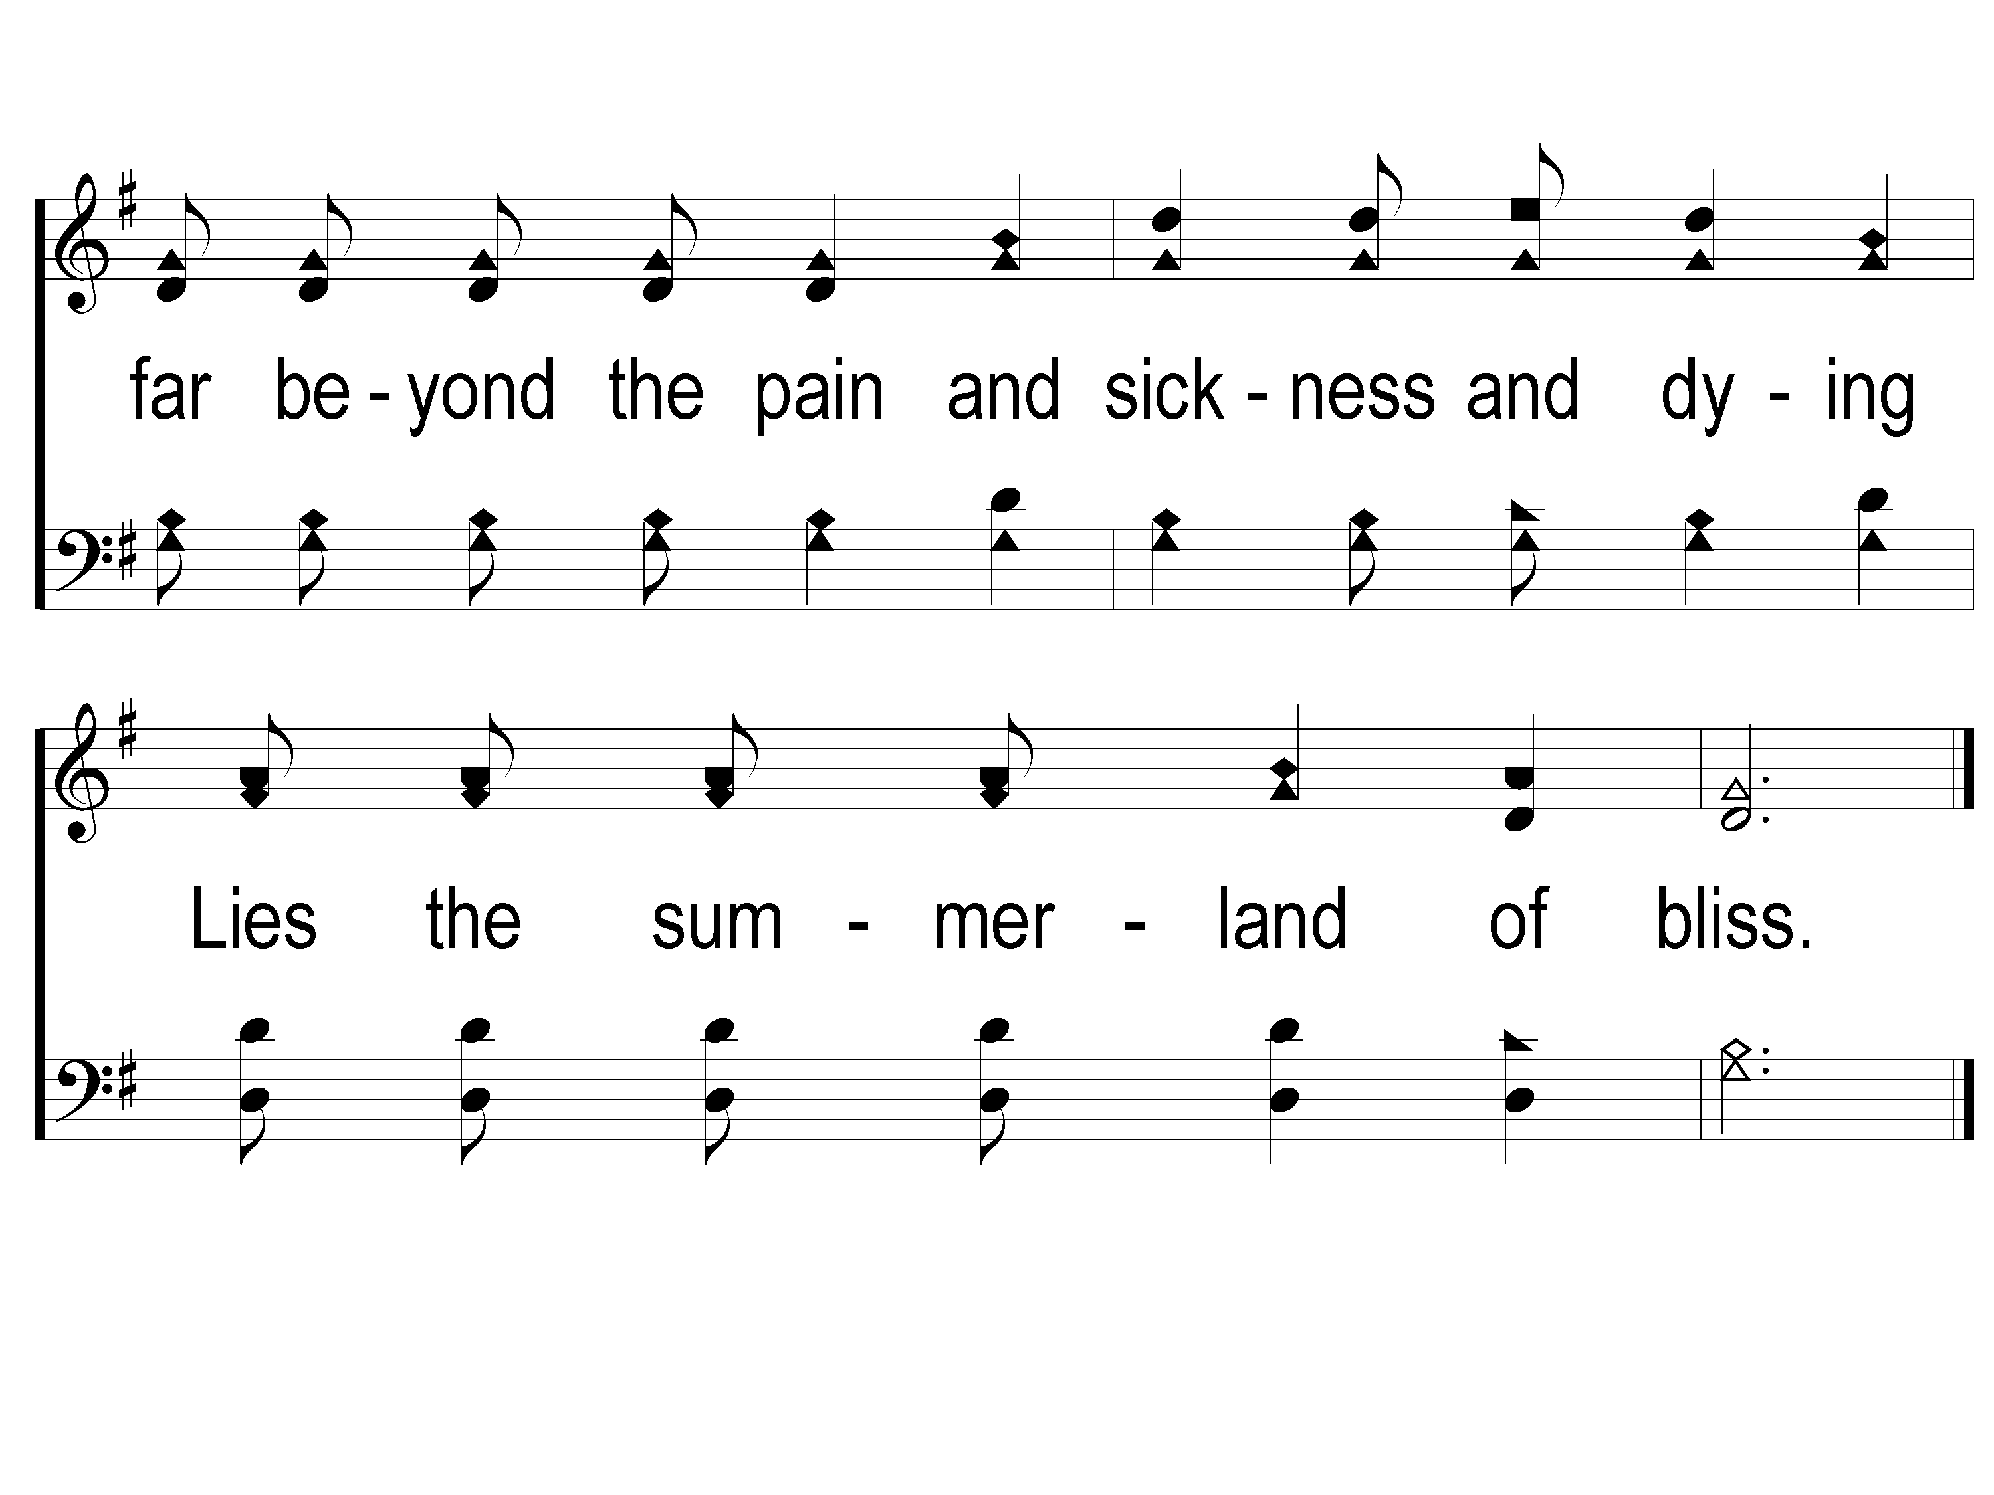
3-2 Beyond this Land of Parting
Beyond This Land Of Parting
870
ePraise Hymn Presentation © 2005 Taylor Publications

Slide 107
C-1 Beyond this Land of Parting
Beyond This Land Of Parting
870
ePraise Hymn Presentation © 2005 Taylor Publications

Slide 108
C-2 Beyond this Land of Parting
Beyond This Land Of Parting
870
ePraise Hymn Presentation © 2005 Taylor Publications

Slide 109
RESTORE REBUILD RENEW
Wednesday
LTC @ 5:30 PM
Worship & Bible Classes
& 6:30 PM
IN 2022
WHEELER
CHURCH
OF
CHRIST

