Slide 1
1-1 Anywhere with Jesus
Anywhere With Jesus
414

Slide 2
1-2 Anywhere with Jesus
Anywhere With Jesus
414

Slide 3
C-1 Anywhere with Jesus
Anywhere With Jesus
414

Slide 4
4-1 Anywhere with Jesus
Anywhere With Jesus
414

Slide 5
4-2 Anywhere with Jesus
Anywhere With Jesus
414

Slide 6
C-1 Anywhere with Jesus
Anywhere With Jesus
414

Slide 7
RESTORE REBUILD RENEW
welcome
we are glad to
Have you with us
IN 2022
WHEELER
CHURCH
OF
CHRIST

Slide 8
Song:
I Will Call Upon The Lord
#63

Slide 9
1 I Will Call Upon the Lord
I Will Call Upon the Lord
63

Slide 10
2 I Will Call Upon the Lord
I Will Call Upon the Lord
63

Slide 11
3 I Will Call Upon the Lord
I Will Call Upon the Lord
63

Slide 12
4 I Will Call Upon the Lord
I Will Call Upon the Lord
63

Slide 13
DC1 I Will Call Upon the Lord
I Will Call Upon the Lord
63

Slide 14
DC2 I Will Call Upon the Lord
I Will Call Upon the Lord
63

Slide 15
DC3 I Will Call Upon the Lord
I Will Call Upon the Lord
63

Slide 16
DC4 I Will Call Upon the Lord
I Will Call Upon the Lord
63

Slide 17
tag I Will Call Upon the Lord
I Will Call Upon the Lord
63

Slide 18
Song:
O Worship The King
#144

Slide 19
1-1 O Worship the King
O Worship the King
144

Slide 20
1-2 O Worship the King
O Worship the King
144

Slide 21
2-1 O Worship the King
O Worship the King
144

Slide 22
2-2 O Worship the King
O Worship the King
144

Slide 23
3-1 O Worship the King
O Worship the King
144

Slide 24
3-2 O Worship the King
O Worship the King
144

Slide 25
Opening Prayer

Slide 26
Song:
The Love Of God
#122

Slide 27
1-1 The Love of God
The Love Of God
122

Slide 28
1-2 The Love of God
The Love Of God
122

Slide 29
C-1 The Love of God
The Love Of God
122

Slide 30
C-2 The Love of God
The Love Of God
122

Slide 31
C-3 The Love of God
The Love Of God
122

Slide 32
C-4 The Love of God
The Love Of God
122

Slide 33
C-5 The Love of God
The Love Of God
122

Slide 34
3-1 The Love of God
The Love Of God
122

Slide 35
3-2 The Love of God
The Love Of God
122

Slide 36
C-1 The Love of God
The Love Of God
122

Slide 37
C-2 The Love of God
The Love Of God
122

Slide 38
C-3 The Love of God
The Love Of God
122

Slide 39
C-4 The Love of God
The Love Of God
122

Slide 40
C-5 The Love of God
The Love Of God
122

Slide 41
Song:
Faithful Love
#18

Slide 42
1-1 Faithful Love
Faithful Love
18

Slide 43
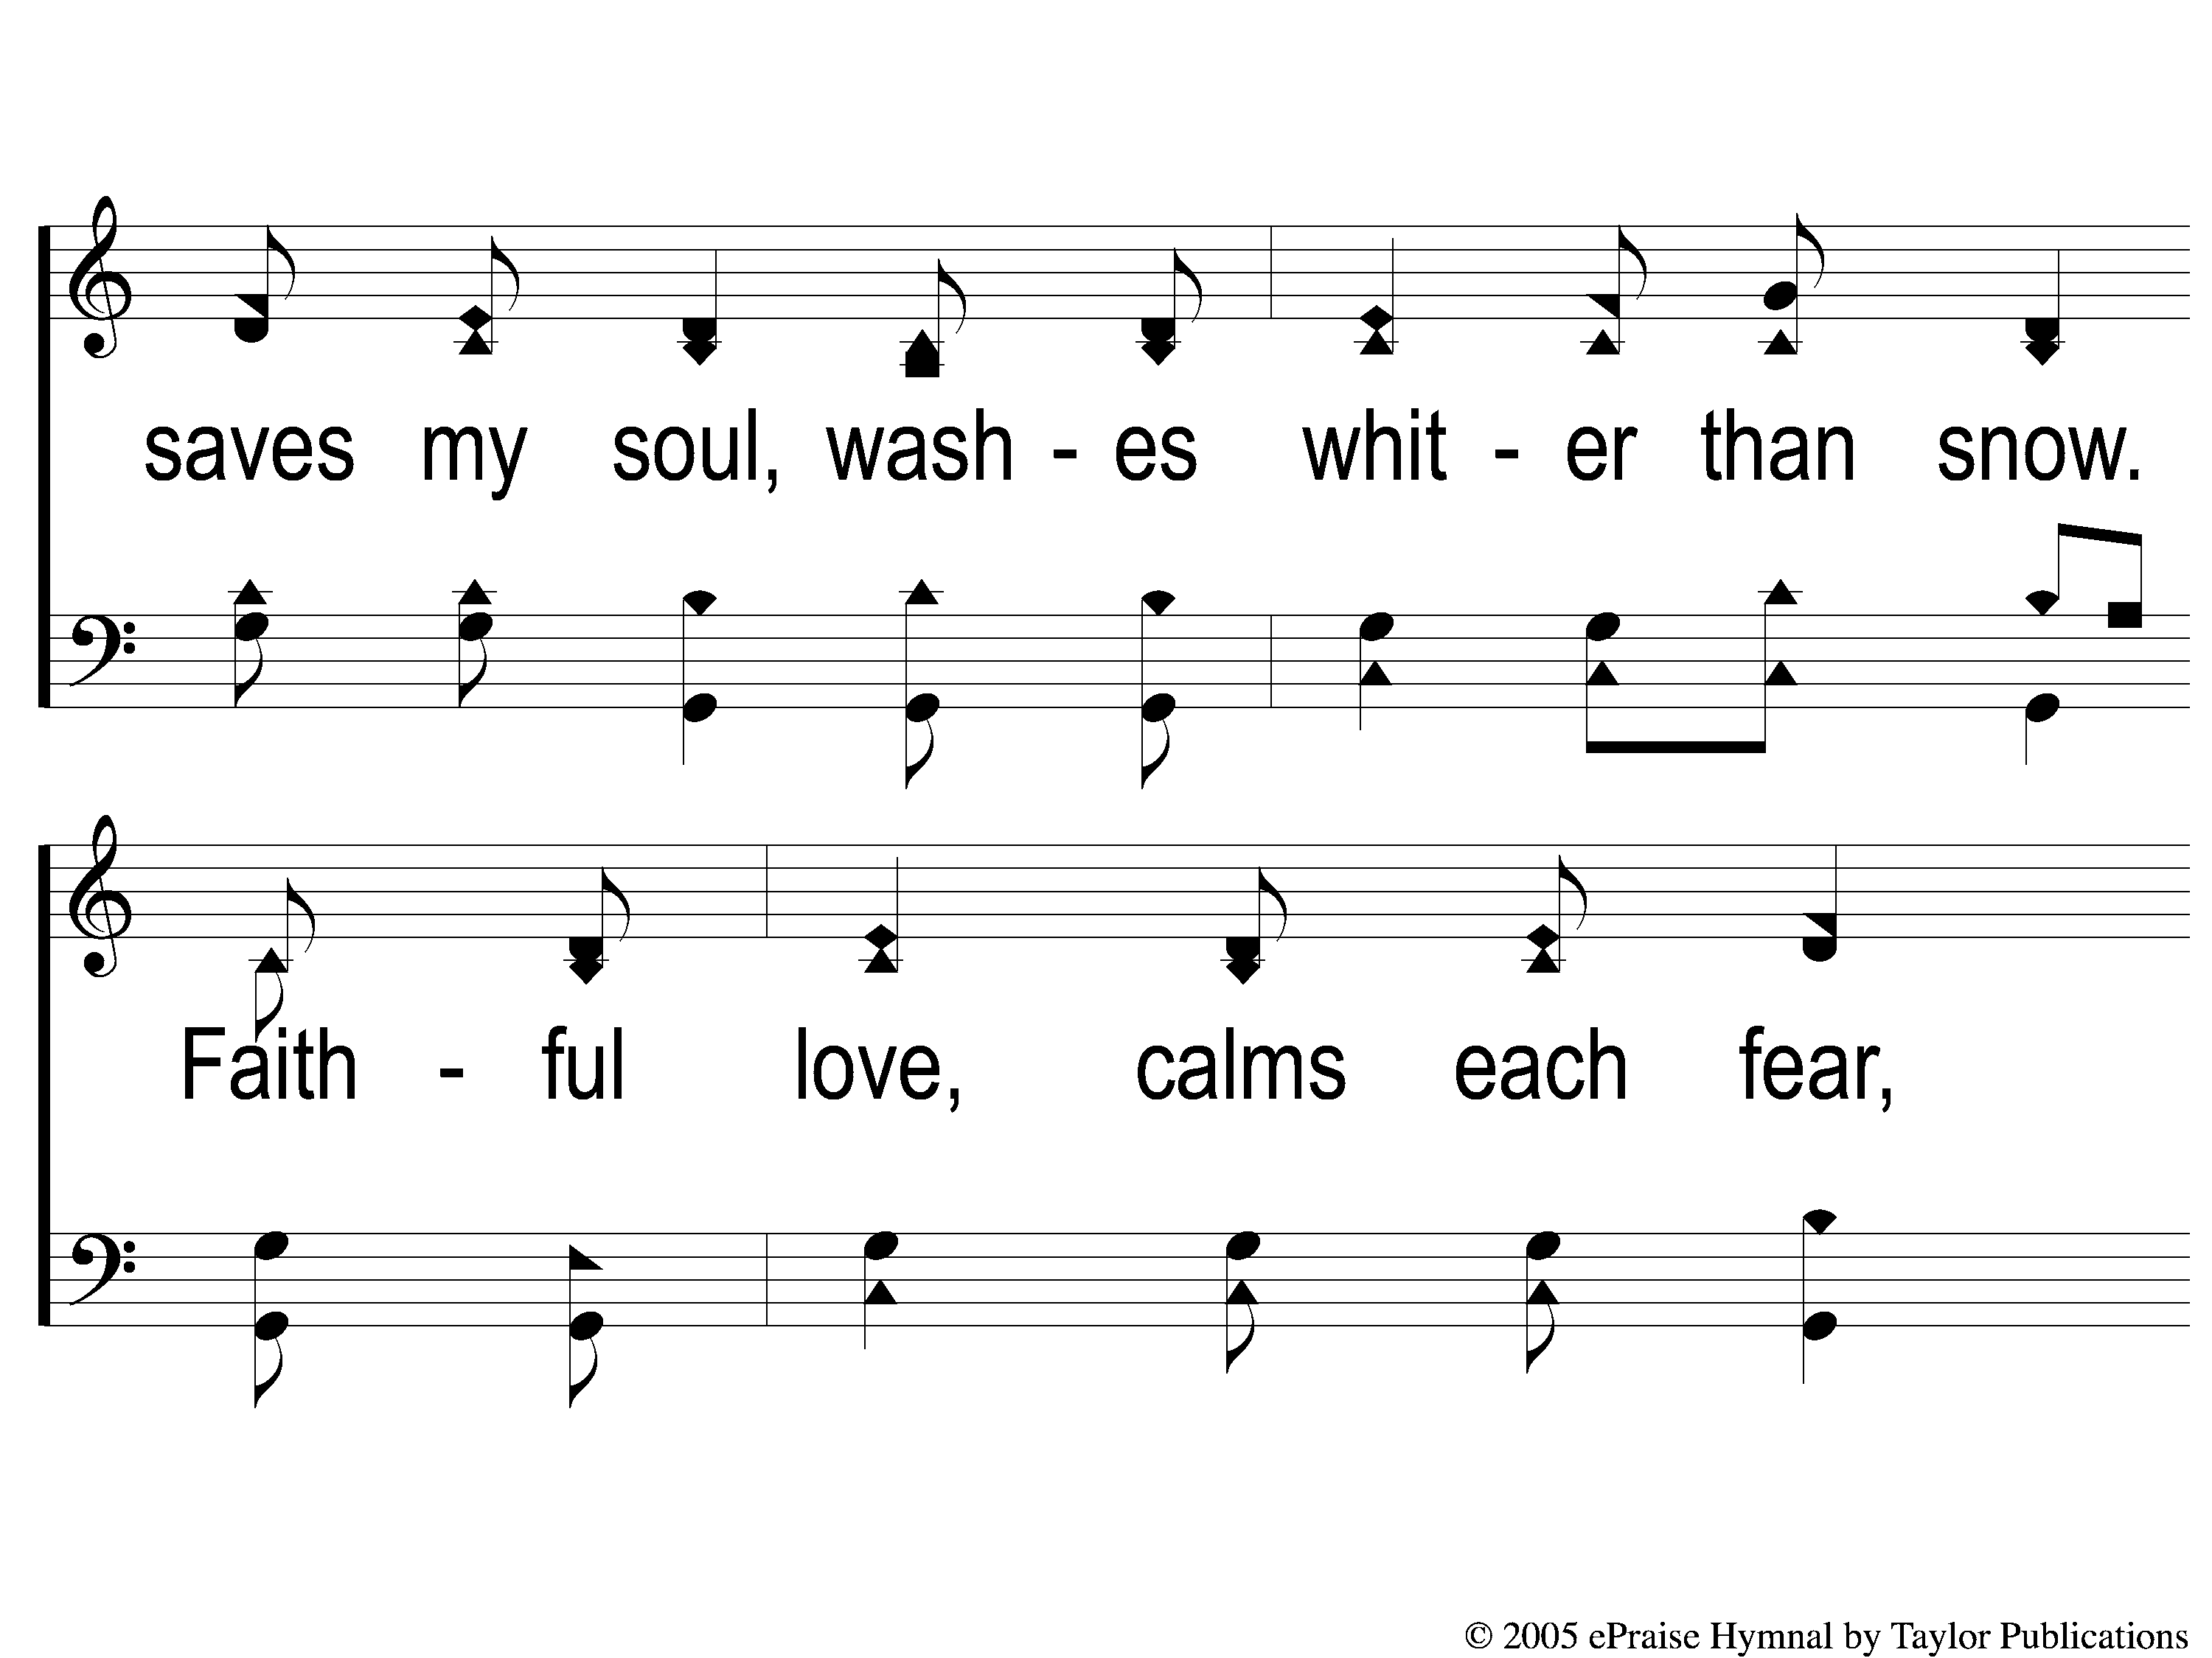
1-2 Faithful Love
Faithful Love
18

Slide 44
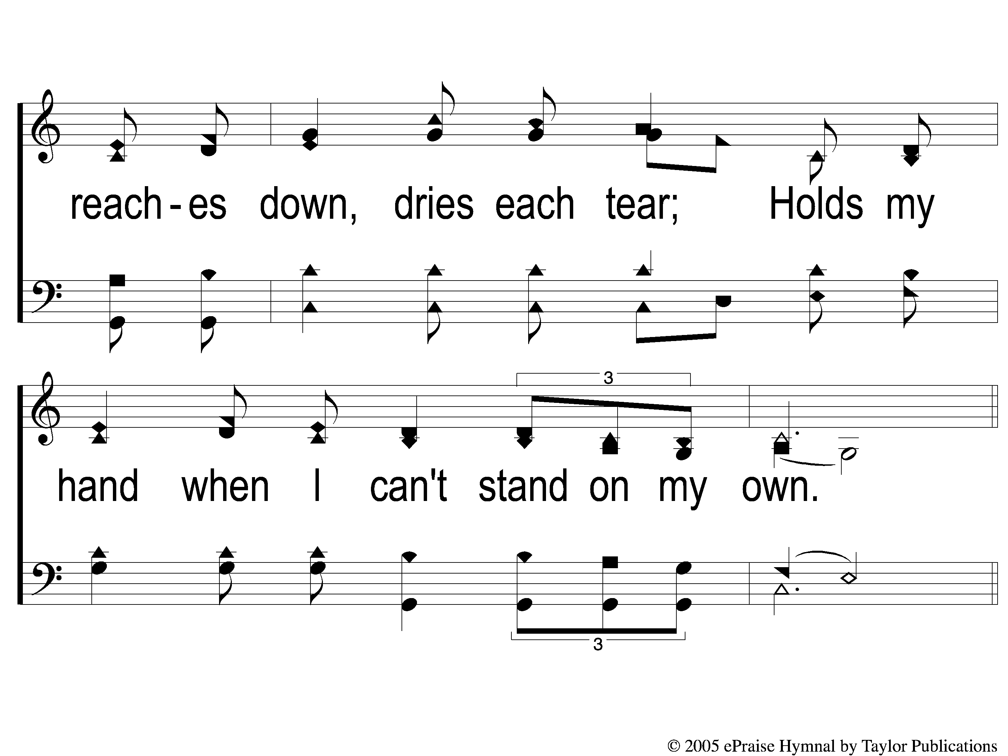
1-3 Faithful Love
Faithful Love
18

Slide 45
C-1 Faithful Love
Faithful Love
18

Slide 46
C-2 Faithful Love
Faithful Love
18

Slide 47
2-1 Faithful Love
Faithful Love
18

Slide 48
2-2 Faithful Love
Faithful Love
18

Slide 49
2-3 Faithful Love
Faithful Love
18

Slide 50
C-1 Faithful Love
Faithful Love
18

Slide 51
C-2 Faithful Love
Faithful Love
18

Slide 52
Scripture Reading:
1 John 1:5-2:2

Slide 53
Christianity
Joys
The of

Slide 54
Joy & The Christian
Gal. 5:19-22
Psa. 144:15
Acts 8:39

Slide 55
Forgiveness
Joy
The of

Slide 56
Assurance
Joy
The of

Slide 57
Our Advocate
Joy
The of

Slide 58
CASA = Court Appointed Special Advocate
GAL = Guardian Ad Litem

Slide 59
“…volunteers advocate on behalf of children who have experienced abuse or neglect. Their best-interest advocacy helps ensure that children are safe, have a permanent home and have the opportunity to thrive.”

Slide 60
The Advocate
1 John 2:1
Παράκλητος (Paraklatos)

Slide 61
The Advocate
1 John 2:1
Παράκλητος (Paraklatos)
Klatos = called

Slide 62
The Advocate
1 John 2:1
Παράκλητος (Paraklatos)
Klatos = called
Para = alongside

Slide 63
The Advocate
1 John 2:1
Παράκλητος (Paraklatos)
= “one who may be called upon to provide help or assistance”

Slide 64
The Advocate
Παράκλητος (Paraklatos)
Rom. 8:34
1 Tim. 2:5
Heb. 7:25

Slide 65
We Have An Advocate…
…Who Understands The Judge
God Is Our Judge
Isa. 33:22, Psa. 94:2, 96:10

Slide 66
We Have An Advocate…
…Who Understands The Judge
God As Our Judge
Just – Deut. 32:4, Jer. 9:24, Rev. 16:7
Punishes Sin – Prov. 11:21, Eccl. 12:14

Slide 67
We Have An Advocate…
…Who Understands The Accuser
Who he accuses – Rev. 12:10
How he works – Mt. 4:1-11, 1 Jn. 2:16
What he seeks – Jn. 8:44, 10:10

Slide 68
We Have An Advocate…
…Who Understands The Accuser
Who he accuses – Rev. 12:10
How he works – Mt. 4:1-11, 1 Jn. 2:16
What he seeks – Jn. 8:44, 10:10

Slide 69
We Have An Advocate…
…Who Understands The Circumstances
Has “walked in our shoes”
Temptations – Heb. 4:15, Mt. 4:1-11

Slide 70
We Have An Advocate…
…Who Understands The Circumstances
Has “walked in our shoes”
Temptations – Heb. 4:15, Mt. 4:1-11
Trials – Isa. 53:4, Jn. 11:35, Matt. 8:20

Slide 71
We Have An Advocate…
…Who Understands The Circumstances
Has Overcome
2 Cor. 5:21
Heb. 4:15-16, 5:7

Slide 72
We Have An Advocate…
…Who Took The Punishment
Matt. 26:28
2 Cor. 5:21
Heb. 9:16, 27-28

Slide 73
We Have An Advocate…
…Who Understands The Judge
…Who Understands The Accuser
…Who Understands The Circumstances
…Who Took The Punishment

Slide 74
We Have An Advocate…
…Who Understands OUR Judge
…Who Understands OUR Accuser
…Who Understands OUR Circumstances
…Who Took OUR Punishment

Slide 75
There Is A Judgment Day
Heb. 9:27
2 Cor. 5:10
Matt. 12:36

Slide 76
Is Jesus Christ Your
Advocate?

Slide 77
Christ For The World We Sing
#626
Invitation
Song:

Slide 78
1-1 Christ for the World we Sing
Christ For the World We Sing
626

Slide 79
1-2 Christ for the World we Sing
Christ For the World We Sing
626

Slide 80
2-1 Christ for the World we Sing
Christ For the World We Sing
626

Slide 81
2-2 Christ for the World we Sing
Christ For the World We Sing
626

Slide 82
3-1 Christ for the World we Sing
Christ For the World We Sing
626

Slide 83
3-2 Christ for the World we Sing
Christ For the World We Sing
626

Slide 84
Our Contribution:
Mark 10:21
“Then Jesus, looking at him, loved him, and said to him, ‘One thing you lack: Go your way, sell whatever you have and give to the poor, and you will have treasure in heaven; and come, take up the cross, and follow Me.’ ”

Slide 85
Song:
Years I Spent In Vanity
#381

Slide 86
1-1 Years I Spent in Vanity`
Years I Spent in Vanity
381

Slide 87
1-2 Years I Spent in Vanity
Years I Spent in Vanity
381

Slide 88
C-1 Years I Spent in Vanity
Years I Spent in Vanity
381

Slide 89
C-2 Years I Spent in Vanity
Years I Spent in Vanity
381

Slide 90
2-1 Years I Spent in Vanity
Years I Spent in Vanity
381

Slide 91
2-2 Years I Spent in Vanity
Years I Spent in Vanity
381

Slide 92
C-1 Years I Spent in Vanity
Years I Spent in Vanity
381

Slide 93
C-2 Years I Spent in Vanity
Years I Spent in Vanity
381

Slide 94
4-1 Years I Spent in Vanity
Years I Spent in Vanity
381

Slide 95
4-2 Years I Spent in Vanity
Years I Spent in Vanity
381

Slide 96
C-1 Years I Spent in Vanity
Years I Spent in Vanity
381

Slide 97
C-2 Years I Spent in Vanity
Years I Spent in Vanity
381

Slide 98
The Unleavened Bread
Mark 14:22
“And as they were eating, Jesus took bread, blessed and broke it, and gave it to them and said, ‘Take, eat; this is My body.’ ”

Slide 99
The Fruit
of the Vine
Mark 14:23-25
“Then He took the cup, and when He had given thanks He gave it to them, and they all drank from it. And He said to them, “This is My blood of the new covenant, which is shed for many. Assuredly, I say to you, I will no longer drink of the fruit of the vine until that day when I drink it new in the kingdom of God.’ ”

Slide 100
Closing Prayer

Slide 101
Song:
I Know That
My Redeemer Lives
#528

Slide 102
1-1 I Know That My Redeemer Lives
I Know That My Redeemer Lives
528

Slide 103
1-2 I Know That My Redeemer Lives
I Know That My Redeemer Lives
528

Slide 104
C-1 I Know That My Redeemer Lives
I Know That My Redeemer Lives
528

Slide 105
C-2 I Know That My Redeemer Lives
I Know That My Redeemer Lives
528

Slide 106
4-1 I Know That My Redeemer Lives
I Know That My Redeemer Lives
528

Slide 107
4-2 I Know That My Redeemer Lives
I Know That My Redeemer Lives
528

Slide 108
C-1 I Know That My Redeemer Lives
I Know That My Redeemer Lives
528

Slide 109
C-2 I Know That My Redeemer Lives
I Know That My Redeemer Lives
528

Slide 110
Today
LTC @ 4:30 PM
Worship @ 6:00 PM
Wednesday
LTC @ 5:30 PM
Worship & Bible Classes @ 6:30 PM
RESTORE REBUILD RENEW
IN 2022
WHEELER
CHURCH
OF
CHRIST

