Slide 1
1-1 Send the Light
Send the Light
650

Slide 2
1-2 Send the Light
Send the Light
650

Slide 3
C-1 Send the Light
Send the Light
650

Slide 4
C-2 Send the Light
Send the Light
650

Slide 5
C-3 Send the Light
Send the Light
650

Slide 6
3-1 Send the Light
Send the Light
650

Slide 7
3-2 Send the Light
Send the Light
650

Slide 8
C-1 Send the Light
Send the Light
650

Slide 9
C-2 Send the Light
Send the Light
650

Slide 10
C-3 Send the Light
Send the Light
650

Slide 11
4-1 Send the Light
Send the Light
650

Slide 12
4-2 Send the Light
Send the Light
650

Slide 13
C-1 Send the Light
Send the Light
650

Slide 14
C-2 Send the Light
Send the Light
650

Slide 15
C-3 Send the Light
Send the Light
650

Slide 16
RESTORE REBUILD RENEW
welcome
we are glad to
Have you with us
IN 2022
WHEELER
CHURCH
OF
CHRIST

Slide 17
Song:
Come Thou Fount
Of Every Blessing
#226

Slide 18
1-1 Come Thou Fount of Every Blessing
Come Thou Fount of Every Blessing
226

Slide 19
1-2 Come Thou Fount of Every Blessing
Come Thou Fount of Every Blessing
226

Slide 20
1-3 Come Thou Fount of Every Blessing
Come Thou Fount of Every Blessing
226

Slide 21
1-4 Come Thou Fount of Every Blessing
Come Thou Fount of Every Blessing
226

Slide 22
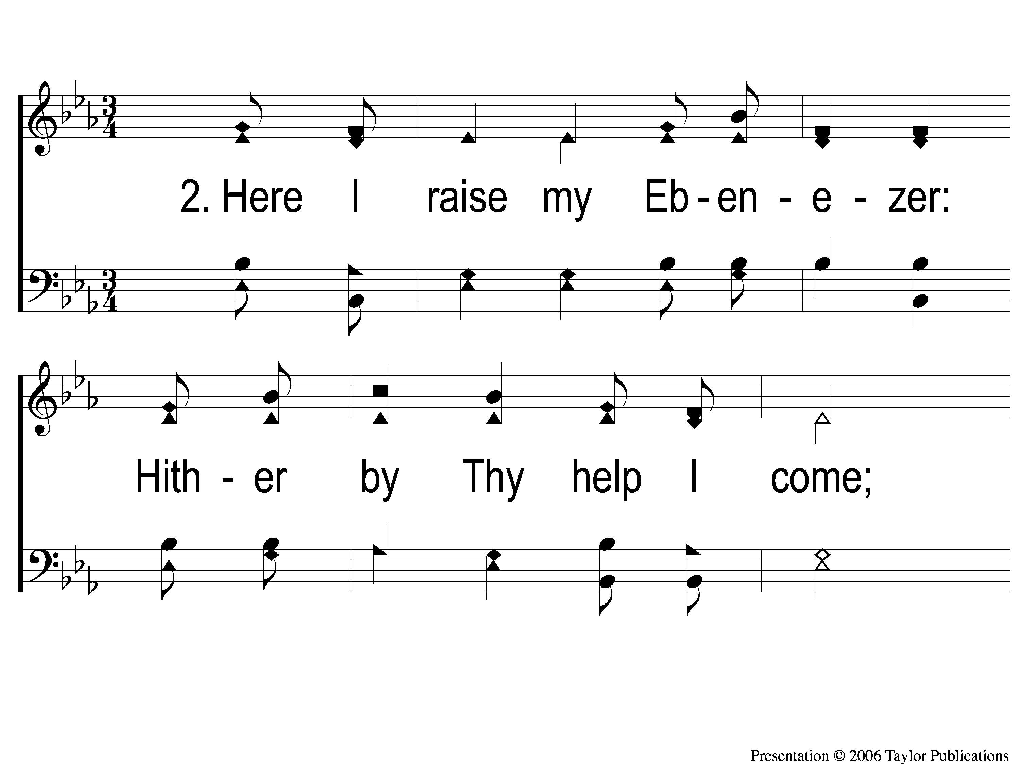
2-1 Come Thou Fount of Every Blessing
Come Thou Fount of Every Blessing
226

Slide 23
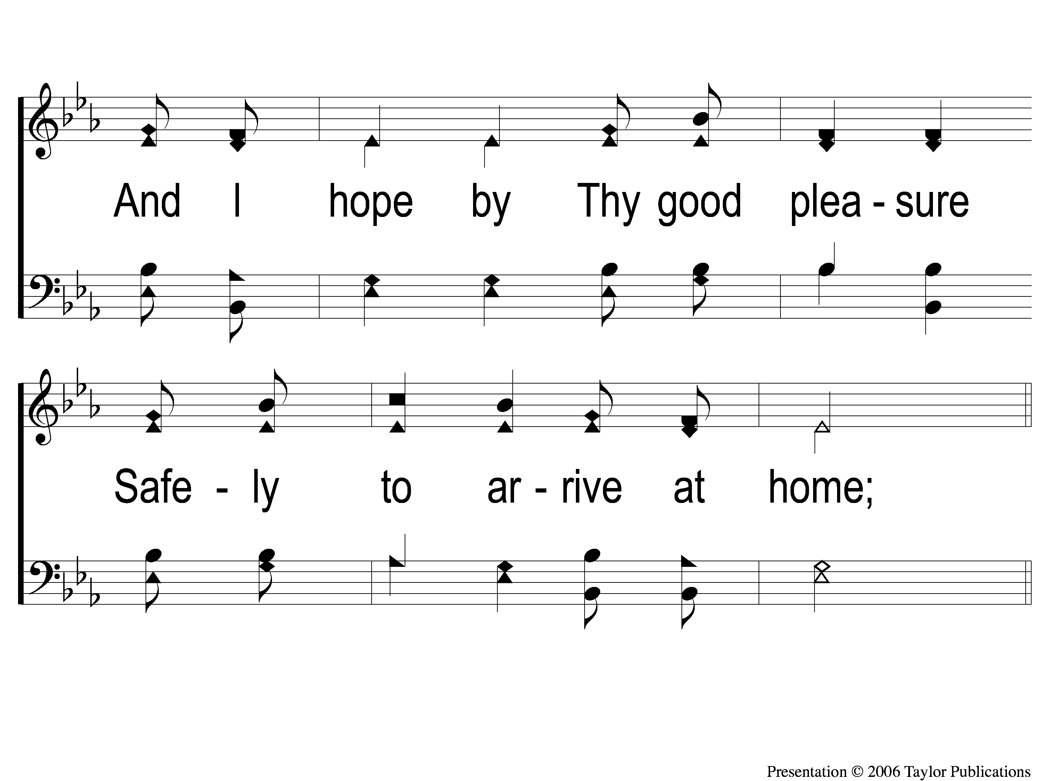
2-2 Come Thou Fount of Every Blessing
Come Thou Fount of Every Blessing
226

Slide 24
2-3 Come Thou Fount of Every Blessing
Come Thou Fount of Every Blessing
226

Slide 25
2-4 Come Thou Fount of Every Blessing
Come Thou Fount of Every Blessing
226

Slide 26
3-1 Come Thou Fount of Every Blessing
Come Thou Fount of Every Blessing
226

Slide 27
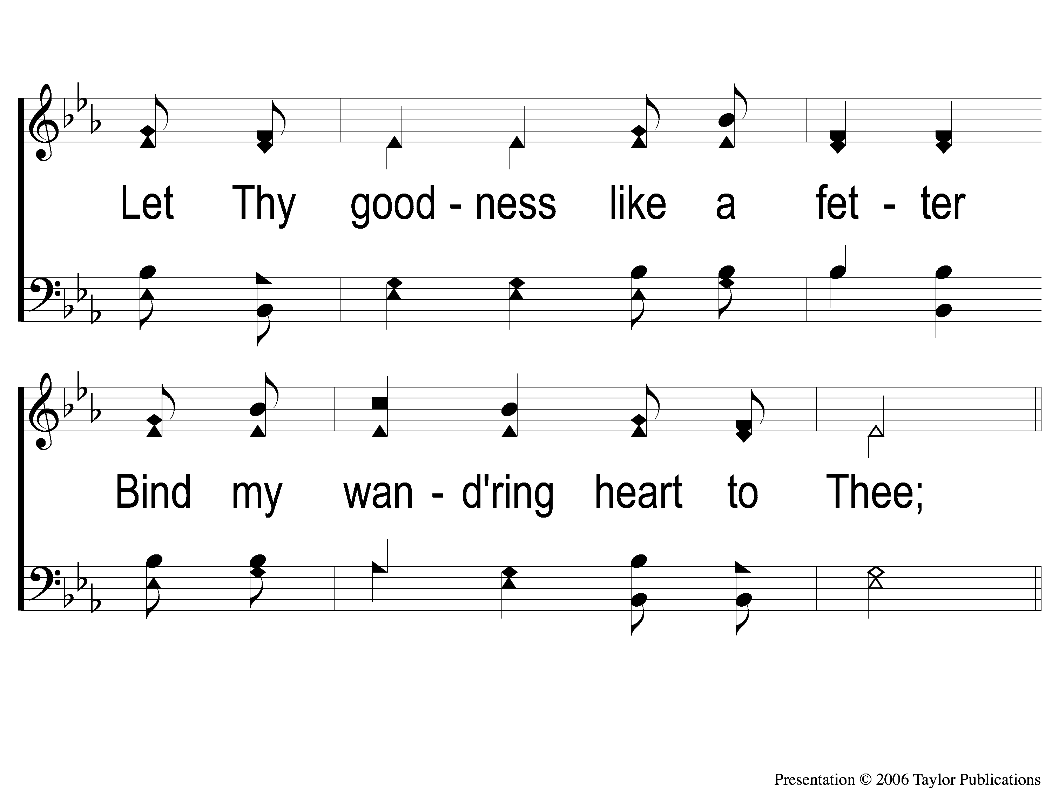
3-2 Come Thou Fount of Every Blessing
Come Thou Fount of Every Blessing
226

Slide 28
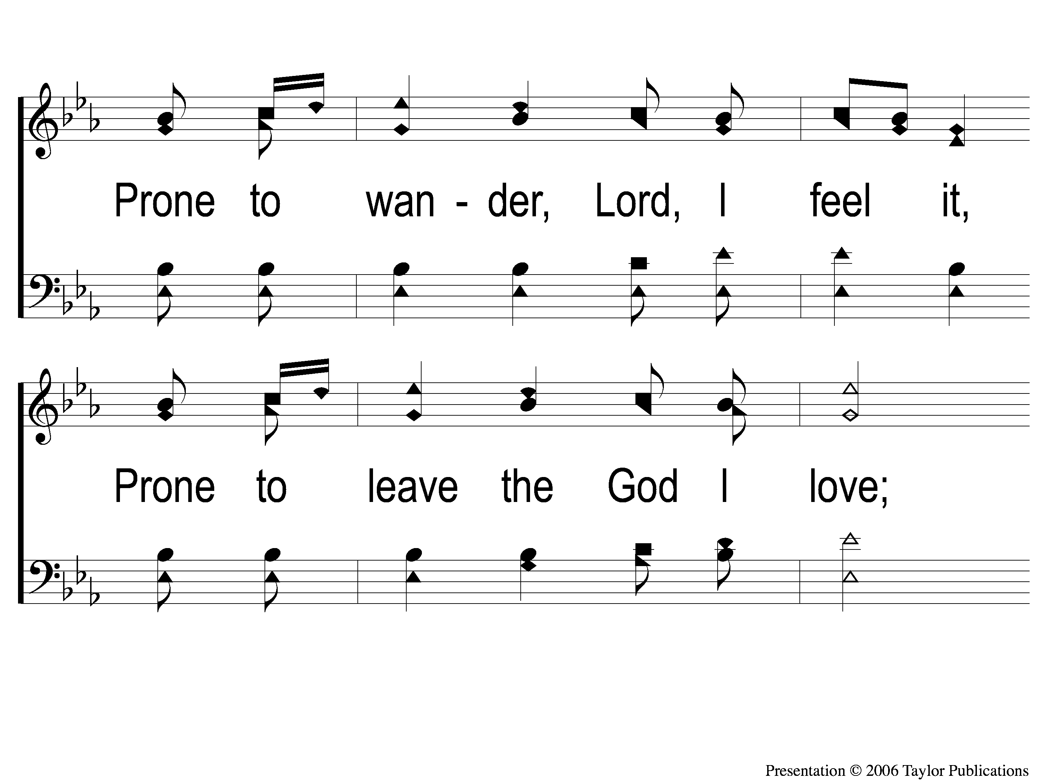
3-3 Come Thou Fount of Every Blessing
Come Thou Fount of Every Blessing
226

Slide 29
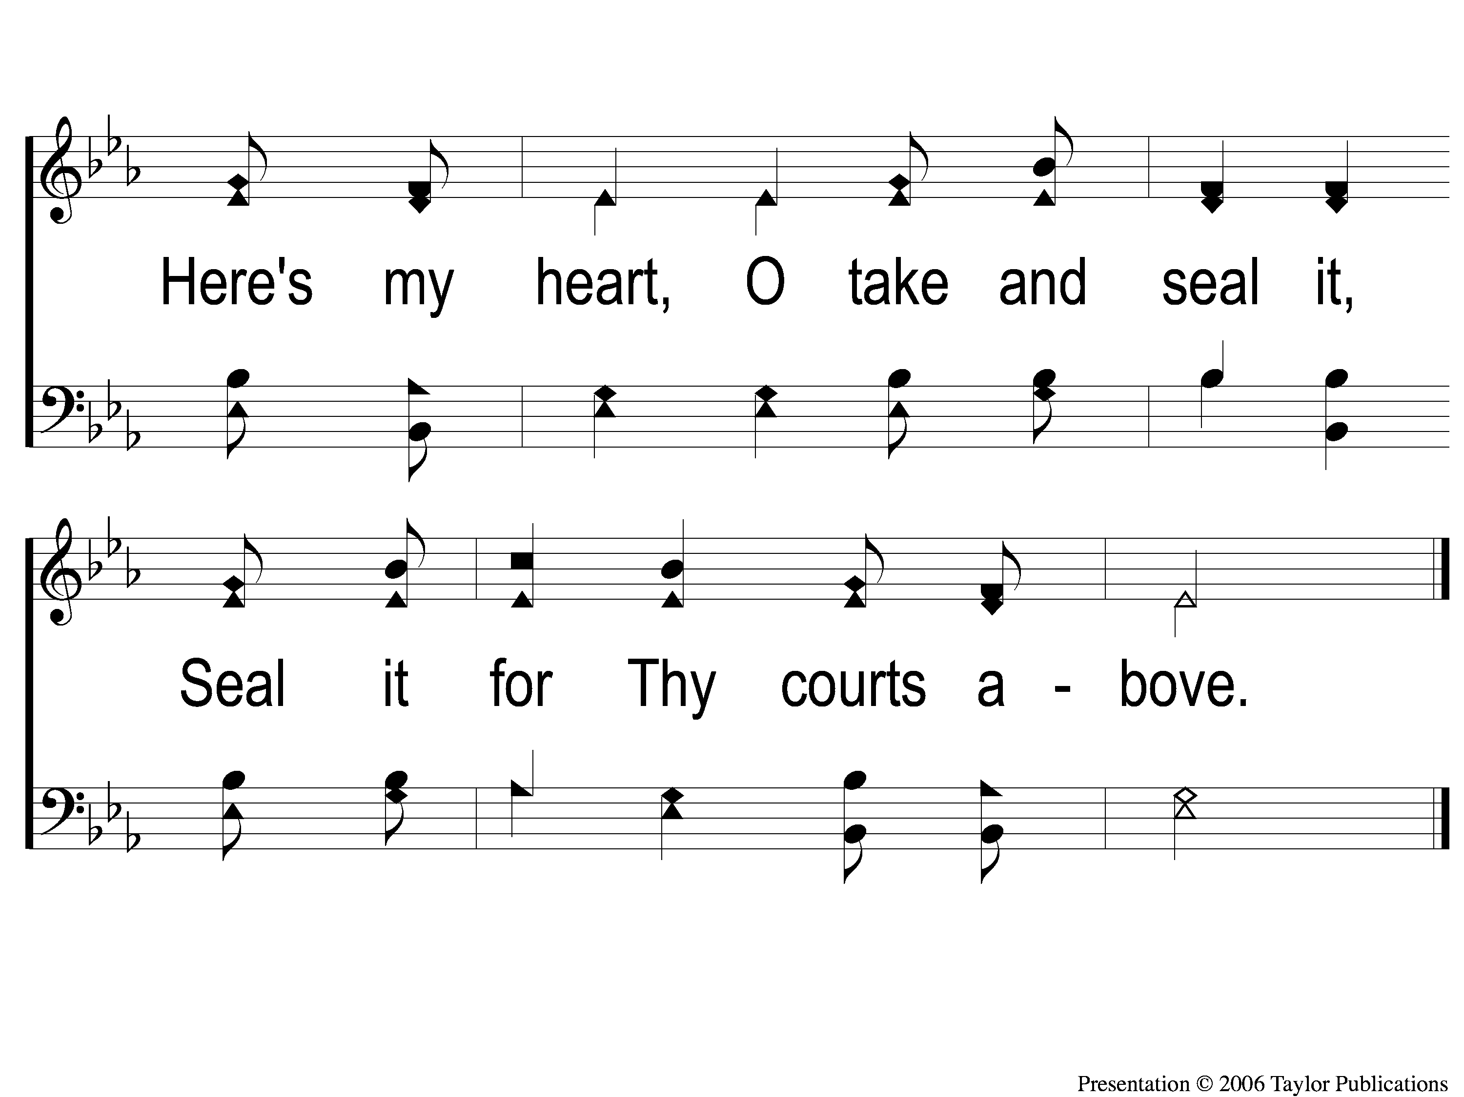
3-4 Come Thou Fount of Every Blessing
Come Thou Fount of Every Blessing
226

Slide 30
Song:
Every Time
PH #168

Slide 31
1-1 Every time
Every Time

Slide 32
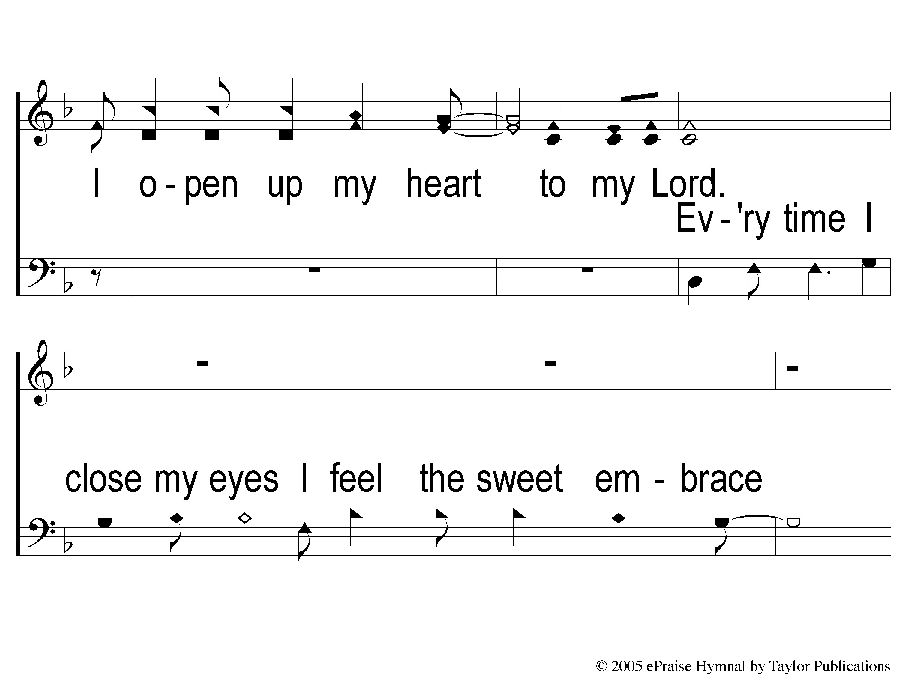
1-2 Every time
Every Time

Slide 33
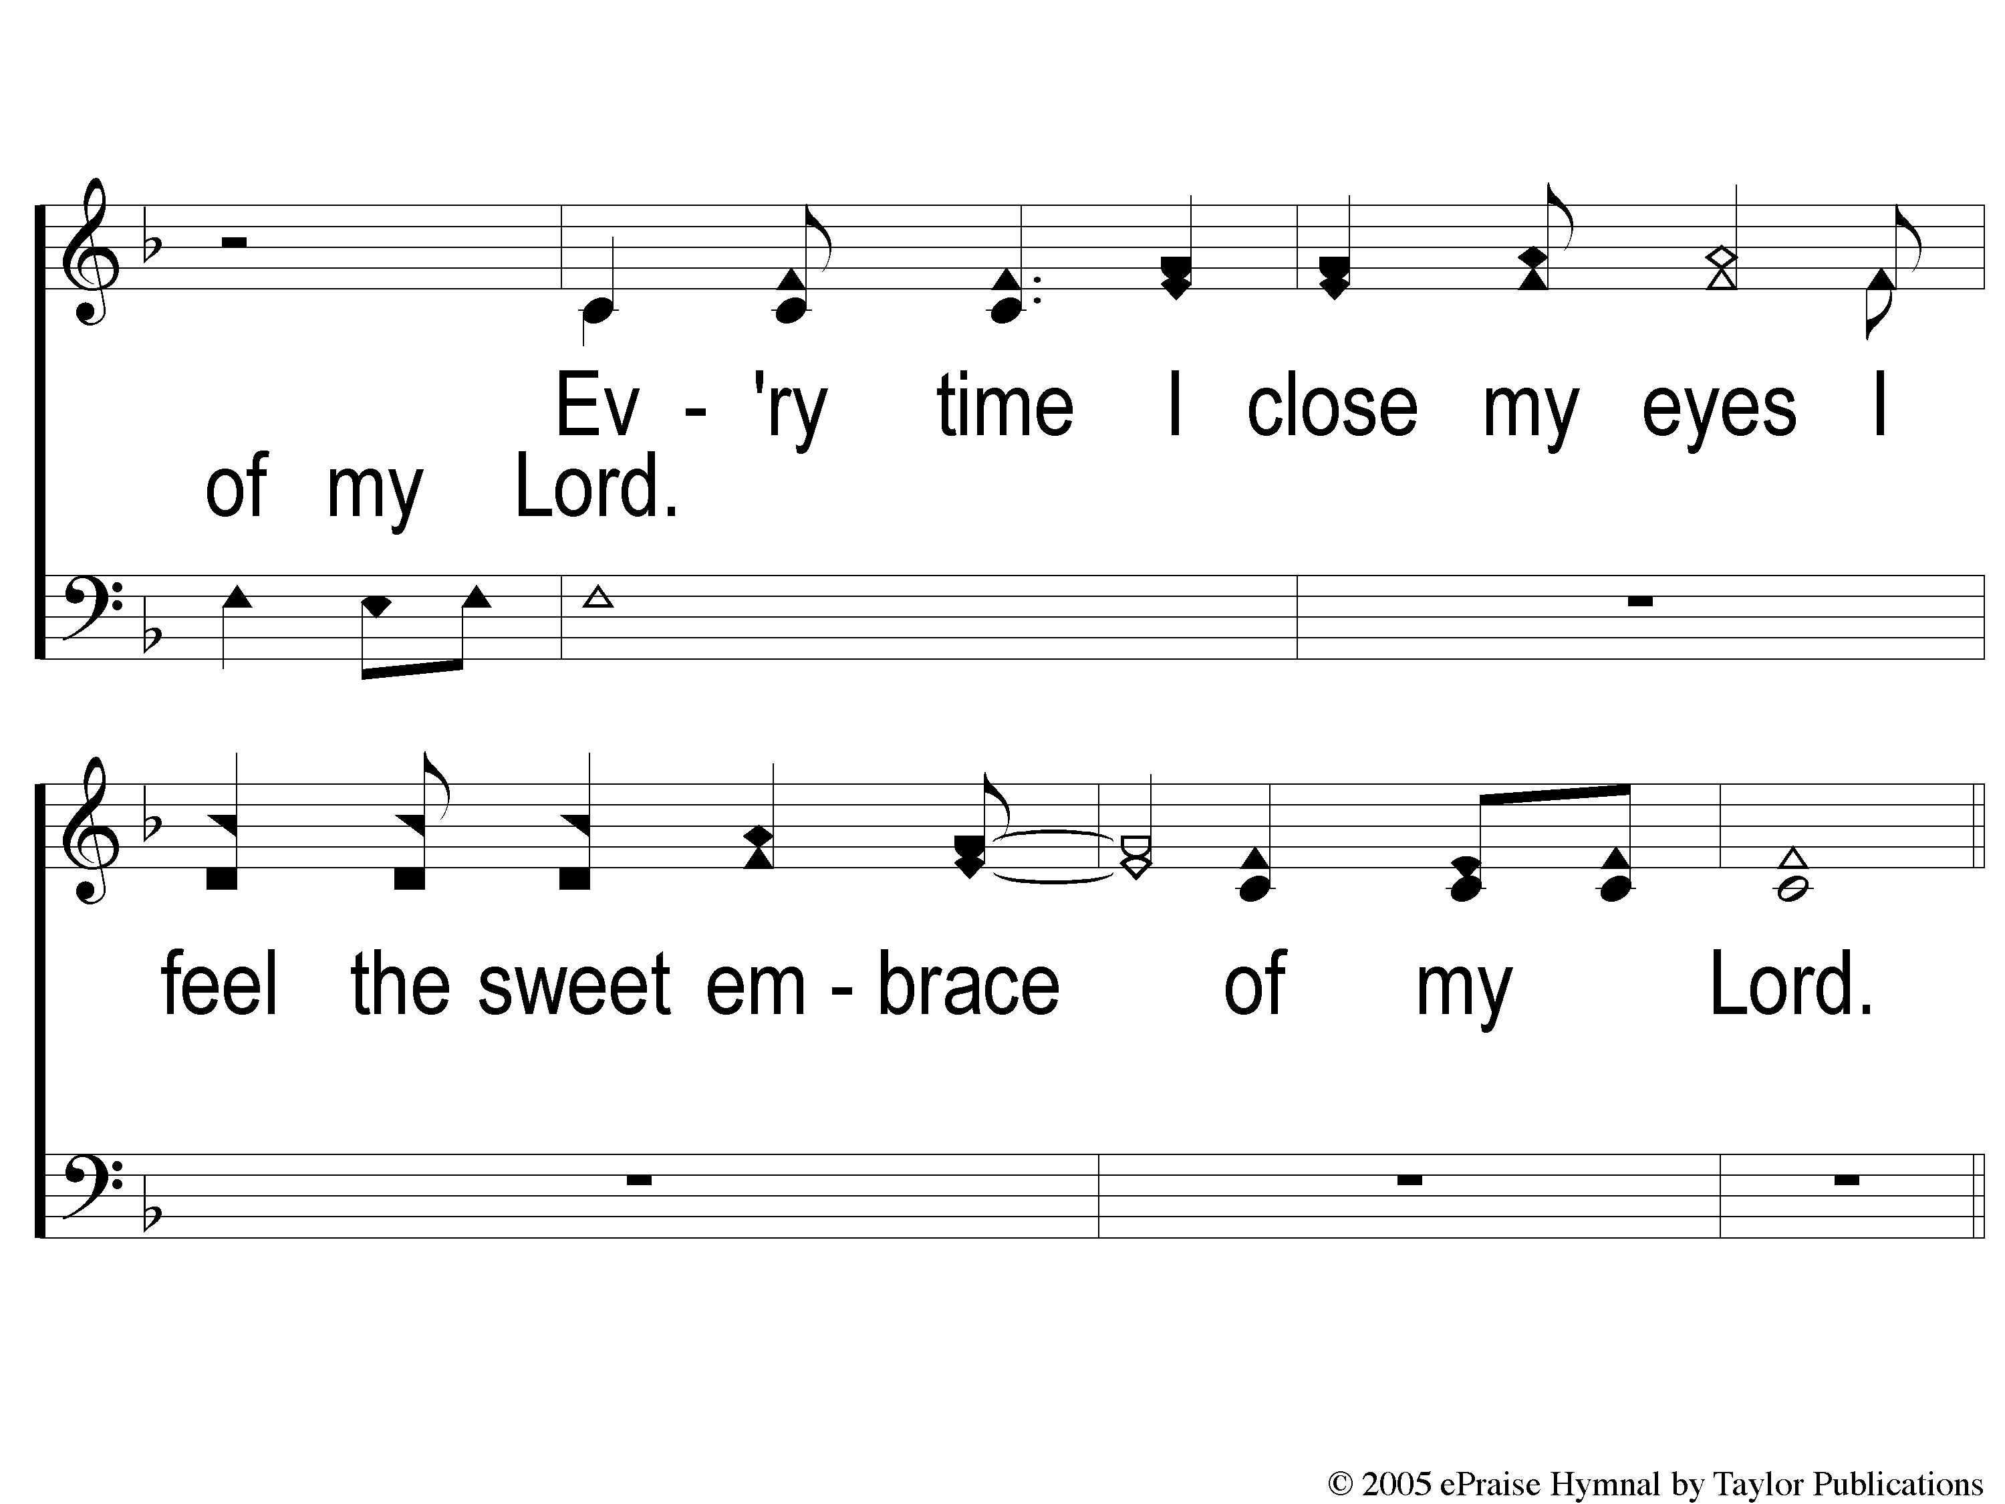
1-3 Every time
Every Time

Slide 34
C-1 Every time
Every Time

Slide 35
C-2 Every time
Every Time

Slide 36
2-1 Every time
Every Time

Slide 37
2-2 Every time
Every Time

Slide 38
2-3 Every time
Every Time

Slide 39
C-1 Every time
Every Time

Slide 40
C-2 Every time
Every Time

Slide 41
3-1 Every time
Every Time

Slide 42
Opening Prayer

Slide 43
Song:
Blue Skies & Rainbows

Slide 44
1-1 Blue Skies and Rainbows
Blue Skies and Rainbows

Slide 45
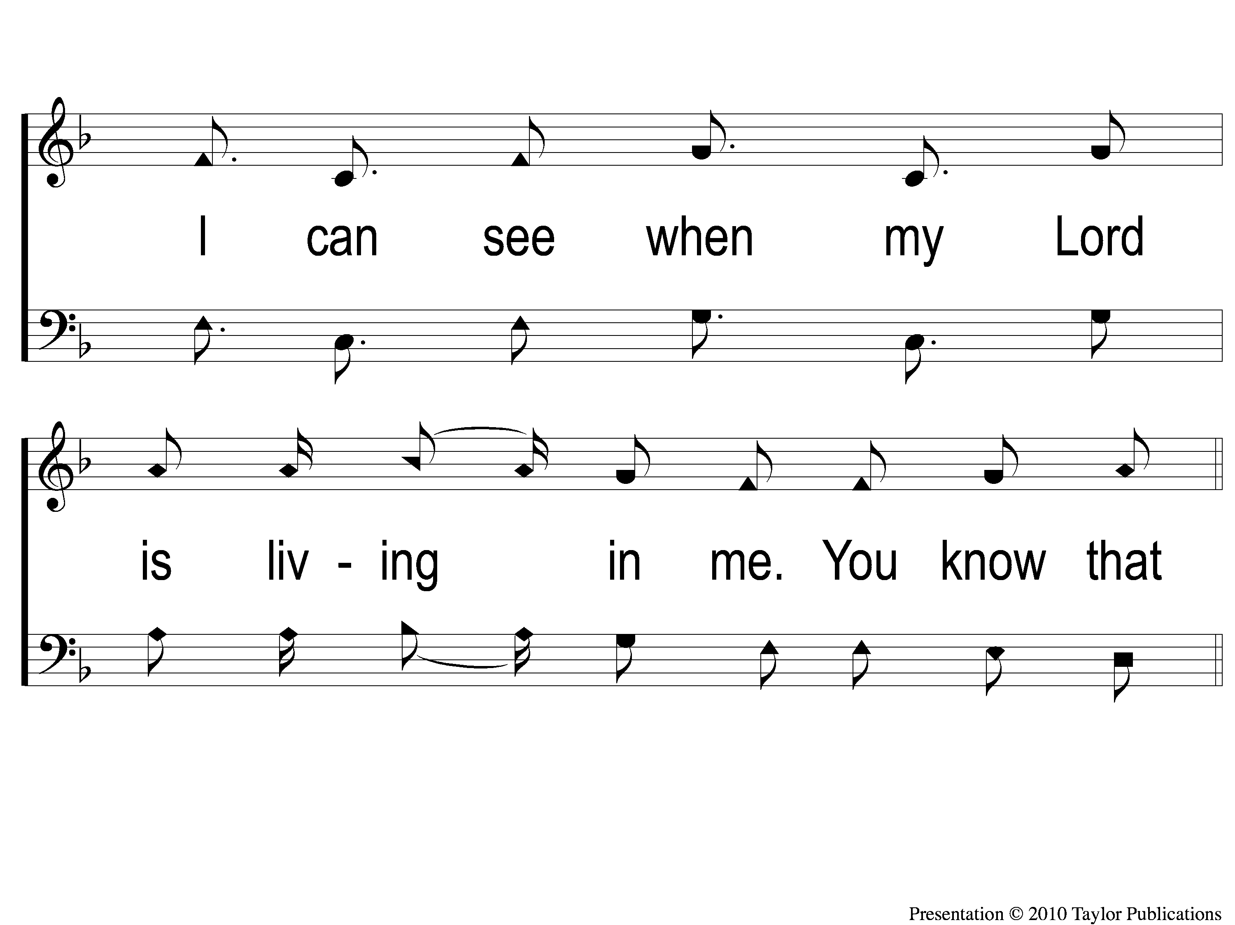
1-2 Blue Skies and Rainbows
Blue Skies and Rainbows

Slide 46
C-1 Blue Skies and Rainbows
Blue Skies and Rainbows

Slide 47
C-2 Blue Skies and Rainbows
Blue Skies and Rainbows

Slide 48
3-1 Blue Skies and Rainbows
Blue Skies and Rainbows

Slide 49
3-2 Blue Skies and Rainbows
Blue Skies and Rainbows

Slide 50
C-1 Blue Skies and Rainbows
Blue Skies and Rainbows

Slide 51
C-2 Blue Skies and Rainbows
Blue Skies and Rainbows

Slide 52
Song:
God’s Family
#744

Slide 53
1-1 God’s Family
God’s Family
744

Slide 54
1-2 God’s Family
God’s Family
744

Slide 55
1-3 God’s Family
God’s Family
744

Slide 56
C-1 God’s Family
God’s Family
744

Slide 57
C-2 God’s Family
God’s Family
744

Slide 58
C-3 God’s Family
God’s Family
744

Slide 59
2-1 God’s Family
God’s Family
744

Slide 60
2-2 God’s Family
God’s Family
744

Slide 61
2-3 God’s Family
God’s Family
744

Slide 62
C-1 God’s Family
God’s Family
744

Slide 63
C-2 God’s Family
God’s Family
744

Slide 64
C-3 God’s Family
God’s Family
744

Slide 65
3-1 God’s Family
God’s Family
744

Slide 66
3-2 God’s Family
God’s Family
744

Slide 67
3-3 God’s Family
God’s Family
744

Slide 68
C-1 God’s Family
God’s Family
744

Slide 69
C-2 God’s Family
God’s Family
744

Slide 70
C-3 God’s Family
God’s Family
744

Slide 71
Scripture Reading:
1 Timothy 5:1-2

Slide 72
Christianity
Joys
The of

Slide 73
Joy & The Christian
Gal. 5:19-22
Psa. 144:15
Acts 8:39

Slide 74
Forgiveness
Joy
The of

Slide 75
Assurance
Joy
The of

Slide 76
Our Advocate
Joy
The of

Slide 77
Stability
Joy
The of

Slide 78
Spiritual Family
Joy
The of

Slide 79
The Church Is A Family
Adopted by God
Eph. 1:5, 6:10
Gal. 4:5

Slide 80
The Church Is A Family
Rom. 16:1 – Phoebe a “sister”
1 Pet. 5:12 - Silvanus a “brother”
1 Tim. 5:1 – Fathers & Mothers

Slide 81
The Blessings Of God’s Family
Accountability
The Elders – Heb. 13:7, 17

Slide 82
The Blessings Of God’s Family
Accountability
The Elders – Heb. 13:7, 17
One Another – Prov. 27:17, Gal. 6:1

Slide 83
The Blessings Of God’s Family
Accountability
The Process
Matt. 18:15-20

Slide 84
The Blessings Of God’s Family
Accountability
Examples:
Simon – Acts 8:18-24

Slide 85
The Blessings Of God’s Family
Accountability
Examples:
Simon – Acts 8:18-24
Peter – Gal. 2:11-14

Slide 86
The Blessings Of God’s Family
Accountability
Examples:
Simon – Acts 8:18-24
Peter – Gal. 2:11-14
Ananias & Sapphira – Acts 5:1-11

Slide 87
The Blessings Of God’s Family
Assistance

Slide 88
The Blessings Of God’s Family
Assistance
Physical Needs
Acts 2:41-45, 4:32, 34-35; Rom. 12:13

Slide 89
The Blessings Of God’s Family
Assistance
Physical Needs
Acts 2:42, 47, Rom. 12:13
Spiritual Needs
Rom. 12:10; Gal. 6:2, 10; 1 Cor. 12:26

Slide 90
The Blessings Of God’s Family
Addition

Slide 91
The Blessings Of God’s Family
Addition
Lost Sheep – Lk. 15:3-7
Lost Coin – Lk. 15:8-10
Lost Son – Lk. 15:11-32

Slide 92
Are You Part Of
God’s Family?

Slide 93
Room At The Cross
#906
Invitation
Song:

Slide 94
1-1 Room at the Cross
Room At the Cross
906

Slide 95
1-2 Room at the Cross
Room At the Cross
906

Slide 96
C-1 Room at the Cross
Room At the Cross
906

Slide 97
C-2 Room at the Cross
Room At the Cross
906

Slide 98
3-1 Room at the Cross
Room At the Cross
906

Slide 99
3-2 Room at the Cross
Room At the Cross
906

Slide 100
C-1 Room at the Cross
Room At the Cross
906

Slide 101
C-2 Room at the Cross
Room At the Cross
906

Slide 102
Our Contribution:
Acts 20:35
“I have shown you in every way, by laboring like this, that you must support the weak. And remember the words of the Lord Jesus, that He said, ‘It is more blessed to give than to receive.’ ”

Slide 103
Song:
When I Survey
The Wondrous Cross
#315

Slide 104
1-1 When I Survey the Wondrous Cross
When I Survey the Wondrous Cross
315

Slide 105
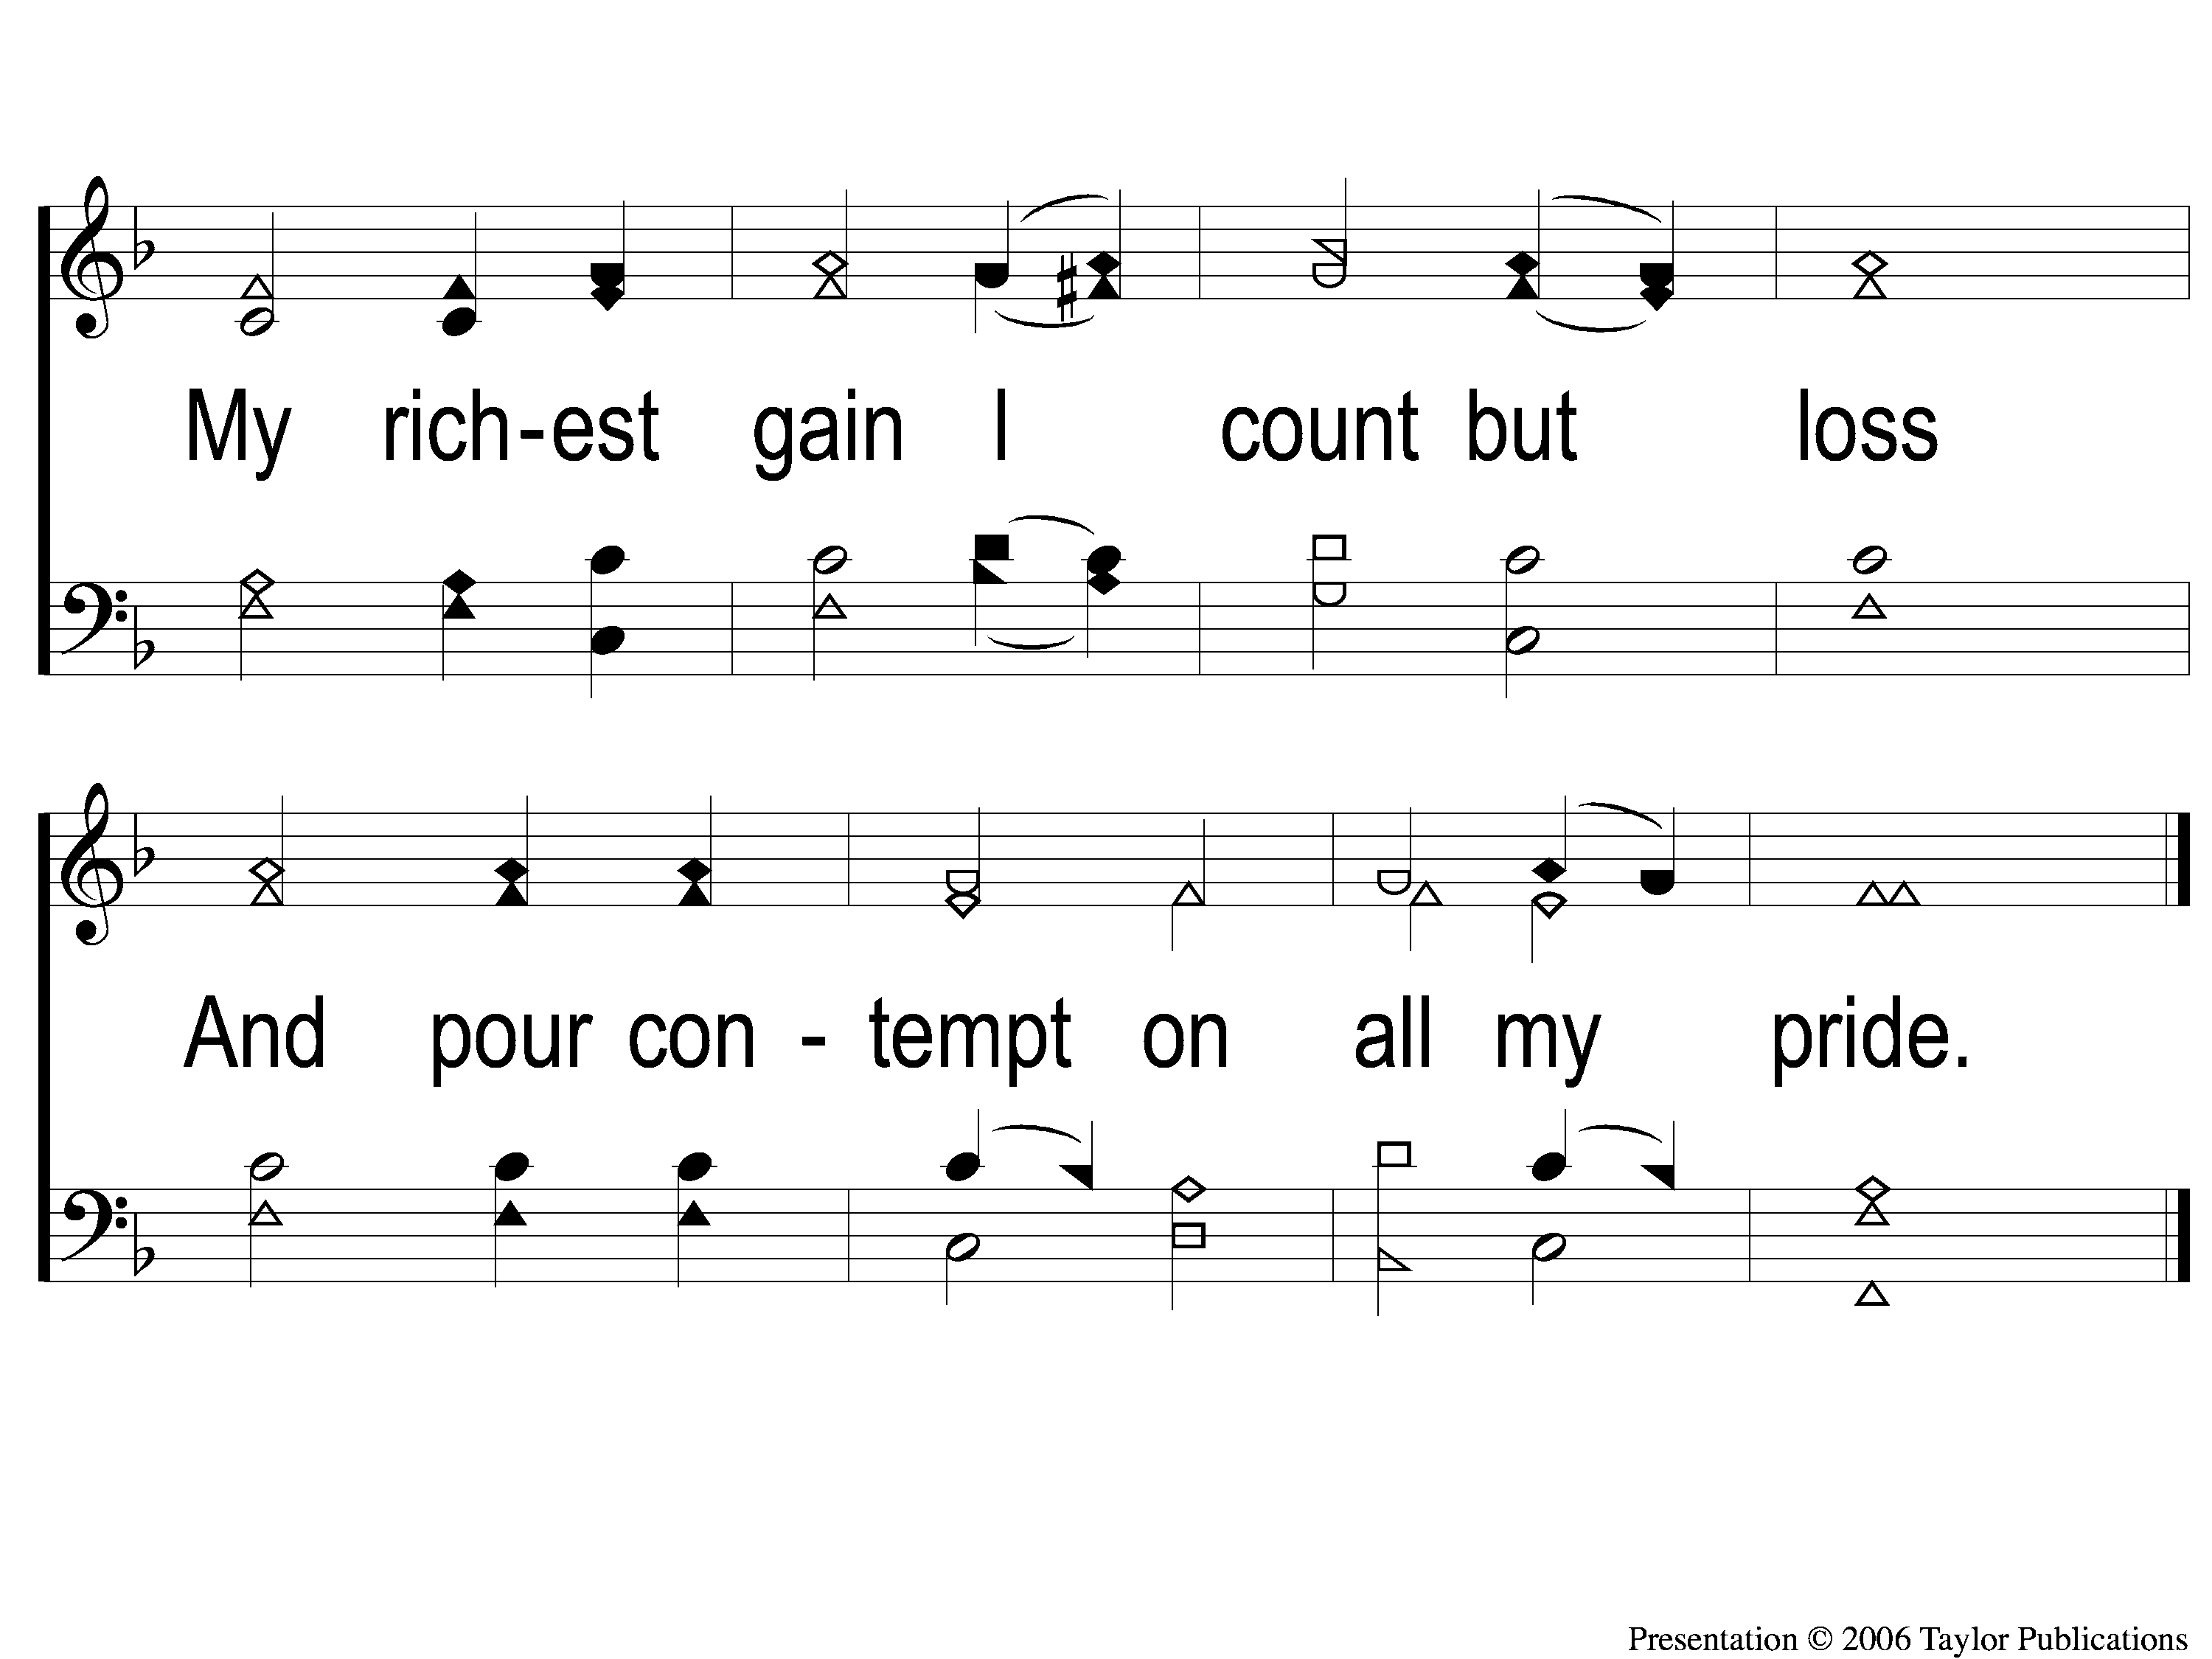
1-2 When I Survey the Wondrous Cross
When I Survey the Wondrous Cross
315

Slide 106
2-1 When I Survey the Wondrous Cross
When I Survey the Wondrous Cross
315

Slide 107
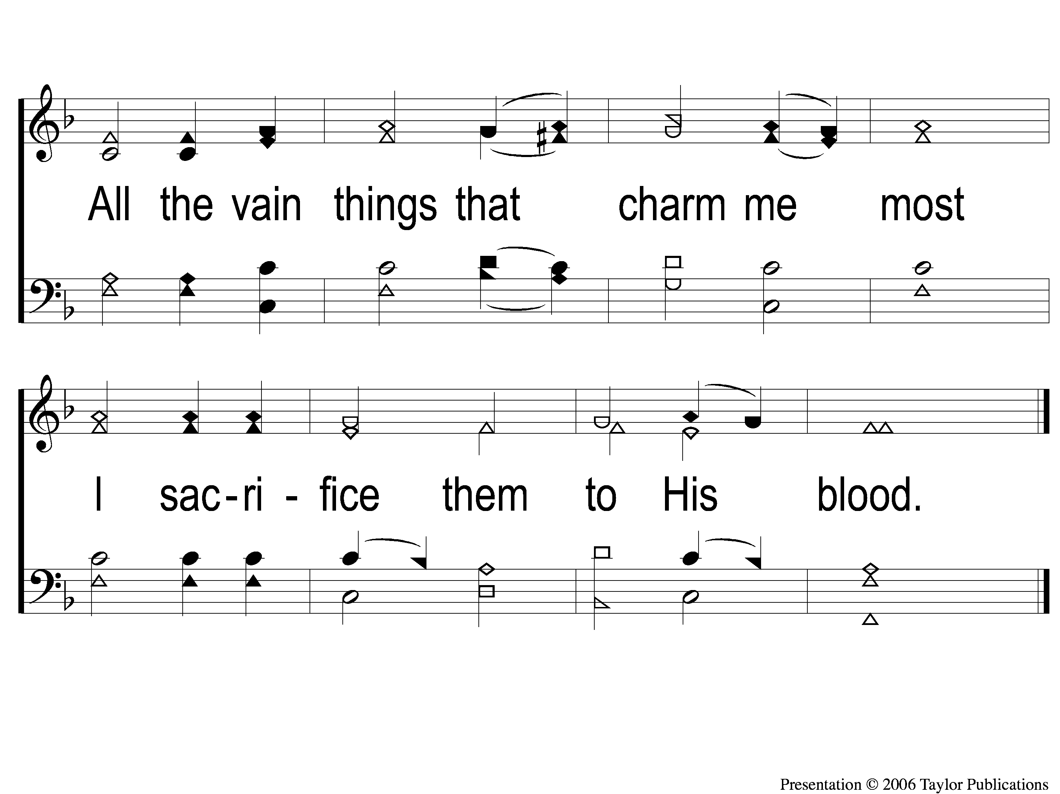
2-2 When I Survey the Wondrous Cross
When I Survey the Wondrous Cross
315

Slide 108
4-1 When I Survey the Wondrous Cross
When I Survey the Wondrous Cross
315

Slide 109
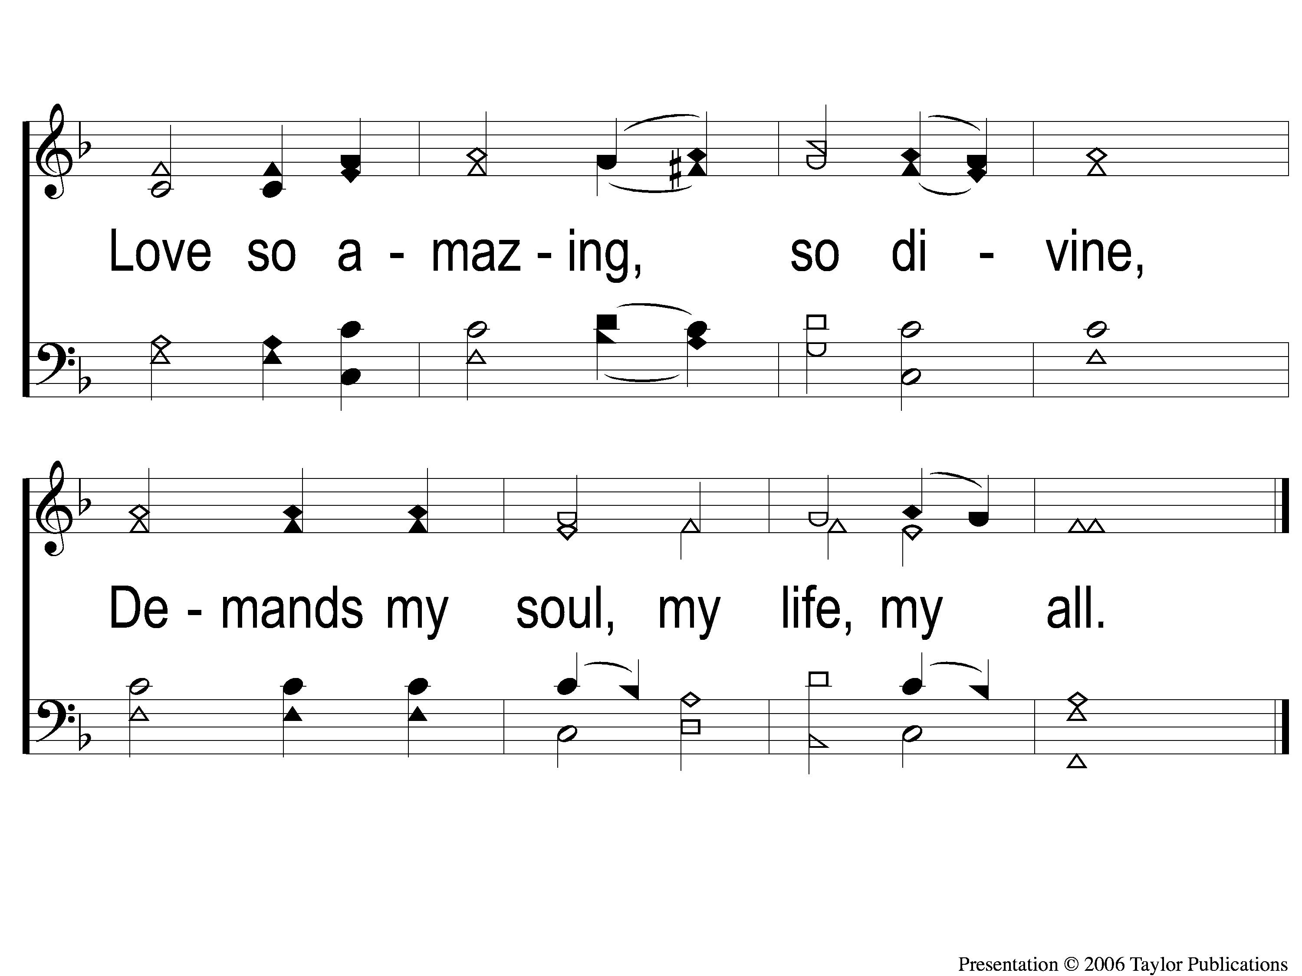
4-2 When I Survey the Wondrous Cross
When I Survey the Wondrous Cross
315

Slide 110
The Unleavened Bread
Romans 8:1-2
“There is therefore now no condemnation to those who are in Christ Jesus, who do not walk according to the flesh, but according to the Spirit. For the law of the Spirit of life in Christ Jesus has made me free from the law of sin and death.”

Slide 111
The Fruit
of the Vine
Romans 8:31-32
“What then shall we say to these things? If God is for us, who can be against us? He who did not spare His own Son, but delivered Him up for us all, how shall He not with Him also freely give us all things?”

Slide 112
Closing Prayer

Slide 113
Song:
When The Roll
Is Called Up Yonder
#852

Slide 114
1-1 When The Roll Is Called Up Yonder
When The Roll Is Called Up Yonder
852

Slide 115
1-2 When The Roll Is Called Up Yonder
When The Roll Is Called Up Yonder
852

Slide 116
1-3 When The Roll Is Called Up Yonder
When The Roll Is Called Up Yonder
852

Slide 117
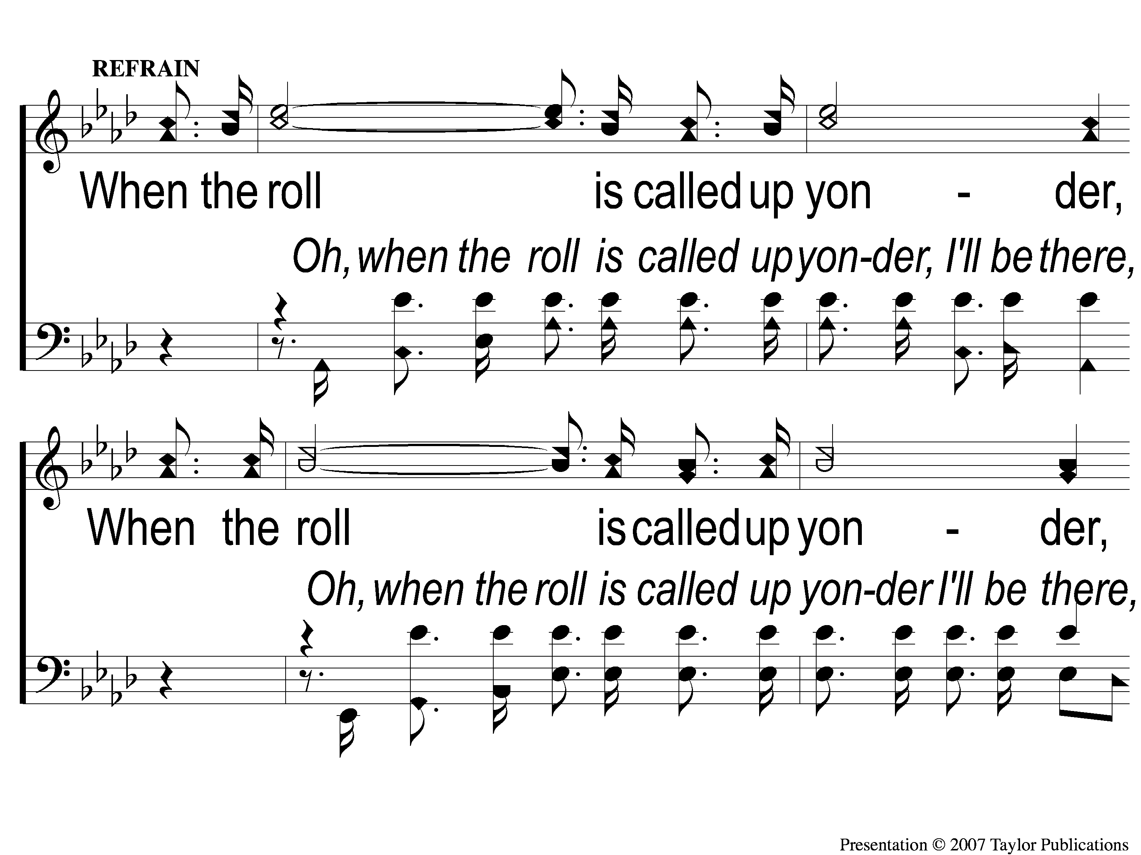
C-1 When The Roll Is Called Up Yonder
When The Roll Is Called Up Yonder
852

Slide 118
C-2 When The Roll Is Called Up Yonder
When The Roll Is Called Up Yonder
852

Slide 119
3-1 When The Roll Is Called Up Yonder
When The Roll Is Called Up Yonder
852

Slide 120
3-2 When The Roll Is Called Up Yonder
When The Roll Is Called Up Yonder
852

Slide 121
3-3 When The Roll Is Called Up Yonder
When The Roll Is Called Up Yonder
852

Slide 122
C-1 When The Roll Is Called Up Yonder
When The Roll Is Called Up Yonder
852

Slide 123
C-2 When The Roll Is Called Up Yonder
When The Roll Is Called Up Yonder
852

Slide 124
Today
LTC @ 5:00 PM
Worship @ 6:00 PM
Wednesday
LTC @ 5:30 PM
Worship & Bible Classes @ 6:30 PM
RESTORE REBUILD RENEW
IN 2022
WHEELER
CHURCH
OF
CHRIST

