Slide 1
1-1 I Know Whom I have Believed
I Know Whom I Believed
524

Slide 2
1-2 I Know Whom I have Believed
I Know Whom I Believed
524

Slide 3
C-1 I Know Whom I have Believed
I Know Whom I Believed
524

Slide 4
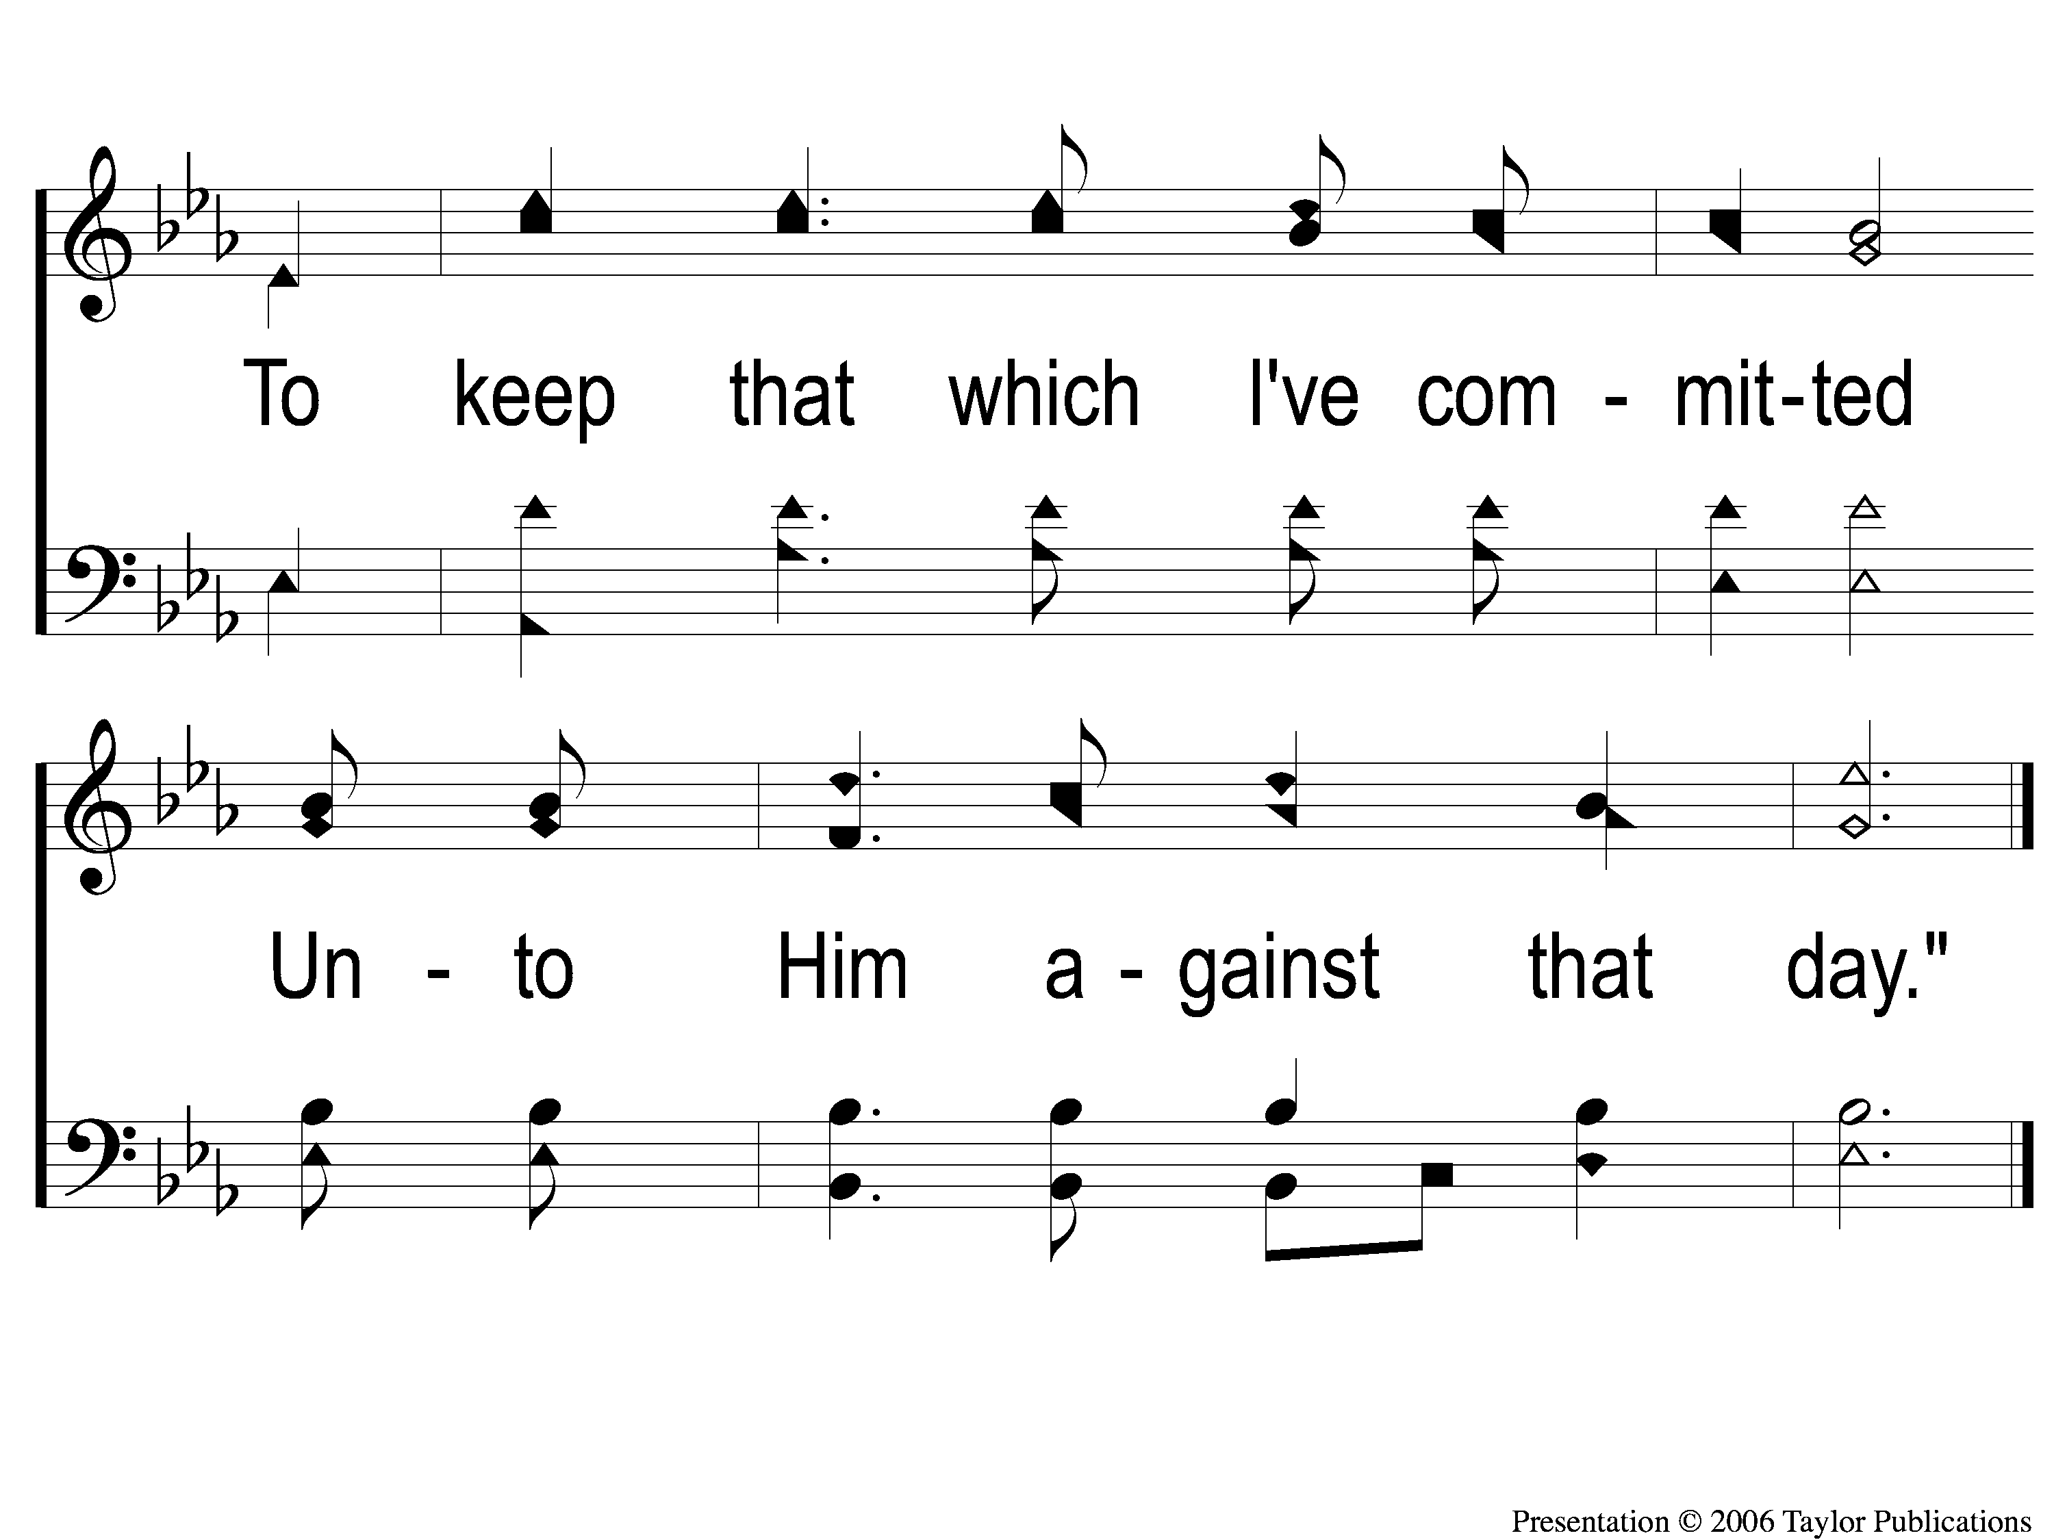
C-2 I Know Whom I have Believed
I Know Whom I Believed
524

Slide 5
4-1 I Know Whom I have Believed
I Know Whom I Believed
524

Slide 6
4-2 I Know Whom I have Believed
I Know Whom I Believed
524

Slide 7
C-1 I Know Whom I have Believed
I Know Whom I Believed
524

Slide 8
C-2 I Know Whom I have Believed
I Know Whom I Believed
524

Slide 9
RESTORE REBUILD RENEW
welcome
we are glad to
Have you with us
IN 2022
WHEELER
CHURCH
OF
CHRIST

Slide 10
Song:
This World Is Not My Home
#957

Slide 11
1-1 This World is Not My Home
This World Is Not My Home
957

Slide 12
1-2 This World is Not My Home
This World Is Not My Home
957

Slide 13
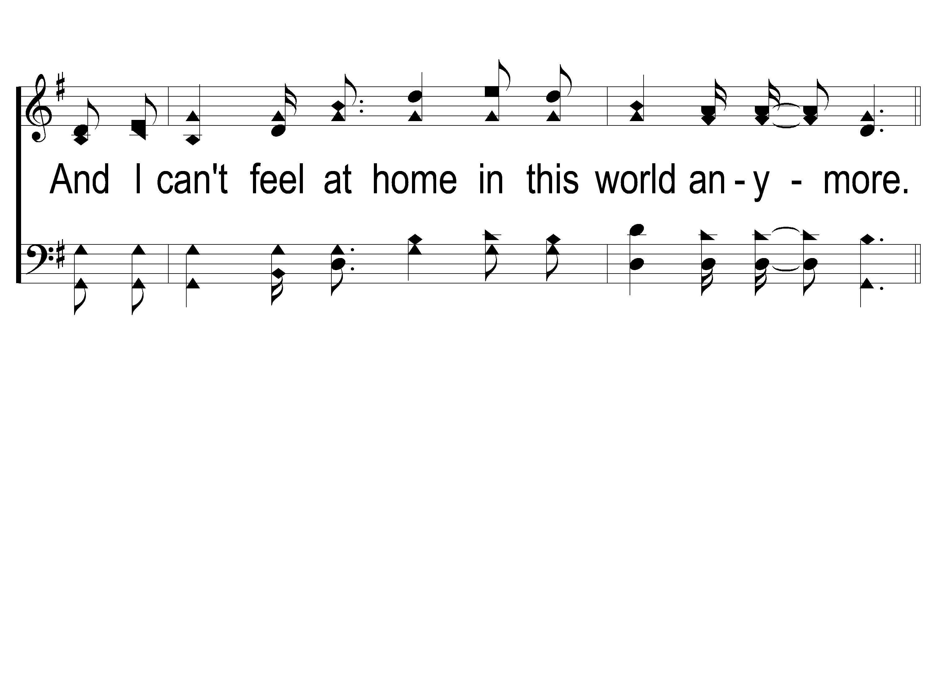
1-3 This World is Not My Home
This World Is Not My Home
957

Slide 14
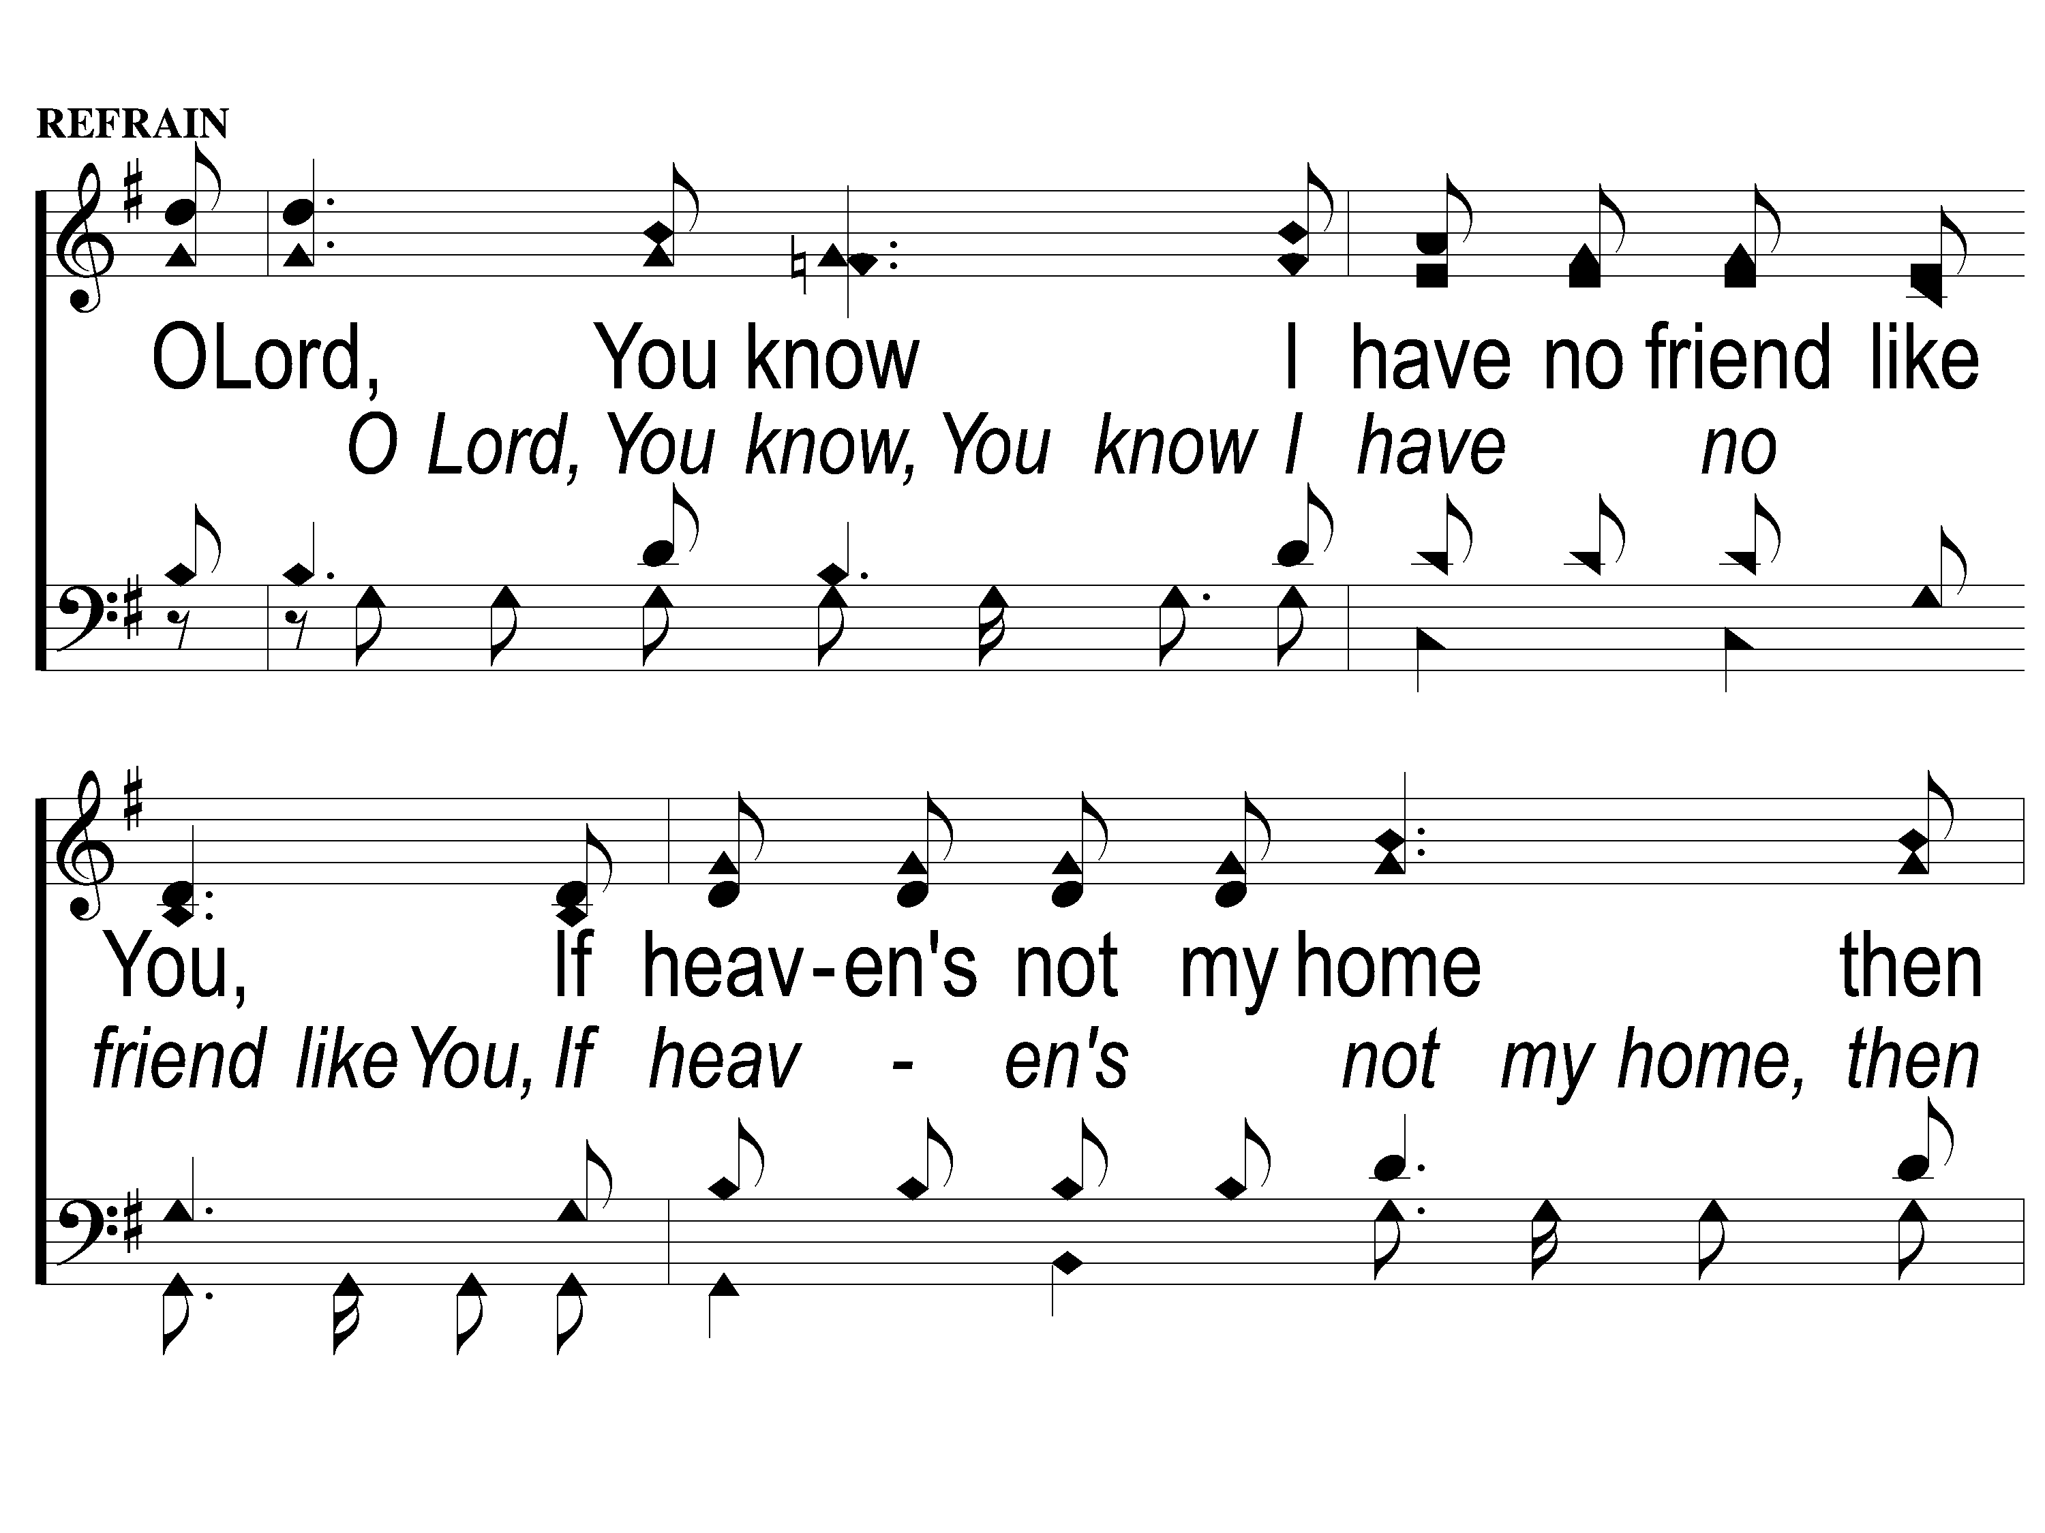
C-1 This World is Not My Home
This World Is Not My Home
957

Slide 15
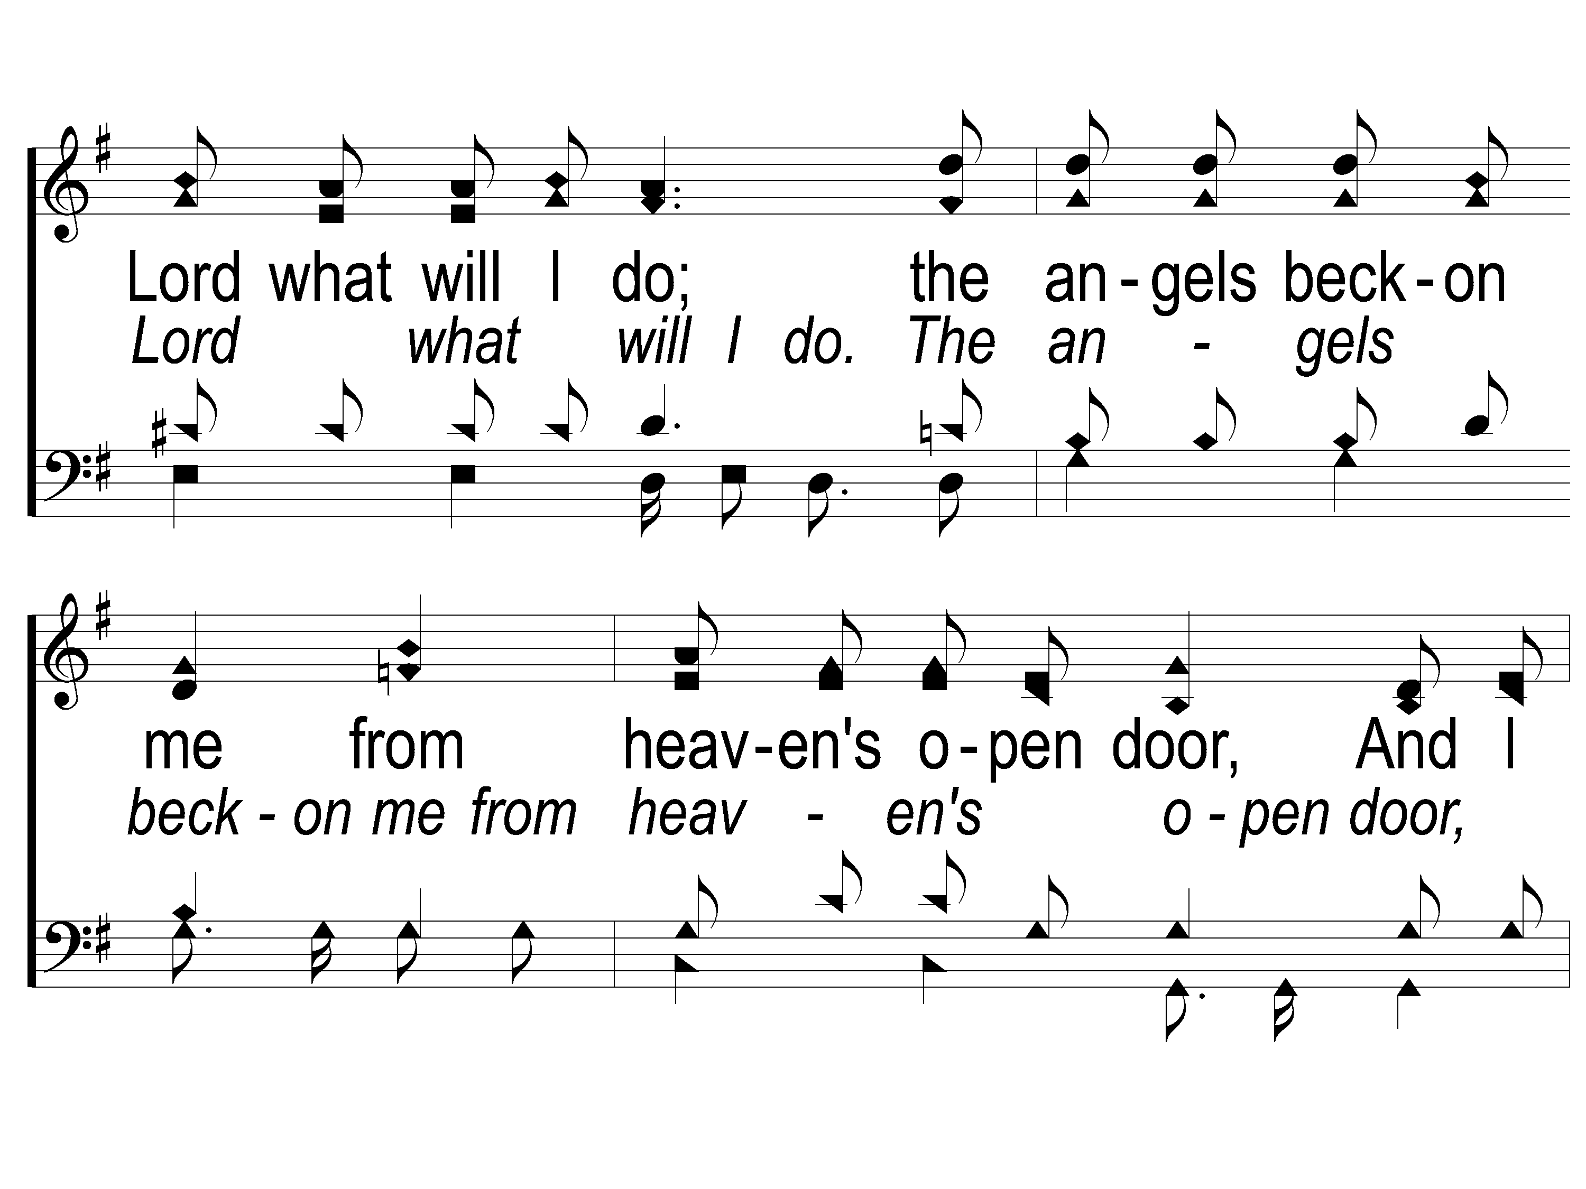
C-2 This World is Not My Home
This World Is Not My Home
957

Slide 16
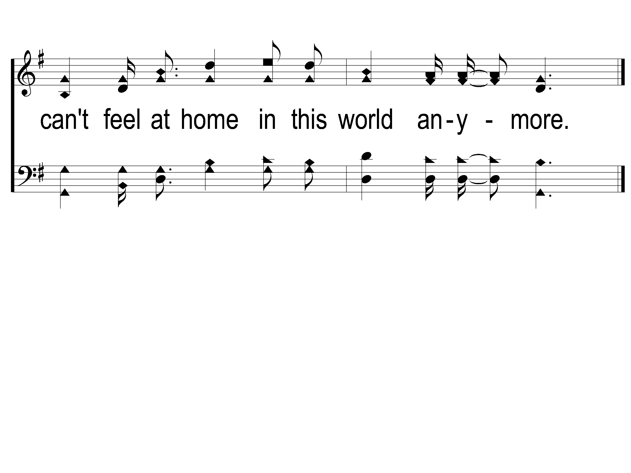
C-3 This World is Not My Home
This World Is Not My Home
957

Slide 17
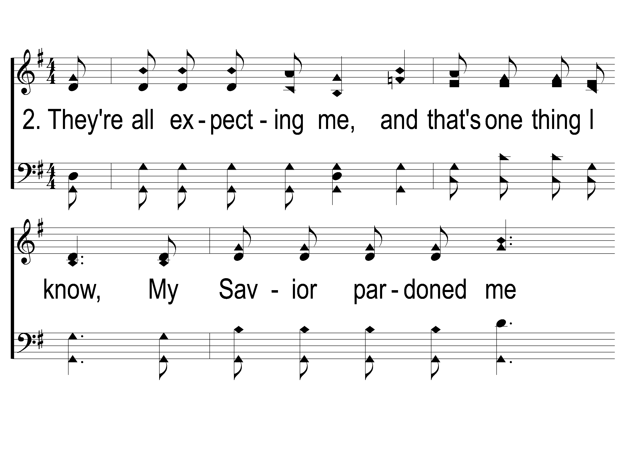
2-1 This World is Not My Home
This World Is Not My Home
957

Slide 18
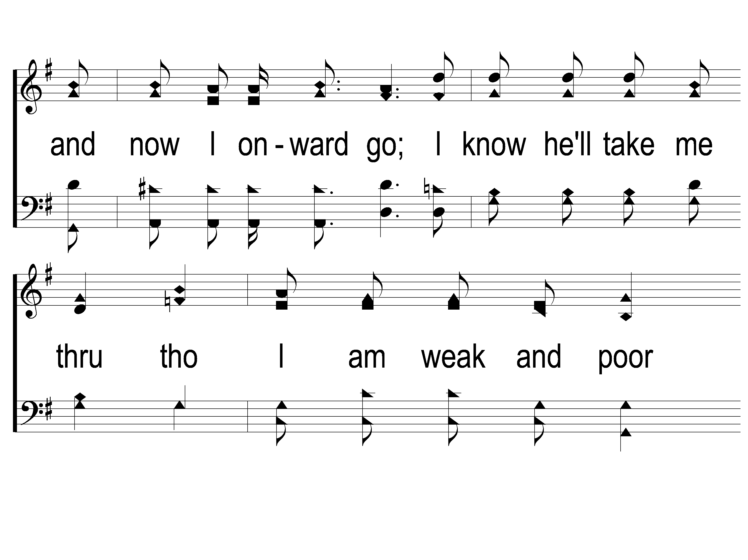
2-2 This World is Not My Home
This World Is Not My Home
957

Slide 19
2-3 This World is Not My Home
This World Is Not My Home
957

Slide 20
C-1 This World is Not My Home
This World Is Not My Home
957

Slide 21
C-2 This World is Not My Home
This World Is Not My Home
957

Slide 22
C-3 This World is Not My Home
This World Is Not My Home
957

Slide 23
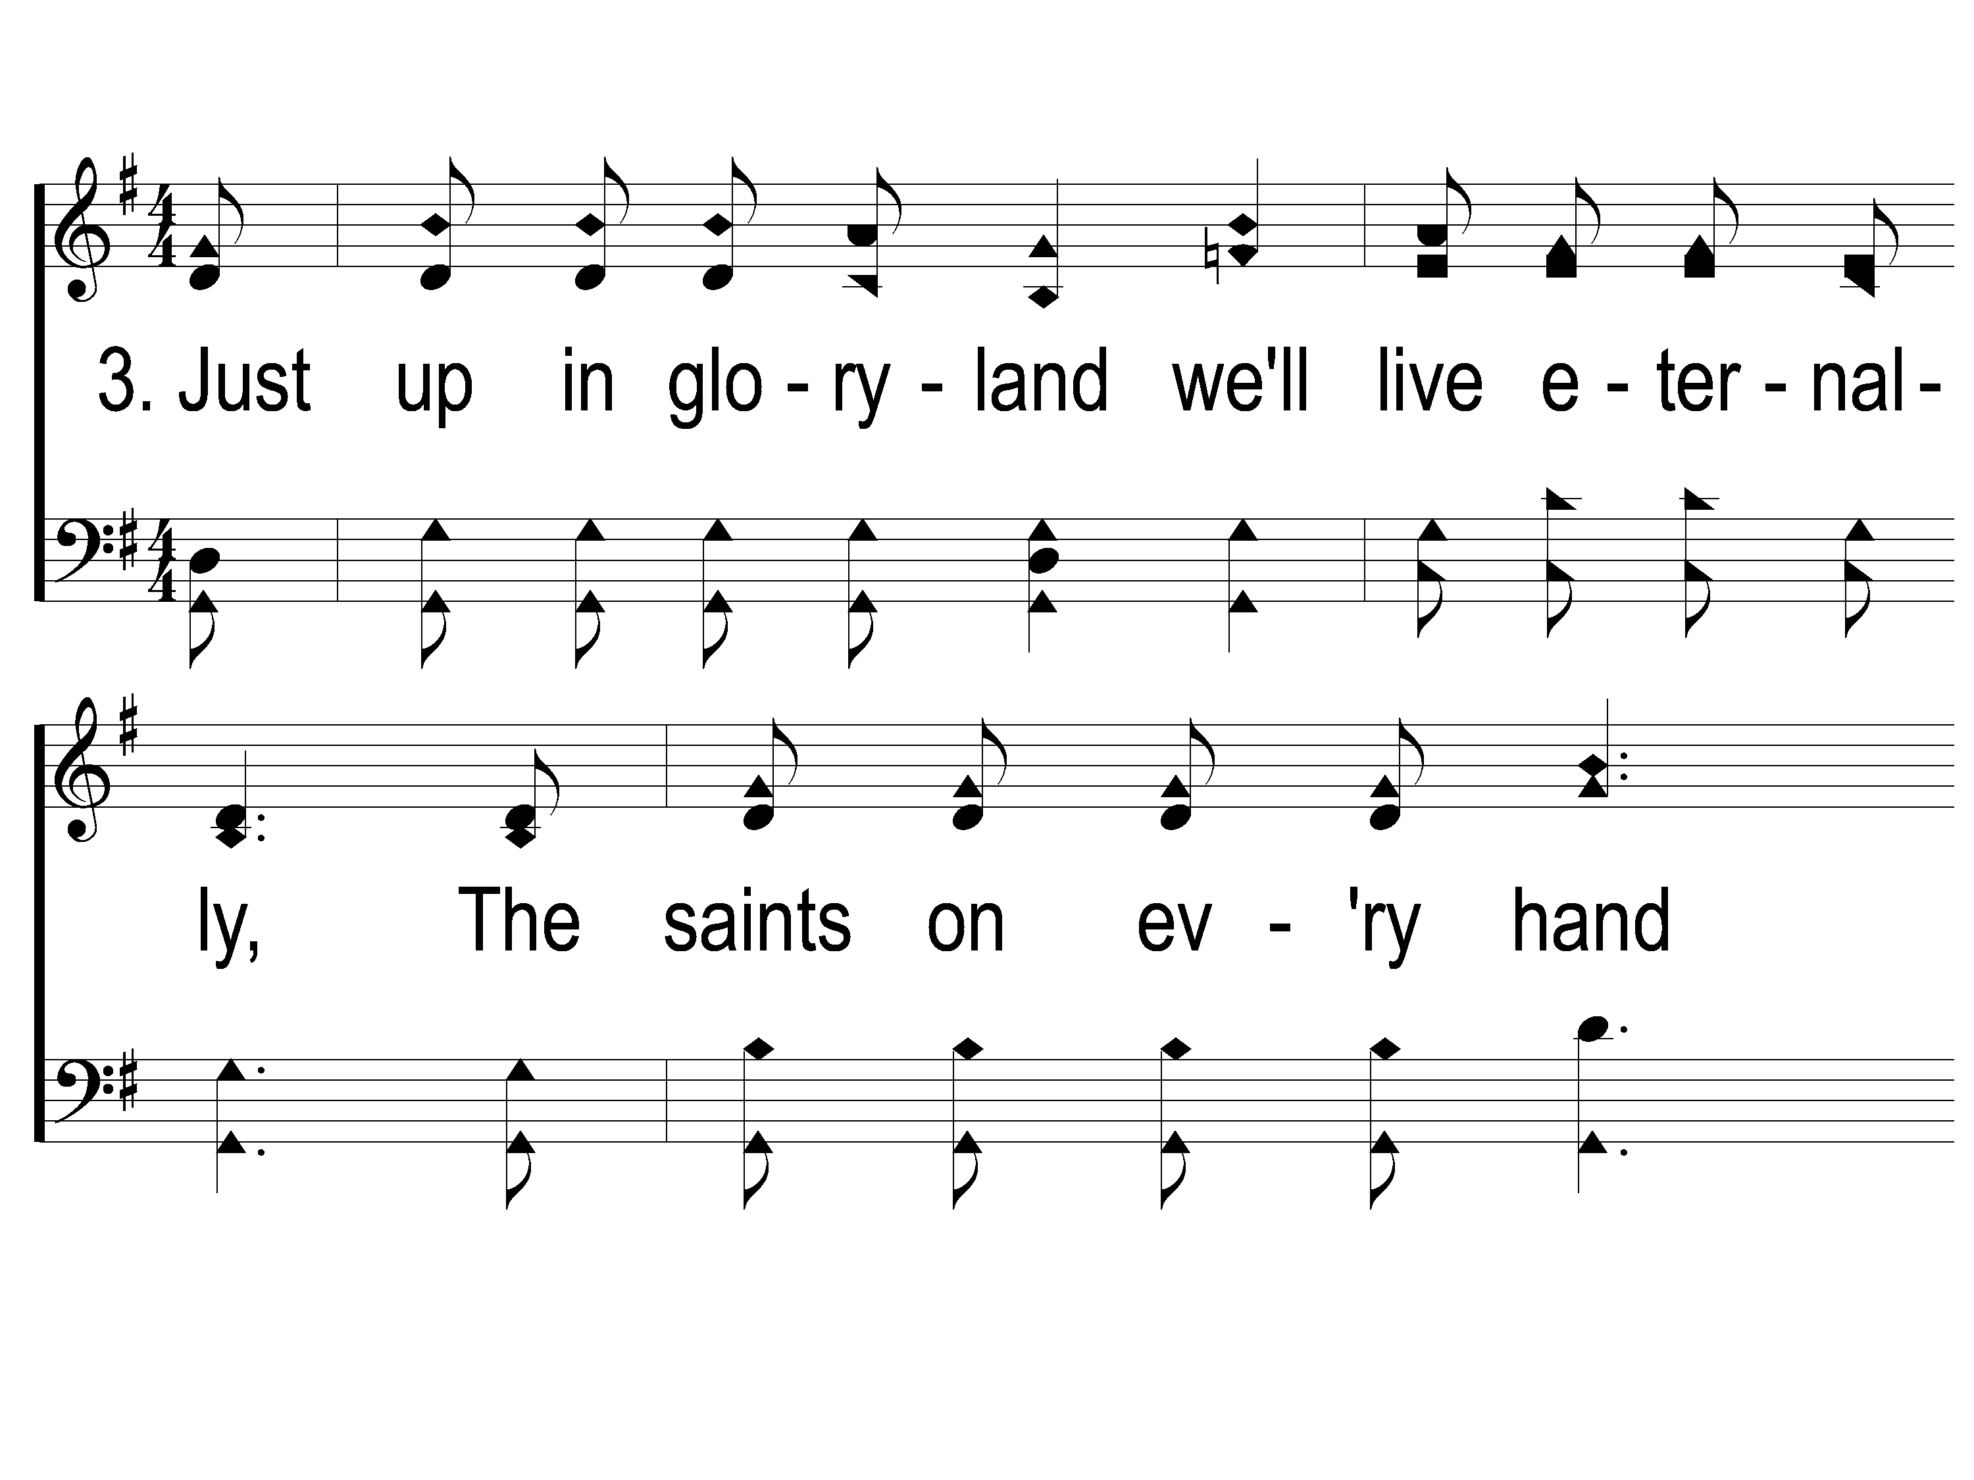
3-1 This World is Not My Home
This World Is Not My Home
957

Slide 24
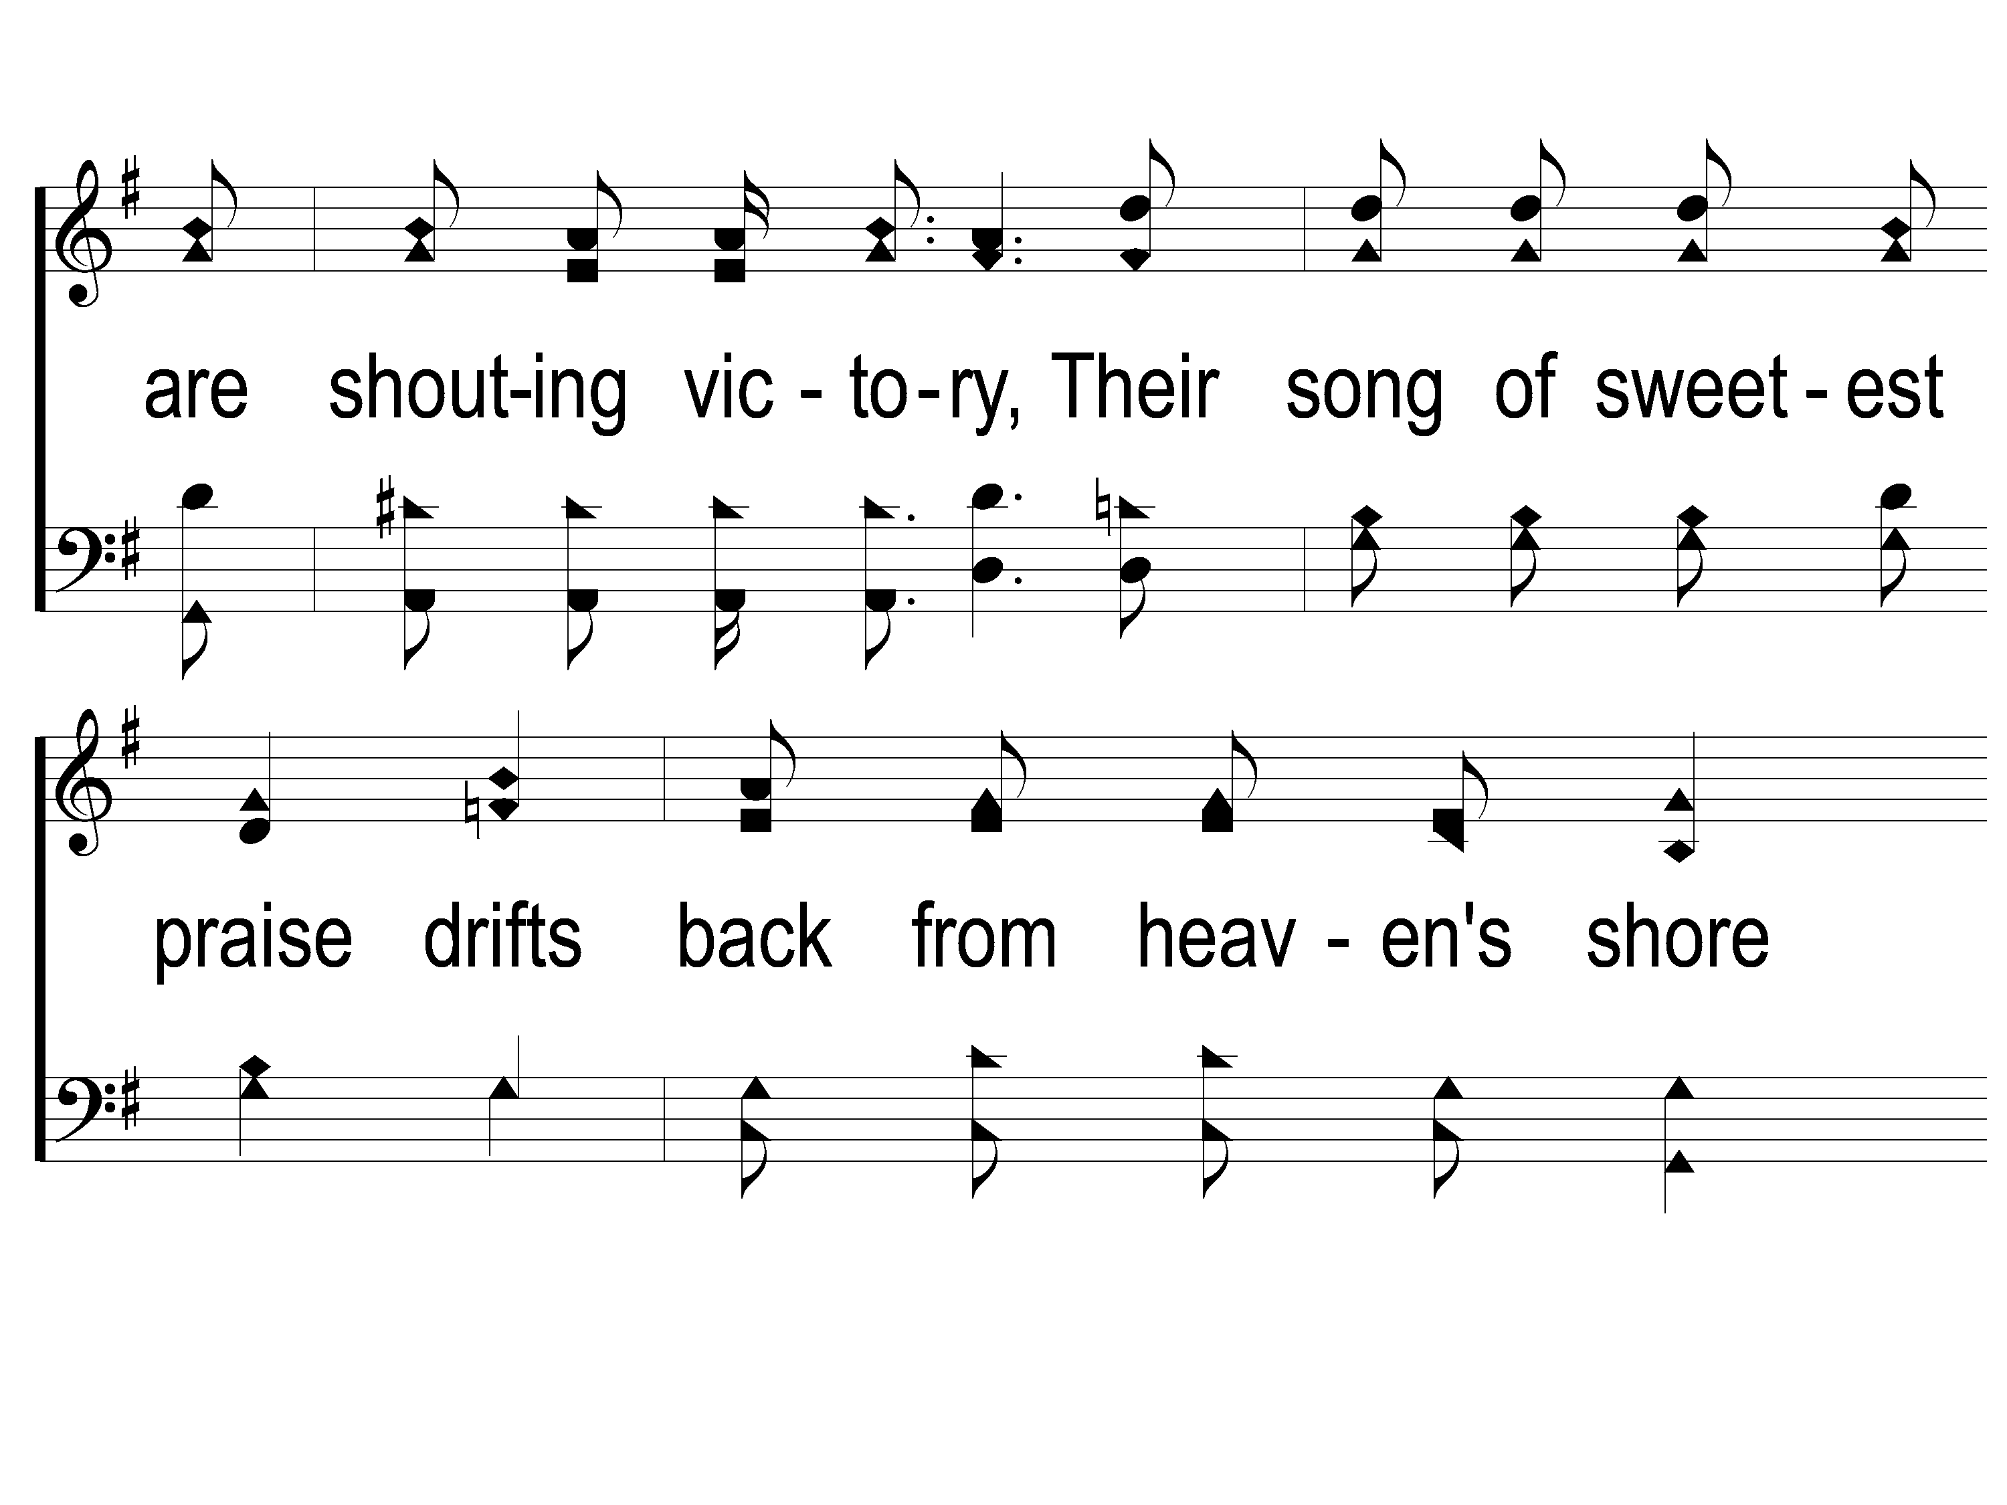
3-2 This World is Not My Home
This World Is Not My Home
957

Slide 25
3-3 This World is Not My Home
This World Is Not My Home
957

Slide 26
C-1 This World is Not My Home
This World Is Not My Home
957

Slide 27
C-2 This World is Not My Home
This World Is Not My Home
957

Slide 28
C-3 This World is Not My Home
This World Is Not My Home
957

Slide 29
Song:
When We All Get To Heaven
#853

Slide 30
1-1 When We All Get To Heaven
When We All Get To Heaven
853

Slide 31
1-2 When We All Get To Heaven
When We All Get To Heaven
853

Slide 32
C-1 When We All Get To Heaven
When We All Get To Heaven
853

Slide 33
C-2 When We All Get To Heaven
When We All Get To Heaven
853

Slide 34
2-1 When We All Get To Heaven
When We All Get To Heaven
853

Slide 35
2-2 When We All Get To Heaven
When We All Get To Heaven
853

Slide 36
C-1 When We All Get To Heaven
When We All Get To Heaven
853

Slide 37
C-2 When We All Get To Heaven
When We All Get To Heaven
853

Slide 38
3-1 When We All Get To Heaven
When We All Get To Heaven
853

Slide 39
3-2 When We All Get To Heaven
When We All Get To Heaven
853

Slide 40
C-1 When We All Get To Heaven
When We All Get To Heaven
853

Slide 41
C-2 When We All Get To Heaven
When We All Get To Heaven
853

Slide 42
Opening Prayer

Slide 43
Song:
The Battle Belongs To The Lord
#749

Slide 44
1-1 The Battle Belongs to the Lord
The Battle Belongs to the Lord
749

Slide 45
1-2 The Battle Belongs to the Lord
The Battle Belongs to the Lord
749

Slide 46
C-1 The Battle Belongs to the Lord
The Battle Belongs to the Lord
749

Slide 47
C-2 The Battle Belongs to the Lord
The Battle Belongs to the Lord
749

Slide 48
2-1 The Battle Belongs to the Lord
The Battle Belongs to the Lord
749

Slide 49
2-2 The Battle Belongs to the Lord
The Battle Belongs to the Lord
749

Slide 50
C-1 The Battle Belongs to the Lord
The Battle Belongs to the Lord
749

Slide 51
C-2 The Battle Belongs to the Lord
The Battle Belongs to the Lord
749

Slide 52
3-1 The Battle Belongs to the Lord
The Battle Belongs to the Lord
749

Slide 53
3-2 The Battle Belongs to the Lord
The Battle Belongs to the Lord
749

Slide 54
C-1 The Battle Belongs to the Lord
The Battle Belongs to the Lord
749

Slide 55
C-2 The Battle Belongs to the Lord
The Battle Belongs to the Lord
749

Slide 56
Song:
On Bended Knee
#791

Slide 57
1-1 On Bended Knee
On Bended Knee
791

Slide 58
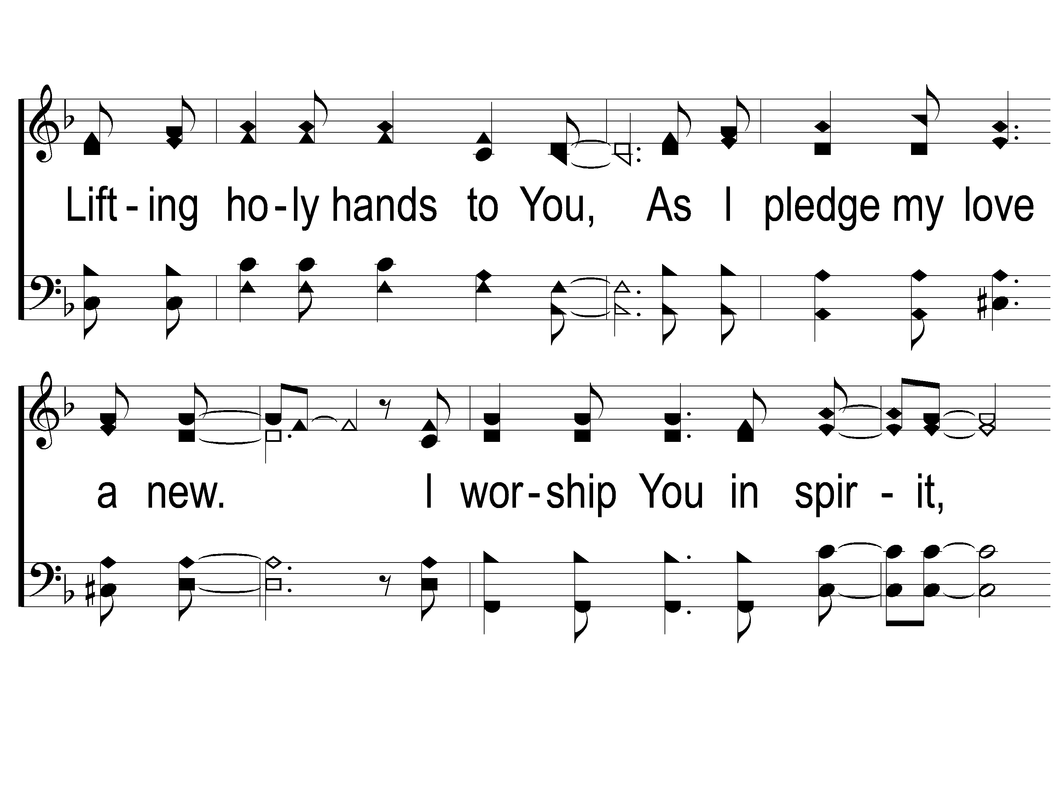
1-2 On Bended Knee
On Bended Knee
791

Slide 59
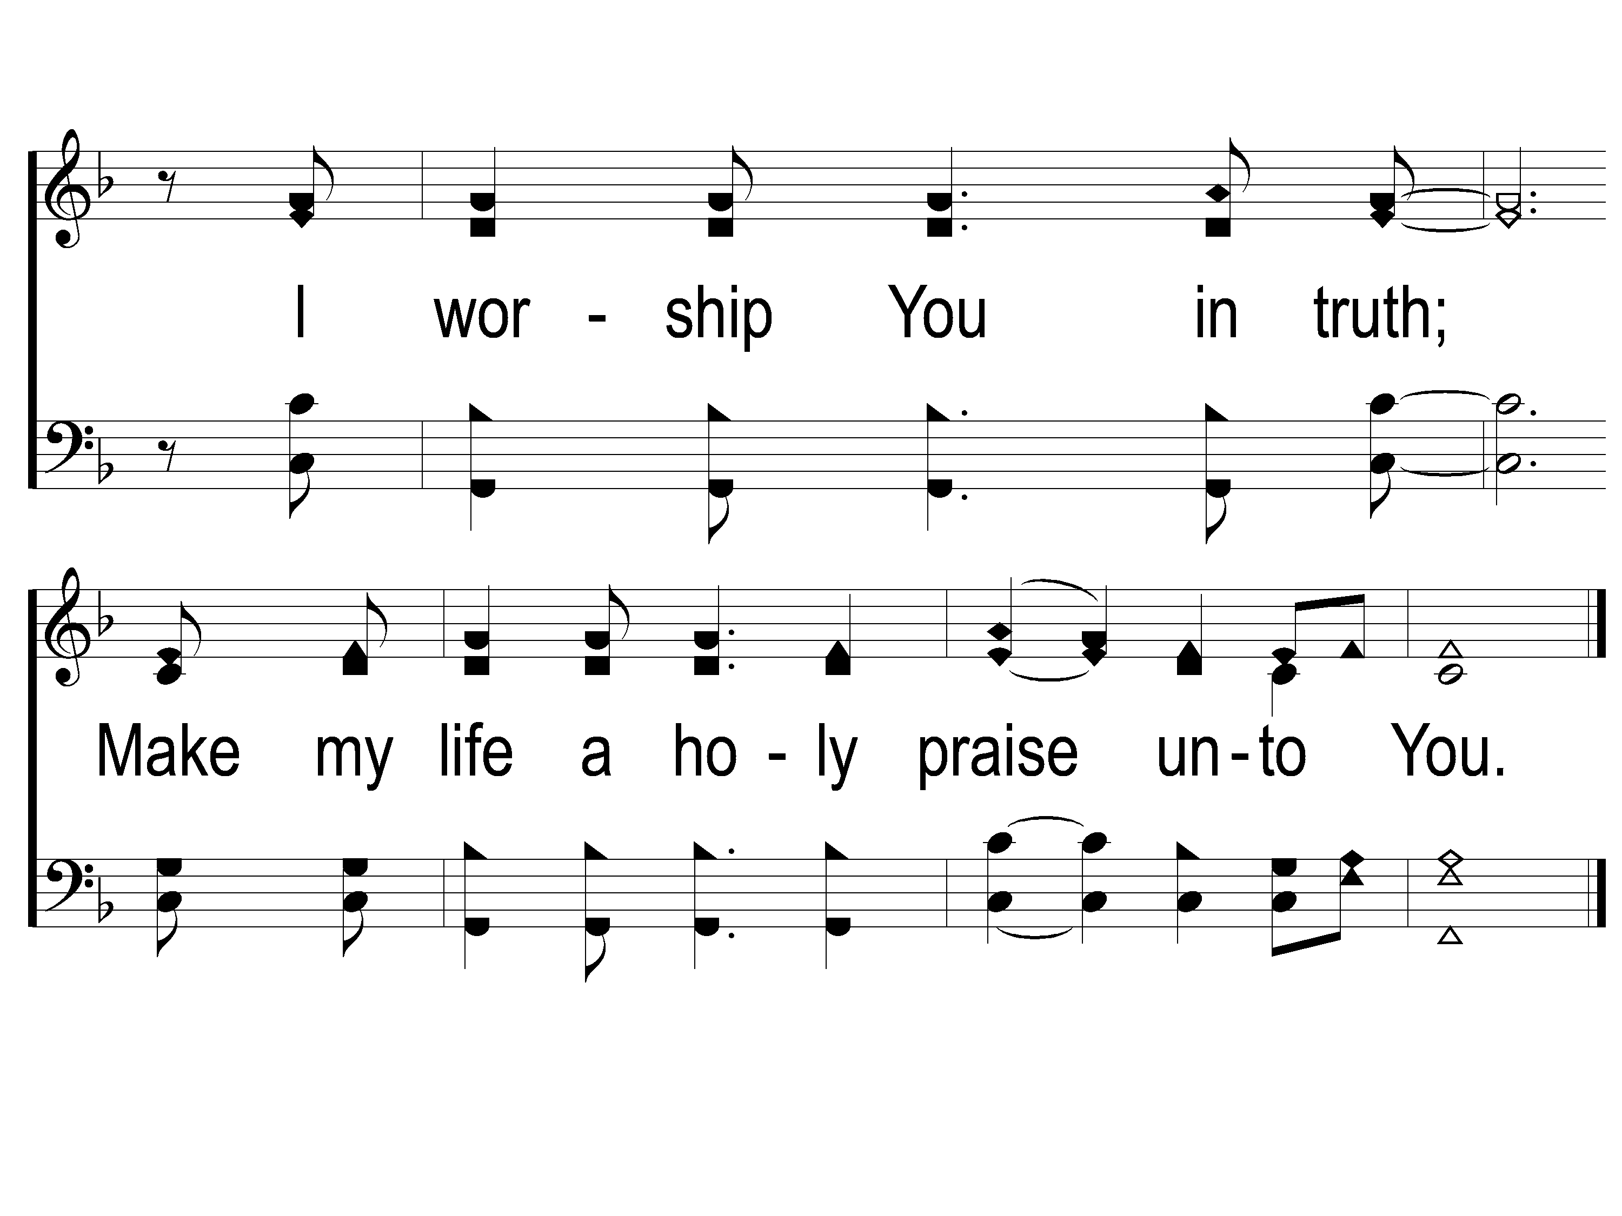
1-3 On Bended Knee
On Bended Knee
791

Slide 60
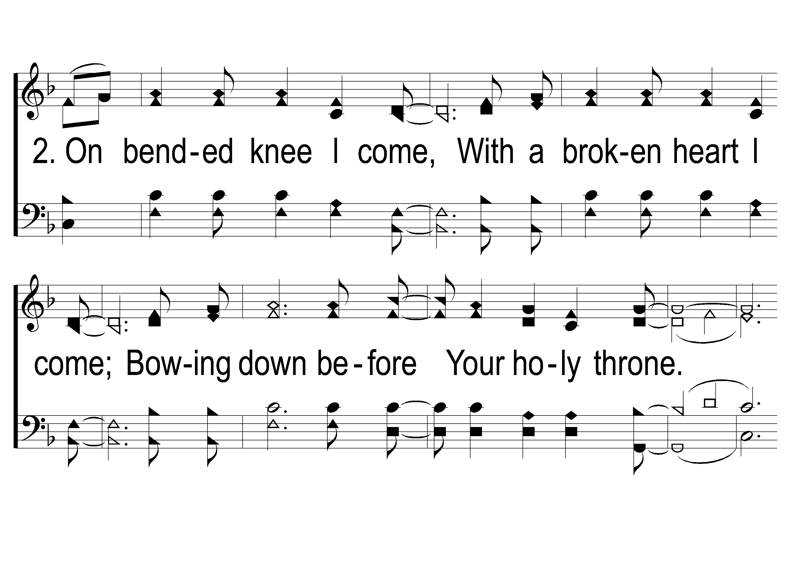
2-1 On Bended Knee
On Bended Knee
791

Slide 61
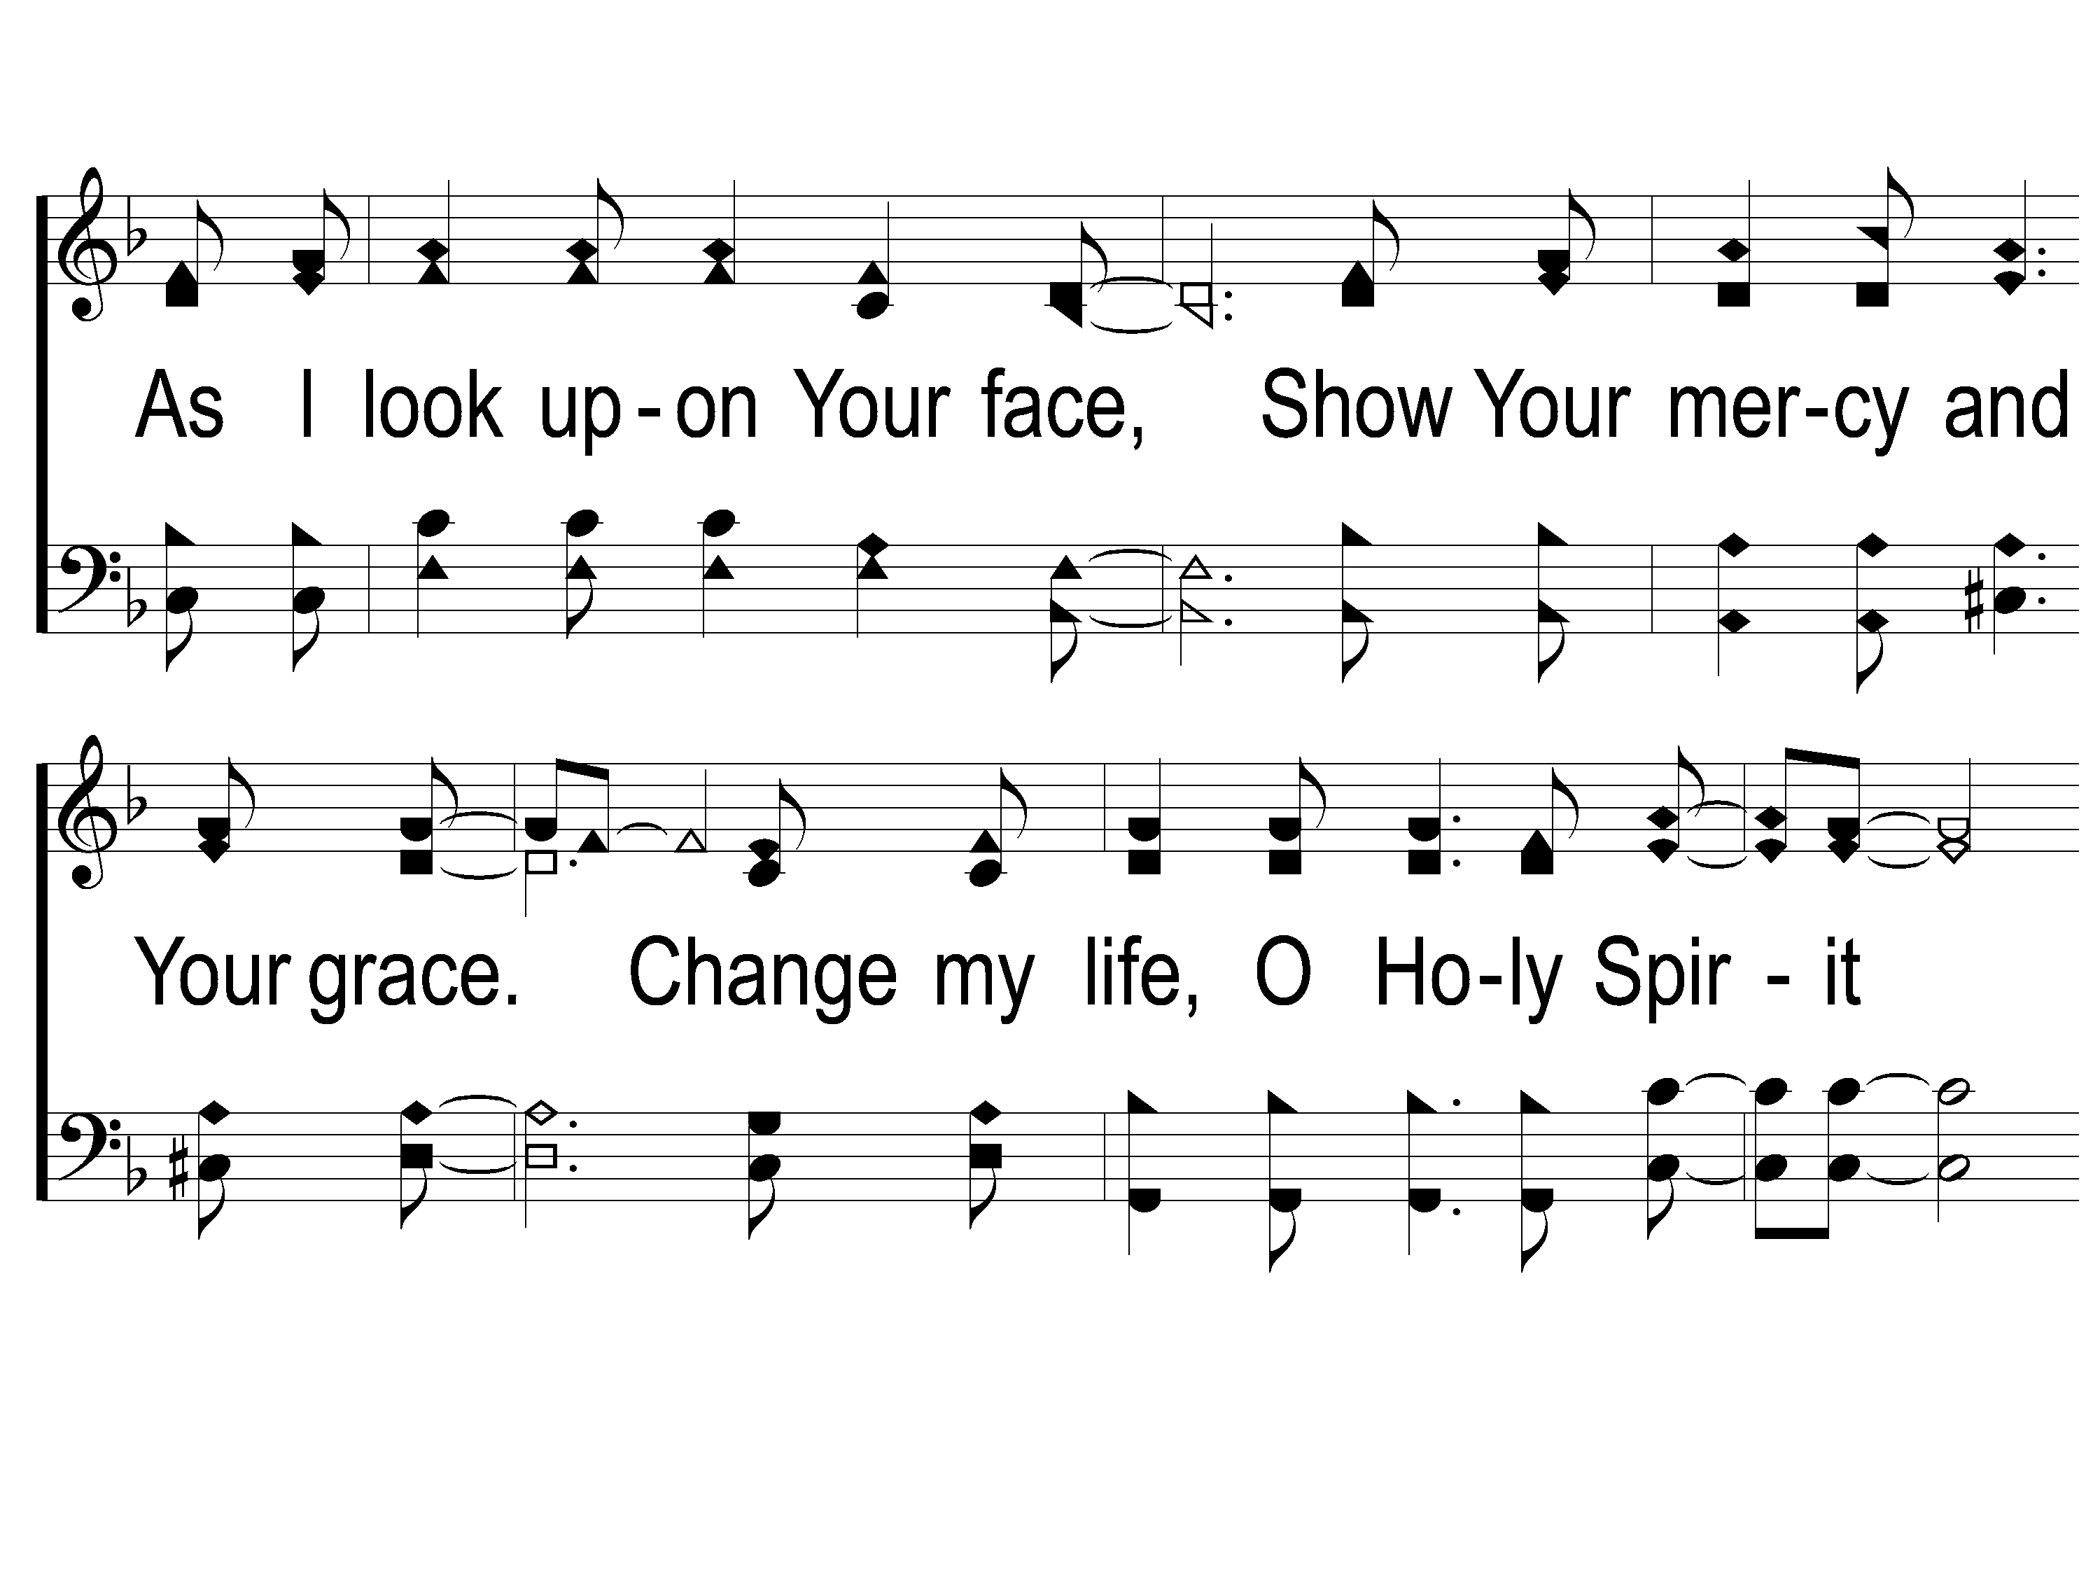
2-2 On Bended Knee
On Bended Knee
791

Slide 62
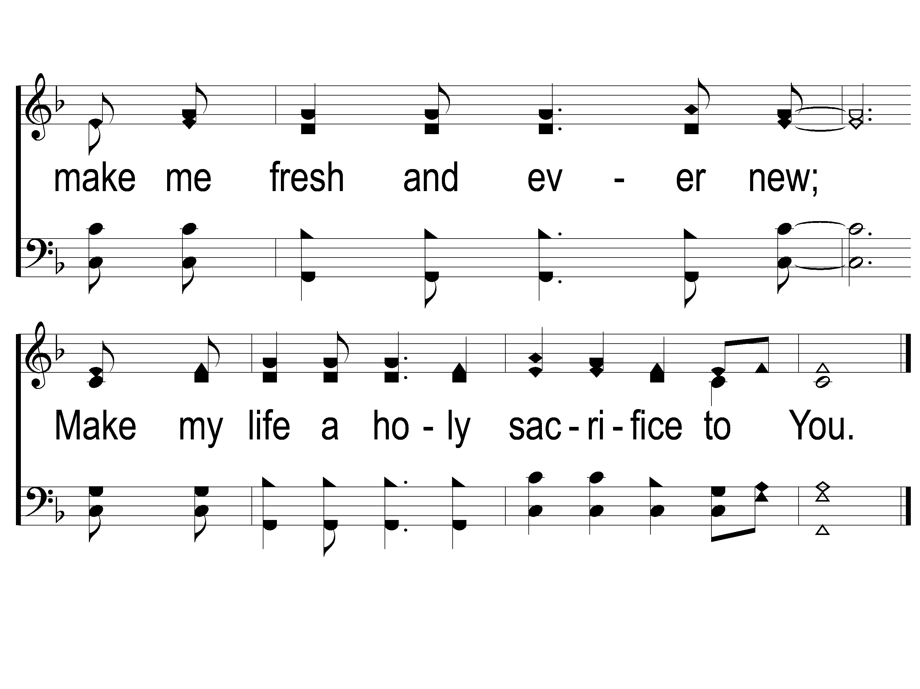
2-3 On Bended Knee
On Bended Knee
791

Slide 63
Scripture Reading:
Romans 12:1-8

Slide 64
RESTORE REBUILD RENEW
IN 2022

Slide 65
Renewed MIND
in
Romans 12:2

Slide 66
A Renewed Mind

Slide 67
A Renewed Mind
Begins Before Baptism

Slide 68
A Renewed Mind
Begins Before Baptism
Belief in Christ
Jn. 6:35, 40, 47, 11:25
Jms. 2:19

Slide 69
A Renewed Mind
Begins Before Baptism
Confession of Christ
Rom. 10:10
Phili. 2:11
1 Tim. 6:12-13
Acts 8:37

Slide 70
A Renewed Mind
Begins Before Baptism
Repentance of Sins
Acts 2:38, 17:30, 26:20
Matt. 3:8, Lk. 3:8
2 Cor. 7:10
Rom. 2:4

Slide 71
A Renewed Mind
Begins Before Baptism
Submits To Baptism

Slide 72
A Renewed Mind
Submits to Baptism
Likeness of Christ
Matt. 3:13-17
Rom. 6:4
1 Cor. 6:14

Slide 73
A Renewed Mind
Submits to Baptism
Forgiveness Received
Acts 2:38, 41, 47
1 Pet. 3:18-22

Slide 74
A Renewed Mind
Submits to Baptism
Placement by God
Acts 2:41, 46-47
1 Pet. 3:18-22

Slide 75
A Renewed Mind
Begins Before Baptism
Submits To Baptism
Continues After Baptism

Slide 76
A Renewed Mind
Continues After Baptism
Constant Renewal
Rom. 6:4

Slide 77
A Renewed Mind
Continues After Baptism
Constant Renewal
Rom. 6:4
2 Cor. 5:17
Col. 3:1-11
Eph. 4:17-32

Slide 78
“Imagine yourself as a living house. God comes in to rebuild that house. At first, perhaps, you can understand what He is doing. He is getting the drains right and stopping the leaks in the roof and so on; you knew that those jobs needed doing and so you are not surprised. But presently He starts knocking the house about in a way that hurts abominably and does not seem to make any sense. What on earth is He up to? The explanation is that He is building quite a different house from the one you thought of - throwing out a new wing here, putting on an extra floor there, running up towers, making courtyards. You thought you were being made into a decent little cottage: but He is building a palace. He intends to come and live in it Himself.” – C. S. Lewis

Slide 79
Are You Renewed in Mind?

Slide 80
Walking In Sunlight
#611
Invitation
Song:

Slide 81
1-1 Walking in Sunlight
Walking In Sunlight
611

Slide 82
1-2 Walking in Sunlight
Walking In Sunlight
611

Slide 83
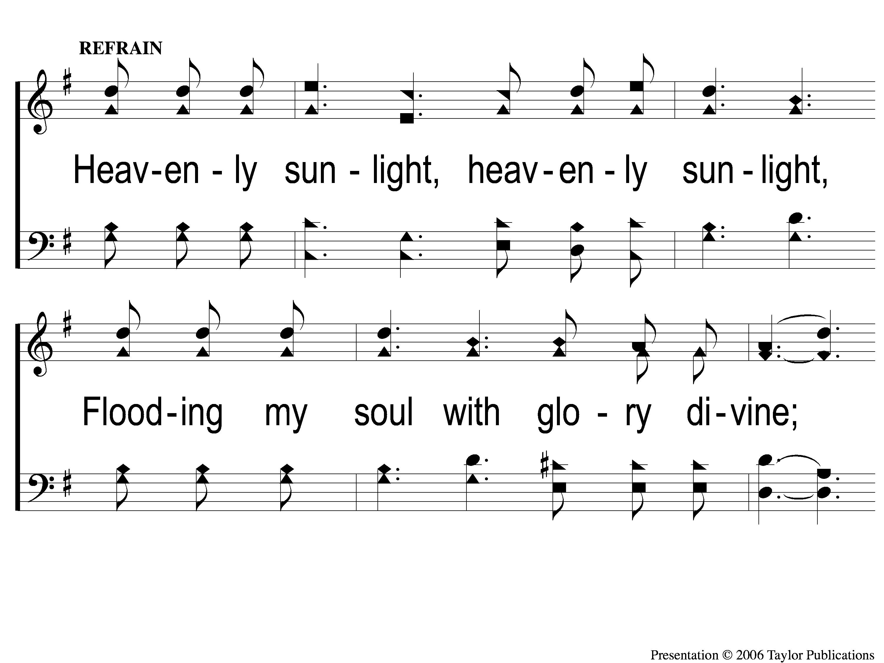
C-1 Walking in Sunlight
Walking In Sunlight
611

Slide 84
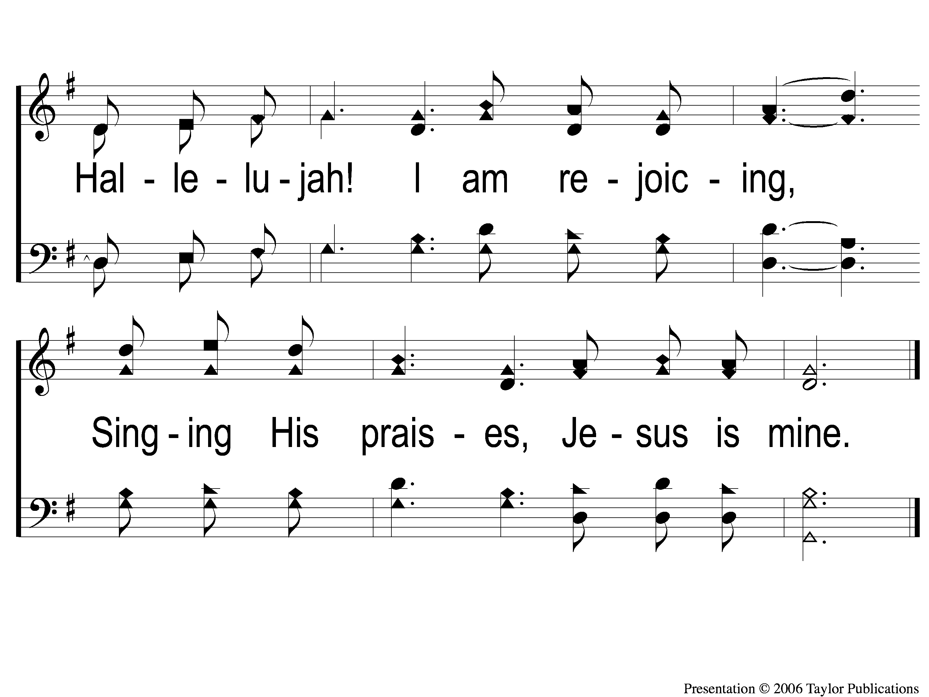
C-2 Walking in Sunlight
Walking In Sunlight
611

Slide 85
3-1 Walking in Sunlight
Walking In Sunlight
611

Slide 86
3-2 Walking in Sunlight
Walking In Sunlight
611

Slide 87
C-1 Walking in Sunlight
Walking In Sunlight
611

Slide 88
C-2 Walking in Sunlight
Walking In Sunlight
611

Slide 89
Our Contribution:
2 Corinthians 9:7-8
“So let each one give as he purposes in his heart, not grudgingly or of necessity; for God loves a cheerful giver. And God is able to make all grace abound toward you, that you, always having all sufficiency in all things, may have an abundance for every good work.”

Slide 90
Song:
He Paid A Debt
#376

Slide 91
1-1 He Paid a Debt
He Paid A Debt
376

Slide 92
1-2 He Paid a Debt
He Paid A Debt
376

Slide 93
c He Paid a Debt
He Paid A Debt
376

Slide 94
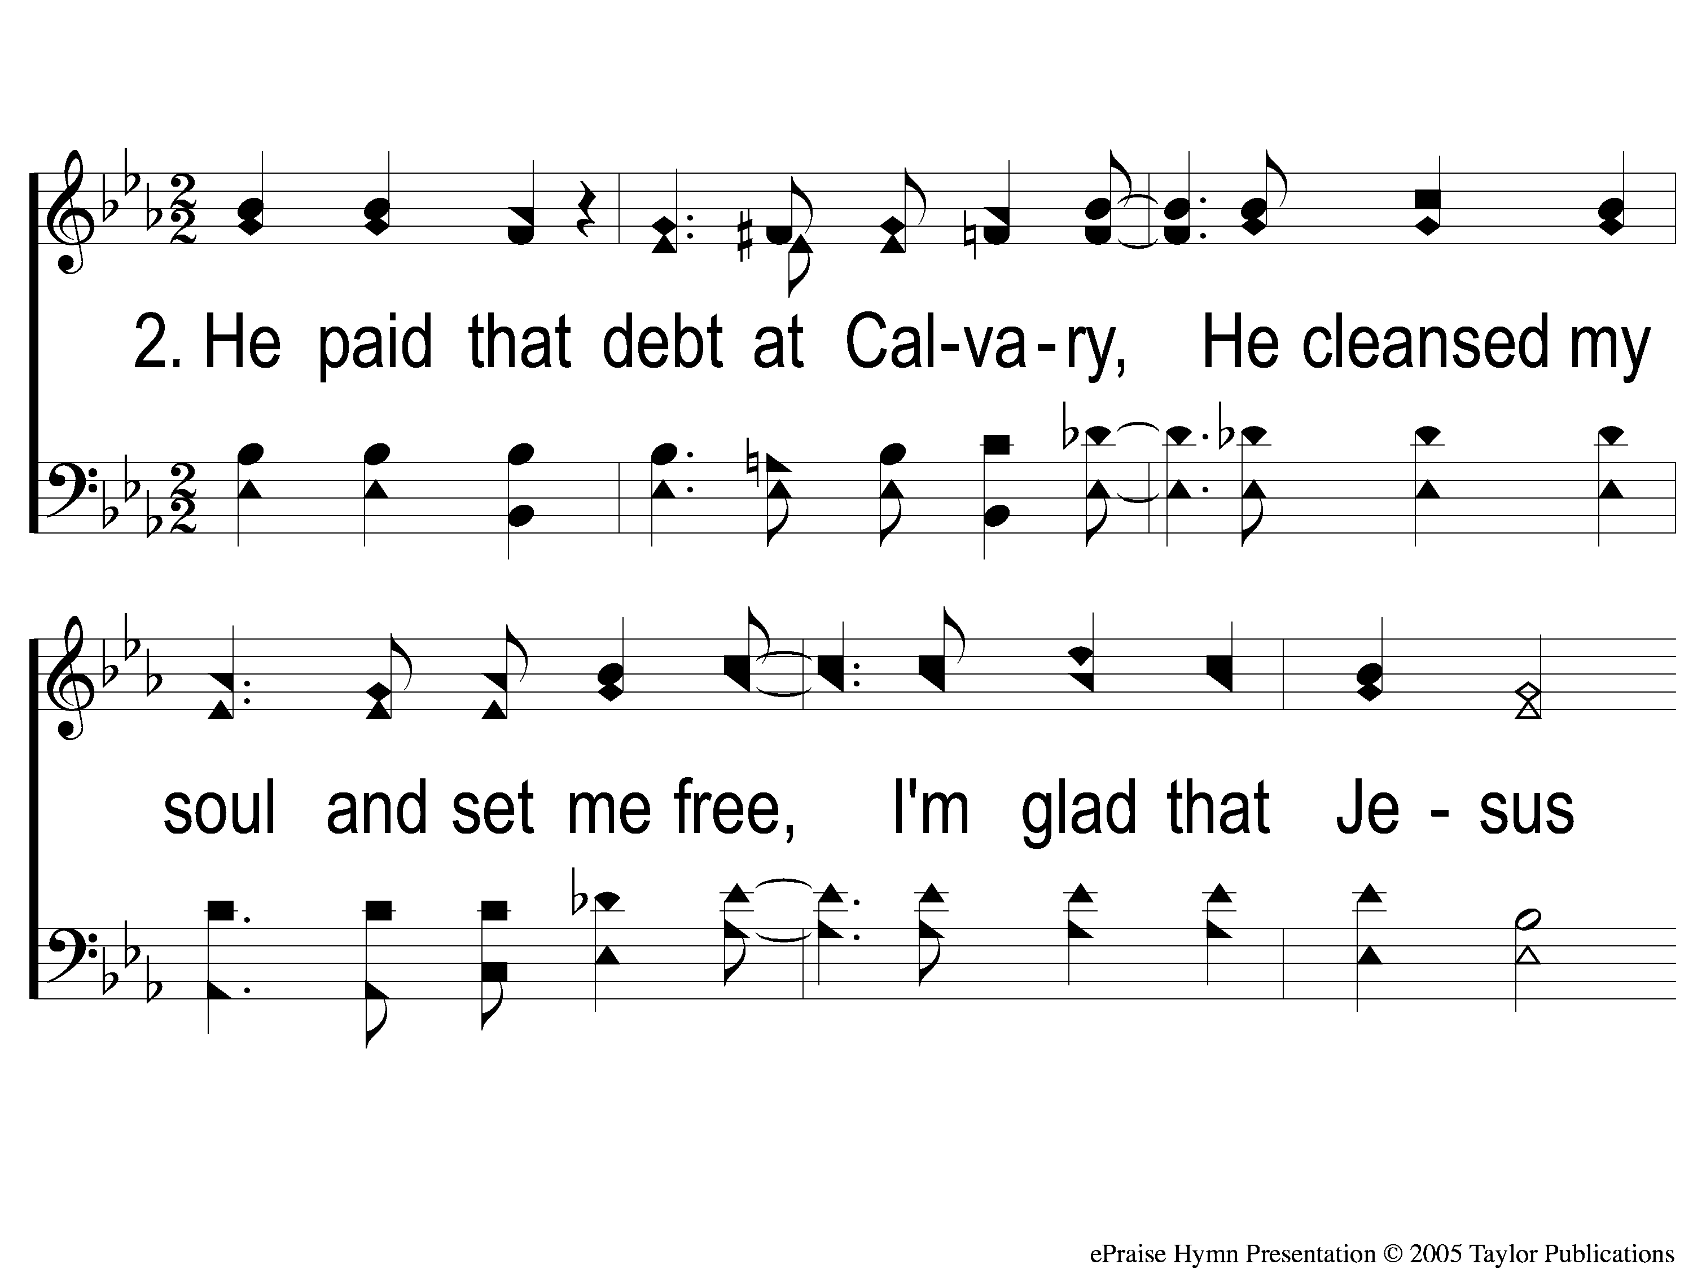
2-1 He Paid a Debt
He Paid A Debt
376

Slide 95
2-2 He Paid a Debt
He Paid A Debt
376

Slide 96
c He Paid a Debt
He Paid A Debt
376

Slide 97
3-1 He Paid a Debt
He Paid A Debt
376

Slide 98
3-2 He Paid a Debt
He Paid A Debt
376

Slide 99
c He Paid a Debt
He Paid A Debt
376

Slide 100
The Unleavened Bread
1 Peter 4:1-2
“Therefore, since Christ suffered for us in the flesh, arm yourselves also with the same mind, for he who has suffered in the flesh has ceased from sin, that he no longer should live the rest of his time in the flesh for the lusts of men, but for the will of God.”

Slide 101
The Fruit
of the Vine
1 Peter 1:17-19
“And if you call on the Father, who without partiality judges according to each one’s work, conduct yourselves throughout the time of your stay here in fear; knowing that you were not redeemed with corruptible things, like silver or gold, from your aimless conduct received by tradition from your fathers, but with the precious blood of Christ, as of a lamb without blemish and without spot.”

Slide 102
Closing Prayer

Slide 103
Song:
He Keeps Me Singing
#615

Slide 104
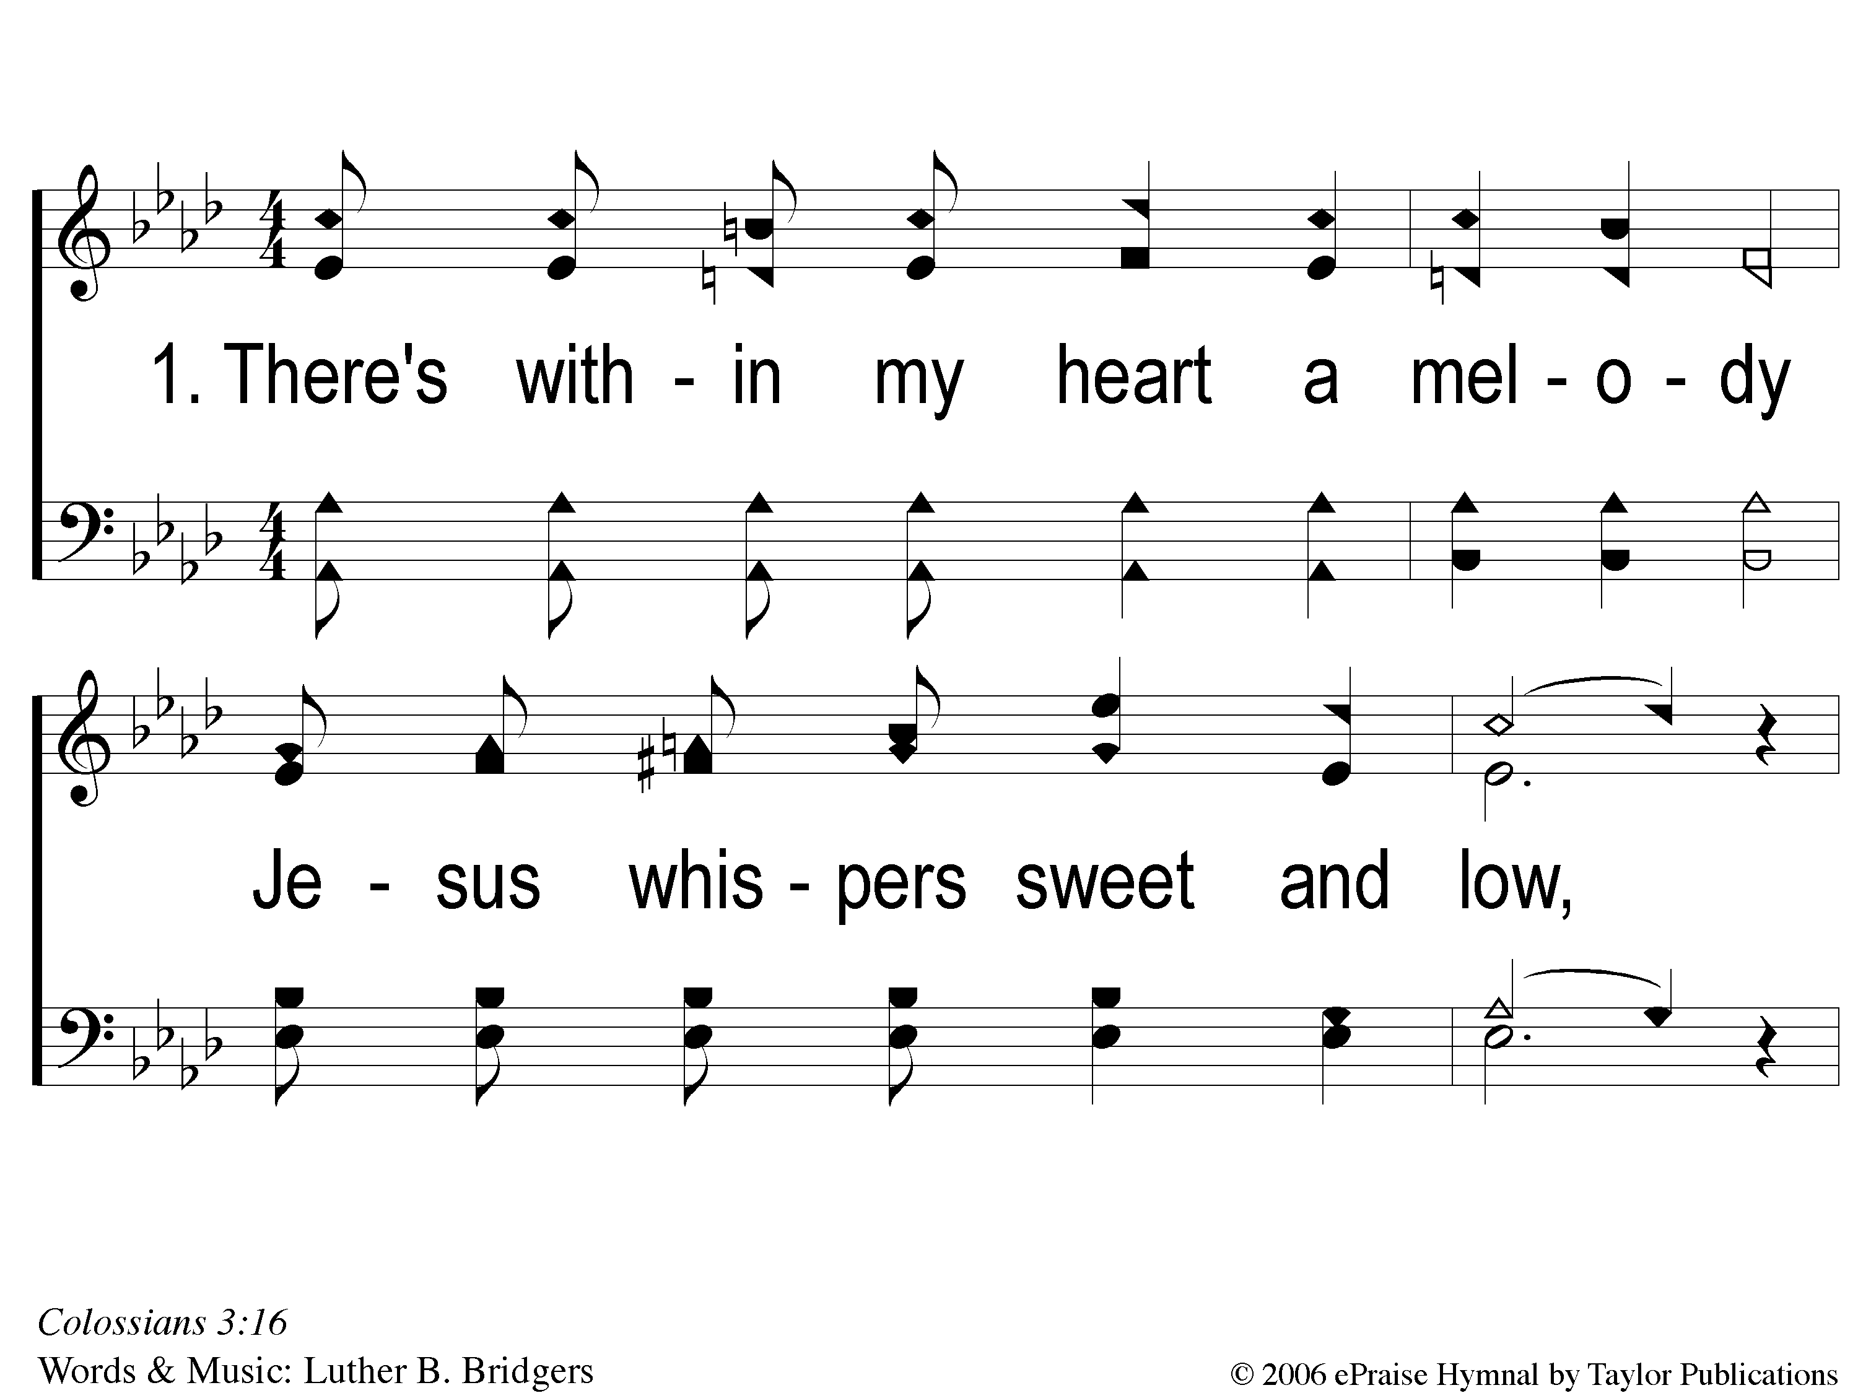
1-1 He Keeps Me Singing
He Keeps Me Singing
615

Slide 105
1-2 He Keeps Me Singing
He Keeps Me Singing
615

Slide 106
C-1 He Keeps Me Singing
He Keeps Me Singing
615

Slide 107
3-1 He Keeps Me Singing
He Keeps Me Singing
615

Slide 108
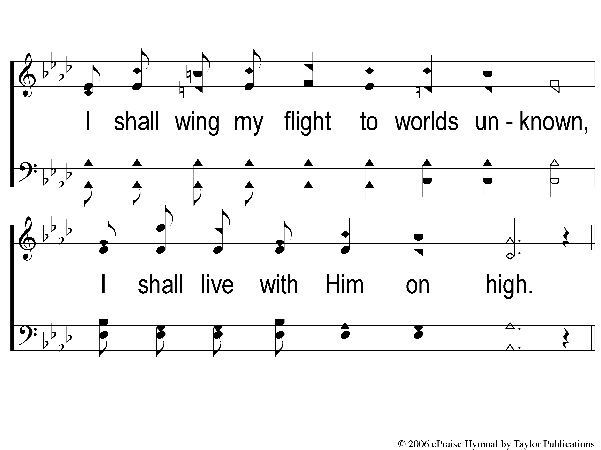
3-2 He Keeps Me Singing
He Keeps Me Singing
615

Slide 109
C-1 He Keeps Me Singing
He Keeps Me Singing
615

Slide 110
Wednesday
Worship & Bible Classes @ 6:30 PM
RESTORE REBUILD RENEW
IN 2022
WHEELER
CHURCH
OF
CHRIST

