Slide 1
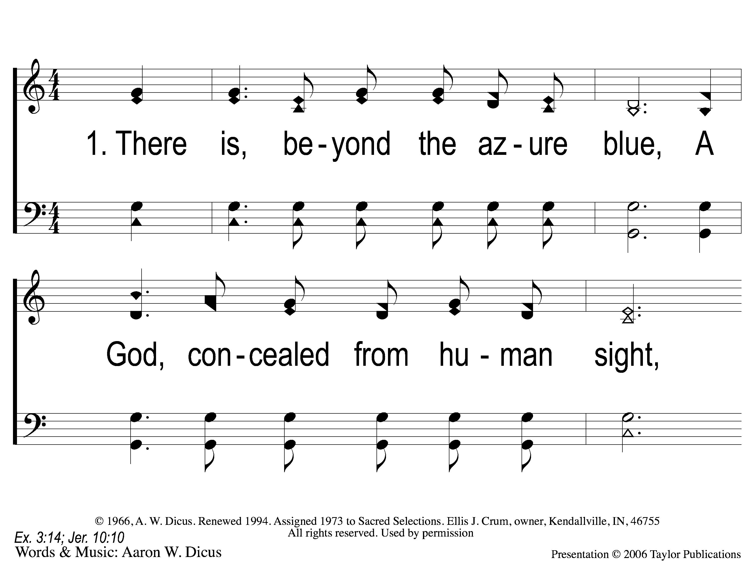
1-1 Our God He Is Alive
Our God, He Is Alive
23

Slide 2
1-2 Our God He Is Alive
Our God, He Is Alive
23

Slide 3
C-1 Our God He Is Alive
Our God, He Is Alive
23

Slide 4
C-2 Our God He Is Alive
Our God, He Is Alive
23

Slide 5
4-1 Our God He Is Alive
Our God, He Is Alive
23

Slide 6
4-2 Our God He Is Alive
Our God, He Is Alive
23

Slide 7
C-1 Our God He Is Alive
Our God, He Is Alive
23

Slide 8
C-2 Our God He Is Alive
Our God, He Is Alive
23

Slide 9
RESTORE REBUILD RENEW
welcome
we are glad to
Have you with us
IN 2022
WHEELER
CHURCH
OF
CHRIST

Slide 10
Song:
The Love Of God
#122

Slide 11
1-1 The Love of God
The Love Of God
122

Slide 12
1-2 The Love of God
The Love Of God
122

Slide 13
C-1 The Love of God
The Love Of God
122

Slide 14
C-2 The Love of God
The Love Of God
122

Slide 15
C-3 The Love of God
The Love Of God
122

Slide 16
C-4 The Love of God
The Love Of God
122

Slide 17
C-5 The Love of God
The Love Of God
122

Slide 18
2-1 The Love of God
The Love Of God
122

Slide 19
2-2 The Love of God
The Love Of God
122

Slide 20
C-1 The Love of God
The Love Of God
122

Slide 21
C-2 The Love of God
The Love Of God
122

Slide 22
C-3 The Love of God
The Love Of God
122

Slide 23
C-4 The Love of God
The Love Of God
122

Slide 24
C-5 The Love of God
The Love Of God
122

Slide 25
3-1 The Love of God
The Love Of God
122

Slide 26
3-2 The Love of God
The Love Of God
122

Slide 27
C-1 The Love of God
The Love Of God
122

Slide 28
C-2 The Love of God
The Love Of God
122

Slide 29
C-3 The Love of God
The Love Of God
122

Slide 30
C-4 The Love of God
The Love Of God
122

Slide 31
C-5 The Love of God
The Love Of God
122

Slide 32
Song:
Blessed Assurance
#480

Slide 33
1-1 Blessed Assurance
Blessed Assurance
480

Slide 34
1-2 Blessed Assurance
Blessed Assurance
480

Slide 35
C-1 Blessed Assurance
Blessed Assurance
480

Slide 36
C-2 Blessed Assurance
Blessed Assurance
480

Slide 37
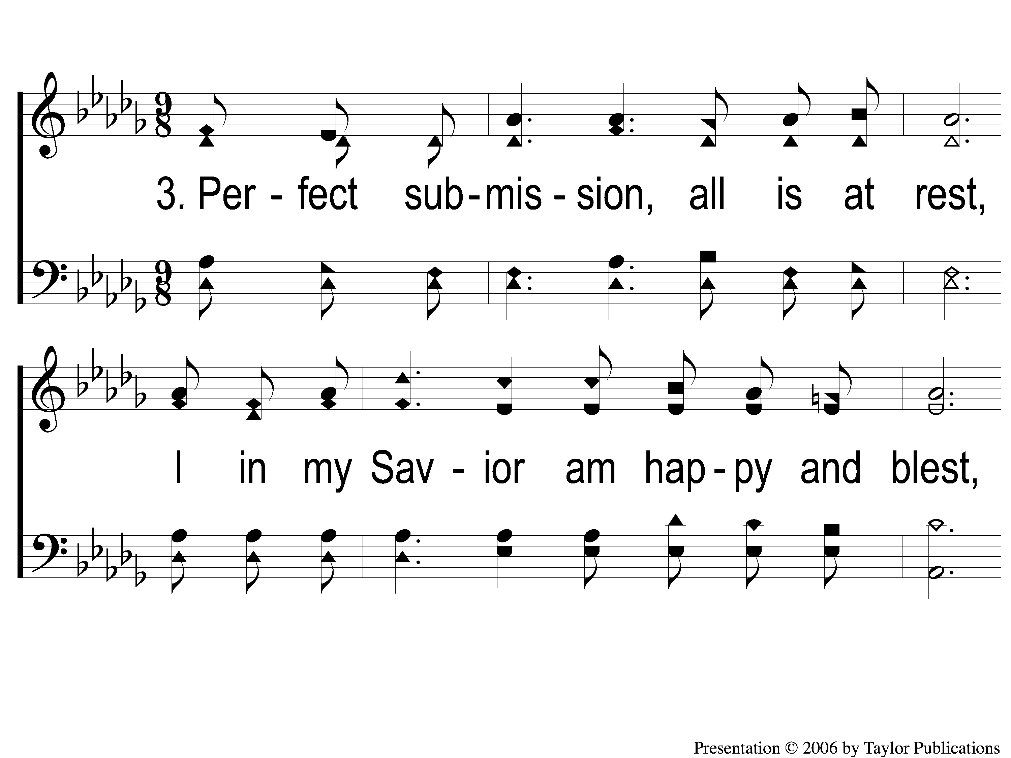
3-1 Blessed Assurance
Blessed Assurance
480

Slide 38
3-2 Blessed Assurance
Blessed Assurance
480

Slide 39
C-1 Blessed Assurance
Blessed Assurance
480

Slide 40
C-2 Blessed Assurance
Blessed Assurance
480

Slide 41
Opening Prayer

Slide 42
Song:
I Must Tell Jesus
#564

Slide 43
1-1 I Must Tell Jesus
I Must Tell Jesus
564

Slide 44
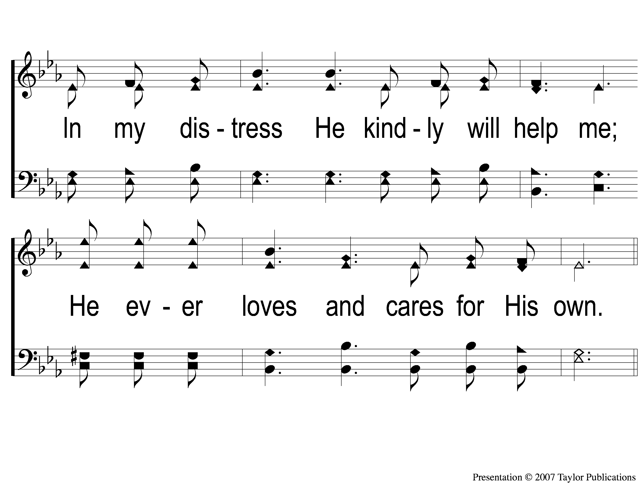
1-2 I Must Tell Jesus
I Must Tell Jesus
564

Slide 45
C-1 I Must Tell Jesus
I Must Tell Jesus
564

Slide 46
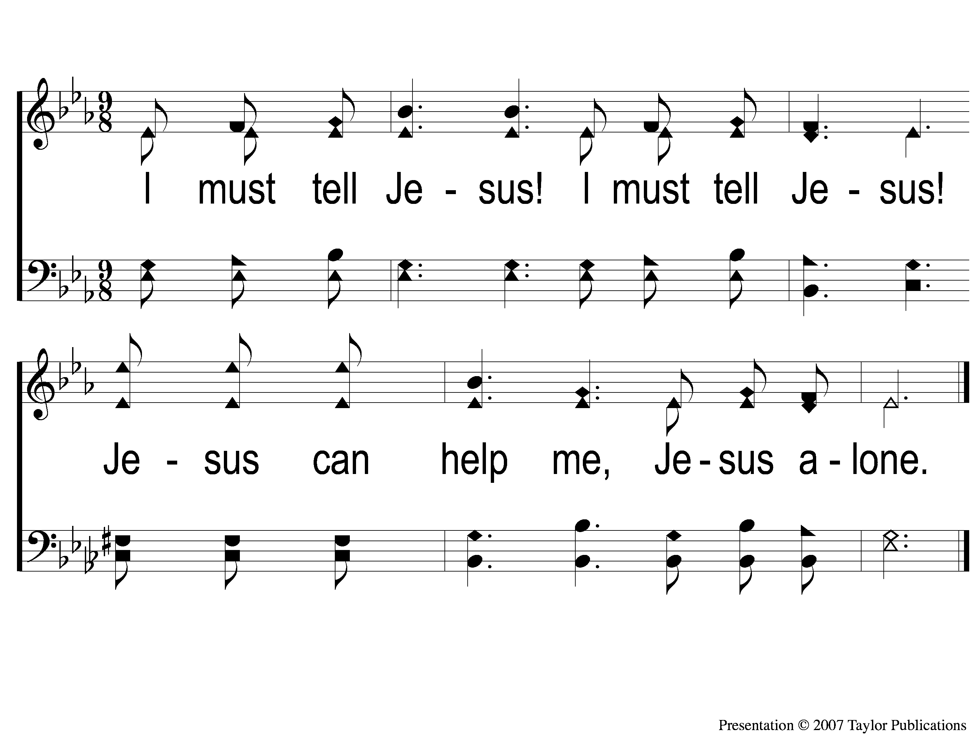
C-2 I Must Tell Jesus
I Must Tell Jesus
564

Slide 47
3-1 I Must Tell Jesus
I Must Tell Jesus
564

Slide 48
3-2 I Must Tell Jesus
I Must Tell Jesus
564

Slide 49
C-1 I Must Tell Jesus
I Must Tell Jesus
564

Slide 50
C-2 I Must Tell Jesus
I Must Tell Jesus
564

Slide 51
Song:
Take My Hand Precious Lord
#786

Slide 52
1-1 Take My Hand Precious Lord
Take My Hand Precious Lord
786

Slide 53
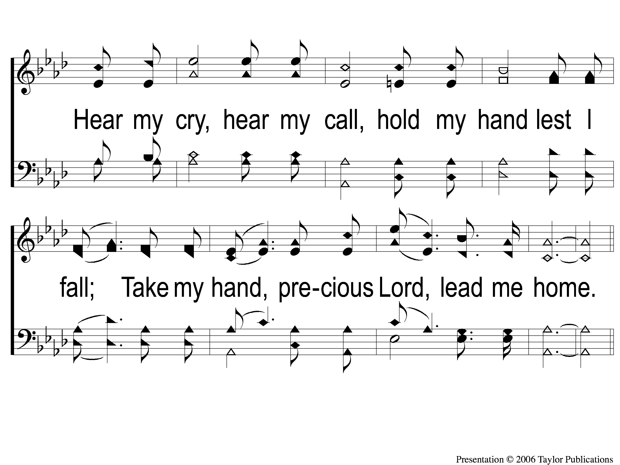
1-2 Take My Hand Precious Lord
Take My Hand Precious Lord
786

Slide 54
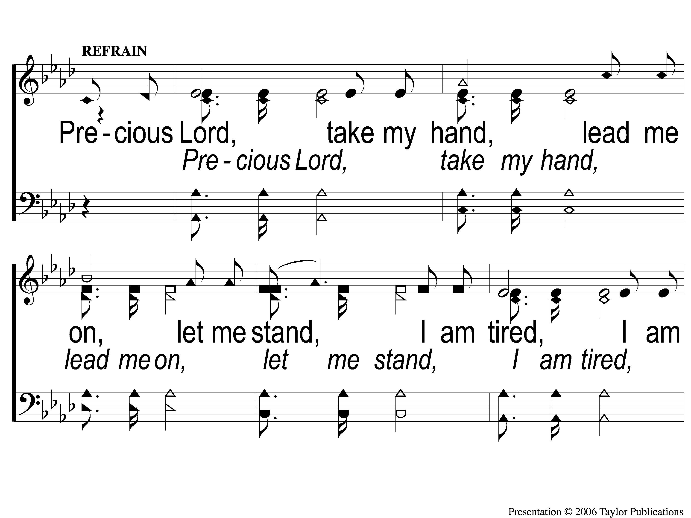
C-1 Take My Hand Precious Lord
Take My Hand Precious Lord
786

Slide 55
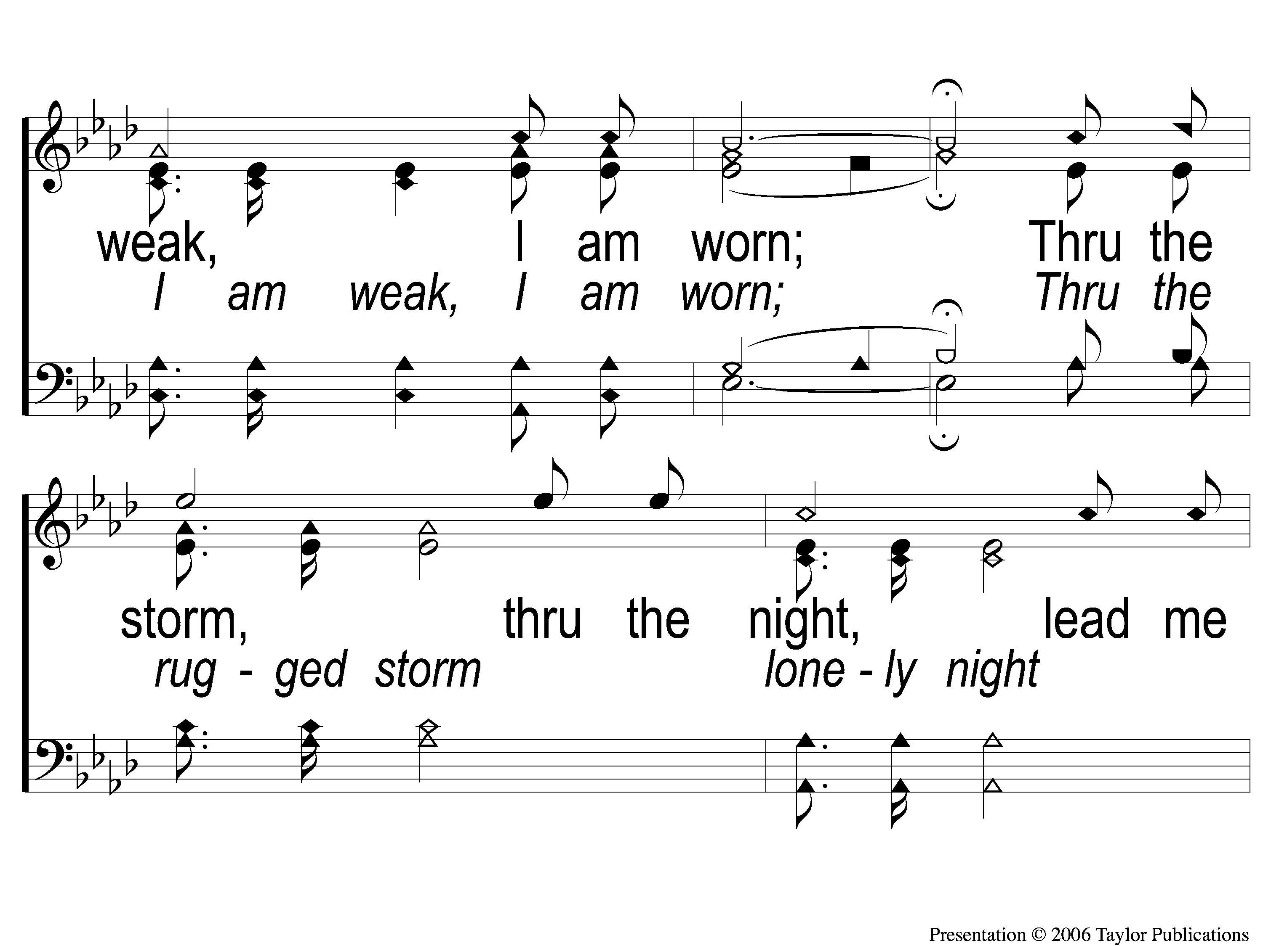
C-2 Take My Hand Precious Lord
Take My Hand Precious Lord
786

Slide 56
C-3 Take My Hand Precious Lord
Take My Hand Precious Lord
786

Slide 57
2-1 Take My Hand Precious Lord
Take My Hand Precious Lord
786

Slide 58
2-2 Take My Hand Precious Lord
Take My Hand Precious Lord
786

Slide 59
C-1 Take My Hand Precious Lord
Take My Hand Precious Lord
786

Slide 60
C-2 Take My Hand Precious Lord
Take My Hand Precious Lord
786

Slide 61
C-3 Take My Hand Precious Lord
Take My Hand Precious Lord
786

Slide 62
Scripture Reading:
Romans 12:1-2

Slide 63
RESTORE REBUILD RENEW
IN 2022

Slide 64
Renewed MIND
in
Romans 12:2

Slide 65
A Renewed Mind
Thinks Right

Slide 66
A Renewed Mind
Thinks Right
Reasoning
Rom. 12:3-6, 10, 16

Slide 67
A Renewed Mind
Thinks Right
Ourselves & God
Rom. 12:3-6, 10, 16
Prov. 27:2
Obad. 1:3

Slide 68
A Renewed Mind
Thinks Right
Ourselves & Others
Rom. 12:3-6, 10, 16
Phili. 2:3-4, 20-22

Slide 69
A Renewed Mind
Thinks Right
Acts Right

Slide 70
A Renewed Mind
Acts Right
Toward Others
Rom. 12:6-8
1 Cor. 12:12-27

Slide 71
A Renewed Mind
Acts Right
Use Your Abilities
Rom. 12:6-8
Matt. 25:14-30

Slide 72
A Renewed Mind
Thinks Right
Acts Right
Thinks & Acts Consistently

Slide 73
A Renewed Mind
Thinks & Acts Consistently
Sincere & Unhypocritical
Rom. 12:9a
2 Cor. 6:4-6
Matt. 23

Slide 74
Are You Renewed in Mind & Deed?

Slide 75
Just As I Am—I Come Broken
Invitation
Song:

Slide 76
1-1 Just as I am-I come broken
Just As I Am-I Come Broken

Slide 77
1-2 Just as I am-I come broken
Just As I Am-I Come Broken

Slide 78
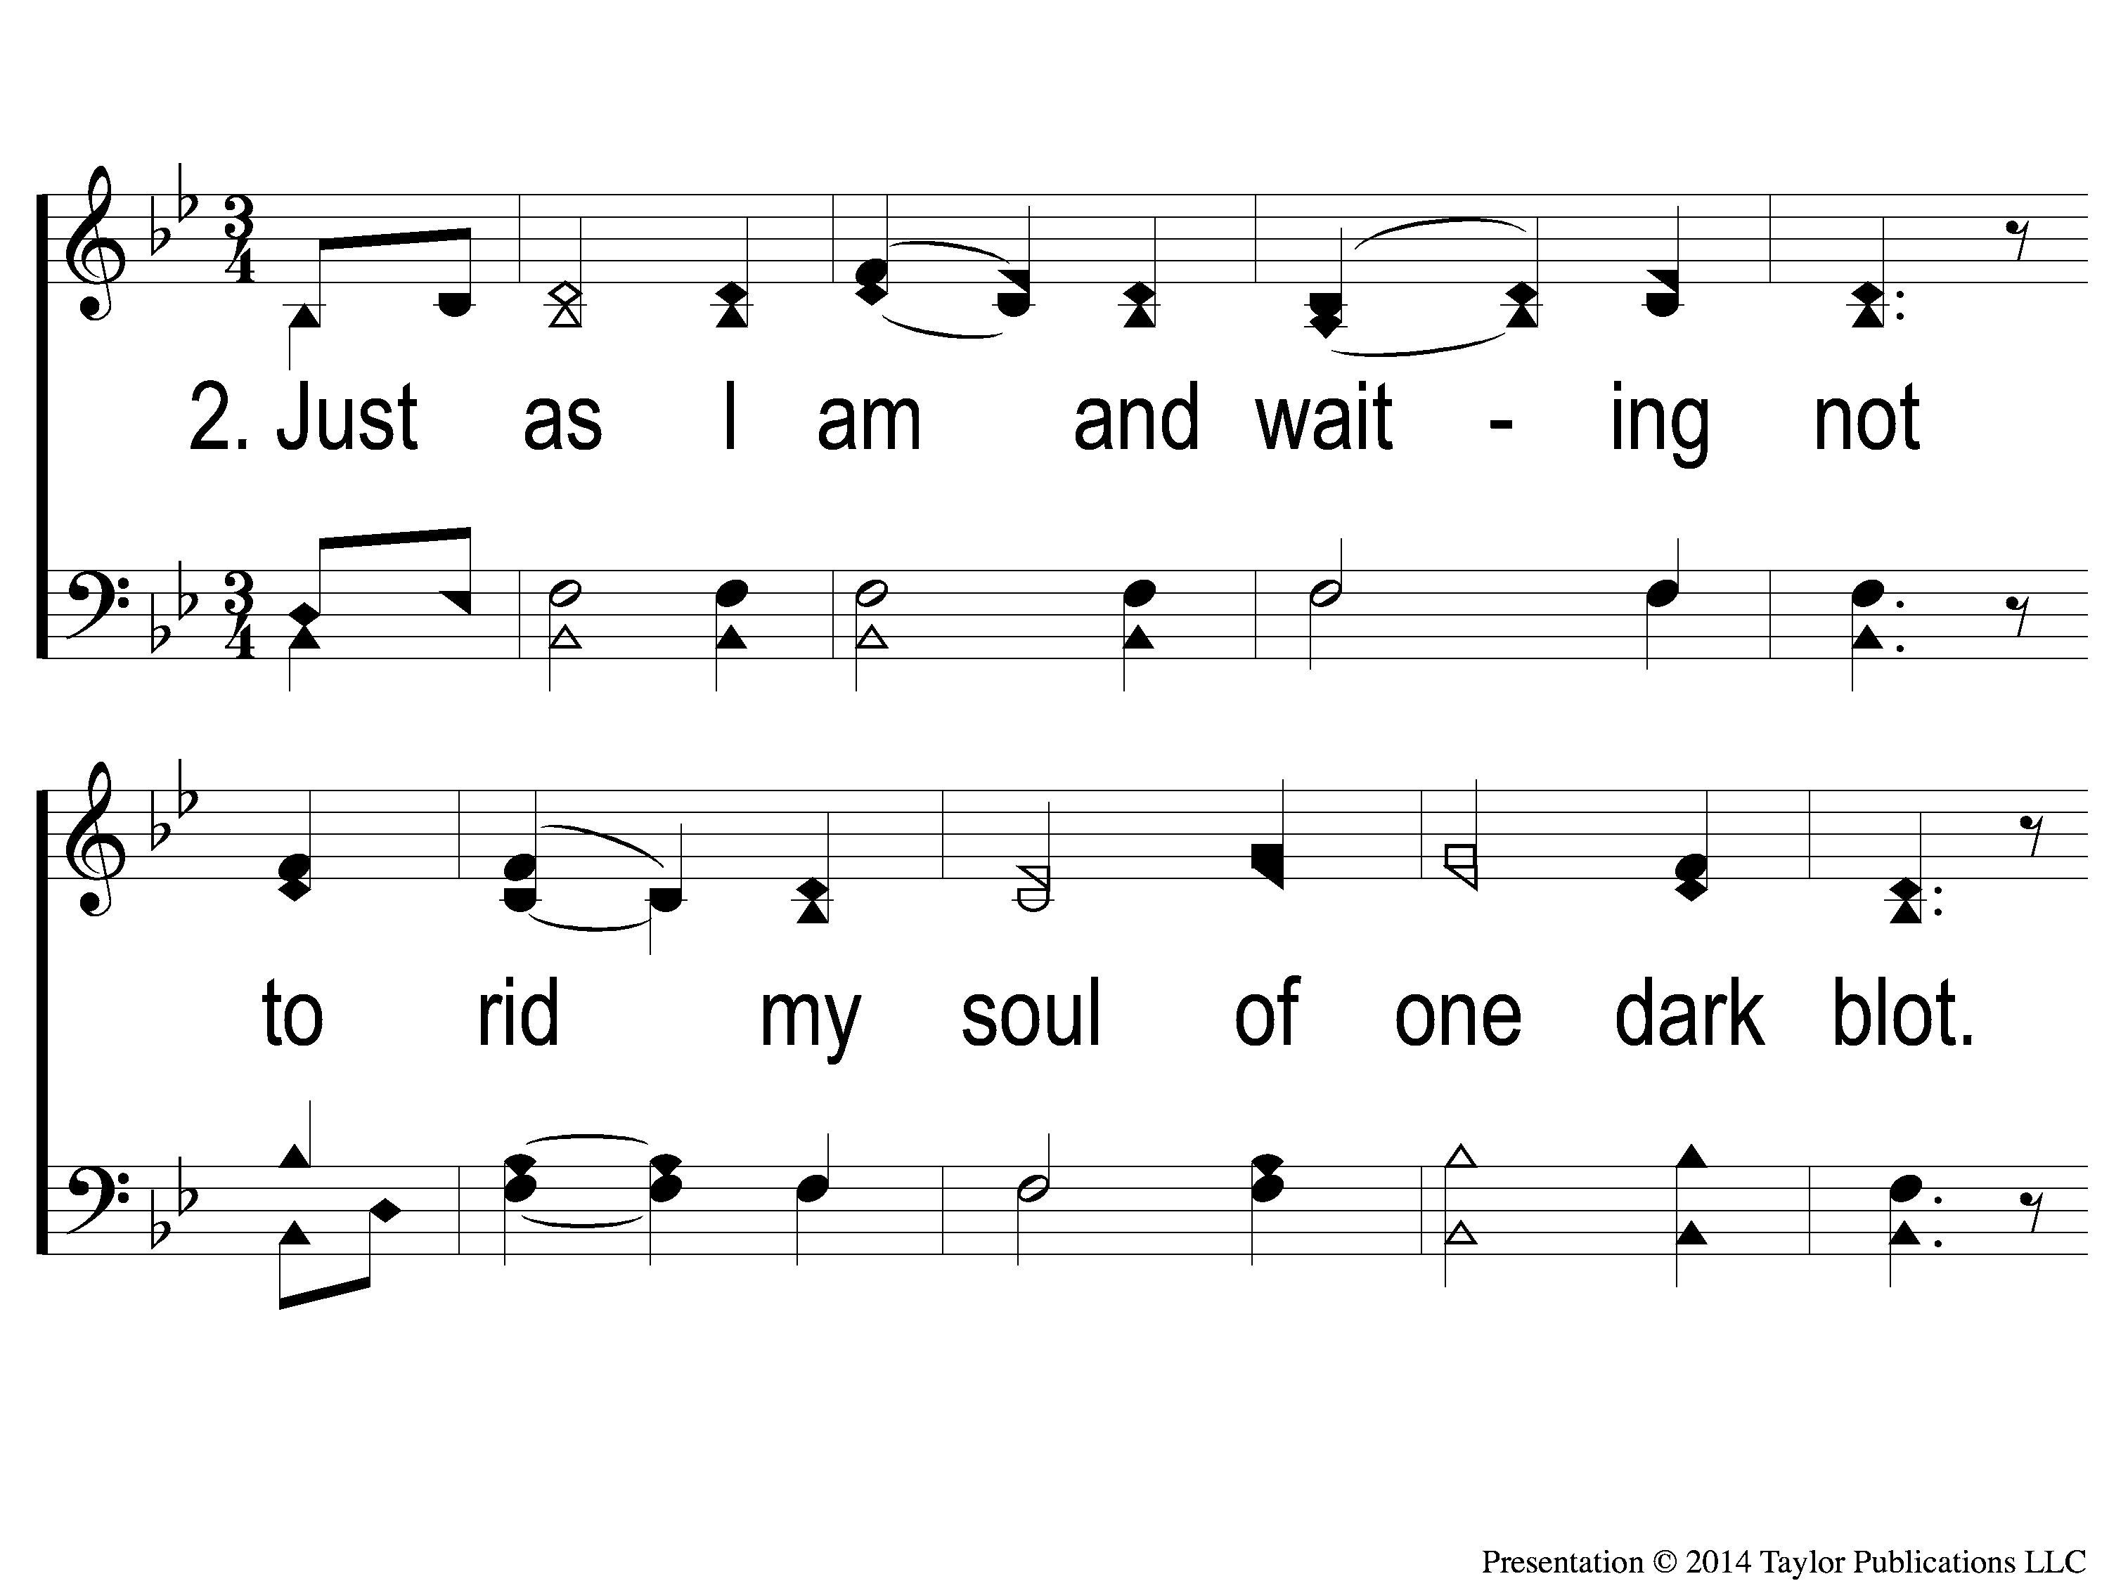
2-1 Just as I am-I come broken
Just As I Am-I Come Broken

Slide 79
2-2 Just as I am-I come broken
Just As I Am-I Come Broken

Slide 80
1c-1 Just as I am-I come broken
Just As I Am-I Come Broken

Slide 81
1c-2 Just as I am-I come broken
Just As I Am-I Come Broken

Slide 82
1c-3 Just as I am-I come broken
Just As I Am-I Come Broken

Slide 83
3-1 Just as I am-I come broken
Just As I Am-I Come Broken

Slide 84
3-2 Just as I am-I come broken
Just As I Am-I Come Broken

Slide 85
2c-1 Just as I am-I come broken
Just As I Am-I Come Broken

Slide 86
2c-2 Just as I am-I come broken
Just As I Am-I Come Broken

Slide 87
2c-3 Just as I am-I come broken
Just As I Am-I Come Broken

Slide 88
Ds-1 Just as I am-I come broken
Just As I Am-I Come Broken

Slide 89
Ds-2 Just as I am-I come broken
Just As I Am-I Come Broken

Slide 90
Ds-3 Just as I am-I come broken
Just As I Am-I Come Broken

Slide 91
Our Contribution:
Hebrews 13:15-16
“Therefore by Him let us continually offer the sacrifice of praise to God, that is, the fruit of our lips, giving thanks to His name. But do not forget to do good and to share, for with such sacrifices God is well pleased.”

Slide 92
Song:
Ten Thousand Angels
#349

Slide 93
1-1 Ten Thousand Angels
Ten Thousand Angels
349

Slide 94
1-2 Ten Thousand Angels
Ten Thousand Angels
349

Slide 95
C-1 Ten Thousand Angels
Ten Thousand Angels
349

Slide 96
C-2 Ten Thousand Angels
Ten Thousand Angels
349

Slide 97
2-1 Ten Thousand Angels
Ten Thousand Angels
349

Slide 98
2-2 Ten Thousand Angels
Ten Thousand Angels
349

Slide 99
C-1 Ten Thousand Angels
Ten Thousand Angels
349

Slide 100
C-2 Ten Thousand Angels
Ten Thousand Angels
349

Slide 101
3-1 Ten Thousand Angels
Ten Thousand Angels
349

Slide 102
3-2 Ten Thousand Angels
Ten Thousand Angels
349

Slide 103
C-1 Ten Thousand Angels
Ten Thousand Angels
349

Slide 104
C-2 Ten Thousand Angels
Ten Thousand Angels
349

Slide 105
4-1 Ten Thousand Angels
Ten Thousand Angels
349

Slide 106
4-2 Ten Thousand Angels
Ten Thousand Angels
349

Slide 107
C-1 Ten Thousand Angels
Ten Thousand Angels
349

Slide 108
C-2 Ten Thousand Angels
Ten Thousand Angels
349

Slide 109
The Unleavened Bread
Hebrews 4:14-16
“Seeing then that we have a great High Priest who has passed through the heavens, Jesus the Son of God, olet us hold fast our confession. For we do not have a High Priest who cannot sympathize with our weaknesses, but was in all points tempted as we are, yet without sin. Let us therefore come boldly to the throne of grace, that we may obtain mercy and find grace to help in time of need.”

Slide 110
The Fruit of the Vine
“But Christ came as High Priest of the good things to come, …Not with the blood of goats and calves, but with His own blood He entered the Most Holy Place once for all, having obtained eternal redemption…the blood of Christ, who through the eternal Spirit offered Himself without spot to God, cleanse your conscience from dead works to serve the living God? And for this reason He is the Mediator of the new covenant, by means of death, for the redemption of the transgressions under the first covenant, that those who are called may receive the promise of the eternal inheritance.” - Hebrews 9:11-15

Slide 111
Closing Prayer

Slide 112
Song:
The Greatest Commands
#448

Slide 113
1-1 The Greatest Commands-SFP
The Greatest Commands
448

Slide 114
1-2 The Greatest Commands-SFP
The Greatest Commands
448

Slide 115
1-3 The Greatest Commands-SFP
The Greatest Commands
448

Slide 116
1-4 The Greatest Commands-SFP
The Greatest Commands
448

Slide 117
2-1 The Greatest Commands-SFP
The Greatest Commands
448

Slide 118
2-2 The Greatest Commands-SFP
The Greatest Commands
448

Slide 119
2-3 The Greatest Commands-SFP
The Greatest Commands
448

Slide 120
2-4 The Greatest Commands-SFP
The Greatest Commands
448

Slide 121
3-1 The Greatest Commands-SFP
The Greatest Commands
448

Slide 122
3-2 The Greatest Commands-SFP
The Greatest Commands
448

Slide 123
3-3 The Greatest Commands-SFP
The Greatest Commands
448

Slide 124
3-4 The Greatest Commands-SFP
The Greatest Commands
448

Slide 125
4-1 The Greatest Commands-SFP
The Greatest Commands
448

Slide 126
4-2 The Greatest Commands-SFP
The Greatest Commands
448

Slide 127
4-3 The Greatest Commands-SFP
The Greatest Commands
448

Slide 128
4-4 The Greatest Commands-SFP
The Greatest Commands
448

Slide 129
RESTORE REBUILD RENEW
This Evening
LTC @ 5:00 PM
Worship & Bible Classes @ 6:30 PM
Wednesday
Worship & Bible Classes @ 6:30 PM
IN 2022
WHEELER
CHURCH
OF
CHRIST

