Slide 1
RESTORE REBUILD RENEW
welcome
we are glad to
Have you with us
IN 2022
WHEELER
CHURCH
OF
CHRIST

Slide 2
Songs of Praise To God

Slide 3
Opening Prayer

Slide 4
Songs of Praise To God

Slide 5
Renewed MIND
in
Romans 12:2

Slide 6
A Renewed Mind
Abhors Evil (Rom. 12:9b)

Slide 7
A Renewed Mind
Abhors Evil (v. 9b)
“Abhor” (ἀποστυγέω) = “to have a strong dislike for someone or something, implying repulsion and desire for avoidance” (LN)
Psa. 5:5-6, 11:5, 31:6

Slide 8
A Renewed Mind
Abhors Evil (v. 9b)
“Evil” (πονηρός) = bad, morally corrupt
Gal. 5:19-21
Rom. 1:29-32
Eph. 5:25ff

Slide 9
A Renewed Mind
Abhors Evil (v. 9b)
Fleeing
Opposite of Prov. 1:16, 6:18
1 Cor. 6:18, 10:14
1 Tim. 6:11

Slide 10
A Renewed Mind
Abhors Evil (v. 9b)
Not Fellowshipping
Eph. 5:11
2 Jn. 10-11

Slide 11
A Renewed Mind
Clings To Good (Rom. 12:9c)

Slide 12
A Renewed Mind
Clings To Good (v. 9c)
“Cling” (κολλάω) = join oneself to, glue or weld together
Matt. 19:4-5
1 Thess. 5:21

Slide 14
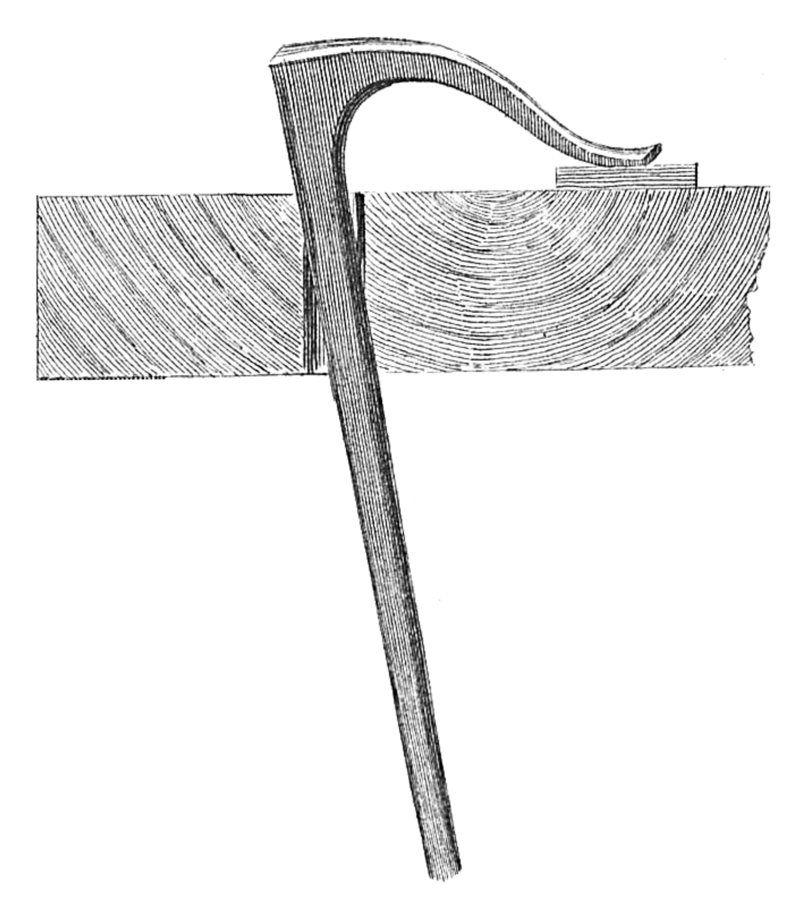

Slide 17
A Renewed Mind
Clings To Good
“Good” (ἀγαθός) = positive moral qualities
Phili. 4:8

Slide 18
A Renewed Mind
Clings To Good
“Good” (ἀγαθός) = positive moral qualities
God – Mk. 10:18
God’s Word – Rom. 7:12
Serving Others – Matt. 25:35, Lk. 10

Slide 19
A Renewed Mind
Clings To Good
What does it look like?
Eph.5:8-10
Rom. 12:2

Slide 20
Are You Abhorring Evil & Clinging to Good?

Slide 21
Songs of Praise To God

Slide 22
The Lord’s Supper
Acts 20:7

Slide 23
Closing Prayer

Slide 24
Songs of Praise To God

Slide 25
RESTORE REBUILD RENEW
Wednesday
Worship & Bible Classes
@ 6:30 PM
IN 2022
WHEELER
CHURCH
OF
CHRIST

