Slide 1
1 I Will Call Upon the Lord
I Will Call Upon the Lord
63

Slide 2
2 I Will Call Upon the Lord
I Will Call Upon the Lord
63

Slide 3
3 I Will Call Upon the Lord
I Will Call Upon the Lord
63

Slide 4
4 I Will Call Upon the Lord
I Will Call Upon the Lord
63

Slide 5
DC1 I Will Call Upon the Lord
I Will Call Upon the Lord
63

Slide 6
DC2 I Will Call Upon the Lord
I Will Call Upon the Lord
63

Slide 7
DC3 I Will Call Upon the Lord
I Will Call Upon the Lord
63

Slide 8
DC4 I Will Call Upon the Lord
I Will Call Upon the Lord
63

Slide 9
tag I Will Call Upon the Lord
I Will Call Upon the Lord
63

Slide 10
RESTORE REBUILD RENEW
welcome
we are glad to
Have you with us
IN 2022
WHEELER
CHURCH
OF
CHRIST

Slide 11
Song:
A Beautiful Life
#570

Slide 12
1-1 A Beautiful Life
A Beautiful Life
570

Slide 13
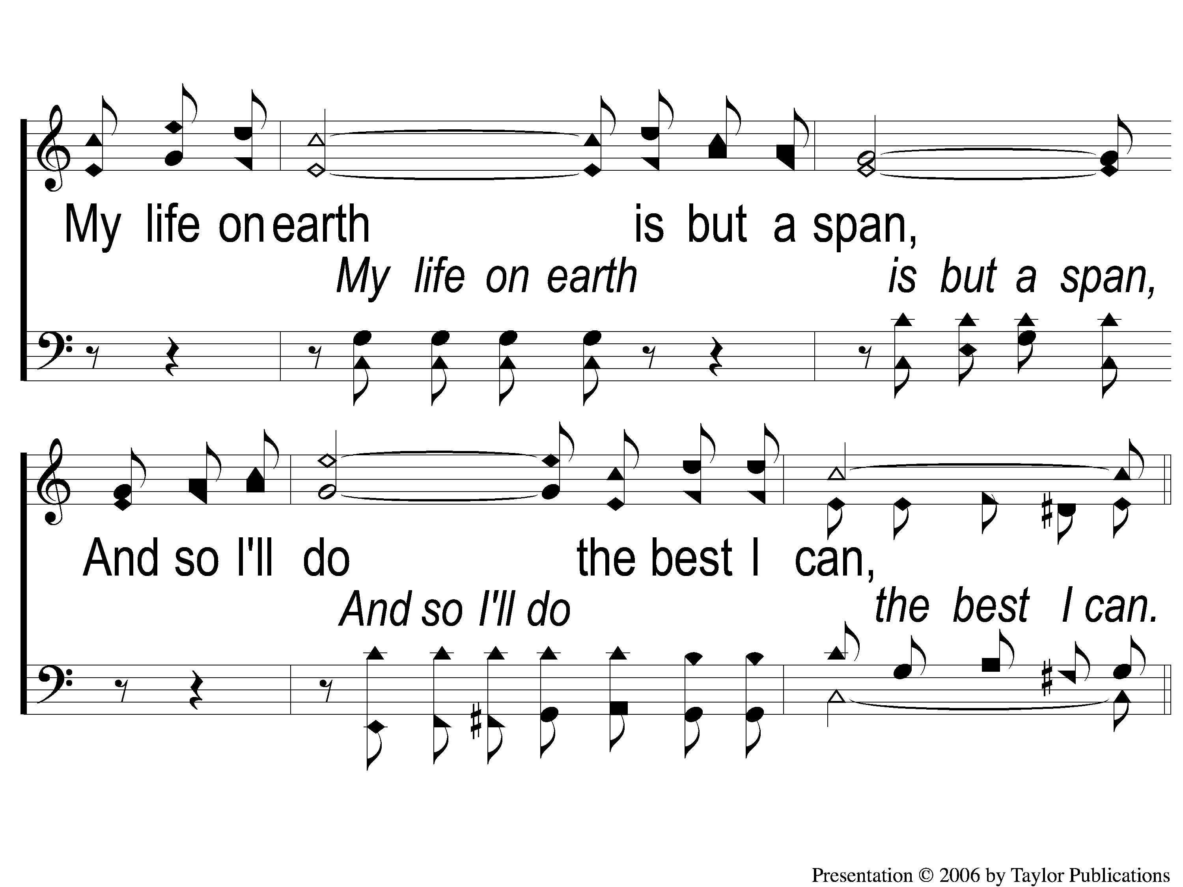
1-2 A Beautiful Life
A Beautiful Life
570

Slide 14
C-1 A Beautiful Life
A Beautiful Life
570

Slide 15
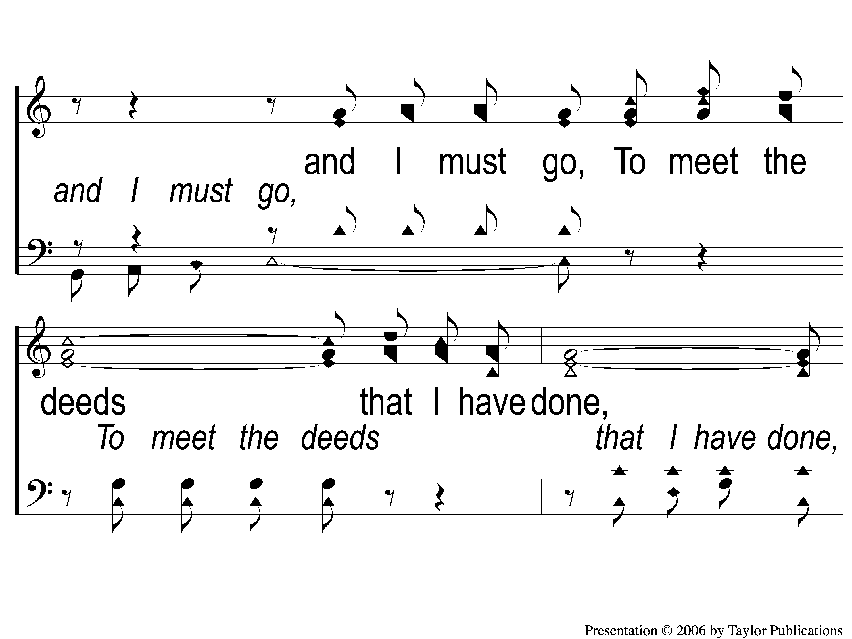
C-2 A Beautiful Life
A Beautiful Life
570

Slide 16
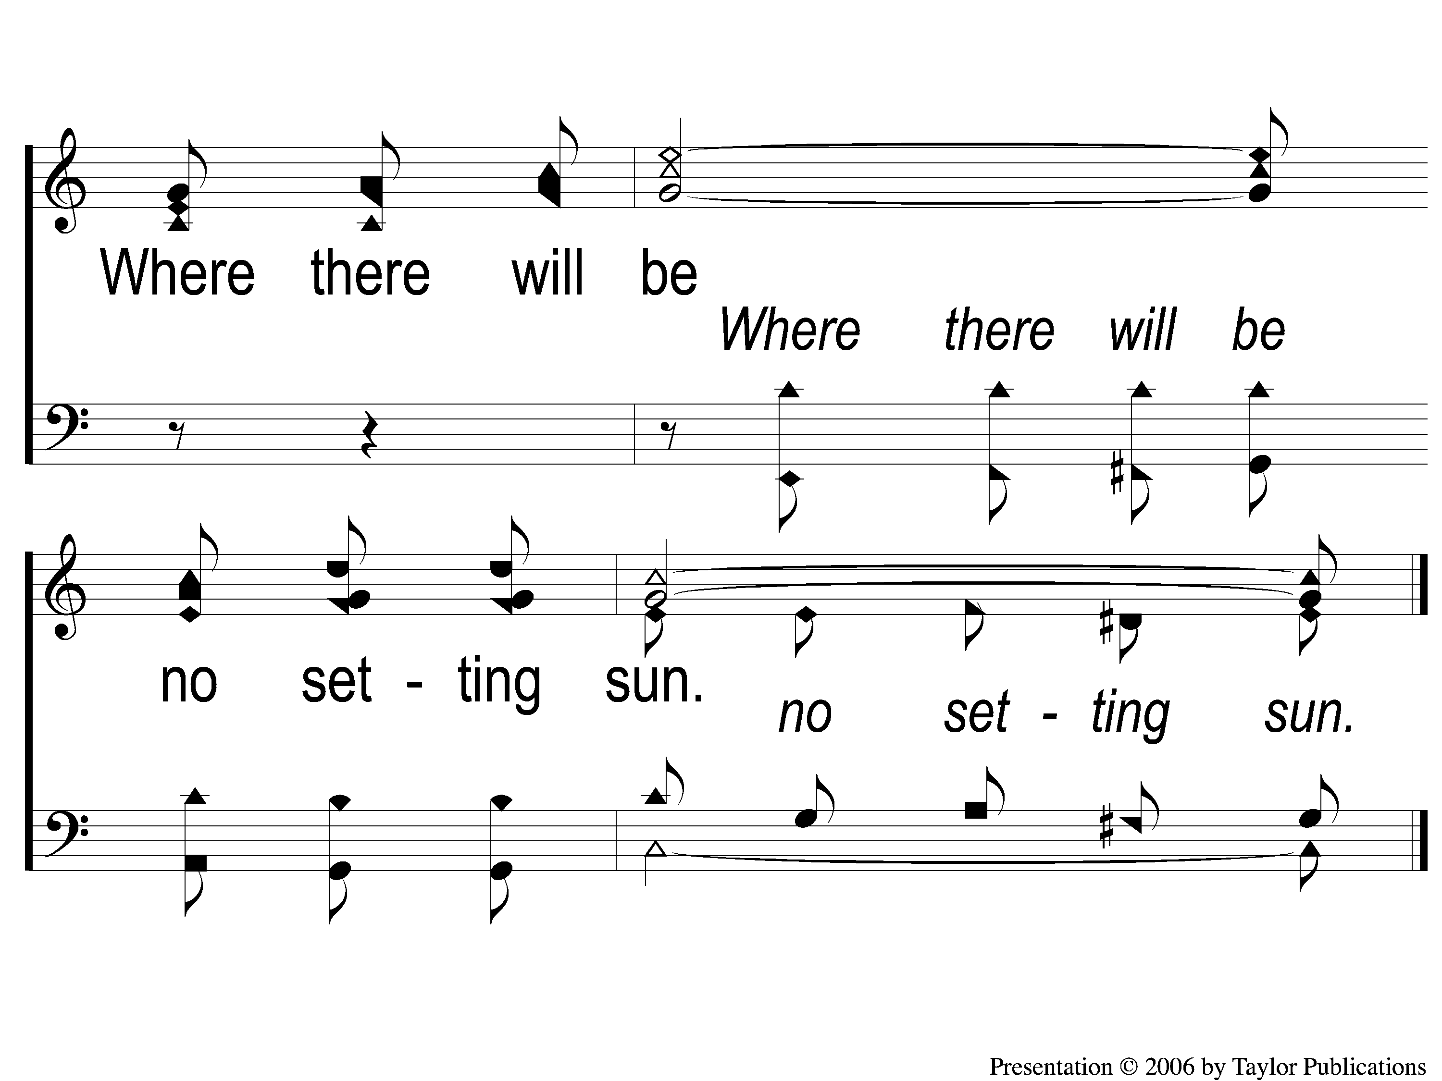
C-3 A Beautiful Life
A Beautiful Life
570

Slide 17
2-1 A Beautiful Life
A Beautiful Life
570

Slide 18
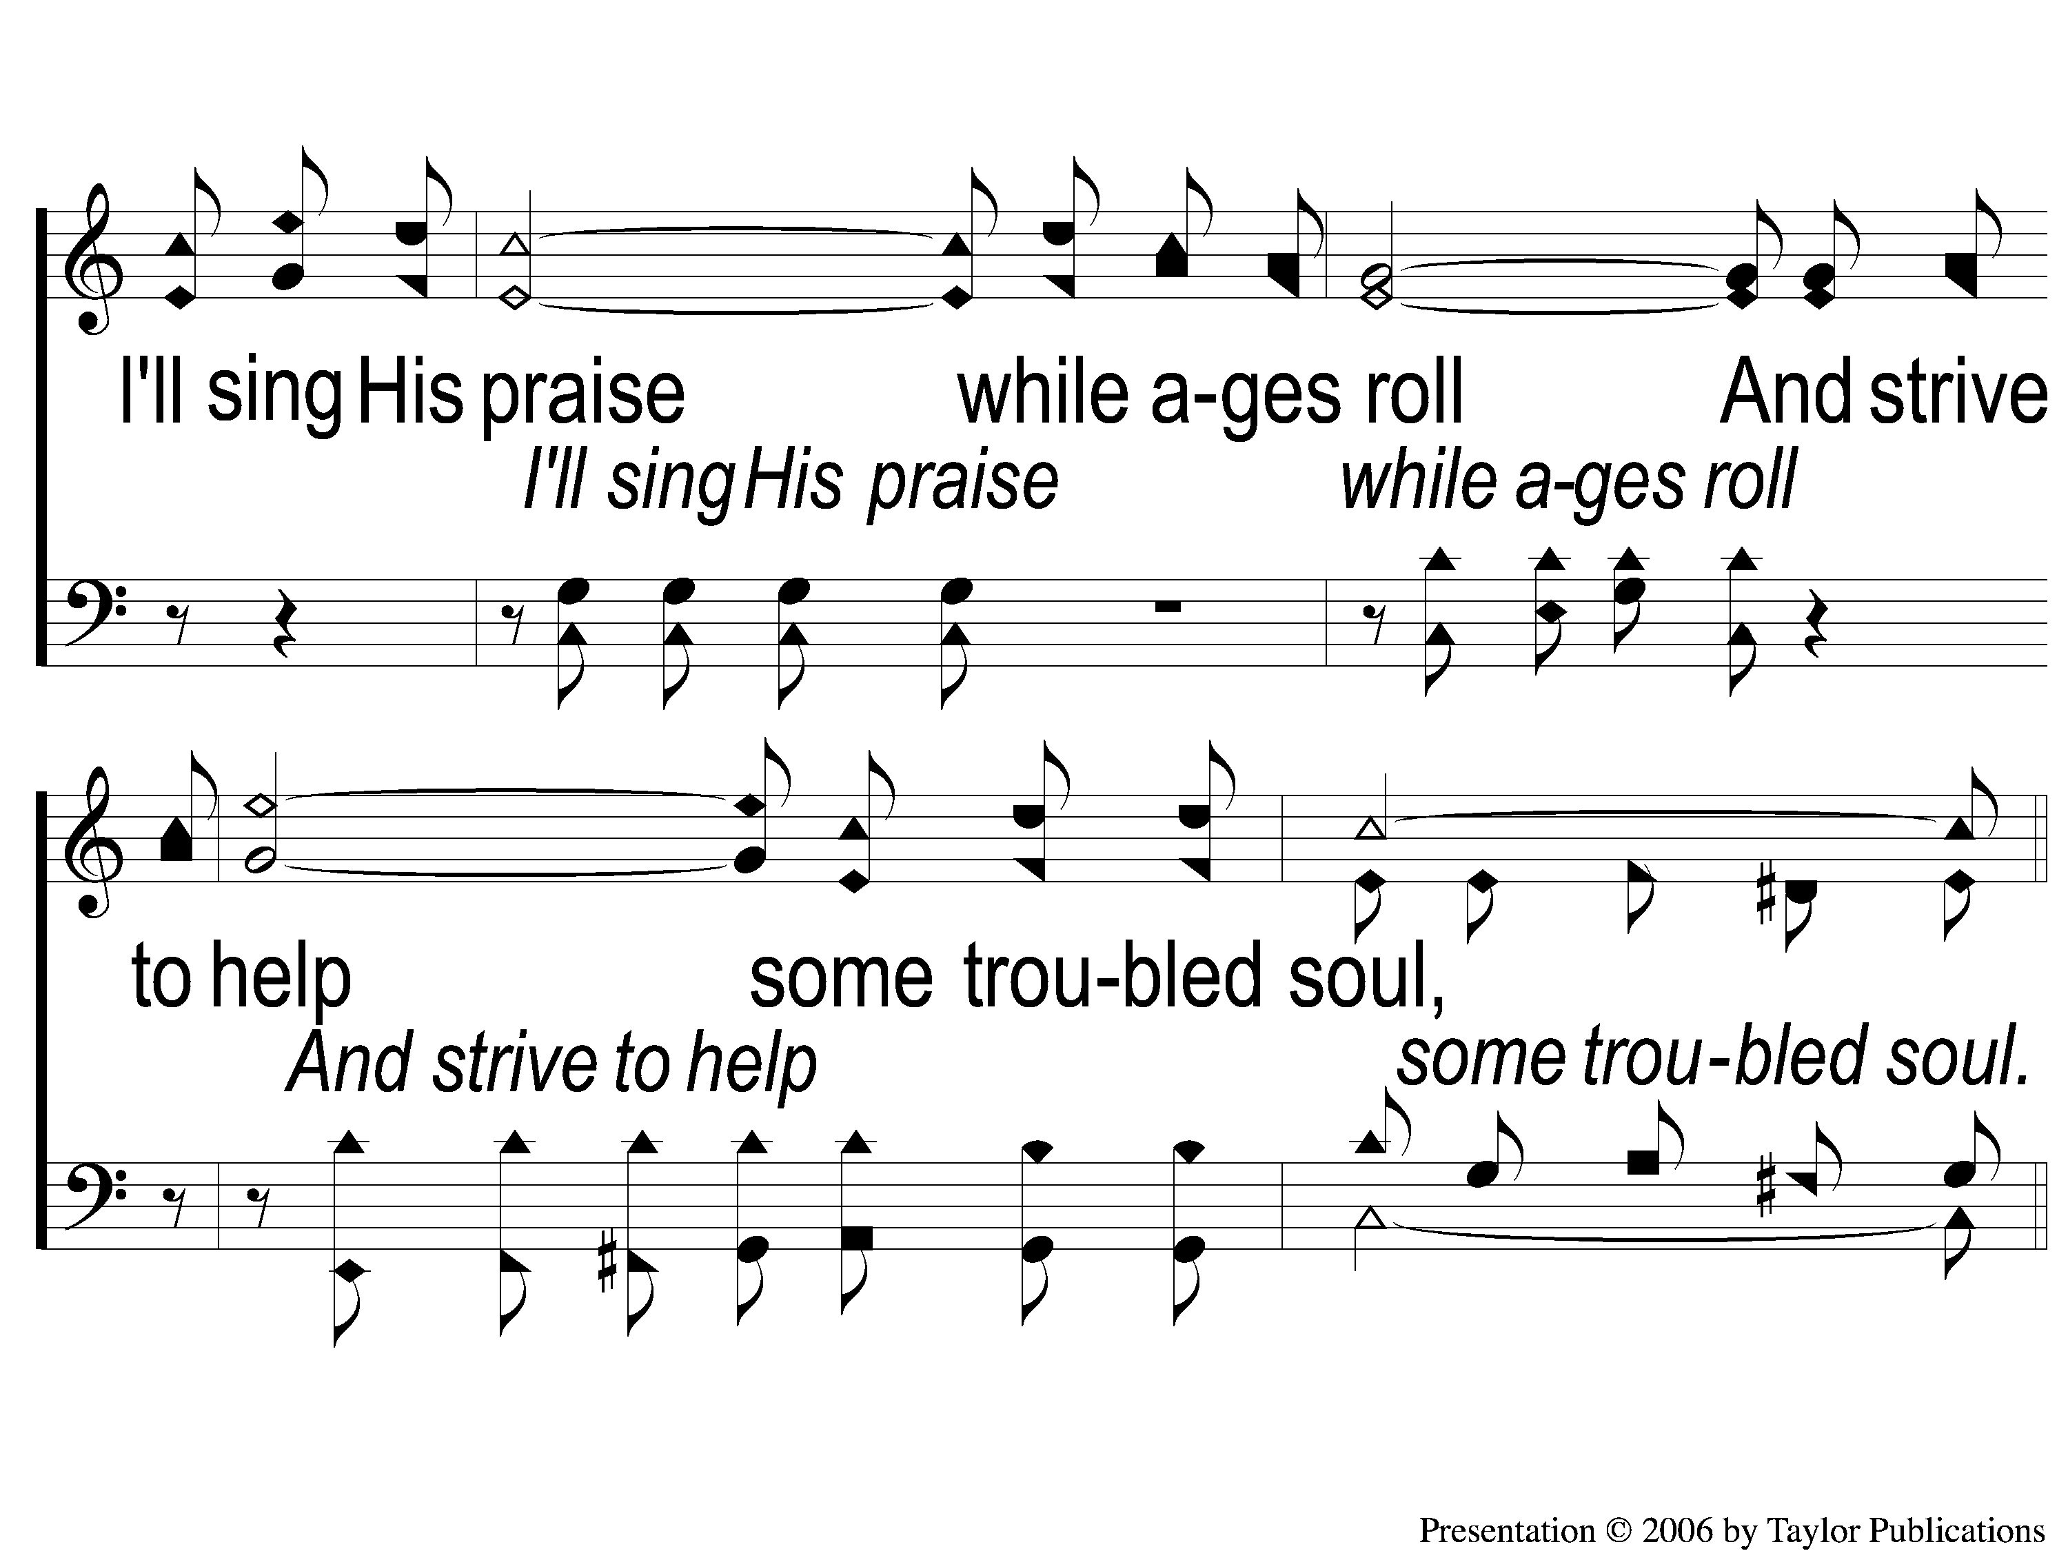
2-2 A Beautiful Life
A Beautiful Life
570

Slide 19
C-1 A Beautiful Life
A Beautiful Life
570

Slide 20
C-2 A Beautiful Life
A Beautiful Life
570

Slide 21
C-3 A Beautiful Life
A Beautiful Life
570

Slide 22
3-1 A Beautiful Life
A Beautiful Life
570

Slide 23
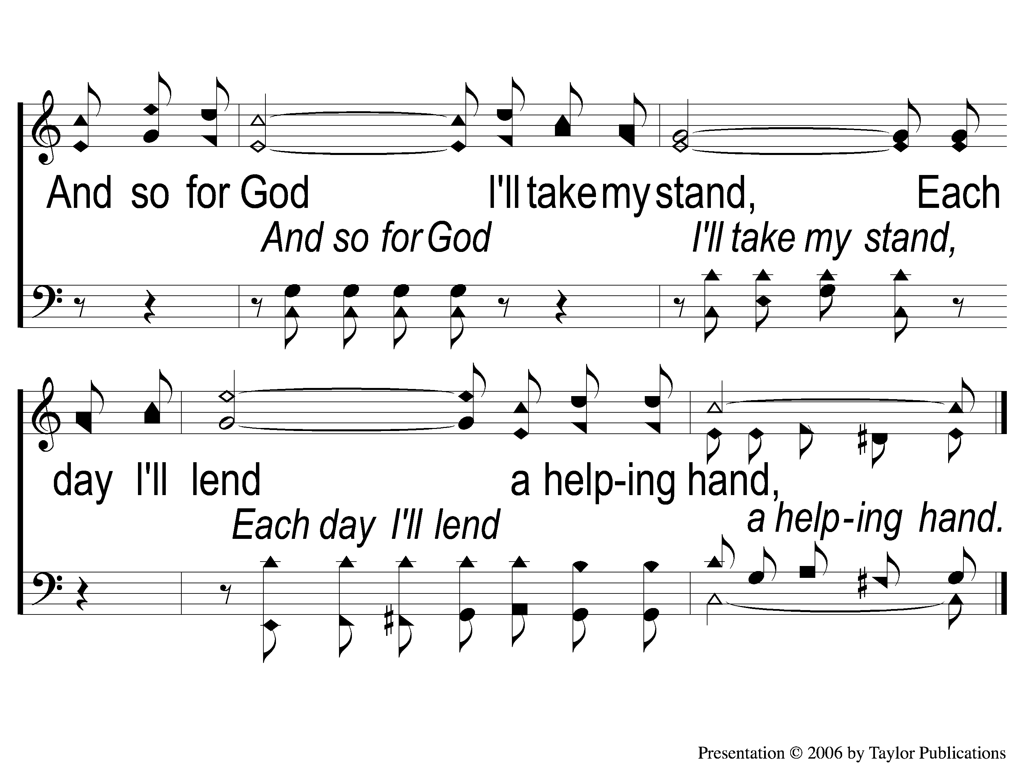
3-2 A Beautiful Life
A Beautiful Life
570

Slide 24
C-1 A Beautiful Life
A Beautiful Life
570

Slide 25
C-2 A Beautiful Life
A Beautiful Life
570

Slide 26
C-3 A Beautiful Life
A Beautiful Life
570

Slide 27
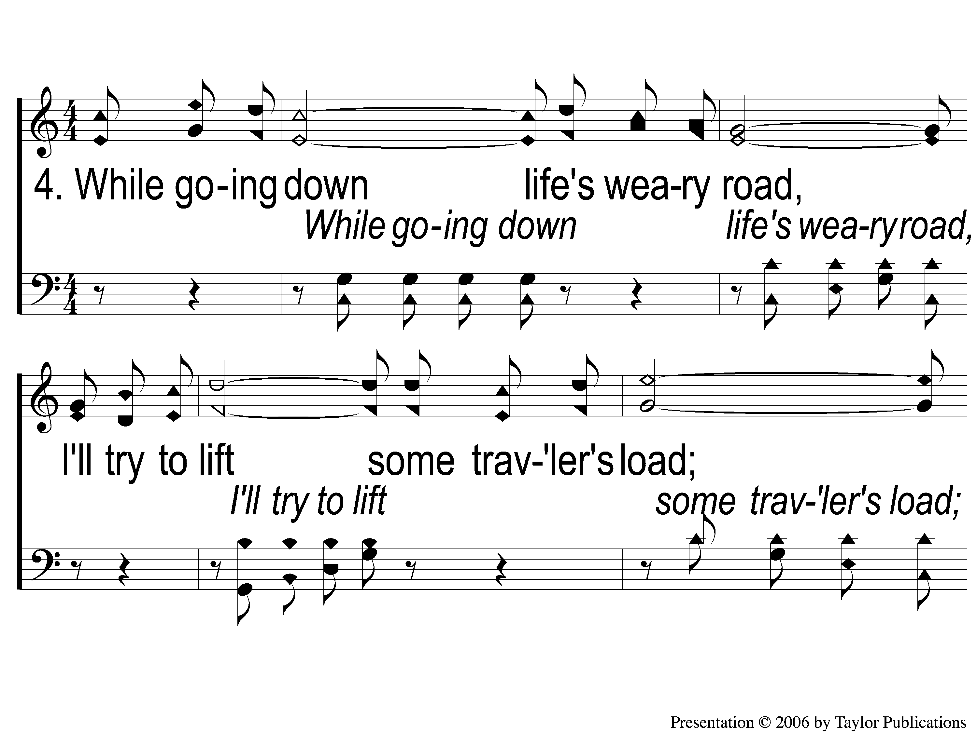
4-1 A Beautiful Life
A Beautiful Life
570

Slide 28
4-2 A Beautiful Life
A Beautiful Life
570

Slide 29
C-1 A Beautiful Life
A Beautiful Life
570

Slide 30
C-2 A Beautiful Life
A Beautiful Life
570

Slide 31
C-3 A Beautiful Life
A Beautiful Life
570

Slide 32
Song:
There Stands A Rock
#558

Slide 33
1-1 There Stands A Rock
There Stands A Rock
558

Slide 34
1-2 There’s Stands A Rock
There Stands A Rock
558

Slide 35
C-1 There’s Stands A Rock
There Stands A Rock
558

Slide 36
C-2 There’s Stands A Rock
There Stands A Rock
558

Slide 37
2-1 There’s Stands A Rock
There Stands A Rock
558

Slide 38
2-2 There’s Stands A Rock
There Stands A Rock
558

Slide 39
C-1 There’s Stands A Rock
There Stands A Rock
558

Slide 40
C-2 There’s Stands A Rock
There Stands A Rock
558

Slide 41
3-1 There’s Stands A Rock
There Stands A Rock
558

Slide 42
3-2 There’s Stands A Rock
There Stands A Rock
558

Slide 43
C-1 There’s Stands A Rock
There Stands A Rock
558

Slide 44
C-2 There’s Stands A Rock
There Stands A Rock
558

Slide 45
Opening Prayer

Slide 46
Song:
My Hope Is Built
#538

Slide 47
1-1 My Hope is Built
My Hope Is Built
538

Slide 48
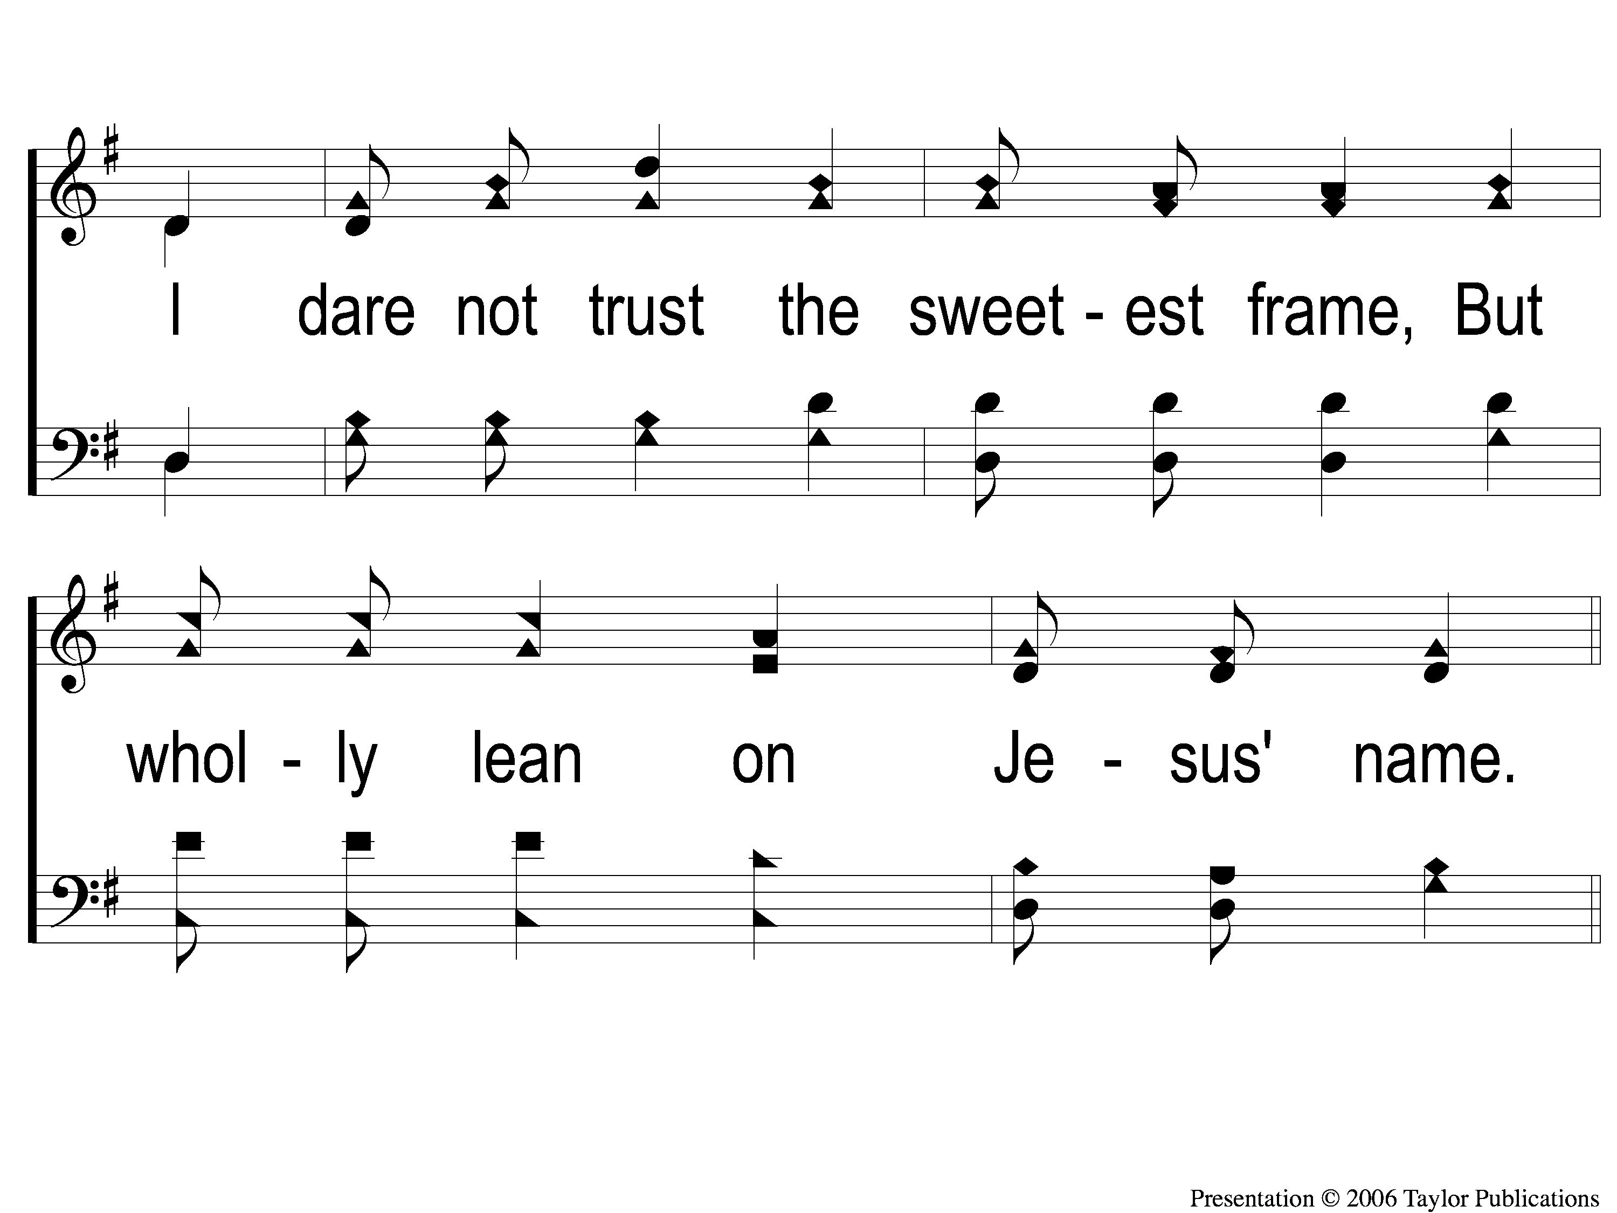
1-2 My Hope is Built
My Hope Is Built
538

Slide 49
c My Hope is Built
My Hope Is Built
538

Slide 50
2-1 My Hope is Built
My Hope Is Built
538

Slide 51
2-2 My Hope is Built
My Hope Is Built
538

Slide 52
c My Hope is Built
My Hope Is Built
538

Slide 53
4-1 My Hope is Built
My Hope Is Built
538

Slide 54
4-2 My Hope is Built
My Hope Is Built
538

Slide 55
c My Hope is Built
My Hope Is Built
538

Slide 56
Song:
Give Me The Bible
#450

Slide 57
1-1 Give Me the Bible
Give Me The Bible
450

Slide 58
1-2 Give Me the Bible
Give Me The Bible
450

Slide 59
C-1 Give Me the Bible
Give Me The Bible
450

Slide 60
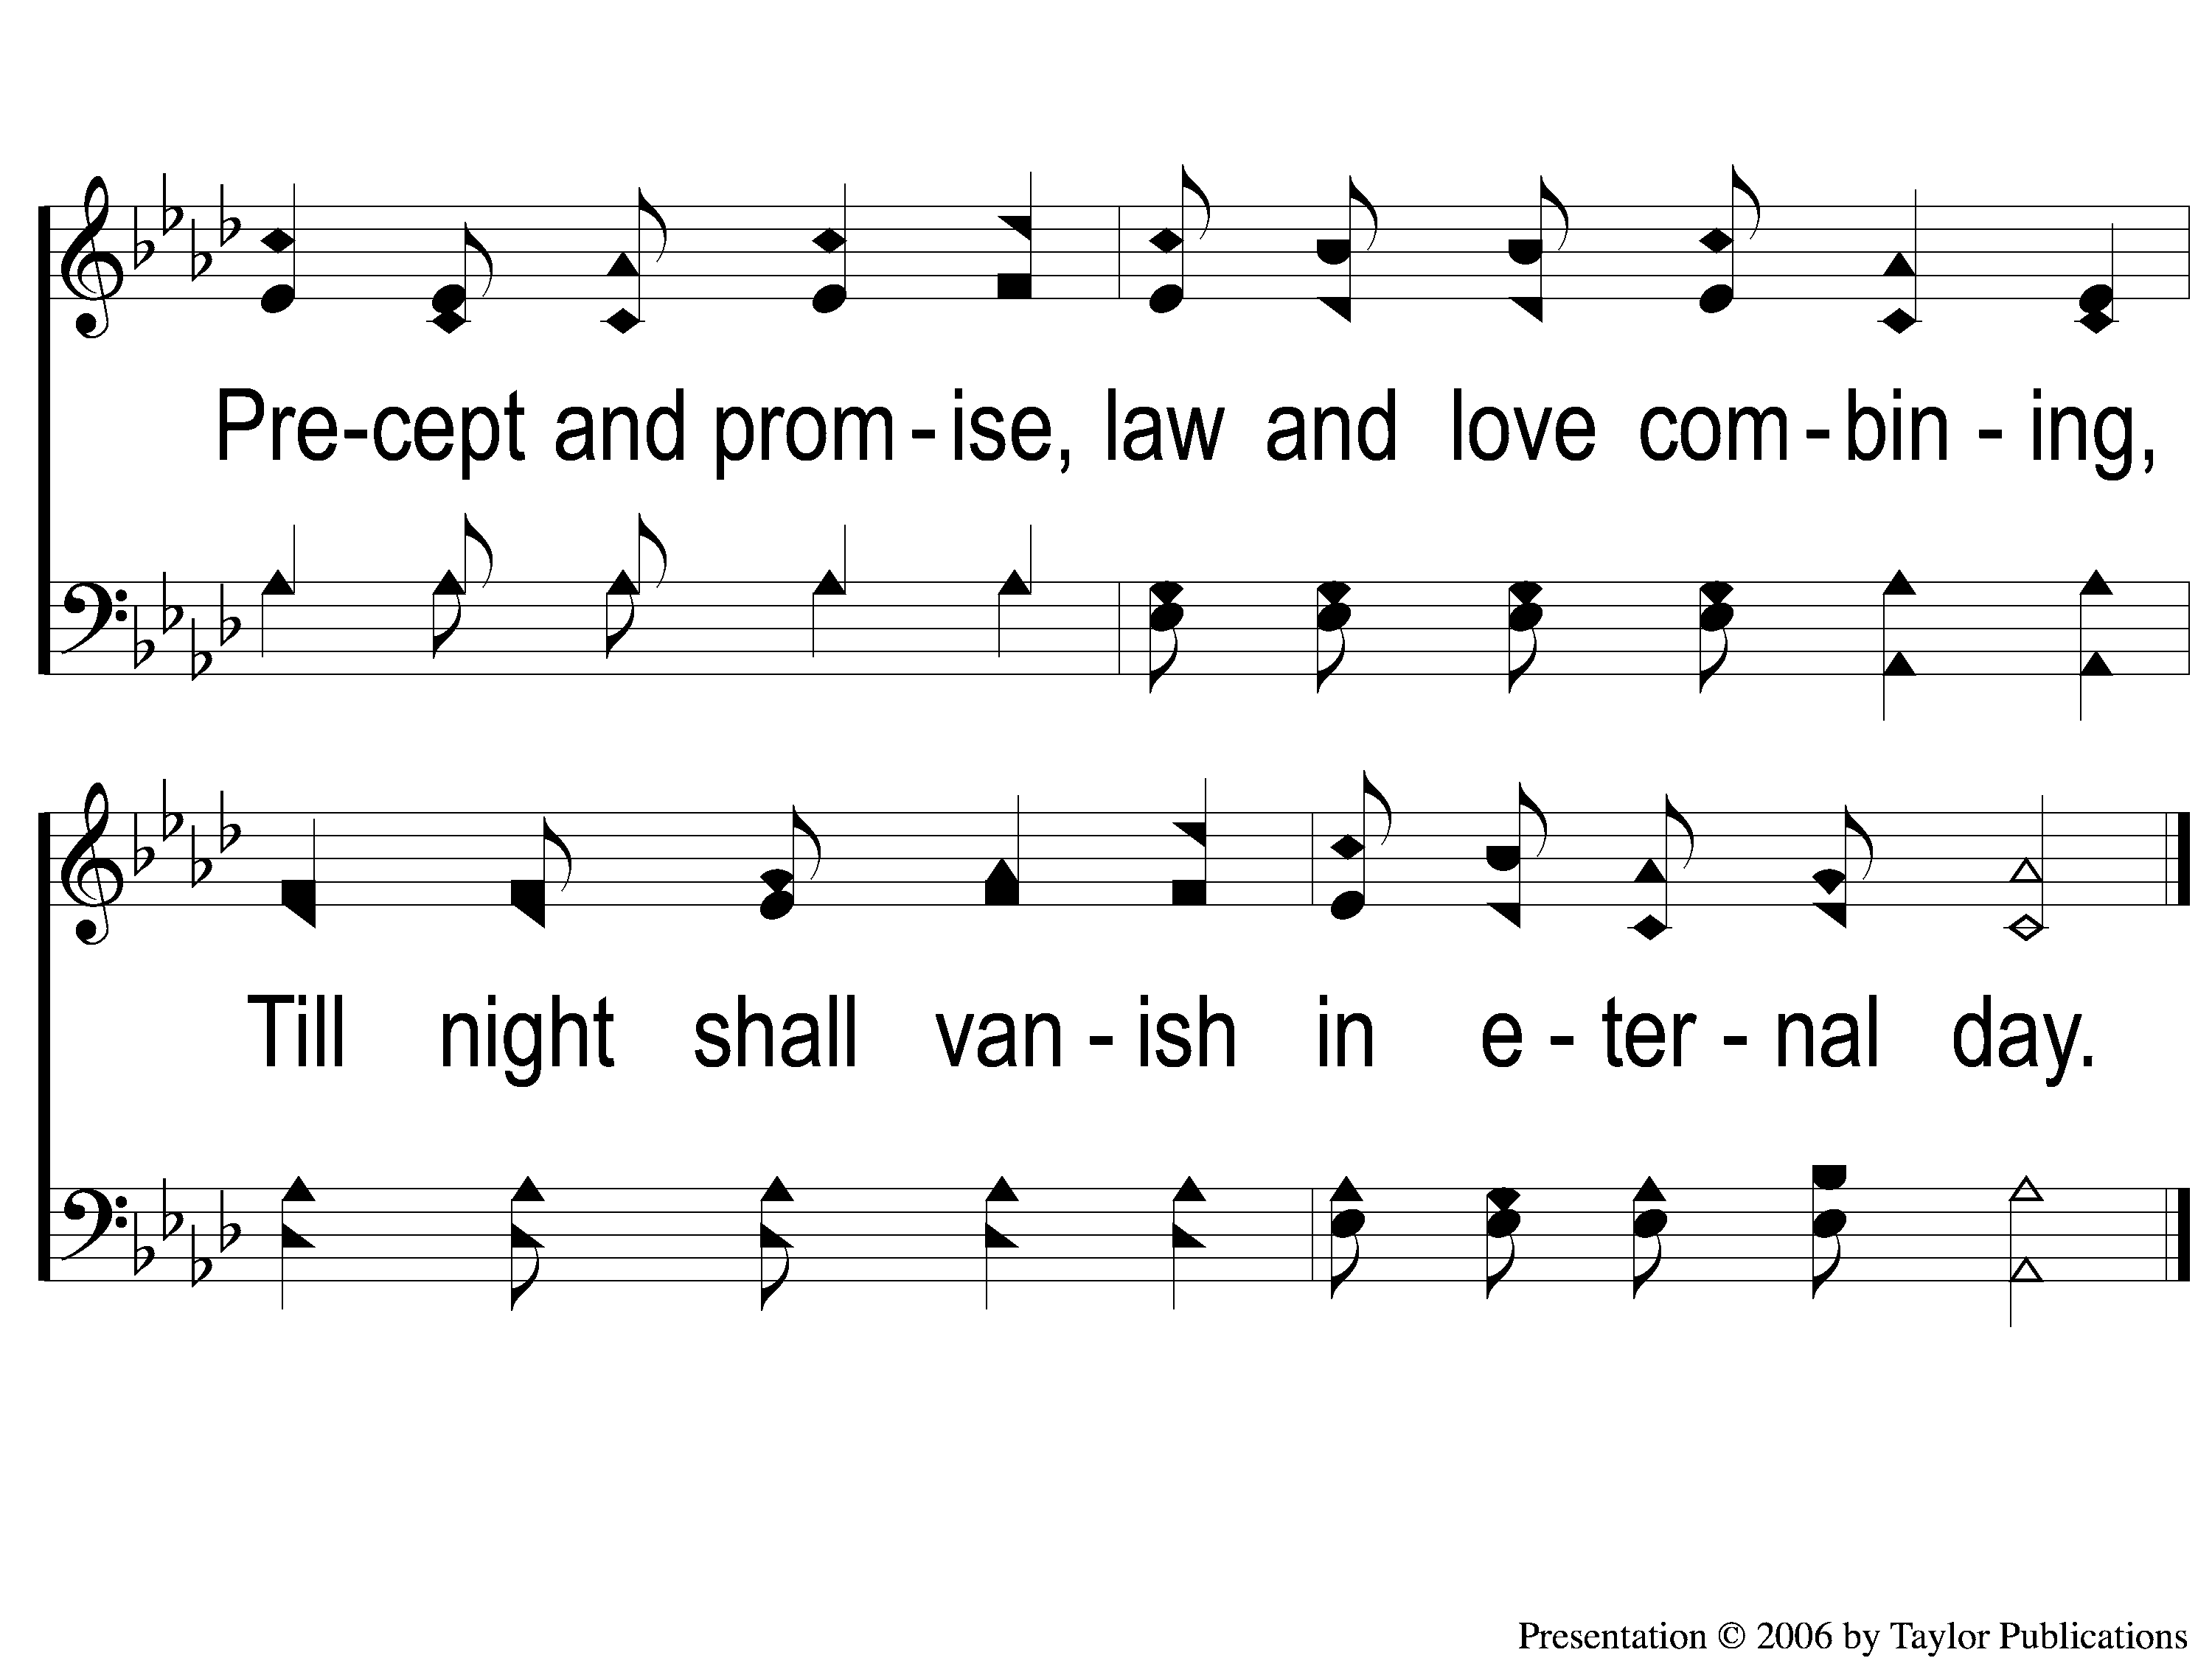
C-2 Give Me the Bible
Give Me The Bible
450

Slide 61
2-1 Give Me the Bible
Give Me The Bible
450

Slide 62
2-2 Give Me the Bible
Give Me The Bible
450

Slide 63
C-1 Give Me the Bible
Give Me The Bible
450

Slide 64
C-2 Give Me the Bible
Give Me The Bible
450

Slide 65
3-1 Give Me the Bible
Give Me The Bible
450

Slide 66
3-2 Give Me the Bible
Give Me The Bible
450

Slide 67
C-1 Give Me the Bible
Give Me The Bible
450

Slide 68
C-2 Give Me the Bible
Give Me The Bible
450

Slide 69
Scripture Reading:
Romans 12:10-13

Slide 70
Renewed MIND
in
Romans 12:2

Slide 71
A Renewed Mind Is Characterized By:

Slide 72
A Renewed Mind Is Characterized By:
Intensity (v. 11)

Slide 73
A Renewed Mind
Intensity (v. 11)
In Desire – Acts 18:24-26, Heb. 11:16, 13:18

Slide 74
A Renewed Mind
Intensity (v. 11)
In Desire – Acts 18:24-26, Heb. 11:16, 13:18
In Service – Gal. 5:24, Matt. 6:24, 1 Pet. 4:4

Slide 75
A Renewed Mind Is Characterized By:
Intensity (v. 11)
Durability (v. 12)

Slide 76
A Renewed Mind
Durability (v. 12)
In Hoping – 1 Thess. 5:16, Rom. 15:13

Slide 77
A Renewed Mind
Durability (v. 12)
In Hoping – 1 Thess. 5:16, Rom. 15:13
Through Suffering – Jms. 1:12, Psa. 34:19

Slide 78
A Renewed Mind
Durability (v. 12)
In Hoping – 1 Thess. 5:16, Rom. 15:13
Through Suffering – Jms. 1:12, Psa. 34:19
By Praying – 1 Thess. 5:17, Eph. 6:18

Slide 79
A Renewed Mind Is Characterized By:
Intensity (v. 11)
Durability (v. 12)
Generosity (v. 13)

Slide 80
A Renewed Mind
Generosity (v. 13)
Distributing – Acts 2:45, 4:35

Slide 81
A Renewed Mind
Generosity (v. 13)
Distributing – Acts 2:45, 4:35
Seeking – Matt. 25:31-36, 40

Slide 82
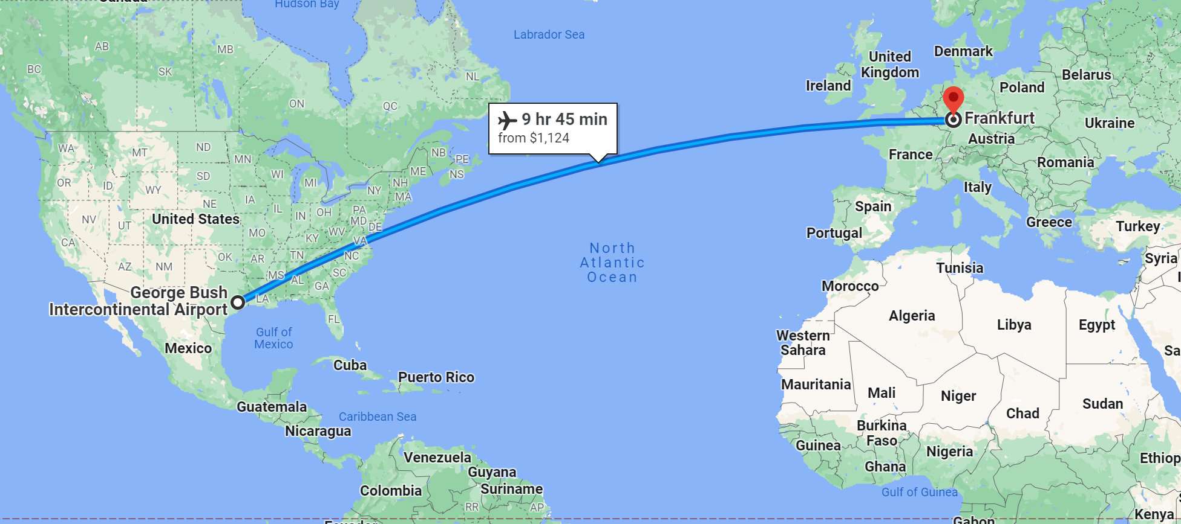

Slide 83
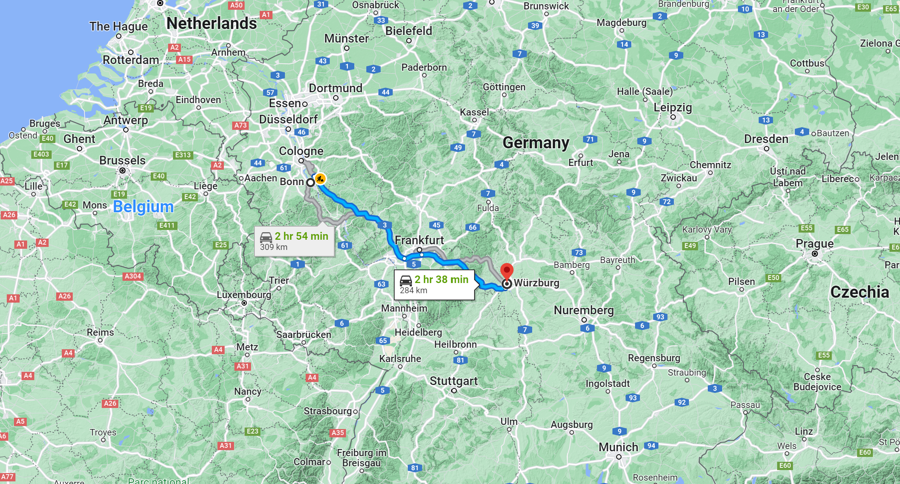

Slide 84
A Renewed Mind Is Characterized By:
Intensity
Durability
Generosity

Slide 85
Are You Renewed in Mind?

Slide 86
Just As I Am
#924
Invitation
Song:

Slide 87
1-1 Just As I Am
Just As I Am
924

Slide 88
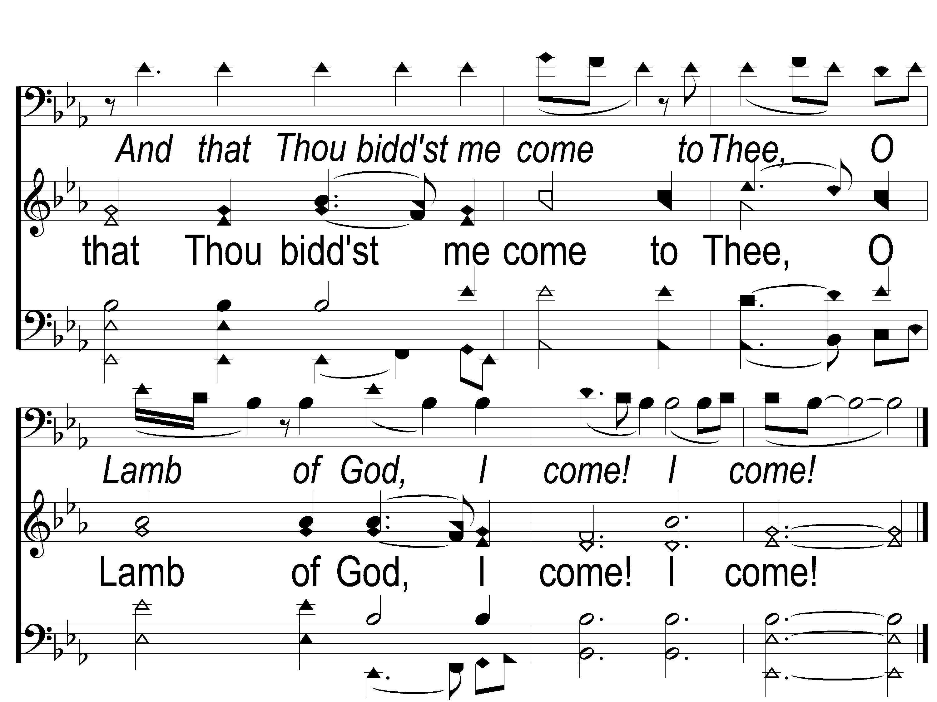
1-2 Just As I Am
Just As I Am
924

Slide 89
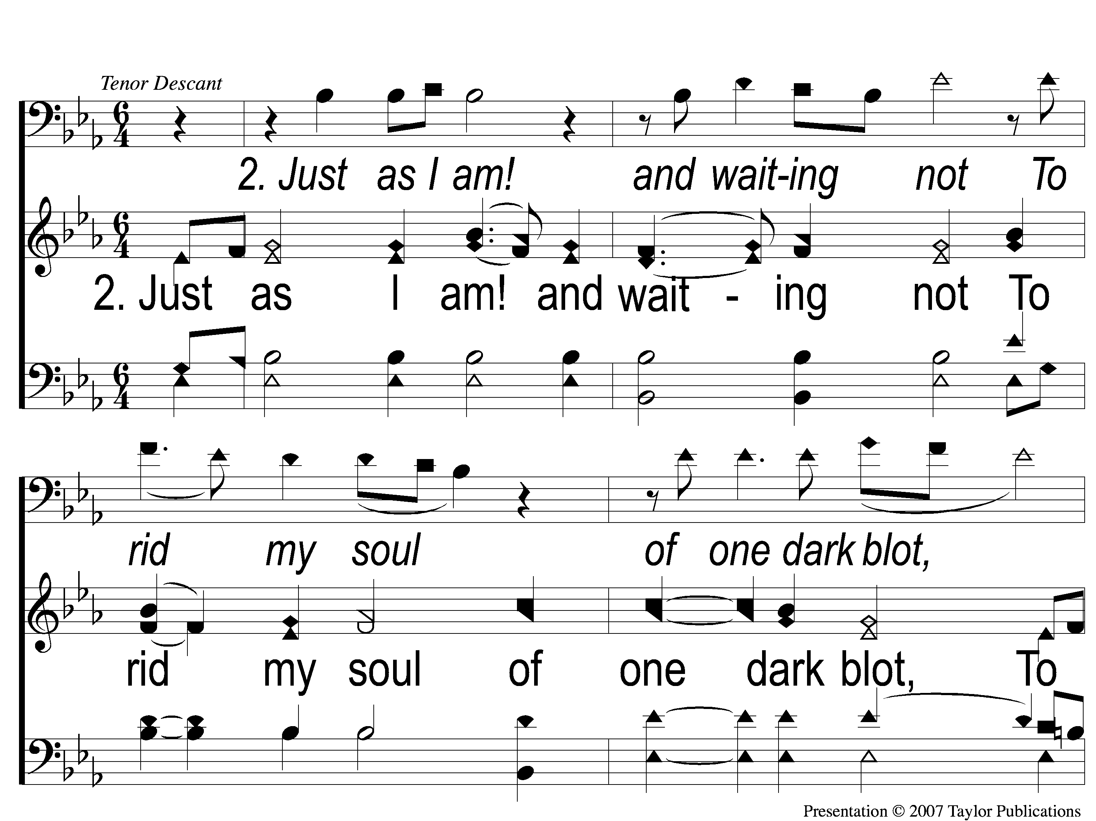
2-1 Just As I Am
Just As I Am
924

Slide 90
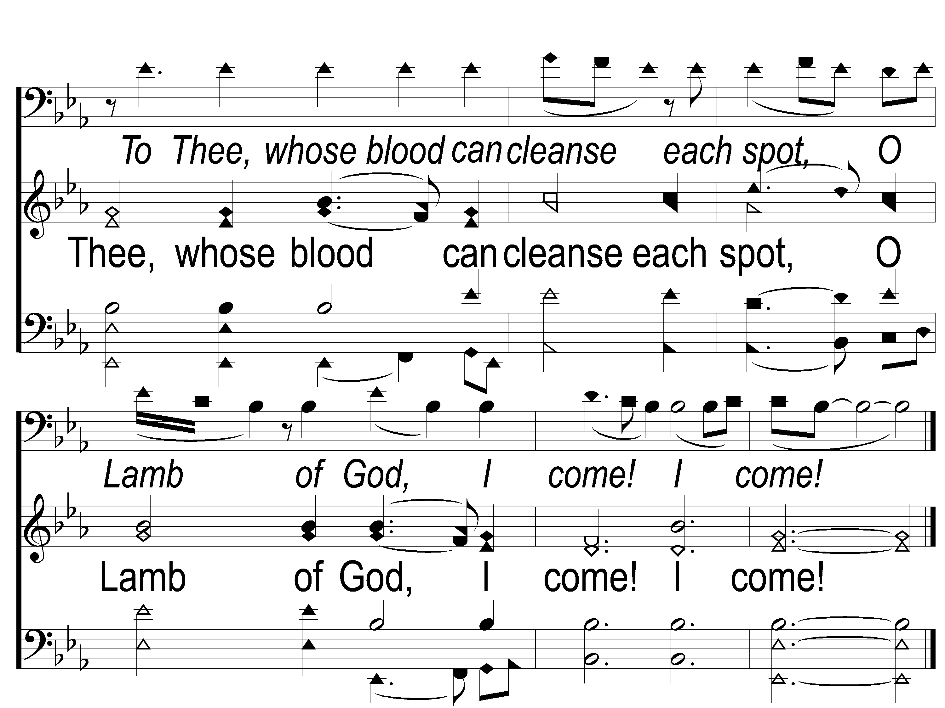
2-2 Just As I Am
Just As I Am
924

Slide 91
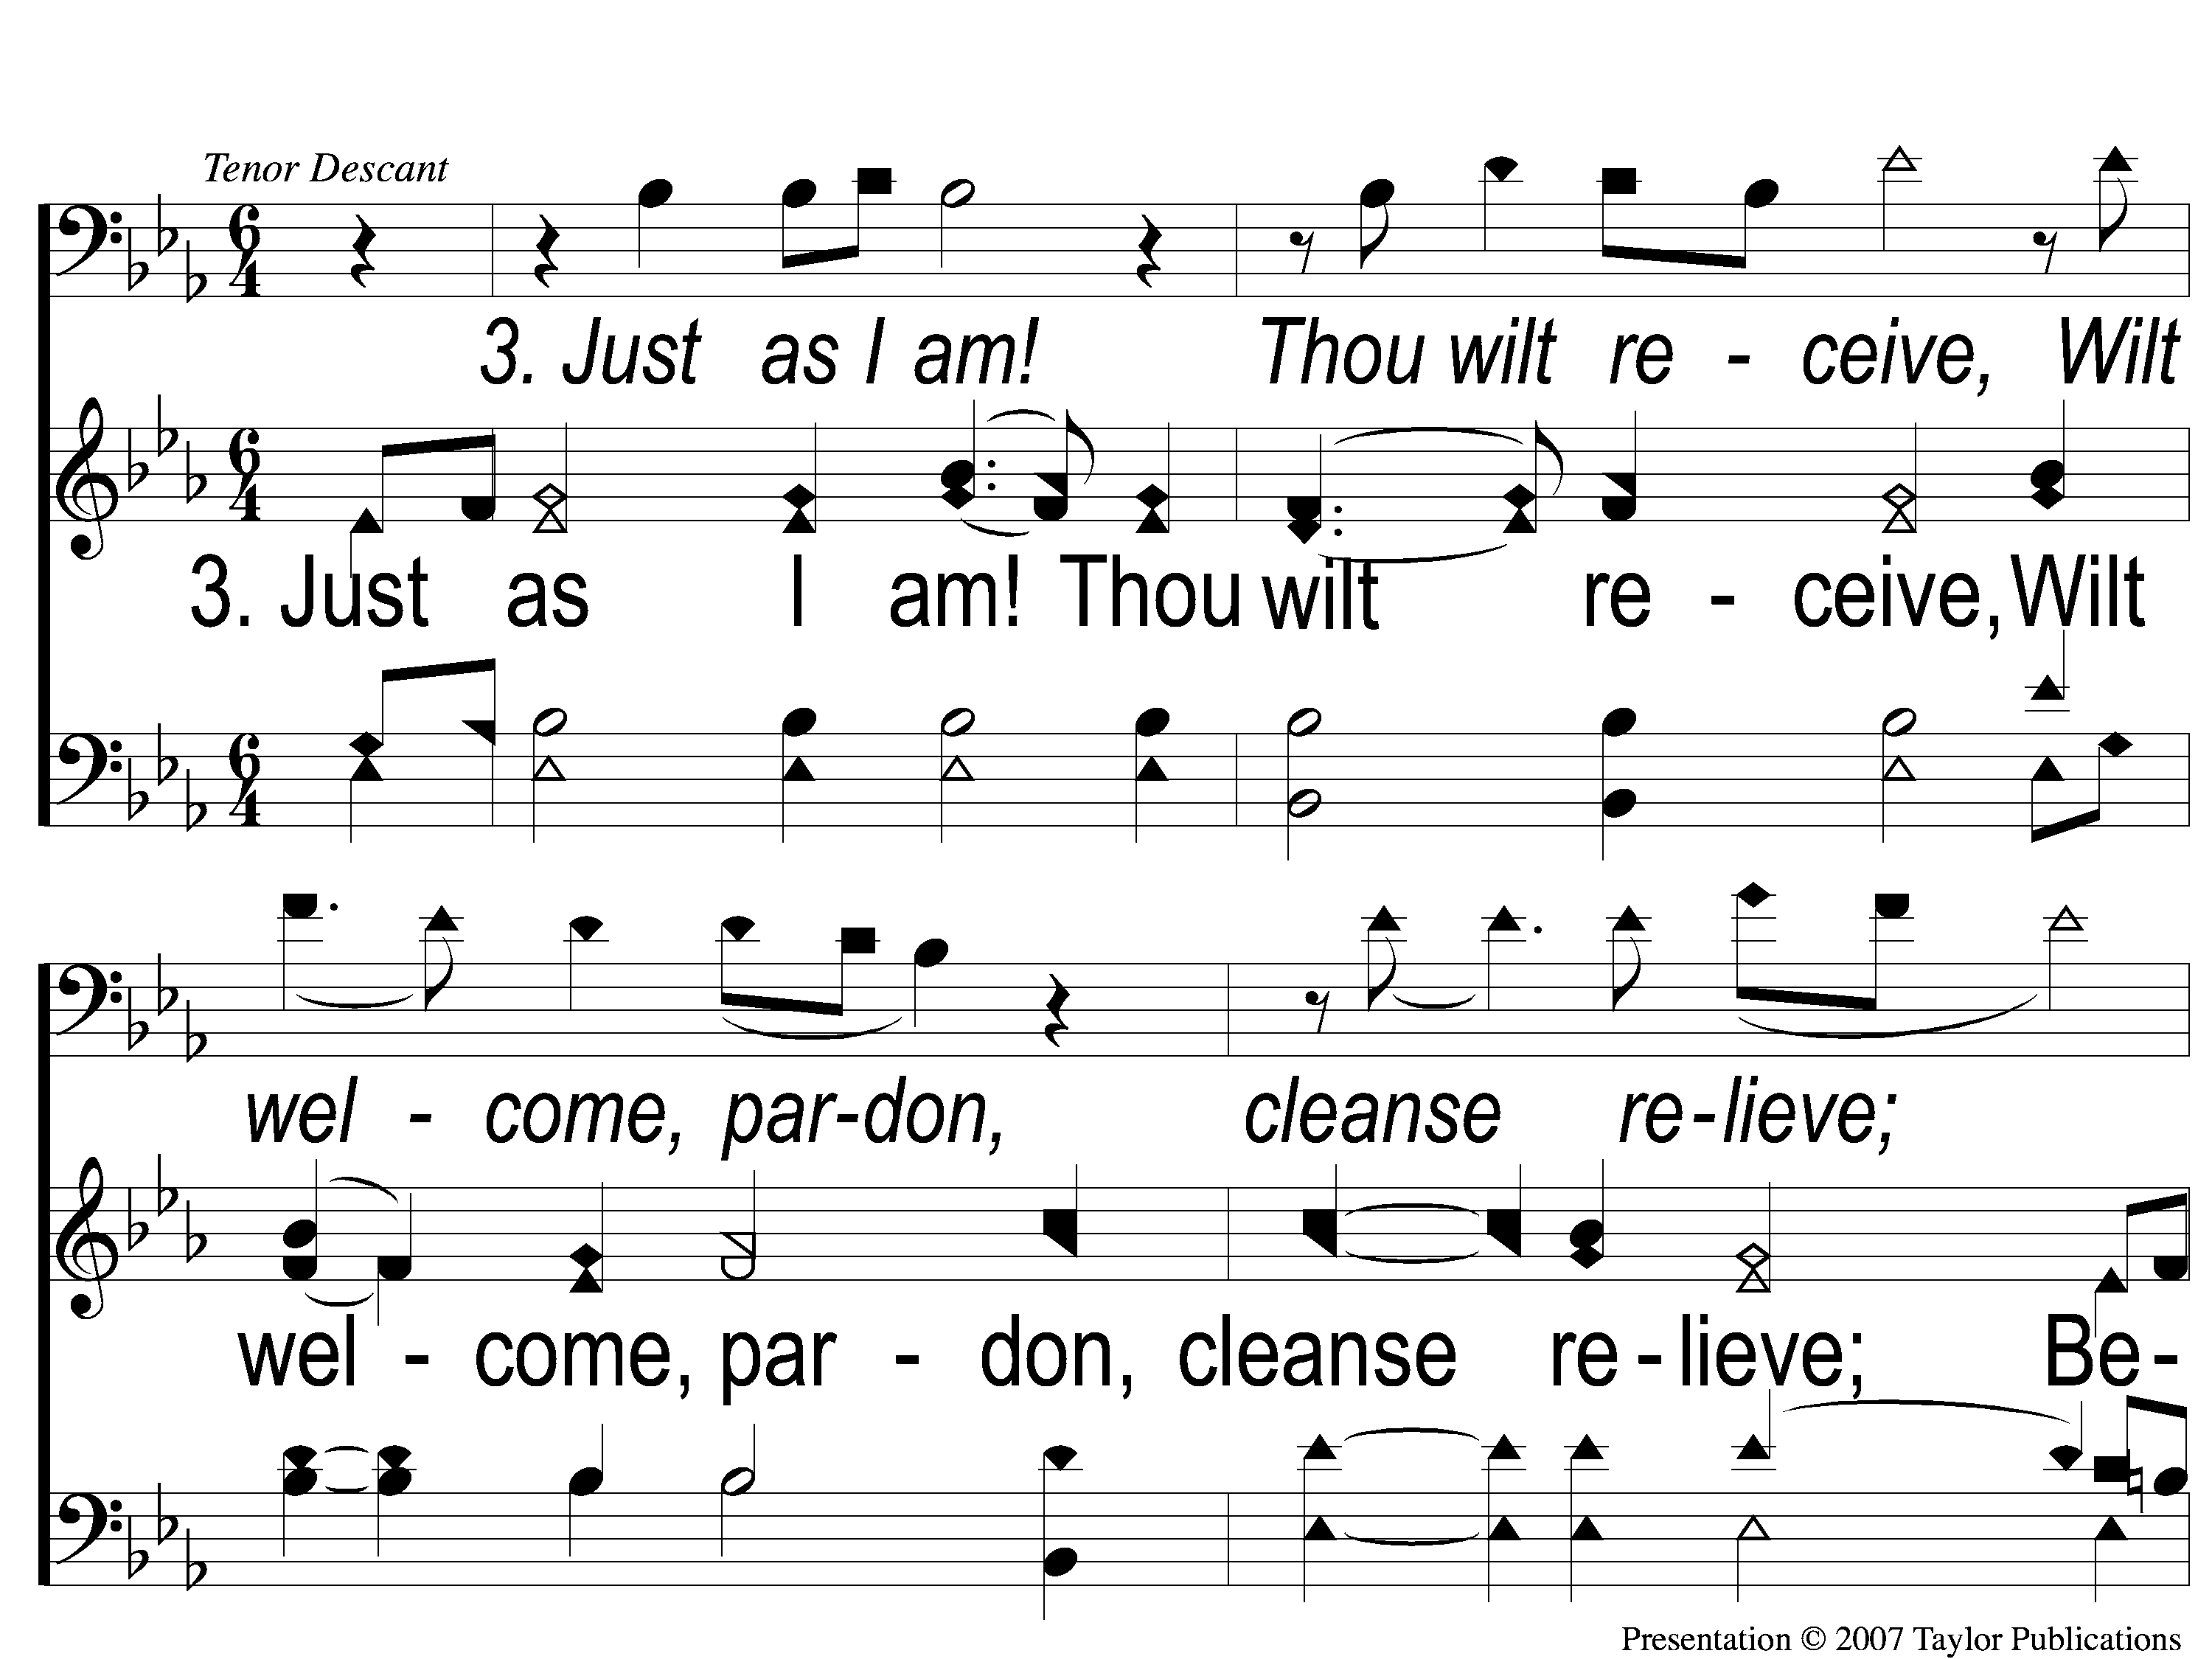
3-1 Just As I Am
Just As I Am
924

Slide 92
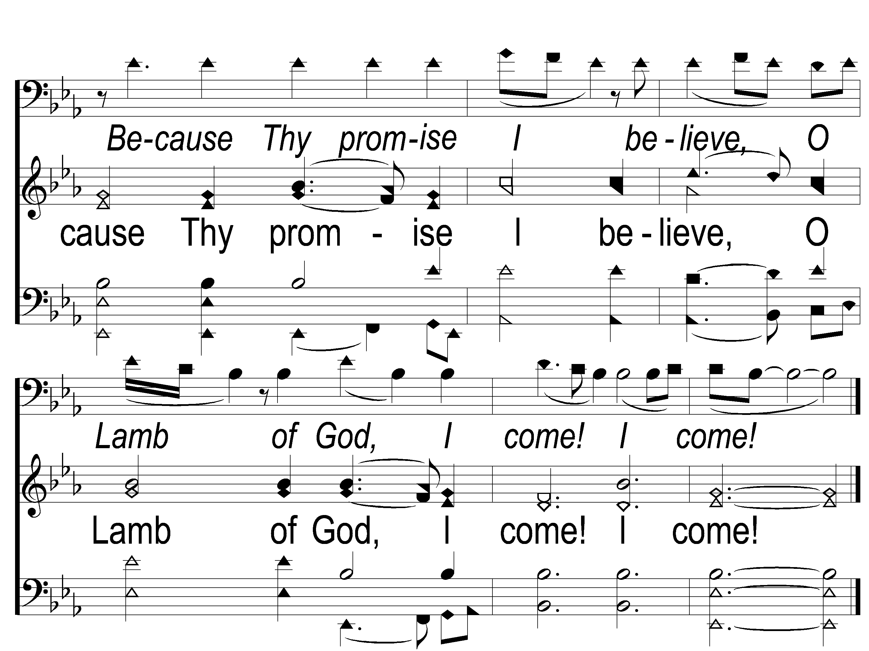
3-2 Just As I Am
Just As I Am
924

Slide 93
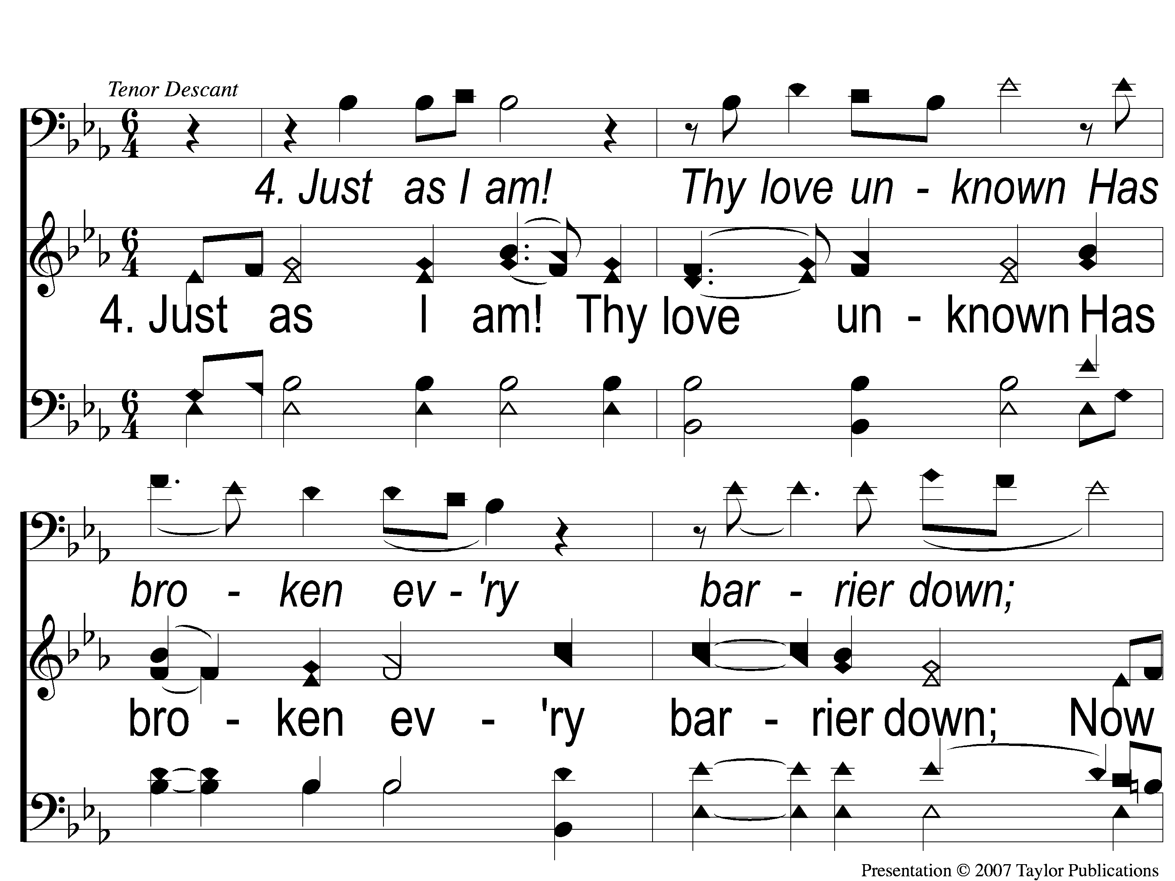
4-1 Just As I Am
Just As I Am
924

Slide 94
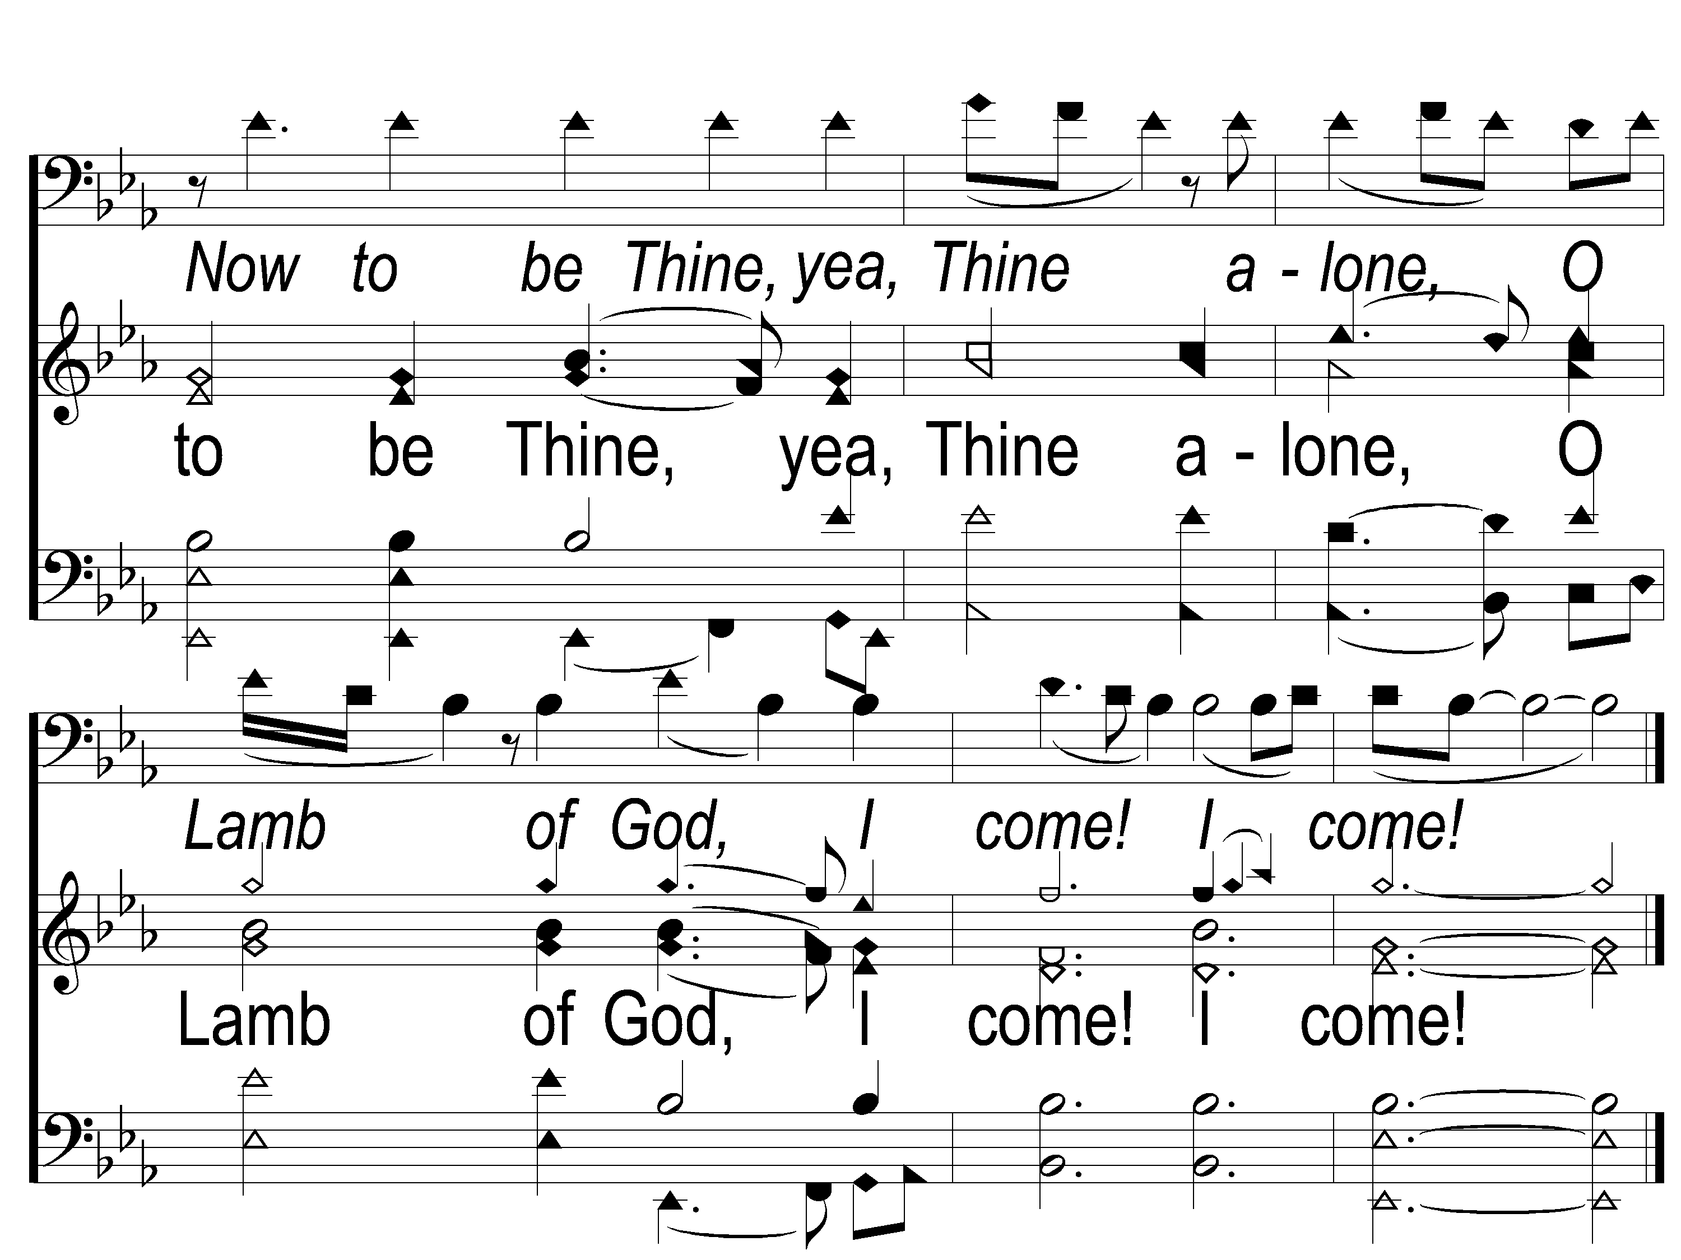
4-2 Just As I Am
Just As I Am
924

Slide 95
Our Contribution:
1 Corinthians 16:1-2
“Now concerning the collection for the saints, as I have given orders to the churches of Galatia, so you must do also: On the first day of the week let each one of you lay something aside, storing up as he may prosper, that there be no collections when I come.”

Slide 96
Song:
When I Survey
The Wondrous Cross
#315

Slide 97
1-1 When I Survey the Wondrous Cross
When I Survey the Wondrous Cross
315

Slide 98
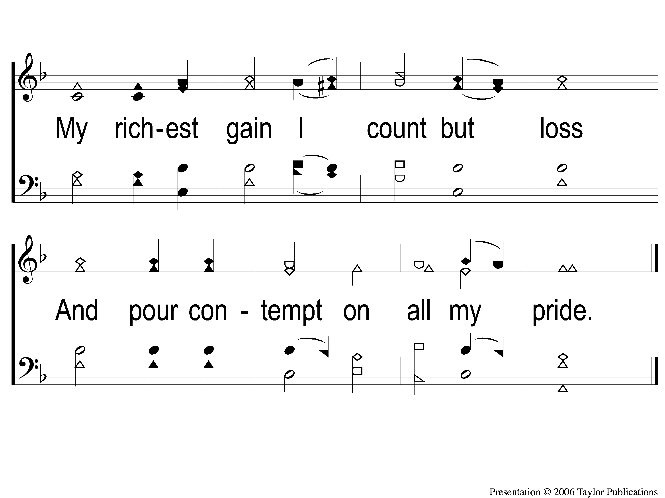
1-2 When I Survey the Wondrous Cross
When I Survey the Wondrous Cross
315

Slide 99
2-1 When I Survey the Wondrous Cross
When I Survey the Wondrous Cross
315

Slide 100
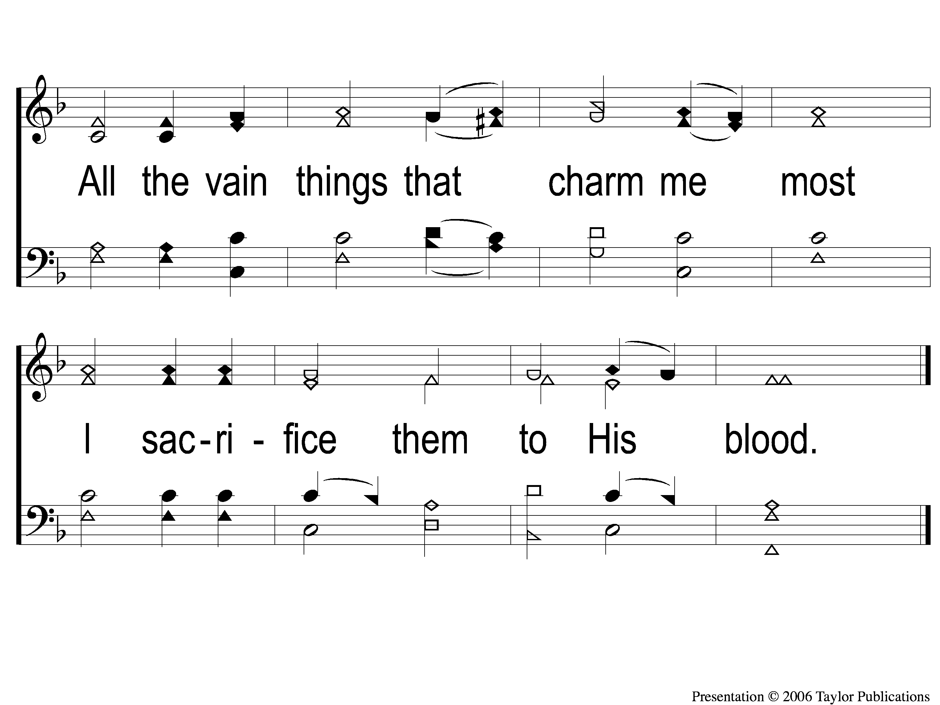
2-2 When I Survey the Wondrous Cross
When I Survey the Wondrous Cross
315

Slide 101
3-1 When I Survey the Wondrous Cross
When I Survey the Wondrous Cross
315

Slide 102
3-2 When I Survey the Wondrous Cross
When I Survey the Wondrous Cross
315

Slide 103
4-1 When I Survey the Wondrous Cross
When I Survey the Wondrous Cross
315

Slide 104
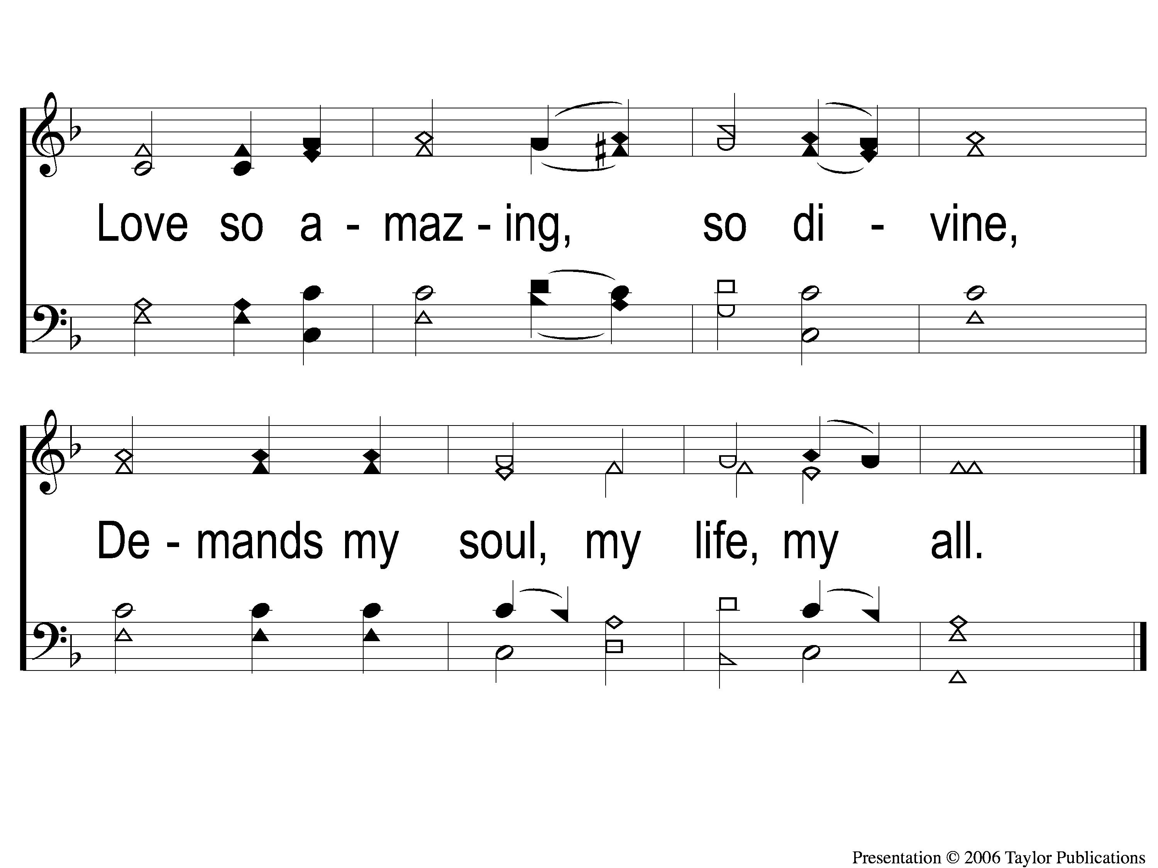
4-2 When I Survey the Wondrous Cross
When I Survey the Wondrous Cross
315

Slide 105
The Unleavened Bread
Mark 14:17-22
“In the evening He came with the twelve. Now as they sat and ate, Jesus said, ‘Assuredly, I say to you, one of you who eats with Me will betray Me.’ And they began to be sorrowful, and to say to Him one by one, ‘Is it I?’ And another said, ‘Is it I?’ He answered and said to them, ‘It is one of the twelve, who dips with Me in the dish. The Son of Man indeed goes just as it is written of Him, but woe to that man by whom the Son of Man is betrayed! It would have been good for that man if he had never been born.’ And as they were eating, Jesus took bread, blessed and broke it, and gave it to them and said, “Take, eat; this is My body.”

Slide 106
The Fruit of the Vine
Mark 14:23-26
“Then He took the cup, and when He had given thanks He gave it to them, and they all drank from it. And He said to them, ‘This is My blood of the new covenant, which is shed for many. Assuredly, I say to you, I will no longer drink of the fruit of the vine until that day when I drink it new in the kingdom of God.’ And when they had sung a hymn, they went out to the Mount of Olives.”

Slide 107
Closing Prayer

Slide 108
Song:
We’ll Work Till Jesus Comes
#634

Slide 109
1-1 We’ll Work Till Jesus Comes
We’ll Work Till Jesus Comes
634

Slide 110
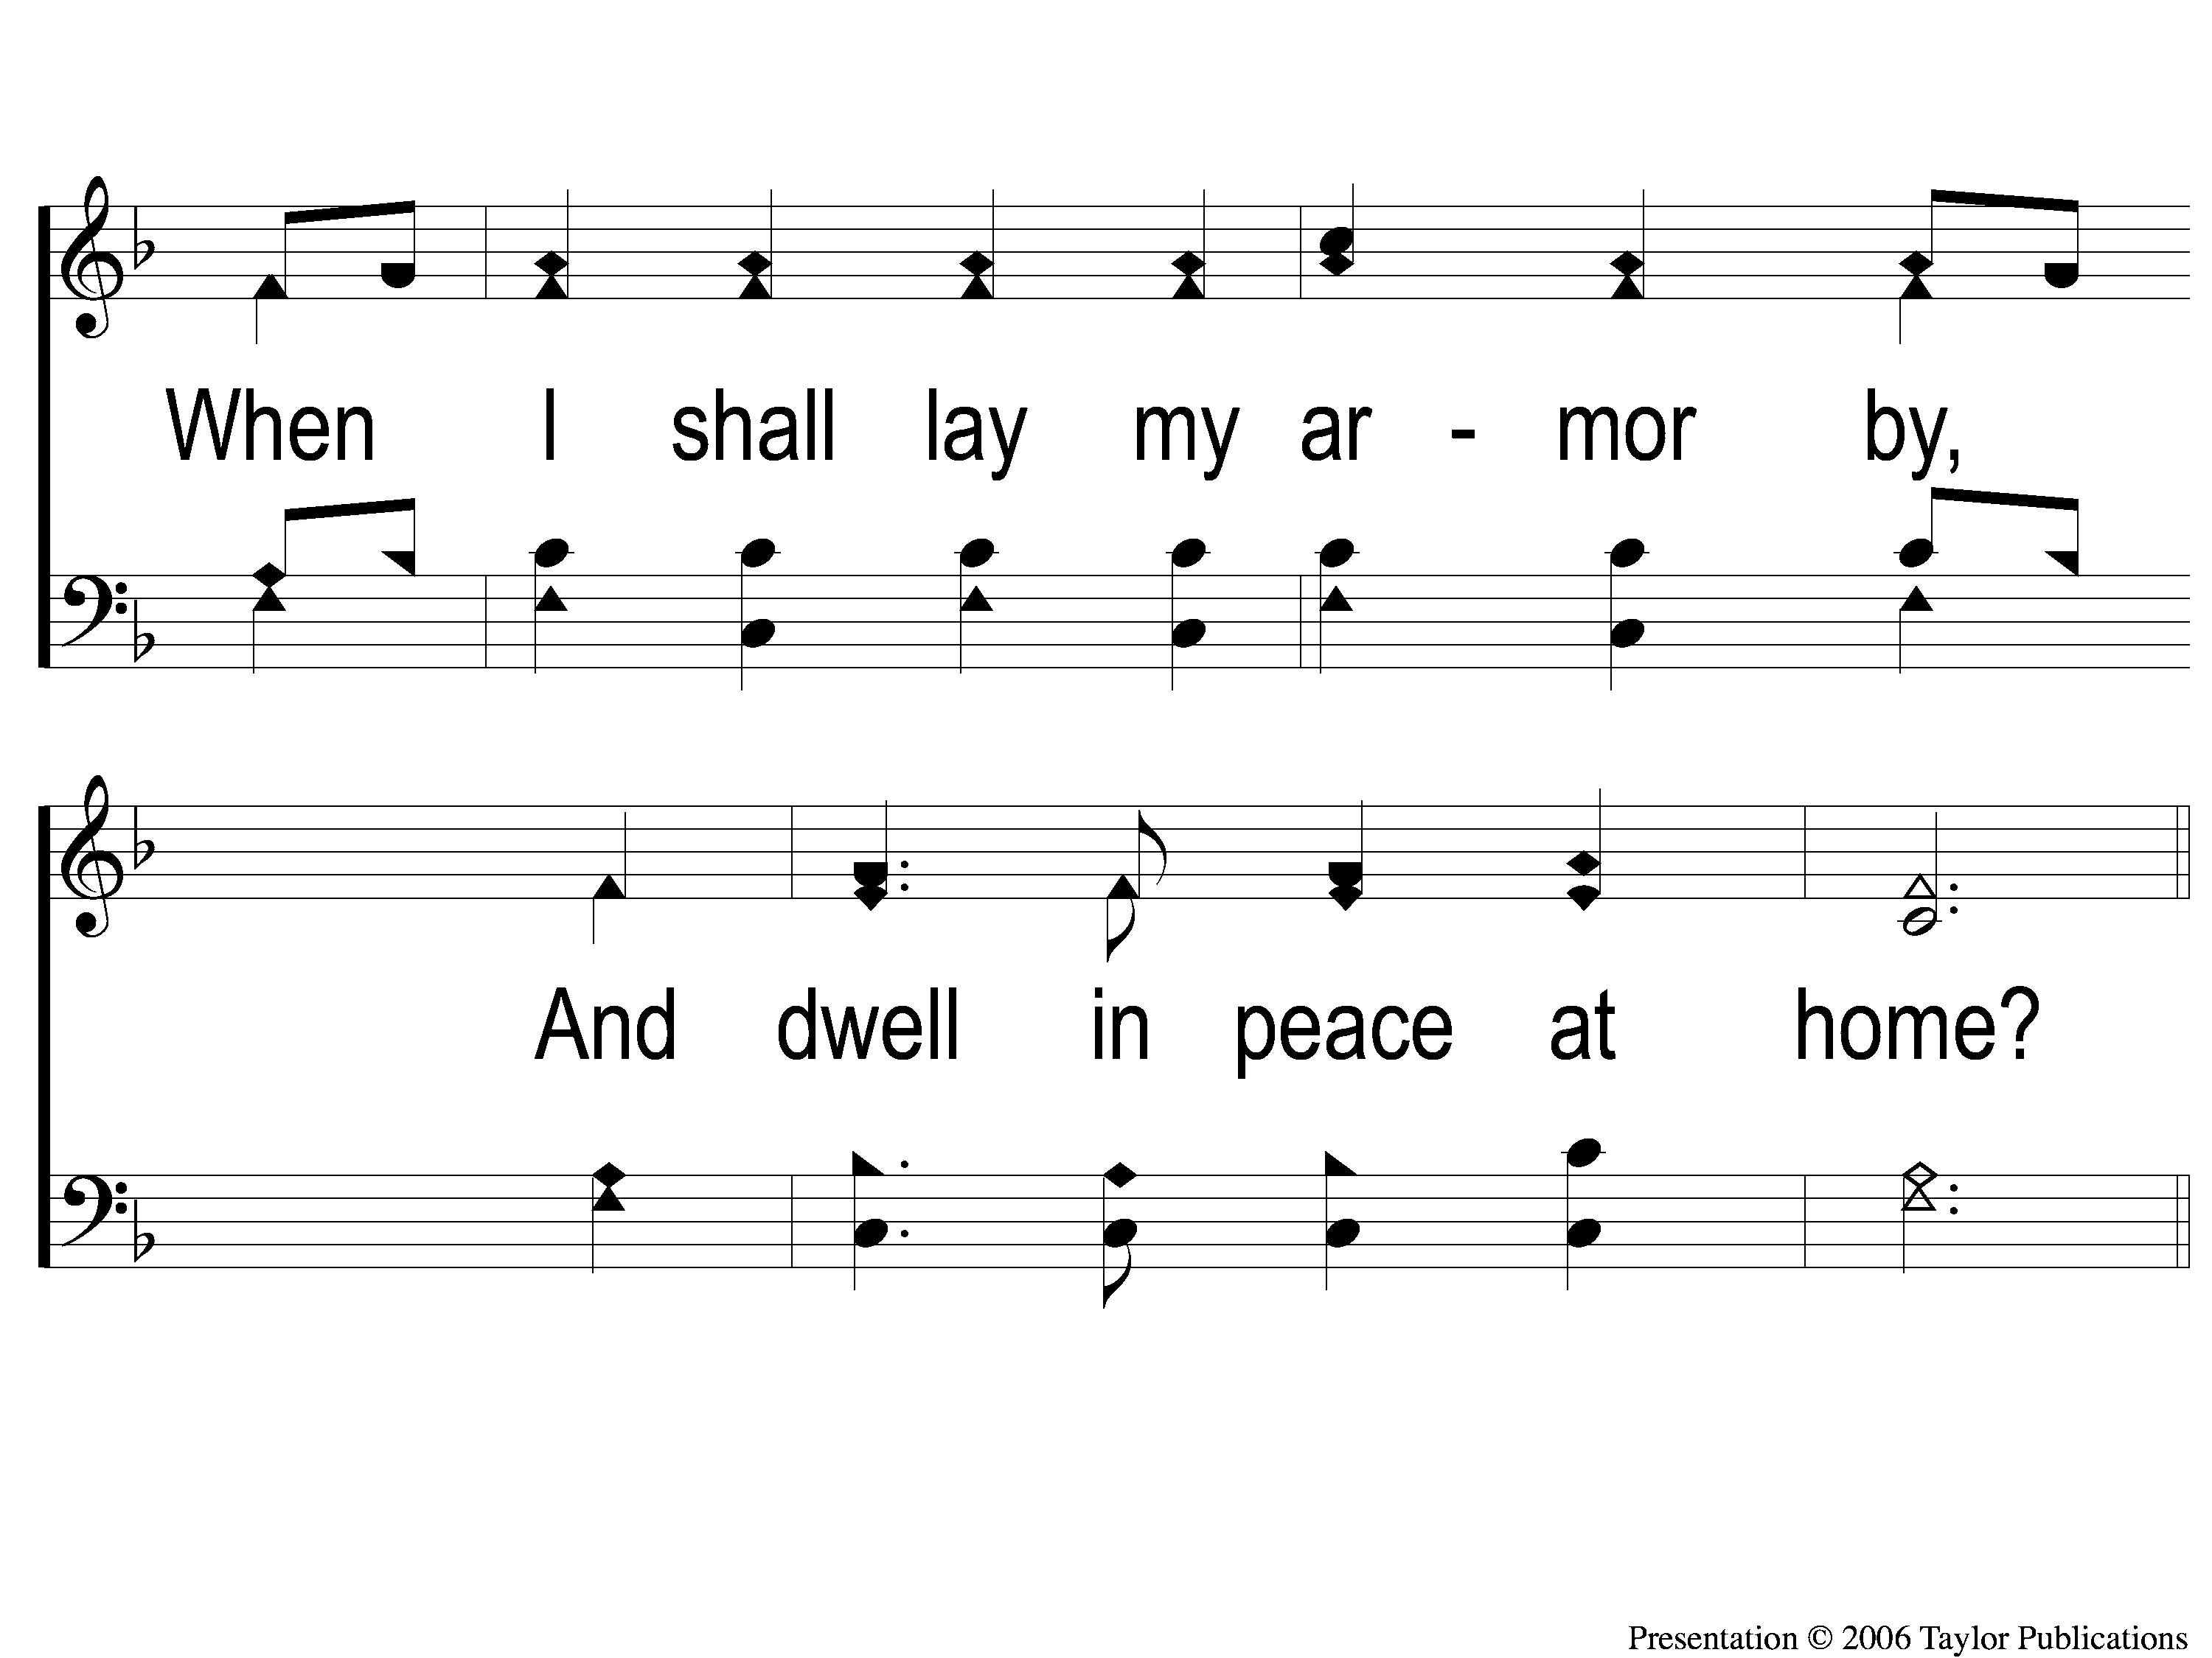
1-2 We’ll Work Till Jesus Comes
We’ll Work Till Jesus Comes
634

Slide 111
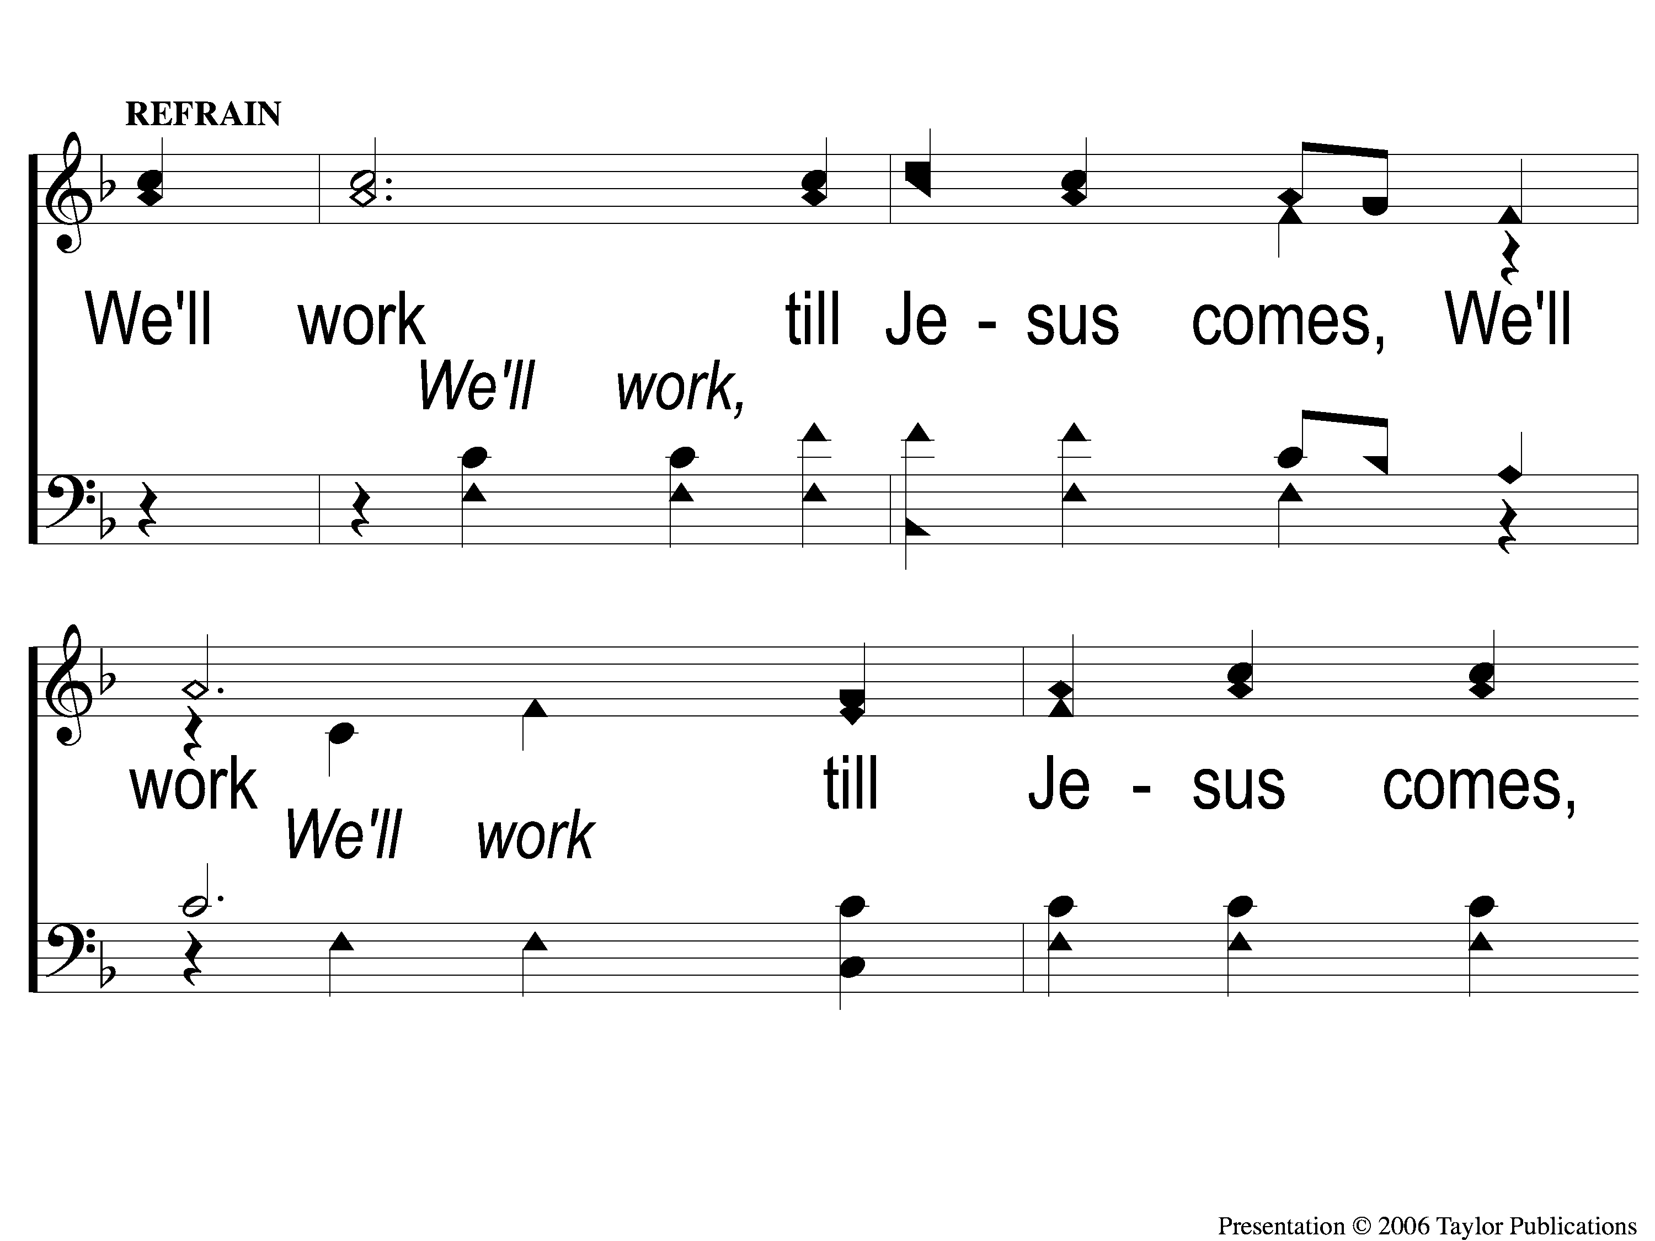
C-1 We’ll Work Till Jesus Comes
We’ll Work Till Jesus Comes
634

Slide 112
C-2 We’ll Work Till Jesus Comes
We’ll Work Till Jesus Comes
634

Slide 113
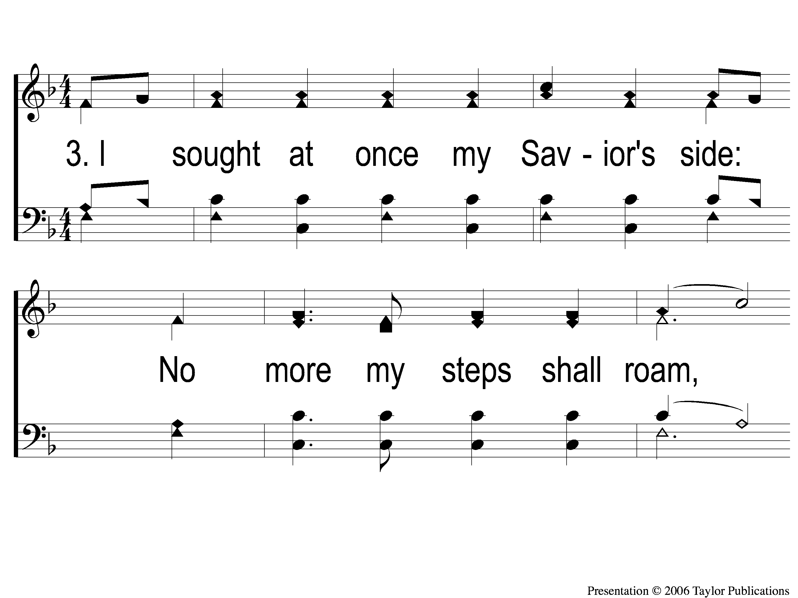
3-1 We’ll Work Till Jesus Comes
We’ll Work Till Jesus Comes
634

Slide 114
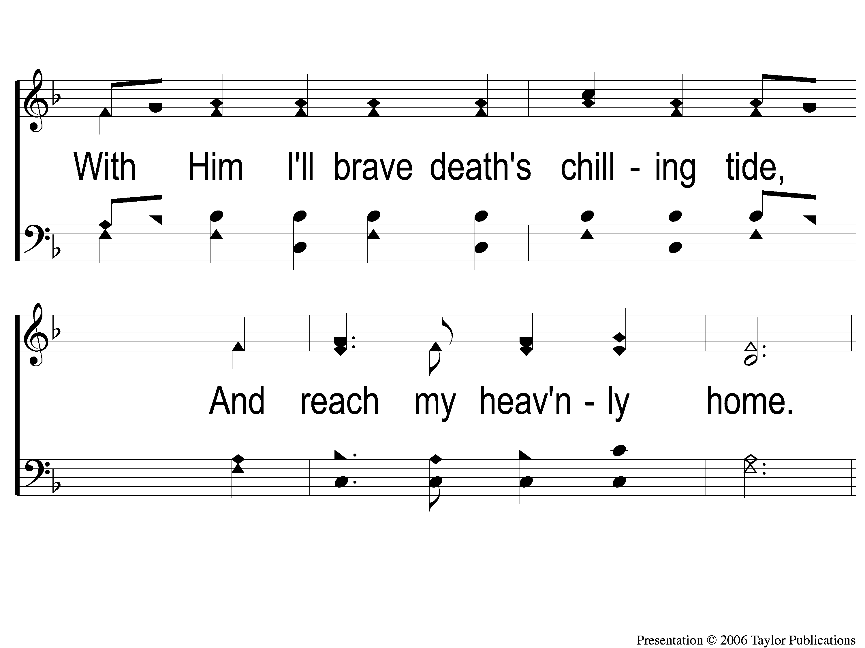
3-2 We’ll Work Till Jesus Comes
We’ll Work Till Jesus Comes
634

Slide 115
C-1 We’ll Work Till Jesus Comes
We’ll Work Till Jesus Comes
634

Slide 116
C-2 We’ll Work Till Jesus Comes
We’ll Work Till Jesus Comes
634

Slide 117
RESTORE REBUILD RENEW
This Evening
Cookies & Caroling @ 2-5 PM
Worship @ 6:00 PM
Wednesday
Worship @ 6:30 PM
IN 2022
WHEELER
CHURCH
OF
CHRIST

