Slide 1
1 Jesus Name Above All Names
Jesus, Name Above All Names
221

Slide 2
2 Jesus Name Above All Names
Jesus, Name Above All Names
221

Slide 3
2-1 Faithful Love
Faithful Love
18

Slide 4
2-2 Faithful Love
Faithful Love
18

Slide 5
2-3 Faithful Love
Faithful Love
18

Slide 6
C-1 Faithful Love
Faithful Love
18

Slide 7
C-2 Faithful Love
Faithful Love
18

Slide 8
RESTORE REBUILD RENEW
welcome
we are glad to
Have you with us
IN 2022
WHEELER
CHURCH
OF
CHRIST

Slide 9
Song:
You’re My All In All
#484

Slide 10
1 All in All
You Are My All in All
484

Slide 11
2 All in All
You Are My All in All
484

Slide 12
3 All in All
You Are My All in All
484

Slide 13
4 All in All
You Are My All in All
484

Slide 14
5 All in All
You Are My All in All
484

Slide 15
6 All in All
You Are My All in All
484

Slide 16
C-1 All in All
You Are My All in All
484

Slide 17
C-2 All in All
You Are My All in All
484

Slide 18
Song:
Ancient Words
PH #

Slide 19
1-1 Ancient Words
Ancient Words

Slide 20
1-2 Ancient Words
Ancient Words

Slide 21
1-3 Ancient Words
Ancient Words

Slide 22
C-1 Ancient Words
Ancient Words

Slide 23
C-2 Ancient Words
Ancient Words

Slide 24
2-1 Ancient Words
Ancient Words

Slide 25
2-2 Ancient Words
Ancient Words

Slide 26
2-3 Ancient Words
Ancient Words

Slide 27
C-1 Ancient Words
Ancient Words

Slide 28
C-2 Ancient Words
Ancient Words

Slide 29
Coda-1 Ancient Words
Ancient Words

Slide 30
Coda-2 Ancient Words
Ancient Words

Slide 31
tag Ancient Words
Ancient Words

Slide 32
Opening Prayer

Slide 33
Song:
We Will Glorify
#578

Slide 34
1-1 We Will Glorify
We Will Glorify
578

Slide 35
1-2 We Will Glorify
We Will Glorify
578

Slide 36
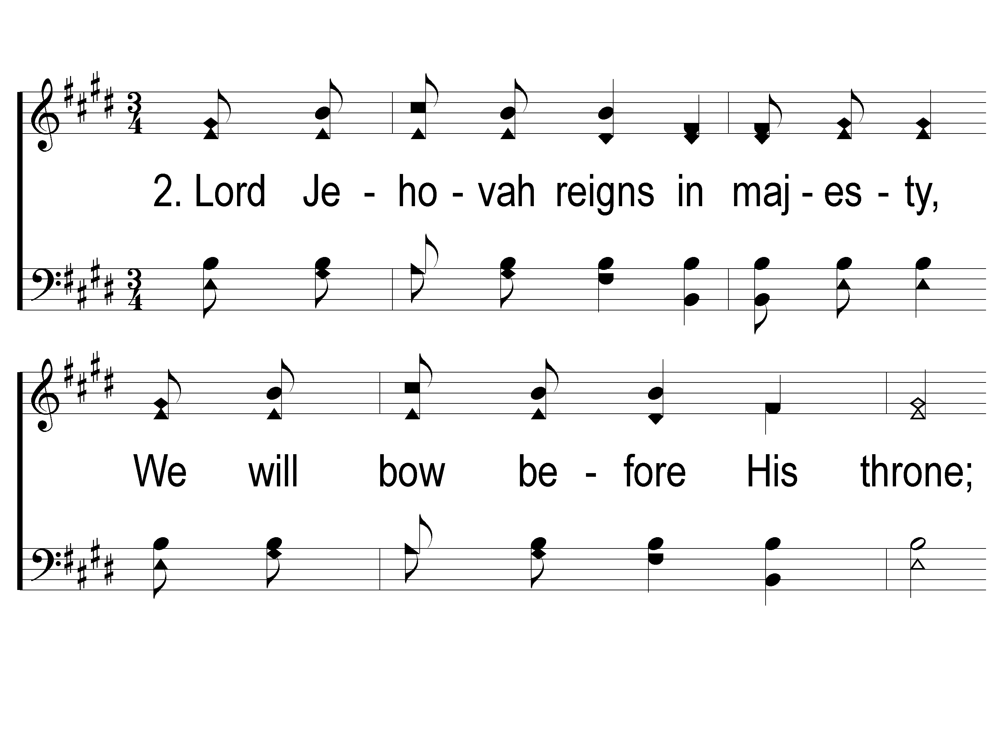
2-1 We Will Glorify
We Will Glorify
578

Slide 37
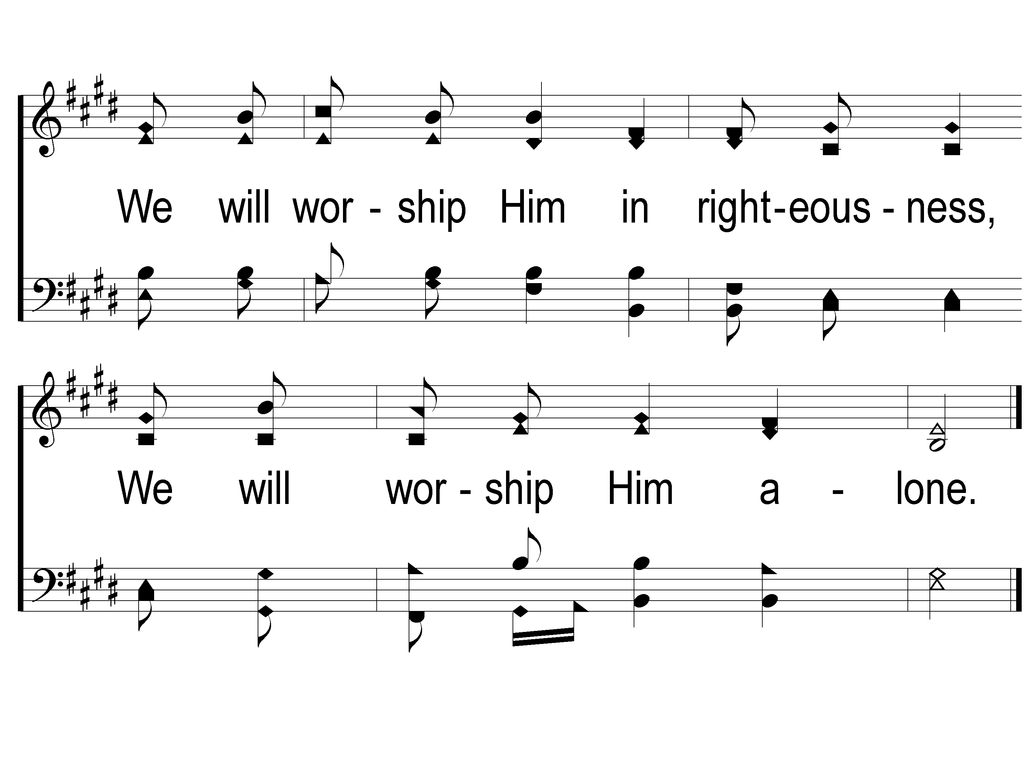
2-2 We Will Glorify
We Will Glorify
578

Slide 38
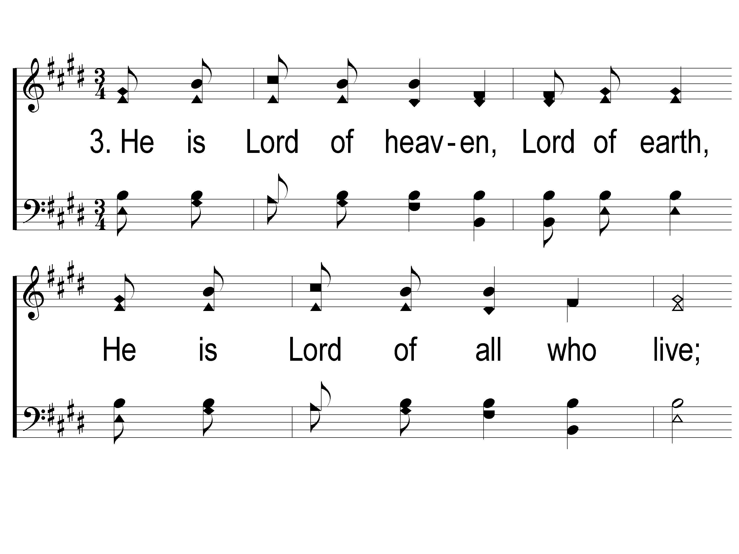
3-1 We Will Glorify
We Will Glorify
578

Slide 39
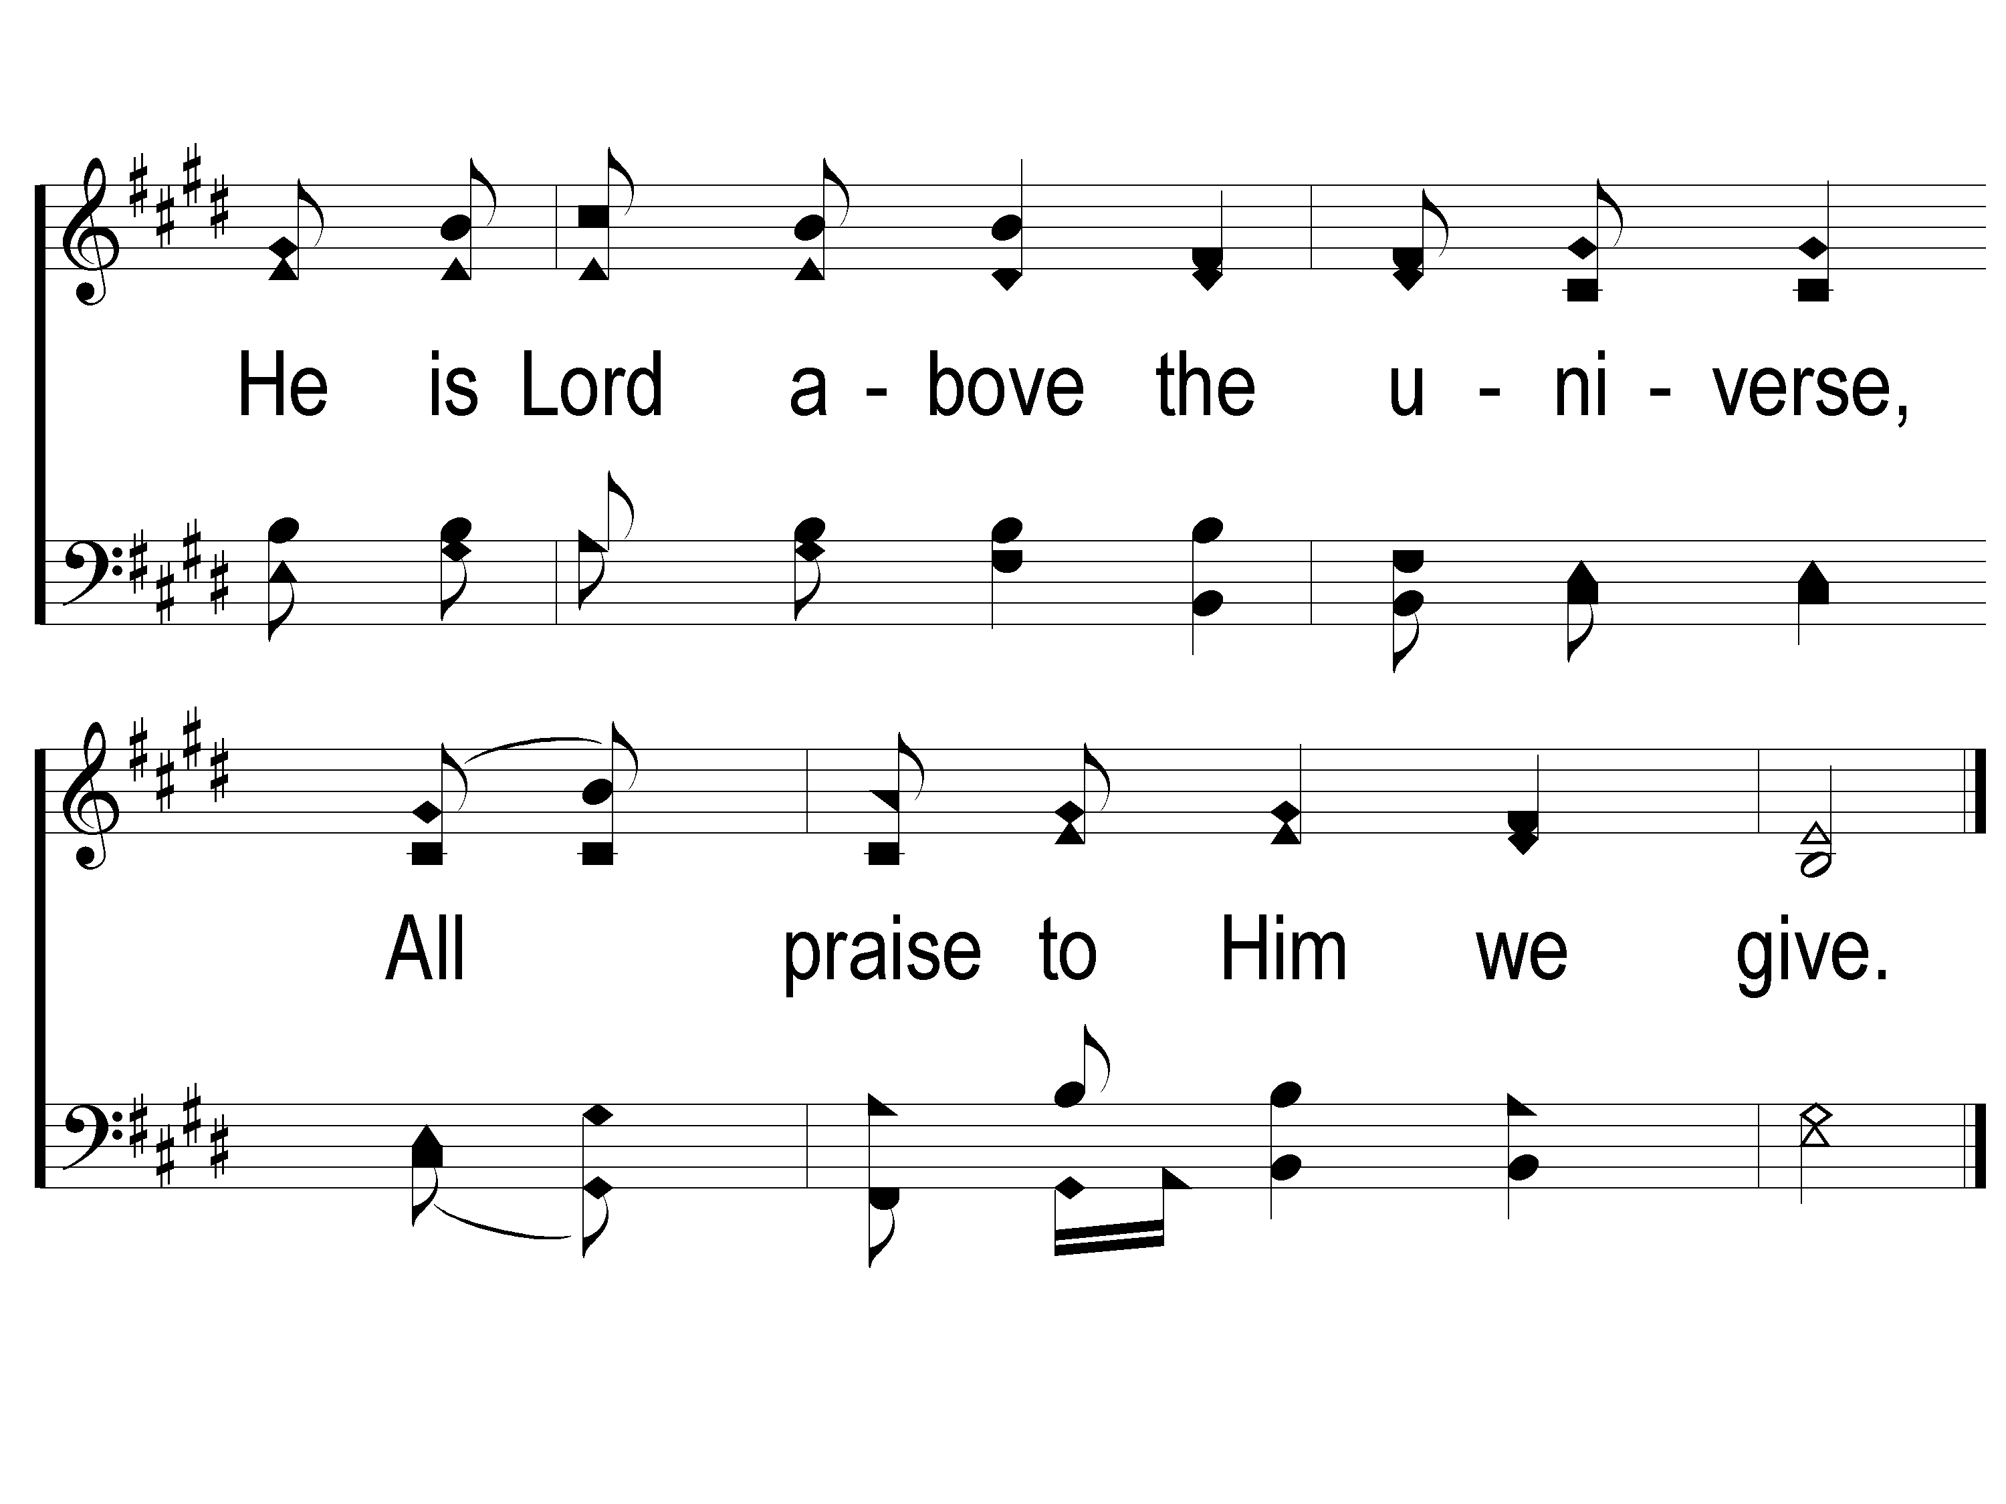
3-2 We Will Glorify
We Will Glorify
578

Slide 40
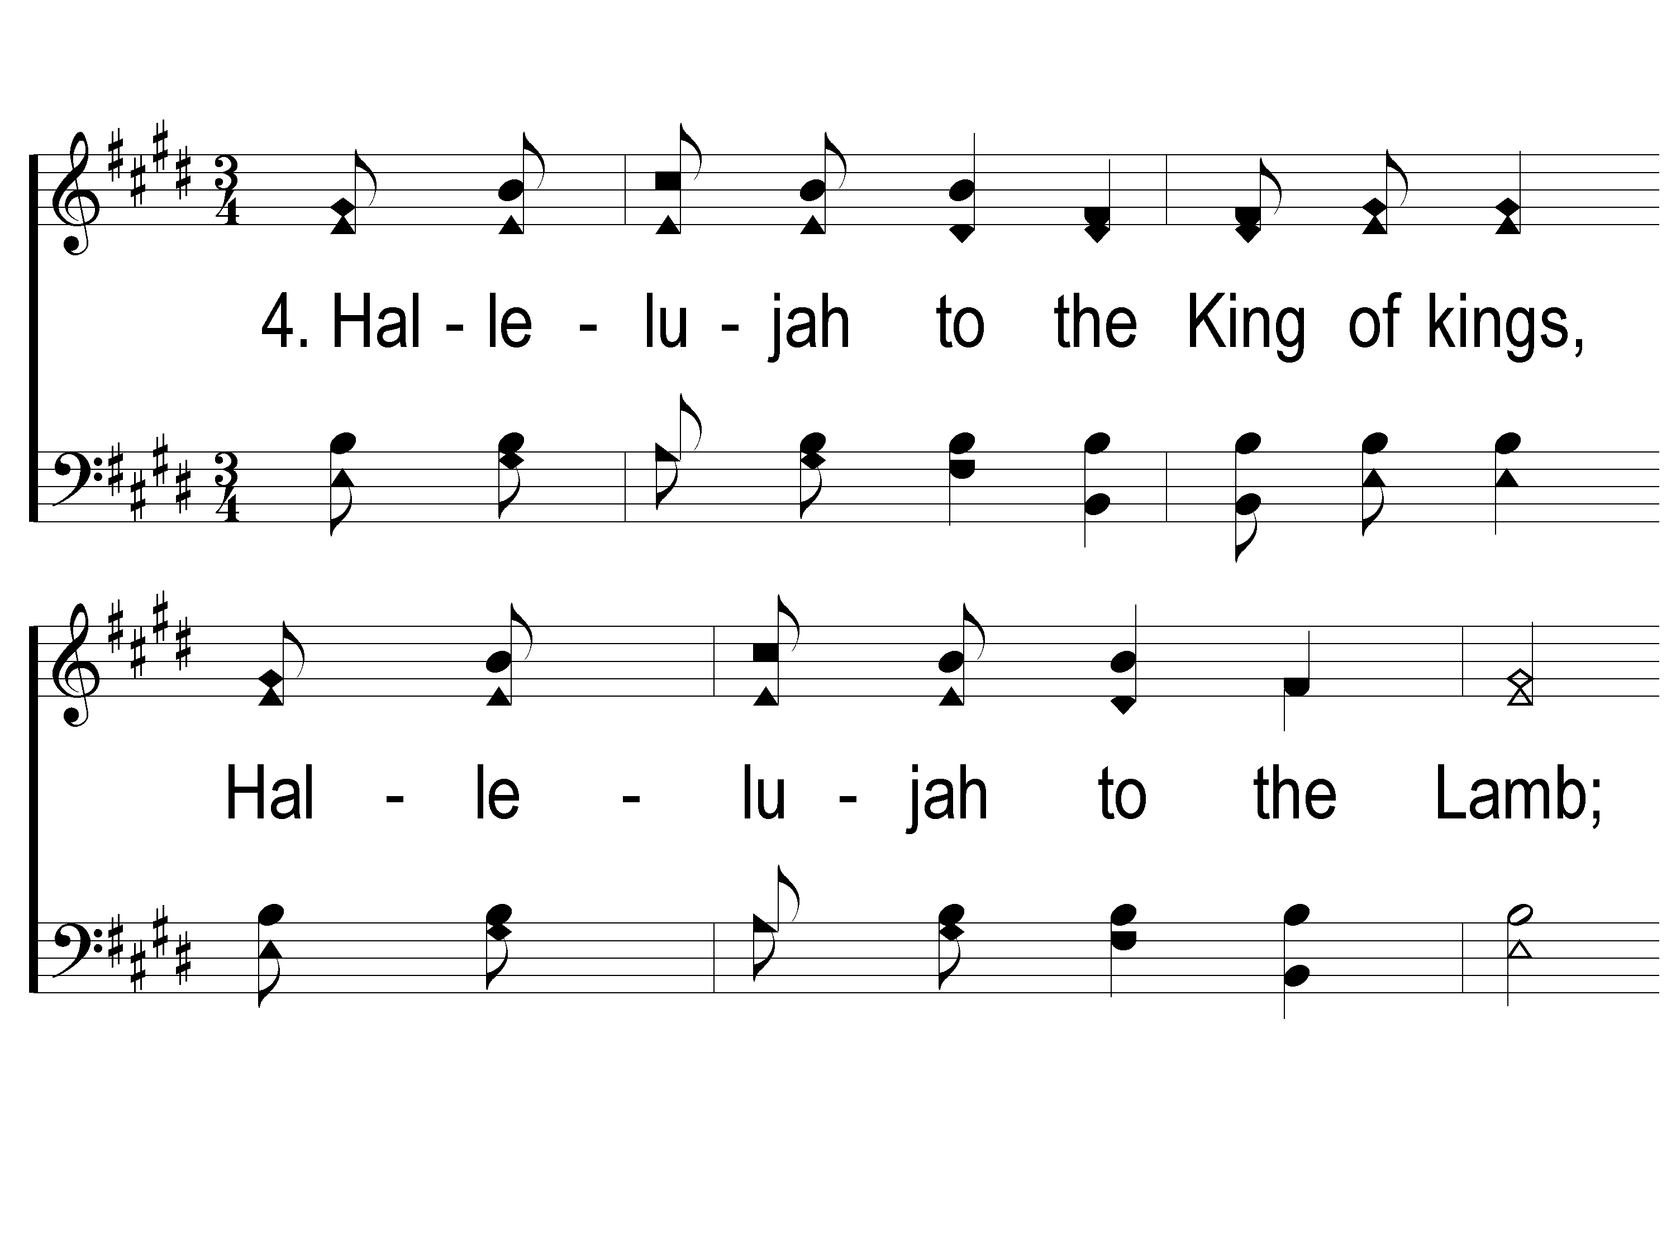
4-1 We Will Glorify
We Will Glorify
578

Slide 41
4-2 We Will Glorify
We Will Glorify
578

Slide 42
Song:
God Is So Good
#83

Slide 43
1 God is So Good
God Is So Good
83

Slide 44
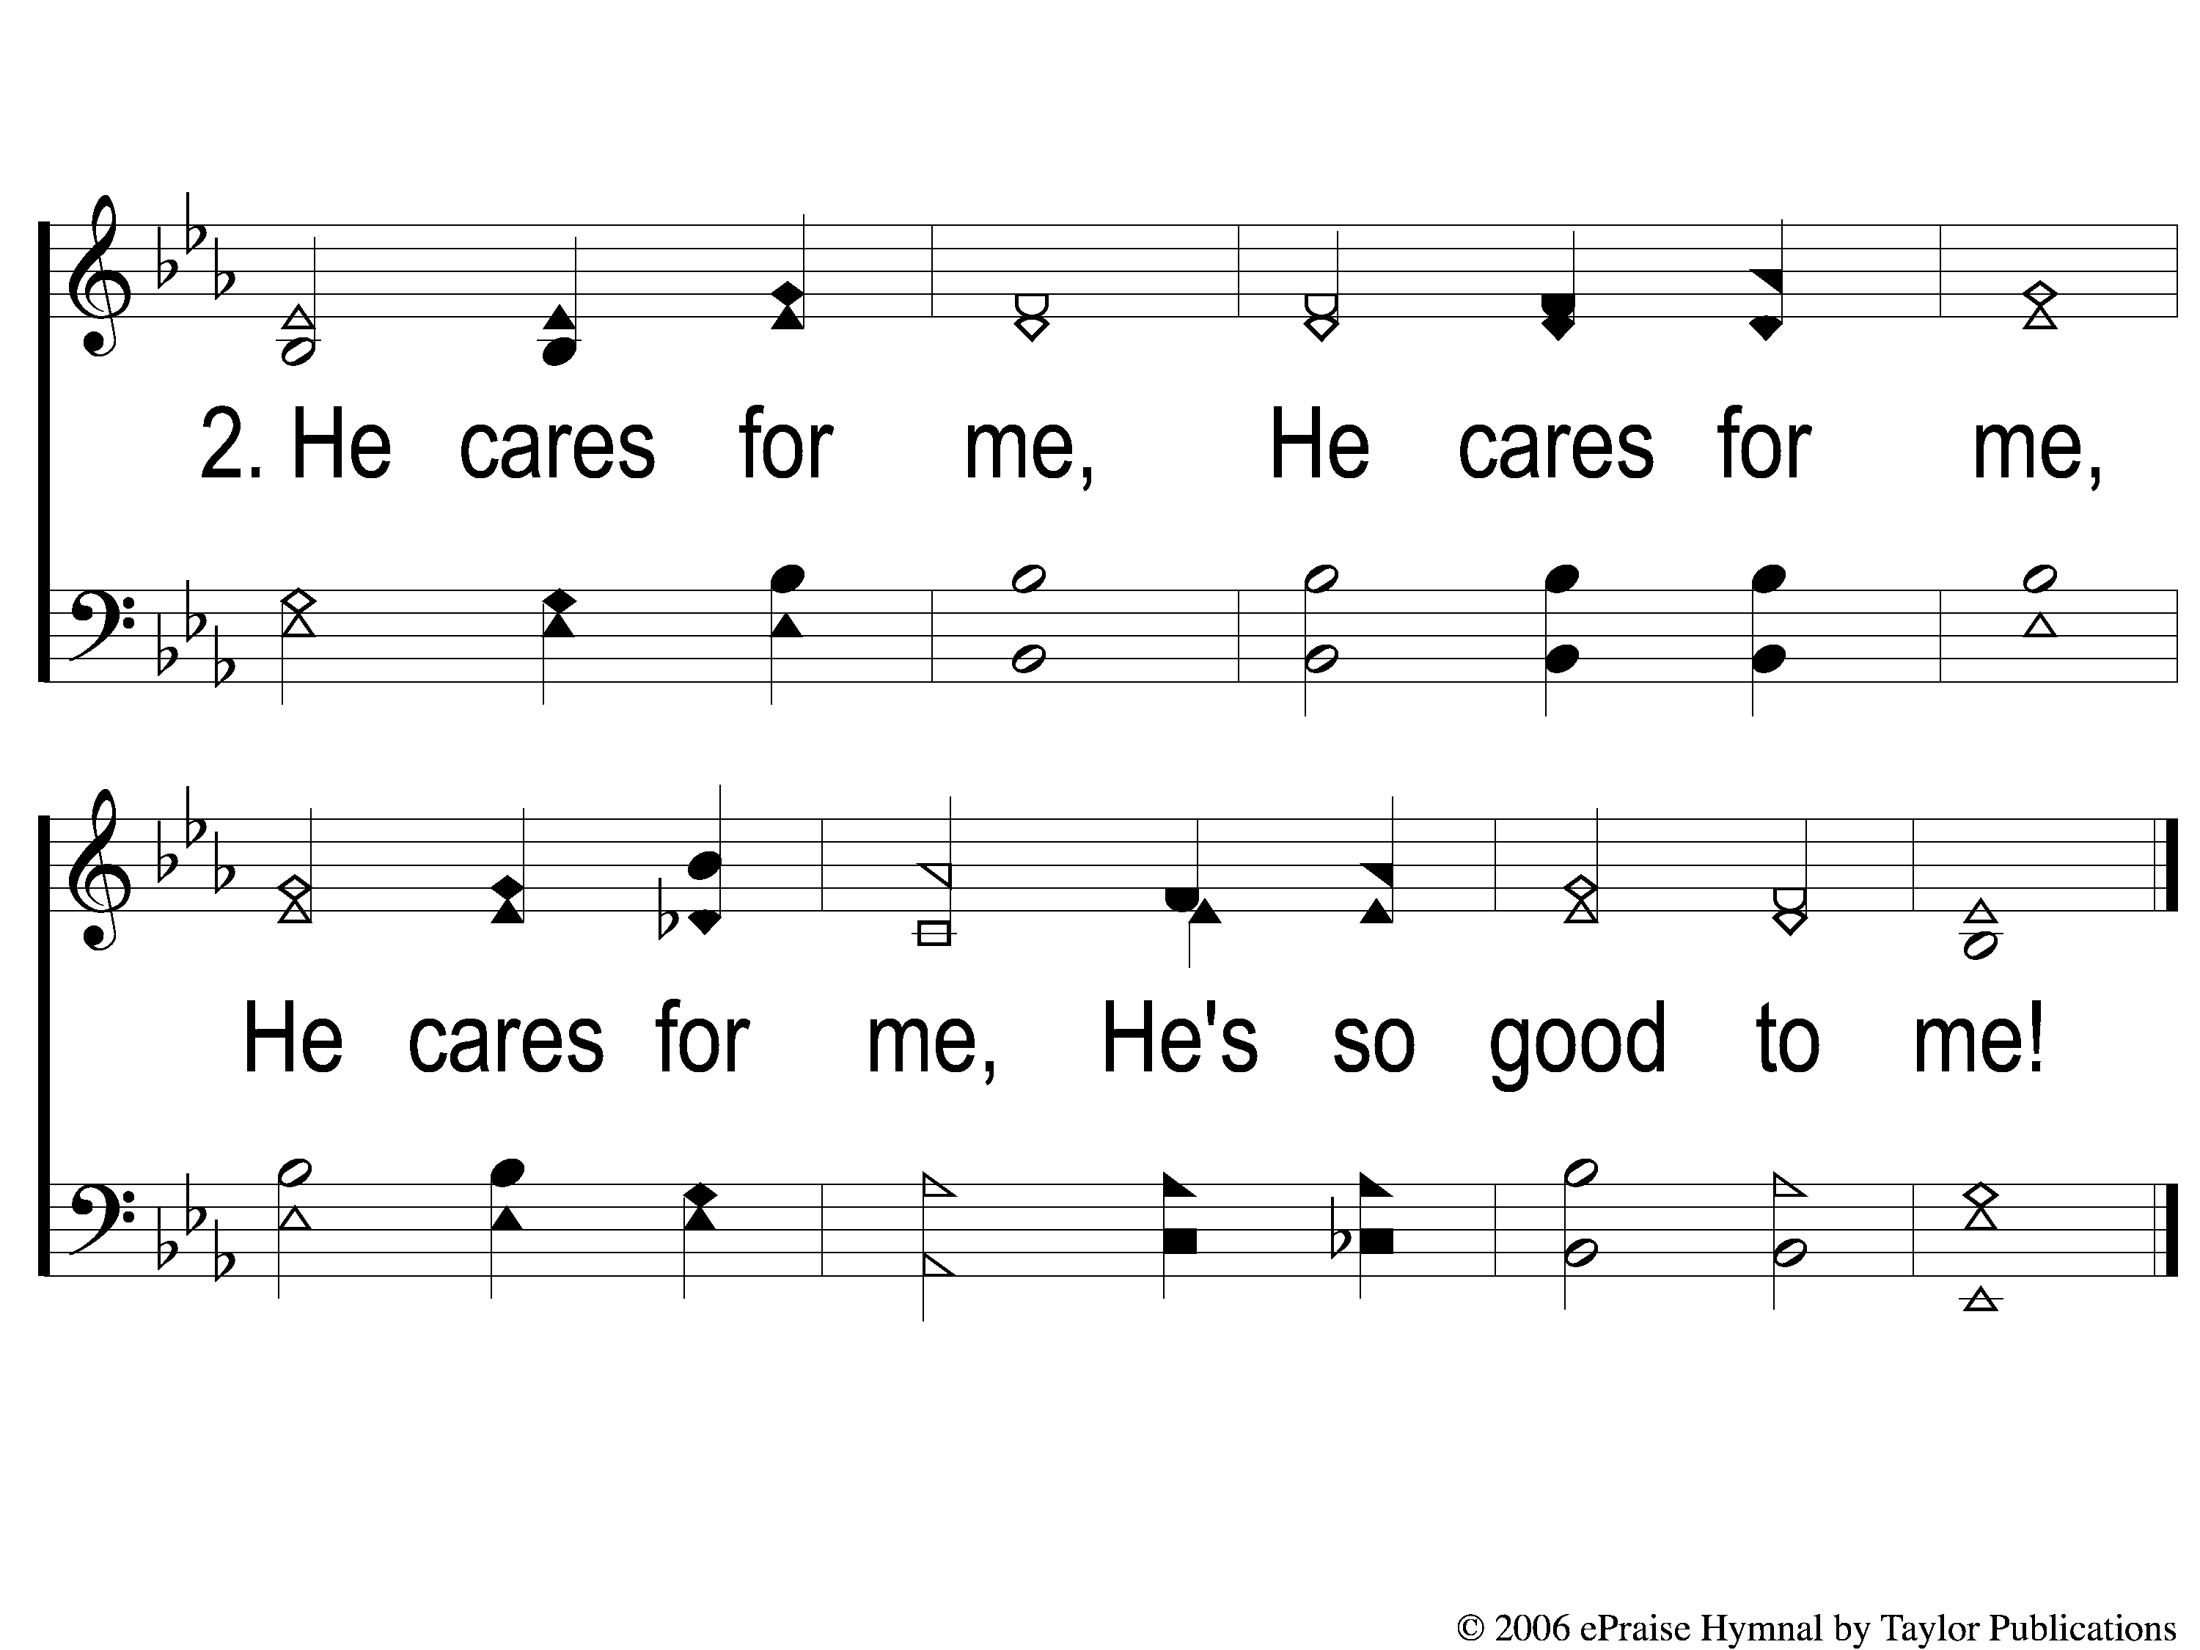
2 God is So Good
God Is So Good
83

Slide 45
4 God is So Good
God Is So Good
83

Slide 46
1 The Steadfast Love of the Lord
The Steadfast Love of the Lord
123

Slide 47
2 The Steadfast Love of the Lord
The Steadfast Love of the Lord
123

Slide 48
3 The Steadfast Love of the Lord
The Steadfast Love of the Lord
123

Slide 49
DC-1 The Steadfast Love of the Lord
The Steadfast Love of the Lord
123

Slide 50
DC-2 The Steadfast Love of the Lord
The Steadfast Love of the Lord
123

Slide 51
DC-3 The Steadfast Love of the Lord
The Steadfast Love of the Lord
123

Slide 52
DC-4 The Steadfast Love of the Lord
The Steadfast Love of the Lord
123

Slide 53
Scripture Reading:
Romans 12:14-21

Slide 54
IN PURSUIT
2023

Slide 55
Renewed MIND
in
Romans 12:2

Slide 56
A Renewed Mind…
Thinks & Acts Right (v. 3-8)

Slide 57
A Renewed Mind…
Thinks & Acts Right (v. 3-8)
Characterized by: Intensity, Durability, & Generosity (v. 10-13)

Slide 58
A Renewed Mind…
Thinks & Acts Right (v. 3-8)
Characterized by: Intensity, Durability, & Generosity (v. 10-13)
Overcomes Evil with Good (v. 14-21)

Slide 59
How Do We Overcome Evil with Good?
Eulogizing (v. 14)

Slide 60
How Do We Overcome Evil with Good?
Eulogizing (v. 14)
Those who Persecute You
2 Tim. 3:12, Gal. 4:17, Rom. 16:17

Slide 61
How Do We Overcome Evil with Good?
Eulogizing (v. 14)
Bless, not Curse!
1 Cor. 4:12, Matt. 5:44-45

Slide 62
How Do We Overcome Evil with Good?
Eulogizing (v. 14)
Empathizing (v. 15-16)

Slide 63
How Do We Overcome Evil with Good?
Empathizing (v. 15-16)

Slide 64
How Do We Overcome Evil with Good?
Empathizing (v. 15-16)
The Key: Humility
Rom. 12:3-8, Jms. 3:16, Phili. 2:5

Slide 65
How Do We Overcome Evil with Good?
Eulogizing (v. 14)
Empathizing (v. 15-16)
Evangelizing (v. 17-21)

Slide 66
How Do We Overcome Evil with Good?
Evangelizing (v. 17-20)

Slide 67
How Do We Overcome Evil with Good?
Evangelizing (v. 17-20)
Leave Wrath to God
Deut. 23:25, Prov. 25:21-22

Slide 68
How Do We Overcome Evil with Good?
Evangelizing (v. 17-20)
Focus on Doing Good
Acts 16:22-25, Mk. 16:15-16

Slide 69
An Example of Overcoming Evil with Good:
God Eulogizes His Enemies

Slide 70
An Example:
God Eulogizes His Enemies
Matt. 5:43-48

Slide 71
An Example:
God Eulogizes His Enemies
Giving Us His Son
Matt. 1:20-23, Heb. 2:9, 14
Lk. 2:12-14

Slide 72
An Example of Overcoming Evil with Good:
God Eulogizes His Enemies
God Empathizes with His Creation

Slide 73
An Example:
Empathizes with His Creation
Jesus Understands
Heb. 4:15-16

Slide 74
An Example of Overcoming Evil with Good:
God Eulogizes His Enemies
God Empathizes with His Creation
God Evangelizes with His People

Slide 75
An Example:
God Evangelizes with His People
Fellow Workers with God
1 Cor. 3:6, 9

Slide 76
An Example:
God Evangelizes with His People
The Gospel
1 Cor. 15:3-4, 2 Thess. 1:6-9, Col. 1:21-23

Slide 77
Have You Overcome Evil with Good?

Slide 78
Why Did My Savior
Come To Earth?
#382
Invitation
Song:

Slide 79
1-1 Why Did My Savior Come to Earth?
Why Did My Savior Come to Earth?
382

Slide 80
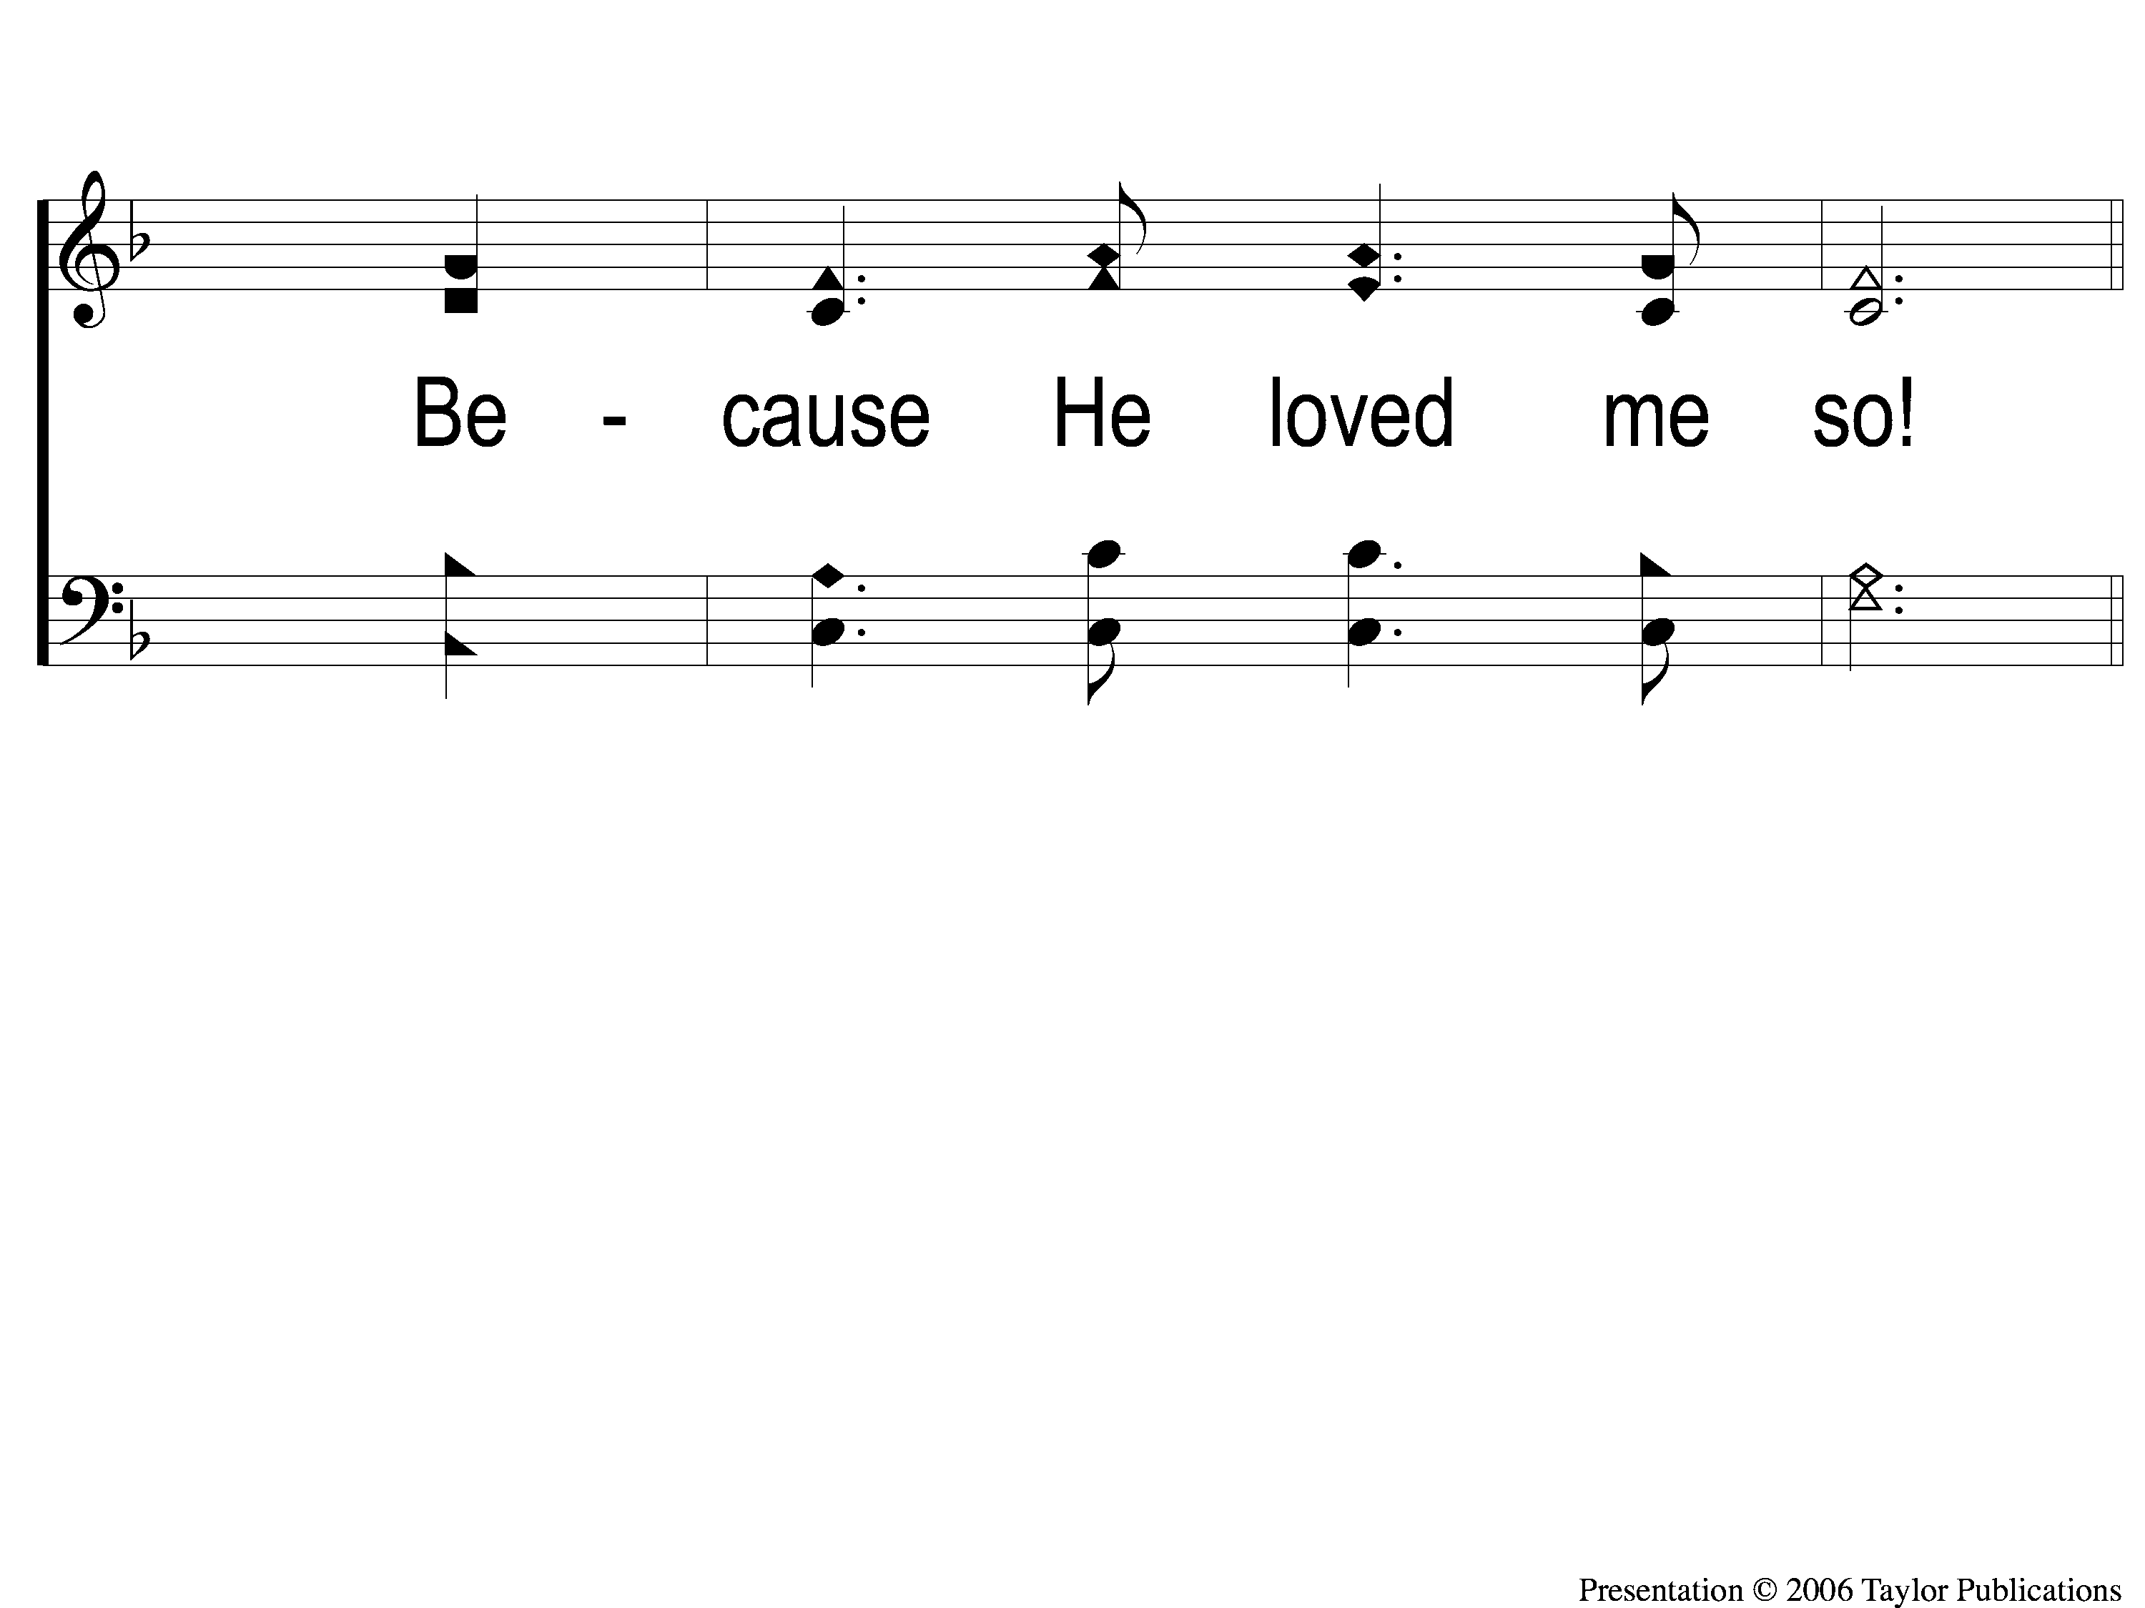
1-2 Why Did My Savior Come to Earth?
Why Did My Savior Come to Earth?
382

Slide 81
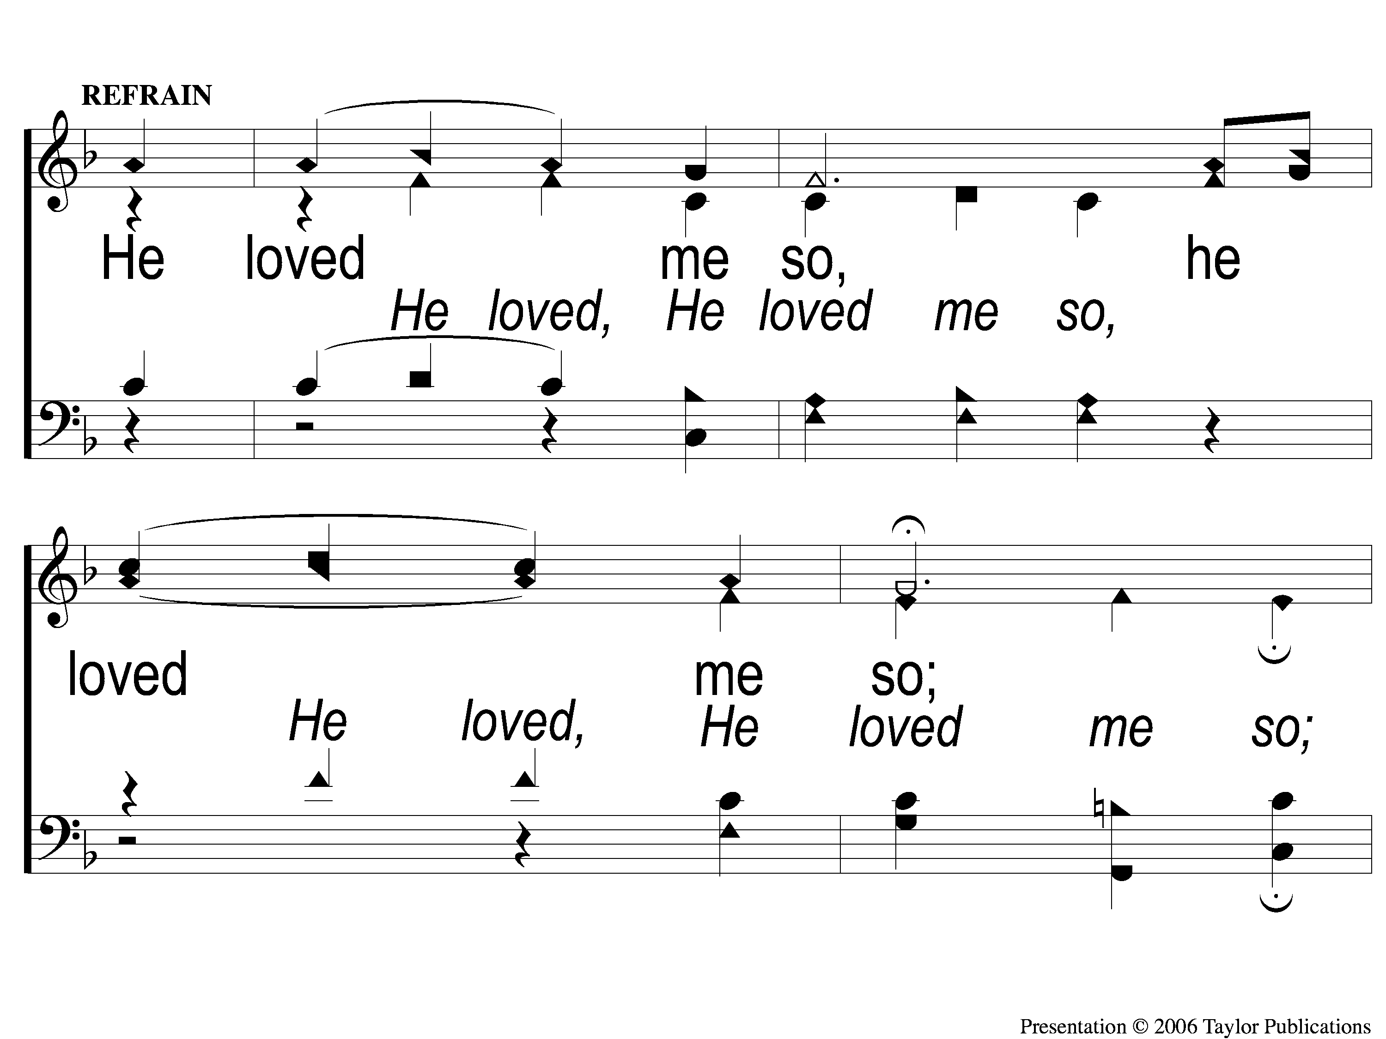
C-1 Why Did My Savior Come to Earth?
Why Did My Savior Come to Earth?
382

Slide 82
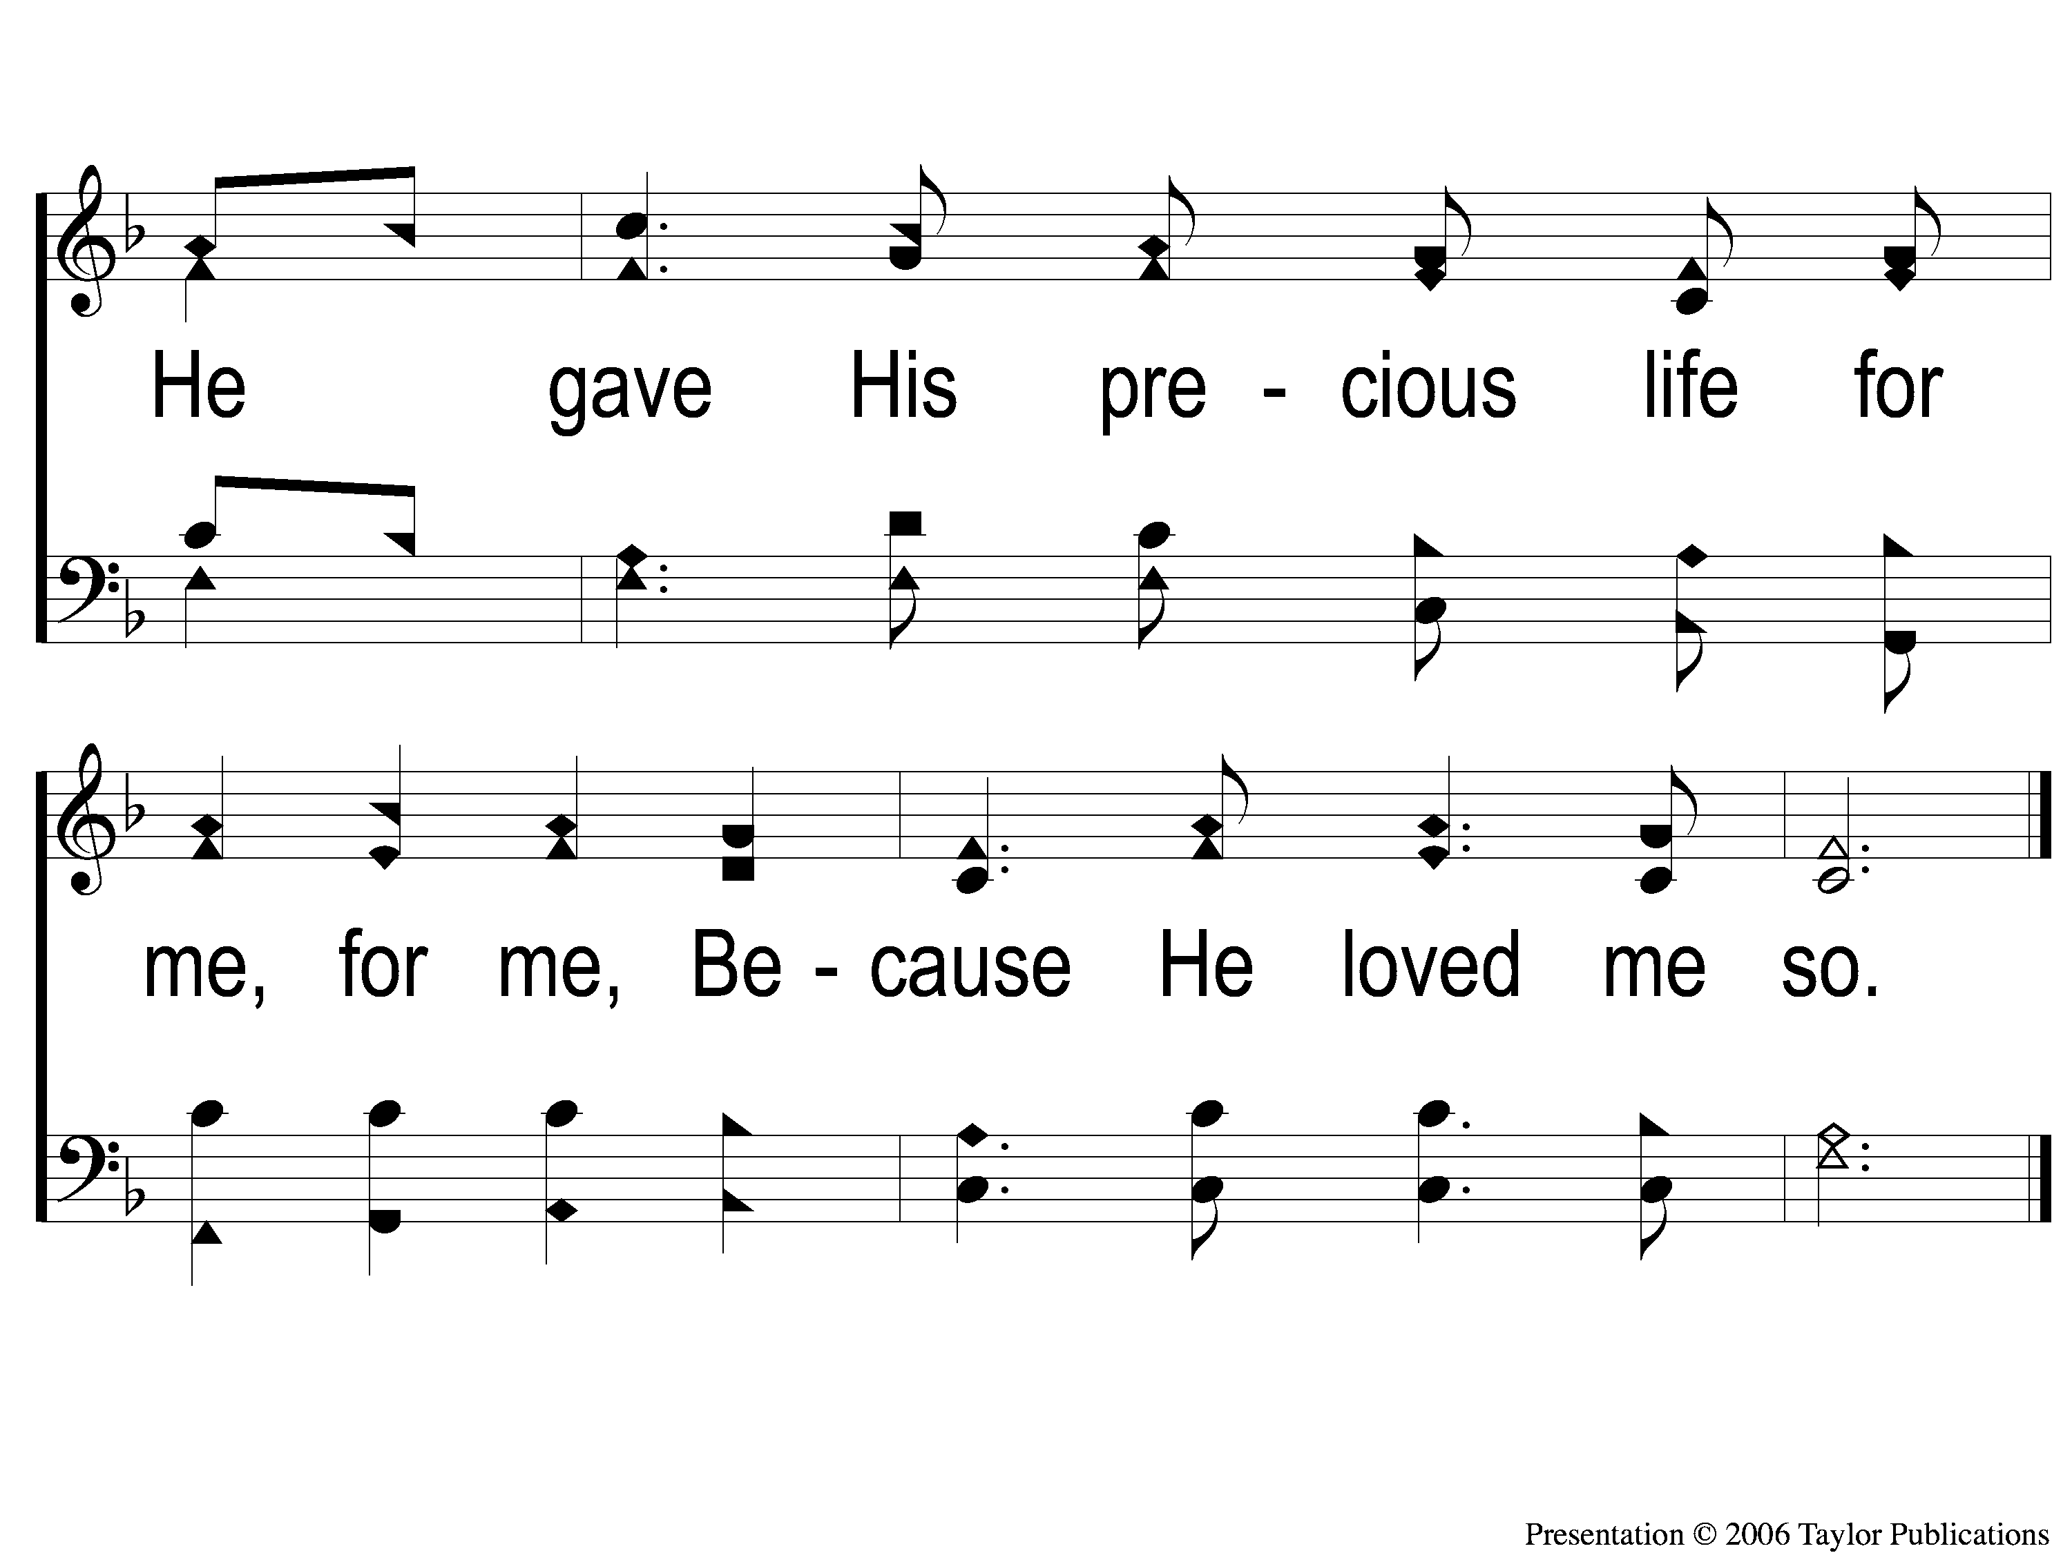
C-2 Why Did My Savior Come to Earth?
Why Did My Savior Come to Earth?
382

Slide 83
2-1 Why Did My Savior Come to Earth?
Why Did My Savior Come to Earth?
382

Slide 84
2-2 Why Did My Savior Come to Earth?
Why Did My Savior Come to Earth?
382

Slide 85
C-1 Why Did My Savior Come to Earth?
Why Did My Savior Come to Earth?
382

Slide 86
C-2 Why Did My Savior Come to Earth?
Why Did My Savior Come to Earth?
382

Slide 87
3-1 Why Did My Savior Come to Earth?
Why Did My Savior Come to Earth?
382

Slide 88
3-2 Why Did My Savior Come to Earth?
Why Did My Savior Come to Earth?
382

Slide 89
C-1 Why Did My Savior Come to Earth?
Why Did My Savior Come to Earth?
382

Slide 90
C-2 Why Did My Savior Come to Earth?
Why Did My Savior Come to Earth?
382

Slide 91
Our Contribution:
2 Corinthians 8:9
“For you know the grace of our Lord Jesus Christ, that though He was rich, yet for your sakes He became poor, that you through His poverty might become rich.”

Slide 92
Song:
Lamb Of God
#176

Slide 93
1-1 Lamb of God
Lamb of God
176

Slide 94
1-2 Lamb of God
Lamb of God
176

Slide 95
1-3 Lamb of God
Lamb of God
176

Slide 96
1-4 Lamb of God
Lamb of God
176

Slide 97
C-1 Lamb of God
Lamb of God
176

Slide 98
C-2 Lamb of God
Lamb of God
176

Slide 99
2-1 Lamb of God
Lamb of God
176

Slide 100
2-2 Lamb of God
Lamb of God
176

Slide 101
C-1 Lamb of God
Lamb of God
176

Slide 102
C-2 Lamb of God
Lamb of God
176

Slide 103
The Unleavened Bread
1 Corinthians 11:23-24
“For I received from the Lord that which I also delivered to you: that the Lord Jesus on the same night in which He was betrayed took bread; and when He had given thanks, He broke it and said, ‘Take, eat; this is My body which is broken for you; do this in remembrance of Me.’ In the same manner He also took the cup after supper, saying, ‘This cup is the new covenant in My blood. This do, as often as you drink it, in remembrance of Me.’ ”

Slide 104
The Fruit of the Vine
1 Corinthians 11:25-26
“In the same manner He also took the cup after supper, saying, ‘This cup is the new covenant in My blood. This do, as often as you drink it, in remembrance of Me.’ For as often as you eat this bread and drink this cup, you proclaim the Lord’s death till He comes.”

Slide 105
Closing Prayer

Slide 106
Song:
I Am Resolved
#948

Slide 107
1-1 I Am Resolved
I Am Resolved
948

Slide 108
1-2 I Am Resolved
I Am Resolved
948

Slide 109
C-1 I Am Resolved
I Am Resolved
948

Slide 110
C-2 I Am Resolved
I Am Resolved
948

Slide 111
3-1 I Am Resolved
I Am Resolved
948

Slide 112
3-2 I Am Resolved
I Am Resolved
948

Slide 113
C-1 I Am Resolved
I Am Resolved
948

Slide 114
C-2 I Am Resolved
I Am Resolved
948

Slide 115
4-1 I Am Resolved
I Am Resolved
948

Slide 116
4-2 I Am Resolved
I Am Resolved
948

Slide 117
C-1 I Am Resolved
I Am Resolved
948

Slide 118
C-2 I Am Resolved
I Am Resolved
948

Slide 119
RESTORE REBUILD RENEW
Wednesday
Worship & Bible Classes
@ 6:30 PM
IN 2022
WHEELER
CHURCH
OF
CHRIST

