Slide 1
1-1 Restore My Soul
Restore My Soul
567

Slide 2
1-2 Restore My Soul
Restore My Soul
567

Slide 3
2-1 Restore My Soul
Restore My Soul
567

Slide 4
2-2 Restore My Soul
Restore My Soul
567

Slide 5
3-1 Restore My Soul
Restore My Soul
567

Slide 6
3-2 Restore My Soul
Restore My Soul
567

Slide 7
WELCOME
To the Wheeler church of christ

Slide 8
SONG:
Home of the soul
#875

Slide 9
1-1 Home of the Soul
Home of the Soul
875

Slide 10
1-2 Home of the Soul
Home of the Soul
875

Slide 11
C-1 Home of the Soul
Home of the Soul
875

Slide 12
C-2 Home of the Soul
Home of the Soul
875

Slide 13
C-3 Home of the Soul
Home of the Soul
875

Slide 14
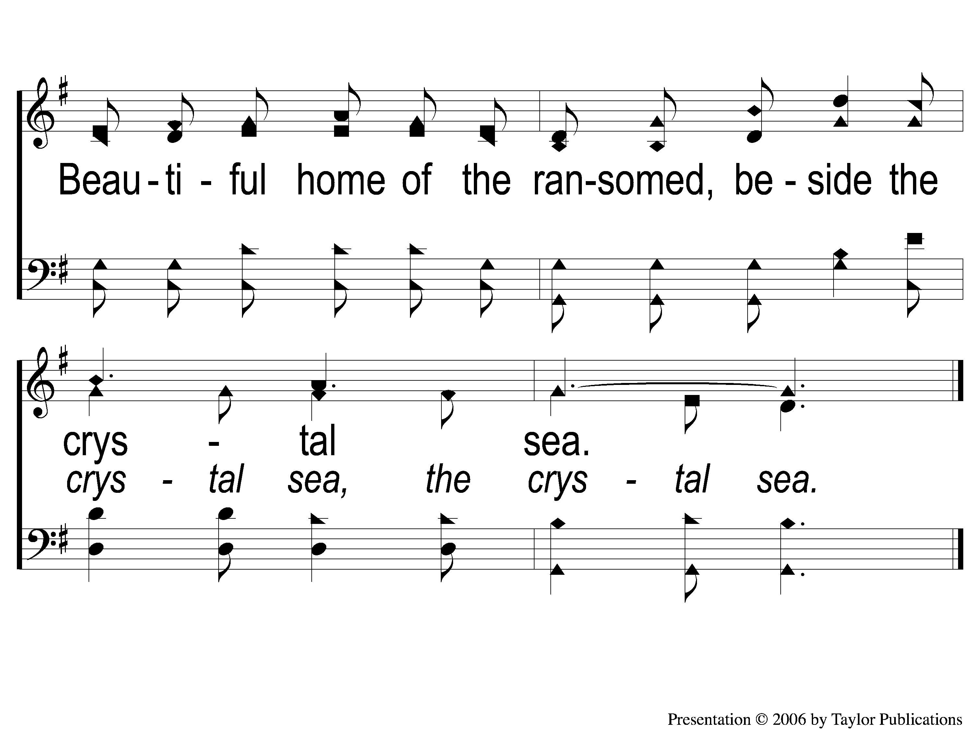
C-4 Home of the Soul
Home of the Soul
875

Slide 15
2-1 Home of the Soul
Home of the Soul
875

Slide 16
2-2 Home of the Soul
Home of the Soul
875

Slide 17
C-1 Home of the Soul
Home of the Soul
875

Slide 18
C-2 Home of the Soul
Home of the Soul
875

Slide 19
C-3 Home of the Soul
Home of the Soul
875

Slide 20
C-4 Home of the Soul
Home of the Soul
875

Slide 21
3-1 Home of the Soul
Home of the Soul
875

Slide 22
3-2 Home of the Soul
Home of the Soul
875

Slide 23
C-1 Home of the Soul
Home of the Soul
875

Slide 24
C-2 Home of the Soul
Home of the Soul
875

Slide 25
C-3 Home of the Soul
Home of the Soul
875

Slide 26
C-4 Home of the Soul
Home of the Soul
875

Slide 27
SONG:
Walking alone at eve
#874

Slide 28
1-1 Walking Alone at eve
Walking Alone At Eve
874

Slide 29
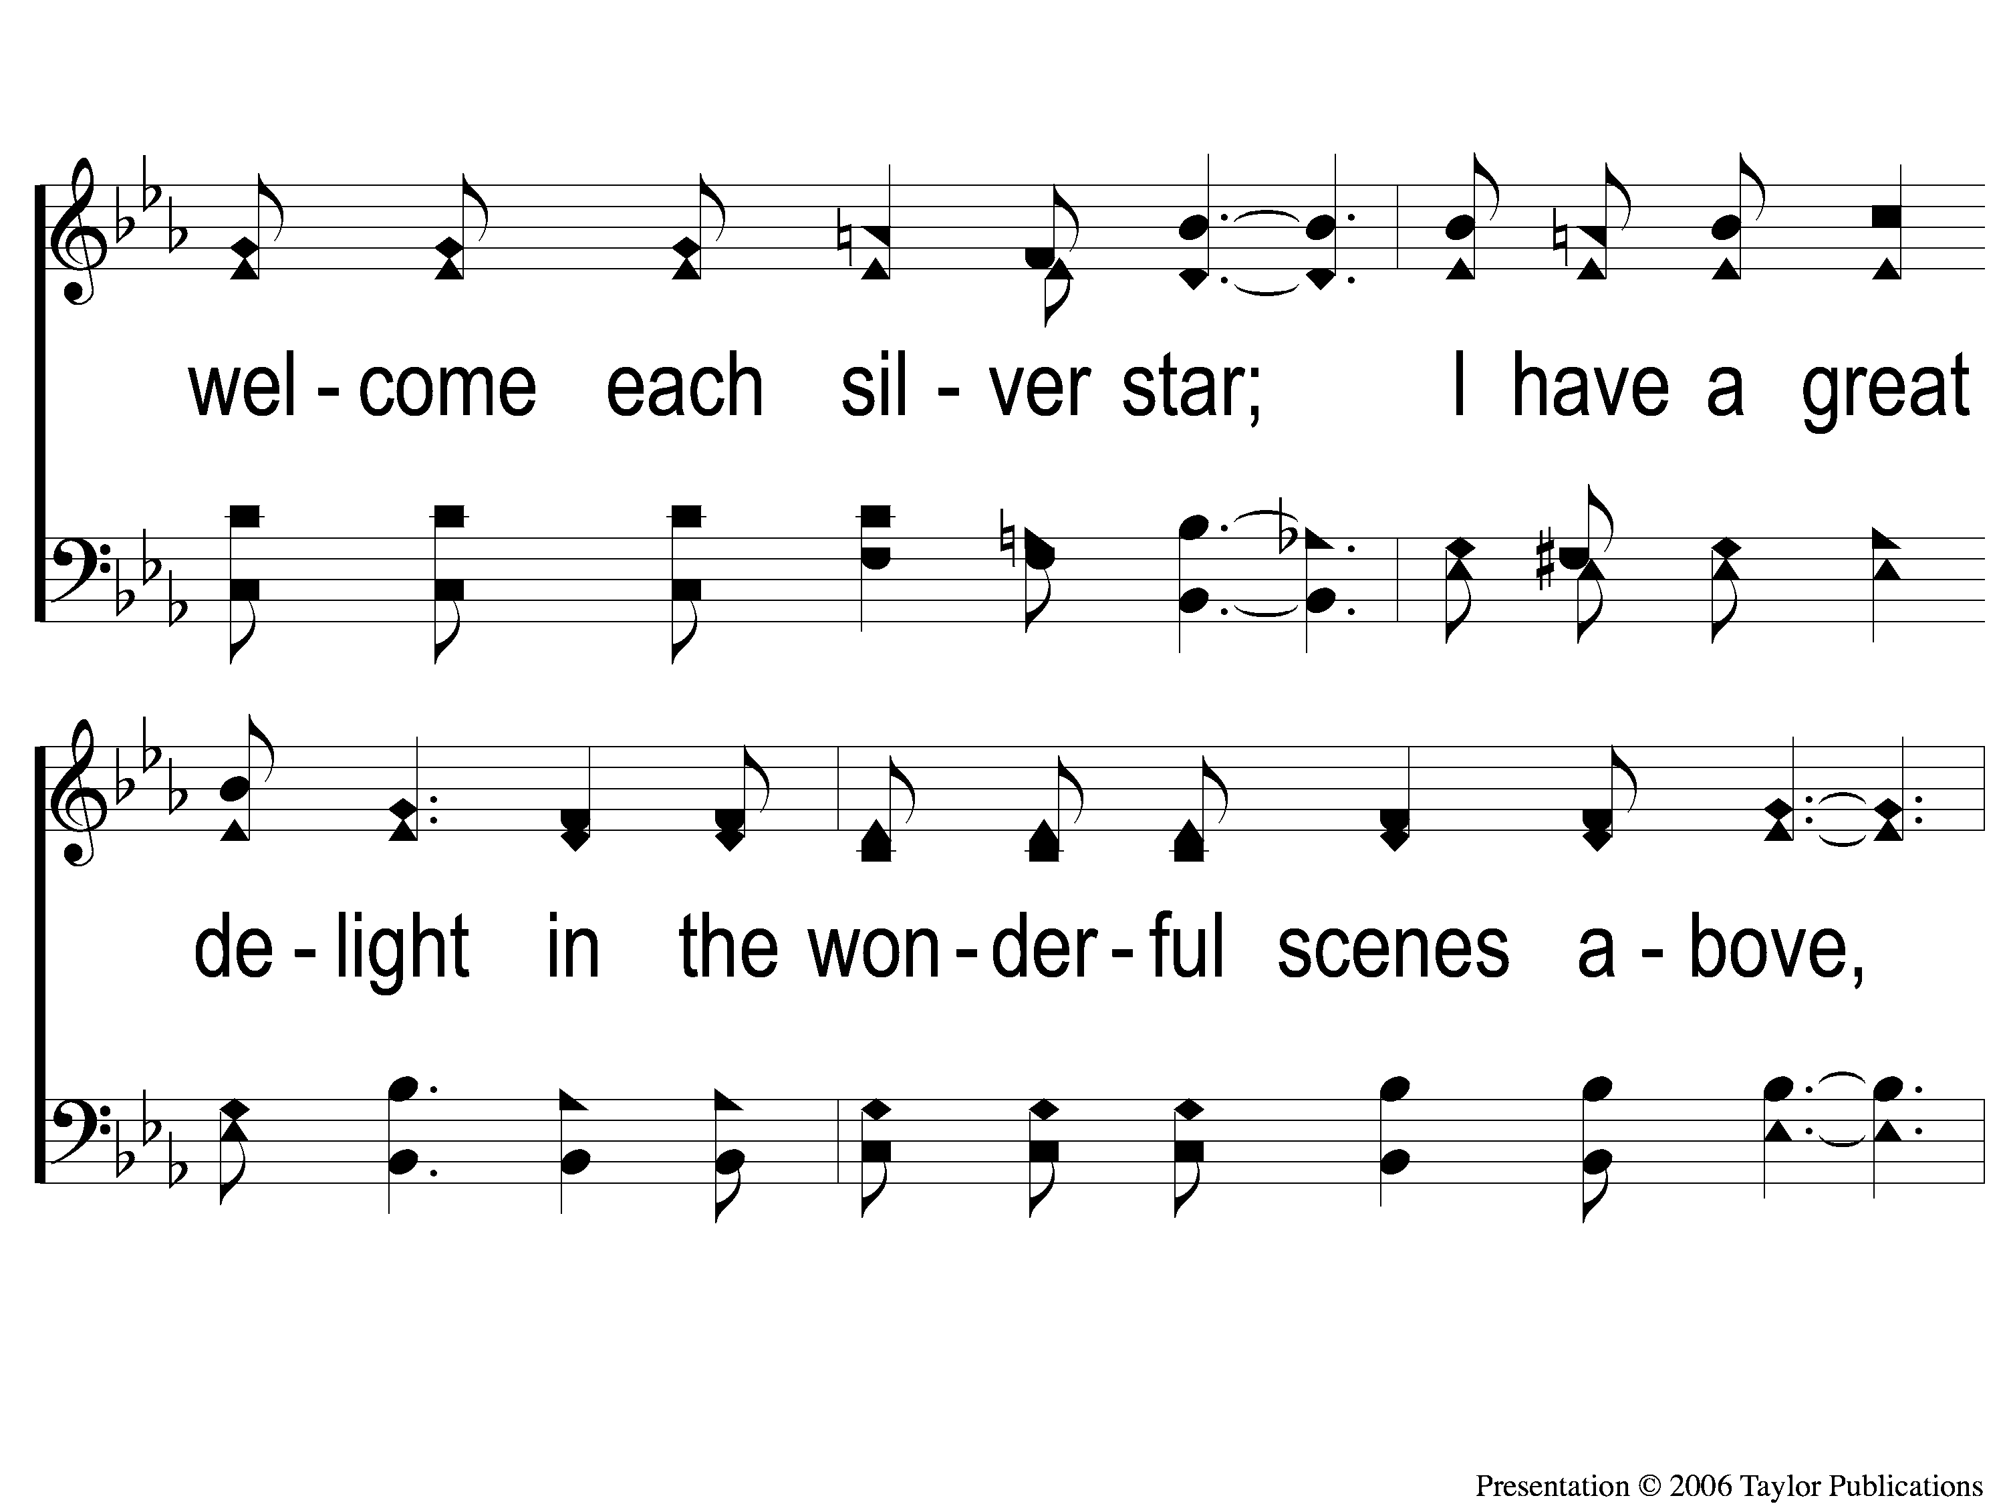
1-2 Walking Alone at eve
Walking Alone At Eve
874

Slide 30
1-3 Walking Alone at eve
Walking Alone At Eve
874

Slide 31
C-1 Walking Alone at eve
Walking Alone At Eve
874

Slide 32
C-2 Walking Alone at eve
Walking Alone At Eve
874

Slide 33
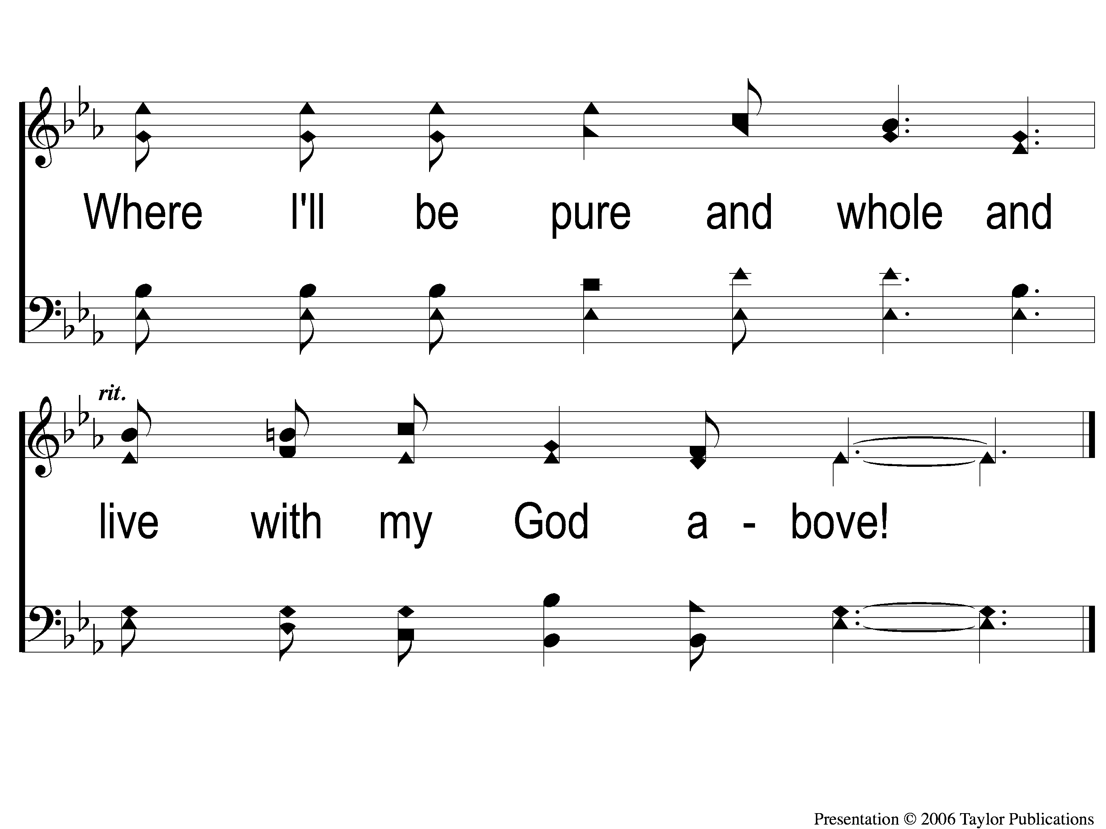
C-3 Walking Alone at eve
Walking Alone At Eve
874

Slide 34
2-1 Walking Alone at eve
Walking Alone At Eve
874

Slide 35
2-2 Walking Alone at eve
Walking Alone At Eve
874

Slide 36
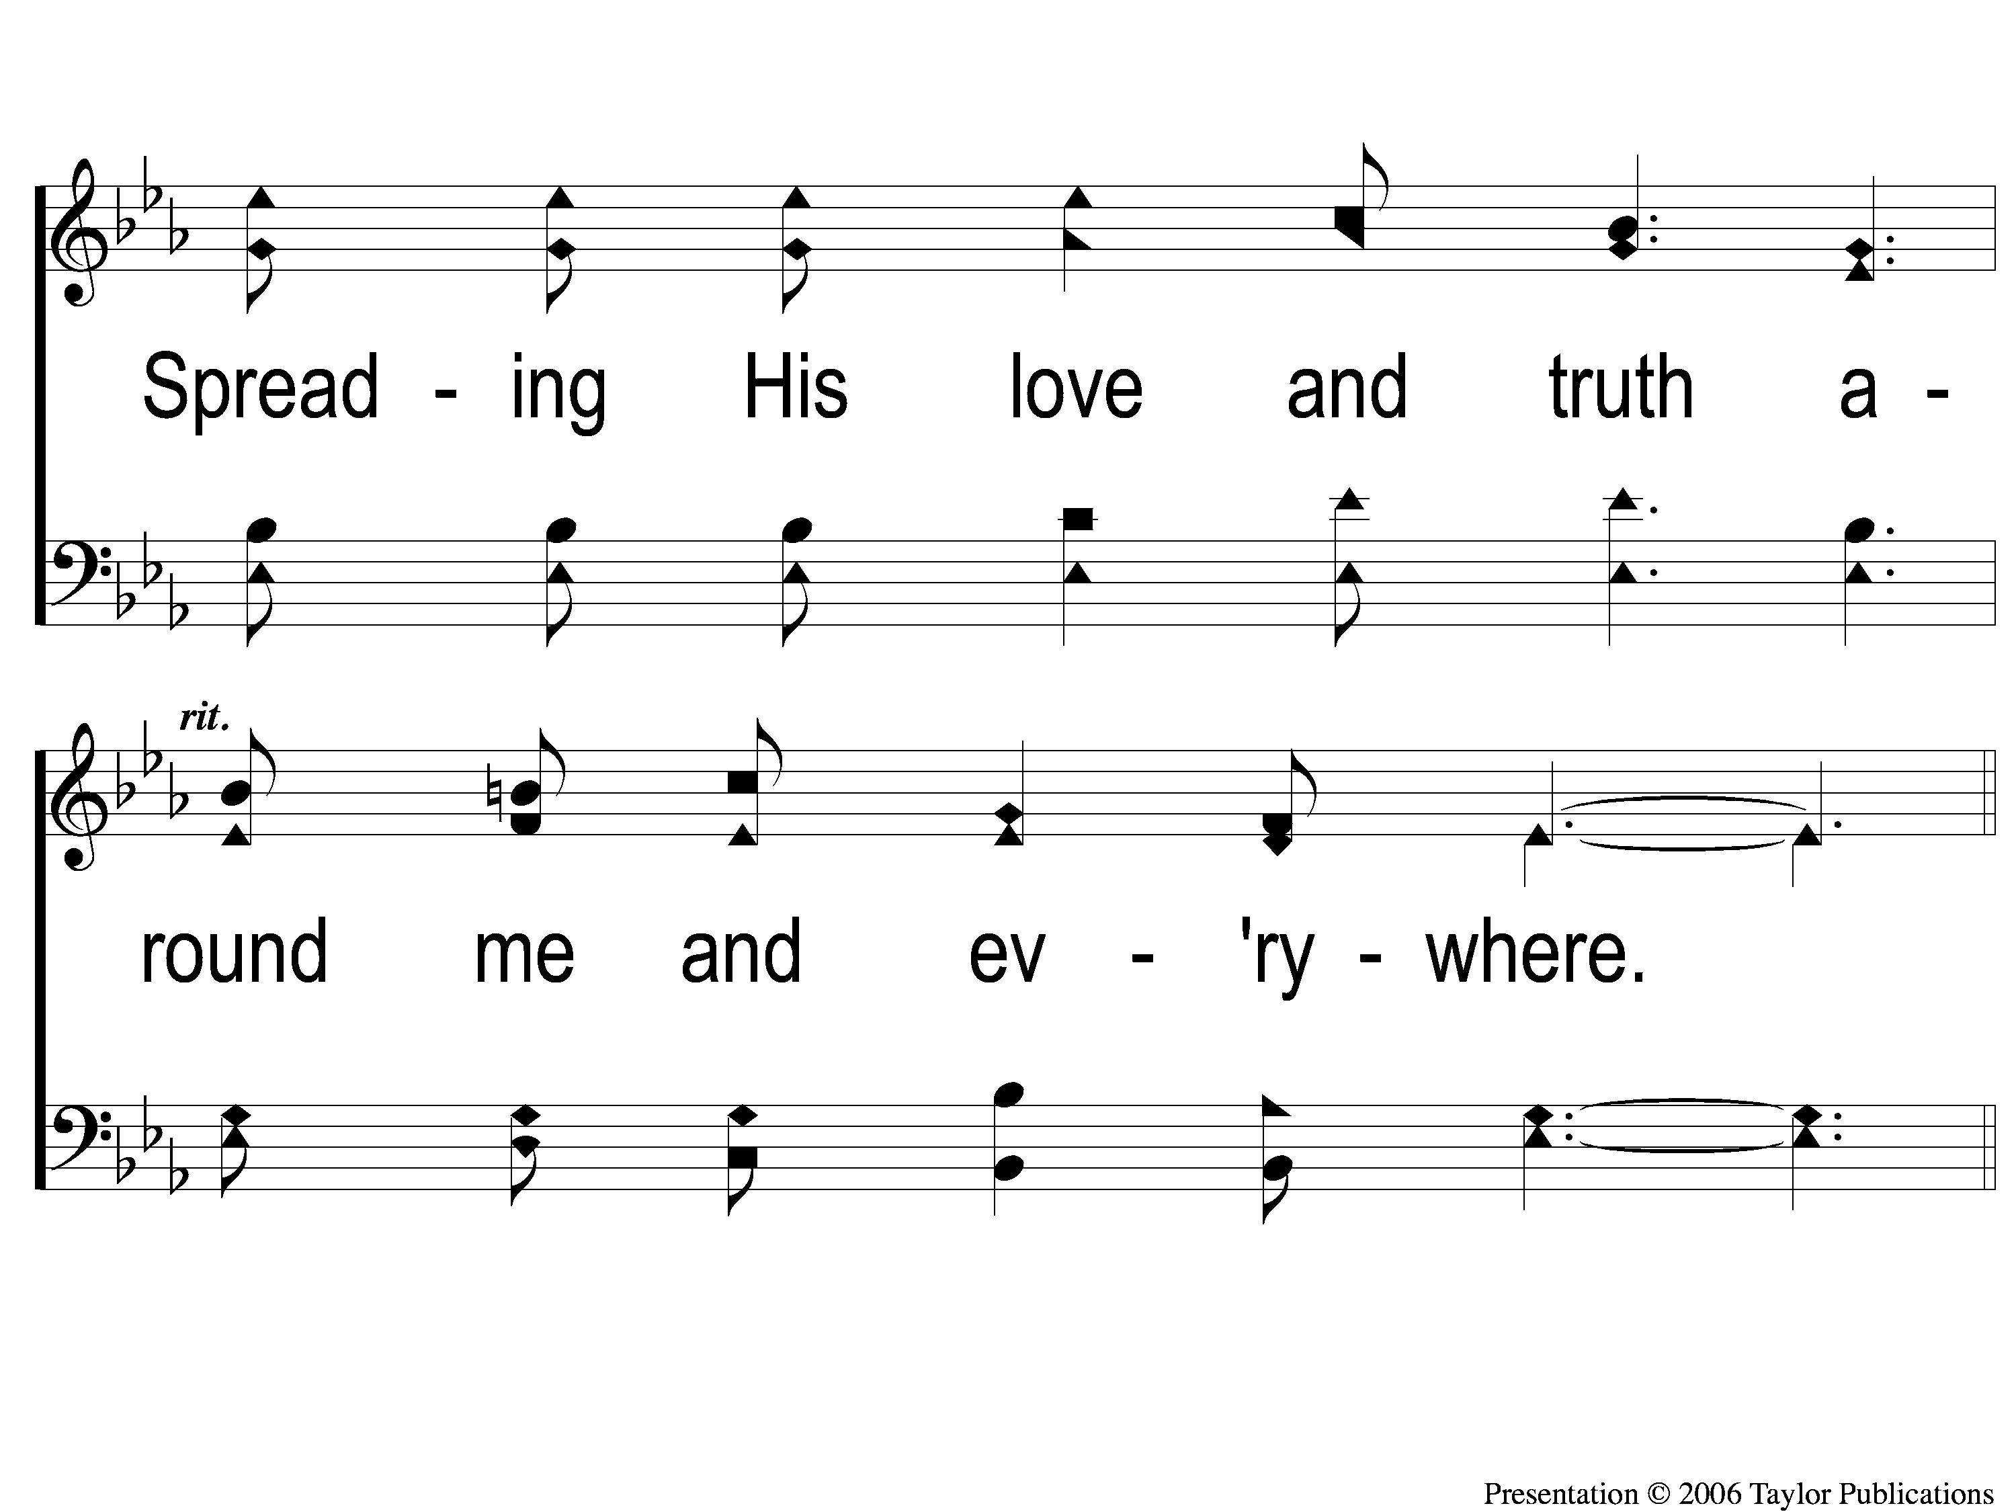
2-3 Walking Alone at eve
Walking Alone At Eve
874

Slide 37
C-1 Walking Alone at eve
Walking Alone At Eve
874

Slide 38
C-2 Walking Alone at eve
Walking Alone At Eve
874

Slide 39
C-3 Walking Alone at eve
Walking Alone At Eve
874

Slide 40
3-1 Walking Alone at eve
Walking Alone At Eve
874

Slide 41
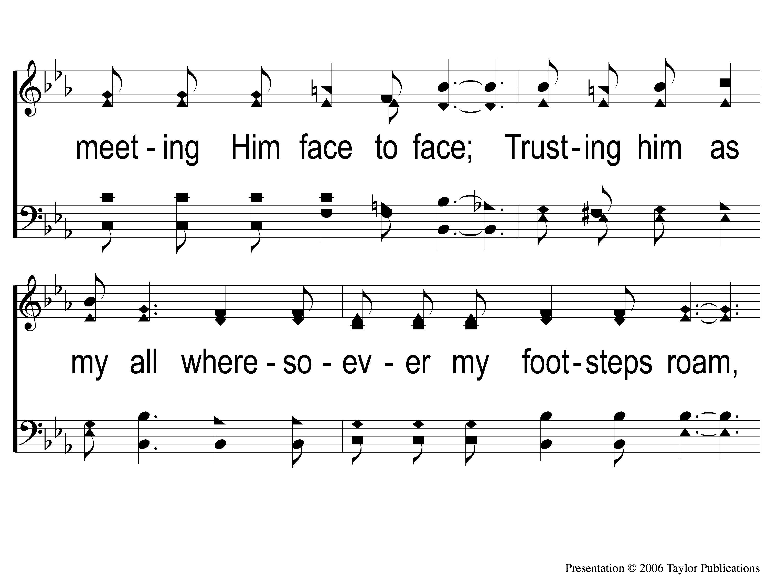
3-2 Walking Alone at eve
Walking Alone At Eve
874

Slide 42
3-3 Walking Alone at eve
Walking Alone At Eve
874

Slide 43
C-1 Walking Alone at eve
Walking Alone At Eve
874

Slide 44
C-2 Walking Alone at eve
Walking Alone At Eve
874

Slide 45
C-3 Walking Alone at eve
Walking Alone At Eve
874

Slide 46
OPENING PRAYER

Slide 47
SONG:
Nearer, still nearer
#478

Slide 48
1-1 Nearer Still Nearer
Nearer, Still Nearer
478

Slide 49
1-2 Nearer Still Nearer
Nearer, Still Nearer
478

Slide 50
2-1 Nearer Still Nearer
Nearer, Still Nearer
478

Slide 51
2-2 Nearer Still Nearer
Nearer, Still Nearer
478

Slide 52
4-1 Nearer Still Nearer
Nearer, Still Nearer
478

Slide 53
4-2 Nearer Still Nearer
Nearer, Still Nearer
478

Slide 54
SONG:
We have an anchor
#467

Slide 55
1-1 We Have an Anchor
We Have an Anchor
467

Slide 56
1-2 We Have an Anchor
We Have an Anchor
467

Slide 57
C-1 We Have an Anchor
We Have an Anchor
467

Slide 58
C-2 We Have an Anchor
We Have an Anchor
467

Slide 59
2-1 We Have an Anchor
We Have an Anchor
467

Slide 60
2-2 We Have an Anchor
We Have an Anchor
467

Slide 61
C-1 We Have an Anchor
We Have an Anchor
467

Slide 62
C-2 We Have an Anchor
We Have an Anchor
467

Slide 63
3-1 We Have an Anchor
We Have an Anchor
467

Slide 64
3-2 We Have an Anchor
We Have an Anchor
467

Slide 65
C-1 We Have an Anchor
We Have an Anchor
467

Slide 66
C-2 We Have an Anchor
We Have an Anchor
467

Slide 67
SCRIPTURE READING:
Matthew 16:24-26

Slide 68
IN PURSUIT
2023

Slide 69
IN PURSUIT
OF THE KINGDOM

Slide 70
IN PURSUIT
OF THE KINGDOM

Slide 71
IN PURSUIT
OF THE KING

Slide 72
What does it mean to pursue?
Dioko = to follow after
30 of 45 times translated “persecute”
“to do something with intense effort
and with a definite goal”

Slide 73
WHY SHOULD WE PURSUE JESUS?
HIS BEING

Slide 74
His BEING
“When Jesus came into the region of Caesarea Philippi, He asked His disciples, saying,
‘Who do men say that I, the Son of Man, am?”
– Matt. 16:13

Slide 75
His BEING
1:1, 17 – the Messiah
2:2 – king of the jews
2:23 - the “Nazarene”
3:17 – god’s beloved son
4:1-3 – conqueror
9:6 – forgiver of sins
9:13 – ate with sinners
9:35 – great physician
12:8 – lord of the sabbath

Slide 76
His BEING
1:1, 17 – the Messiah
2:2 – king of the jews
2:23 - the “Nazarene”
3:17 – god’s beloved son
4:1-3 – conqueror
9:6 – forgiver of sins
9:13 – ate with sinners
9:35 – great physician
12:8 – lord of the sabbath
15:24 – the good shepherd
16:16 – the son of god
16:18 – the head of his church
17:5 – the prophet
19:16 - the “good teacher”
21:42 – the chief cornerstone
22:45 – lord & son of David
28:18 – given all authority

Slide 77
WHY SHOULD WE PURSUE JESUS?
HIS BEING
HIS TEACHING

Slide 78
His teaching
5 teaching sections:
5-7 – kingdom people
10 – kingdom purpose
13 – kingdom priority
18 – kingdom principles
23-25 – kingdom pending

Slide 79
His teaching
What he taught:
The gospel of the kingdom – Matt. 10:7, 11:1, 5

Slide 80
His teaching
What he taught:
The gospel of the kingdom – Matt. 10:7, 11:1, 5
The truth – Matt. 22:16, Jn. 1:17, 8:26, 46

Slide 81
His teaching
Who he taught:
Those who listened – Matt. 22:33, Mk. 12:37

Slide 82
His teaching
Who he taught:
Those who listened – Matt. 22:33, Mk. 12:37
Those who did not listen – Matt. 13:15, 23:13ff

Slide 83
His teaching
how he taught:
With Questions – Matt. 5:46-47, 6:27-28, 21:24-27

Slide 84
His teaching
how he taught:
With Questions – Matt. 5:46-47, 6:27-28, 21:24-27
With silence – Jn. 8:6, Matt. 26:62-63

Slide 85
His teaching
how he taught:
With Questions – Matt. 5:46-47, 6:27-28, 21:24-27
With silence – Jn. 8:6, Matt. 26:62-63
With authority – Matt. 7:28-29, 13:54-55, 19:25, 22:33

Slide 86
WHY SHOULD WE PURSUE JESUS?
HIS BEING
HIS TEACHING
HIS DOING

Slide 87
His doing
HIS LIFE – ACTS 10:38, 2 COR. 5:21

Slide 88
His doing
HIS LIFE – ACTS 10:38, 2 COR. 5:21
HIS DEATH – Jn. 8:21, Rom. 3:24-25, 1 Cor. 15:3

Slide 89
His doing
HIS LIFE – ACTS 10:38, 2 COR. 5:21
HIS DEATH – Jn. 8:21, Rom. 3:24-25, 1 Cor. 15:3
HIS BURIAL – 1 Cor. 15:4, Matt. 27:57-61

Slide 90
His doing
HIS LIFE – ACTS 10:38, 2 COR. 5:21
HIS DEATH – Jn. 8:21, Rom. 3:24-25, 1 Cor. 15:3
HIS BURIAL – 1 Cor. 15:4, Matt. 27:57-61
HIS RESURRECTION – Matt. 28:1-6, LK. 24:50-51

Slide 91
how SHOULD WE PURSUE JESUS?

Slide 92
how SHOULD WE PURSUE JESUS?
Not like herod
Not like the pharisees & scribes
Not like the material-minded

Slide 93
Are you IN PURSUIT
Of the king?

Slide 94
Invitation SONG:
There’s a fountain free
#909

Slide 95
1-1 There’s A Fountain free
There’s A Fountain Free
909

Slide 96
1-2 There’s A Fountain free
There’s A Fountain Free
909

Slide 97
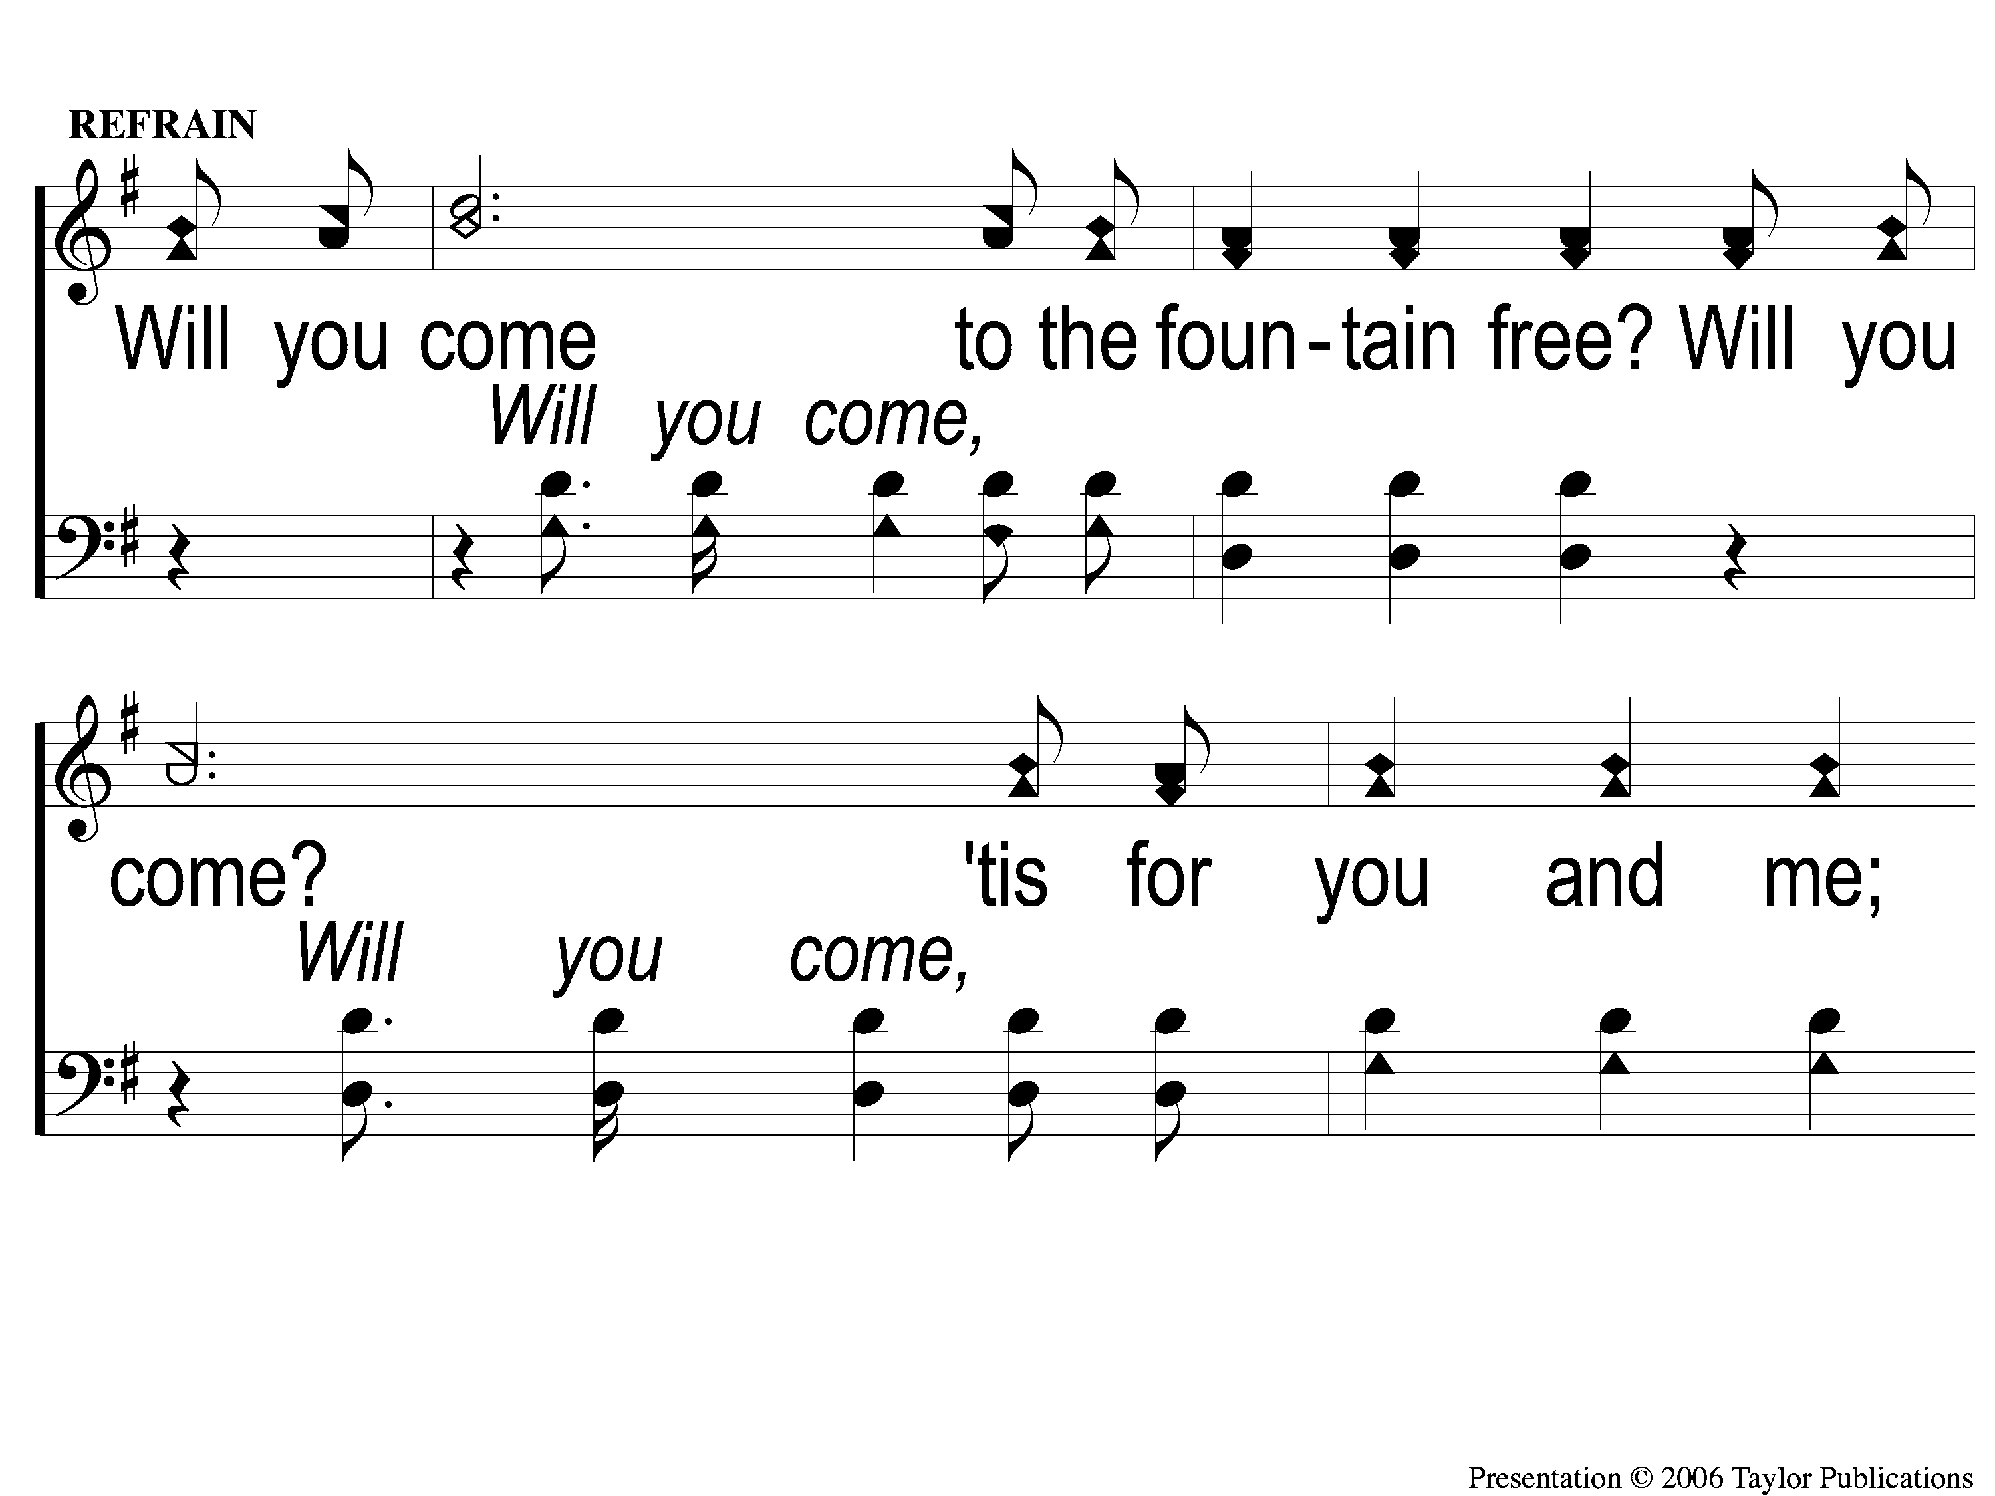
C-1 There’s A Fountain free
There’s A Fountain Free
909

Slide 98
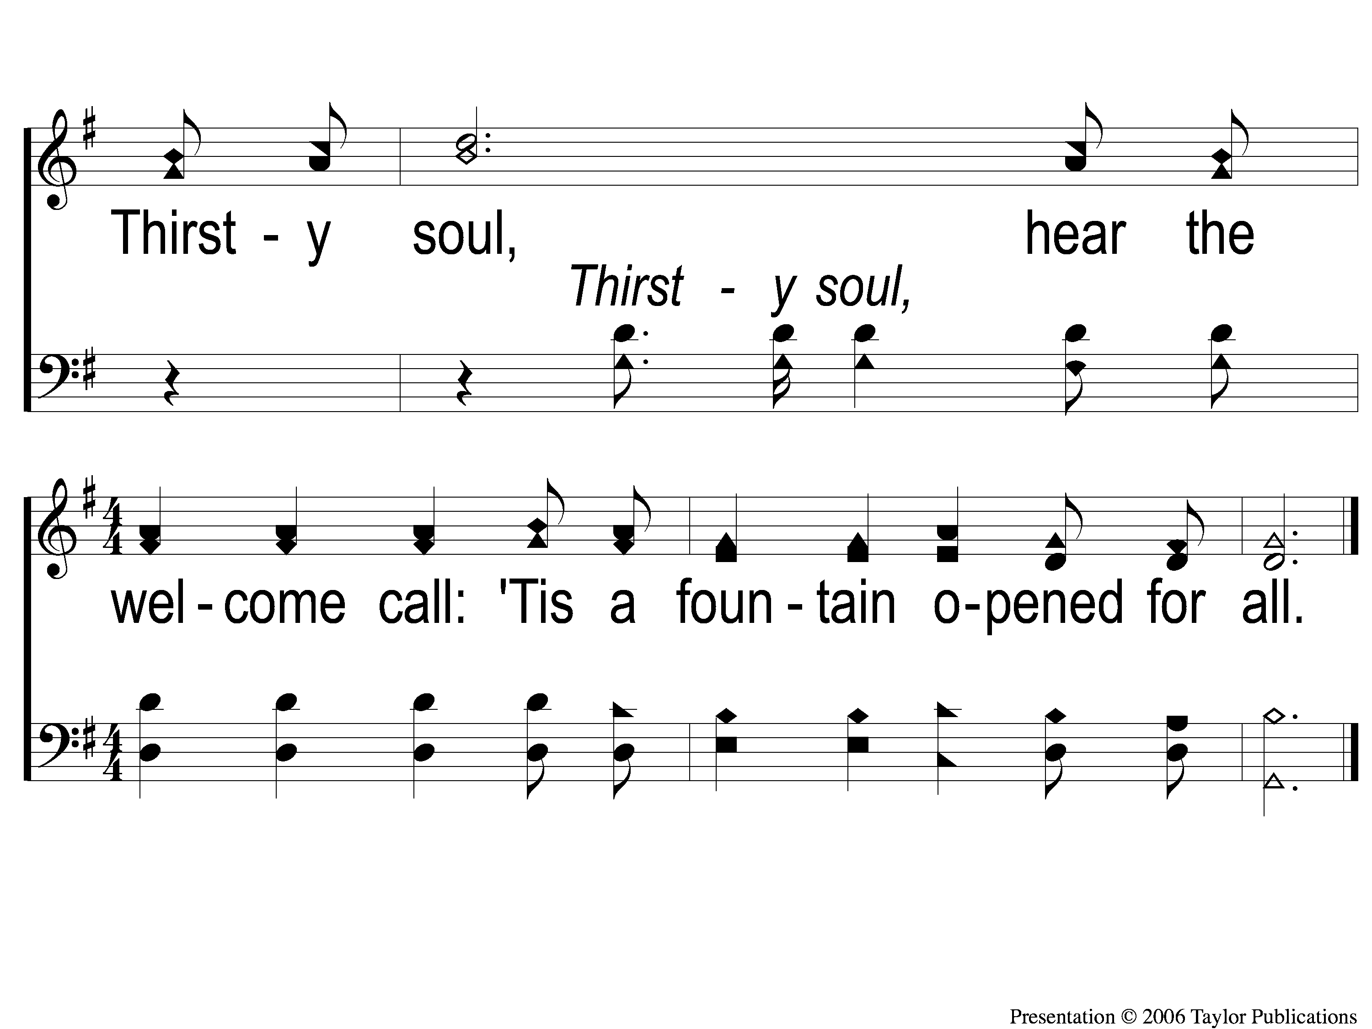
C-2 There’s A Fountain free
There’s A Fountain Free
909

Slide 99
3-1 There’s A Fountain free
There’s A Fountain Free
909

Slide 100
3-2 There’s A Fountain free
There’s A Fountain Free
909

Slide 101
C-1 There’s A Fountain free
There’s A Fountain Free
909

Slide 102
C-2 There’s A Fountain free
There’s A Fountain Free
909

Slide 103
OUR CONTRIBUTION:
6The point is this: whoever sows sparingly will also reap sparingly, and whoever sows bountifully will also reap bountifully. 7 Each one must give as he has decided in his heart, not reluctantly or under compulsion, for God loves a cheerful giver. 8 And God is able to make all grace abound to you, so that having all sufficiency in all things at all times, you may abound in every good work.

Slide 104
OUR CONTRIBUTION
“The point is this: whoever sows sparingly will also reap sparingly, and whoever sows bountifully will also reap bountifully. Each one must give as he has decided in his heart, not reluctantly or under compulsion, for God loves a cheerful giver. And God is able to make all grace abound to you, so that having all sufficiency in all things at all times, you may abound in every good work.” – 2 Cor. 9:6-8

Slide 105
SONG:
Hallelujah! What a savior
#337

Slide 106
1-1 Hallelujah What A Savior
Hallelujah! What A Savior
337

Slide 107
1-2 Hallelujah What A Savior
Hallelujah! What A Savior
337

Slide 108
2-1 Hallelujah What A Savior
Hallelujah! What A Savior
337

Slide 109
2-2 Hallelujah What A Savior
Hallelujah! What A Savior
337

Slide 110
3-1 Hallelujah What A Savior
Hallelujah! What A Savior
337

Slide 111
3-2 Hallelujah What A Savior
Hallelujah! What A Savior
337

Slide 112
4-1 Hallelujah What A Savior
Hallelujah! What A Savior
337

Slide 113
4-2 Hallelujah What A Savior
Hallelujah! What A Savior
337

Slide 114
5-1 Hallelujah What A Savior
Hallelujah! What A Savior
337

Slide 115
5-2 Hallelujah What A Savior
Hallelujah! What A Savior
337

Slide 116
THE UNLEAVENED BREAD
“Therefore, as through one man’s offense judgment came to all men, resulting in condemnation, even so through one Man’s righteous act the free gift came to all men, resulting in justification of life. 19 For as by one man’s disobedience many were made sinners, so also by one Man’s obedience many will be made righteous.” – Rom. 5:18-19

Slide 117
THE FRUIT OF THE VINE
“Since, therefore, we have now been justified by his blood, much more shall we be saved by him from the wrath of God. For if while we were enemies we were reconciled to God by the death of his Son, much more, now that we are reconciled, shall we be saved by his life. More than that, we also rejoice in God through our Lord Jesus Christ, through whom we have now received reconciliation.” – Rom. 5:9-11

Slide 118
closing PRAYER

Slide 119
SONG:
Listen to our hearts
#810

Slide 120
1-1 Listen to our Hearts
Listen To Our Hearts
810

Slide 121
1-2 Listen to our Hearts
Listen To Our Hearts
810

Slide 122
1-3 Listen to our Hearts
Listen To Our Hearts
810

Slide 123
C-1 Listen to our Hearts
Listen To Our Hearts
810

Slide 124
C-2 Listen to our Hearts
Listen To Our Hearts
810

Slide 125
C-3 Listen to our Hearts
Listen To Our Hearts
810

Slide 126
C-4 Listen to our Hearts
Listen To Our Hearts
810

Slide 127
2-1 Listen to our Hearts
Listen To Our Hearts
810

Slide 128
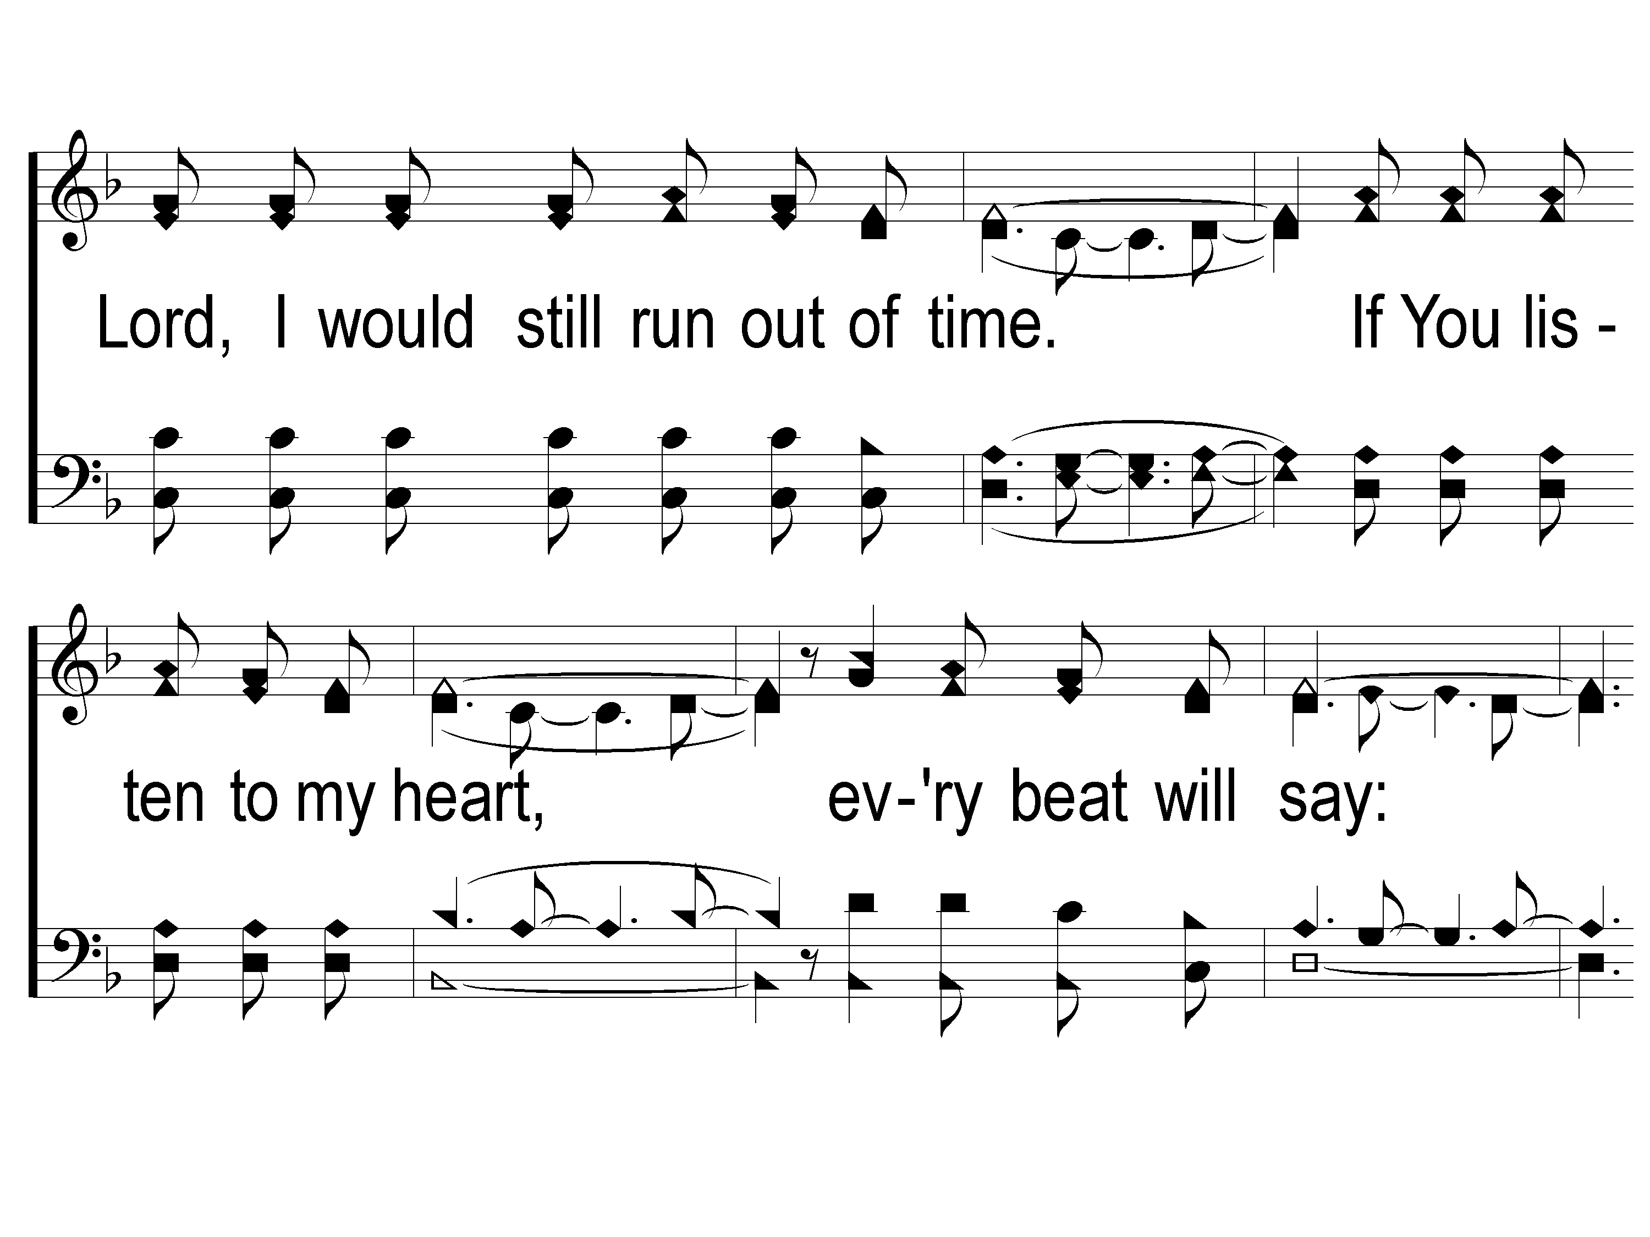
2-2 Listen to our Hearts
Listen To Our Hearts
810

Slide 129
2-3 Listen to our Hearts
Listen To Our Hearts
810

Slide 130
C-1 Listen to our Hearts
Listen To Our Hearts
810

Slide 131
C-2 Listen to our Hearts
Listen To Our Hearts
810

Slide 132
C-3 Listen to our Hearts
Listen To Our Hearts
810

Slide 133
C-4 Listen to our Hearts
Listen To Our Hearts
810

Slide 134
Today
Join us for a Meal in the mpb
Wednesday
LTC @ 5:30
Worship & Bible classes @ 6:30

