Slide 1
1-1 Just A Little Talk With Jesus
Just A Little Talk With Jesus
959

Slide 2
1-2 Just A Little Talk With Jesus
Just A Little Talk With Jesus
959

Slide 3
C-1 Just A Little Talk With Jesus
Just A Little Talk With Jesus
959

Slide 4
C-2 Just A Little Talk With Jesus
Just A Little Talk With Jesus
959

Slide 5
C-3 Just A Little Talk With Jesus
Just A Little Talk With Jesus
959

Slide 6
3-1 Just A Little Talk With Jesus
Just A Little Talk With Jesus
959

Slide 7
3-2 Just A Little Talk With Jesus
Just A Little Talk With Jesus
959

Slide 8
C-1 Just A Little Talk With Jesus
Just A Little Talk With Jesus
959

Slide 9
C-2 Just A Little Talk With Jesus
Just A Little Talk With Jesus
959

Slide 10
C-3 Just A Little Talk With Jesus
Just A Little Talk With Jesus
959

Slide 11
WELCOME
To the Wheeler church of Christ

Slide 12
SONG:
I will call upon the lord
#63

Slide 13
1 I Will Call Upon the Lord
I Will Call Upon the Lord
63

Slide 14
2 I Will Call Upon the Lord
I Will Call Upon the Lord
63

Slide 15
3 I Will Call Upon the Lord
I Will Call Upon the Lord
63

Slide 16
4 I Will Call Upon the Lord
I Will Call Upon the Lord
63

Slide 17
DC1 I Will Call Upon the Lord
I Will Call Upon the Lord
63

Slide 18
DC2 I Will Call Upon the Lord
I Will Call Upon the Lord
63

Slide 19
DC3 I Will Call Upon the Lord
I Will Call Upon the Lord
63

Slide 20
DC4 I Will Call Upon the Lord
I Will Call Upon the Lord
63

Slide 21
tag I Will Call Upon the Lord
I Will Call Upon the Lord
63

Slide 22
SONG:
there is a habitation
#860

Slide 23
1 There is a Habitation
There Is A Habitation
860

Slide 24
c There is a Habitation
There Is A Habitation
860

Slide 25
2 There is a Habitation
There Is A Habitation
860

Slide 26
c There is a Habitation
There Is A Habitation
860

Slide 27
4 There is a Habitation
There Is A Habitation
860

Slide 28
c There is a Habitation
There Is A Habitation
860

Slide 29
OPENING PRAYER

Slide 30
SONG:
The battle belongs to the lord
#749

Slide 31
1-1 The Battle Belongs to the Lord
The Battle Belongs to the Lord
749

Slide 32
1-2 The Battle Belongs to the Lord
The Battle Belongs to the Lord
749

Slide 33
C-1 The Battle Belongs to the Lord
The Battle Belongs to the Lord
749

Slide 34
C-2 The Battle Belongs to the Lord
The Battle Belongs to the Lord
749

Slide 35
2-1 The Battle Belongs to the Lord
The Battle Belongs to the Lord
749

Slide 36
2-2 The Battle Belongs to the Lord
The Battle Belongs to the Lord
749

Slide 37
C-1 The Battle Belongs to the Lord
The Battle Belongs to the Lord
749

Slide 38
C-2 The Battle Belongs to the Lord
The Battle Belongs to the Lord
749

Slide 39
3-1 The Battle Belongs to the Lord
The Battle Belongs to the Lord
749

Slide 40
3-2 The Battle Belongs to the Lord
The Battle Belongs to the Lord
749

Slide 41
C-1 The Battle Belongs to the Lord
The Battle Belongs to the Lord
749

Slide 42
C-2 The Battle Belongs to the Lord
The Battle Belongs to the Lord
749

Slide 43
SONG:
Victory in jesus
#470

Slide 44
1-1 Victory in Jesus
Victory in Jesus
470

Slide 45
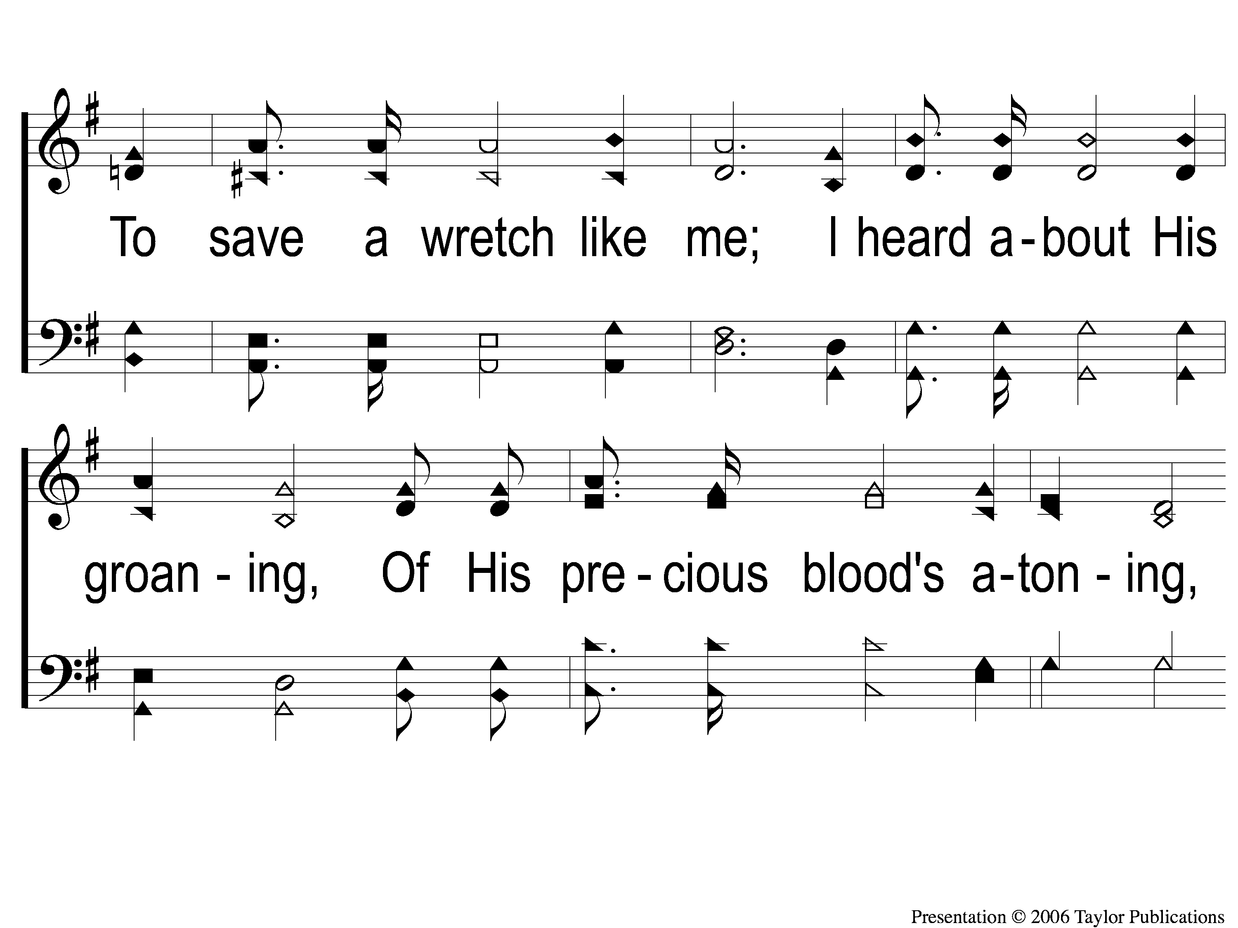
1-2 Victory in Jesus
Victory in Jesus
470

Slide 46
1-3 Victory in Jesus
Victory in Jesus
470

Slide 47
C-1 Victory in Jesus
Victory in Jesus
470

Slide 48
C-2 Victory in Jesus
Victory in Jesus
470

Slide 49
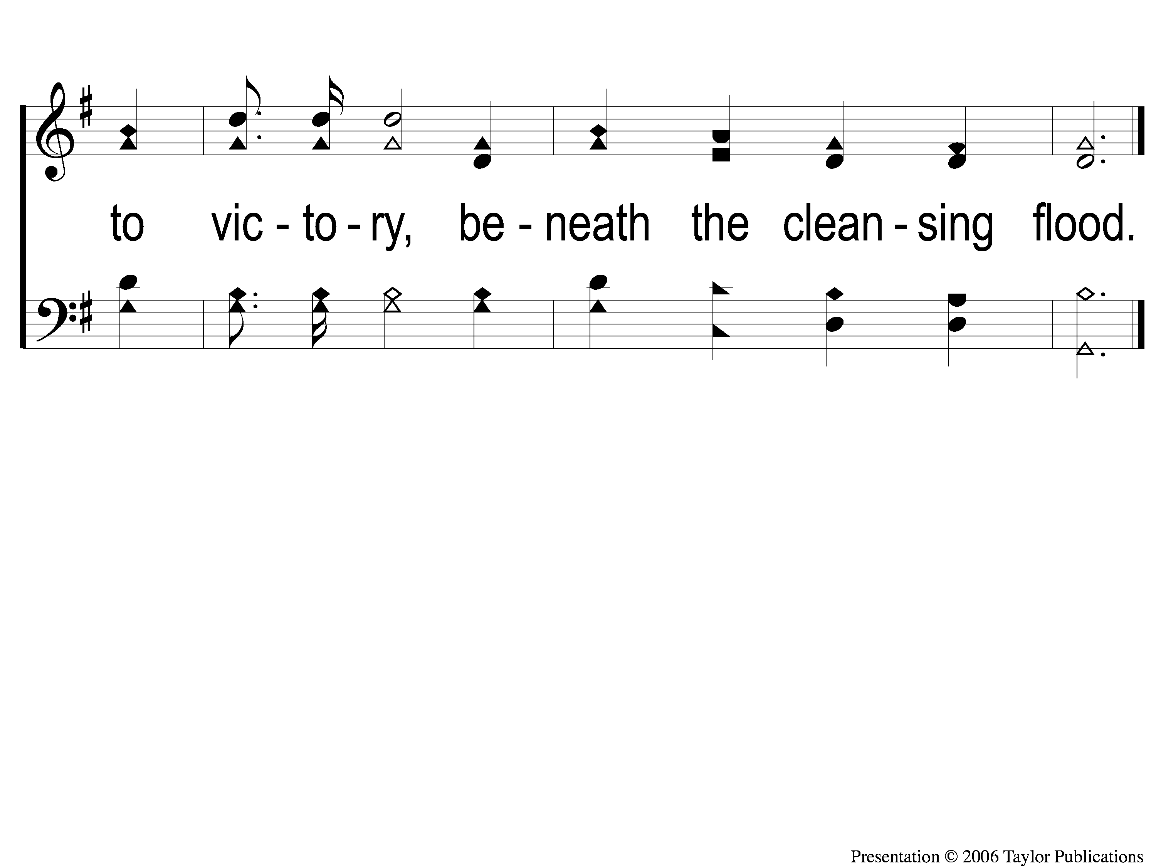
C-3 Victory in Jesus
Victory in Jesus
470

Slide 50
2-1 Victory in Jesus
Victory in Jesus
470

Slide 51
2-2 Victory in Jesus
Victory in Jesus
470

Slide 52
2-3 Victory in Jesus
Victory in Jesus
470

Slide 53
C-1 Victory in Jesus
Victory in Jesus
470

Slide 54
C-2 Victory in Jesus
Victory in Jesus
470

Slide 55
C-3 Victory in Jesus
Victory in Jesus
470

Slide 56
3-1 Victory in Jesus
Victory in Jesus
470

Slide 57
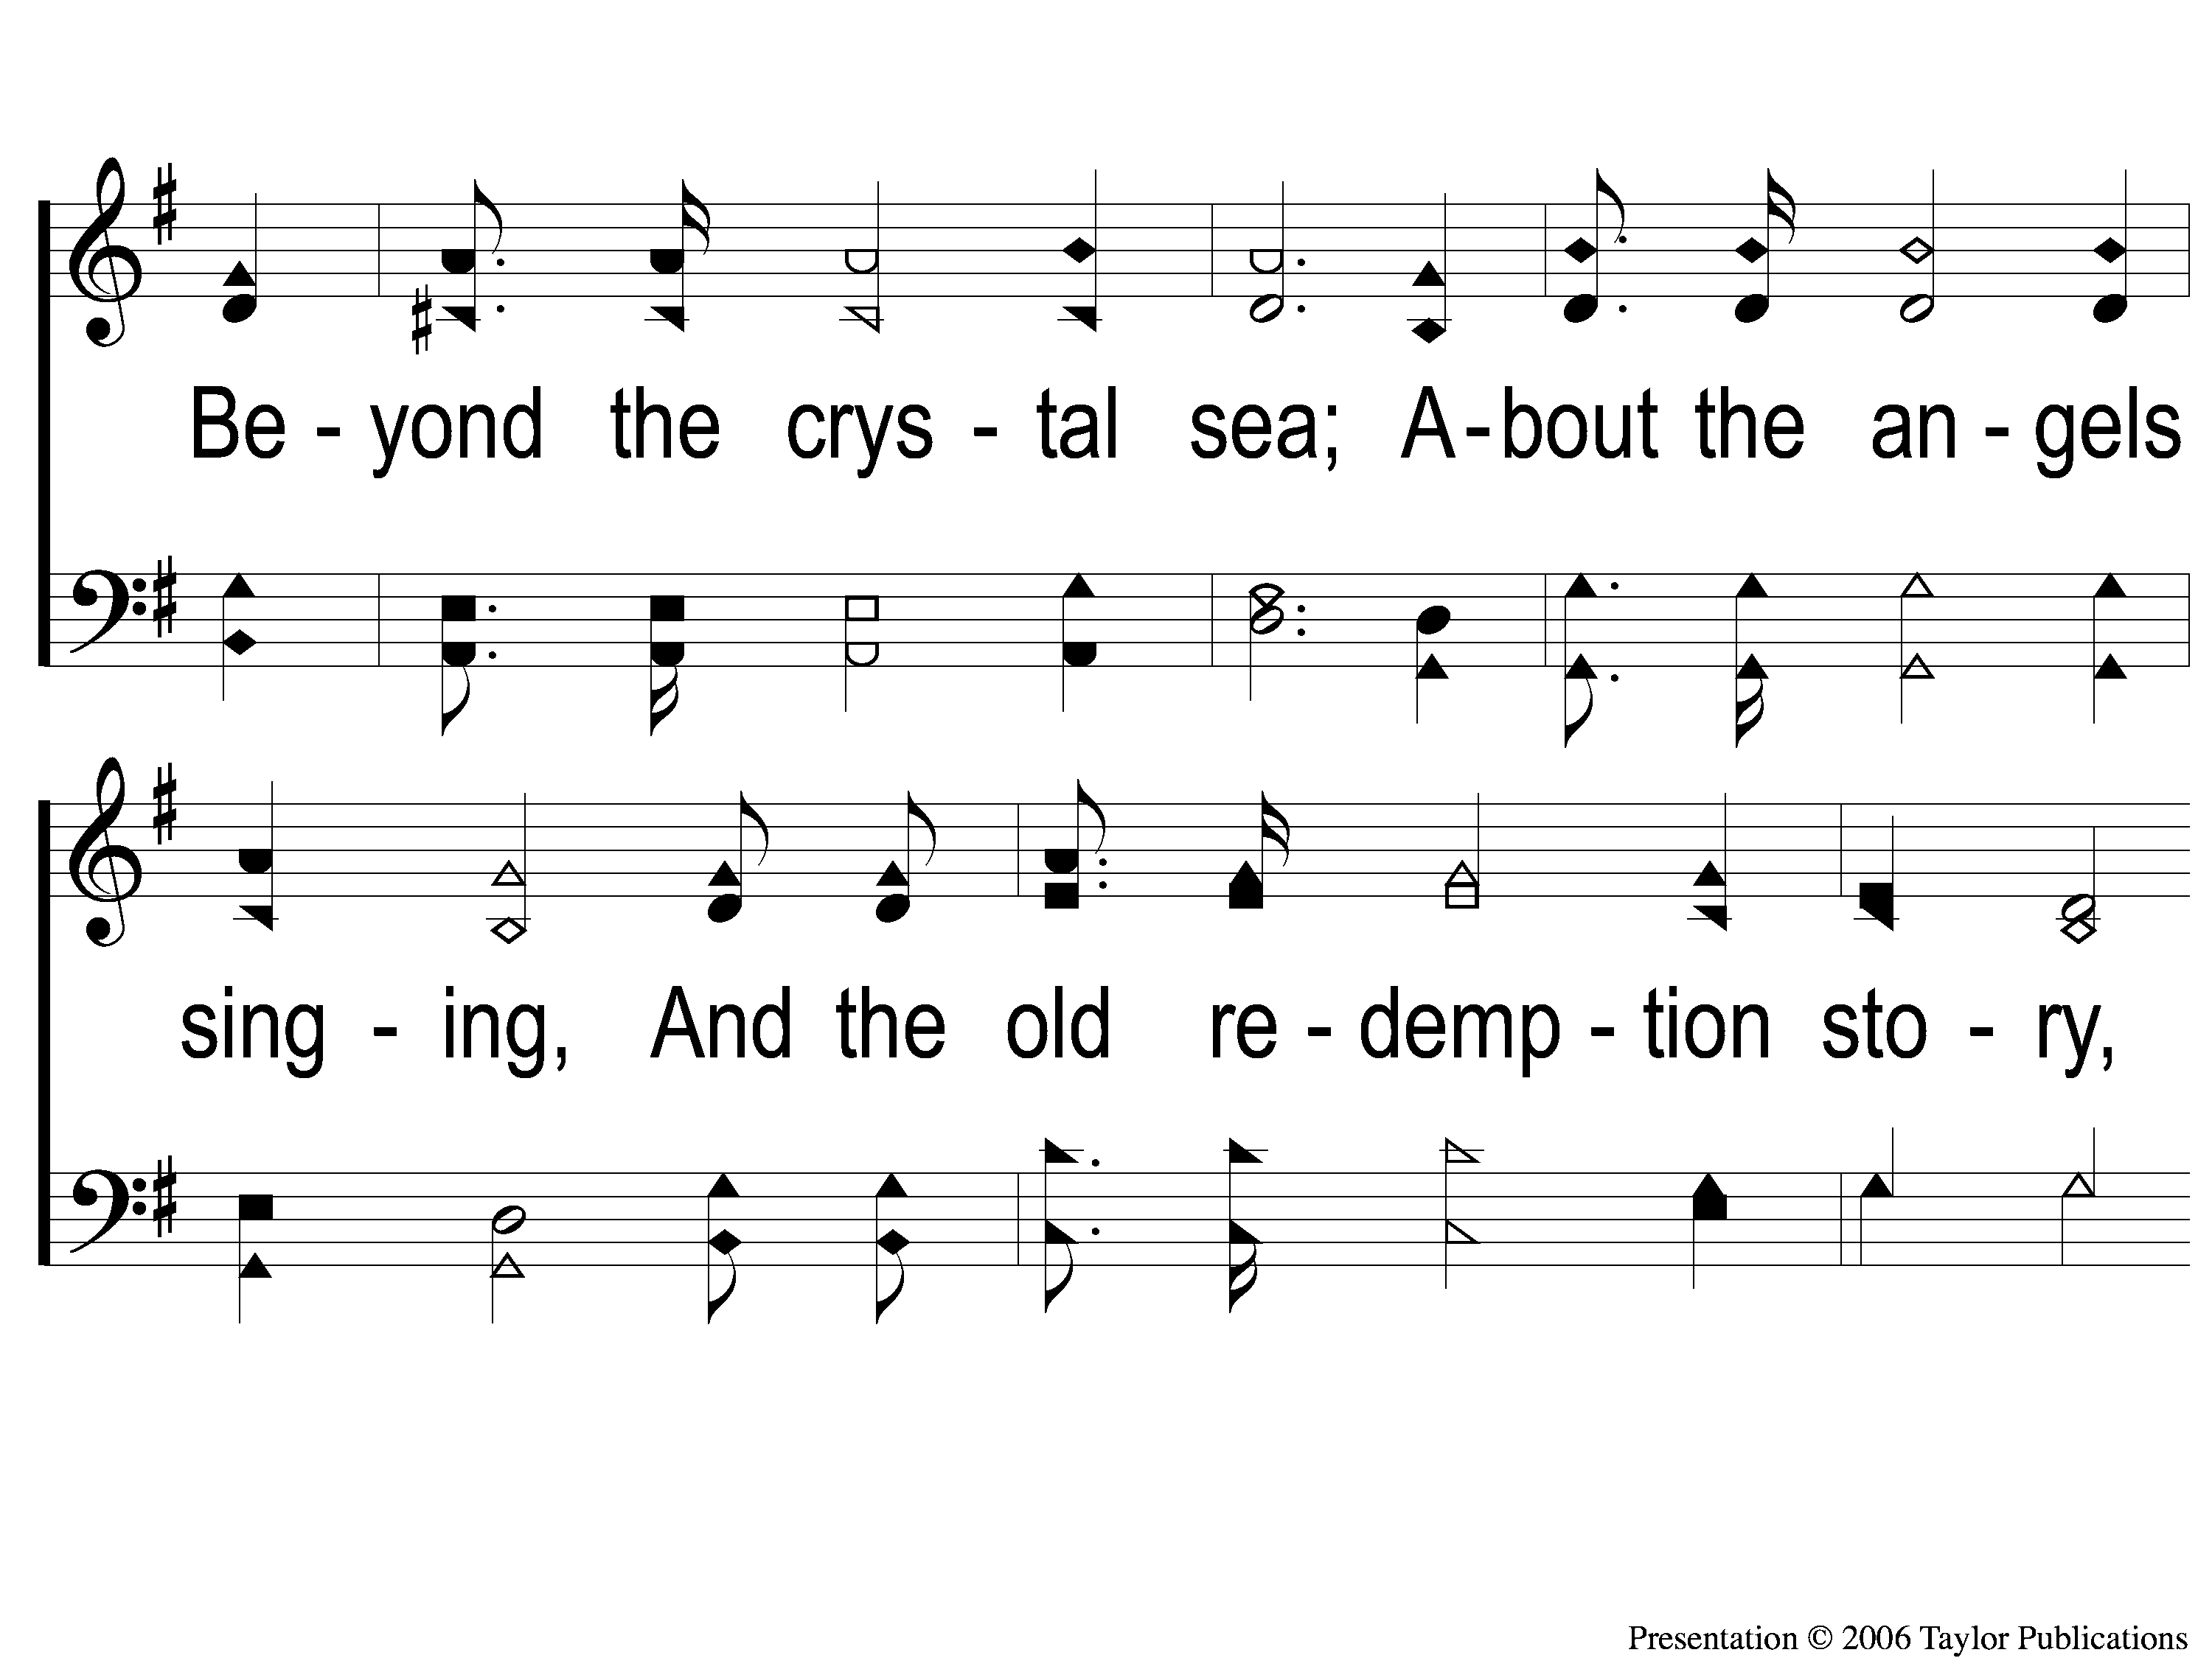
3-2 Victory in Jesus
Victory in Jesus
470

Slide 58
3-3 Victory in Jesus
Victory in Jesus
470

Slide 59
C-1 Victory in Jesus
Victory in Jesus
470

Slide 60
C-2 Victory in Jesus
Victory in Jesus
470

Slide 61
C-3 Victory in Jesus
Victory in Jesus
470

Slide 62
SCRIPTURE READING:
Matthew 1:1, 17-

Slide 63
IN PURSUIT
2023

Slide 64
IN PURSUIT
OF THE KINGDOM

Slide 65
IN PURSUIT
OF THE KINGDOM

Slide 66
THE TEACHINGS OF JESUS:
Kingdom people (ch. 5-7)

Slide 67
IN PURSUIT
OF THE KING

Slide 68
Who is Jesus?

Slide 69
Who is Jesus?
According to matthew

Slide 70
“When Jesus came into the region of Caesarea Philippi, He asked His disciples, saying,
‘Who do men say that I, the Son of Man, am?”
– Matt. 16:13

Slide 71
Messiah / Christ = “anointed one”

Slide 72
Messiah / Christ = “anointed one”
Old testament anointed ones:
Kings – 1 Sam. 10:1, 16:13

Slide 73
Messiah / Christ = “anointed one”
Old testament anointed ones:
Kings – 1 Sam. 10:1, 16:13
Priests – Ex. 28:41, 30:30

Slide 74
THE MESSIAH
PROPHESIEd

Slide 75
THE MESSIAH
PROPHESIEd
Son of Abraham, Isaac, Jacob, & judah
Gen. 12:1-3, 22:18, 35:11, 49:10

Slide 76
THE MESSIAH
PROPHESIEd
Son of david
2 sam. 7:12-14
Matt. 1:1, 6, 12:22-23

Slide 77
THE MESSIAH
PROPHESIEd
Son of a virgin
Isa. 7:14
Gen. 3:15, Jer. 31:22

Slide 78
THE MESSIAH
PROPHESIEd
Proclaimed

Slide 79
THE MESSIAH
PROCLAIMED
BY MATTHEW – 1:1, 9:9

Slide 80
THE MESSIAH
PROCLAIMED
BY MATTHEW – 1:1, 9:9
By an angel – 1:20-21

Slide 81
THE MESSIAH
PROCLAIMED
BY MATTHEW – 1:1, 9:9
By an angel – 1:20-21
By joseph & mary – 1:25

Slide 82
THE MESSIAH
PROPHESIEd
Proclaimed
proven

Slide 83
THE MESSIAH
proven
By prophecies fulfilled
300+ fulfilled by Jesus alone

Slide 84
THE MESSIAH
proven
By prophecies fulfilled
300+ fulfilled by Jesus alone
8 prophecies → 1 in 10¹⁷ (100,000,000,000,000,000)

Slide 85
THE MESSIAH
proven
By prophecies fulfilled – Mic. 5:2, Lk. 2:1-7

Slide 86
THE MESSIAH
proven
By prophecies fulfilled – Mic. 5:2, Lk. 2:1-7
By miracles performed – 9:35, 12:38-40, 28:9-10, 16-17

Slide 87
Are you IN PURSUIT
Of the messiah?

Slide 88
Invitation SONG:
Lord, reign in me

Slide 89
1-1 Lord Reign in Me
Lord, Reign In Me

Slide 90
1-2 Lord Reign in Me
Lord, Reign In Me

Slide 91
C-1 Lord Reign in Me
Lord, Reign In Me

Slide 92
C-2 Lord Reign in Me
Lord, Reign In Me

Slide 93
2-1 Lord Reign in Me
Lord, Reign In Me

Slide 94
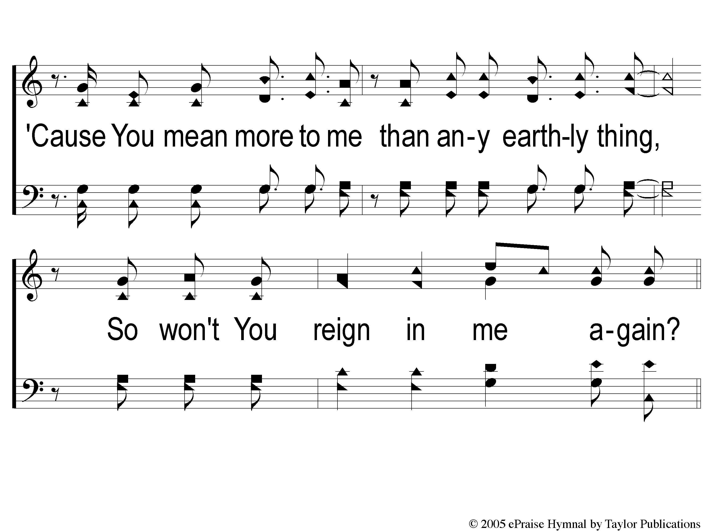
2-2 Lord Reign in Me
Lord, Reign In Me

Slide 95
2C-1 Lord Reign in Me
Lord, Reign In Me

Slide 96
2C-2 Lord Reign in Me
Lord, Reign In Me

Slide 97
Ds-1 Lord Reign in Me
Lord, Reign In Me

Slide 98
Ds-2 Lord Reign in Me
Lord, Reign In Me

Slide 99
Coda Lord Reign in Me
Lord, Reign In Me

Slide 100
OUR CONTRIBUTION
1 Peter 4:10
“As each one has received a gift, minister it to one another, as good stewards of the manifold grace of God.”

Slide 101
SONG:
Lamb of god
#176

Slide 102
1-1 Lamb of God
Lamb of God
176

Slide 103
1-2 Lamb of God
Lamb of God
176

Slide 104
1-3 Lamb of God
Lamb of God
176

Slide 105
1-4 Lamb of God
Lamb of God
176

Slide 106
C-1 Lamb of God
Lamb of God
176

Slide 107
C-2 Lamb of God
Lamb of God
176

Slide 108
2-1 Lamb of God
Lamb of God
176

Slide 109
2-2 Lamb of God
Lamb of God
176

Slide 110
C-1 Lamb of God
Lamb of God
176

Slide 111
C-2 Lamb of God
Lamb of God
176

Slide 112
THE UNLEAVENED BREAD
Ephesians 5:11-13
“Therefore remember that you, once Gentiles in the flesh—who are called Uncircumcision by what is called the Circumcision made in the flesh by hands— that at that time you were without Christ, being aliens from the commonwealth of Israel and strangers from the covenants of promise, having no hope and without God in the world. But now in Christ Jesus you who once were far off have been brought near by the blood of Christ.”

Slide 113
THE FRUIT OF THE VINE
Ephesians 1:7-10
“In Him we have redemption through His blood, the forgiveness of sins, according to the riches of His grace which He made to abound toward us in all wisdom and prudence, having made known to us the mystery of His will, according to His good pleasure which He purposed in Himself, that in the dispensation of the fullness of the times He might gather together in one pall things in Christ, 3both which are in heaven and which are on earth—in Him.”

Slide 114
closing PRAYER

Slide 115
SONG:
I’ll fly away
#851

Slide 116
1-1 I’ll Fly Away
I’ll Fly Away
851

Slide 117
1-2 I’ll Fly Away
I’ll Fly Away
851

Slide 118
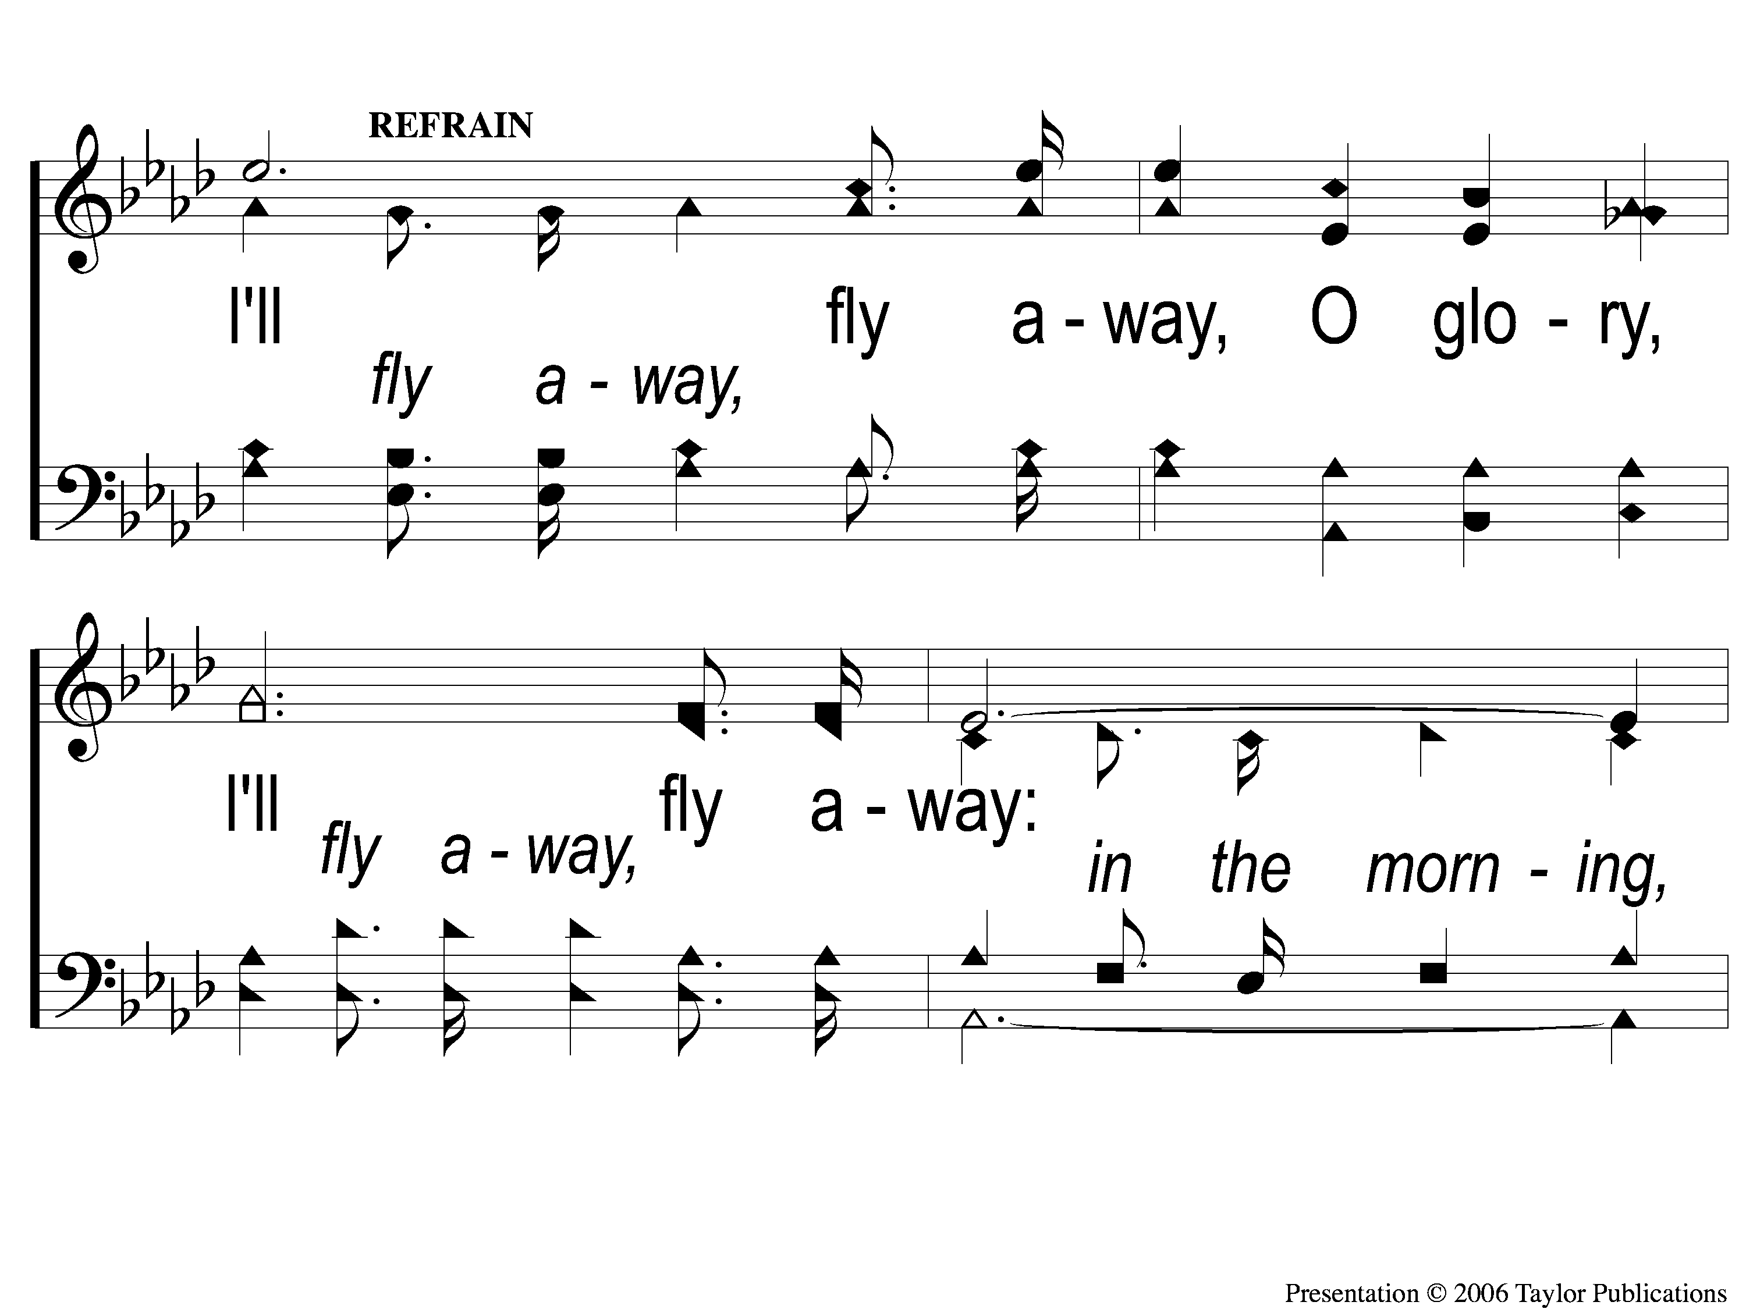
C-1 I’ll Fly Away
I’ll Fly Away
851

Slide 119
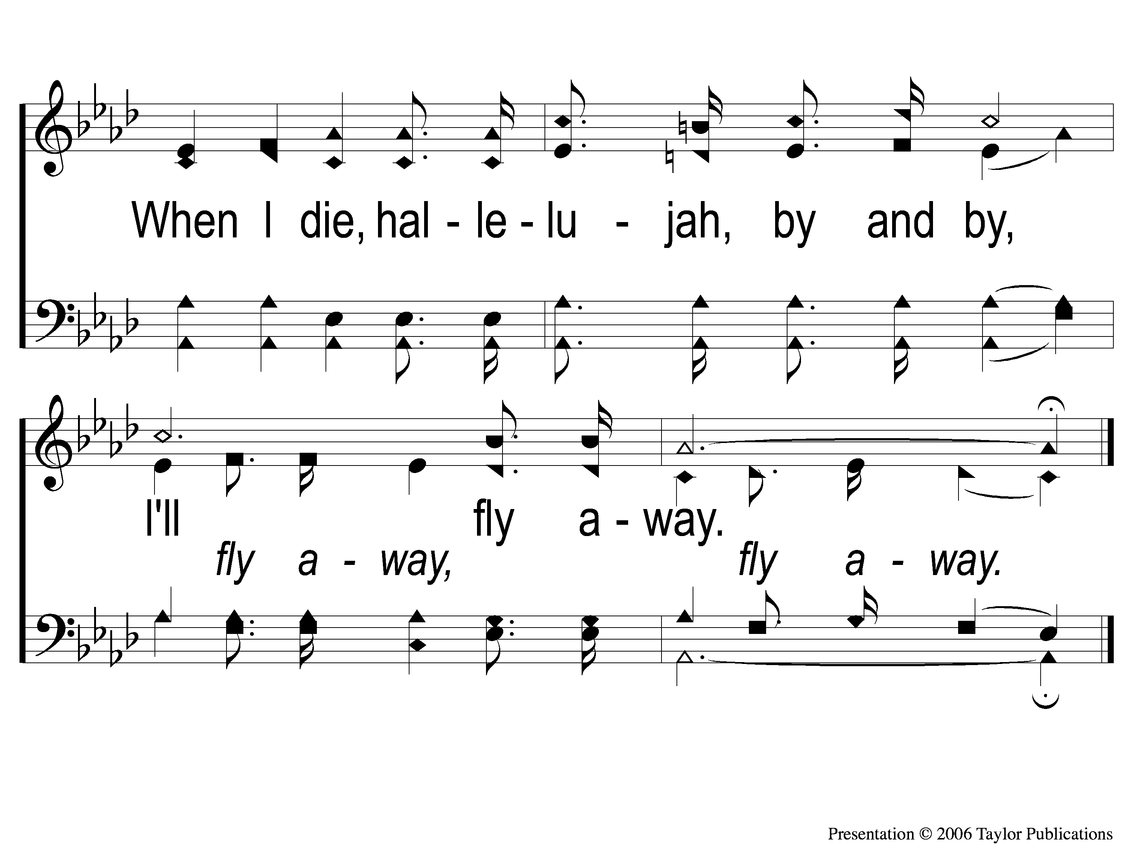
C-2 I’ll Fly Away
I’ll Fly Away
851

Slide 120
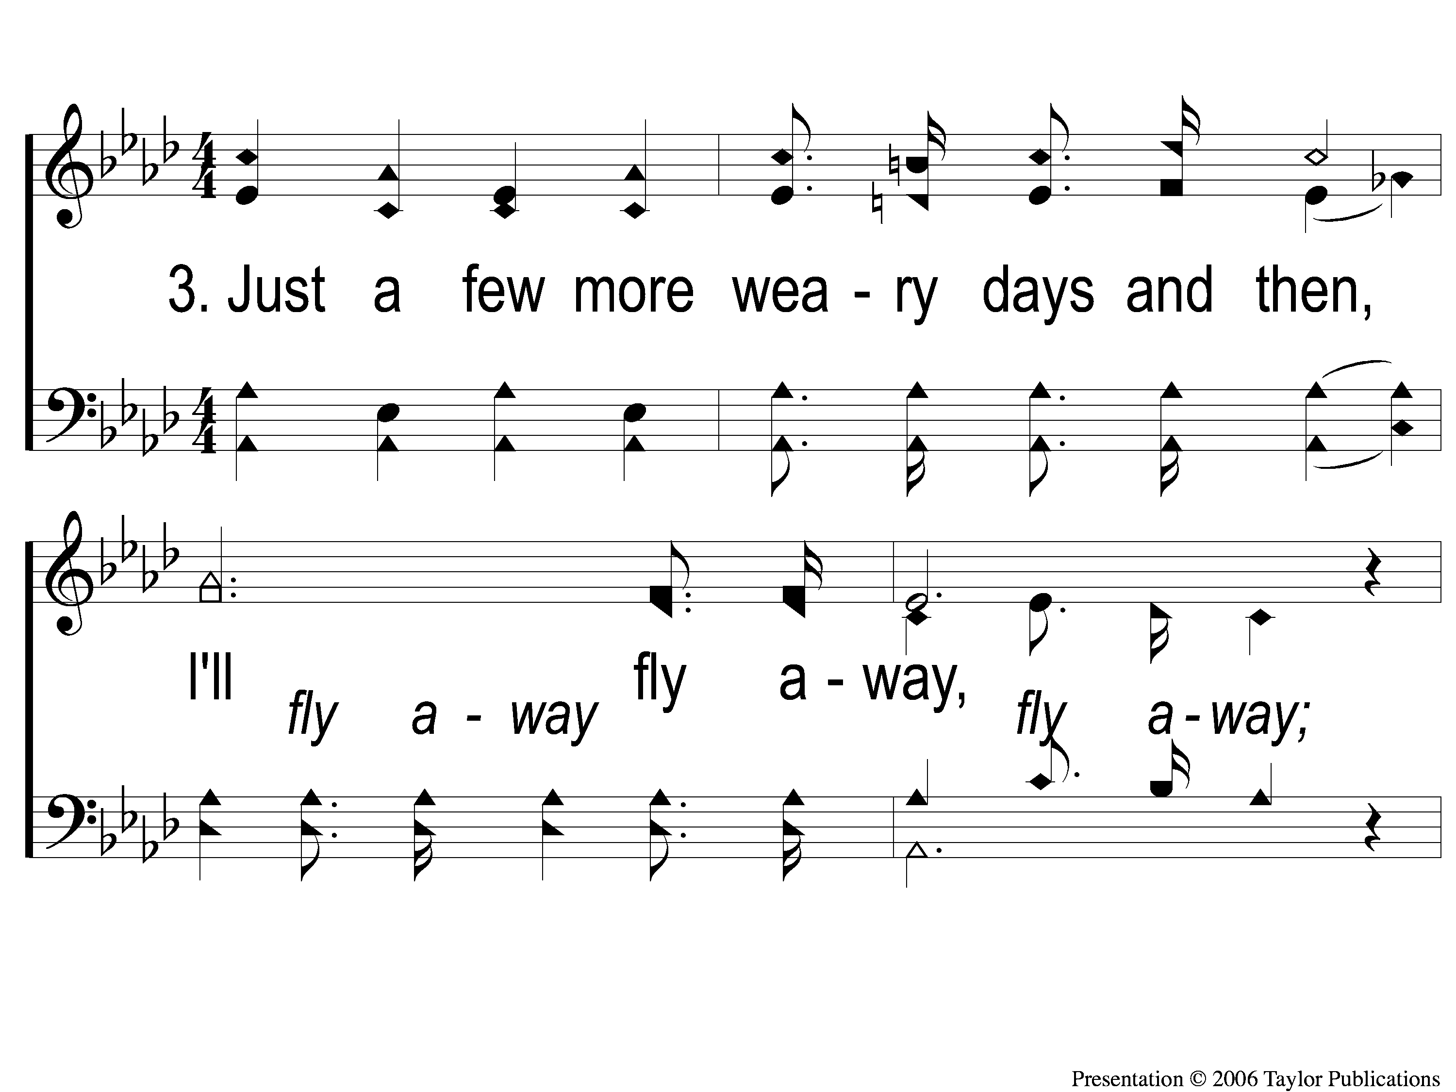
3-1 I’ll Fly Away
I’ll Fly Away
851

Slide 121
3-2 I’ll Fly Away
I’ll Fly Away
851

Slide 122
C-1 I’ll Fly Away
I’ll Fly Away
851

Slide 123
C-2 I’ll Fly Away
I’ll Fly Away
851

Slide 124
Today
LTC service challenge @ 1:30
WORSHIP @ 6:00
Men’s meeting to follow
Wednesday
Worship & Bible classes @ 6:30

Slide 125
Today
Join us for a Meal in the mpb
Wednesday
LTC @ 5:30
Worship & Bible classes @ 6:30

