Slide 1
WELCOME
To the Wheeler church of Christ

Slide 2
Songs of praise to God

Slide 3
OPENING PRAYER

Slide 4
Songs of praise to God

Slide 5
IN PURSUIT
2023

Slide 6
IN PURSUIT
OF THE KINGDOM

Slide 7
His teaching
5 teaching sections:
5-7 – kingdom people
10 – kingdom purpose
13 – kingdom priority
18 – kingdom principles
23-25 – kingdom pending

Slide 8
THE TEACHINGS OF JESUS:
Kingdom people (ch. 5-7)

Slide 9
THE TEACHINGS OF JESUS:
Kingdom people are different

Slide 10
Kingdom people…
…have a different heart

Slide 11
A different heart
The beatitudes
Latin: “beatus” = BLESSED, FORTUNATE;
favored by god

Slide 12
THE DIFFERENT HEART OF KINGDOM PEOPLE:
HUMBLE – V. 3

Slide 13
THE DIFFERENT HEART OF KINGDOM PEOPLE:
HUMBLE – V. 3
Prov. 16:19, 22:4
Isa. 66:2
Jn. 15:5

Slide 14
THE DIFFERENT HEART OF KINGDOM PEOPLE:
HUMBLE – V. 3
SPIRITUAL– V. 4

Slide 15
THE DIFFERENT HEART OF KINGDOM PEOPLE:
SPIRITUAL– V. 4
2 Cor. 7:10
Psa. 51:10
LK. 18:13

Slide 16
THE DIFFERENT HEART OF KINGDOM PEOPLE:
HUMBLE – V. 3
SPIRITUAL– V. 4
SELF-CONTROLLED – V. 5

Slide 17
THE DIFFERENT HEART OF KINGDOM PEOPLE:
Self-controlled – v. 5
Matt. 1:20

Slide 18
THE DIFFERENT HEART OF KINGDOM PEOPLE:
HUMBLE – V. 3
SPIRITUAL– V. 4
SELF-CONTROLLED – V. 5
ZEALOUS – V. 6

Slide 19
THE DIFFERENT HEART OF KINGDOM PEOPLE:
zealous – v. 6
Psa. 42:1-2
Job 23:12

Slide 20
THE DIFFERENT HEART OF KINGDOM PEOPLE:
HUMBLE – V. 3
SPIRITUAL– V. 4
SELF-CONTROLLED – V. 5
ZEALOUS – V. 6
MERCIFUL – V. 7

Slide 21
THE DIFFERENT HEART OF KINGDOM PEOPLE:
merciful – v. 7
Mic. 6:8

Slide 22
THE DIFFERENT HEART OF KINGDOM PEOPLE:
HUMBLE – V. 3
SPIRITUAL– V. 4
SELF-CONTROLLED – V. 5
ZEALOUS – V. 6
MERCIFUL – V. 7
PURE – V. 8

Slide 23
THE DIFFERENT HEART OF KINGDOM PEOPLE:
pure – v. 8
Matt. 23:25-26
Matt 19:14

Slide 24
THE DIFFERENT HEART OF KINGDOM PEOPLE:
HUMBLE – V. 3
SPIRITUAL– V. 4
SELF-CONTROLLED – V. 5
ZEALOUS – V. 6
MERCIFUL – V. 7
PURE – V. 8
PEACEMAKERS – V. 9

Slide 25
THE DIFFERENT HEART OF KINGDOM PEOPLE:
peacemakers – v. 7
Rom. 12:18

Slide 26
THE DIFFERENT HEART OF KINGDOM PEOPLE:
HUMBLE – V. 3
SPIRITUAL– V. 4
SELF-CONTROLLED – V. 5
ZEALOUS – V. 6
MERCIFUL – V. 7
PURE – V. 8
PEACEMAKERS – V. 9
PERSECUTED – V. 10-12

Slide 27
THE DIFFERENT HEART OF KINGDOM PEOPLE:
persecuted – v. 10-12
Acts 5:41
Isa. 51:7

Slide 28
THE DIFFERENT HEART OF KINGDOM PEOPLE:
HUMBLE – V. 3
SPIRITUAL– V. 4
SELF-CONTROLLED – V. 5
ZEALOUS – V. 6
MERCIFUL – V. 7
PURE – V. 8
PEACEMAKERS – V. 9
PERSECUTED – V. 10-12

Slide 29
Kingdom people…
…have a different heart
…make a POSITIVE difference

Slide 30
A POSITIVE DIFFERENCE
As salt (v. 13)

Slide 31
A POSITIVE DIFFERENCE
As salt (v. 13)
Preserves

Slide 32
A POSITIVE DIFFERENCE
As salt (v. 13)
Preserves
Purifies

Slide 33
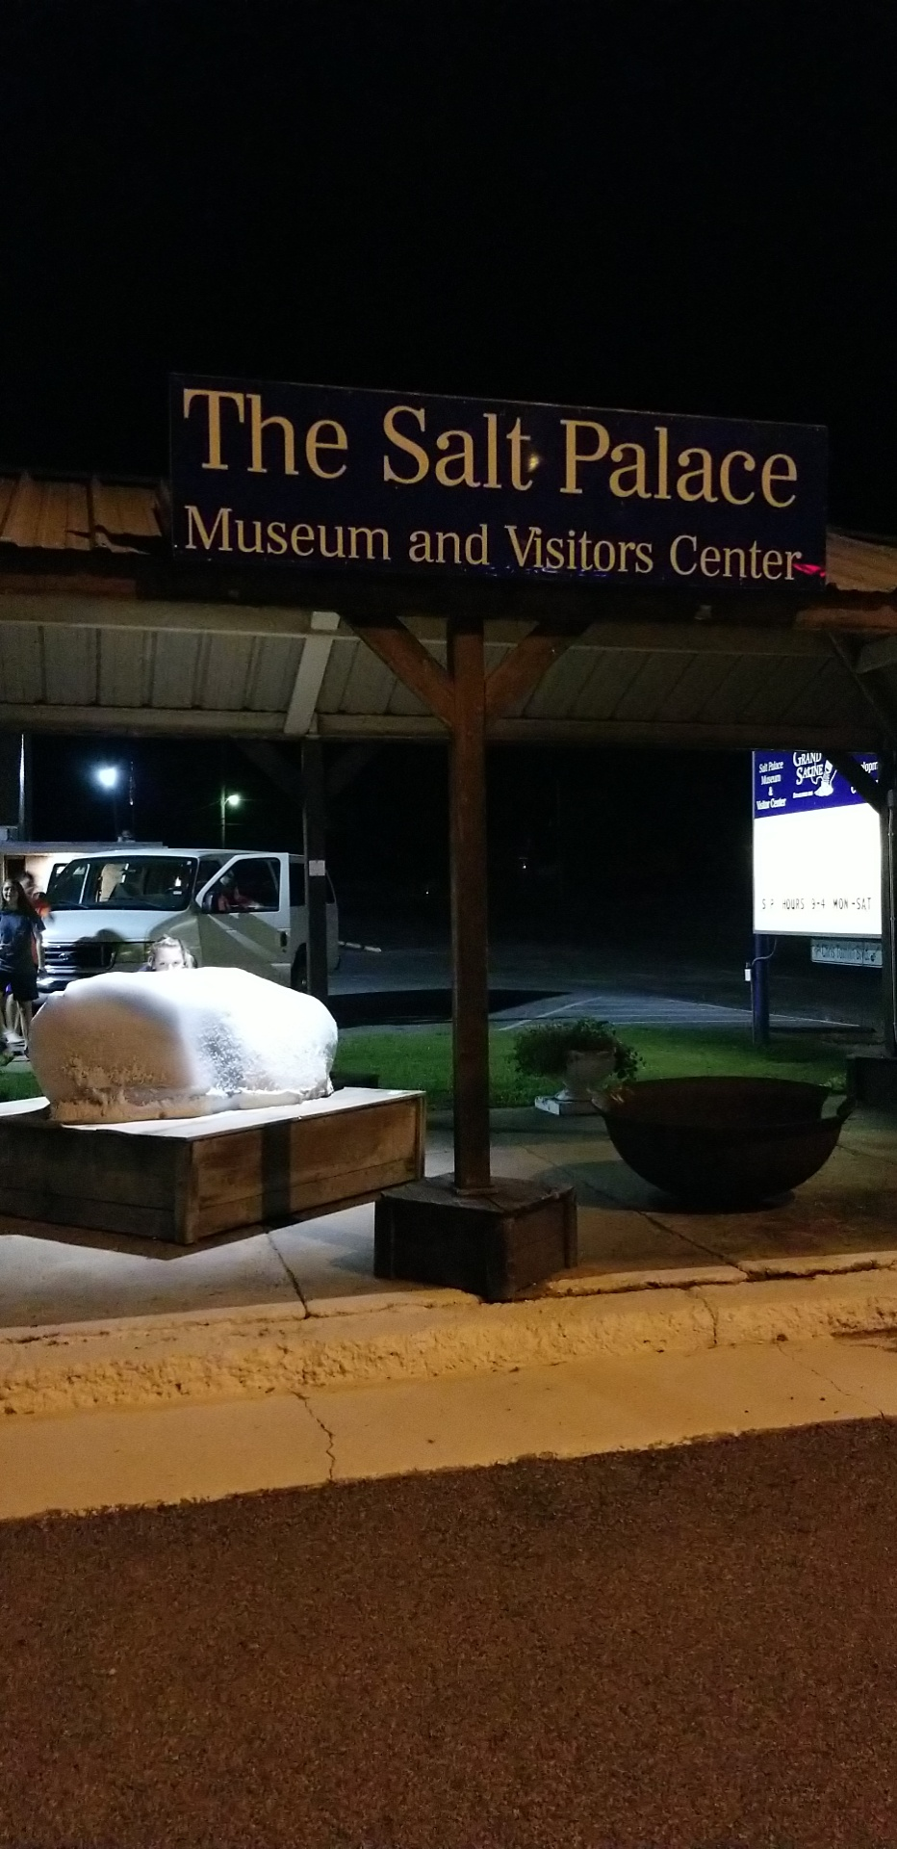

Slide 34
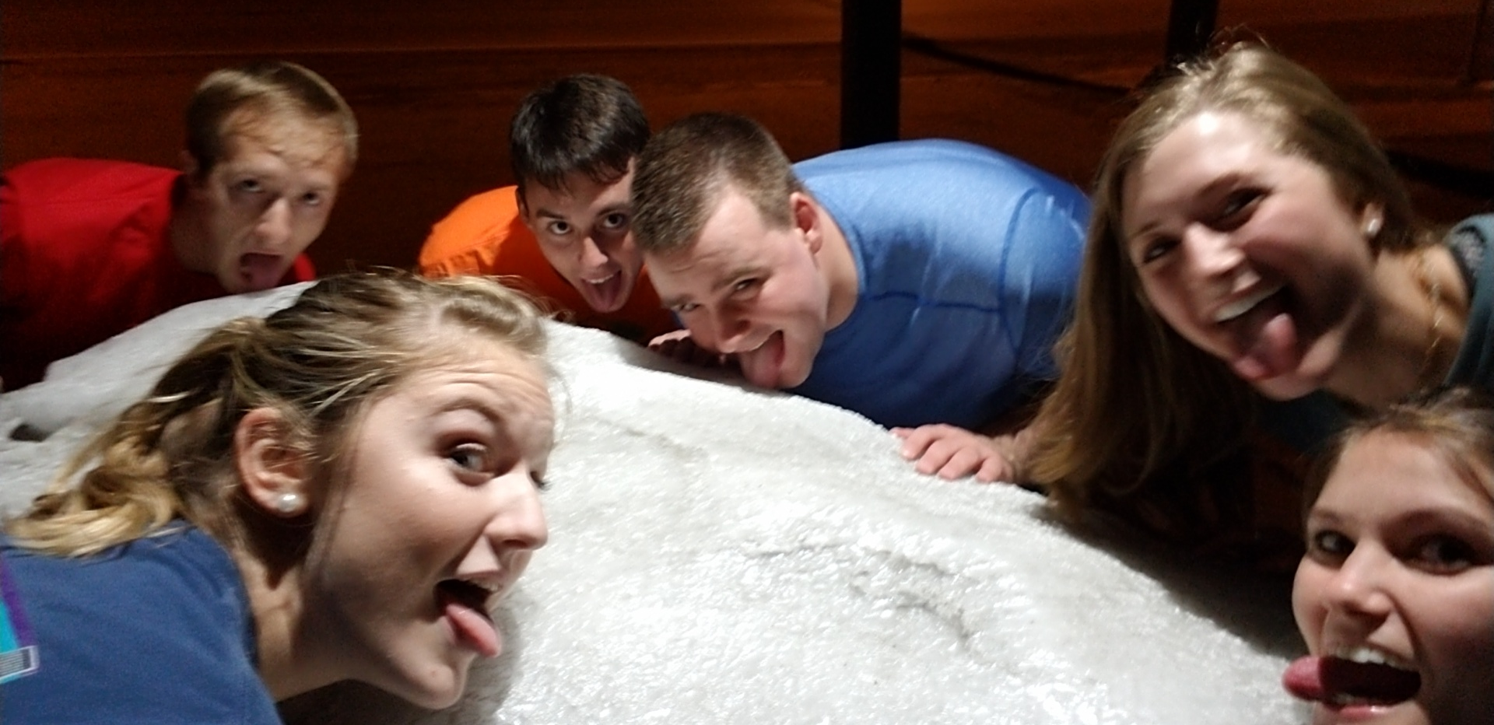

Slide 35
A POSITIVE DIFFERENCE
As salt (v. 13)
Preserves
Purifies
Brings out flavor

Slide 36
A POSITIVE DIFFERENCE
As salt (v. 13)
Preserves
Purifies
Brings out flavor
Creates thirst

Slide 37
A POSITIVE DIFFERENCE
As light (v. 14-16)

Slide 38
A POSITIVE DIFFERENCE
As light (v. 14-16)
Reveals

Slide 39
A POSITIVE DIFFERENCE
As light (v. 14-16)
Reveals
Comforts

Slide 40
A POSITIVE DIFFERENCE
As light (v. 14-16)
Reveals
Comforts
guides

Slide 41
Are you making
a positive difference?

Slide 42
Songs of praise to God

Slide 43
The lord’s supper
Acts 20:7

Slide 44
closing PRAYER

Slide 45
Songs of praise to God

Slide 46
Wednesday
Worship & Bible classes @ 6:30

