Slide 1
1-1 Walking in Sunlight
Walking In Sunlight
611

Slide 2
1-2 Walking in Sunlight
Walking In Sunlight
611

Slide 3
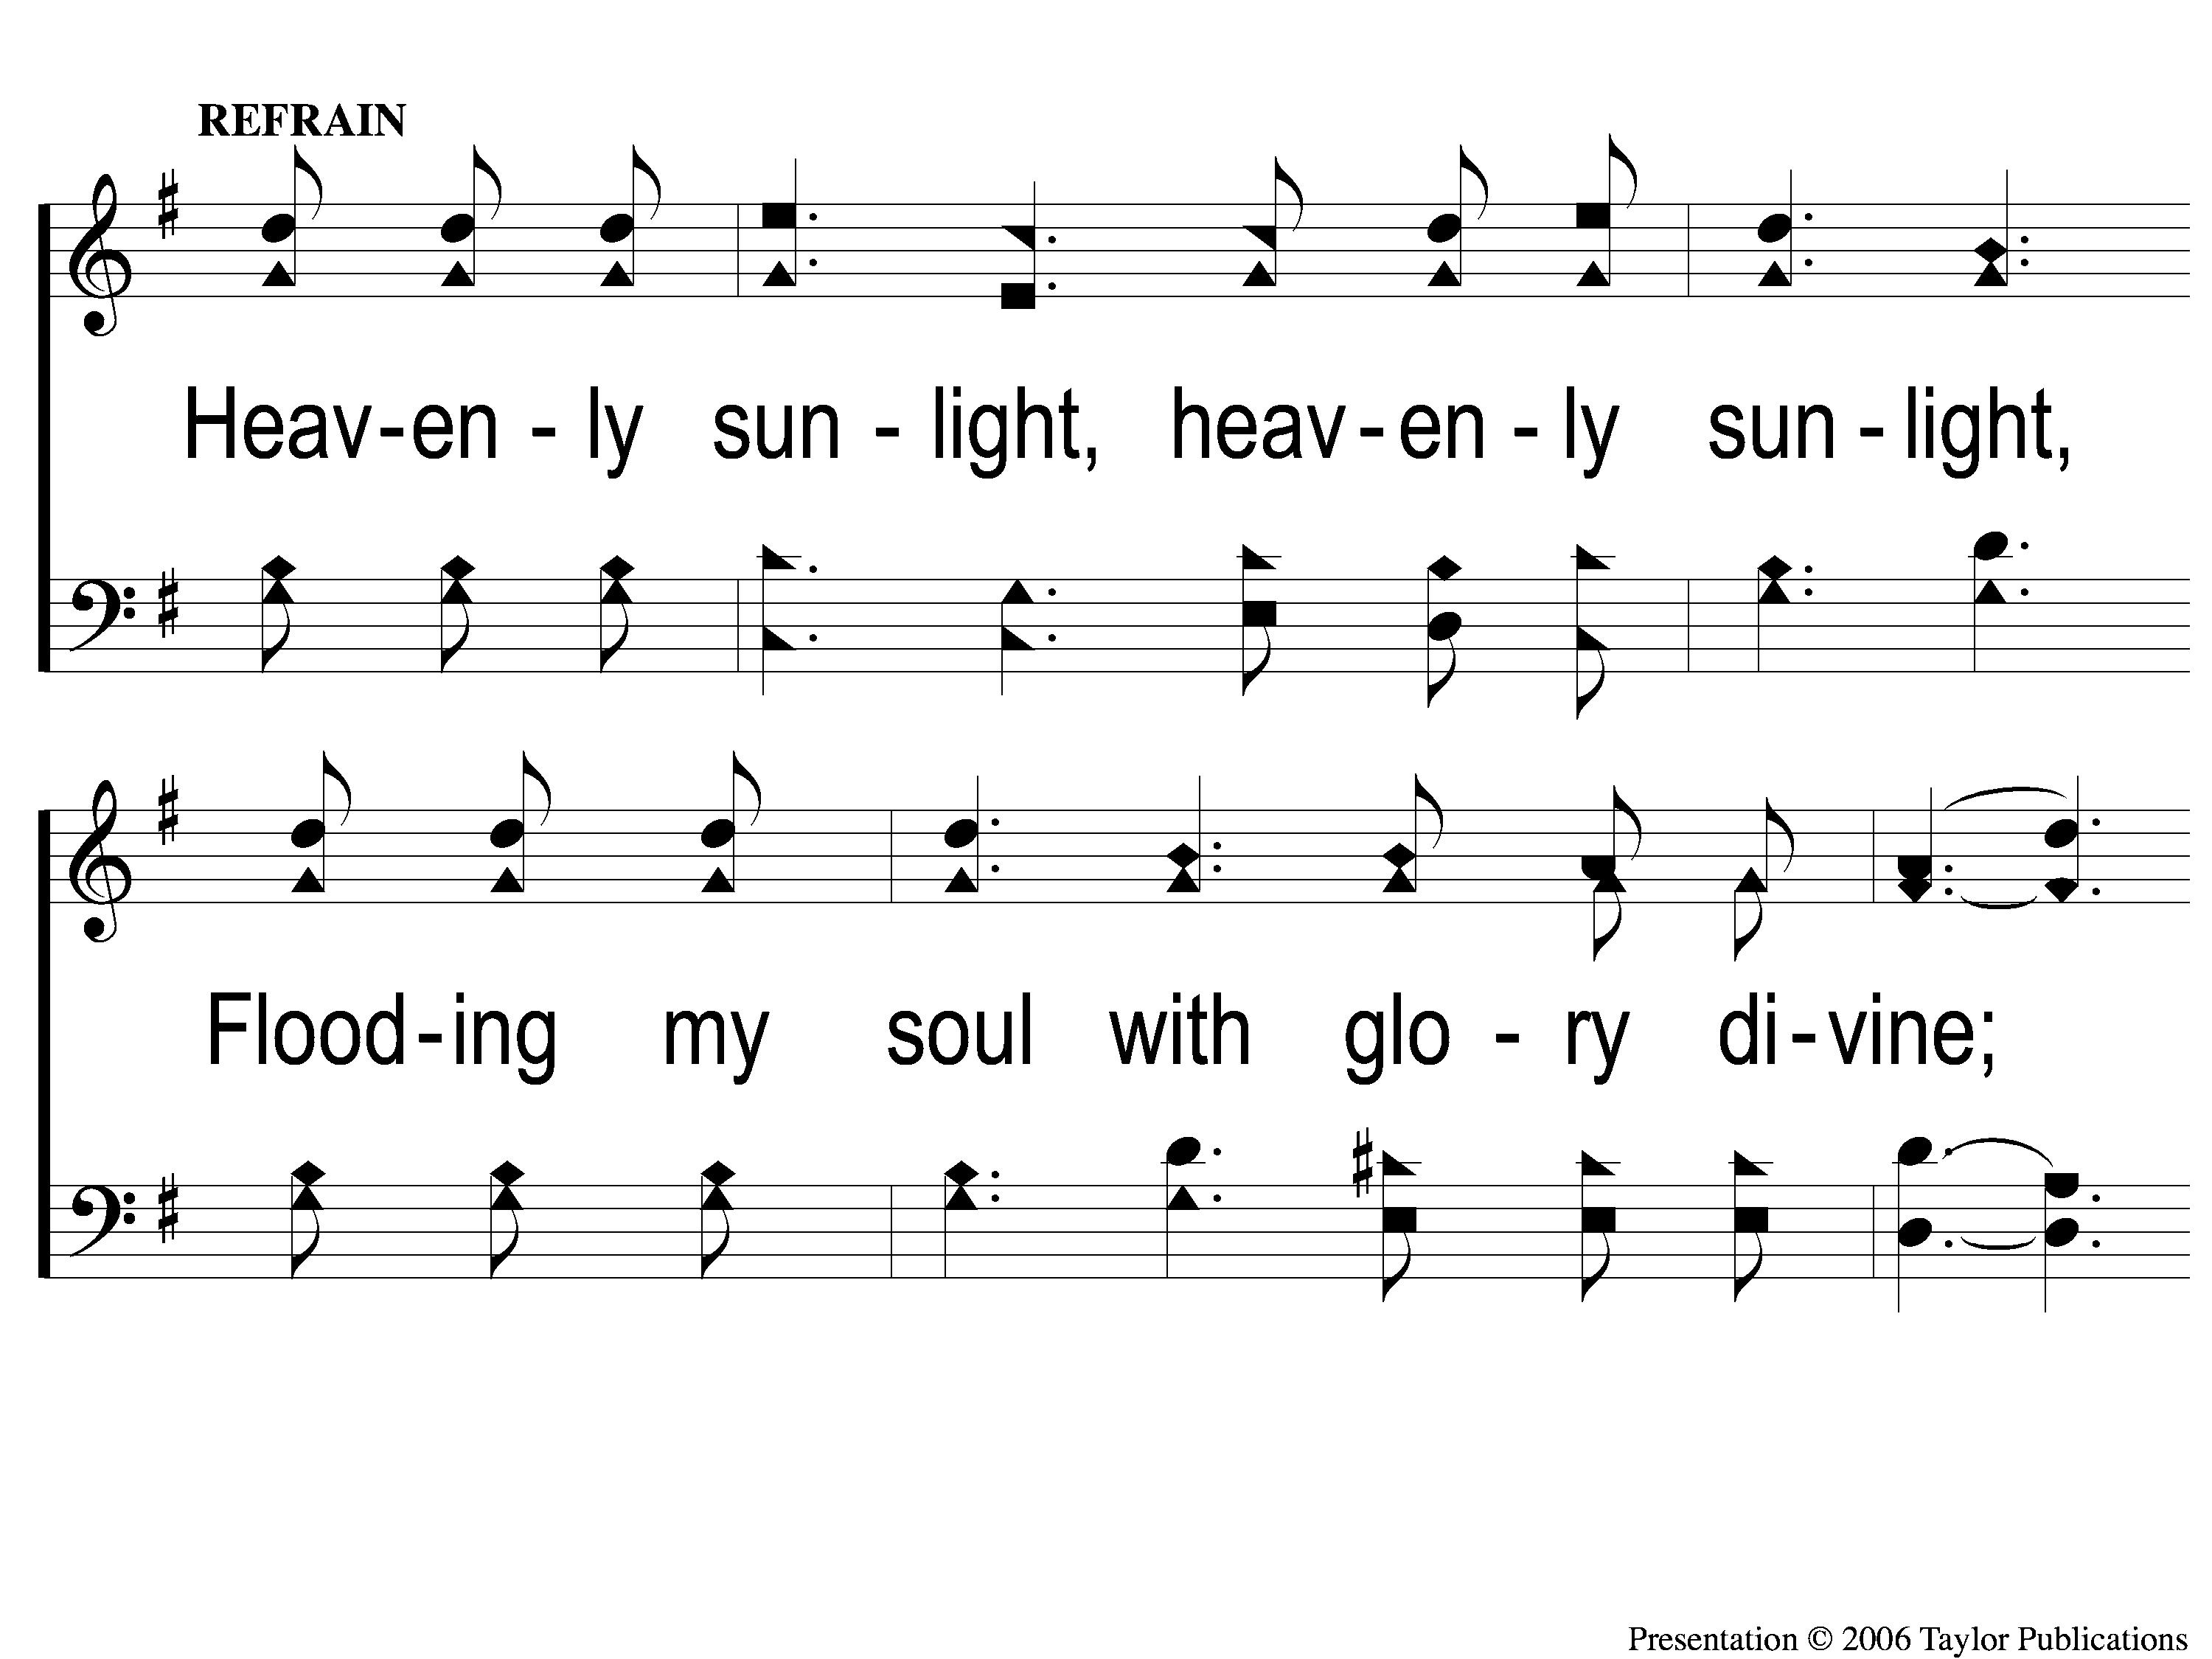
C-1 Walking in Sunlight
Walking In Sunlight
611

Slide 4
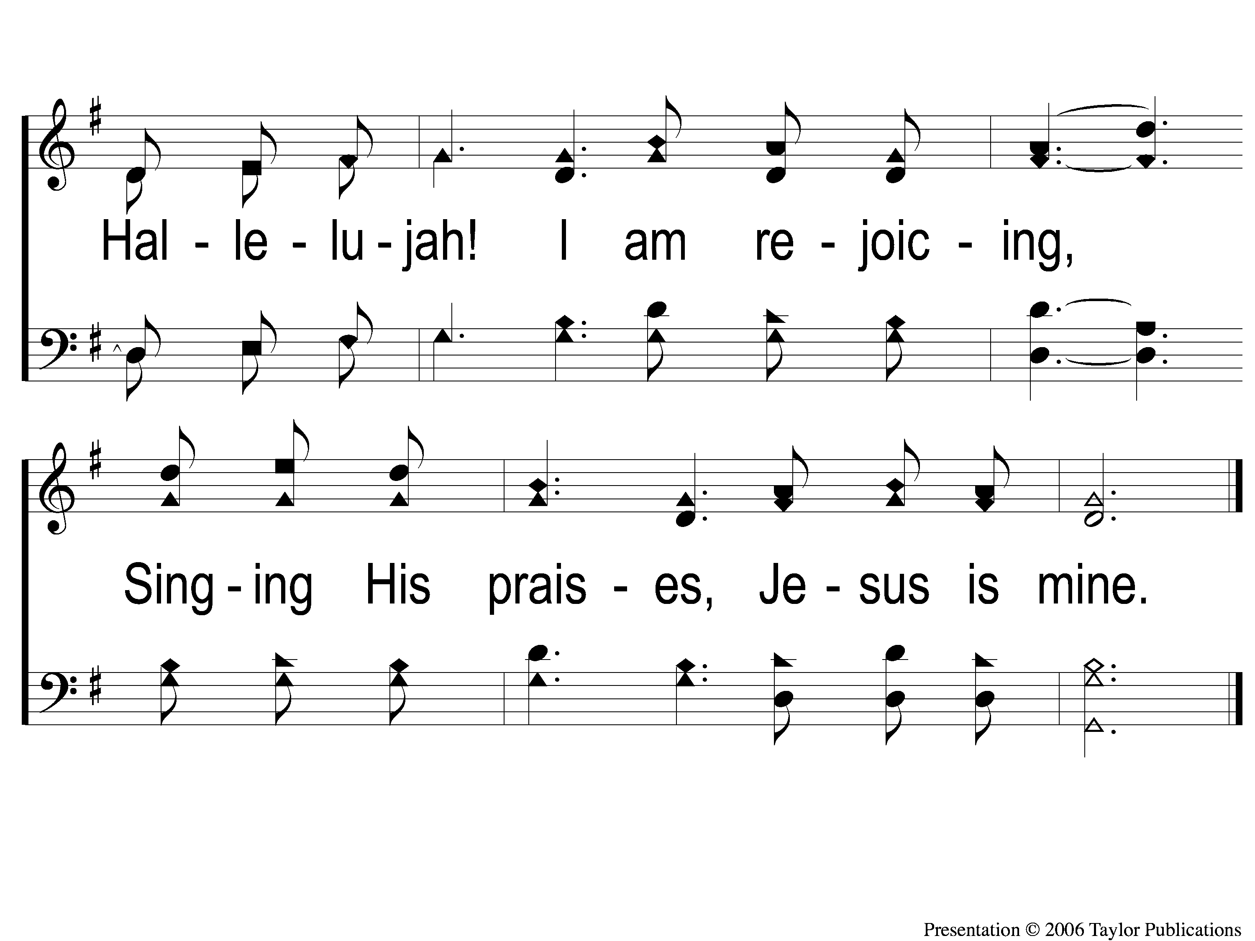
C-2 Walking in Sunlight
Walking In Sunlight
611

Slide 5
3-1 Walking in Sunlight
Walking In Sunlight
611

Slide 6
3-2 Walking in Sunlight
Walking In Sunlight
611

Slide 7
C-1 Walking in Sunlight
Walking In Sunlight
611

Slide 8
C-2 Walking in Sunlight
Walking In Sunlight
611

Slide 9
WELCOME
To the Wheeler church of Christ

Slide 10
SONG:
To canaan’s land I’m on my way
#867

Slide 11
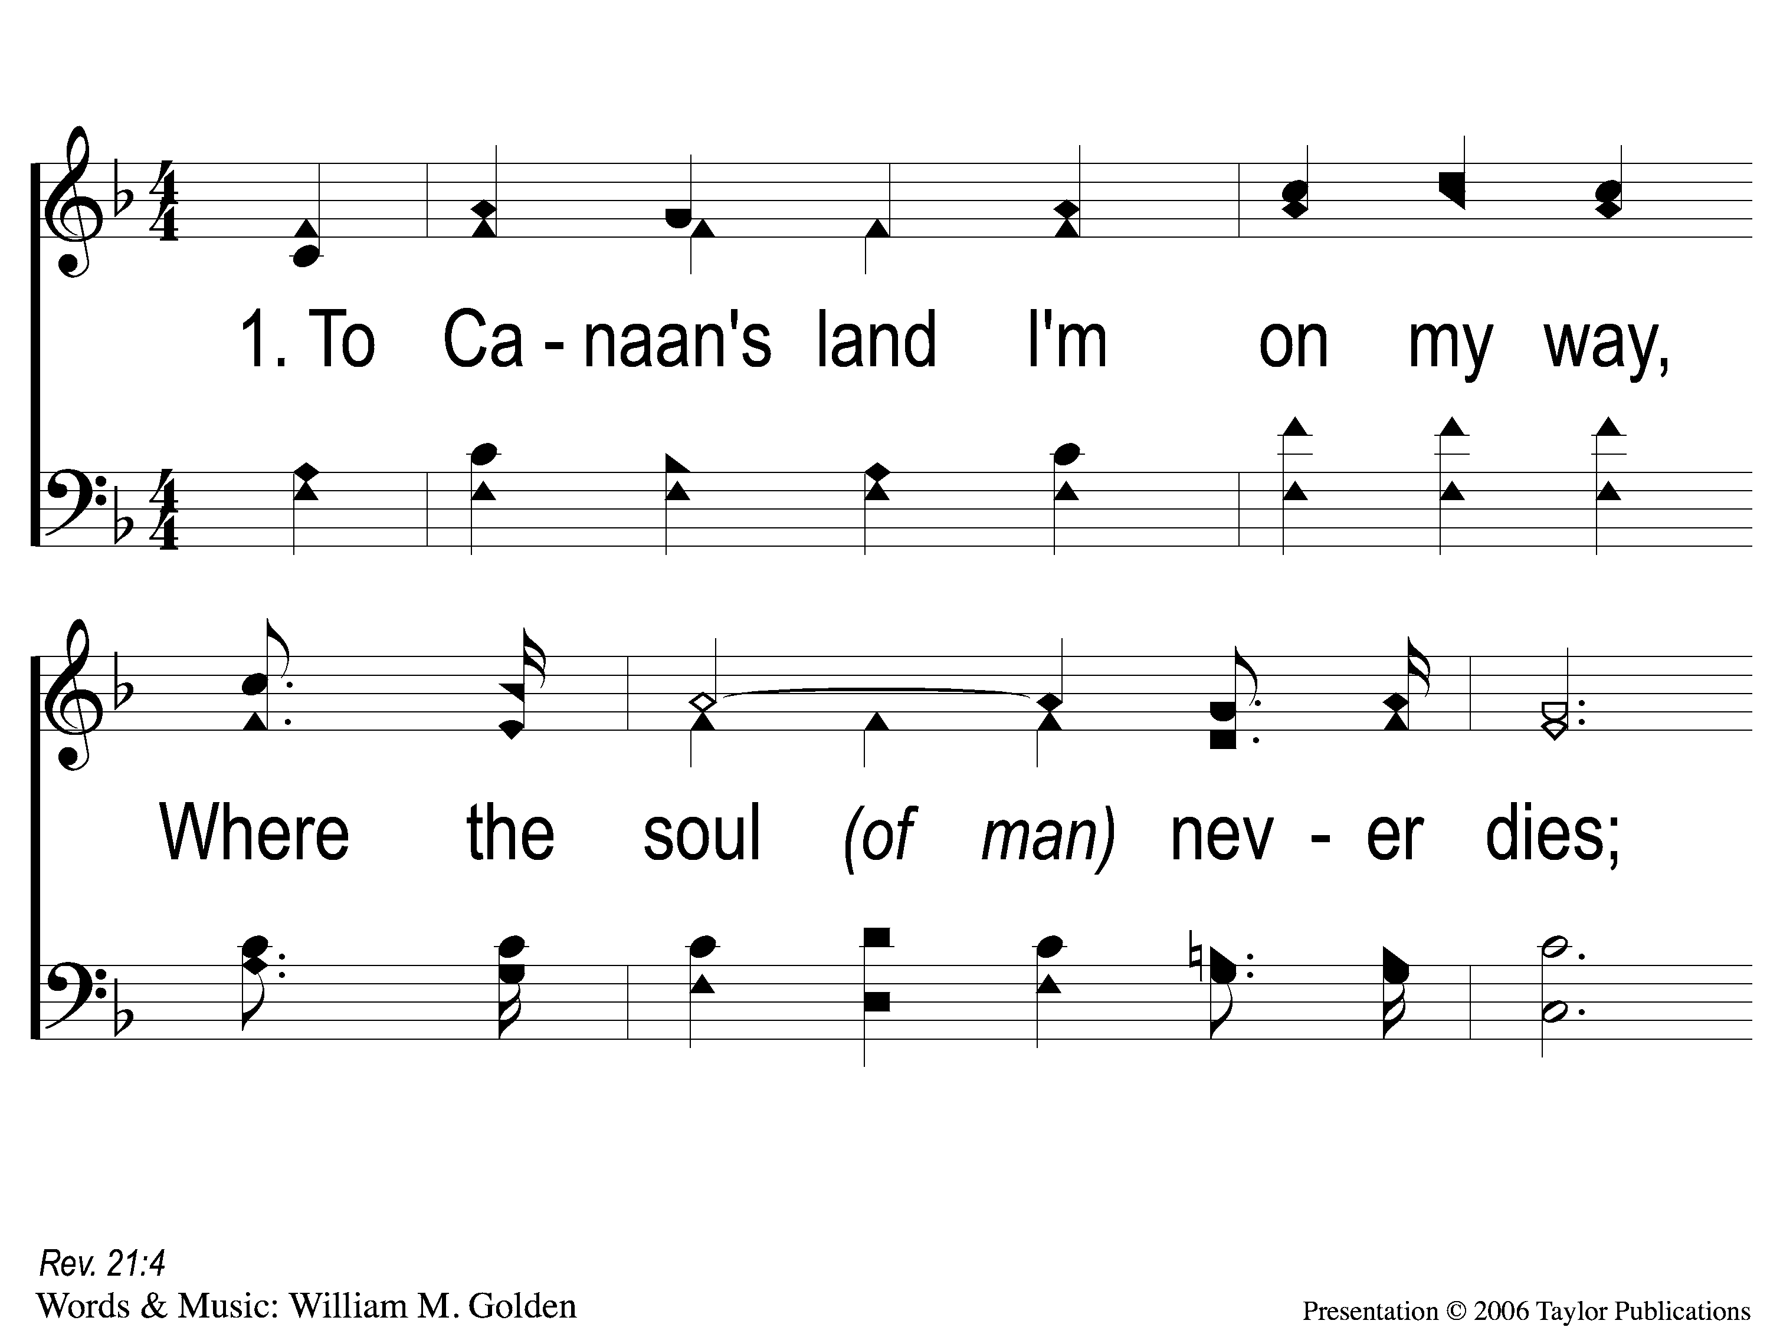
1-1 To Canaan’s Land
To Canaan’s Land I’m On My Way
867

Slide 12
1-2 To Canaan’s Land
To Canaan’s Land I’m On My Way
867

Slide 13
C-1 To Canaan’s Land
To Canaan’s Land I’m On My Way
867

Slide 14
C-2 To Canaan’s Land
To Canaan’s Land I’m On My Way
867

Slide 15
2-1 To Canaan’s Land
To Canaan’s Land I’m On My Way
867

Slide 16
2-2 To Canaan’s Land
To Canaan’s Land I’m On My Way
867

Slide 17
C-1 To Canaan’s Land
To Canaan’s Land I’m On My Way
867

Slide 18
C-2 To Canaan’s Land
To Canaan’s Land I’m On My Way
867

Slide 19
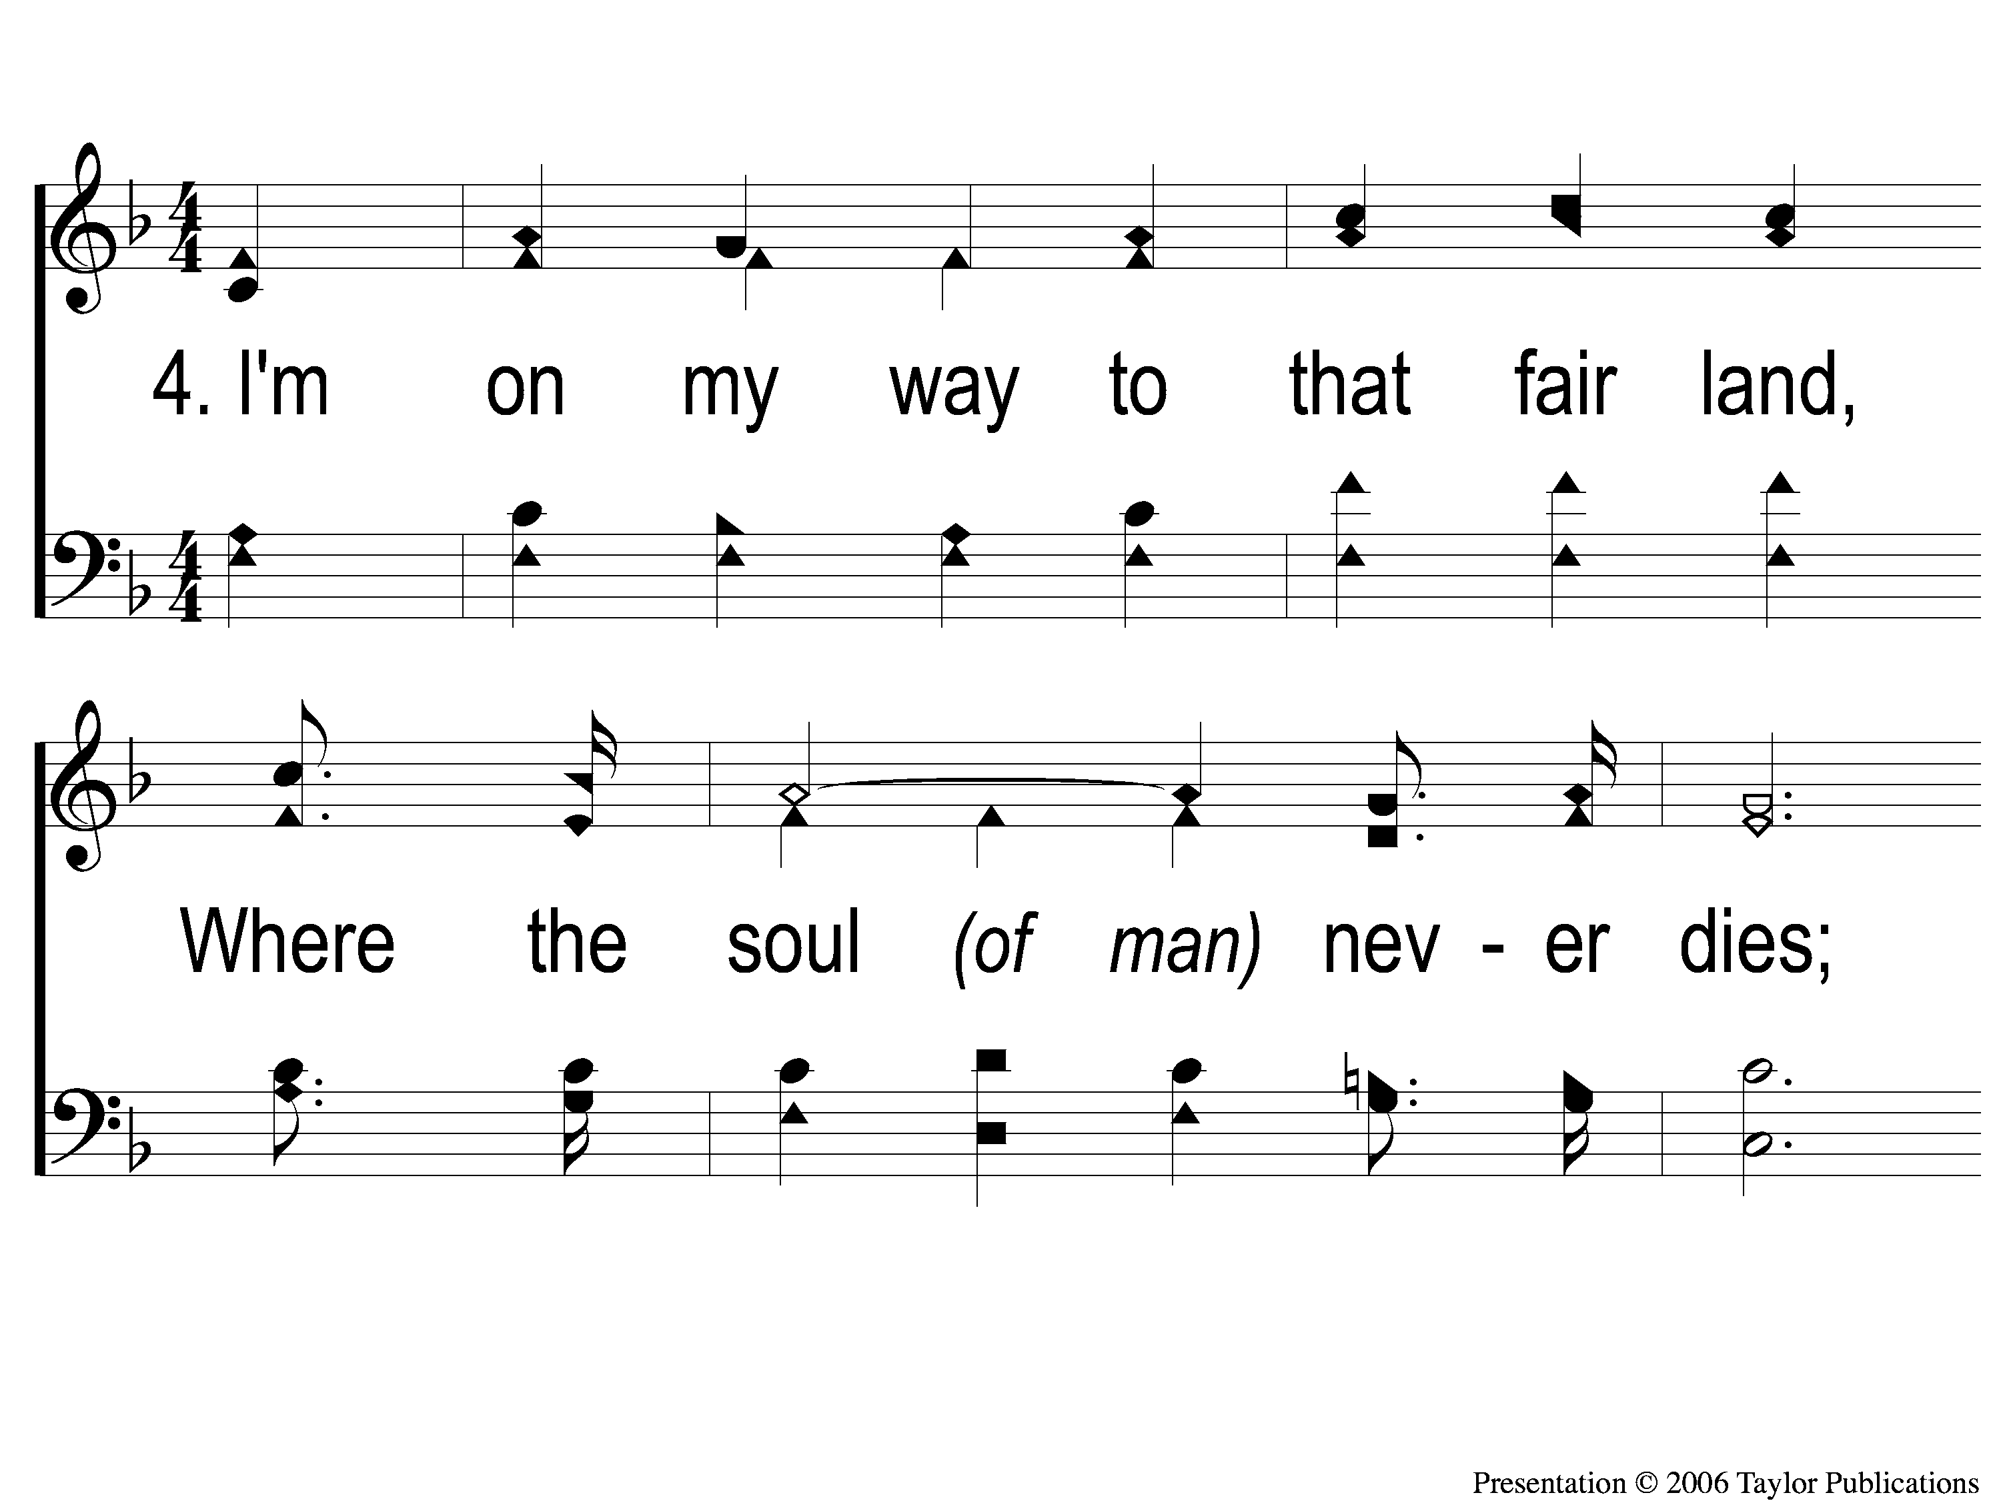
4-1 To Canaan’s Land
To Canaan’s Land I’m On My Way
867

Slide 20
4-2 To Canaan’s Land
To Canaan’s Land I’m On My Way
867

Slide 21
C-1 To Canaan’s Land
To Canaan’s Land I’m On My Way
867

Slide 22
C-2 To Canaan’s Land
To Canaan’s Land I’m On My Way
867

Slide 23
SONG:
Sing to me of heaven
#716

Slide 24
1-1 Sing to Me of Heaven
Sing To Me of Heaven
716

Slide 25
1-2 Sing to Me of Heaven
Sing To Me of Heaven
716

Slide 26
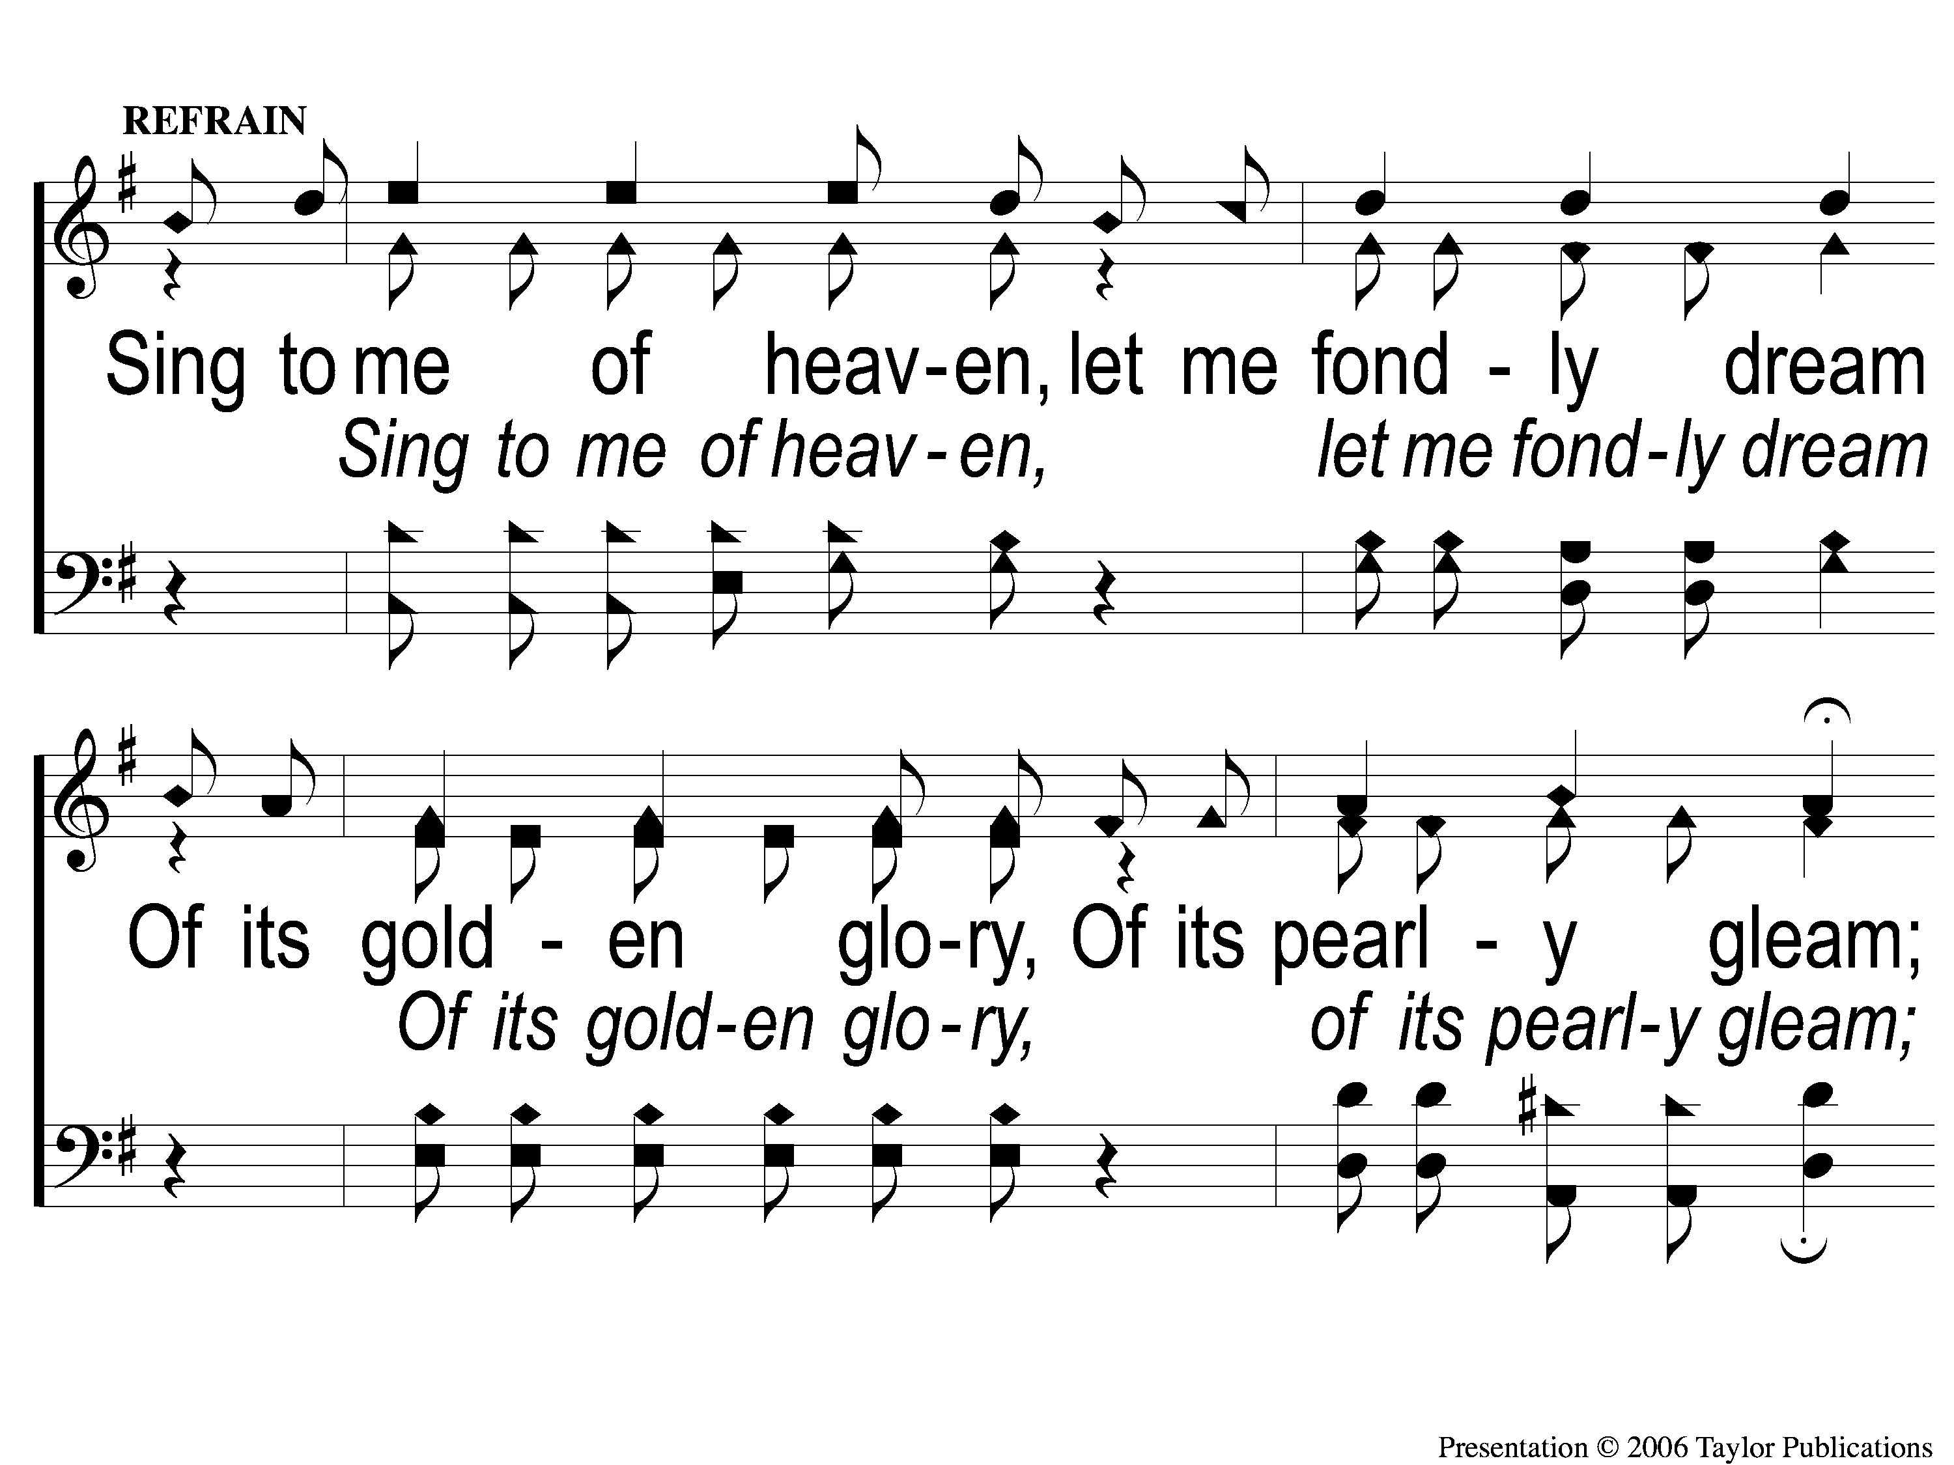
C-1 Sing to Me of Heaven
Sing To Me of Heaven
716

Slide 27
C-2 Sing to Me of Heaven
Sing To Me of Heaven
716

Slide 28
3-1 Sing to Me of Heaven
Sing To Me of Heaven
716

Slide 29
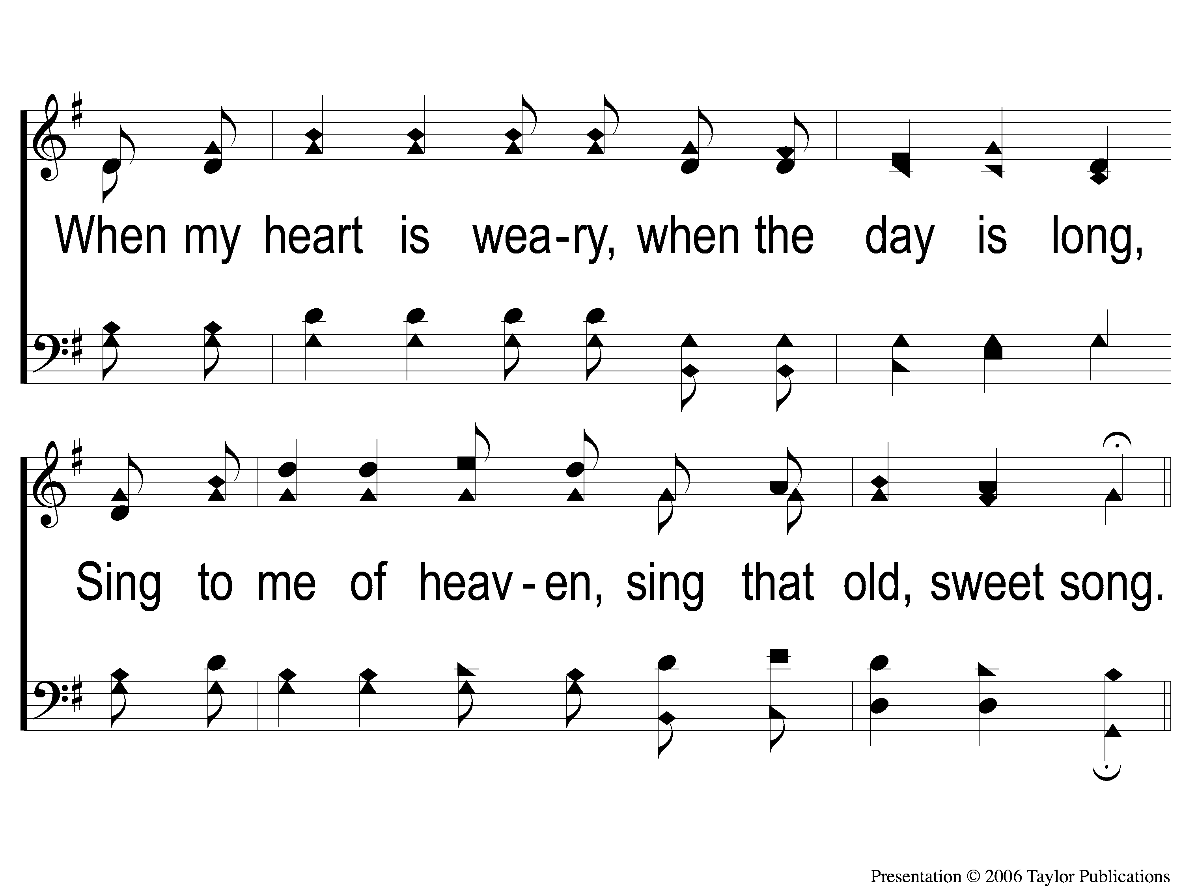
3-2 Sing to Me of Heaven
Sing To Me of Heaven
716

Slide 30
C-1 Sing to Me of Heaven
Sing To Me of Heaven
716

Slide 31
C-2 Sing to Me of Heaven
Sing To Me of Heaven
716

Slide 32
OPENING PRAYER

Slide 33
SONG:
Whispering hope
#497

Slide 34
1-1 Whispering Hope
Whispering Hope
497

Slide 35
1-2 Whispering Hope
Whispering Hope
497

Slide 36
1-3 Whispering Hope
Whispering Hope
497

Slide 37
C-1 Whispering Hope
Whispering Hope
497

Slide 38
C-2 Whispering Hope
Whispering Hope
497

Slide 39
2-1 Whispering Hope
Whispering Hope
497

Slide 40
2-2 Whispering Hope
Whispering Hope
497

Slide 41
2-3 Whispering Hope
Whispering Hope
497

Slide 42
C-1 Whispering Hope
Whispering Hope
497

Slide 43
C-2 Whispering Hope
Whispering Hope
497

Slide 44
3-1 Whispering Hope
Whispering Hope
497

Slide 45
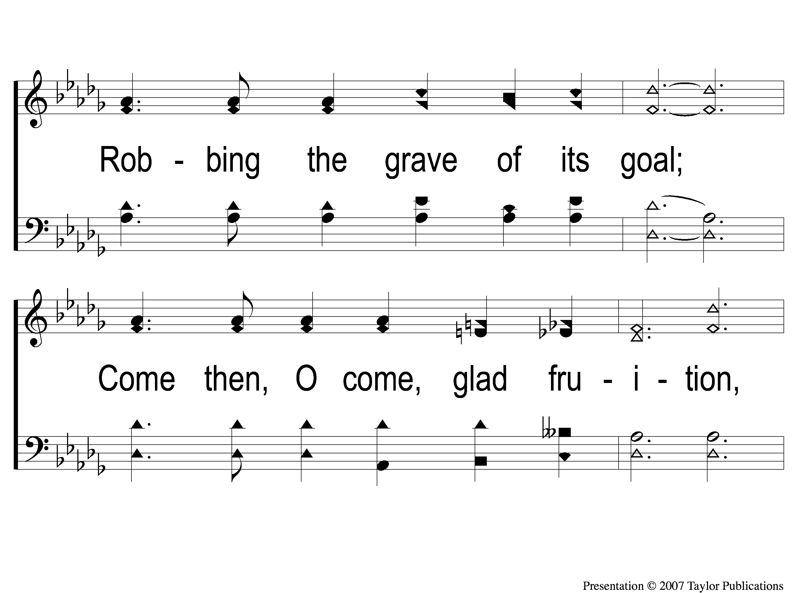
3-2 Whispering Hope
Whispering Hope
497

Slide 46
3-3 Whispering Hope
Whispering Hope
497

Slide 47
C-1 Whispering Hope
Whispering Hope
497

Slide 48
C-2 Whispering Hope
Whispering Hope
497

Slide 49
SONG:
Heaven came down
#517

Slide 50
1-1 Heaven Came Down
Heaven Came Down
517

Slide 51
1-2 Heaven Came Down
Heaven Came Down
517

Slide 52
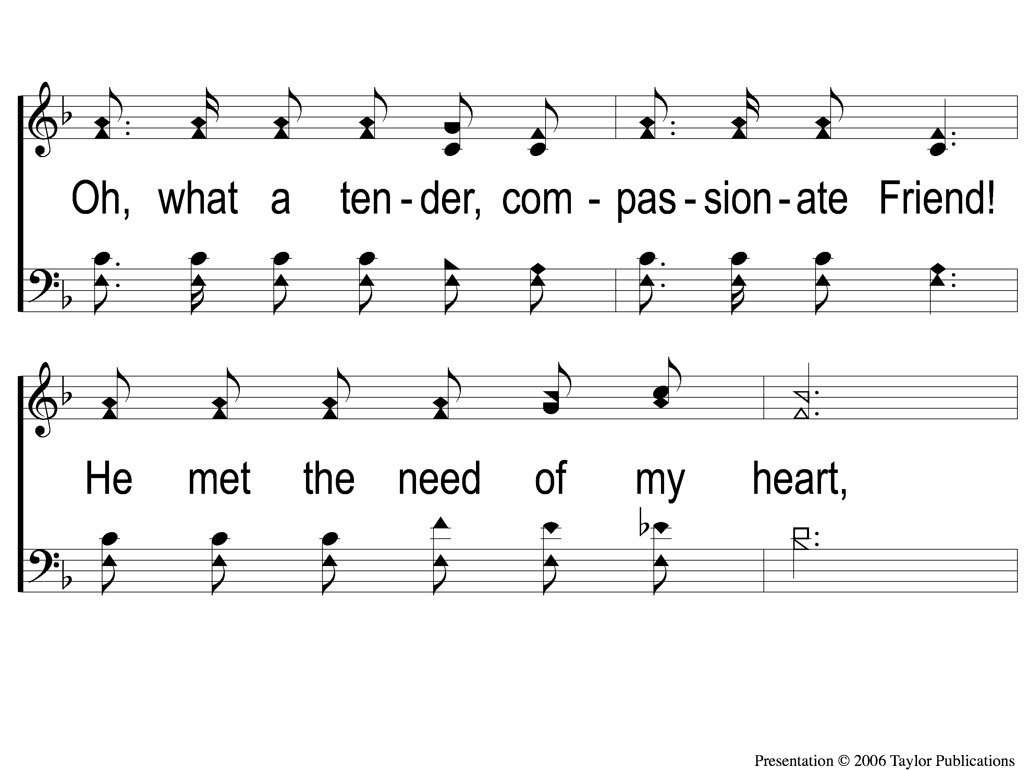
1-3 Heaven Came Down
Heaven Came Down
517

Slide 53
1-4 Heaven Came Down
Heaven Came Down
517

Slide 54
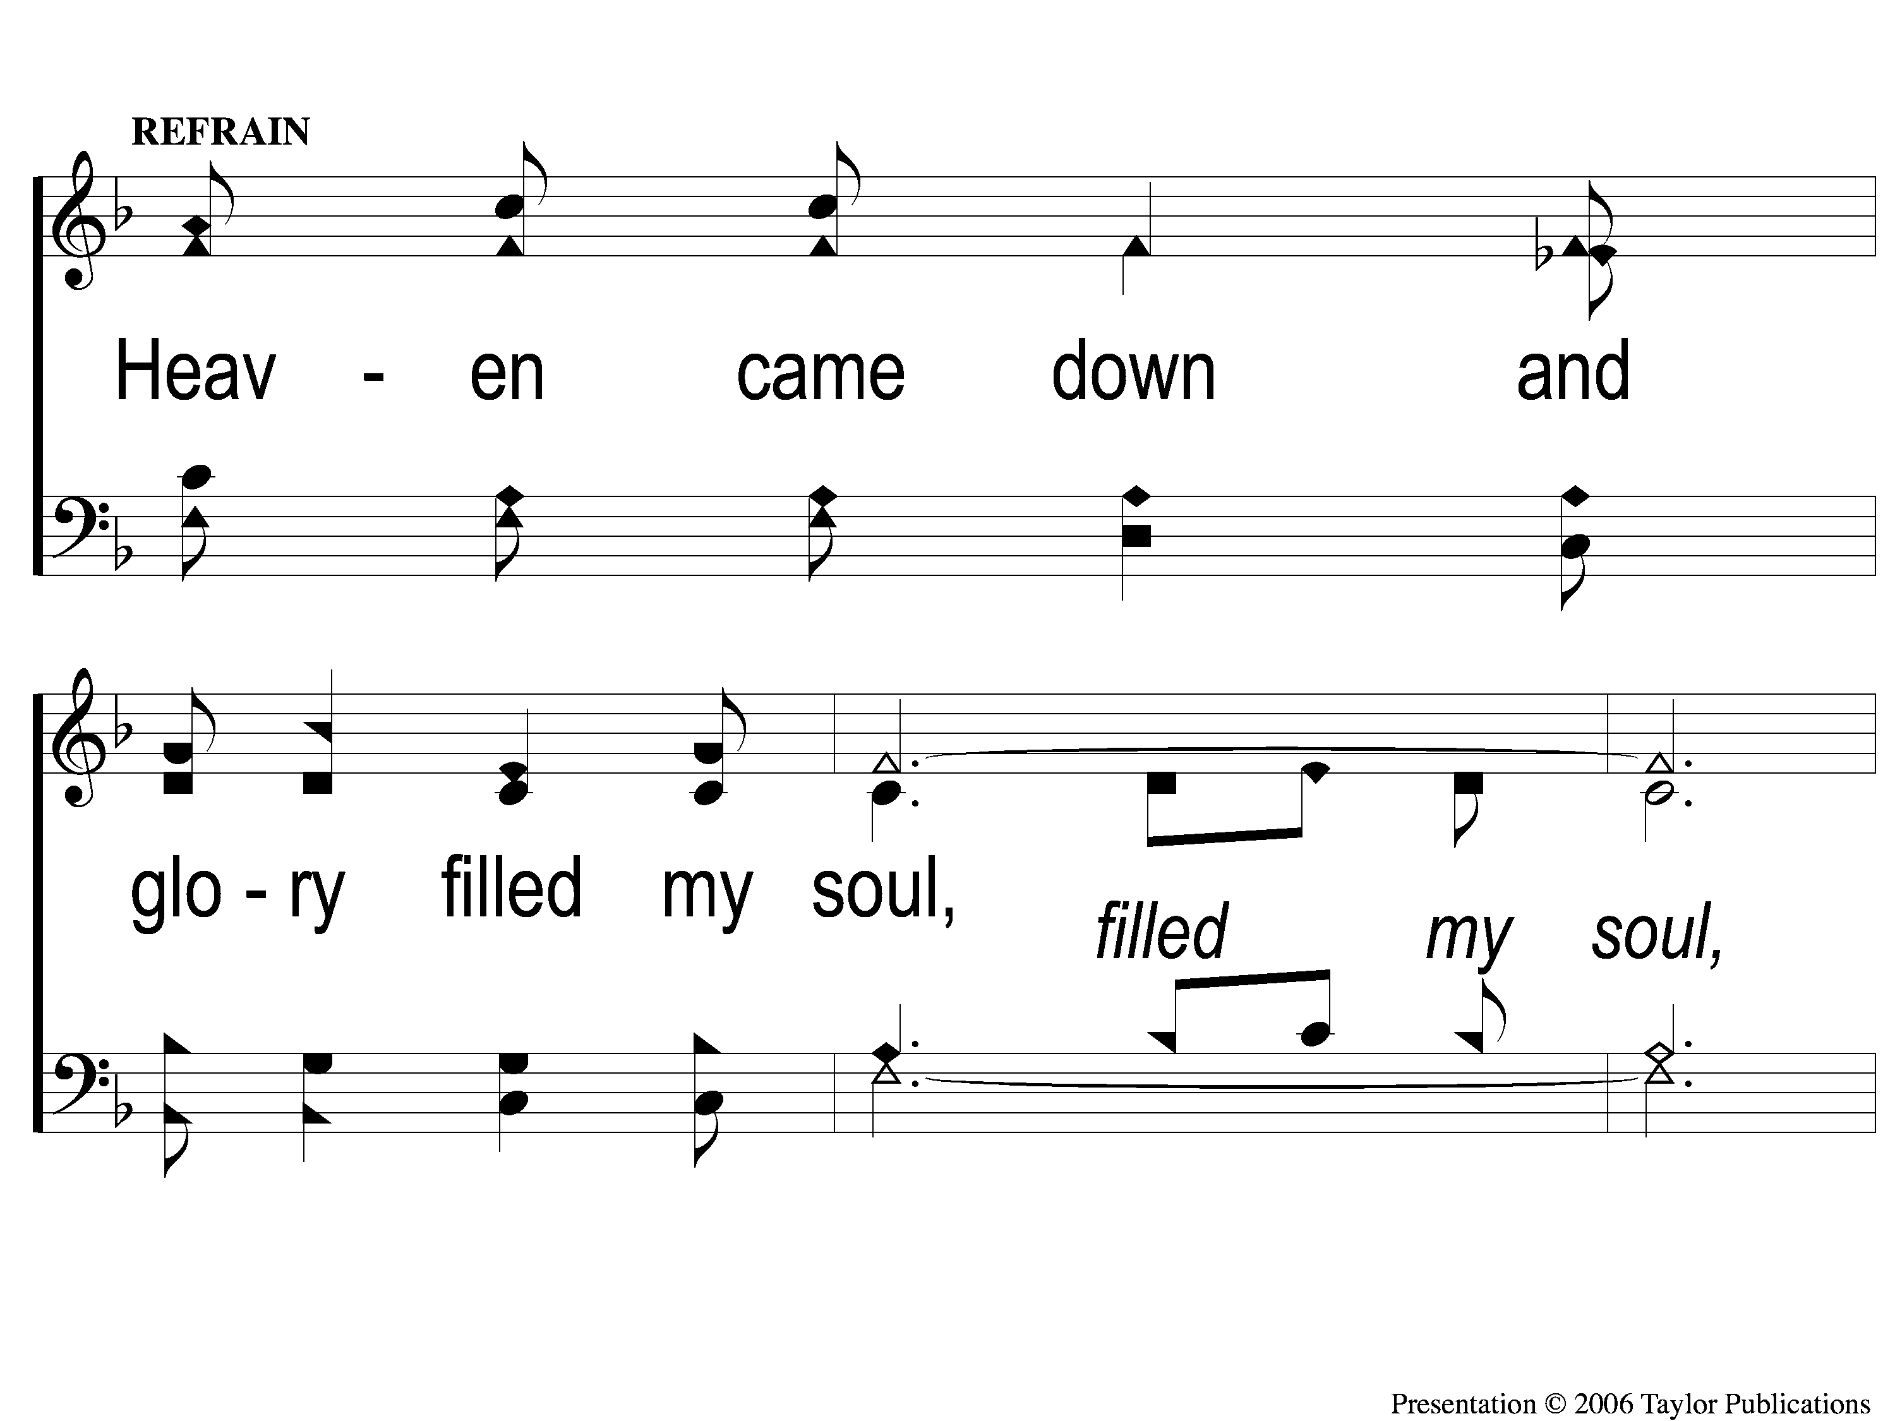
C-1 Heaven Came Down
Heaven Came Down
517

Slide 55
C-2 Heaven Came Down
Heaven Came Down
517

Slide 56
C-3 Heaven Came Down
Heaven Came Down
517

Slide 57
3-1 Heaven Came Down
Heaven Came Down
517

Slide 58
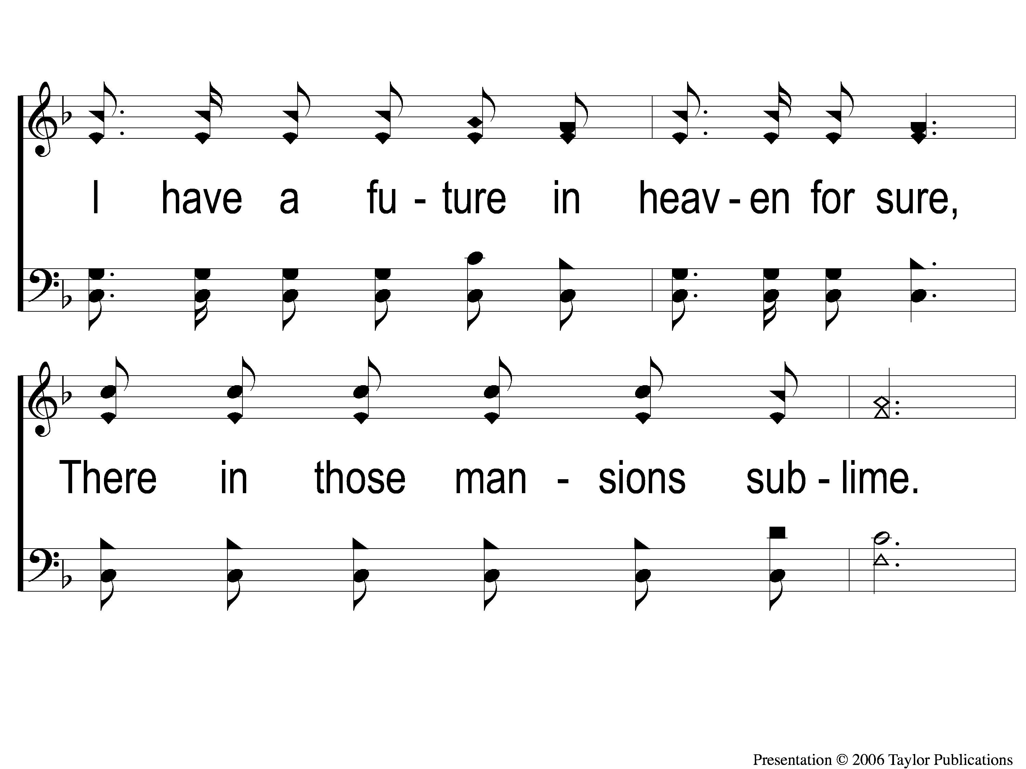
3-2 Heaven Came Down
Heaven Came Down
517

Slide 59
3-3 Heaven Came Down
Heaven Came Down
517

Slide 60
3-4 Heaven Came Down
Heaven Came Down
517

Slide 61
C-1 Heaven Came Down
Heaven Came Down
517

Slide 62
C-2 Heaven Came Down
Heaven Came Down
517

Slide 63
C-3 Heaven Came Down
Heaven Came Down
517

Slide 64
SCRIPTURE READING:
Matthew 2:1-2

Slide 65
IN PURSUIT
OF THE KINGDOM

Slide 66
Who is Jesus?
According to matthew

Slide 67
“When Jesus came into the region of Caesarea Philippi, He asked His disciples, saying,
‘Who do men say that I, the Son of Man, am?”
– Matt. 16:13

Slide 68
“JESUS OF NAZARETH
King of the jews”

Slide 69
Who is jesus?
The NAZARENE

Slide 70
Who is Jesus?
The NAZARENE
Matt 1:19-23
Jn. 1:46
Isa. 53:3

Slide 71
Who is jesus?
The NAZARENE
The KING OF THE JEWS

Slide 72
Who is Jesus?
The king of the jews
At his birth
By a sign – 2:2b

Slide 73
Who is Jesus?
The king of the jews
At his birth
By a sign – 2:2b
By the wise men – 2:1-2a, 7-12

Slide 74
Who is Jesus?
The king of the jews
At his birth
By a sign – 2:2b
By the wise men – 2:1-2a, 7-12
By HEROD – 2:3-8, 12, 16-17

Slide 75
Herodian dynasty
Antipater – 47-44 BC
Herod the great – 47-4 BC
Herod Archelaus – 4 BC – 6 AD
Herod ANTIPAS – 4 BC – 39 AD

Slide 76
Herodian dynasty
Antipater – 47-44 BC
Herod the great – 47-4 BC
Herod Archelaus – 4 BC – 6 AD
Herod ANTIPAS – 4 BC – 39 AD

Slide 77
Herodian dynasty
Antipater – 47-44 BC
Herod the great – 47-4 BC
Herod Archelaus – 4 BC – 6 AD
Herod ANTIPAS – 4 BC – 39 AD

Slide 78
Herodian dynasty
Antipater – 47-44 BC
Herod the great – 47-4 BC
Herod Archelaus – 4 BC – 6 AD
Herod ANTIPAS – 4 BC – 39 AD

Slide 79
Herodian dynasty
Herod the great – 47-4 BC
GOVERNOR OF GALILEE – 47-44 BC
TETRARCH OF GALILEE – 44-40 bc
KING OF JUDAEA – 37-4 bc

Slide 80
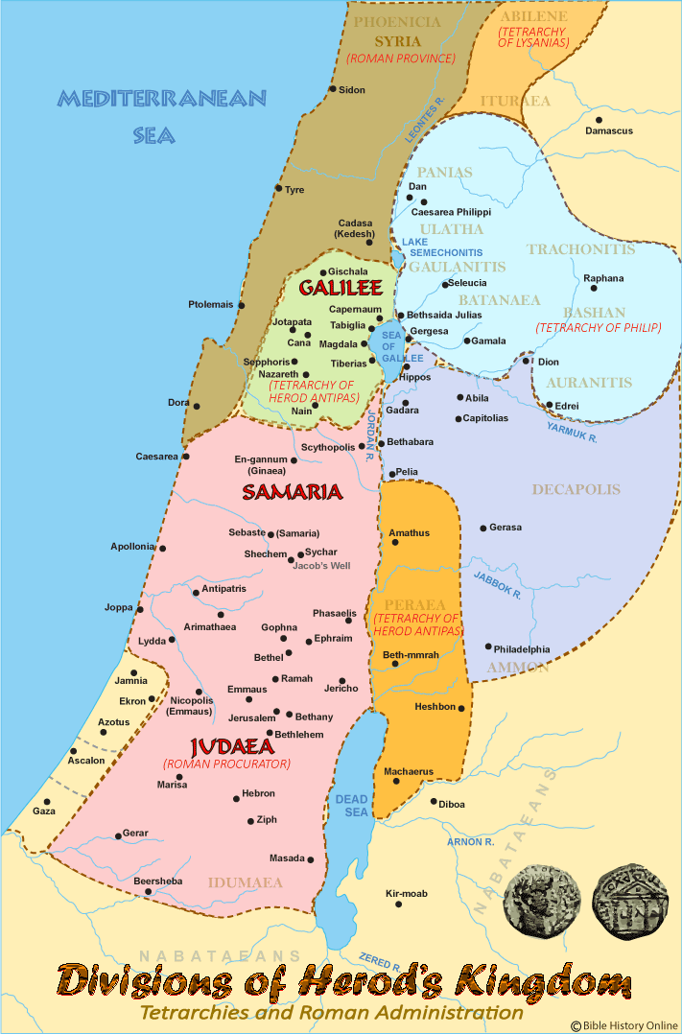

Slide 81
Who is Jesus?
The king of the jews
At his birth
By a sign – 2:2b
By the wise men – 2:1-2a, 7-12
By HEROD – 2:3-8, 12, 16-17

Slide 82
Who is Jesus?
The king of the jews
At his death
By Jesus’ words – 27:11

Slide 83
Who is Jesus?
The king of the jews
At his death
By Jesus’ words – 27:11
By mockers/unbelievers – 27:29, LK. 23:39

Slide 84
Who is Jesus?
The king of the jews
At his death
By Jesus’ words – 27:11
By mockers/unbelievers – 27:29, LK. 23:39
By PILATE – 27:37, Mk. 15:9, 11, 13, Jn. 19:14-15

Slide 85
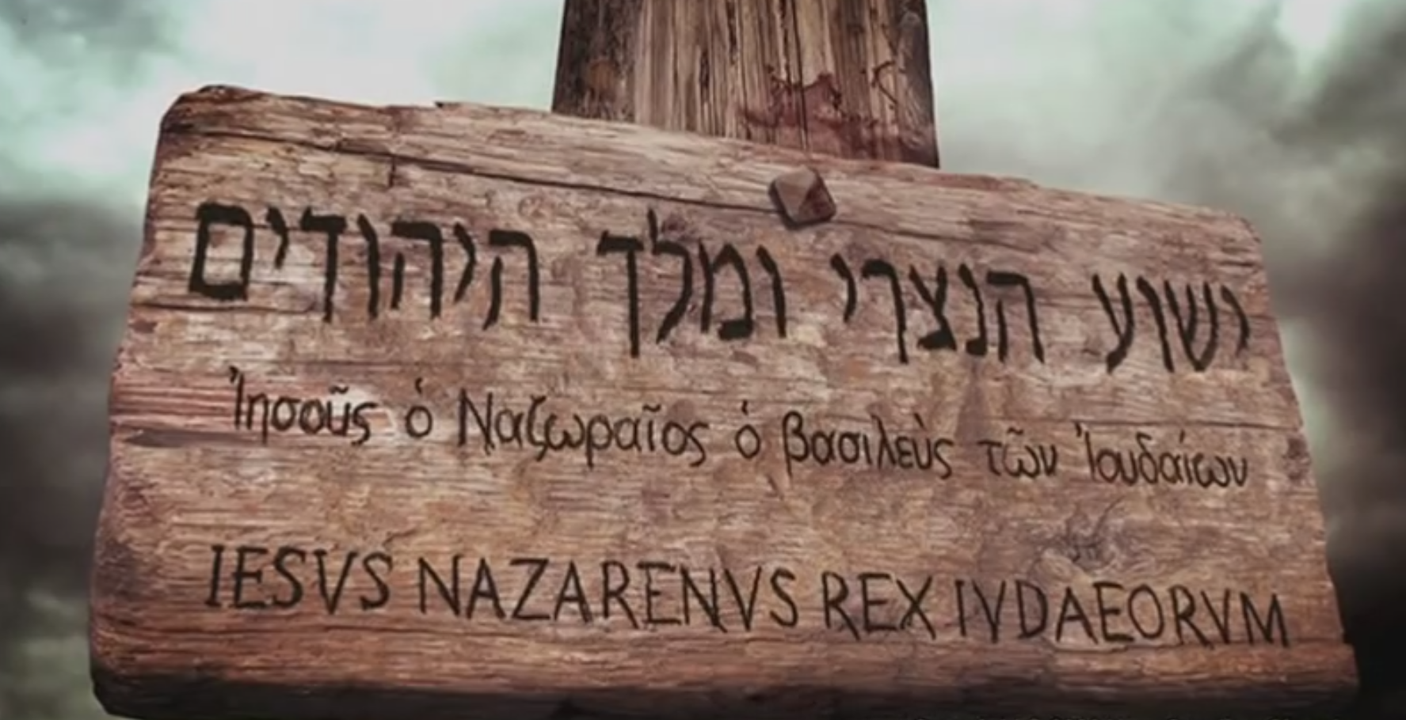

Slide 86
DO you RECOGNIZE
JESUS OF NAZARETH AS KING?

Slide 87
Invitation SONG:
There’s a fountain free
#909

Slide 88
1-1 There’s A Fountain free
There’s A Fountain Free
909

Slide 89
1-2 There’s A Fountain free
There’s A Fountain Free
909

Slide 90
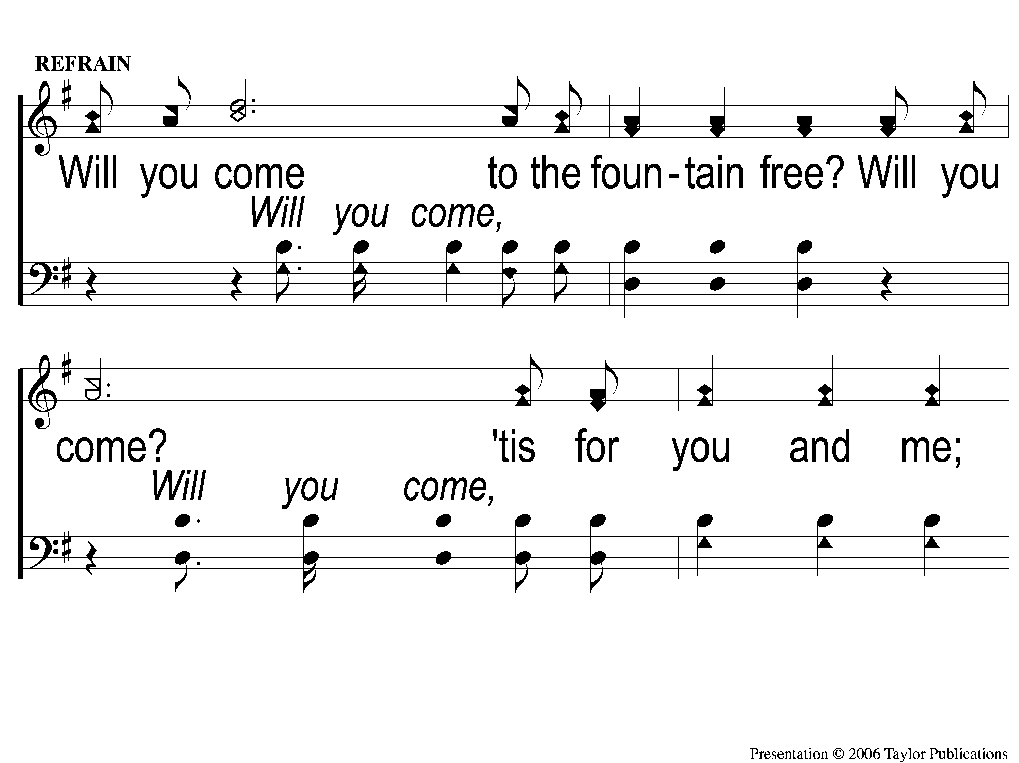
C-1 There’s A Fountain free
There’s A Fountain Free
909

Slide 91
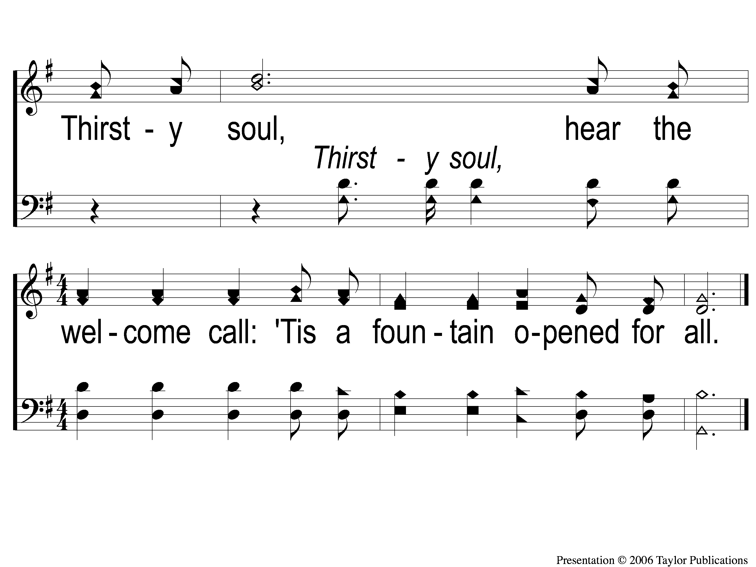
C-2 There’s A Fountain free
There’s A Fountain Free
909

Slide 92
3-1 There’s A Fountain free
There’s A Fountain Free
909

Slide 93
3-2 There’s A Fountain free
There’s A Fountain Free
909

Slide 94
C-1 There’s A Fountain free
There’s A Fountain Free
909

Slide 95
C-2 There’s A Fountain free
There’s A Fountain Free
909

Slide 96
OUR CONTRIBUTION
Hebrews 13:15-16
“Therefore by Him let us continually offer the sacrifice of praise to God, that is, the fruit of our lips, giving thanks to His name. But do not forget to do good and to share, for with such sacrifices God is well pleased.”

Slide 97
SONG:
When my love to christ grows weak
#350

Slide 98
1-1 When My Love To Christ Grows Weak
When My Love to Christ Grows Weak
350

Slide 99
1-2 When My Love To Christ Grows Weak
When My Love to Christ Grows Weak
350

Slide 100
2-1 When My Love To Christ Grows Weak
When My Love to Christ Grows Weak
350

Slide 101
2-2 When My Love To Christ Grows Weak
When My Love to Christ Grows Weak
350

Slide 102
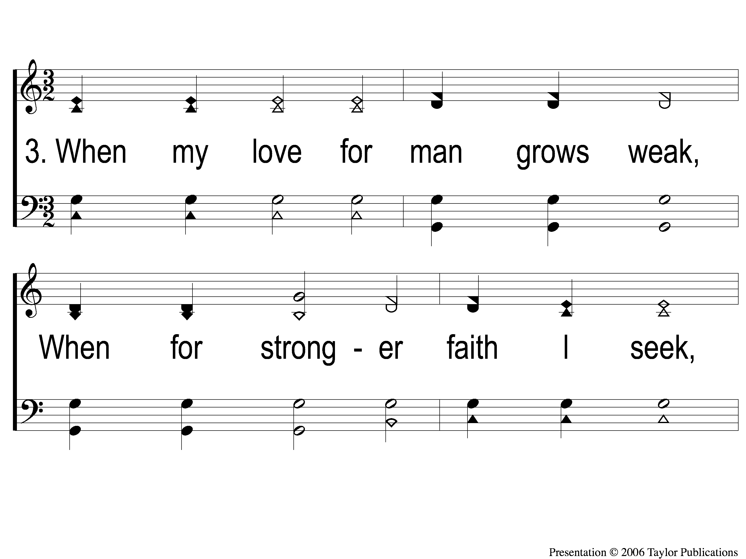
3-1 When My Love To Christ Grows Weak
When My Love to Christ Grows Weak
350

Slide 103
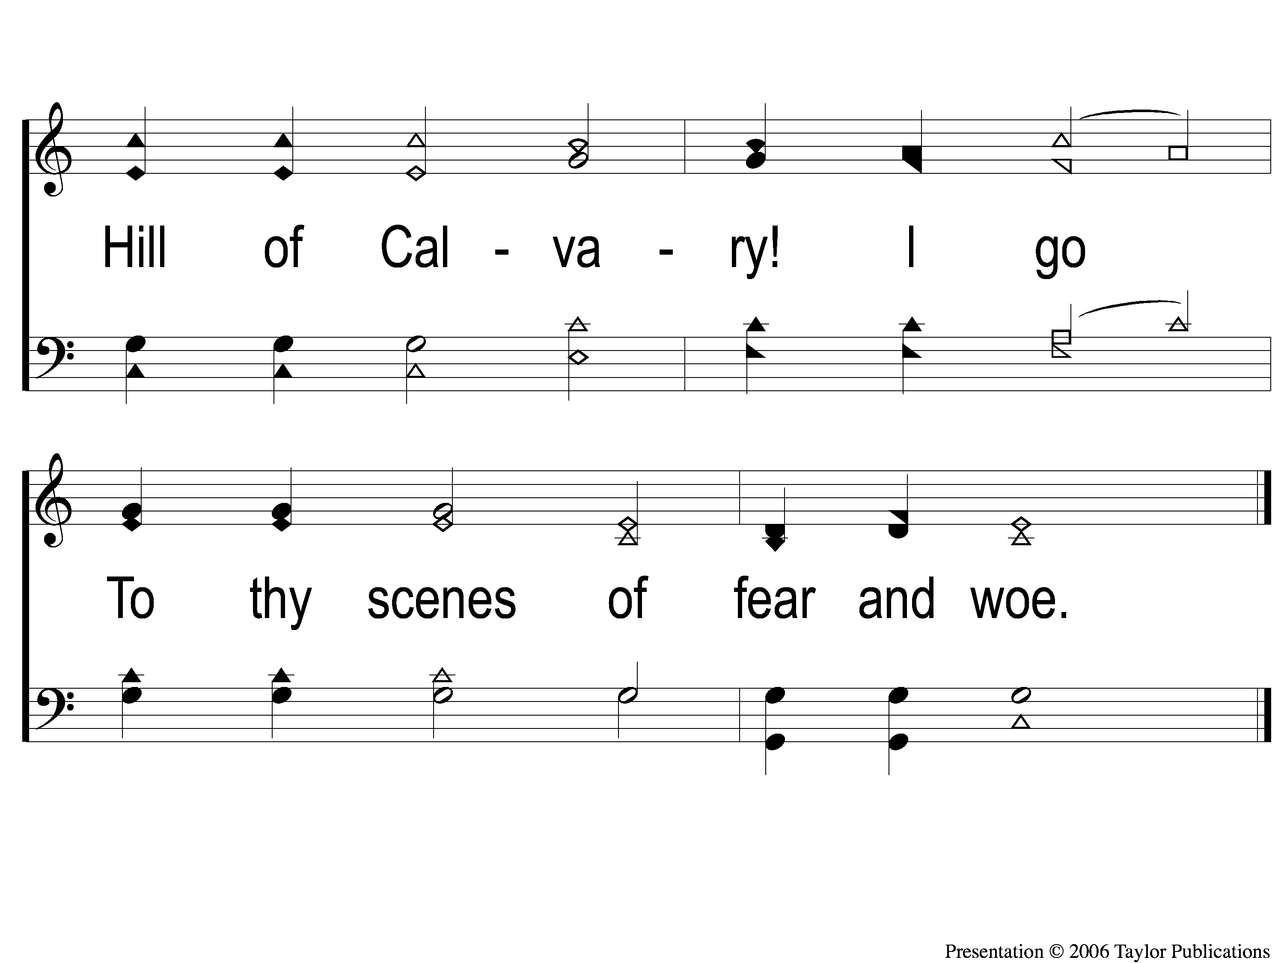
3-2 When My Love To Christ Grows Weak
When My Love to Christ Grows Weak
350

Slide 104
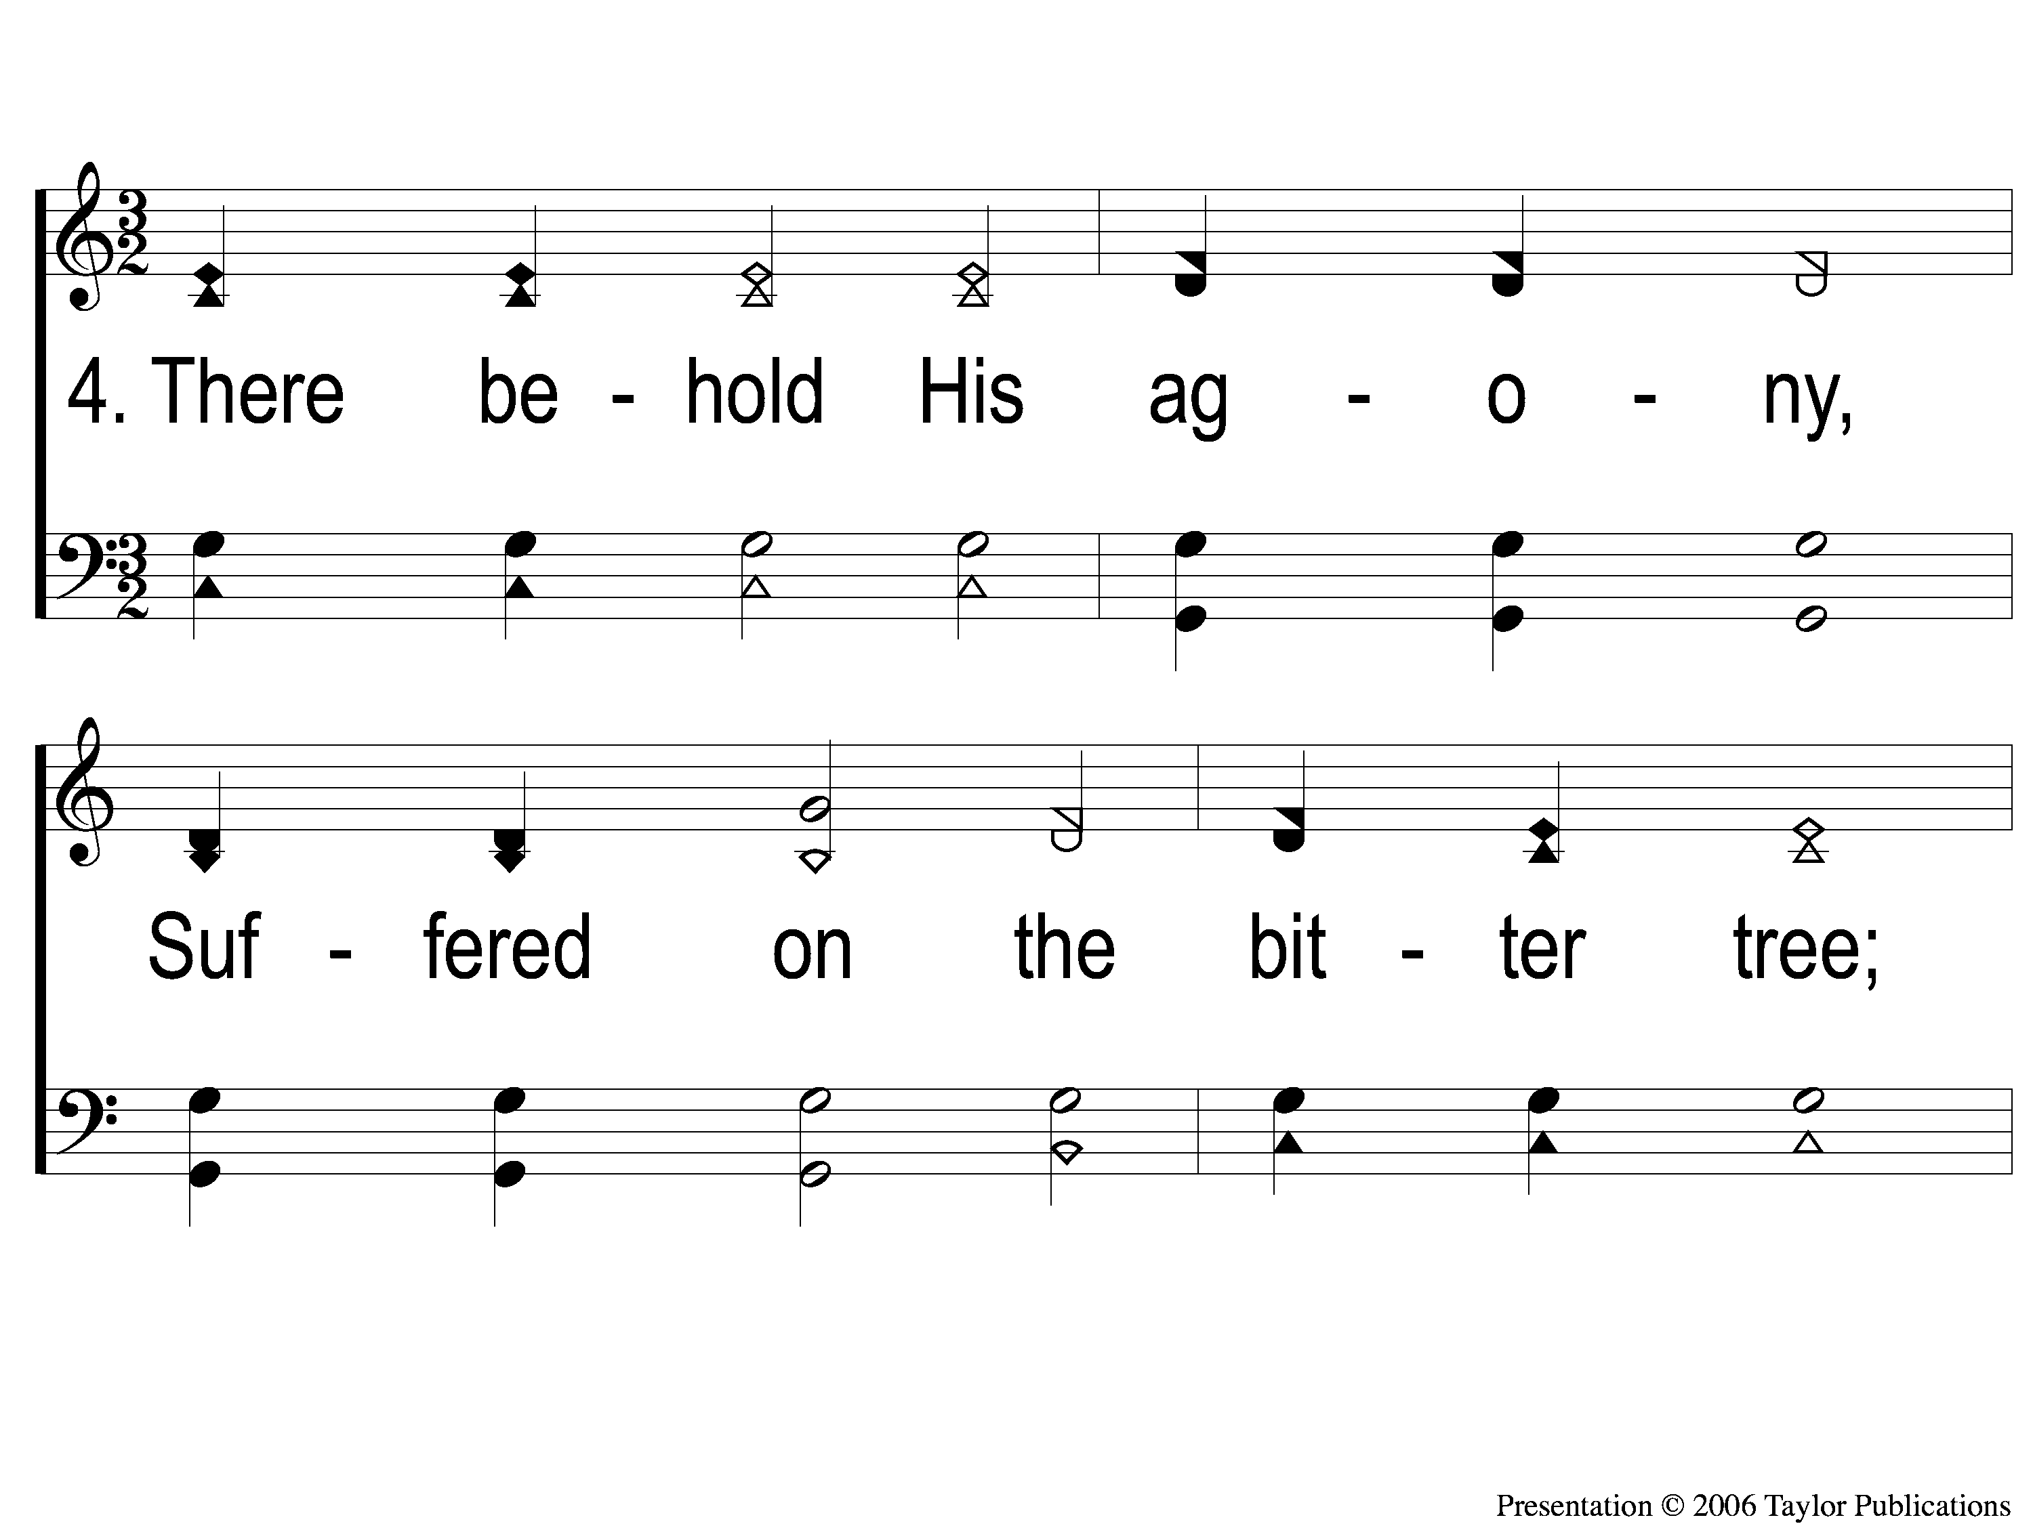
4-1 When My Love To Christ Grows Weak
When My Love to Christ Grows Weak
350

Slide 105
4-2 When My Love To Christ Grows Weak
When My Love to Christ Grows Weak
350

Slide 106
5-1 When My Love To Christ Grows Weak
When My Love to Christ Grows Weak
350

Slide 107
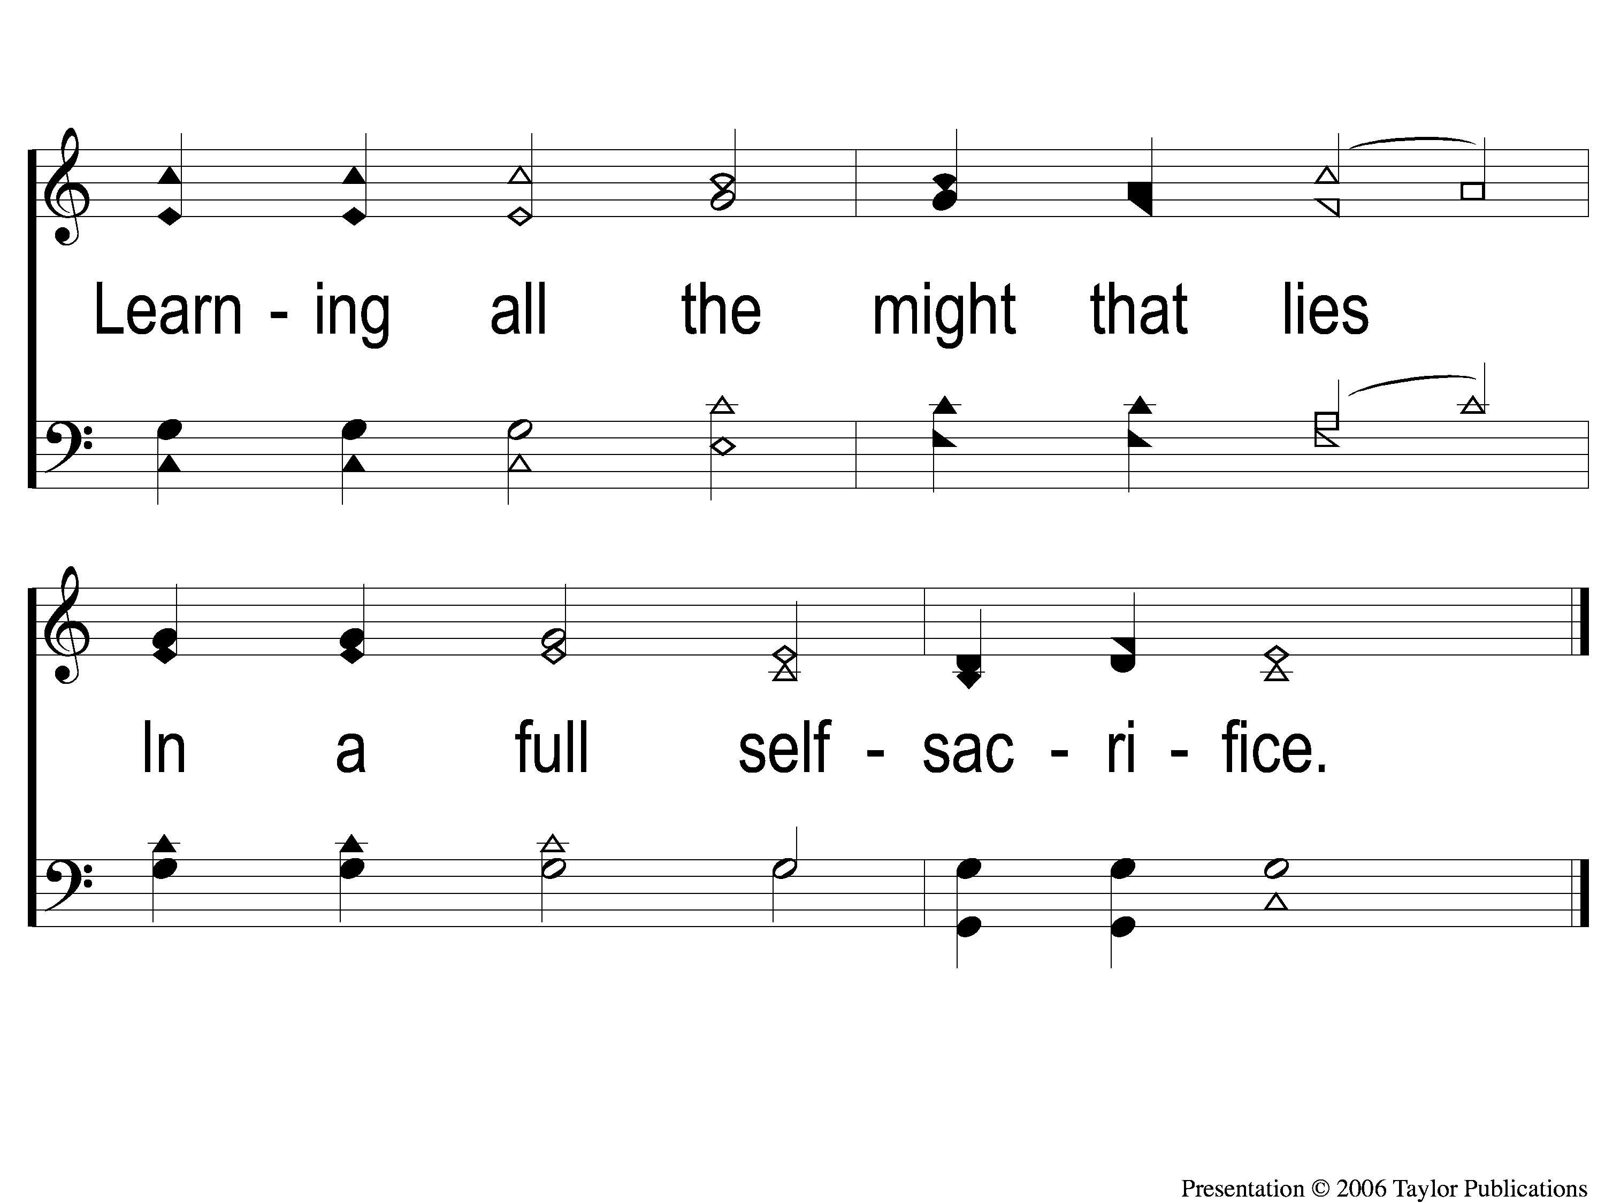
5-2 When My Love To Christ Grows Weak
When My Love to Christ Grows Weak
350

Slide 108
THE UNLEAVENED BREAD
Hebrews 4:14-16
“Seeing then that we have a great High Priest who has passed through the heavens, Jesus the Son of God, let us hold fast our confession. for we do not have a High Priest who cannot sympathize with our weaknesses, but was in all points tempted as we are, yet without sin. Let us therefore come boldly to the throne of grace, that we may obtain mercy and find grace to help in time of need.”

Slide 109
THE FRUIT OF THE VINE
Hebrews 9:11-15
“But Christ came as High Priest of the good things to come, with the greater and more perfect tabernacle not made with hands, that is, not of this creation. Not with the blood of goats and calves, but with His own blood He entered the Most Holy Place once for all, having obtained eternal redemption. For if the blood of bulls and goats and the ashes of a heifer, sprinkling the unclean, sanctifies for the purifying of the flesh, how much more shall the blood of Christ, who through the eternal Spirit offered Himself without spot to God, cleanse your conscience from dead works to serve the living God? And for this reason He is the Mediator of the new covenant, by means of death, for the redemption of the transgressions under the first covenant, that those who are called may receive the promise of the eternal inheritance.”

Slide 110
closing PRAYER

Slide 111
SONG:
To christ be true
#736

Slide 112
1-1 To Christ Be True
To Christ Be True
736

Slide 113
1-2 To Christ Be True
To Christ Be True
736

Slide 114
C-1 To Christ Be True
To Christ Be True
736

Slide 115
C-2 To Christ Be True
To Christ Be True
736

Slide 116
3-1 To Christ Be True
To Christ Be True
736

Slide 117
3-2 To Christ Be True
To Christ Be True
736

Slide 118
C-1 To Christ Be True
To Christ Be True
736

Slide 119
C-2 To Christ Be True
To Christ Be True
736

Slide 120
Today
LTC @ 3:00
WORSHIP @ 6:00
Wednesday
Worship & Bible classes @ 6:30

Slide 121
Today
Join us for a Meal in the mpb
Wednesday
Worship & Bible classes @ 6:30

