Slide 1
1 Highest Place
Highest Place
155

Slide 2
2 Highest Place
Highest Place
155

Slide 3
3 Highest Place
Highest Place
155

Slide 4
4 Highest Place
Highest Place
155

Slide 5
5 Highest Place
Highest Place
155

Slide 6
Tag Highest Place
Highest Place
155

Slide 7
WELCOME
To the Wheeler church of Christ

Slide 8
SONG:
A Beautiful life
#570

Slide 9
1-1 A Beautiful Life
A Beautiful Life
570

Slide 10
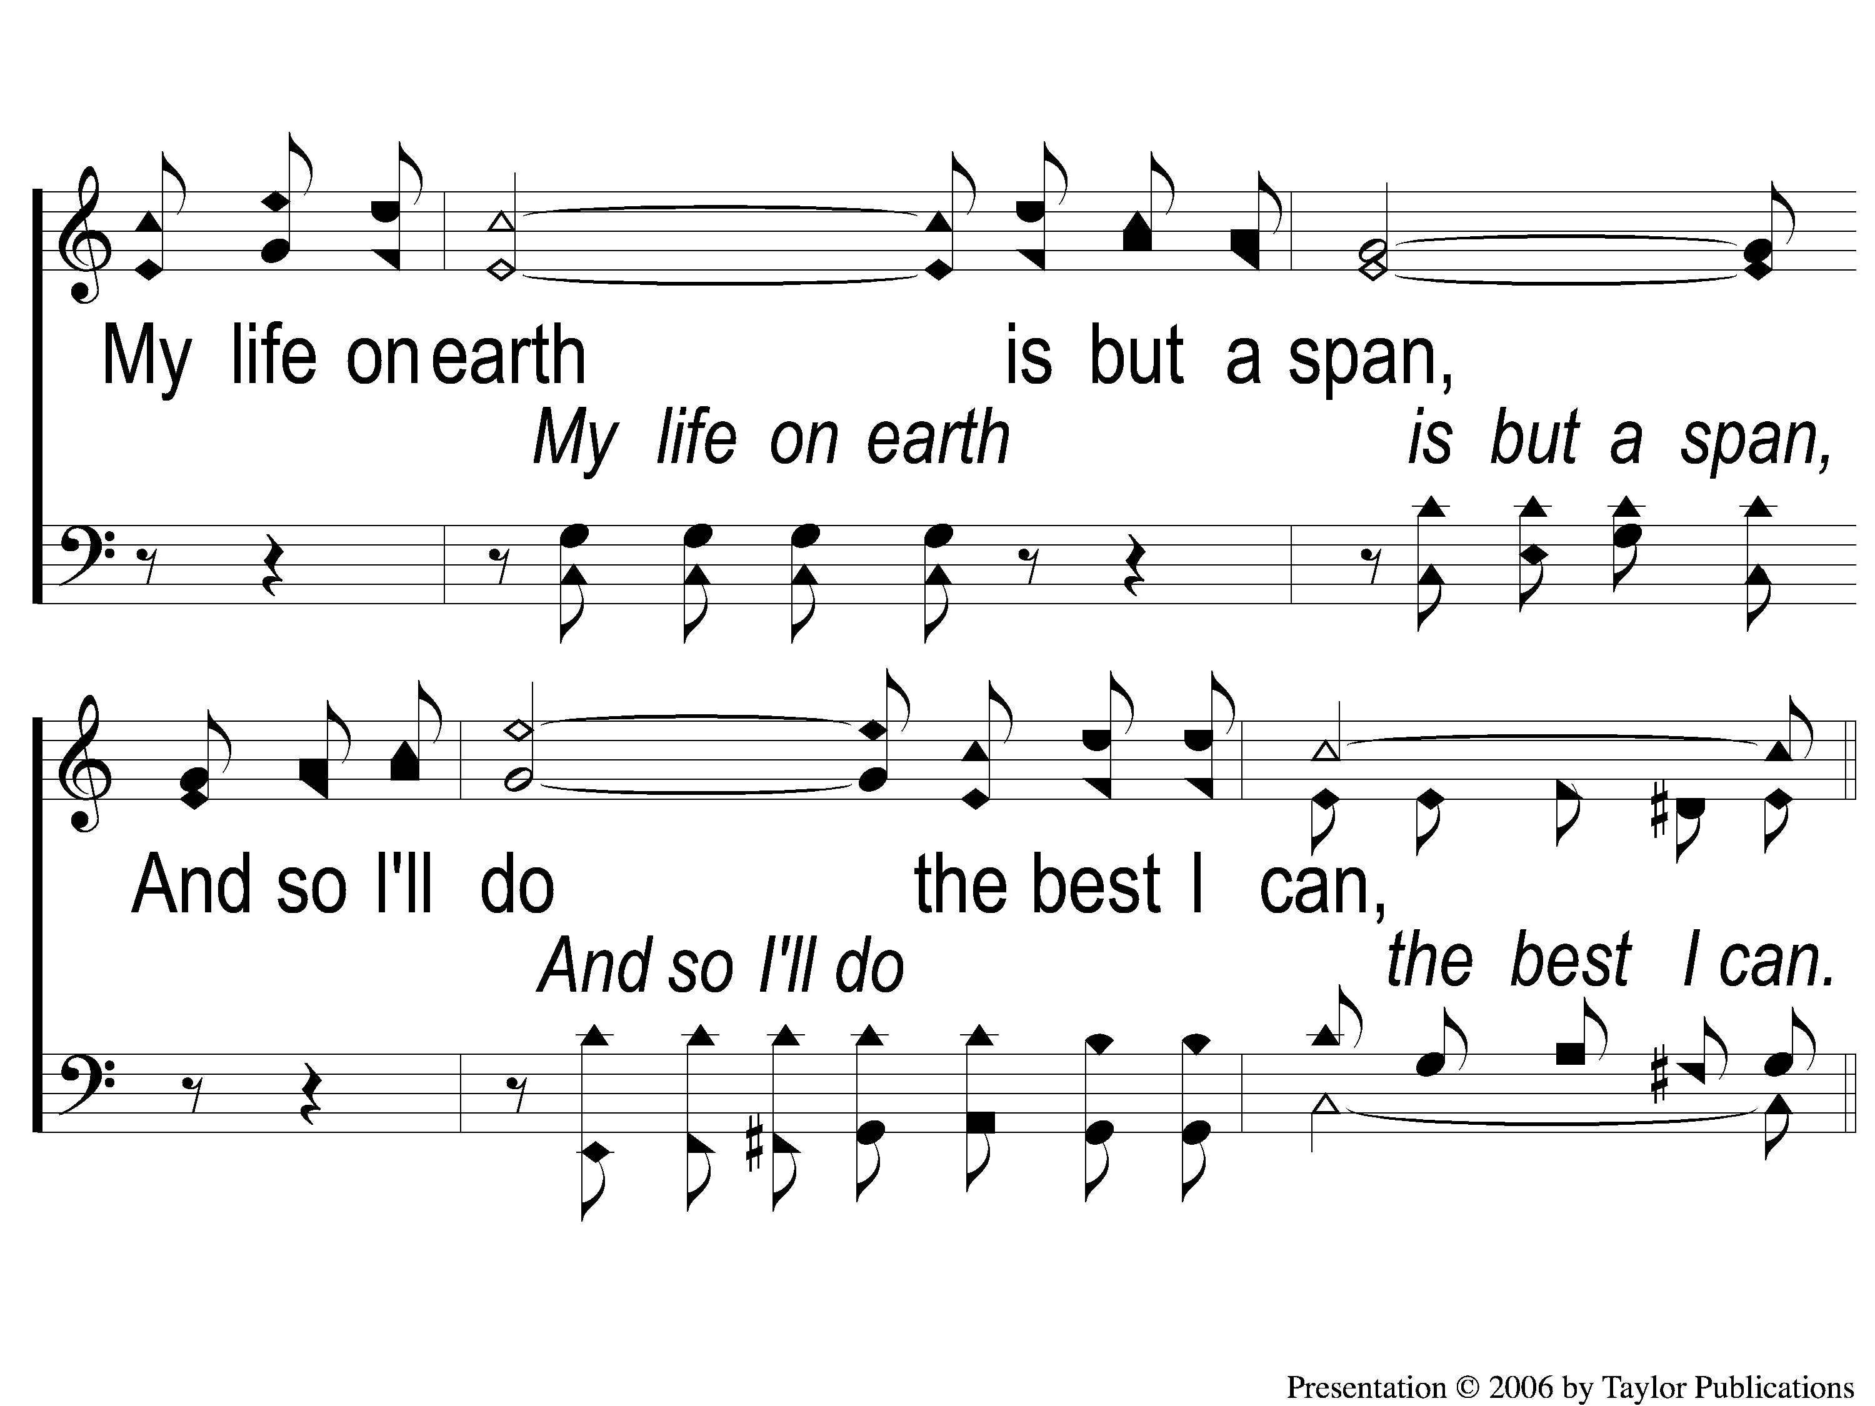
1-2 A Beautiful Life
A Beautiful Life
570

Slide 11
C-1 A Beautiful Life
A Beautiful Life
570

Slide 12
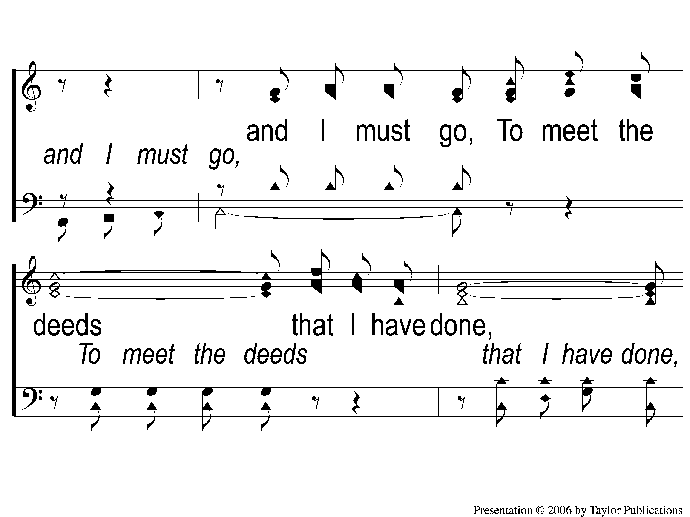
C-2 A Beautiful Life
A Beautiful Life
570

Slide 13
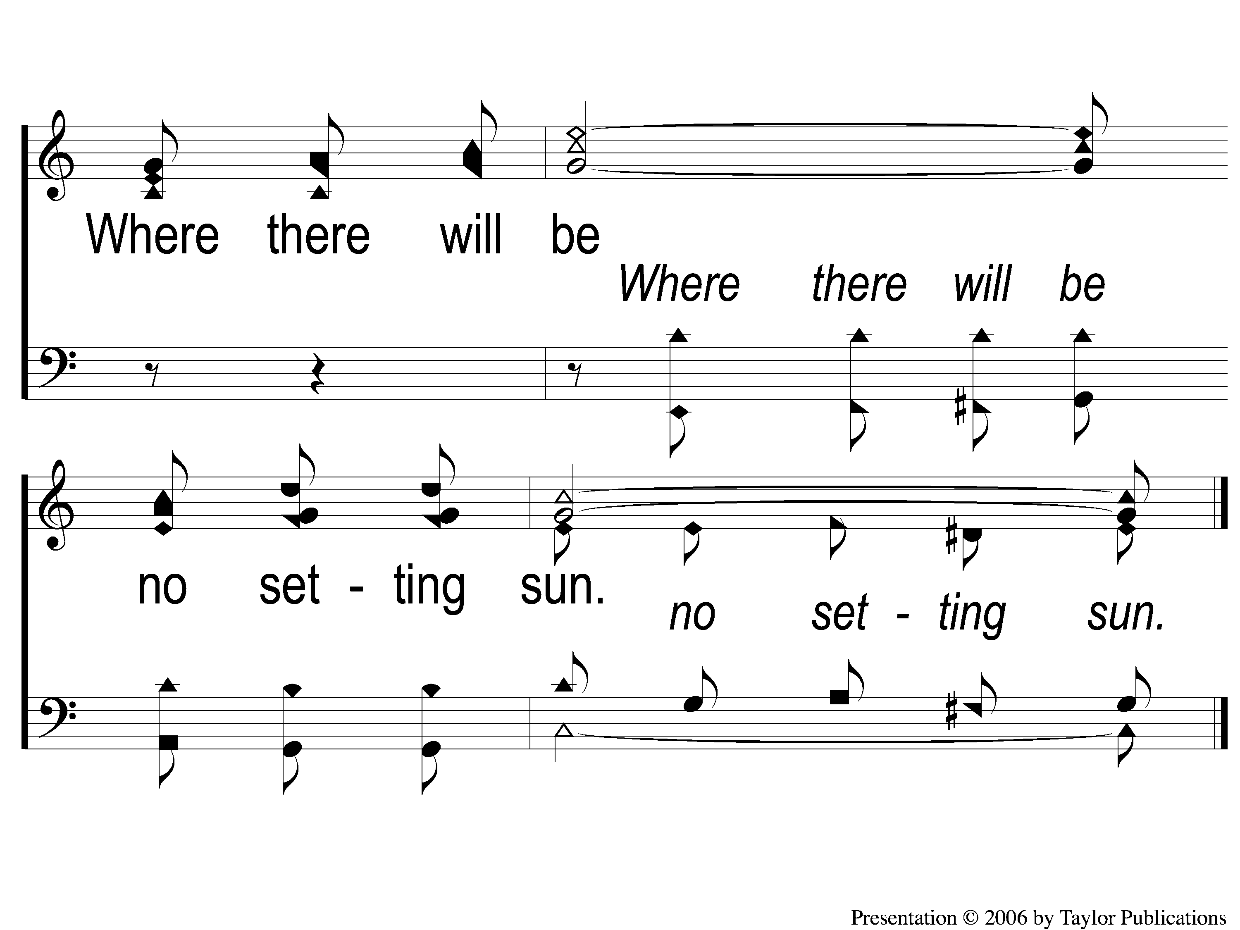
C-3 A Beautiful Life
A Beautiful Life
570

Slide 14
2-1 A Beautiful Life
A Beautiful Life
570

Slide 15
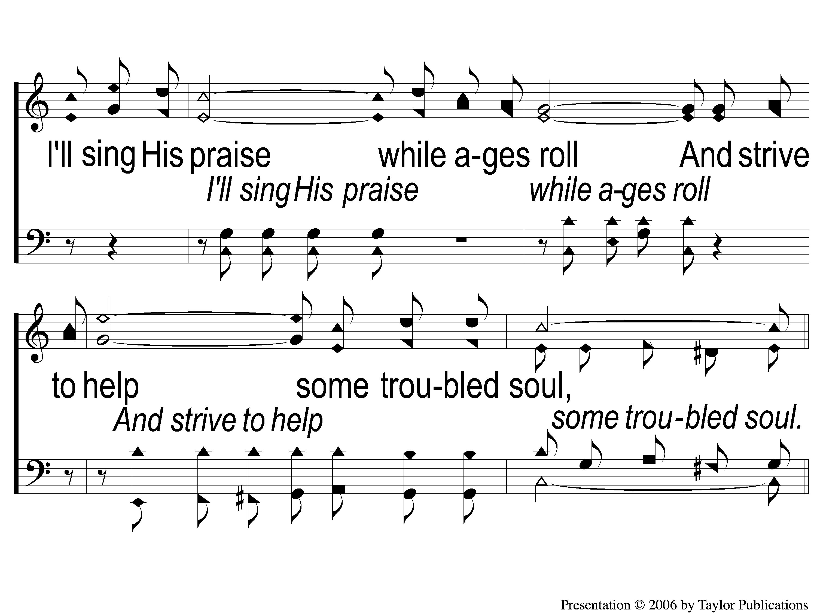
2-2 A Beautiful Life
A Beautiful Life
570

Slide 16
C-1 A Beautiful Life
A Beautiful Life
570

Slide 17
C-2 A Beautiful Life
A Beautiful Life
570

Slide 18
C-3 A Beautiful Life
A Beautiful Life
570

Slide 19
3-1 A Beautiful Life
A Beautiful Life
570

Slide 20
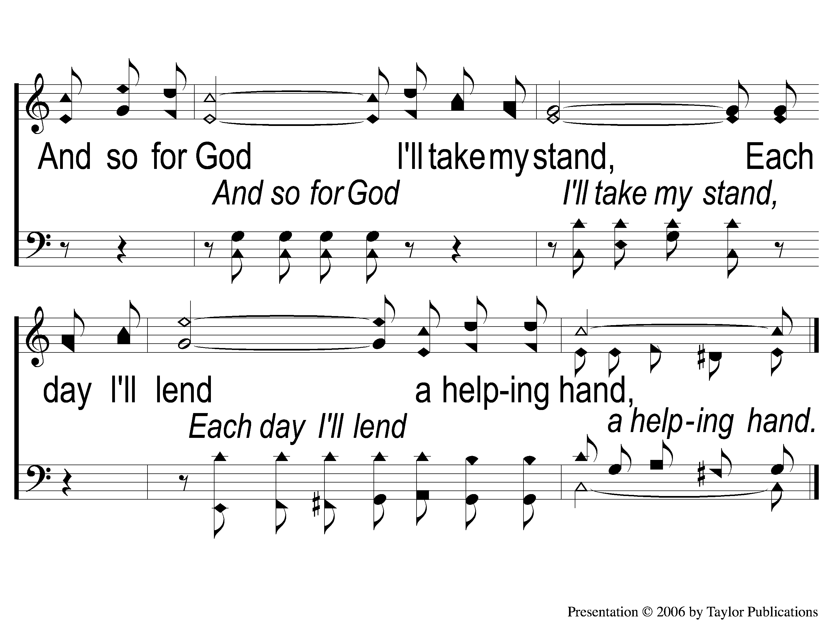
3-2 A Beautiful Life
A Beautiful Life
570

Slide 21
C-1 A Beautiful Life
A Beautiful Life
570

Slide 22
C-2 A Beautiful Life
A Beautiful Life
570

Slide 23
C-3 A Beautiful Life
A Beautiful Life
570

Slide 24
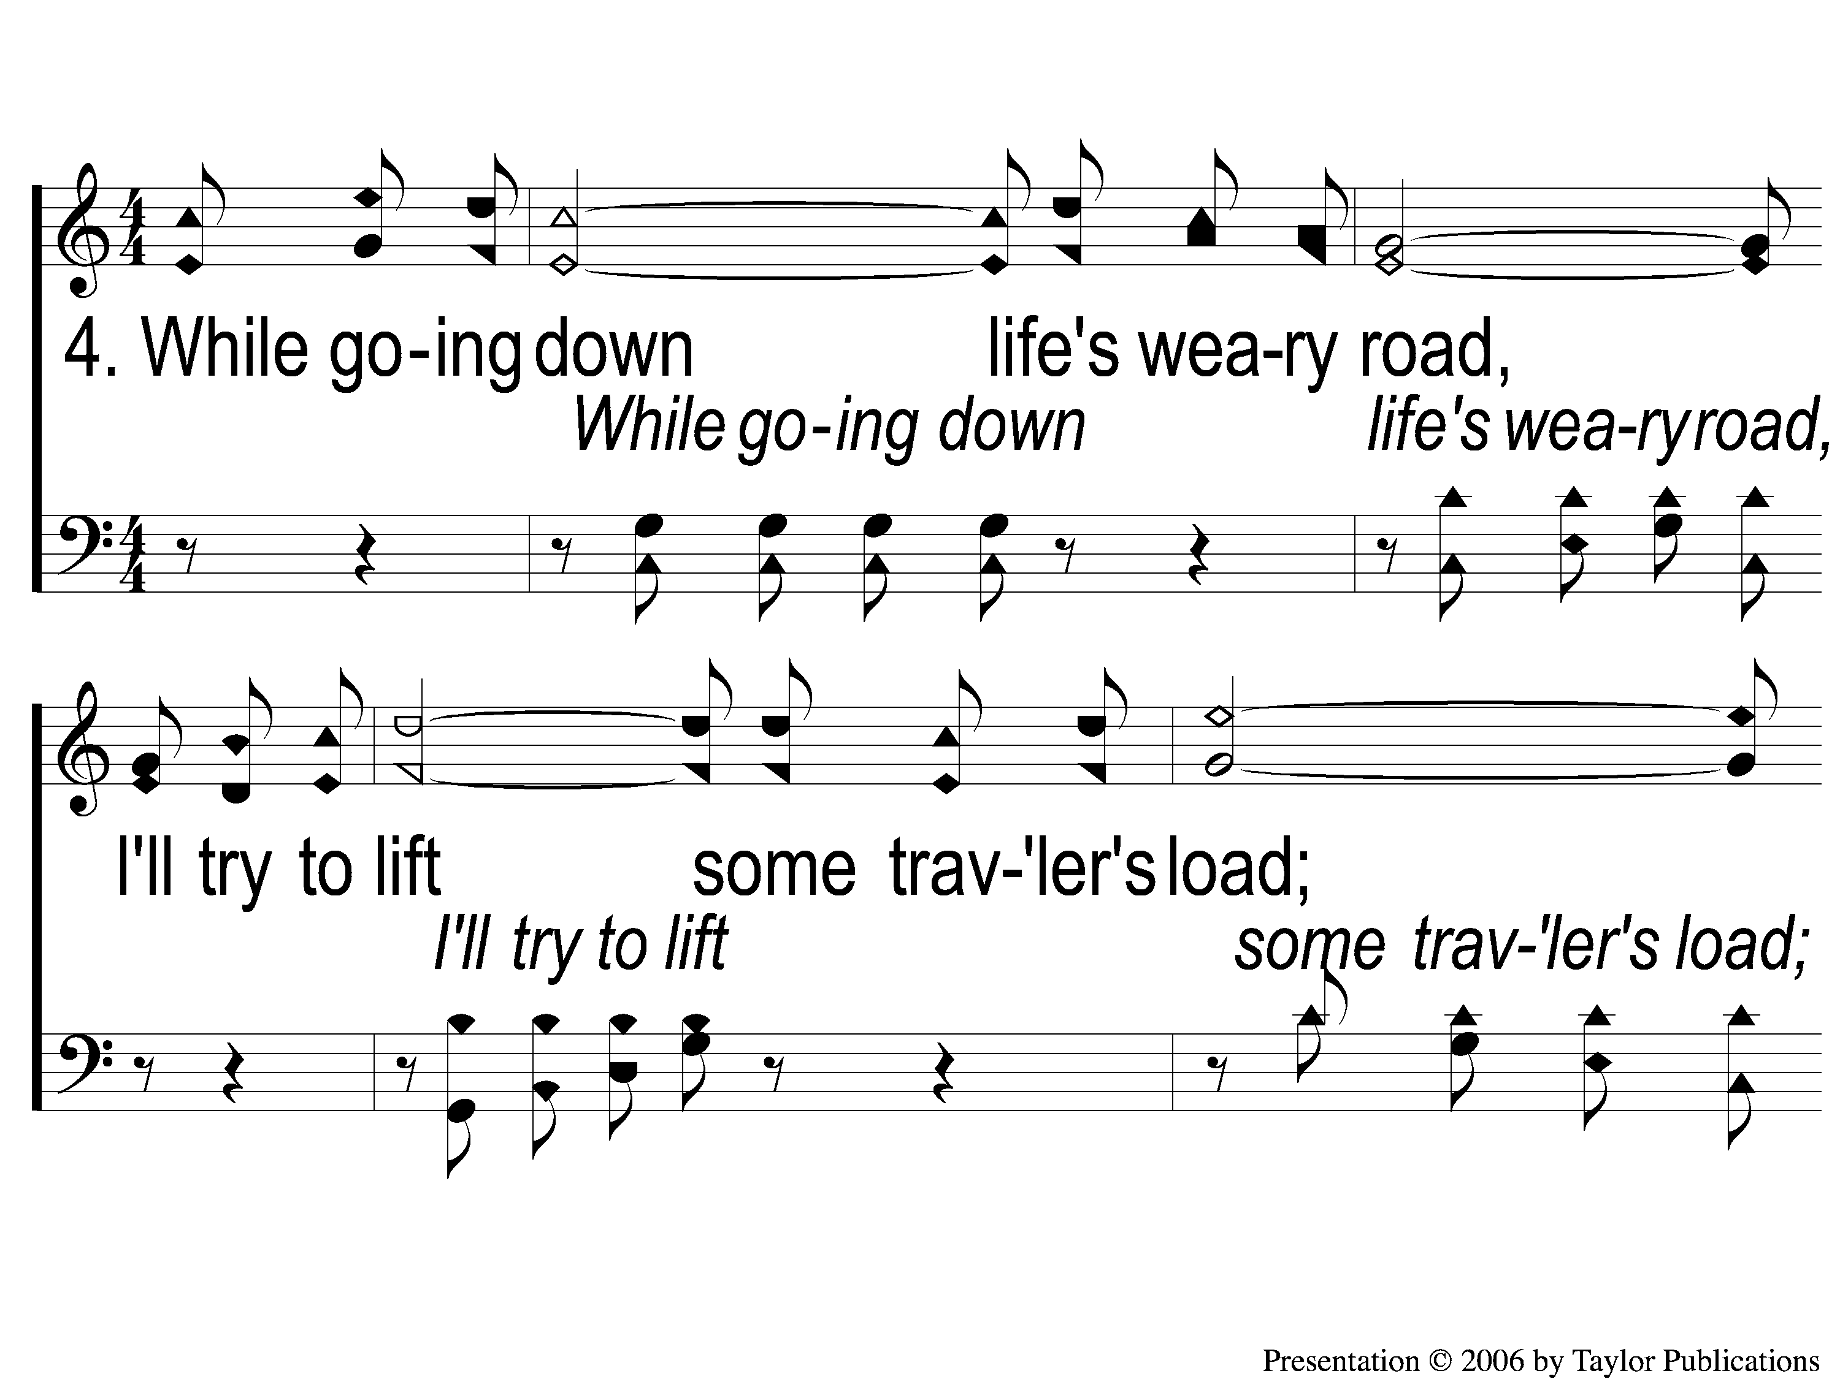
4-1 A Beautiful Life
A Beautiful Life
570

Slide 25
4-2 A Beautiful Life
A Beautiful Life
570

Slide 26
C-1 A Beautiful Life
A Beautiful Life
570

Slide 27
C-2 A Beautiful Life
A Beautiful Life
570

Slide 28
C-3 A Beautiful Life
A Beautiful Life
570

Slide 29
SONG:
Did you think to pray?
#848

Slide 30
1-1 Did You Think to Pray
Did You Think To Pray
848

Slide 31
1-2 Did You Think to Pray
Did You Think To Pray
848

Slide 32
C-1 Did You Think to Pray
Did You Think To Pray
848

Slide 33
C-2 Did You Think to Pray
Did You Think To Pray
848

Slide 34
2-1 Did You Think to Pray
Did You Think To Pray
848

Slide 35
2-2 Did You Think to Pray
Did You Think To Pray
848

Slide 36
C-1 Did You Think to Pray
Did You Think To Pray
848

Slide 37
C-2 Did You Think to Pray
Did You Think To Pray
848

Slide 38
4-1 Did You Think to Pray
Did You Think To Pray
848

Slide 39
4-2 Did You Think to Pray
Did You Think To Pray
848

Slide 40
C-1 Did You Think to Pray
Did You Think To Pray
848

Slide 41
C-2 Did You Think to Pray
Did You Think To Pray
848

Slide 42
OPENING PRAYER

Slide 43
SONG:
Farther along
#753

Slide 44
1-1 Farther Along
Farther Along
753

Slide 45
1-2 Farther Along
Farther Along
753

Slide 46
C-1 Farther Along
Farther Along
753

Slide 47
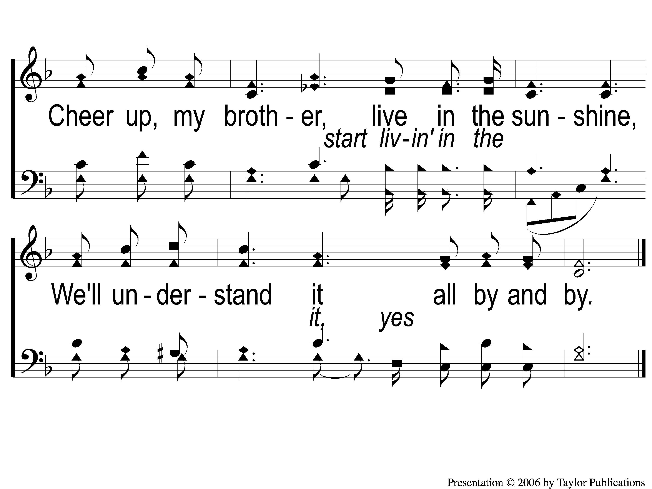
C-2 Farther Along
Farther Along
753

Slide 48
2-1 Farther Along
Farther Along
753

Slide 49
2-2 Farther Along
Farther Along
753

Slide 50
C-1 Farther Along
Farther Along
753

Slide 51
C-2 Farther Along
Farther Along
753

Slide 52
3-1 Farther Along
Farther Along
753

Slide 53
3-2 Farther Along
Farther Along
753

Slide 54
C-1 Farther Along
Farther Along
753

Slide 55
C-2 Farther Along
Farther Along
753

Slide 56
SONG:
We’ll work till jesus comes
#634

Slide 57
1-1 We’ll Work Till Jesus Comes
We’ll Work Till Jesus Comes
634

Slide 58
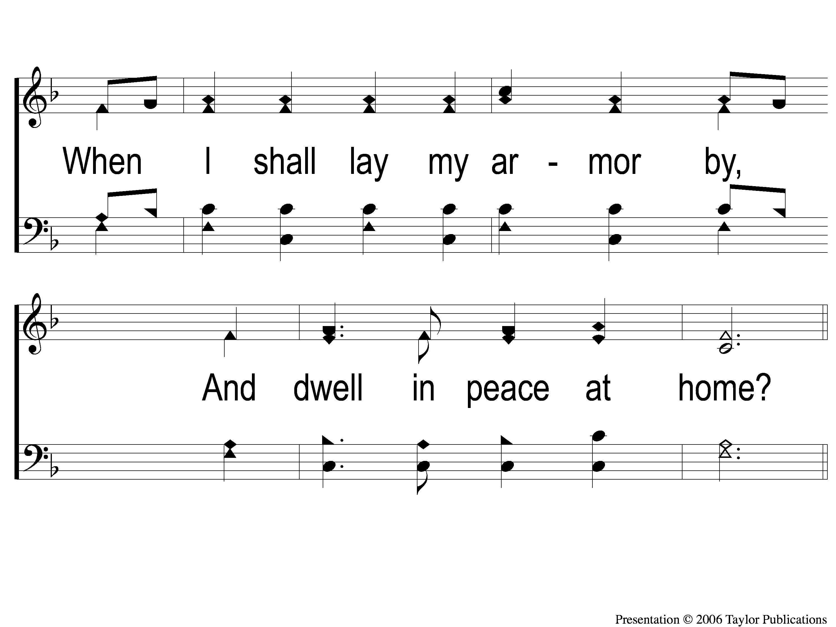
1-2 We’ll Work Till Jesus Comes
We’ll Work Till Jesus Comes
634

Slide 59
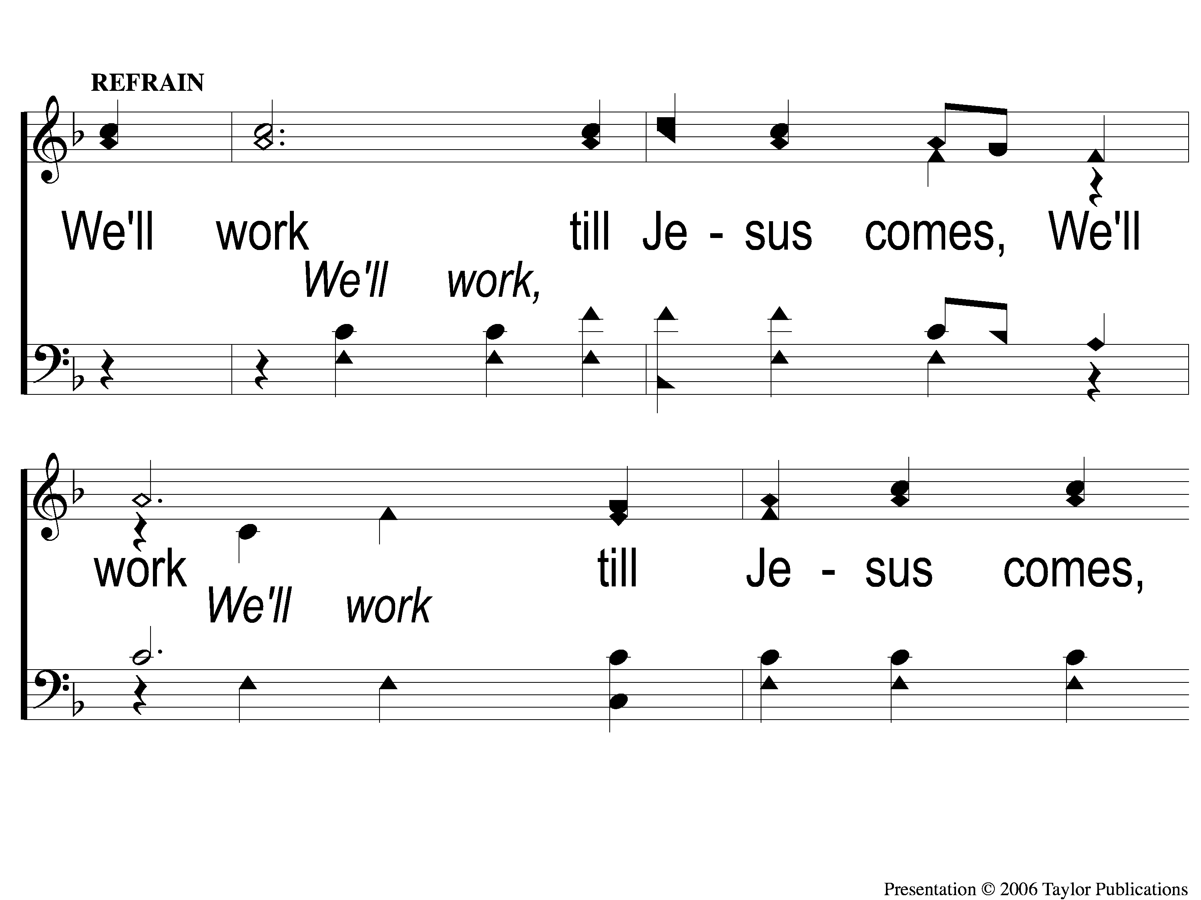
C-1 We’ll Work Till Jesus Comes
We’ll Work Till Jesus Comes
634

Slide 60
C-2 We’ll Work Till Jesus Comes
We’ll Work Till Jesus Comes
634

Slide 61
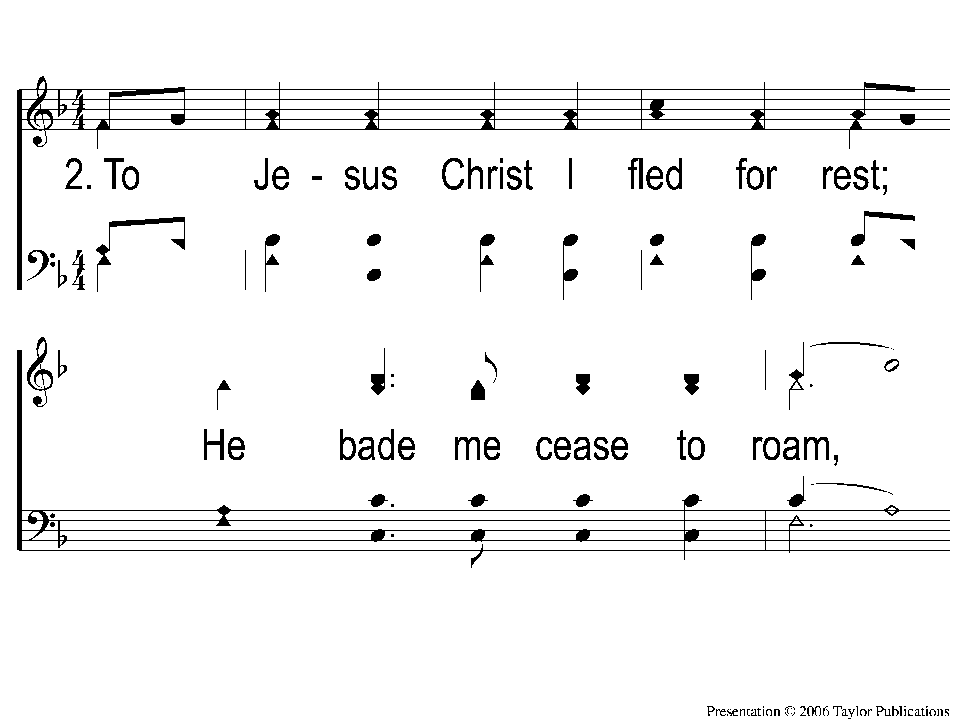
2-1 We’ll Work Till Jesus Comes
We’ll Work Till Jesus Comes
634

Slide 62
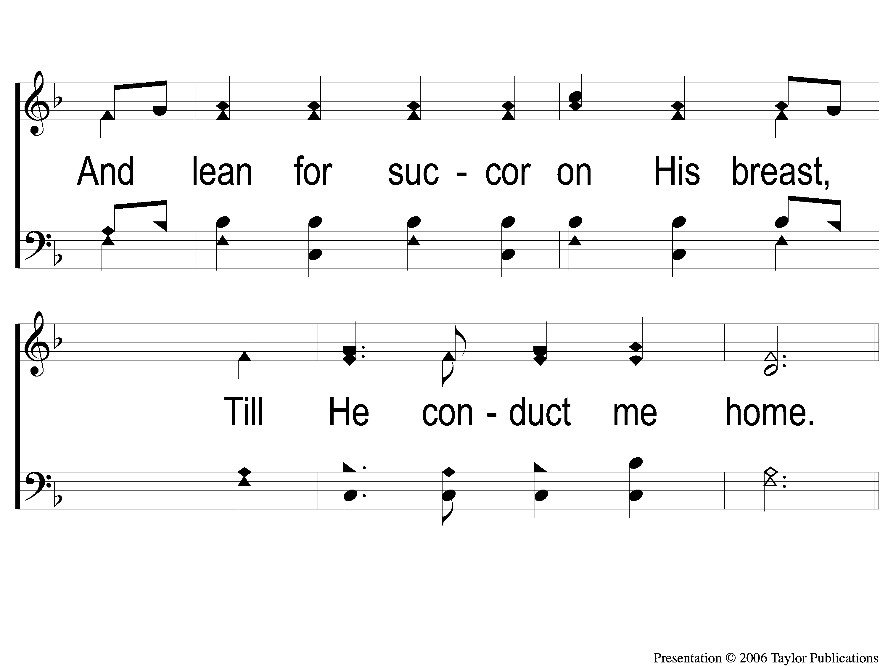
2-2 We’ll Work Till Jesus Comes
We’ll Work Till Jesus Comes
634

Slide 63
C-1 We’ll Work Till Jesus Comes
We’ll Work Till Jesus Comes
634

Slide 64
C-2 We’ll Work Till Jesus Comes
We’ll Work Till Jesus Comes
634

Slide 65
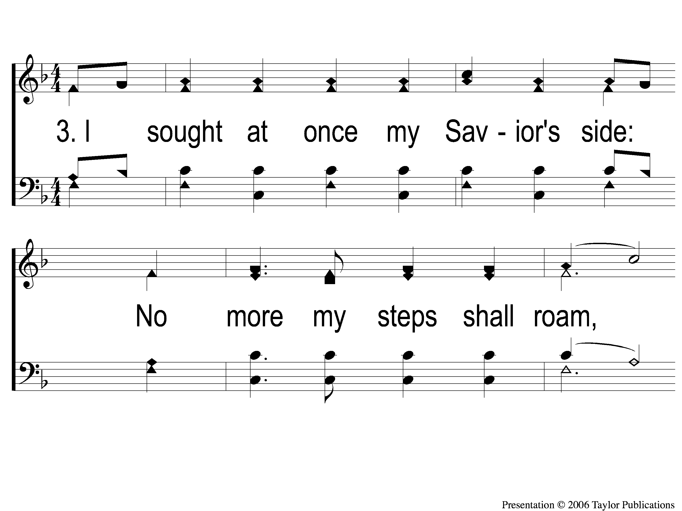
3-1 We’ll Work Till Jesus Comes
We’ll Work Till Jesus Comes
634

Slide 66
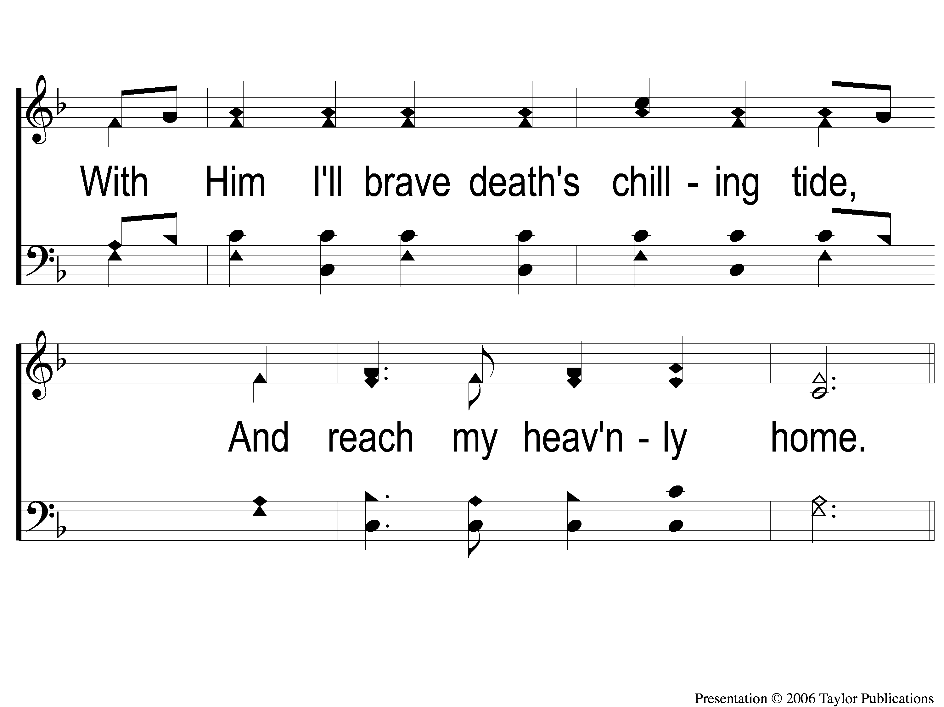
3-2 We’ll Work Till Jesus Comes
We’ll Work Till Jesus Comes
634

Slide 67
C-1 We’ll Work Till Jesus Comes
We’ll Work Till Jesus Comes
634

Slide 68
C-2 We’ll Work Till Jesus Comes
We’ll Work Till Jesus Comes
634

Slide 69
SCRIPTURE READING:
Matthew 3:1-4

Slide 70
IN PURSUIT
OF THE KINGDOM

Slide 71
Who is Jesus?
According to matthew

Slide 72
“When Jesus came into the region of Caesarea Philippi, He asked His disciples, saying,
‘Who do men say that I, the Son of Man, am?”
– Matt. 16:13

Slide 73
“Messiah” (ch. 1)
“king of the jews” (ch. 2)
“son of god” (ch. 3)

Slide 74
“son of god”

Slide 75
Son of god
His baptism – ch. 3
His transfiguration – ch. 17
His crucifixion – ch. 27

Slide 76
Who is Jesus?
The one to succeed john the baptizer (3:1-10)

Slide 77
Who is Jesus?
The one to succeed john the baptizer
Matt. 3:1-10
Jn. 3:30

Slide 78
Who is Jesus?
The one to succeed john the baptizer (3:1-10)
The one to baptize with the holy spirit and fire (3:11)

Slide 79
Who is Jesus?
The one to baptize with the holy spirit & fire
Matt. 3:11-12

Slide 80
Jesus & baptism
OF THE HOLY SPIRIT

Slide 81
Jesus & baptism
OF THE HOLY SPIRIT → MIRACULOUS POWERS
Joel 2:28-32
Acts 2:1-4, 14ff

Slide 82
Jesus & baptism
OF THE HOLY SPIRIT → MIRACULOUS POWERS
OF FIRE

Slide 83
Jesus & baptism
OF THE HOLY SPIRIT → MIRACULOUS POWERS
OF FIRE → FOR JUDGMENT
Matt. 5:22, 7:19, 13:40, 42, 50, 18:8-9, 25:41

Slide 84
Jesus & baptism
OF THE HOLY SPIRIT → MIRACULOUS POWERS
OF FIRE → FOR JUDGMENT
OF WATER → FOR SALVATION
Acts 2:38, Gal. 3:28

Slide 85
Who is Jesus?
The one to succeed john the baptizer (3:1-10)
The one to baptize with the holy spirit and fire (3:11)
The one to fulfill all righteousness (3:15)

Slide 86
Who is Jesus?
The one to fulfill all righteousness
Matt. 3:15, 5:17
Heb. 7:28, 12:2
Gal. 3:13-14

Slide 87
Jesus’ baptism
to Obey God

Slide 88
Jesus’ baptism
to Obey God
to Sanctify John’s Ministry

Slide 89
Jesus’ baptism
to Obey God
to Sanctify John’s Ministry
To Set An Example

Slide 90
Jesus’ baptism
to Obey God
to Sanctify John’s Ministry
To Set An Example
To Identify with Sinners

Slide 91
Jesus’ baptism
to Obey God
to Sanctify John’s Ministry
To Set An Example
To Identify with Sinners
To begin His Ministry

Slide 92
Jesus’ baptism
to Obey God
to Sanctify John’s Ministry
To Set An Example
To Identify with Sinners
To begin His Ministry
To Reveal Himself to Israel

Slide 93
Jesus’ baptism
to Obey God
to Sanctify John’s Ministry
To Set An Example
To Identify with Sinners
To begin His Ministry
To Reveal Himself to Israel
To Receive Power to do Miracles

Slide 94
Who is Jesus?
The one to succeed john the baptizer (3:1-10)
The one to baptize with the holy spirit and fire (3:11)
The one to fulfill all righteousness (3:15)
The one we should hear (17:5)

Slide 95
Who is Jesus?
The one we should hear
Matt. 17:5
Deut. 18:15, 18-19

Slide 96
Who is Jesus?
The one to succeed john the baptizer (3:1-10)
The one to baptize with the holy spirit and fire (3:11)
The one to fulfill all righteousness (3:15)
The one we should hear (17:5)
The one who pleased god (3:17, 17:5)

Slide 97
Who is Jesus?
The one who pleased god
Matt. 3:17, 17:5
Acts 2:38, 47

Slide 98
DO you RECOGNIZE
JESUS as son of God?

Slide 99
are you
Pleasing To god?

Slide 100
Invitation SONG:
Have you been to jesus?
#904

Slide 101
1-1 Have You Been To Jesus
Have You Been To Jesus?
904

Slide 102
1-2 Have You Been To Jesus
Have You Been To Jesus?
904

Slide 103
C-1 Have You Been To Jesus
Have You Been To Jesus?
904

Slide 104
C-2 Have You Been To Jesus
Have You Been To Jesus?
904

Slide 105
2-1 Have You Been To Jesus
Have You Been To Jesus?
904

Slide 106
2-2 Have You Been To Jesus
Have You Been To Jesus?
904

Slide 107
C-1 Have You Been To Jesus
Have You Been To Jesus?
904

Slide 108
C-2 Have You Been To Jesus
Have You Been To Jesus?
904

Slide 109
4-1 Have You Been To Jesus
Have You Been To Jesus?
904

Slide 110
4-2 Have You Been To Jesus
Have You Been To Jesus?
904

Slide 111
C-1 Have You Been To Jesus
Have You Been To Jesus?
904

Slide 112
C-2 Have You Been To Jesus
Have You Been To Jesus?
904

Slide 113
OUR CONTRIBUTION
Hebrews 13:15-16
“Therefore by Him let us continually offer the sacrifice of praise to God, that is, the fruit of our lips, giving thanks to His name. But do not forget to do good and to share, for with such sacrifices God is well pleased.”

Slide 114
SONG:
Lead me to calvary
#332

Slide 115
1-1 Lead Me To Calvary
Lead Me To Calvary
332

Slide 116
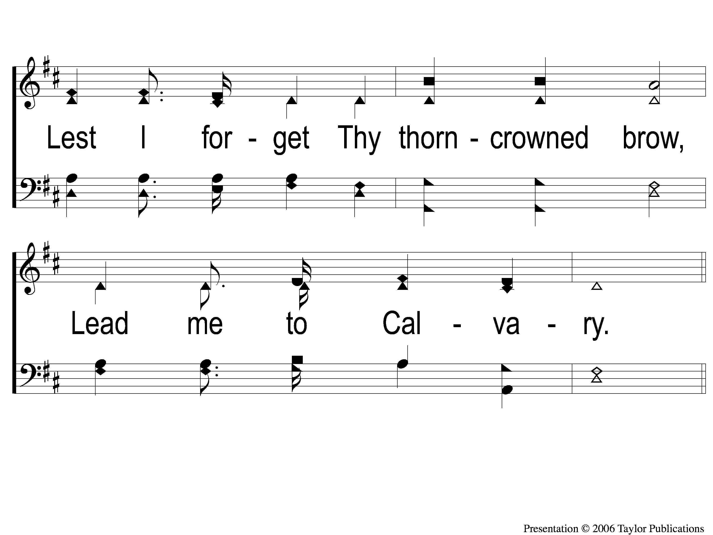
1-2 Lead Me To Calvary
Lead Me To Calvary
332

Slide 117
C-1 Lead Me To Calvary
Lead Me To Calvary
332

Slide 118
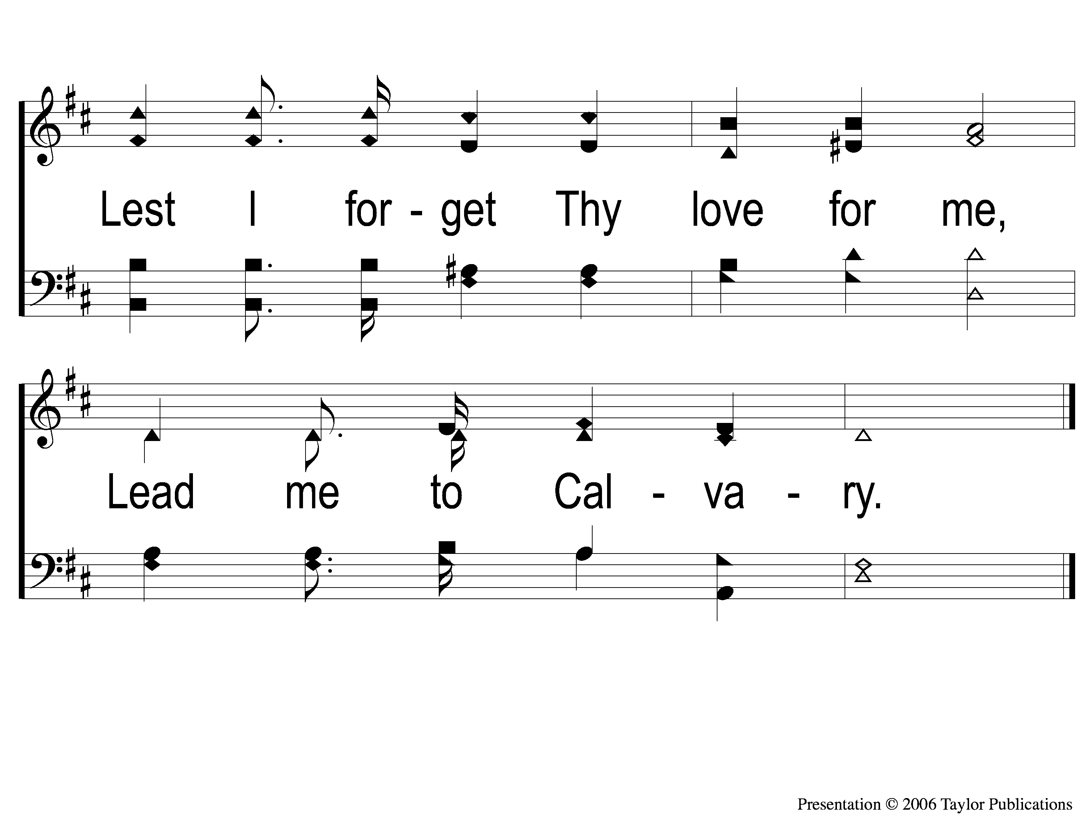
C-2 Lead Me To Calvary
Lead Me To Calvary
332

Slide 119
2-1 Lead Me To Calvary
Lead Me To Calvary
332

Slide 120
2-2 Lead Me To Calvary
Lead Me To Calvary
332

Slide 121
C-1 Lead Me To Calvary
Lead Me To Calvary
332

Slide 122
C-2 Lead Me To Calvary
Lead Me To Calvary
332

Slide 123
3-1 Lead Me To Calvary
Lead Me To Calvary
332

Slide 124
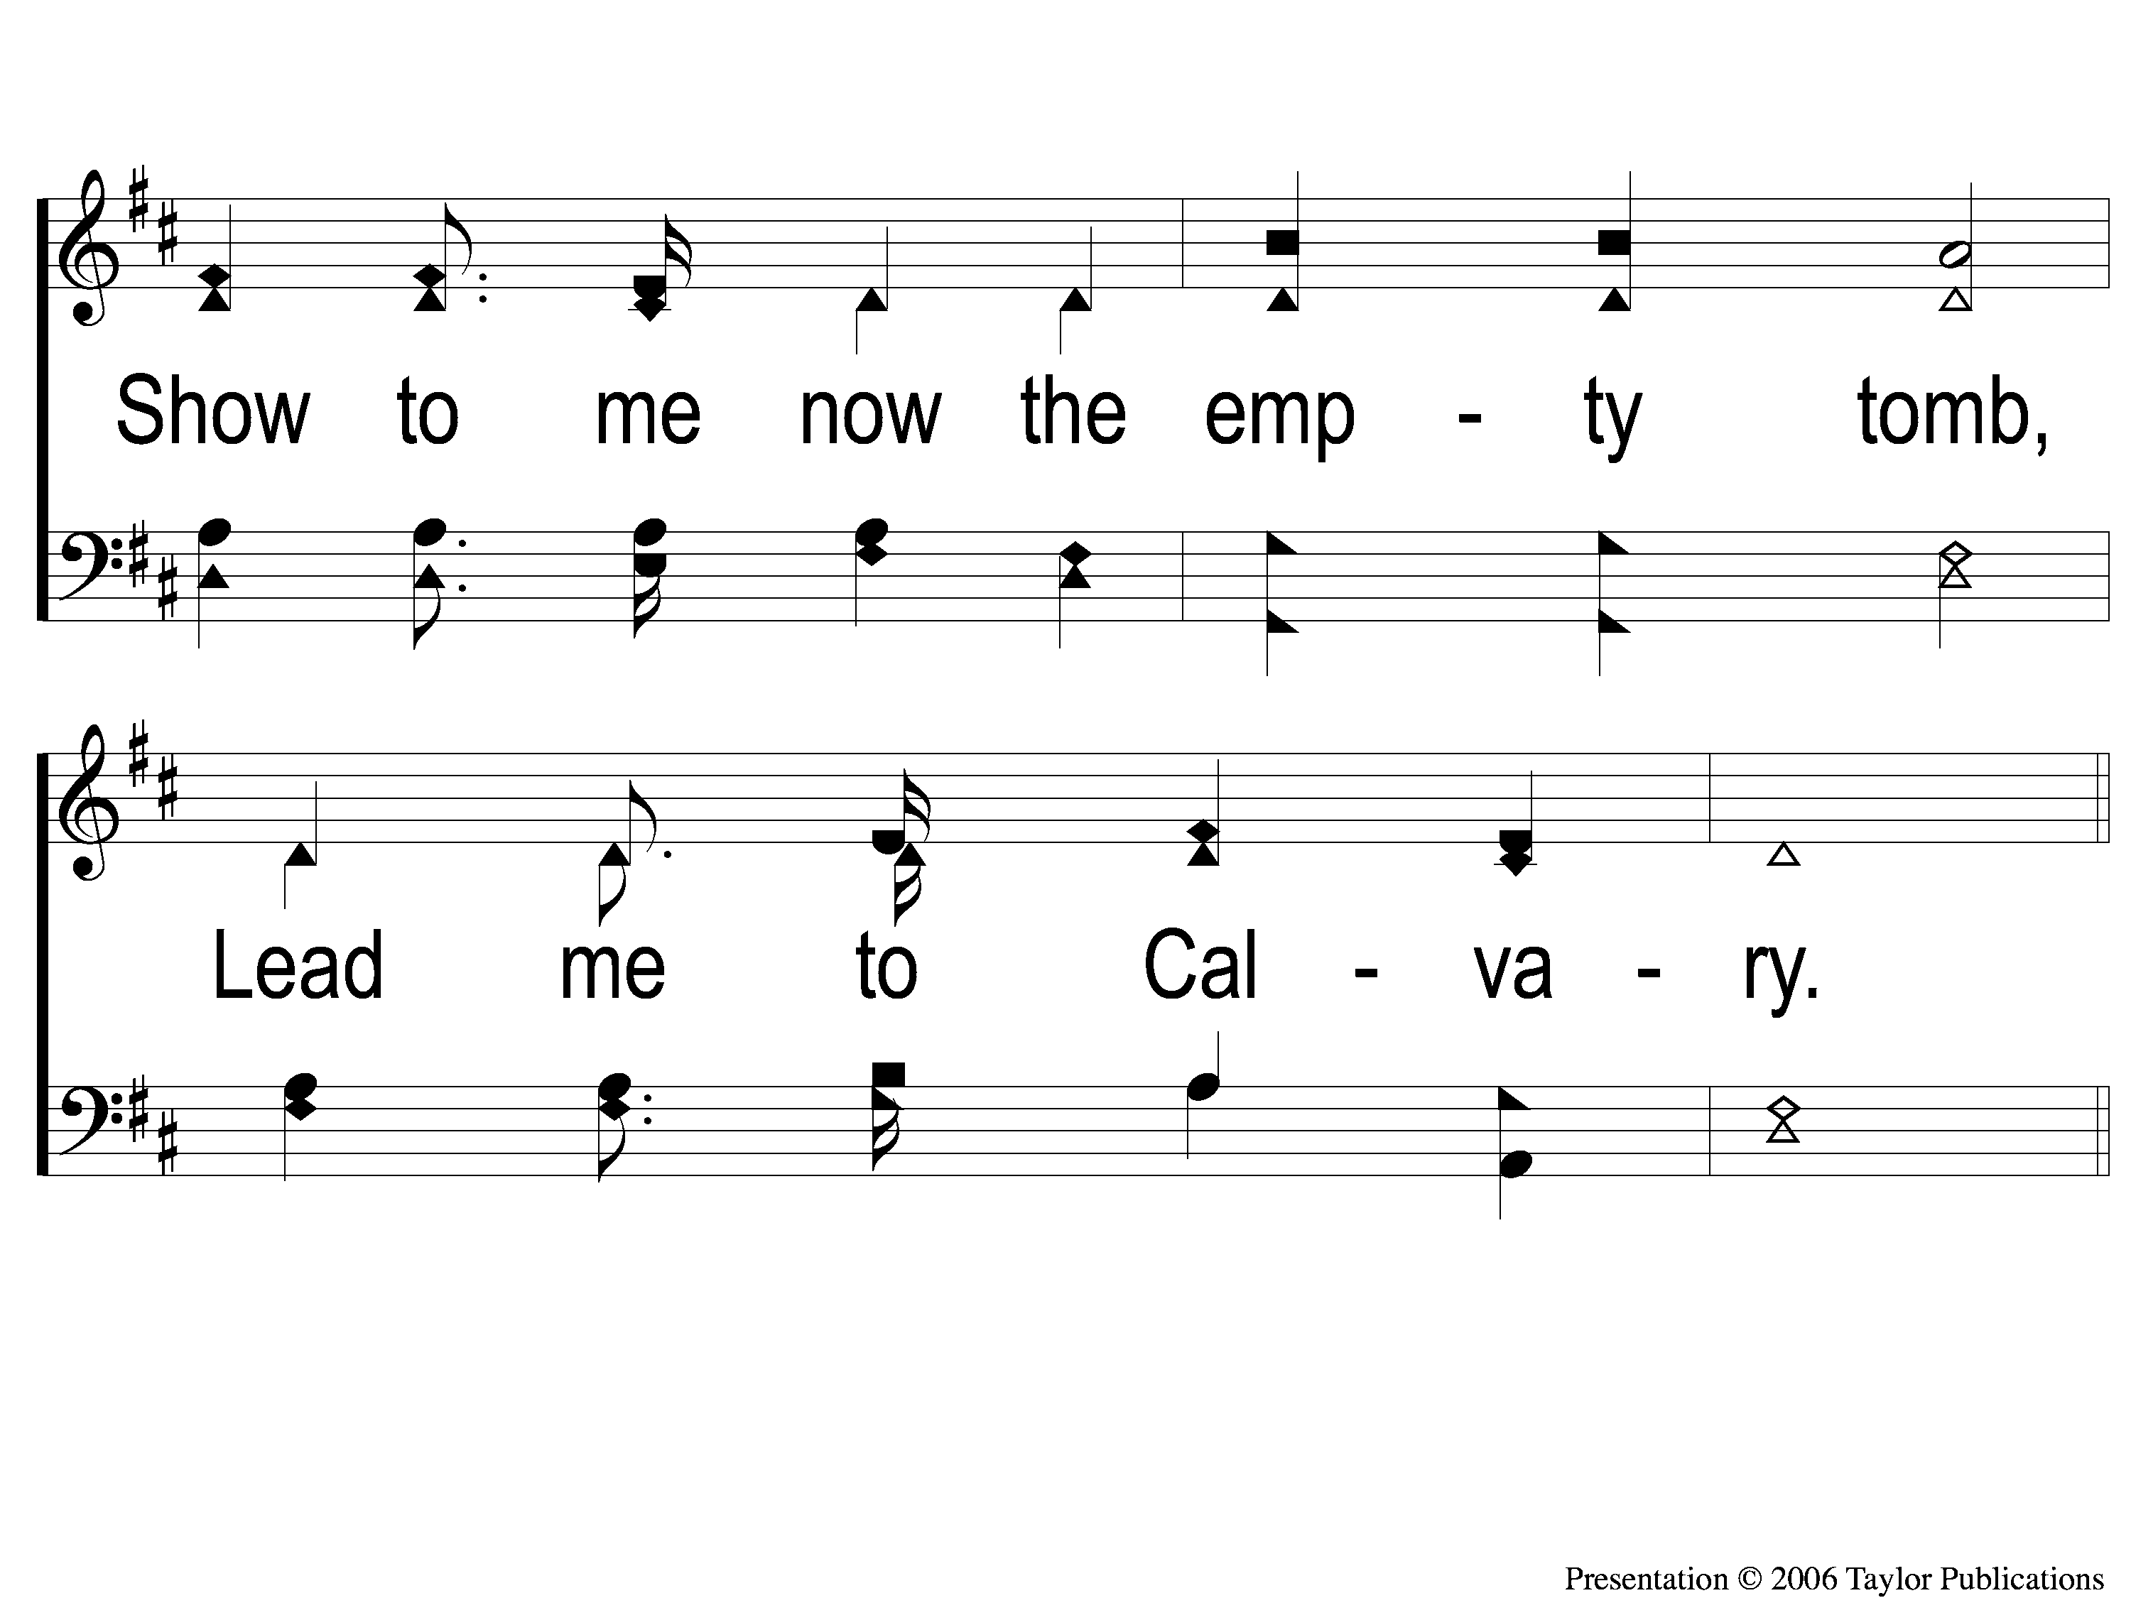
3-2 Lead Me To Calvary
Lead Me To Calvary
332

Slide 125
C-1 Lead Me To Calvary
Lead Me To Calvary
332

Slide 126
C-2 Lead Me To Calvary
Lead Me To Calvary
332

Slide 127
4-1 Lead Me To Calvary
Lead Me To Calvary
332

Slide 128
4-2 Lead Me To Calvary
Lead Me To Calvary
332

Slide 129
C-1 Lead Me To Calvary
Lead Me To Calvary
332

Slide 130
C-2 Lead Me To Calvary
Lead Me To Calvary
332

Slide 131
THE UNLEAVENED BREAD
Hebrews 4:14-16
“Seeing then that we have a great High Priest who has passed through the heavens, Jesus the Son of God, let us hold fast our confession. for we do not have a High Priest who cannot sympathize with our weaknesses, but was in all points tempted as we are, yet without sin. Let us therefore come boldly to the throne of grace, that we may obtain mercy and find grace to help in time of need.”

Slide 132
THE FRUIT OF THE VINE
Hebrews 9:11-15
“But Christ came as High Priest of the good things to come, with the greater and more perfect tabernacle not made with hands, that is, not of this creation. Not with the blood of goats and calves, but with His own blood He entered the Most Holy Place once for all, having obtained eternal redemption. For if the blood of bulls and goats and the ashes of a heifer, sprinkling the unclean, sanctifies for the purifying of the flesh, how much more shall the blood of Christ, who through the eternal Spirit offered Himself without spot to God, cleanse your conscience from dead works to serve the living God? And for this reason He is the Mediator of the new covenant, by means of death, for the redemption of the transgressions under the first covenant, that those who are called may receive the promise of the eternal inheritance.”

Slide 133
closing PRAYER

Slide 134
SONG:
Everybody will be happy over there
#973

Slide 135
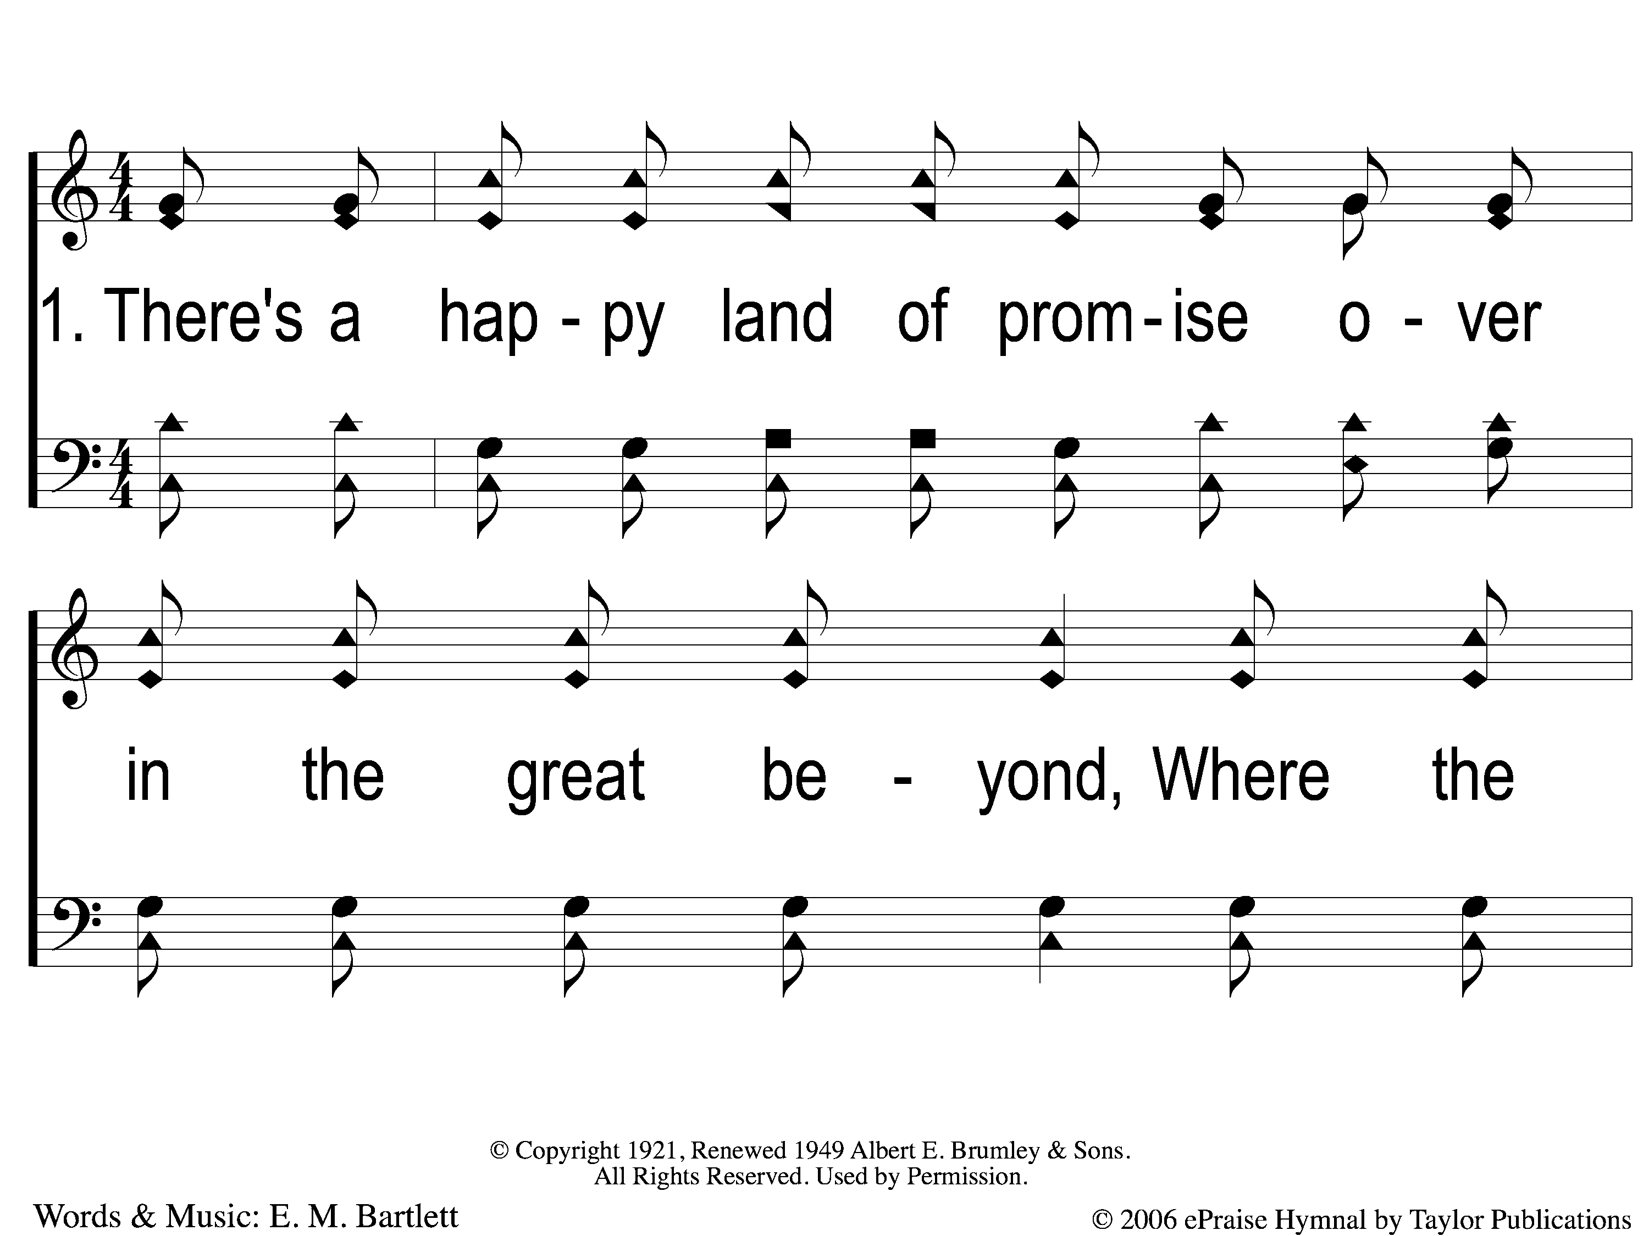
1-1 Everybody Will Be Happy Overthere
Everybody Will Be Happy Over There
973

Slide 136
1-2 Everybody Will Be Happy Overthere
Everybody Will Be Happy Over There
973

Slide 137
1-3 Everybody Will Be Happy Overthere
Everybody Will Be Happy Over There
973

Slide 138
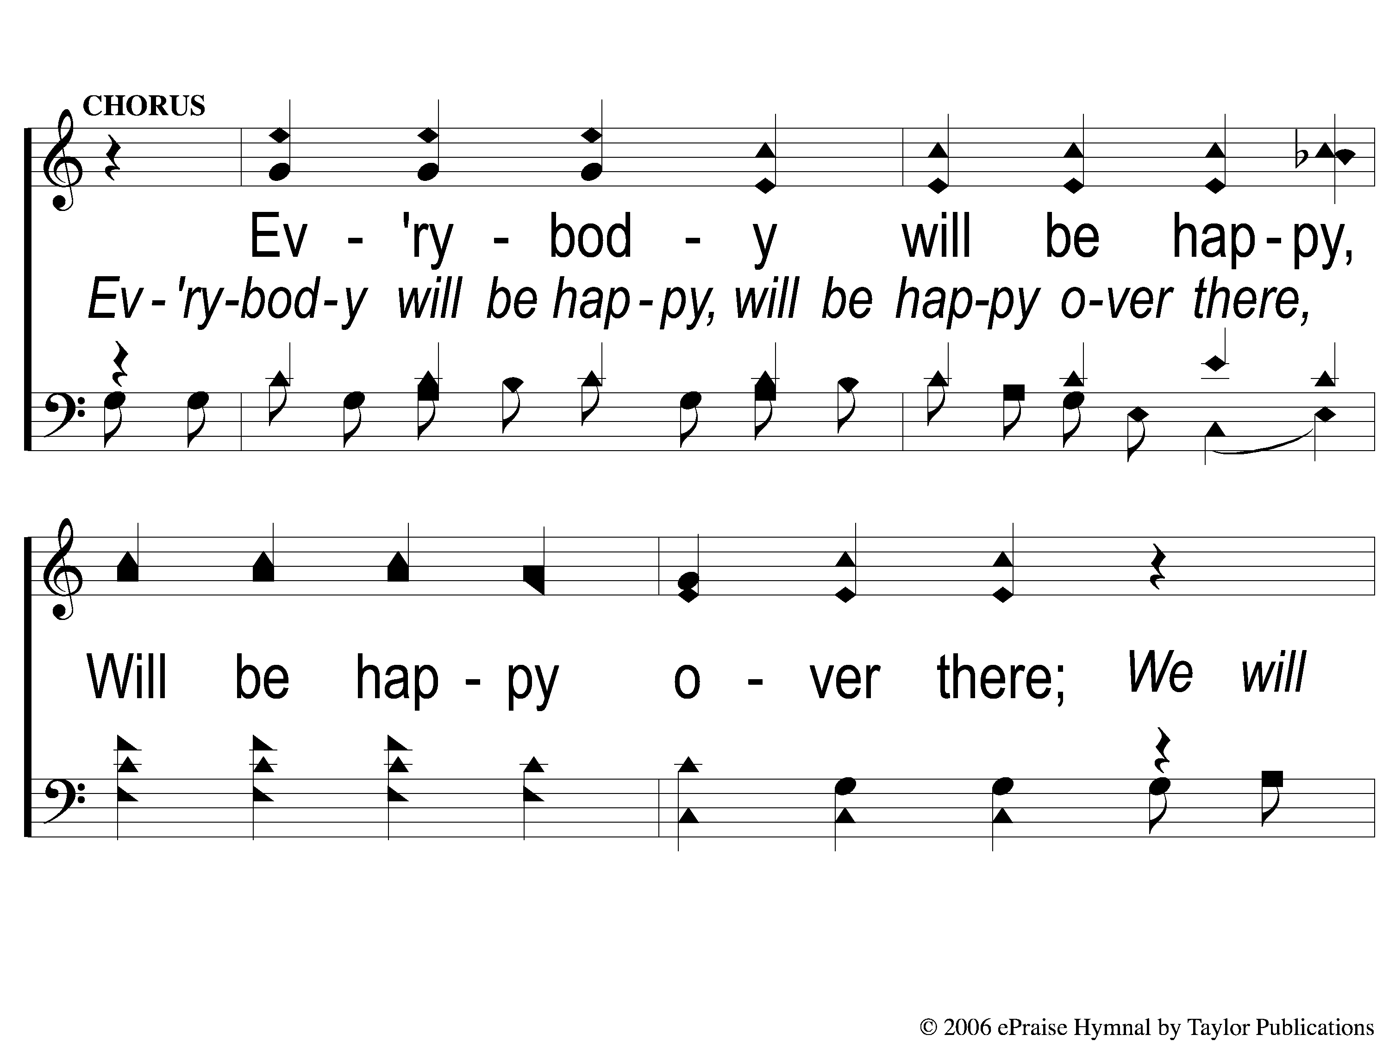
C-1 Everybody Will Be Happy Overthere
Everybody Will Be Happy Over There
973

Slide 139
C-2 Everybody Will Be Happy Overthere
Everybody Will Be Happy Over There
973

Slide 140
3-1 Everybody Will Be Happy Overthere
Everybody Will Be Happy Over There
973

Slide 141
3-2 Everybody Will Be Happy Overthere
Everybody Will Be Happy Over There
973

Slide 142
3-3 Everybody Will Be Happy Overthere
Everybody Will Be Happy Over There
973

Slide 143
C-1 Everybody Will Be Happy Overthere
Everybody Will Be Happy Over There
973

Slide 144
C-2 Everybody Will Be Happy Overthere
Everybody Will Be Happy Over There
973

Slide 145
Today
WORSHIP @ 6:00
Wednesday
Worship & Bible classes @ 6:30

Slide 146
Today
Join us for a Meal in the mpb
Wednesday
LTC @ 5:30
Worship & Bible classes @ 6:30

