Slide 1
1-1 We Bow Down
We Bow Down
577

Slide 2
1-2 We Bow Down
We Bow Down
577

Slide 3
1-3 We Bow Down
We Bow Down
577

Slide 4
1-4 We Bow Down
We Bow Down
577

Slide 5
2-1 We Bow Down
We Bow Down
577

Slide 6
2-2 We Bow Down
We Bow Down
577

Slide 7
2-3 We Bow Down
We Bow Down
577

Slide 8
2-4 We Bow Down
We Bow Down
577

Slide 9
WELCOME
To the Wheeler church of Christ

Slide 10
SONG:
We praise thee, o god
#2

Slide 11
1 We Praise Thee O God
We Praise Thee, O God
2

Slide 12
C We Praise Thee O God
We Praise Thee, O God
2

Slide 13
4 We Praise Thee O God
We Praise Thee, O God
2

Slide 14
C We Praise Thee O God
We Praise Thee, O God
2

Slide 15
5 We Praise Thee O God
We Praise Thee, O God
2

Slide 16
C We Praise Thee O God
We Praise Thee, O God
2

Slide 17
SONG:
Prince of peace! Control my will
#761

Slide 18
1-1 Prince of Peace Control
Prince of Peace Control
761

Slide 19
1-2 Prince of Peace Control
Prince of Peace Control
761

Slide 20
2-1 Prince of Peace Control
Prince of Peace Control
761

Slide 21
2-2 Prince of Peace Control
Prince of Peace Control
761

Slide 22
3-1 Prince of Peace Control
Prince of Peace Control
761

Slide 23
3-2 Prince of Peace Control
Prince of Peace Control
761

Slide 24
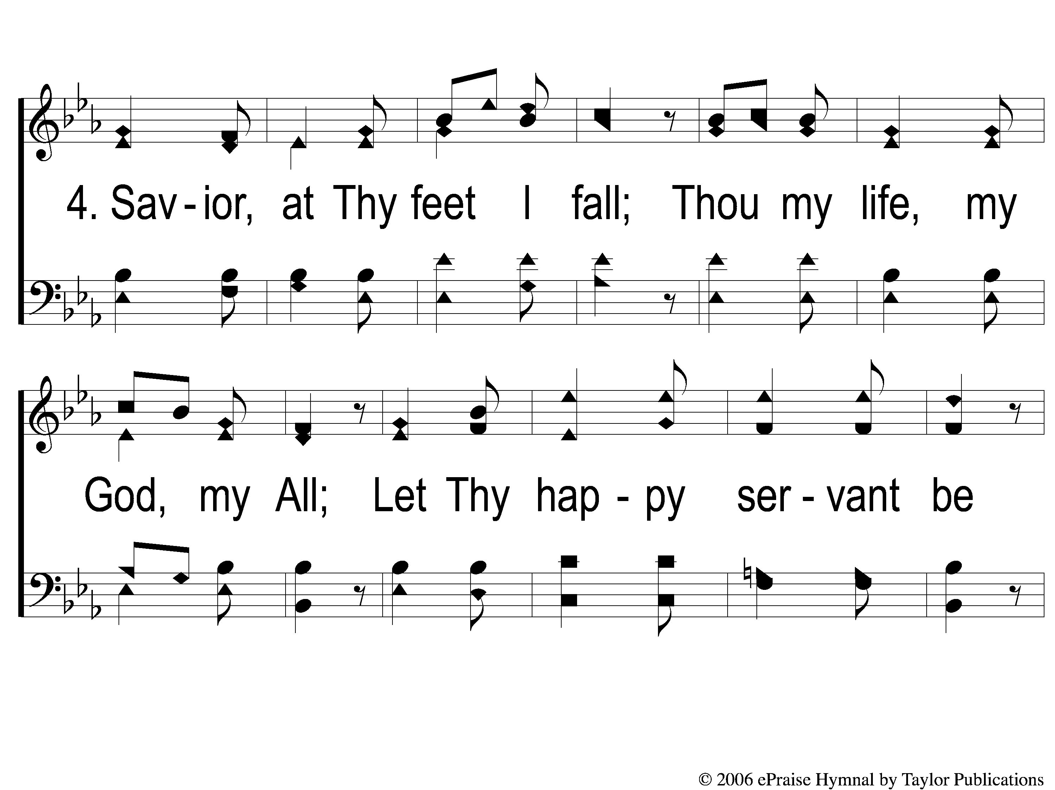
4-1 Prince of Peace Control
Prince of Peace Control
761

Slide 25
4-2 Prince of Peace Control
Prince of Peace Control
761

Slide 26
OPENING PRAYER

Slide 27
SONG:
I am mine no more
#682

Slide 28
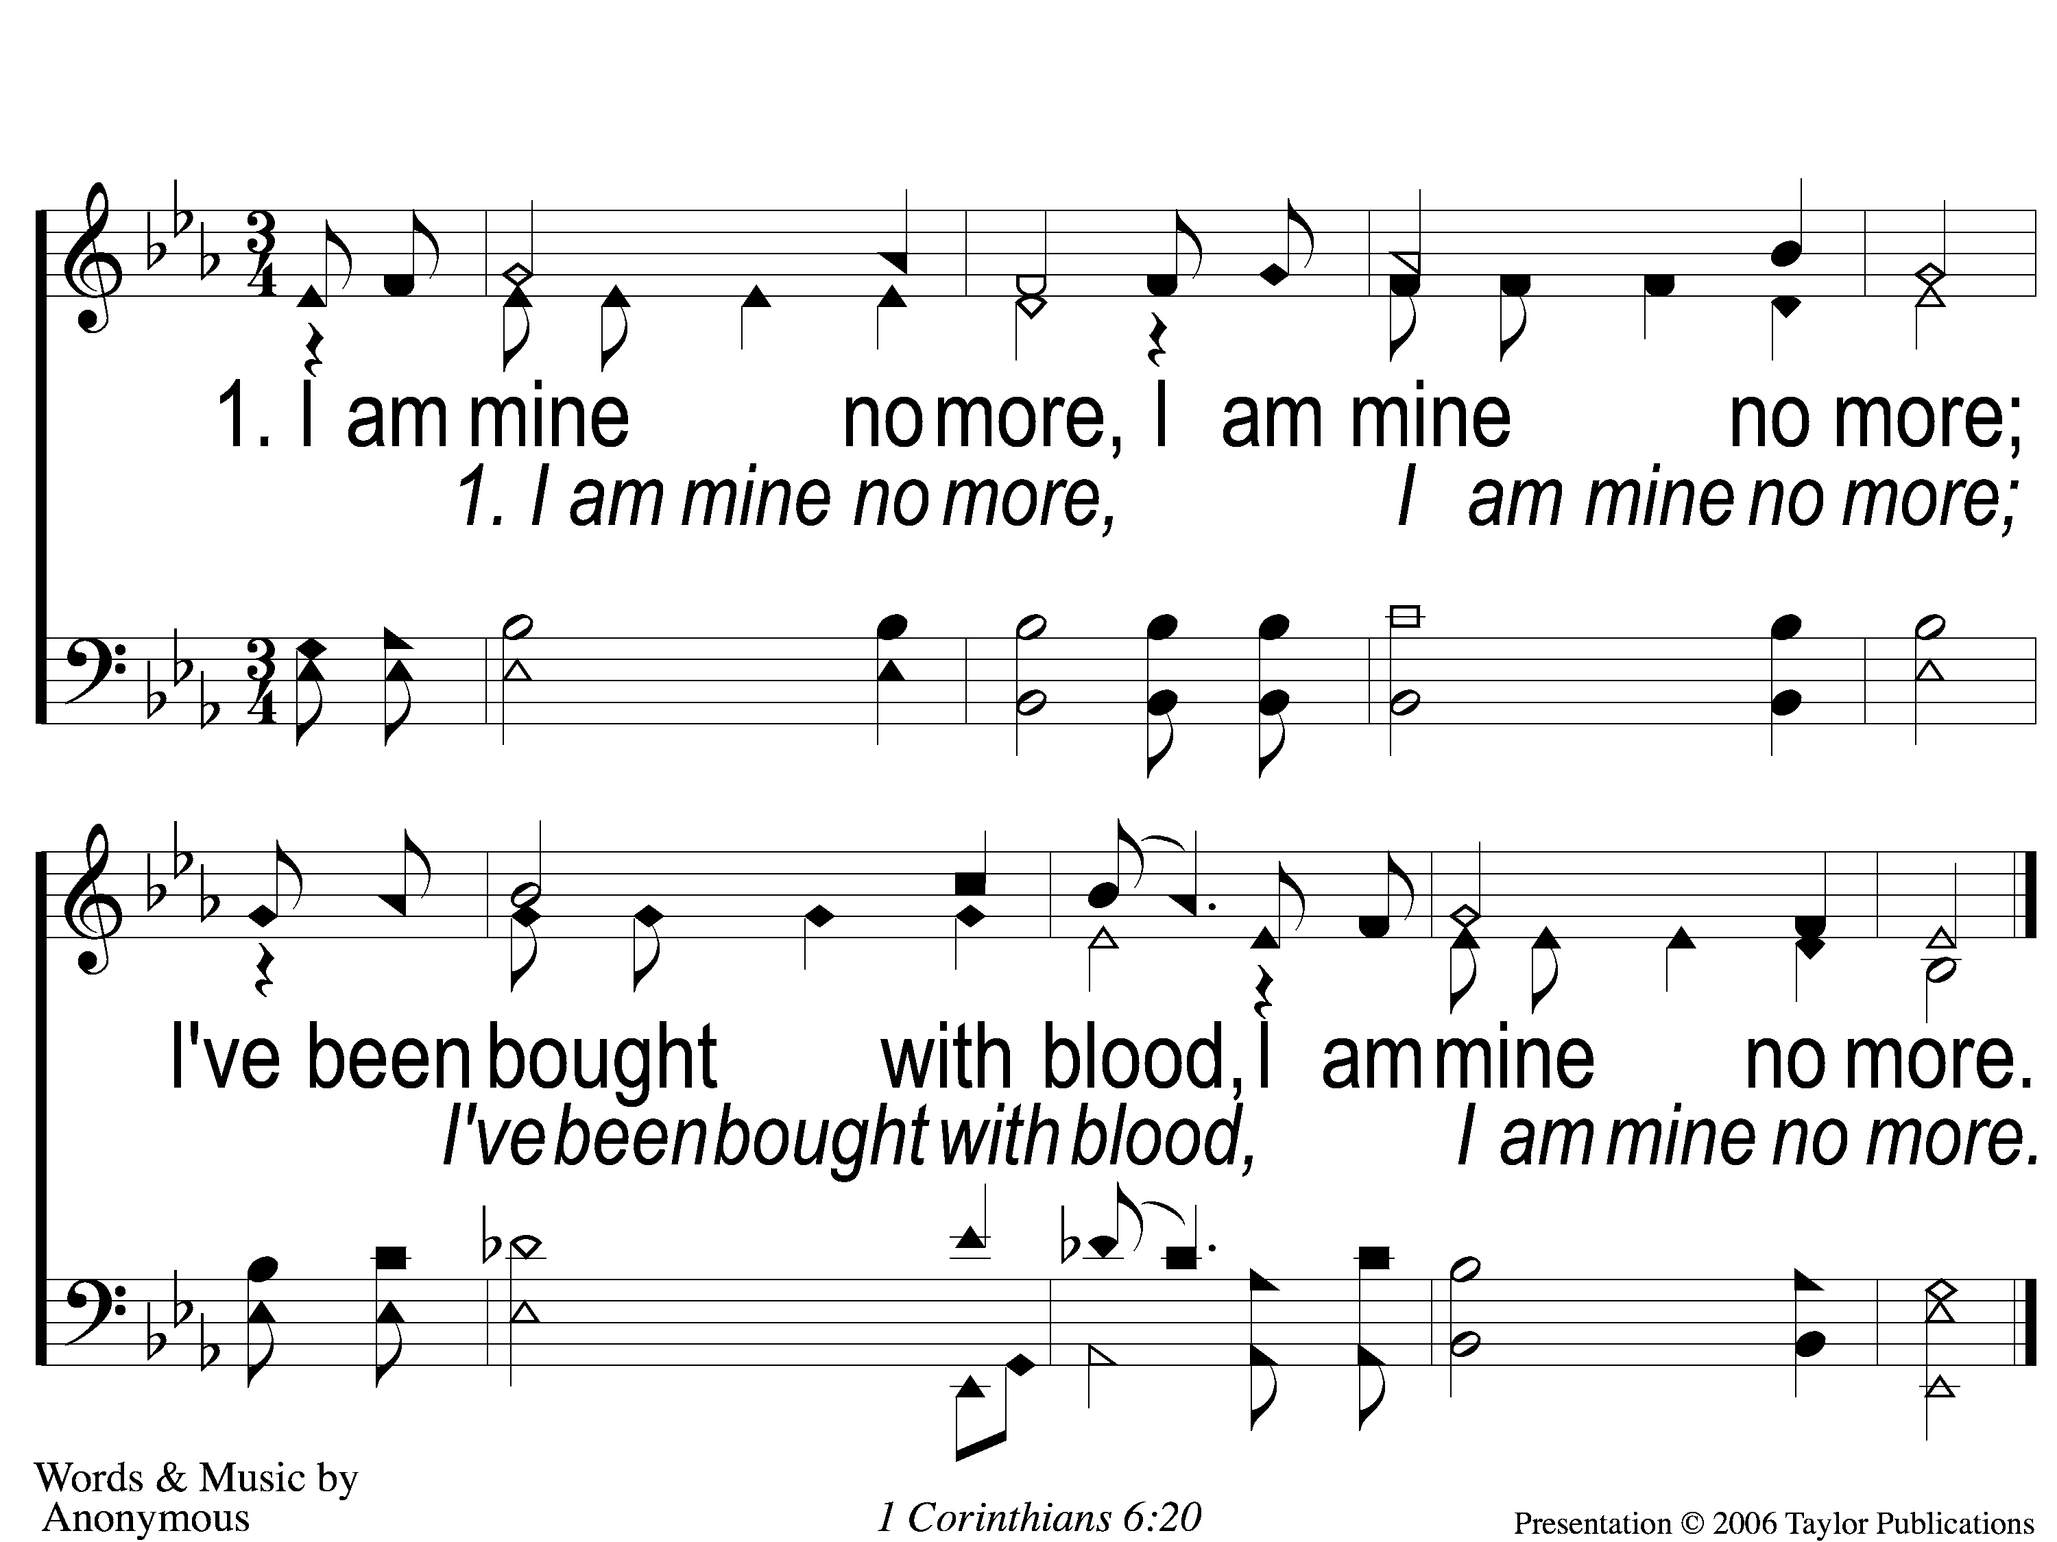
1-I Am Mine No More
I Am Mine No More
683

Slide 29
2-I Am Mine No More
I Am Mine No More
683

Slide 30
3-I Am Mine No More
I Am Mine No More
683

Slide 31
4-I Am Mine No More
I Am Mine No More
683

Slide 32
SONG:
We shall assemble
PH #70

Slide 33
1-1 We Shall Assemble
We Shall Assemble

Slide 34
1-2 We Shall Assemble
We Shall Assemble

Slide 35
C-1 We Shall Assemble
We Shall Assemble

Slide 36
C-2 We Shall Assemble
We Shall Assemble

Slide 37
3-1 We Shall Assemble
We Shall Assemble

Slide 38
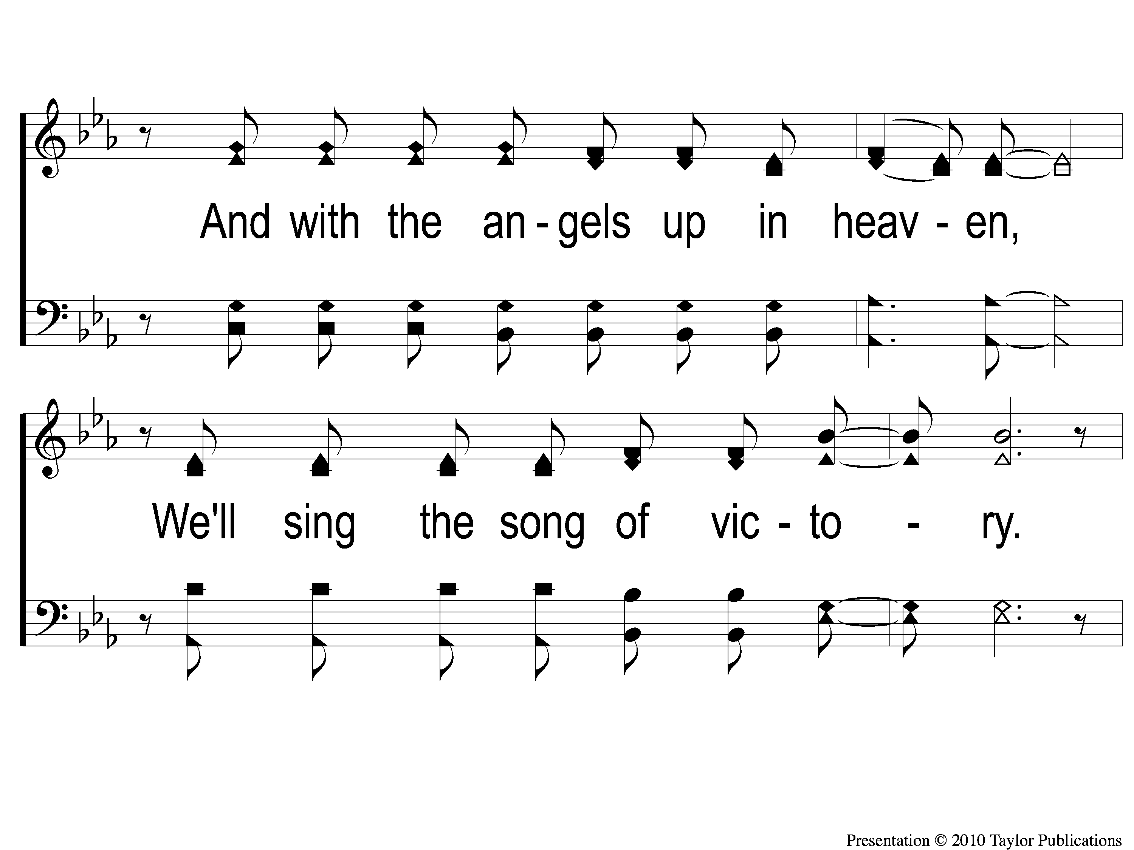
3-2 We Shall Assemble
We Shall Assemble

Slide 39
C-1 We Shall Assemble
We Shall Assemble

Slide 40
C-2 We Shall Assemble
We Shall Assemble

Slide 41
SCRIPTURE READING:
Matthew 5:17-20

Slide 42
IN PURSUIT
OF THE KINGDOM

Slide 43
Who is Jesus?
According to matthew

Slide 44
Who is Jesus?
The one to succeed john the baptizer (3:1-10)
The one to baptize with the holy spirit and fire (3:11)
The one to fulfill all righteousness (3:15)
The one we should hear (17:5)
The one who pleased god (3:17, 17:5)

Slide 45
His teaching
5 teaching sections:
5-7 – kingdom people
10 – kingdom purpose
13 – kingdom priority
18 – kingdom principles
23-25 – kingdom pending

Slide 46
THE TEACHINGS OF JESUS:
Kingdom people (ch. 5-7)

Slide 47
THE TEACHINGS OF JESUS:
Kingdom people are different

Slide 48
Kingdom people…
…have a different heart
…make a POSITIVE difference
…have a different mindset

Slide 49
Pharisaical mindset
Symbolism over substance – Matt. 23:25-28
Loopholes over laws – mk. 7:9-13
Haughtiness over humility – lk. 18:9-14

Slide 50
7 TRUTHS ABOUT Kingdom people…

Slide 51
7 TRUTHS ABOUT Kingdom people…
…have a different motivation (6:1-18)

Slide 52
A different MOTIVATION
Motivation of the pharisees
Giving (6:1-2)

Slide 53
A different MOTIVATION
Motivation of the pharisees
Giving (6:1-2)
Prayer (6:5)

Slide 54
A different MOTIVATION
Motivation of the pharisees
Giving (6:1-2)
Prayer (6:5)
Fasting (6:16)

Slide 55
A different MOTIVATION
Motivation of the pharisees
“that they may have glory from men” (6:2)
“that they may be seen by men” (6:5)
“that they may appear to men to be fasting” (6:16)

Slide 56
A different MOTIVATION
Motivation of kingdom people
“that they may see your good works
and glorify your father in heaven.”
– Matt. 5:16

Slide 57
A different MOTIVATION
Motivation of kingdom people
Giving (6:3-4)
Praying (6:6-7)
Fasting (6:17-18)

Slide 58
7 TRUTHS ABOUT Kingdom people…
…have a different motivation (6:1-18)
…HAVE A DIFFERENT FOCUS (6:19-34)

Slide 59
A different focus
focus of pharisees
physical Wealth (6:19)

Slide 60
A different focus
focus of pharisees
physical Wealth (6:19)
Serving self (6:22-24)

Slide 61
A different focus
focus of pharisees
physical Wealth (6:19)
Serving self (6:22-24)
Worrying (6:25-29)

Slide 62
A different focus
focus of kingdom people
Spiritual wealth (6:20)

Slide 63
A different focus
focus of kingdom people
Spiritual wealth (6:20)
Serving god (6:24-25)

Slide 64
A different focus
focus of kingdom people
Spiritual wealth (6:20)
Serving god (6:24-25)
Peace (6:30-34)

Slide 65
7 TRUTHS ABOUT Kingdom people…
…have a different motivation (6:1-18)
…HAVE A DIFFERENT FOCUS (6:19-34)
…HAVE DIFFERENT JUDGMENTS (7:1-6)

Slide 66
different judgments
Pharisaical judgments
Hypocritical (7:3)

Slide 67
different judgments
Pharisaical judgments
Hypocritical (7:3)
Hypercritical (7:4-5)

Slide 68
different judgments
Judgments of kingdom people
Righteous (7:5)
Jn. 7:24
Gal. 6:1

Slide 69
7 TRUTHS ABOUT Kingdom people…
…have a different motivation (6:1-18)
…HAVE A DIFFERENT FOCUS (6:19-34)
…HAVE DIFFERENT JUDGMENTS (7:1-6)
…HAVE DIFFERENT RELATIONSHIPS (7:7-12)

Slide 70
different RELATIONSHIPS
PharisEES & GOD
IMPERSISTENT (7:7)

Slide 71
different RELATIONSHIPS
PharisEES & GOD
IMPERSISTENT (7:7)
CYNICAL (7:9)

Slide 72
different RELATIONSHIPS
KINGDOM PEOPLE & GOD
CONSTANT & PERSISTENT (7:7-8)

Slide 73
different RELATIONSHIPS
KINGDOM PEOPLE & GOD
CONSTANT & PERSISTENT (7:7-8)
OPTIMISTIC (7:9-11)
1 thess. 5:17, jms. 1:5-6, 17

Slide 74
different RELATIONSHIPS
PharisEES & OTHERS
Focus more on self than others
Retaliation (5:38)

Slide 75
different RELATIONSHIPS
KINGDOM PEOPLE & others
Treat them as we would desire to be treated (7:12)
Luke 10:29-37

Slide 76
7 TRUTHS ABOUT Kingdom people…
…have a different motivation (6:1-18)
…HAVE A DIFFERENT FOCUS (6:19-34)
…HAVE DIFFERENT JUDGMENTS (7:1-6)
…HAVE DIFFERENT RELATIONSHIPS (7:7-12)
…WALK A DIFFERENT PATH (7:13-14)

Slide 77
A different path
PharisEES’ path
Wide & broad (7:13)

Slide 78
A different path
PharisEES’ path
Wide & broad (7:13)
accompanied by many (7:13)
Psa. 1:1

Slide 79
A different path
Path of kingdom people
Narrow & difficult (7:14)

Slide 80
A different path
Path of kingdom people
Narrow & difficult (7:14)
accompanied by few (7:14)
Psa. 1:1

Slide 81
7 TRUTHS ABOUT Kingdom people…
…have a different motivation (6:1-18)
…HAVE A DIFFERENT FOCUS (6:19-34)
…HAVE DIFFERENT JUDGMENTS (7:1-6)
…HAVE DIFFERENT RELATIONSHIPS (7:7-12)
…WALK A DIFFERENT PATH (7:13-14)
…PRODUCE DIFFERENT FRUIT (7:15-20)

Slide 82
different fruit
PharisEES’ fruit
False (7:15)

Slide 83
different fruit
PharisEES’ fruit
False (7:15)
Deceptive (7:15)

Slide 84
different fruit
PharisEES’ fruit
False (7:15)
Deceptive (7:15)
Rotten (7:17)

Slide 85
different fruit
Fruit of kingdom people
True (7:15)

Slide 86
different fruit
Fruit of kingdom people
True (7:15)
Transparent (7:15)

Slide 87
different fruit
Fruit of kingdom people
True (7:15)
Transparent (7:15)
Good (7:17-18)

Slide 88
7 TRUTHS ABOUT Kingdom people…
…have a different motivation (6:1-18)
…HAVE A DIFFERENT FOCUS (6:19-34)
…HAVE DIFFERENT JUDGMENTS (7:1-6)
…HAVE DIFFERENT RELATIONSHIPS (7:7-12)
…WALK A DIFFERENT PATH (7:13-14)
…PRODUCE DIFFERENT FRUIT (7:15-20)
…HAVE A DIFFERENT END (7:21-27)

Slide 89
A different end
PharisEES’ end
Departure from god’s presence (7:23)

Slide 90
A different end
PharisEES’ end
Departure from god’s presence (7:23)
Destruction (7:26-27)

Slide 91
A different end
End of kingdom people
Dwelling in god’s presence (25:21)

Slide 92
A different end
End of kingdom people
Dwelling in god’s presence (25:21)
endurance (7:24-25)

Slide 93
ARE you PART
OF HIS kingdom?

Slide 94
Do you REFLECT
JESUS’ TEACHINGS?

Slide 95
Invitation SONG:
Jesus is tenderly calling
#947

Slide 96
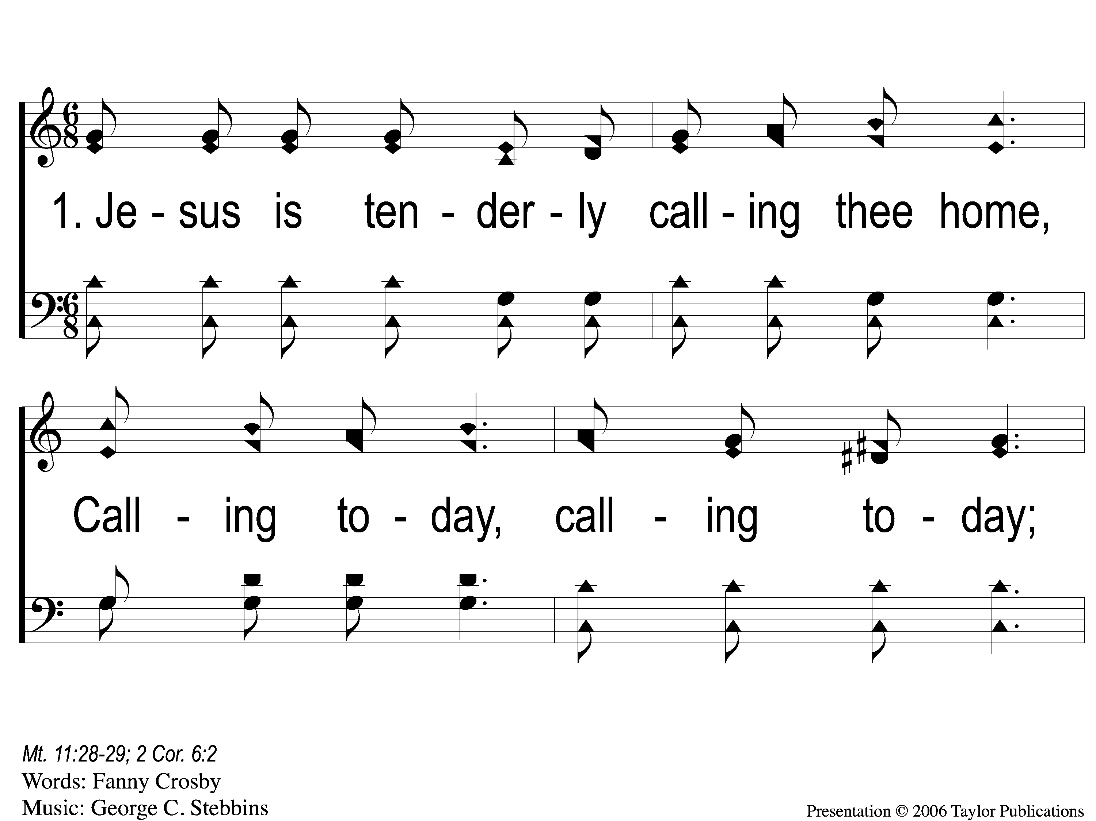
1-1 Jesus is Tenderly Calling
Jesus Is Tenderly Calling
947

Slide 97
1-2 Jesus is Tenderly Calling
Jesus Is Tenderly Calling
947

Slide 98
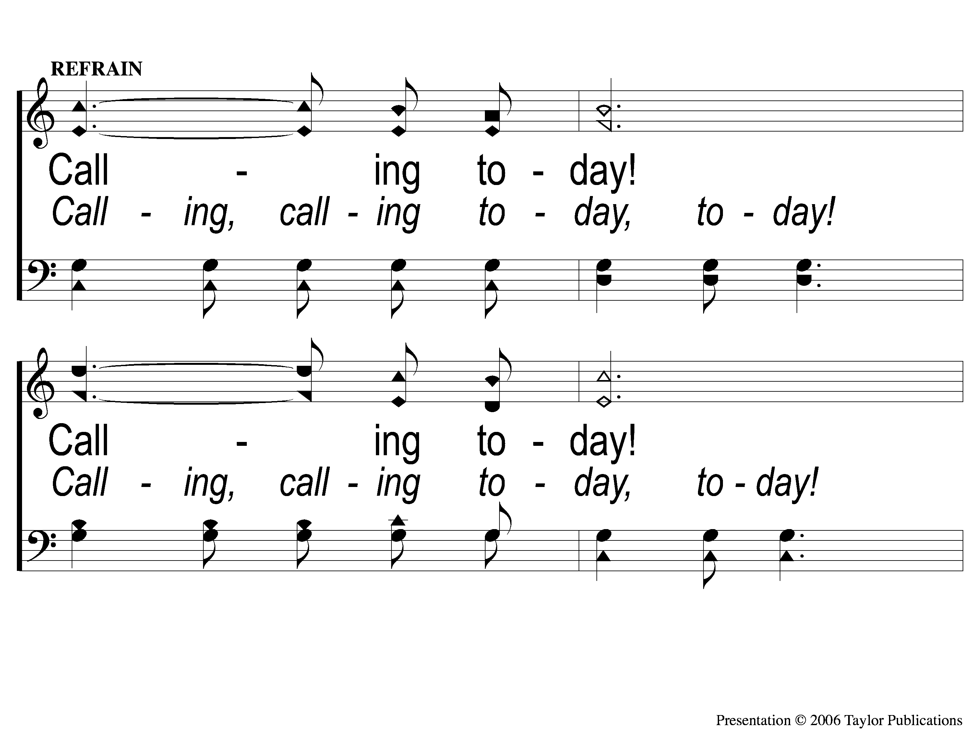
C-1 Jesus is Tenderly Calling
Jesus Is Tenderly Calling
947

Slide 99
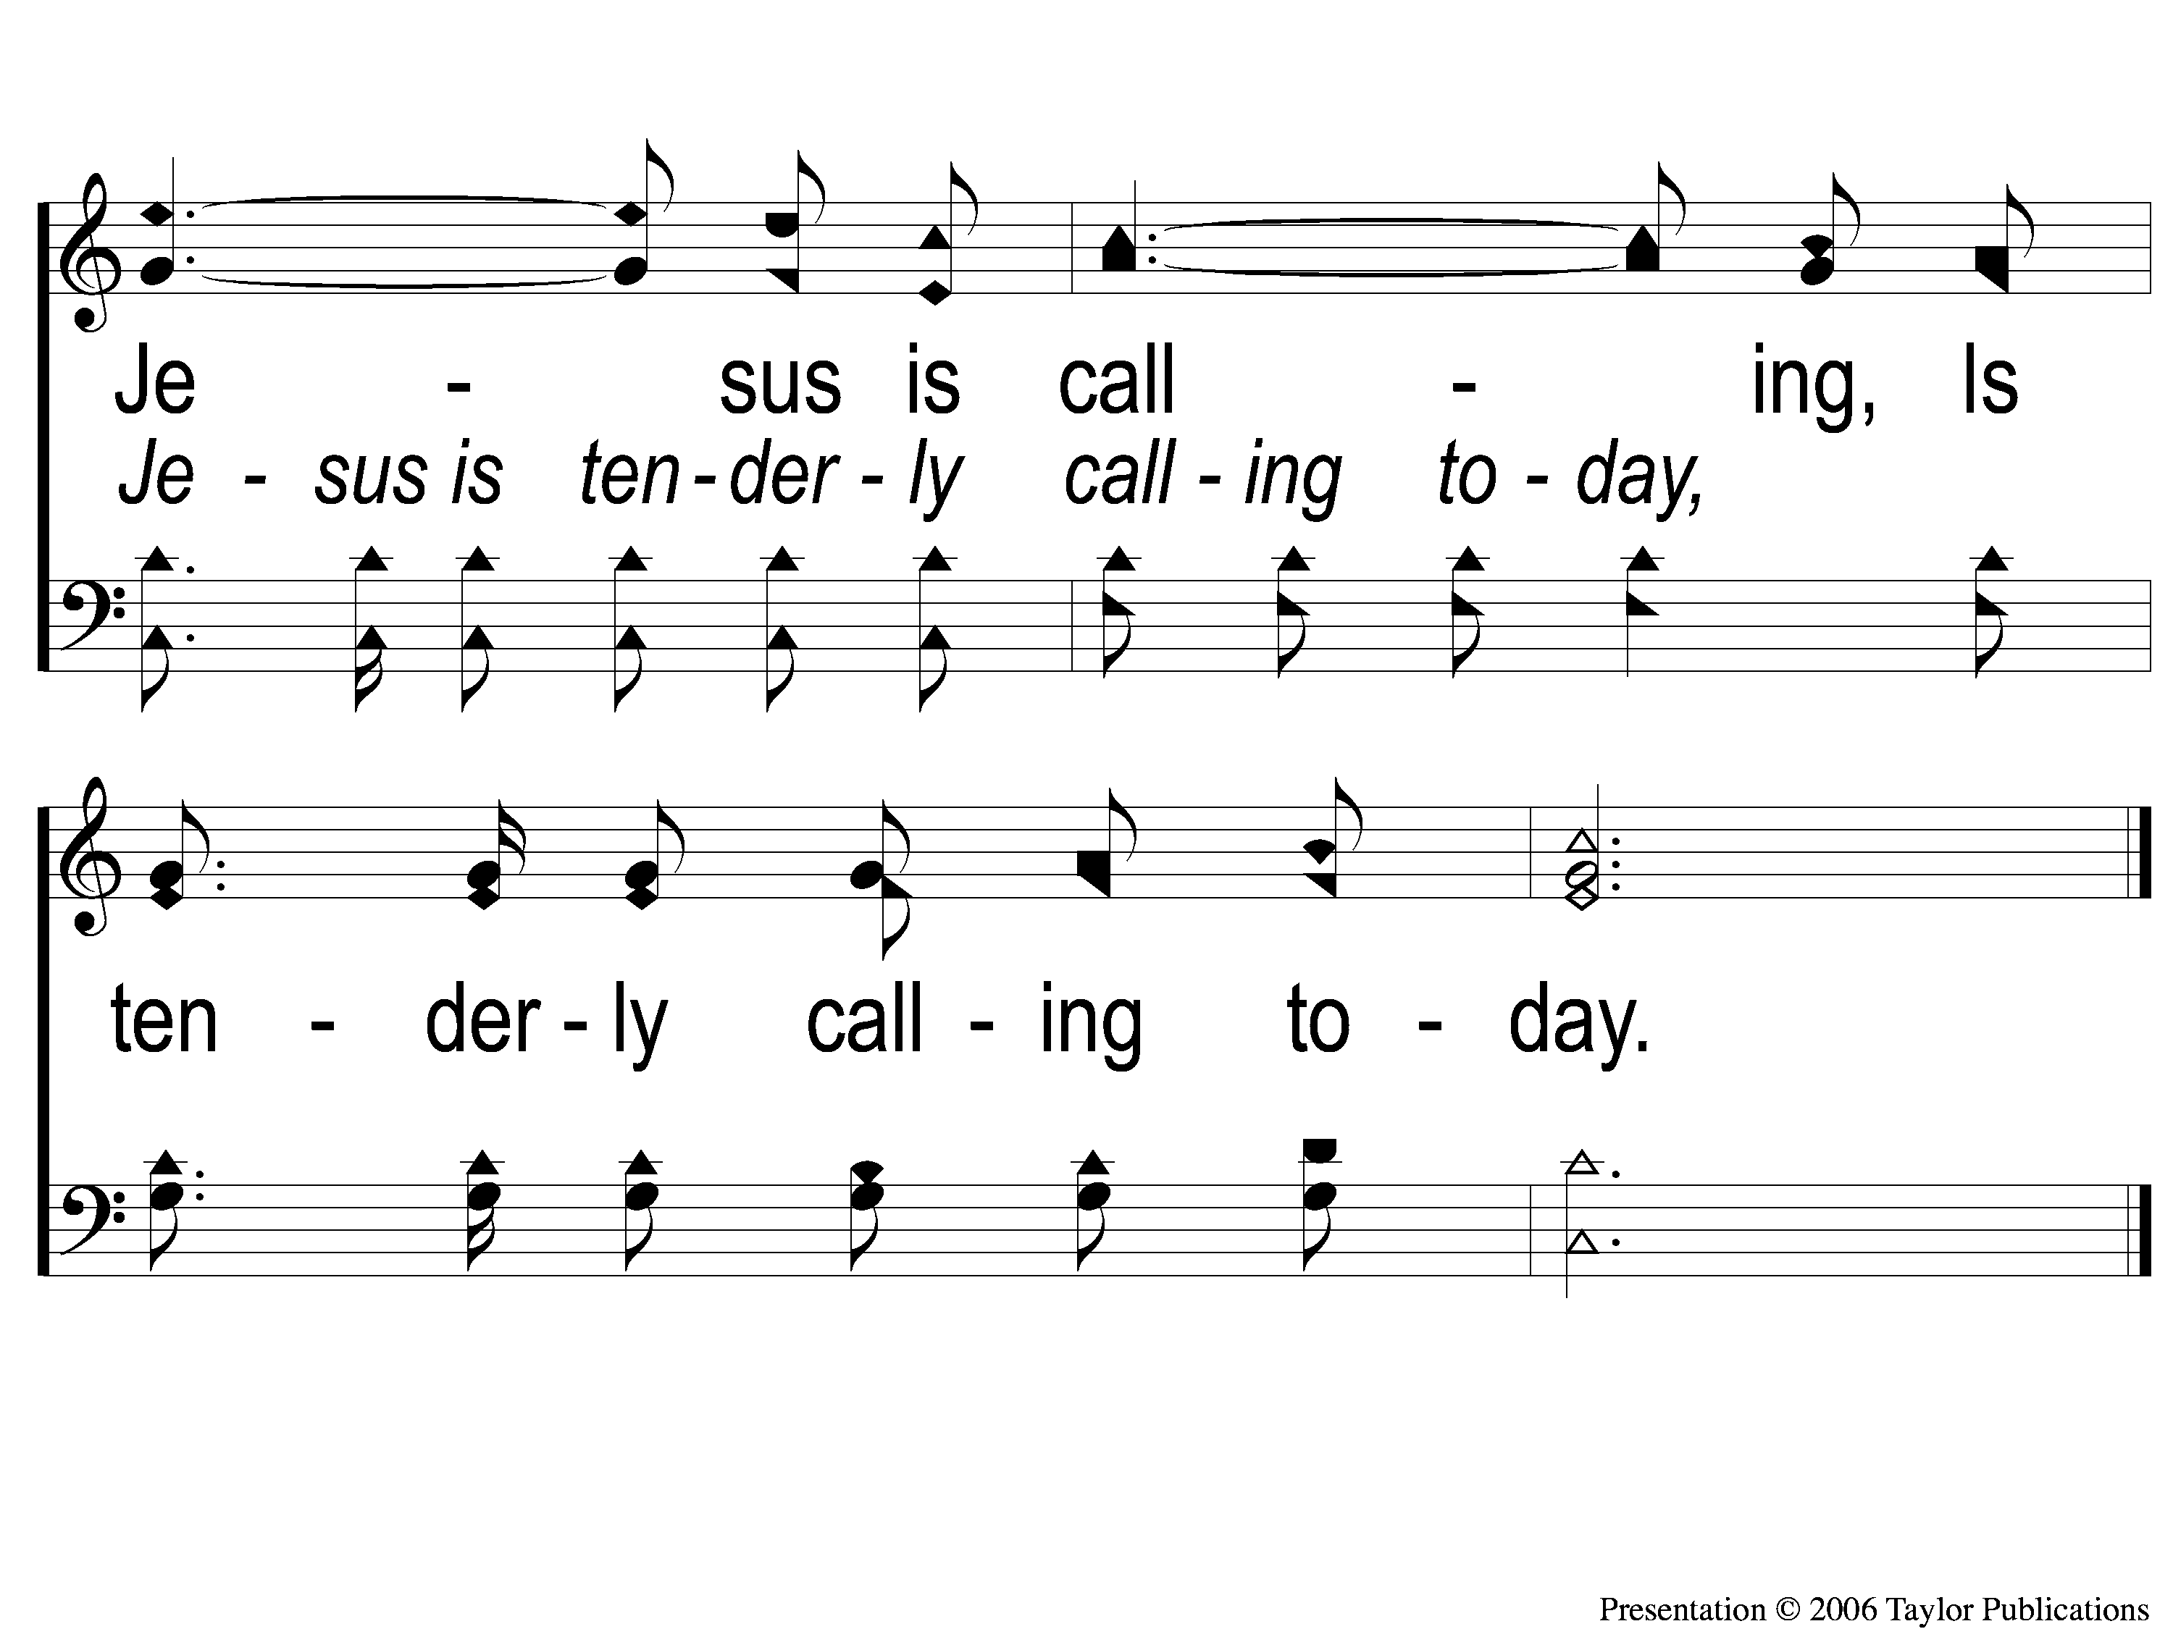
C-2 Jesus is Tenderly Calling
Jesus Is Tenderly Calling
947

Slide 100
3-1 Jesus is Tenderly Calling
Jesus Is Tenderly Calling
947

Slide 101
3-2 Jesus is Tenderly Calling
Jesus Is Tenderly Calling
947

Slide 102
C-1 Jesus is Tenderly Calling
Jesus Is Tenderly Calling
947

Slide 103
C-2 Jesus is Tenderly Calling
Jesus Is Tenderly Calling
947

Slide 104
4-1 Jesus is Tenderly Calling
Jesus Is Tenderly Calling
947

Slide 105
4-2 Jesus is Tenderly Calling
Jesus Is Tenderly Calling
947

Slide 106
C-1 Jesus is Tenderly Calling
Jesus Is Tenderly Calling
947

Slide 107
C-2 Jesus is Tenderly Calling
Jesus Is Tenderly Calling
947

Slide 108
OUR OFFERING
2 Corinthians 8:12
“For if there is first a willing mind, it is accepted according to what one has, and not according to what he does not have.”

Slide 109
SONG:
I gave my life for thee
#354

Slide 110
1-1 I Gave My Life For Thee
I Gave My Life for Thee
354

Slide 111
1-2 I Gave My Life For Thee
I Gave My Life for Thee
354

Slide 112
3-1 I Gave My Life For Thee
I Gave My Life for Thee
354

Slide 113
3-2 I Gave My Life For Thee
I Gave My Life for Thee
354

Slide 114
4-1 I Gave My Life For Thee
I Gave My Life for Thee
354

Slide 115
4-2 I Gave My Life For Thee
I Gave My Life for Thee
354

Slide 116
THE UNLEAVENED BREAD
Isaiah 53:1-3
“Who has believed our report? And to whom has the arm of the Lord been revealed? For He shall grow up before Him as a tender plant, And as a root out of dry ground. He has no form or comeliness; And when we see Him, There is no beauty that we should desire Him. He is despised and rejected by men, A Man of sorrows and acquainted with grief. And we hid, as it were, our faces from Him; He was despised, and we did not esteem Him.”

Slide 117
THE FRUIT OF THE VINE
Isaiah 53:4-5
“Surely He has borne our griefs And carried our sorrows; Yet we esteemed Him stricken, Smitten by God, and afflicted. But He was wounded for our transgressions, He was bruised for our iniquities; The chastisement for our peace was upon Him, And by His stripes we are healed.”

Slide 118
closing PRAYER

Slide 119
SONG:
We have heard the joyful sound
#652

Slide 120
1-1 We Have Heard the Joyful Sound
We Have Heard the Joyful Sound
652

Slide 121
1-2 We Have Heard the Joyful Sound
We Have Heard the Joyful Sound
652

Slide 122
1-3 We Have Heard the Joyful Sound
We Have Heard the Joyful Sound
652

Slide 123
2-1 We Have Heard the Joyful Sound
We Have Heard the Joyful Sound
652

Slide 124
2-2 We Have Heard the Joyful Sound
We Have Heard the Joyful Sound
652

Slide 125
2-3 We Have Heard the Joyful Sound
We Have Heard the Joyful Sound
652

Slide 126
4-1 We Have Heard the Joyful Sound
We Have Heard the Joyful Sound
652

Slide 127
4-2 We Have Heard the Joyful Sound
We Have Heard the Joyful Sound
652

Slide 128
4-3 We Have Heard the Joyful Sound
We Have Heard the Joyful Sound
652

Slide 129
Today
LTC @ 3:30
WORSHIP @ 6:00
Wednesday
Worship & Bible classes @ 6:30

