Slide 1
WELCOME
To the Wheeler church of Christ

Slide 2
Songs of praise to God

Slide 3
OPENING PRAYER

Slide 4
Songs of praise to God

Slide 5
SONG:
We shall assemble
PH #70

Slide 6
1-1 We Shall Assemble
We Shall Assemble

Slide 7
1-2 We Shall Assemble
We Shall Assemble

Slide 8
C-1 We Shall Assemble
We Shall Assemble

Slide 9
C-2 We Shall Assemble
We Shall Assemble

Slide 10
3-1 We Shall Assemble
We Shall Assemble

Slide 11
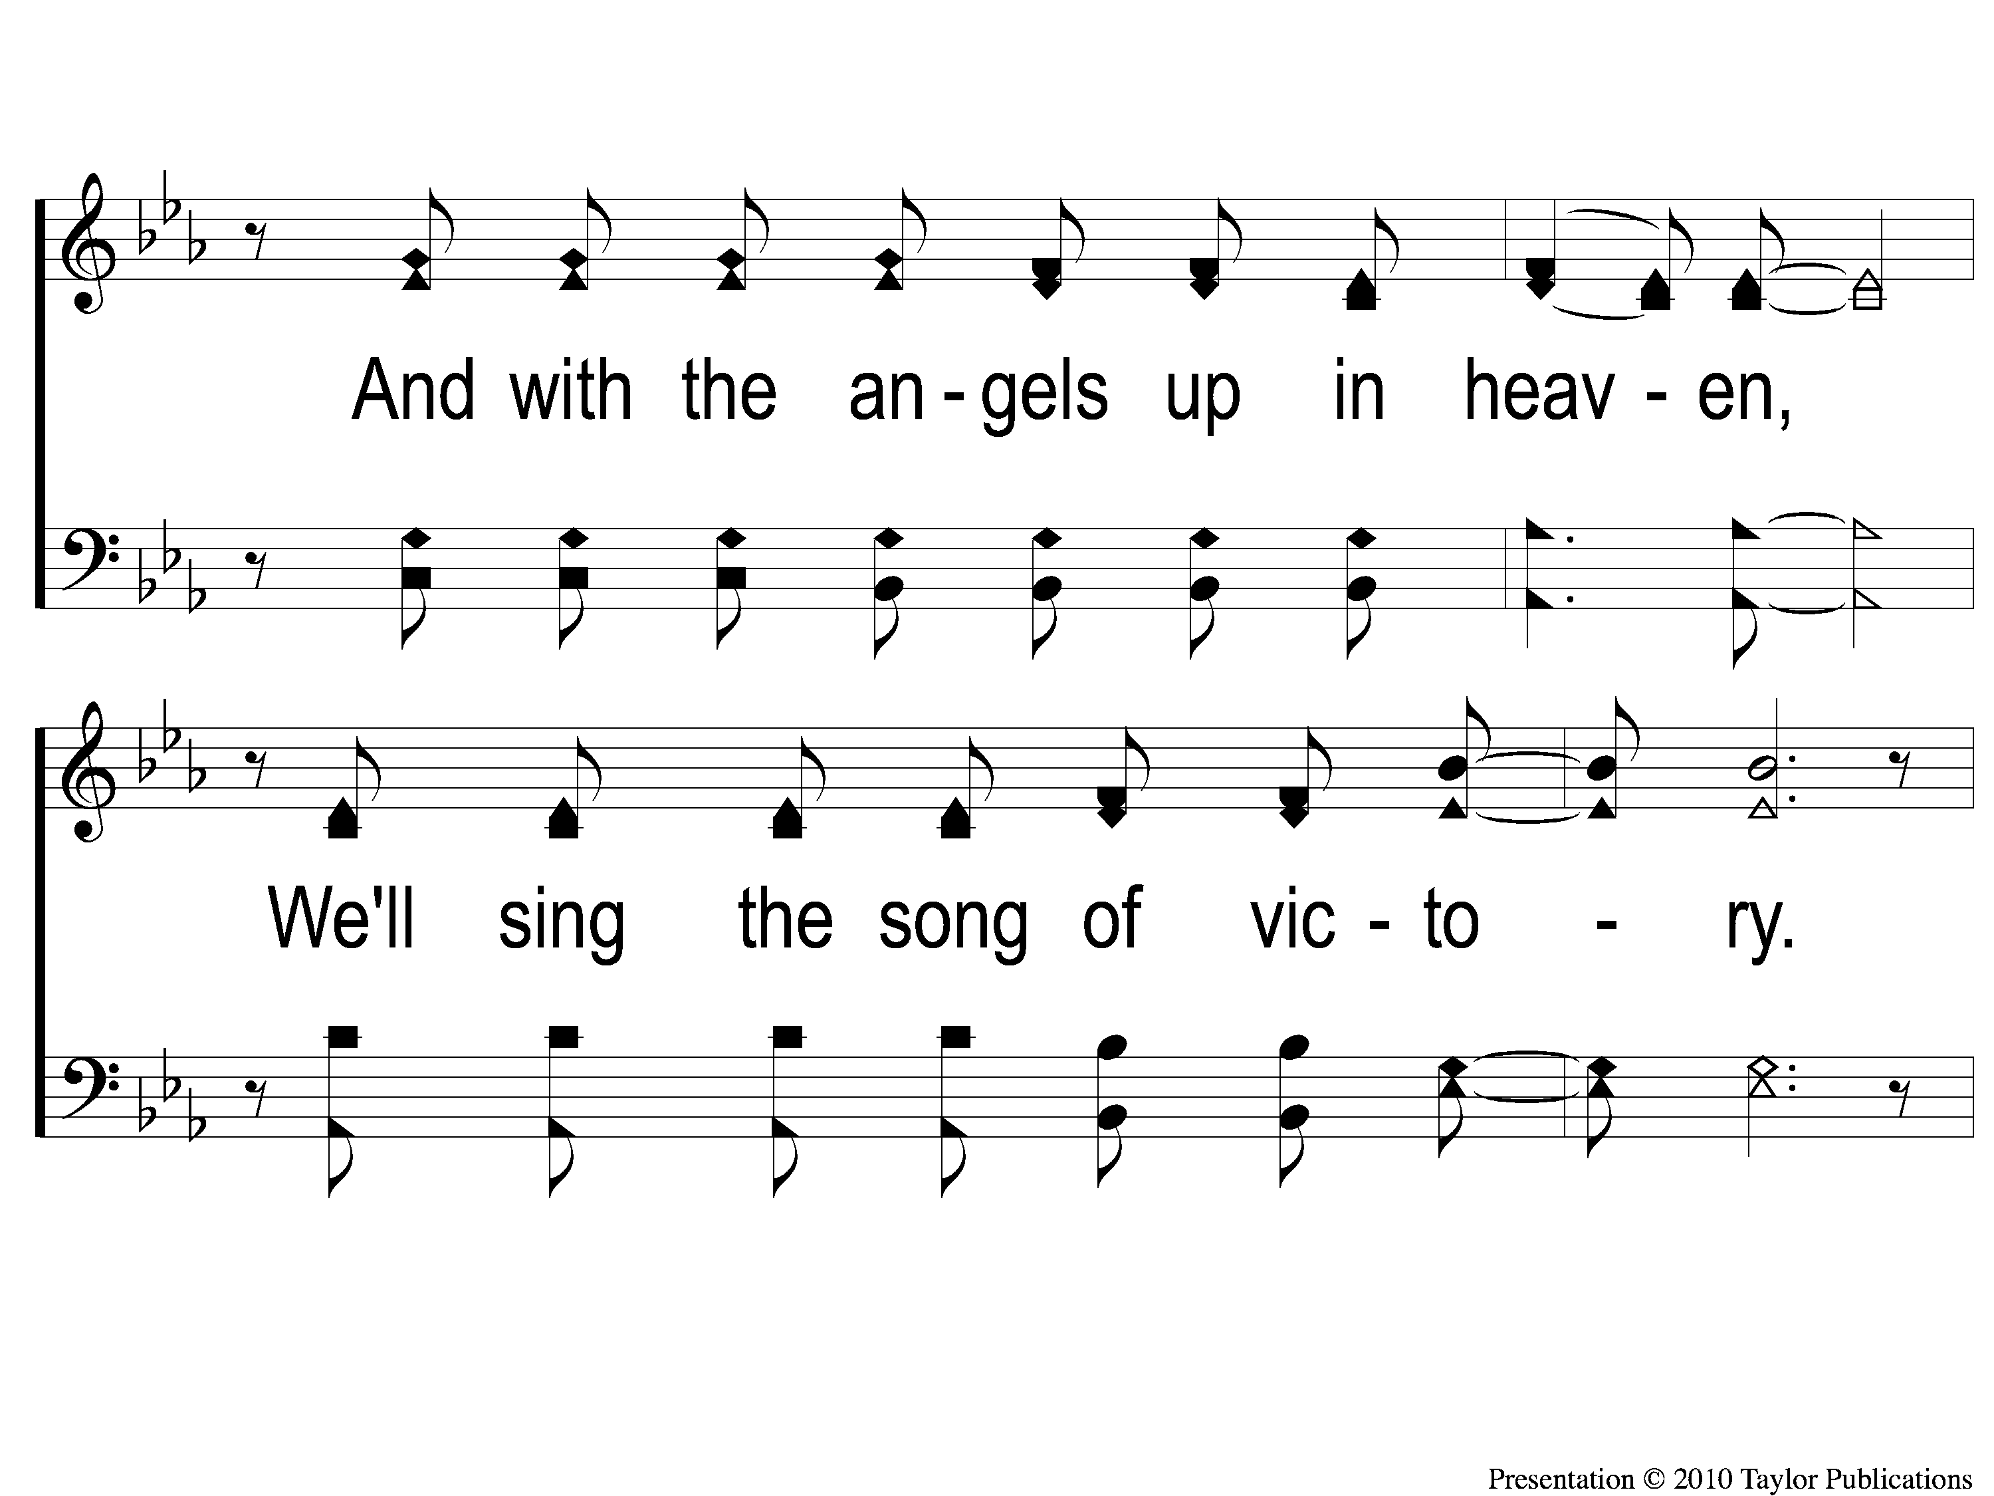
3-2 We Shall Assemble
We Shall Assemble

Slide 12
C-1 We Shall Assemble
We Shall Assemble

Slide 13
C-2 We Shall Assemble
We Shall Assemble

Slide 14
IN PURSUIT
OF THE KINGDOM

Slide 15
IN PURSUIT
OF THE KING

Slide 16
Who is Jesus?
According to matthew

Slide 17
“When Jesus came into the region of Caesarea Philippi, He asked His disciples, saying,
‘Who do men say that I, the Son of Man, am?”
– Matt. 16:13

Slide 18
“Messiah” (ch. 1)
“king of the jews” (ch. 2)
“son of god” (ch. 3)

Slide 19
Conqueror (ch. 4)

Slide 20
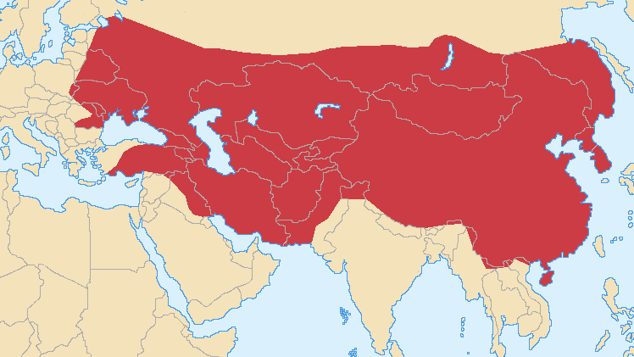

Slide 21
What did jesus conquer?
Self (4:1-2)
2 Cor. 10:4-5
Matt. 26:36-39, 42

Slide 22
What did jesus conquer?
Temptation (4:3-11)
Heb. 4:15
2 Cor. 5:21
Jn. 8:46

Slide 23
What did Jesus conquer?
The devil (4:11)
Heb. 2:14, 18, 4:15
Job 1:7

Slide 24
how did Jesus conquer?
He knew his weaknesses (4:1-2)
Jn. 1:14
Heb. 2:14, 4:21a, 5:7-8
Rom. 8:13
Matt. 5:29-30

Slide 25
How did jesus conquer?
He knew god’s word (4:4, 7, 10)
2 cor. 10:3
Lk. 2:39-40, 46, 49-52
Heb. 5:8

Slide 26
how did Jesus conquer?
He knew the enemy (4:1-11)
His tactics – 1 Jn. 2:16

Slide 27
how did Jesus conquer?
He knew the enemy (4:1-11)
His tactics – 1 Jn. 2:16
His targets – matt. 6:24, gen. 37, 2 sam. 11

Slide 28
how did Jesus conquer?
He knew the enemy (4:1-11)
His tactics – 1 Jn. 2:16
His targets – matt. 6:24, gen. 37, 2 sam. 11
His character – Jn. 8:44, rev. 12:10

Slide 29
how did Jesus conquer?
He knew the enemy (4:1-11)
His tactics – 1 Jn. 2:16
His targets – matt. 6:24, gen. 37, 2 sam. 11
His character – Jn. 8:44, rev. 12:10
His weakness – jms. 4:7

Slide 30
how can we conquer sin?
Look for the way of escape (1 cor. 10:13)

Slide 31
how can we conquer sin?
Look for the way of escape (1 cor. 10:13)
Know god’s word
Read god’s word
Pray to god

Slide 32
are you
Conquering sin & self?

Slide 33
Songs of praise to God

Slide 34
The lord’s supper
Acts 20:7

Slide 35
closing PRAYER

Slide 36
Songs of praise to God

Slide 37
Wednesday
Worship & Bible classes @ 6:30

