Slide 1
1-1 We Will Glorify
We Will Glorify
578

Slide 2
1-2 We Will Glorify
We Will Glorify
578

Slide 3
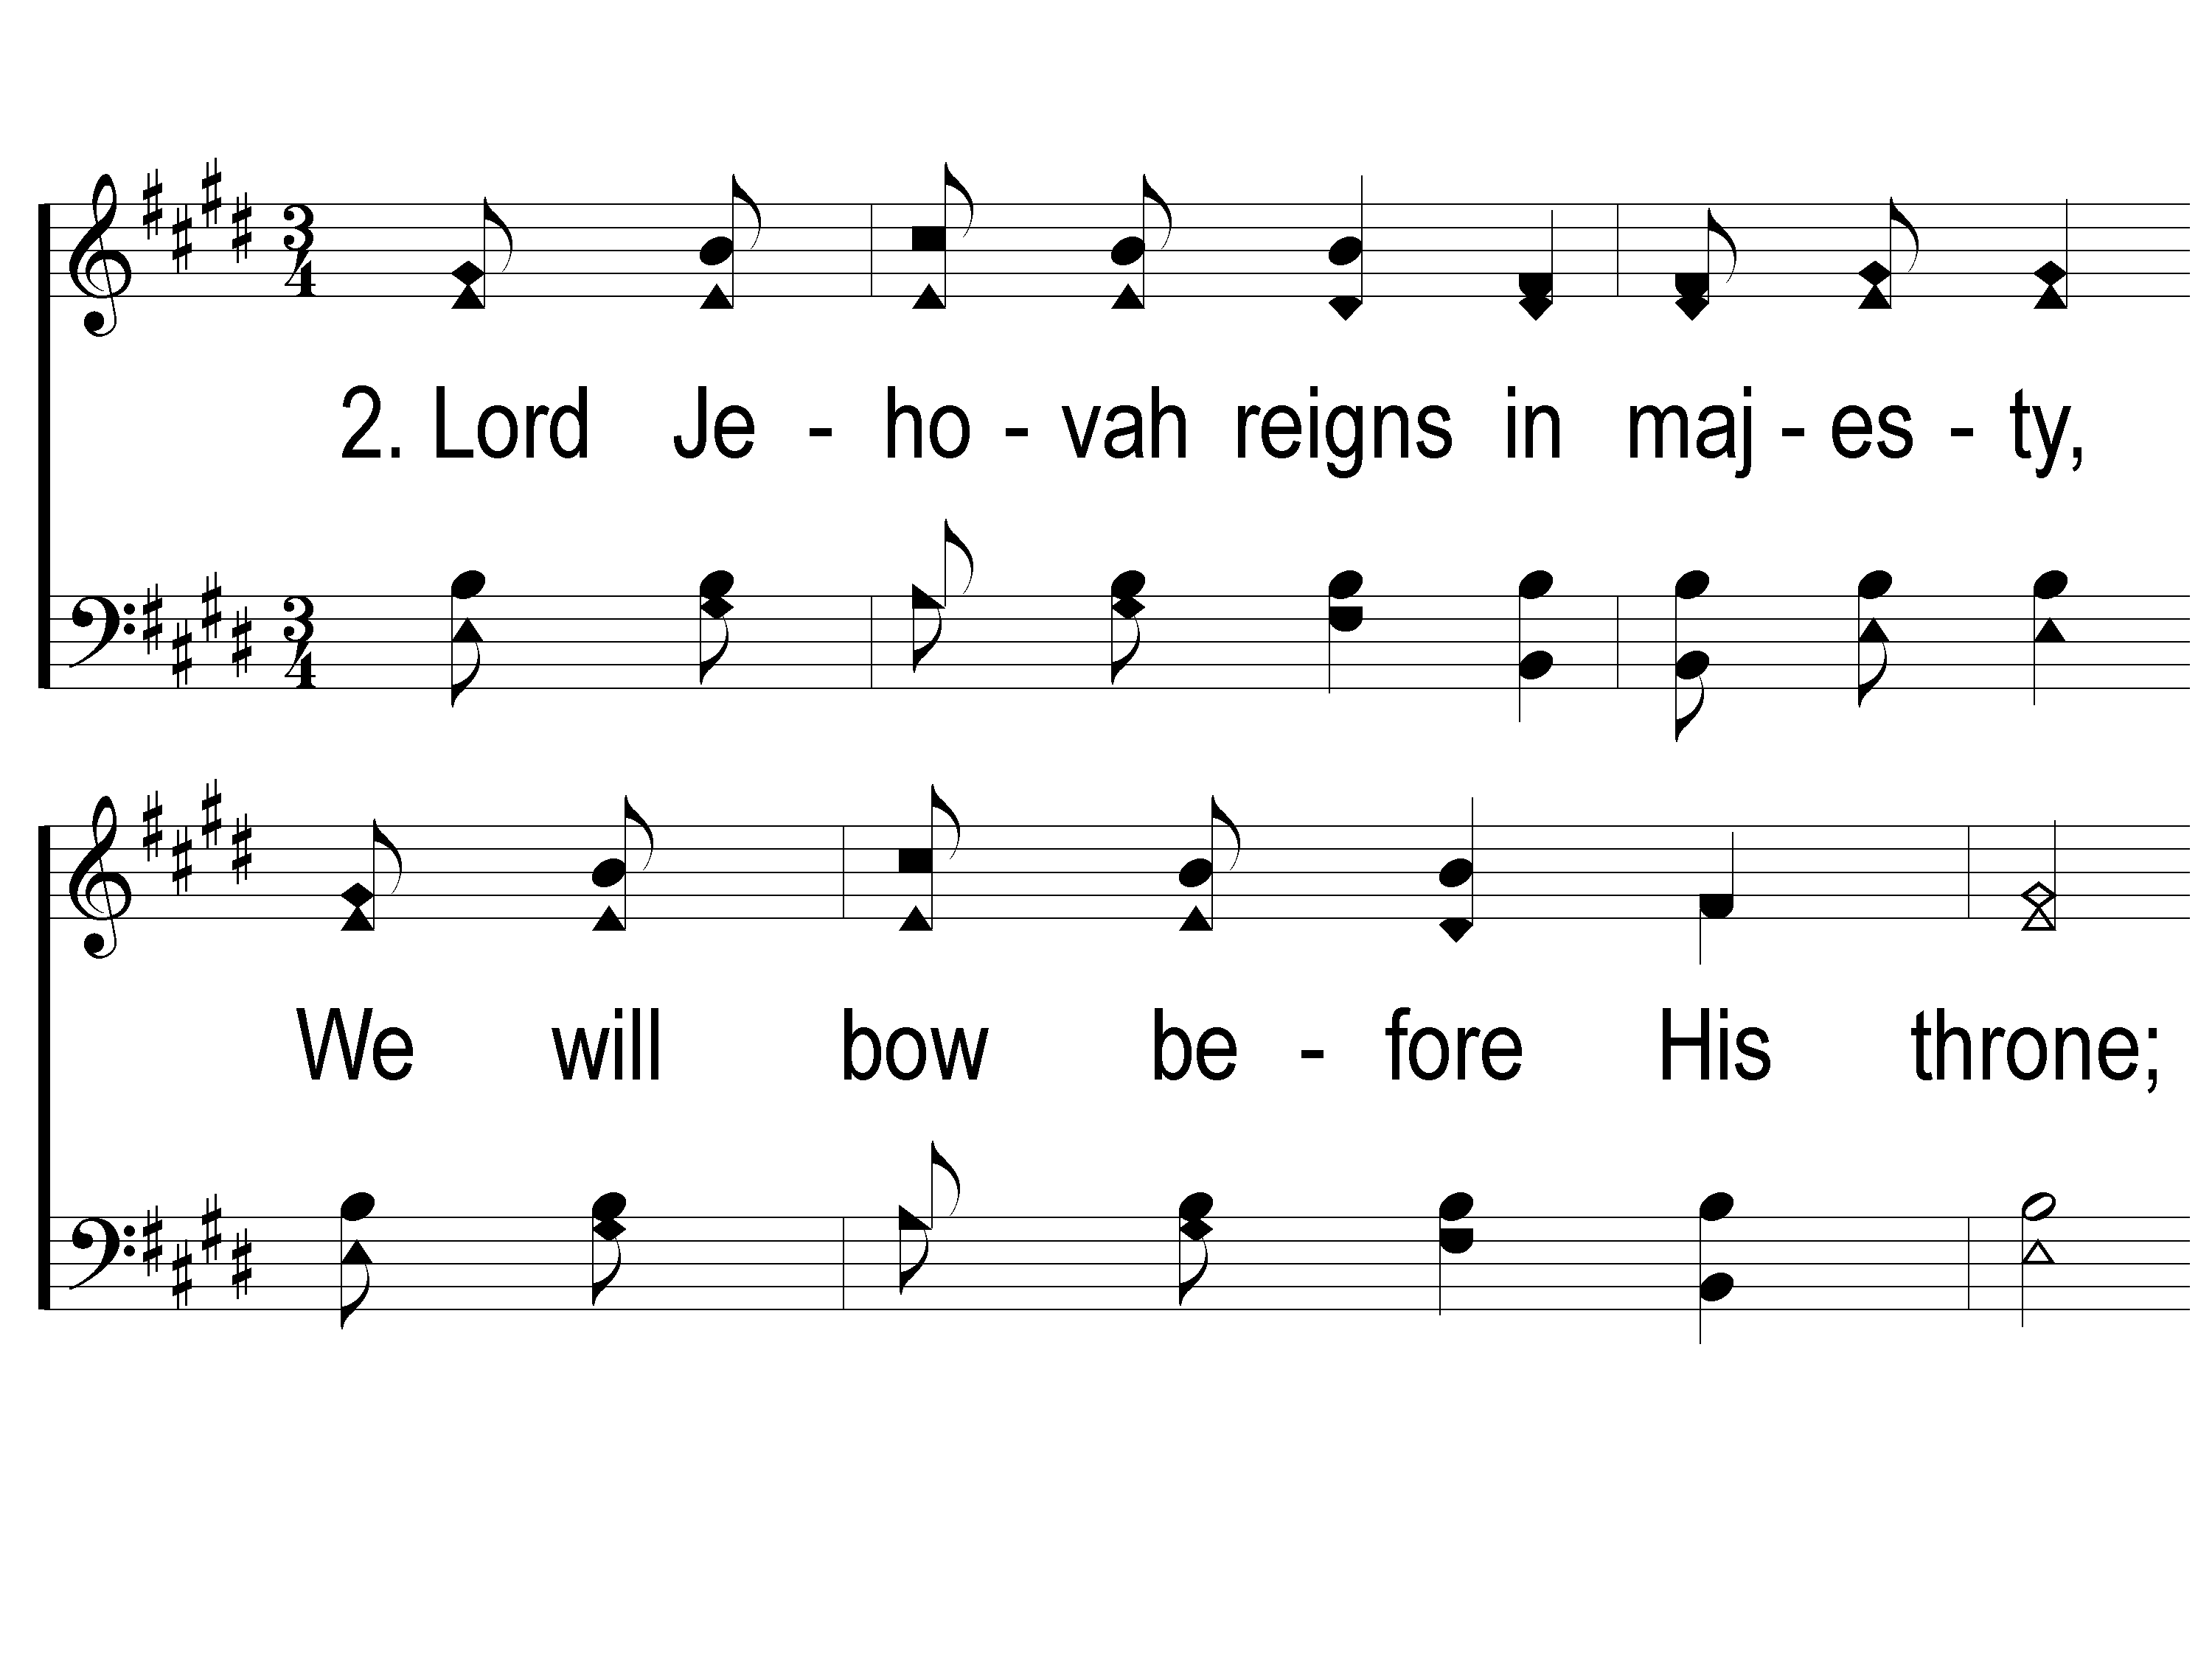
2-1 We Will Glorify
We Will Glorify
578

Slide 4
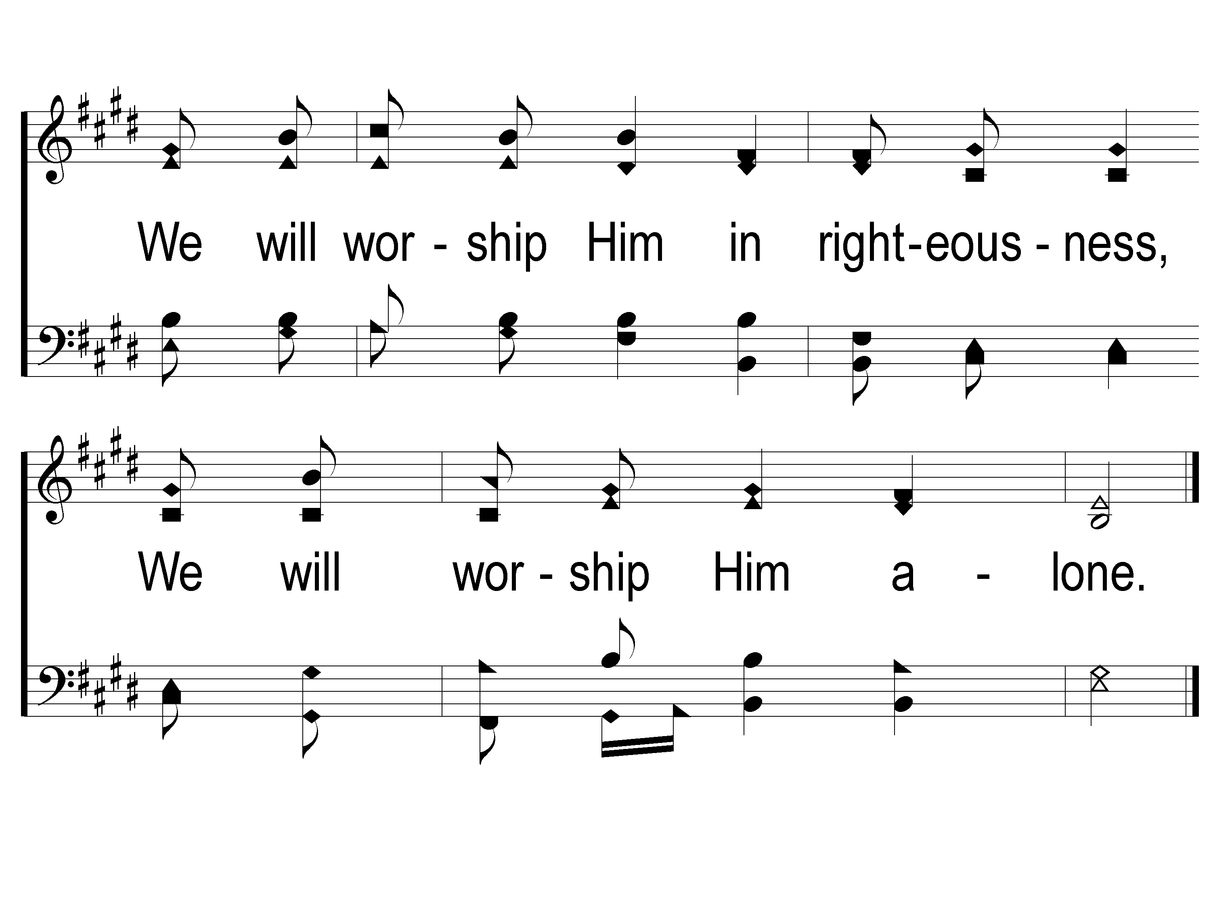
2-2 We Will Glorify
We Will Glorify
578

Slide 5
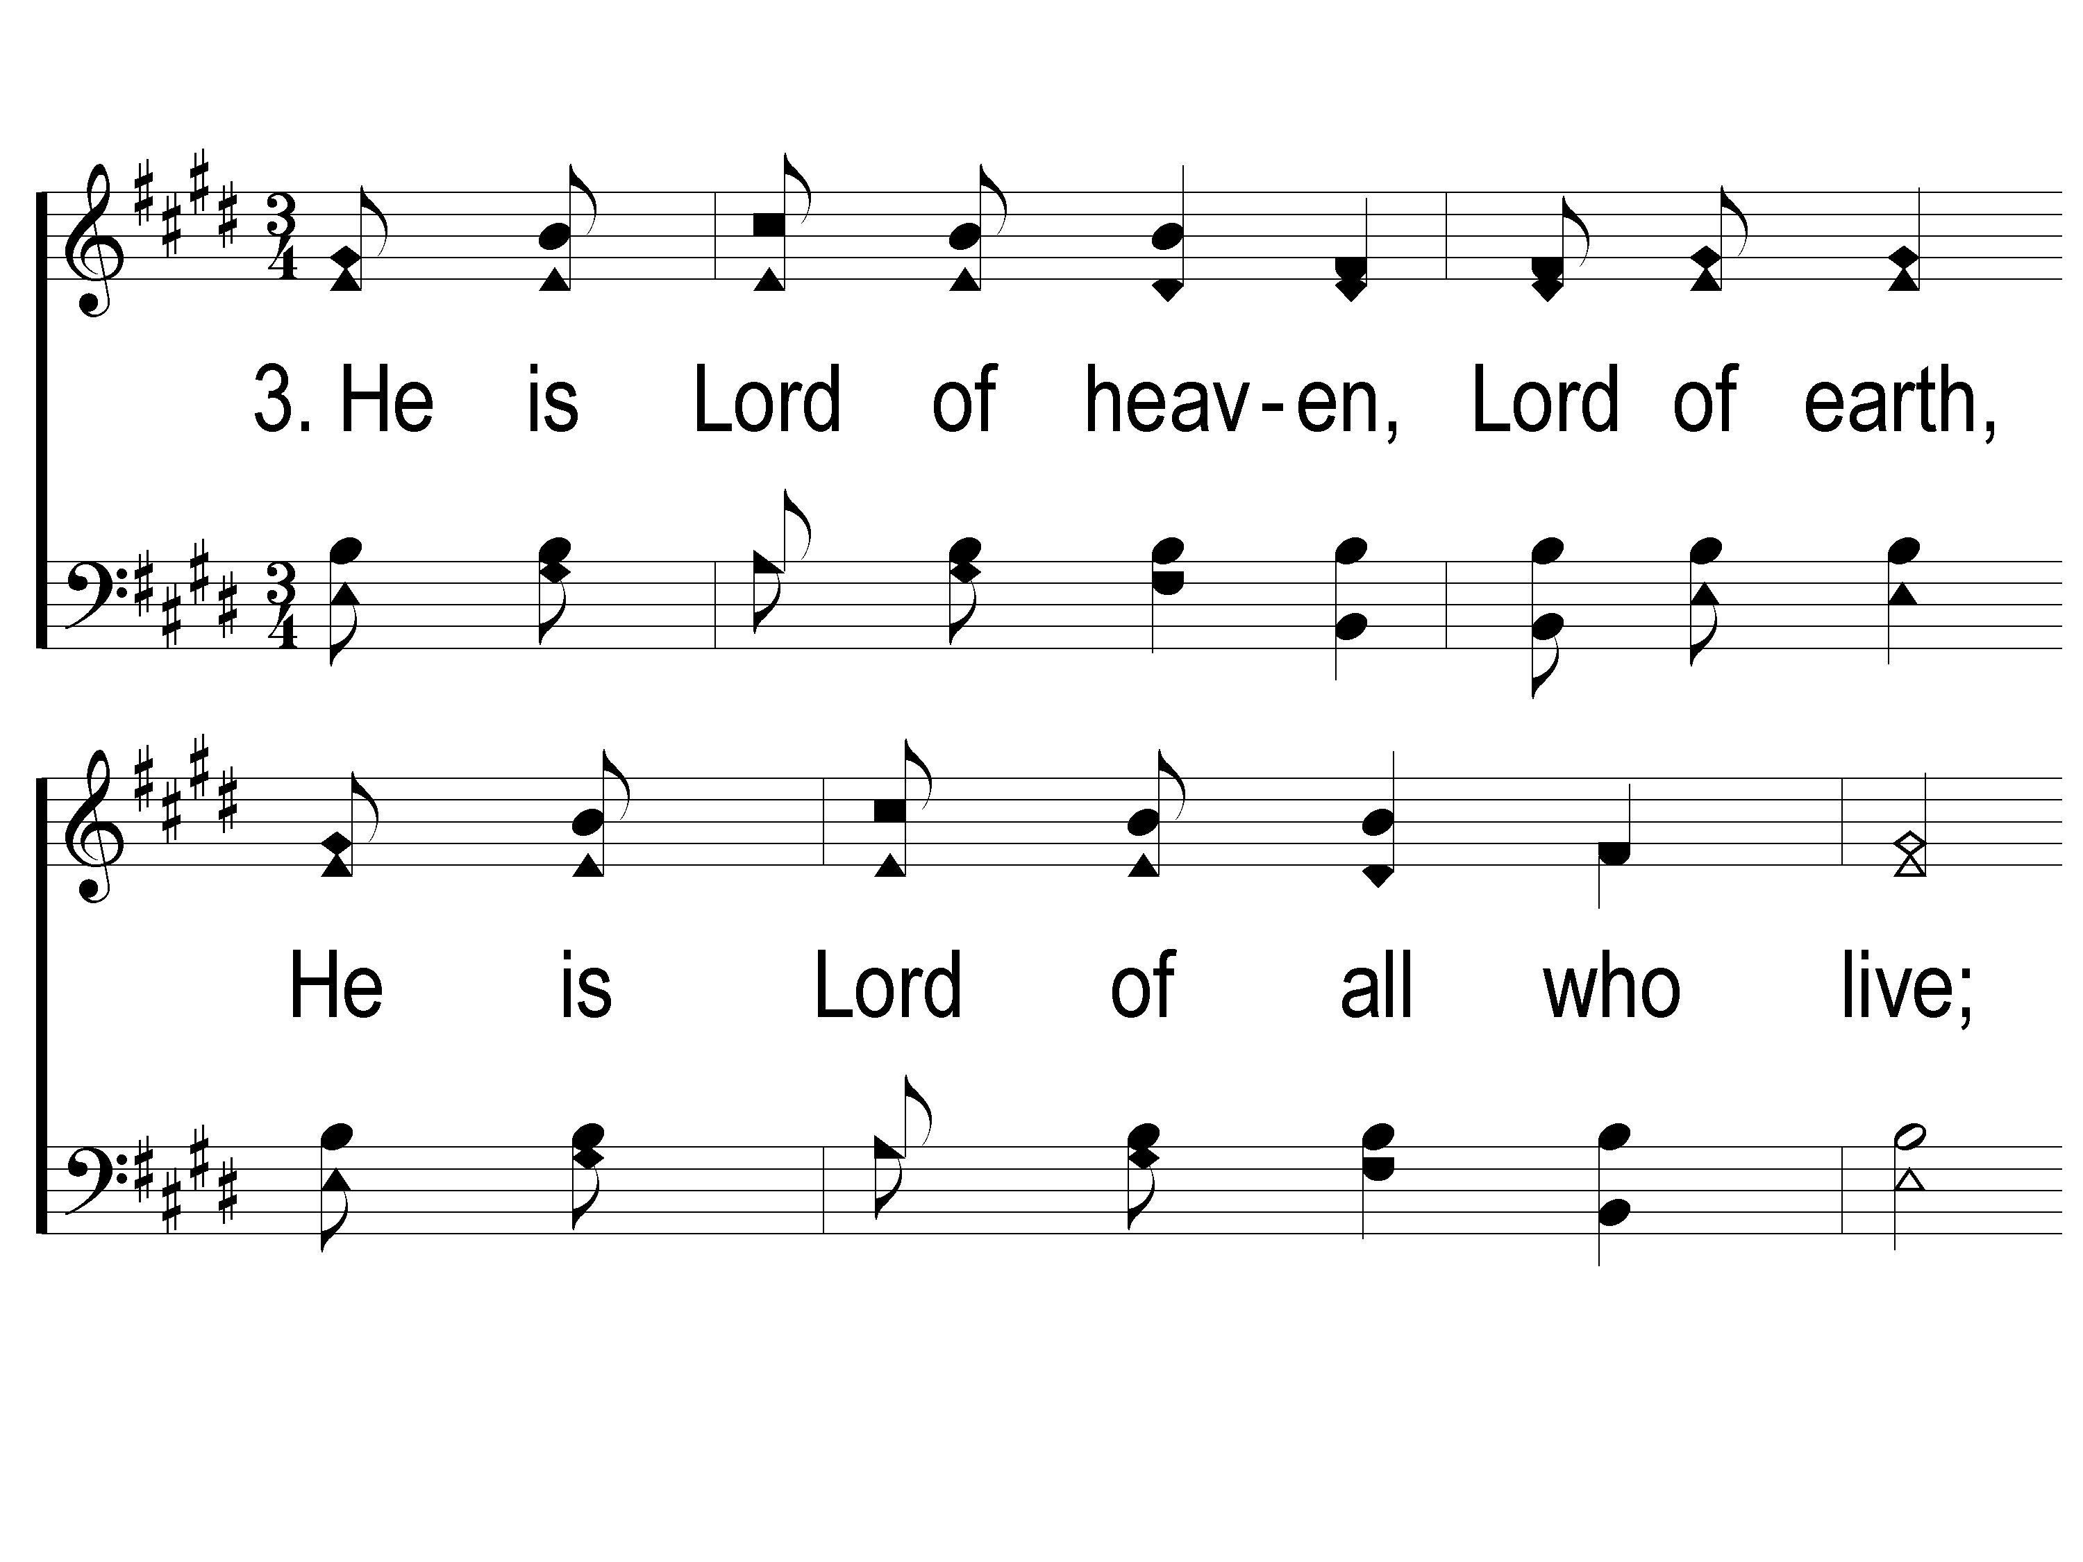
3-1 We Will Glorify
We Will Glorify
578

Slide 6
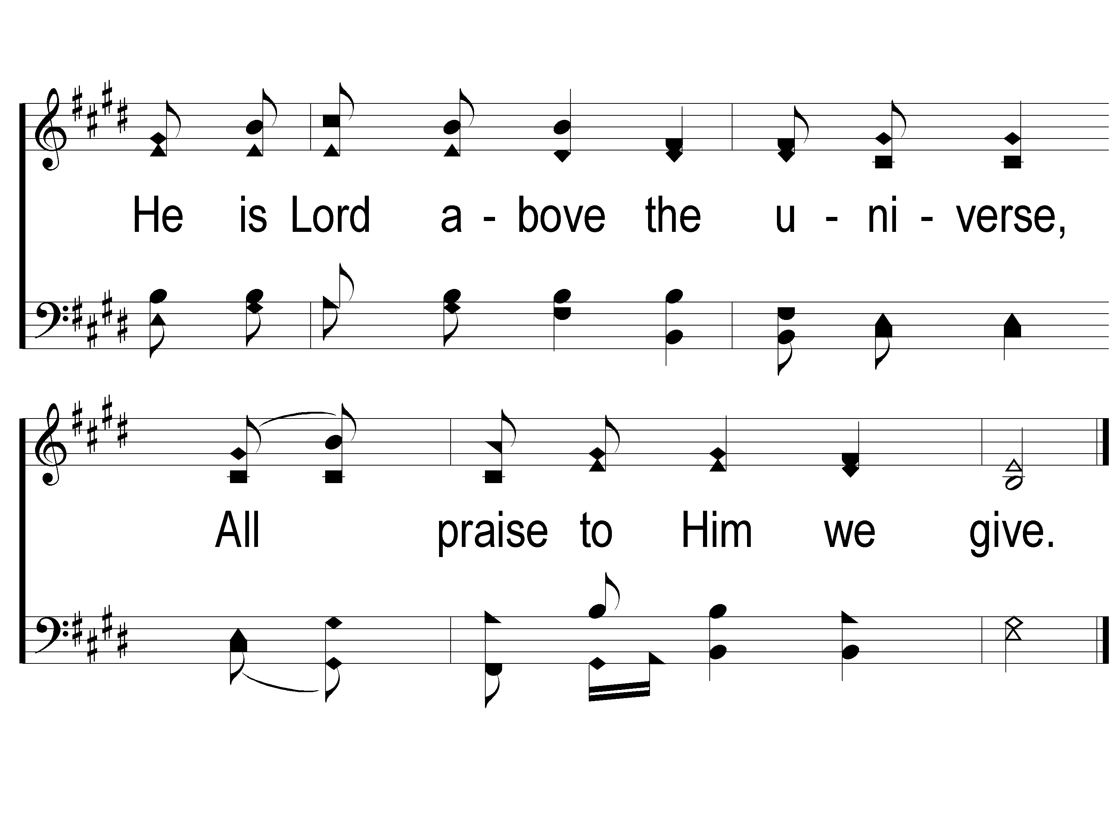
3-2 We Will Glorify
We Will Glorify
578

Slide 7
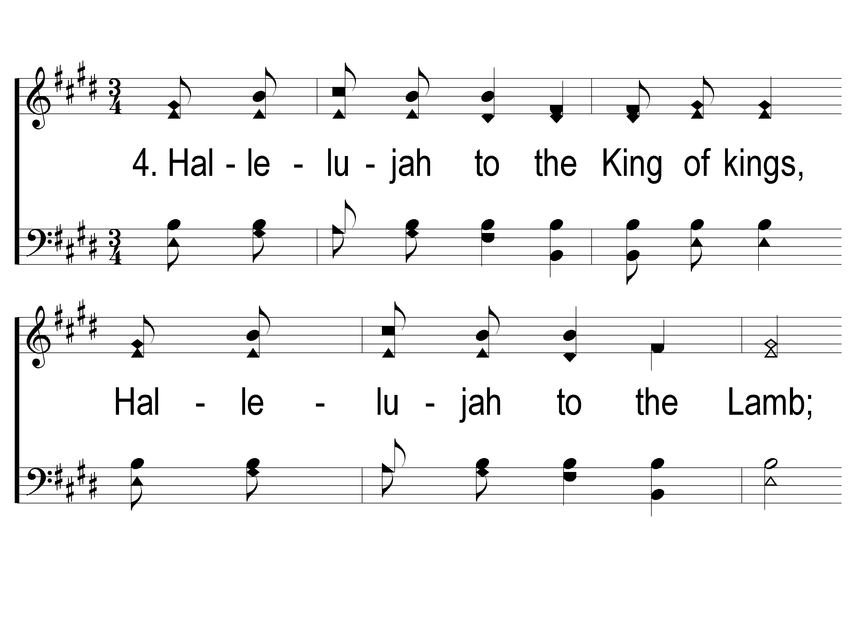
4-1 We Will Glorify
We Will Glorify
578

Slide 8
4-2 We Will Glorify
We Will Glorify
578

Slide 9
WELCOME
To the Wheeler church of Christ

Slide 10
SONG:
Come, thou fount of every blessing
#226

Slide 11
1-1 Come Thou Fount of Every Blessing
Come Thou Fount of Every Blessing
226

Slide 12
1-2 Come Thou Fount of Every Blessing
Come Thou Fount of Every Blessing
226

Slide 13
1-3 Come Thou Fount of Every Blessing
Come Thou Fount of Every Blessing
226

Slide 14
1-4 Come Thou Fount of Every Blessing
Come Thou Fount of Every Blessing
226

Slide 15
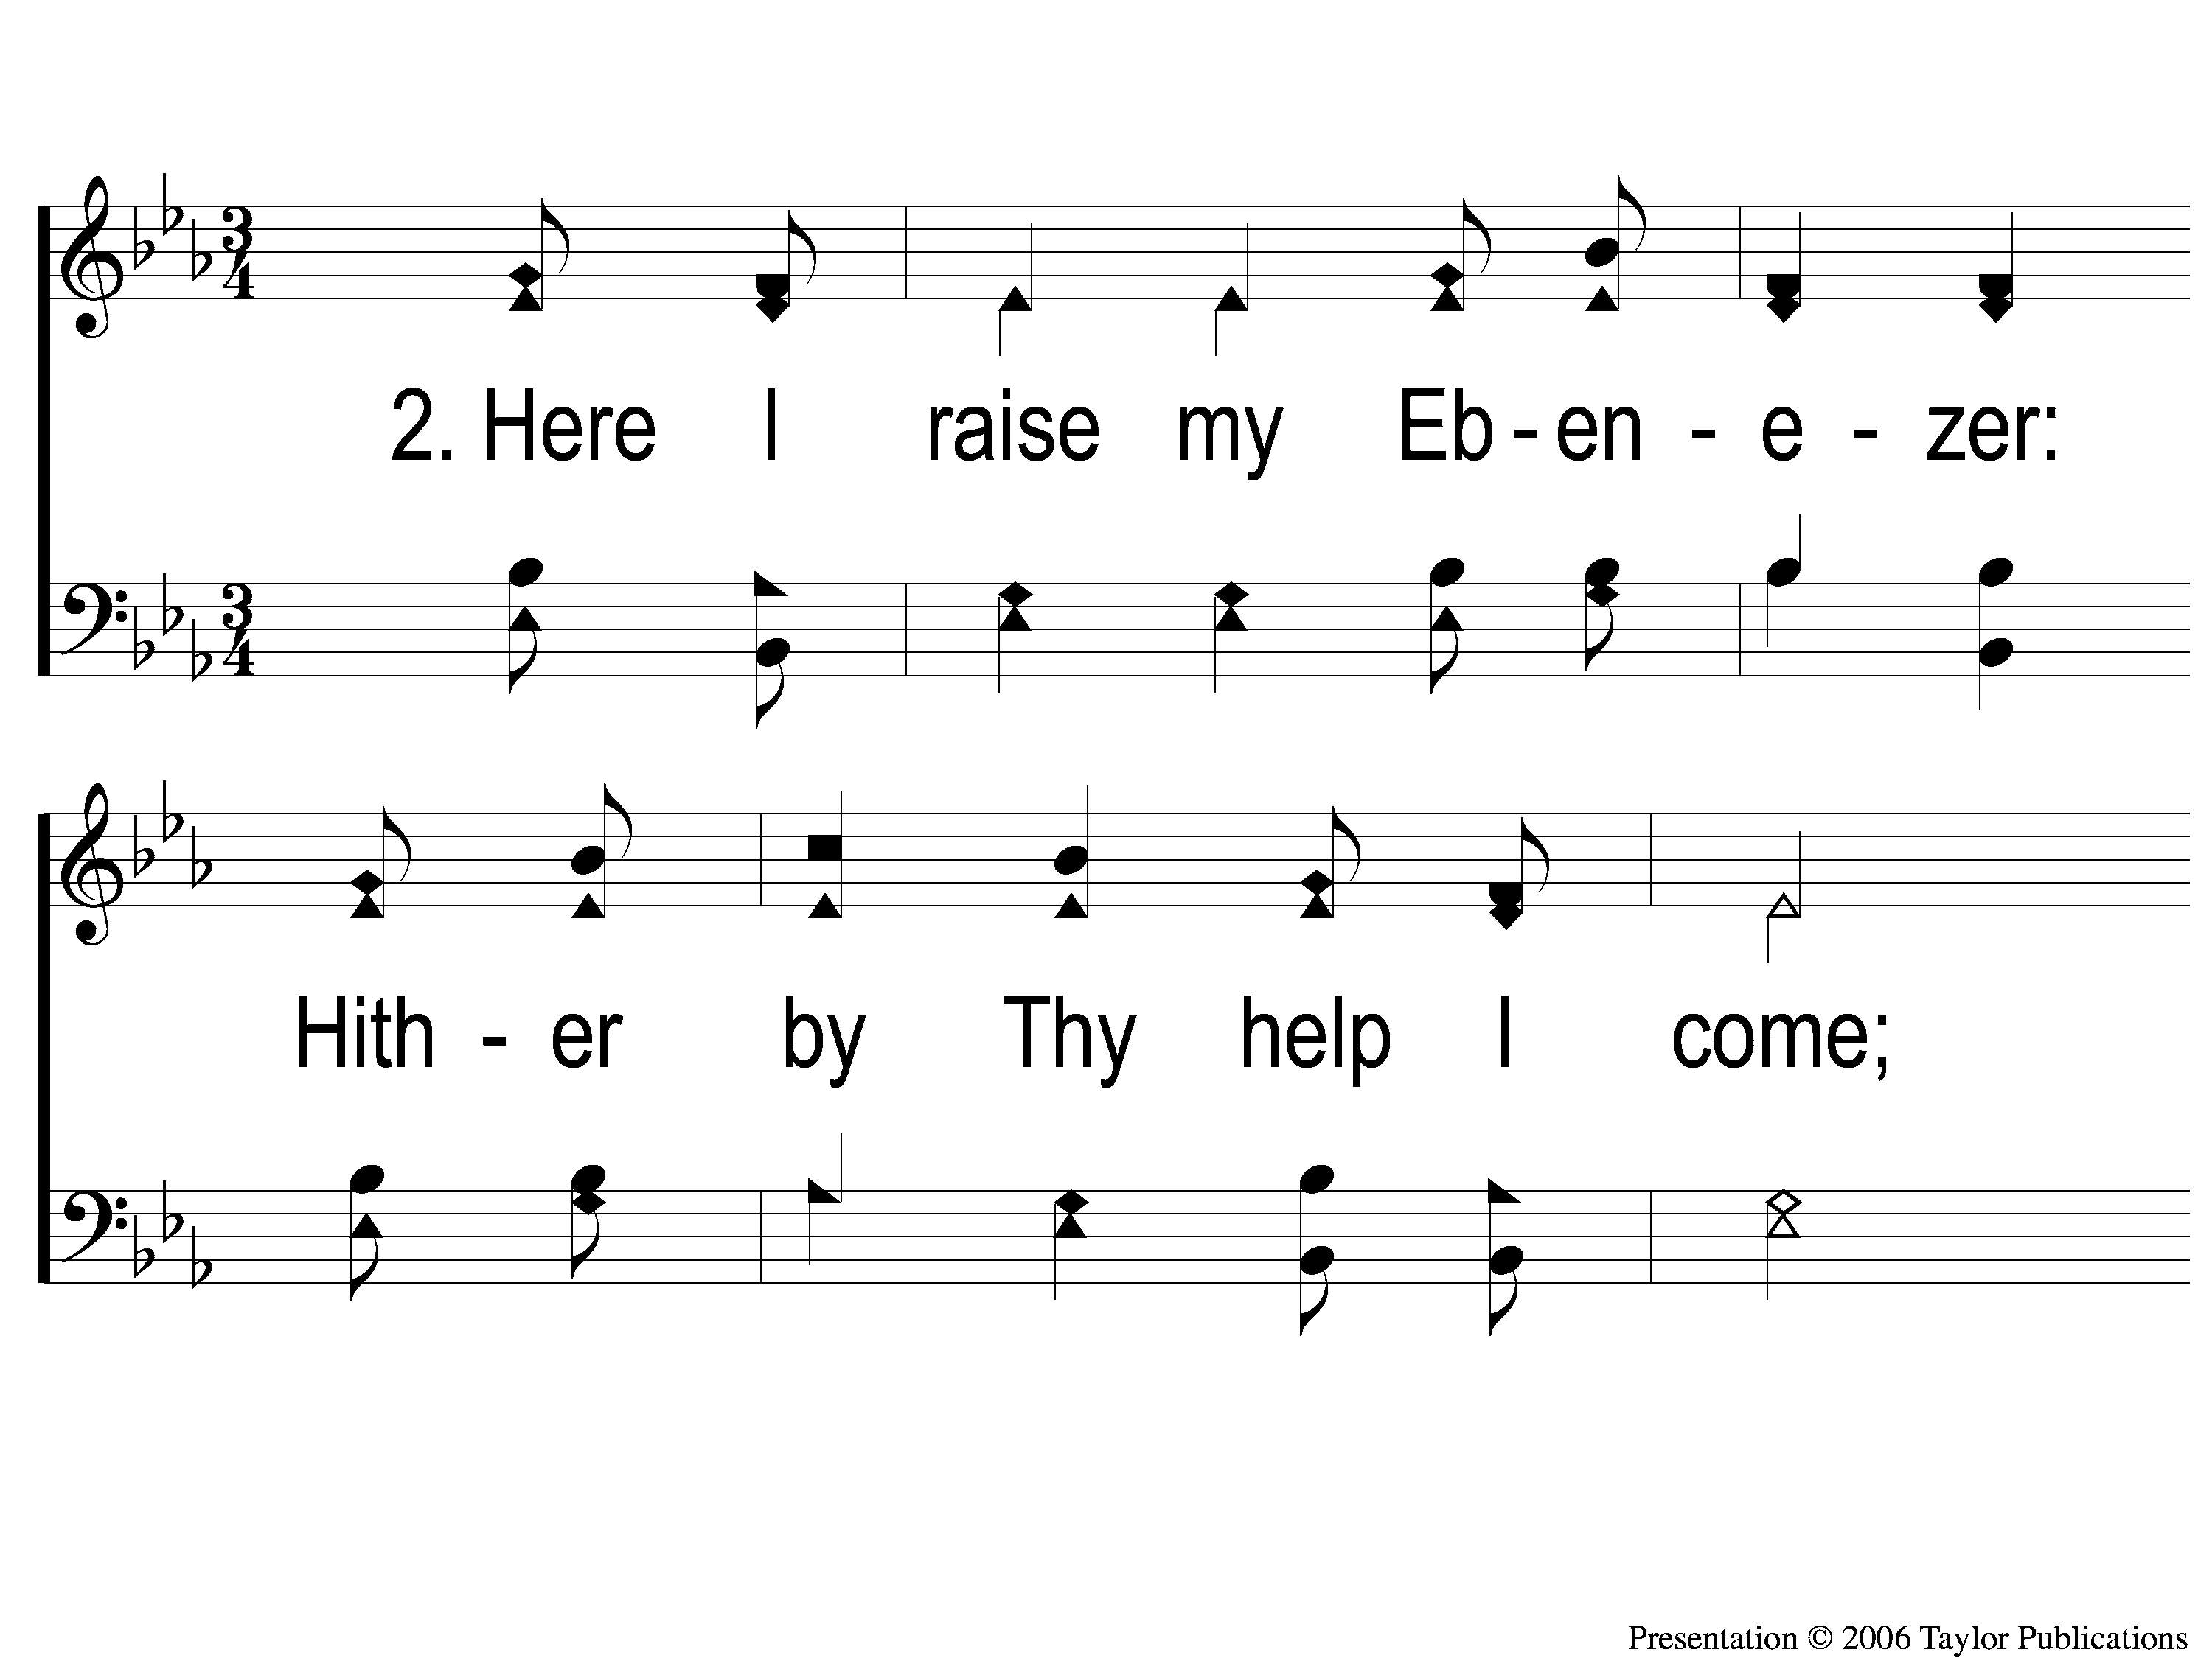
2-1 Come Thou Fount of Every Blessing
Come Thou Fount of Every Blessing
226

Slide 16
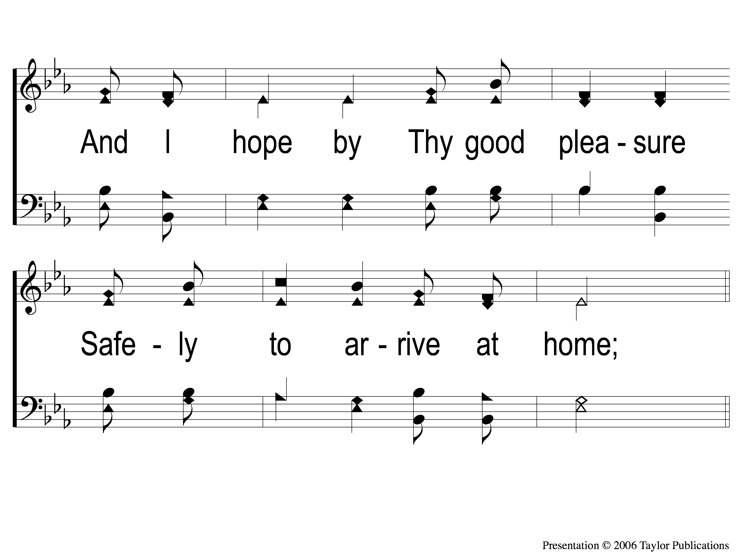
2-2 Come Thou Fount of Every Blessing
Come Thou Fount of Every Blessing
226

Slide 17
2-3 Come Thou Fount of Every Blessing
Come Thou Fount of Every Blessing
226

Slide 18
2-4 Come Thou Fount of Every Blessing
Come Thou Fount of Every Blessing
226

Slide 19
3-1 Come Thou Fount of Every Blessing
Come Thou Fount of Every Blessing
226

Slide 20
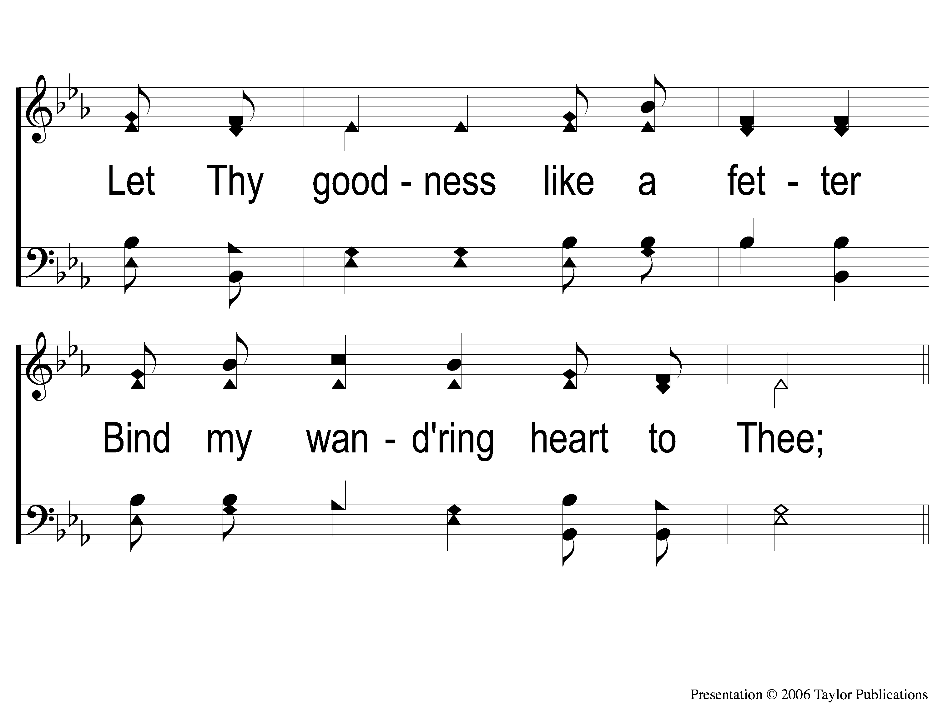
3-2 Come Thou Fount of Every Blessing
Come Thou Fount of Every Blessing
226

Slide 21
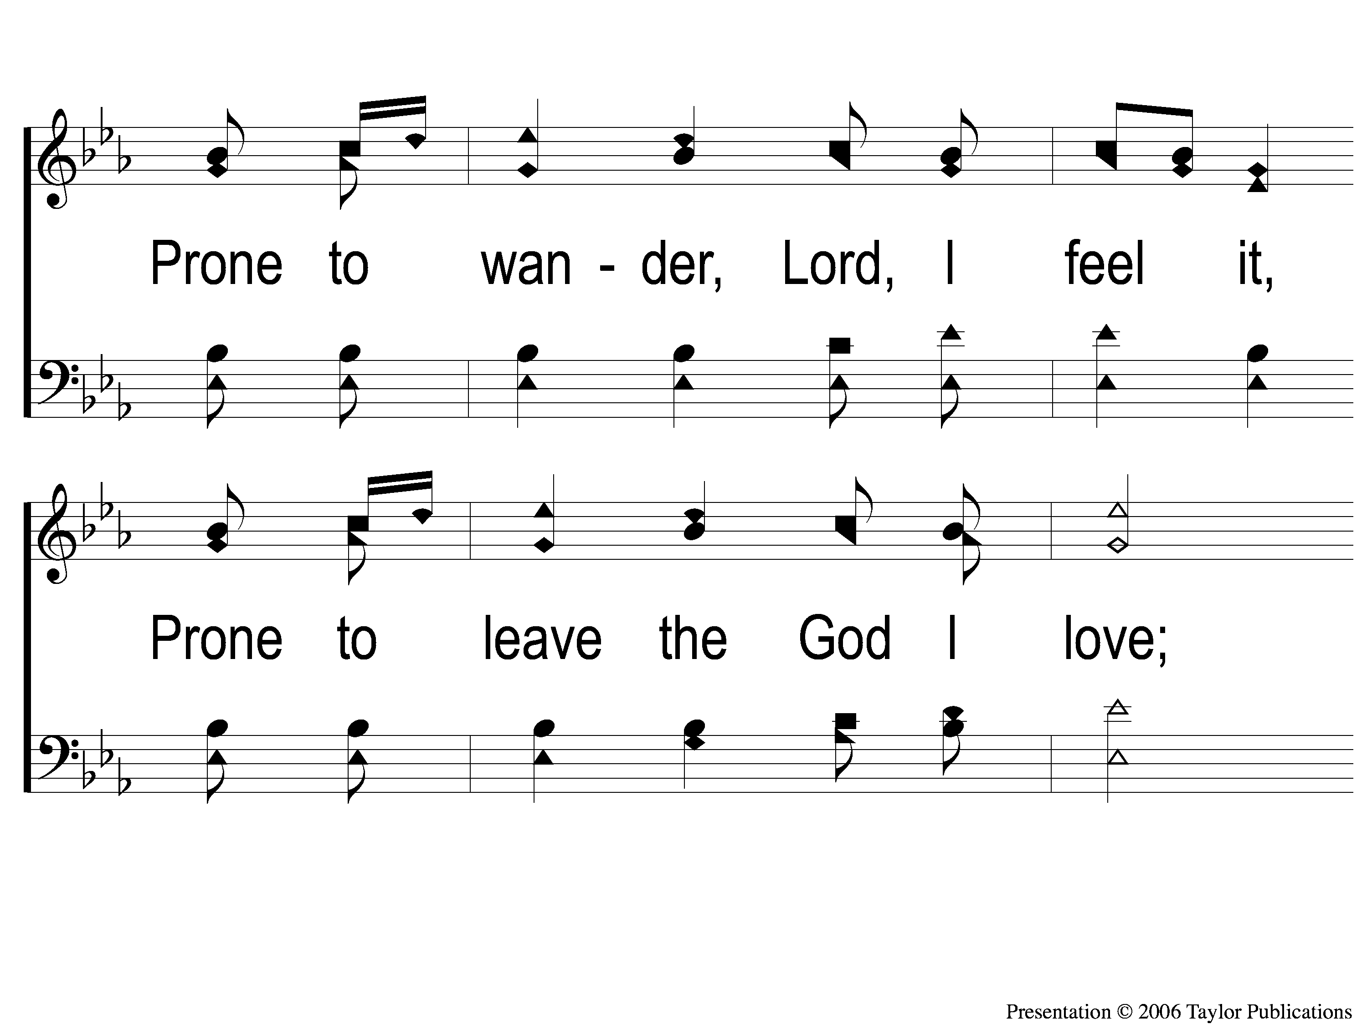
3-3 Come Thou Fount of Every Blessing
Come Thou Fount of Every Blessing
226

Slide 22
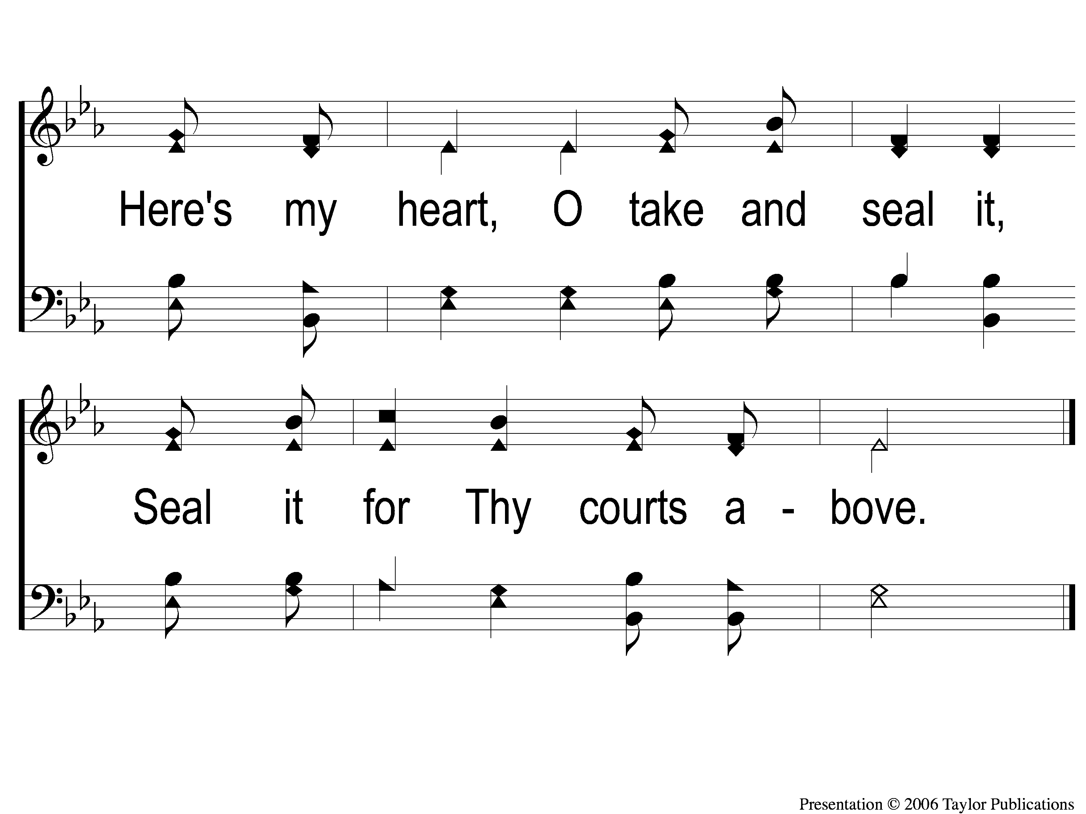
3-4 Come Thou Fount of Every Blessing
Come Thou Fount of Every Blessing
226

Slide 23
SONG:
Prince of peace control
#761

Slide 24
1-1 Prince of Peace Control
Prince of Peace Control
761

Slide 25
1-2 Prince of Peace Control
Prince of Peace Control
761

Slide 26
3-1 Prince of Peace Control
Prince of Peace Control
761

Slide 27
3-2 Prince of Peace Control
Prince of Peace Control
761

Slide 28
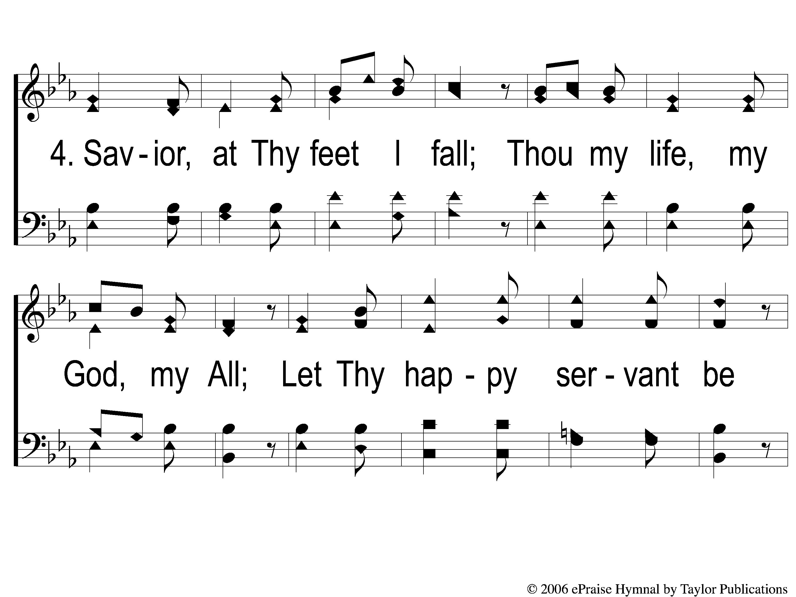
4-1 Prince of Peace Control
Prince of Peace Control
761

Slide 29
4-2 Prince of Peace Control
Prince of Peace Control
761

Slide 30
OPENING PRAYER

Slide 31
SONG:
It is well with my soul
#490

Slide 32
1-1 It Is Well With My Soul
It Is Well With My Soul
490

Slide 33
1-2 It Is Well With My Soul
It Is Well With My Soul
490

Slide 34
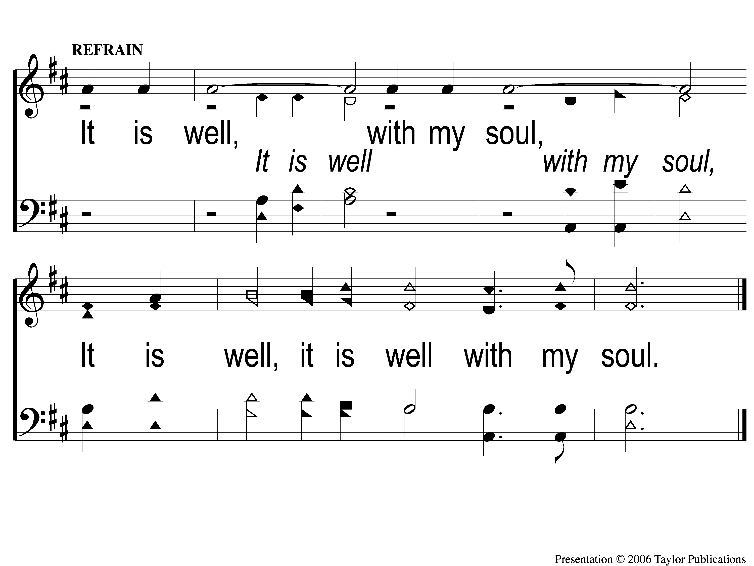
C-1 It Is Well With My Soul
It Is Well With My Soul
490

Slide 35
2-1 It Is Well With My Soul
It Is Well With My Soul
490

Slide 36
2-2 It Is Well With My Soul
It Is Well With My Soul
490

Slide 37
C-1 It Is Well With My Soul
It Is Well With My Soul
490

Slide 38
3-1 It Is Well With My Soul
It Is Well With My Soul
490

Slide 39
3-2 It Is Well With My Soul
It Is Well With My Soul
490

Slide 40
C-1 It Is Well With My Soul
It Is Well With My Soul
490

Slide 41
SONG:
All to Jesus I surrender
#662

Slide 42
1-1 I Surrender All
I Surrender All
662

Slide 43
1-2 I Surrender All
I Surrender All
662

Slide 44
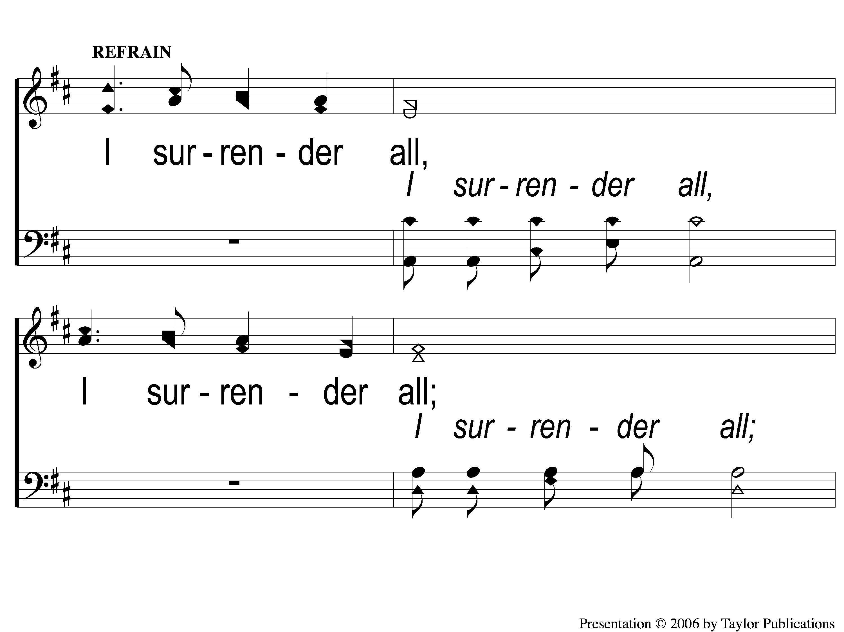
C-1 I Surrender All
I Surrender All
662

Slide 45
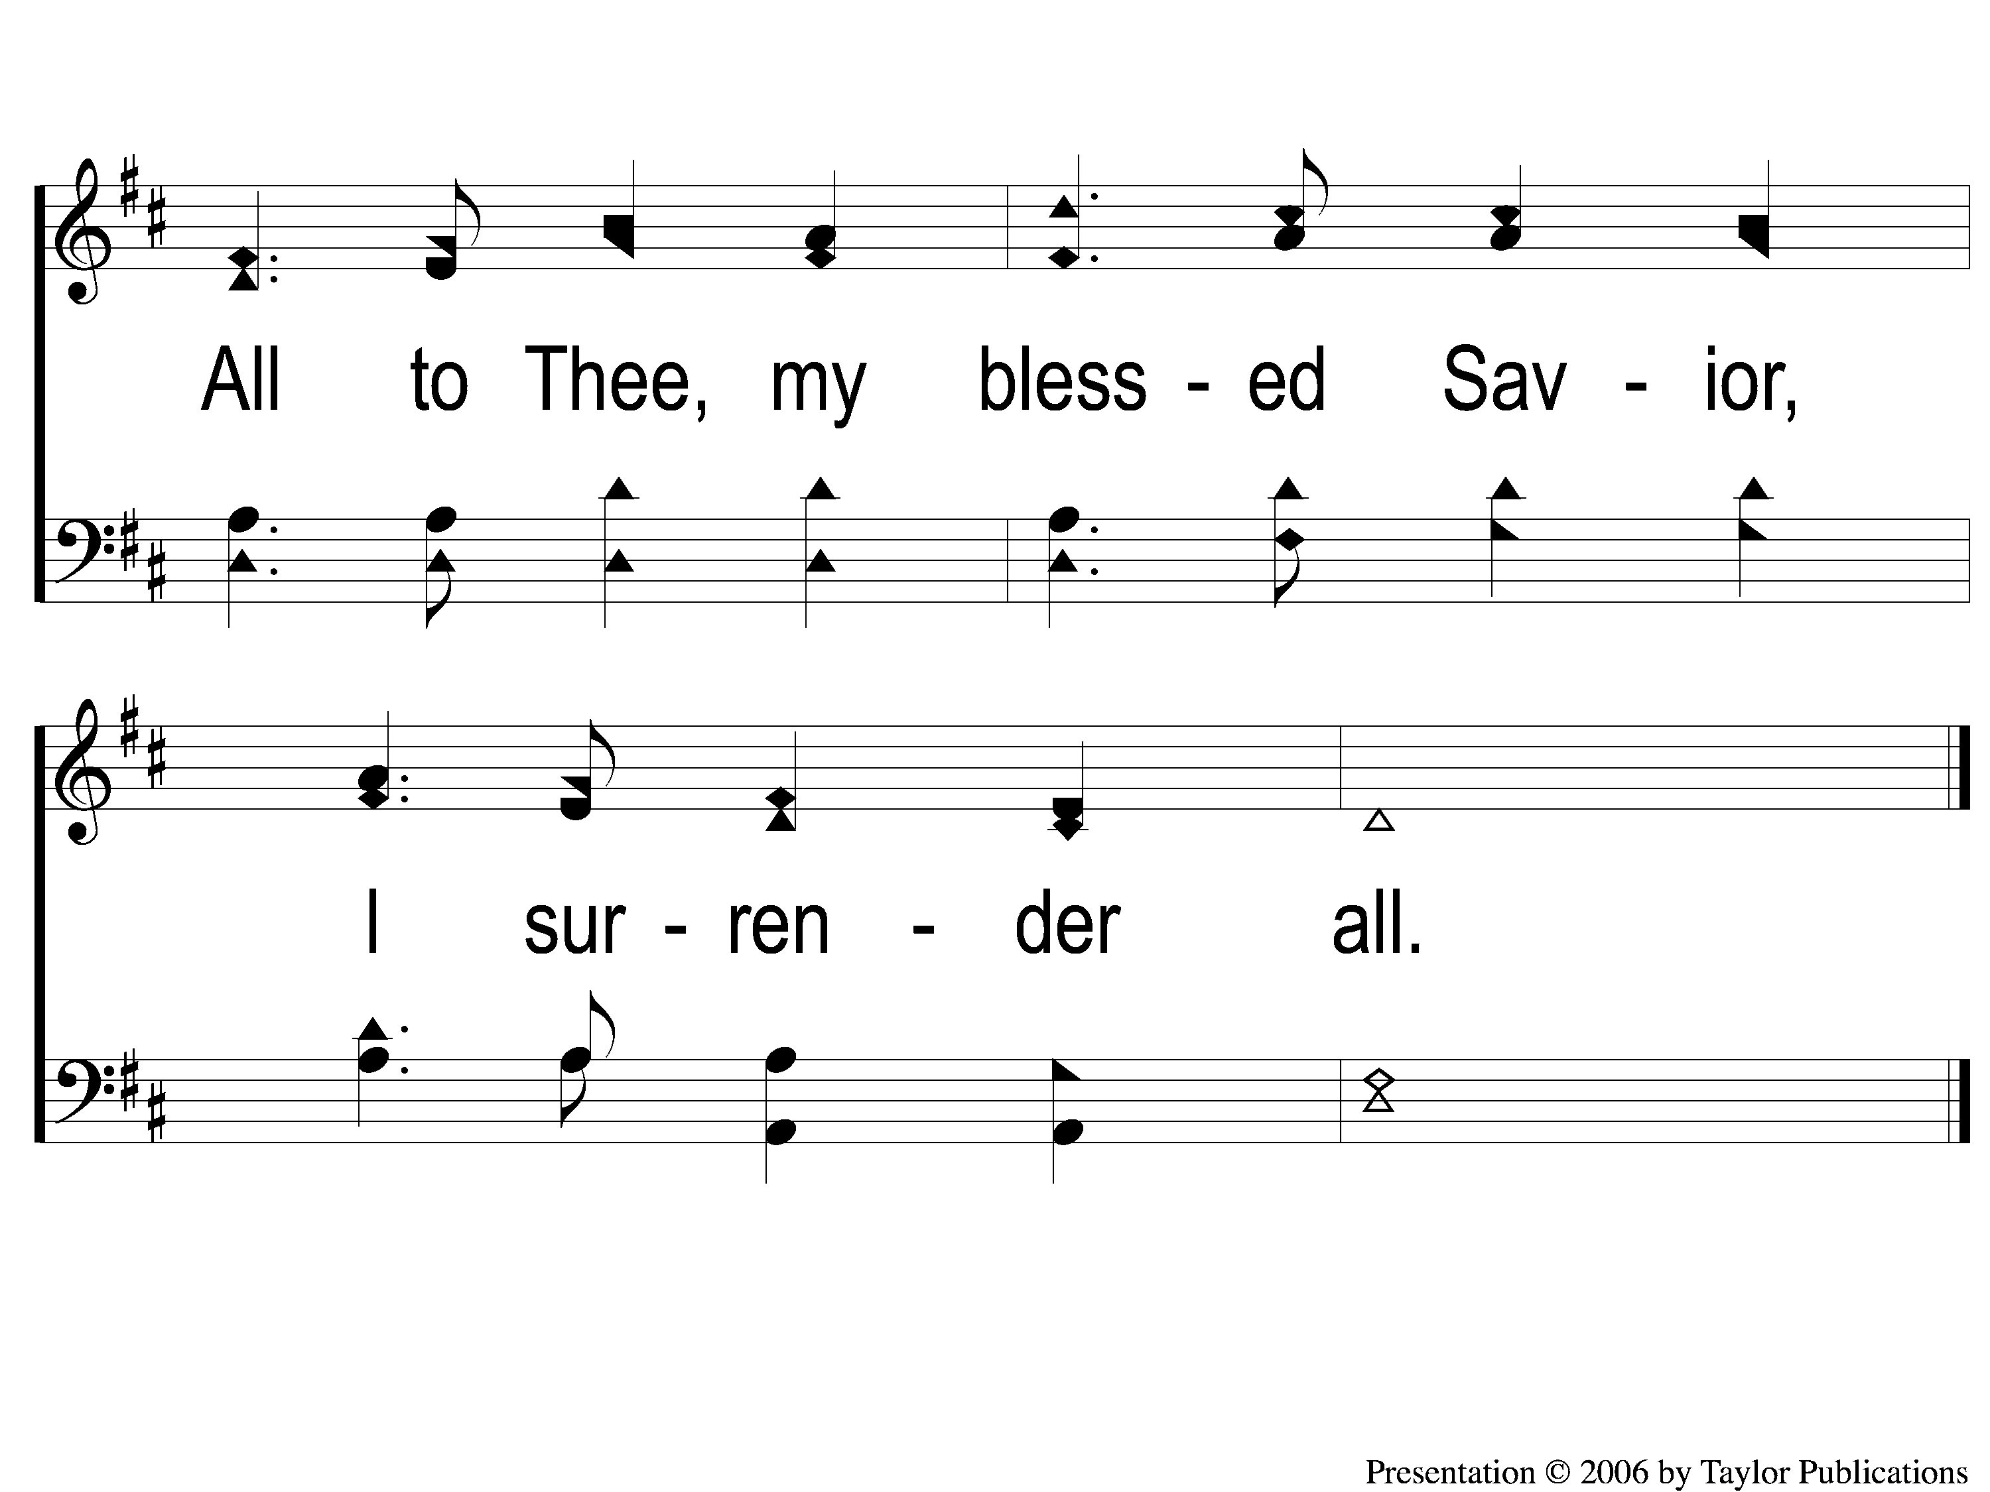
C-2 I Surrender All
I Surrender All
662

Slide 46
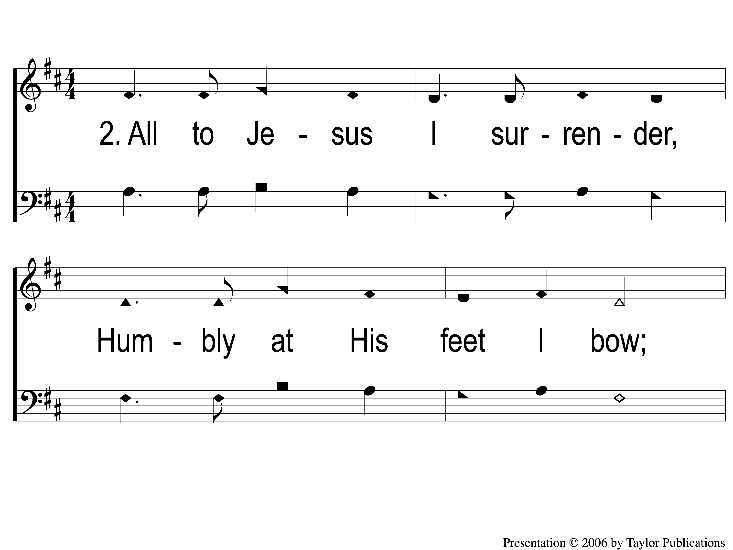
2-1 I Surrender All
I Surrender All
662

Slide 47
2-2 I Surrender All
I Surrender All
662

Slide 48
C-1 I Surrender All
I Surrender All
662

Slide 49
C-2 I Surrender All
I Surrender All
662

Slide 50
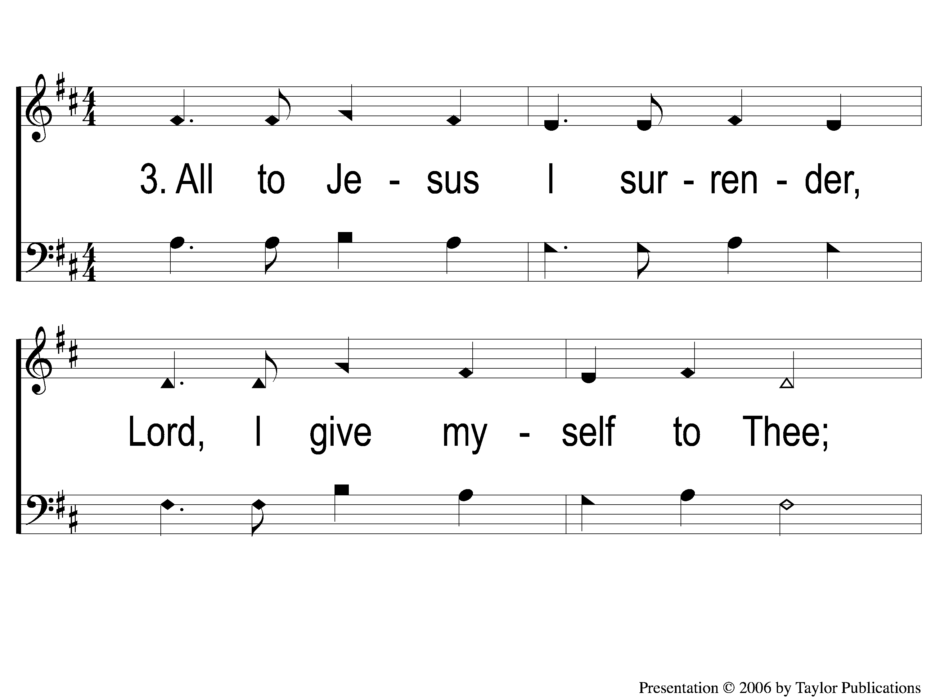
3-1 I Surrender All
I Surrender All
662

Slide 51
3-2 I Surrender All
I Surrender All
662

Slide 52
C-1 I Surrender All
I Surrender All
662

Slide 53
C-2 I Surrender All
I Surrender All
662

Slide 54
SCRIPTURE READING:
Matthew 10:32-34

Slide 55
IN PURSUIT
OF THE KINGDOM

Slide 56
Who is Jesus?
A Friend of sinners?

Slide 57
The teachings of jesus
5 teaching sections:
5-7 – kingdom people
10 – kingdom purpose
13 – kingdom priority
18 – kingdom principles
23-25 – kingdom pending

Slide 58
THE TEACHINGS OF JESUS:
Kingdom purpose (ch. 10)

Slide 59
WHAT are the differences?
THE LIMITED Commission
Limited disciples (10 : 1)
Limited audience (10 : 5 - 6)
Limited power (10 : 8)
Short time (10 : 9 - 10)
THE GREAT Commission
Unlimited disciples (28 : 16 - 18)
Unlimited audience (28 : 19)
COMPLETE power (28 : 20)
long time (28 : 20)

Slide 60
THE TEACHINGS OF JESUS:
3 Hallmarks of disciples

Slide 61
Hallmarks of disciples:
Confess their lord (10:32-33)

Slide 62
Disciples Confess their lord
Confession is necessary

Slide 63
Disciples Confess their lord
Confession is necessary
in word – Rom. 10:9-10, Acts 8:37, Psa. 119:46

Slide 64
Disciples Confess their lord
Confession is necessary
in word – Rom. 10:9-10, Acts 8:37, Psa. 119:46
In action – Matt. 7:21, 23:1-3

Slide 65
Hallmarks of disciples:
Confess their lord (10:32-33)
Crucify their desires (10:34-38)

Slide 66
Disciples crucify their desires
Crucifixion → rejection
Matt. 21:42, mk. 8:31

Slide 67
Disciples crucify their desires
Family might reject you (10:34-38)
Mk. 3:20-21, 31-35

Slide 68
Disciples crucify their desires
You must reject worldly things
Gal. 2:20, 5:24
Lk. 14:26-27

Slide 69
Hallmarks of disciples:
Confess their lord (10:32-33)
Crucify their desires (10:34-38)
Collect Their reward (10:40-42)

Slide 70
Disciples collect their reward
God will reward the faithful
Matt. 10:39-42, 13:44-46
Mk. 10:29-30

Slide 71
have you surrendered
All to Jesus?

Slide 72
Invitation SONG:
Lord, I’m coming home
#936

Slide 73
1-1 Lord I’m Coming Home
Lord, I’m Coming Home
936

Slide 74
1-2 Lord I’m Coming Home
Lord, I’m Coming Home
936

Slide 75
C Lord I’m Coming Home
Lord, I’m Coming Home
936

Slide 76
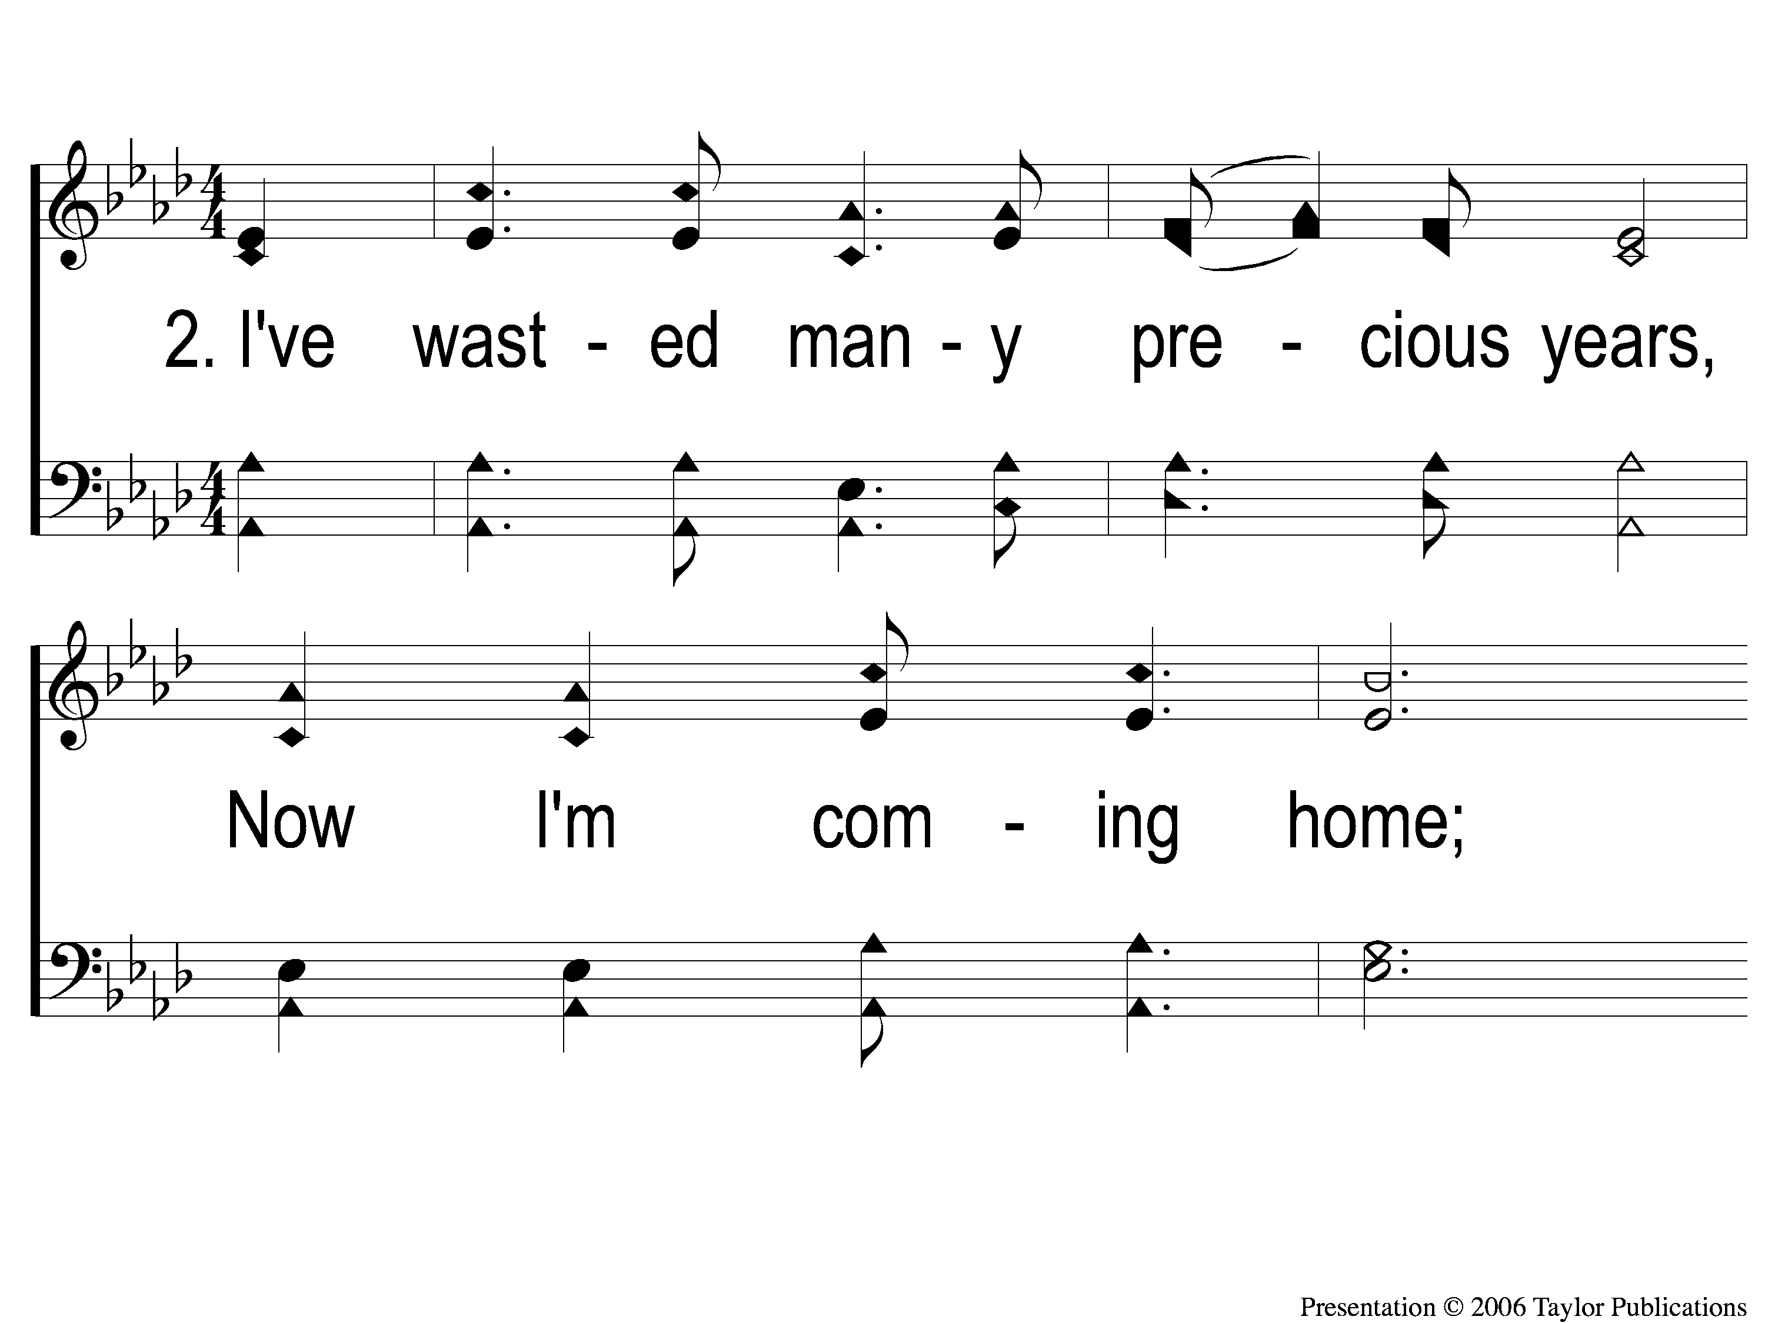
2-1 Lord I’m Coming Home
Lord, I’m Coming Home
936

Slide 77
2-2 Lord I’m Coming Home
Lord, I’m Coming Home
936

Slide 78
C Lord I’m Coming Home
Lord, I’m Coming Home
936

Slide 79
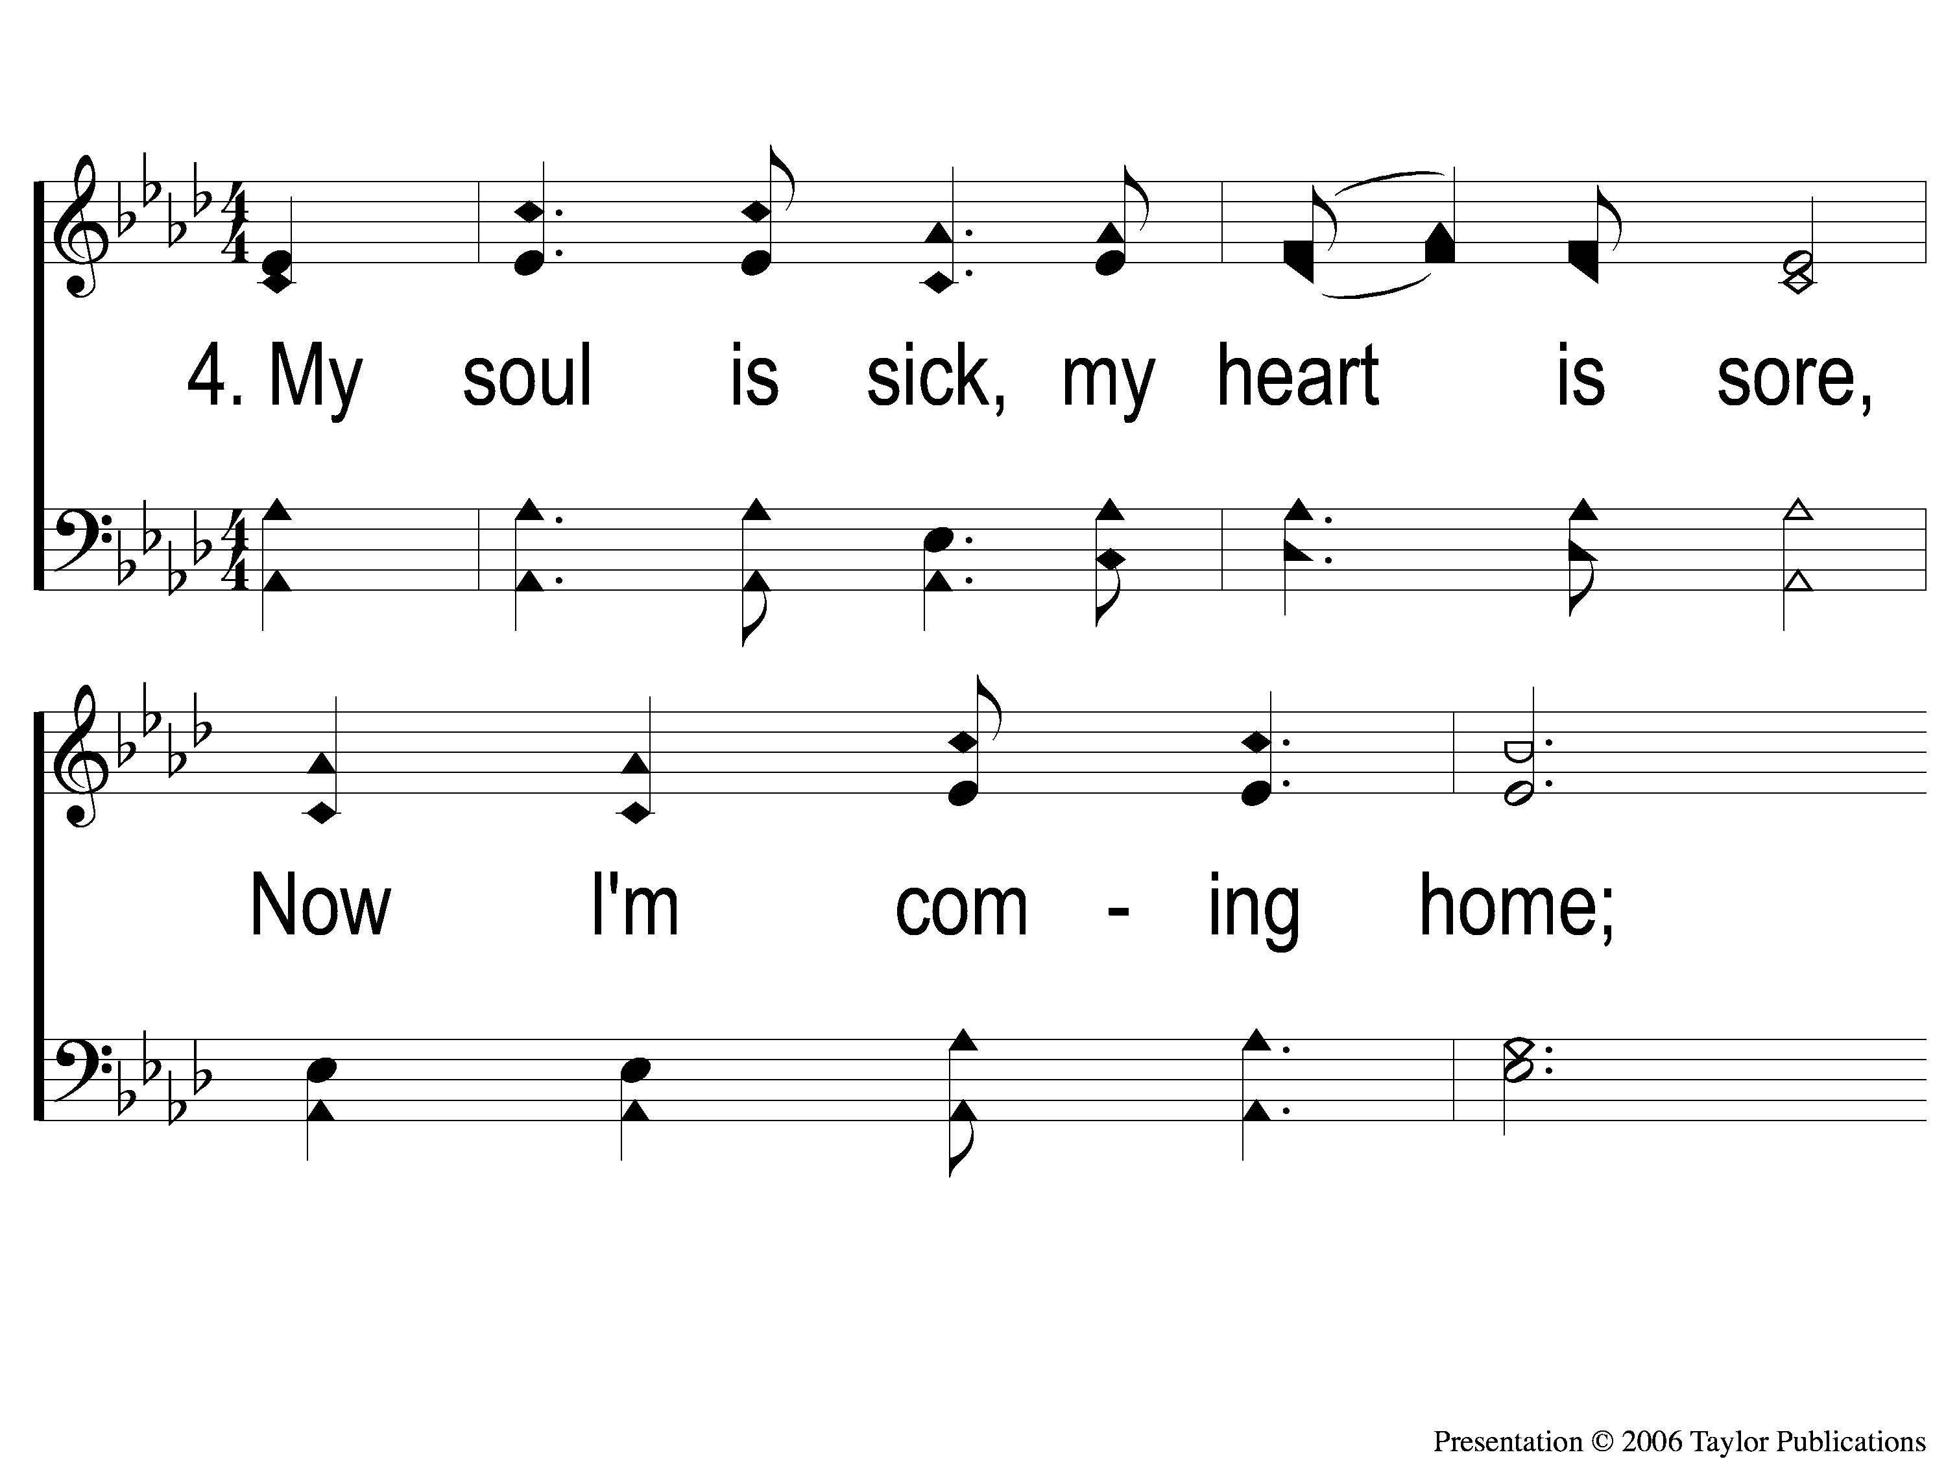
4-1 Lord I’m Coming Home
Lord, I’m Coming Home
936

Slide 80
4-2 Lord I’m Coming Home
Lord, I’m Coming Home
936

Slide 81
C Lord I’m Coming Home
Lord, I’m Coming Home
936

Slide 82
OUR CONTRIBUTION
Acts 20:35
“I have shown you in every way, by laboring like this, that you must support the weak. And remember the words of the Lord Jesus, that He said, ‘It is more blessed to give than to receive.’ ”

Slide 83
SONG:
By Christ redeemed
#366

Slide 84
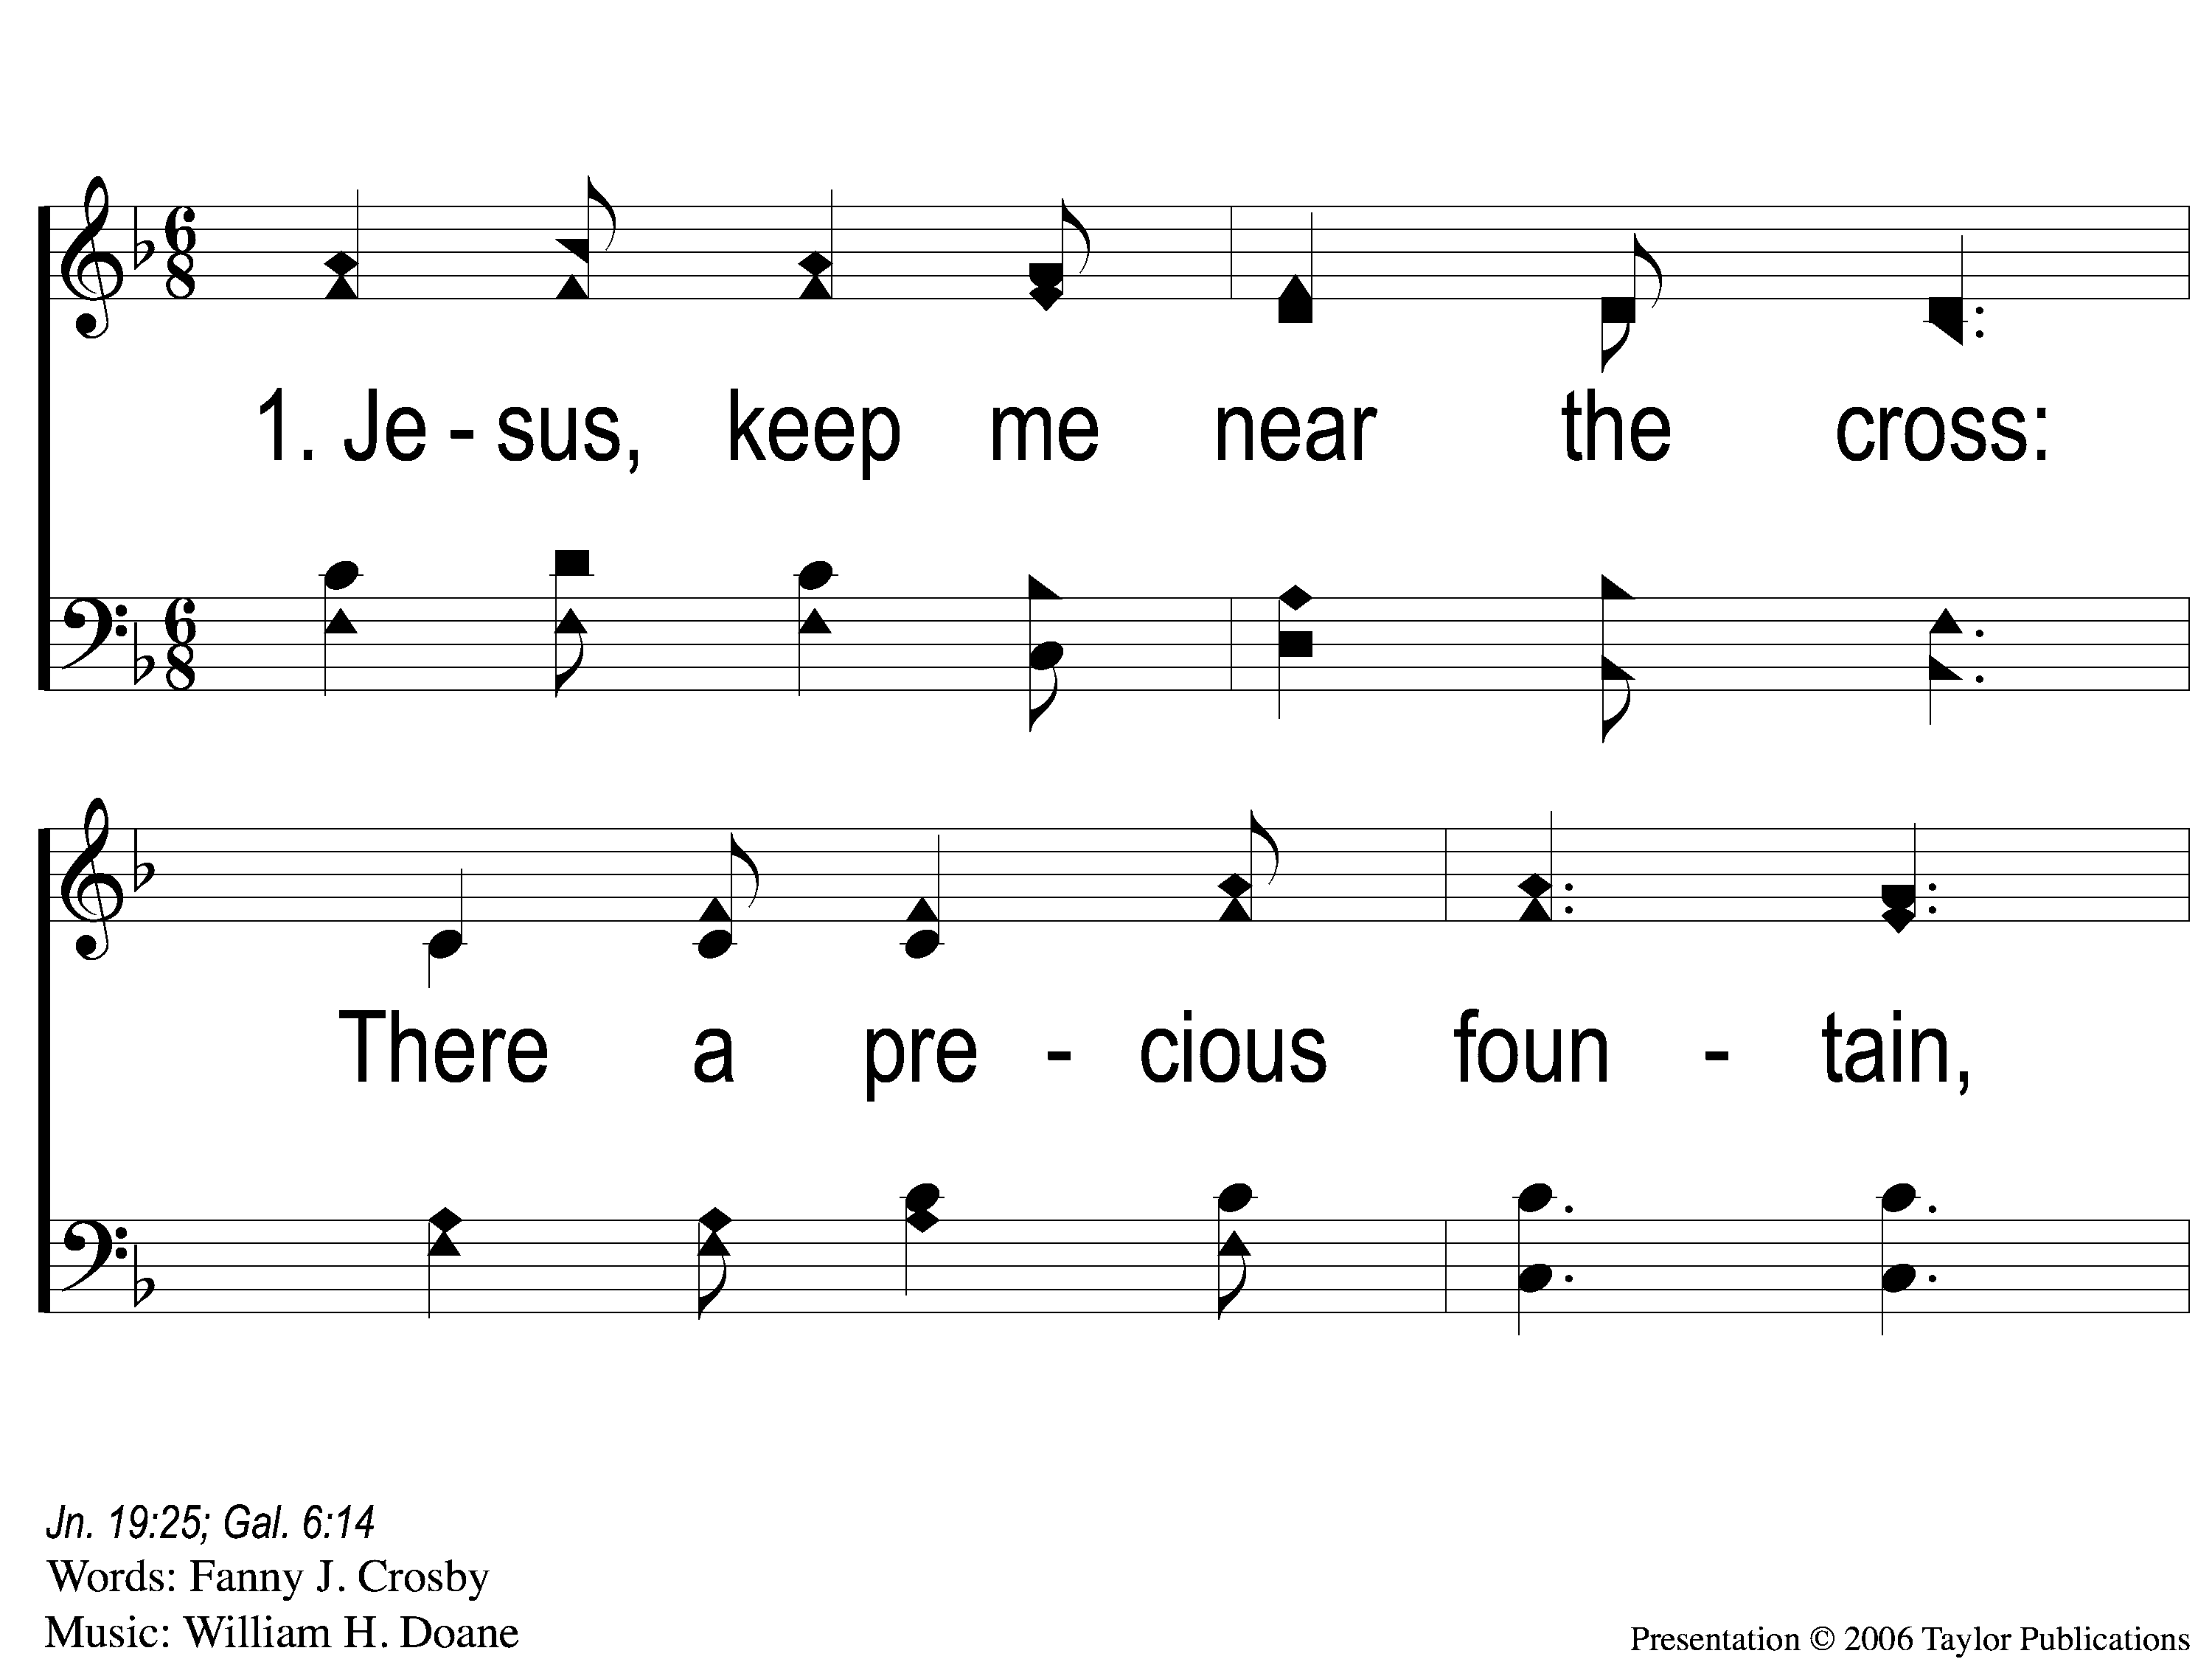
1-1 Jesus Keep Me Near the Cross
Jesus Keep Me Near The Cross
383

Slide 85
1-2 Jesus Keep Me Near the Cross
Jesus Keep Me Near The Cross
383

Slide 86
C Jesus Keep Me Near the Cross
Jesus Keep Me Near The Cross
383

Slide 87
3-1 Jesus Keep Me Near the Cross
Jesus Keep Me Near The Cross
383

Slide 88
3-2 Jesus Keep Me Near the Cross
Jesus Keep Me Near The Cross
383

Slide 89
C Jesus Keep Me Near the Cross
Jesus Keep Me Near The Cross
383

Slide 90
THE UNLEAVENED BREAD
Romans 8:1-2
“There is therefore now no condemnation to those who are in Christ Jesus, who do not walk according to the flesh, but according to the Spirit. For the law of the Spirit of life in Christ Jesus has made me free from the law of sin and death.”

Slide 91
THE FRUIT OF THE VINE
Romans 8:31-32
“What then shall we say to these things? If God is for us, who can be against us? He who did not spare His own Son, but delivered Him up for us all, how shall He not with Him also freely give us all things?”

Slide 92
closing PRAYER

Slide 93
SONG:
Sweet by and by
#878

Slide 94
1-1 Sweet By And By
Sweet By and By
878

Slide 95
1-2 Sweet By And By
Sweet By and By
878

Slide 96
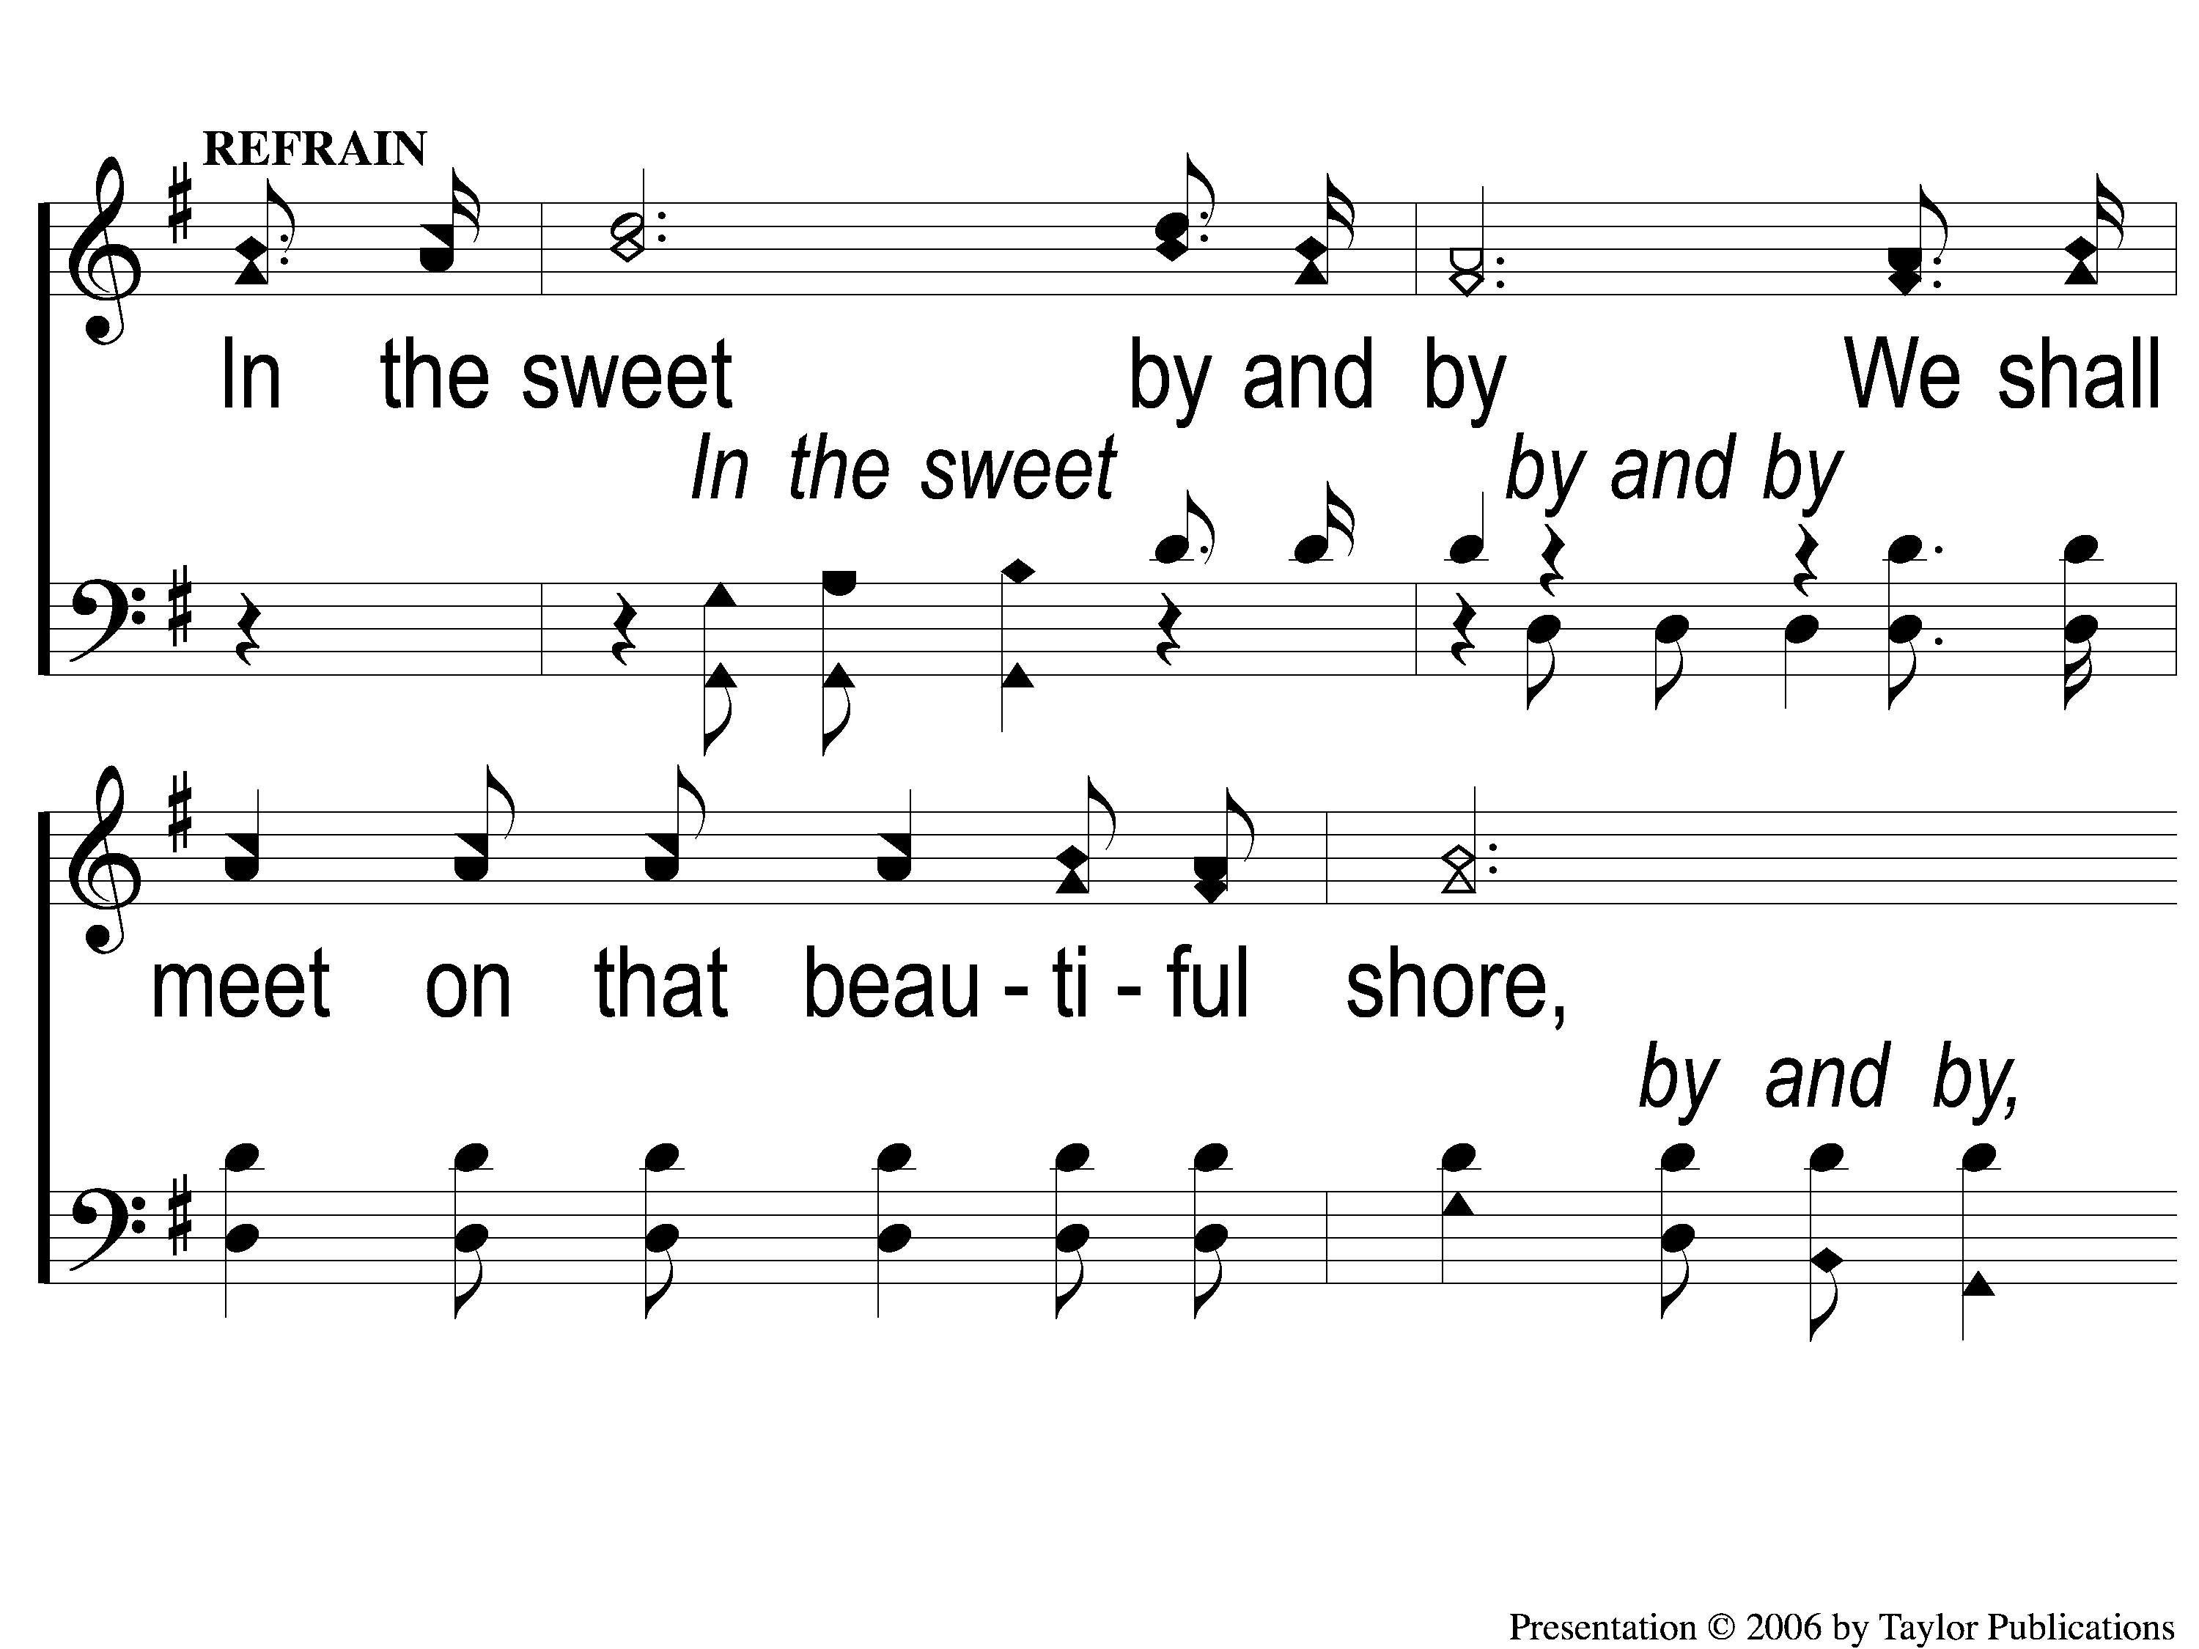
C-1 Sweet By And By
Sweet By and By
878

Slide 97
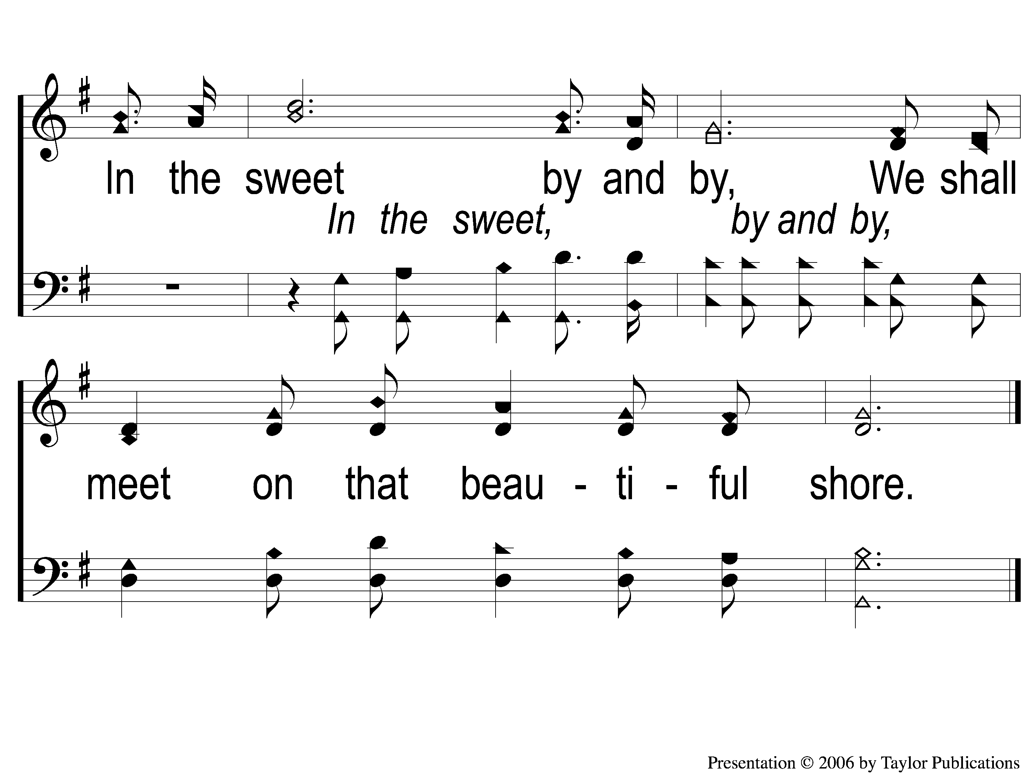
C-2 Sweet By And By
Sweet By and By
878

Slide 98
3-1 Sweet By And By
Sweet By and By
878

Slide 99
3-2 Sweet By And By
Sweet By and By
878

Slide 100
C-1 Sweet By And By
Sweet By and By
878

Slide 101
C-2 Sweet By And By
Sweet By and By
878

Slide 102
Today
Ladies planning meeting
Worship @ 6:00 PM
Men’s meeting @ 7:00 PM
Wednesday
Worship & Bible classes @ 6:30

