Slide 1
WELCOME
To the Wheeler church of Christ

Slide 2
Songs of praise to God

Slide 3
OPENING PRAYER

Slide 4
Songs of praise to God

Slide 5
Who is Jesus?
According to matthew

Slide 6
“When Jesus came into the region of Caesarea Philippi, He asked His disciples, saying,
‘Who do men say that I, the Son of Man, am?”
– Matt. 16:13

Slide 7
“Messiah” (ch. 1)
“king of the jews” (ch. 2)
“son of god” (ch. 3)
Conqueror (ch. 4)

Slide 8
Ch. 9 & 11 – “friend of…sinners” ?
11:18-19

Slide 9
Ch. 9 & 11 – “friend to sinners”
Prov. 20:30, 27:6
Psa. 141:5

Slide 10
FRIENDS TO SINNERS MUST BE…
…WILLING TO OVERLOOK APPEARANCES

Slide 11
BE WILLING TO OVERLOOK APPEARANCES
God shows no partiality
1 sam. 16:7 – Acts 10:34
Rom. 2:11 – eph. 6:9
1 Tim. 5:21

Slide 12
BE WILLING TO OVERLOOK APPEARANCES
Christians show no partiality
Jms. 2:9 – Matt. 5:48

Slide 13
FRIENDS TO SINNERS MUST BE…
…WILLING TO OVERLOOK APPEARANCES
…WILLING TO CALL OUT SIN

Slide 14
BE WILLING TO OVERLOOK APPEARANCES
LOVE =/= ACCEPTANCE OF SINFUL BEHAVIOR

Slide 15
BE WILLING TO OVERLOOK APPEARANCES
LOVE =/= ACCEPTANCE OF SINFUL BEHAVIOR
JUDGING OTHERS SINS =/= UNLOVING
GAL. 6:1 – 1 Cor. 5:9-11 – Matt. 7:1-5

Slide 16
FRIENDS TO SINNERS MUST BE…
…WILLING TO OVERLOOK APPEARANCES
…WILLING TO CALL OUT SIN
…WILLING TO BE CRITICIZED

Slide 17
BE WILLING TO be criticized
We are not above our teacher
Matt. 15:1, 16:1, 19:3
Mk. 7:1

Slide 18
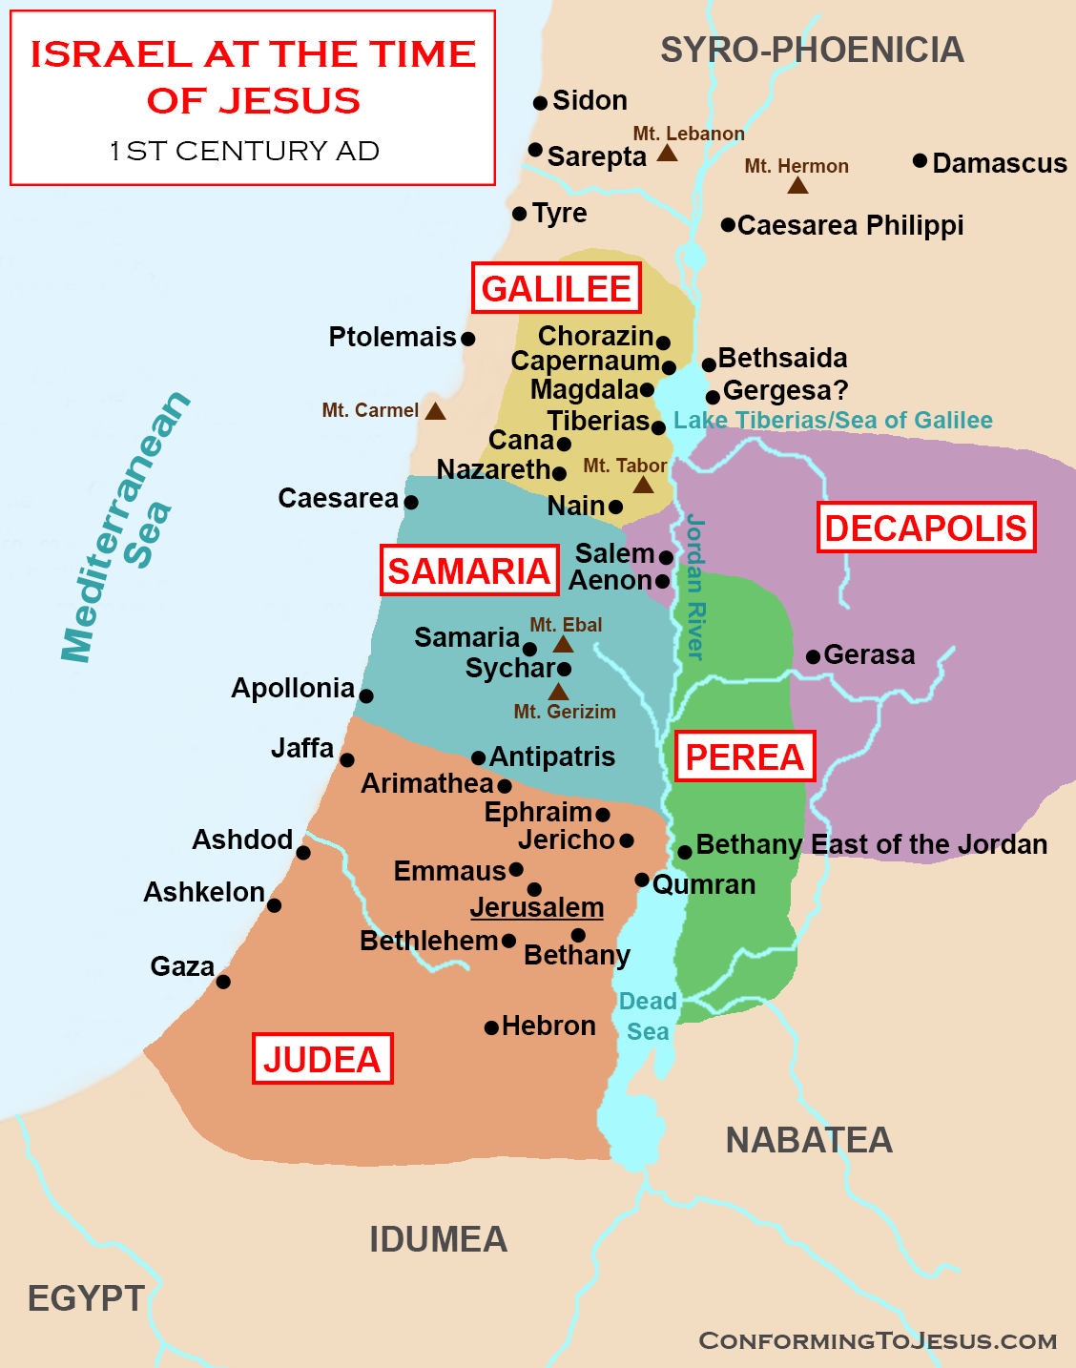

Slide 20
BE WILLING TO be criticized
We are not above our teacher
1 tim. 5:12-16

Slide 21
are you
A friend to sinners?

Slide 22
Songs of praise to God

Slide 23
The lord’s supper
Acts 20:7

Slide 24
closing PRAYER

Slide 25
Songs of praise to God

Slide 26
Wednesday
Worship & Bible classes @ 6:30

