Slide 1
WELCOME
To the Wheeler church of Christ

Slide 2
SONG:
Jesus, hold my hand
#412

Slide 3
SONG:
I stand amazed
#147

Slide 4
OPENING PRAYER

Slide 5
SONG:
A wonderful savior
#508

Slide 6
SONG:
Tell me the story of jesus
#387

Slide 7
SCRIPTURE READING:
Matthew 12:31-32

Slide 12
“Demons,
Delights,
&
Doing
Righteously”

Slide 13
Question #1:
WHAT ARE ALL THE “EVIL SPIRITS”, “DEMONS”, ETC. IN THE BIBLE?
(IN MATTHEW SPECIFICALLY)

Slide 14
“evil spirits” or “demons”
Sources:
Apologeticspress.org
Christiancourier.com
Q
&
A

Slide 15
“evil spirits” or “demons”
What we know:
There is a spiritual realm
2 Cor. 10:3-4, Eph. 6:13
Q
&
A

Slide 16
“evil spirits” or “demons”
What we know:
There is a spiritual realm
Demons are spiritual beings
Matt. 8:16, Lk. 24:39, 2 Pet. 2:4
Q
&
A

Slide 17
“evil spirits” or “demons”
Hierarchy of Beings:
Divine – God → Father, Son, Spirit
Spirits – Angels & demons
Mankind
Animals
Q
&
A

Slide 18
“evil spirits” or “demons”
What we know:
There is a spiritual realm
Demons are spiritual beings
Demons are created beings – Col. 1:16
Q
&
A

Slide 19
“evil spirits” or “demons”
What we know:
There is a spiritual realm
Demons are spiritual beings
Demons are created beings
Demons are Subject To Jesus – Mk. 1:27
Q
&
A

Slide 20
Question #2:
WHAT DOES AN ELDER’S OR DEACON’S WIFE LOOK LIKE, BIBLICALLY SPEAKING?

Slide 21
An elder or deacon’s wife?
3 Good Bible Texts to Consider:
Prov. 31:11-31
Q
&
A

Slide 22
An elder or deacon’s wife?
3 Good Bible Texts to Consider:
Prov. 31:11-31
1 Tim. 3:11
Q
&
A

Slide 23
An elder or deacon’s wife?
3 Good Bible Texts to Consider:
Prov. 31:11-31
1 Tim. 3:11
Titus 2:3-5
Q
&
A

Slide 24
An elder or deacon’s wife?
3 Good Examples:
Lydia – Acts 16:11-15, 40
Q
&
A

Slide 25
An elder or deacon’s wife?
3 Good Examples:
Lydia – Acts 16:11-15, 40
Damaris – Acts 17:32-34
Q
&
A

Slide 26
An elder or deacon’s wife?
3 Good Examples:
Lydia – Acts 16:11-15, 40
Damaris – Acts 17:32-34
Priscilla – Acts 18:1-26
Q
&
A

Slide 27
Question #3:
DOES GOD WANT US
TO ENJOY LIFE?

Slide 28
Enjoy Life?
Be Careful with Scripture
Josh. 1:15 NKJV – “enjoy it”
Q
&
A

Slide 29
Enjoy Life?
Be Careful with Scripture
Josh. 1:15 NKJV – “enjoy it”
1 tim. 6:17 – “all things to enjoy”
Q
&
A

Slide 30
Enjoy Life?
Be Careful with Scripture
Josh. 1:15 NKJV – “enjoy it”
1 tim. 6:17 – “all things to enjoy”
Eccl. 2:1, 10-11, 24-25, 5:18-19
Jms. 5:5
Q
&
A

Slide 31
Enjoy Life?
Enjoyments Can Be Right or Wrong
Consult God on Each Matter
2 thess. 2:11-12, 1 Tim. 5:6
Lk. 8:14
2 Cor. 12:10
Q
&
A

Slide 32
Question #4:
WHAT IS THE UNFORGIVEABLE SIN? (MATT. 12:31-32)

Slide 33
The Unforgiveable Sin
What We Know About God:
Q
&
A

Slide 34
The Unforgiveable Sin
What We Know About God:
He is all-powerful – 2 Chr. 20:6
Q
&
A

Slide 35
The Unforgiveable Sin
What We Know About God:
He is all-powerful – 2 Chr. 20:6
He is always ready to forgive – Lk. 15:20
Q
&
A

Slide 36
The Unforgiveable Sin
What We Know About God:
He is all-powerful – 2 Chr. 20:6
He is always ready to forgive – Lk. 15:20
He forgives conditionally – Matt. 6:14-15
Q
&
A

Slide 37
The Unforgiveable Sin
What We Know About God:
He is all-powerful – 2 Chr. 20:6
He is always ready to forgive – Lk. 15:20
He forgives conditionally – Matt. 6:14-15
He sees every sin as equal – Isa. 59:1-2
Q
&
A

Slide 38
Q
&
A
https://www.google.com/url?sa=i&url=https%3A%2F%2Frevcollins.com%2F2018%2F09%2F08%2Fsin-from-gods-perspective%2F&psig=AOvVaw2vYpFlNPa3IKBVvcBo67an&ust=1677535133162000&source=images&cd=vfe&ved=0CA8QjRxqFwoTCMiVyr-XtP0CFQAAAAAdAAAAABAF

Slide 39
The Unforgiveable Sin
Blasphemy of the Holy Spirit
(Matt. 12:22-37)
Q
&
A

Slide 40
The Unforgiveable Sin
Blasphemy of the Holy Spirit
(Matt. 12:22-37)
Pharisees saw miracles done by the power of the Spirit and attributed it to the power of the devil
Q
&
A

Slide 41
The Unforgiveable Sin
Is there any sin God will not forgive?
Any sin that is not repented of
Acts 17:30, 1 Jn. 1:6, 3:7, 10
Q
&
A

Slide 42
Question #5:
DO WE EVER GIVE UP ON SOMEONE AFTER “SHAKING THE DUST OFF OUR FEET?” & IS THERE A POINT TO WHICH SOMEONE IS “TOO FAR” TO RETURN TO GOD, TO FIX THINGS?

Slide 43
Do We Ever Give Up?
No; Not as long as they live.
Acts 13:51, 49-50, 14:21
Q
&
A

Slide 44
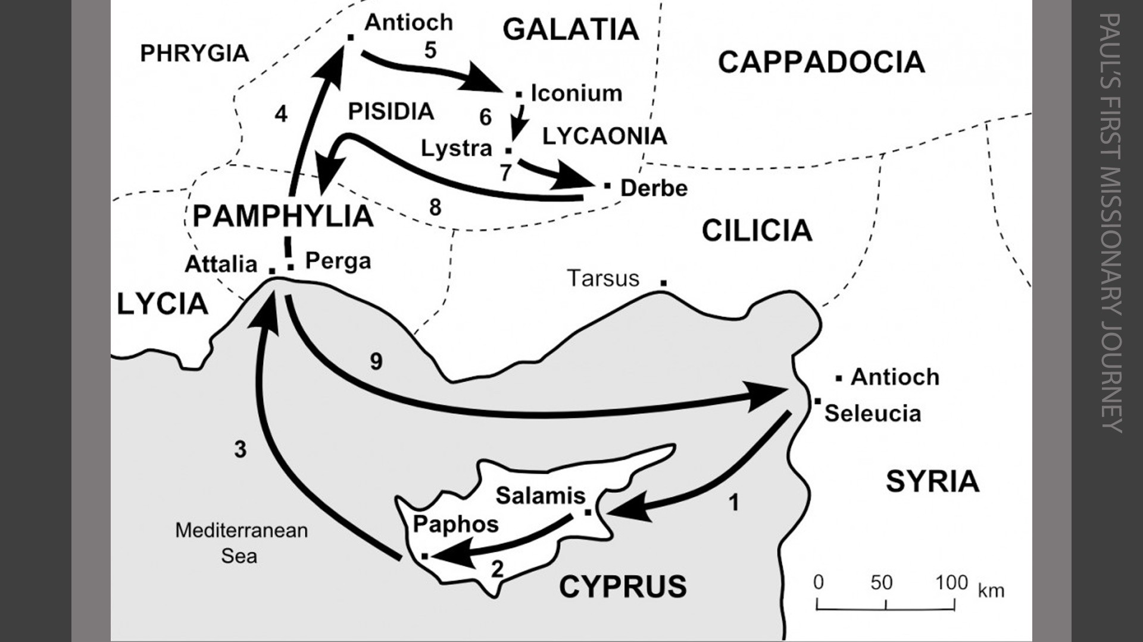

Slide 45
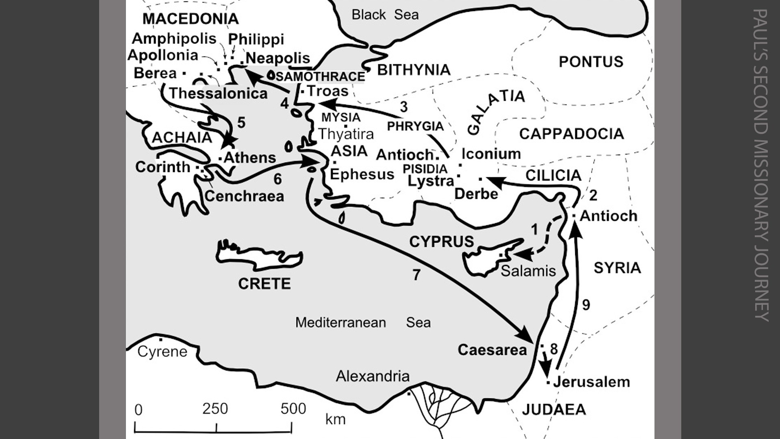

Slide 46
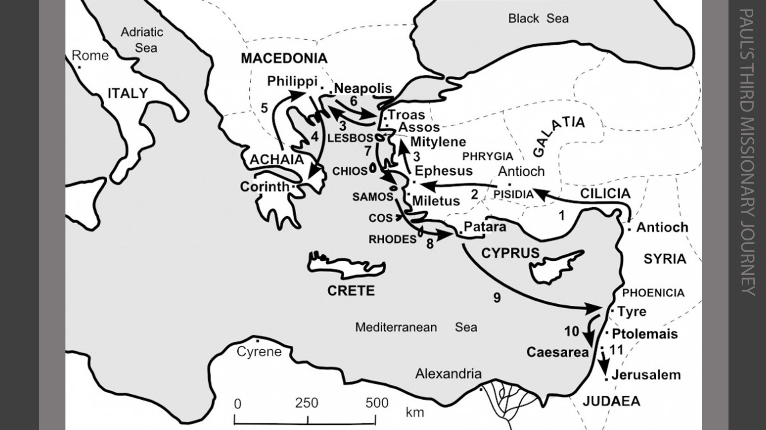

Slide 47
What point is “too far” to be saved?
Q
&
A

Slide 48
What point is “too far” to be saved?
Death – Heb. 9:27, Lk. 16:19-31
Q
&
A

Slide 49
What point is “too far” to be saved?
Death – Heb. 9:27, Lk. 16:19-31
Loss of Mental Capacity
Q
&
A

Slide 50
Question #6:
HOW DO BALANCE LIFE AS A CHRISTIAN BEING CALLED RIGHTEOUS OR BEING TOLD YOU SPEAK DIFFERENT AND ACT DIFFERENT?

Slide 51
How do I react to being called
righteous or different?
Praise God
Matt. 5:12, 16
1 Pet. 4:13-14
Acts 5:40-42
Q
&
A

Slide 52
Question #6:
IS A “LITTLE WHITE LIE” STILL A LIE?

Slide 53
Is a “little white lie” still a lie?
How God Views Sin
Isa 59:1-2
1 Jn. 5:17
Q
&
A

Slide 54
Is a “little white lie” still a lie?
How God Views Lying
Prov. 6:16-17, 12:17-22
Rev. 21:8, 22:15
Q
&
A

Slide 55
Is a “little white lie” still a lie?
How God Views Our Words
Eph. 4:29-31
Matt. 12:34
Q
&
A

Slide 56
Question #7:
HOW DO I HELP PEOPLE WHO BLAME GOD FOR TRAGEDY?

Slide 57
How do I Help Those Who Blame God?
Sit & Listen
Job 2:11-13, Eccl. 3:7
Q
&
A

Slide 58
How do I Help Those Who Blame God?
Sit & Listen
Job 2:11-13, Eccl. 3:7
Stop Giving False Hope
Job 4:7ff
Q
&
A

Slide 59
How do I Help Those Who Blame God?
Why Does Tragedy Happen?
1. Natural Disasters
Q
&
A

Slide 60
How do I Help Those Who Blame God?
Why Does Tragedy Happen?
1. Natural Disasters
2. Consequences of Sin
Q
&
A

Slide 61
How do I Help Those Who Blame God?
Who Should You Go To?
God
Matt. 8:5ff, 14ff
Q
&
A

Slide 62
Invitation SONG:
I am resolved
#948

Slide 63
OUR CONTRIBUTION
Luke 9:23-24
Then He said to them all, “If anyone desires to come after Me, let him deny himself, and take up his cross daily, and follow Me. For whoever desires to save his life will lose it, but whoever loses his life for My sake will save it.”

Slide 64
SONG:
Why did my savior come to earth?
#382

Slide 65
THE UNLEAVENED BREAD
Hebrews 2:14-15
“Inasmuch then as the children have partaken of flesh and blood, He Himself likewise shared in the same, that through death He might destroy him who had the power of death, that is, the devil, and release those who through fear of death were all their lifetime subject to bondage.”

Slide 66
THE FRUIT OF THE VINE
Hebrews 12:1-2
“Therefore we also, since we are surrounded by so great a cloud of witnesses, let us lay aside every weight, and the sin which so easily ensnares us, and let us run with endurance the race that is set before us, looking unto Jesus, the author and finisher of our faith, who for the joy that was set before Him endured the cross, despising the shame, and has sat down at the right hand of the throne of God.”

Slide 67
closing PRAYER

Slide 68
SONG:
Hold to god’s unchanging hand
#613

Slide 69
Today
Join us in the MPB
For a meal & devotional
Wednesday
Worship & Bible classes @ 6:30

