Slide 1
1-1 Anywhere with Jesus
Anywhere With Jesus
414

Slide 2
1-2 Anywhere with Jesus
Anywhere With Jesus
414

Slide 3
C-1 Anywhere with Jesus
Anywhere With Jesus
414

Slide 4
4-1 Anywhere with Jesus
Anywhere With Jesus
414

Slide 5
4-2 Anywhere with Jesus
Anywhere With Jesus
414

Slide 6
C-1 Anywhere with Jesus
Anywhere With Jesus
414

Slide 7
WELCOME
To the Wheeler church of Christ

Slide 8
SONG:
In moments like these
#239

Slide 9
1-1 In Moments Like These
In Moments Like These
239

Slide 10
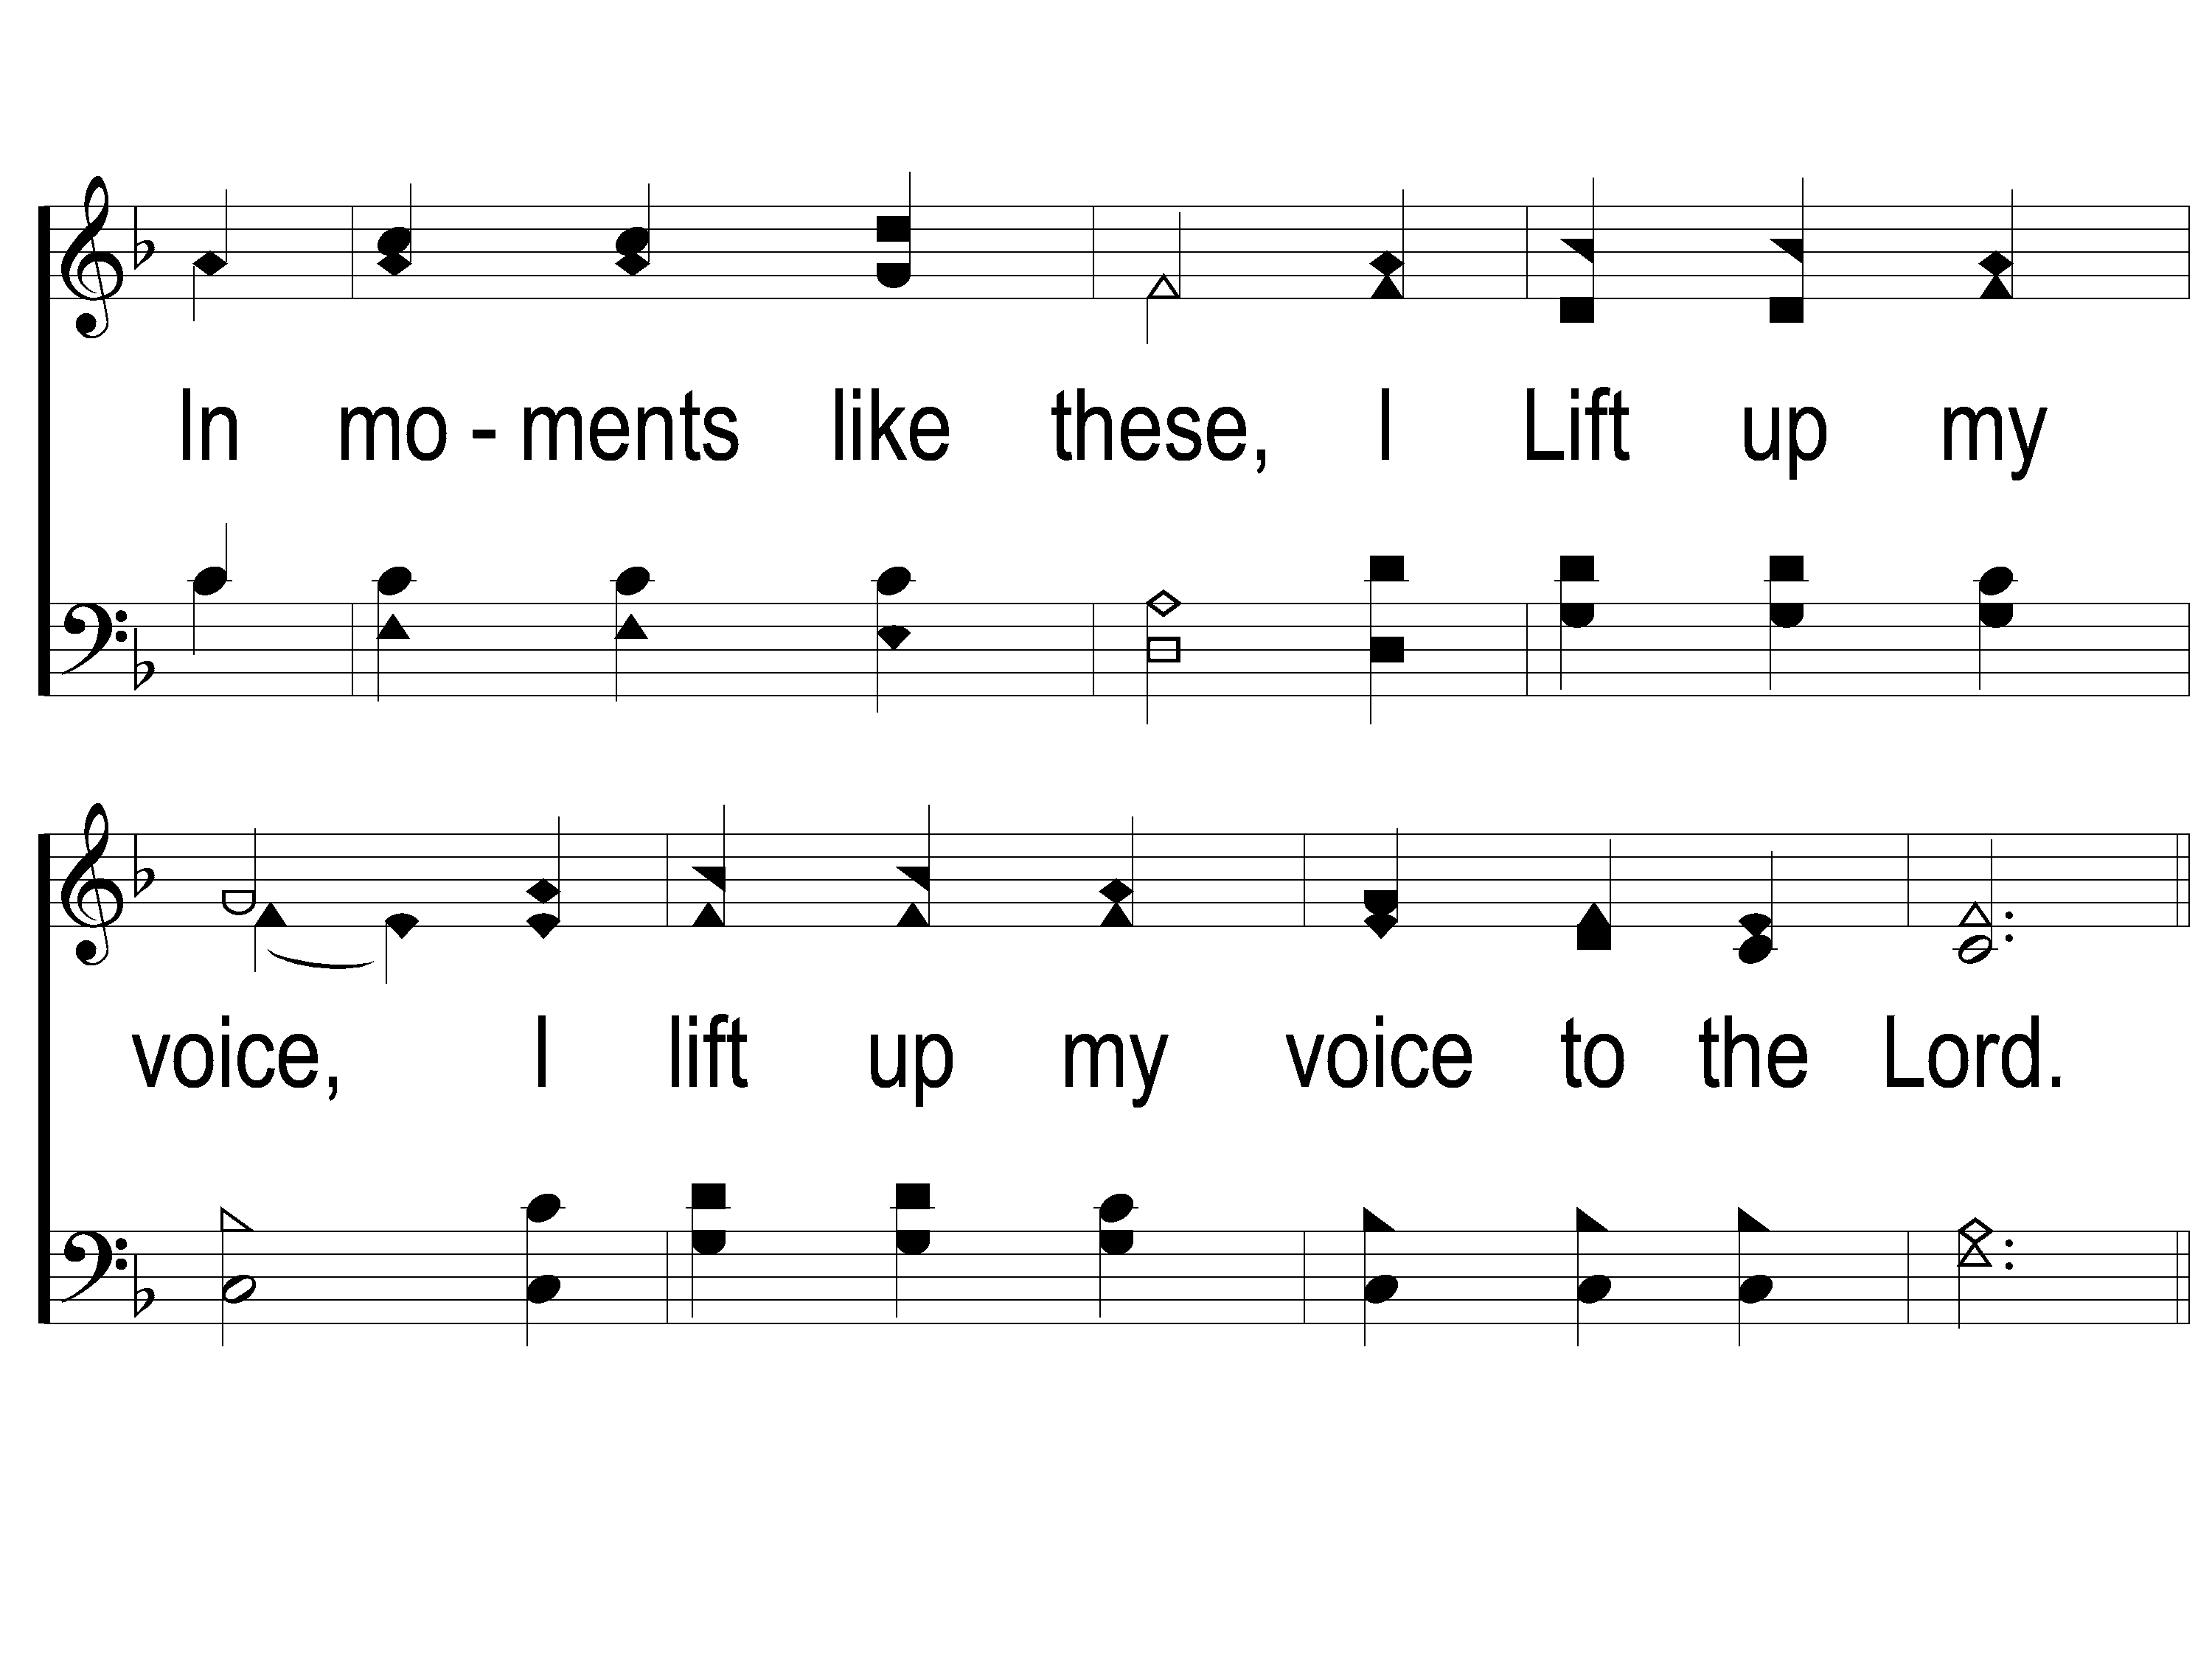
1-2 In Moments Like These
In Moments Like These
239

Slide 11
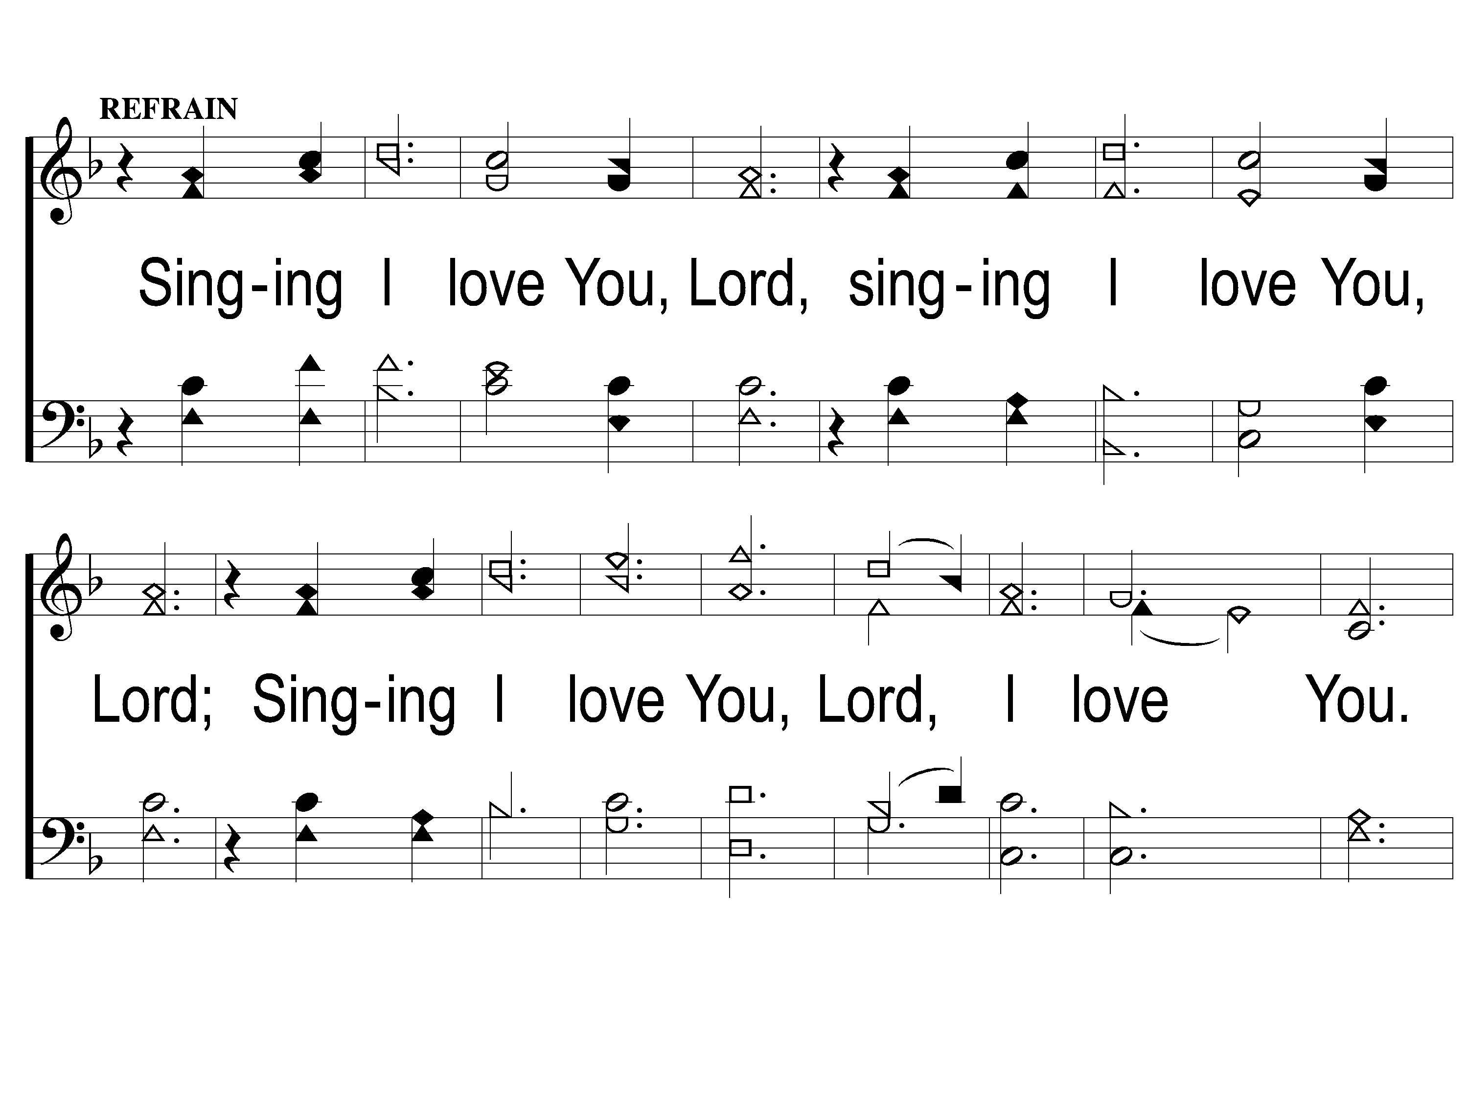
C-1 In Moments Like These
In Moments Like These
239

Slide 12
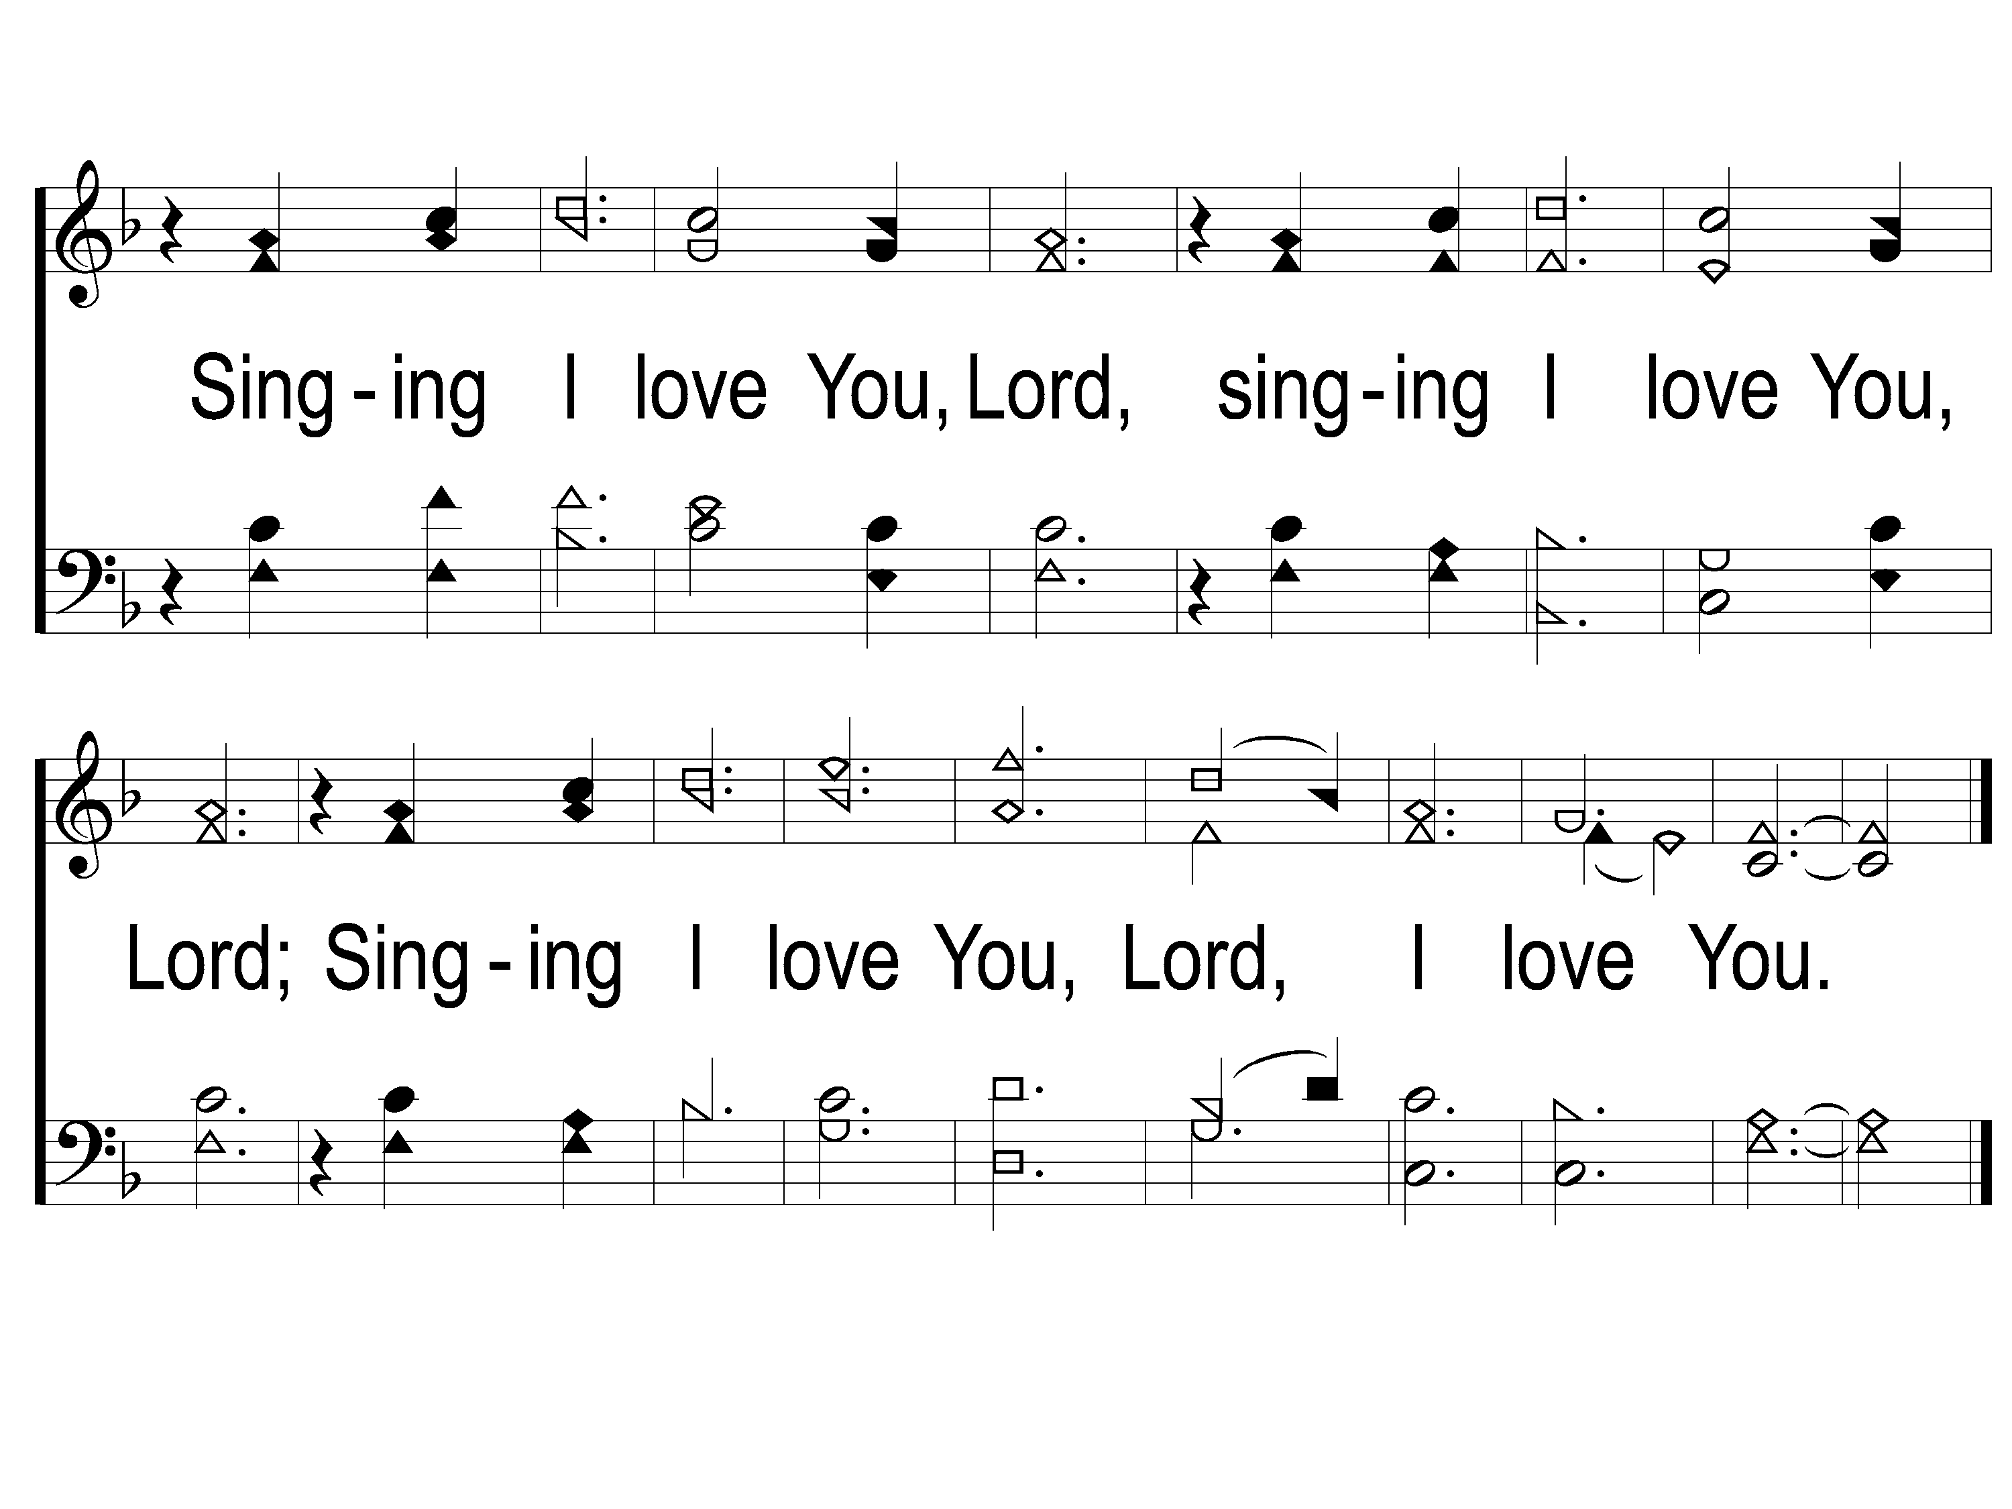
C-2 In Moments Like These
In Moments Like These
239

Slide 13
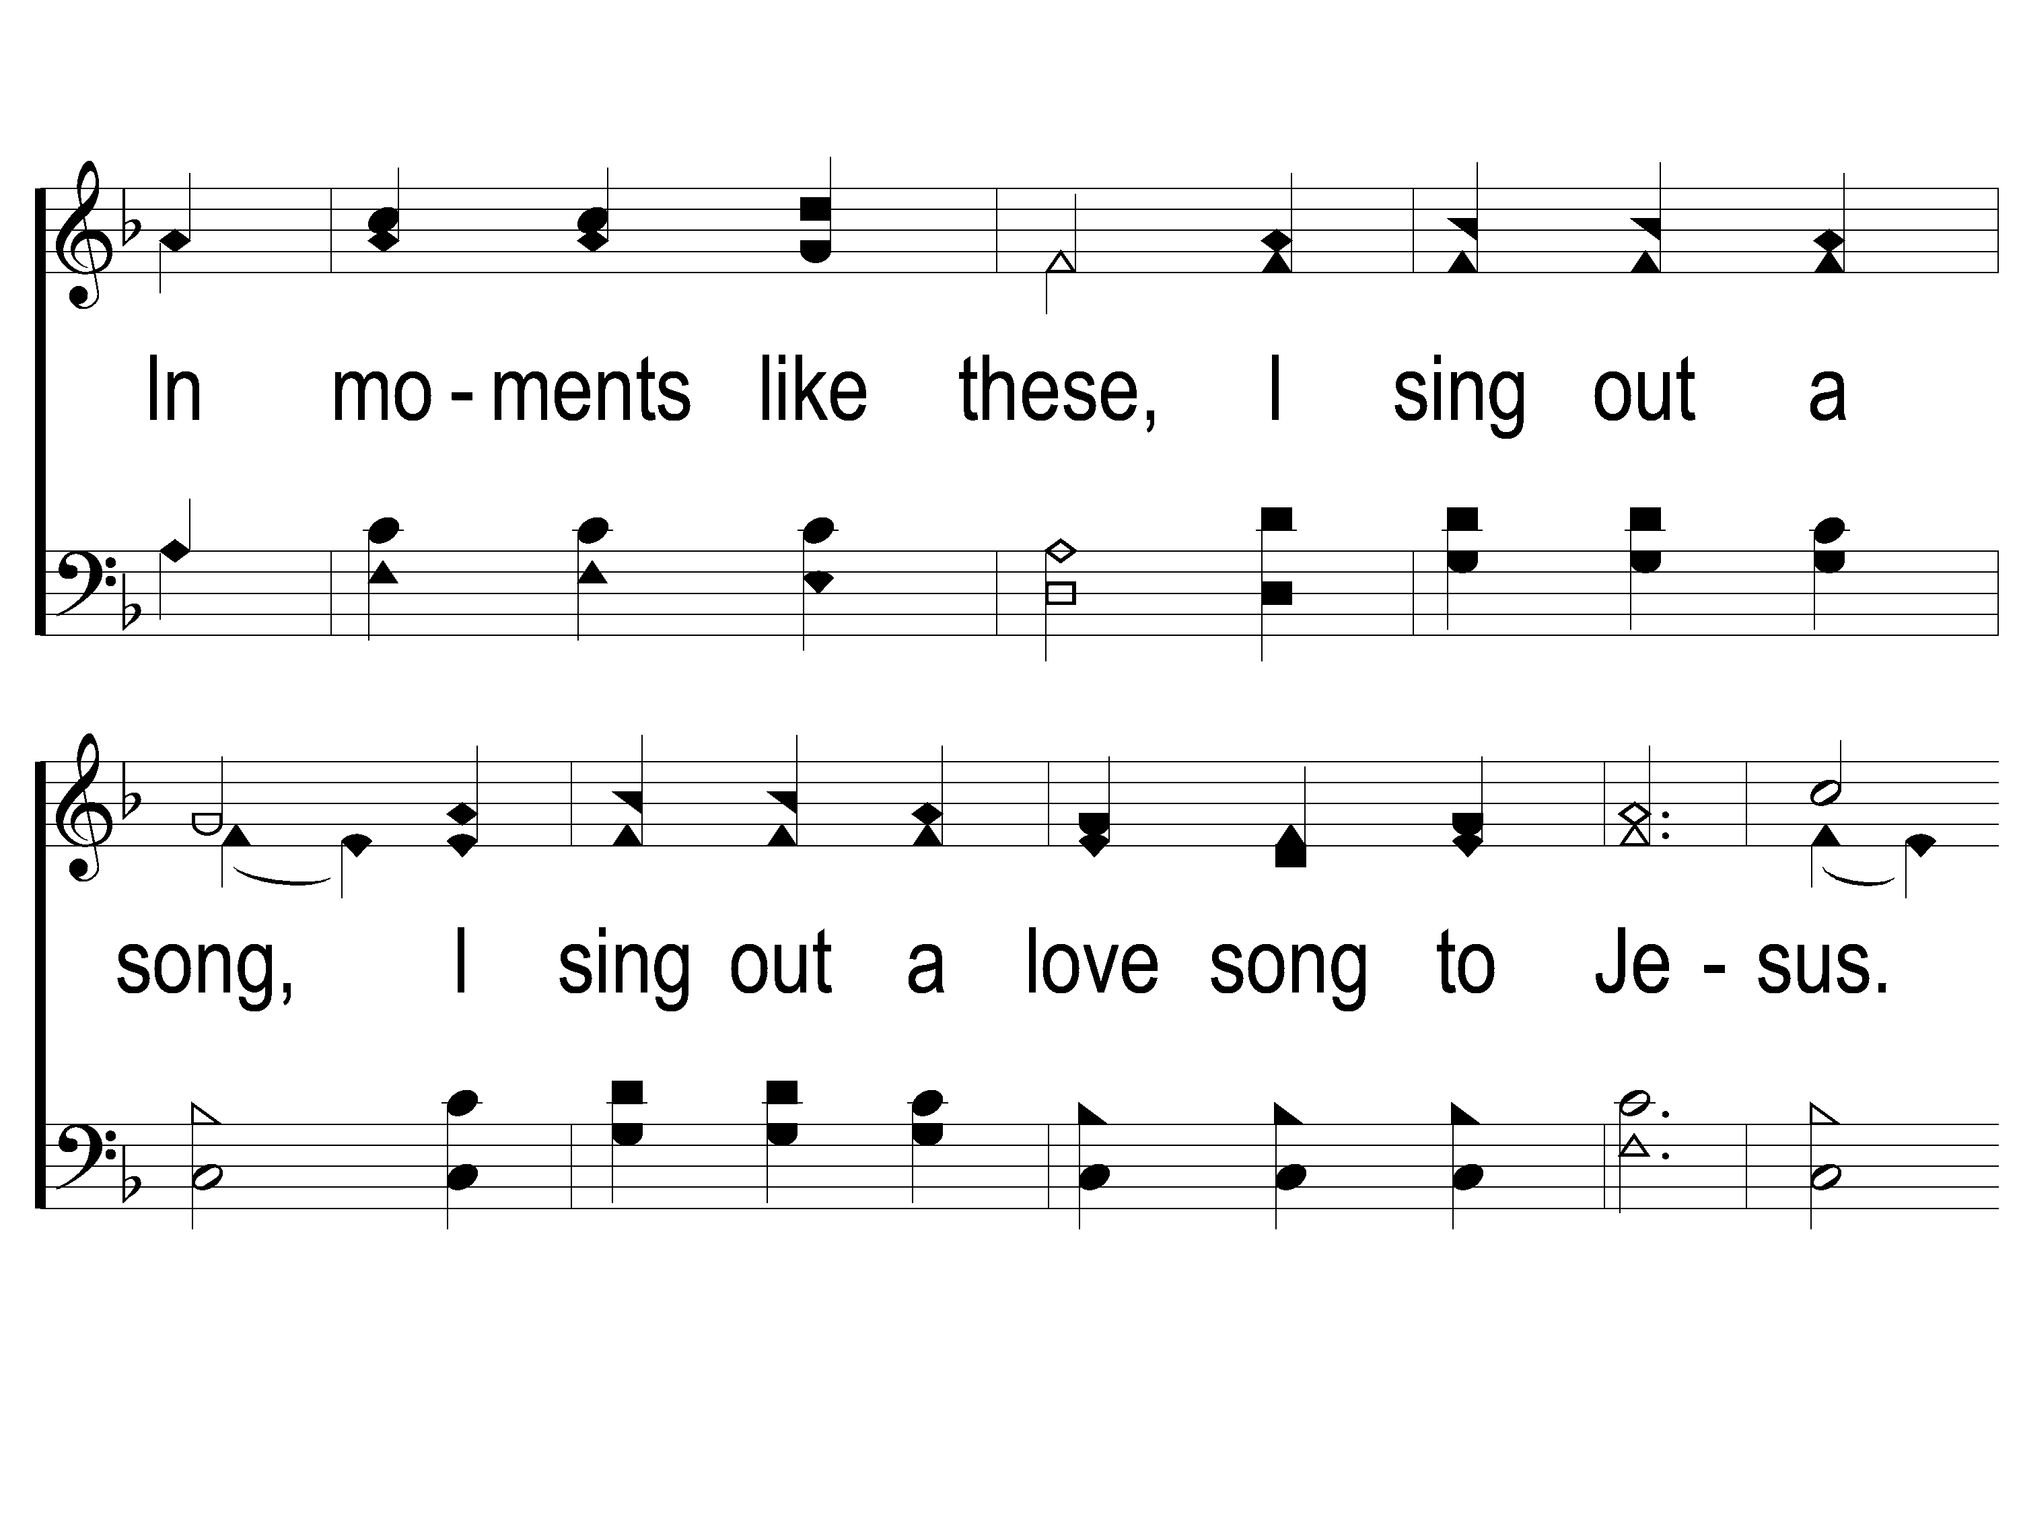
2-1 In Moments Like These
In Moments Like These
239

Slide 14
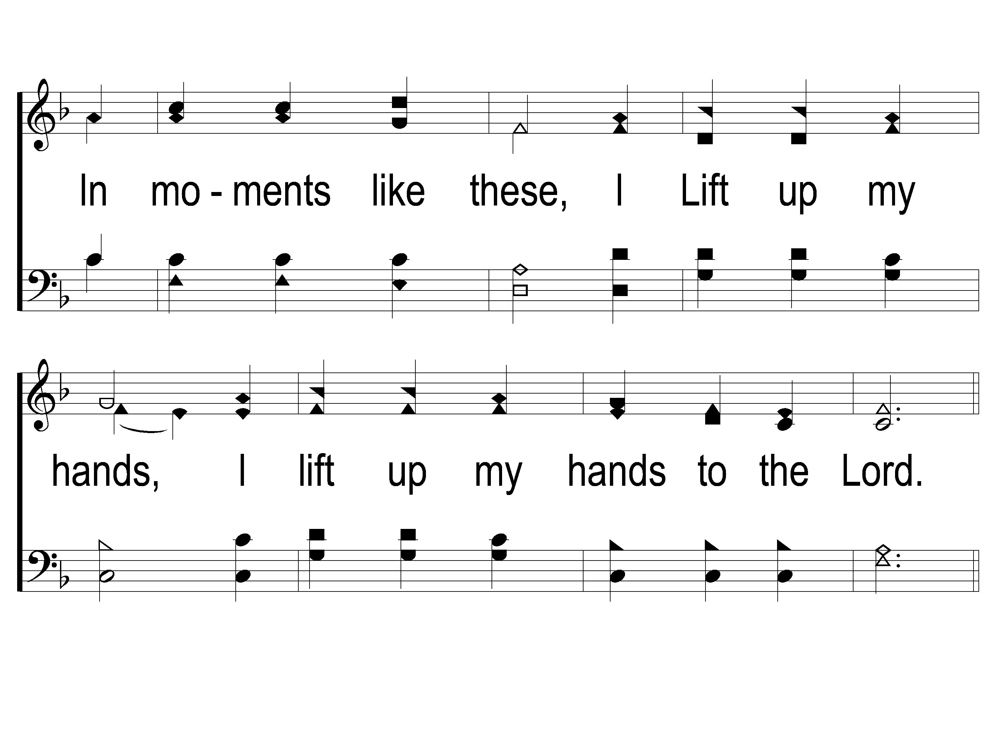
2-2 In Moments Like These
In Moments Like These
239

Slide 15
C-1 In Moments Like These
In Moments Like These
239

Slide 16
C-2 In Moments Like These
In Moments Like These
239

Slide 17
SONG:
I stand amazed
#147

Slide 18
1-1 I Stand Amazed
I Stand Amazed
147

Slide 19
1-2 I Stand Amazed
I Stand Amazed
147

Slide 20
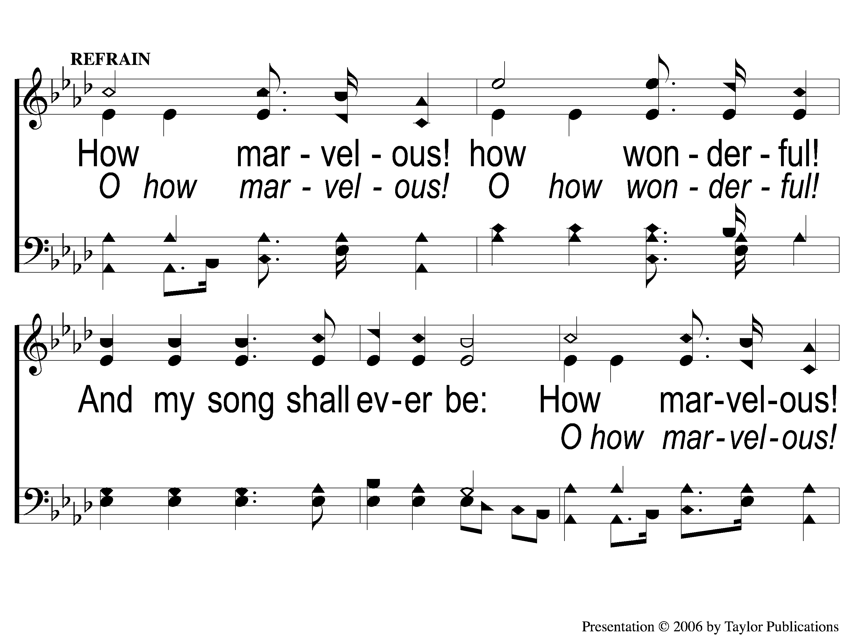
C-1 I Stand Amazed
I Stand Amazed
147

Slide 21
C-2 I Stand Amazed
I Stand Amazed
147

Slide 22
2-1 I Stand Amazed
I Stand Amazed
147

Slide 23
2-2 I Stand Amazed
I Stand Amazed
147

Slide 24
C-1 I Stand Amazed
I Stand Amazed
147

Slide 25
C-2 I Stand Amazed
I Stand Amazed
147

Slide 26
4-1 I Stand Amazed
I Stand Amazed
147

Slide 27
4-2 I Stand Amazed
I Stand Amazed
147

Slide 28
C-1 I Stand Amazed
I Stand Amazed
147

Slide 29
C-2 I Stand Amazed
I Stand Amazed
147

Slide 30
OPENING PRAYER

Slide 31
SONG:
Heaven came down
#517

Slide 32
1-1 Heaven Came Down
Heaven Came Down
517

Slide 33
1-2 Heaven Came Down
Heaven Came Down
517

Slide 34
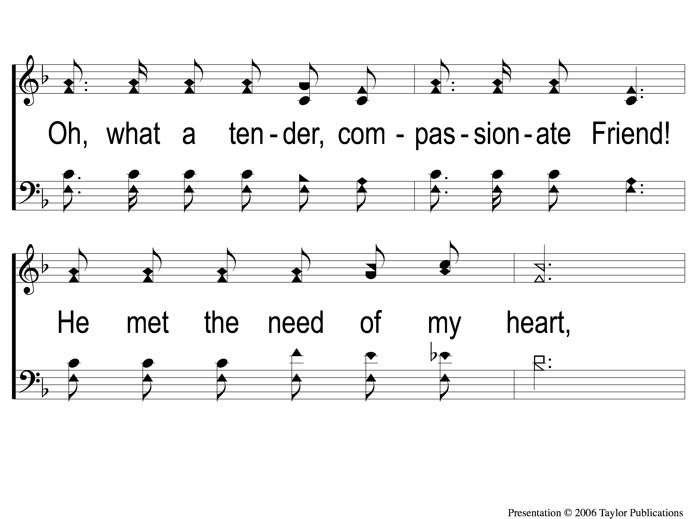
1-3 Heaven Came Down
Heaven Came Down
517

Slide 35
1-4 Heaven Came Down
Heaven Came Down
517

Slide 36
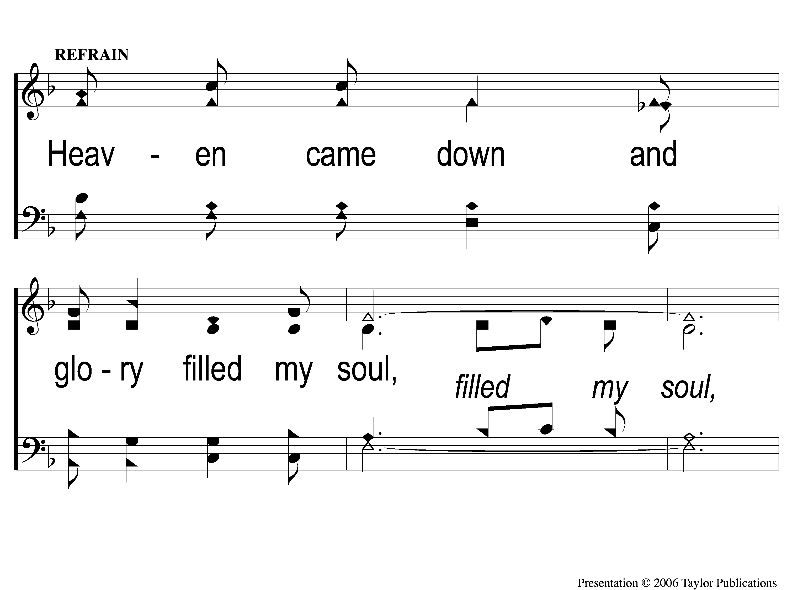
C-1 Heaven Came Down
Heaven Came Down
517

Slide 37
C-2 Heaven Came Down
Heaven Came Down
517

Slide 38
C-3 Heaven Came Down
Heaven Came Down
517

Slide 39
2-1 Heaven Came Down
Heaven Came Down
517

Slide 40
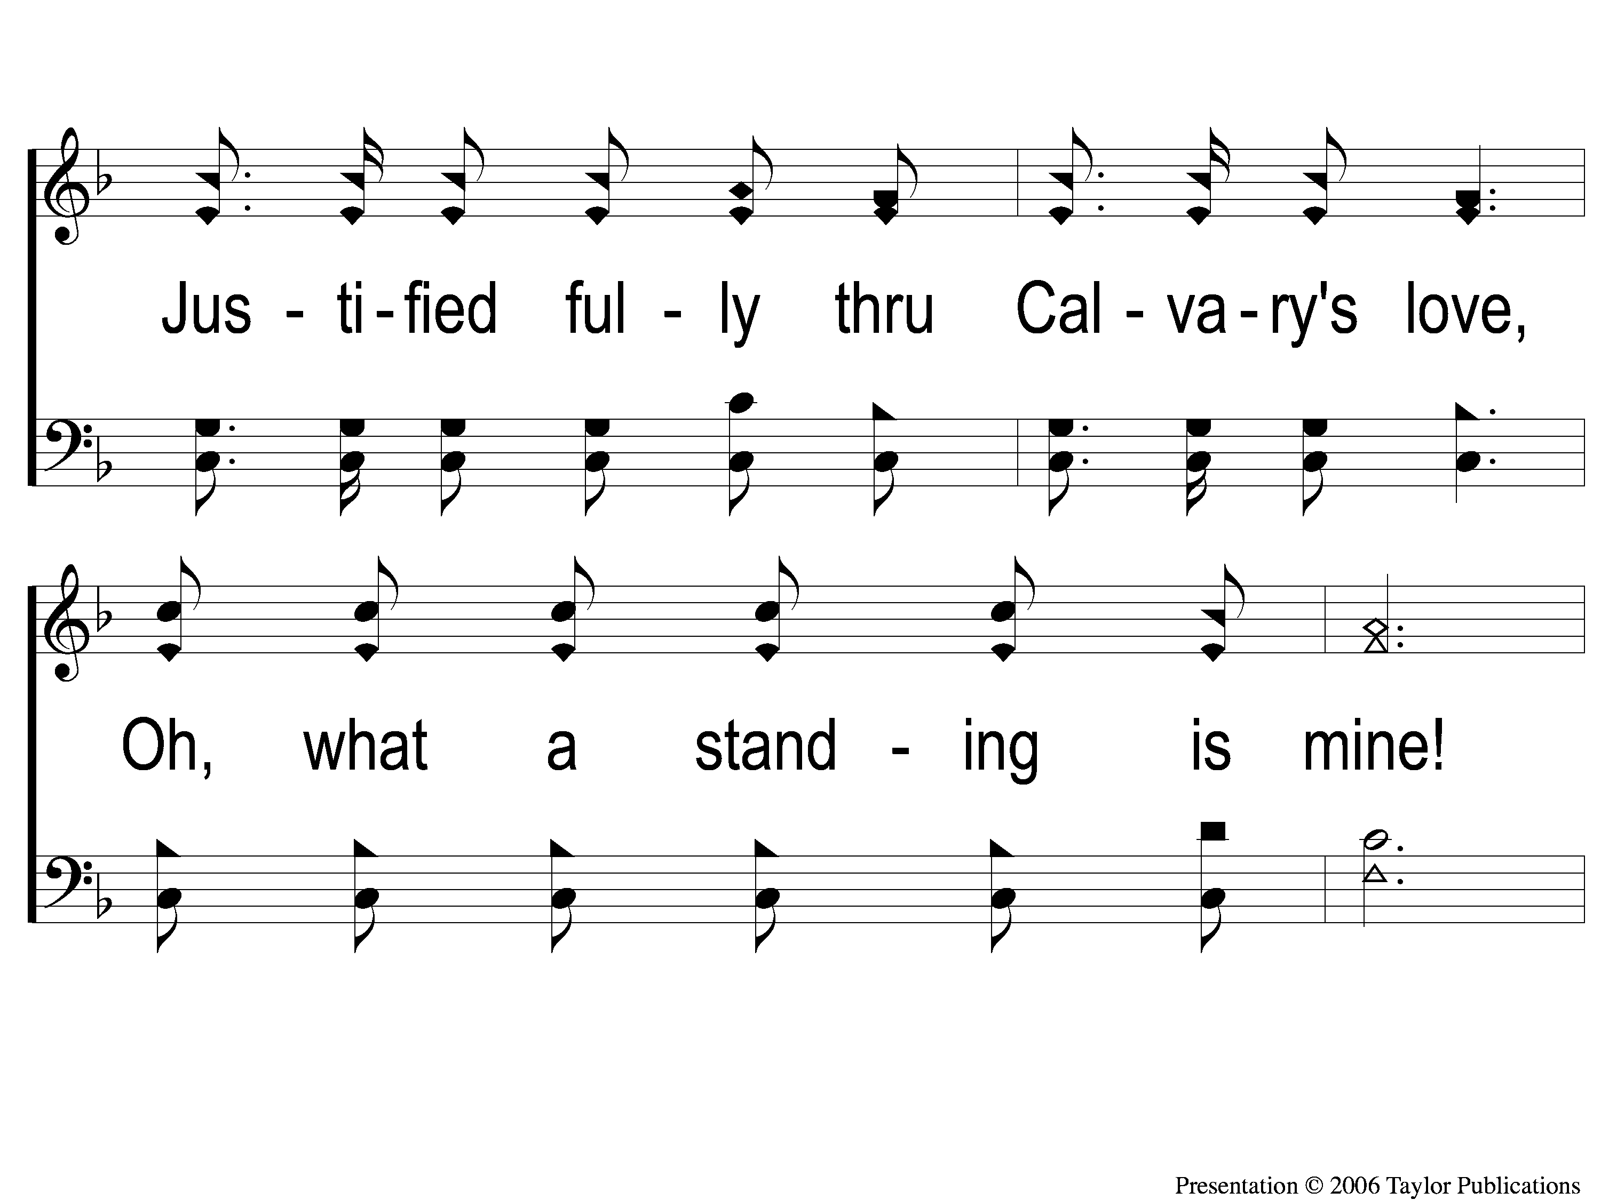
2-2 Heaven Came Down
Heaven Came Down
517

Slide 41
2-3 Heaven Came Down
Heaven Came Down
517

Slide 42
2-4 Heaven Came Down
Heaven Came Down
517

Slide 43
C-1 Heaven Came Down
Heaven Came Down
517

Slide 44
C-2 Heaven Came Down
Heaven Came Down
517

Slide 45
C-3 Heaven Came Down
Heaven Came Down
517

Slide 46
3-1 Heaven Came Down
Heaven Came Down
517

Slide 47
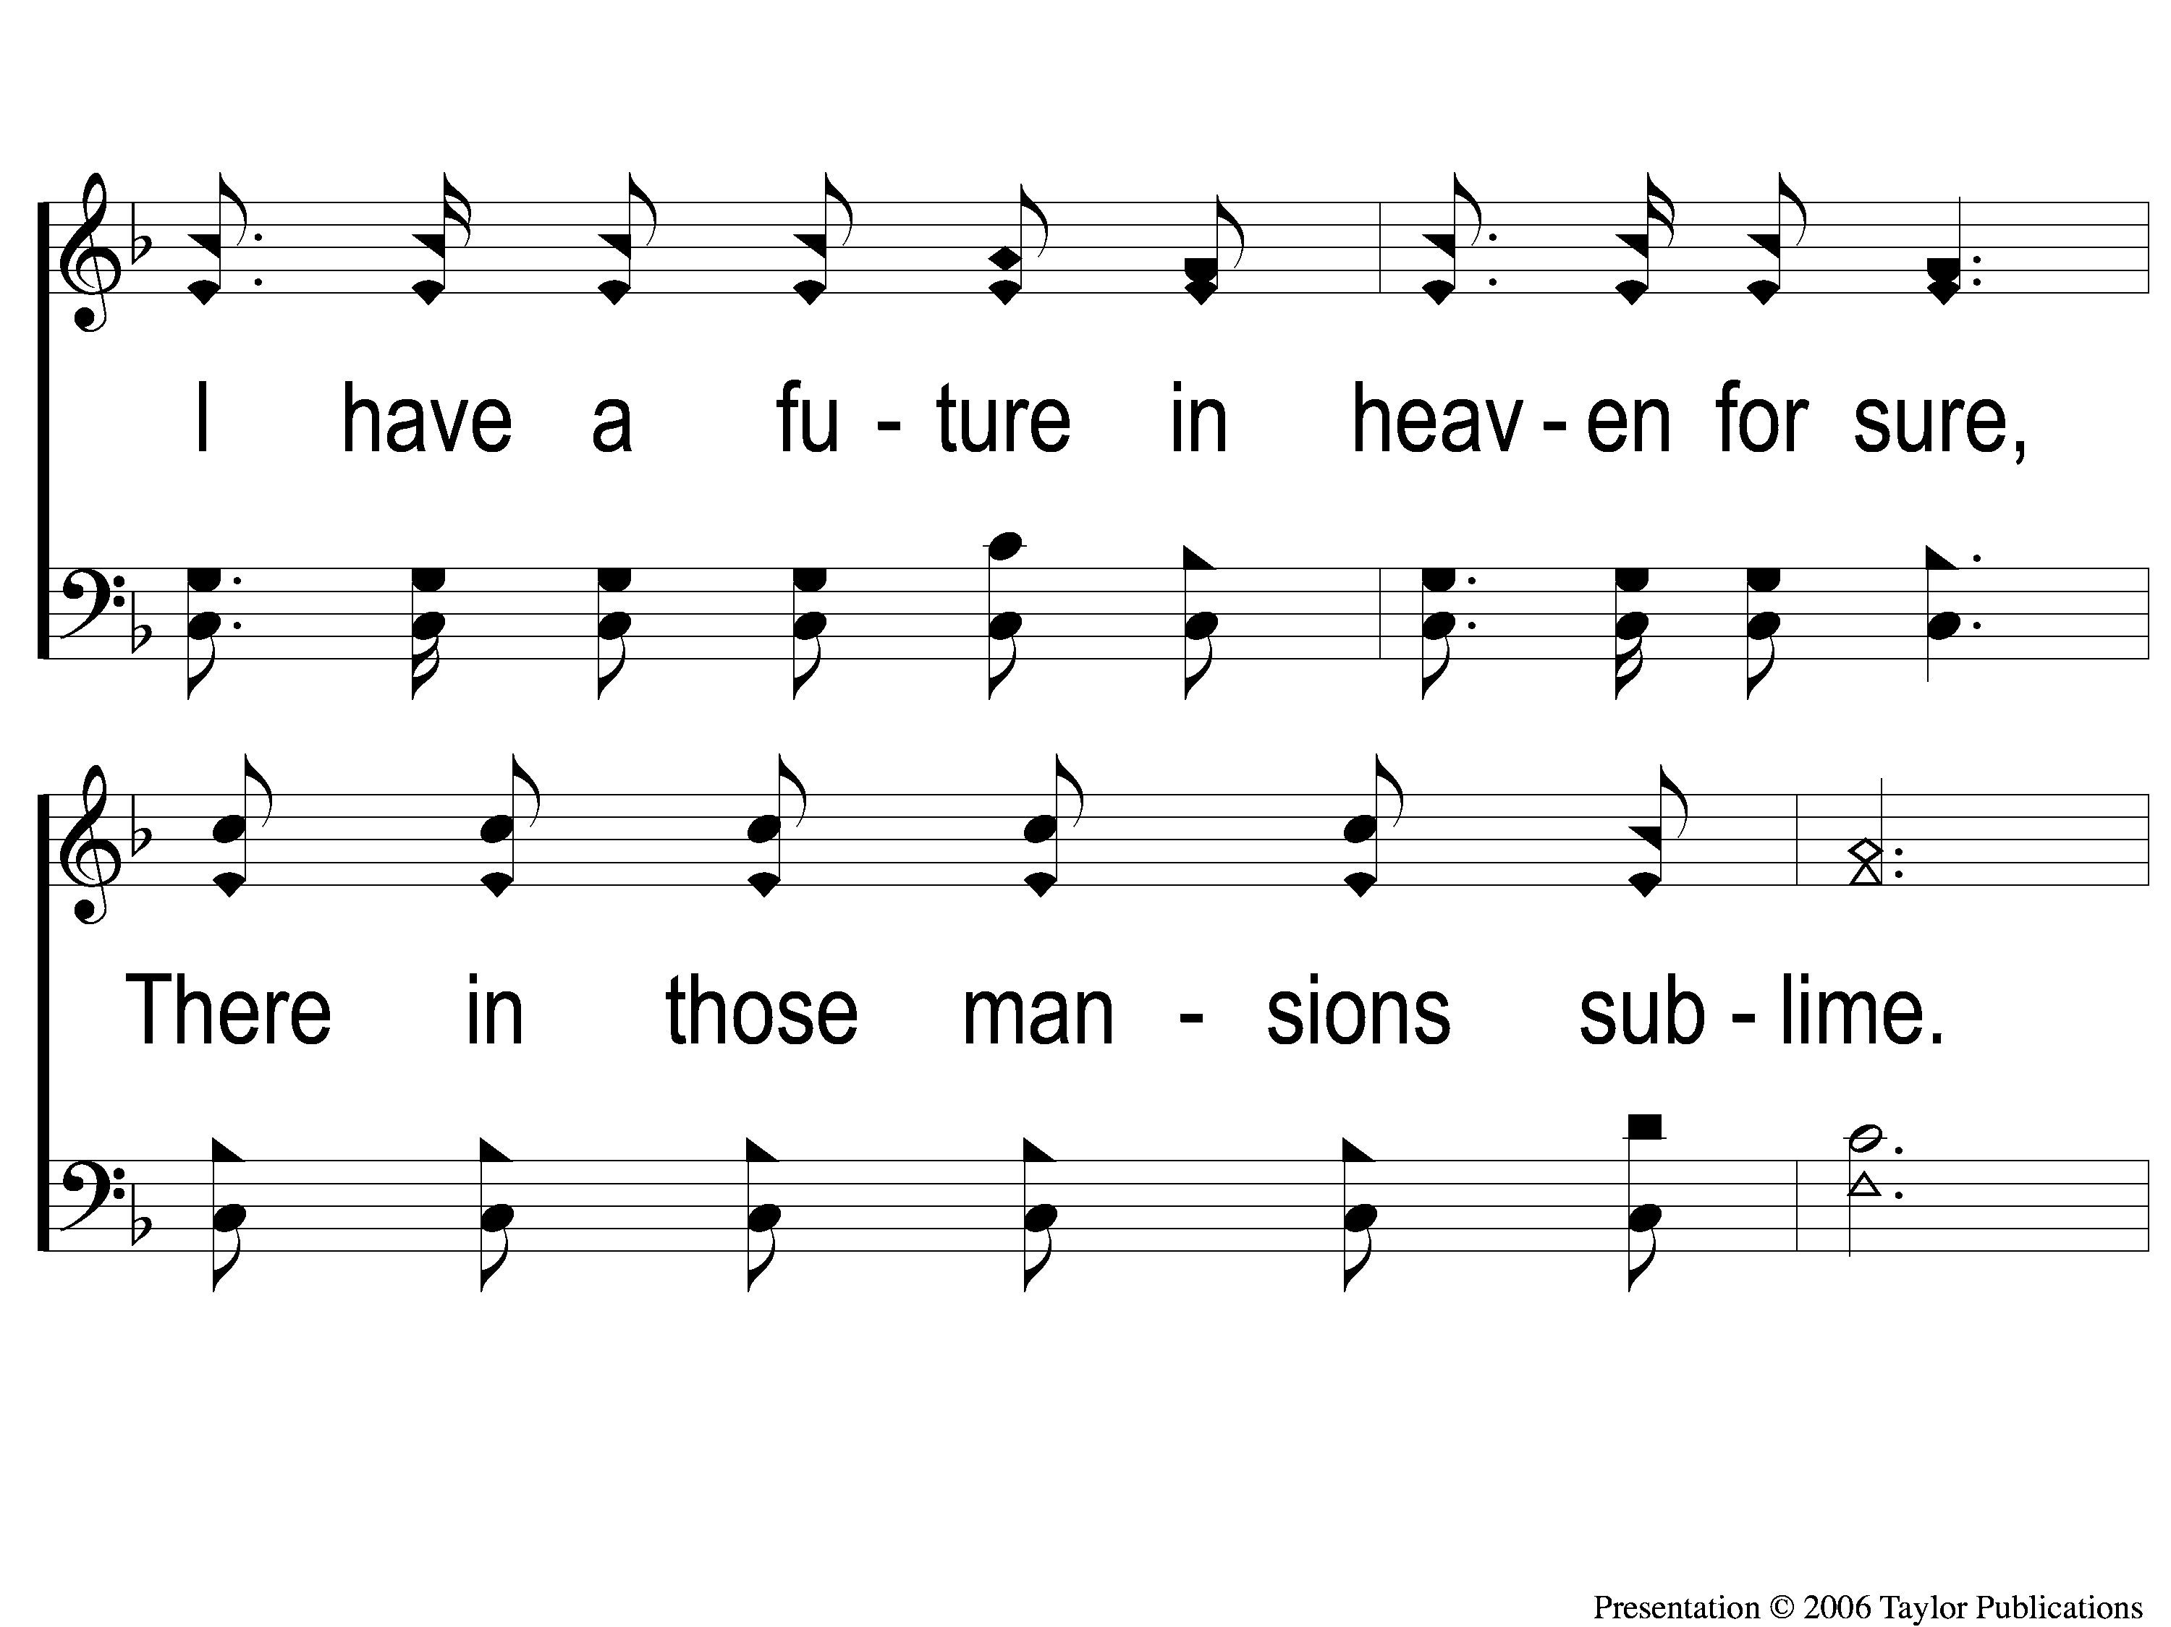
3-2 Heaven Came Down
Heaven Came Down
517

Slide 48
3-3 Heaven Came Down
Heaven Came Down
517

Slide 49
3-4 Heaven Came Down
Heaven Came Down
517

Slide 50
C-1 Heaven Came Down
Heaven Came Down
517

Slide 51
C-2 Heaven Came Down
Heaven Came Down
517

Slide 52
C-3 Heaven Came Down
Heaven Came Down
517

Slide 53
SONG:
The great physician
#291

Slide 54
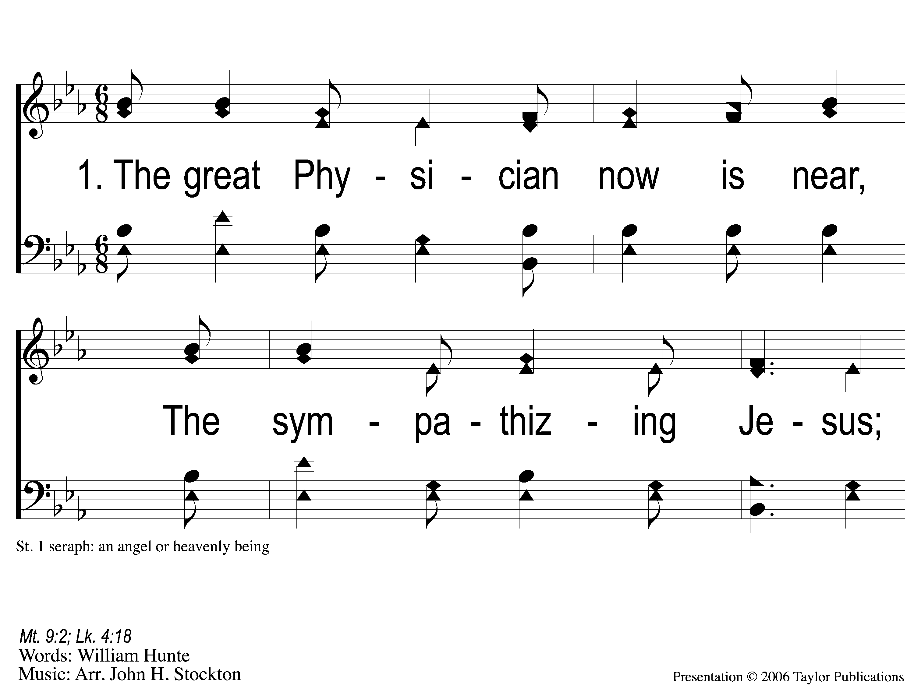
1-1 The Great Physician
The Great Physician
291

Slide 55
1-2 The Great Physician
The Great Physician
291

Slide 56
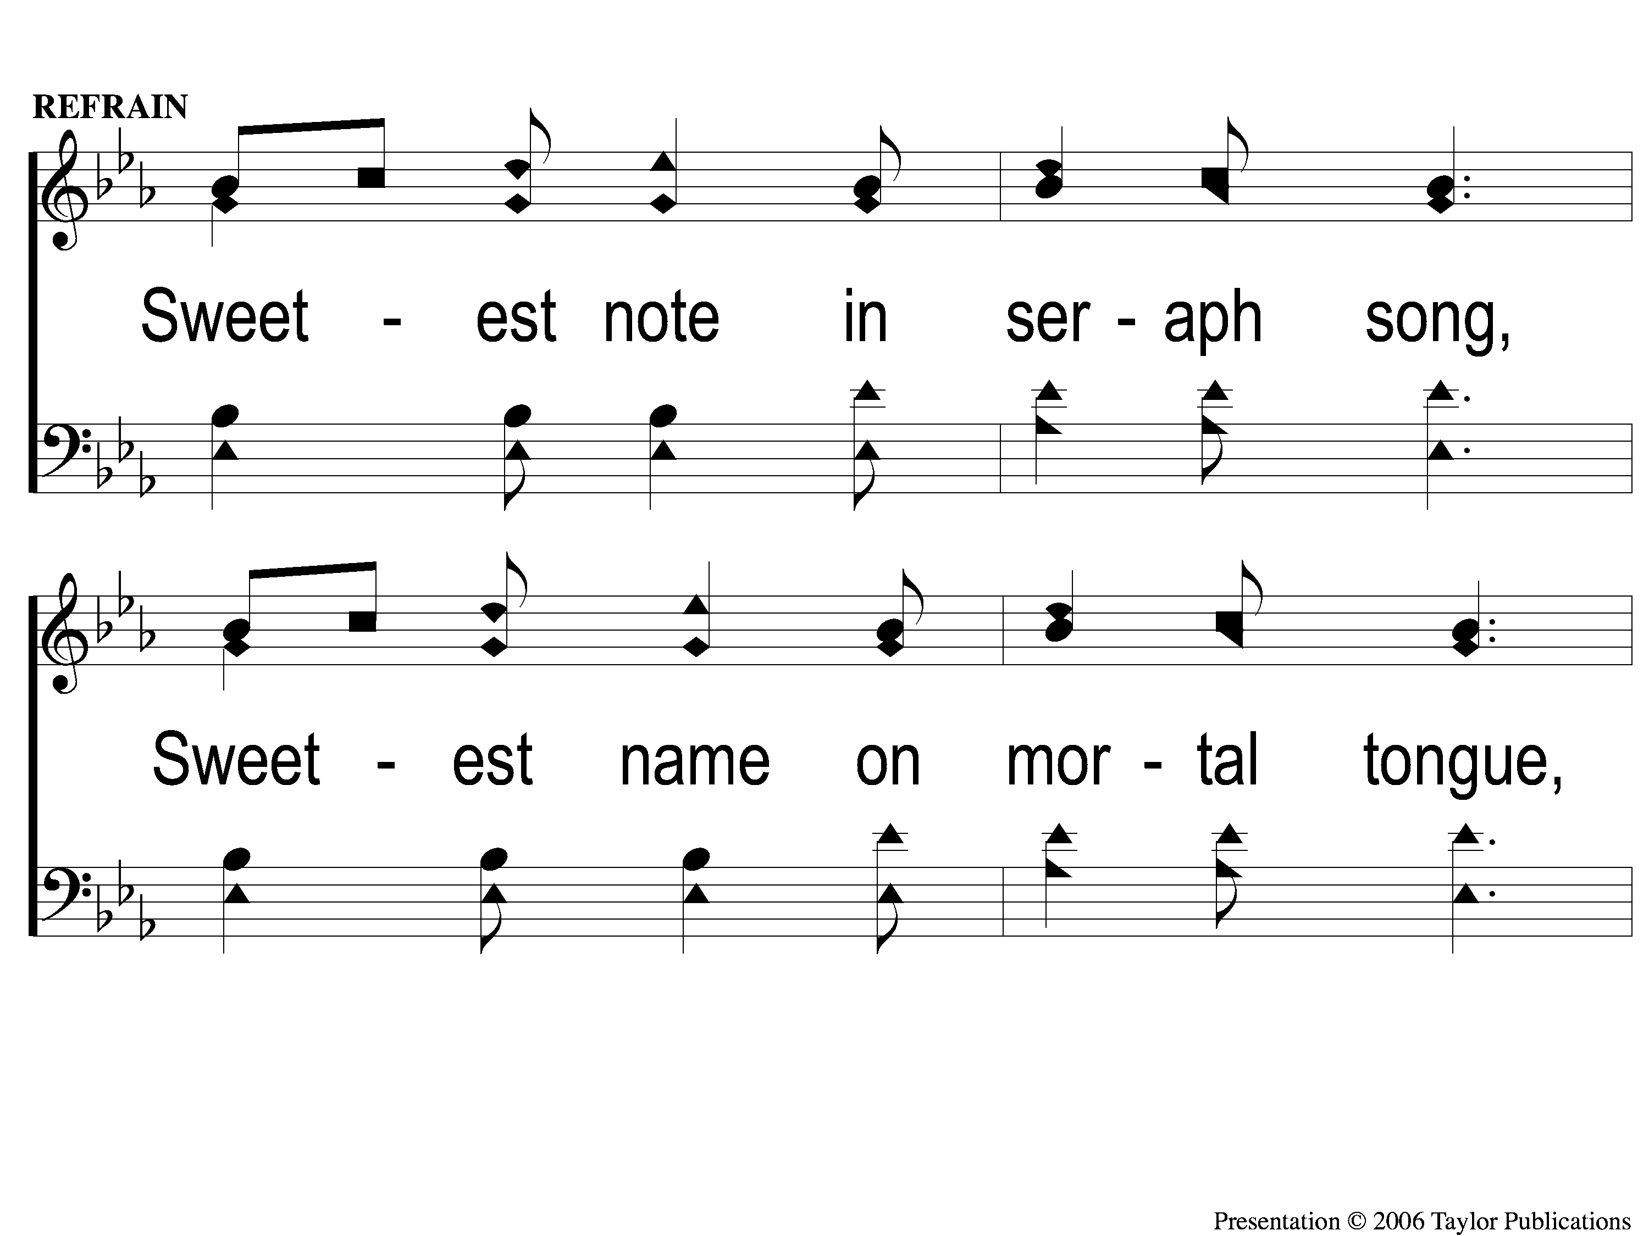
C-1 The Great Physician
The Great Physician
291

Slide 57
C-2 The Great Physician
The Great Physician
291

Slide 58
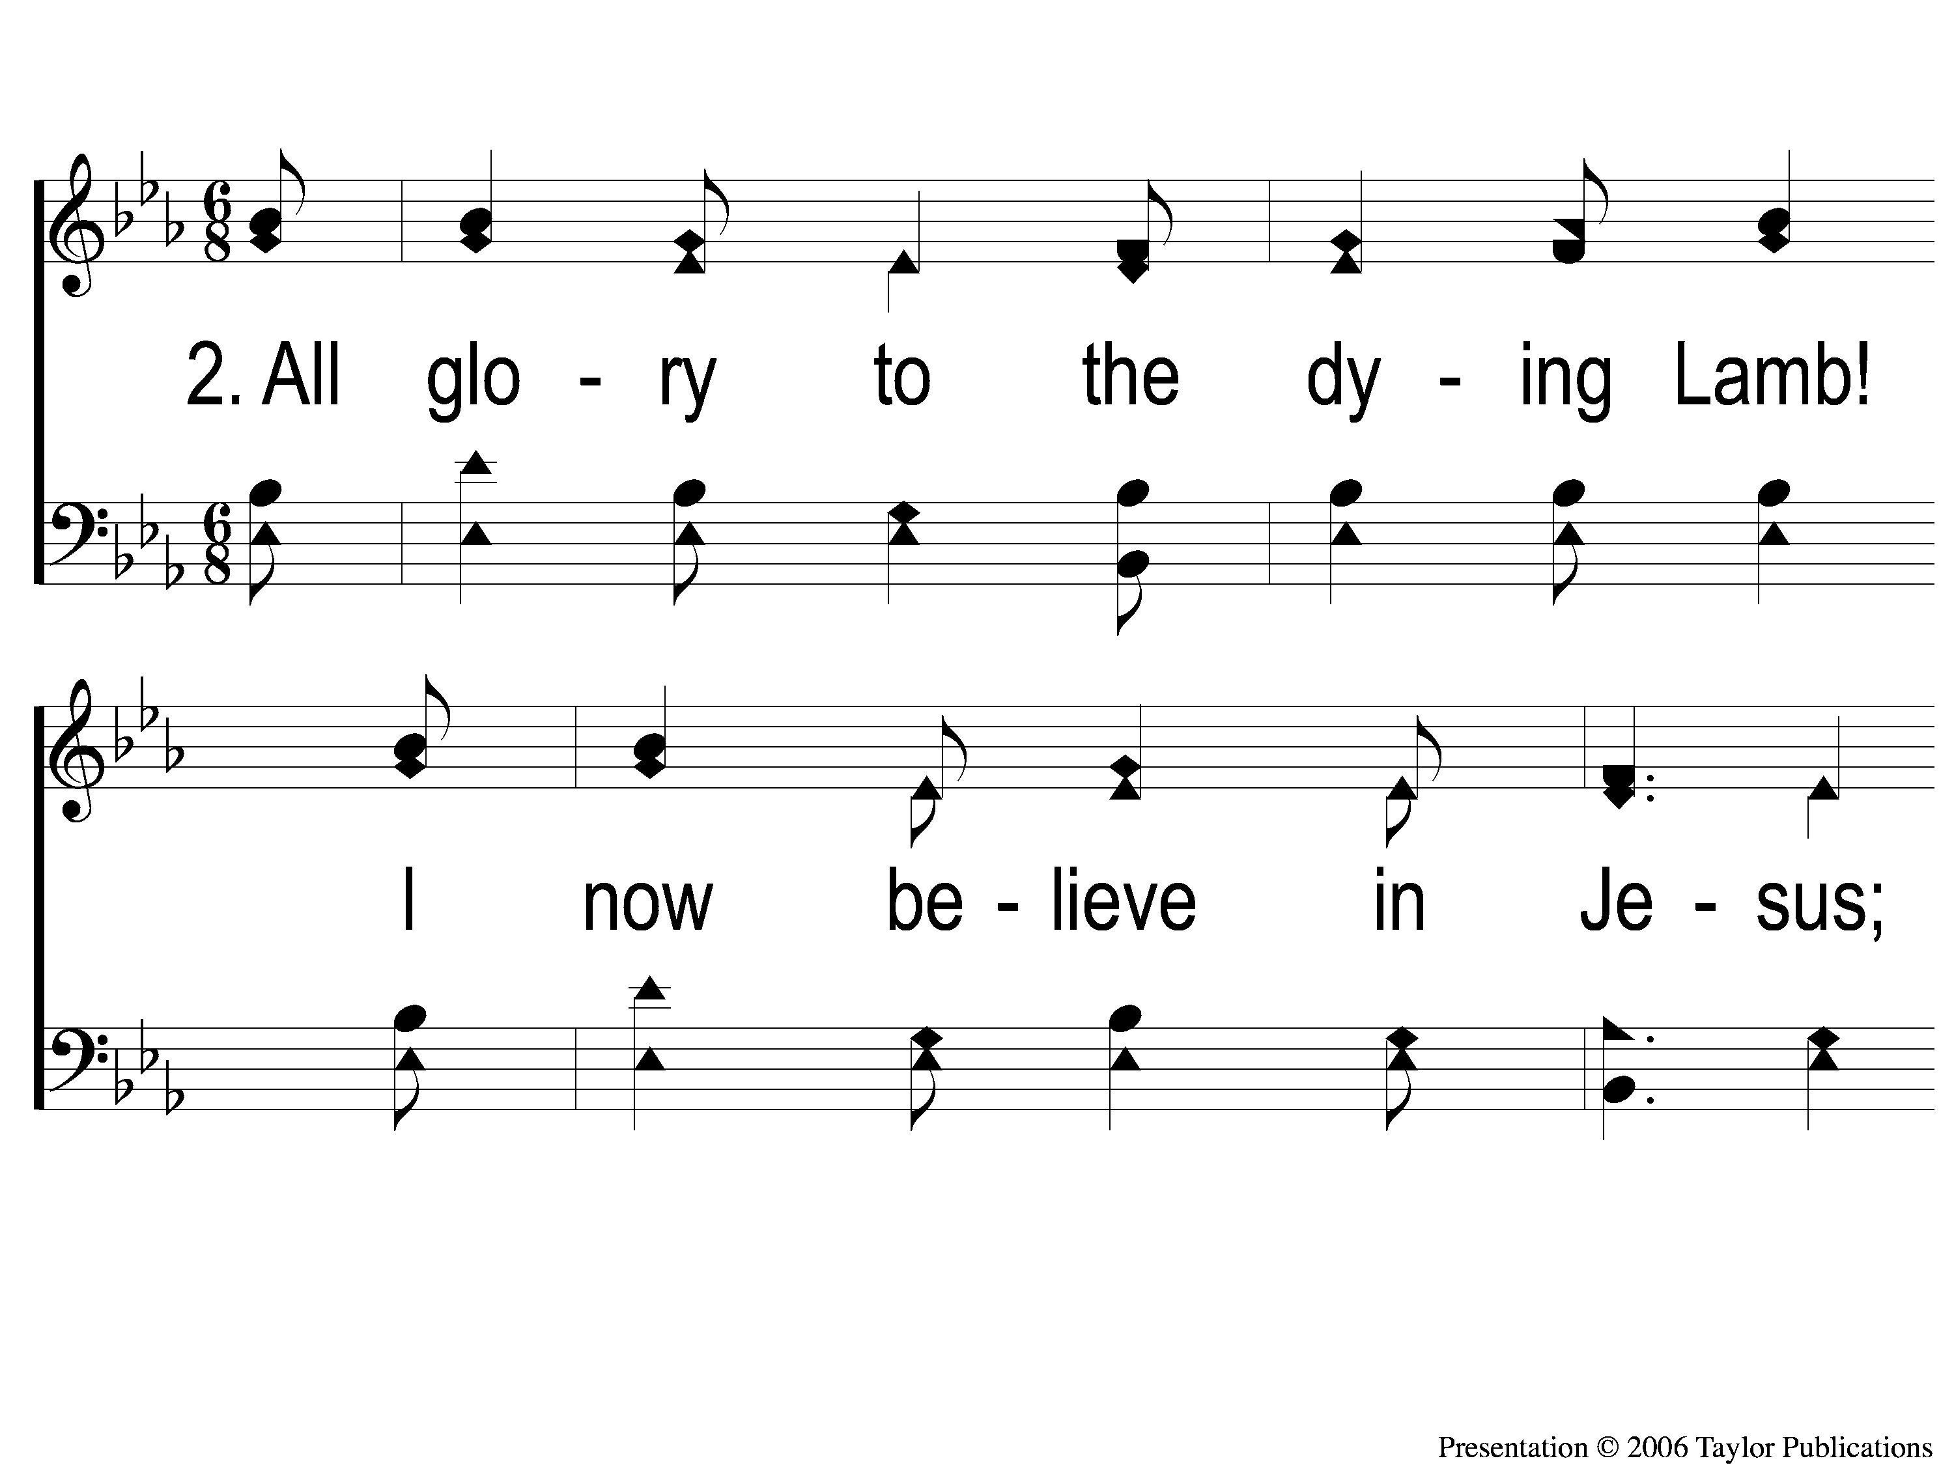
2-1 The Great Physician
The Great Physician
291

Slide 59
2-2 The Great Physician
The Great Physician
291

Slide 60
C-1 The Great Physician
The Great Physician
291

Slide 61
C-2 The Great Physician
The Great Physician
291

Slide 62
3-1 The Great Physician
The Great Physician
291

Slide 63
3-2 The Great Physician
The Great Physician
291

Slide 64
C-1 The Great Physician
The Great Physician
291

Slide 65
C-2 The Great Physician
The Great Physician
291

Slide 66
4-1 The Great Physician
The Great Physician
291

Slide 67
4-2 The Great Physician
The Great Physician
291

Slide 68
C-1 The Great Physician
The Great Physician
291

Slide 69
C-2 The Great Physician
The Great Physician
291

Slide 70
SCRIPTURE READING:
Matthew 9:12

Slide 71
IN PURSUIT
OF THE KINGDOM

Slide 72
IN PURSUIT
OF THE KING

Slide 73
Who is Jesus?
According to matthew

Slide 74
The Messiah (ch. 1)
The “king of the jews” (ch. 2, 27)
The “son of god” (ch. 3, 17)
The Conqueror (Ch. 4)

Slide 75
The Messiah (ch. 1)
The “king of the jews” (ch. 2, 27)
The “son of god” (ch. 3, 17)
The Conqueror (Ch. 4)
The great physician (ch. 8-9)

Slide 76
Matthew chapters 8-9
3 stories of miracles (8:1-17)
Discipleship lesson
3 stories of miracles (8:23-9:8)
Discipleship lesson
3 stories of miracles (9:18-34

Slide 77
Jesus has power over…

Slide 78
Jesus has power over…
…Disease (8:1-4, 14-17)

Slide 79
Jesus has power over…
…Disease (8:1-4, 14-17)
…Distance (8:5-13)

Slide 80
Jesus has power over…
…Disease (8:1-4, 14-17)
…Distance (8:5-13)
…Disciples (8:18-22)

Slide 81
Jesus has power over…
…Disease (8:1-4, 14-17)
…Distance (8:5-13)
…Disciples (8:18-22)
…Disaster (8:23-27)

Slide 82
Jesus has power over…
…Disease (8:1-4, 14-17)
…Distance (8:5-13)
…Disciples (8:18-22)
…Disaster (8:23-27)
…Demons (8:1-4, 16, 28-34)

Slide 83
Jesus has power over…
…Disease (8:1-4, 14-17)
…Distance (8:5-13)
…Disciples (8:18-22)
…Disaster (8:23-27)
…Demons (8:1-4, 16, 28-34)
…Despair (9:1-8)

Slide 84
Jesus has power over…
…Disease (8:1-4, 14-17)
…Distance (8:5-13)
…Disciples (8:18-22)
…Disaster (8:23-27)
…Demons (8:1-4, 16, 28-34)
…Despair (9:1-8)
…Disdain (9:9-17)

Slide 85
Jesus has power over…
…Disease (8:1-4, 14-17)
…Distance (8:5-13)
…Disciples (8:18-22)
…Disaster (8:23-27)
…Demons (8:1-4, 16, 28-34)
…Despair (9:1-8)
…Disdain (9:9-17)
…Death (9:18-25)

Slide 86
Jesus has power over…
…Disease (8:1-4, 14-17)
…Distance (8:5-13)
…Disciples (8:18-22)
…Disaster (8:23-27)
…Demons (8:1-4, 16, 28-34)
…Despair (9:1-8)
…Disdain (9:9-17)
…Death (9:18-25)
…Doubt (9:27-31)

Slide 87
Jesus can heal you…

Slide 88
Jesus can heal you…
…despite your status

Slide 89
Despite your status
Equal at the foot of the cross

Slide 90
Despite your status
Equal at the foot of the cross
Centurion or a servant
Ruler or subject
Acclaimed or outcast
Gal. 3:26-27

Slide 91
Jesus can heal you…
…despite your status
…despite your situation

Slide 92
Despite your situation
Any place or background

Slide 93
Despite your situation
Any place or background
Near jesus or far away from him
Matt. 8:1-13

Slide 94
Jesus can heal you…
…despite your status
…despite your situation
…despite your sickness(es)

Slide 95
Despite your sickness(es)
Any sin
Matt. 4:23, 9:6
1 cor. 6:9-11
Rom. 5:20

Slide 96
Despite your sickness(es)
Any amount of sins
Matt. 9:32-33
12:22

Slide 97
Jesus can heal you…
…despite your status
…despite your situation
…despite your sickness(es)
…despite your suffering

Slide 98
Despite your sickness(es)
No matter how long you’ve been afflicted
Matt. 9:18-25

Slide 99
Despite your sickness(es)
No matter how long you’ve been afflicted
Matt. 9:18-25
“just died” or “for twelve years”

Slide 100
The prescription:
The blood of Jesus
Matt. 26:28
Acts 20:28
Rom. 5:9
Eph. 1:7
Col. 1:14

Slide 101
The prescription:
Access to Jesus’ blood
Jn. 19:34
Eph. 2:18, 4:4-6
1 Pet. 3:20-21

Slide 102
The prescription:
Hear god’s word – Rom. 10:17
Believe in his son – Jn. 14:1
Confess his son – Rom. 10:9-10
Repent of your sins – aCts 17:30
Be baptized to receive forgiveness of sins – Acts 2:38

Slide 103
are you WASHED IN THE BLOOD?

Slide 104
Invitation SONG:
Walking in sunlight
#611

Slide 105
1-1 Walking in Sunlight
Walking In Sunlight
611

Slide 106
1-2 Walking in Sunlight
Walking In Sunlight
611

Slide 107
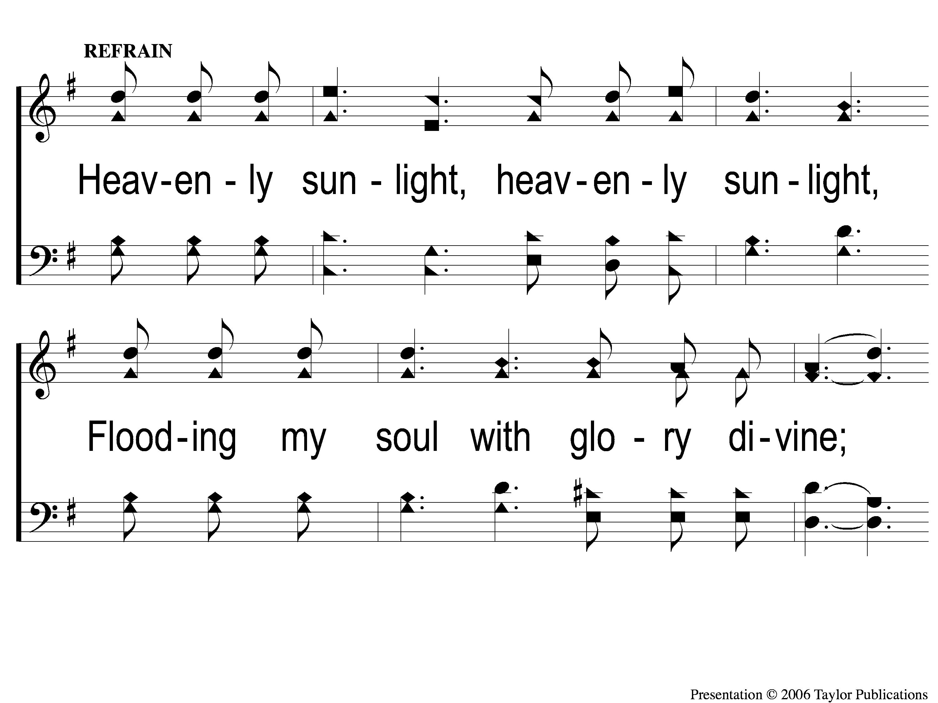
C-1 Walking in Sunlight
Walking In Sunlight
611

Slide 108
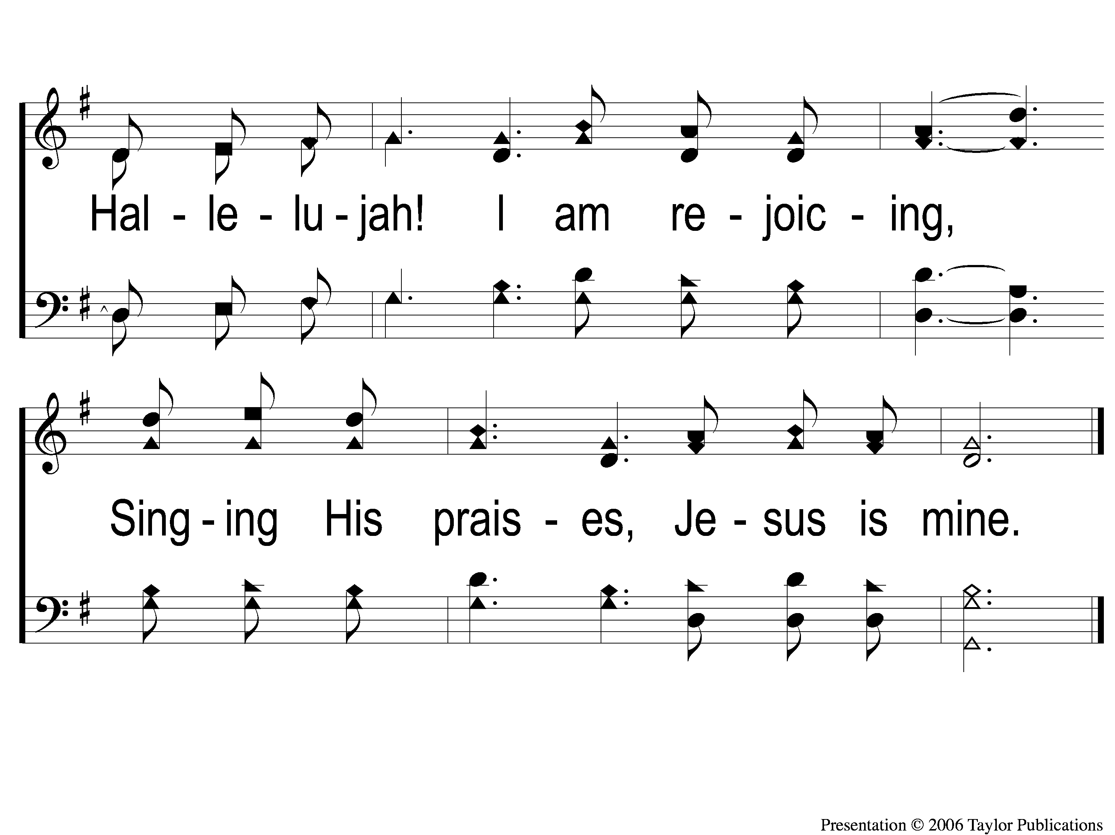
C-2 Walking in Sunlight
Walking In Sunlight
611

Slide 109
3-1 Walking in Sunlight
Walking In Sunlight
611

Slide 110
3-2 Walking in Sunlight
Walking In Sunlight
611

Slide 111
C-1 Walking in Sunlight
Walking In Sunlight
611

Slide 112
C-2 Walking in Sunlight
Walking In Sunlight
611

Slide 113
OUR CONTRIBUTION
1 john 3:16-17
“By this we know love, because He laid down His life for us. And we also ought to lay down our lives for the brethren. But whoever has this world’s goods, and sees his brother in need, and shuts up his heart from him, how does the love of God abide in him?”

Slide 114
SONG:
He paid a debt
#376

Slide 115
1-1 He Paid a Debt
He Paid A Debt
376

Slide 116
1-2 He Paid a Debt
He Paid A Debt
376

Slide 117
c He Paid a Debt
He Paid A Debt
376

Slide 118
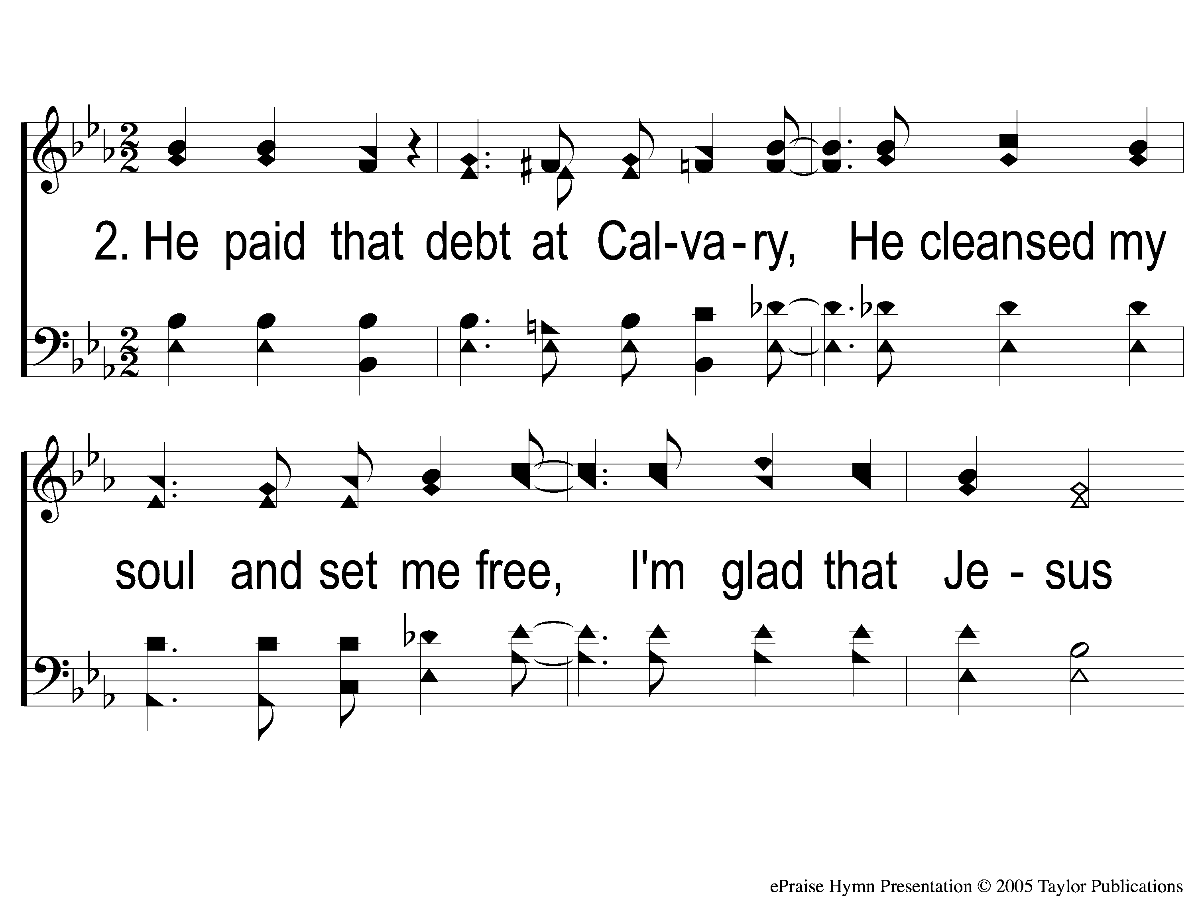
2-1 He Paid a Debt
He Paid A Debt
376

Slide 119
2-2 He Paid a Debt
He Paid A Debt
376

Slide 120
c He Paid a Debt
He Paid A Debt
376

Slide 121
3-1 He Paid a Debt
He Paid A Debt
376

Slide 122
3-2 He Paid a Debt
He Paid A Debt
376

Slide 123
c He Paid a Debt
He Paid A Debt
376

Slide 124
THE UNLEAVENED BREAD
Revelation 1:17-18
“And when I saw Him, I fell at His feet as dead. But He laid His right hand on me, saying to me, “Do not be afraid; I am the First and the Last. I am He who lives, and was dead, and behold, I am alive forevermore.”

Slide 125
THE FRUIT OF THE VINE
Revelation 5:9-10
“ And they sang a new song, saying: ‘You are worthy to take the scroll, And to open its seals; For You were slain, And have redeemed us to God by Your blood Out of every tribe and tongue and people and nation, And have made us kings and priests to our God; And we shall reign on the earth.’ ”

Slide 126
closing PRAYER

Slide 127
SONG:
Jesus is all the world to me
#590

Slide 128
1-1 Jesus is all the World to Me
Jesus Is All the World To Me
590

Slide 129
1-2 Jesus is all the World to Me
Jesus Is All the World To Me
590

Slide 130
1-3 Jesus is all the World to Me
Jesus Is All the World To Me
590

Slide 131
3-1 Jesus is all the World to Me
Jesus Is All the World To Me
590

Slide 132
3-2 Jesus is all the World to Me
Jesus Is All the World To Me
590

Slide 133
3-3 Jesus is all the World to Me
Jesus Is All the World To Me
590

Slide 134
Today
WORSHIP @ 6:00
Wednesday
Worship & Bible classes @ 6:30

