Slide 1
1-1 We Have Heard the Joyful Sound
We Have Heard the Joyful Sound
652

Slide 2
1-2 We Have Heard the Joyful Sound
We Have Heard the Joyful Sound
652

Slide 3
1-3 We Have Heard the Joyful Sound
We Have Heard the Joyful Sound
652

Slide 4
2-1 We Have Heard the Joyful Sound
We Have Heard the Joyful Sound
652

Slide 5
2-2 We Have Heard the Joyful Sound
We Have Heard the Joyful Sound
652

Slide 6
2-3 We Have Heard the Joyful Sound
We Have Heard the Joyful Sound
652

Slide 7
WELCOME
To the Wheeler church of Christ

Slide 8
SONG:
Seeking the lost
#624

Slide 9
1-1 Seeking the Lost
Seeking the Lost
624

Slide 10
1-2 Seeking the Lost
Seeking the Lost
624

Slide 11
C-1 Seeking the Lost
Seeking the Lost
624

Slide 12
C-2 Seeking the Lost
Seeking the Lost
624

Slide 13
3-1 Seeking the Lost
Seeking the Lost
624

Slide 14
3-2 Seeking the Lost
Seeking the Lost
624

Slide 15
C-1 Seeking the Lost
Seeking the Lost
624

Slide 16
C-2 Seeking the Lost
Seeking the Lost
624

Slide 17
SONG:
Dear lord and father of mankind
#770

Slide 18
1-1 Dear Lord and Father of Mankind
Dear Lord and Father of Mankind
770

Slide 19
1-2 Dear Lord and Father of Mankind
Dear Lord and Father of Mankind
770

Slide 20
2-1 Dear Lord and Father of Mankind
Dear Lord and Father of Mankind
770

Slide 21
2-2 Dear Lord and Father of Mankind
Dear Lord and Father of Mankind
770

Slide 22
4-1 Dear Lord and Father of Mankind
Dear Lord and Father of Mankind
770

Slide 23
4-2 Dear Lord and Father of Mankind
Dear Lord and Father of Mankind
770

Slide 24
OPENING PRAYER

Slide 25
SONG:
I am mine no more
#683

Slide 26
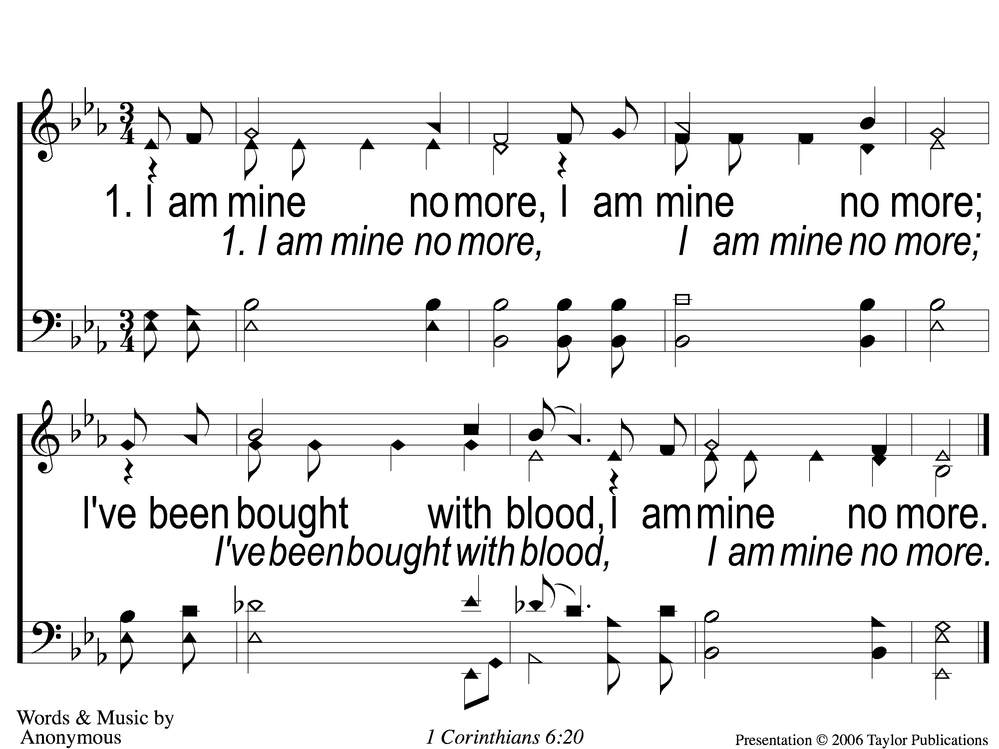
1-I Am Mine No More
I Am Mine No More
683

Slide 27
2-I Am Mine No More
I Am Mine No More
683

Slide 28
3-I Am Mine No More
I Am Mine No More
683

Slide 29
4-I Am Mine No More
I Am Mine No More
683

Slide 30
SONG:
Jesus, hold my hand
#412

Slide 31
1-1 Jesus Hold My Hand
Jesus, Hold My Hand
412

Slide 32
1-2 Jesus Hold My Hand
Jesus, Hold My Hand
412

Slide 33
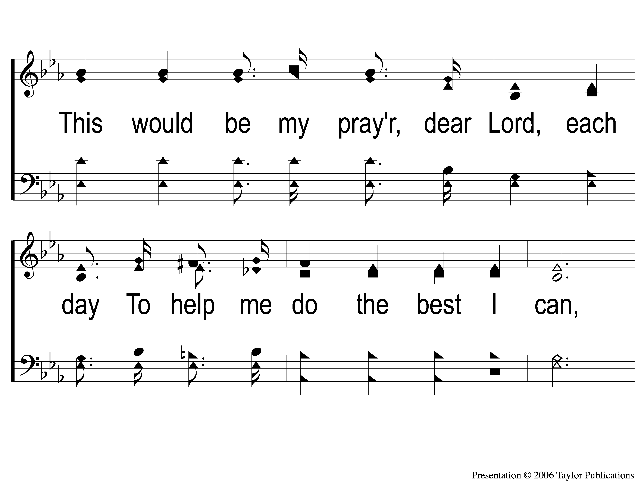
1-3 Jesus Hold My Hand
Jesus, Hold My Hand
412

Slide 34
1-4 Jesus Hold My Hand
Jesus, Hold My Hand
412

Slide 35
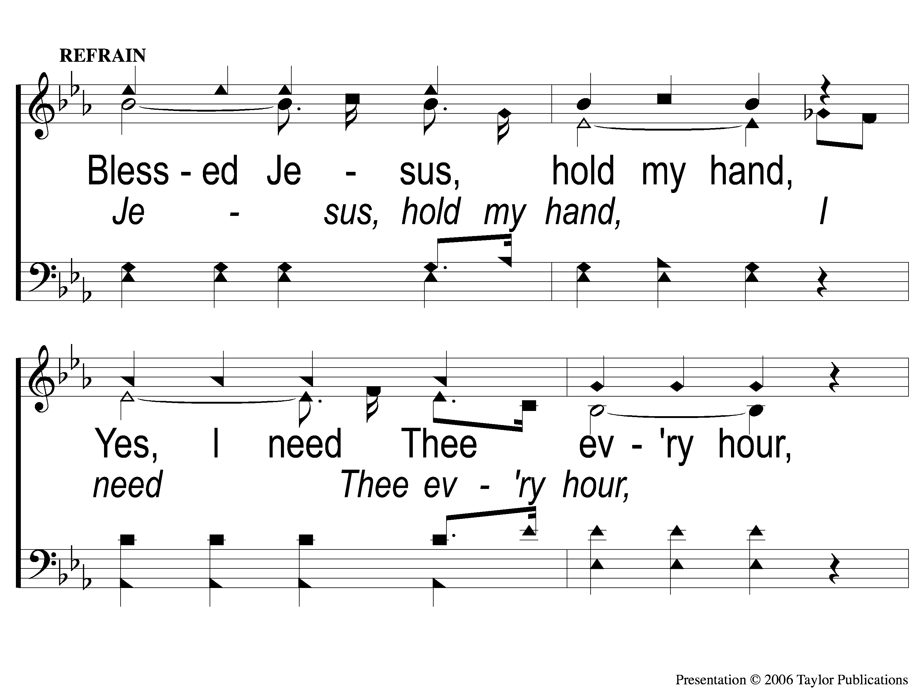
C-1 Jesus Hold My Hand
Jesus, Hold My Hand
412

Slide 36
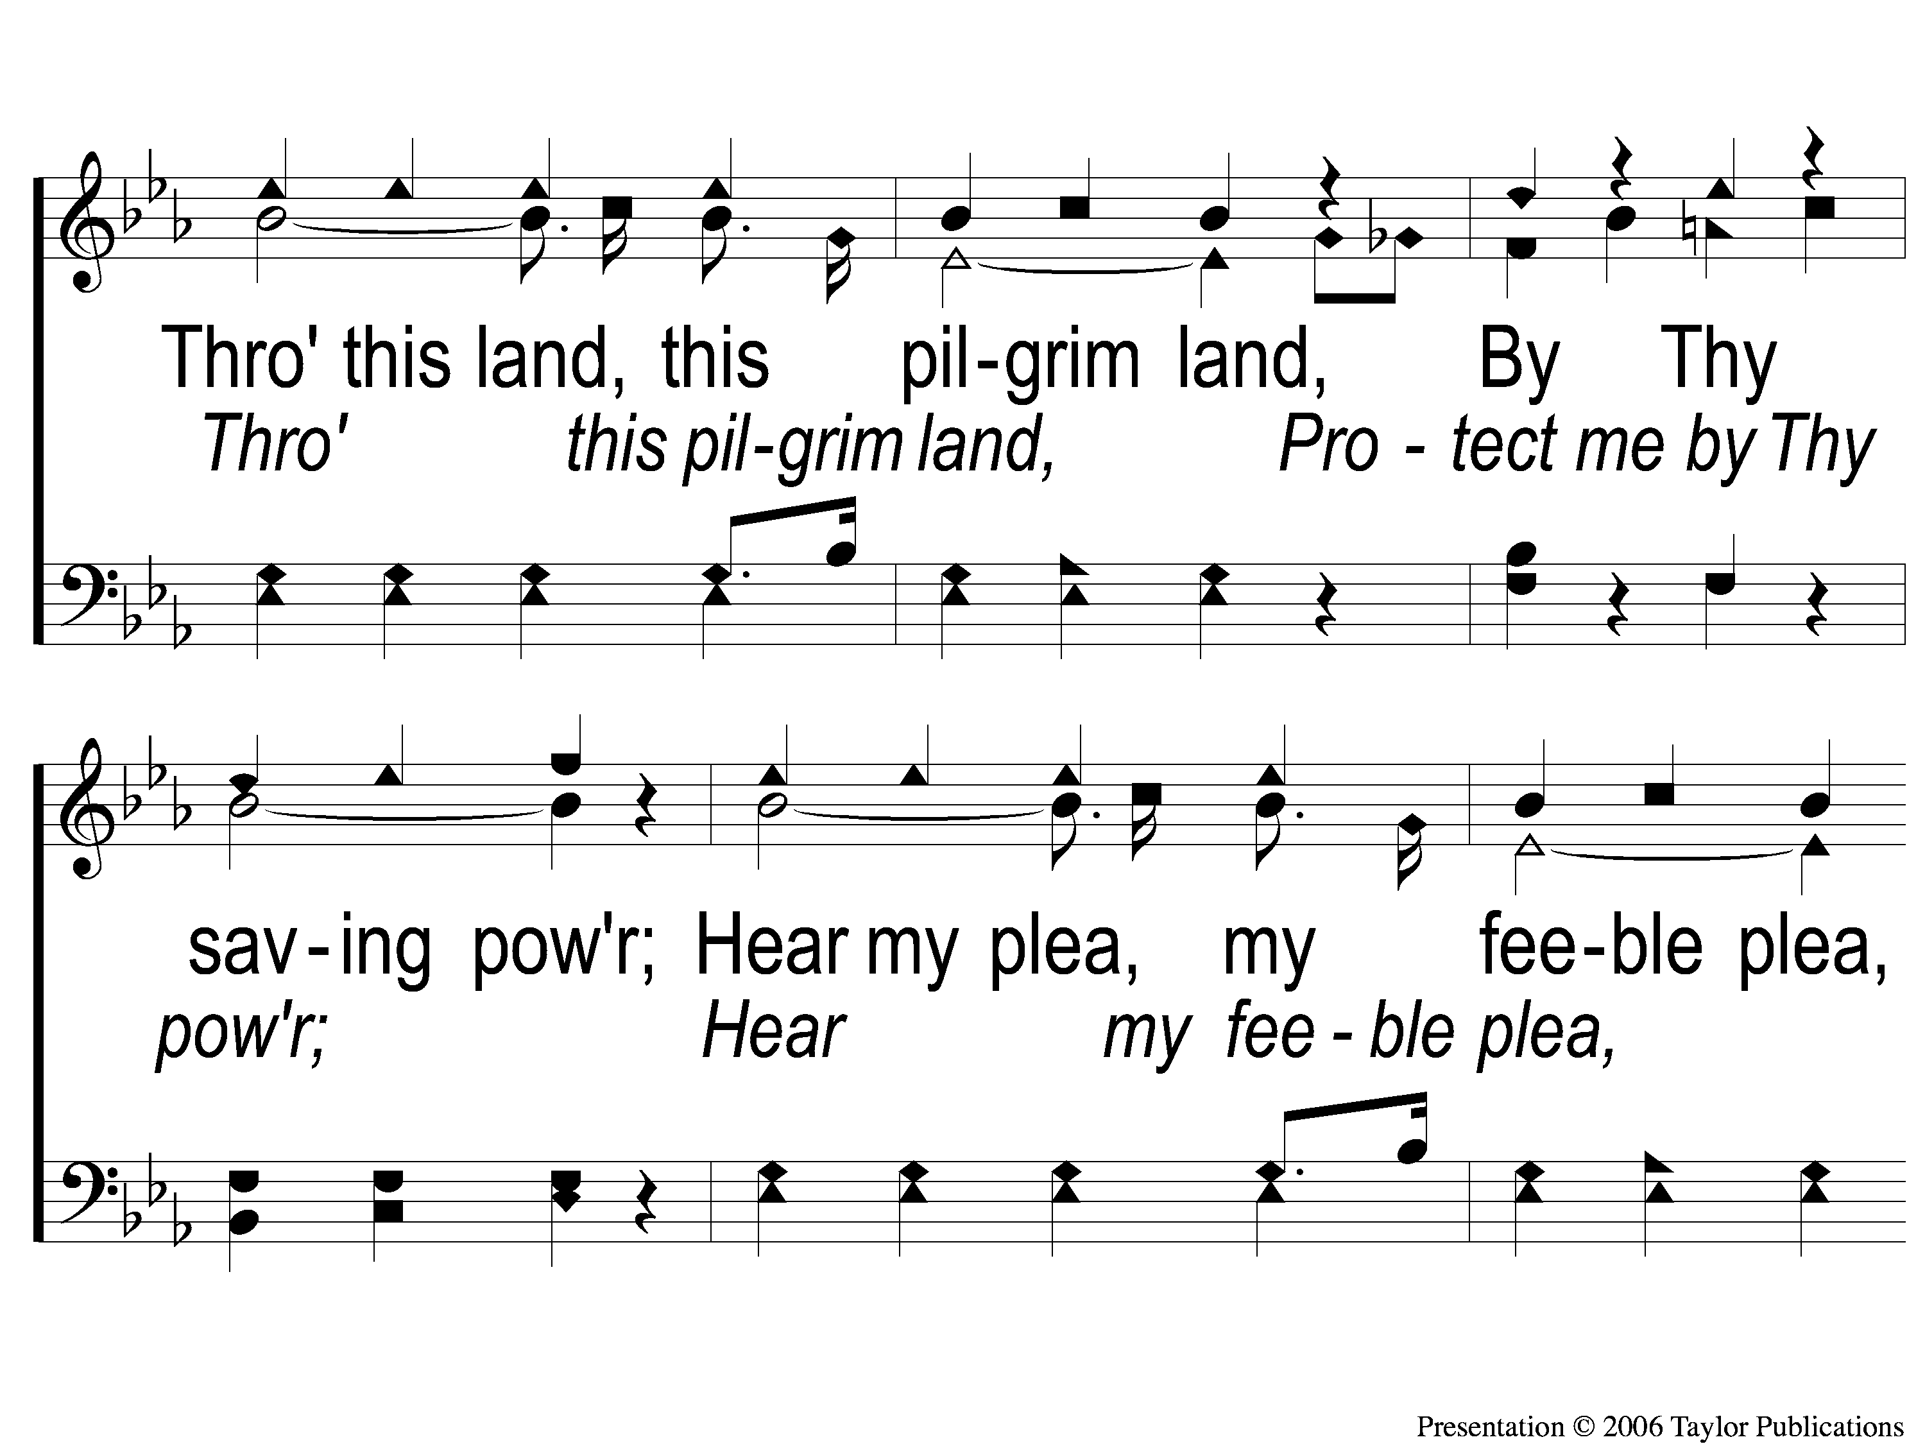
C-2 Jesus Hold My Hand
Jesus, Hold My Hand
412

Slide 37
C-3 Jesus Hold My Hand
Jesus, Hold My Hand
412

Slide 38
2-1 Jesus Hold My Hand
Jesus, Hold My Hand
412

Slide 39
2-2 Jesus Hold My Hand
Jesus, Hold My Hand
412

Slide 40
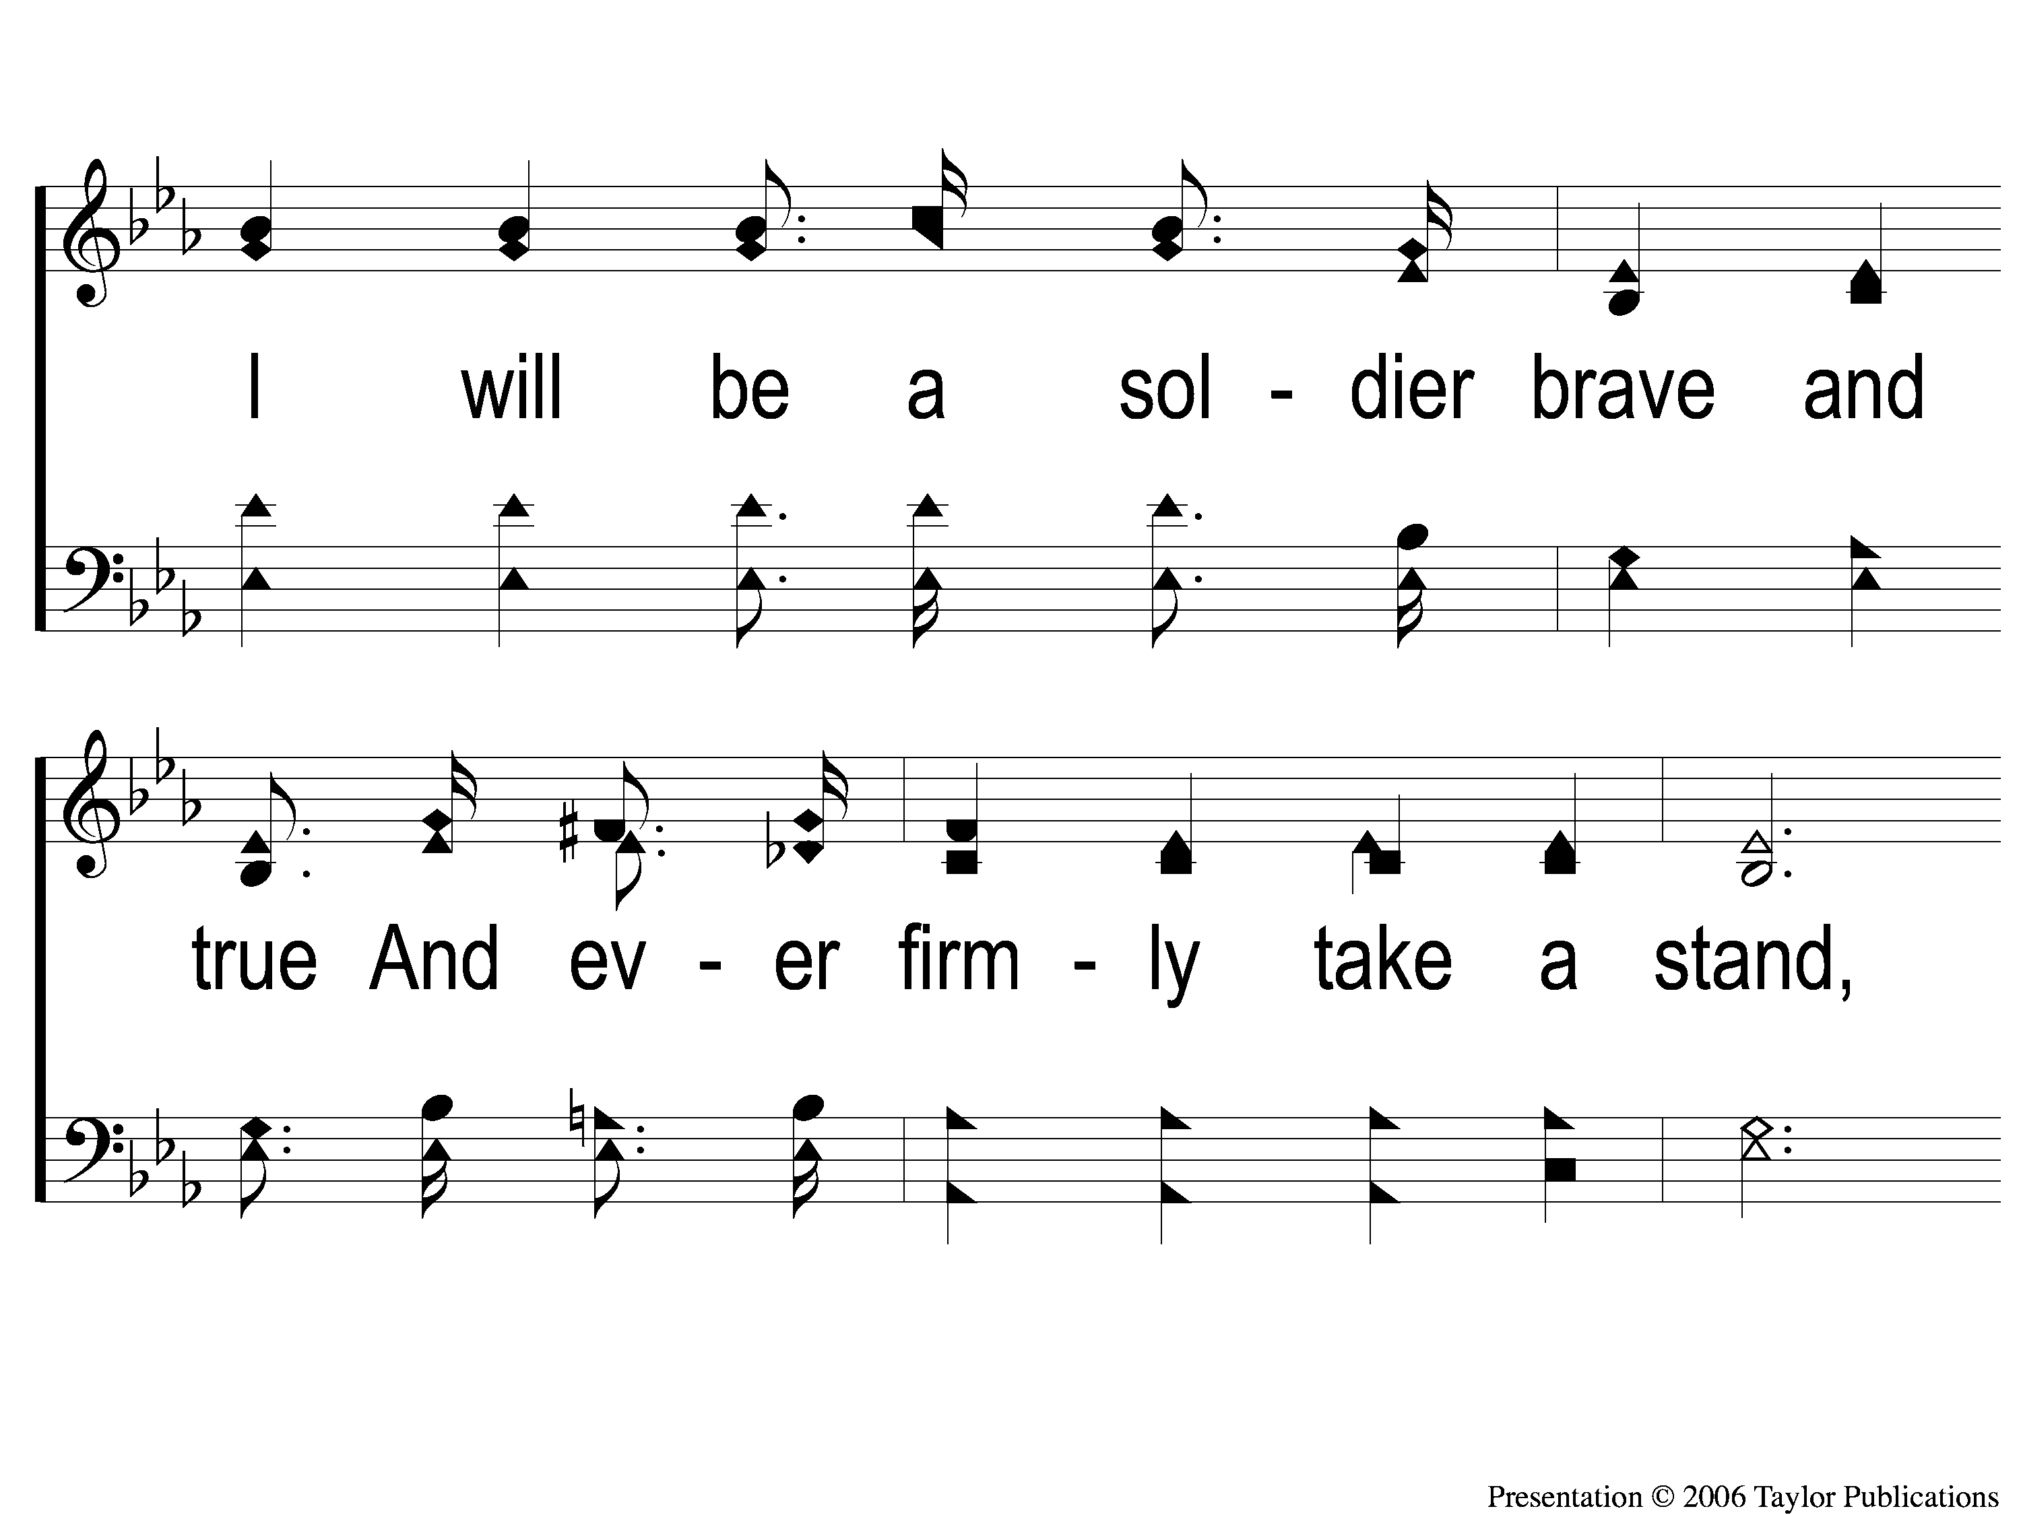
2-3 Jesus Hold My Hand
Jesus, Hold My Hand
412

Slide 41
2-4 Jesus Hold My Hand
Jesus, Hold My Hand
412

Slide 42
C-1 Jesus Hold My Hand
Jesus, Hold My Hand
412

Slide 43
C-2 Jesus Hold My Hand
Jesus, Hold My Hand
412

Slide 44
C-3 Jesus Hold My Hand
Jesus, Hold My Hand
412

Slide 45
SCRIPTURE READING:
Matthew 16:15-16

Slide 46
Who is Jesus?
According to matthew

Slide 47
The Messiah (ch. 1)
The “king of the jews” (ch. 2, 27)
The “son of god” (ch. 3, 17)
The Conqueror (Ch. 4)
The great physician (ch. 8-9)

Slide 48
The Messiah (ch. 1)
The “king of the jews” (ch. 2, 27)
The “son of god” (ch. 3, 17)
The Conqueror (Ch. 4)
The great physician (ch. 8-9)
The head of the church (ch. 16)

Slide 49
The setting
Chapter 16

Slide 50
CHAPTER 14 & 15
HEROD: “John the baptizer”
Multitudes: breadgiver & miracle worker
Pharisees: tradition-breaker
Disciples: son of god

Slide 51
Chapter 16
Discovering the danger of FALSE TEACHINGS (v. 1-12)
Discovering the king & his kingdom (v. 13-20)
Discovering the cost of discipleship (v. 21-28)

Slide 52
“When Jesus came into the region of Caesarea Philippi, He asked His disciples, saying,
‘Who do men say that I, the Son of Man, am?”
– Matt. 16:13

Slide 53
Multitudes say:
Elijah
John
jeremiah

Slide 54
Multitudes say:
Elijah – Miracles
John – message
Jeremiah – ministry

Slide 55
He said to them, “But who do you say that I am?”
– Matt. 16:15

Slide 56
Matthew 16:17-18

Slide 57
Who is Jesus?
The head of his church

Slide 58
Because jesus is the head of the church…
…the church belongs to CHRIST

Slide 59
The church belongs to christ
The purchaser
Eph. 1:7, 14
Acts 20:28
1 Pet. 2:9

Slide 60
The church belongs to christ
The patron
Matt. 16:18

Slide 61
The church belongs to christ
The patron
“church of god” – Acts 20:28, 1 Cor. 1:2, 10:32, 11:22, 15:9, 2 Cor. 1:1

Slide 62
The church belongs to christ
The patron
“church of god” – Acts 20:28, 1 Cor. 1:2, 10:32, 11:22, 15:9, 2 Cor. 1:1
“Church of the Firstborn” - Heb. 12:23

Slide 63
The church belongs to christ
The patron
“church of god” – Acts 20:28, 1 Cor. 1:2, 10:32, 11:22, 15:9, 2 Cor. 1:1
“Church of the Firstborn” - Heb. 12:23
“churches of Christ” - Rom. 16:16, Gal. 1:22, 1 Thess. 2:14

Slide 64
The church belongs to christ
The patron
The church = His body
Eph. 1:23, 2:16, 3:6, 5:23
1 cor. 12:12-13

Slide 65
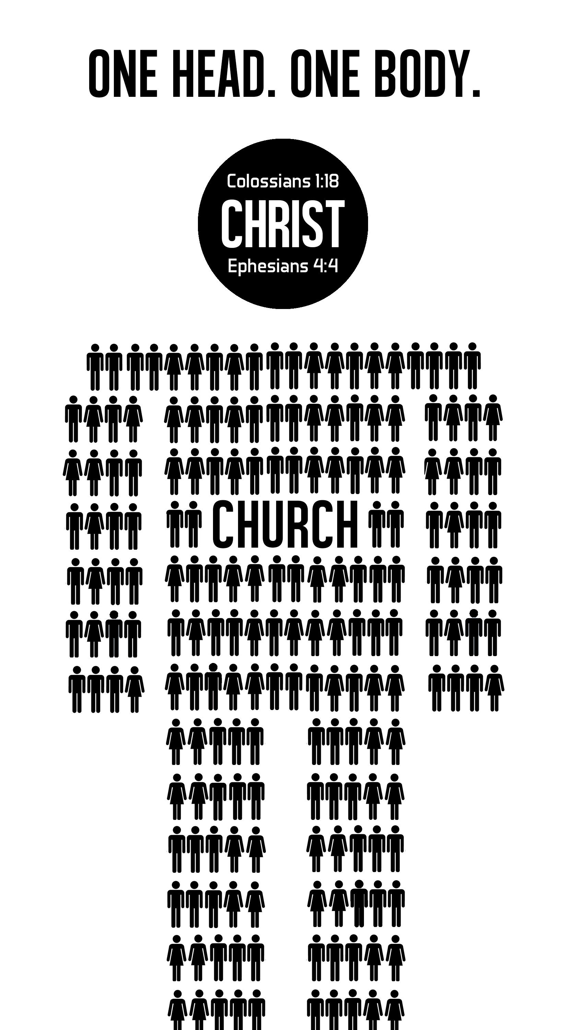
https://pin.it/3SsnoHh

Slide 66
Because jesus is the head of the church…
…the church belongs to CHRIST
…the church is governed by CHRIST

Slide 67
The church IS GOVERNED BY christ
The monarch
1 Pet. 2:9, Rev. 1:6, 5:10, 19:16
1 tim. 6:15

Slide 68
The church IS GOVERNED BY christ
The monarch
Matt. 16:19
“…and whatever you bind on earth will be bound in heaven, and whatever you loose on earth will be loosed in heaven.”

Slide 69
The church IS GOVERNED BY christ
The monarch
Matt. 16:19
“…and whatever you bind on earth will be, having been bound in heaven, and whatever you loose on earth will be, having been loosed…”

Slide 70
The church IS GOVERNED BY christ
The monarch
Human morality – Matt. 22:37-40, jn. 14:15

Slide 71
The church IS GOVERNED BY christ
The monarch
Human morality – Matt. 22:37-40, jn. 14:15
Human salvation – acts 4:12

Slide 72
The church IS GOVERNED BY christ
The monarch
Church organization – acts 14:23, titus 1:5

Slide 73
The church IS GOVERNED BY christ
The monarch
Church organization – acts 14:23, titus 1:5
Church worship – acts 20:7, 1 cor. 16:1-2, rev. 1:9-10

Slide 74
Because jesus is the head of the church…
…the church belongs to CHRIST
…the church is governed by CHRIST
…the church stands because of CHRIST

Slide 75
The church stand because of christ
The foundational cornerstone
Matt. 16:18

Slide 76
The church stand because of christ
The foundational cornerstone
Inevitably built
Acts 4:11, eph. 2:20, 1 pet. 2:4-6
1 cor. 3:11

Slide 77
The church stand because of christ
The firstborn from the dead
Matt. 16:18 – “the gates of hades”

Slide 78
The church stand because of christ
The firstborn from the dead
Matt. 16:18 – “the gates of hades”
“hades” = realm of the dead

Slide 79
The church stand because of christ
The firstborn from the dead
inevitably stands
Col. 1:18, rev. 1:5, 18, 21:4
Jn. 11:26

Slide 80
are you PART OF HIS CHURCH?

Slide 81
Invitation SONG:
Trust & obey
#915

Slide 82
1-1 Trust and Obey
Trust and Obey
915

Slide 83
1-2 Trust and Obey
Trust and Obey
915

Slide 84
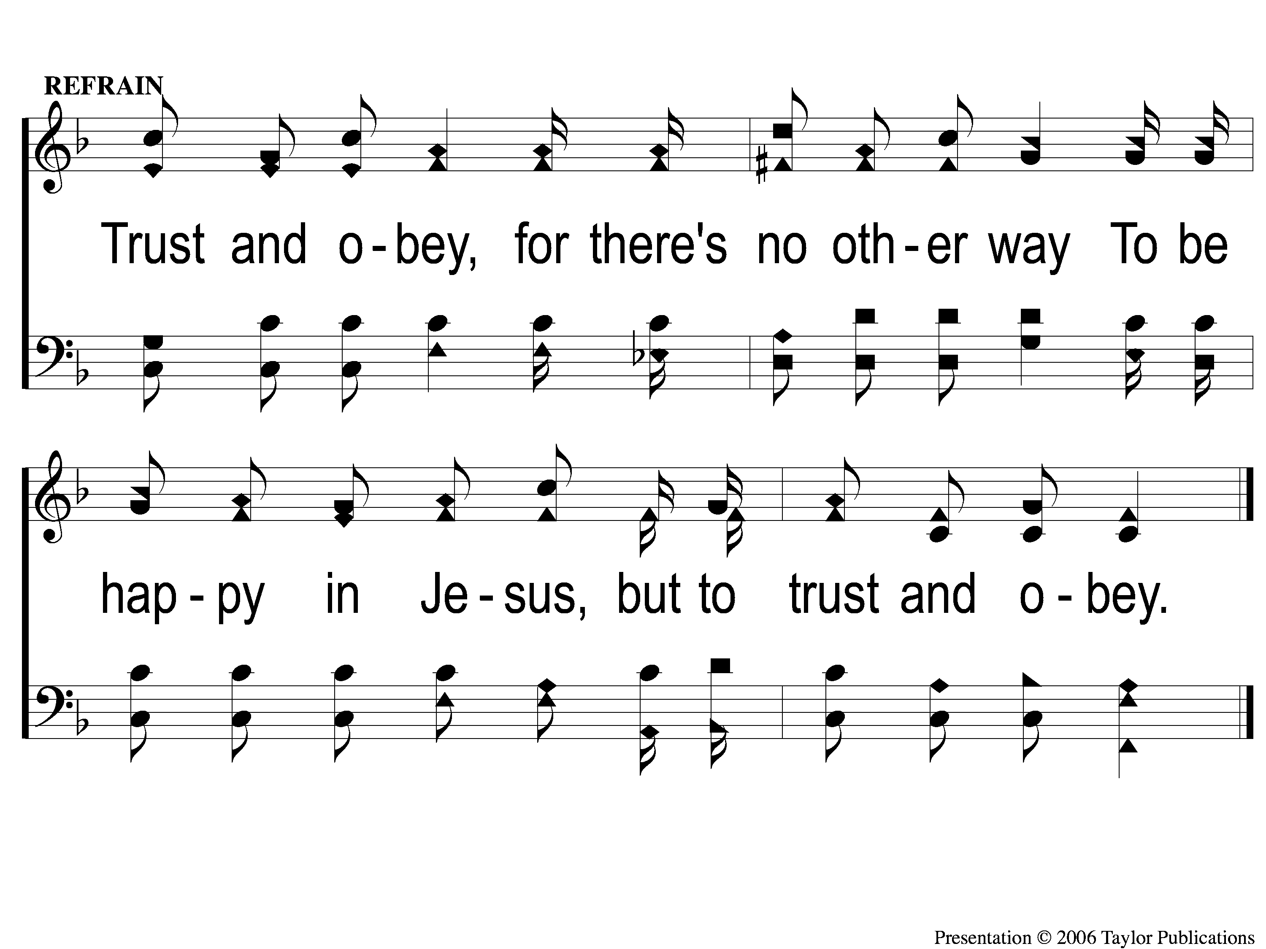
C Trust and Obey
Trust and Obey
915

Slide 85
2-1 Trust and Obey
Trust and Obey
915

Slide 86
2-2 Trust and Obey
Trust and Obey
915

Slide 87
C Trust and Obey
Trust and Obey
915

Slide 88
3-1 Trust and Obey
Trust and Obey
915

Slide 89
3-2 Trust and Obey
Trust and Obey
915

Slide 90
C Trust and Obey
Trust and Obey
915

Slide 91
4-1 Trust and Obey
Trust and Obey
915

Slide 92
4-2 Trust and Obey
Trust and Obey
915

Slide 93
C Trust and Obey
Trust and Obey
915

Slide 94
5-1 Trust and Obey
Trust and Obey
915

Slide 95
5-2 Trust and Obey
Trust and Obey
915

Slide 96
C Trust and Obey
Trust and Obey
915

Slide 97
OUR CONTRIBUTION
“The point is this: whoever sows sparingly will also reap sparingly, and whoever sows bountifully will also reap bountifully. Each one must give as he has decided in his heart, not reluctantly or under compulsion, for God loves a cheerful giver. And God is able to make all grace abound to you, so that having all sufficiency in all things at all times, you may abound in every good work.” – 2 Cor. 9:6-8

Slide 98
SONG:
Alas! And did my savior bleed?
#324

Slide 99
1-1 Alas and Did My Savior Bleed
Alas! And Did My Savior Bleed?
324

Slide 100
1-2 Alas and Did My Savior Bleed
Alas! And Did My Savior Bleed?
324

Slide 101
C-1 Alas and Did My Savior Bleed
Alas! And Did My Savior Bleed?
324

Slide 102
C-2 Alas and Did My Savior Bleed
Alas! And Did My Savior Bleed?
324

Slide 103
3-1 Alas and Did My Savior Bleed
Alas! And Did My Savior Bleed?
324

Slide 104
3-2 Alas and Did My Savior Bleed
Alas! And Did My Savior Bleed?
324

Slide 105
C-1 Alas and Did My Savior Bleed
Alas! And Did My Savior Bleed?
324

Slide 106
C-2 Alas and Did My Savior Bleed
Alas! And Did My Savior Bleed?
324

Slide 107
4-1 Alas and Did My Savior Bleed
Alas! And Did My Savior Bleed?
324

Slide 108
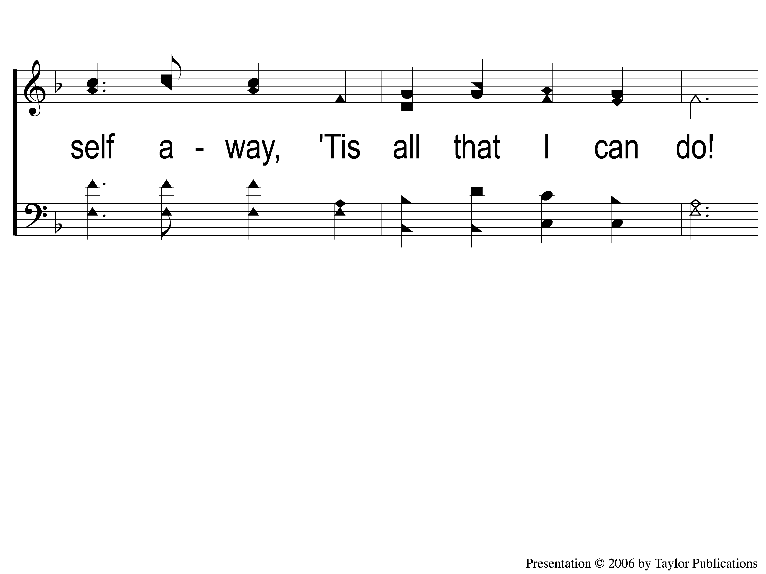
4-2 Alas and Did My Savior Bleed
Alas! And Did My Savior Bleed?
324

Slide 109
C-1 Alas and Did My Savior Bleed
Alas! And Did My Savior Bleed?
324

Slide 110
C-2 Alas and Did My Savior Bleed
Alas! And Did My Savior Bleed?
324

Slide 111
THE UNLEAVENED BREAD
Romans 5:18-19
“Therefore, as through one man’s offense judgment came to all men, resulting in condemnation, even so through one Man’s righteous act the free gift came to all men, resulting in justification of life. 19 For as by one man’s disobedience many were made sinners, so also by one Man’s obedience many will be made righteous.”

Slide 112
THE FRUIT OF THE VINE
Romans 5:9-11
“Since, therefore, we have now been justified by his blood, much more shall we be saved by him from the wrath of God. For if while we were enemies we were reconciled to God by the death of his Son, much more, now that we are reconciled, shall we be saved by his life. More than that, we also rejoice in God through our Lord Jesus Christ, through whom we have now received reconciliation.”

Slide 113
closing PRAYER

Slide 114
SONG:
On Jordan’s stormy banks
#886

Slide 115
1-1 On Jordan’s Stormy Banks
On Jordan’s Stormy Banks
886

Slide 116
1-2 On Jordan’s Stormy Banks
On Jordan’s Stormy Banks
886

Slide 117
C-1 On Jordan’s Stormy Banks
On Jordan’s Stormy Banks
886

Slide 118
C-2 On Jordan’s Stormy Banks
On Jordan’s Stormy Banks
886

Slide 119
4-1 On Jordan’s Stormy Banks
On Jordan’s Stormy Banks
886

Slide 120
4-2 On Jordan’s Stormy Banks
On Jordan’s Stormy Banks
886

Slide 121
C-1 On Jordan’s Stormy Banks
On Jordan’s Stormy Banks
886

Slide 122
C-2 On Jordan’s Stormy Banks
On Jordan’s Stormy Banks
886

Slide 123
Today
WORSHIP @ 6:00
Tuesday
Biblically equipped class @ 6 PM

