Slide 1
1 Servant Song
Servant Song
694

Slide 2
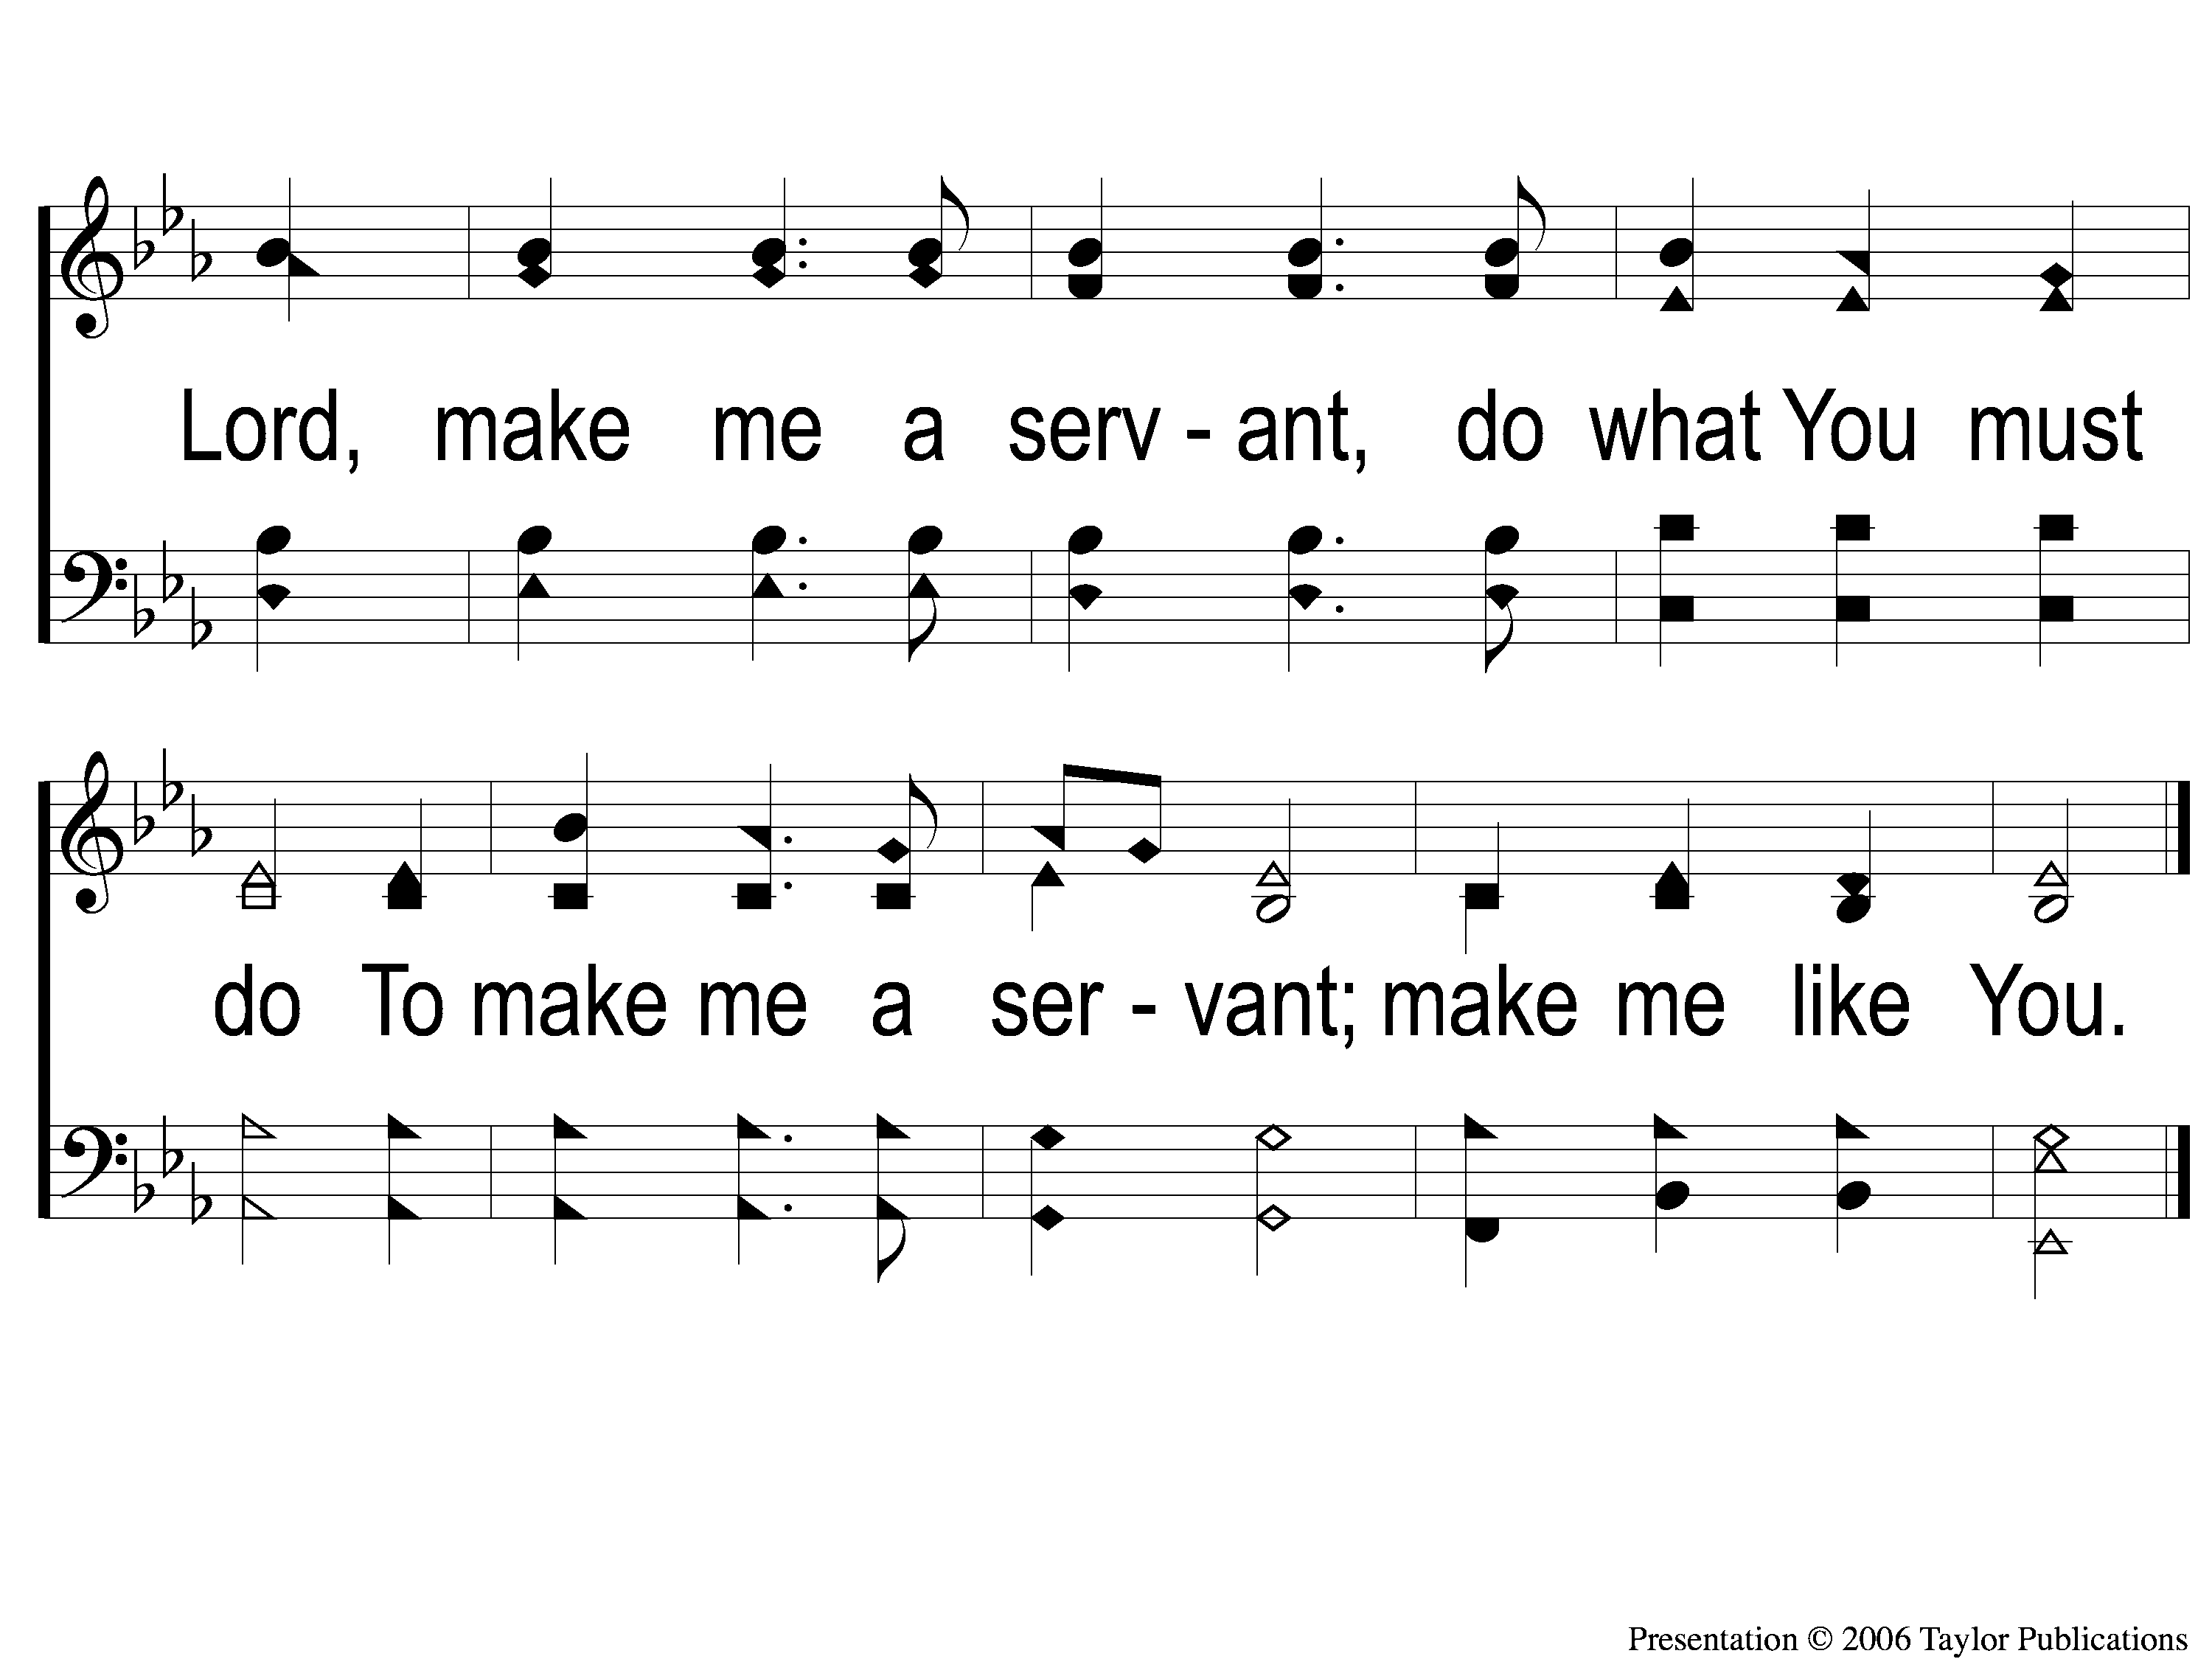
2 Servant Song
Servant Song
694

Slide 3
1 Servant Song
Servant Song
694

Slide 4
2 Servant Song
Servant Song
694

Slide 5
WELCOME
To the Wheeler church of Christ

Slide 6
SONG:
There is a redeemer
#287

Slide 7
1 There is a Redeemer
There Is A Redeemer
287

Slide 8
2 There is a Redeemer
There Is A Redeemer
287

Slide 9
3 There is a Redeemer
There Is A Redeemer
287

Slide 10
c There is a Redeemer
There Is A Redeemer
287

Slide 11
SONG:
Let the beauty of jesus
#722

Slide 12
1-1 Let the Beauty of Jesus be Seen in Me
Let the Beauty of Jesus
722

Slide 13
1-2 Let the Beauty of Jesus be Seen in Me
Let the Beauty of Jesus
722

Slide 14
2-1 Let the Beauty of Jesus be Seen in Me
Let the Beauty of Jesus
722

Slide 15
2-2 Let the Beauty of Jesus be Seen in Me
Let the Beauty of Jesus
722

Slide 16
3-1 Let the Beauty of Jesus be Seen in Me
Let the Beauty of Jesus
722

Slide 17
3-2 Let the Beauty of Jesus be Seen in Me
Let the Beauty of Jesus
722

Slide 18
OPENING PRAYER

Slide 19
SONG:
There stands a rock
#558

Slide 20
1-1 There Stands A Rock
There Stands A Rock
558

Slide 21
1-2 There’s Stands A Rock
There Stands A Rock
558

Slide 22
C-1 There’s Stands A Rock
There Stands A Rock
558

Slide 23
C-2 There’s Stands A Rock
There Stands A Rock
558

Slide 24
2-1 There’s Stands A Rock
There Stands A Rock
558

Slide 25
2-2 There’s Stands A Rock
There Stands A Rock
558

Slide 26
C-1 There’s Stands A Rock
There Stands A Rock
558

Slide 27
C-2 There’s Stands A Rock
There Stands A Rock
558

Slide 28
3-1 There’s Stands A Rock
There Stands A Rock
558

Slide 29
3-2 There’s Stands A Rock
There Stands A Rock
558

Slide 30
C-1 There’s Stands A Rock
There Stands A Rock
558

Slide 31
C-2 There’s Stands A Rock
There Stands A Rock
558

Slide 32
SONG:
Living by faith
#560

Slide 33
1-1 Living by Faith
Living by Faith
560
© 2005 ePraise Hymn Presentation by Taylor Publications

Slide 34
1-2 Living by Faith
Living by Faith
560
© 2005 ePraise Hymn Presentation by Taylor Publications

Slide 35
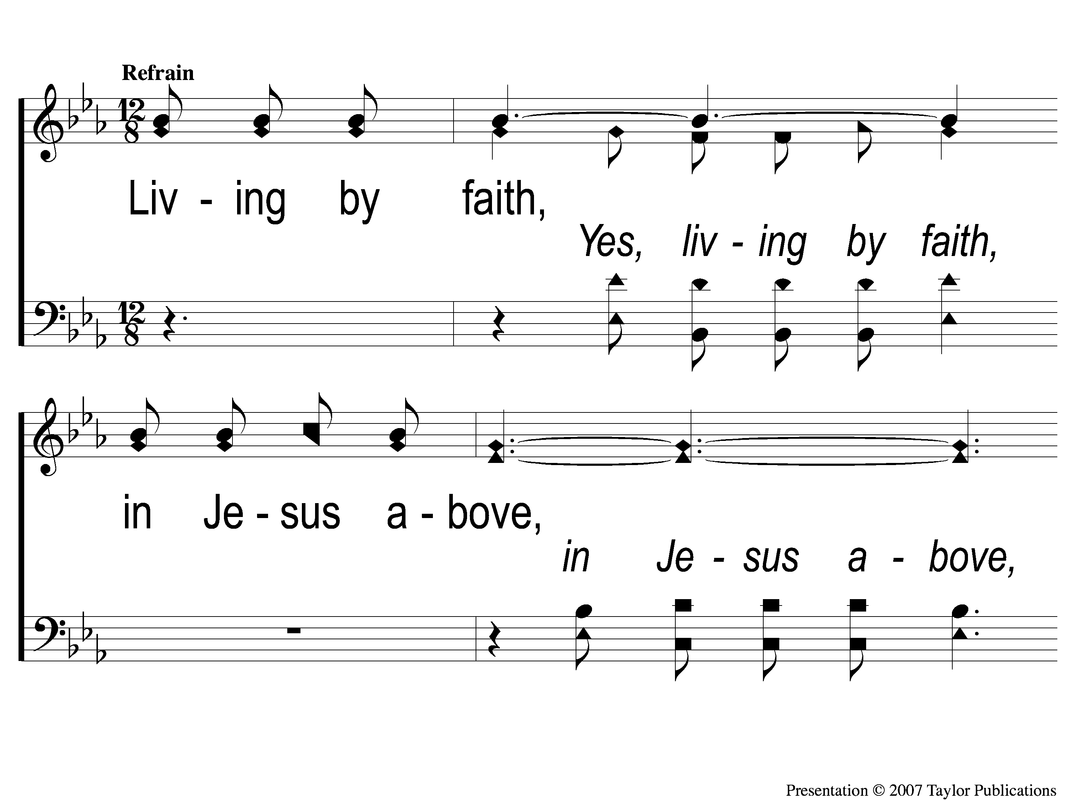
C-1 Living by Faith
Living by Faith
560
© 2005 ePraise Hymn Presentation by Taylor Publications

Slide 36
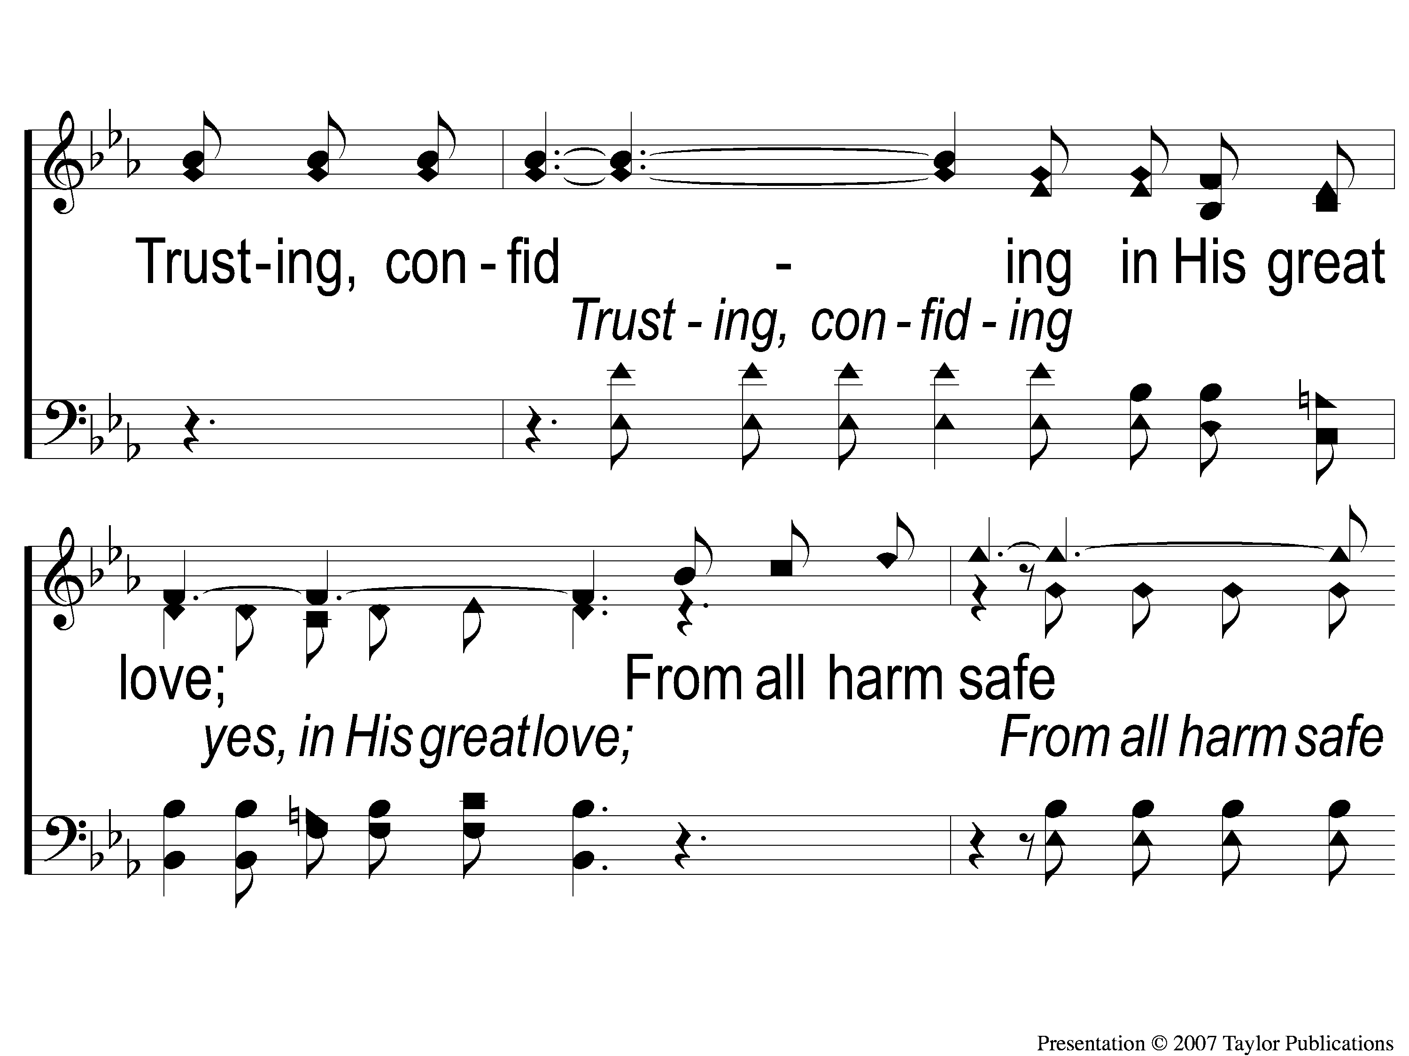
C-2 Living by Faith
Living by Faith
560
© 2005 ePraise Hymn Presentation by Taylor Publications

Slide 37
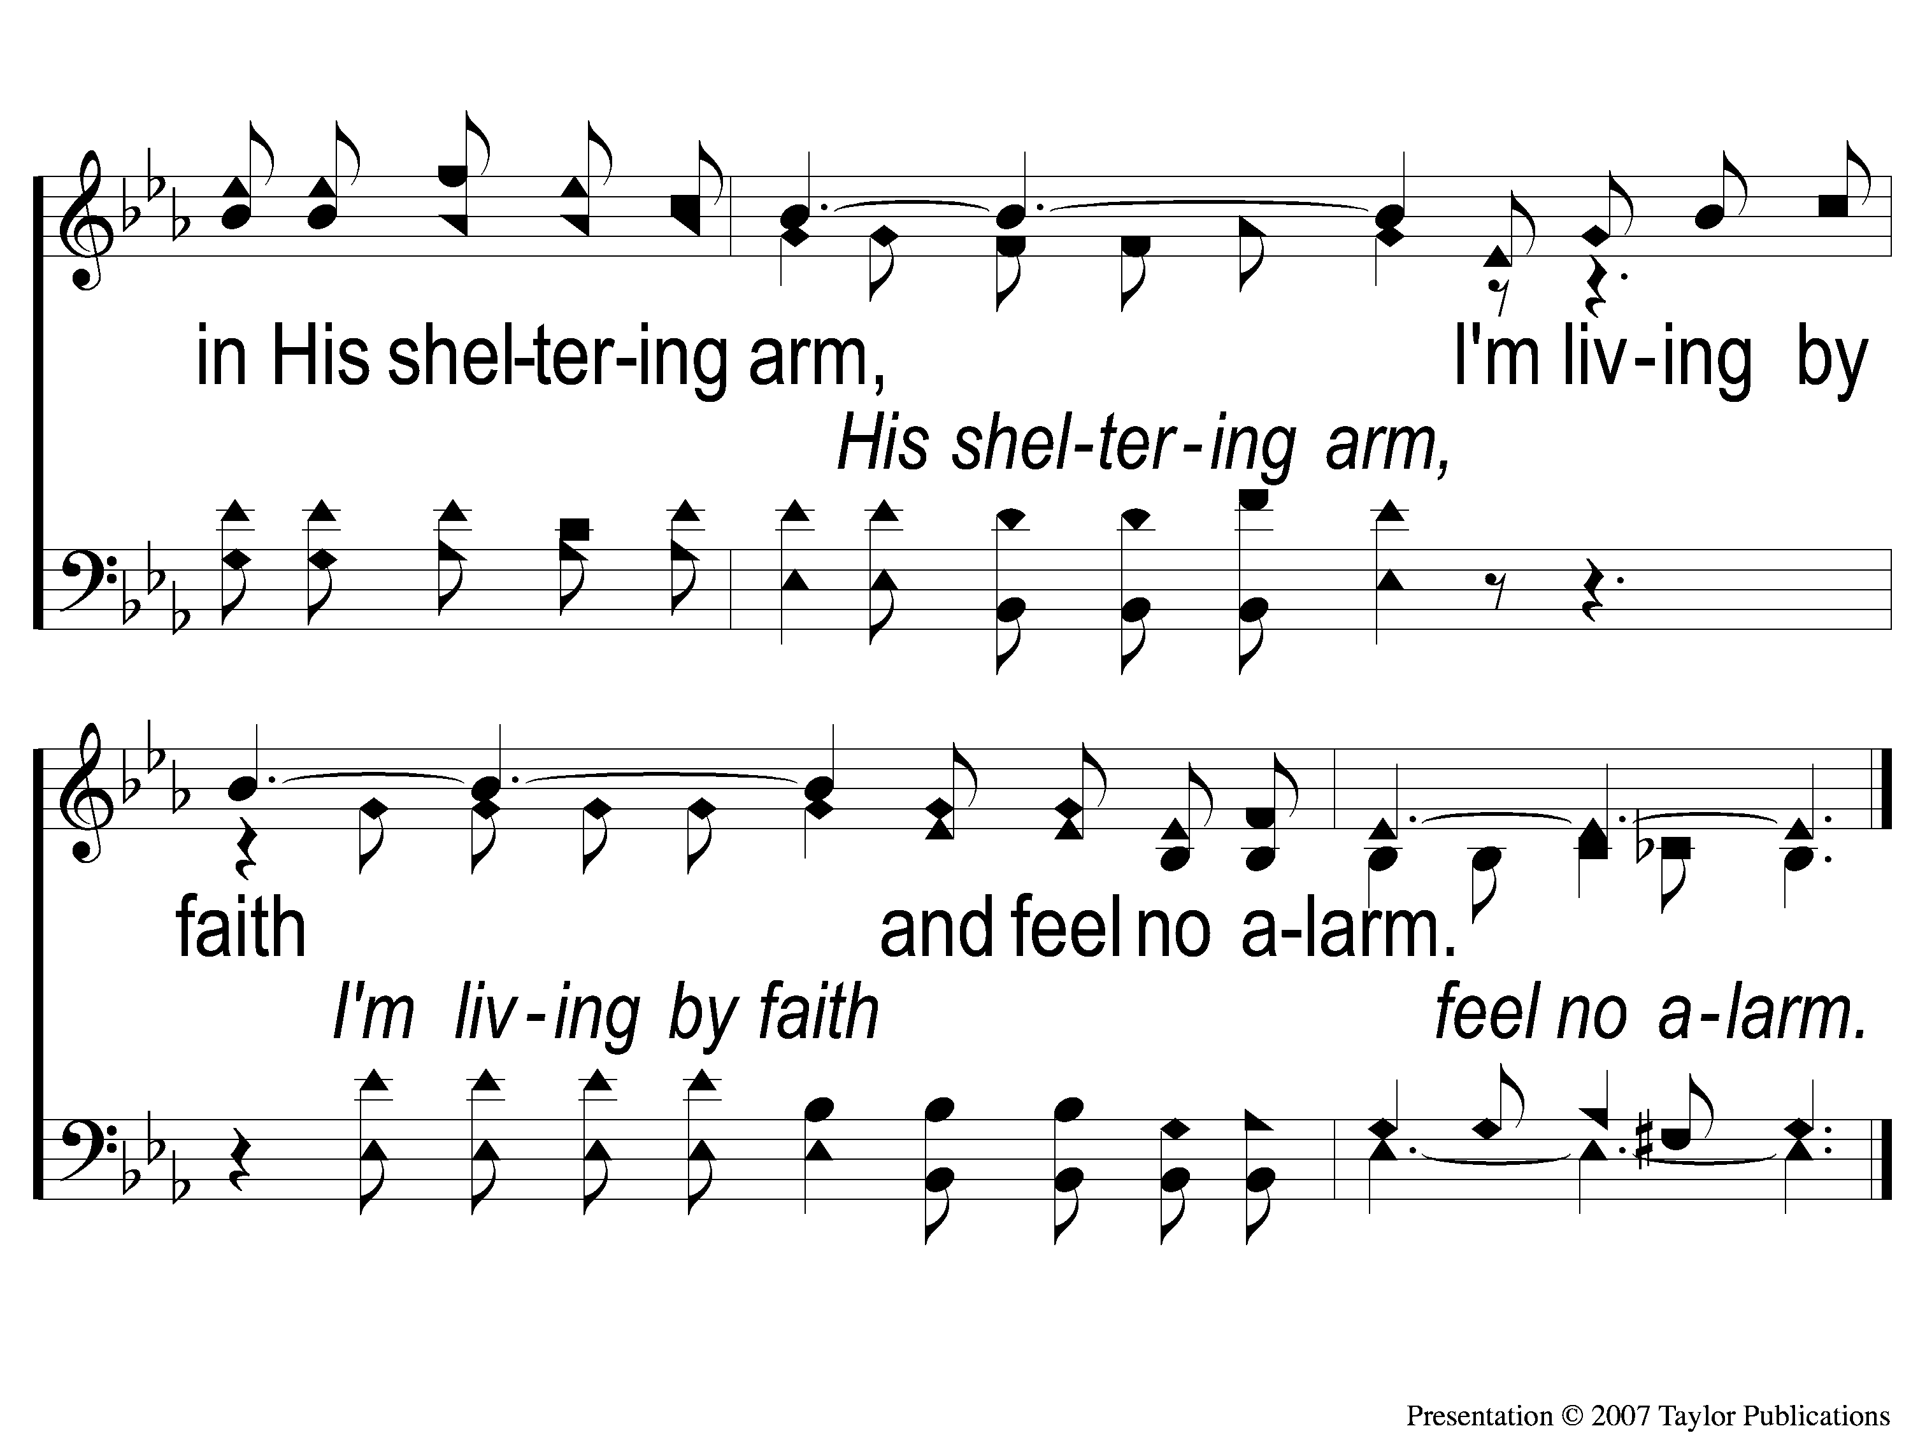
C-3 Living by Faith
Living by Faith
560
© 2005 ePraise Hymn Presentation by Taylor Publications

Slide 38
2-1 Living by Faith
Living by Faith
560
© 2005 ePraise Hymn Presentation by Taylor Publications

Slide 39
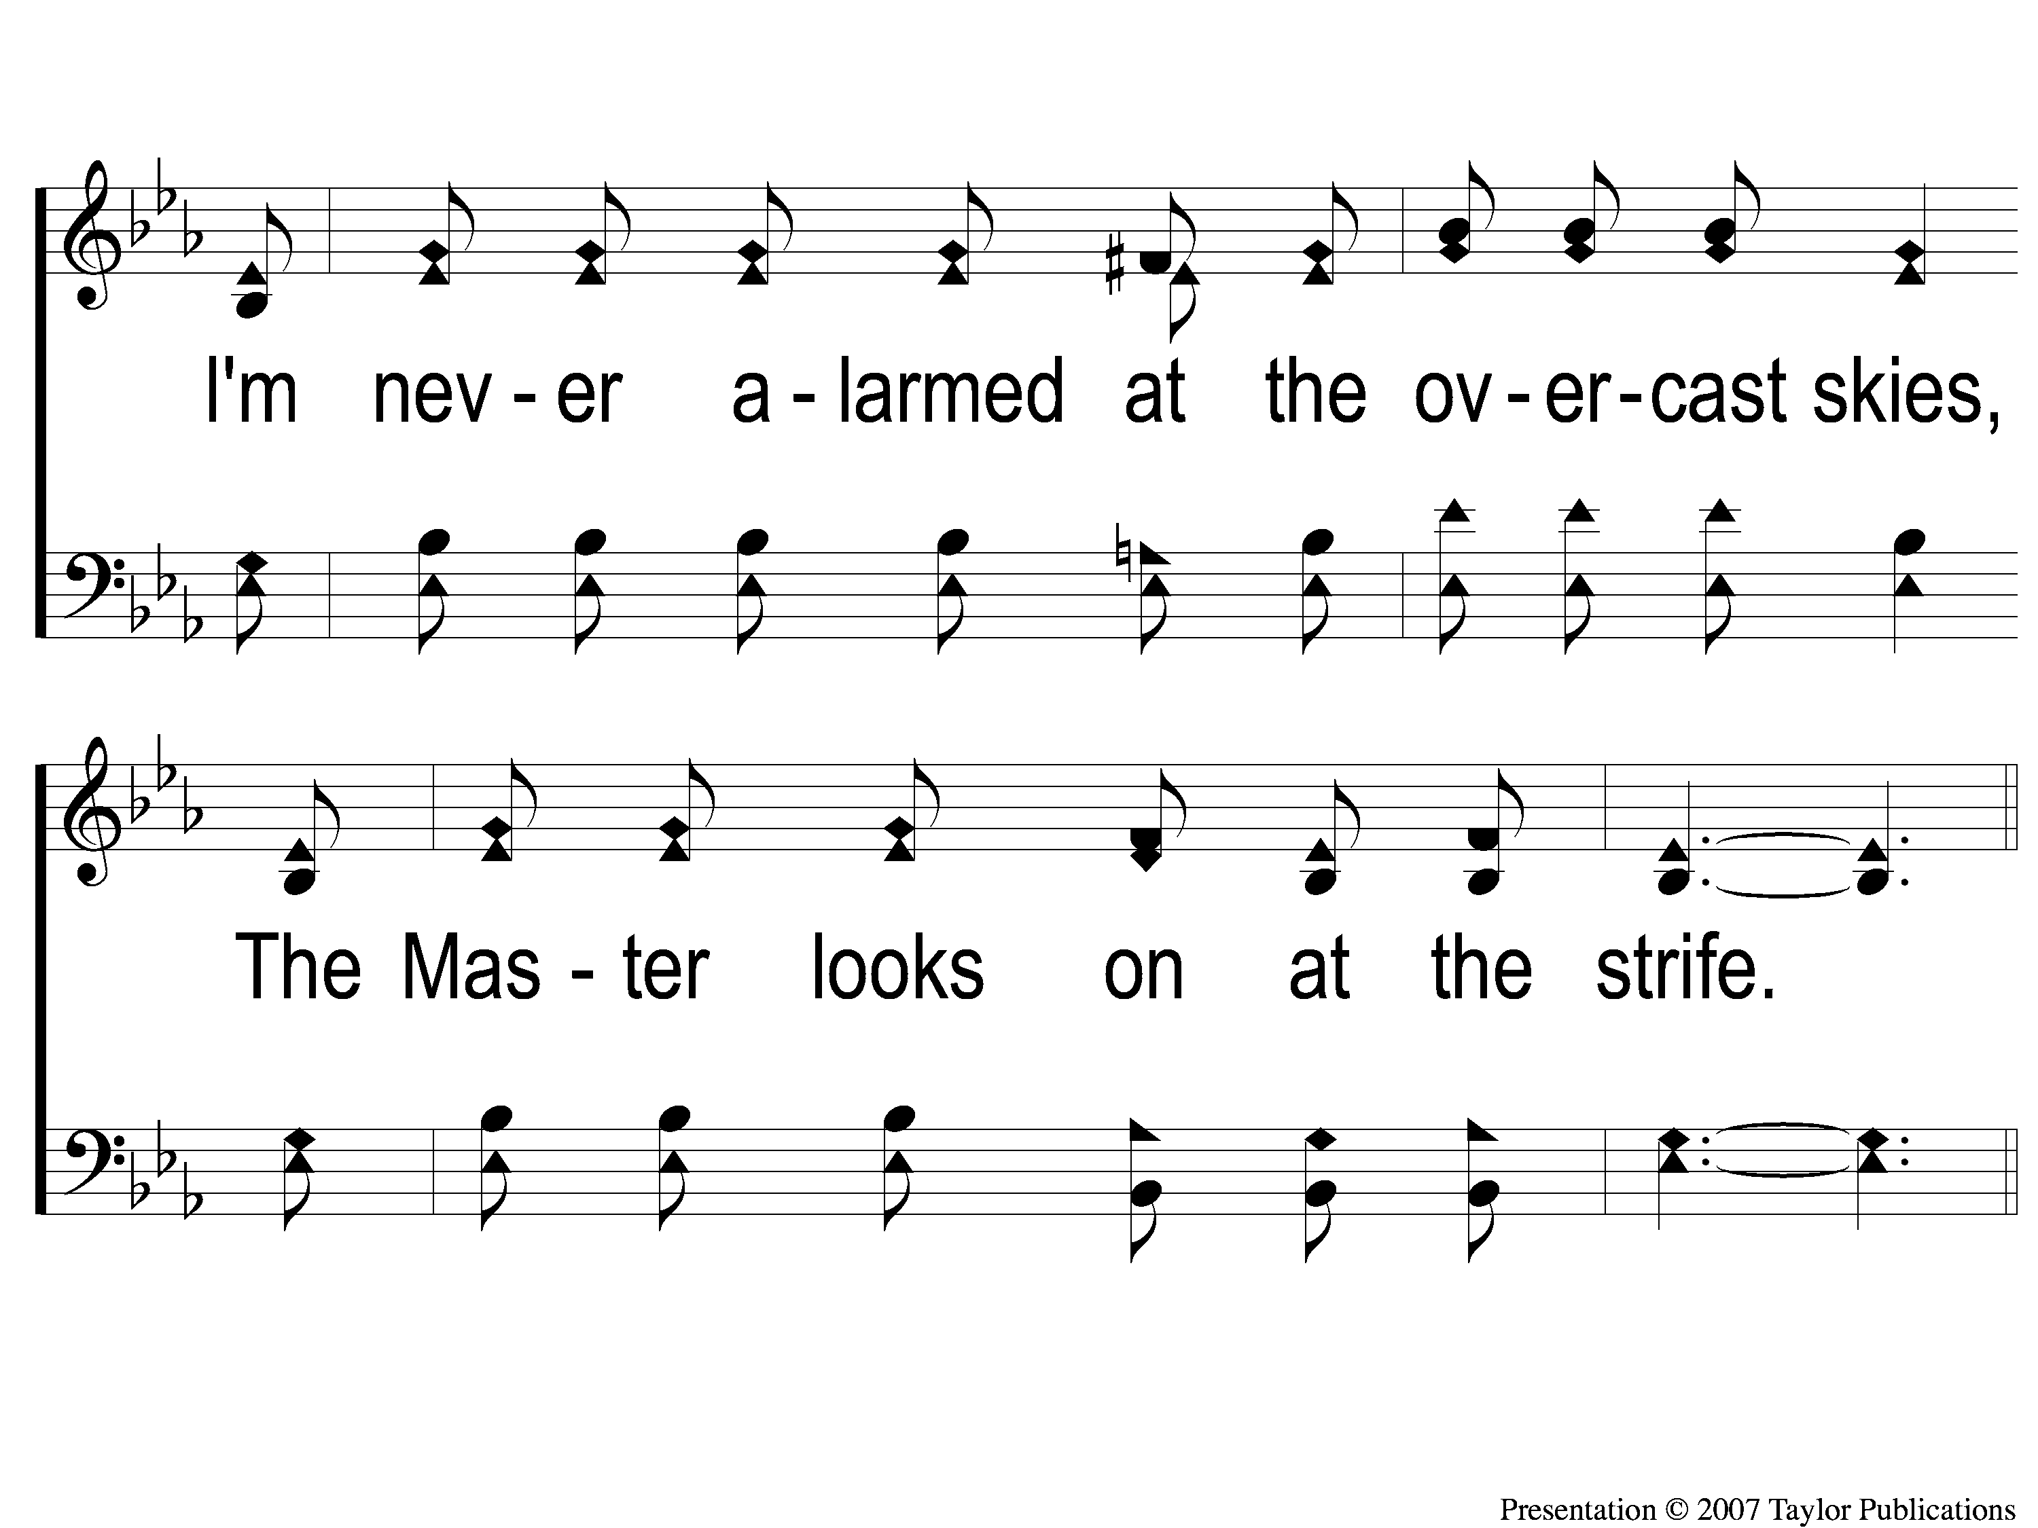
2-2 Living by Faith
Living by Faith
560
© 2005 ePraise Hymn Presentation by Taylor Publications
© 2005 ePraise Hymn Presentation by Taylor Publications

Slide 40
C-1 Living by Faith
Living by Faith
560
© 2005 ePraise Hymn Presentation by Taylor Publications

Slide 41
C-2 Living by Faith
Living by Faith
560
© 2005 ePraise Hymn Presentation by Taylor Publications

Slide 42
C-3 Living by Faith
Living by Faith
560
© 2005 ePraise Hymn Presentation by Taylor Publications

Slide 43
3-1 Living by Faith
Living by Faith
560
© 2005 ePraise Hymn Presentation by Taylor Publications

Slide 44
3-2 Living by Faith
Living by Faith
560
© 2005 ePraise Hymn Presentation by Taylor Publications

Slide 45
C-1 Living by Faith
Living by Faith
560
© 2005 ePraise Hymn Presentation by Taylor Publications

Slide 46
C-2 Living by Faith
Living by Faith
560
© 2005 ePraise Hymn Presentation by Taylor Publications

Slide 47
C-3 Living by Faith
Living by Faith
560
© 2005 ePraise Hymn Presentation by Taylor Publications

Slide 48
SCRIPTURE READING:
Matthew 18:1-5

Slide 49
Who is Jesus?
According to matthew

Slide 50
Who is Jesus?
The good teacher

Slide 51
What did jesus teach?
5 teaching sections:
5-7 – kingdom people
10 – kingdom purpose
13 – kingdom priority
18 – kingdom principles
23-25 – kingdom pending

Slide 52
What did jesus teach?
5 teaching sections:
5-7 – kingdom people
10 – kingdom purpose
13 – kingdom priority
18 – kingdom principles
23-25 – kingdom pending

Slide 53
FAITH
a child-like

Slide 54
FAITH
“Who is the Greatest...?”
a child-like

Slide 55
FAITH
“Who is the Greatest...?”
The Whole Story
Matt. 18:1
Mk. 9:33-37
Lk. 9:46-48
a child-like

Slide 56
FAITH
“Who is the Greatest...?”
1 Cor. 13:11 Principle
“When I was a child, I spoke as a child, I understood as a child, I thought as a child; but when I became a man, I put away childish things.”
a child-like

Slide 57
FAITH
“Who is the Greatest...?”
1 Cor. 13:11 Principle
“When I was a child, I spoke as a child, I understood as a child, I thought as a child; but when I became a man, I put away childish things.”
Children must grow out of some things.
a child-like

Slide 58
FAITH
“Childish Faith”
a child-like

Slide 59
FAITH
“Childish Faith”
Greedy
a child-like

Slide 60
FAITH
“Childish Faith”
Greedy
Envious
a child-like

Slide 61
FAITH
“Childish Faith”
Greedy
Envious
Defiant
a child-like

Slide 62
FAITH
“Childish Faith”
Greedy
Envious
Defiant
Whiny
a child-like

Slide 63
FAITH
“Childish Faith”
Greedy
Envious
Defiant
Whiny
Gullible
a child-like

Slide 64
FAITH
“Childish Faith”
Greedy
Envious
Defiant
Whiny
Gullible
Blunt
a child-like

Slide 65
FAITH
Child-like Faith Is…
a child-like

Slide 66
FAITH
Child-like Faith Is…
“little children…of such is the kingdom of heaven”
Matt. 18:2-3, 19:13-14
a child-like

Slide 67
FAITH
Child-like Faith Is…
Persistent
a child-like

Slide 68
FAITH
Child-like Faith Is…
Persistent
Matt. 7:7-8
Lk. 18:1-8
a child-like

Slide 69
FAITH
Child-like Faith Is…
Persistent
Outspoken
a child-like

Slide 70
FAITH
Child-like Faith Is…
Outspoken
Eph. 4:15
2 Cor. 3:12
1 Thess. 2:2
Acts 4:13, 5:29
a child-like

Slide 71
FAITH
Child-like Faith Is…
Persistent
Outspoken
Eager
a child-like

Slide 72
FAITH
Child-like Faith Is…
Eager
2 Tim. 2:15
2 Cor. 7:11, 9:2
a child-like

Slide 73
FAITH
Child-like Faith Is…
Persistent
Outspoken
Eager
Curious
a child-like

Slide 74
FAITH
Child-like Faith Is…
Curious
Prov. 1:5
Acts 1:6, 8:30-35
a child-like

Slide 75
FAITH
Child-like Faith Is…
Persistent
Outspoken
Eager
Curious
Pure
a child-like

Slide 76
FAITH
Child-like Faith Is…
Pure
Lk. 18:15
Matt. 5:6
Phili. 4:8
a child-like

Slide 77
FAITH
Child-like Faith Is…
Persistent
Outspoken
Eager
Curious
Pure
Humble
a child-like

Slide 78
FAITH
Child-like Faith Is…
Humble
Jn. 13:2-5
Matt. 5:3
a child-like

Slide 79
FAITH?
How is your

Slide 80
Invitation SONG:
I know who holds tomorrow
#463

Slide 81
1-1 I Know Who Holds Tomorrow
I Know Who Holds Tomorrow
463

Slide 82
1-2 I Know Who Holds Tomorrow
I Know Who Holds Tomorrow
463

Slide 83
1-3 I Know Who Holds Tomorrow
I Know Who Holds Tomorrow
463

Slide 84
C-1 I Know Who Holds Tomorrow
I Know Who Holds Tomorrow
463

Slide 85
C-2 I Know Who Holds Tomorrow
I Know Who Holds Tomorrow
463

Slide 86
3-1 I Know Who Holds Tomorrow
I Know Who Holds Tomorrow
463

Slide 87
3-2 I Know Who Holds Tomorrow
I Know Who Holds Tomorrow
463

Slide 88
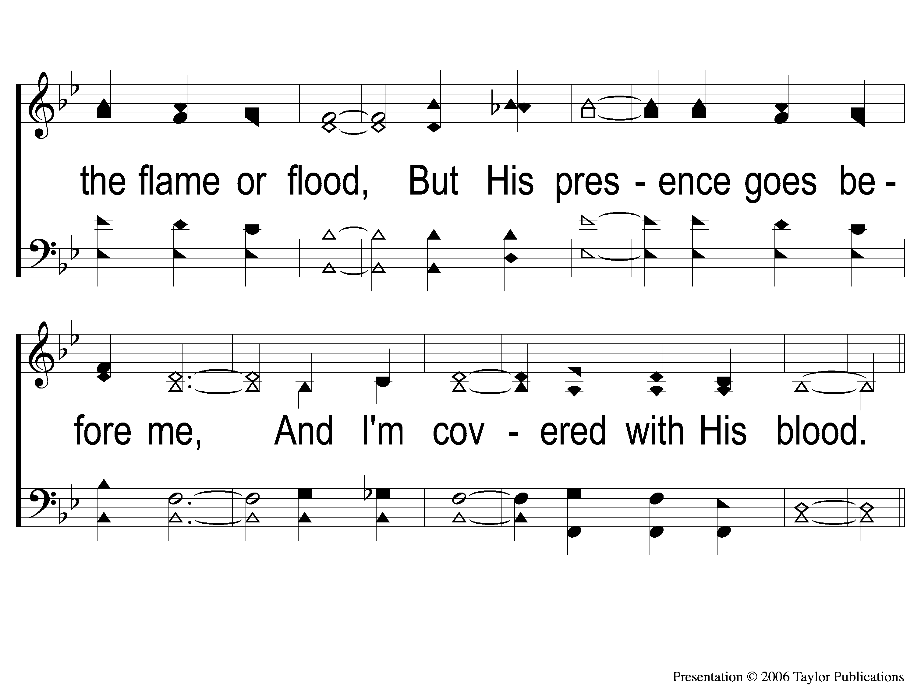
3-3 I Know Who Holds Tomorrow
I Know Who Holds Tomorrow
463

Slide 89
C-1 I Know Who Holds Tomorrow
I Know Who Holds Tomorrow
463

Slide 90
C-2 I Know Who Holds Tomorrow
I Know Who Holds Tomorrow
463

Slide 91
OUR CONTRIBUTION
1 Peter 4:10
“As each one has received a gift, minister it to one another, as good stewards of the manifold grace of God.”

Slide 92
SONG:
Beneath the cross of jesus
#314

Slide 93
1-1 Beneath the Cross of Jesus
Beneath the Cross of Jesus
314

Slide 94
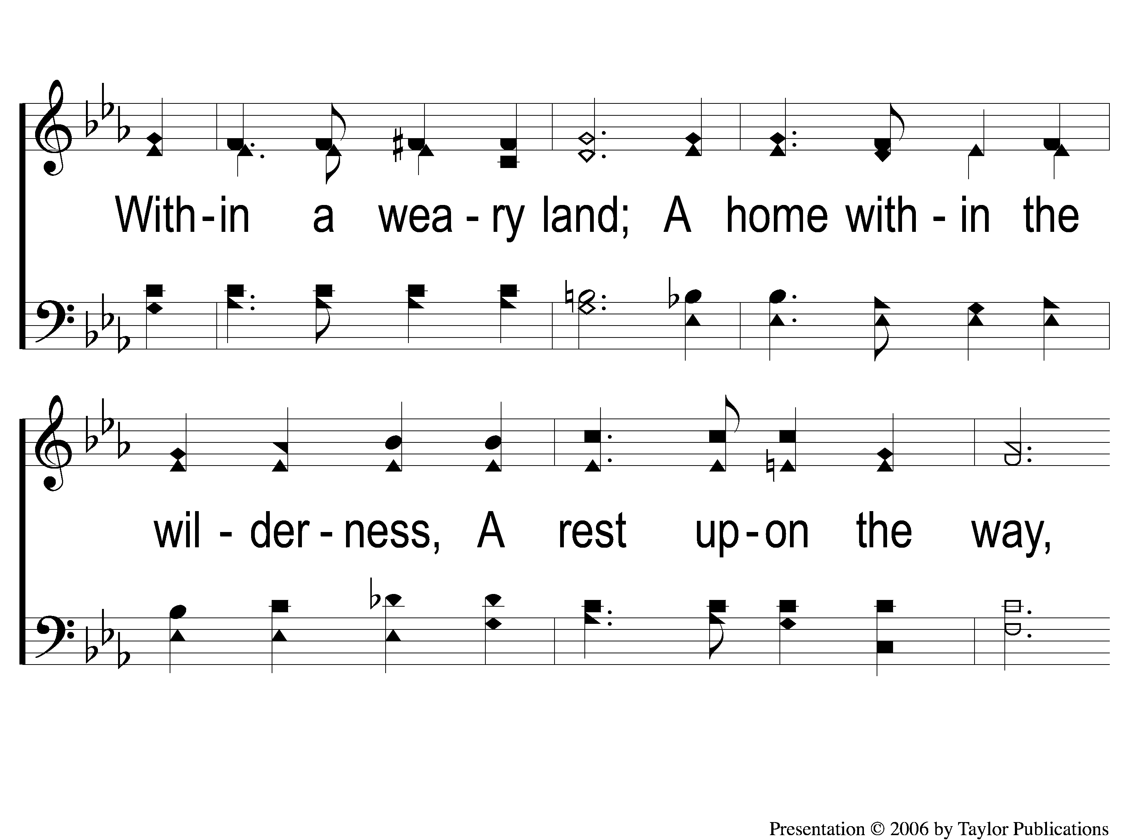
1-2 Beneath the Cross of Jesus
Beneath the Cross of Jesus
314

Slide 95
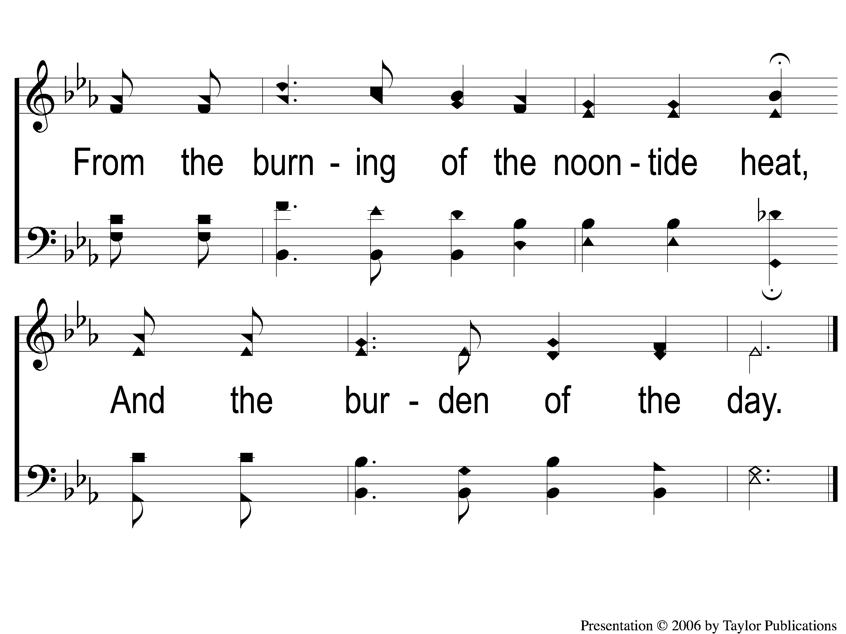
1-3 Beneath the Cross of Jesus
Beneath the Cross of Jesus
314

Slide 96
4-1 Beneath the Cross of Jesus
Beneath the Cross of Jesus
314

Slide 97
4-2 Beneath the Cross of Jesus
Beneath the Cross of Jesus
314

Slide 98
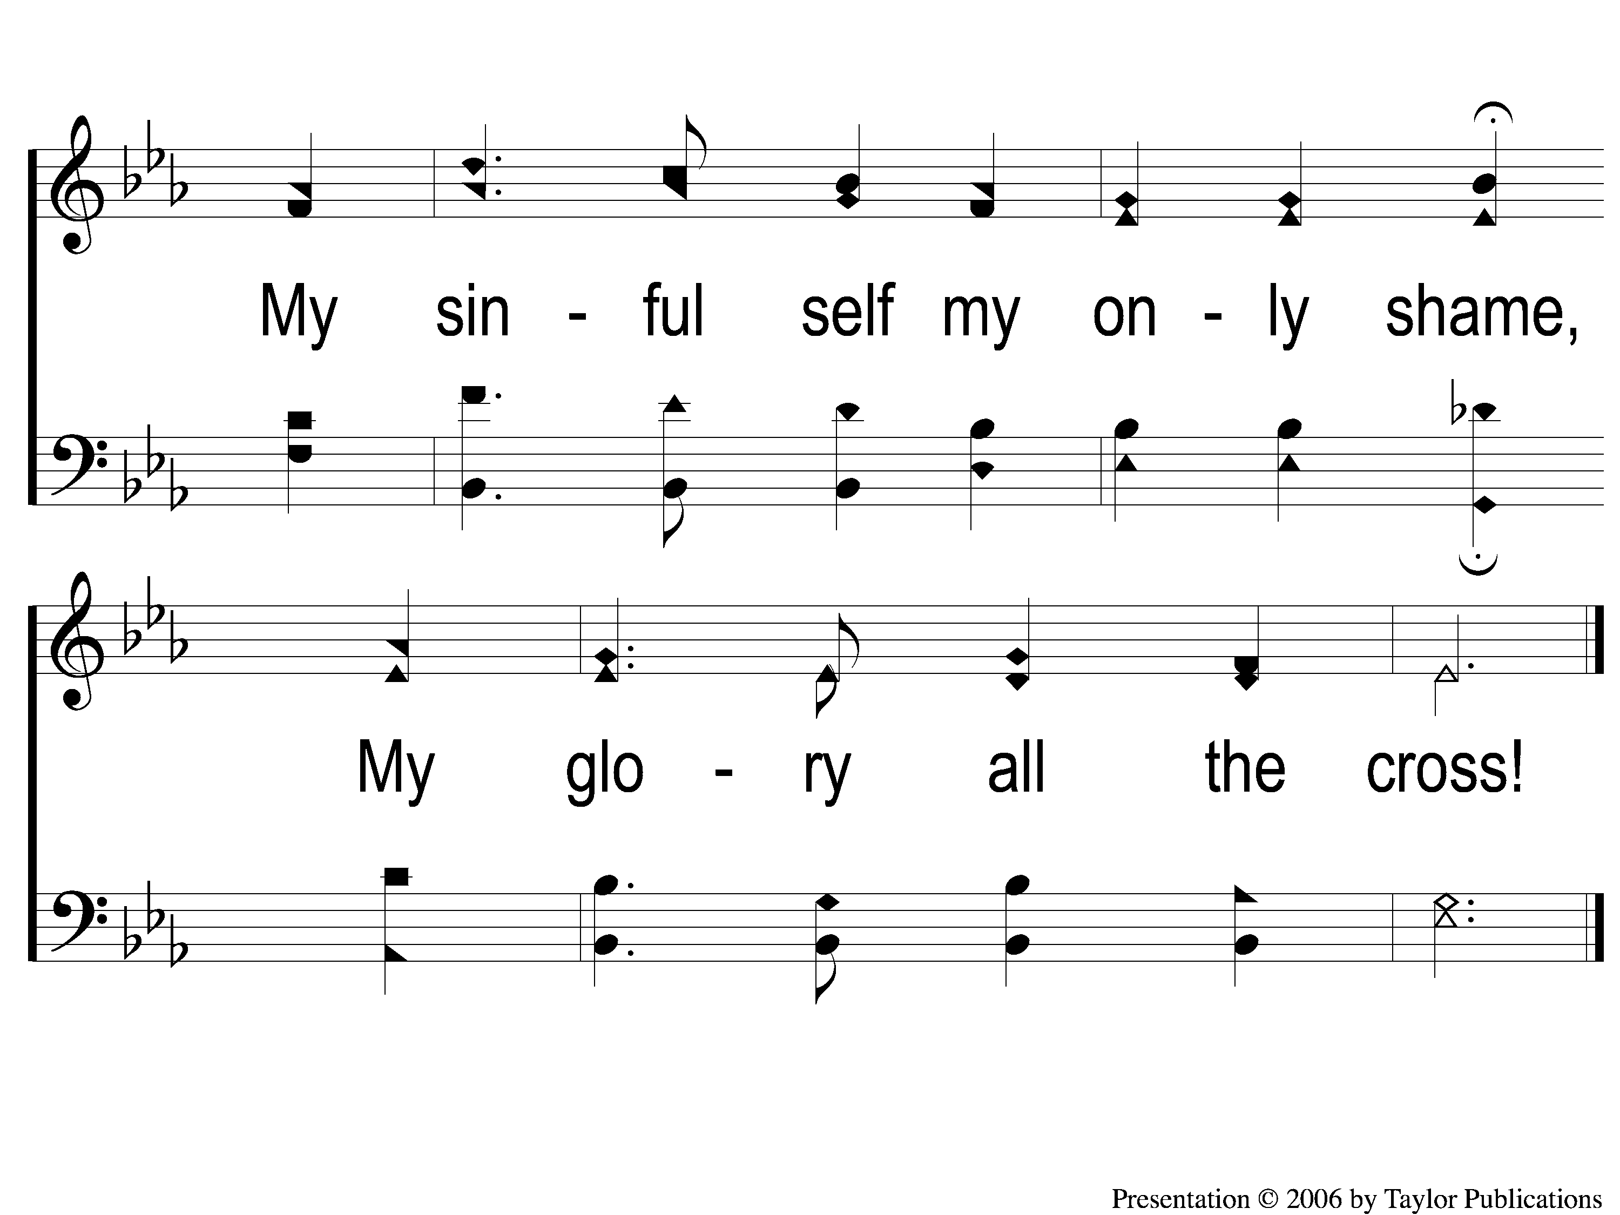
4-3 Beneath the Cross of Jesus
Beneath the Cross of Jesus
314

Slide 99
THE UNLEAVENED BREAD
Ephesians 5:11-13
“Therefore remember that you, once Gentiles in the flesh—who are called Uncircumcision by what is called the Circumcision made in the flesh by hands— that at that time you were without Christ, being aliens from the commonwealth of Israel and strangers from the covenants of promise, having no hope and without God in the world. But now in Christ Jesus you who once were far off have been brought near by the blood of Christ.”

Slide 100
THE FRUIT OF THE VINE
Ephesians 1:7-10
“In Him we have redemption through His blood, the forgiveness of sins, according to the riches of His grace which He made to abound toward us in all wisdom and prudence, having made known to us the mystery of His will, according to His good pleasure which He purposed in Himself, that in the dispensation of the fullness of the times He might gather together in one pall things in Christ, 3both which are in heaven and which are on earth—in Him.”

Slide 101
closing PRAYER

Slide 102
SONG:
When the roll is called up yonder
#852

Slide 103
1-1 When The Roll Is Called Up Yonder
When The Roll Is Called Up Yonder
852

Slide 104
1-2 When The Roll Is Called Up Yonder
When The Roll Is Called Up Yonder
852

Slide 105
1-3 When The Roll Is Called Up Yonder
When The Roll Is Called Up Yonder
852

Slide 106
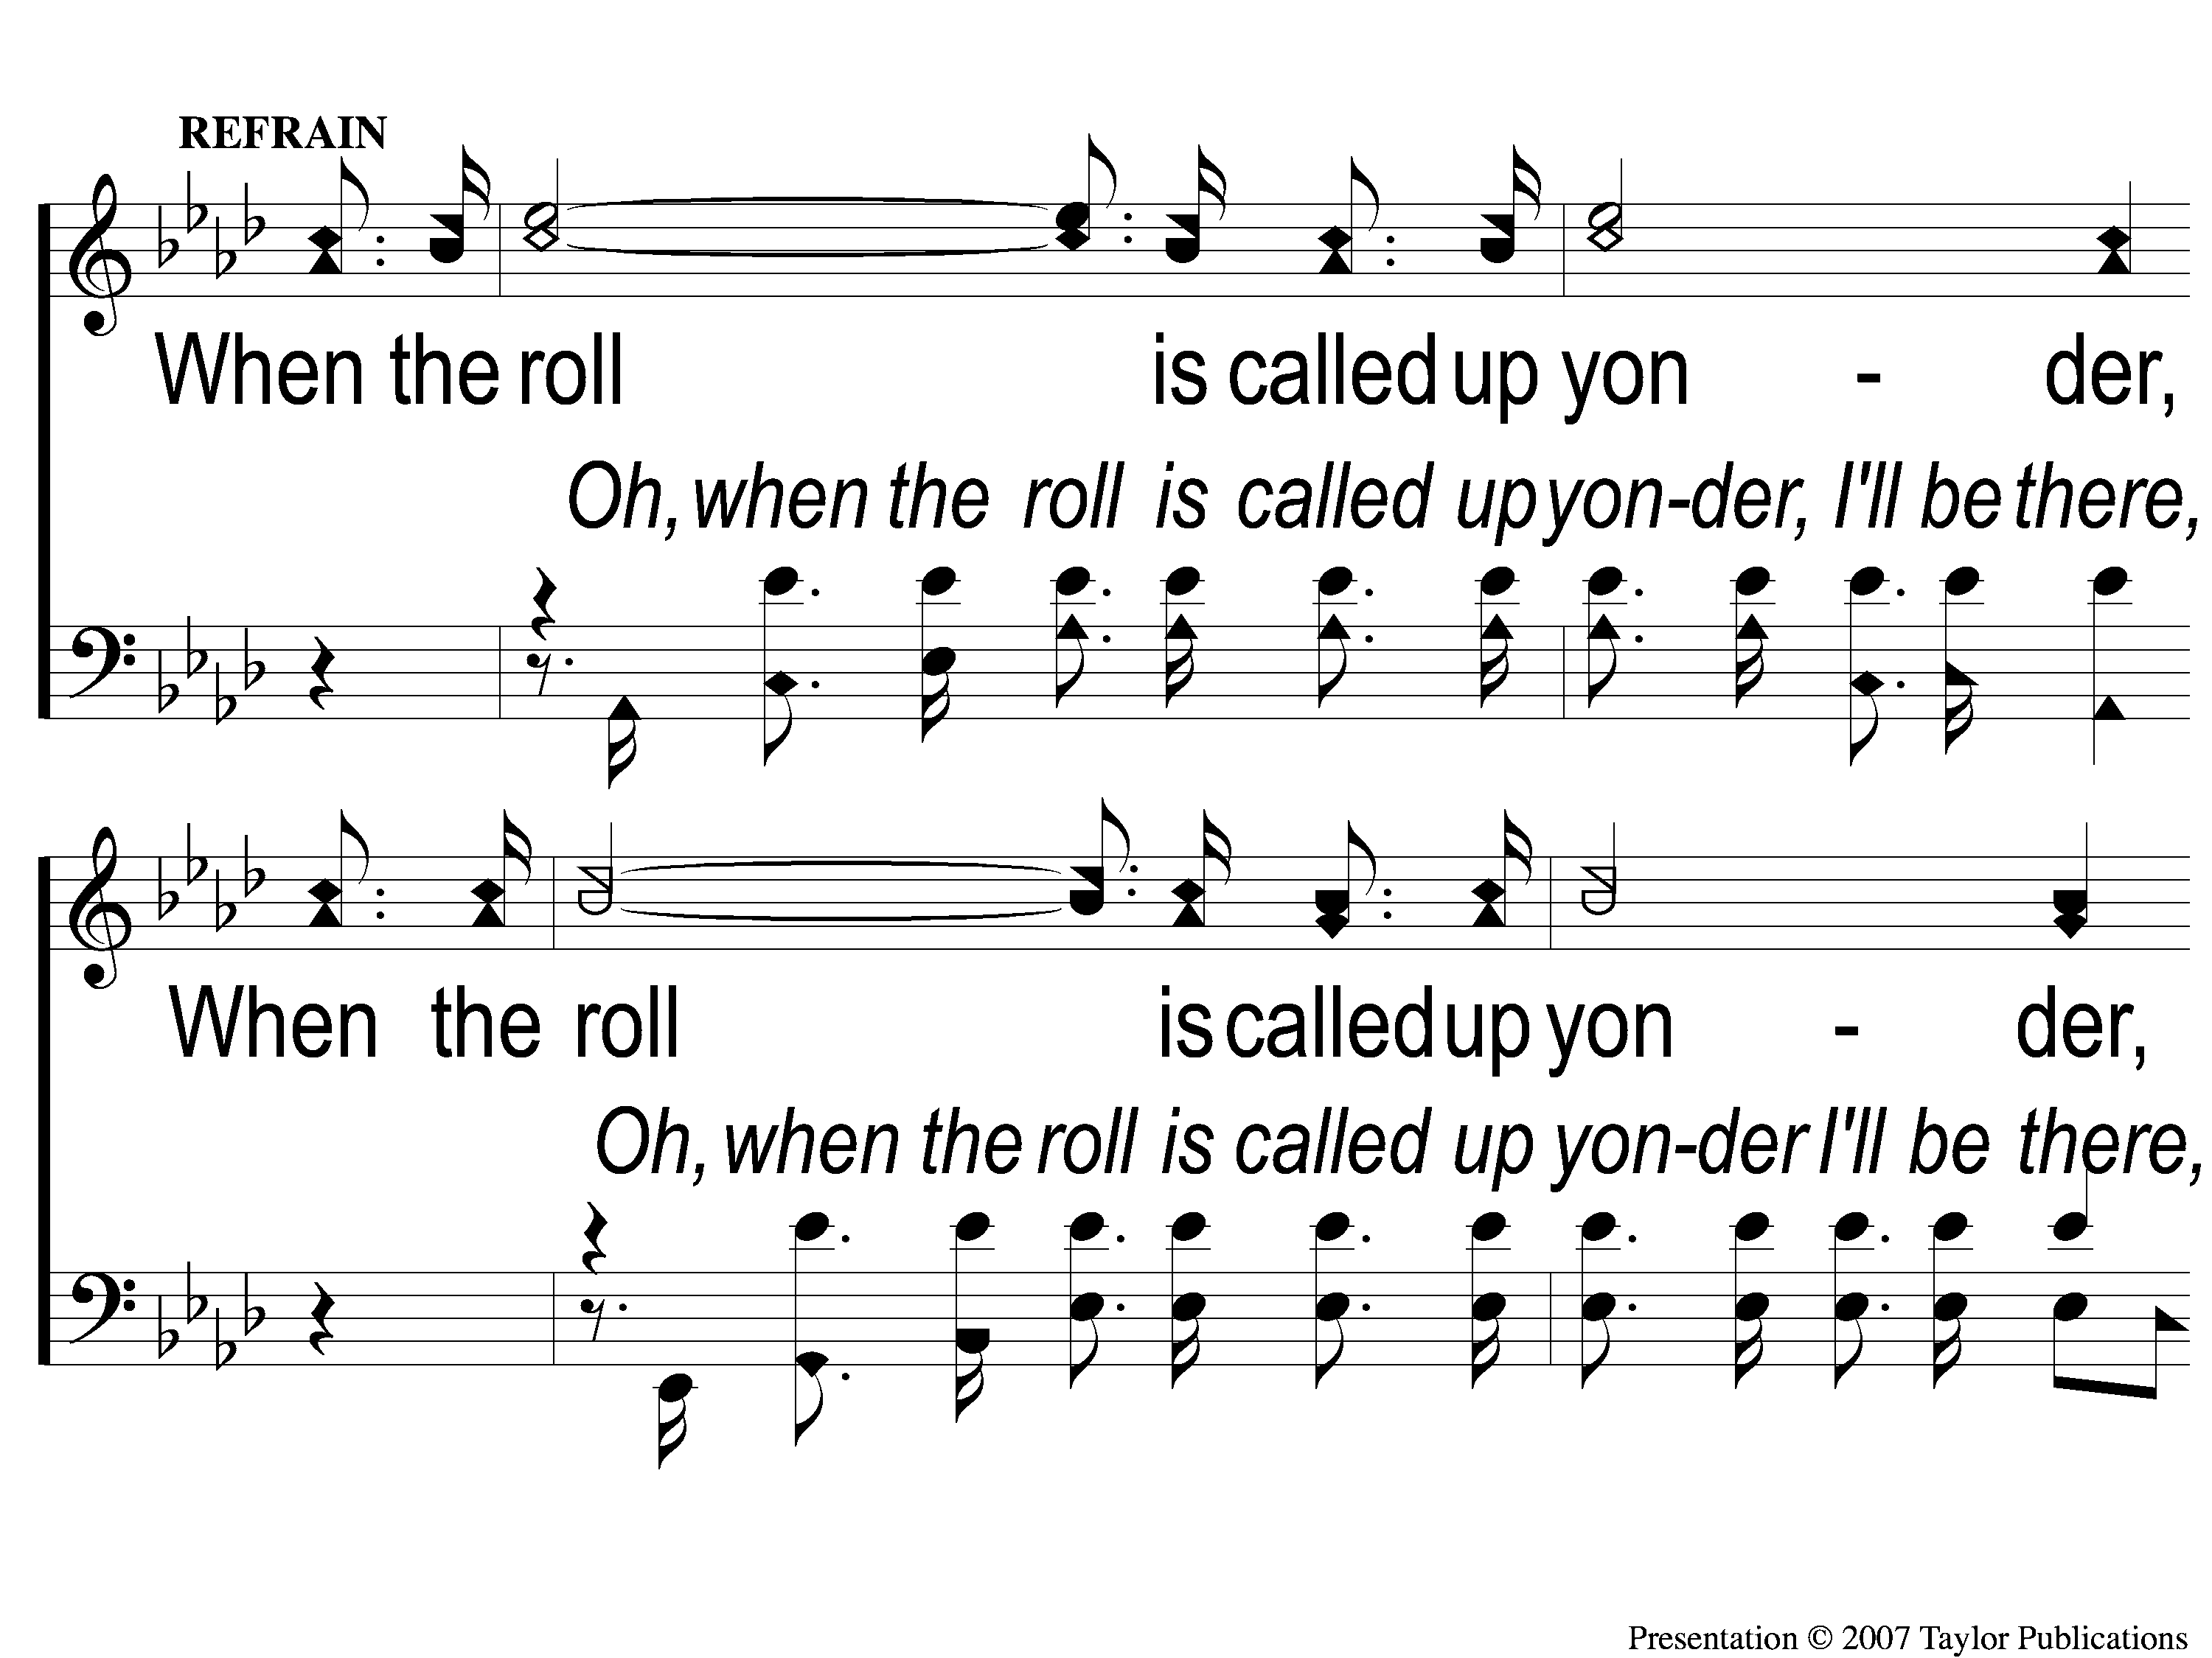
C-1 When The Roll Is Called Up Yonder
When The Roll Is Called Up Yonder
852

Slide 107
C-2 When The Roll Is Called Up Yonder
When The Roll Is Called Up Yonder
852

Slide 108
2-1 When The Roll Is Called Up Yonder
When The Roll Is Called Up Yonder
852

Slide 109
2-2 When The Roll Is Called Up Yonder
When The Roll Is Called Up Yonder
852

Slide 110
2-3 When The Roll Is Called Up Yonder
When The Roll Is Called Up Yonder
852

Slide 111
C-1 When The Roll Is Called Up Yonder
When The Roll Is Called Up Yonder
852

Slide 112
C-2 When The Roll Is Called Up Yonder
When The Roll Is Called Up Yonder
852

Slide 113
3-1 When The Roll Is Called Up Yonder
When The Roll Is Called Up Yonder
852

Slide 114
3-2 When The Roll Is Called Up Yonder
When The Roll Is Called Up Yonder
852

Slide 115
3-3 When The Roll Is Called Up Yonder
When The Roll Is Called Up Yonder
852

Slide 116
C-1 When The Roll Is Called Up Yonder
When The Roll Is Called Up Yonder
852

Slide 117
C-2 When The Roll Is Called Up Yonder
When The Roll Is Called Up Yonder
852

Slide 118
Today
WORSHIP @ 6:00
Tuesday
Biblically equipped class @ 6 PM

