Slide 1
1-1 Standing on the Promises
Standing On the Promises
452

Slide 2
1-2 Standing on the Promises
Standing On the Promises
452

Slide 3
C-1 Standing on the Promises
Standing On the Promises
452

Slide 4
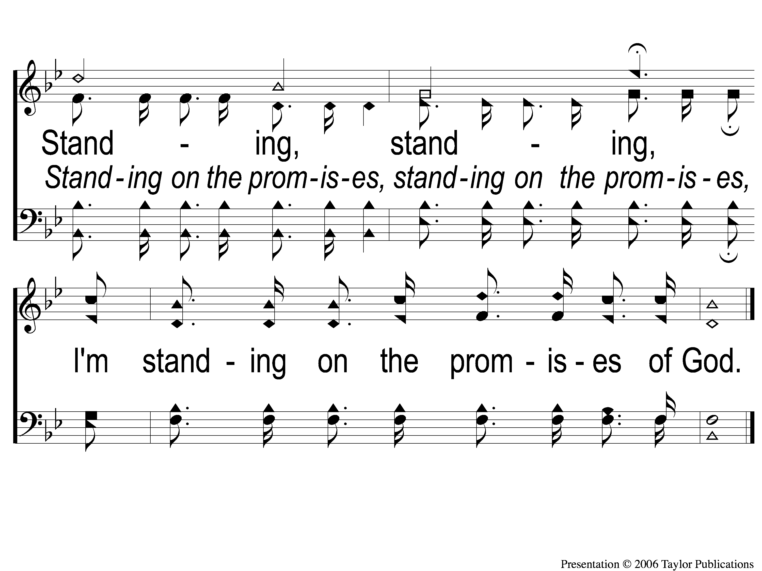
C-2 Standing on the Promises
Standing On the Promises
452

Slide 5
4-1 Standing on the Promises
Standing On the Promises
452

Slide 6
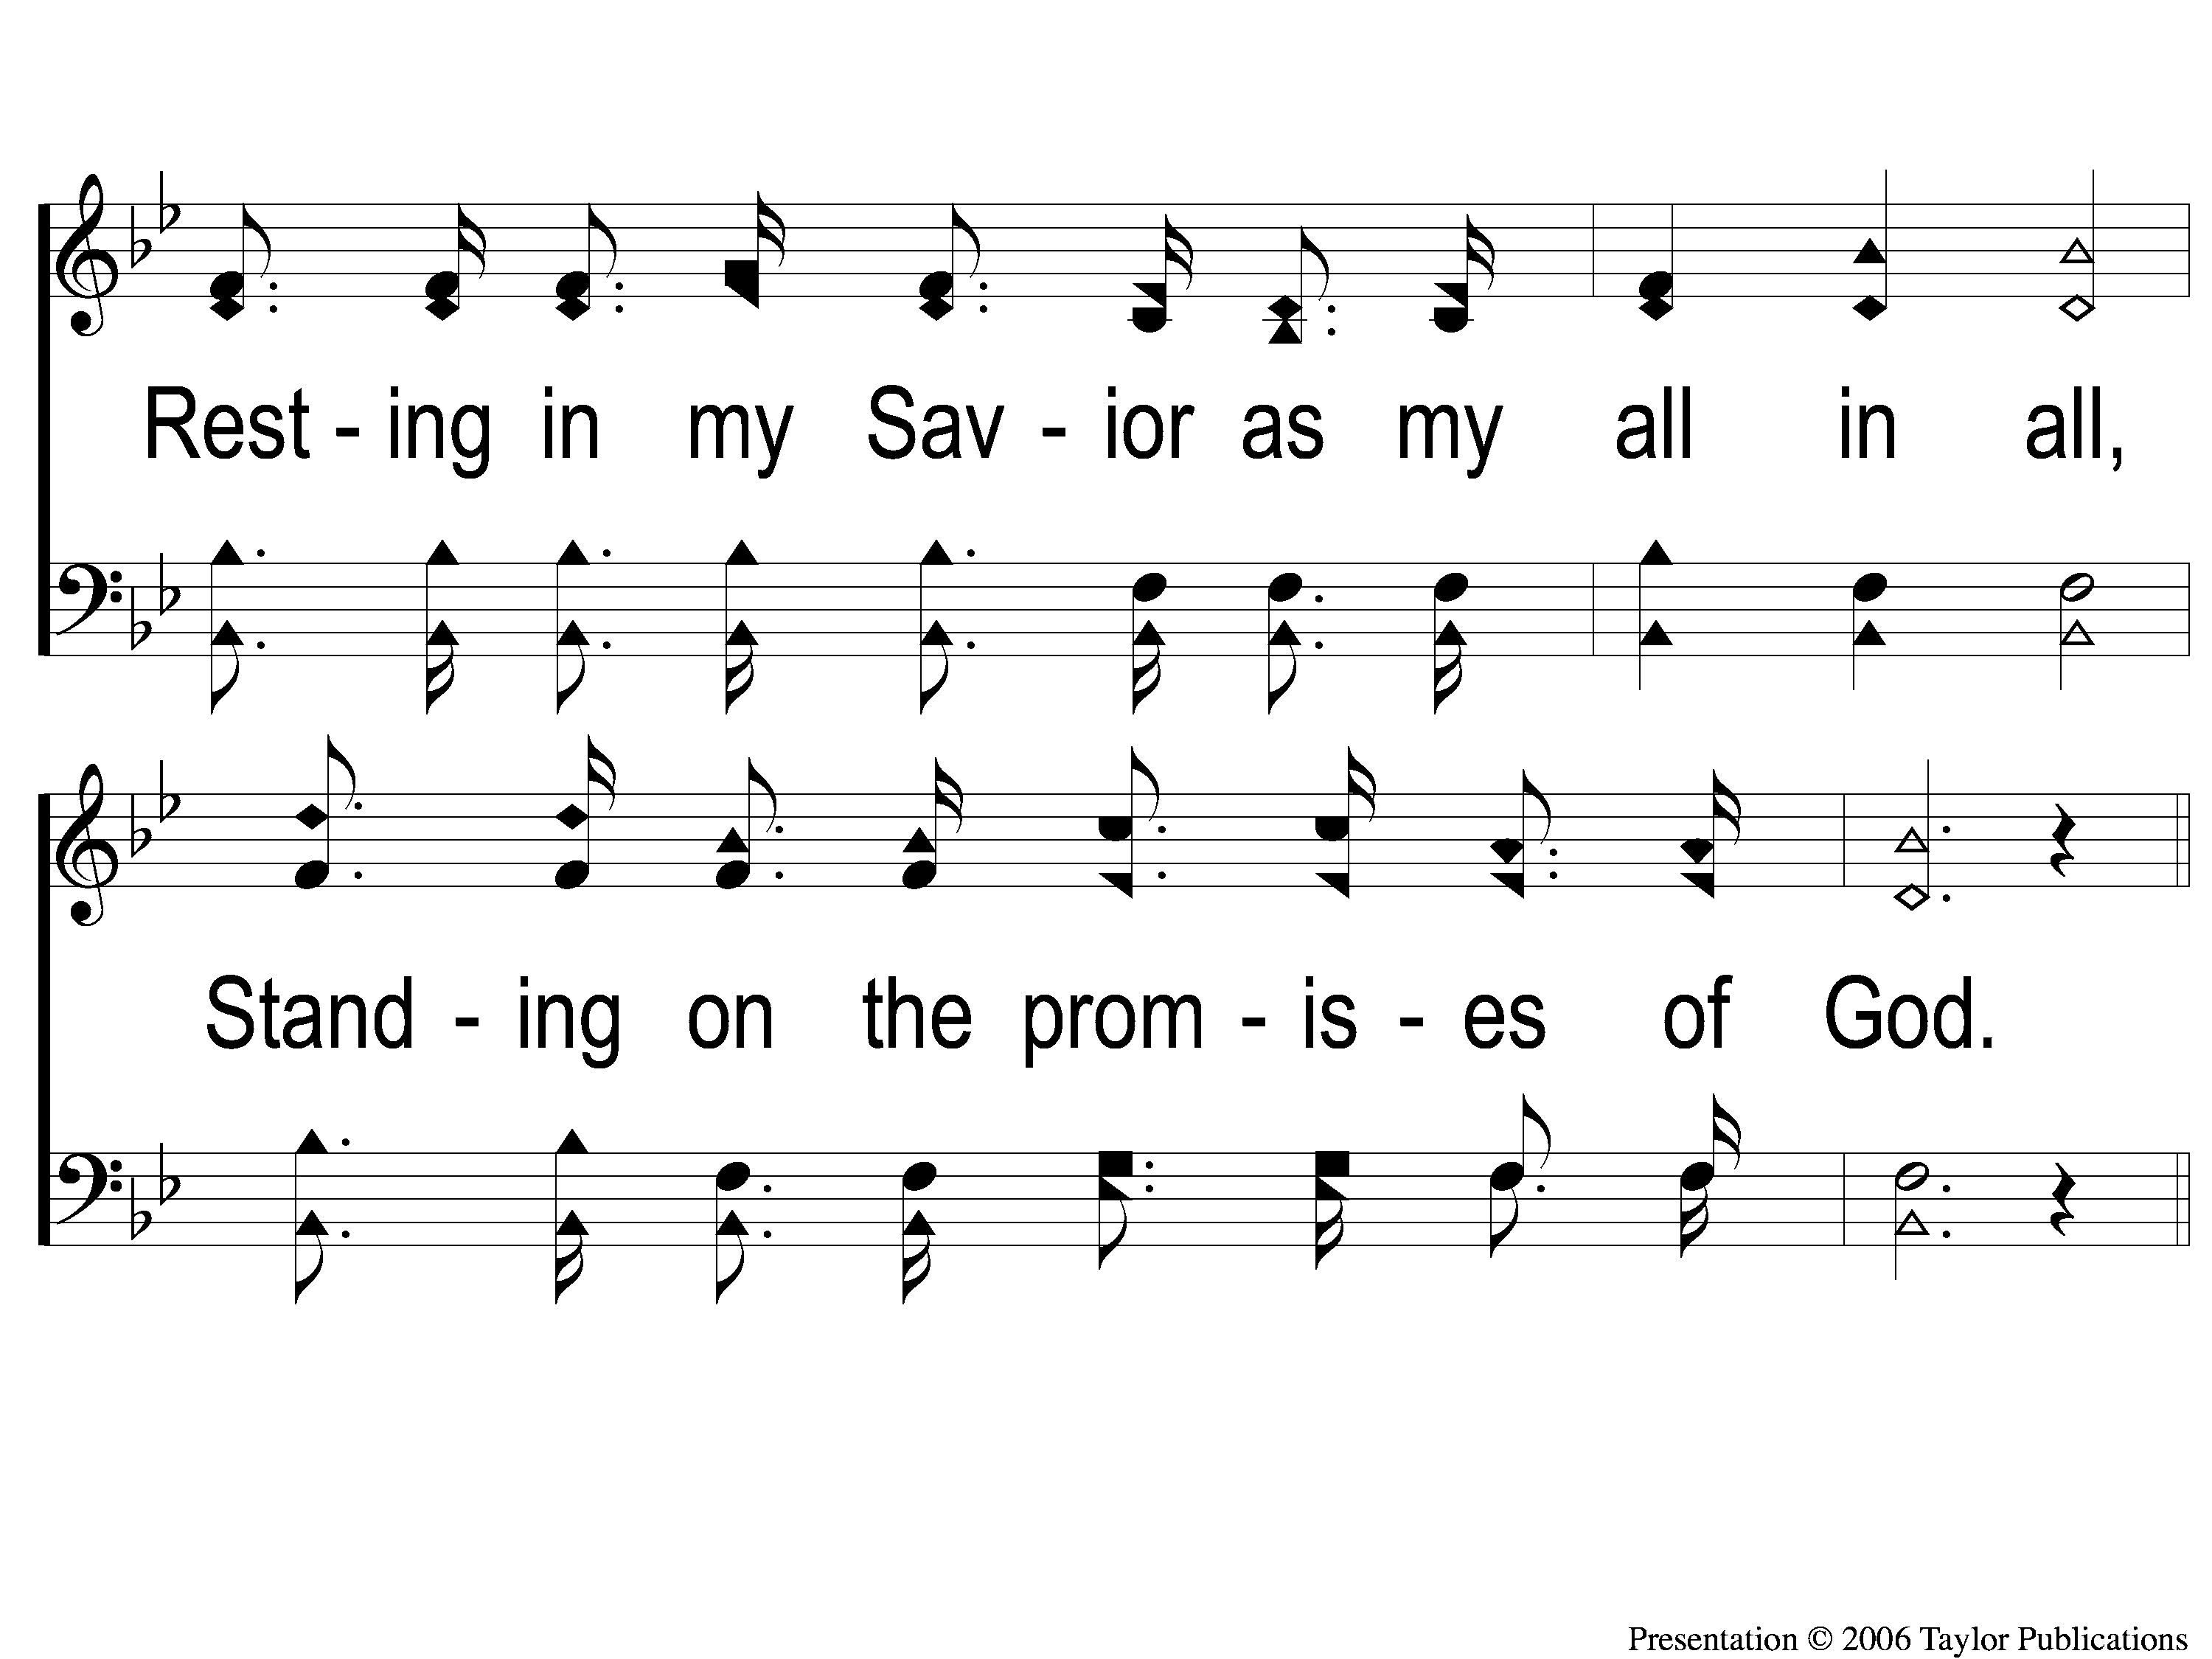
4-2 Standing on the Promises
Standing On the Promises
452

Slide 7
C-1 Standing on the Promises
Standing On the Promises
452

Slide 8
C-2 Standing on the Promises
Standing On the Promises
452

Slide 9
WELCOME
To the Wheeler church of Christ

Slide 10
SONG:
Because he lives
#464

Slide 11
1-1 Because He Lives
Because He Lives
464

Slide 12
1-2 Because He Lives
Because He Lives
464

Slide 13
C-1 Because He Lives
Because He Lives
464

Slide 14
C-2 Because He Lives
Because He Lives
464

Slide 15
2-1 Because He Lives
Because He Lives
464

Slide 16
2-2 Because He Lives
Because He Lives
464

Slide 17
C-1 Because He Lives
Because He Lives
464

Slide 18
C-2 Because He Lives
Because He Lives
464

Slide 19
3-1 Because He Lives
Because He Lives
464

Slide 20
3-2 Because He Lives
Because He Lives
464

Slide 21
C-1 Because He Lives
Because He Lives
464

Slide 22
C-2 Because He Lives
Because He Lives
464

Slide 23
SONG:
I know that my redeemer lives
#528

Slide 24
1-1 I Know That My Redeemer Lives
I Know That My Redeemer Lives
528

Slide 25
1-2 I Know That My Redeemer Lives
I Know That My Redeemer Lives
528

Slide 26
C-1 I Know That My Redeemer Lives
I Know That My Redeemer Lives
528

Slide 27
C-2 I Know That My Redeemer Lives
I Know That My Redeemer Lives
528

Slide 28
2-1 I Know That My Redeemer Lives
I Know That My Redeemer Lives
528

Slide 29
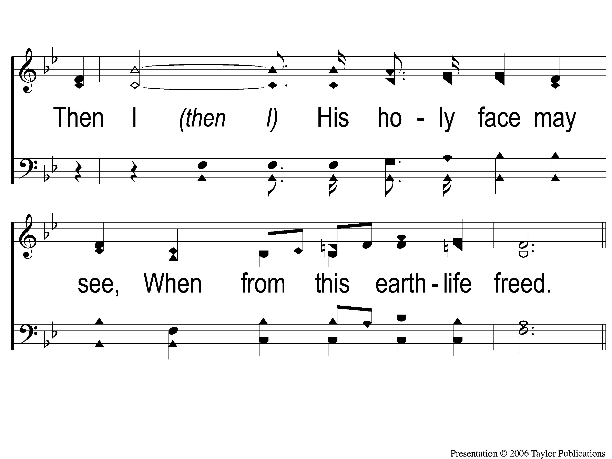
2-2 I Know That My Redeemer Lives
I Know That My Redeemer Lives
528

Slide 30
C-1 I Know That My Redeemer Lives
I Know That My Redeemer Lives
528

Slide 31
C-2 I Know That My Redeemer Lives
I Know That My Redeemer Lives
528

Slide 32
4-1 I Know That My Redeemer Lives
I Know That My Redeemer Lives
528

Slide 33
4-2 I Know That My Redeemer Lives
I Know That My Redeemer Lives
528

Slide 34
C-1 I Know That My Redeemer Lives
I Know That My Redeemer Lives
528

Slide 35
C-2 I Know That My Redeemer Lives
I Know That My Redeemer Lives
528

Slide 36
OPENING PRAYER

Slide 37
SONG:
The love of god
#122

Slide 38
1-1 The Love of God
The Love Of God
122

Slide 39
1-2 The Love of God
The Love Of God
122

Slide 40
C-1 The Love of God
The Love Of God
122

Slide 41
C-2 The Love of God
The Love Of God
122

Slide 42
C-3 The Love of God
The Love Of God
122

Slide 43
C-4 The Love of God
The Love Of God
122

Slide 44
C-5 The Love of God
The Love Of God
122

Slide 45
3-1 The Love of God
The Love Of God
122

Slide 46
3-2 The Love of God
The Love Of God
122

Slide 47
C-1 The Love of God
The Love Of God
122

Slide 48
C-2 The Love of God
The Love Of God
122

Slide 49
C-3 The Love of God
The Love Of God
122

Slide 50
C-4 The Love of God
The Love Of God
122

Slide 51
C-5 The Love of God
The Love Of God
122

Slide 52
SONG:
Low in the grave he lay
#344

Slide 53
1 Low in the Grave He Lay
Low in the Grave He Lay
344

Slide 54
C-1 Low in the Grave He Lay
Low in the Grave He Lay
344

Slide 55
C-2 Low in the Grave He Lay
Low in the Grave He Lay
344

Slide 56
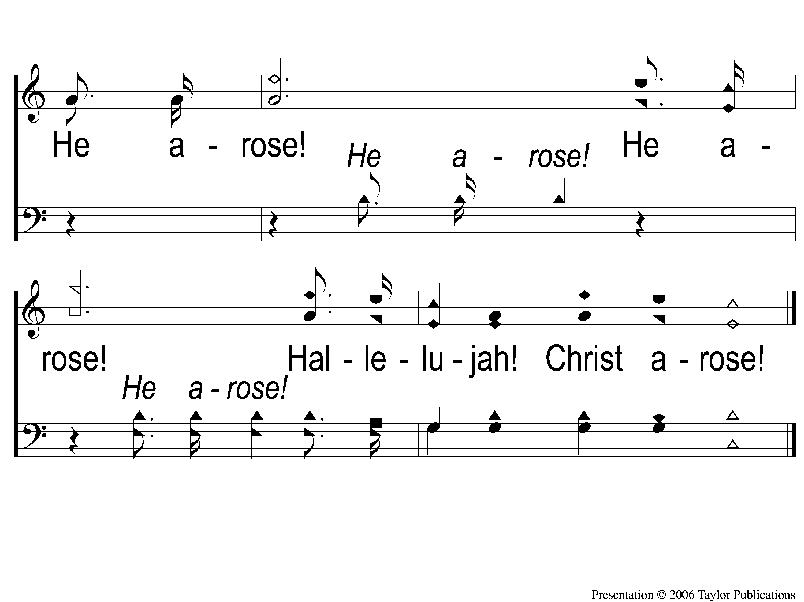
C-3 Low in the Grave He Lay
Low in the Grave He Lay
344

Slide 57
2 Low in the Grave He Lay
Low in the Grave He Lay
344

Slide 58
C-1 Low in the Grave He Lay
Low in the Grave He Lay
344

Slide 59
C-2 Low in the Grave He Lay
Low in the Grave He Lay
344

Slide 60
C-3 Low in the Grave He Lay
Low in the Grave He Lay
344

Slide 61
3 Low in the Grave He Lay
Low in the Grave He Lay
344

Slide 62
C-1 Low in the Grave He Lay
Low in the Grave He Lay
344

Slide 63
C-2 Low in the Grave He Lay
Low in the Grave He Lay
344

Slide 64
C-3 Low in the Grave He Lay
Low in the Grave He Lay
344

Slide 65
SCRIPTURE READING:
Matthew 28:5-6

Slide 66
Who is Jesus?

Slide 67
The Messiah (ch. 1)
The “king of the jews” (ch. 2, 27)
The “son of god” (ch. 3, 17)
The Conqueror (Ch. 4)
The great physician (ch. 8-9)
The giver of rest (ch. 11)
The lord of the sabbath (ch. 12)
The head of the church (ch. 14-17)
The teacher of difficult things (ch. 19)
The son of David (ch. 20)
The cleanser of god’s house (ch. 21)
The good teacher (ch. 22)

Slide 68
Who is Jesus?
IN MATTHEW 26-28

Slide 69
THE BETRAYED ONE
Matthew 26

Slide 70
WHO PLOTTED AGAINST HIM?
Matt. 26:1-5

Slide 71
WHO PLOTTED AGAINST HIM?
Matt. 26:1-5
The Chief Priests
The Scribes
The Elders
The High Priest

Slide 72
WHO PLOTTED AGAINST HIM?
Plotted = “to engage in joint planning so as to devise a course of common action, often one with a harmful or evil purpose” (Louw-Nida)

Slide 73
WHO PLOTTED AGAINST HIM?
Plotted = “to engage in joint planning so as to devise a course of common action, often one with a harmful or evil purpose” (Louw-Nida)
1 Cor. 15:33, Gen. 11:4-6

Slide 74
WHO BETRAYED HIM?

Slide 75
WHO BETRAYED HIM?
Judas – 26:14-16, 44-49

Slide 76
WHO BETRAYED HIM?
Judas
Peter – 26:33-35, 69-75

Slide 77
WHO BETRAYED HIM?
Judas
Peter
Disciples – 26:30-32, 35, 55-56

Slide 78
WHO BETRAYED HIM?
Judas
Peter
Disciples
Us – Acts 2:38, Rom. 3:23, 5:6-8

Slide 79
THE CRUCIFIED ONE
Matthew 27

Slide 80
WHAT DID JESUS SUFFER THROUGH?
Illegal Trial – 26:47-50, 57-66

Slide 81
WHAT DID JESUS SUFFER THROUGH?
Illegal Trial – 26:47-50, 57-66
Mocking – 26:67-68, 27:27-29

Slide 82
WHAT DID JESUS SUFFER THROUGH?
Illegal Trial – 26:47-50, 57-66
Mocking – 26:67-68, 27:27-29
Beating – 26:67, 27:30

Slide 83
WHAT DID JESUS SUFFER THROUGH?
Illegal Trial – 26:47-50, 57-66
Mocking – 26:67-68, 27:27-29
Beating – 26:67, 27:30
Scourging – 27:26

Slide 84
WHAT DID JESUS SUFFER THROUGH?
Illegal Trial – 26:47-50, 57-66
Mocking – 26:67-68, 27:27-29
Beating – 26:67, 27:30
Scourging – 27:26
Crucifixion – 27:35ff

Slide 85
WHY DID JESUS SUFFER?

Slide 86
WHY DID JESUS SUFFER?
To Obey His Father
Jn. 8:29
Matt. 3:17, 17:5

Slide 87
WHY DID JESUS SUFFER?
For Us
Rom. 5:8, 8:32
1 Cor. 5:7
2 Cor. 5:21
Gal. 3:13
Eph. 5:2

Slide 88
THE RESURRECTED ONE
Matthew 28

Slide 89
WHEN WAS HE RESURRECTED?

Slide 90
WHEN WAS HE RESURRECTED?
On “the Third Day”
Prophesied by the Prophets
Psa. 22:25-27, 16:9-11, 110:1
Hos. 6:2
Isa. 53:10

Slide 91
WHEN WAS HE RESURRECTED?
On “the Third Day”
Prophesied by Jesus Himself:
Jn. 2:19
Matt. 12:40, 16:21, 17:23, 20:17-19

Slide 92
WHEN WAS HE RESURRECTED?
On “the First Day of the Week”
Every Sunday Is Momentous
Acts 2:29-36, 20:7

Slide 93
WHAT DOES HIS RESURRECTION MEAN?

Slide 94
WHAT DOES HIS RESURRECTION MEAN?
We Have Hope

Slide 95
WHAT DOES HIS RESURRECTION MEAN?
We Have Hope
Of Resurrection To Eternal Life
Jn. 11:26

Slide 96
Are YOU Crucified
With Christ?

Slide 97
Invitation SONG:
Kneel at the cross
#945

Slide 98
1-1 Kneel At the Cross
Kneel At the Cross
945

Slide 99
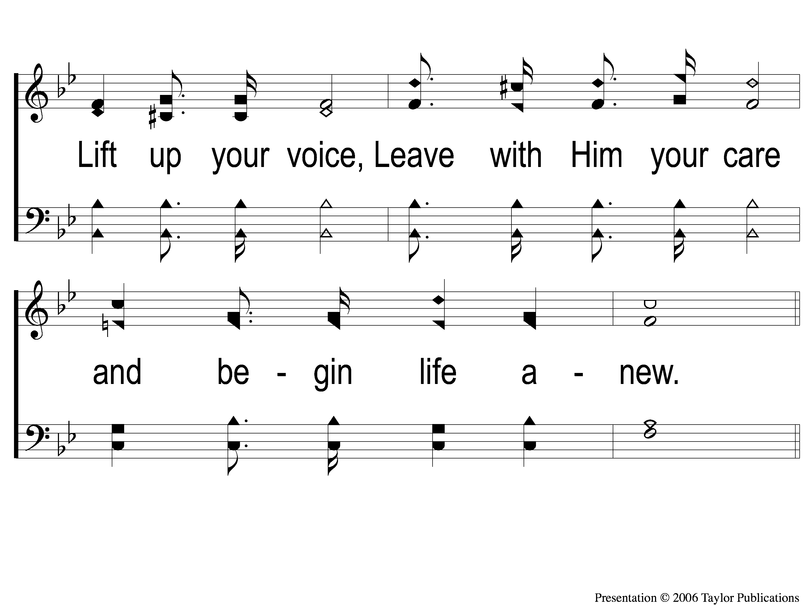
1-2 Kneel At the Cross
Kneel At the Cross
945

Slide 100
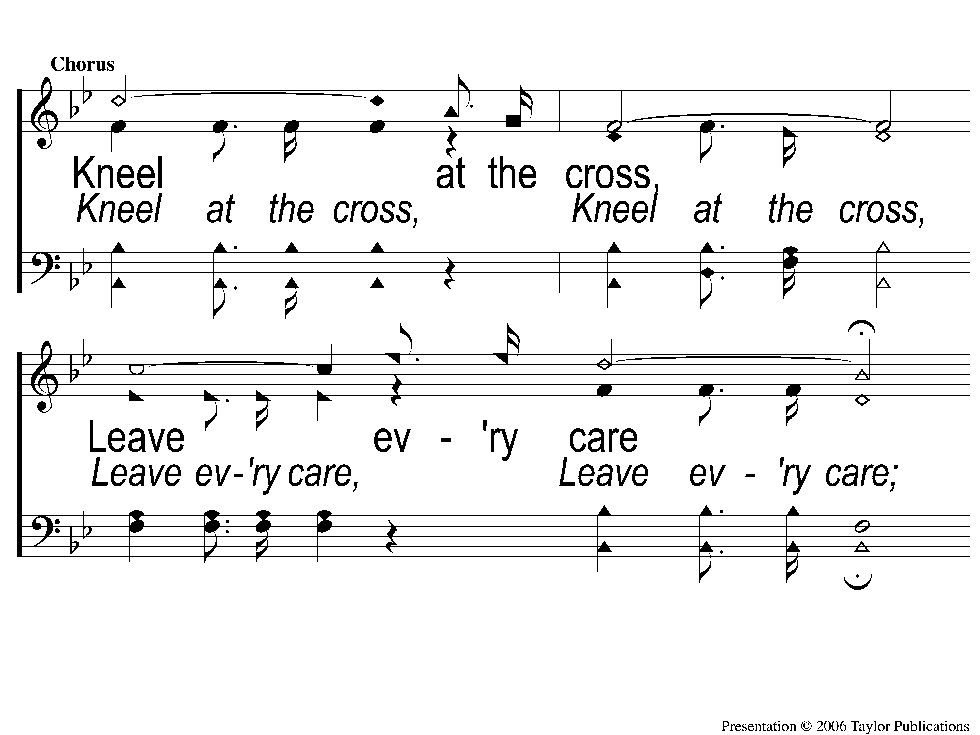
C-1 Kneel At the Cross
Kneel At the Cross
945

Slide 101
C-2 Kneel At the Cross
Kneel At the Cross
945

Slide 102
3-1 Kneel At the Cross
Kneel At the Cross
945

Slide 103
3-2 Kneel At the Cross
Kneel At the Cross
945

Slide 104
C-1 Kneel At the Cross
Kneel At the Cross
945

Slide 105
C-2 Kneel At the Cross
Kneel At the Cross
945

Slide 106
OUR CONTRIBUTION
2 Corinthians 8:12
“For if there is first a willing mind, it is accepted according to what one has, and not according to what he does not have.”

Slide 107
SONG:
Jesus keep me near the cross
#383

Slide 108
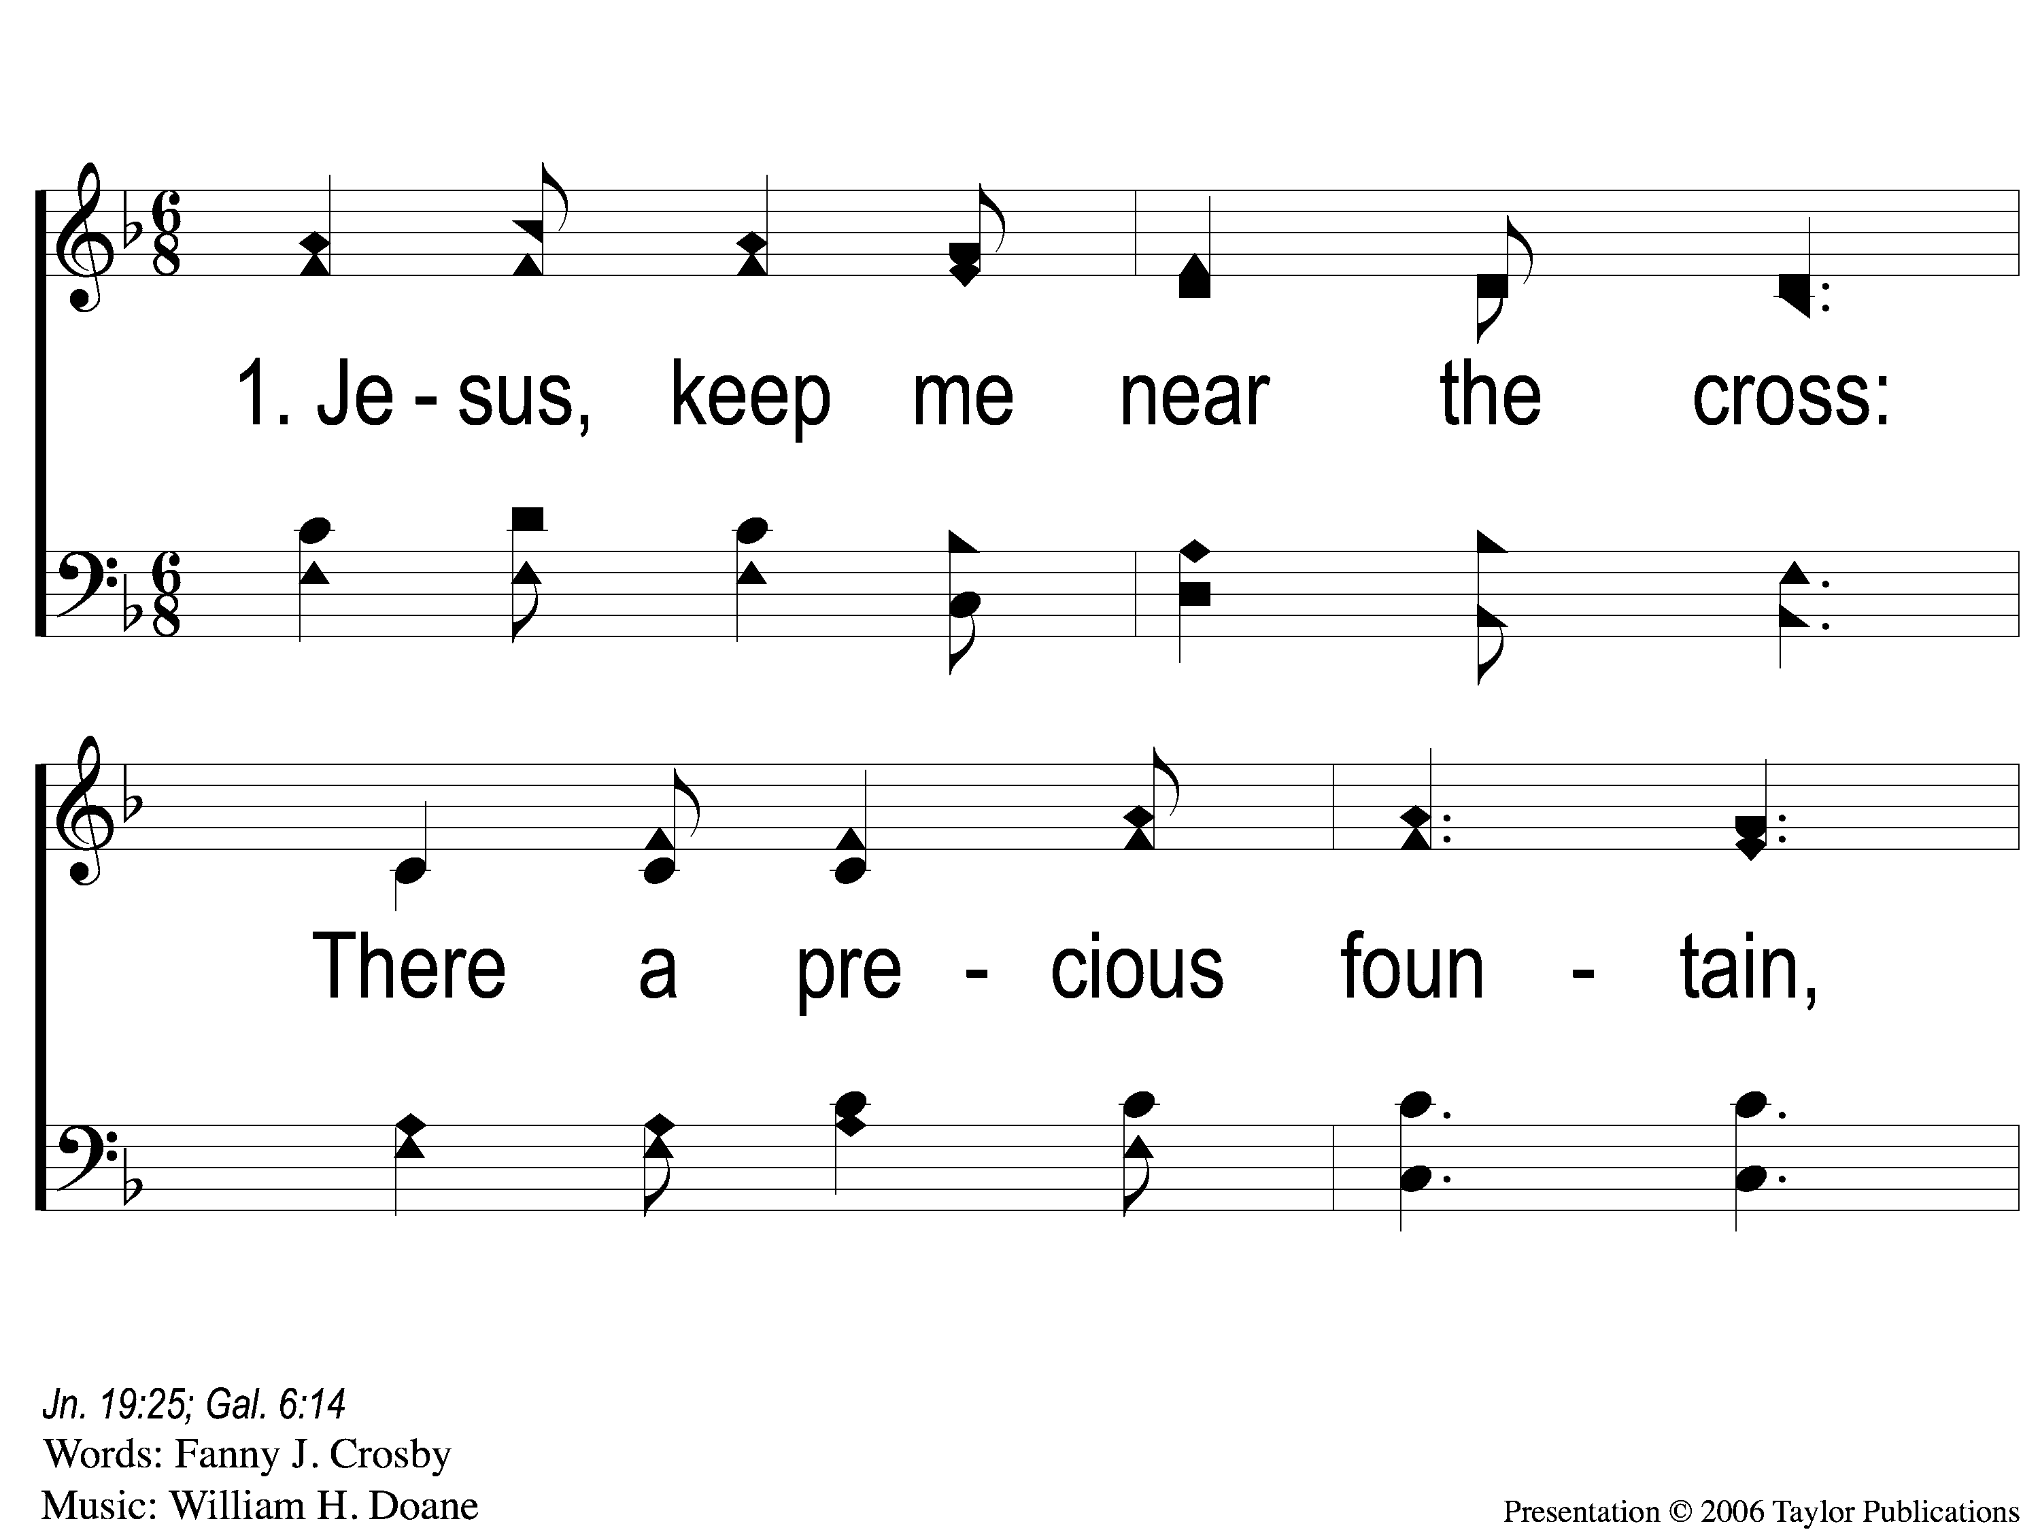
1-1 Jesus Keep Me Near the Cross
Jesus Keep Me Near The Cross
383

Slide 109
1-2 Jesus Keep Me Near the Cross
Jesus Keep Me Near The Cross
383

Slide 110
C Jesus Keep Me Near the Cross
Jesus Keep Me Near The Cross
383

Slide 111
2-1 Jesus Keep Me Near the Cross
Jesus Keep Me Near The Cross
383

Slide 112
2-2 Jesus Keep Me Near the Cross
Jesus Keep Me Near The Cross
383

Slide 113
C Jesus Keep Me Near the Cross
Jesus Keep Me Near The Cross
383

Slide 114
3-1 Jesus Keep Me Near the Cross
Jesus Keep Me Near The Cross
383

Slide 115
3-2 Jesus Keep Me Near the Cross
Jesus Keep Me Near The Cross
383

Slide 116
C Jesus Keep Me Near the Cross
Jesus Keep Me Near The Cross
383

Slide 117
THE UNLEAVENED BREAD
Isaiah 53:1-3
“Who has believed our report? And to whom has the arm of the Lord been revealed? For He shall grow up before Him as a tender plant, And as a root out of dry ground. He has no form or comeliness; And when we see Him, There is no beauty that we should desire Him. He is despised and rejected by men, A Man of sorrows and acquainted with grief. And we hid, as it were, our faces from Him; He was despised, and we did not esteem Him.”

Slide 118
THE FRUIT OF THE VINE
Isaiah 53:4-5
“Surely He has borne our griefs And carried our sorrows; Yet we esteemed Him stricken, Smitten by God, and afflicted. But He was wounded for our transgressions, He was bruised for our iniquities; The chastisement for our peace was upon Him, And by His stripes we are healed.”

Slide 119
closing PRAYER

Slide 120
SONG:
‘tis so sweet to trust in jesus
#679

Slide 121
1-1 ‘Tis so Sweet To Trust in Jesus
‘Tis So Sweet To Trust In Jesus
679

Slide 122
1-2 ‘Tis so Sweet To Trust in Jesus
‘Tis So Sweet To Trust In Jesus
679

Slide 123
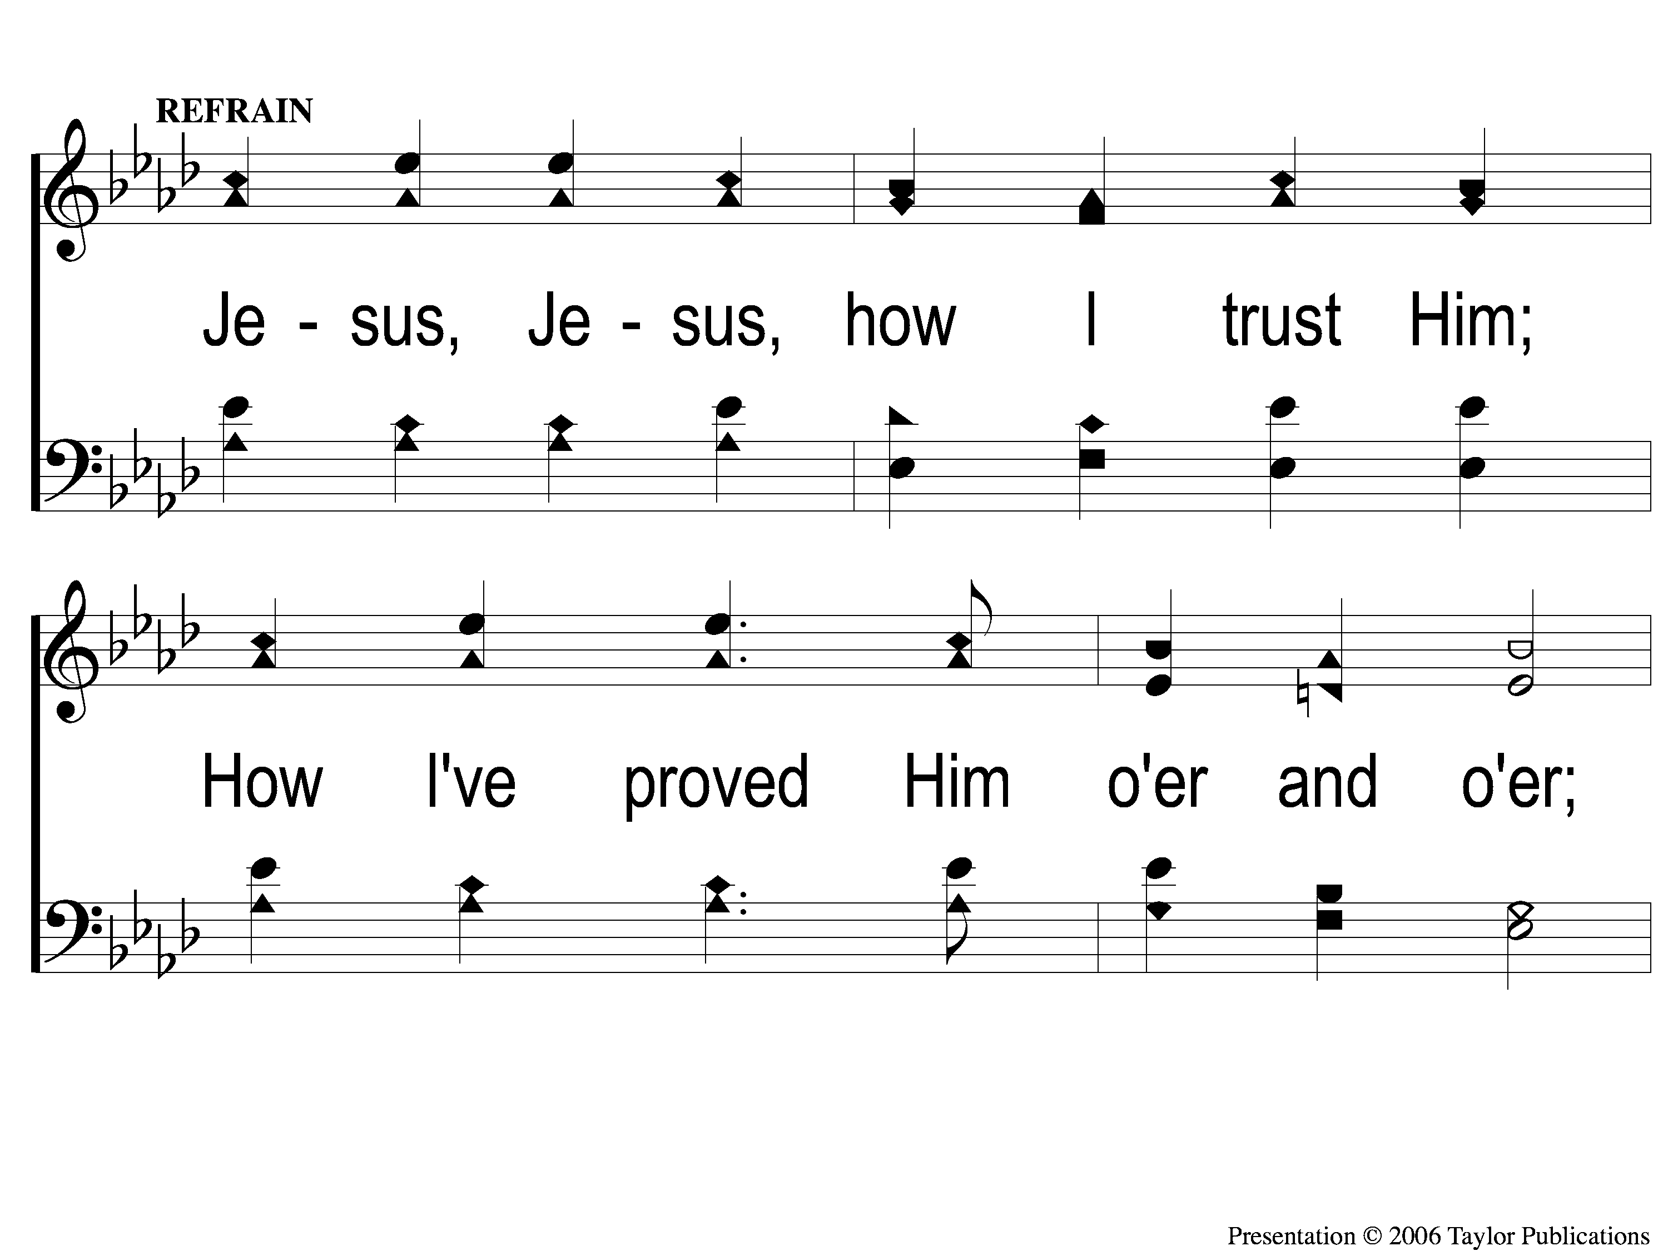
C-1 ‘Tis so Sweet To Trust in Jesus
‘Tis So Sweet To Trust In Jesus
679

Slide 124
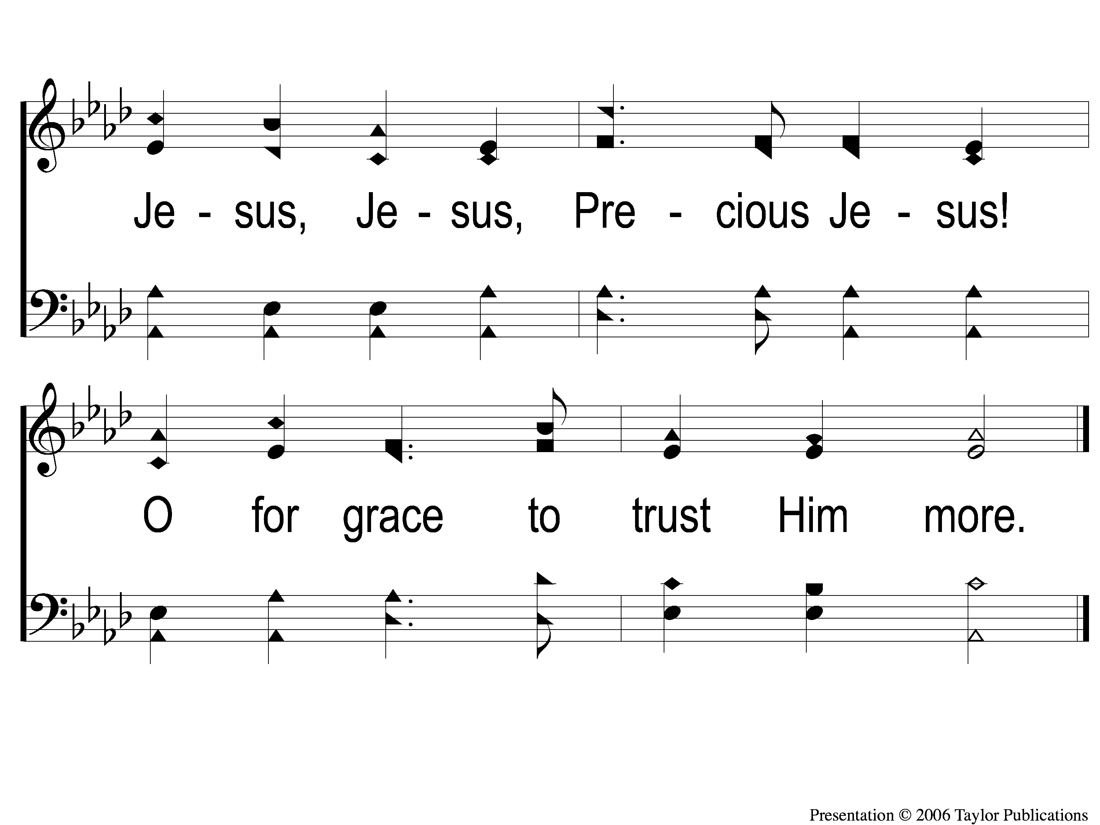
C-2 ‘Tis so Sweet To Trust in Jesus
‘Tis So Sweet To Trust In Jesus
679

Slide 125
Today
WORSHIP @ 6 Pm
wEDNESDAY
WORSHIP & BIBLE CLASSES @ 6:30 PM

Slide 126
Today
FELLOWSHIP MEAL @ NOON
DEVO & SINGING @ 1 PM
wEDNESDAY
WORSHIP & BIBLE CLASSES @ 6 PM

