Slide 1
1 The Steadfast Love of the Lord
The Steadfast Love of the Lord
123

Slide 2
2 The Steadfast Love of the Lord
The Steadfast Love of the Lord
123

Slide 3
3 The Steadfast Love of the Lord
The Steadfast Love of the Lord
123

Slide 4
DC-1 The Steadfast Love of the Lord
The Steadfast Love of the Lord
123

Slide 5
DC-2 The Steadfast Love of the Lord
The Steadfast Love of the Lord
123

Slide 6
DC-3 The Steadfast Love of the Lord
The Steadfast Love of the Lord
123

Slide 7
DC-4 The Steadfast Love of the Lord
The Steadfast Love of the Lord
123

Slide 8
1 The Steadfast Love of the Lord
The Steadfast Love of the Lord
123

Slide 9
2 The Steadfast Love of the Lord
The Steadfast Love of the Lord
123

Slide 10
3 The Steadfast Love of the Lord
The Steadfast Love of the Lord
123

Slide 11
DC-1 The Steadfast Love of the Lord
The Steadfast Love of the Lord
123

Slide 12
DC-2 The Steadfast Love of the Lord
The Steadfast Love of the Lord
123

Slide 13
DC-3 The Steadfast Love of the Lord
The Steadfast Love of the Lord
123

Slide 14
DC-4 The Steadfast Love of the Lord
The Steadfast Love of the Lord
123

Slide 15
WELCOME
To the Wheeler church of Christ

Slide 16
SONG:
Praise him! Praise him!
#300

Slide 17
1-1 Praise Him, Praise Him
Praise Him! Praise Him
300

Slide 18
1-2 Praise Him, Praise Him
Praise Him! Praise Him
300

Slide 19
1-3 Praise Him, Praise Him
Praise Him! Praise Him
300

Slide 20
C Praise Him, Praise Him
Praise Him! Praise Him
300

Slide 21
3-1 Praise Him, Praise Him
Praise Him! Praise Him
300

Slide 22
3-2 Praise Him, Praise Him
Praise Him! Praise Him
300

Slide 23
3-3 Praise Him, Praise Him
Praise Him! Praise Him
300

Slide 24
C Praise Him, Praise Him
Praise Him! Praise Him
300

Slide 25
SONG:
Pierce my ear
PH #273

Slide 26
1-1 Pierce my ear
Pierce My Ear
0

Slide 27
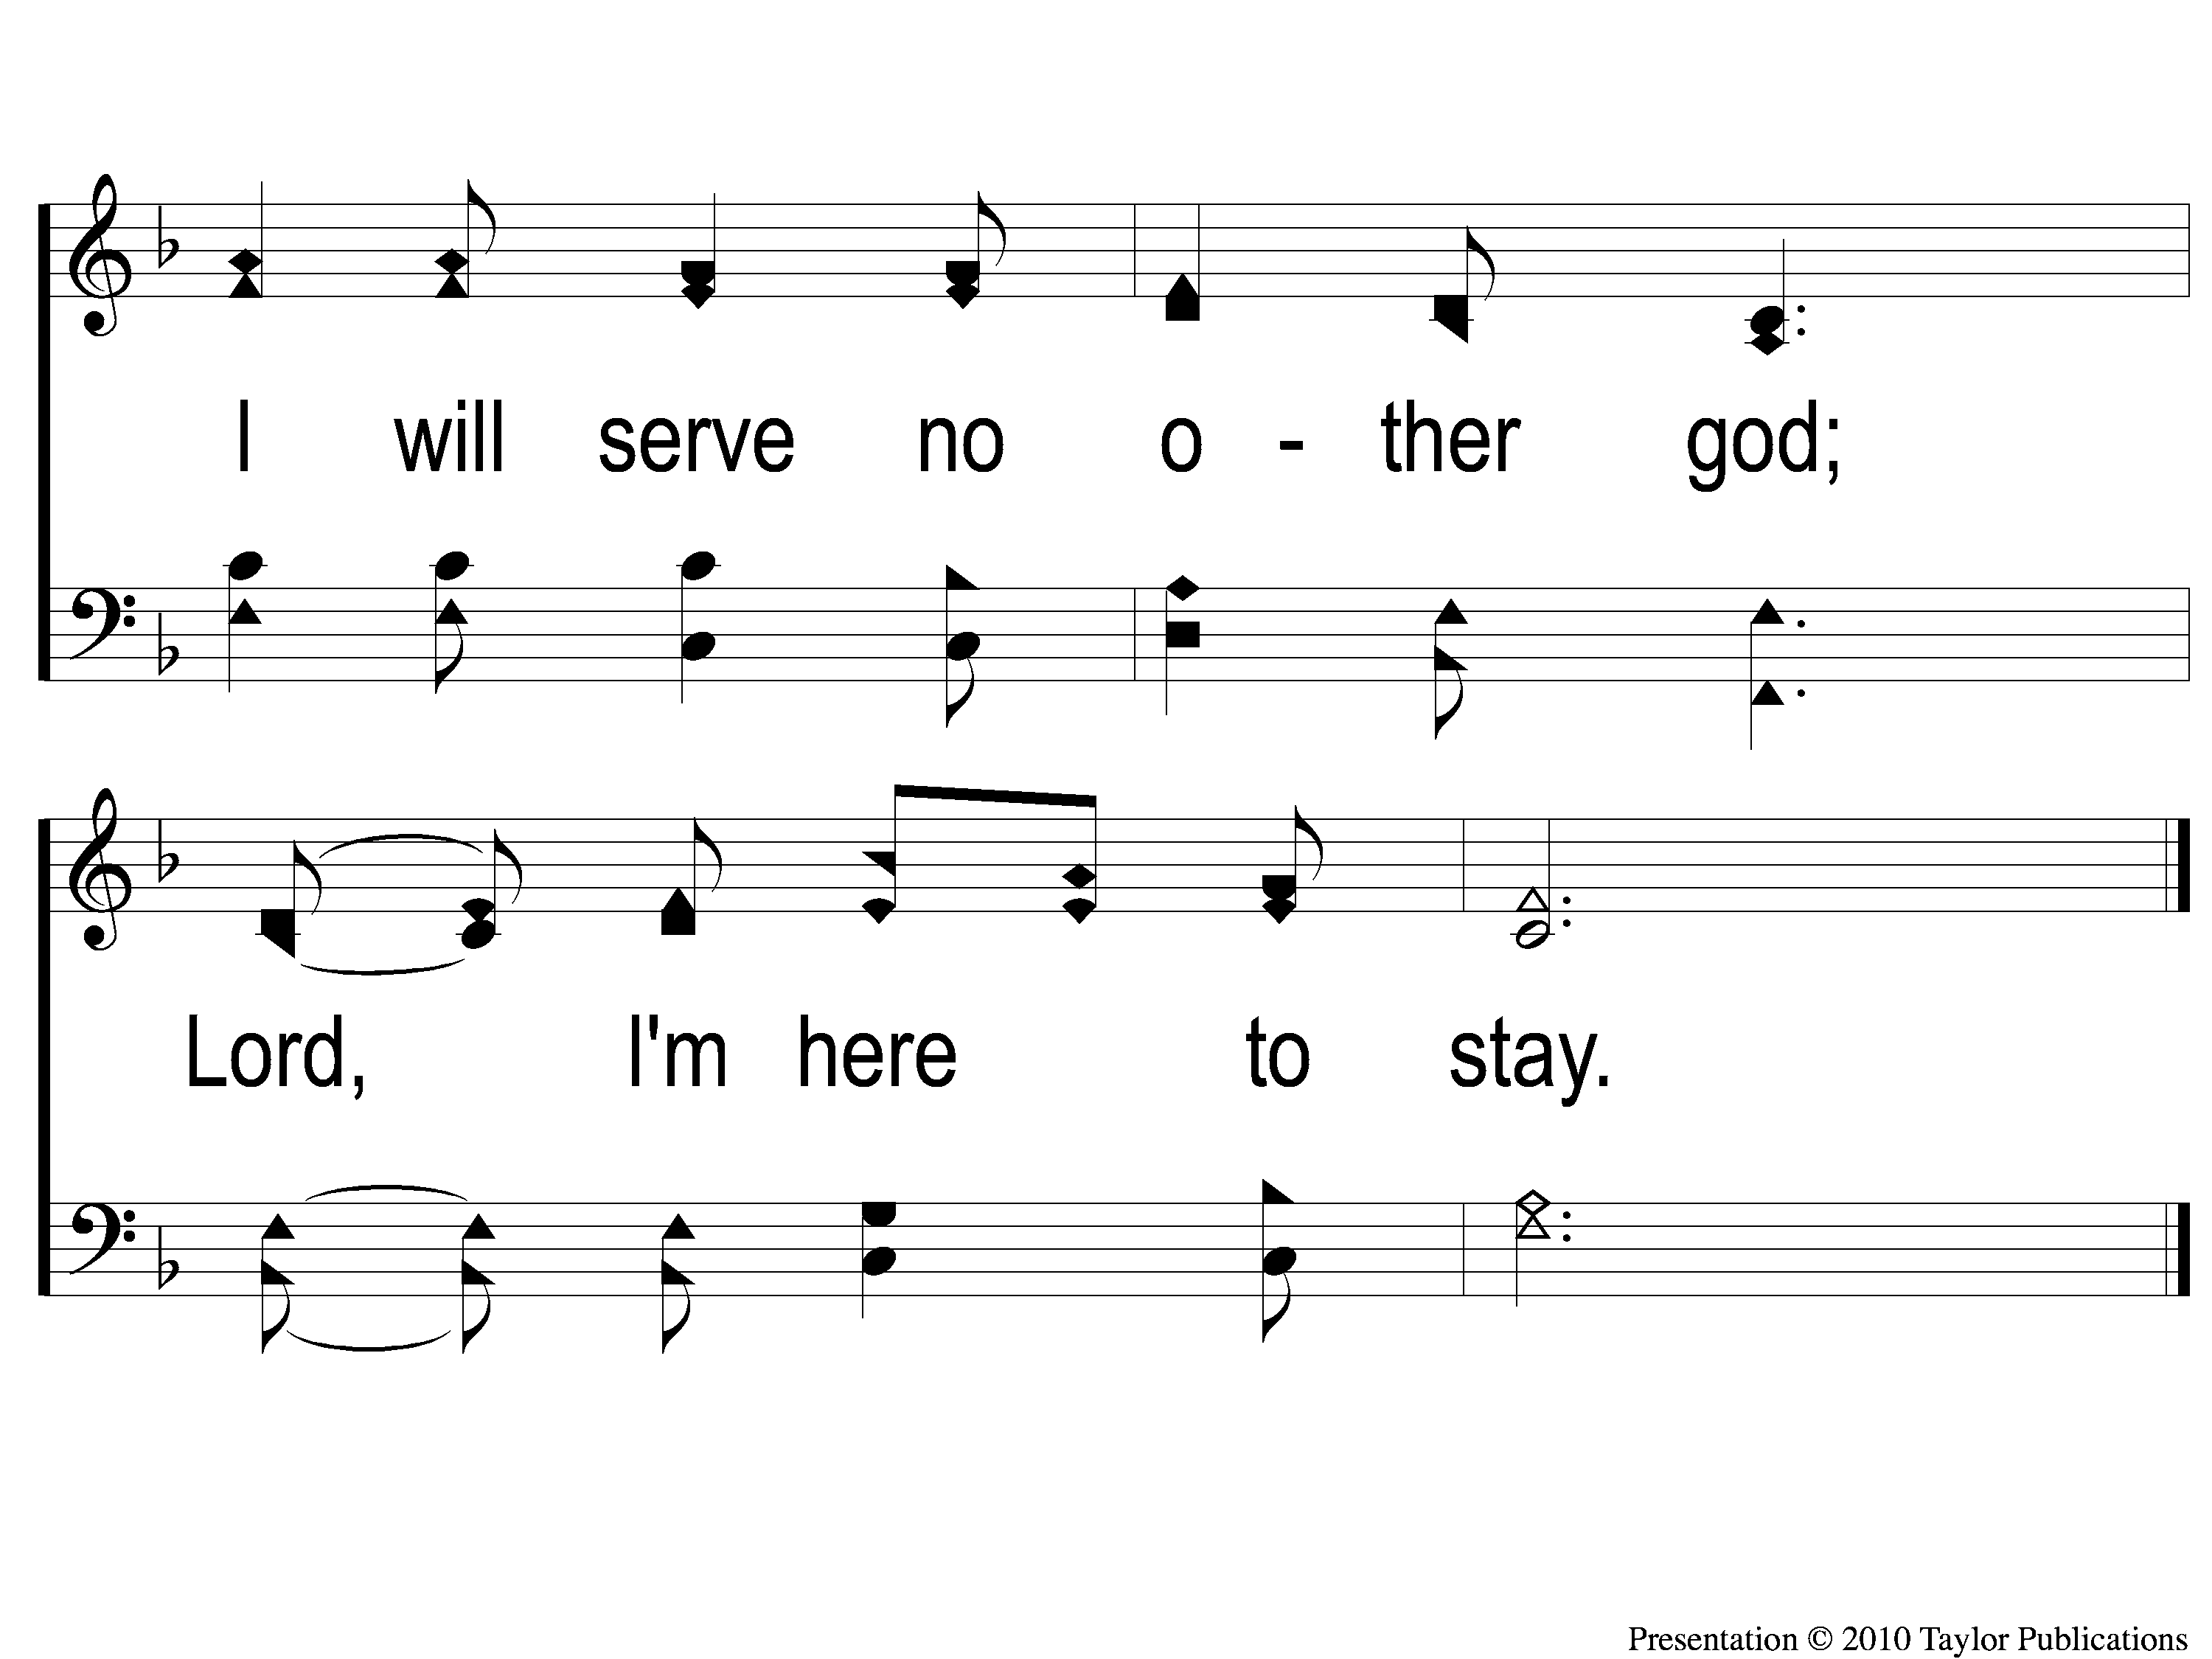
1-2 Pierce my ear
Pierce My Ear
0

Slide 28
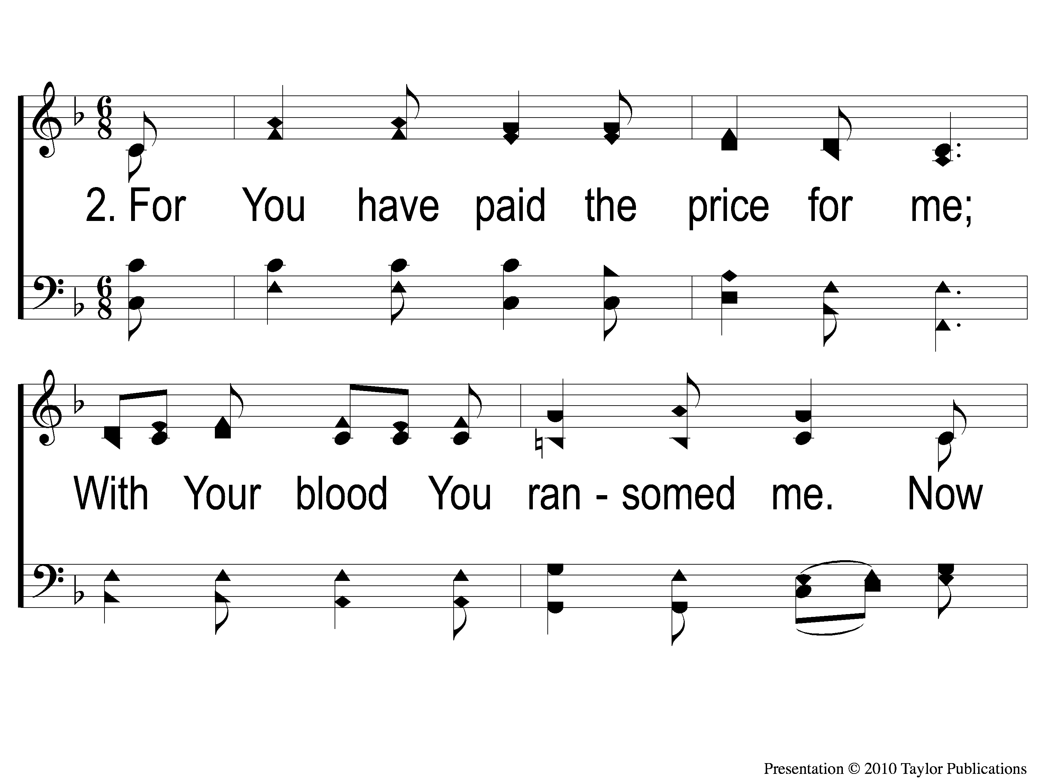
2-1 Pierce my ear
Pierce My Ear
0

Slide 29
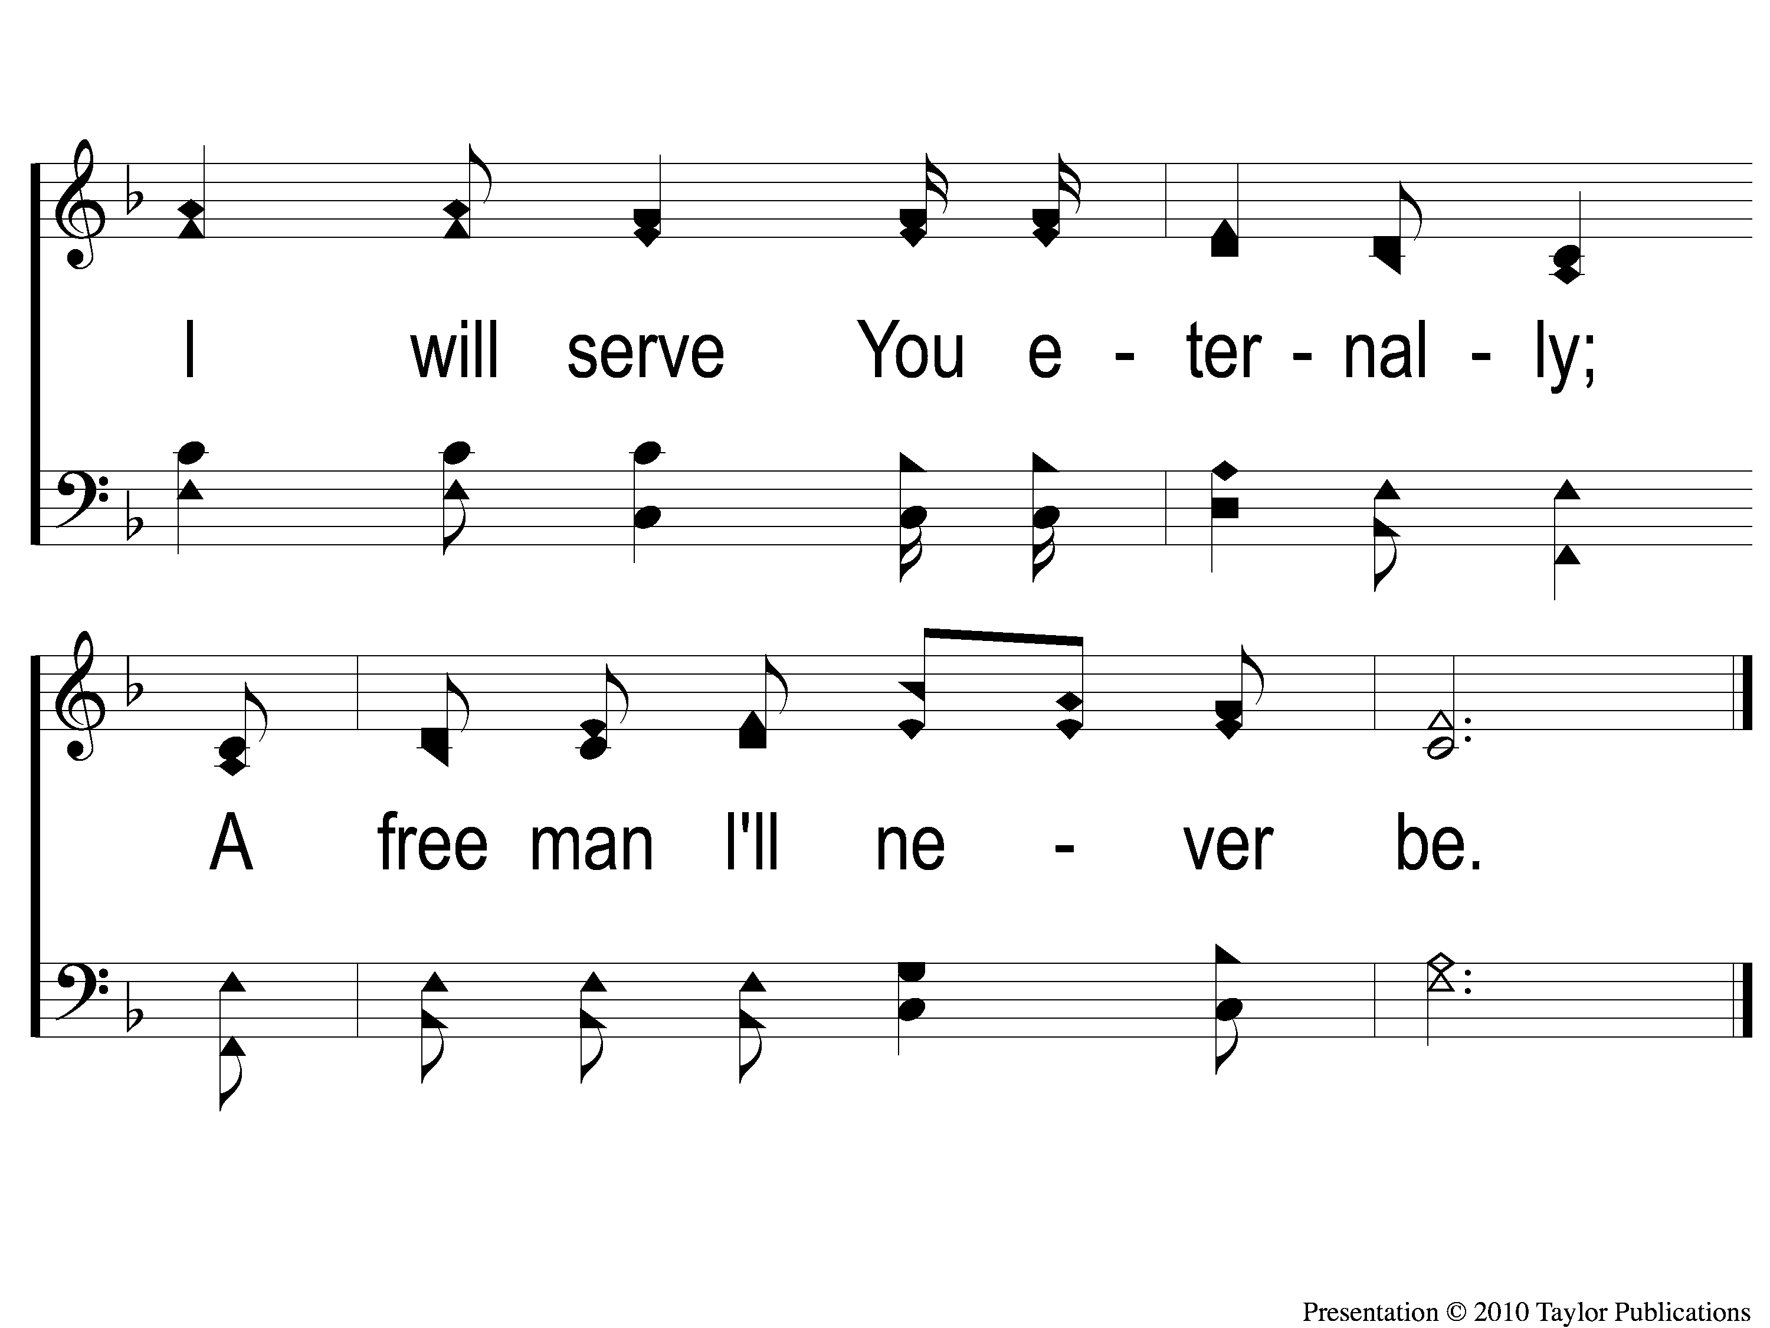
2-2 Pierce my ear
Pierce My Ear
0

Slide 30
3-1 Pierce my ear
Pierce My Ear
0

Slide 31
3-2 Pierce my ear
Pierce My Ear
0

Slide 32
OPENING PRAYER

Slide 33
SONG:
Be with me lord
#778

Slide 34
1-1 Be With Me Lord
Be With Me Lord
778

Slide 35
1-2 Be With Me Lord
Be With Me Lord
778

Slide 36
2-1 Be With Me Lord
Be With Me Lord
778

Slide 37
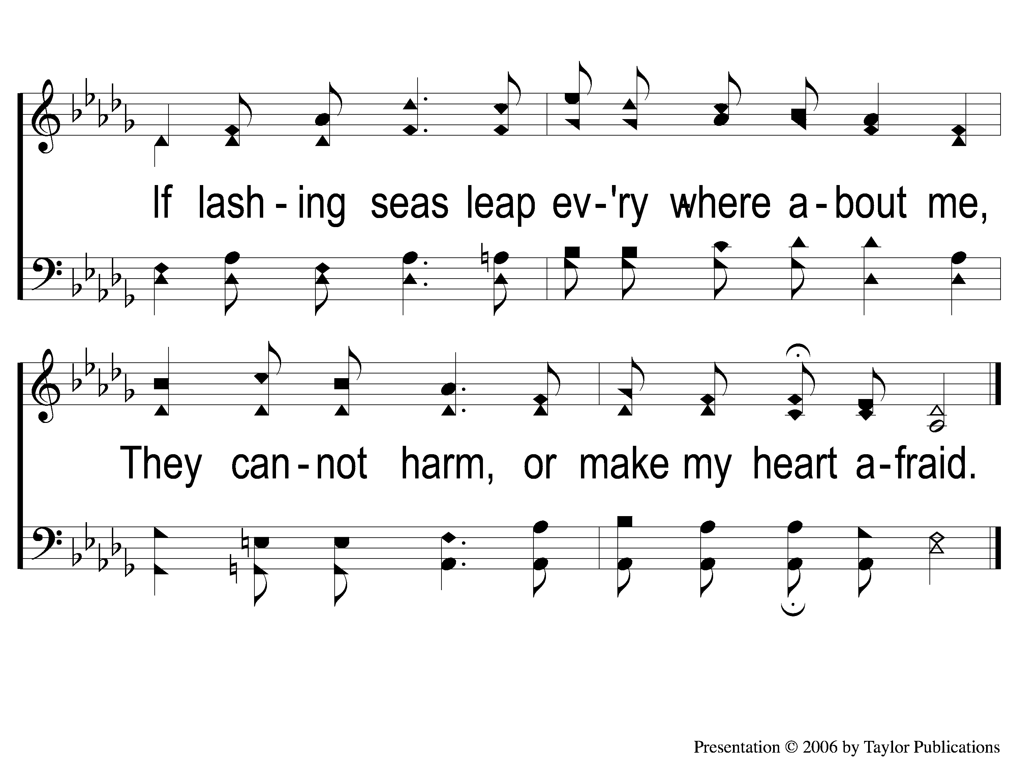
2-2 Be With Me Lord
Be With Me Lord
778

Slide 38
4-1 Be With Me Lord
Be With Me Lord
778

Slide 39
4-2 Be With Me Lord
Be With Me Lord
778

Slide 40
SONG:
God give us Christian homes
#

Slide 41
1-1 God Give Us Christian Homes
God Give Us Christian Homes
843
ePraise Hymn Presentation © 2005 Taylor Publications
ePraise Hymn Presentation © 2005 Taylor Publications

Slide 42
1-2 God Give Us Christian Homes
God Give Us Christian Homes
843
ePraise Hymn Presentation © 2005 Taylor Publications
ePraise Hymn Presentation © 2005 Taylor Publications

Slide 43
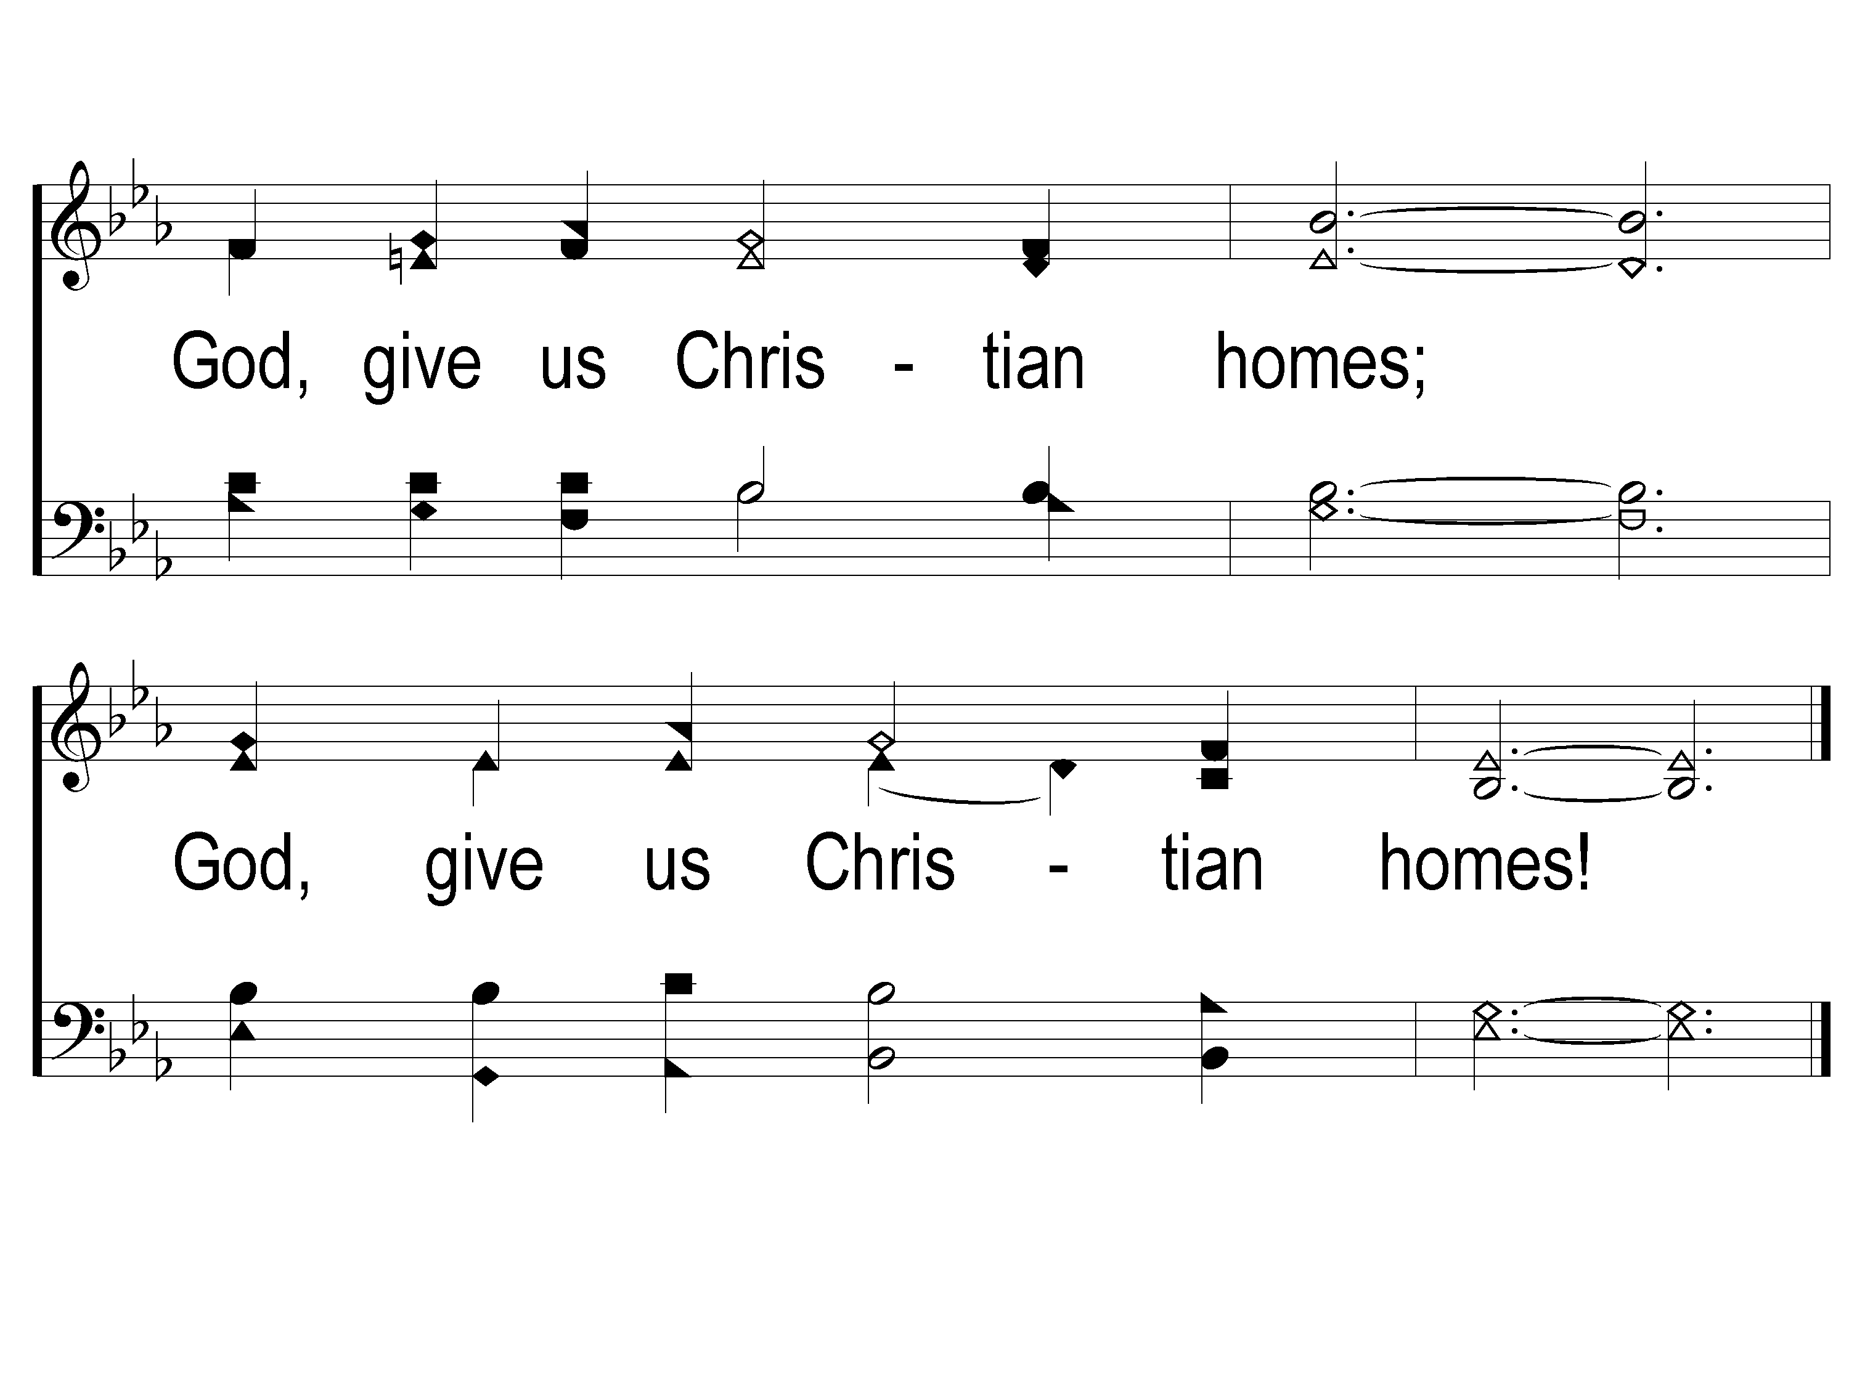
1-3 God Give Us Christian Homes
God Give Us Christian Homes
843
ePraise Hymn Presentation © 2005 Taylor Publications
ePraise Hymn Presentation © 2005 Taylor Publications

Slide 44
2-1 God Give Us Christian Homes
God Give Us Christian Homes
843
ePraise Hymn Presentation © 2005 Taylor Publications
ePraise Hymn Presentation © 2005 Taylor Publications

Slide 45
2-2 God Give Us Christian Homes
God Give Us Christian Homes
843
ePraise Hymn Presentation © 2005 Taylor Publications
ePraise Hymn Presentation © 2005 Taylor Publications

Slide 46
2-3 God Give Us Christian Homes
God Give Us Christian Homes
843
ePraise Hymn Presentation © 2005 Taylor Publications
ePraise Hymn Presentation © 2005 Taylor Publications

Slide 47
3-1 God Give Us Christian Homes
God Give Us Christian Homes
843
ePraise Hymn Presentation © 2005 Taylor Publications
ePraise Hymn Presentation © 2005 Taylor Publications

Slide 48
3-2 God Give Us Christian Homes
God Give Us Christian Homes
843
ePraise Hymn Presentation © 2005 Taylor Publications
ePraise Hymn Presentation © 2005 Taylor Publications

Slide 49
3-3 God Give Us Christian Homes
God Give Us Christian Homes
843
ePraise Hymn Presentation © 2005 Taylor Publications
ePraise Hymn Presentation © 2005 Taylor Publications

Slide 50
4-1 God Give Us Christian Homes
God Give Us Christian Homes
843
ePraise Hymn Presentation © 2005 Taylor Publications
ePraise Hymn Presentation © 2005 Taylor Publications

Slide 51
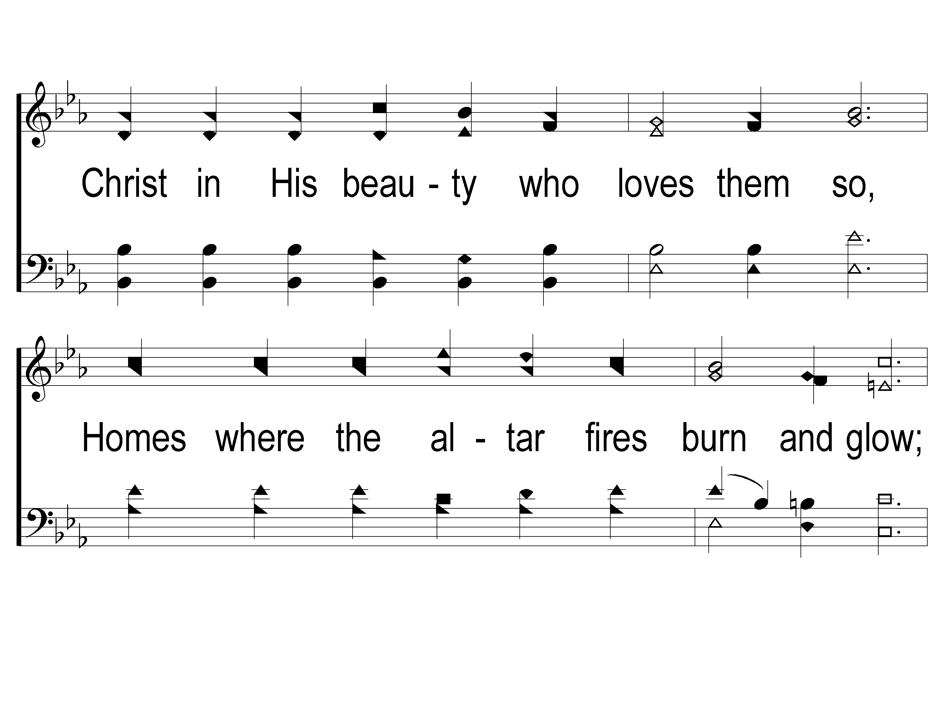
4-2 God Give Us Christian Homes
God Give Us Christian Homes
843
ePraise Hymn Presentation © 2005 Taylor Publications
ePraise Hymn Presentation © 2005 Taylor Publications

Slide 52
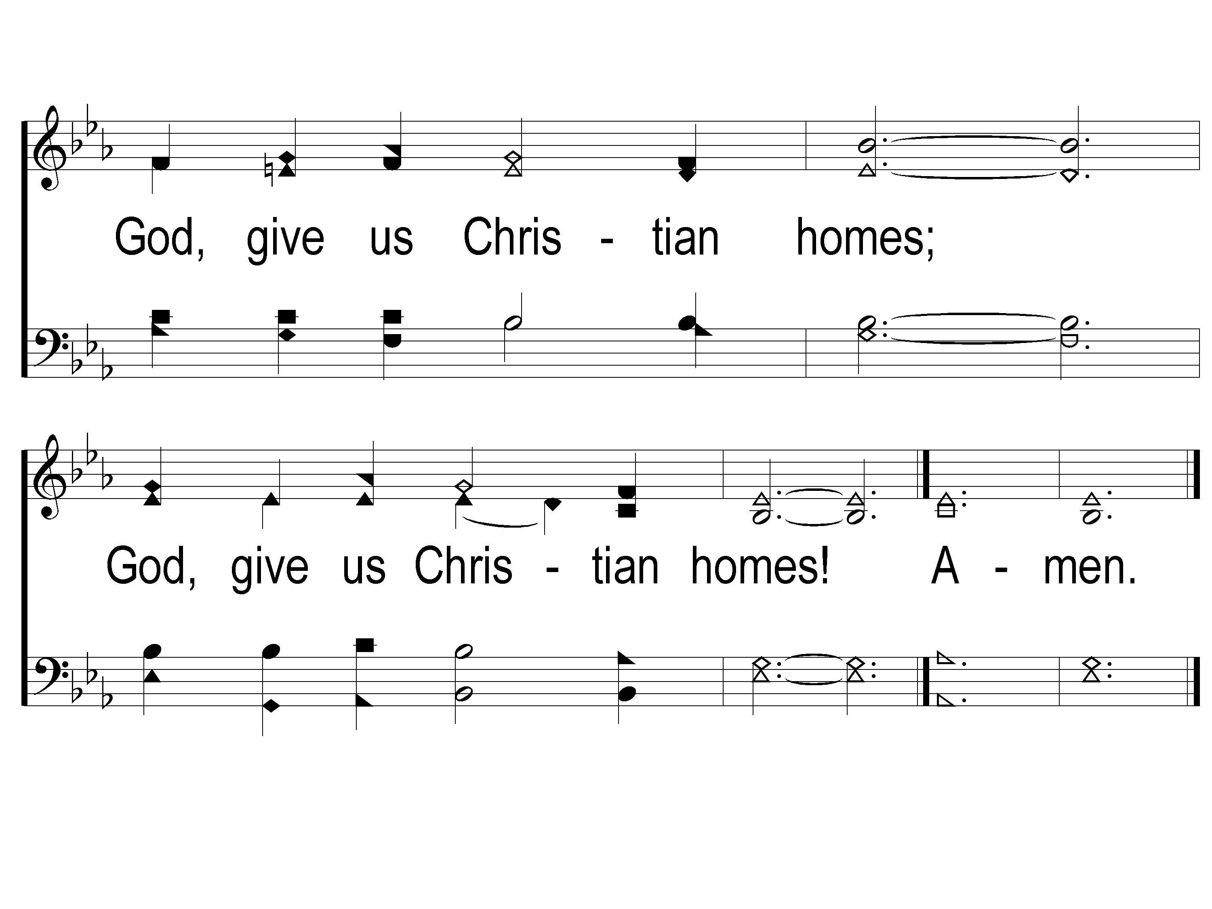
4-3 God Give Us Christian Homes
God Give Us Christian Homes
843
ePraise Hymn Presentation © 2005 Taylor Publications
ePraise Hymn Presentation © 2005 Taylor Publications

Slide 53
SCRIPTURE READING:
Proverbs 31:28-30

Slide 54
Godly wisdom
IN PURSUIT OF

Slide 55
The
WISDOM
of a Mother
2 Tim. 1:5-9

Slide 56
Eunice, A Wise Mother
Had Genuine Faith
2 Tim. 1:5
Rom. 14:22
2 Thess. 3:2
Philemon 5

Slide 57
Eunice, A Wise Mother
Transferred Genuine Faith
2 Tim. 1:5-6

Slide 58
Eunice, A Wise Mother
Transferred Genuine Faith By:
Developing Spiritual Disciplines

Slide 59
Eunice, A Wise Mother
Developing Spiritual Disciplines
Listening to God – 2 Tim. 3:15, Deut. 6:6-9

Slide 60
Eunice, A Wise Mother
Developing Spiritual Disciplines
Listening to God – 2 Tim. 3:15, Deut. 6:6-9
Talking to God – 1 Thess. 5:17

Slide 61
Eunice, A Wise Mother
Transferred Genuine Faith By:
Developing Spiritual Disciplines
Setting Forth Spiritual Goals

Slide 62
Eunice, A Wise Mother
Setting Forth Spiritual Goals
Good Leaders – 1 Tim. 3:1, Prov. 22:6

Slide 63
Eunice, A Wise Mother
Setting Forth Spiritual Goals
Good Leaders – 1 Tim. 3:1, Prov. 22:6
Good Followers – 1 Cor. 11:1, Heb. 13:17

Slide 64
Eunice, A Wise Mother
Transferred Genuine Faith By:
Developing Spiritual Disciplines
Setting Forth Spiritual Goals
Understanding Spiritual Necessities

Slide 65
Eunice, A Wise Mother
Understanding Spiritual Necessities
Suffering for the Gospel – 2 Tim. 3:12

Slide 66
Eunice, A Wise Mother
Understanding Spiritual Necessities
Suffering for the Gospel – 2 Tim. 3:12
Spreading the Gospel – Matt. 28:18-20

Slide 67
Is Your
FAITH
Like that of Eunice?

Slide 68
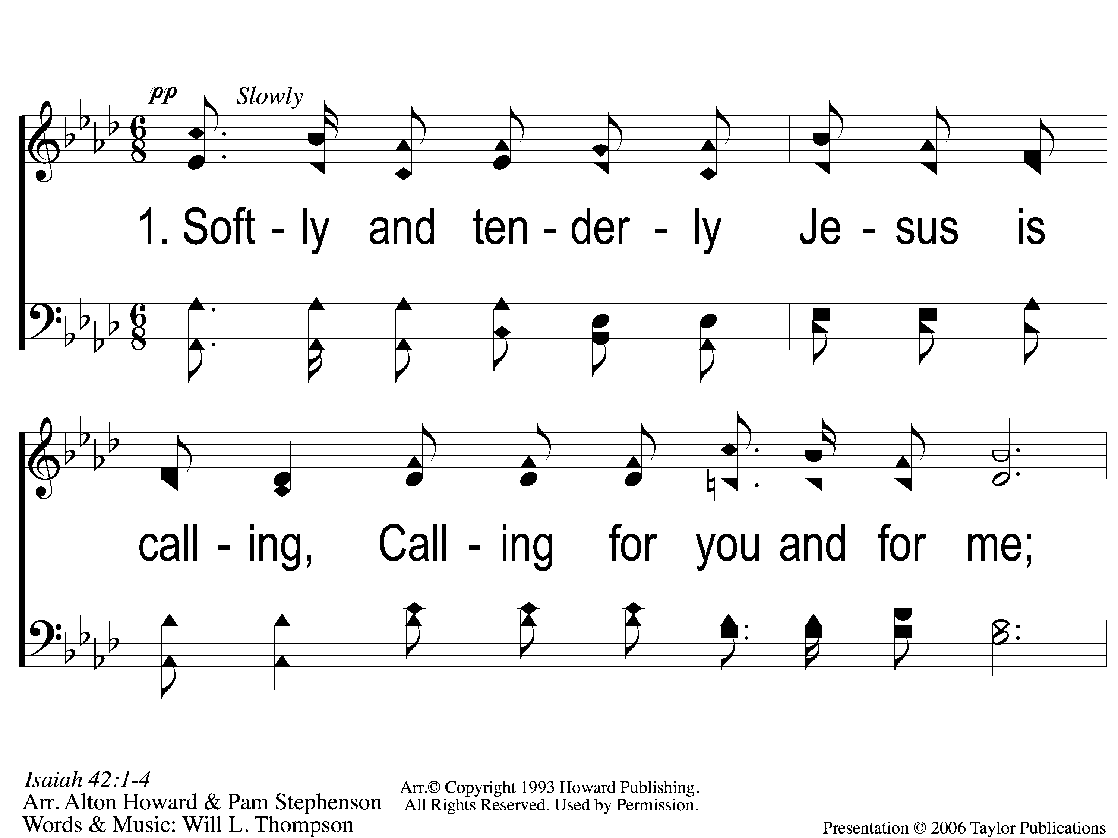
1-1 Softly and Tenderly
Softly and Tenderly
934

Slide 69
1-2 Softly and Tenderly
Softly and Tenderly
934

Slide 70
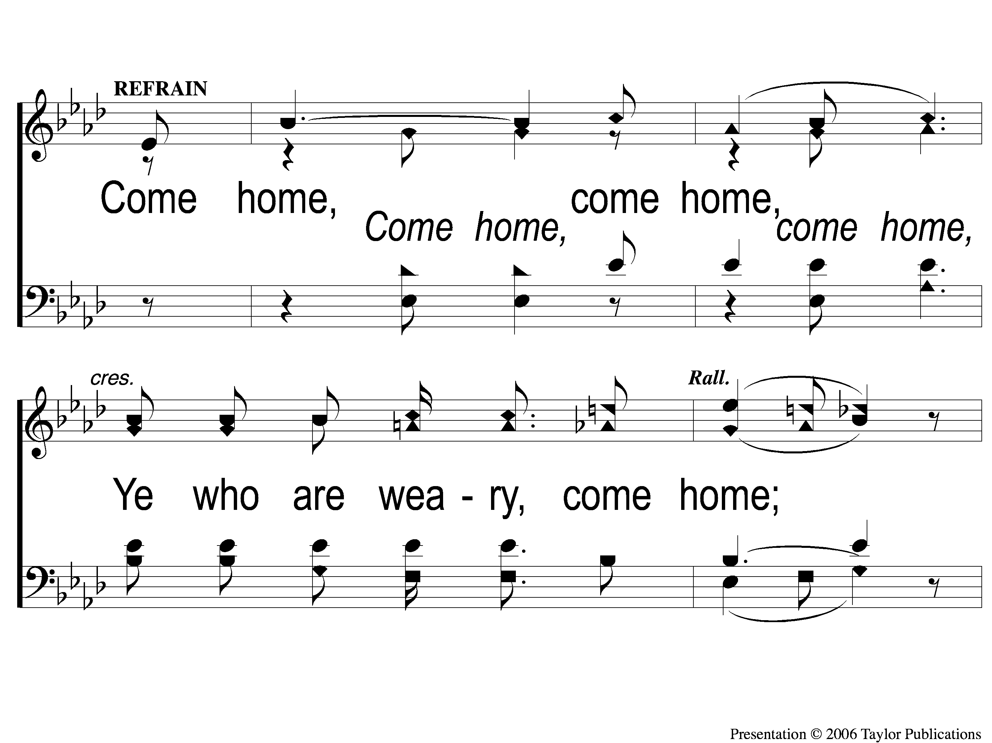
C-1 Softly and Tenderly
Softly and Tenderly
934

Slide 71
C-2 Softly and Tenderly
Softly and Tenderly
934

Slide 72
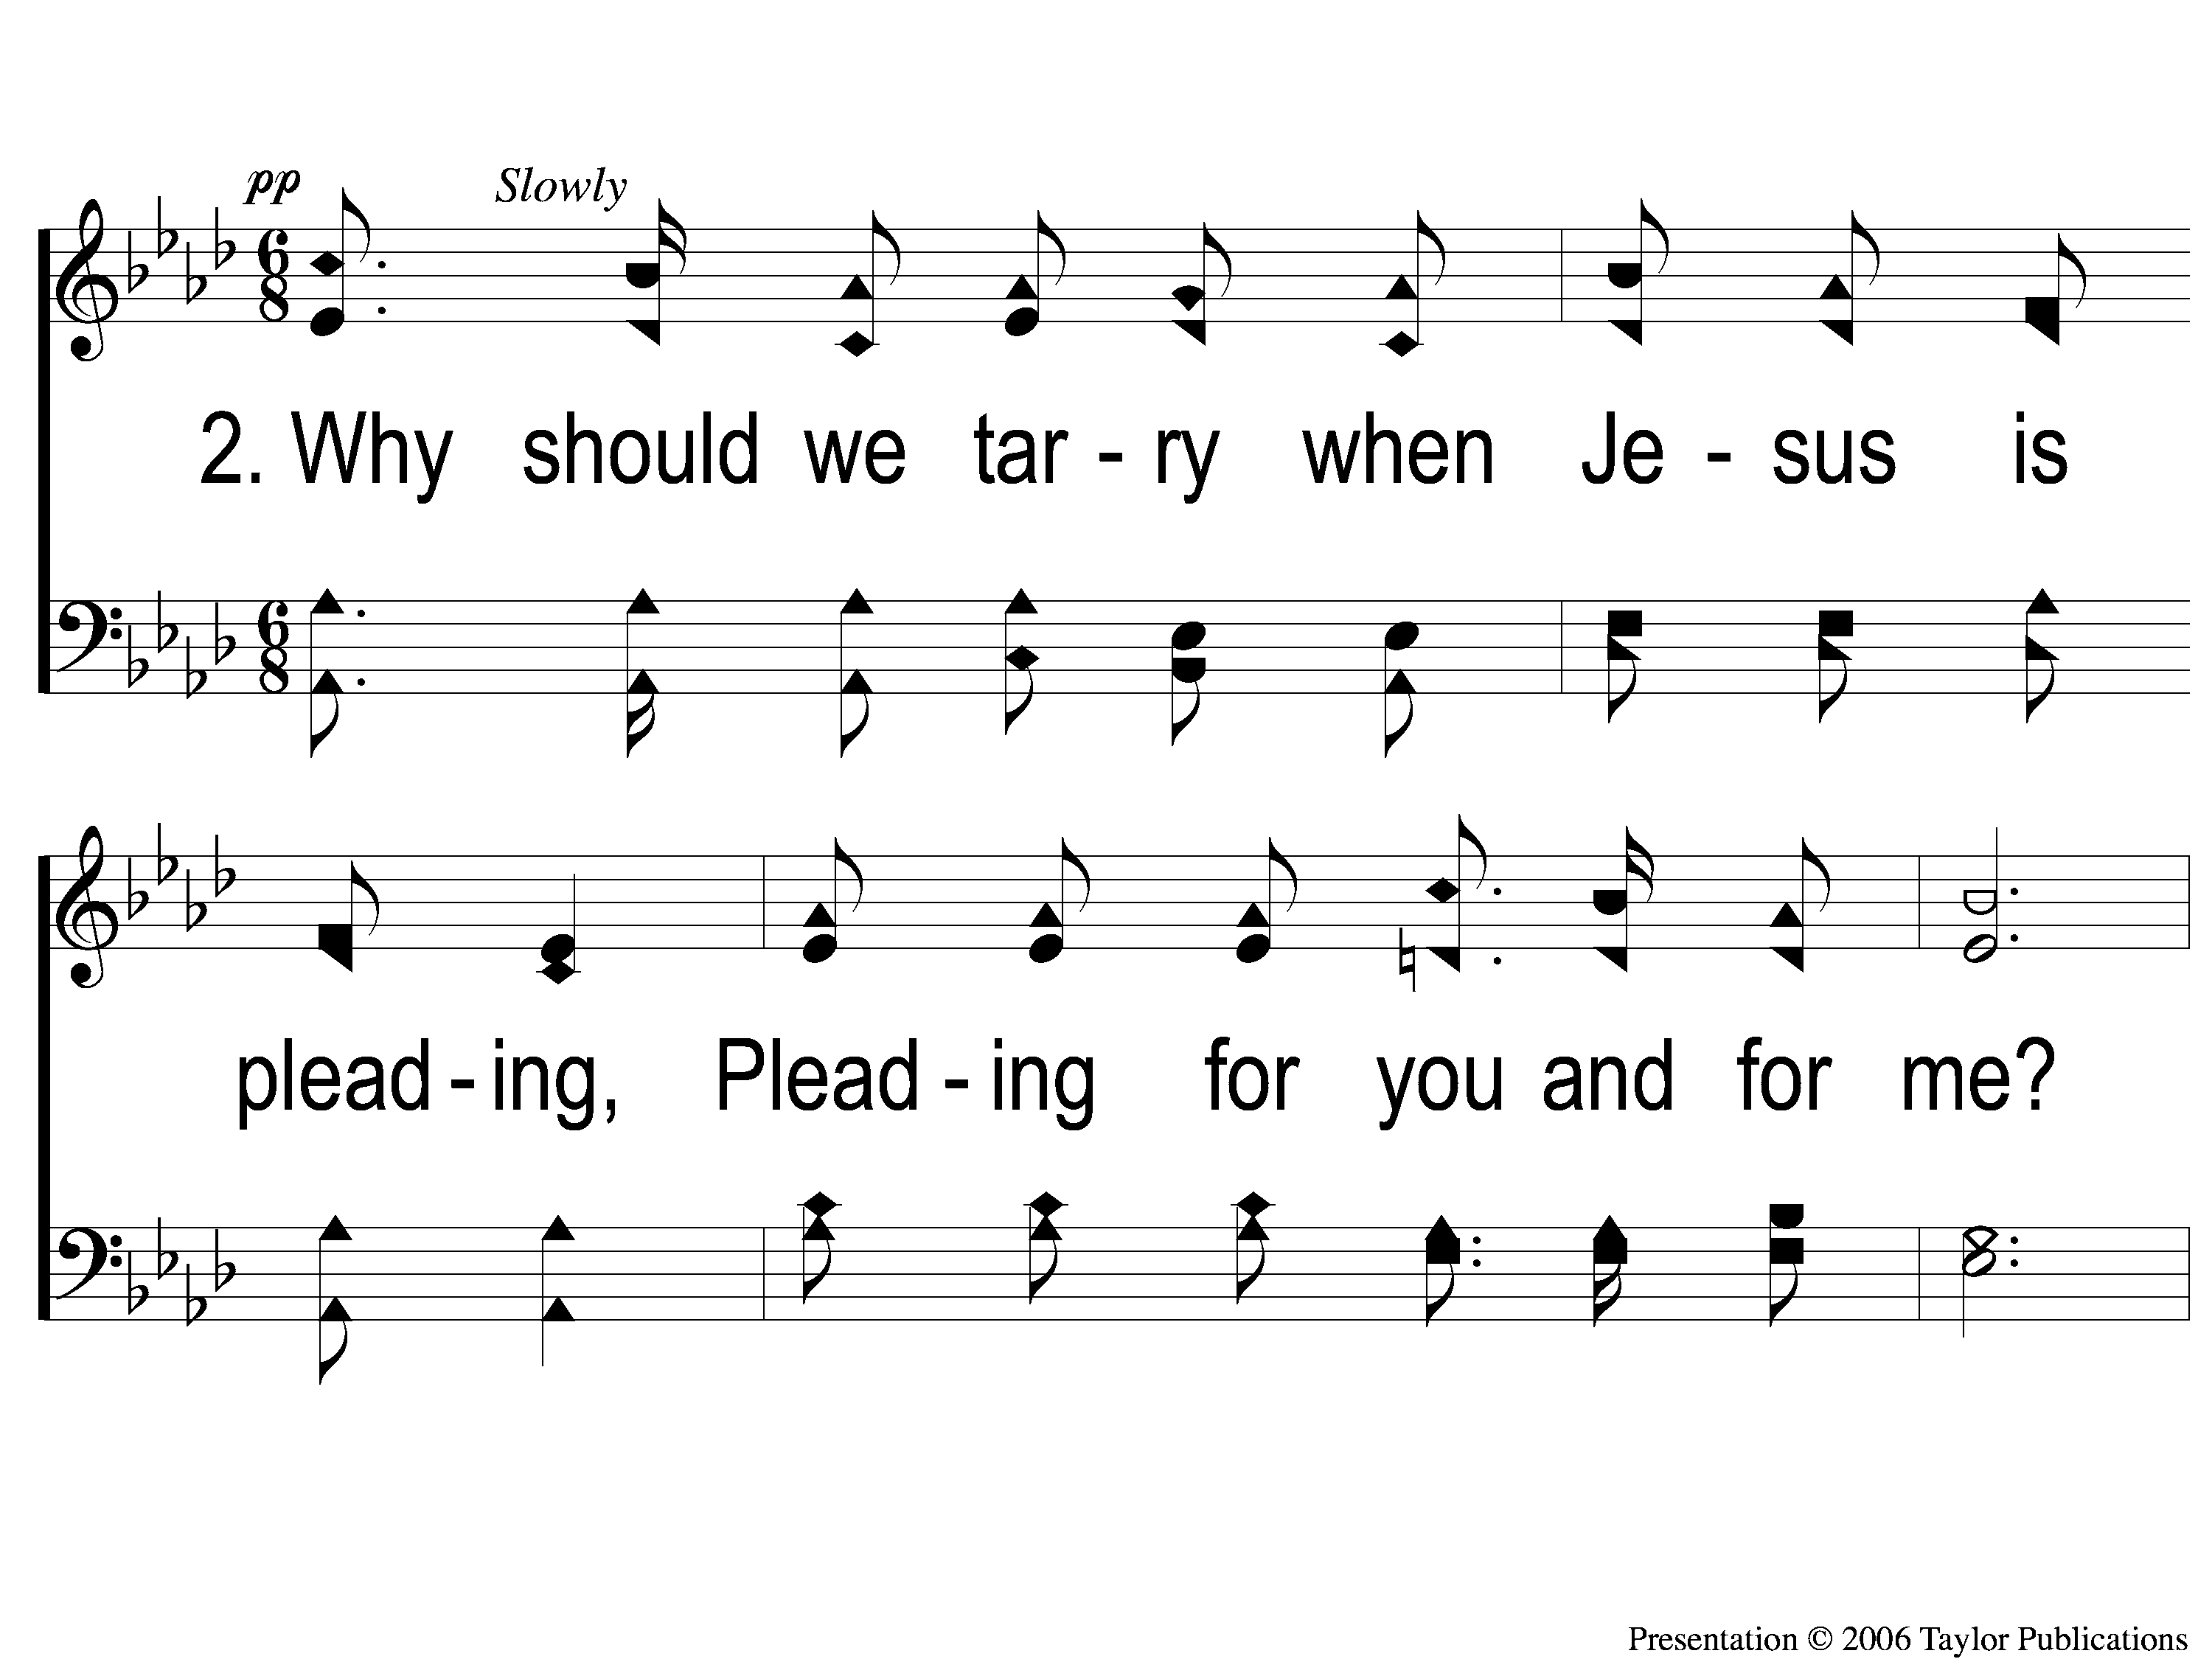
2-1 Softly and Tenderly
Softly and Tenderly
934

Slide 73
2-2 Softly and Tenderly
Softly and Tenderly
934

Slide 74
C-1 Softly and Tenderly
Softly and Tenderly
934

Slide 75
C-2 Softly and Tenderly
Softly and Tenderly
934

Slide 76
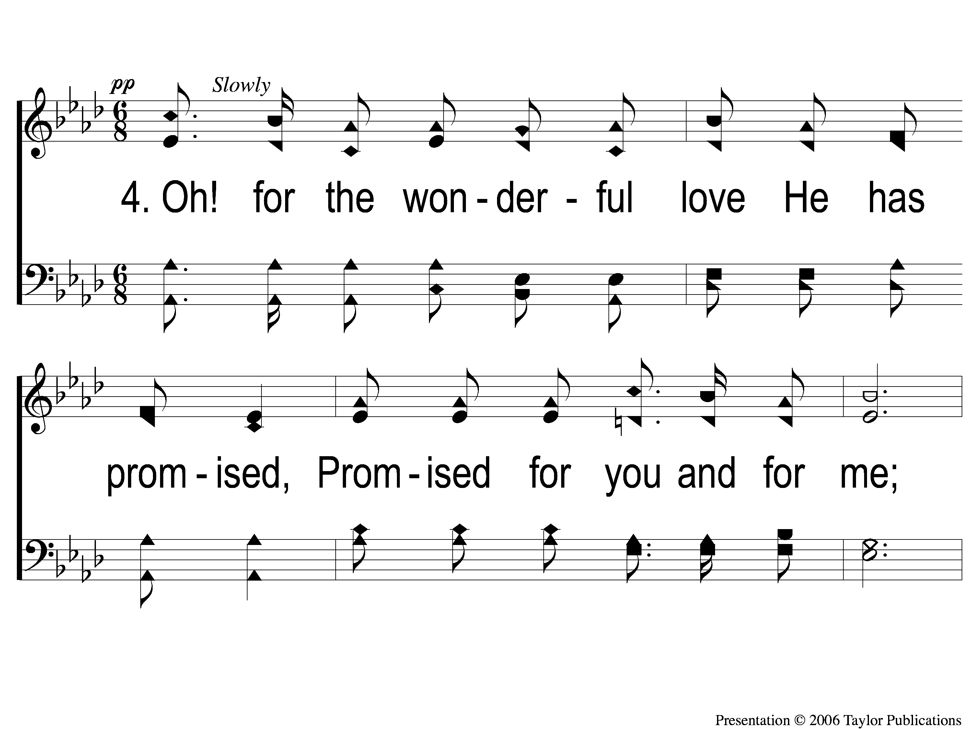
4-1 Softly and Tenderly
Softly and Tenderly
934

Slide 77
4-2 Softly and Tenderly
Softly and Tenderly
934

Slide 78
C-1 Softly and Tenderly
Softly and Tenderly
934

Slide 79
C-2 Softly and Tenderly
Softly and Tenderly
934

Slide 80
OUR CONTRIBUTION
1 john 3:16-17
“By this we know love, because He laid down His life for us. And we also ought to lay down our lives for the brethren. But whoever has this world’s goods, and sees his brother in need, and shuts up his heart from him, how does the love of God abide in him?”

Slide 81
SONG:
Jesus keep me near the cross
#383

Slide 82
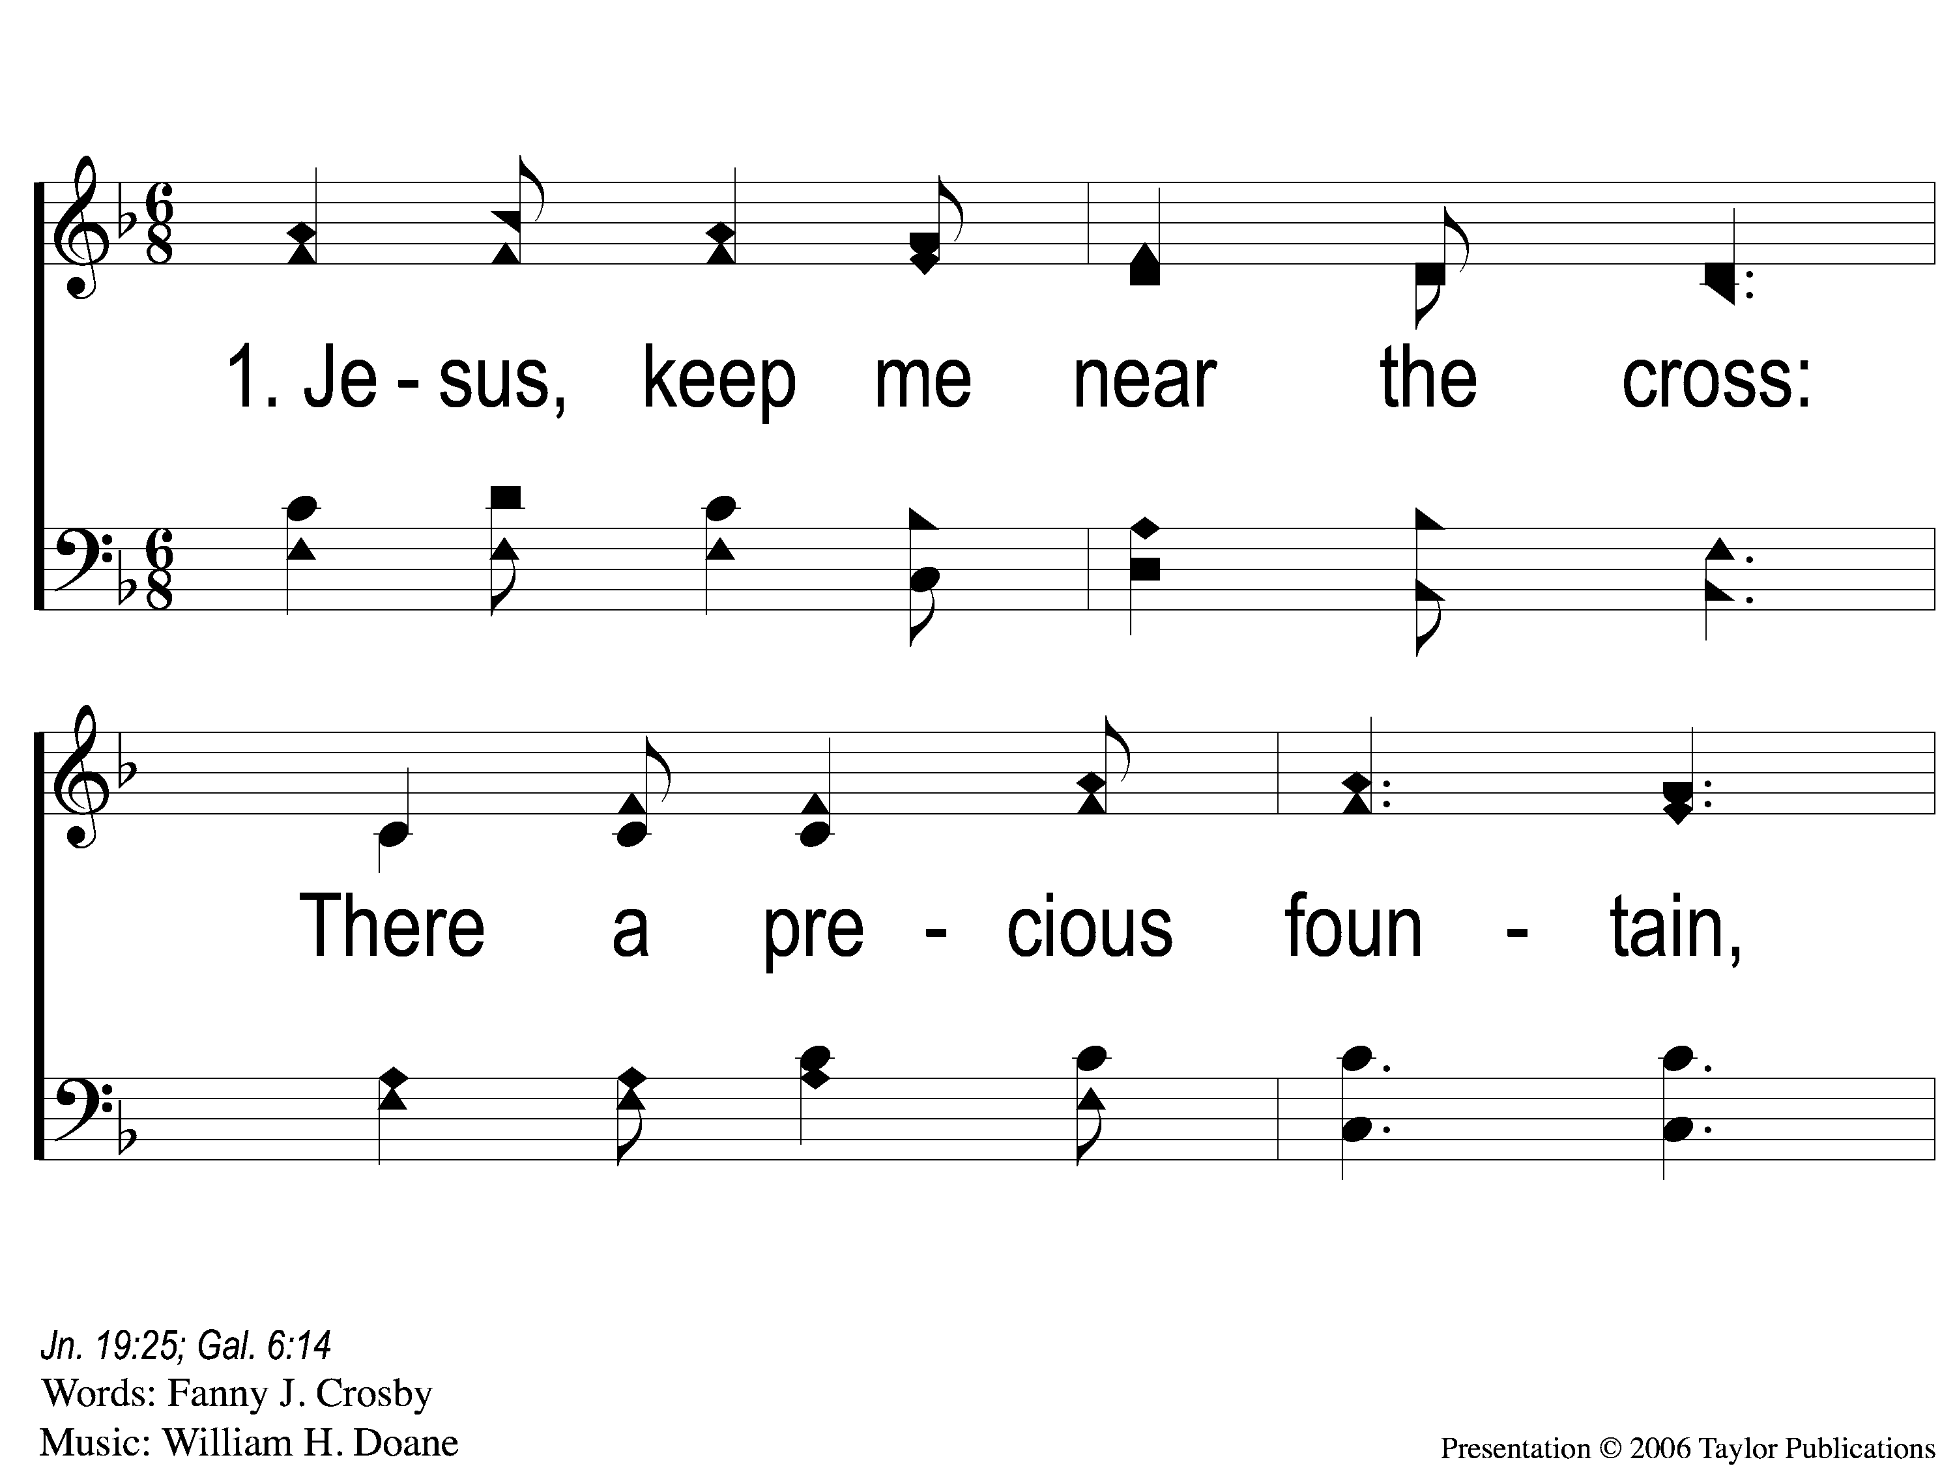
1-1 Jesus Keep Me Near the Cross
Jesus Keep Me Near The Cross
383

Slide 83
1-2 Jesus Keep Me Near the Cross
Jesus Keep Me Near The Cross
383

Slide 84
C Jesus Keep Me Near the Cross
Jesus Keep Me Near The Cross
383

Slide 85
3-1 Jesus Keep Me Near the Cross
Jesus Keep Me Near The Cross
383

Slide 86
3-2 Jesus Keep Me Near the Cross
Jesus Keep Me Near The Cross
383

Slide 87
C Jesus Keep Me Near the Cross
Jesus Keep Me Near The Cross
383

Slide 88
THE UNLEAVENED BREAD
Revelation 1:17-18
“And when I saw Him, I fell at His feet as dead. But He laid His right hand on me, saying to me, “Do not be afraid; I am the First and the Last. I am He who lives, and was dead, and behold, I am alive forevermore.”

Slide 89
THE FRUIT OF THE VINE
Revelation 5:9-10
“ And they sang a new song, saying: ‘You are worthy to take the scroll, And to open its seals; For You were slain, And have redeemed us to God by Your blood Out of every tribe and tongue and people and nation, And have made us kings and priests to our God; And we shall reign on the earth.’ ”

Slide 90
closing PRAYER

Slide 91
SONG:
This world is not my home
#957

Slide 92
1-1 This World is Not My Home
This World Is Not My Home
957

Slide 93
1-2 This World is Not My Home
This World Is Not My Home
957

Slide 94
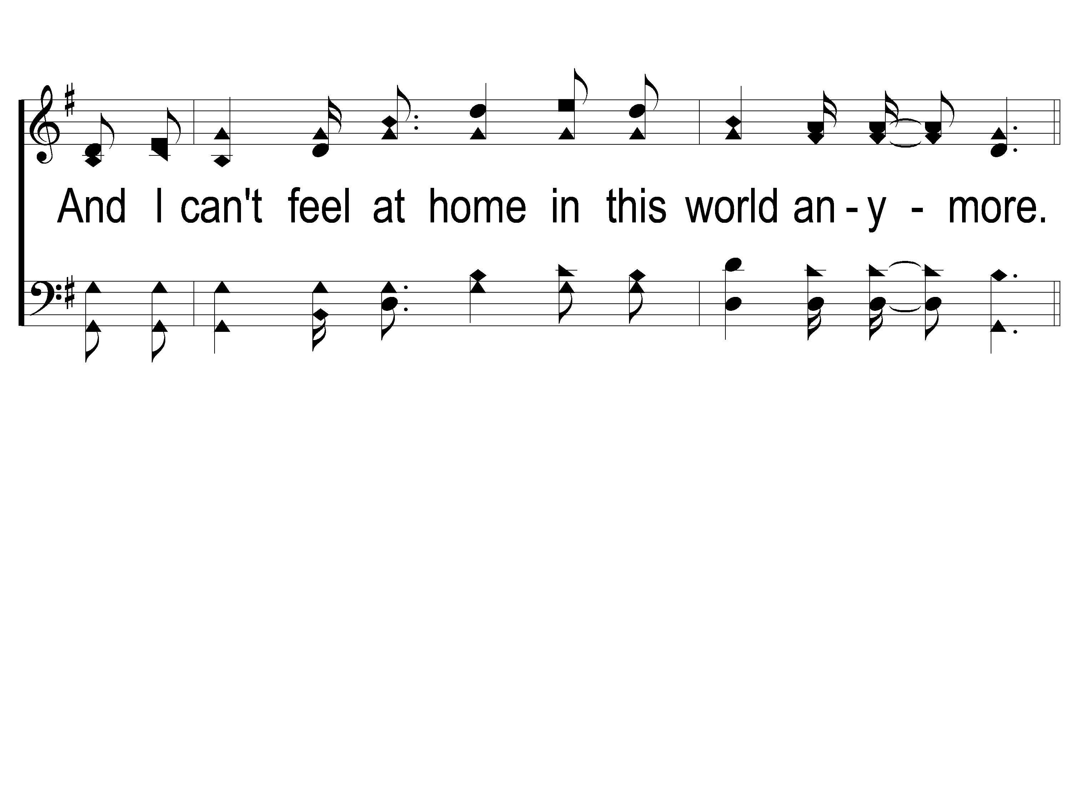
1-3 This World is Not My Home
This World Is Not My Home
957

Slide 95
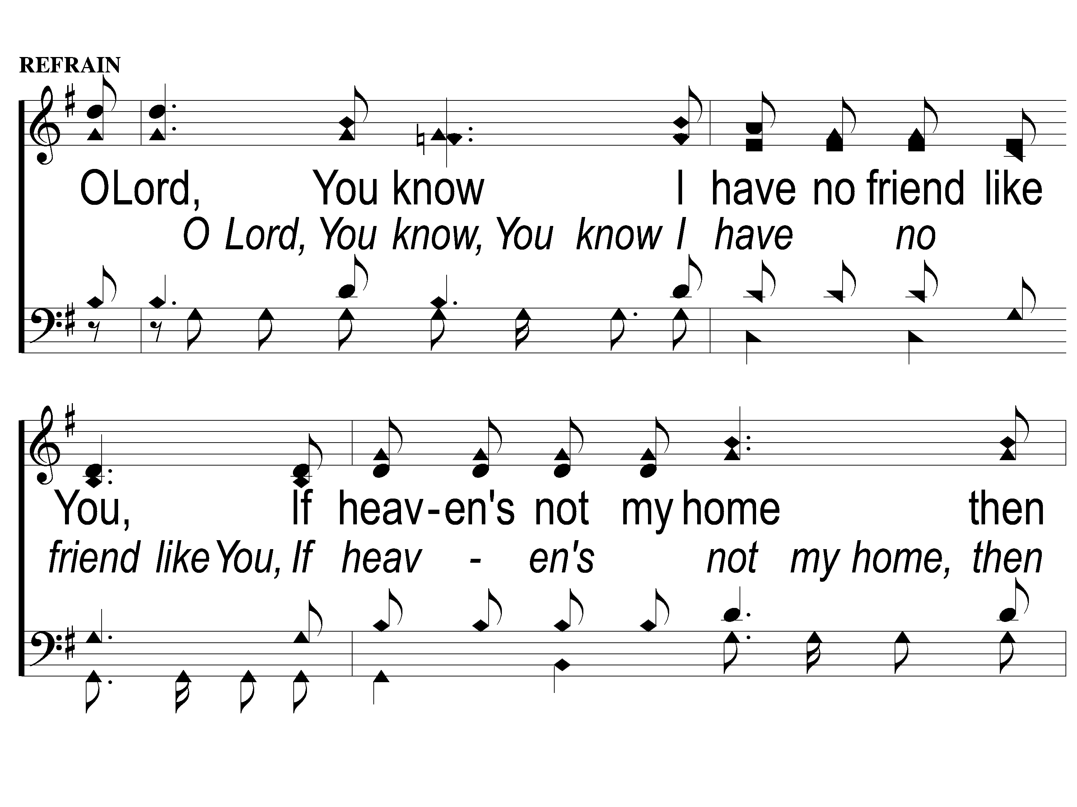
C-1 This World is Not My Home
This World Is Not My Home
957

Slide 96
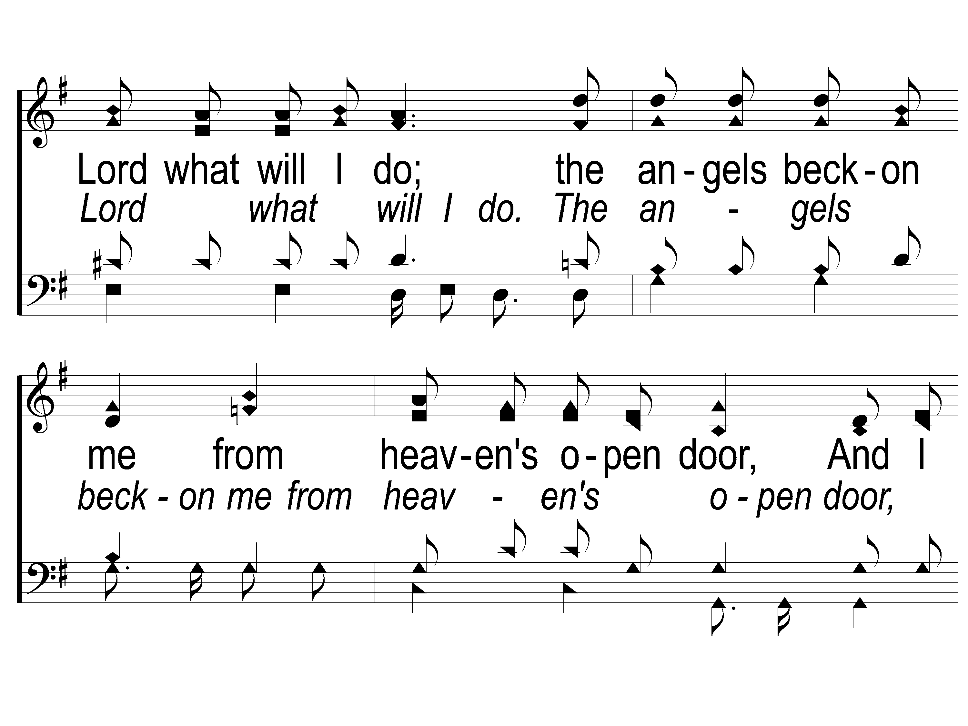
C-2 This World is Not My Home
This World Is Not My Home
957

Slide 97
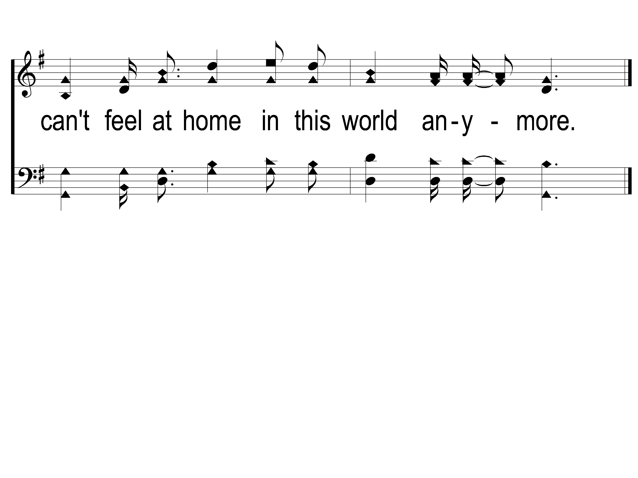
C-3 This World is Not My Home
This World Is Not My Home
957

Slide 98
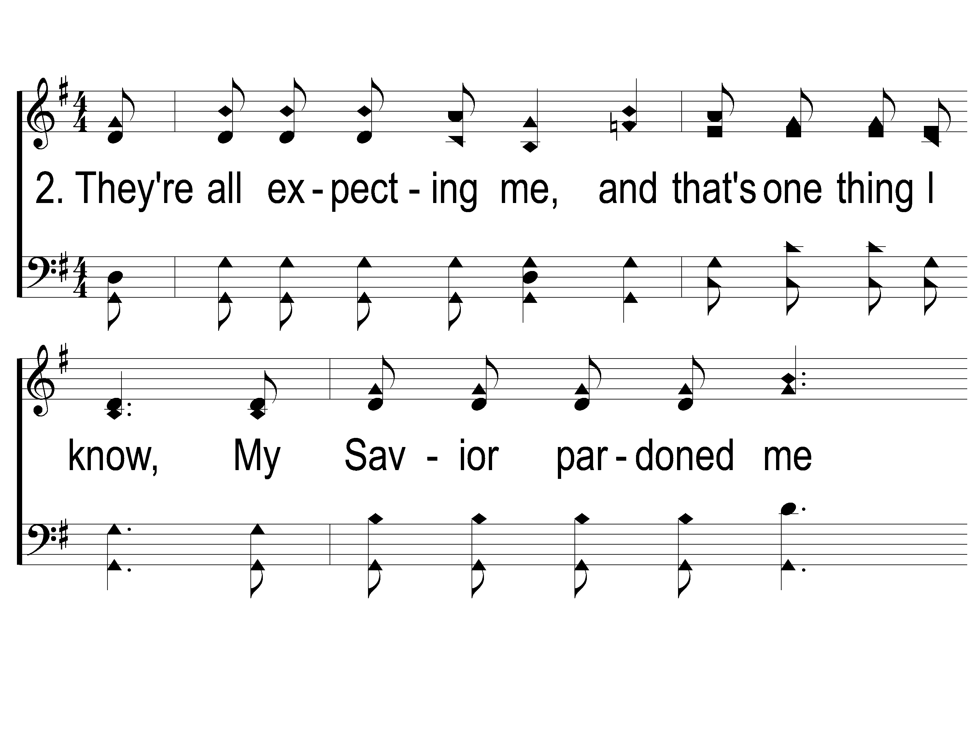
2-1 This World is Not My Home
This World Is Not My Home
957

Slide 99
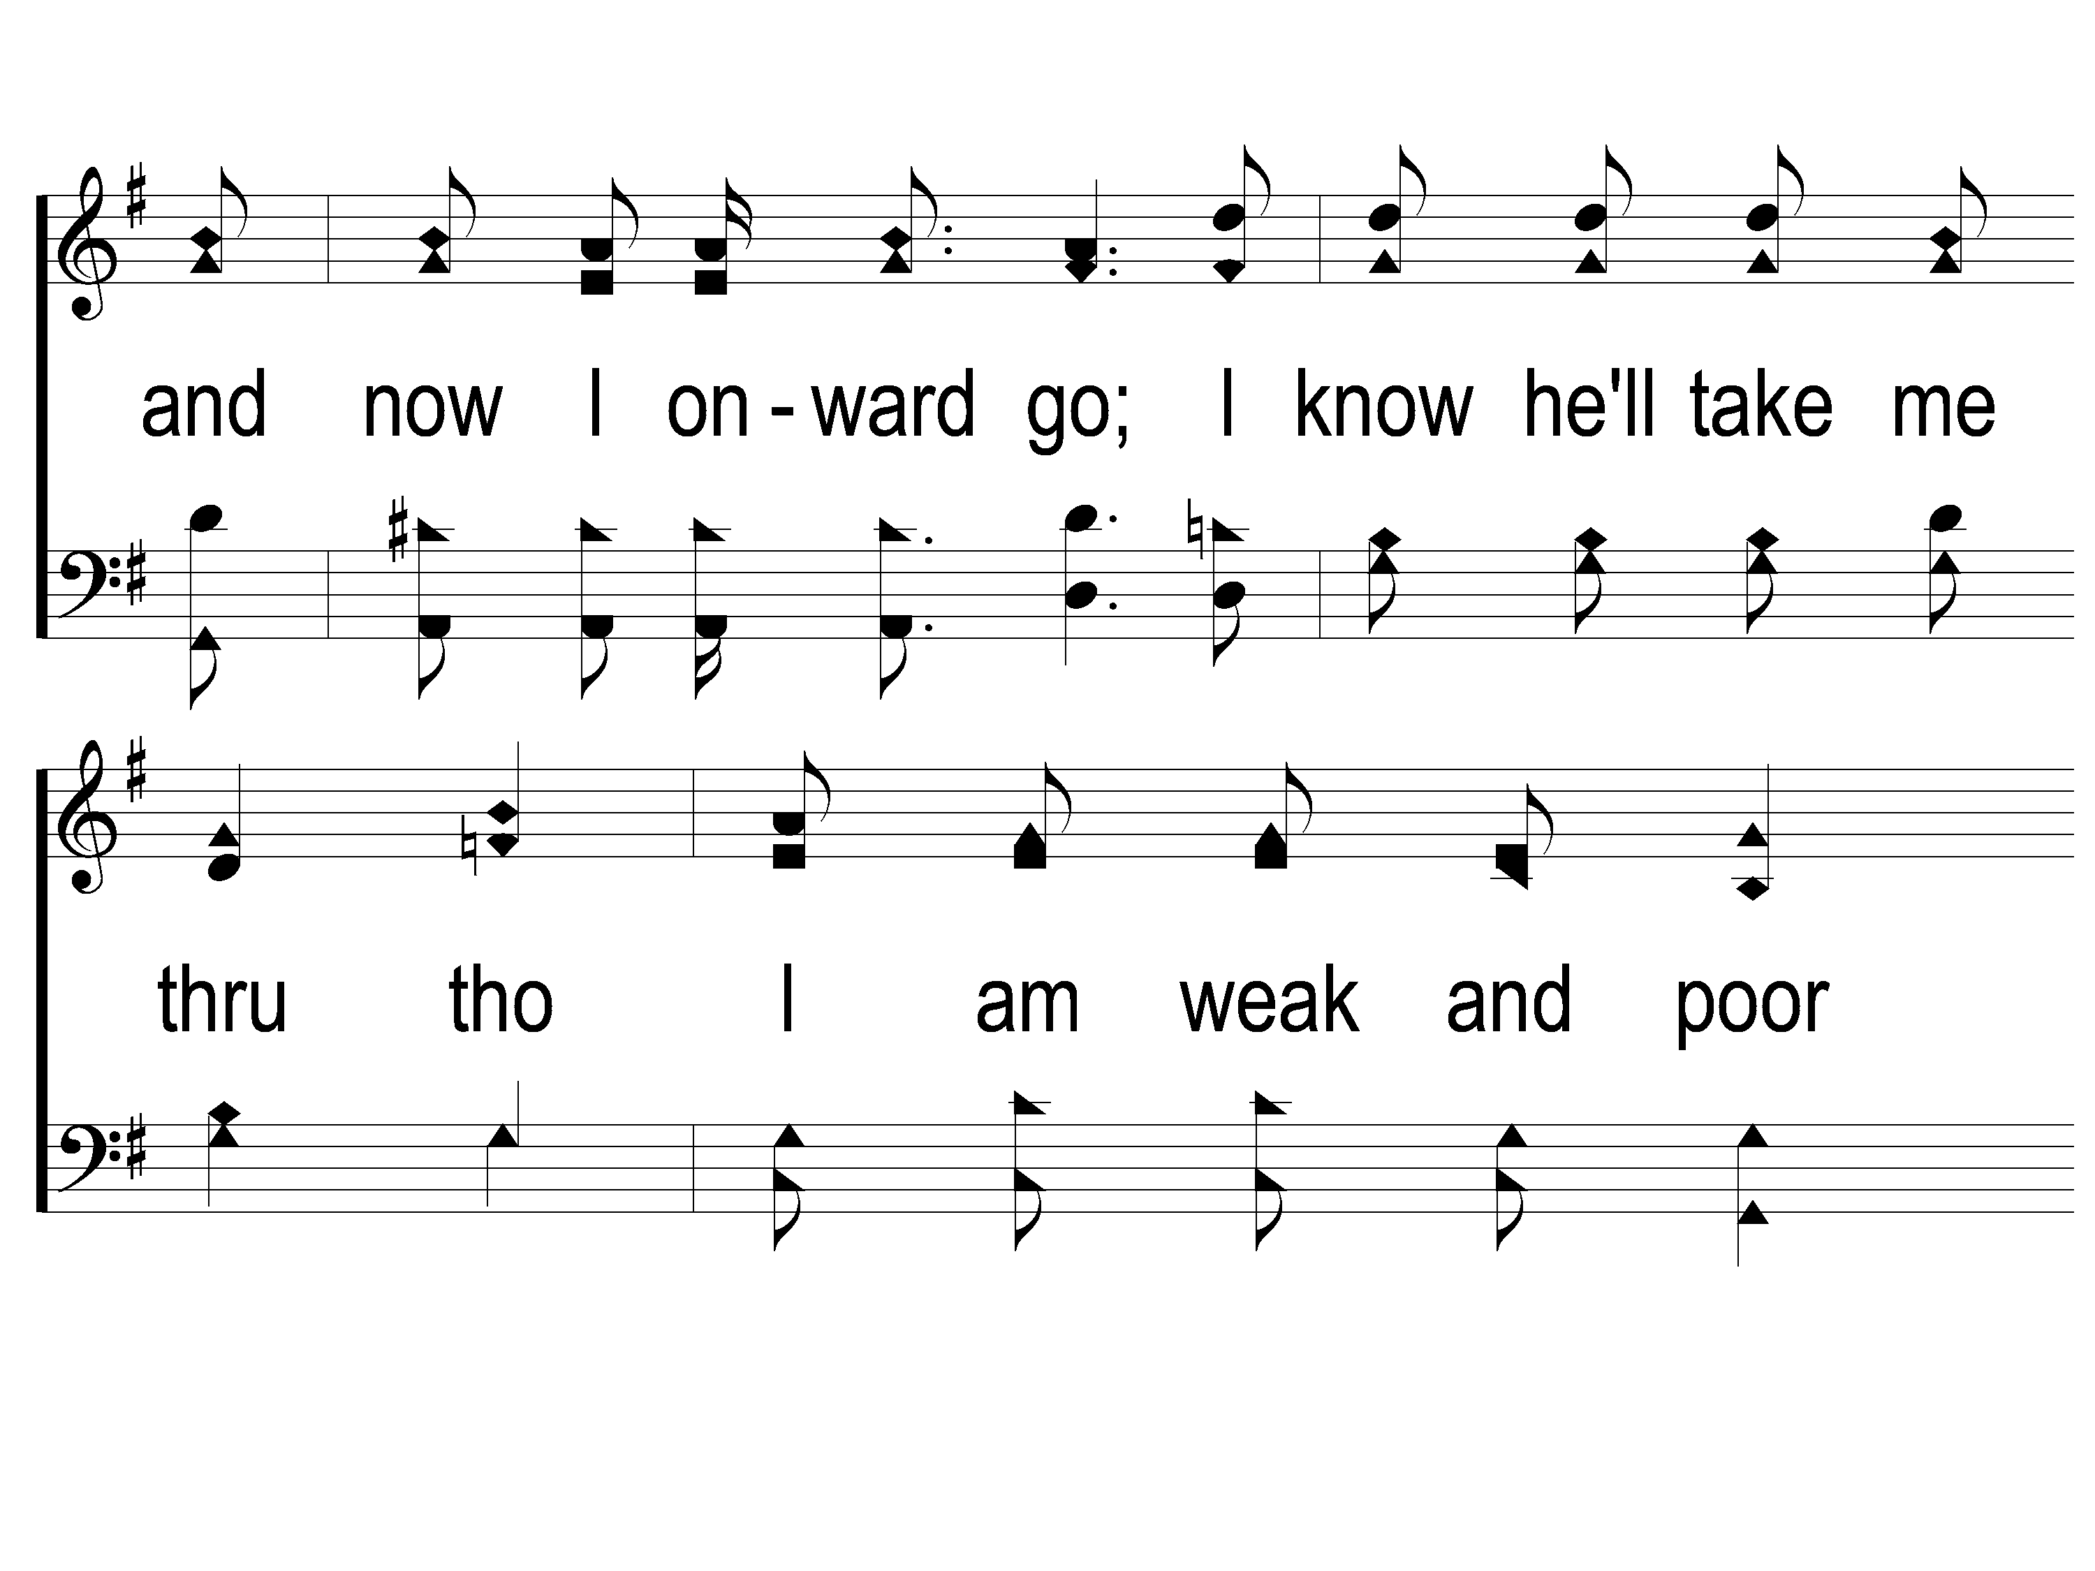
2-2 This World is Not My Home
This World Is Not My Home
957

Slide 100
2-3 This World is Not My Home
This World Is Not My Home
957

Slide 101
C-1 This World is Not My Home
This World Is Not My Home
957

Slide 102
C-2 This World is Not My Home
This World Is Not My Home
957

Slide 103
C-3 This World is Not My Home
This World Is Not My Home
957

Slide 104
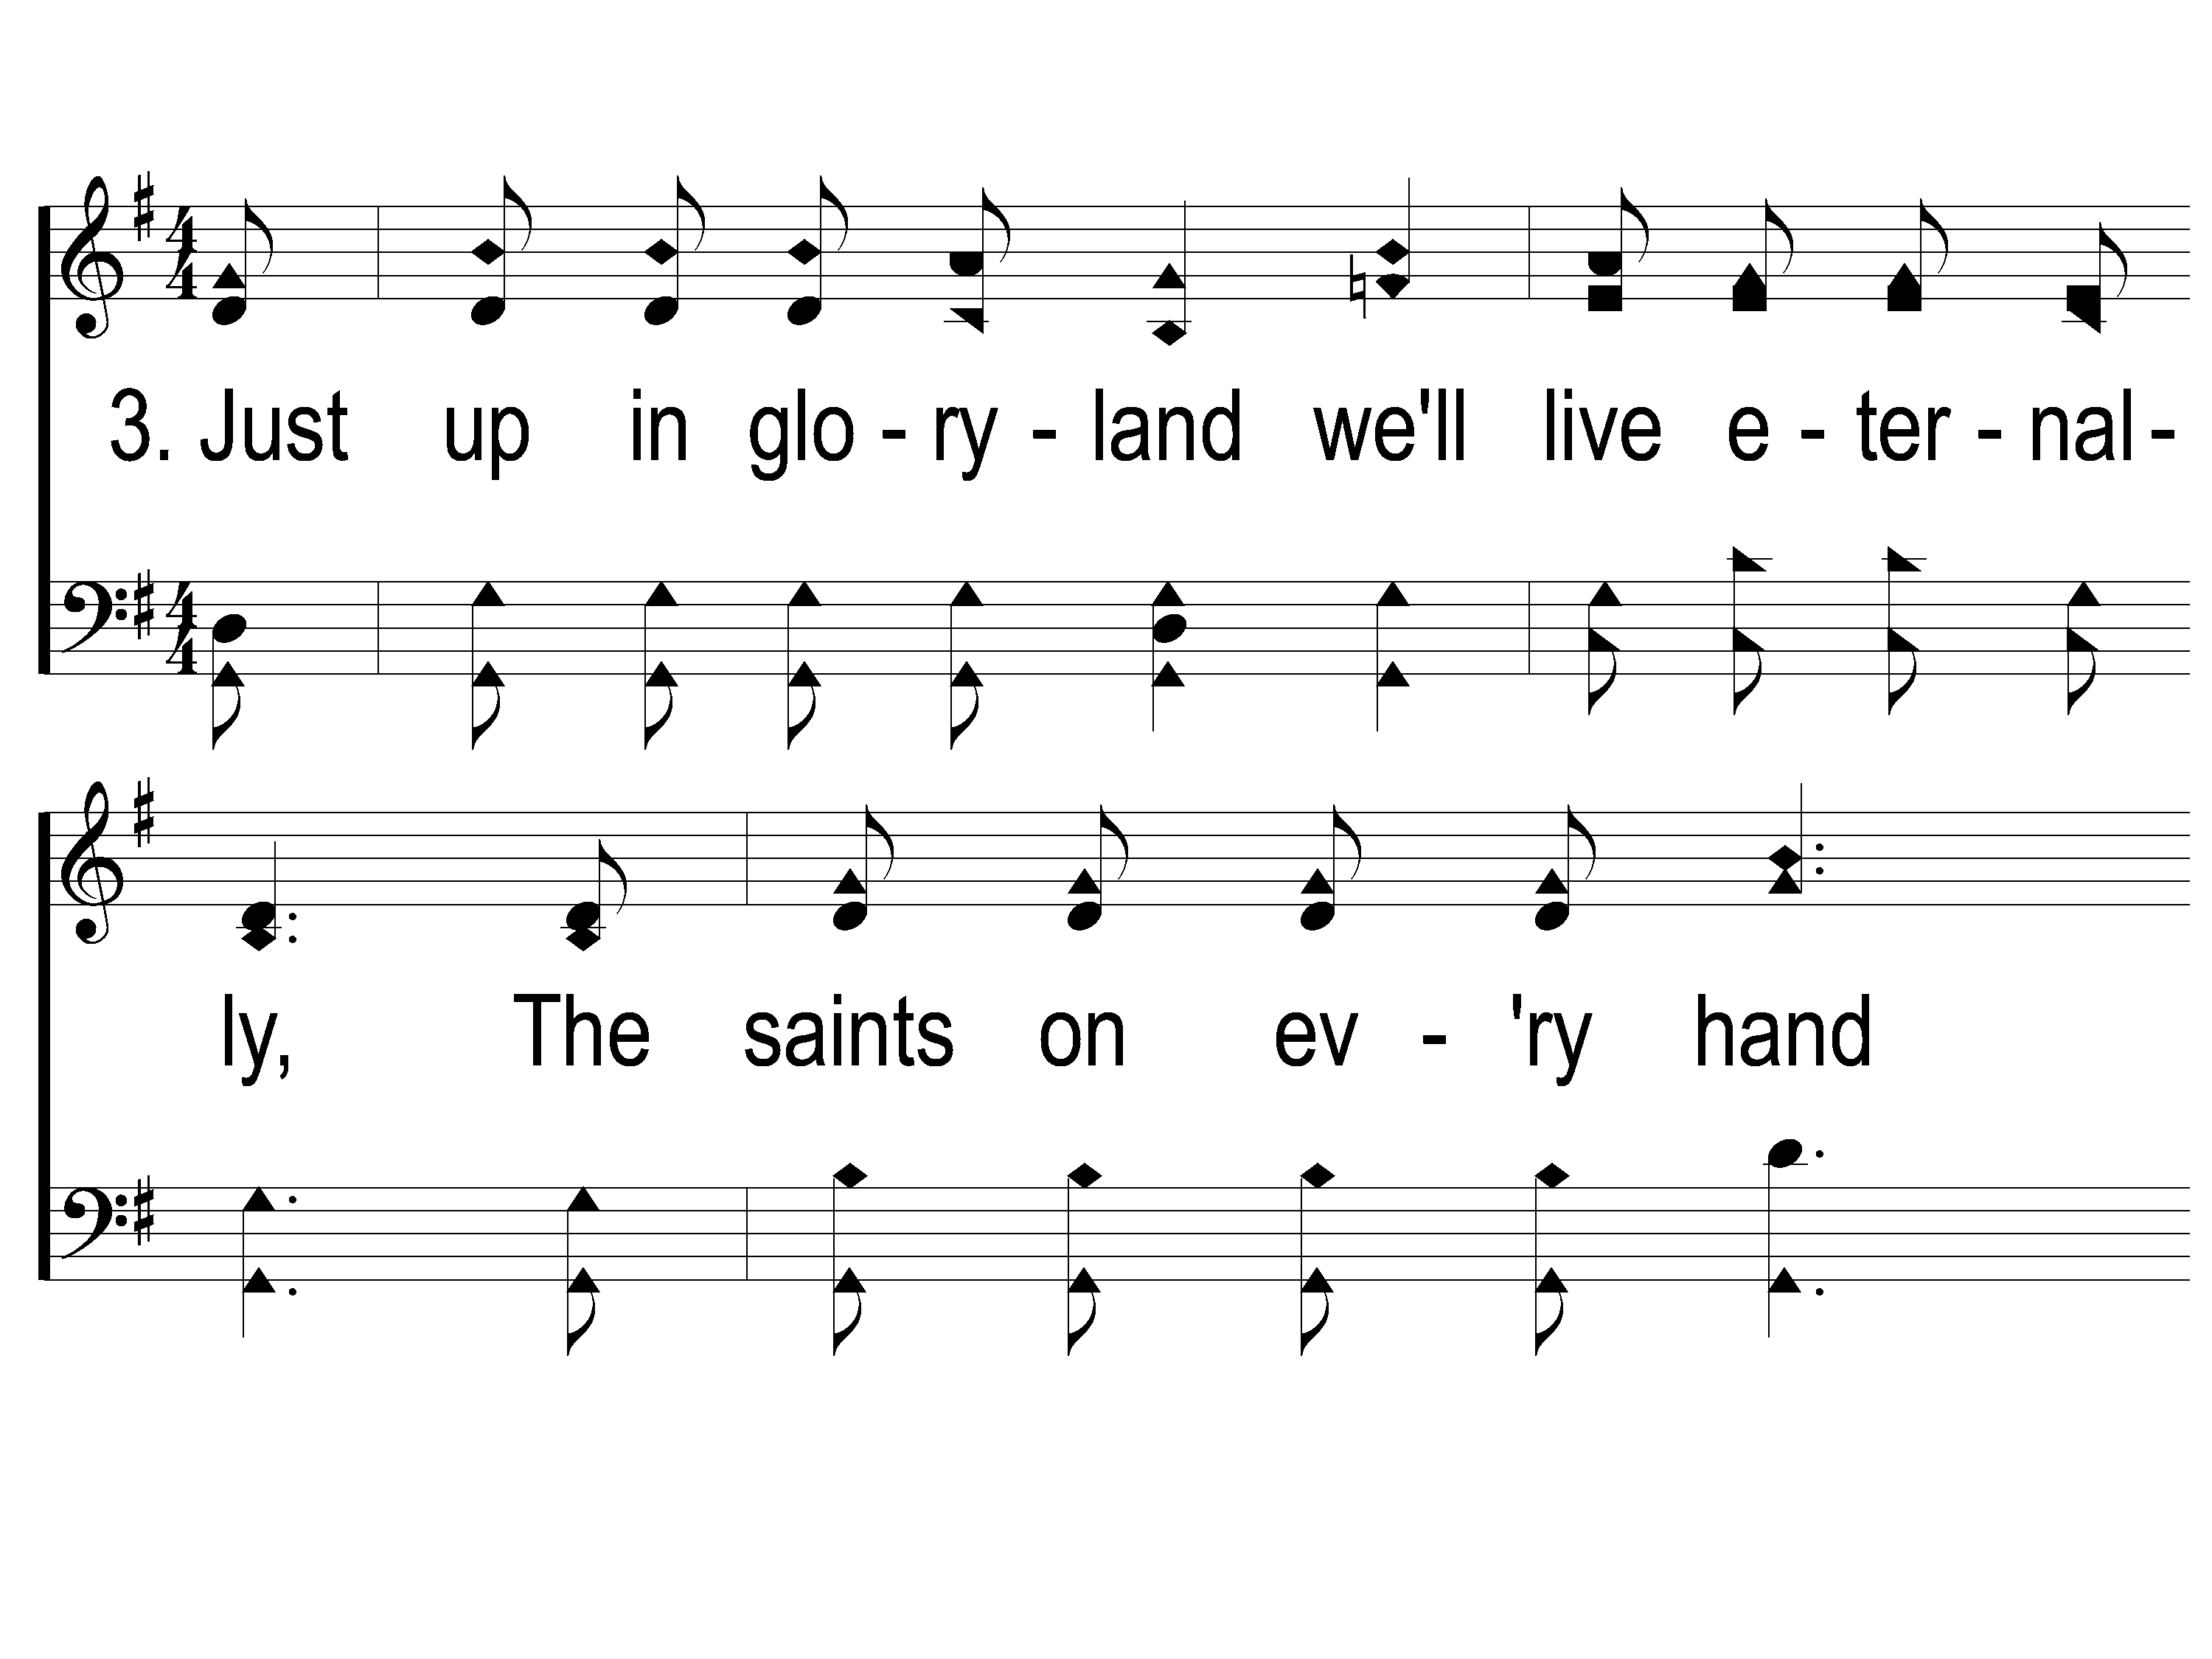
3-1 This World is Not My Home
This World Is Not My Home
957

Slide 105
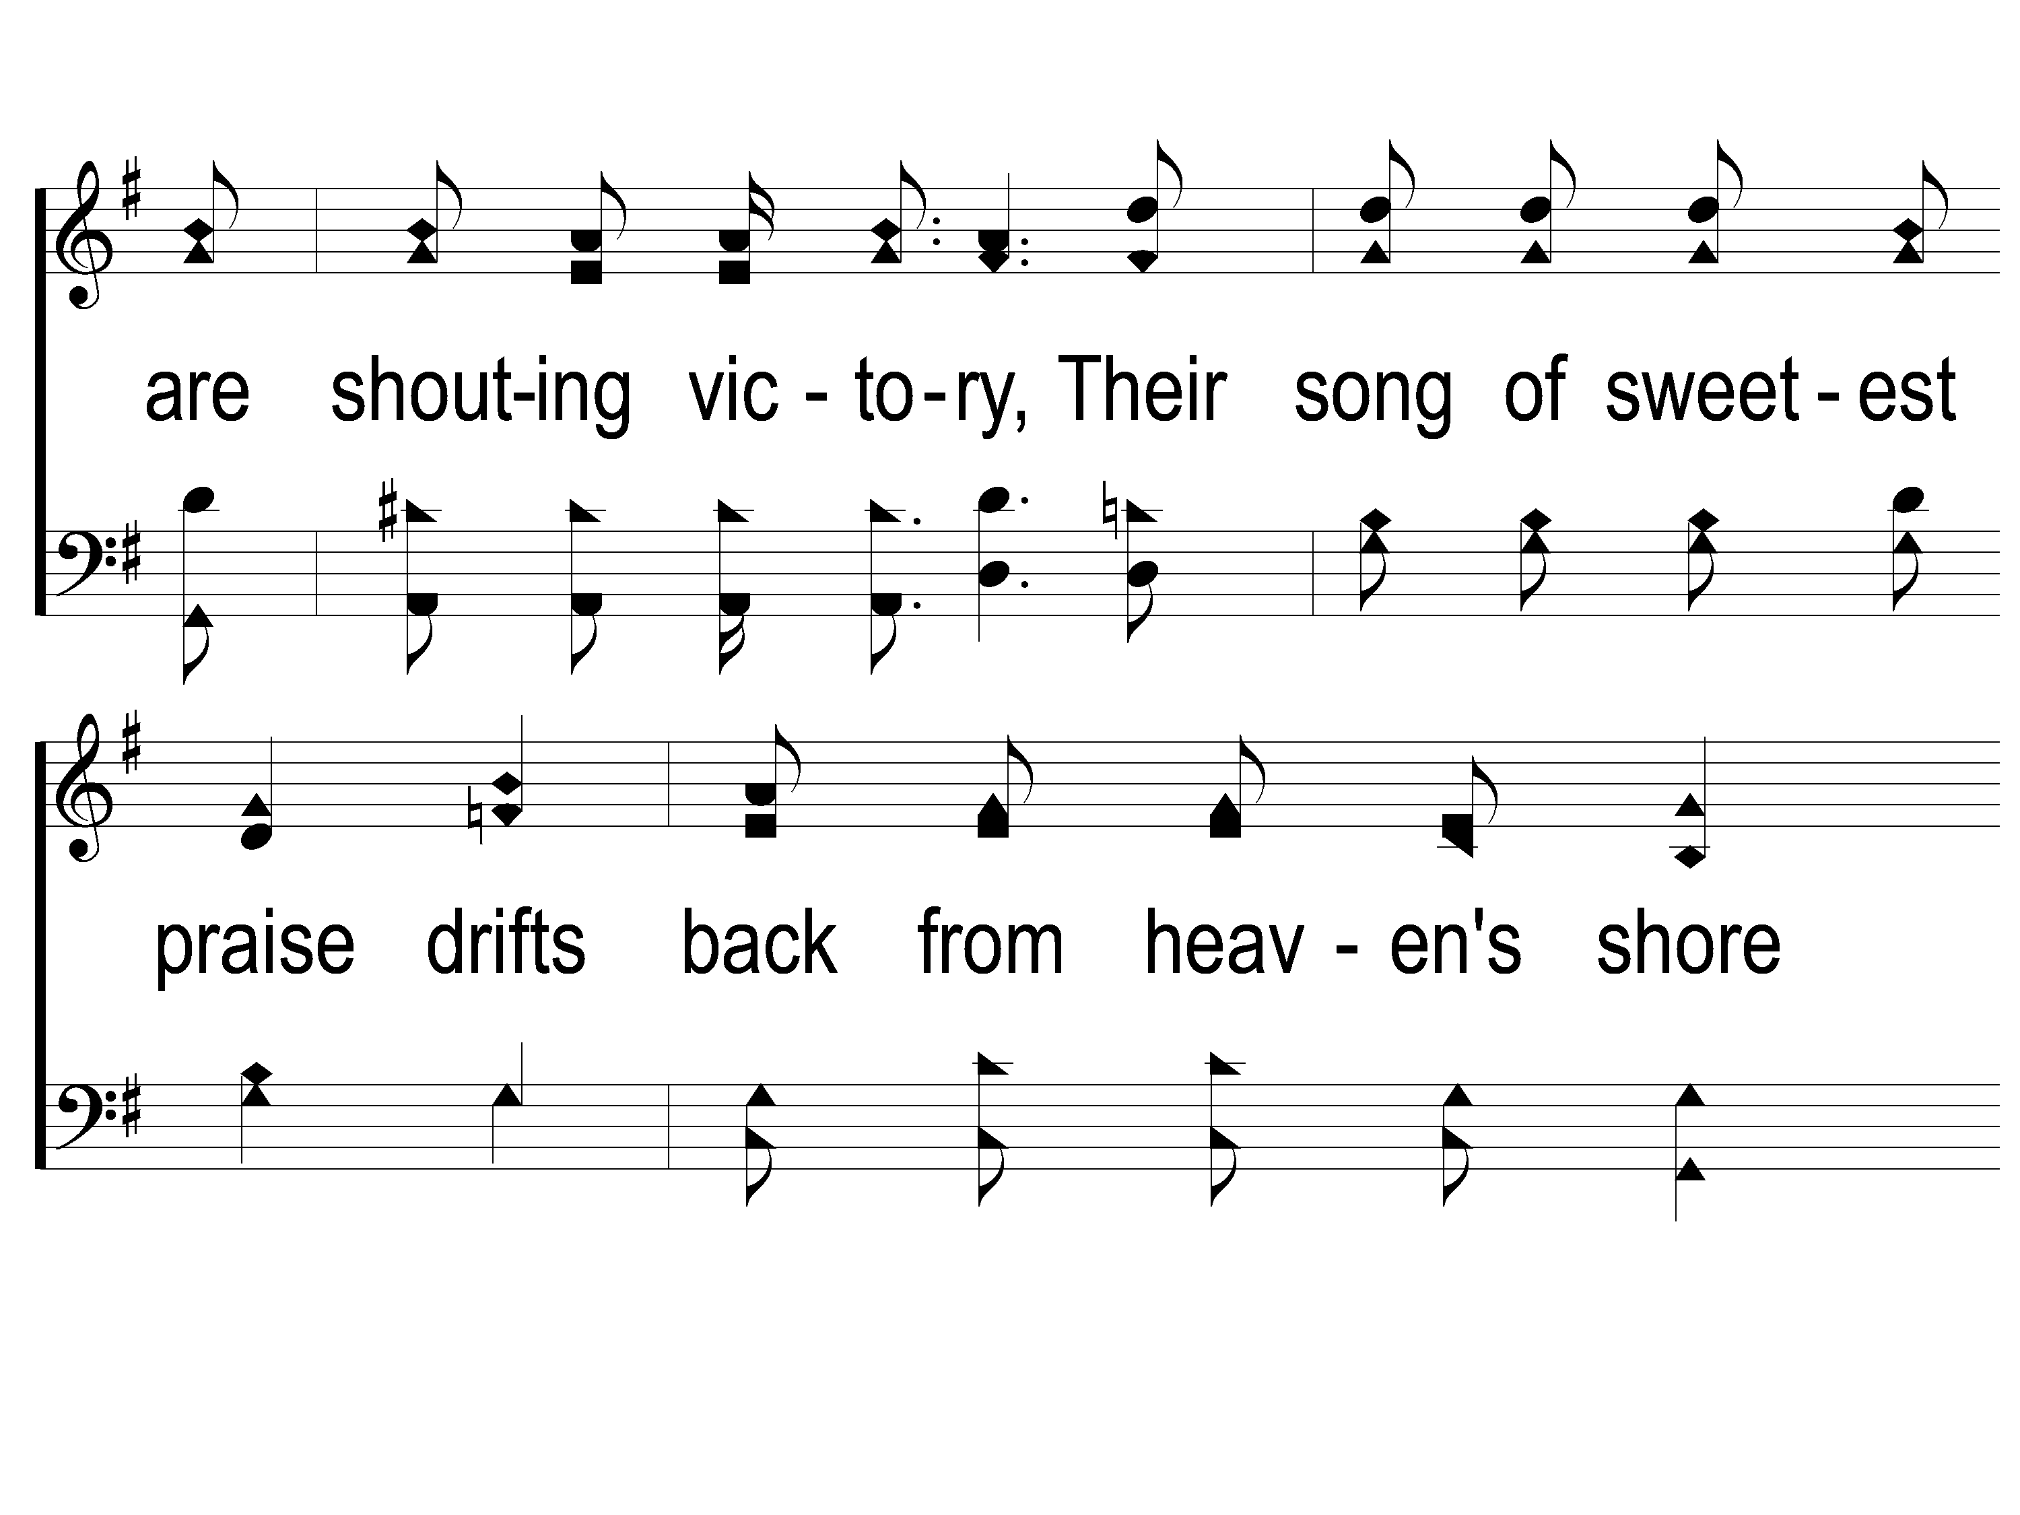
3-2 This World is Not My Home
This World Is Not My Home
957

Slide 106
3-3 This World is Not My Home
This World Is Not My Home
957

Slide 107
C-1 This World is Not My Home
This World Is Not My Home
957

Slide 108
C-2 This World is Not My Home
This World Is Not My Home
957

Slide 109
C-3 This World is Not My Home
This World Is Not My Home
957

Slide 110
Today
Worship @ 6 pm
Wednesday
Worship & Bible classes @ 6:30

