Slide 1
WELCOME
To the Wheeler church of Christ

Slide 2
Songs of praise to God

Slide 3
OPENING PRAYER

Slide 4
Songs of praise to God

Slide 5
The Queen Mother

Slide 6
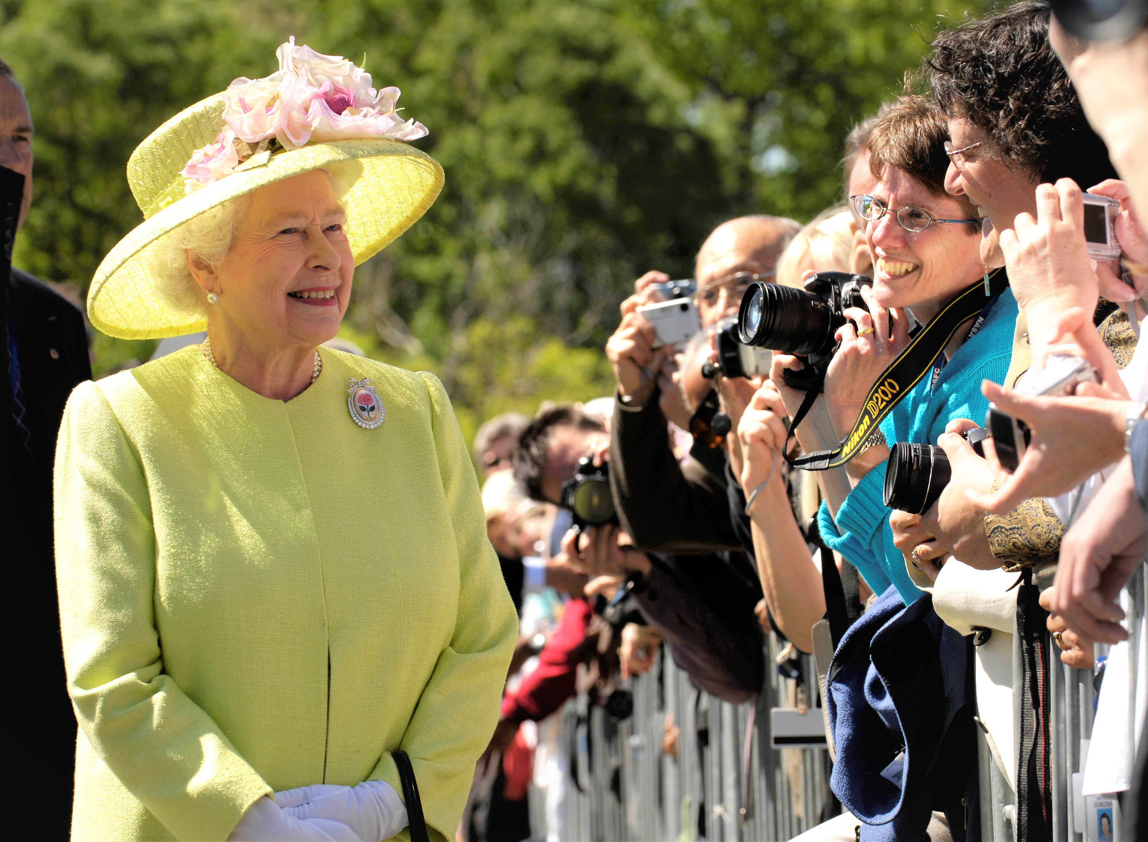

Slide 7
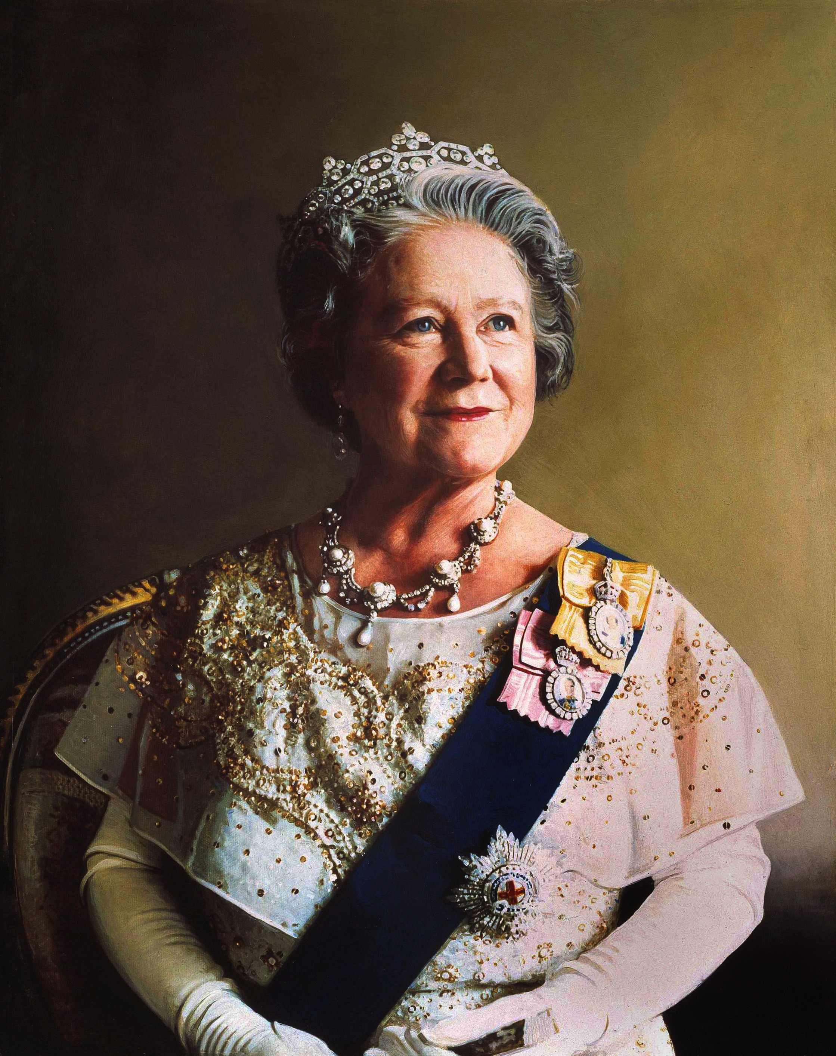

Slide 8
The Queen Mother
Why are the King’s mother’s mentioned?
1 Kings 15:9-10
2 Kings 24:8
2 Chron. 22:3

Slide 9
The Queen Mother
“Gebirah”
“Queen Mother” or “Great Lady”
Jer. 13:18

Slide 10
The Queen Mother
Three Roles:
Royal Power
Counselor
intercessor

Slide 11
Royal Power
Had Claim to the Throne
2 Kings 11;1-3, 24:12, 15
Jer. 13:18, 29:2

Slide 12
Counselor
Purpose: Give Godly Counsel

Slide 13
Counselor
Some Gave Unwise Counsel
Bathsheba – 1 Ki. 2:10, 12-24

Slide 14
Counselor
Some Gave Unwise Counsel
Bathsheba – 1 Ki. 2:10, 12-24
Maachah – 2 chron. 15:16

Slide 15
Counselor
Some Gave Unwise Counsel
Bathsheba – 1 Ki. 2:10, 12-24
Maachah – 1 Ki. 15:11-13
Athaliah – 2 Chron. 22:3

Slide 16
Counselor
Some Gave Wise Counsel
Hephzibah? – 2 Chron. 33:10

Slide 17
Counselor
Some Gave Wise Counsel
Hephzibah? – 2 Chron. 33:10
King Lemuel’s Mother – Prov. 31:1-9

Slide 18
Intercessor
= Request on Behalf Of Another
Bathsheba – 1 ki. 2:10-21

Slide 19
Intercessor
= Request on Behalf Of Another
Bathsheba – 1 ki. 2:10-21
Hannah – 1 Sam. 1:10-12, 16

Slide 20
Intercessor
= Request on Behalf Of Another
Bathsheba – 1 ki. 2:10-21
Hannah – 1 Sam. 1:10-12, 16
Lois & Eunice – 2 tim. 1:5

Slide 21
Takeaways:
Let us all seek to have & give godly counsel
Let us pray for the future generations

Slide 22
Songs of praise to God

Slide 23
The lord’s supper
Acts 20:7

Slide 24
closing PRAYER

Slide 25
Songs of praise to God

Slide 26
Wednesday
Worship & Bible classes @ 6:30

