Slide 1
1-1 Faithful Love
Faithful Love
18

Slide 2
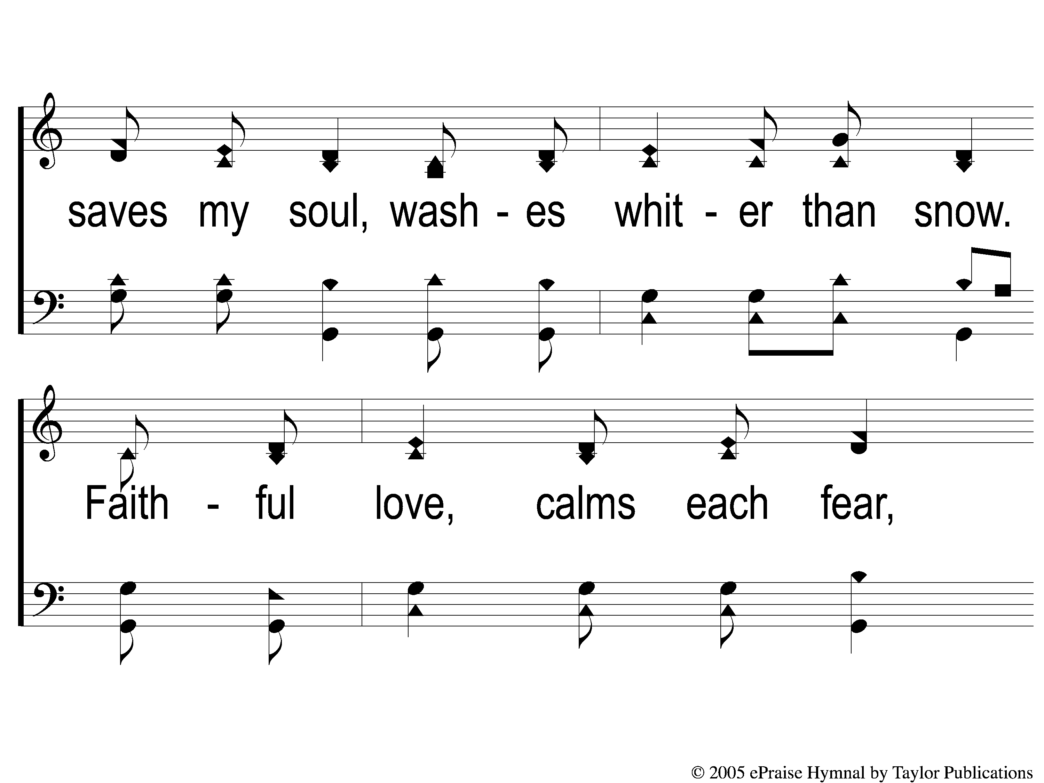
1-2 Faithful Love
Faithful Love
18

Slide 3
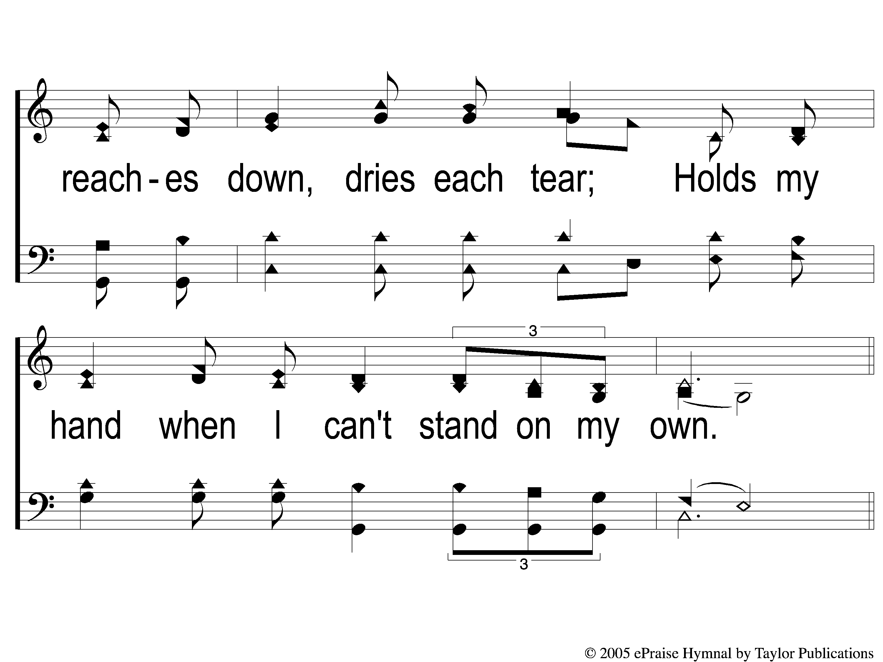
1-3 Faithful Love
Faithful Love
18

Slide 4
C-1 Faithful Love
Faithful Love
18

Slide 5
C-2 Faithful Love
Faithful Love
18

Slide 6
2-1 Faithful Love
Faithful Love
18

Slide 7
2-2 Faithful Love
Faithful Love
18

Slide 8
2-3 Faithful Love
Faithful Love
18

Slide 9
C-1 Faithful Love
Faithful Love
18

Slide 10
C-2 Faithful Love
Faithful Love
18

Slide 11
WELCOME
To the Wheeler church of Christ

Slide 12
SONG:
Home of the soul
#875

Slide 13
1-1 Home of the Soul
Home of the Soul
875

Slide 14
1-2 Home of the Soul
Home of the Soul
875

Slide 15
C-1 Home of the Soul
Home of the Soul
875

Slide 16
C-2 Home of the Soul
Home of the Soul
875

Slide 17
C-3 Home of the Soul
Home of the Soul
875

Slide 18
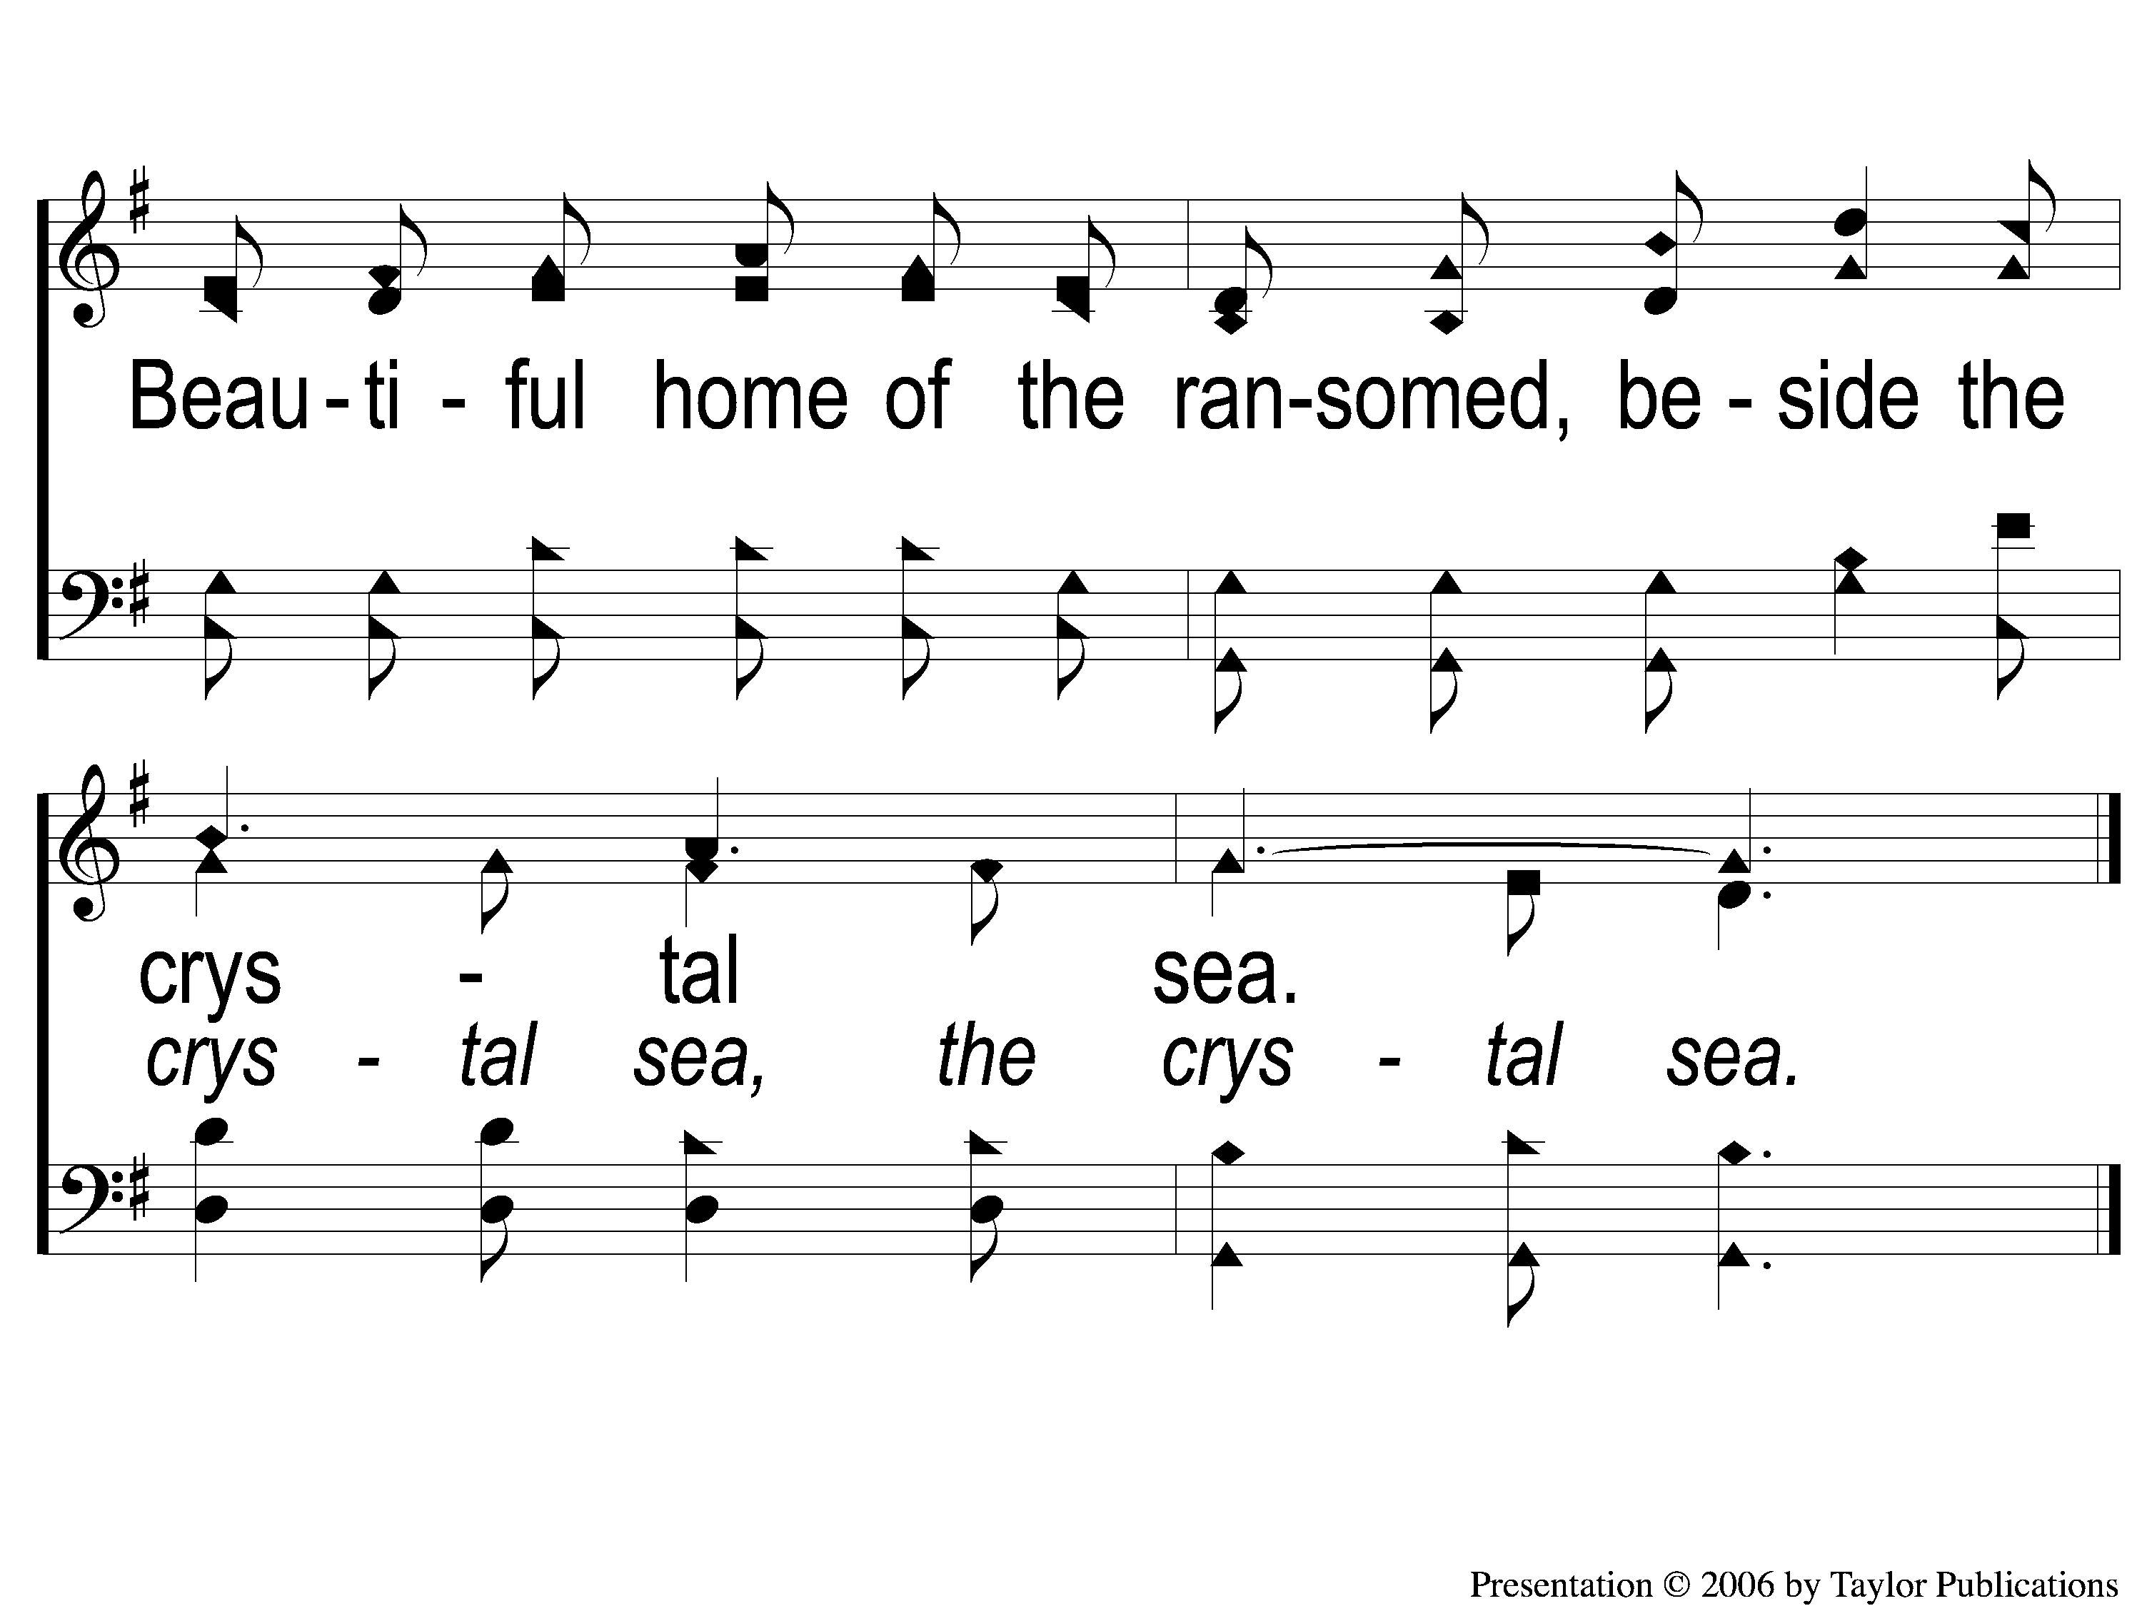
C-4 Home of the Soul
Home of the Soul
875

Slide 19
3-1 Home of the Soul
Home of the Soul
875

Slide 20
3-2 Home of the Soul
Home of the Soul
875

Slide 21
C-1 Home of the Soul
Home of the Soul
875

Slide 22
C-2 Home of the Soul
Home of the Soul
875

Slide 23
C-3 Home of the Soul
Home of the Soul
875

Slide 24
C-4 Home of the Soul
Home of the Soul
875

Slide 25
SONG:
Walking alone at eve
#874

Slide 26
1-1 Walking Alone at eve
Walking Alone At Eve
874

Slide 27
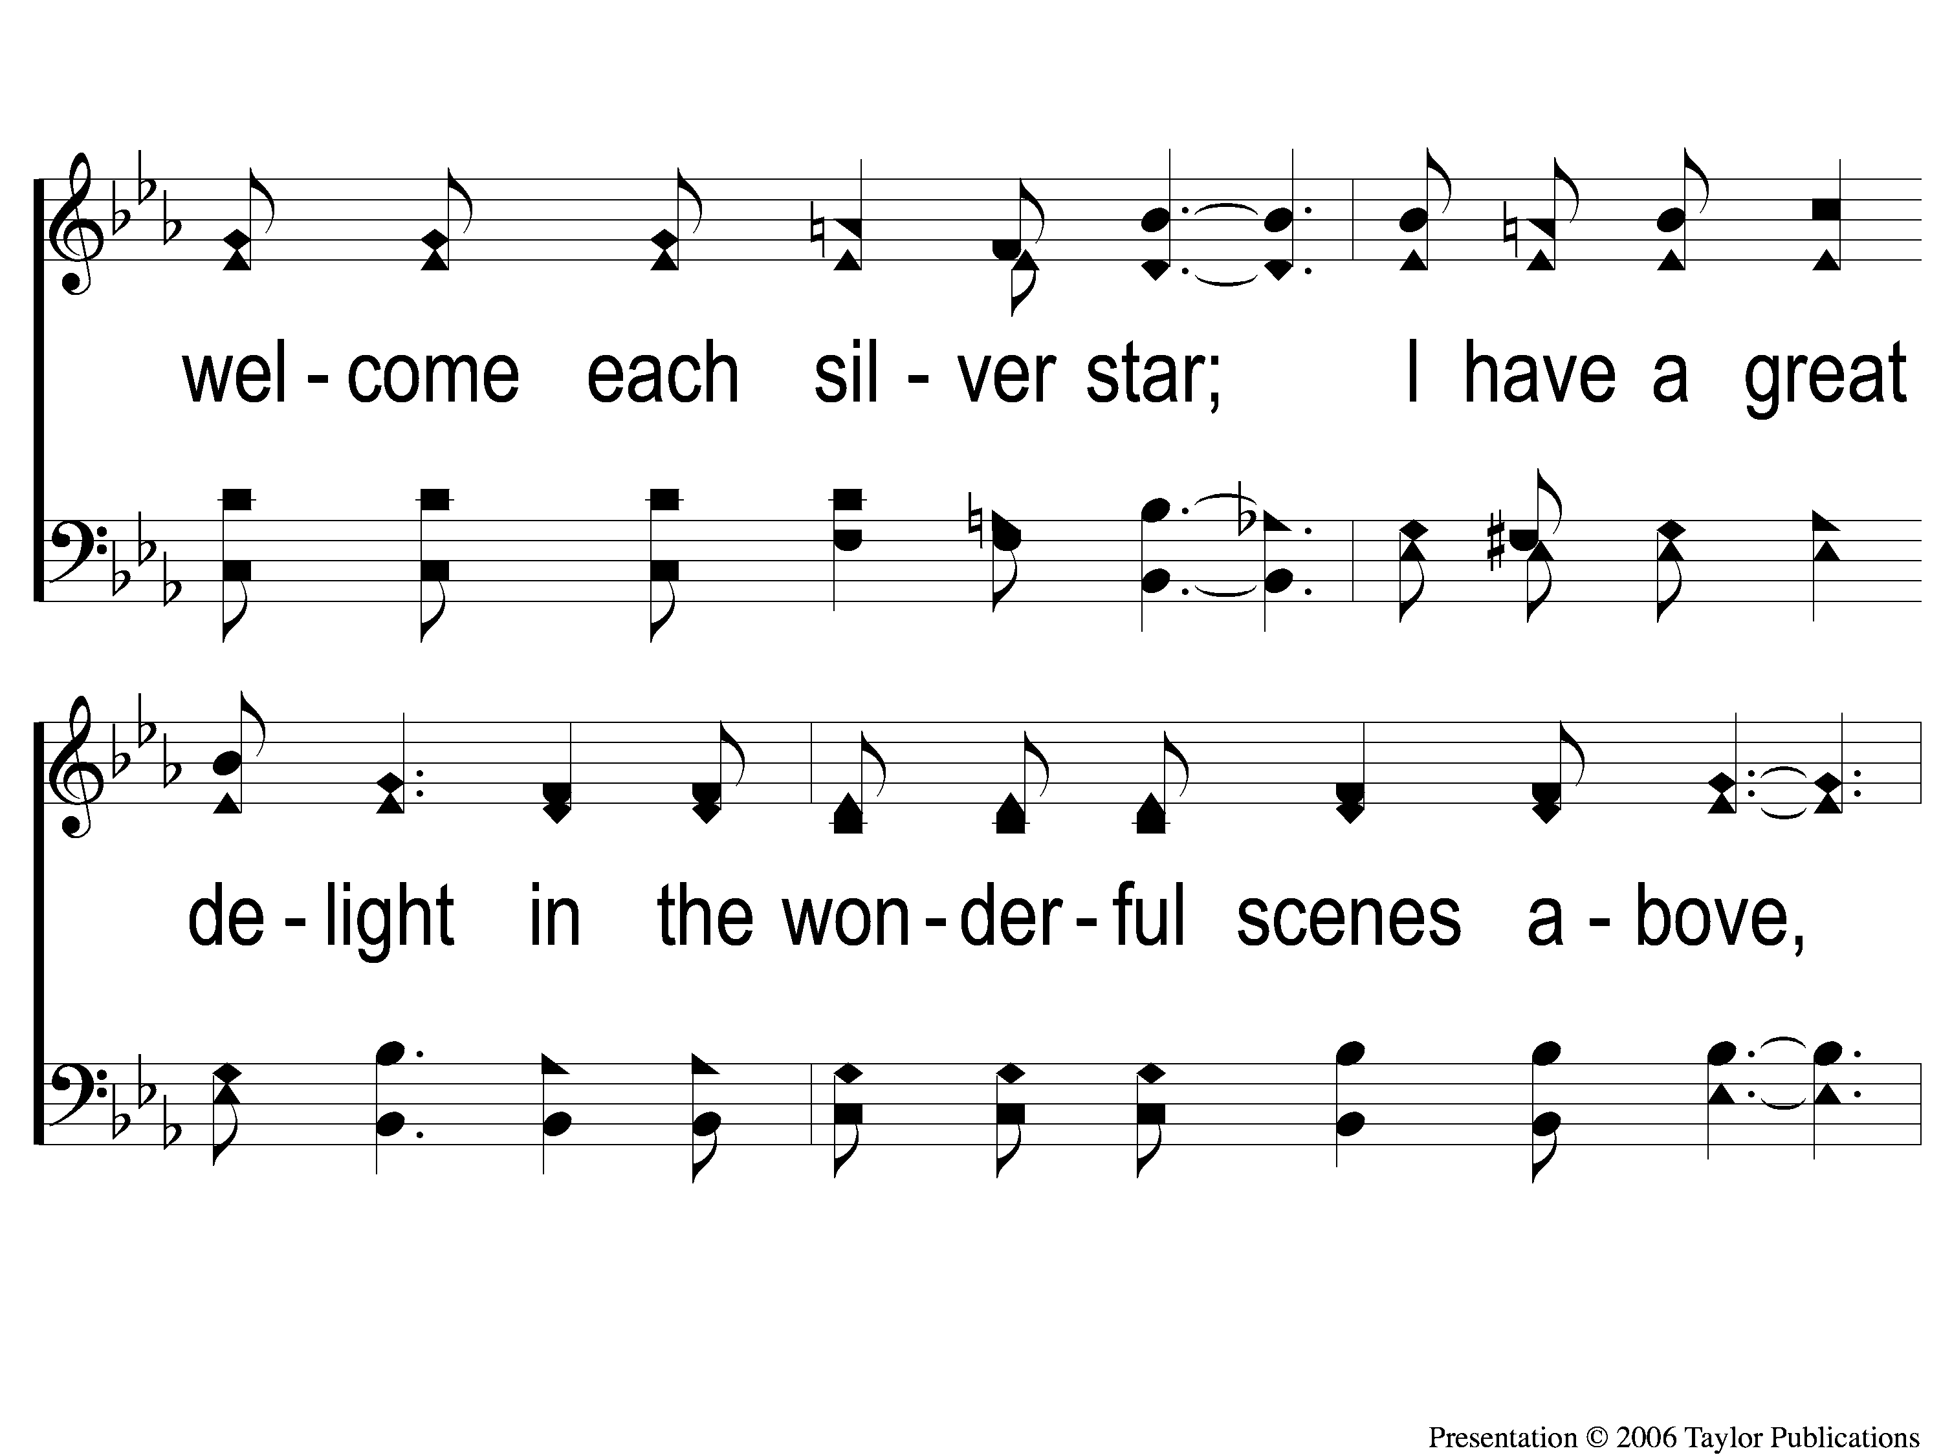
1-2 Walking Alone at eve
Walking Alone At Eve
874

Slide 28
1-3 Walking Alone at eve
Walking Alone At Eve
874

Slide 29
C-1 Walking Alone at eve
Walking Alone At Eve
874

Slide 30
C-2 Walking Alone at eve
Walking Alone At Eve
874

Slide 31
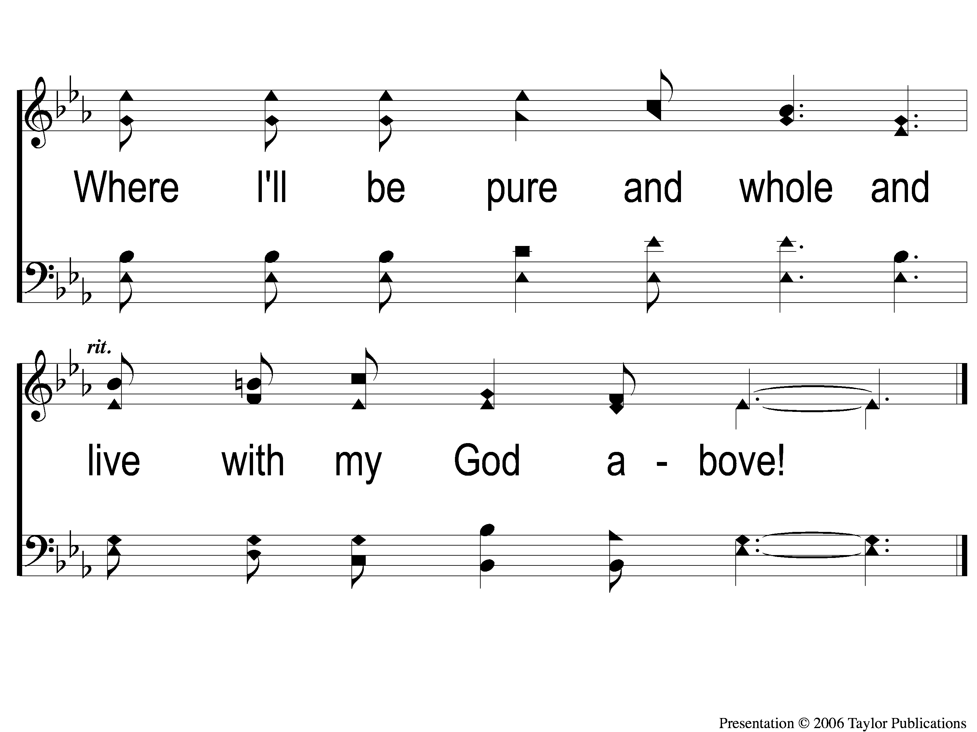
C-3 Walking Alone at eve
Walking Alone At Eve
874

Slide 32
2-1 Walking Alone at eve
Walking Alone At Eve
874

Slide 33
2-2 Walking Alone at eve
Walking Alone At Eve
874

Slide 34
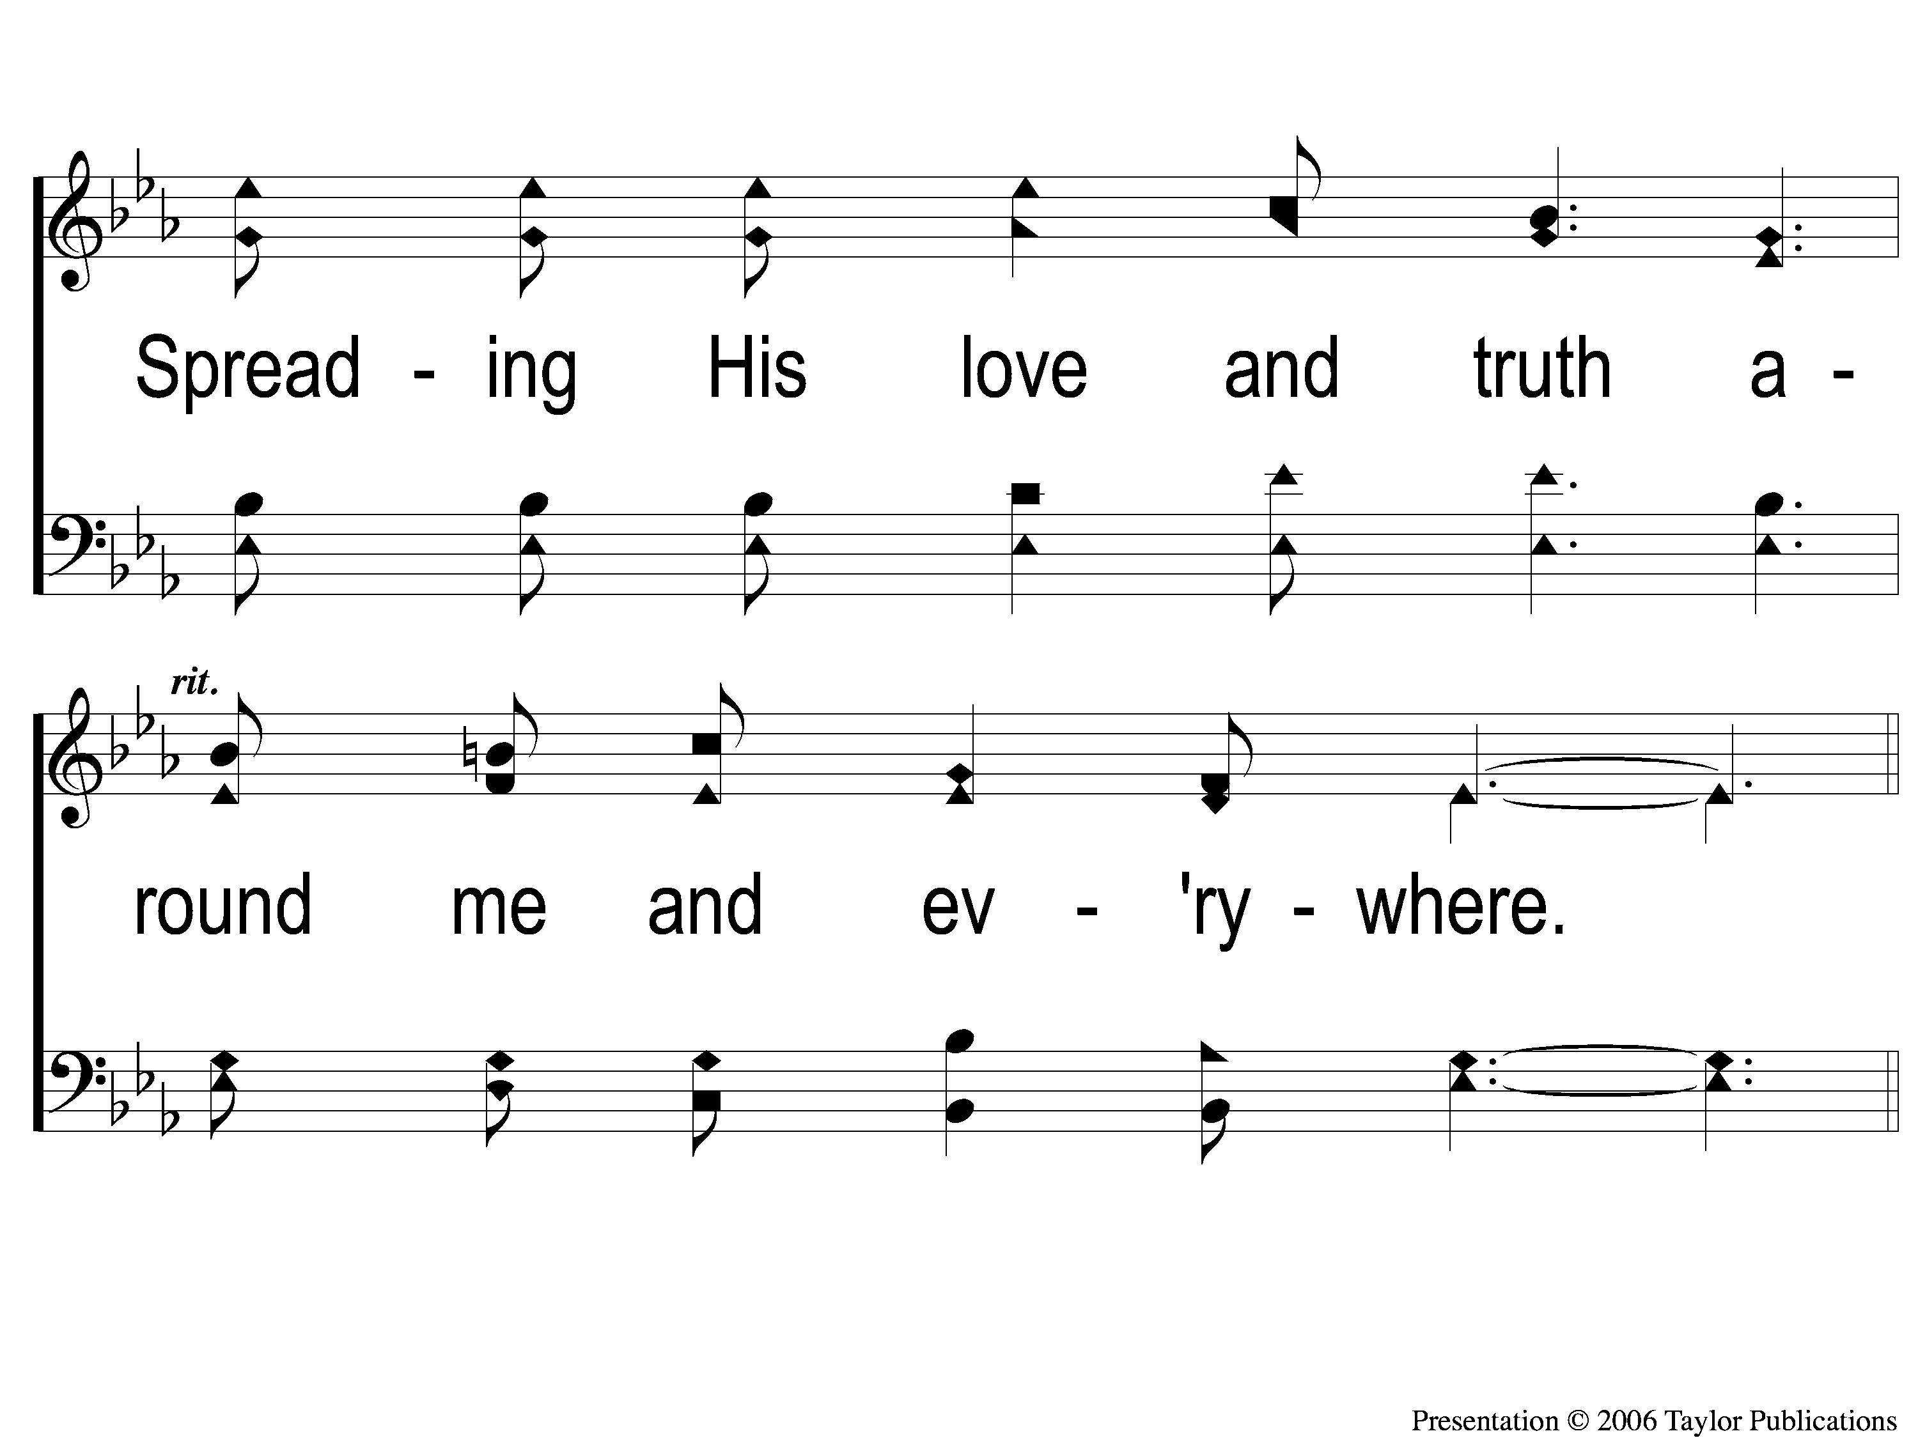
2-3 Walking Alone at eve
Walking Alone At Eve
874

Slide 35
C-1 Walking Alone at eve
Walking Alone At Eve
874

Slide 36
C-2 Walking Alone at eve
Walking Alone At Eve
874

Slide 37
C-3 Walking Alone at eve
Walking Alone At Eve
874

Slide 38
3-1 Walking Alone at eve
Walking Alone At Eve
874

Slide 39
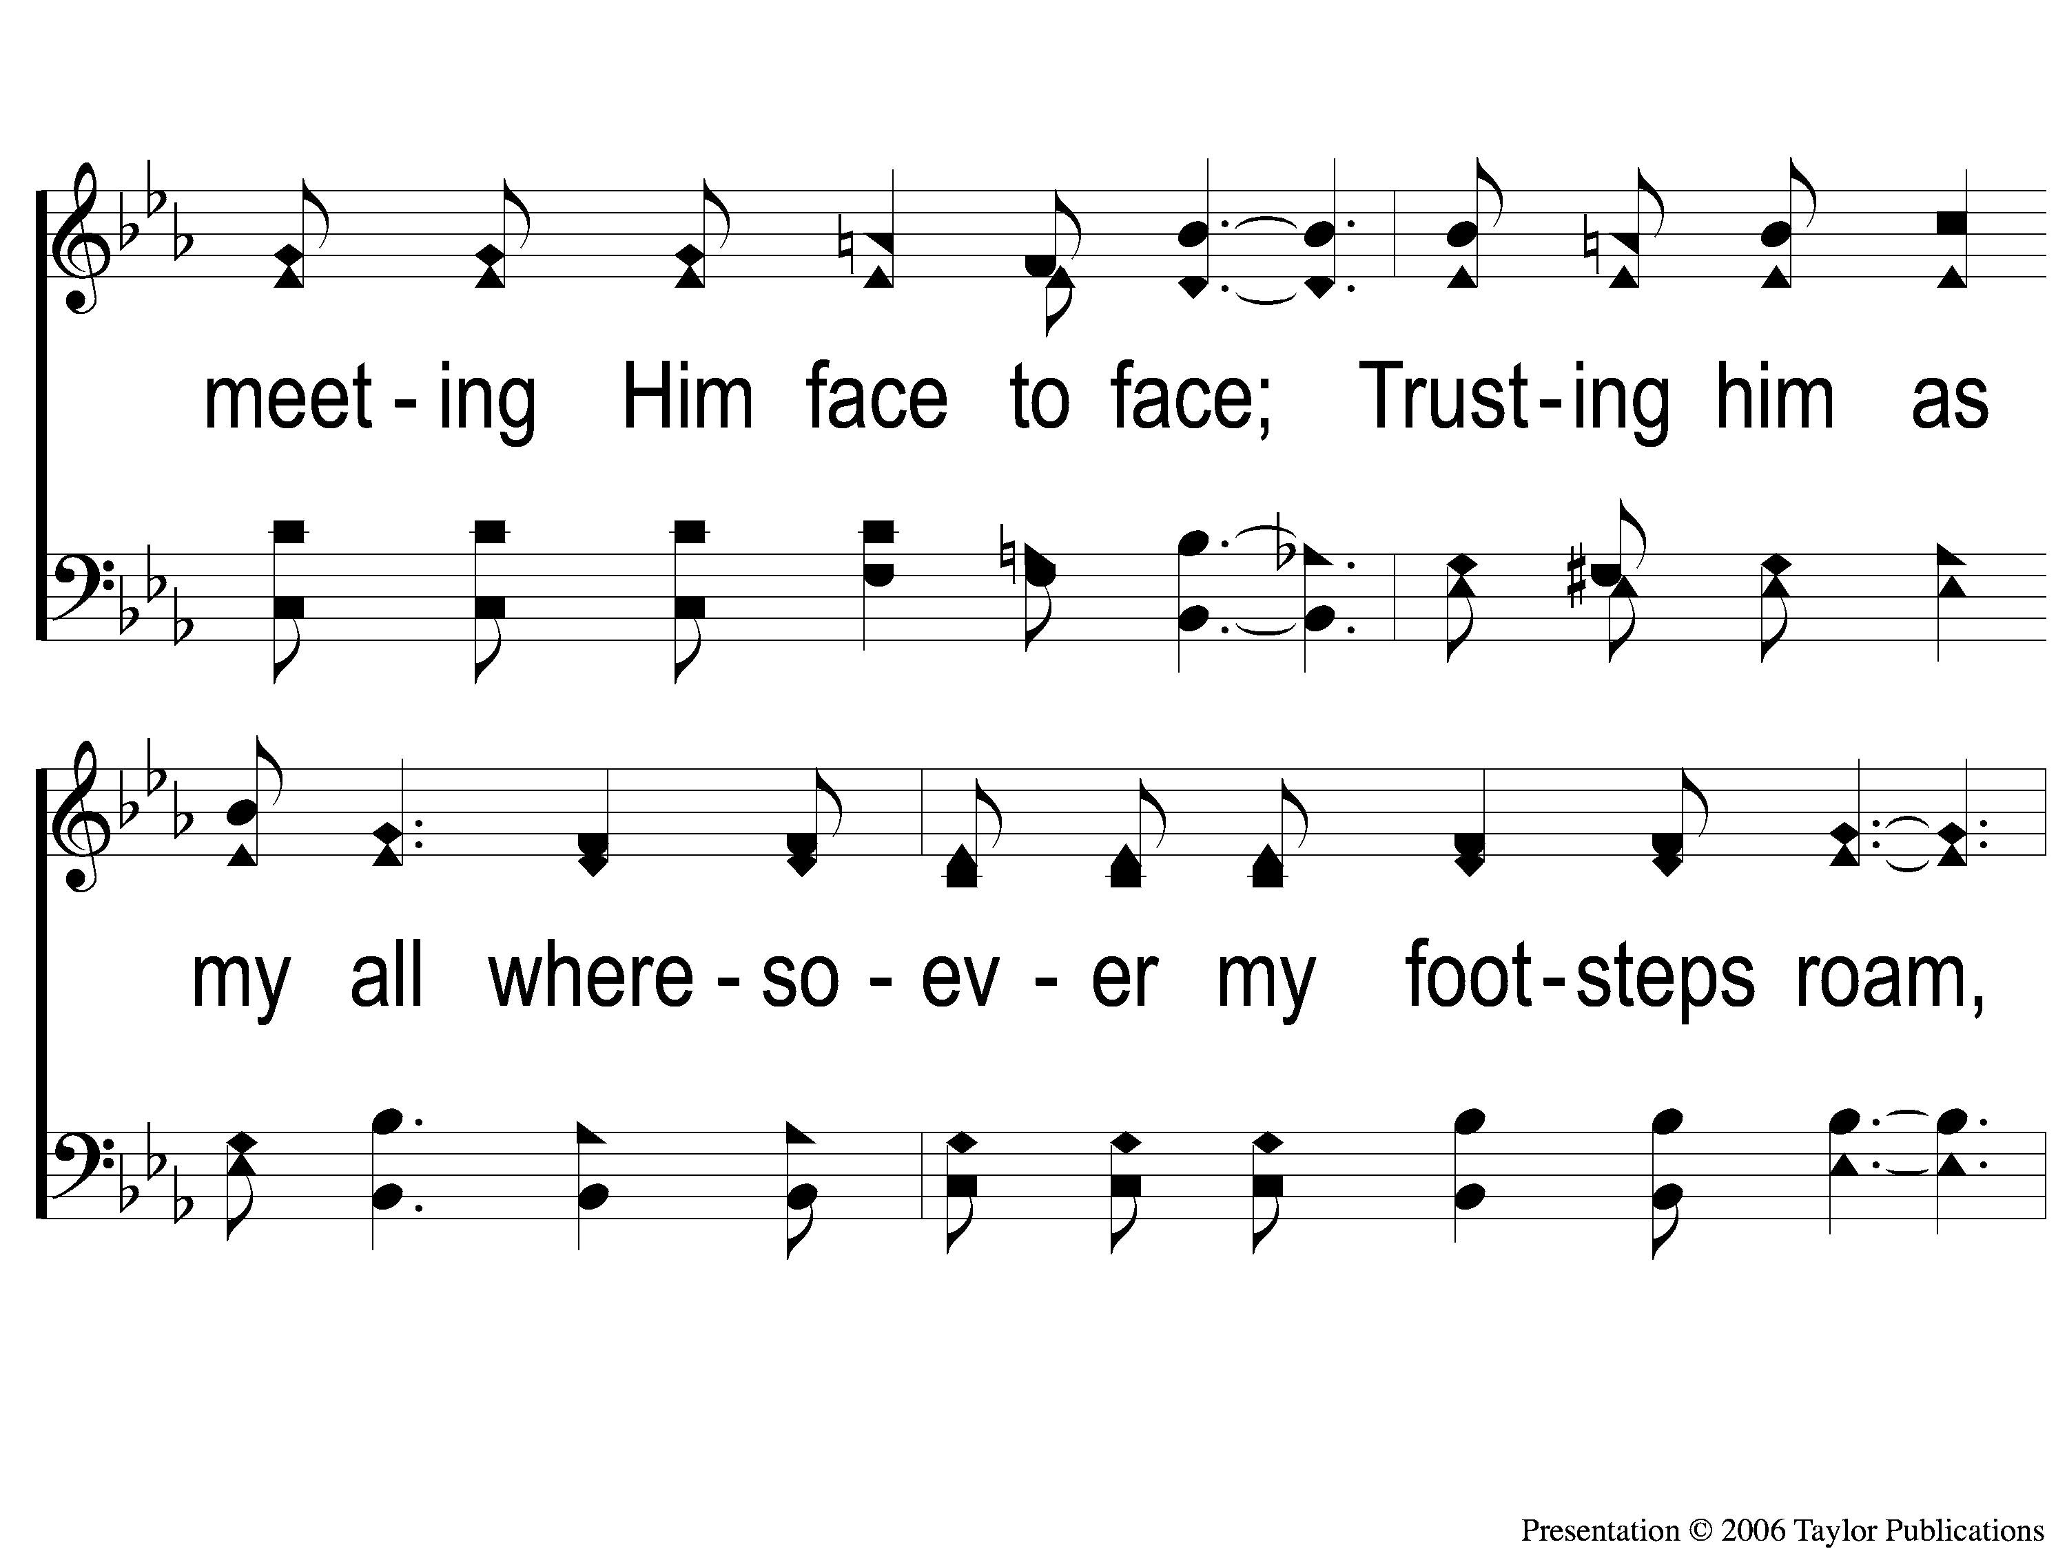
3-2 Walking Alone at eve
Walking Alone At Eve
874

Slide 40
3-3 Walking Alone at eve
Walking Alone At Eve
874

Slide 41
C-1 Walking Alone at eve
Walking Alone At Eve
874

Slide 42
C-2 Walking Alone at eve
Walking Alone At Eve
874

Slide 43
C-3 Walking Alone at eve
Walking Alone At Eve
874

Slide 44
OPENING PRAYER

Slide 45
SONG:
Farther along
#753

Slide 46
1-1 Farther Along
Farther Along
753

Slide 47
1-2 Farther Along
Farther Along
753

Slide 48
C-1 Farther Along
Farther Along
753

Slide 49
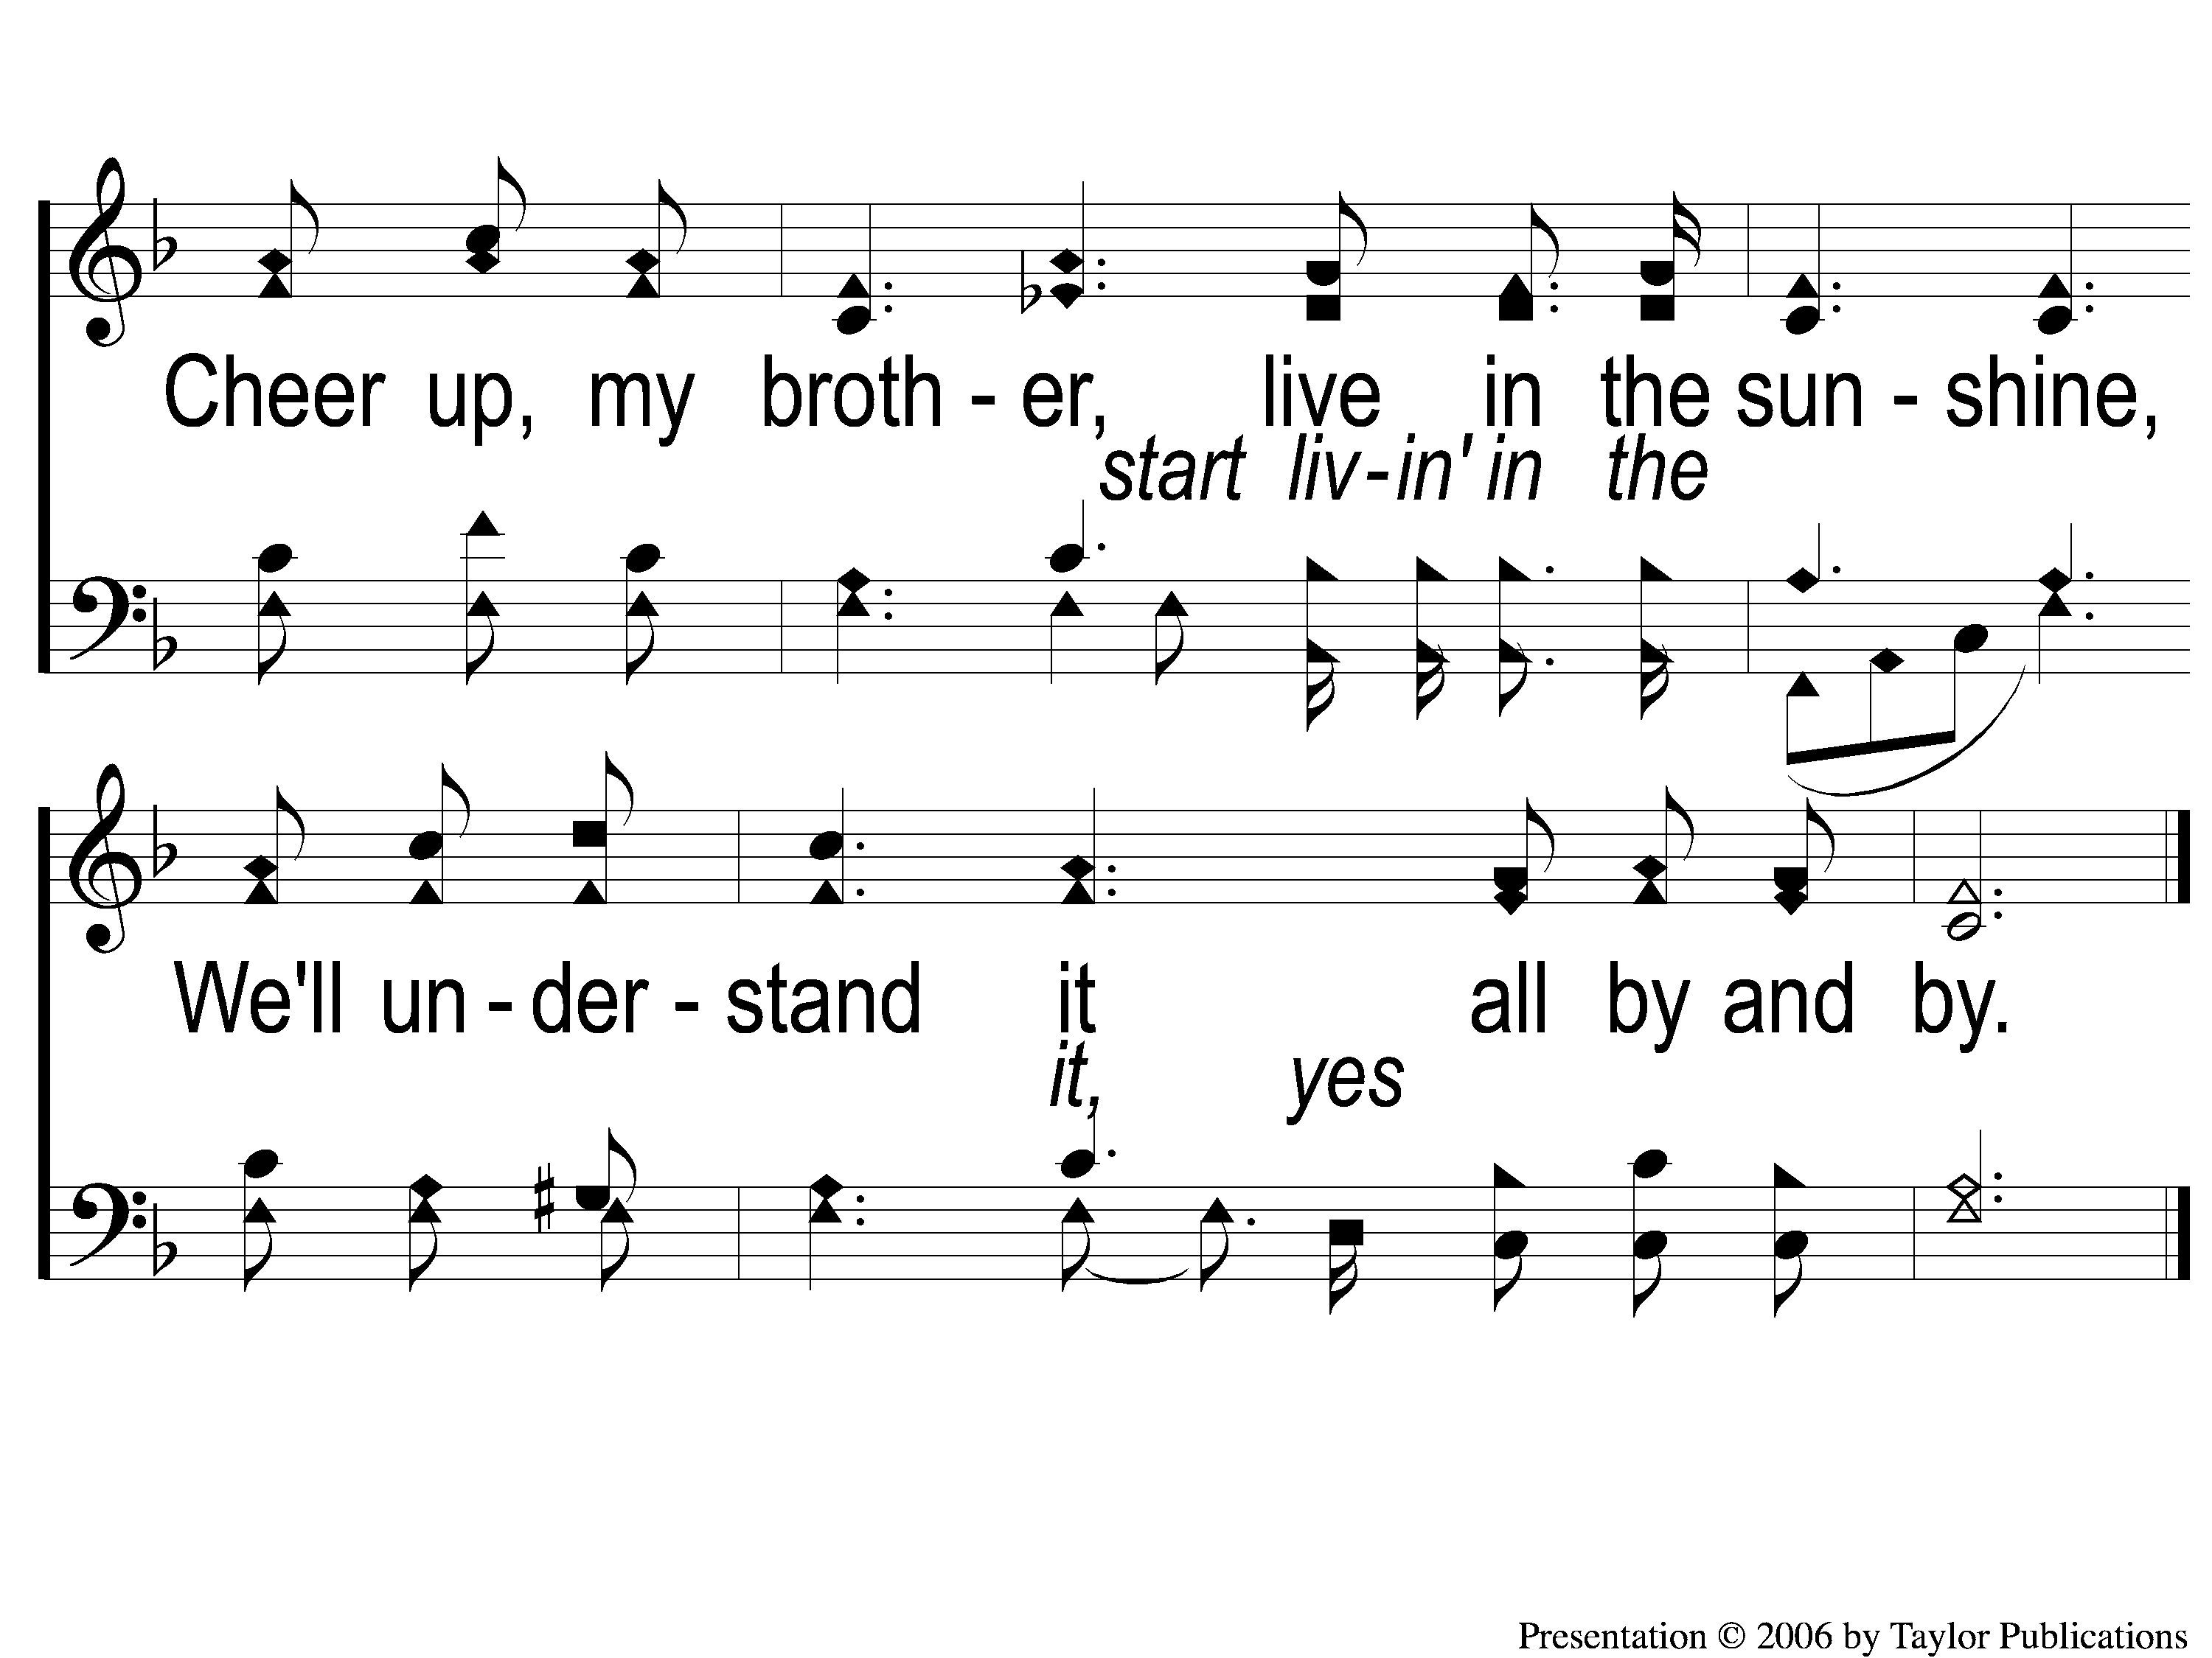
C-2 Farther Along
Farther Along
753

Slide 50
2-1 Farther Along
Farther Along
753

Slide 51
2-2 Farther Along
Farther Along
753

Slide 52
C-1 Farther Along
Farther Along
753

Slide 53
C-2 Farther Along
Farther Along
753

Slide 54
3-1 Farther Along
Farther Along
753

Slide 55
3-2 Farther Along
Farther Along
753

Slide 56
C-1 Farther Along
Farther Along
753

Slide 57
C-2 Farther Along
Farther Along
753

Slide 58
SONG:
Sowing the seed of the kingdom
#643

Slide 59
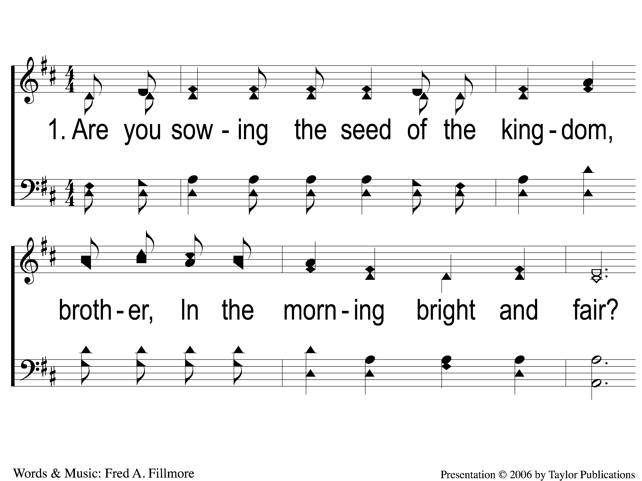
1-1 Sowing the Seed of the Kingdom
Sowing The Seed Of The Kingdom
643

Slide 60
1-2 Sowing the Seed of the Kingdom
Sowing The Seed Of The Kingdom
643

Slide 61
C-1 Sowing the Seed of the Kingdom
Sowing The Seed Of The Kingdom
643

Slide 62
C-2 Sowing the Seed of the Kingdom
Sowing The Seed Of The Kingdom
643

Slide 63
2-1 Sowing the Seed of the Kingdom
Sowing The Seed Of The Kingdom
643

Slide 64
2-2 Sowing the Seed of the Kingdom
Sowing The Seed Of The Kingdom
643

Slide 65
C-1 Sowing the Seed of the Kingdom
Sowing The Seed Of The Kingdom
643

Slide 66
C-2 Sowing the Seed of the Kingdom
Sowing The Seed Of The Kingdom
643

Slide 67
3-1 Sowing the Seed of the Kingdom
Sowing The Seed Of The Kingdom
643

Slide 68
3-2 Sowing the Seed of the Kingdom
Sowing The Seed Of The Kingdom
643

Slide 69
C-1 Sowing the Seed of the Kingdom
Sowing The Seed Of The Kingdom
643

Slide 70
C-2 Sowing the Seed of the Kingdom
Sowing The Seed Of The Kingdom
643

Slide 71
SCRIPTURE READING:
Proverbs 1:8-9

Slide 72
Godly wisdom
IN PURSUIT OF

Slide 73
proverbs
GOD’S WISDOM FOR LIVING

Slide 74
proverbs
THE WISDOM OF A FATHER

Slide 75
Wisdom literature
Job
Psalms
Proverbs
Ecclesiastes
Song of Solomon

Slide 76
Fatherless homes
63% of youth suicides
90% of all homeless and runaway children
85% of all children who show behavioral disorders
70% of youth in state operated institutions (1988)
85% of all youths in prison (TxDC)

Slide 77
A Spiritual pandemic
13 million more women assemble regularly than men
20-25% more likely to attend worship weekly

Slide 78
A Spiritual pandemic
13 million more women assemble regularly than men
20-25% more likely to attend worship weekly
90% more likely to attend if the man attends

Slide 79
A wise father
Leads His Home Spiritually
Rom. 1:16

Slide 80
God-ordained structure of a family
1 Cor. 11:3
God, the Father → Christ → Husband → Wife

Slide 81
Proverbs: The wisdom of a father
Prov. 1:8
19 times in Proverbs
693 times in the Bible (NKJV)
Deut. 8:5

Slide 82
A wise father
Leads His Home Spiritually
Abraham – Gen. 18:19
Joshua – Josh. 24:15
1 Sam. 3:13

Slide 83
A wise father
Invites Transparency
Prov. 10:9, 16:11, 19:1, 20:7
Job 1:1, 6:22-24

Slide 84
A wise father
Takes Sin Seriously
Prov. 10:23, 14:9, 16:17, 19:28
Job 1:5

Slide 85
A wise father
Worships Regularly
Psa. 9:11
Job 1:5

Slide 86
A wise father
Obeys Faithfully
Prov. 1:7
Eccl. 12:13-14
Gen. 6:8-9, 22

Slide 87
The results
Lack of Male Spiritual Leadership
Jdgs. 2:7-10

Slide 88
The results
Lack of Male Spiritual Leadership
Jdgs. 2:7-10
Abounding Male Spiritual Leadership
Josh. 24:31

Slide 89
Godly wisdom?
ARE YOU PURSUING

Slide 90
1-1 Jesus Paid It All
Jesus Paid It All
922

Slide 91
1-2 Jesus Paid It All
Jesus Paid It All
922

Slide 92
C Jesus Paid It All
Jesus Paid It All
922

Slide 93
2-1 Jesus Paid It All
Jesus Paid It All
922

Slide 94
2-2 Jesus Paid It All
Jesus Paid It All
922

Slide 95
C Jesus Paid It All
Jesus Paid It All
922

Slide 96
3-1 Jesus Paid It All
Jesus Paid It All
922

Slide 97
3-2 Jesus Paid It All
Jesus Paid It All
922

Slide 98
C Jesus Paid It All
Jesus Paid It All
922

Slide 99
OUR CONTRIBUTION
“The point is this: whoever sows sparingly will also reap sparingly, and whoever sows bountifully will also reap bountifully. Each one must give as he has decided in his heart, not reluctantly or under compulsion, for God loves a cheerful giver. And God is able to make all grace abound to you, so that having all sufficiency in all things at all times, you may abound in every good work.” – 2 Cor. 9:6-8

Slide 100
SONG:
Hallelujah! What a savior
#337

Slide 101
1-1 Hallelujah What A Savior
Hallelujah! What A Savior
337

Slide 102
1-2 Hallelujah What A Savior
Hallelujah! What A Savior
337

Slide 103
2-1 Hallelujah What A Savior
Hallelujah! What A Savior
337

Slide 104
2-2 Hallelujah What A Savior
Hallelujah! What A Savior
337

Slide 105
3-1 Hallelujah What A Savior
Hallelujah! What A Savior
337

Slide 106
3-2 Hallelujah What A Savior
Hallelujah! What A Savior
337

Slide 107
4-1 Hallelujah What A Savior
Hallelujah! What A Savior
337

Slide 108
4-2 Hallelujah What A Savior
Hallelujah! What A Savior
337

Slide 109
5-1 Hallelujah What A Savior
Hallelujah! What A Savior
337

Slide 110
5-2 Hallelujah What A Savior
Hallelujah! What A Savior
337

Slide 111
THE UNLEAVENED BREAD
Romans 5:18-19
“Therefore, as through one man’s offense judgment came to all men, resulting in condemnation, even so through one Man’s righteous act the free gift came to all men, resulting in justification of life. 19 For as by one man’s disobedience many were made sinners, so also by one Man’s obedience many will be made righteous.”

Slide 112
THE FRUIT OF THE VINE
Romans 5:9-11
“Since, therefore, we have now been justified by his blood, much more shall we be saved by him from the wrath of God. For if while we were enemies we were reconciled to God by the death of his Son, much more, now that we are reconciled, shall we be saved by his life. More than that, we also rejoice in God through our Lord Jesus Christ, through whom we have now received reconciliation.”

Slide 113
closing PRAYER

Slide 114
SONG:
No tears in heaven
#882

Slide 115
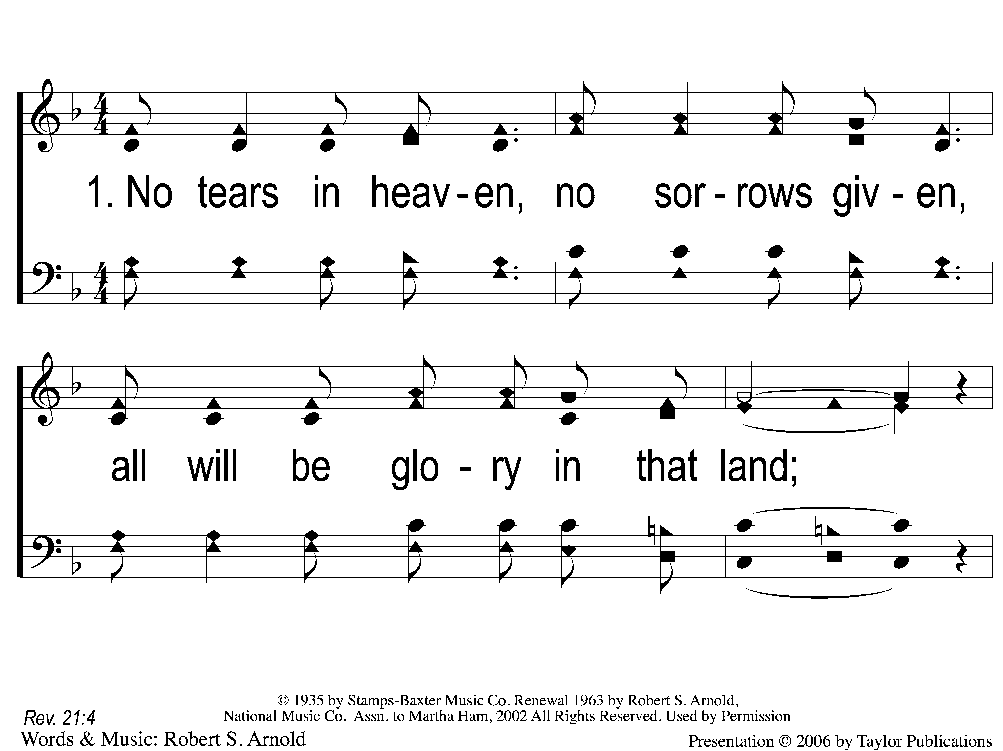
1-1 No Tears in Heaven
No Tears In Heaven
882

Slide 116
1-2 No Tears in Heaven
No Tears In Heaven
882

Slide 117
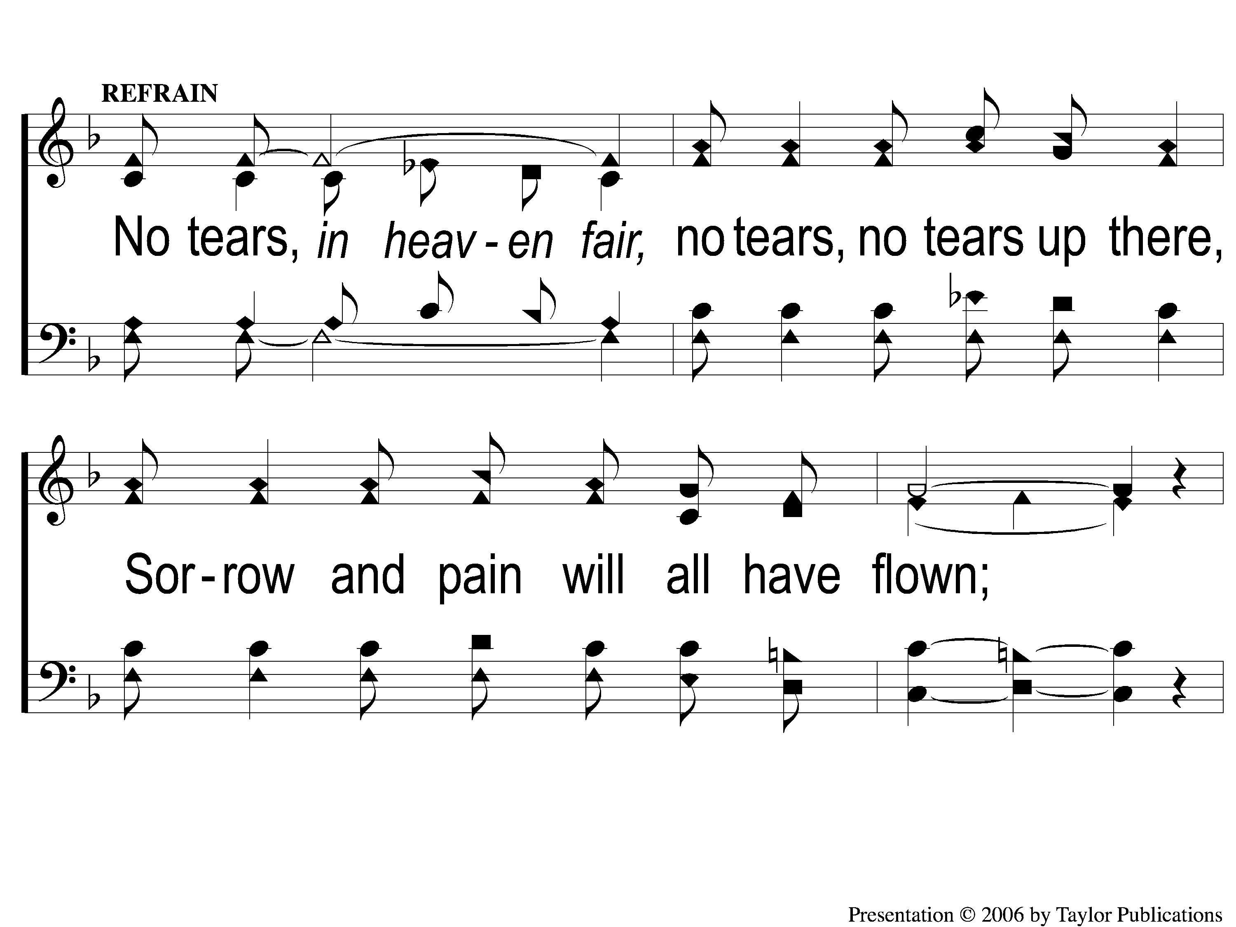
C-1 No Tears in Heaven
No Tears In Heaven
882

Slide 118
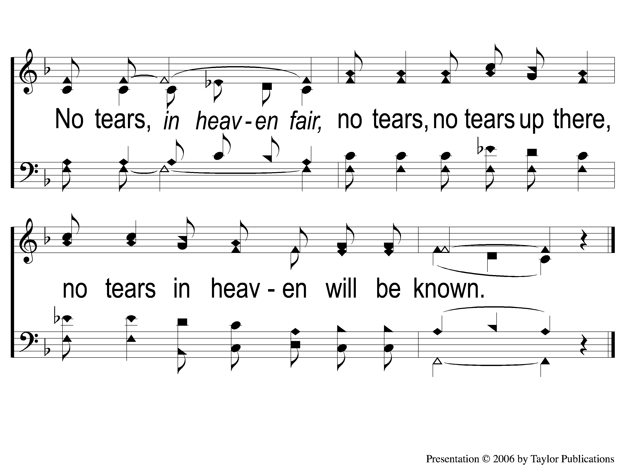
C-2 No Tears in Heaven
No Tears In Heaven
882

Slide 119
3-1 No Tears in Heaven
No Tears In Heaven
882

Slide 120
3-2 No Tears in Heaven
No Tears In Heaven
882

Slide 121
C-1 No Tears in Heaven
No Tears In Heaven
882

Slide 122
C-2 No Tears in Heaven
No Tears In Heaven
882

Slide 123
Today
EVENING WORSHIP @ 6 pm
MEN’S MEETING TO FOLLOW
Wednesday
Worship & Bible classes @ 6:30

