Slide 1
PLEASE STANDBY
OUR LIVESTREAM
WILL BEGIN SOON

Slide 2
WELCOME
THANKS FOR JOINING US!

Slide 3
#608
SONG:
He Gave Me A Song

Slide 4
1-1 He Gave Me A Song
He Gave Me A Song
608

Slide 5
1-2 He Gave Me A Song
He Gave Me A Song
608

Slide 6
1-3 He Gave Me A Song
He Gave Me A Song
608

Slide 7
C-1 He Gave Me A Song
He Gave Me A Song
608

Slide 8
C-2 He Gave Me A Song
He Gave Me A Song
608

Slide 9
C-3 He Gave Me A Song
He Gave Me A Song
608

Slide 10
3-1 He Gave Me A Song
He Gave Me A Song
608

Slide 11
3-2 He Gave Me A Song
He Gave Me A Song
608

Slide 12
3-3 He Gave Me A Song
He Gave Me A Song
608

Slide 13
C-1 He Gave Me A Song
He Gave Me A Song
608

Slide 14
C-2 He Gave Me A Song
He Gave Me A Song
608

Slide 15
C-3 He Gave Me A Song
He Gave Me A Song
608

Slide 16
#874
SONG:
Walking Alone At Eve

Slide 17
1-1 Walking Alone at eve
Walking Alone At Eve
874

Slide 18
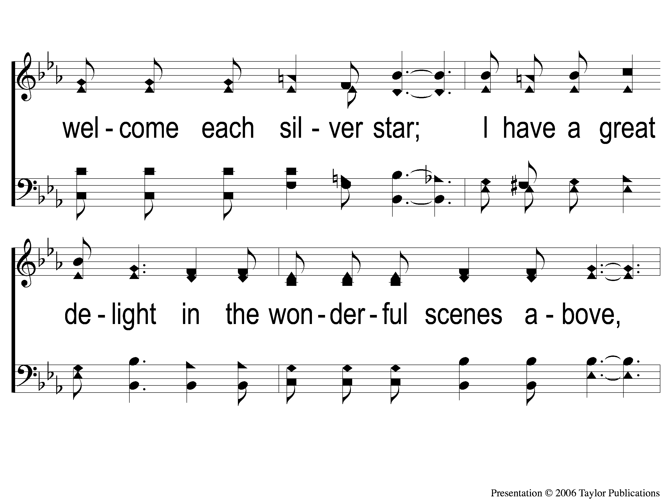
1-2 Walking Alone at eve
Walking Alone At Eve
874

Slide 19
1-3 Walking Alone at eve
Walking Alone At Eve
874

Slide 20
C-1 Walking Alone at eve
Walking Alone At Eve
874

Slide 21
C-2 Walking Alone at eve
Walking Alone At Eve
874

Slide 22
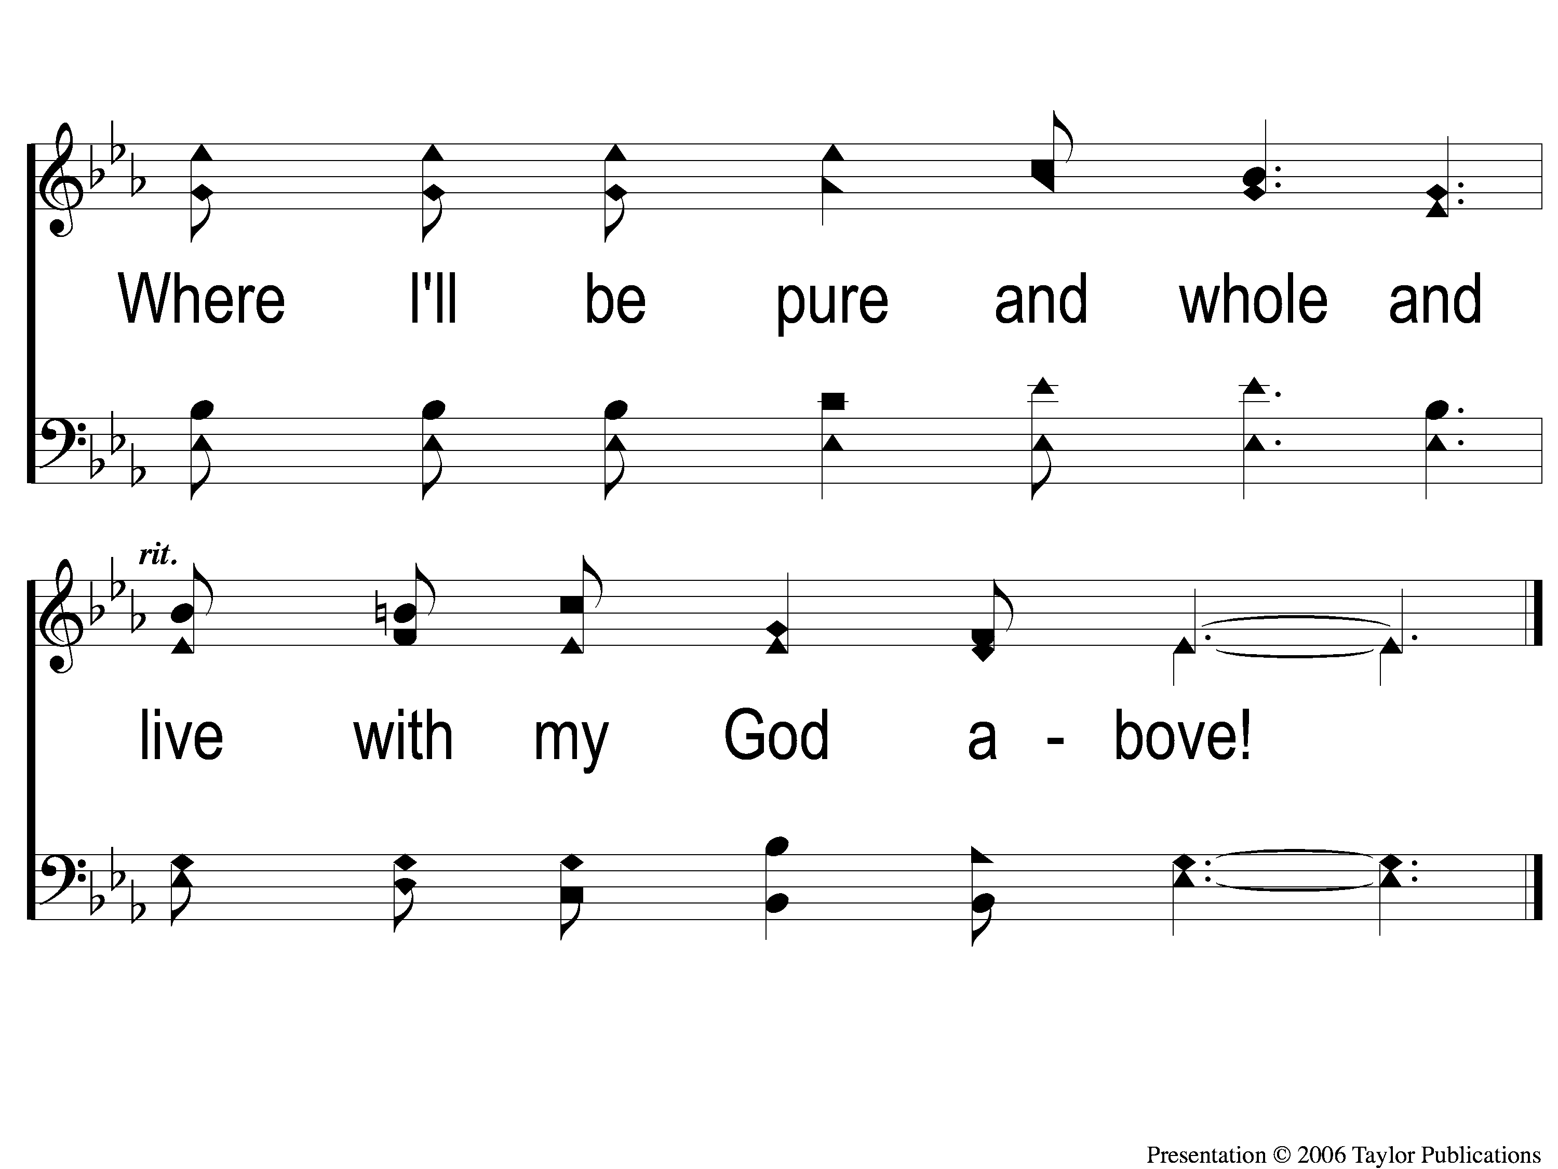
C-3 Walking Alone at eve
Walking Alone At Eve
874

Slide 23
2-1 Walking Alone at eve
Walking Alone At Eve
874

Slide 24
2-2 Walking Alone at eve
Walking Alone At Eve
874

Slide 25
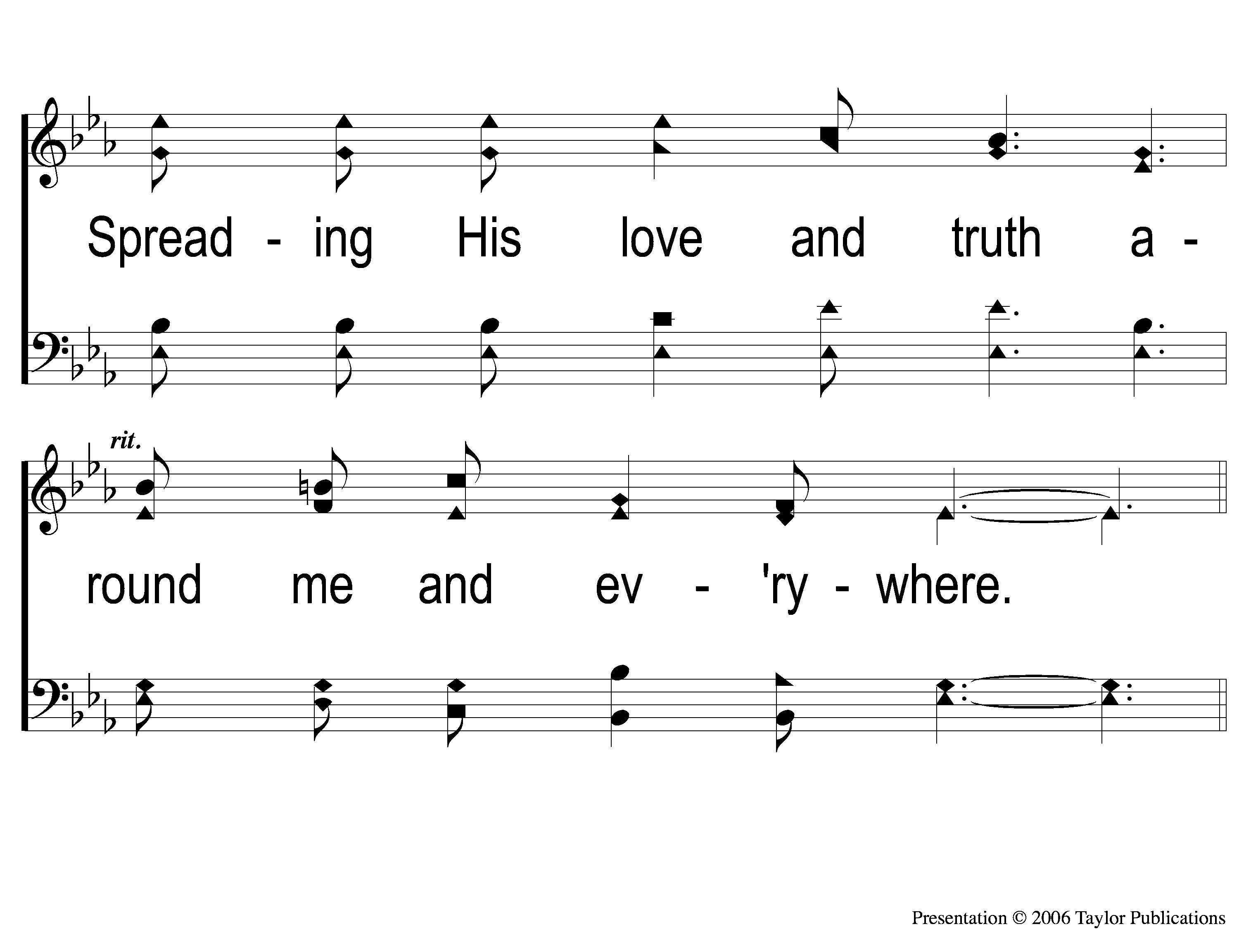
2-3 Walking Alone at eve
Walking Alone At Eve
874

Slide 26
C-1 Walking Alone at eve
Walking Alone At Eve
874

Slide 27
C-2 Walking Alone at eve
Walking Alone At Eve
874

Slide 28
C-3 Walking Alone at eve
Walking Alone At Eve
874

Slide 29
3-1 Walking Alone at eve
Walking Alone At Eve
874

Slide 30
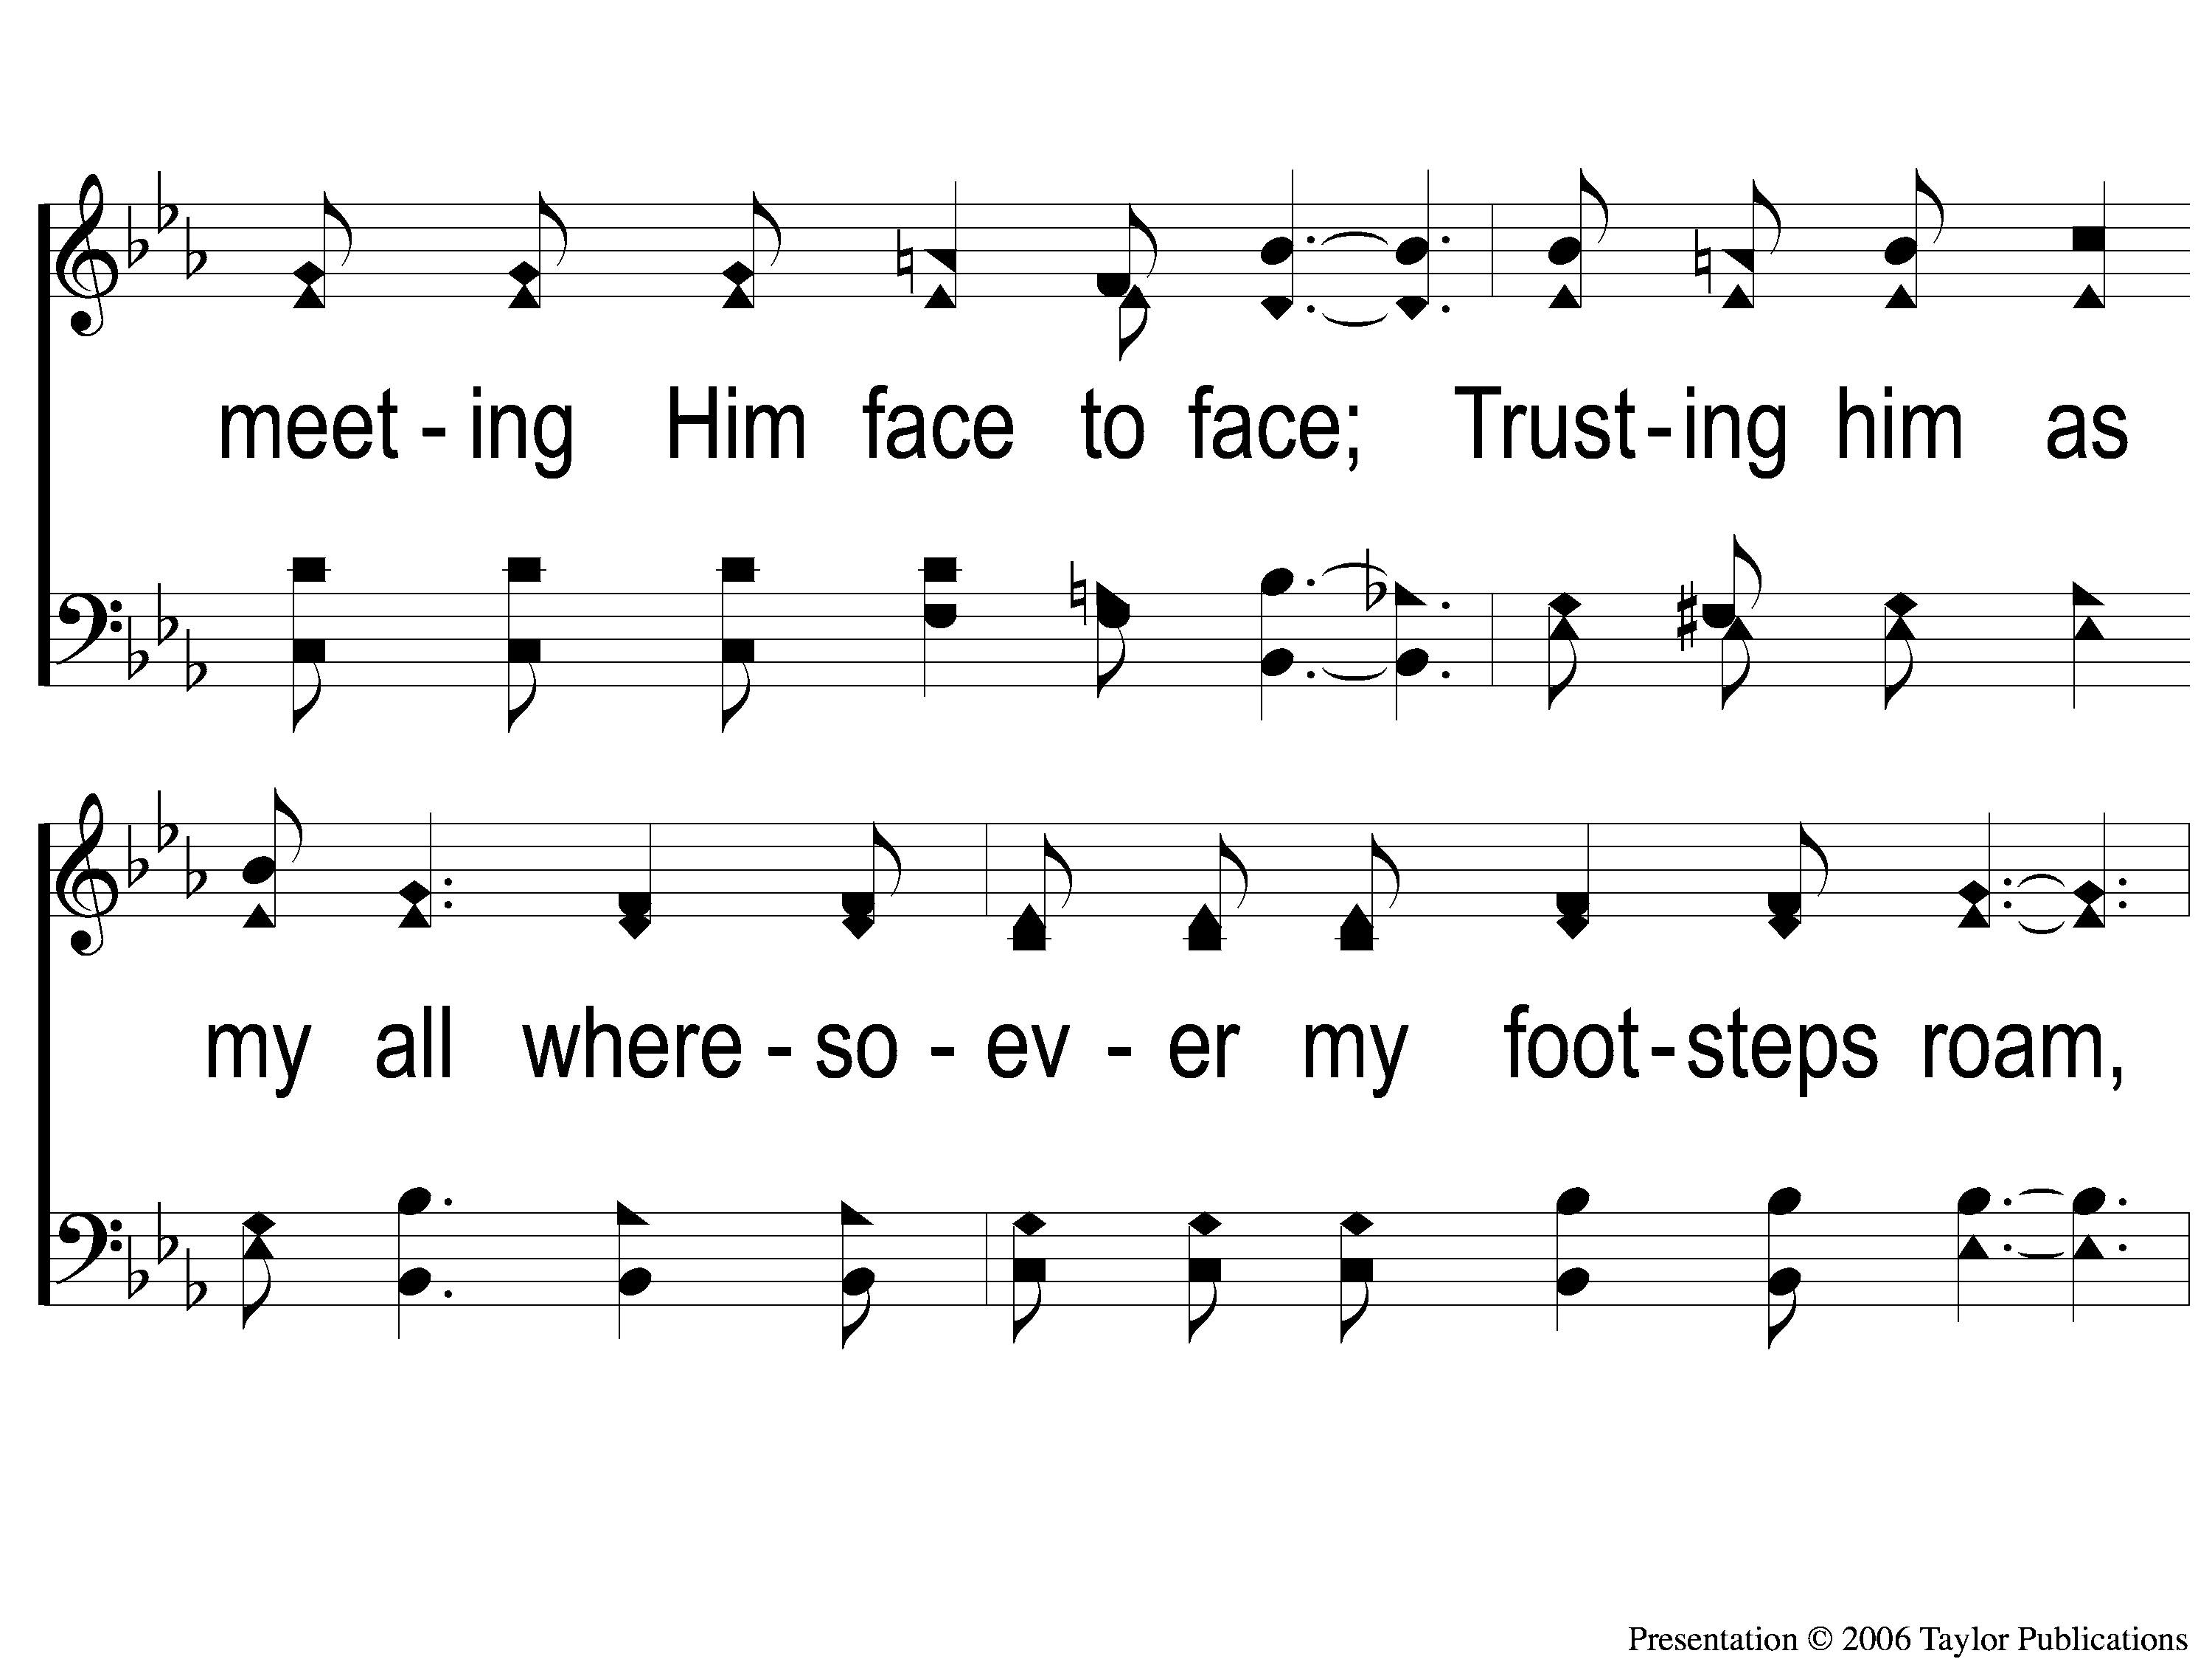
3-2 Walking Alone at eve
Walking Alone At Eve
874

Slide 31
3-3 Walking Alone at eve
Walking Alone At Eve
874

Slide 32
C-1 Walking Alone at eve
Walking Alone At Eve
874

Slide 33
C-2 Walking Alone at eve
Walking Alone At Eve
874

Slide 34
C-3 Walking Alone at eve
Walking Alone At Eve
874

Slide 35
Opening PRAYER

Slide 36
#886
SONG:
On Jordan’s
Stormy Banks

Slide 37
1-1 On Jordan’s Stormy Banks
On Jordan’s Stormy Banks
886

Slide 38
1-2 On Jordan’s Stormy Banks
On Jordan’s Stormy Banks
886

Slide 39
C-1 On Jordan’s Stormy Banks
On Jordan’s Stormy Banks
886

Slide 40
C-2 On Jordan’s Stormy Banks
On Jordan’s Stormy Banks
886

Slide 41
2-1 On Jordan’s Stormy Banks
On Jordan’s Stormy Banks
886

Slide 42
2-2 On Jordan’s Stormy Banks
On Jordan’s Stormy Banks
886

Slide 43
C-1 On Jordan’s Stormy Banks
On Jordan’s Stormy Banks
886

Slide 44
C-2 On Jordan’s Stormy Banks
On Jordan’s Stormy Banks
886

Slide 45
4-1 On Jordan’s Stormy Banks
On Jordan’s Stormy Banks
886

Slide 46
4-2 On Jordan’s Stormy Banks
On Jordan’s Stormy Banks
886

Slide 47
C-1 On Jordan’s Stormy Banks
On Jordan’s Stormy Banks
886

Slide 48
C-2 On Jordan’s Stormy Banks
On Jordan’s Stormy Banks
886

Slide 49
#886
SONG:
I Know That
My Redeemer Lives

Slide 50
1-1 I Know That My Redeemer Lives
I Know That My Redeemer Lives
528

Slide 51
1-2 I Know That My Redeemer Lives
I Know That My Redeemer Lives
528

Slide 52
C-1 I Know That My Redeemer Lives
I Know That My Redeemer Lives
528

Slide 53
C-2 I Know That My Redeemer Lives
I Know That My Redeemer Lives
528

Slide 54
2-1 I Know That My Redeemer Lives
I Know That My Redeemer Lives
528

Slide 55
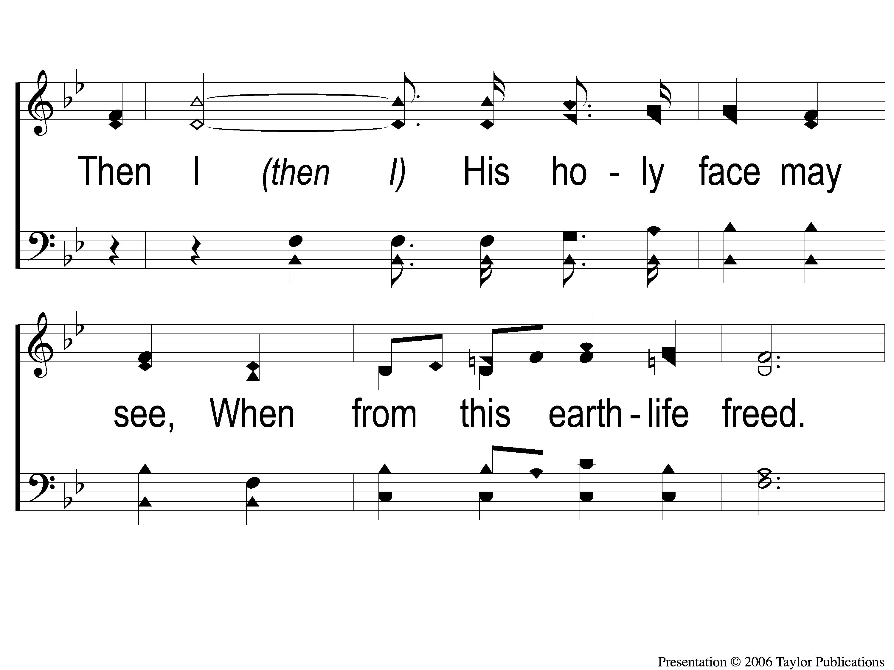
2-2 I Know That My Redeemer Lives
I Know That My Redeemer Lives
528

Slide 56
C-1 I Know That My Redeemer Lives
I Know That My Redeemer Lives
528

Slide 57
C-2 I Know That My Redeemer Lives
I Know That My Redeemer Lives
528

Slide 58
4-1 I Know That My Redeemer Lives
I Know That My Redeemer Lives
528

Slide 59
4-2 I Know That My Redeemer Lives
I Know That My Redeemer Lives
528

Slide 60
C-1 I Know That My Redeemer Lives
I Know That My Redeemer Lives
528

Slide 61
C-2 I Know That My Redeemer Lives
I Know That My Redeemer Lives
528

Slide 62
SCRIPTURE:
Revelation 3:1-6

Slide 63
WHO IS ABLE TO STAND?
WHO IS ABLE TO STAND?

Slide 64
THE REVELATION OF JESUS CHRIST
“WHO IS ABLE TO STAND?”
REVELATION 6:17 (NKJV)

Slide 65
Two Challenges:
Read through all of the book
Write a one-sentence summary of the book

Slide 66
THE REVELATION OF JESUS CHRIST
“THINGS WHICH MUST SHORTLY TAKE PLACE”
REVELATION 1:1 (NKJV)

Slide 67
THE REVELATION OF JESUS CHRIST
“HEAR WHAT THE SPIRIT SAYS TO THE CHURCHES”
REVELATION 3:6 (NKJV)

Slide 68
THE REVELATION OF JESUS CHRIST
7 WARNINGS FROM 7 CHURCHES
PART TWO

Slide 69
LEARNING FROM THE PAST
“For whatever things were written before were written for our learning, that we through the patience and comfort of the Scriptures might have hope.” – Rom. 15:4

Slide 70
THE 7 CHURCHES OF ASIA MINOR:
Ephesus
Smyrna
Pergamos
Thyatira
Sardis
Philadelphia
Laodicea

Slide 71
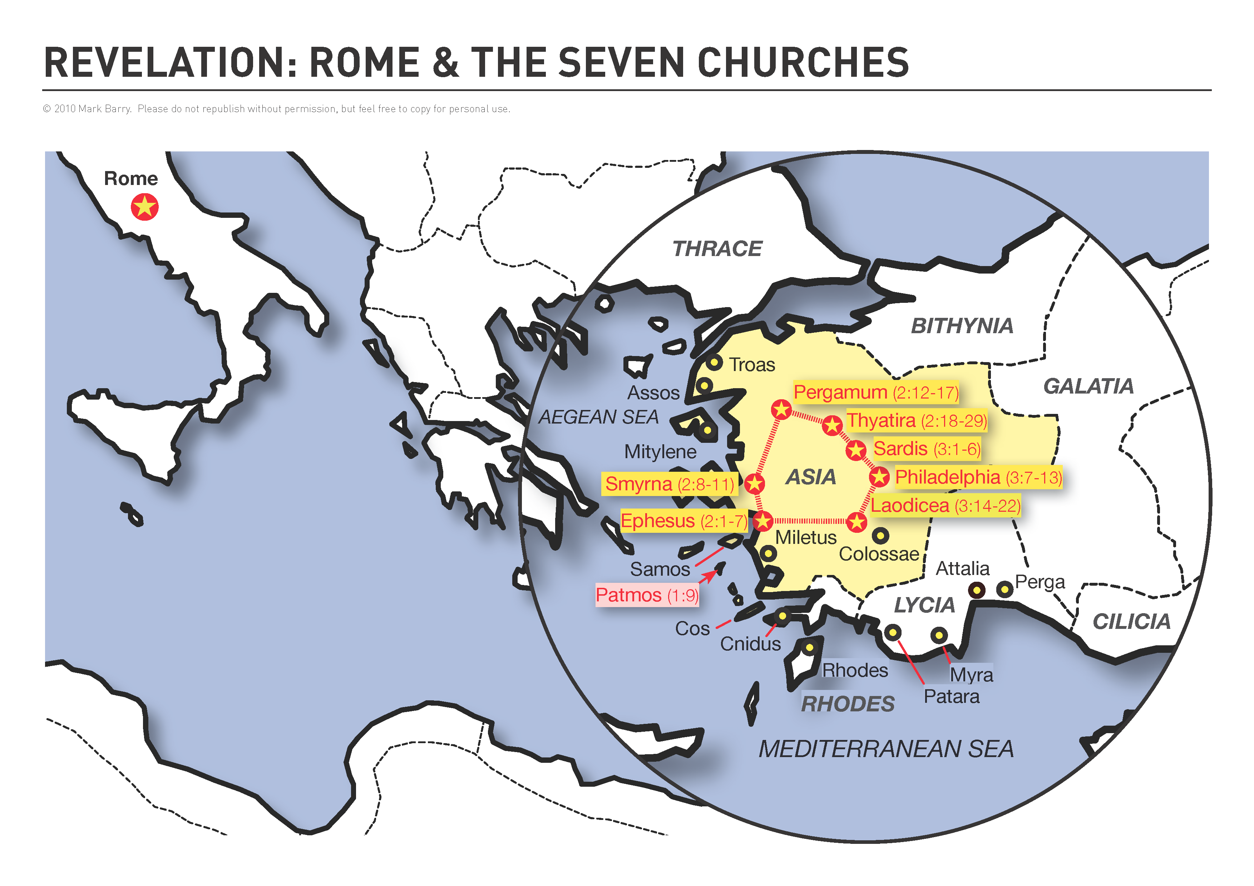

Slide 81
THE 7 CHURCHES OF ASIA:
Estranged Ephesus
Steadfast Smyrna
Permissive Pergamos
Tolerant Thyatira
Sleeping Sardis
Faithful Philadelphia
Lukewarm Laodicea

Slide 82
THE 7 CHURCHES OF ASIA:
Estranged Ephesus
Steadfast Smyrna
Permissive Pergamos
Tolerant Thyatira
Sleeping Sardis
Faithful Philadelphia
Lukewarm Laodicea
Ch. 2

Slide 83
THE 7 CHURCHES OF ASIA:
Estranged Ephesus
Steadfast Smyrna
Permissive Pergamos
Tolerant Thyatira
Sleeping Sardis
Faithful Philadelphia
Lukewarm Laodicea
Ch. 2
Ch. 3

Slide 84
WE LEARN FROM…

Slide 85
WE LEARN FROM…
…Sardis → We CAN Deceive Ourselves

Slide 86
SARDIS: We CAN Deceive Ourselves
Rev. 3:1-6

Slide 87
SARDIS: We CAN Deceive Ourselves
Rev. 3:1-6
Condemned for: Their spiritual state (v. 1)

Slide 88
SARDIS: We CAN Deceive Ourselves
Rev. 3:1-6
Condemned for: Their spiritual state (v. 1)
Commended for: “few left…not defiled” (v. 4)

Slide 89
SARDIS: We CAN Deceive Ourselves
Rev. 3:1-6
Condemned for: Their spiritual state (v. 1)
Commended for: “few left…not defiled” (v. 4)
1 Jn. 1:8, Jms. 1:16, 22, 26

Slide 90
WE LEARN FROM…
…Sardis → We CAN Deceive Ourselves

Slide 91
WE LEARN FROM…
…Sardis → We CAN Deceive Ourselves
…Philadelphia → We CAN Be Faithful

Slide 92
PHILADELPHIA: We CAN Remain Faithful
Rev. 3:7-13

Slide 93
PHILADELPHIA: We CAN Remain Faithful
Rev. 3:7-13
Commended for:
“kept My word” (v. 8a)
“not denied My name” (v. 8b)
“kept My command to persevere” (v. 10)

Slide 94
PHILADELPHIA: We CAN Remain Faithful
Rev. 3:7-13
To Receive:
Safety (v. 10)
Station (v. 12a)
Status (v. 12b)

Slide 95
WE LEARN FROM…
…Sardis → We CAN Deceive Ourselves
…Philadelphia → We CAN Be Faithful

Slide 96
WE LEARN FROM…
…Sardis → We CAN Deceive Ourselves
…Philadelphia → We CAN Be Faithful
…Laodicea → We CANNOT Sit On The Fence

Slide 97
LAODICEA: We CANNOT Sit On The Fence
Rev. 3:14-22

Slide 101
Hieropolis

Slide 102
LAODICEA: We CANNOT Sit On The Fence
Rev. 3:14-22
Commended for: Nothing!

Slide 103
LAODICEA: We CANNOT Sit On The Fence
Rev. 3:14-22
Commended for: Nothing!
Condemned for: Works, Pride, Blindness

Slide 104
LAODICEA: We CANNOT Sit On The Fence
Rev. 3:14-22
Commended for: Nothing!
Condemned for: Works, Pride, Blindness
Mt. 6:24, Lk. 11:23

Slide 105
WE LEARN FROM…
…Sardis → We CAN Deceive Ourselves
…Philadelphia → We CAN Be Faithful
…Laodicea → We CANNOT Sit On The Fence

Slide 106
Are you: Sleeping,
Lukewarm,
or Faithful?

Slide 107
#948
SONG:
I Am Resolved

Slide 108
1-1 I Am Resolved
I Am Resolved
948

Slide 109
1-2 I Am Resolved
I Am Resolved
948

Slide 110
C-1 I Am Resolved
I Am Resolved
948

Slide 111
C-2 I Am Resolved
I Am Resolved
948

Slide 112
4-1 I Am Resolved
I Am Resolved
948

Slide 113
4-2 I Am Resolved
I Am Resolved
948

Slide 114
C-1 I Am Resolved
I Am Resolved
948

Slide 115
C-2 I Am Resolved
I Am Resolved
948

Slide 116
#376
SONG:
He Paid A Debt

Slide 117
1-1 He Paid a Debt
He Paid A Debt
376

Slide 118
1-2 He Paid a Debt
He Paid A Debt
376

Slide 119
c He Paid a Debt
He Paid A Debt
376

Slide 120
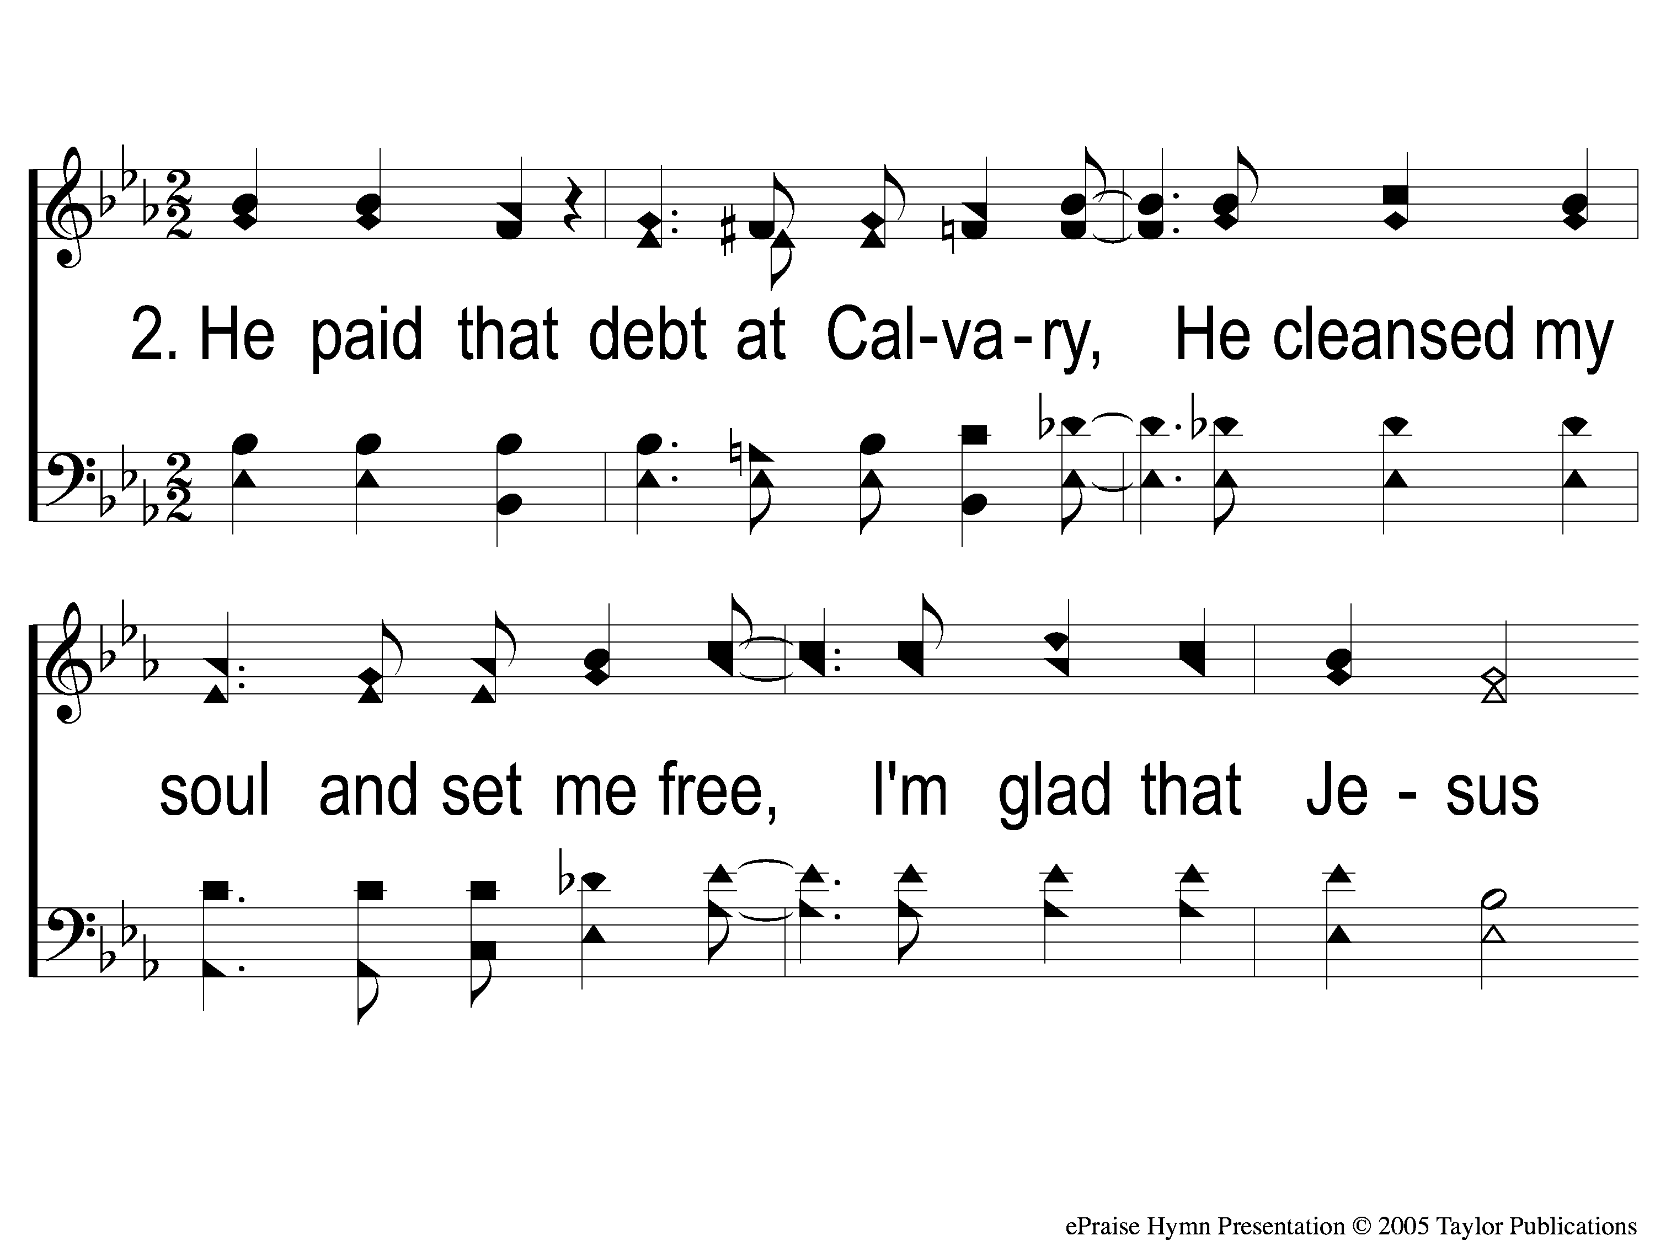
2-1 He Paid a Debt
He Paid A Debt
376

Slide 121
2-2 He Paid a Debt
He Paid A Debt
376

Slide 122
c He Paid a Debt
He Paid A Debt
376

Slide 123
3-1 He Paid a Debt
He Paid A Debt
376

Slide 124
3-2 He Paid a Debt
He Paid A Debt
376

Slide 125
c He Paid a Debt
He Paid A Debt
376

Slide 126
LORD’S SUPPER
The
Matt. 26:26-29

Slide 127
Unleavened Bread
LORD’S SUPPER
¹⁴ Seeing then that we have a great ^{n}High Priest who has passed through the heavens, Jesus the Son of God, ºlet us hold fast our confession. ¹⁵ For ^{p}we do not have a High Priest who cannot sympathize with our weaknesses, but ^{q}was in all points tempted as we are, ^{r}yet without sin. ^{16 s}Let us therefore come boldly to the throne of grace, that we may obtain mercy and find grace to help in time of need.
Hebrews 4:14-16

Slide 128
Fruit of the Vine
LORD’S SUPPER
¹¹ But Christ came as High Priest of the good things to come, with the greater and more perfect tabernacle not made with hands, that is, not of this creation. ¹² Not with the blood of goats and calves, but with His own blood He entered the Most Holy Place once for all, having obtained eternal redemption. ¹³ For if the blood of bulls and goats and the ashes of a heifer, sprinkling the unclean, sanctifies for the purifying of the flesh, ¹⁴ how much more shall the blood of Christ, who through the eternal Spirit offered Himself without spot to God, cleanse your conscience from dead works to serve the living God?
Hebrews 9:11-14

Slide 129
Hebrews 13:15-16
OFFERING
¹⁵ Therefore by Him let us continually offer the sacrifice of praise to God, that is, the fruit of our lips, giving thanks to His name. ¹⁶ But do not forget to do good and to share, for with such sacrifices God is well pleased.

Slide 130
Closing PRAYER

Slide 131
#916
SONG:
What A Day
That Will Be

Slide 132
1-1 What a Day That Will Be
What a Day That Will Be
916

Slide 133
1-2 What a Day That Will Be
What a Day That Will Be
916

Slide 134
1-3 What a Day That Will Be
What a Day That Will Be
916

Slide 135
C-1 What a Day That Will Be
What a Day That Will Be
916

Slide 136
C-2 What a Day That Will Be
What a Day That Will Be
916

Slide 137
C-3 What a Day That Will Be
What a Day That Will Be
916

Slide 138
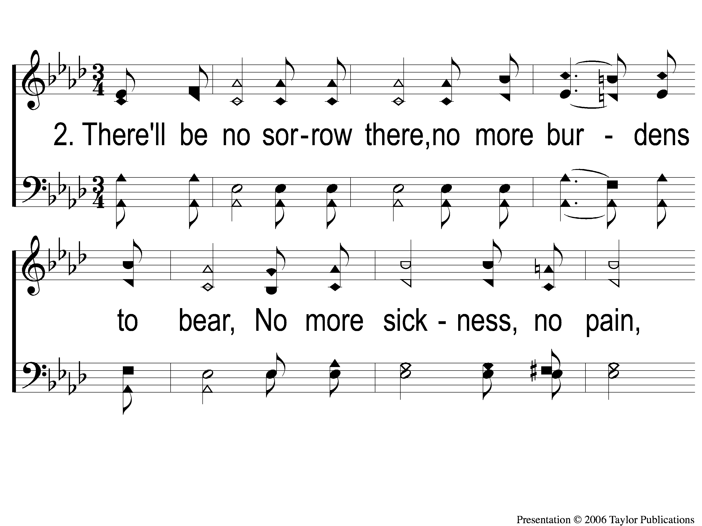
2-1 What a Day That Will Be
What a Day That Will Be
916

Slide 139
2-2 What a Day That Will Be
What a Day That Will Be
916

Slide 140
2-3 What a Day That Will Be
What a Day That Will Be
916

Slide 141
C-1 What a Day That Will Be
What a Day That Will Be
916

Slide 142
C-2 What a Day That Will Be
What a Day That Will Be
916

Slide 143
C-3 What a Day That Will Be
What a Day That Will Be
916

Slide 144
TONIGHT @ 6:00 pm
JOIN US
HOPE TO SEE YOU THERE!

