Slide 1
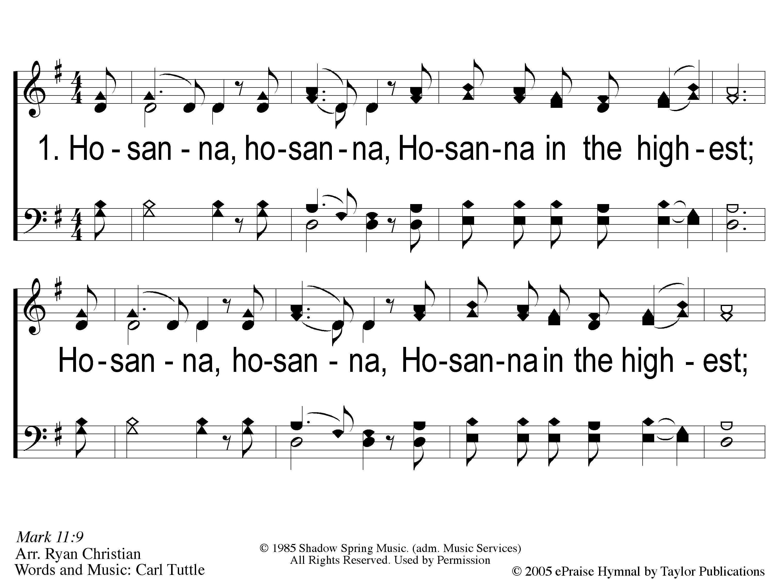
1 Hosanna
Hosanna
167

Slide 2
C-1 Hosanna
Hosanna
167

Slide 3
C-2 Hosanna
Hosanna
167

Slide 4
2 Hosanna
Hosanna
167

Slide 5
C-1 Hosanna
Hosanna
167

Slide 6
C-2 Hosanna
Hosanna
167

Slide 7
RESTORE REBUILD RENEW
welcome
we are glad to
Have you with us
IN 2022
WHEELER
CHURCH
OF
CHRIST

Slide 8
Song:
There Is A Habitation
#860

Slide 9
1 There is a Habitation
There Is A Habitation
860

Slide 10
c There is a Habitation
There Is A Habitation
860

Slide 11
2 There is a Habitation
There Is A Habitation
860

Slide 12
c There is a Habitation
There Is A Habitation
860

Slide 13
3 There is a Habitation
There Is A Habitation
860

Slide 14
c There is a Habitation
There Is A Habitation
860

Slide 15
4 There is a Habitation
There Is A Habitation
860

Slide 16
c There is a Habitation
There Is A Habitation
860

Slide 17
Song:
I Will Call Upon The Lord
#63

Slide 18
1 I Will Call Upon the Lord
I Will Call Upon the Lord
63

Slide 19
2 I Will Call Upon the Lord
I Will Call Upon the Lord
63

Slide 20
3 I Will Call Upon the Lord
I Will Call Upon the Lord
63

Slide 21
4 I Will Call Upon the Lord
I Will Call Upon the Lord
63

Slide 22
DC1 I Will Call Upon the Lord
I Will Call Upon the Lord
63

Slide 23
DC2 I Will Call Upon the Lord
I Will Call Upon the Lord
63

Slide 24
DC3 I Will Call Upon the Lord
I Will Call Upon the Lord
63

Slide 25
DC4 I Will Call Upon the Lord
I Will Call Upon the Lord
63

Slide 26
tag I Will Call Upon the Lord
I Will Call Upon the Lord
63

Slide 27
Opening Prayer

Slide 28
Song:
Teach Me Lord To Wait
#764

Slide 29
1-1 Teach Me Lord to Wait
Teach Me Lord, To Wait
764

Slide 30
1-2 Teach Me Lord to Wait
Teach Me Lord, To Wait
764

Slide 31
C-1 Teach Me Lord to Wait
Teach Me Lord, To Wait
764

Slide 32
C-2 Teach Me Lord to Wait
Teach Me Lord, To Wait
764

Slide 33
2-1 Teach Me Lord to Wait
Teach Me Lord, To Wait
764

Slide 34
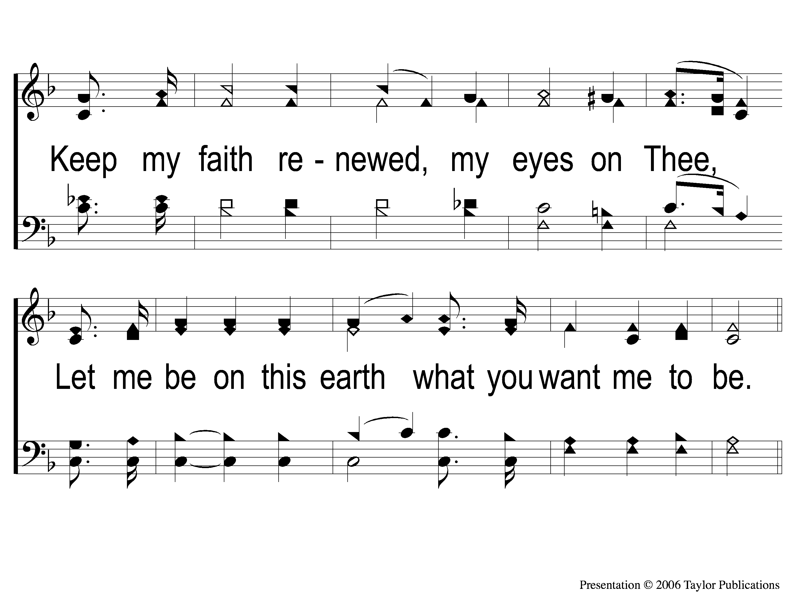
2-2 Teach Me Lord to Wait
Teach Me Lord, To Wait
764

Slide 35
C-1 Teach Me Lord to Wait
Teach Me Lord, To Wait
764

Slide 36
C-2 Teach Me Lord to Wait
Teach Me Lord, To Wait
764

Slide 37
Song:
I Am A Poor
Wayfaring Stranger
#979

Slide 38
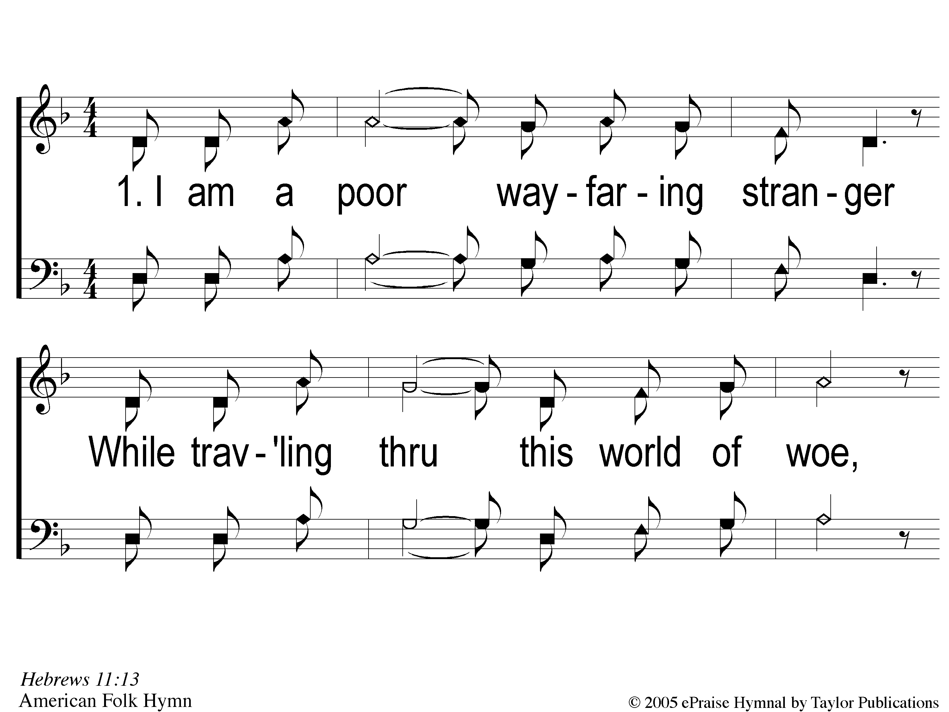
1-1 I Am A Poor Wayfaring Stranger
I Am A Poor Wayfaring Stranger
979

Slide 39
1-2 I Am A Poor Wayfaring Stranger
I Am A Poor Wayfaring Stranger
979

Slide 40
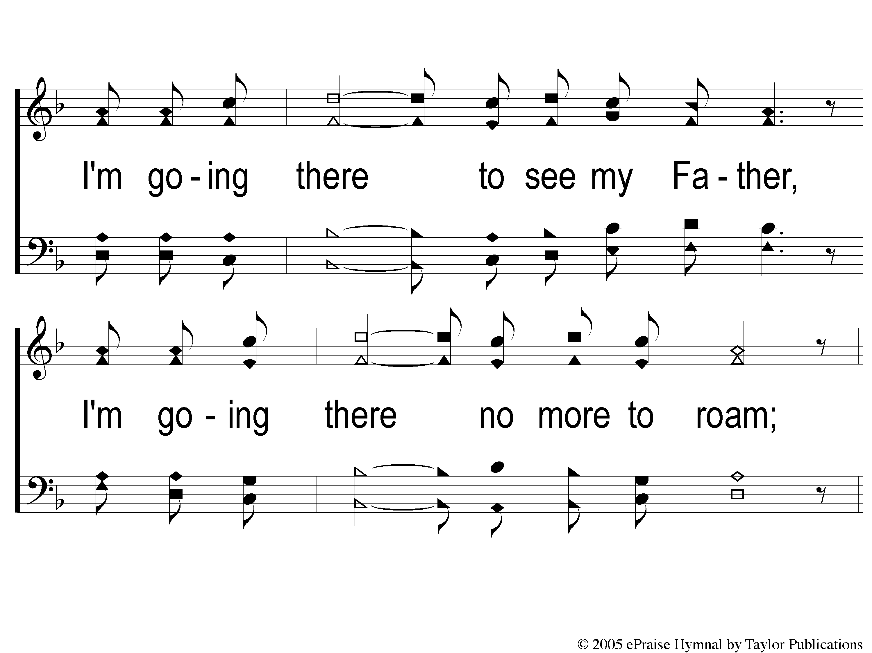
1-3 I Am A Poor Wayfaring Stranger
I Am A Poor Wayfaring Stranger
979

Slide 41
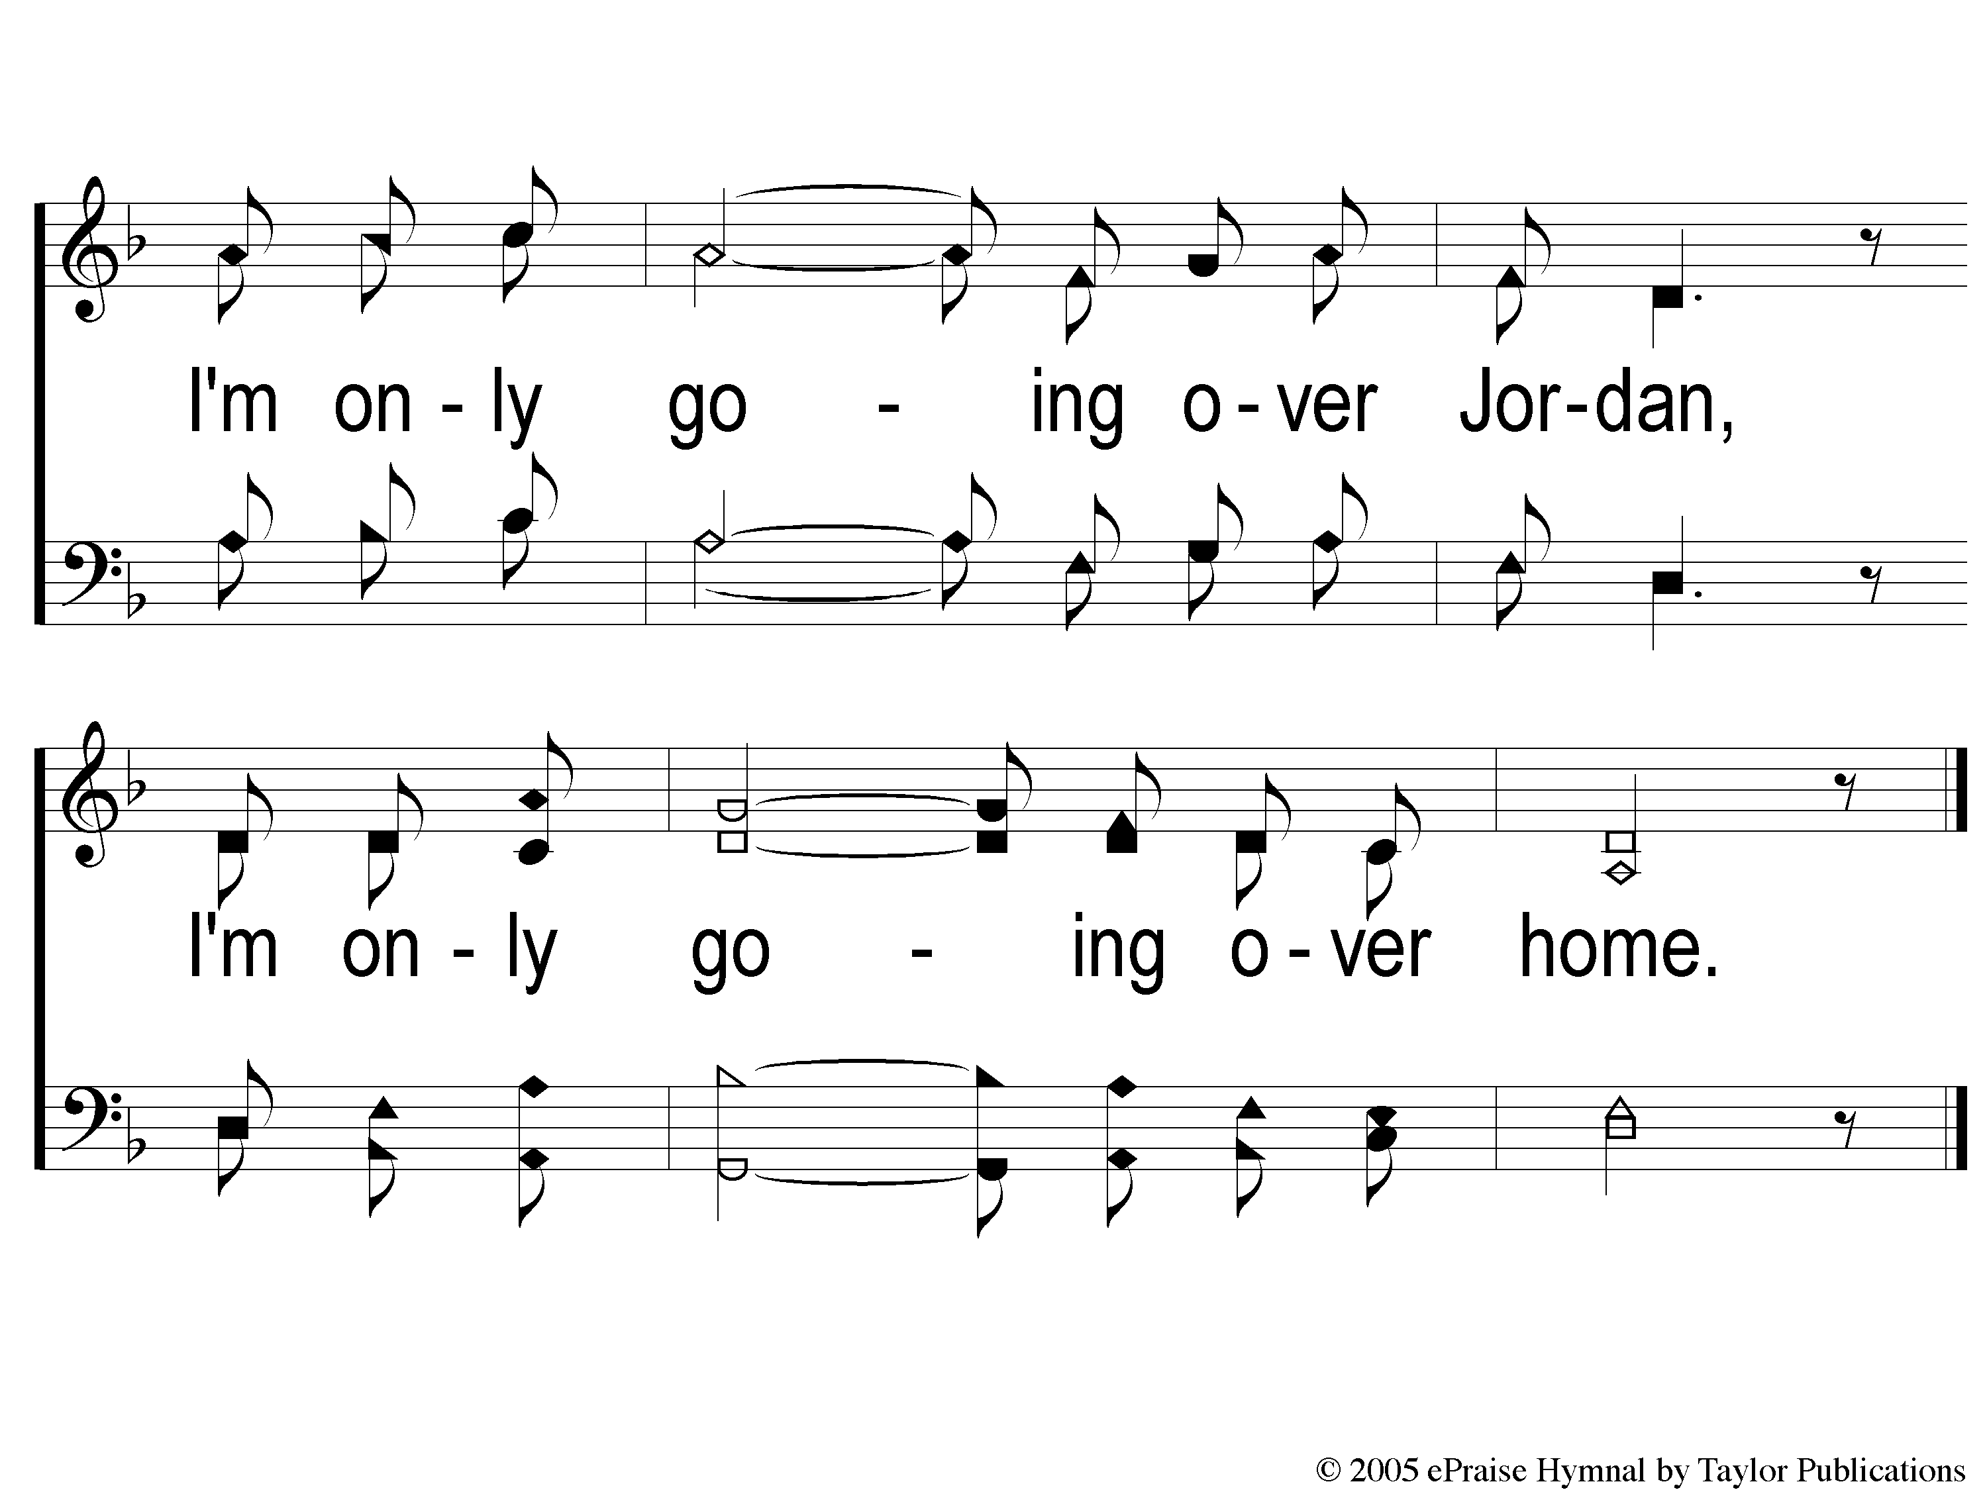
c I Am A Poor Wayfaring Stranger
I Am A Poor Wayfaring Stranger
979

Slide 42
2-1 I Am A Poor Wayfaring Stranger
I Am A Poor Wayfaring Stranger
979

Slide 43
2-2 I Am A Poor Wayfaring Stranger
I Am A Poor Wayfaring Stranger
979

Slide 44
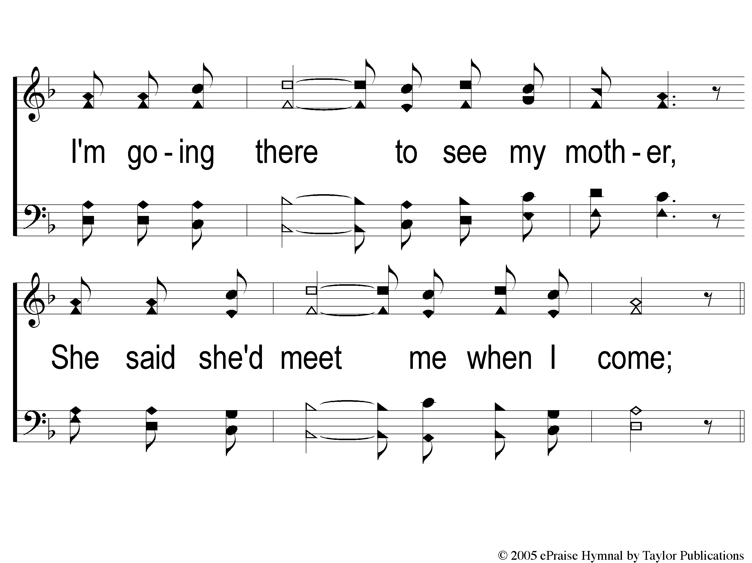
2-3 I Am A Poor Wayfaring Stranger
I Am A Poor Wayfaring Stranger
979

Slide 45
c I Am A Poor Wayfaring Stranger
I Am A Poor Wayfaring Stranger
979

Slide 46
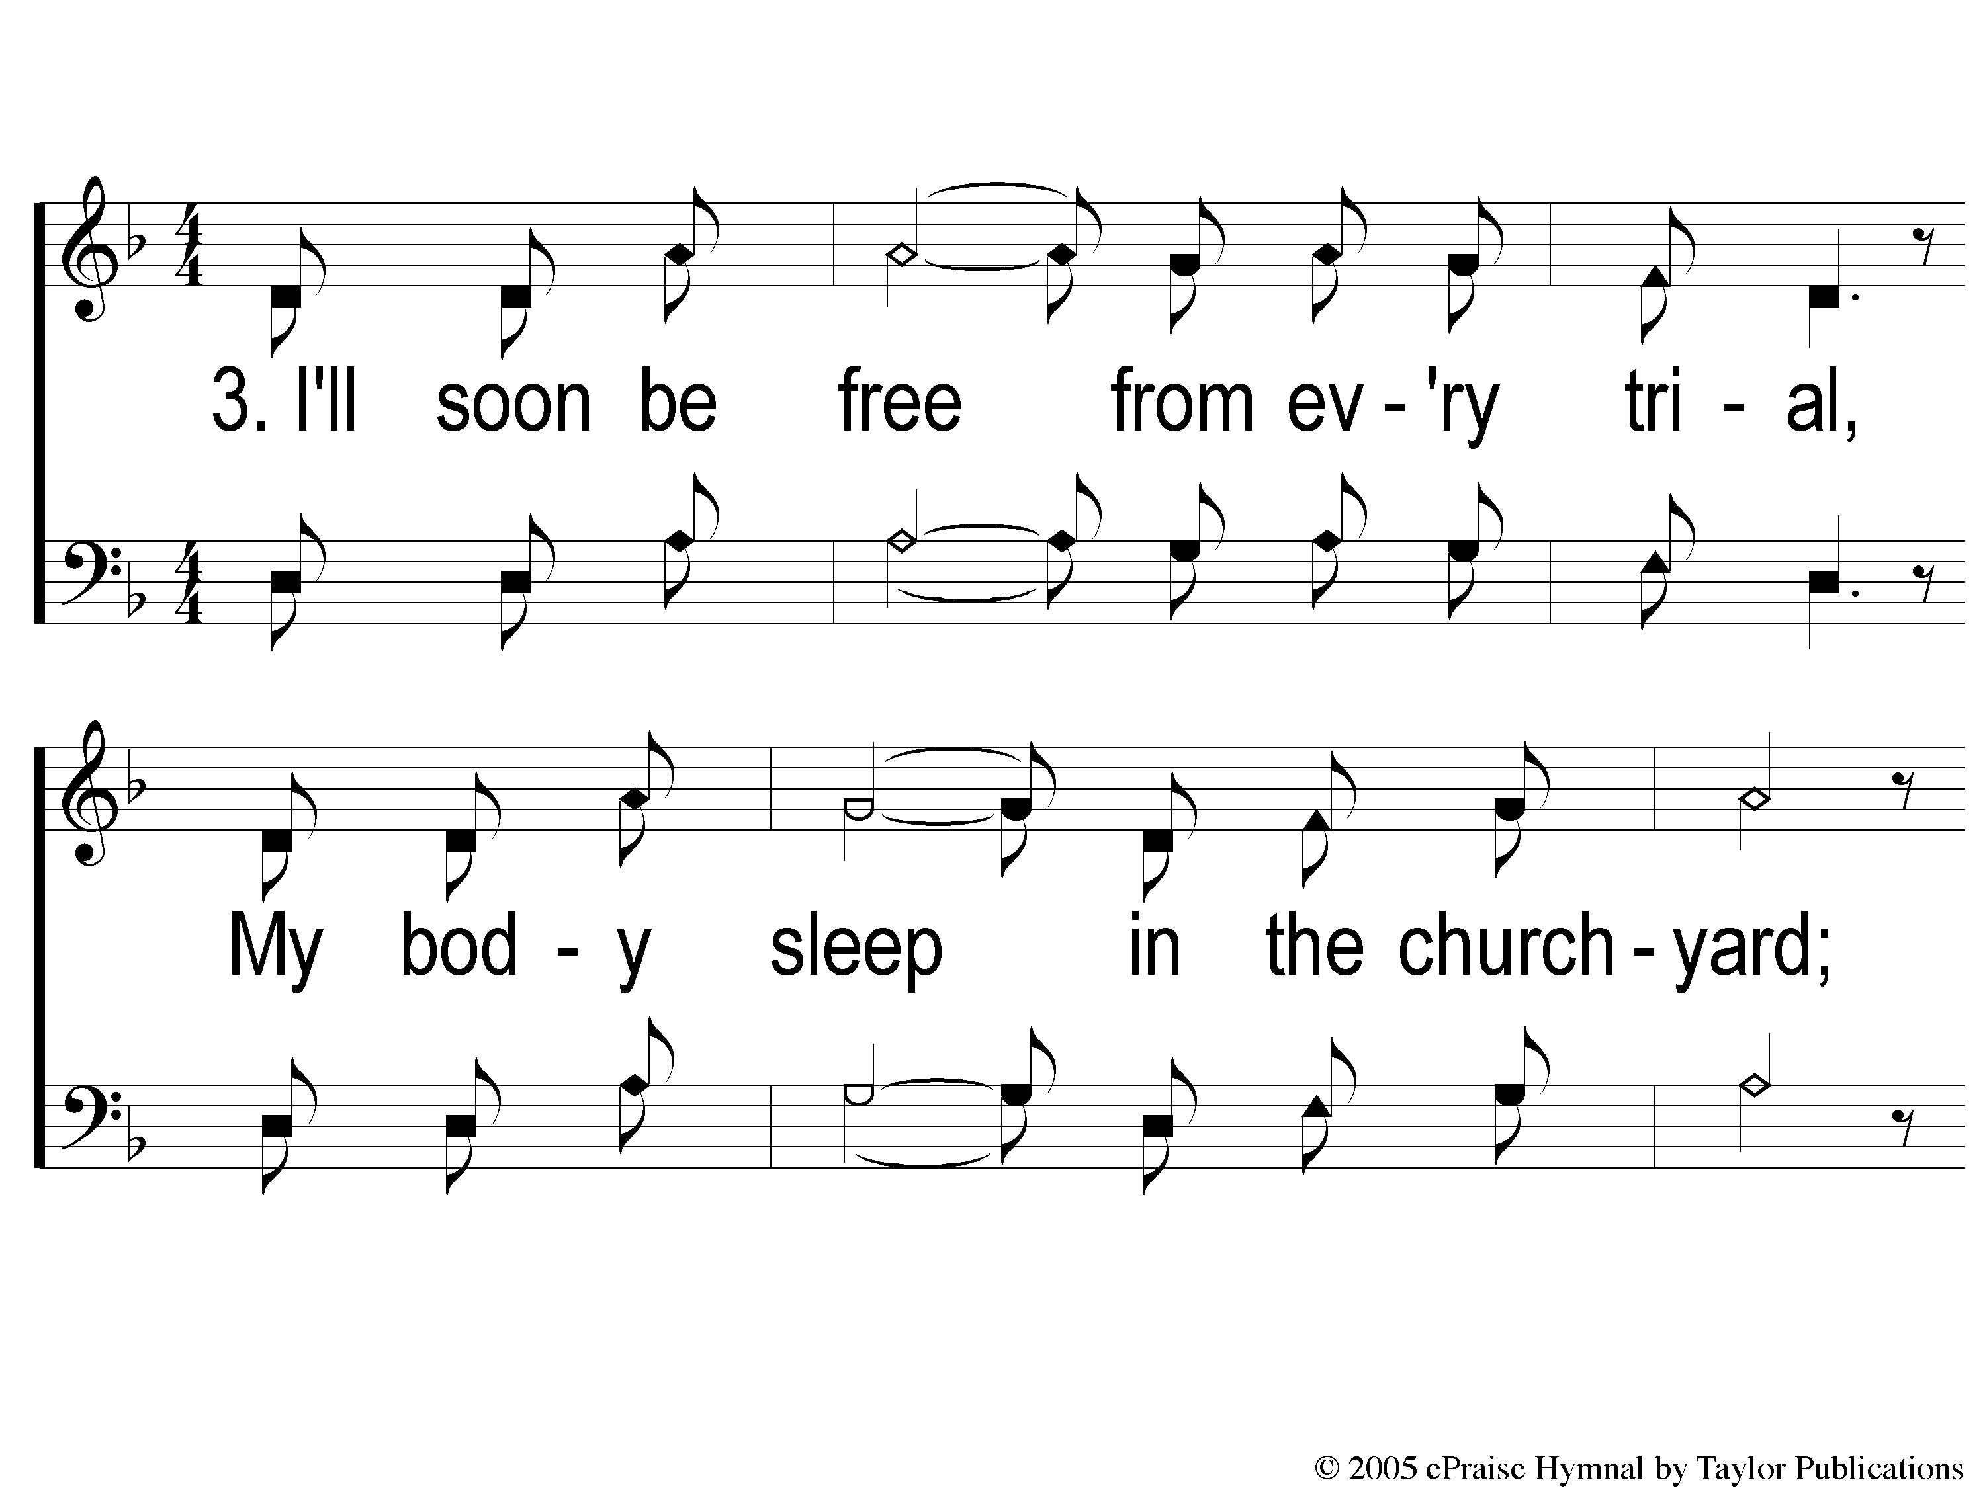
3-1 I Am A Poor Wayfaring Stranger
I Am A Poor Wayfaring Stranger
979

Slide 47
3-2 I Am A Poor Wayfaring Stranger
I Am A Poor Wayfaring Stranger
979

Slide 48
3-3 I Am A Poor Wayfaring Stranger
I Am A Poor Wayfaring Stranger
979

Slide 49
c I Am A Poor Wayfaring Stranger
I Am A Poor Wayfaring Stranger
979

Slide 50
Scripture Reading:
Genesis 25:19-27

Slide 51
RESTORE
OUR
FOUNDATIONS
JANUARY - APRIL

Slide 52
Tonight @ 6pm
“Like Father, Like Son”

Slide 53
Problematic
Parenting Strategies

Slide 54
Problematic
Parenting Strategies:

Slide 55
Problematic
Parenting Strategies:
Discrimination

Slide 56
Discrimination
Gen. 25:27-28

Slide 57
Discrimination
Gen. 25:27-28
Partiality = “Receiving The Face”

Slide 58
Discrimination
Gen. 25:27-28
Partiality = “Receiving The Face”
Deut. 10:17, 16:19
Job 32:21 – Prov. 24:23

Slide 59
Problematic
Parenting Strategies:
Discrimination

Slide 60
Problematic
Parenting Strategies:
Discrimination
Manipulation

Slide 61
Manipulation
Gen. 27:1-11

Slide 62
Manipulation
Gen. 27:1-11
Rebekah’s Idea

Slide 63
Manipulation
Gen. 27:1-11
Rebekah’s Idea
Rom. 16:18 – Col. 2:4

Slide 64
Problematic
Parenting Strategies:
Discrimination
Manipulation

Slide 65
Problematic
Parenting Strategies:
Discrimination
Manipulation
Inattention

Slide 66
Inattention
Gen. 27:1-4

Slide 67
Inattention
Gen. 27:1-4
What About The Prophecy?
Gen. 25:23

Slide 68
Inattention
Deut. 8:11
Prov. 19:16
Psa. 119:83, 109, 141, 153, 176
Heb. 13:2, 16

Slide 69
Problematic
Parenting Results:
Discrimination leads to…
…Conflict & Hostility

Slide 70
Problematic
Parenting Results:
Discrimination leads to…
…Conflict & Hostility
…Ineffective Discipline

Slide 71
Problematic
Parenting Results:
Discrimination leads to…
…Conflict & Hostility
…Ineffective Discipline
…Seeking Attention

Slide 72
Problematic
Parenting Results:
Manipulation leads to…
…Conflict & Hostility

Slide 73
Problematic
Parenting Results:
Manipulation leads to…
…Conflict & Hostility
…Distrust & Lies

Slide 74
Problematic
Parenting Results:
Inattention to God’s laws leads to…
…Half-hearted Children

Slide 75
Problematic
Parenting Results:
Inattention to God’s laws leads to…
…Half-hearted Children
…Unbelieving Children

Slide 76
Invitation
Song:
Jesus Is Coming Soon
#712

Slide 77
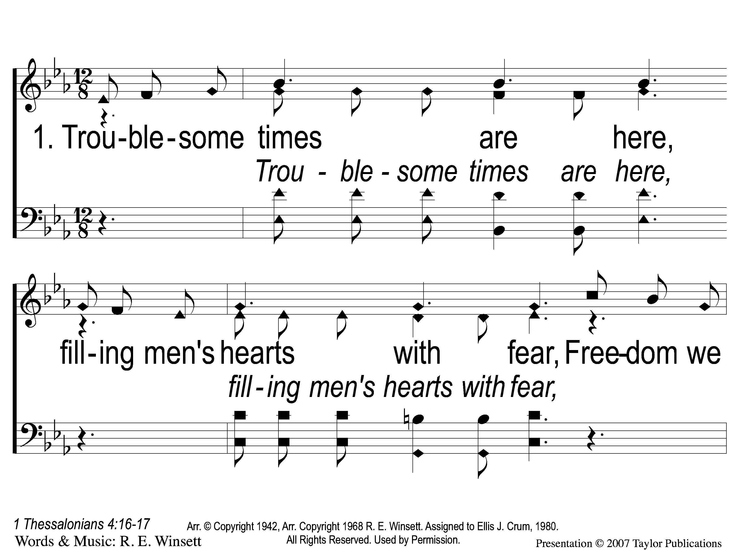
1-1 Jesus is Coming Soon
Jesus is Coming Soon
712

Slide 78
1-2 Jesus is Coming Soon
Jesus is Coming Soon
712

Slide 79
1-3 Jesus is Coming Soon
Jesus is Coming Soon
712

Slide 80
C-1 Jesus is Coming Soon
Jesus is Coming Soon
712

Slide 81
C-2 Jesus is Coming Soon
Jesus is Coming Soon
712

Slide 82
C-3 Jesus is Coming Soon
Jesus is Coming Soon
712

Slide 83
C-4 Jesus is Coming Soon
Jesus is Coming Soon
712

Slide 84
2-1 Jesus is Coming Soon
Jesus is Coming Soon
712

Slide 85
2-2 Jesus is Coming Soon
Jesus is Coming Soon
712

Slide 86
2-3 Jesus is Coming Soon
Jesus is Coming Soon
712

Slide 87
C-1 Jesus is Coming Soon
Jesus is Coming Soon
712

Slide 88
C-2 Jesus is Coming Soon
Jesus is Coming Soon
712

Slide 89
C-3 Jesus is Coming Soon
Jesus is Coming Soon
712

Slide 90
C-4 Jesus is Coming Soon
Jesus is Coming Soon
712

Slide 91
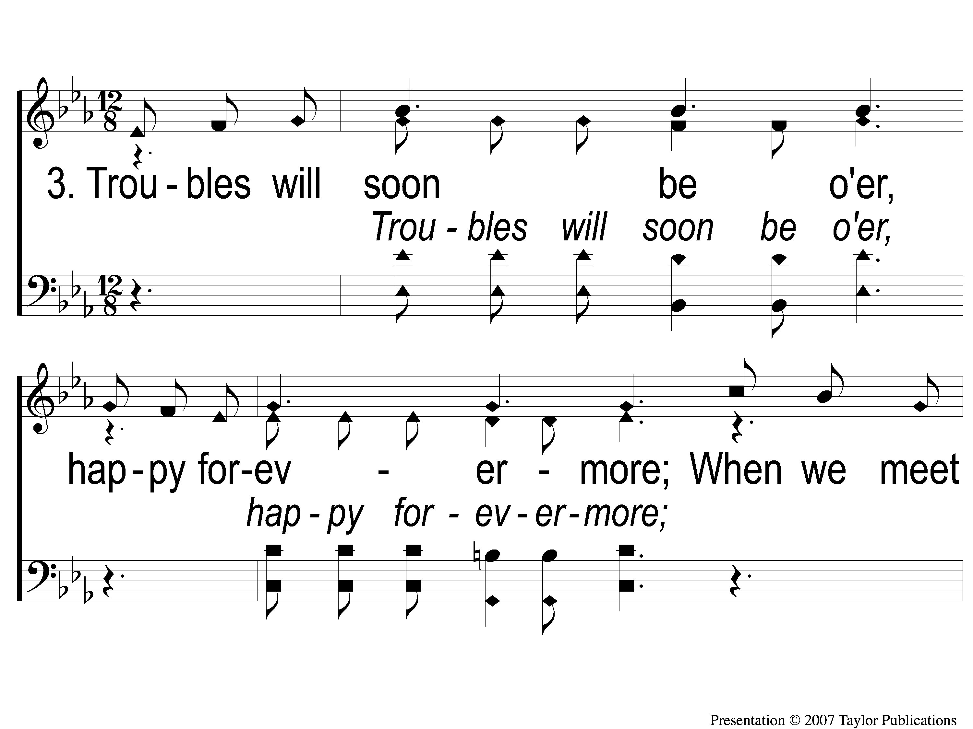
3-1 Jesus is Coming Soon
Jesus is Coming Soon
712

Slide 92
3-2 Jesus is Coming Soon
Jesus is Coming Soon
712

Slide 93
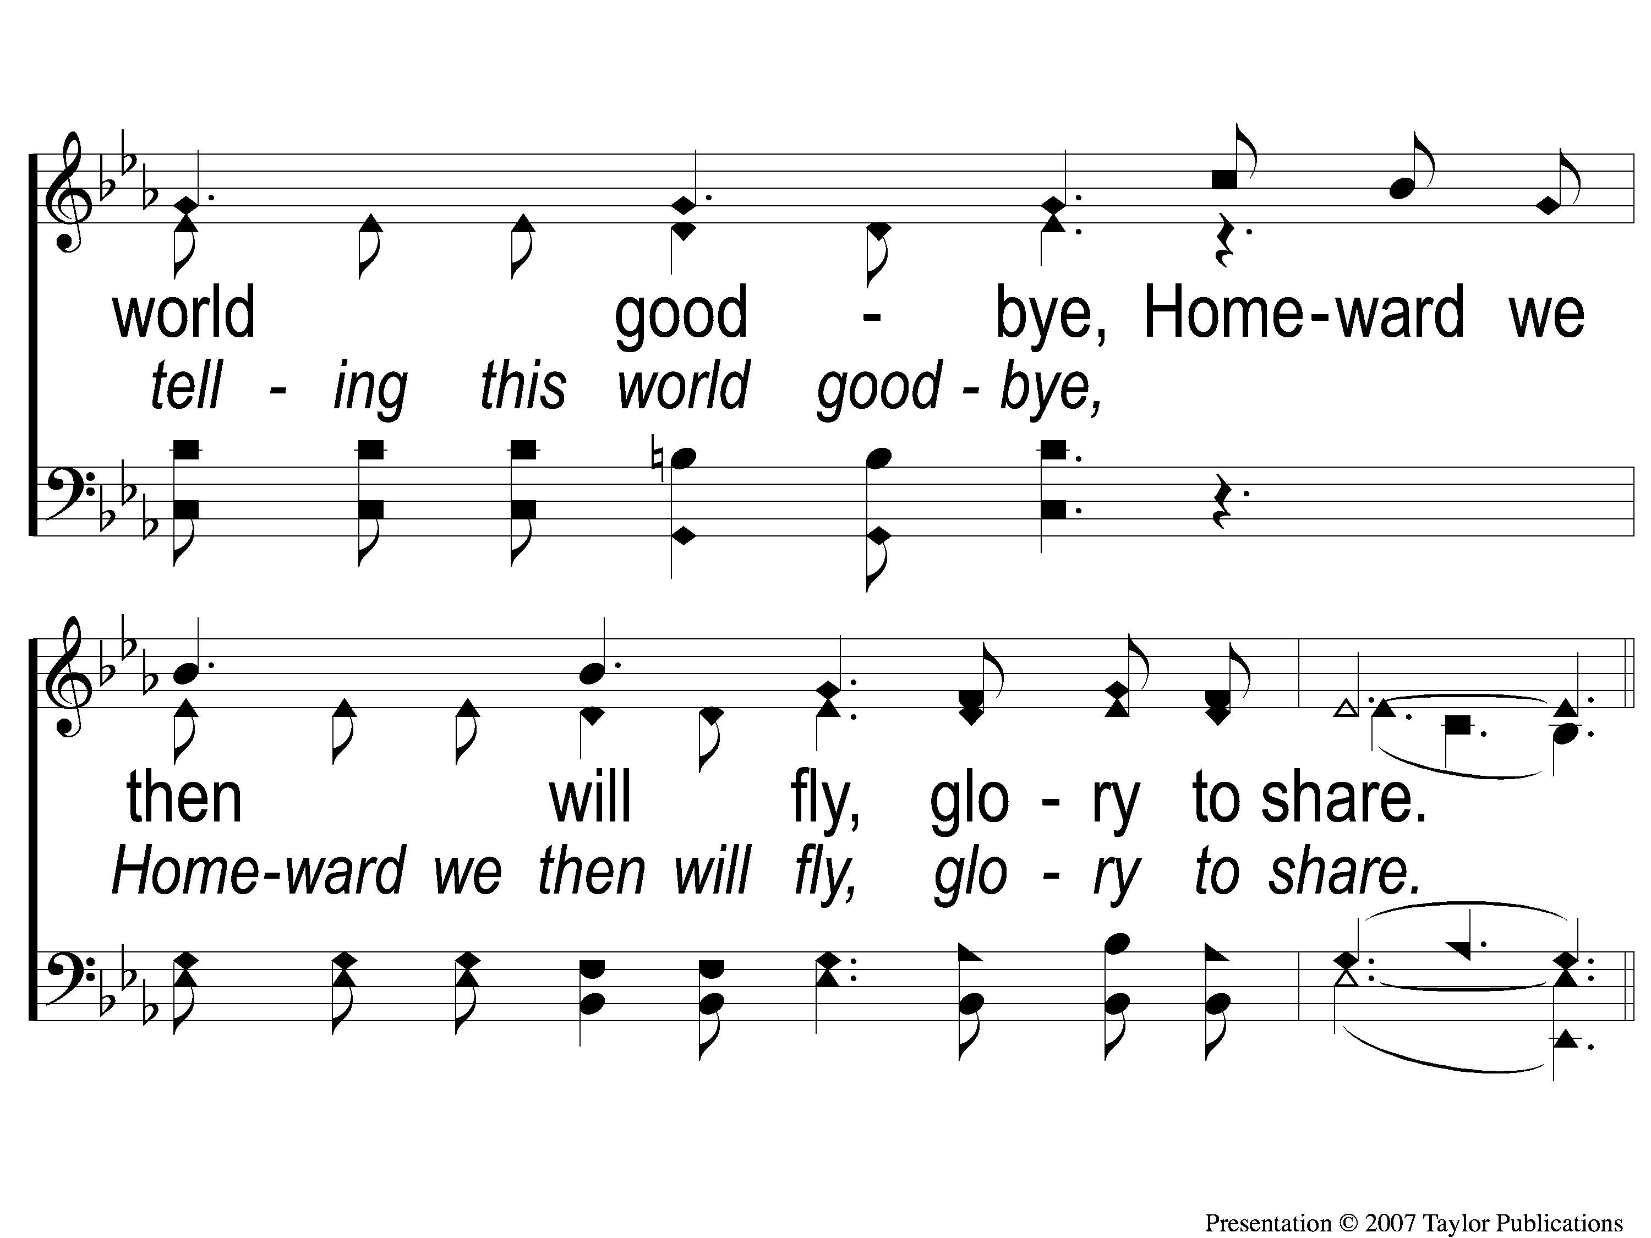
3-3 Jesus is Coming Soon
Jesus is Coming Soon
712

Slide 94
C-1 Jesus is Coming Soon
Jesus is Coming Soon
712

Slide 95
C-2 Jesus is Coming Soon
Jesus is Coming Soon
712

Slide 96
C-3 Jesus is Coming Soon
Jesus is Coming Soon
712

Slide 97
C-4 Jesus is Coming Soon
Jesus is Coming Soon
712

Slide 98
The Contribution:
1 John 3:16-17
“By this we know love, because He laid down His life for us. And we also ought to lay down our lives for the brethren. But whoever has this world’s goods, and sees his brother in need, and shuts up his heart from him, how does the love of God abide in him?”

Slide 99
Song:
Lamb Of God
#176

Slide 100
1-1 Lamb of God
Lamb of God
176

Slide 101
1-2 Lamb of God
Lamb of God
176

Slide 102
1-3 Lamb of God
Lamb of God
176

Slide 103
1-4 Lamb of God
Lamb of God
176

Slide 104
C-1 Lamb of God
Lamb of God
176

Slide 105
C-2 Lamb of God
Lamb of God
176

Slide 106
2-1 Lamb of God
Lamb of God
176

Slide 107
2-2 Lamb of God
Lamb of God
176

Slide 108
C-1 Lamb of God
Lamb of God
176

Slide 109
C-2 Lamb of God
Lamb of God
176

Slide 110
The Unleavened Bread
Revelation 1:17-18
“And when I saw Him, I fell at His feet as dead. But He laid His right hand on me, saying to me, ‘Do not be afraid; I am the First and the Last. I am He who lives, and was dead, and behold, I am alive forevermore.’ ”

Slide 111
The Fruit
of the Vine
Revelation 5:9-10
“And they sang a new song, saying: ‘You are worthy to take the scroll, And to open its seals; For You were slain, And have redeemed us to God by Your blood Out of every tribe and tongue and people and nation, And have made us kings and priests to our God; And we shall reign on the earth.’ ”

Slide 112
Closing Prayer

Slide 113
Song:
The Battle Belongs To The Lord
#749

Slide 114
1-1 The Battle Belongs to the Lord
The Battle Belongs to the Lord
749

Slide 115
1-2 The Battle Belongs to the Lord
The Battle Belongs to the Lord
749

Slide 116
C-1 The Battle Belongs to the Lord
The Battle Belongs to the Lord
749

Slide 117
C-2 The Battle Belongs to the Lord
The Battle Belongs to the Lord
749

Slide 118
2-1 The Battle Belongs to the Lord
The Battle Belongs to the Lord
749

Slide 119
2-2 The Battle Belongs to the Lord
The Battle Belongs to the Lord
749

Slide 120
C-1 The Battle Belongs to the Lord
The Battle Belongs to the Lord
749

Slide 121
C-2 The Battle Belongs to the Lord
The Battle Belongs to the Lord
749

Slide 122
3-1 The Battle Belongs to the Lord
The Battle Belongs to the Lord
749

Slide 123
3-2 The Battle Belongs to the Lord
The Battle Belongs to the Lord
749

Slide 124
C-1 The Battle Belongs to the Lord
The Battle Belongs to the Lord
749

Slide 125
C-2 The Battle Belongs to the Lord
The Battle Belongs to the Lord
749

Slide 126
Tonight
Worship @ 6:00 pm
Monday
Bible Study @ 6:30 pm
Wednesday
WORSHIP/Classes @ 6:30 pm
RESTORE REBUILD RENEW
IN 2022
WHEELER
CHURCH
OF
CHRIST

