Slide 1
PLEASE STANDBY
OUR LIVESTREAM
WILL BEGIN SOON

Slide 2
WELCOME
THANKS FOR JOINING US!

Slide 3
#608
SONG:
He Gave Me A Song

Slide 4
1-1 He Gave Me A Song
He Gave Me A Song
608

Slide 5
1-2 He Gave Me A Song
He Gave Me A Song
608

Slide 6
1-3 He Gave Me A Song
He Gave Me A Song
608

Slide 7
C-1 He Gave Me A Song
He Gave Me A Song
608

Slide 8
C-2 He Gave Me A Song
He Gave Me A Song
608

Slide 9
C-3 He Gave Me A Song
He Gave Me A Song
608

Slide 10
2-1 He Gave Me A Song
He Gave Me A Song
608

Slide 11
2-2 He Gave Me A Song
He Gave Me A Song
608

Slide 12
2-3 He Gave Me A Song
He Gave Me A Song
608

Slide 13
C-1 He Gave Me A Song
He Gave Me A Song
608

Slide 14
C-2 He Gave Me A Song
He Gave Me A Song
608

Slide 15
C-3 He Gave Me A Song
He Gave Me A Song
608

Slide 16
3-1 He Gave Me A Song
He Gave Me A Song
608

Slide 17
3-2 He Gave Me A Song
He Gave Me A Song
608

Slide 18
3-3 He Gave Me A Song
He Gave Me A Song
608

Slide 19
C-1 He Gave Me A Song
He Gave Me A Song
608

Slide 20
C-2 He Gave Me A Song
He Gave Me A Song
608

Slide 21
C-3 He Gave Me A Song
He Gave Me A Song
608

Slide 22
1 Words and Music
Words and Music
238

Slide 23
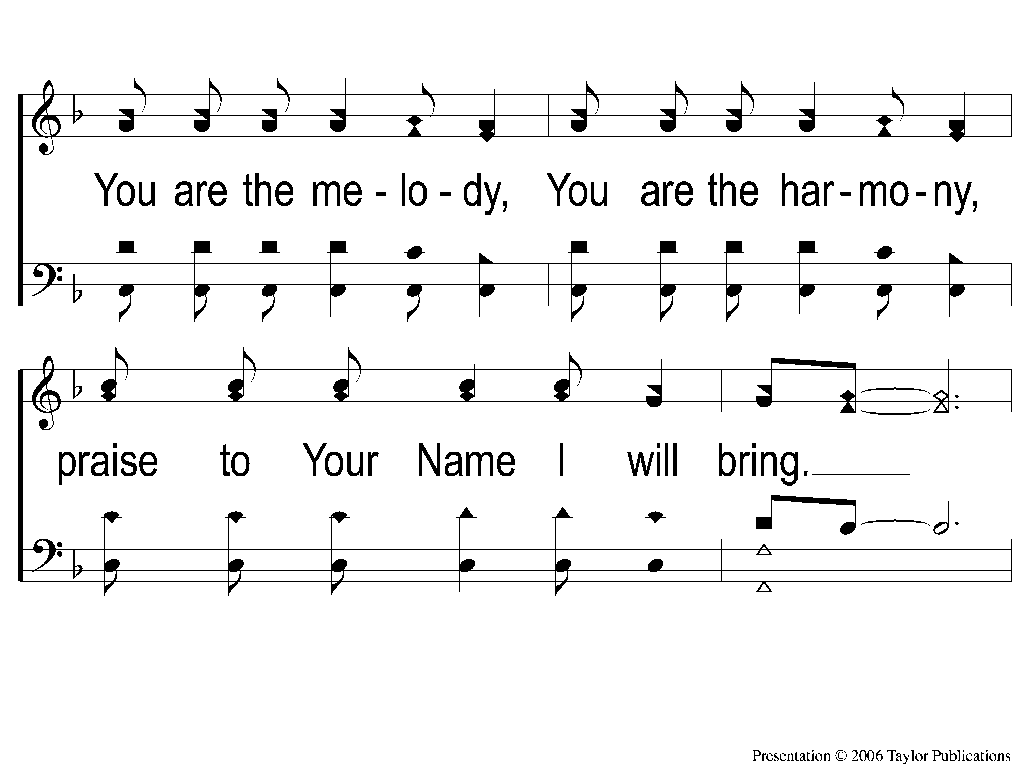
2 Words and Music
Words and Music
238

Slide 24
3 Words and Music
Words and Music
238

Slide 25
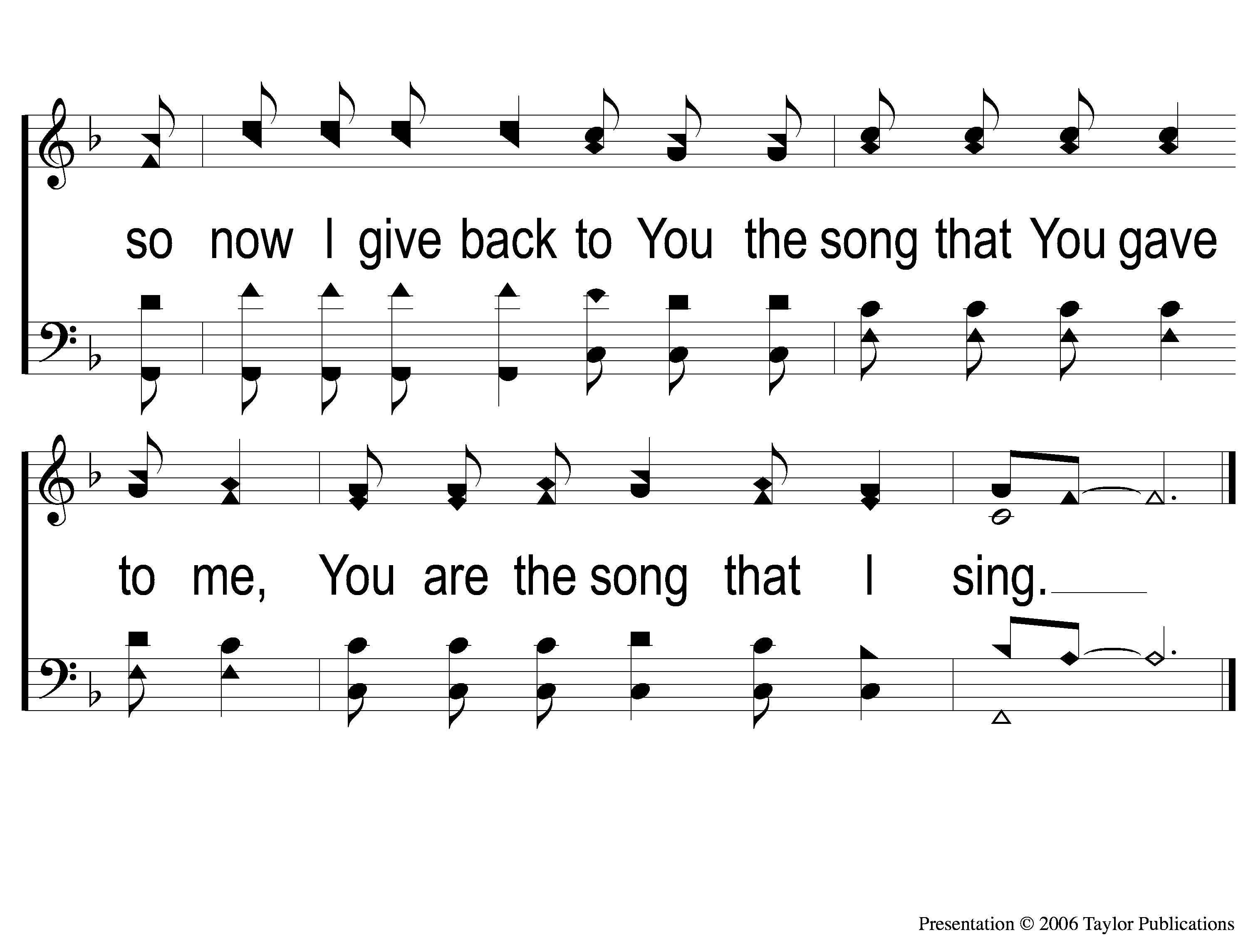
4 Words and Music
Words and Music
238

Slide 26
#483
SONG:
Is It For Me

Slide 27
1 Is It for Me
Is It For Me
483

Slide 28
C Is It for Me
Is It For Me
483

Slide 29
2 Is It for Me
Is It For Me
483

Slide 30
C Is It for Me
Is It For Me
483

Slide 31
4 Is It for Me
Is It For Me
483

Slide 32
C Is It for Me
Is It For Me
483

Slide 33
Opening PRAYER

Slide 34
#484
SONG:
You Are My All In All

Slide 35
1 All in All
You Are My All in All
484

Slide 36
2 All in All
You Are My All in All
484

Slide 37
3 All in All
You Are My All in All
484

Slide 38
4 All in All
You Are My All in All
484

Slide 39
5 All in All
You Are My All in All
484

Slide 40
6 All in All
You Are My All in All
484

Slide 41
C-1 All in All
You Are My All in All
484

Slide 42
C-2 All in All
You Are My All in All
484

Slide 43
1-1 Worthy is the Lamb
Worthy Is the Lamb
234

Slide 44
1-2 Worthy is the Lamb
Worthy Is the Lamb
234

Slide 45
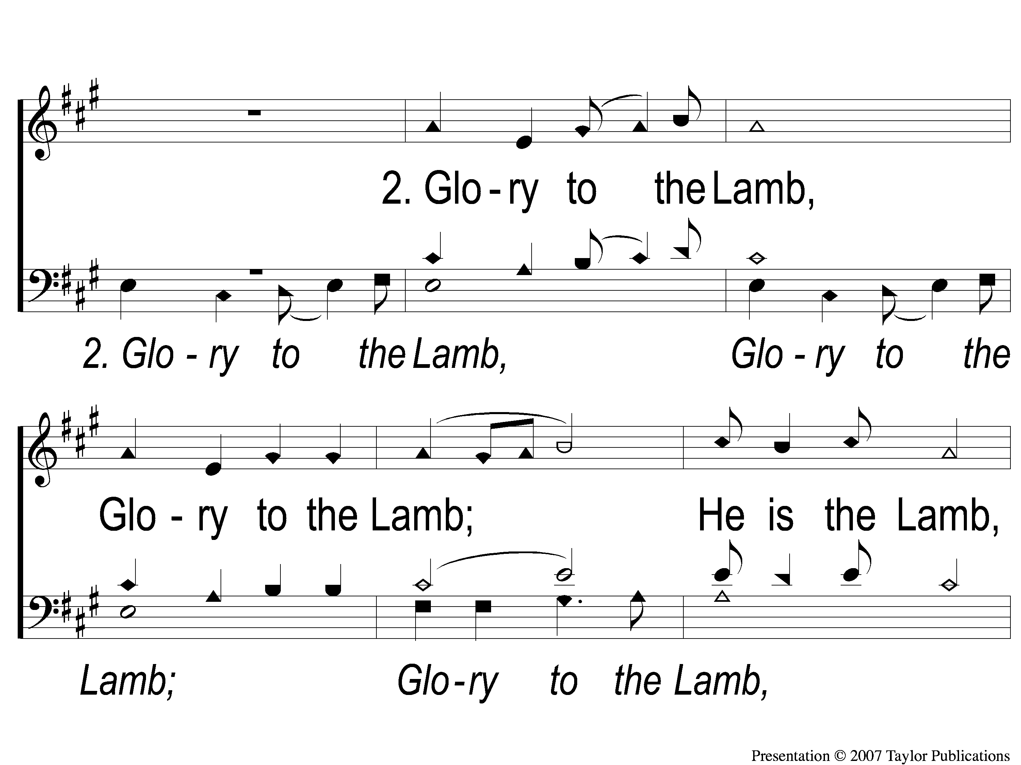
2-1 Worthy is the Lamb
Worthy Is the Lamb
234

Slide 46
2-2 Worthy is the Lamb
Worthy Is the Lamb
234

Slide 47
3-1 Worthy is the Lamb
Worthy Is the Lamb
234

Slide 48
3-2 Worthy is the Lamb
Worthy Is the Lamb
234

Slide 49
SCRIPTURE:
Revelation 5:8-12

Slide 50
THE REVELATION OF JESUS CHRIST
“WHO IS ABLE TO STAND?”
REVELATION 6:17 (NKJV)

Slide 51
Two Challenges:
Read through all of the book
Write a one-sentence summary of the book

Slide 52
THE REVELATION OF JESUS CHRIST
“THINGS WHICH MUST SHORTLY TAKE PLACE”
REVELATION 1:1 (NKJV)

Slide 53
THE REVELATION OF JESUS CHRIST
“HEAR WHAT THE SPIRIT SAYS TO THE CHURCHES”
REVELATION 3:6 (NKJV)

Slide 54
THE REVELATION OF JESUS CHRIST
“WORTHY IS THE LAMB WHO WAS SLAIN”
REVELATION 5:12 (NKJV)

Slide 55
Two Themes:
“Overcome”
Worship God Only

Slide 56
REVIEW
Ch. 1 – Setting: John’s Exile

Slide 57
REVIEW
Ch. 1 – Setting: John’s Exile
Ch. 2-3 – Jesus’ Messages to the 7 Churches

Slide 58
REVIEW
Ch. 1 – Setting: John’s Exile
Ch. 2-3 – Jesus’ Messages to the 7 Churches
Ch. 4-5 – The Throne & The Lamb

Slide 59
REVIEW
Ch. 1 – Setting: John’s Exile
Ch. 2-3 – Jesus’ Messages to the 7 Churches
Ch. 4-7 – The 7 Seals Opened

Slide 60
The Throne In Heaven
Rev. 4:1-7

Slide 61
The Throne In Heaven
Rev. 4:1-7
The Who

Slide 62
The Throne In Heaven
Rev. 4:1-7
The Who
One on the throne (v. 2-3)
24 Elders (v. 4)
4 Living Creatures (v. 6-7)

Slide 63
The Throne In Heaven
Rev. 4:8-11
The What
What are they doing?
Praising God!

Slide 64
The Lamb & The Scroll
Rev. 5:1-4 – The Worrying One

Slide 65
The Lamb & The Scroll
Rev. 5:1-4 – The Worrying One
One on the throne held a 7-sealed scroll

Slide 66
The Lamb & The Scroll
Rev. 5:1-4 – The Worrying One
One on the throne held a 7-sealed scroll
NO ONE could Take it / Read it
None In Heaven
None On Earth
None Under the Earth

Slide 67
The Lamb & The Scroll
Rev. 5:5-7 – The Worthy One

Slide 68
The Lamb & The Scroll
Rev. 5:5-7 – The Worthy One
John told not to weep / worry

Slide 69
The Lamb & The Scroll
Rev. 5:5-7 – The Worthy One
John told not to weep / worry
The Lamb “has prevailed to open the scroll”
Who is a Lion – Gen. 49:10
Who is a King – Mt. 1:1, Jn. 18:37
Who is the High Priest – Heb. 7:15-16

Slide 70
The Lamb & The Scroll
Rev. 5:8-14 – The Worshiping Ones

Slide 71
The Lamb & The Scroll
Rev. 5:8-14 – The Worshiping Ones
Immediately, worship ensues!

Slide 72
The Lamb & The Scroll
Rev. 5:8-14 – The Worshiping Ones
Immediately, worship ensues!
All 4 Living Creatures
All 24 Elders
“Many angels” (v. 11)

Slide 73
The Application
1. No Created Being is Worthy of Worship

Slide 74
The Application
1. No Created Being is Worthy of Worship
None in Heaven – Heb. 1:5

Slide 75
The Application
1. No Created Being is Worthy of Worship
None in Heaven – Heb. 1:5
None on Earth – Acts 10:25-26

Slide 76
The Application
1. No Created Being is Worthy of Worship
None in Heaven – Heb. 1:5
None on Earth – Acts 10:25-26
None under the Earth – 2 Pet. 2:4

Slide 77
The Application
2. Jesus Christ Is Worthy of Worship

Slide 78
The Application
2. Jesus Christ Is Worthy of Worship
The Lion of Judah → The Messiah

Slide 79
The Application
2. Jesus Christ Is Worthy of Worship
The Lion of Judah → The Messiah
The Root of David → The King of Israel

Slide 80
The Application
2. Jesus Christ Is Worthy of Worship
The Lion of Judah → The Messiah
The Root of David → The King of Israel
The Lamb of God → The H.P. & Sacrifice
John 1:29

Slide 81
The Application
3. God Is On His Throne

Slide 82
The Application
3. God Is On His Throne
What did this mean to the 7 churches of Asia?

Slide 83
The Application
3. God Is On His Throne
What did this mean to the 7 churches of Asia?
Now, what does it mean for us?

Slide 84
Am I Worrying or Worshiping?

Slide 85
#903
SONG:
There Is Power
In The Blood

Slide 86
1-1 There Is Power In the Blood
There Is Power In the Blood
903

Slide 87
1-2 There Is Power In the Blood
There Is Power In the Blood
903

Slide 88
C-1 There Is Power In the Blood
There Is Power In the Blood
903

Slide 89
C-2 There Is Power In the Blood
There Is Power In the Blood
903

Slide 90
2-1 There Is Power In the Blood
There Is Power In the Blood
903

Slide 91
2-2 There Is Power In the Blood
There Is Power In the Blood
903

Slide 92
C-1 There Is Power In the Blood
There Is Power In the Blood
903

Slide 93
C-2 There Is Power In the Blood
There Is Power In the Blood
903

Slide 94
4-1 There Is Power In the Blood
There Is Power In the Blood
903

Slide 95
4-2 There Is Power In the Blood
There Is Power In the Blood
903

Slide 96
C-1 There Is Power In the Blood
There Is Power In the Blood
903

Slide 97
C-2 There Is Power In the Blood
There Is Power In the Blood
903

Slide 98
#331
SONG:
Blessed Redeemer

Slide 99
1-1 Blessed Redeemer
Blessed Redeemer
331

Slide 100
1-2 Blessed Redeemer
Blessed Redeemer
331

Slide 101
C-1 Blessed Redeemer
Blessed Redeemer
331

Slide 102
C-2 Blessed Redeemer
Blessed Redeemer
331

Slide 103
3-1 Blessed Redeemer
Blessed Redeemer
331

Slide 104
3-2 Blessed Redeemer
Blessed Redeemer
331

Slide 105
C-1 Blessed Redeemer
Blessed Redeemer
331

Slide 106
C-2 Blessed Redeemer
Blessed Redeemer
331

Slide 107
LORD’S SUPPER
The
Matt. 26:26-29

Slide 108
Unleavened Bread
LORD’S SUPPER
²³ For I received from the Lord that which I also delivered to you: that the Lord Jesus on the same night in which He was betrayed took bread; ²⁴ and when He had given thanks, He broke it and said, “Take, eat; this is My body which is broken for you; do this in remembrance of Me.”
1 Corinthians 11:23-24

Slide 109
Fruit of the Vine
LORD’S SUPPER
²⁵ In the same manner He also took the cup after supper, saying, “This cup is the new covenant in My blood. This do, as often as you drink it, in remembrance of Me.”²⁶ For as often as you eat this bread and drink this cup, you proclaim the Lord’s death till He comes.
1Corinthians 11:25-26

Slide 110
Proverbs 22:9
OFFERING
He who has a generous eye will be blessed,
For he gives of his bread to the poor.

Slide 111
Closing PRAYER

Slide 112
SONG:
Still

Slide 113
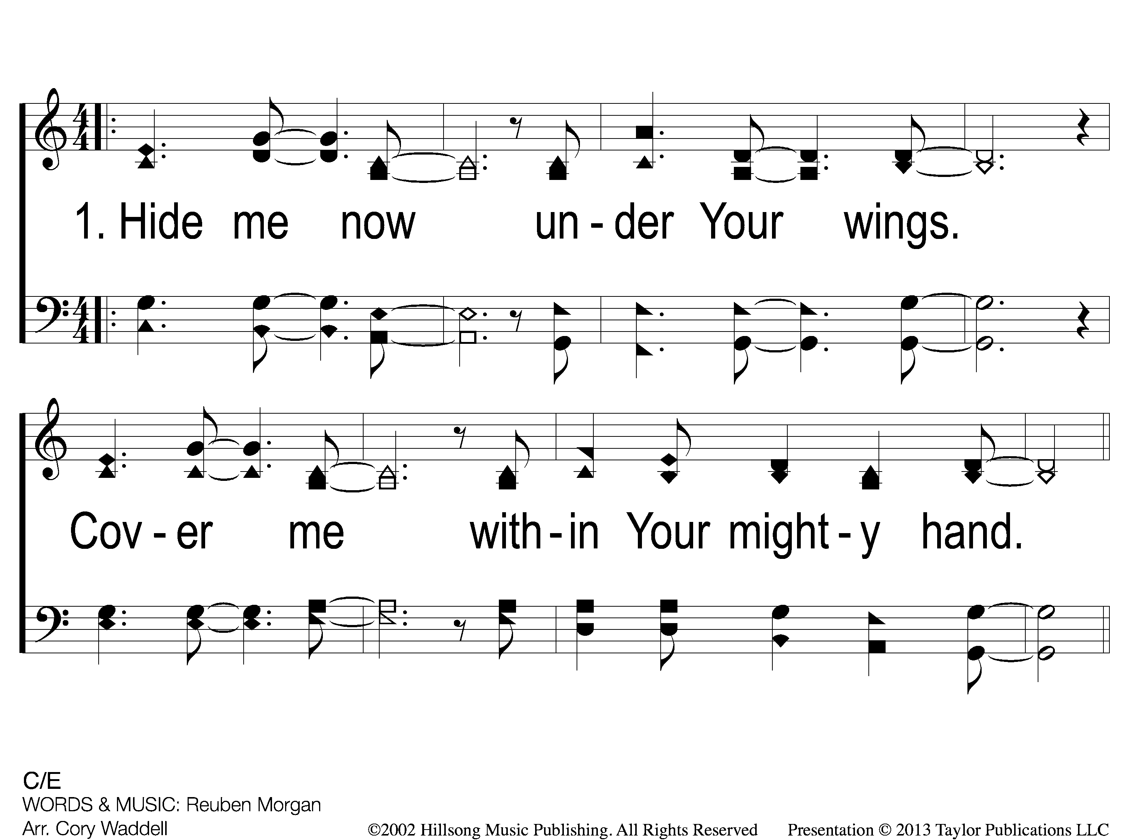
1 Still
Still

Slide 114
C-1 Still
Still

Slide 115
C-2 Still
Still

Slide 116
2 Still
Still

Slide 117
C-1 Still
Still

Slide 118
C-2 Still
Still

Slide 119
Bridge1 Still
Still

Slide 120
Bridge2 Still
Still

Slide 121
2c-1 Still
Still

Slide 122
2c-2 Still
Still

Slide 123
2c-3 Still
Still

Slide 124
TONIGHT @ 6:00 pm
JOIN US
HOPE TO SEE YOU THERE!

